Slide 1
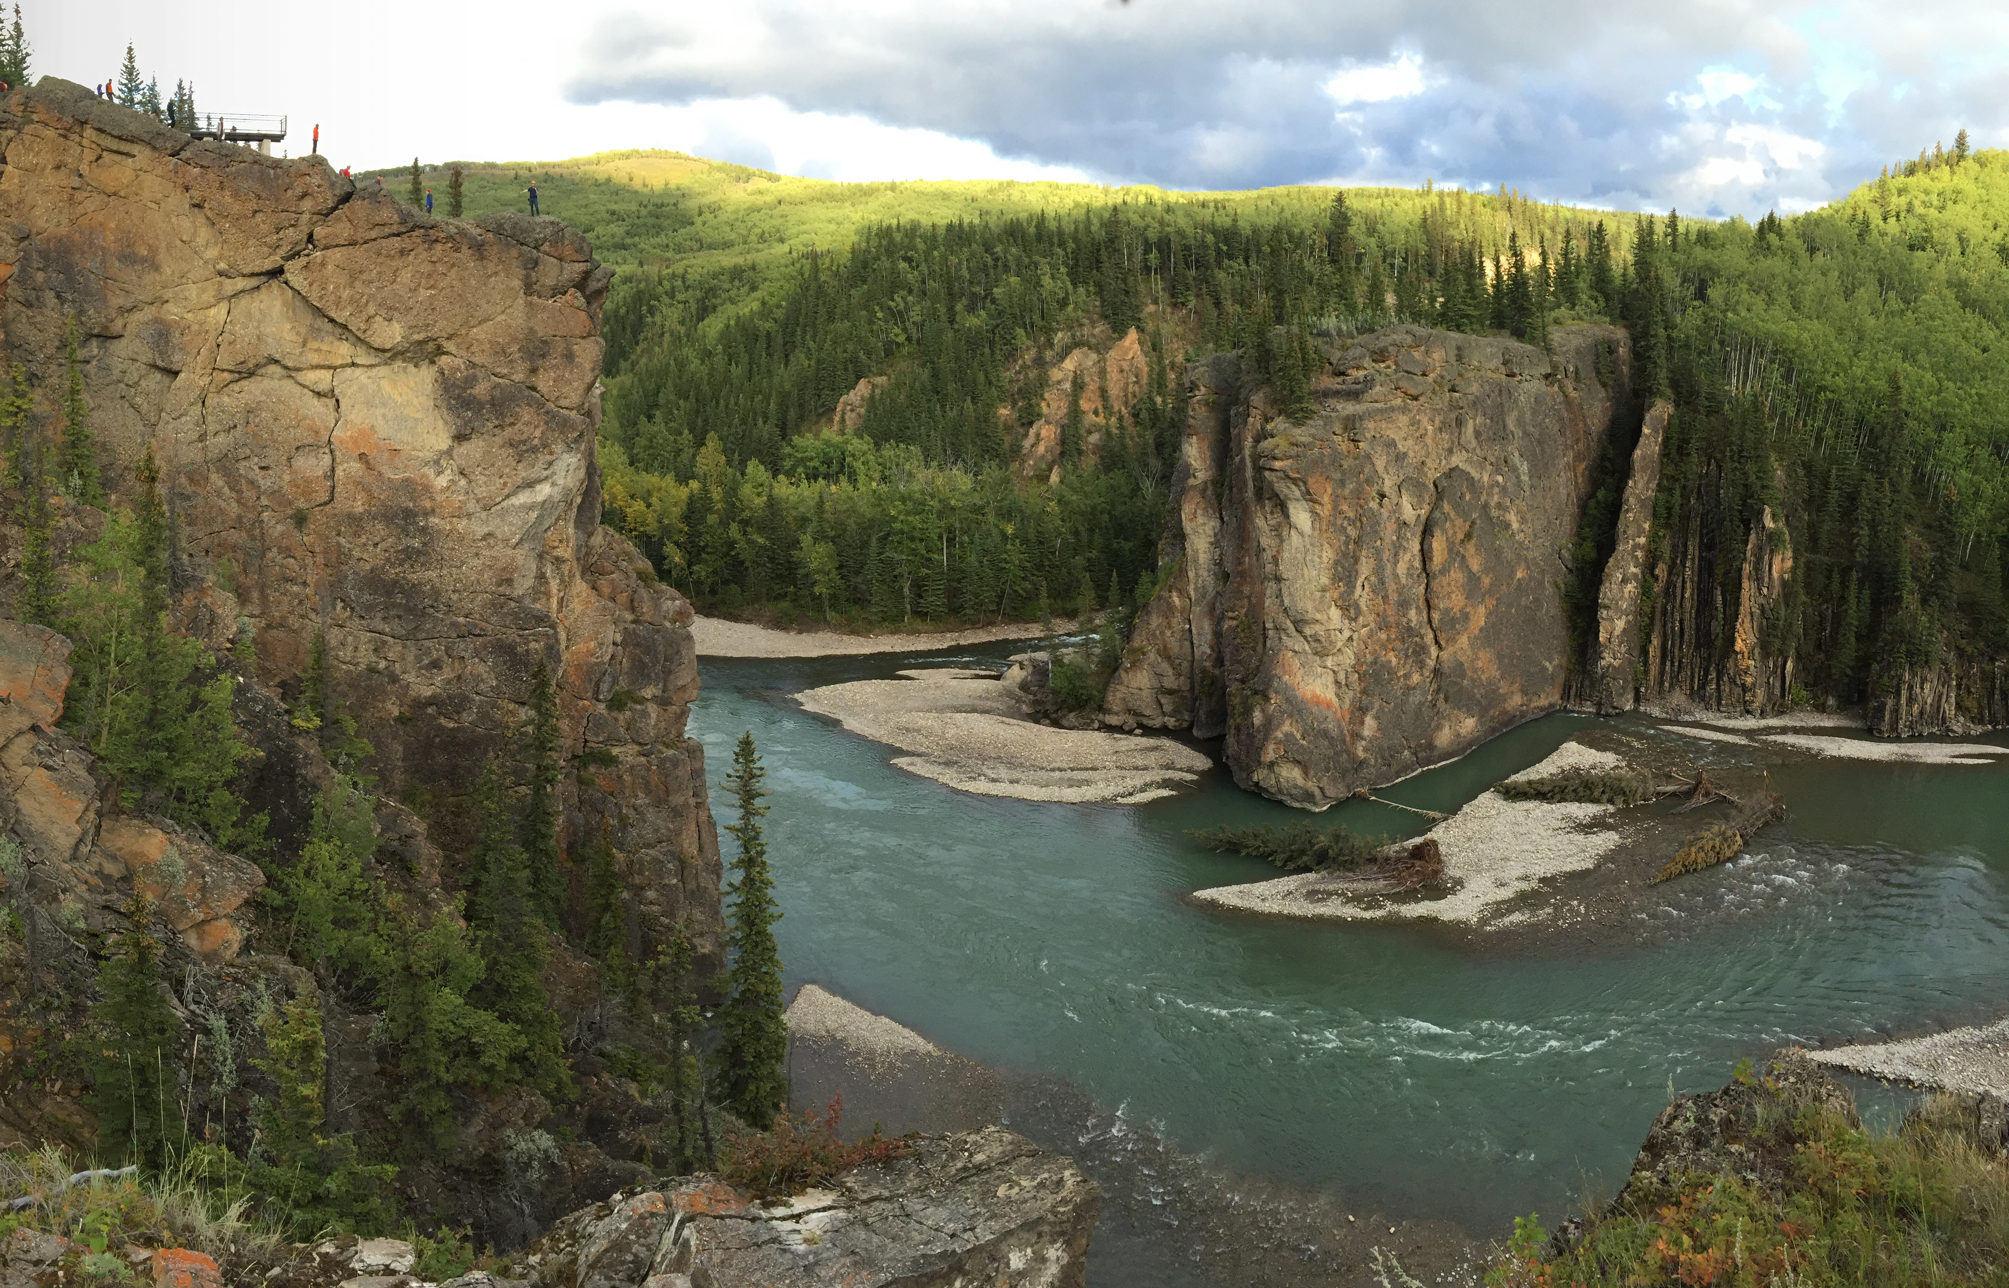
Sediment provenance and dispersal during foreland basin uplift: Lower Cretaceous Mannville Group, Alberta Basin, Canada
Benjamin Daniels, Stephen Hubbard, William Matthews, Garrett Quinn, Bernard Guest, Dale Leckie, and Thomas Hadlari
…with contributions from Rudi Bhargava, Marie-Pier Boivin, Rebecca Englert, Nicolas Garroni, Brad Hayes, Danica Heath, Lauren Madronich, Harrison Martin, Per Pedersen, Peter Putnam, and Dane Synnott

Slide 2
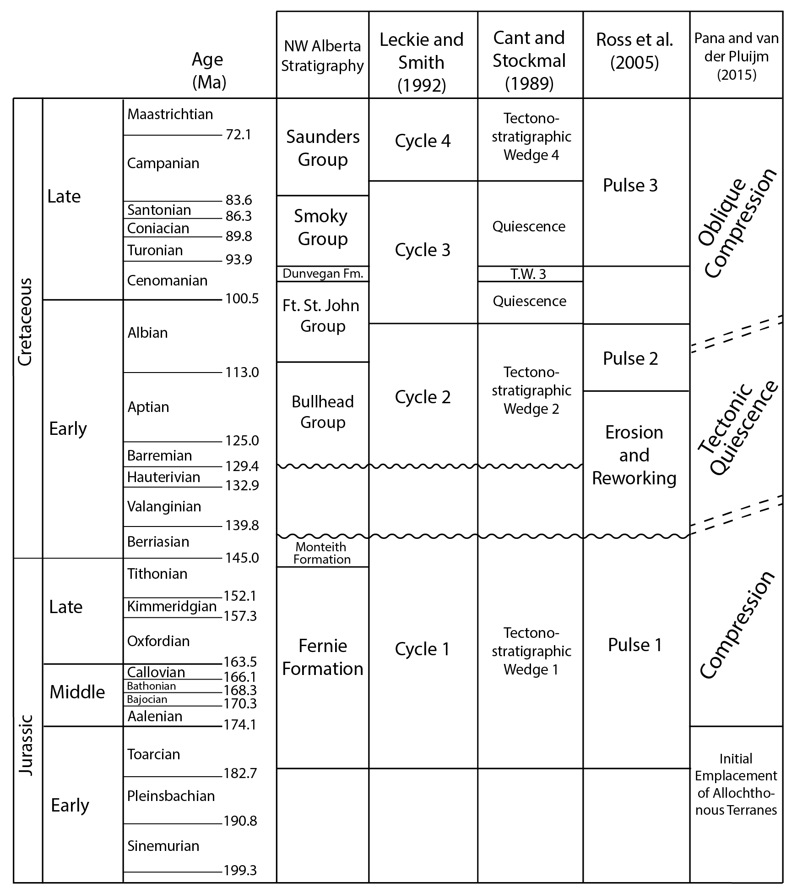
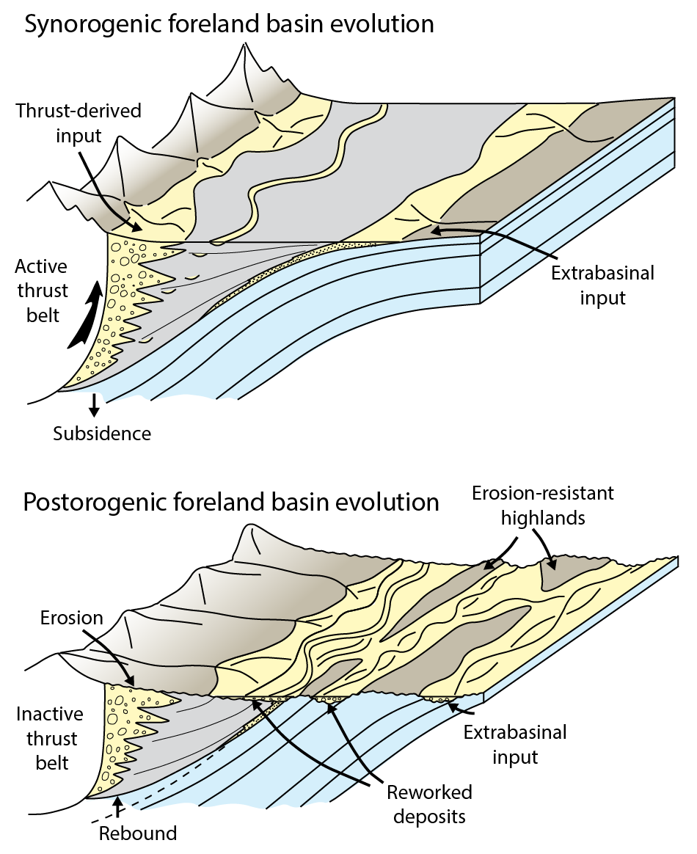
Project Motivation
Sediment dispersal in foreland basins during orogenesis is largely confined to the basin foredeep
During periods of tectonic quiescence, the foredeep can isostatically rebound
Erosion of basin topography can complicate sediment dispersal
What is the nature of sediment dispersal in the Alberta foreland basin during the Early Cretaceous?
Lower Mannville Group
modified from Quinn et al., 2016
modified from Heller et al., 1988

Slide 3
Sediment provenance and dispersal during foreland basin uplift: Lower Cretaceous Mannville Group, Alberta Basin, Canada
Sediment dispersal in foreland basins during orogenesis is largely constrained to the basin foredeep
During periods of tectonic quiescence, the foredeep can isostatically rebound
Basin topography can complicate sediment dispersal
What is the nature of sediment dispersal in the Alberta foreland basin during the Early Cretaceous?
Hypothesis:
Deposits of the Lower Mannville Group largely accumulated in accommodation generated during a period of basin uplift and erosion rather than foreland basin subsidence
Objectives:
Examine variations in stratigraphic thickness and sediment provenance in different parts of the Lower Mannville Group across the Alberta Basin
Use the results to elucidate controls on sediment dispersal in the Alberta Basin during periods of tectonic quiescence
Lower Mannville Group
modified from Quinn et al., 2016
modified from Heller et al., 1988

Slide 4
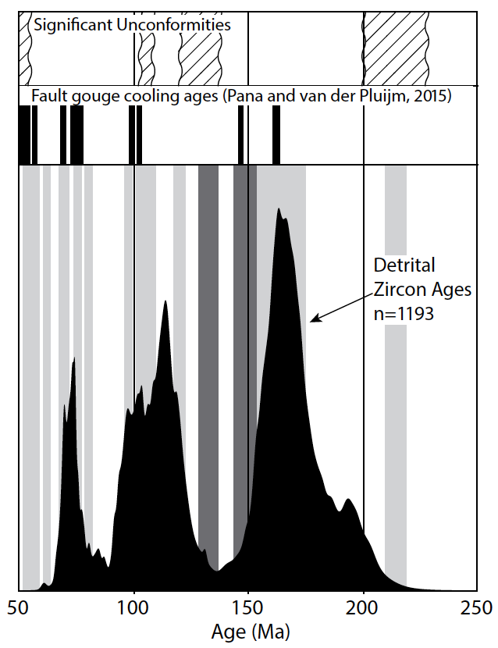
The sub-Cretaceous unconformity and the Mannville Group
74 Ma
165 Ma
Lower Mannville
Group
115 Ma
115 Ma
74 Ma
10-15 Myr hiatus
165 Ma
Quinn et al., 2016, Lithosphere

Slide 5
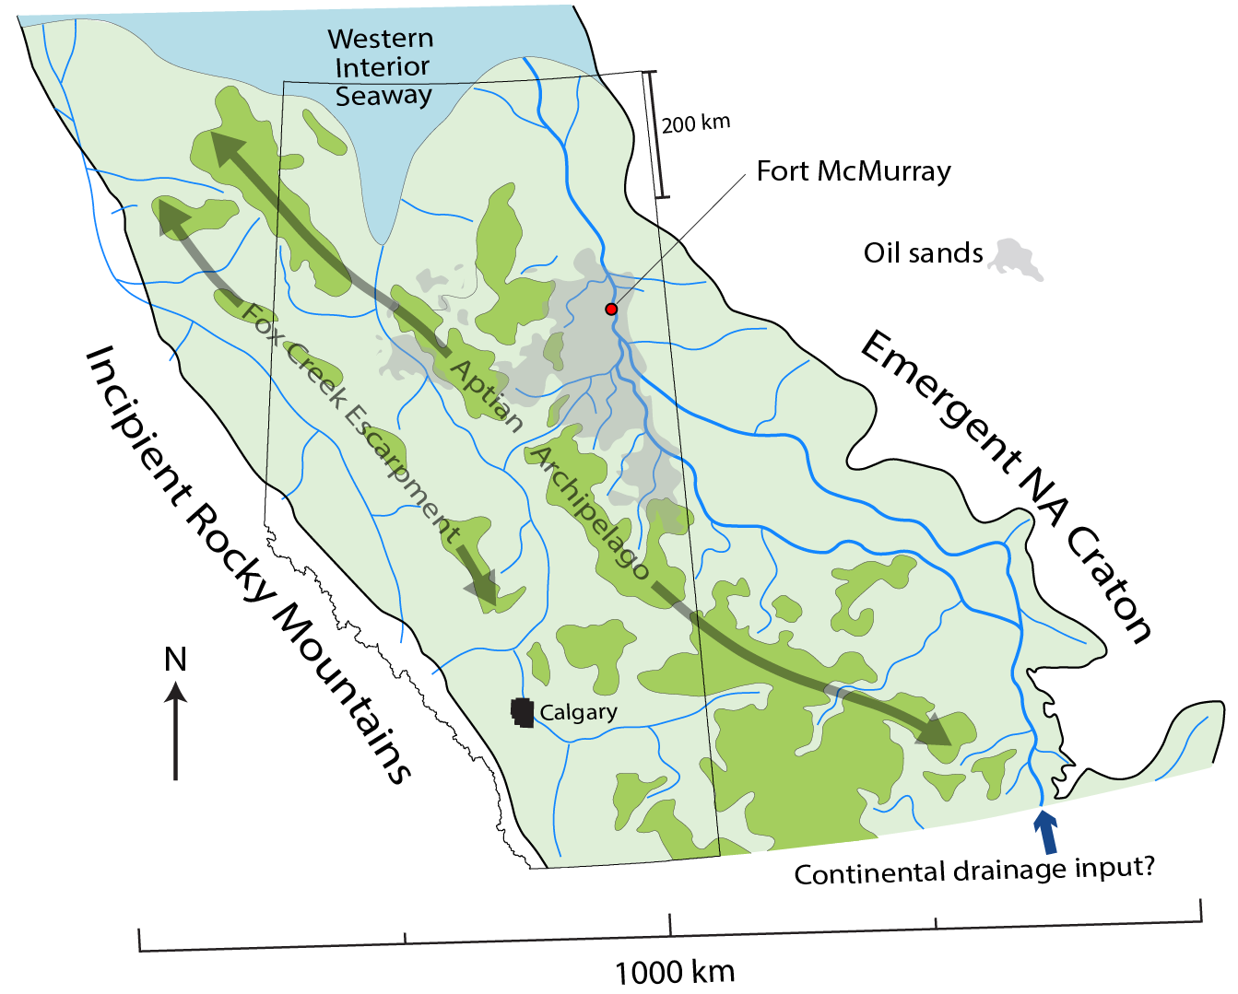
Lower Mannville Paleogeography: Axial Drainages and Topographic Divides
Forebulge?

Slide 6
Lower Mannville Paleogeography: Axial Drainages and Topographic Divides

Slide 7
Sediment provenance and dispersal during foreland basin uplift: Lower Cretaceous Mannville Group, Alberta Basin, Canada
Methodology:
Basin-scale isopach mapping of the Lower Mannville Group
Detrital zircon U-Pb geochronology (8 new samples)
(19 samples from Benyon et al., 2014; Blum and Pecha, 2014; Leier and Gehrels, 2011, Quinn et al., 2016)

Slide 8
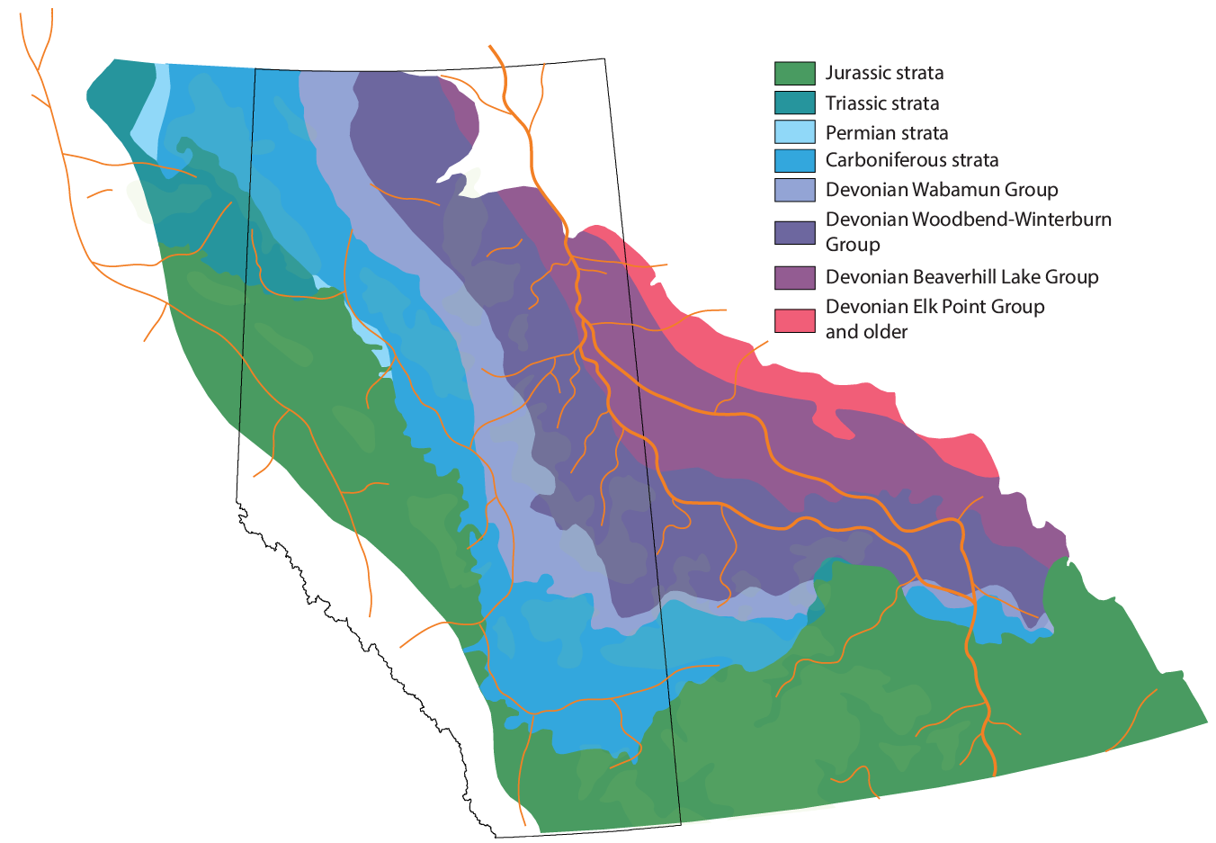
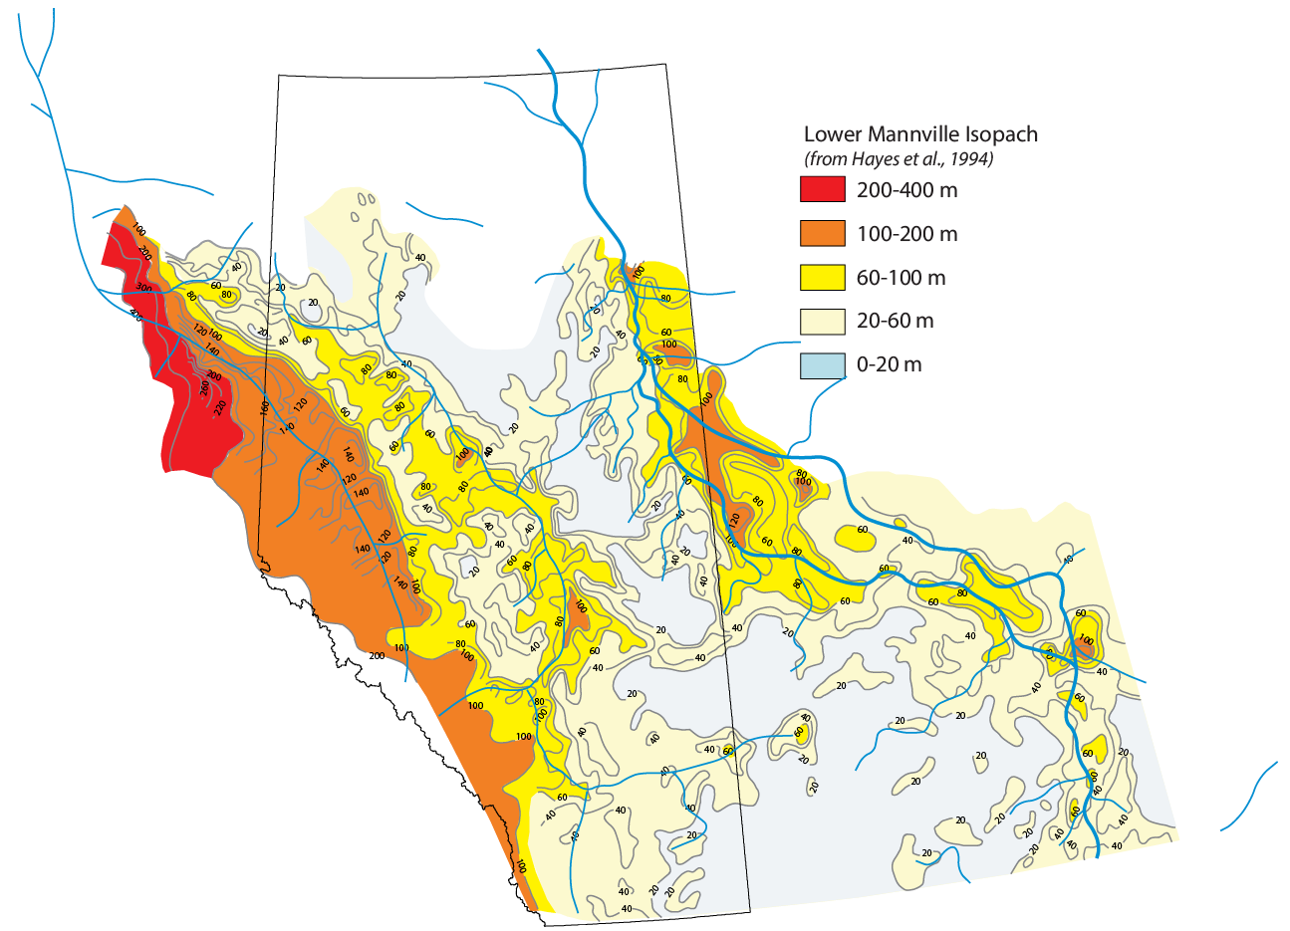
Lower Mannville Isopach Mapping with Implications for Basin-Wide Accommodation Trends

Slide 9
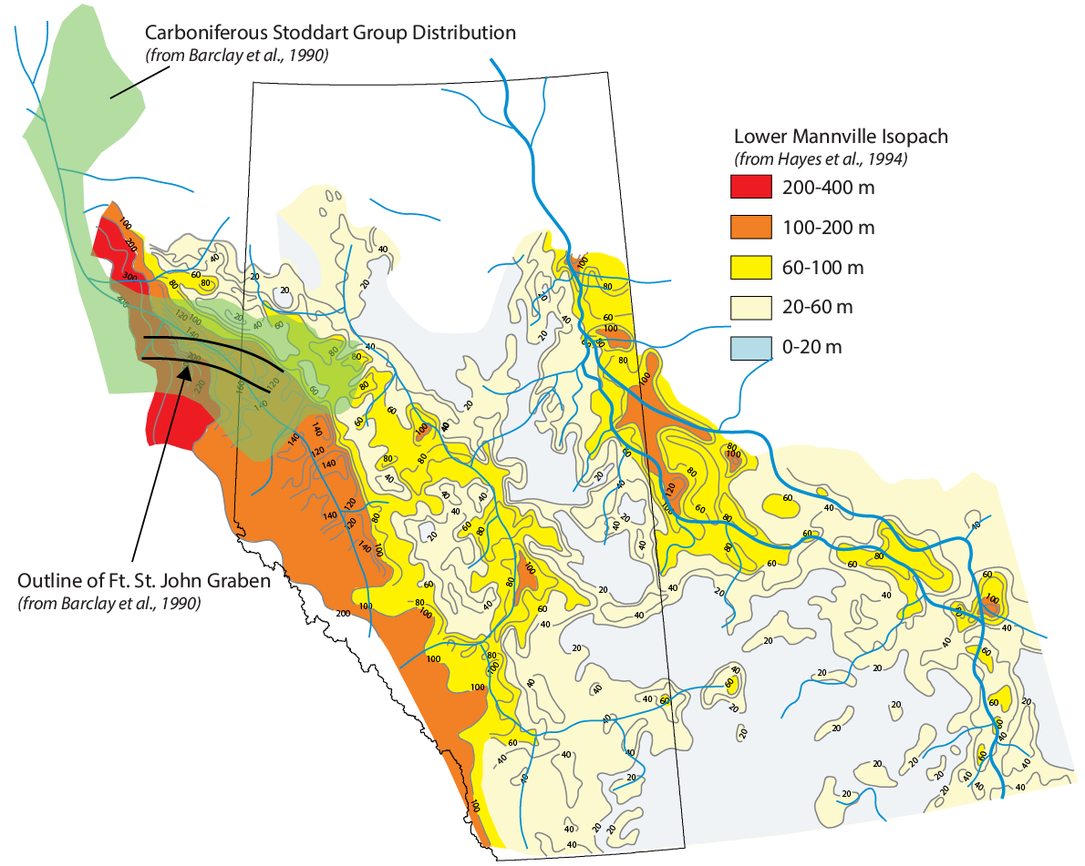
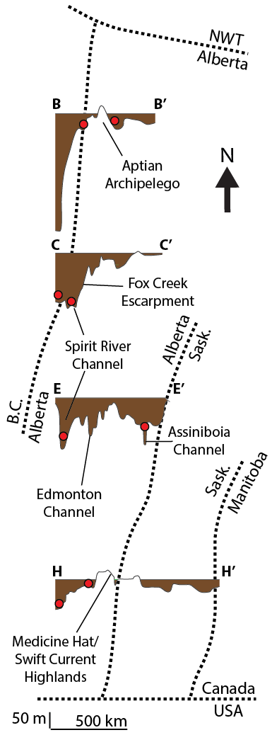
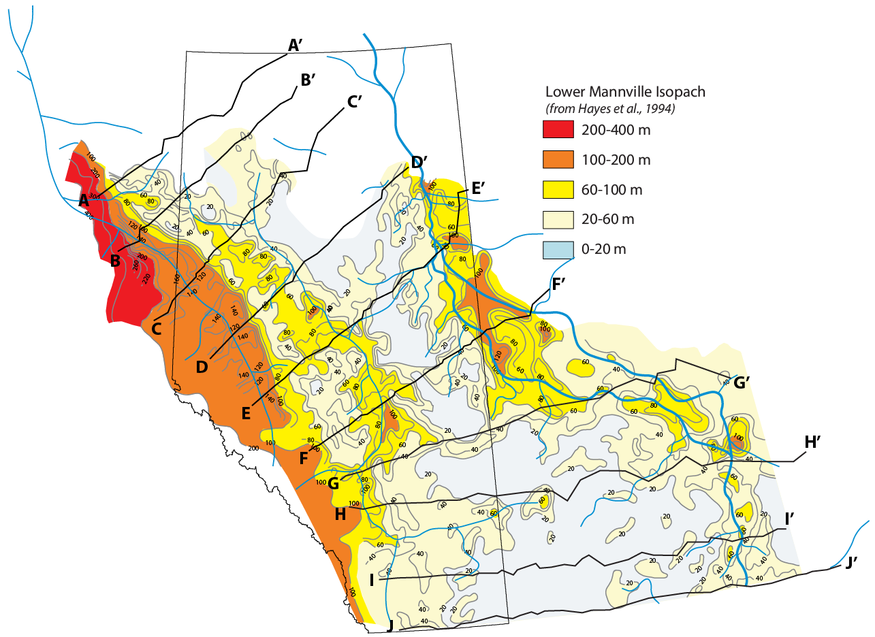
Lower Mannville Isopach Mapping with Implications for Basin-Wide Accommodation Trends

Slide 10

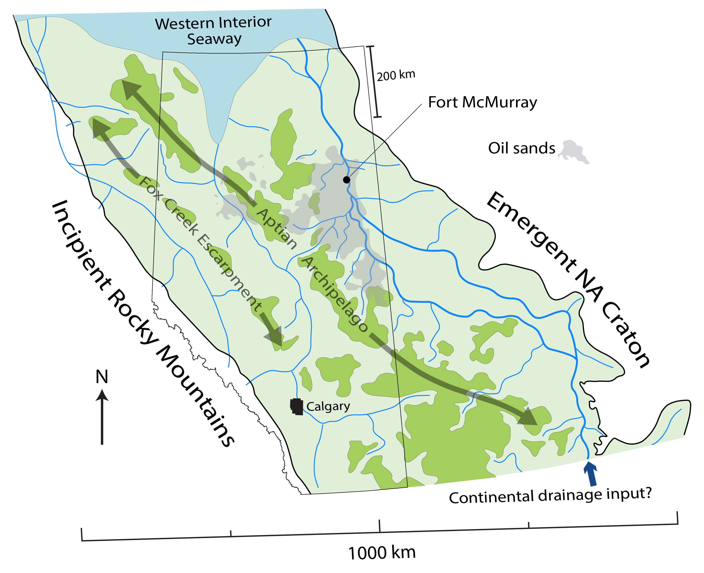
Lower Mannville Sediment Provenance and Sediment Distribution: Detrital Zircon Geochronology

Slide 11
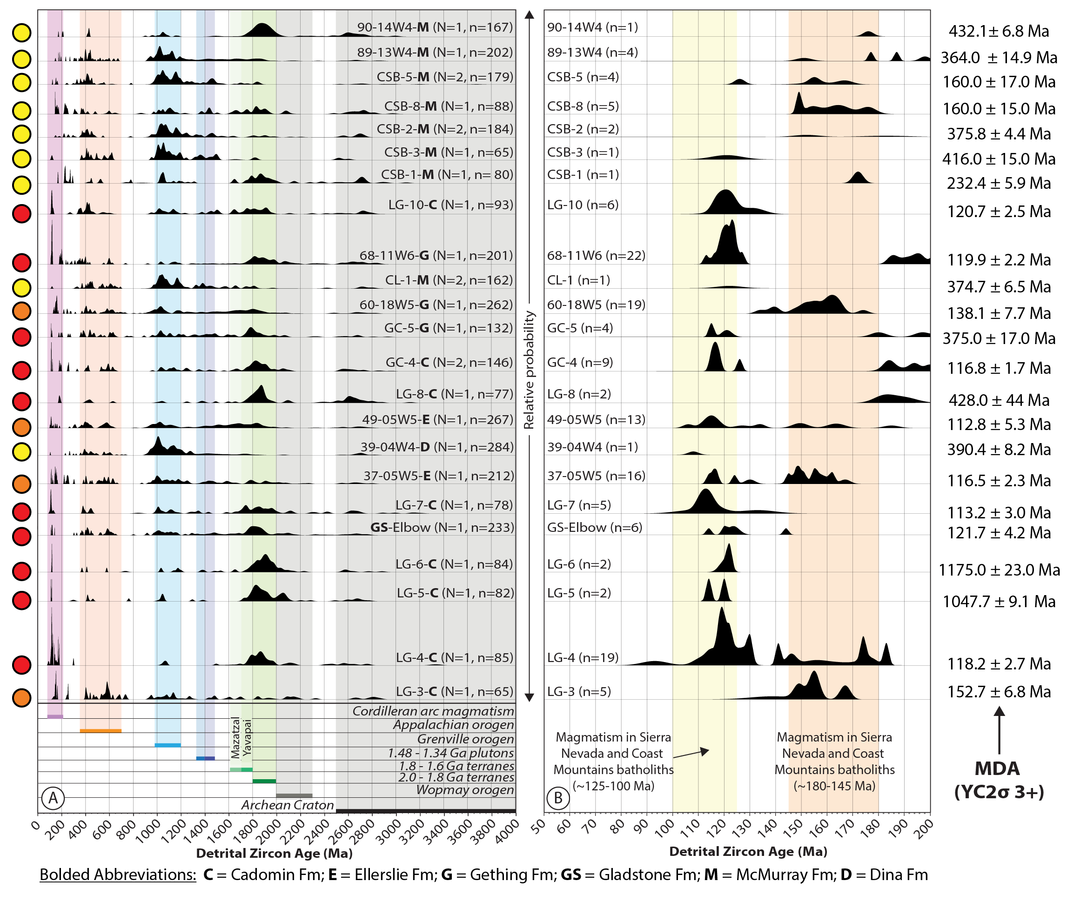

Slide 12
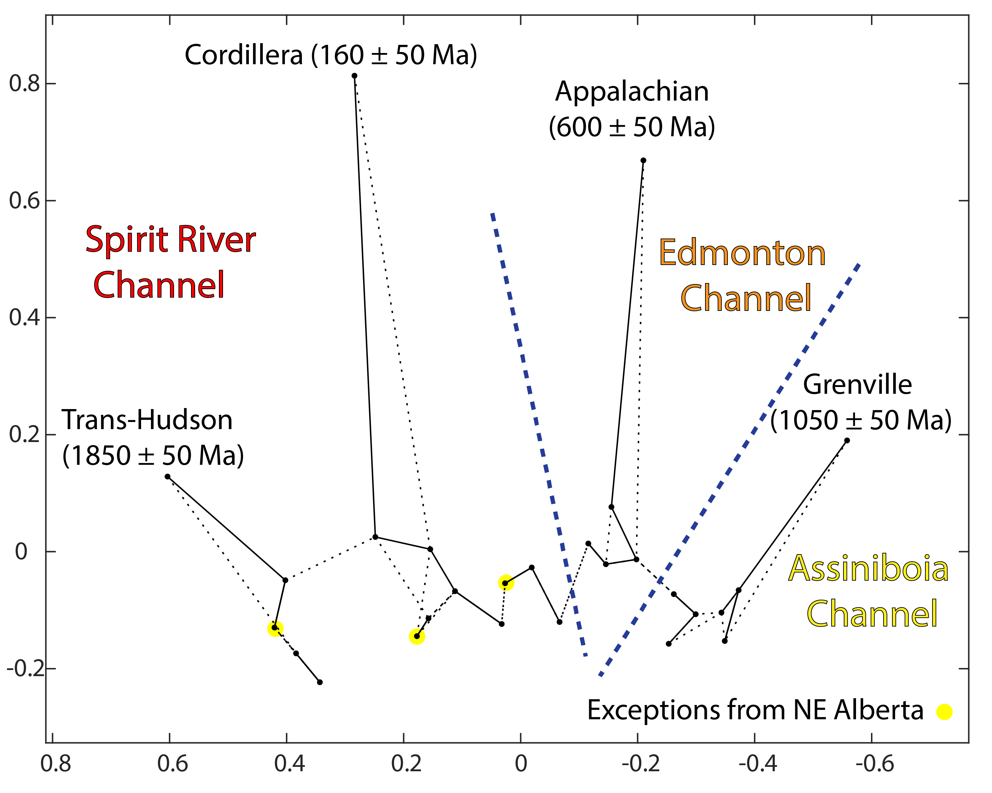
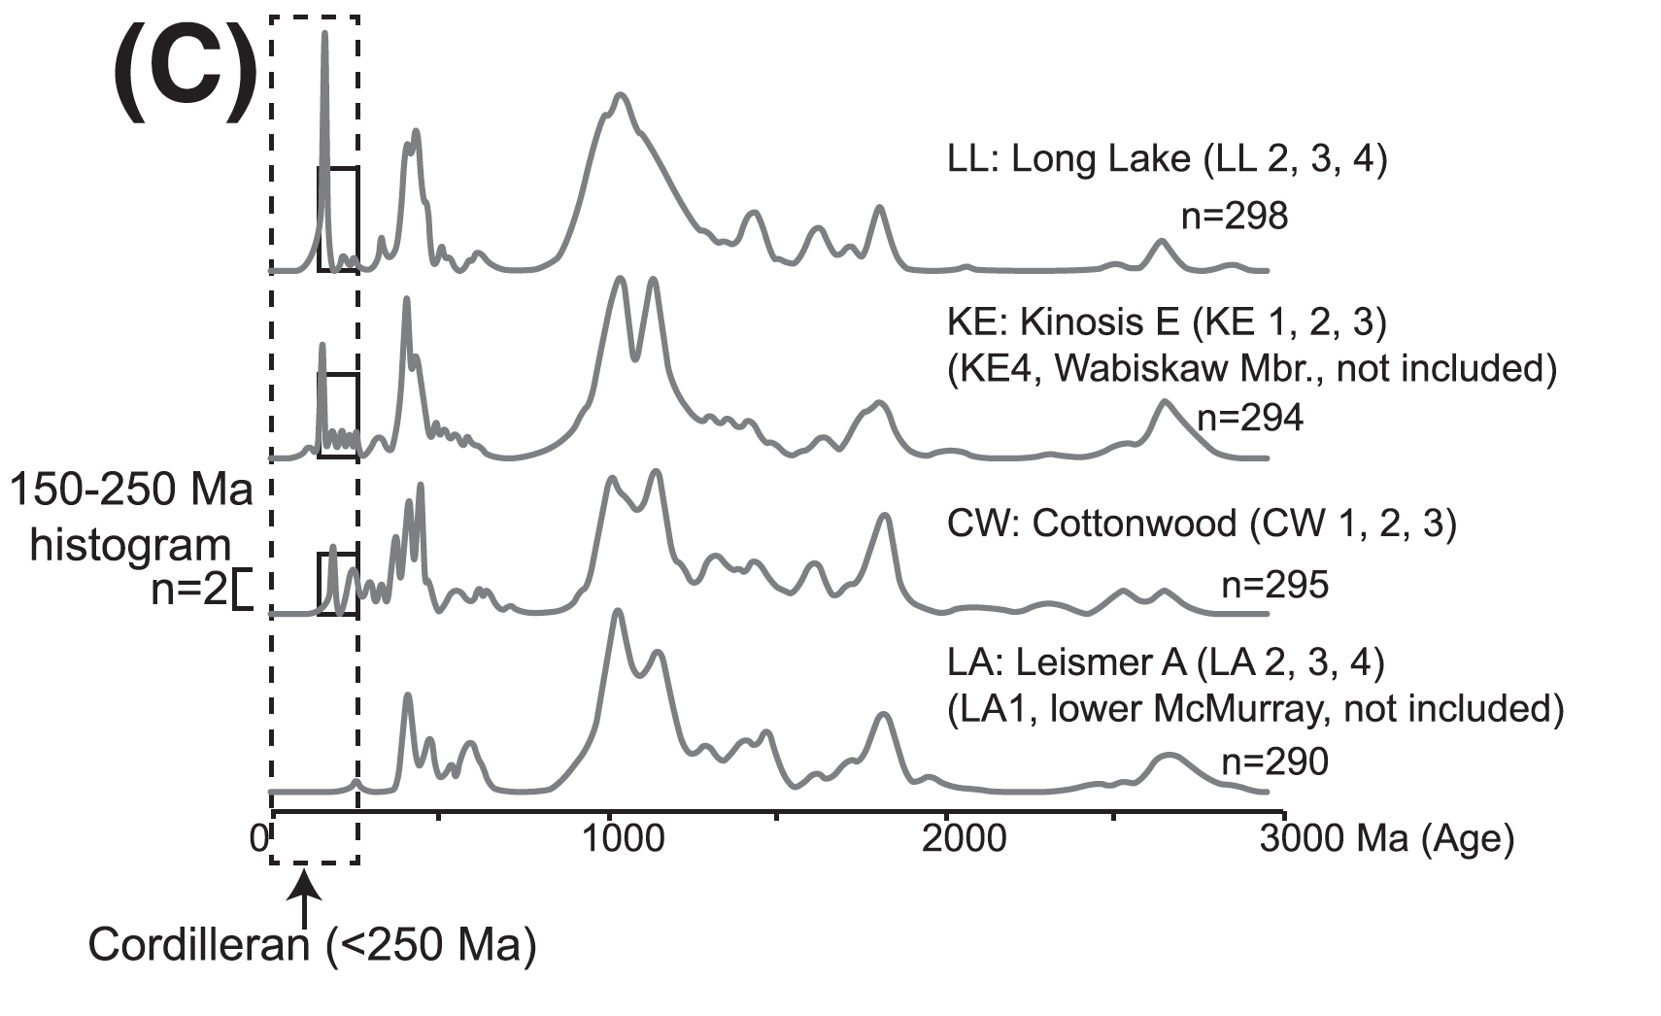
Lower Mannville Sediment Provenance and Sediment Distribution: Multi-Dimensional Scaling
Benyon et al., 2016

Slide 13
What happens in the Alberta Basin when convergence on the western margin of North America resumes?
Upper Mannville Group
modified from Quinn et al., 2016
modified from Heller et al., 1988

Slide 14
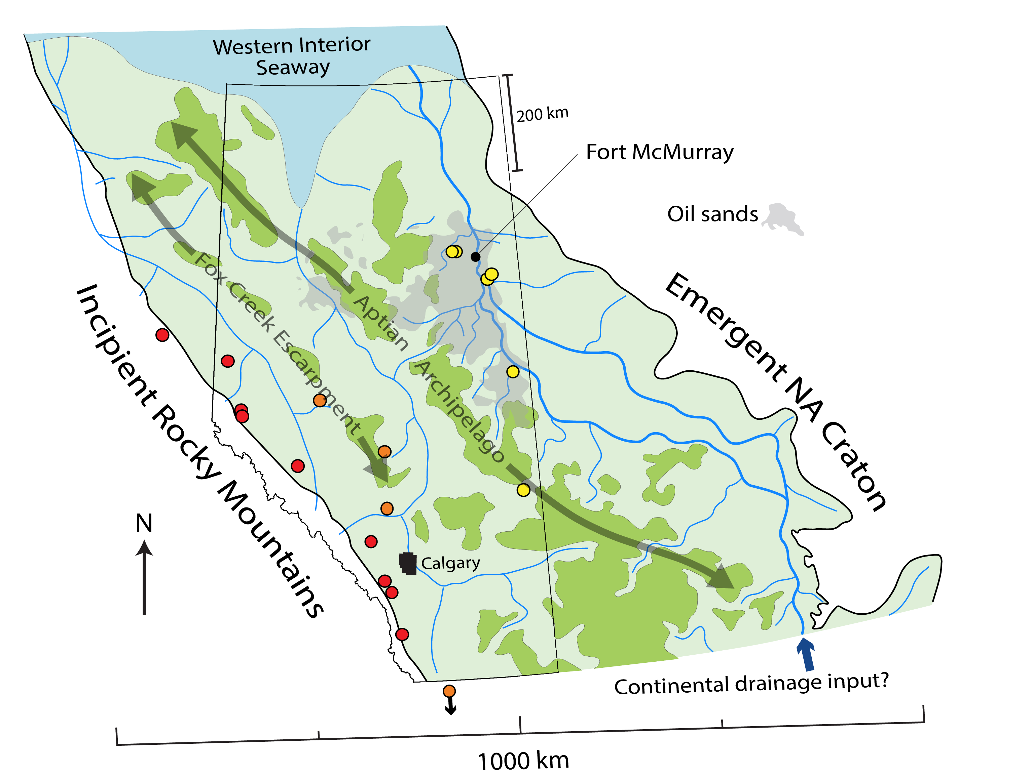
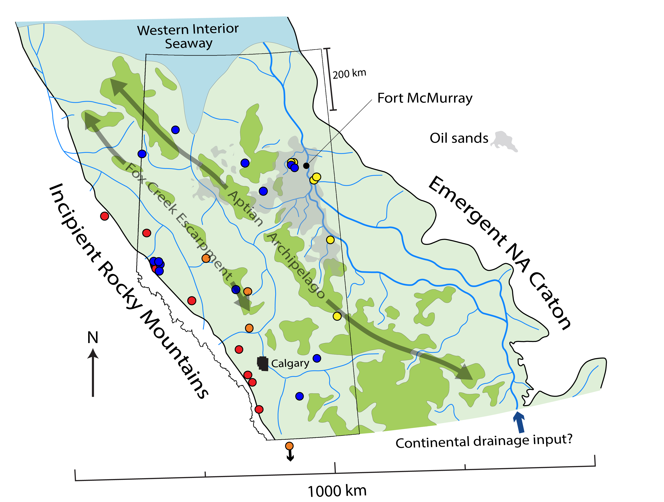
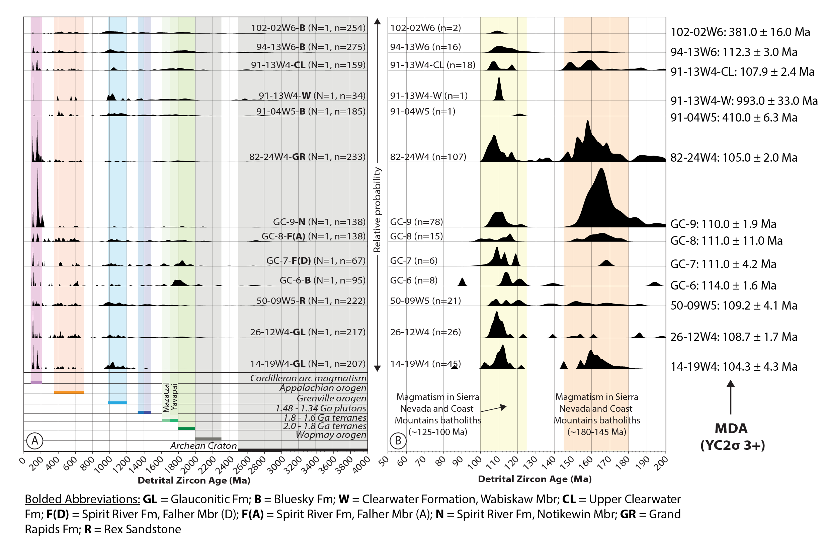
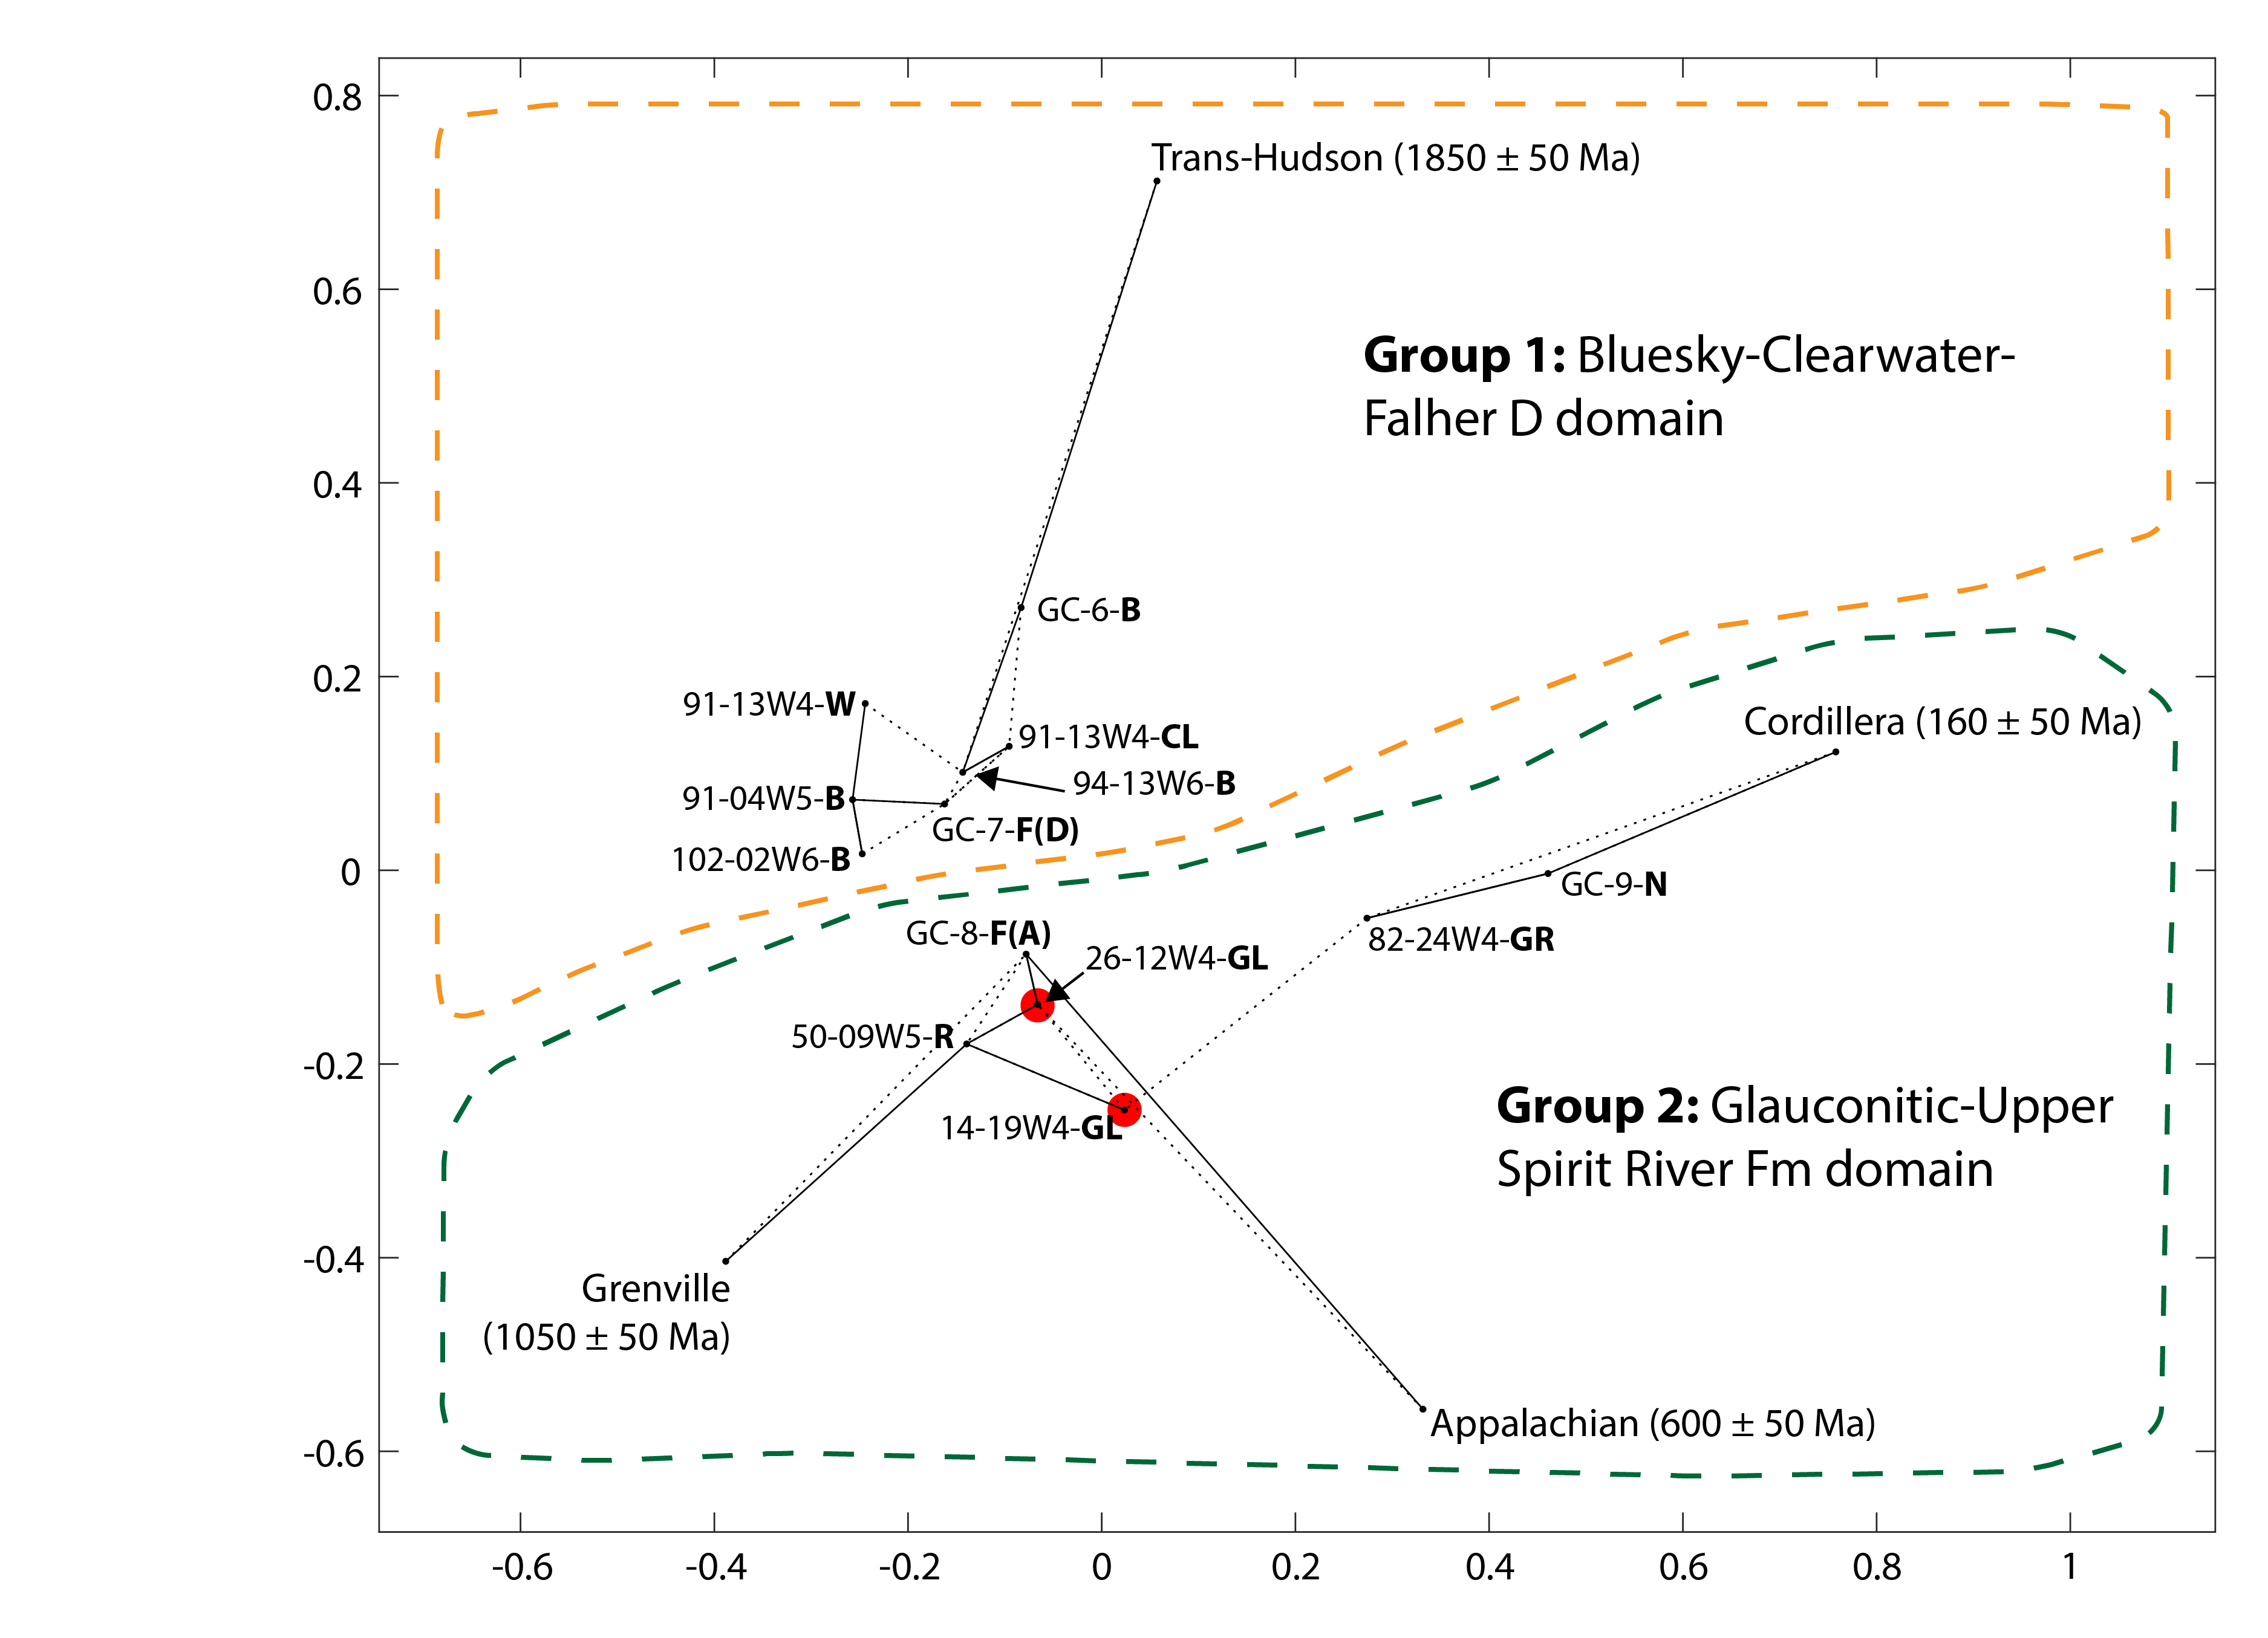
What happens in the Alberta Basin when convergence on the western margin of North America resumes?
NW
SE

Slide 15
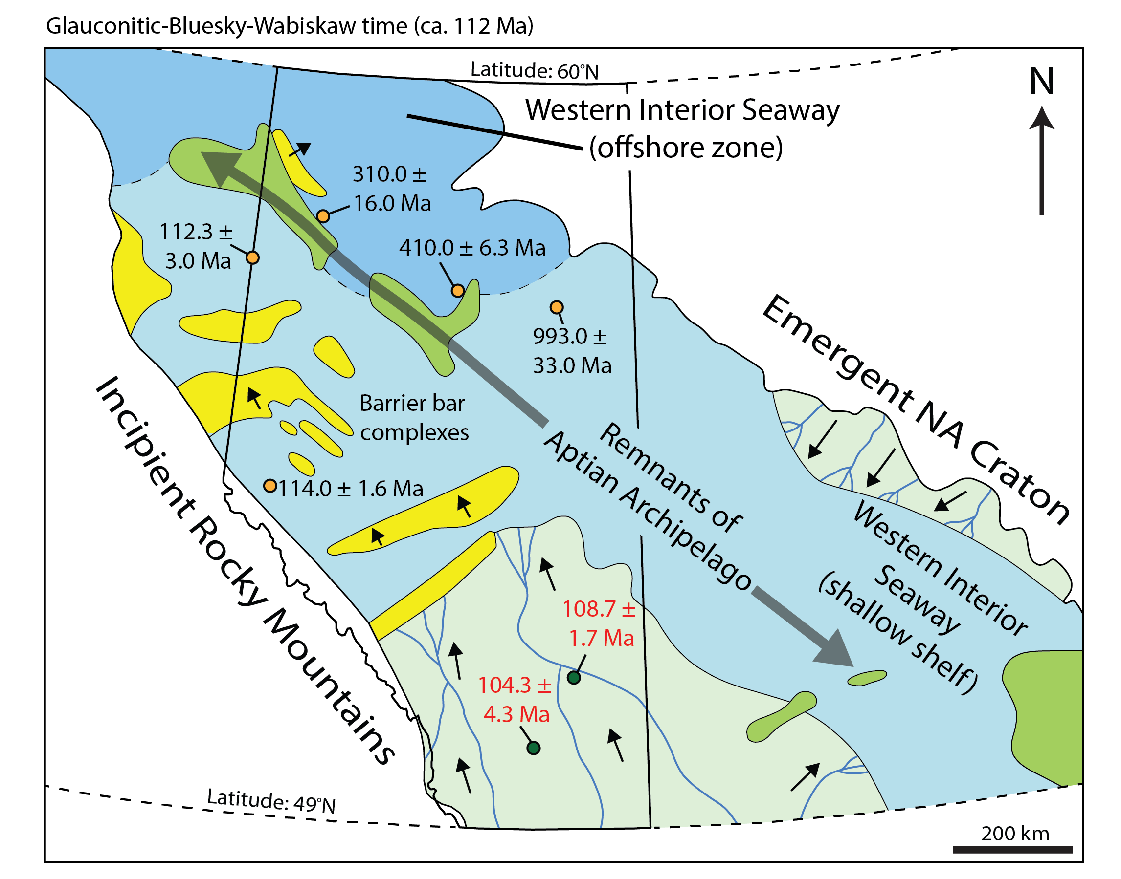
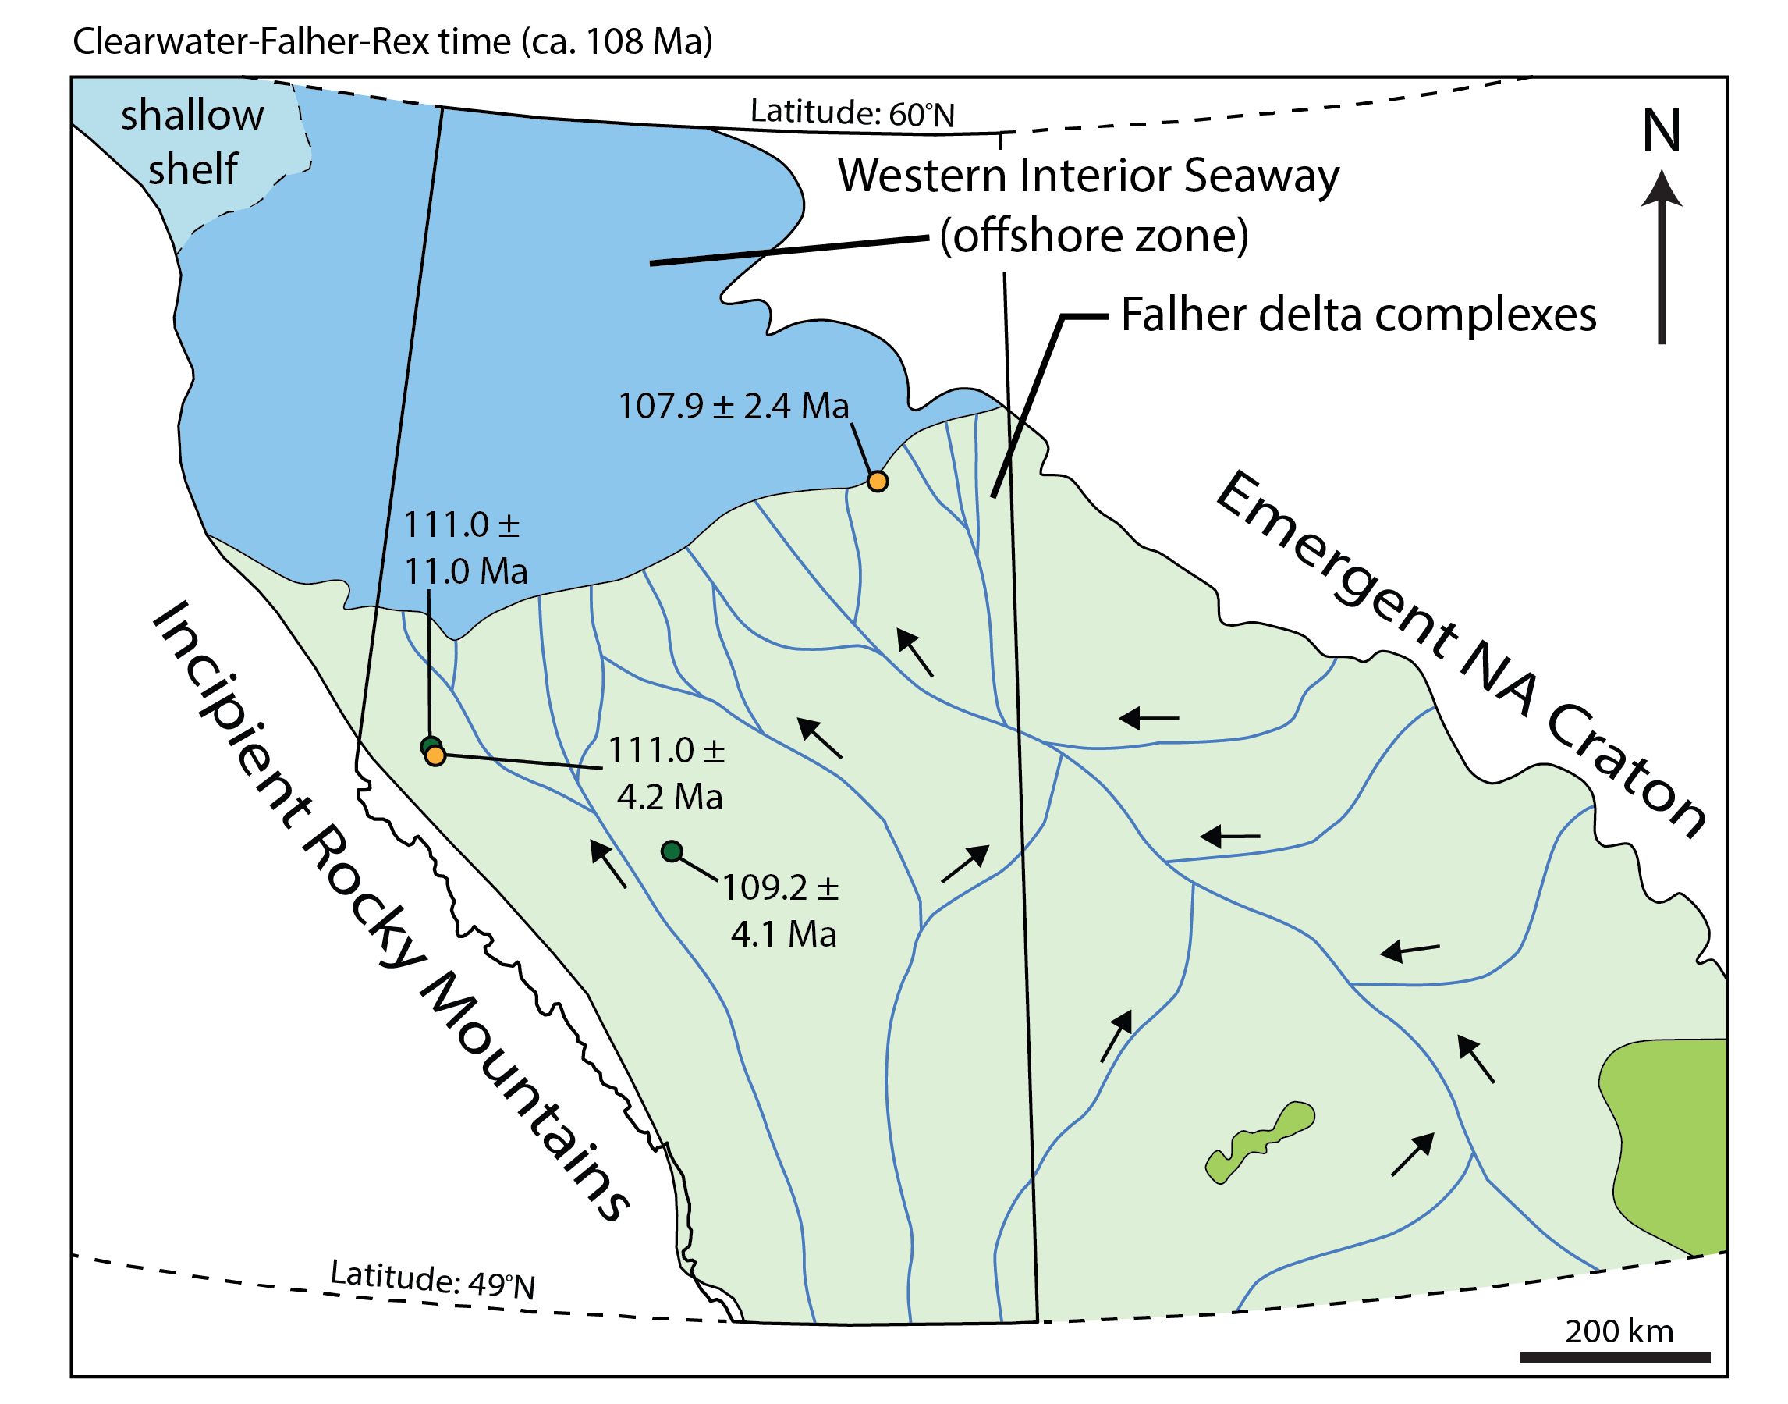
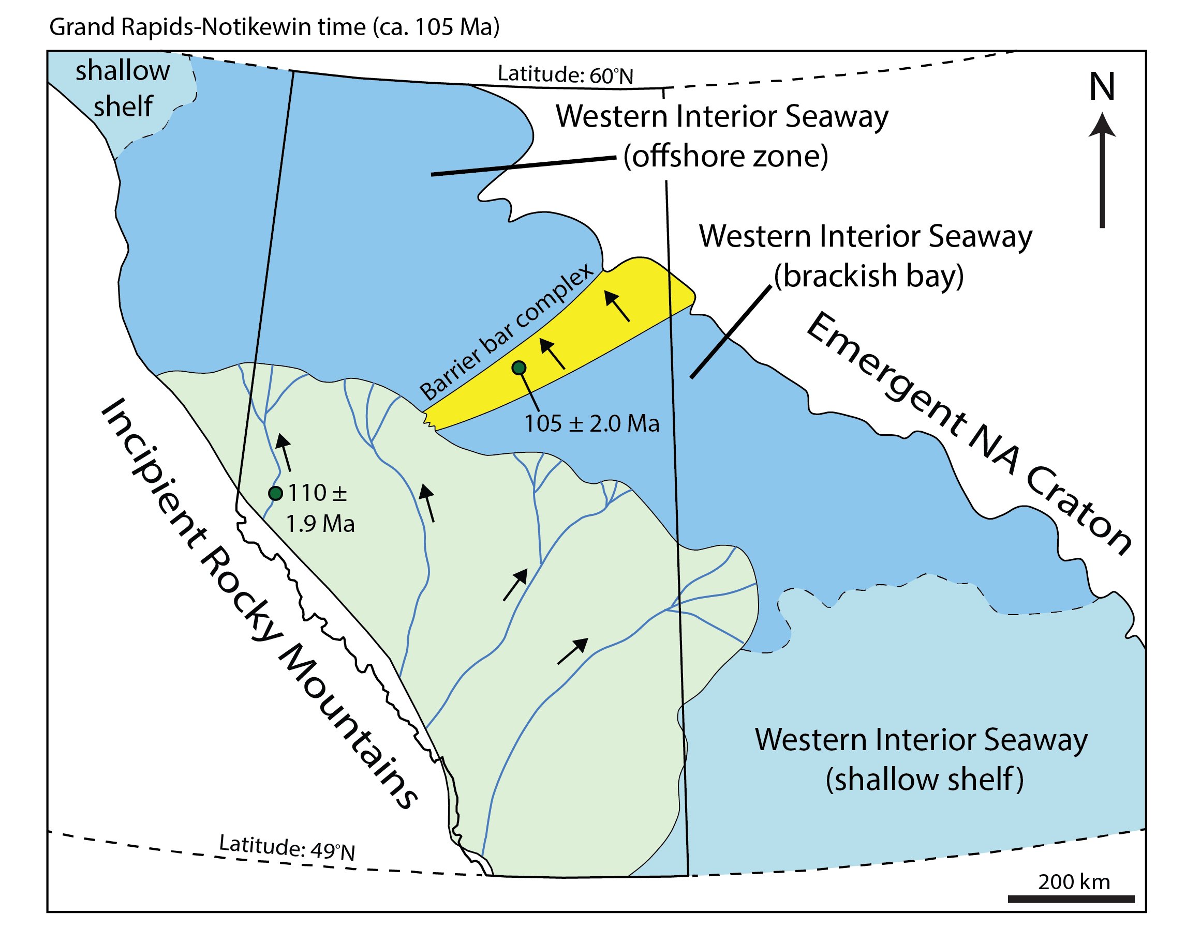
What happens in the Alberta Basin when convergence on the western margin of North America resumes?
modified from Leckie and Smith, 1992

Slide 16
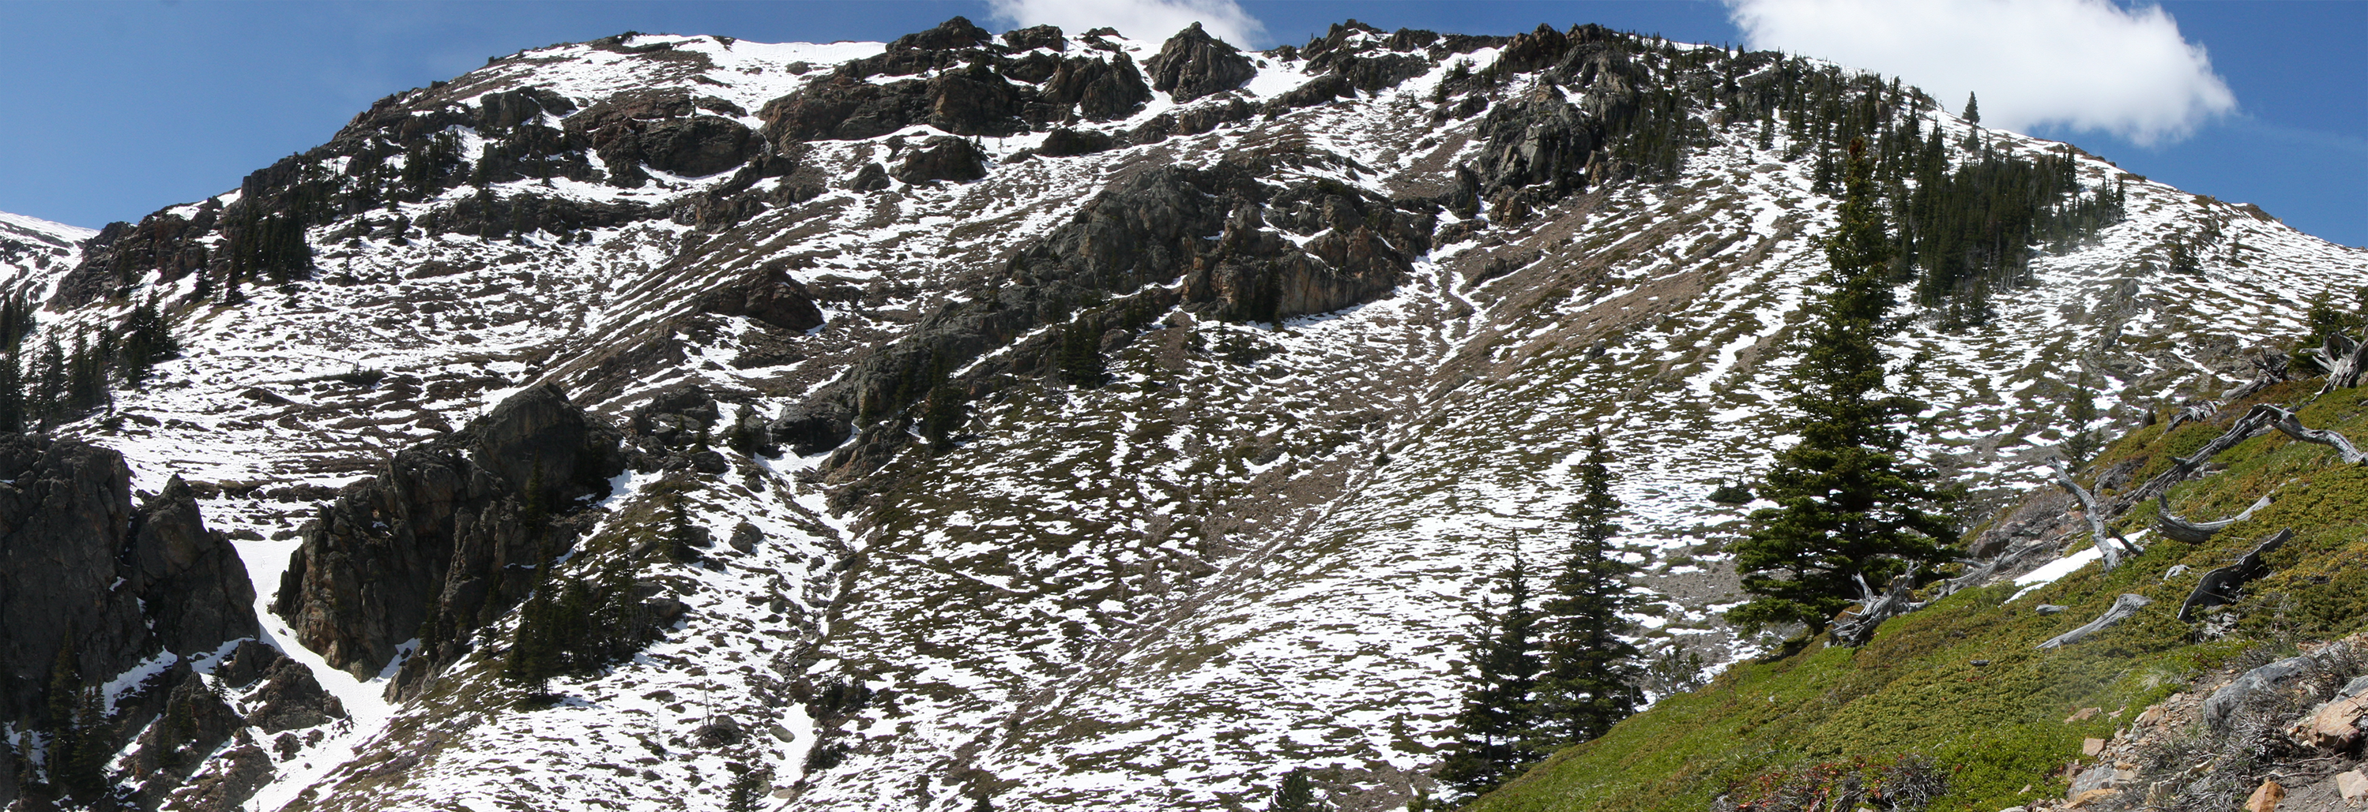
Conclusions
1) Deposits of the Lower Mannville Group largely accumulated in accommodation generated during a period of basin uplift:
Angular sub-Cretaceous unconformity; lack of asymmetric clastic wedge
Segmented basin due to differential erosion of sub-cropping units
Erosion/recycling of proximal units to distal foreland impacted by orogen-parallel topography and capture of continental river
2) Paleotopography from LM time did not impact sediment dispersal as much during UM time; however, there is still evidence for drainages linking UM units from north-south

Slide 17
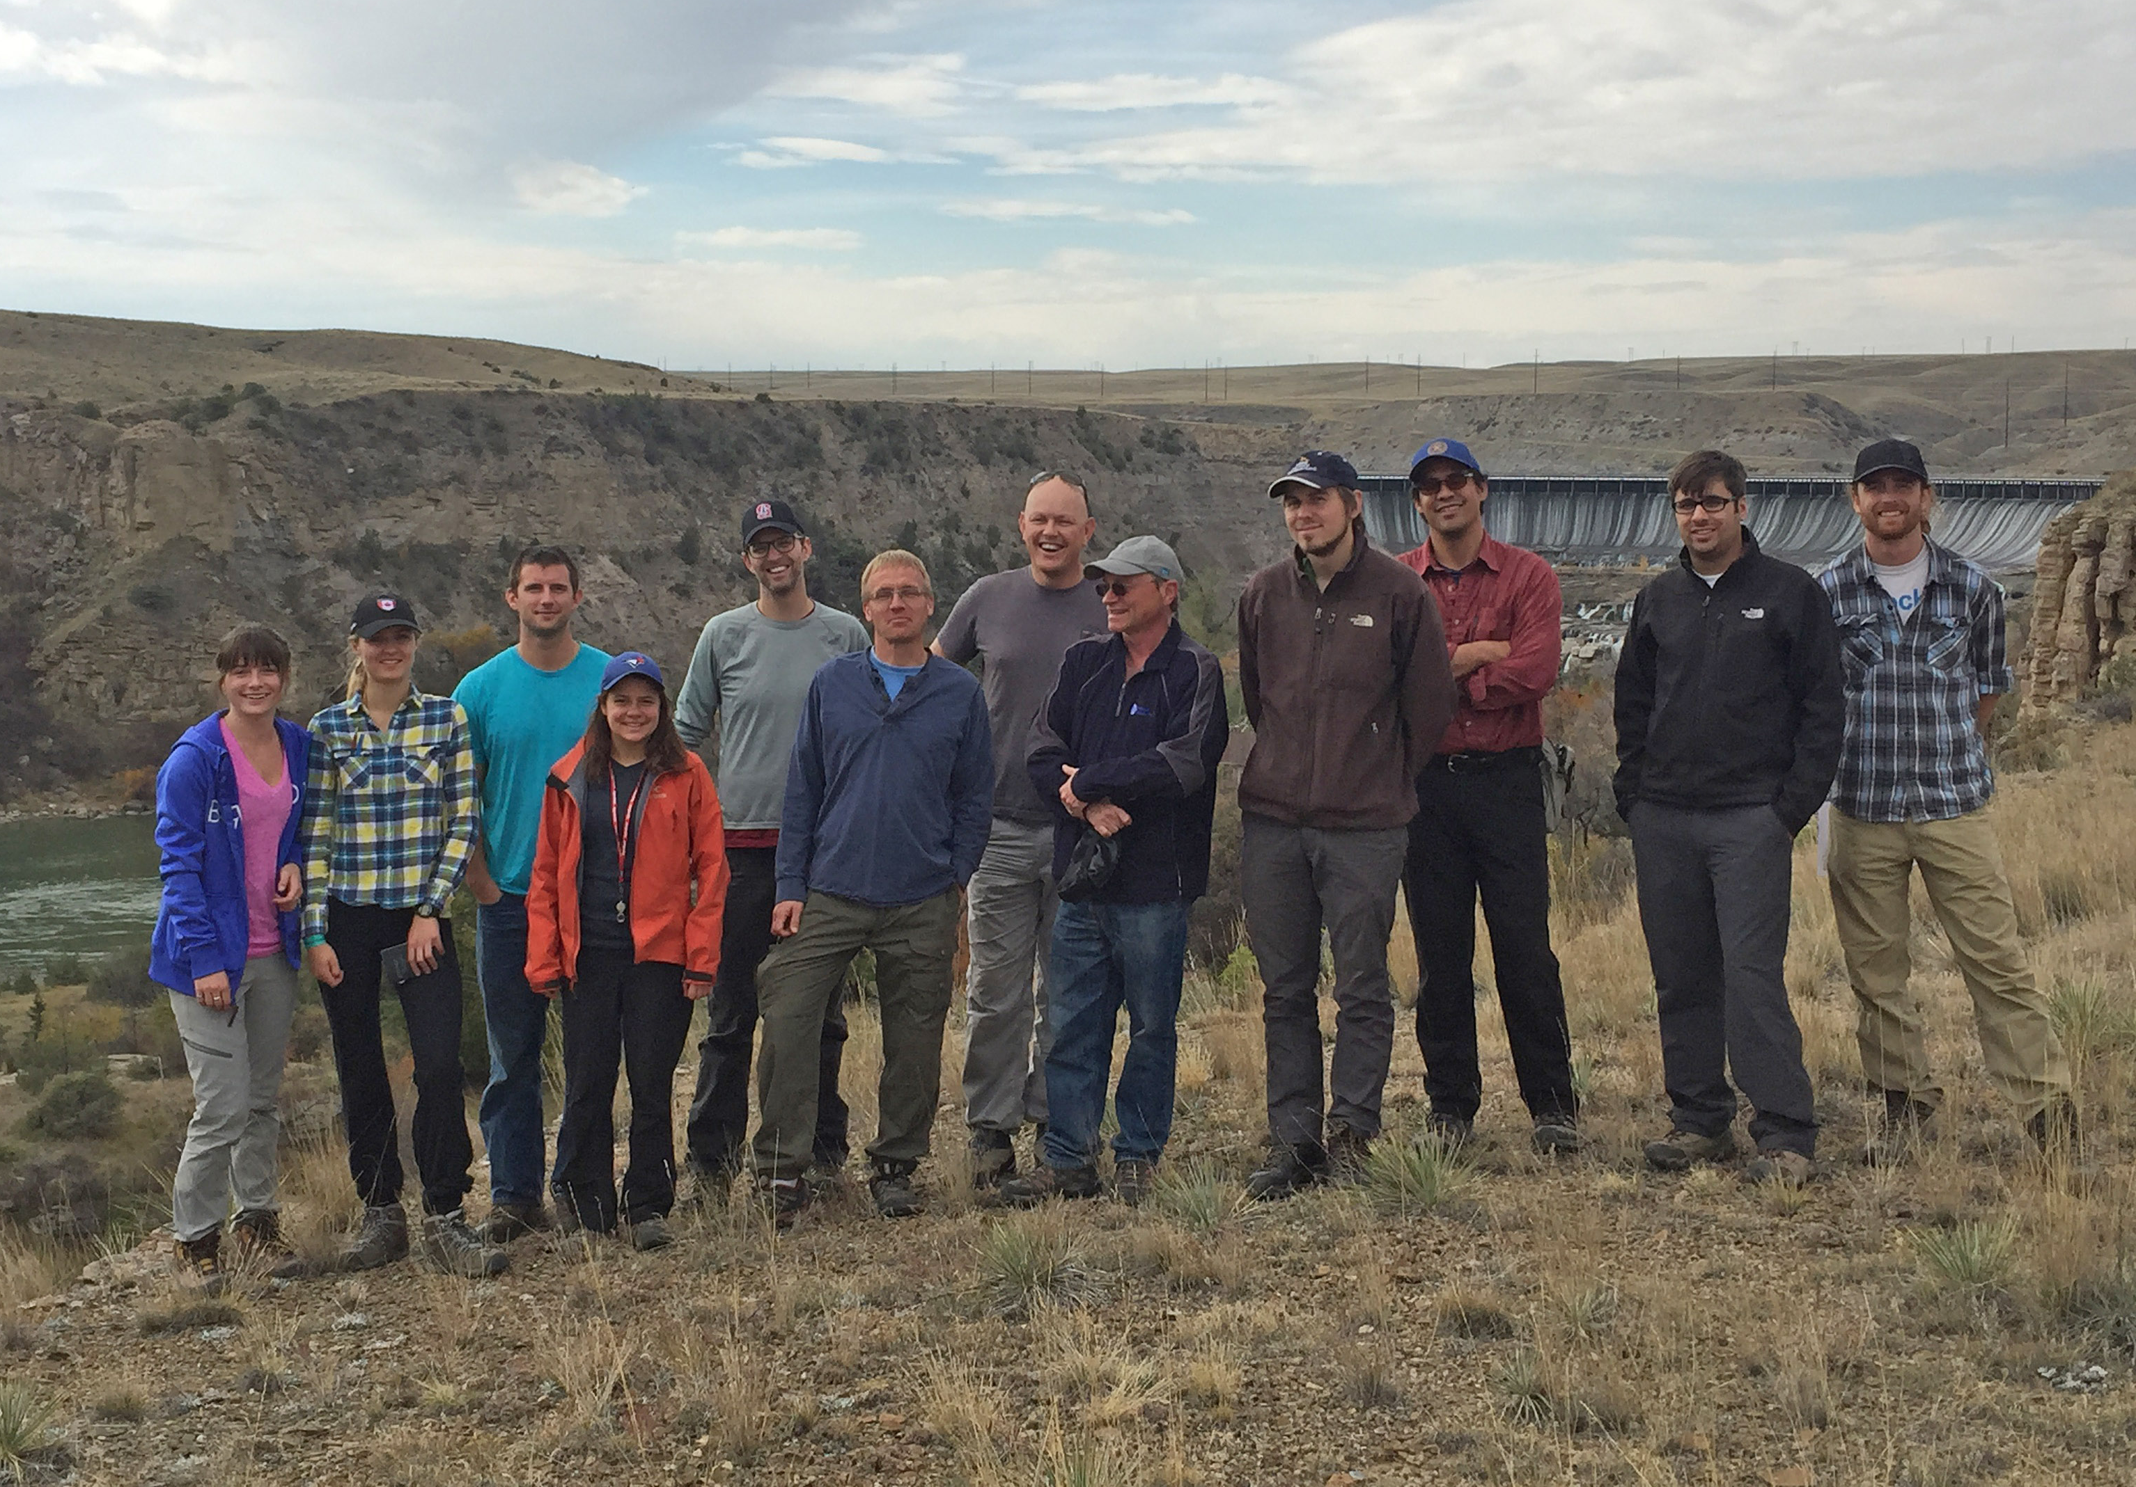


Sediment provenance and dispersal during foreland basin uplift: Lower Cretaceous Mannville Group, Alberta Basin, Canada

