Slide 1

Effects of Urbanization and Land Use Change on Hydrologic Flow Regime
2017 GSA South-Central Section
San Antonio, Texas – Mar 2017
Vahid Zarezadeh, MS
PhD Candidate, Environmental Science and Engineering Program
Marcio Giacomoni, PhD
Assistant Professor, Dep. Civil and Environmental Engineering
University of Texas at San Antonio
Notes:
Good evening. My name is Vahid Zarezadeh, I am a PhD student in the Environmental Science and Engineering Program at University of Texas at San Antonio. My adviser is Dr. Marcio Giacomoni. I will be presenting our work on…

Slide 2
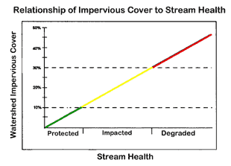
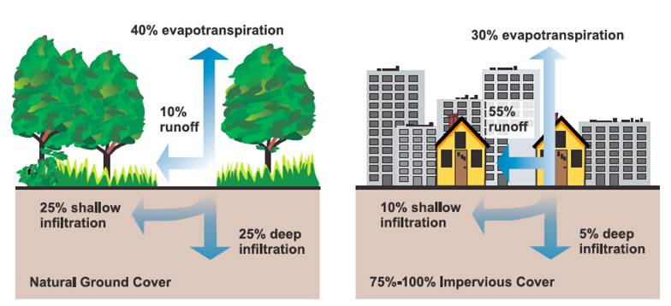
Introduction
Threats to the water sustainability:
Population growth and urbanization
Land Cover Change from Natural Areas to Impervious Surfaces
Impacts on water quality & quantity:
Increases pollutants concentration
Increases runoff volumes and peak flow
Results are:
more frequent and extreme floods
reduced water quality
reduced recharge rate of aquifers
Source: (EPA) U.S. Environmental Protection Agency. 2003. Protecting Water Quality from Urban Runoff.
EPA 841-F-03-003. Washington, D.C.: United States Environmental Protection Agency, Nonpoint Source Control Branch.
Notes:
1st impact note: decreasing the reliability of water distribution systems.
2nd impact note: reduced infiltration rates and groundwater recharge causes hydrologic cycle to be altered.

Slide 3
Traditional Engineering Planning
Water supply and stormwater systems are typically planned/designed in isolation
Existing Paradigm:
Supply side enhancement
Continuous Hydrologic Simulation
Stormwater drainage to regulate excess runoff
Event-based Hydrologic Modeling
One of the drawbacks observed in the current approach:
Land Use/Land Cover is static and exogenous parameter
Notes:
In fact, the land use of large and fast growing cities is dynamic and has profound impacts in the main hydrologic processes.

Slide 4
Objectives
Apply an integrated hydrologic modeling approach to incorporate DYNAMIC land use/land cover.
Assess the impact of land use/land cover change on the hydrologic flow regime in urbanizing watersheds.
Implemented methods include:
Cellular Automata model to represent land use change.
Hydrologic Modeling (Soil and Water Assessment Tool - SWAT).

Slide 5
Integrated Modeling Approach
Watershed
Model
Recharge
Rate
Land
Cover
Groundwater
Model
Land Use
Change Model
Stream Flow
Policymaker
Model
Urban
Growth
Pumpage
Volume
Available
Land
Reservoir
Model
Reservoir
Levels
Population
Growth Model
Water
Conservation
 | Hydrology models
 | Agent Based Models
 | Cellular Automata
 | Systems Dynamics
Water
Demand Model
Population
Water Use
Notes:
Include a colored legend

Slide 6
Integrated Modeling Approach
Watershed
Model
Groundwater
Model
Land Use
Change Model
Policymaker
Model
Reservoir
Model
Population
Growth Model
 | Hydrology models
 | Agent Based Models
 | Cellular Automata
 | Systems Dynamics
Water
Demand Model
Notes:
Include a colored legend

Slide 7
Integrated Modeling Approach
Watershed
Model
Land Use
Change Model
 | Hydrology models
 | Agent Based Models
 | Cellular Automata
 | Systems Dynamics
Notes:
Cellular Automaton is coupled with watershed model

Slide 8

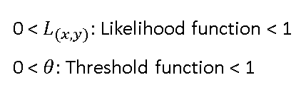
Cellular Automata Land Use Change Model
CA is a method to simulate complex processes between natural and human systems.
It represents the landscape as discrete cells
The state of each cell is a function of neighbors cells
Satellite images
$L_{(x,y)}≥ θ$ urban
$L_{(x,y)}< θ$ no change
Simulated
land cover
surfaces
GIS Layers
CA
Transition
rules
 | Non-urban
 | Urban
0 < $L_{(x,y)}:$ Likelihood function < 1
0 < $θ$: Threshold function < 1

Slide 9
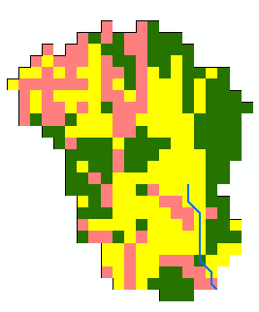
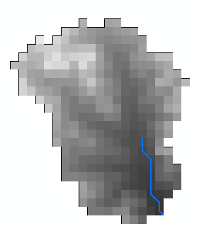
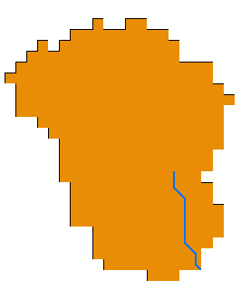
Watershed Model: SWAT
Land Use
Slope Soil Type
Soil and Water Assessment Tool
Continuous, semi-distributed model
Successfully used to test different
water and soil management strategies
Each subwatershed is a set of Hydrologic Response Units (HRUs)
HRU is a unique combination of land use, soil type, and slope class
CA updates fraction of urbanized area at each subwatershed on an annual time step
HRU
Notes:
Explain HRUs and how HRUs change over time
CHANGE FIGURE

Slide 10
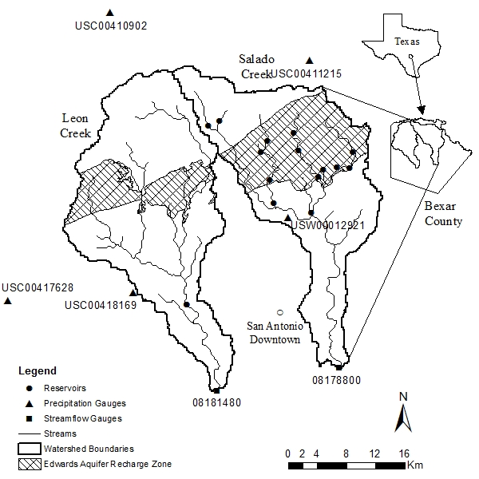
Case Study
City of San Antonio and its surroundings
Population ≈ 1.9 millions
By the year 2060: 2.9 millions
Salado and Leon Creeks
Total area: 1000 km²
59 subbasins, 442 HRUs
Notes:
Edwards Aquifer (EA) meet more than 80% of the water demand of the region.
The EA is a karst aquifer that maintains several springs in the regions, including some that serve as habitats to endangered species.
Because the EA is vulnerable to over extraction and contamination, its pumping is regulated by the Edwards Aquifer Authority (EAA).
Leon Creek: 30 subbasin, 236 HRUs
Salado Creek: 29 Subbasin, 206 HRUs

Slide 11
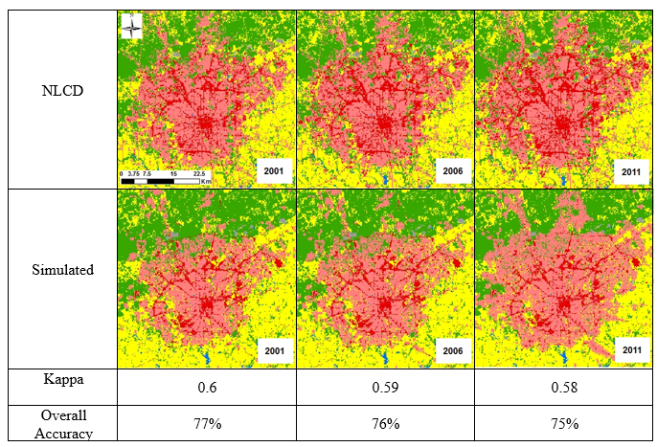
CA Model Results
 | Commercial
 | Residential
 | Forest
 | Grass
 | Water
 | Barren
Notes:
The Kappa index of agreement (KIA) will tell you how much better, or worse, your classifier is than what would be expected by random chance. If you were to randomly assign cases to classes (i.e. a kind of terribly uninformed classifier), you'd get some correct simply by chance. Therefore, you will always find that the Kappa value is lower than the overall accuracy. The Kappa index is however considered to be a more conservative measure than the overall classification accuracy. Your KIA value is telling you essentially that your classifier is about 66% better than a random assignment of cases to the various classes.

Slide 12
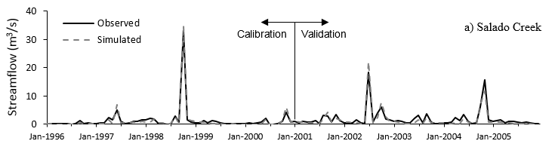
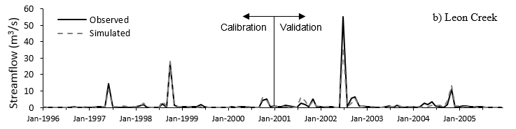
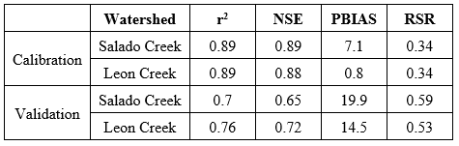
SWAT Calibration & Validation: SWAT-CUP
Notes:
The range of r2 lies between 0 and 1 which describes how much of the observed dispersion is explained by the prediction.
A value of zero means no correlation at all whereas a value of 1 means that the dispersion of the prediction is equal to that of the observation.
The fact that only the dispersion is quantified is one of the major drawbacks of r2 if it is considered alone. A model which systematically over- or underpredicts all the time will still result in good r2 values close to 1.0 even if all predictions were wrong.
The range of E Lies between 1.0 (perfect fit) and −∞ . NSE value = 1·0 indicates perfect model performance (the model perfectly simulates the target output), an NSE value = 0 indicates that the model is,
on average, performing only as good as the use of the mean target value as prediction. An efficiency of lower than zero indicates that the mean value of the observed time series would have been a better predictor than the model.

Slide 13
Static vs. Dynamic Hydrologic Modeling (1)
Daily streamflow from 2000 to 2015
Static LU: modeling based on the 2001 land use
Dynamic CA: Land cover is updated for each year of simulation based on the CA model outputs
Dynamic NLCD: Land cover is updated at specific years
At each 5 years:
Nash Sutcliffe Efficiency (NSE), Coefficient of Determination (r²), and PBIAS
2000 2001 2002 2003 2004 2005 2006 2007

Slide 14
Static vs. Dynamic Hydrologic Modeling (2)

Slide 15
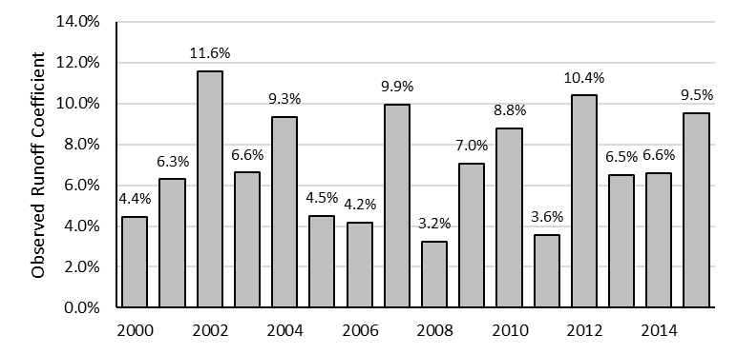

Static vs. Dynamic Hydrologic Modeling (3)
Runoff coefficient$=\frac{Annual runoff}{Annual precipitation}$
Better simulation results by Dynamic modeling
 | Dynamic CA | Dynamic NLCD | Static LU
difference to observed | 29 % | 31 % | 35 %

Slide 16
In Summary
Test and improve a new method to predict Land Cover Change
Couple Hydrologic Modeling with Land Cover Change model
Improve the representation of hydrological processes
Reduce model uncertainties
Next steps:
Improve the accuracy of land use change model
Conduct hydrologic modeling for a longer simulation period

Slide 17
Thank you!

