Slide 1




THE GREAT PENNSYLVANIAN RIVER: A LINK BETWEEN PERMIAN BASIN HYDROCARBONS AND LATE PALEOZOIC COLLISION?
Bob Stern – UT Dallas Geosciences, Richardson TX
Lowell Waite – Pioneer Natural Resources, Irving TX
Majie Fan – UT Arlington Earth and Environmental Sciences, Arlington TX
Stephen Greb – Kentucky Geological Survey, Lexington KY
T10 Tuesday 8:40am

Slide 2
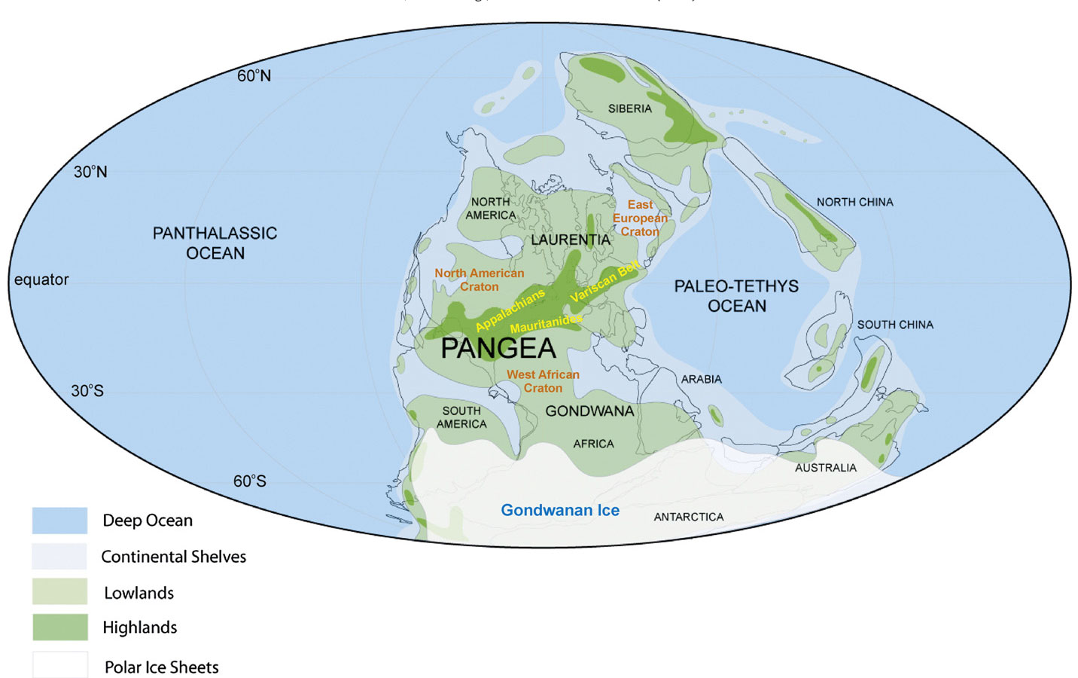
Permian Basin
Variscan (Europe)
Continental reconstruction of the Pennsylvanian world
(Davies and Gibling 2013)

Slide 3
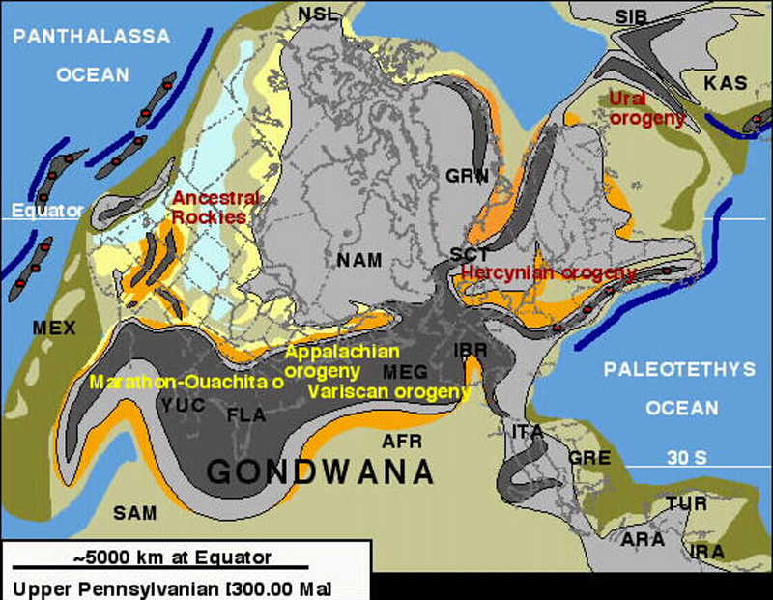

Slide 4
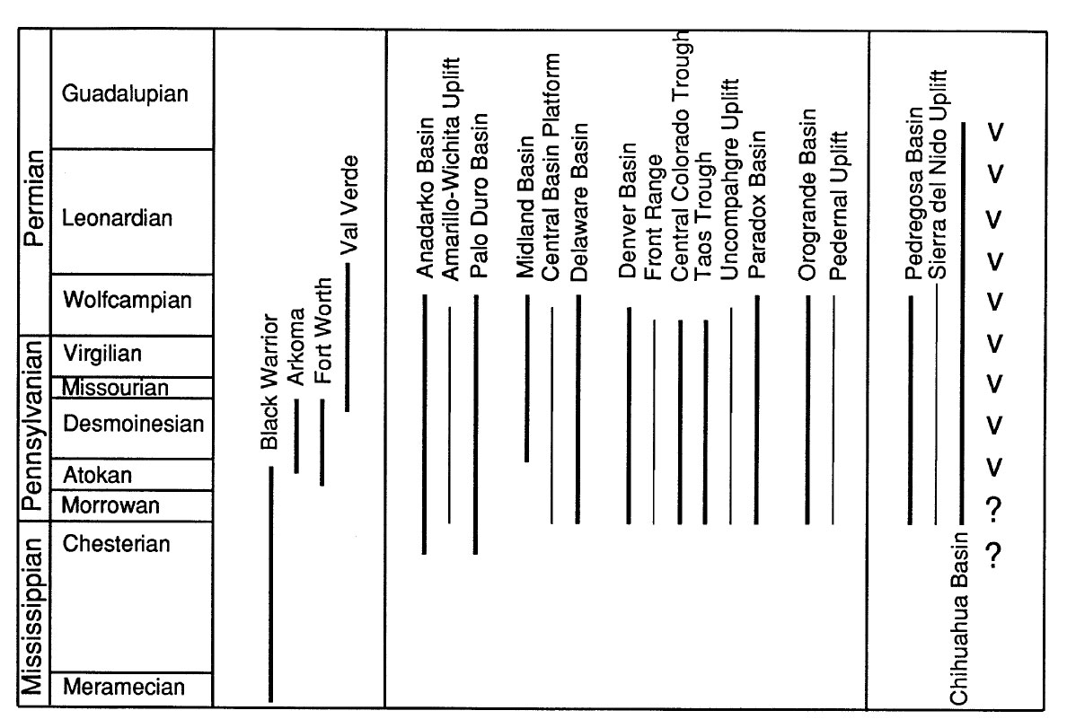
OUACHITA-MARATHON ANCESTRAL ROCKIES MEXICO
Comparative timing of Late Paleozoic events between the Ouachita-Marathon fold and thrust belt, Ancestral Rockies, and western Mexico. Thinner black bars show age of thrusting along the basin margins (for the Ouachita orogen, only thrusting proximal to the margin is shown); heavier black bars show timing of subsidence in the interior basins and the foredeep of the Ouachita orogene. V = volcanic activity in western Mexico (Ye et al., 1996).

Slide 5
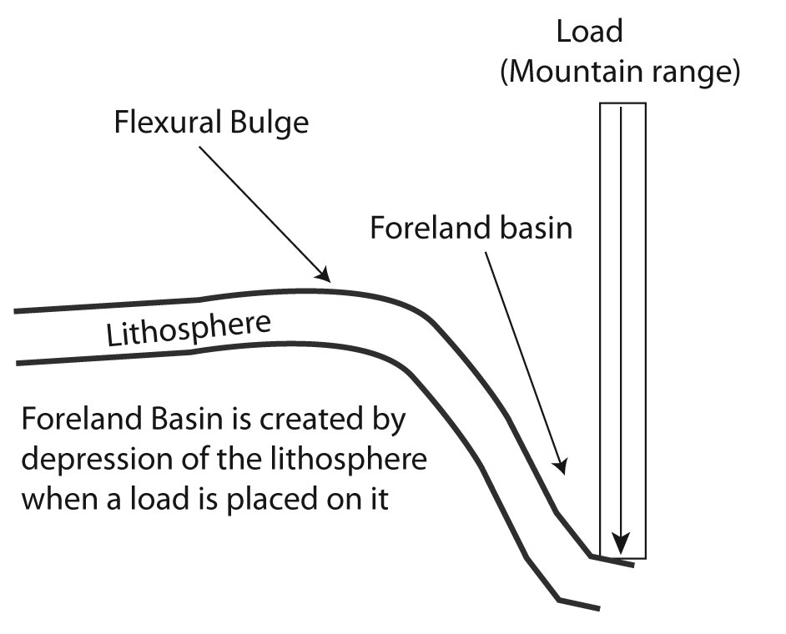
Compressional Sedimentary Basins
(Foreland Basin)

Slide 6
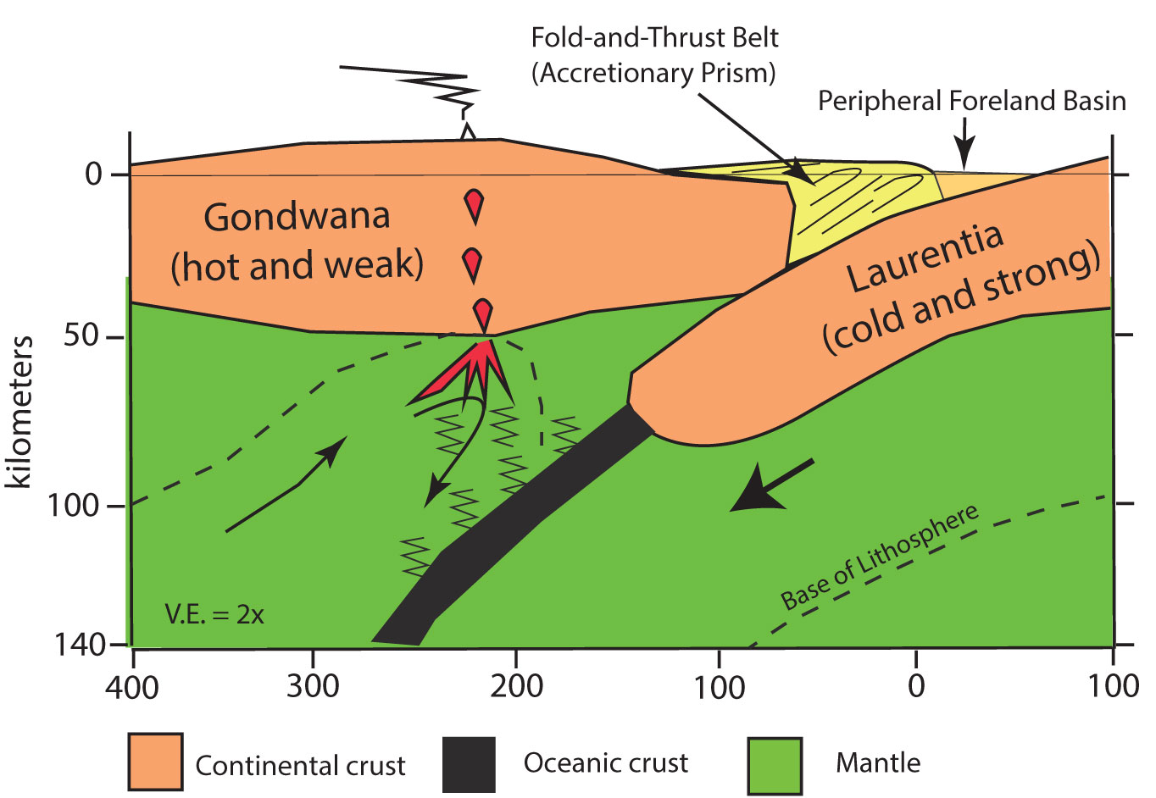
Gondwana was (weak) over-riding plate
Laurentia was (strong) rigid indentor.
Peripheral foreland basin formed above downgoing Laurentia
River flows here

Slide 7
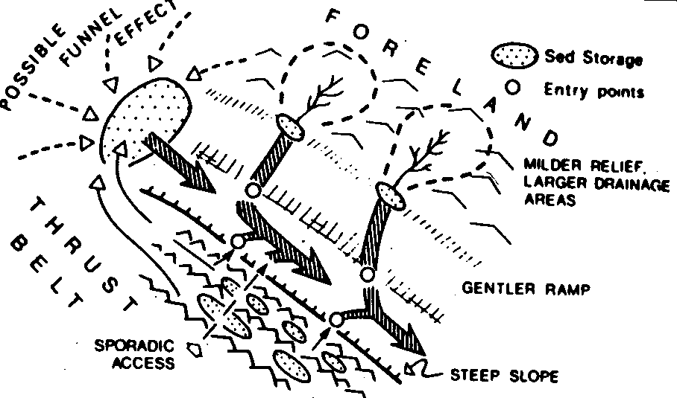
Sediment Transport in Peripheral Foredeeps is mostly Axial

Slide 8
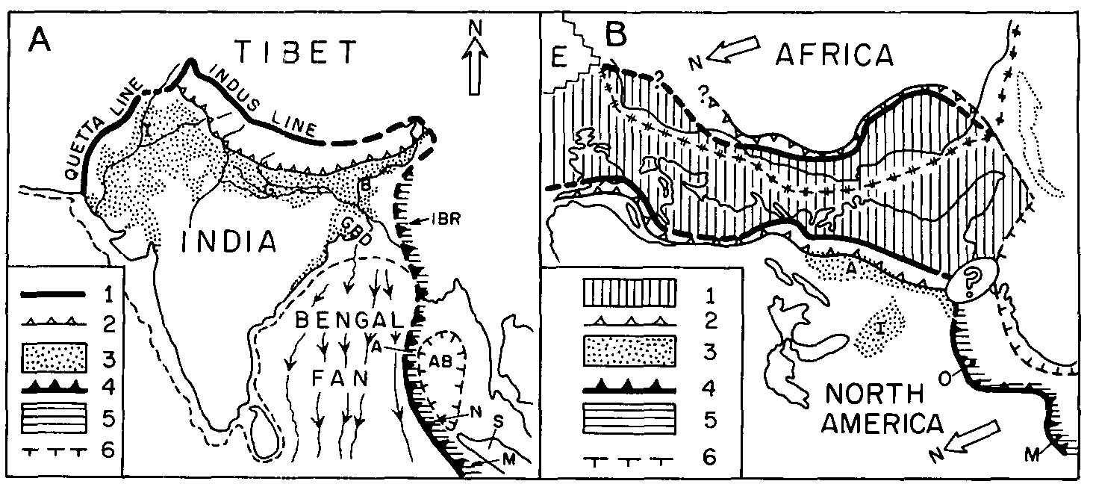
Grand et al. (1975) comparison of Neogene India collision and Gondwana-Laurentia collision as framework for understanding Pennsylvanian drainage
Himalaya-Bengal (Neogene) Appalachia-Ouachita (Pennsylvanian)
1: suture; 2: Main Boundary Fault; 3; Qal;
4: Andaman convergent margin;
5: Accretionary prism;
6: Andaman backarc basin
1: Paleozoic foldbelt; 2, 4: limit of thrusting;
3: Pennsylvanian clastics; 5: Ouachita orogen
6: Gulf of Mexico rifting

Slide 9
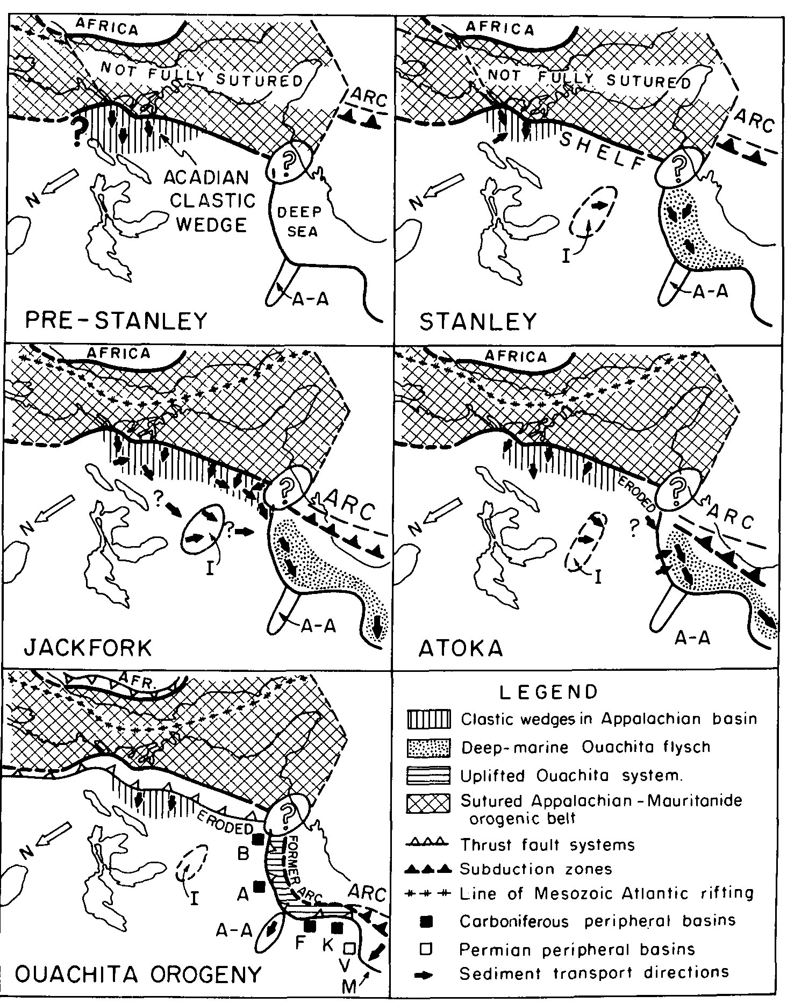
(Miss.)
Interpretive sketches of southeastern North America showing inferred Carboniferous evolution of Ouachita flysch (from Graham et al., 1975).
Features shown include:
A-A: Anadarko-Ardmore basin
B: Black Warrior Basin
F: Ft. Worth Basin
I: Illinois Basin
K: Kerr basin
M: Marathon region
V: Val Verde Basin
(Late D)
(Early Penn)
(Middle Penn)
(Late Penn)

Slide 10
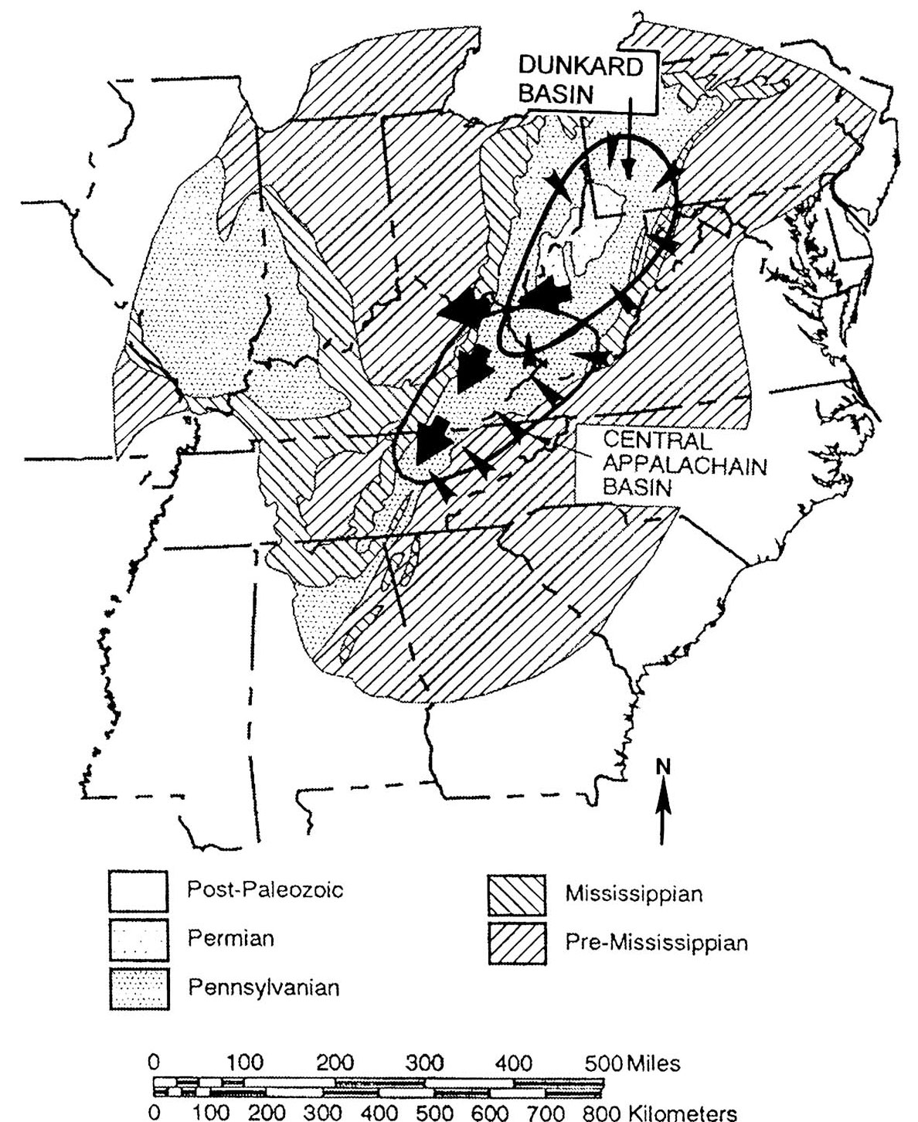
Map of east-central United States showing the Central Appalachian and Dunkard (Northern Appalachian) basins foreland basins. Large dark arrows represent major paleoslope directions in each basin, whereas the smaller arrowheads represent secondary directions. The northward migration of foreland basins in time tracks the progress of the Alleghanian orogeny after collision in the south (Ettensohn, 2008).
But where did it flow to the sea?

Slide 11
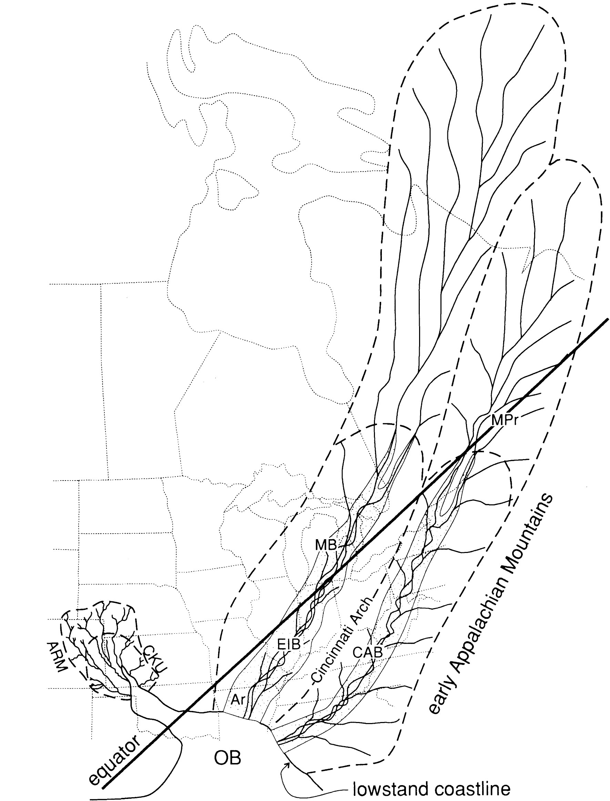
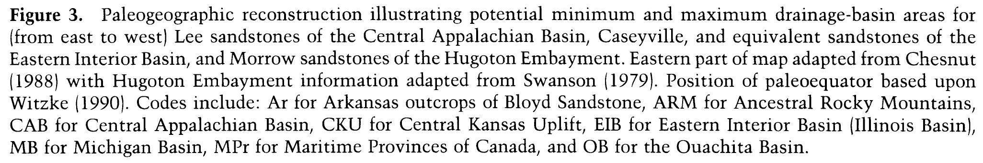
An Amazon-Scale Drainage System in the Early Pennsylvanian of Central North America
Archer & Greb 1995
Morrowan (~ 315 Ma)
When did collision occur and cut of access to the sea?

Slide 12
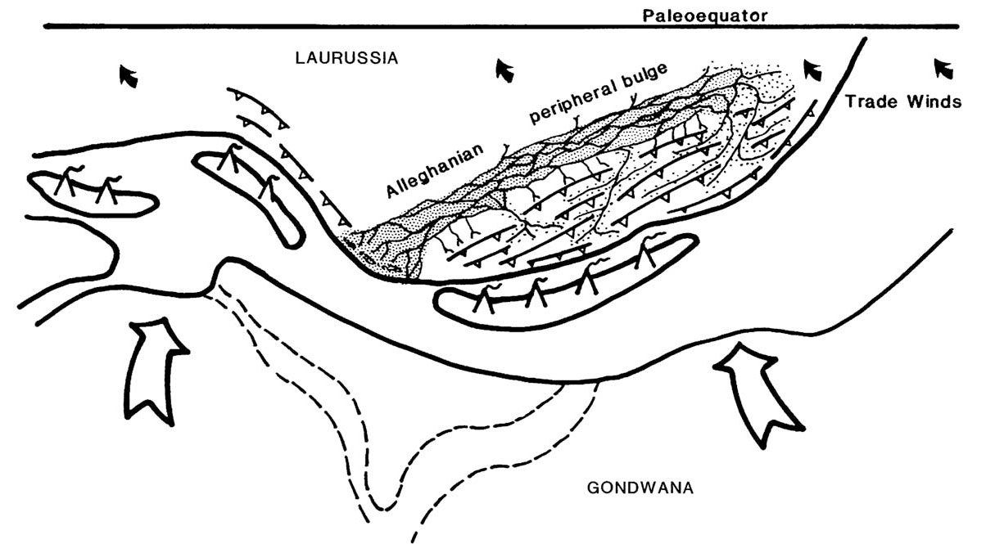
Schematic paleogeographic diagram of the collision zone between Gondwana and Laurussia during Early Pennsylvanian time. The compact stipple represents one of the braidplain sandbelts running longitudinally along the foreland basin; most of the major drainage (loose stipple) from the mountains entered from the north and northeast. During marine transgressions, the foreland basin drainage would have been flooded with marine waters from the south (from Ettensohn, 2008). But there were mountains there!

Slide 13
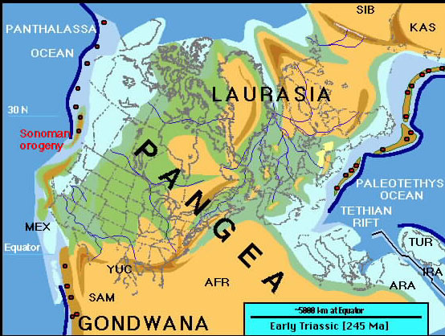
No way for great peripheral foreland basin river to reach
the sea except to the SW via the Permian Basin
PB

Slide 14
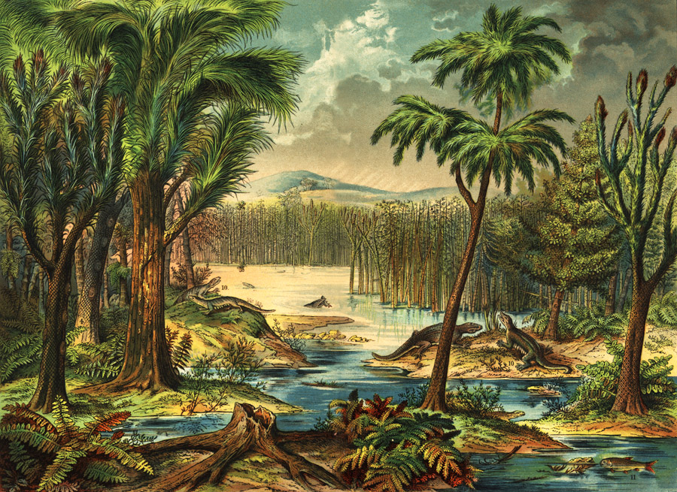
Lots of organic matter would be carried in the Great Pennsylvanian River to the Permian Basin

Slide 15
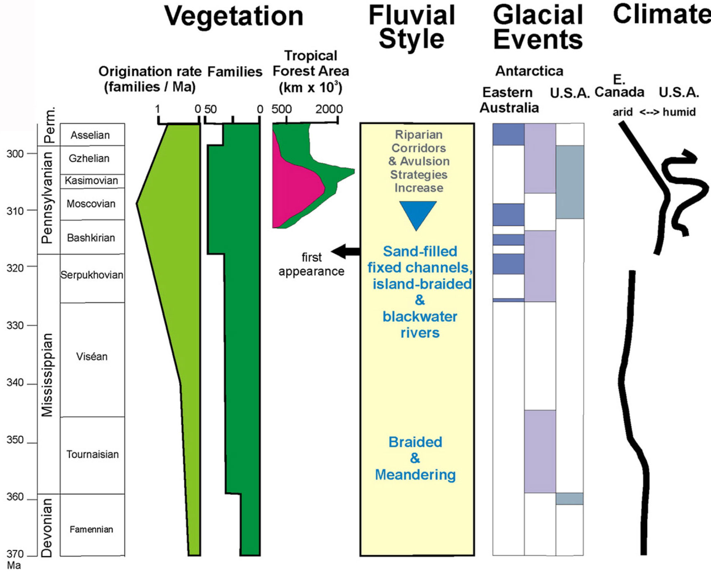
Pennsylvanian Productivity in US
Davis and Gebling 2013

Slide 16
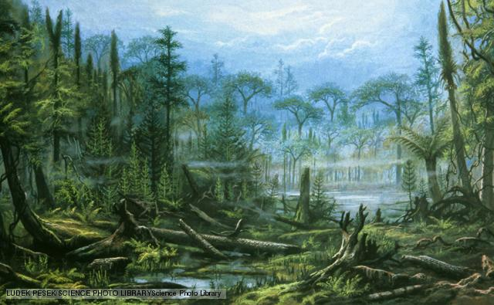
Lots of organic matter would be carried in the Great Pennsylvanian River to the Permian Basin

Slide 17
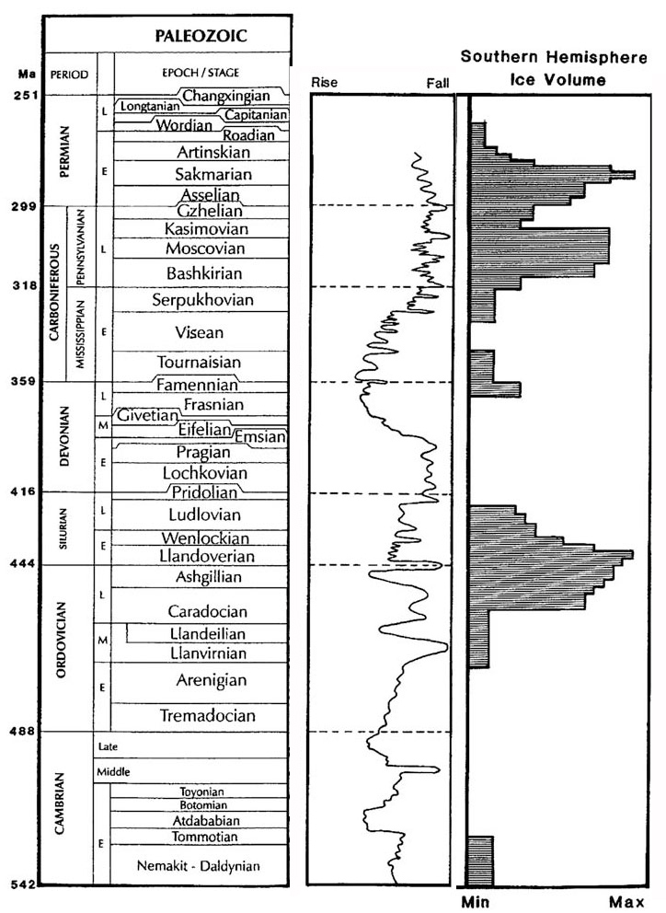
Paleozoic geologic time scale, showing relative sea-level curve and Southern-Hemisphere ice volume (glaciation). Modified from Ettensohn (2008).

Slide 18
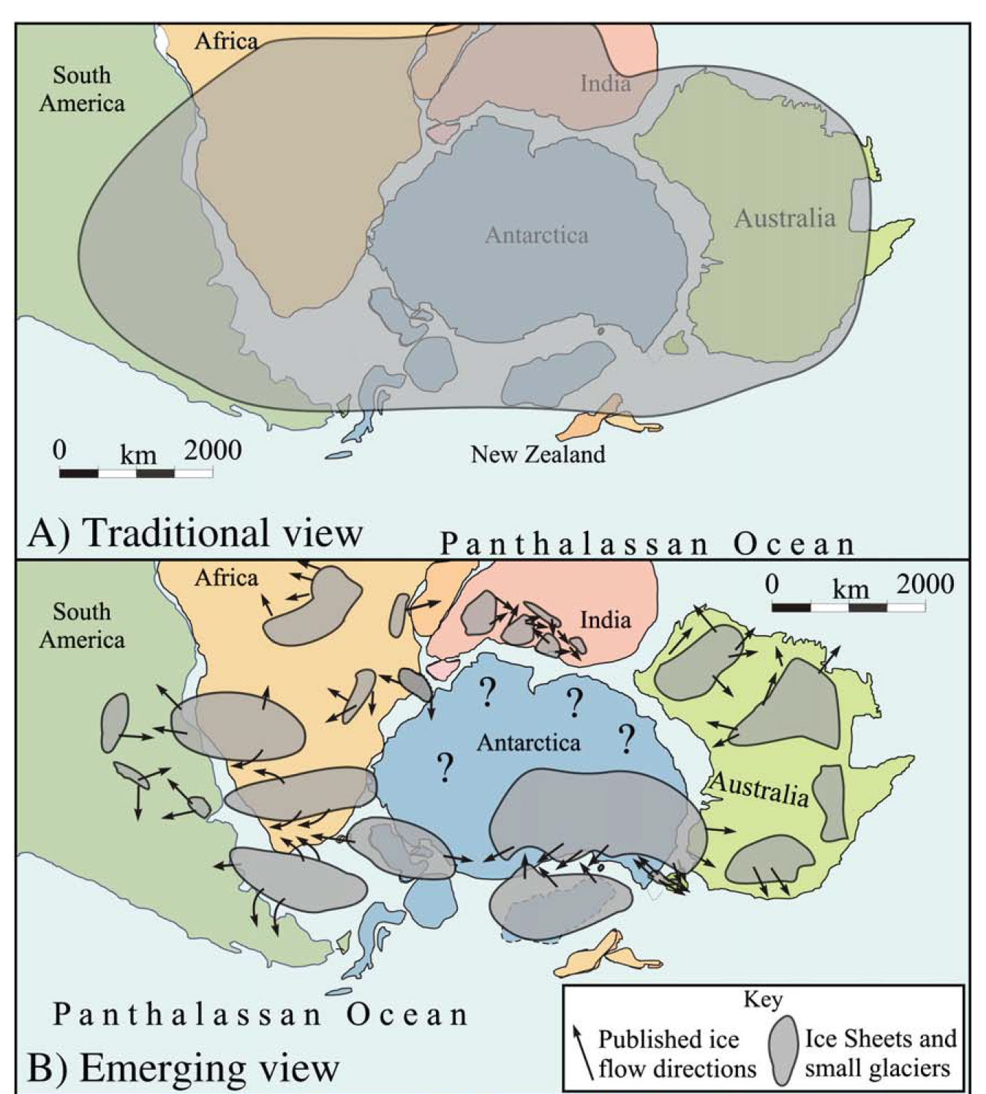
Emerging ideas about the Gondwanan ice sheet
Traditional and Recent reconstructions of maximum glaciation during the late Paleozoic Ice Age. A) Traditional reconstruction showing a massive ice sheet covering much of southern Gondwana (modified from Scotese, 1997, and Scotese and Barrett, 1990).
B) Reconstruction of Gondwana during maximum glaciation during the Gzhelian to early
Sakmarian (Pennsylvanian–Early Permian) based on recent data and ice flow directions. Isbell et al. 2012

Slide 19
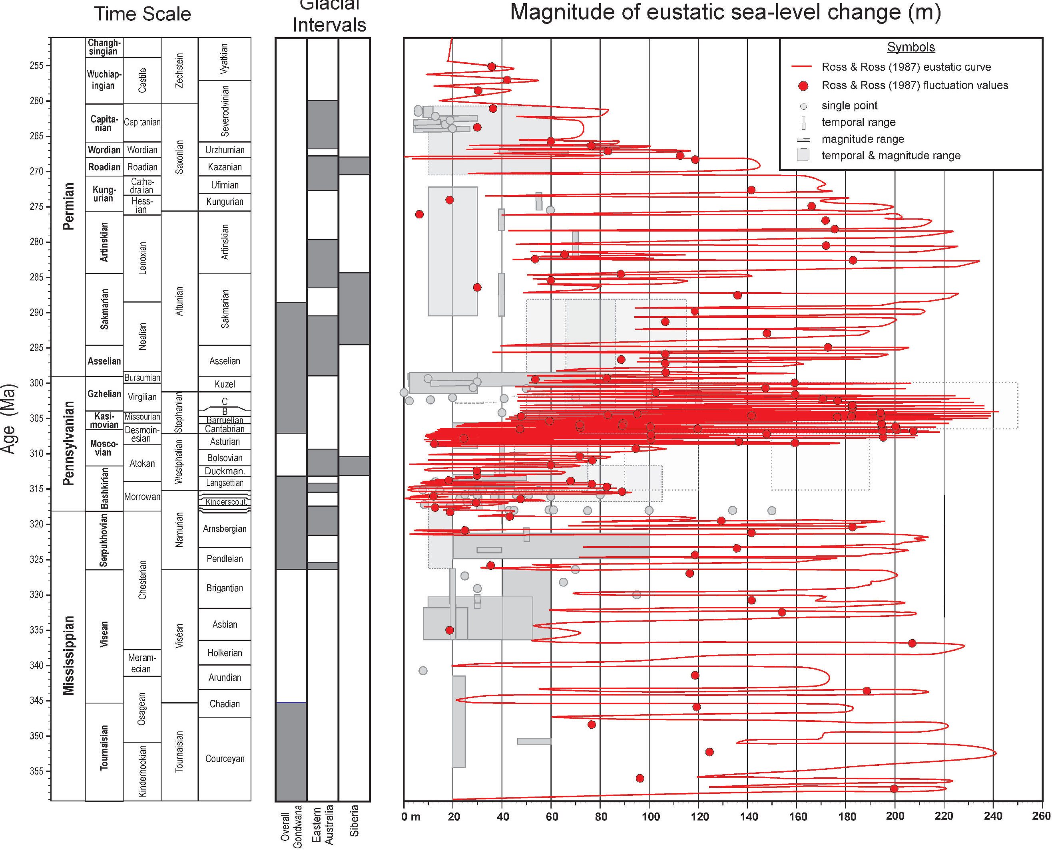
Rygel et al., 2008

Slide 20
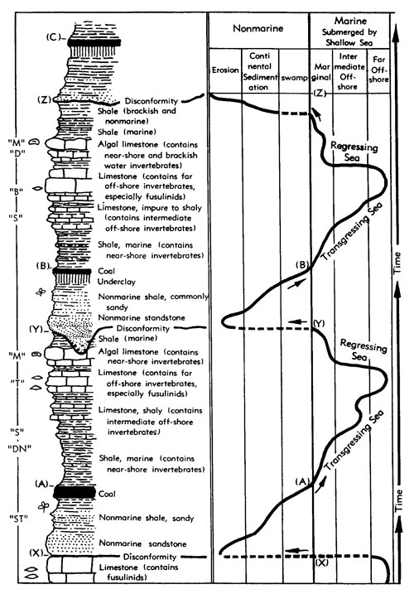
Cyclothems: The record of Pennsylvanian glacioeustatic change in the continental USA

Slide 21
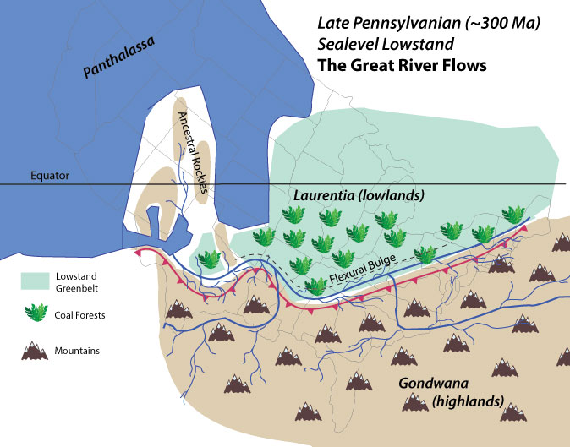
Lots of nutrients delivered to Permian Basin

Slide 22
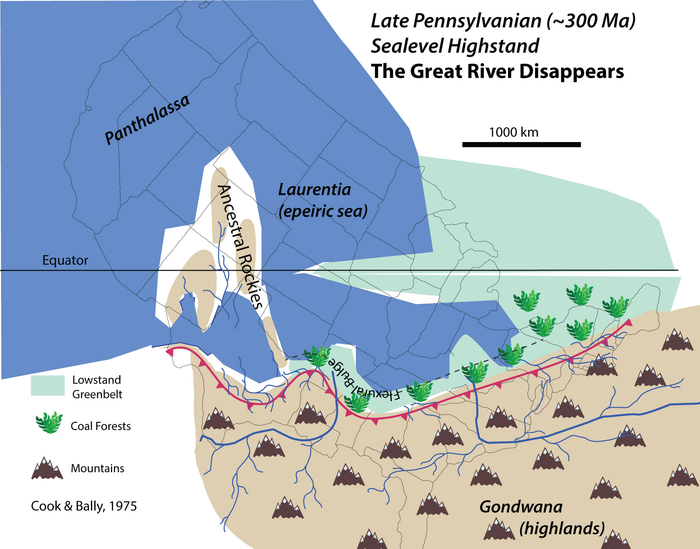
?
?
Few nutrients delivered to Permian Basin
Notes:
Bob. Maybe extend land in the App Basin west to the Cincinnati Arch, with App basin mostly overfilled deltaic. Little evidence for marine in Late Penn App. Basin. Only freshwater limestones that I’m aware of in the Monongehala Fm (Virgillian). Illinois basin does have some in the Mattoon Fm (Virgillian).

Slide 23
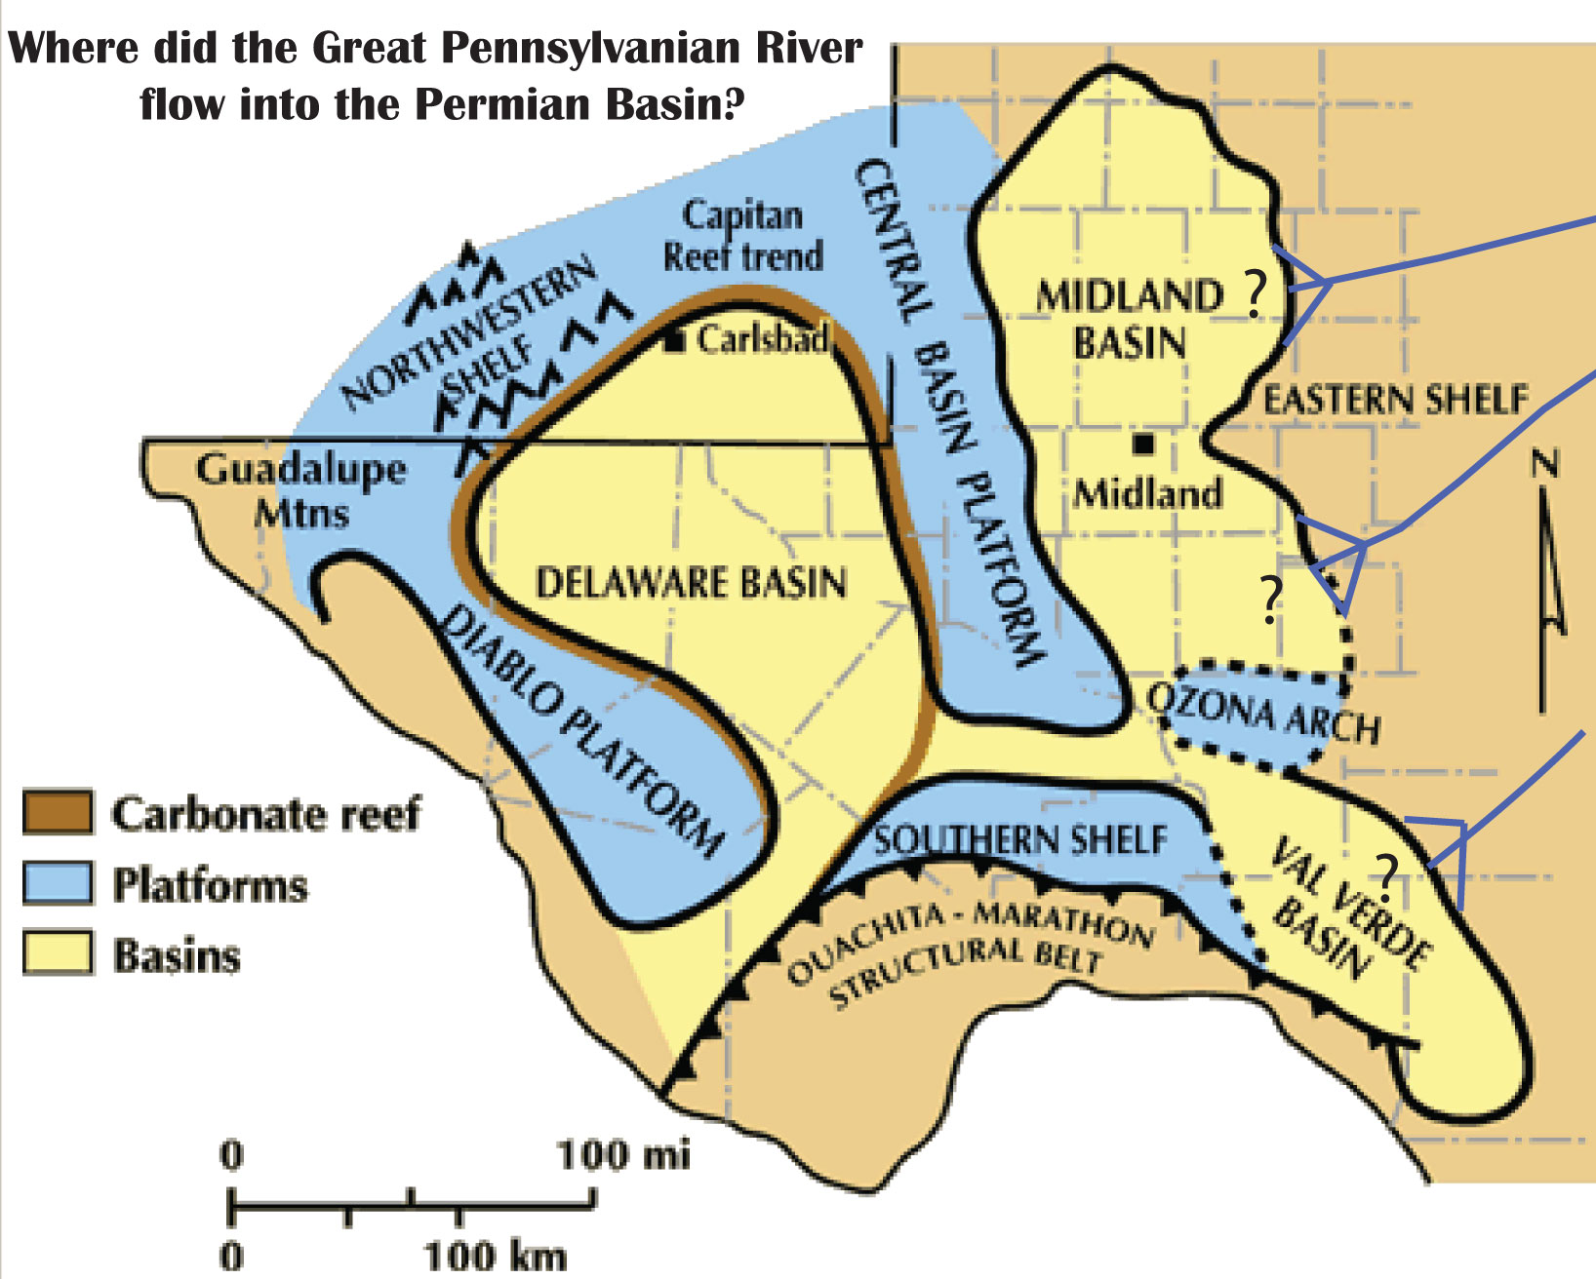
If there was a Great Pennsylvanian River, it ended in the Permian Basin of W Texas and SE New Mexico
What is the relationship between the GPR and hydrocarbon richness of Permian Basin?
Especially interested in Pennsylvanian and Early Permian record
Is there a relationship between hydrocarbon source rocks and sealevel?
?
?
?

Slide 24
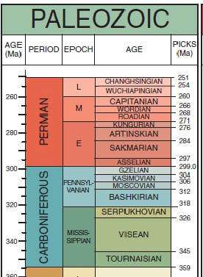
Thanks for Listening!

Slide 25
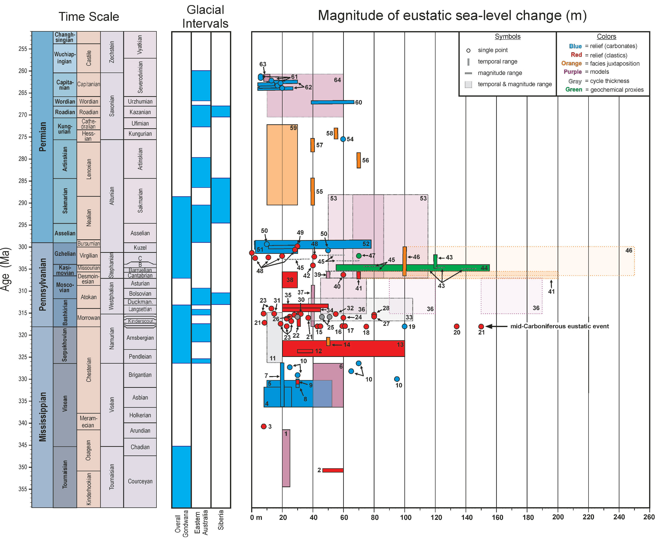
Rygel etal.2008
Notes:
The longitudinal system from the Archer and Greb paper is for lower Penn (Morrowan). That system is mostly gone by the Middle Penn (Atokan). It may have been pushed westward, but we don't know. We know that throughout Atokan, most of the App. Basin paleocurrents in KY, OH, WV and PA are to west and northwest. Not much preserved south in TN, AL, so hard to tell what happened to south. In Illinois Basin throughout Atokan, drainage direction was south toward Mississippi Embayment. Single large (mostly muddy) drainages throughout most of Desmoinesian in Illinois basin. By Virgillian, little data in the east. In Dunkard Basin of northern WV, se OH, and sw PA, paleocurrents are to northwest, and likely feeding westward into Illinois Basin. Quinlan and Beuamont's old work shows forebulge migrating west through Pennsylvanian. Virgillian App. Basin is overfilled deltaic.

Slide 26
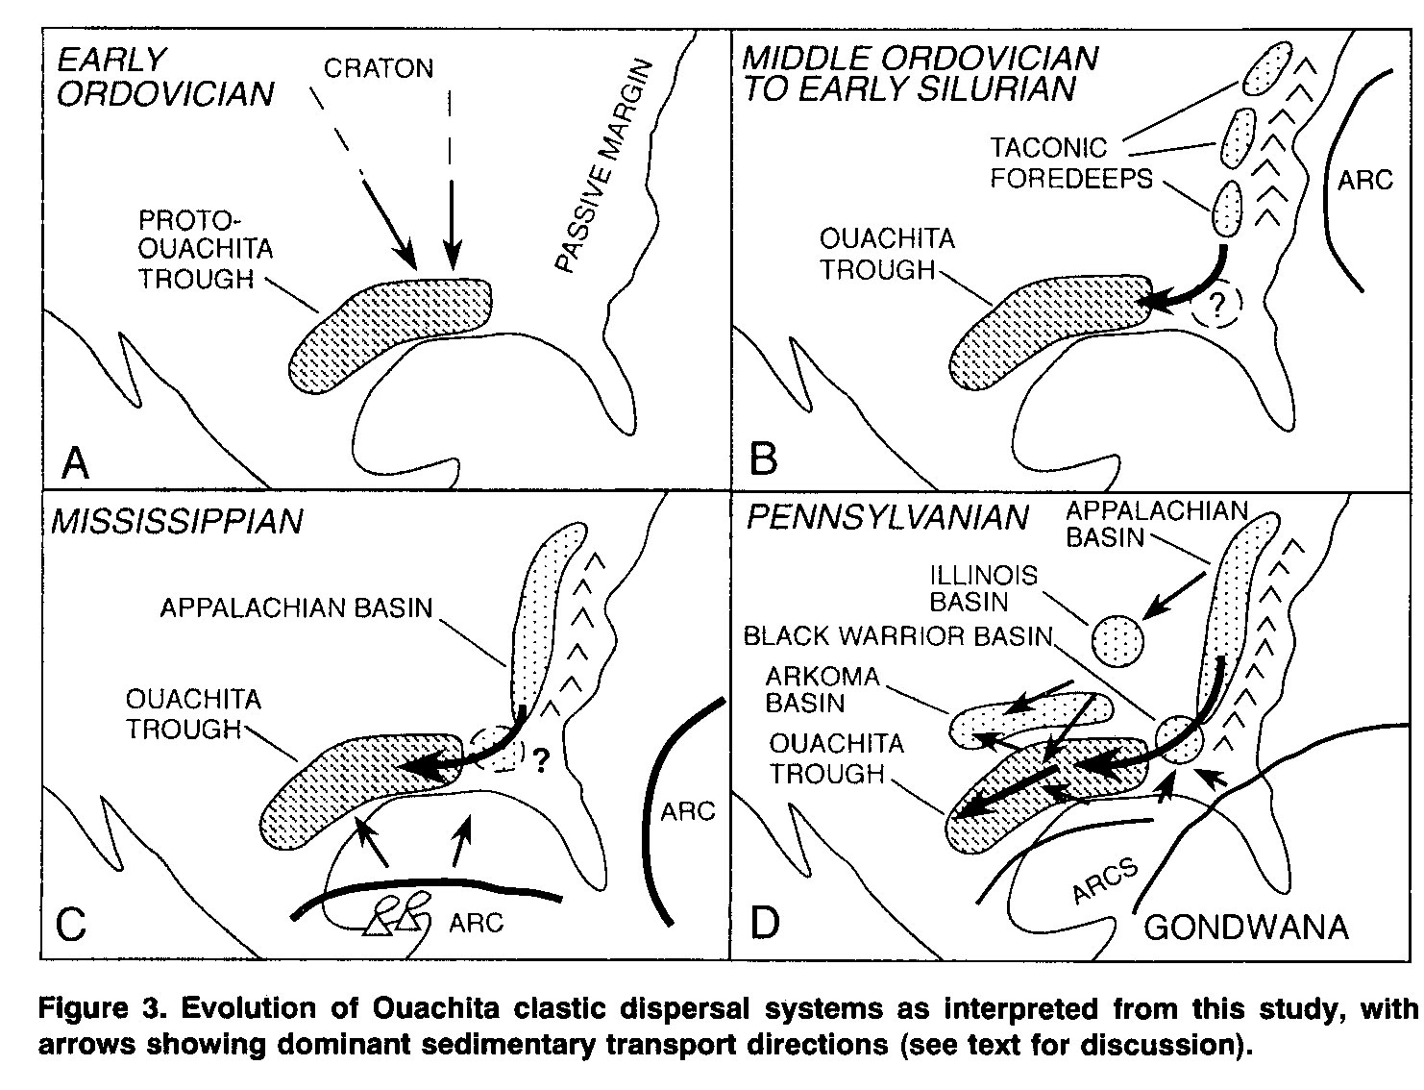
Idea of Pennsylvanian river has been around for a decade or so, link to Permian Basin is new
Gleason et al., 1994

