Slide 1

APPLICATIONS OF tau_{P} AND tau_{Fe} AS INDICATORS OF MICROBIAL BIOCYCLING AND REDOX PROCESSES IN PRECAMBRIAN PALEOSOLS AND PALEOSAPROLITES
Steven G. Driese
Department of Geosciences and
Terrestrial Paleoclimatology Research Group, Baylor University, Waco, TX
L. Gordon Medaris, Jr.
Department of Geoscience, University of Wisconsin, Madison, WI
Gary E. Stinchcomb
Department of Geosciences & Watershed Studies Institute, Murray State University, Murray, KY
March 13, 2017, San Antonio, TX

Slide 2
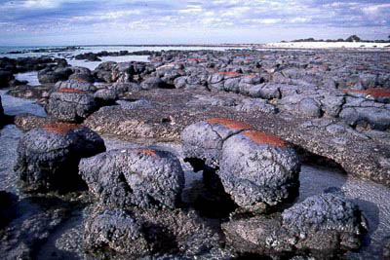
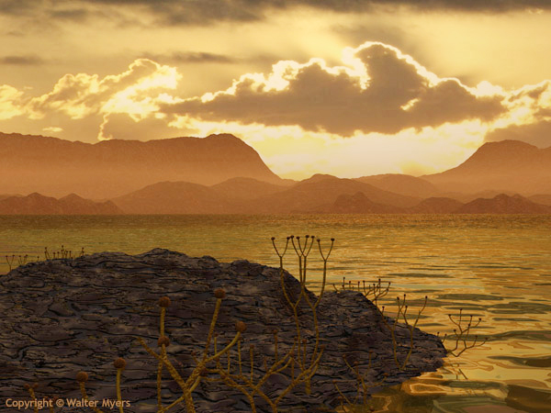
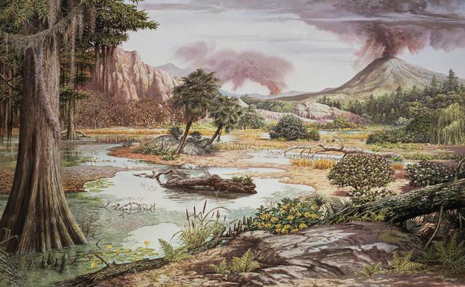
Precambrian: 3.5 billion to 500 million years ago
eucaryotes (green algae)
stromatolites
terrestrial cryptobiotic crusts
cyanobacteria
algae
fungi
Silurian: 425 million years ago
early land plants
Cooksonia caledonica
first vascular land plants
Late Silurian to
Early Devonian
Cretaceous: 100 million
years ago
extensive development
of rooted vascular
land plants
weathering enhanced
by 5 to 10×

Slide 3
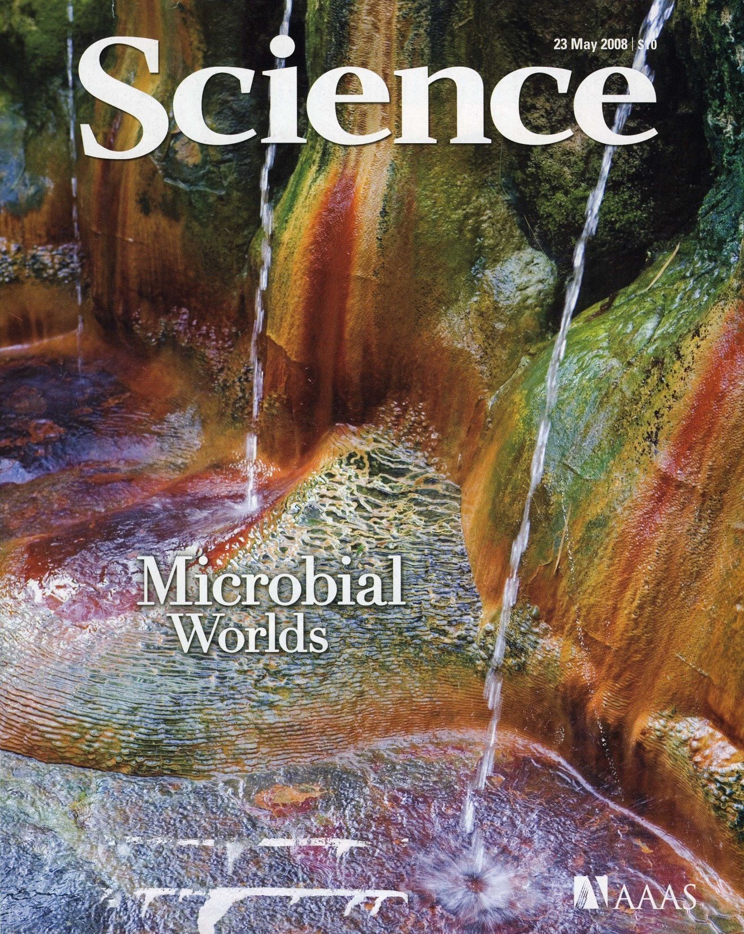
The X-factor: Earliest Microbial Communities and Terrestrial Biomass ?

Slide 4
Methods
thin-sections (standard PPL/XPL + UVf)
bulk geochemistry & mass-balance (τ) assuming immobile Al₂O₃
XRD semi-quantitative mineralogy
CIA-K and Clayeyness, and PPM v.1 model to estimate MAP, MAT; Medaris et al. (2015) correction for K-metasomatism; AlCa used to estimate pH (Lukens et al., in review)

Slide 5
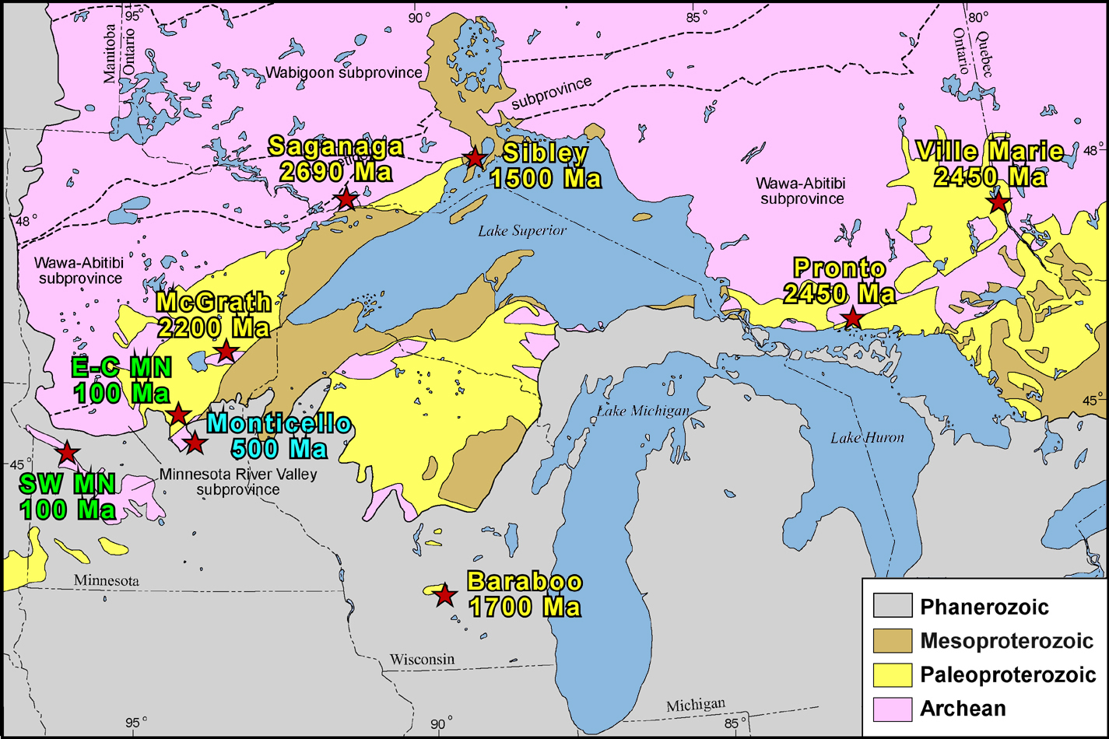
Localities of Granitic Saprolites in the Lake Superior Region
Denison
2450 Ma
TR119
500 Ma
modified from Garrity & Soller, 2009

Slide 6
Conceptual Model: tau Fe₂O₃ (red) and tau P₂O₅ (purple)
Mesoproterozoic
0
*For saprolites and regoliths formed on crystalline basement
Biocycling
Progressive P
biocycling, bioconcentration
Modern
Paleoproterozoic
Depth
Neoproterozoic
Neoarchean
0
Root zone
0
Depth
-tau
0
+tau
0
Cambrian
Depth
0
0
Depth
Depth
Depth
-tau
0
+tau
-tau
0
+tau
-tau
0
+tau
Progressive Fe retention
-tau
0
+tau
-tau
0
+tau

Slide 7
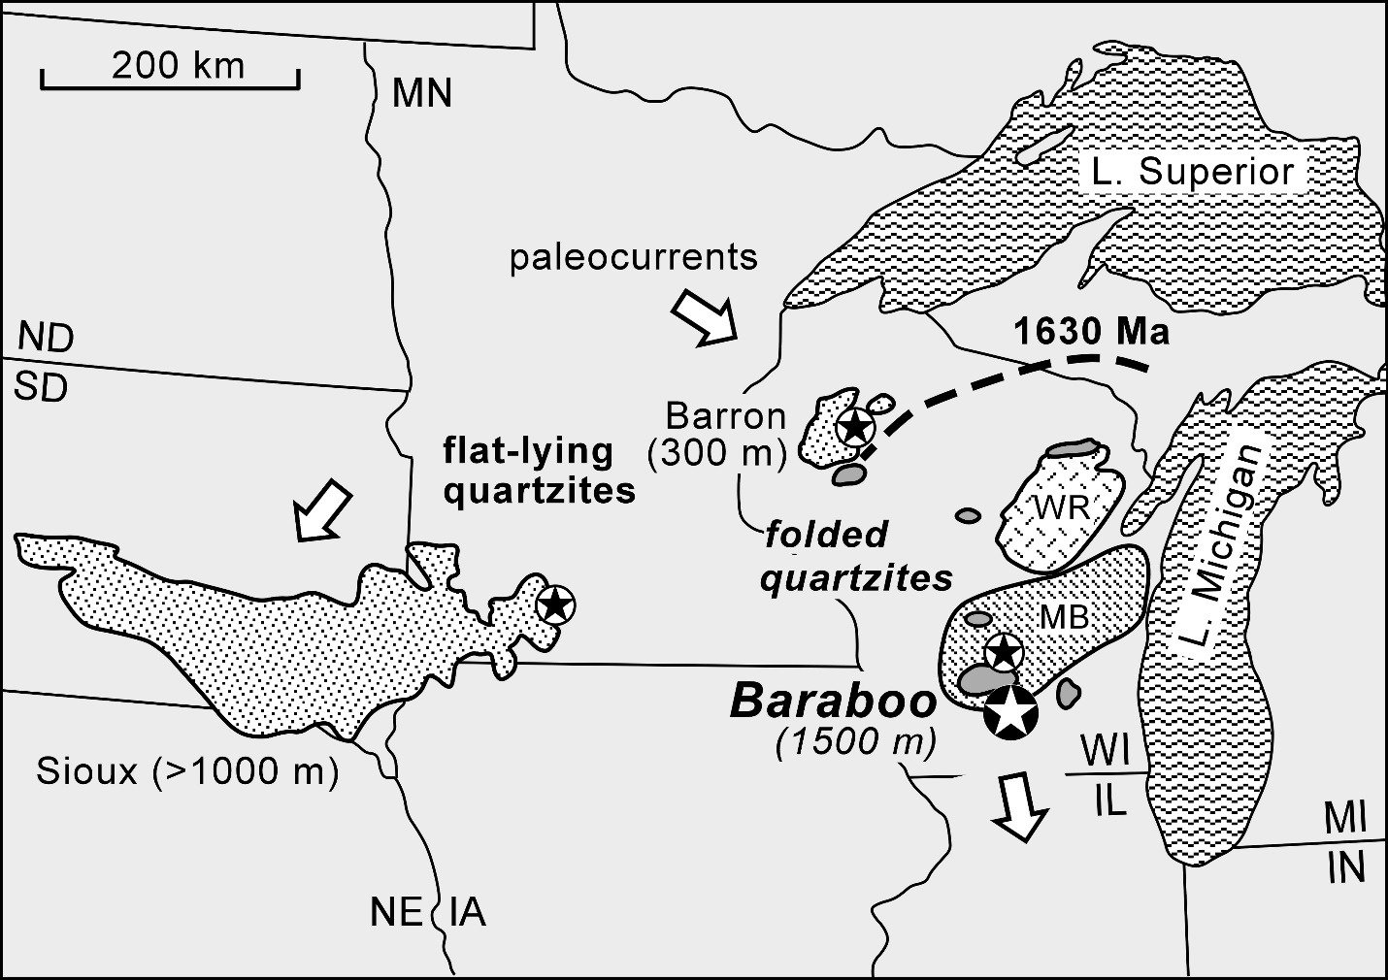
Middle Proterozoic Metaquartzites
Medaris et al., in review, Precambrian Research

Slide 8
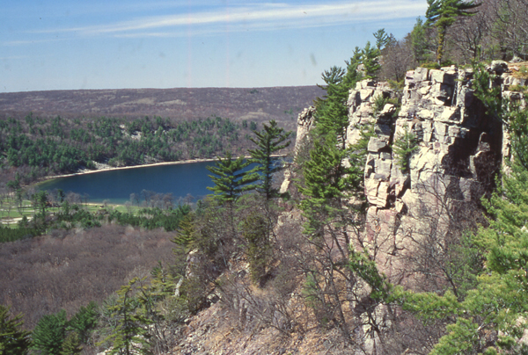
Devil’s Lake State Park, Baraboo Hills, Wisconsin
Baraboo Quartzite

Slide 9
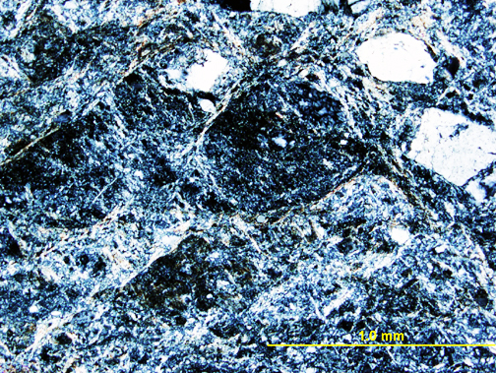
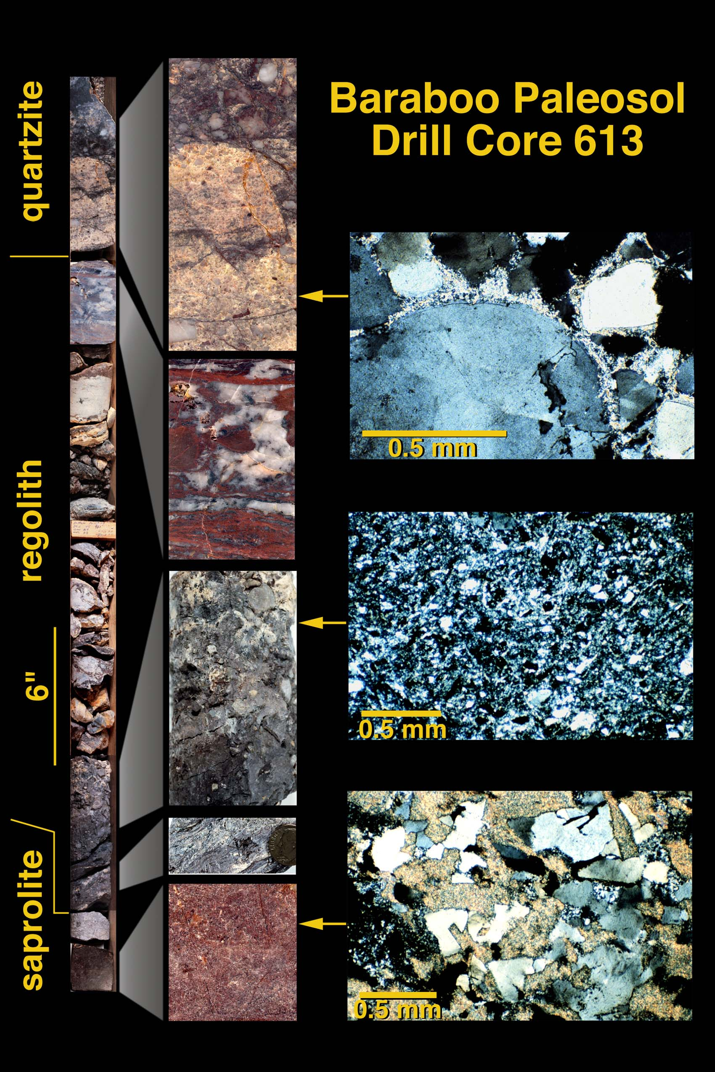
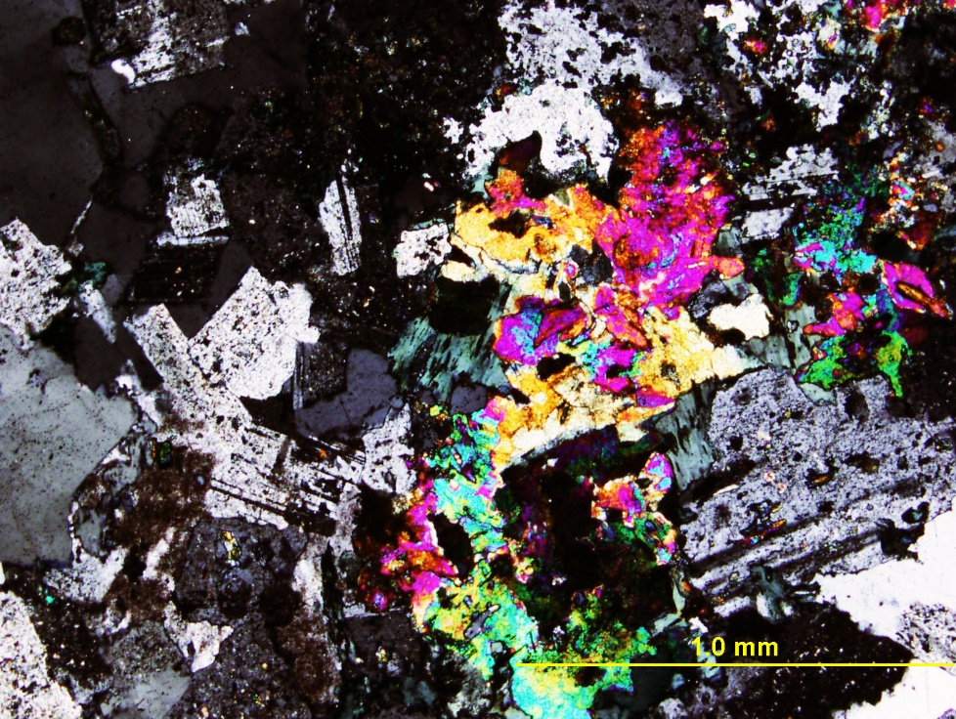
1700 Ma, WI
1.0 mm
Clay paleosol
1.0 mm
Granitic protolith
Driese and Medaris, 2008, JSR

Slide 10
Mass-Balance Geochemical Analysis
% change = 100 × [(c_{j,w} / c_{j,p}) / (c_{i,w} / c_{i,p}) – 1]
where c_{j,w} is the concentration of element j in weathered material, c_{j,p} is the concentration of element j in protolith, c_{i,w} is the concentration of immobile element in weathered material, and c_{i,p} is the concentration of immobile element in protolith.

Slide 11
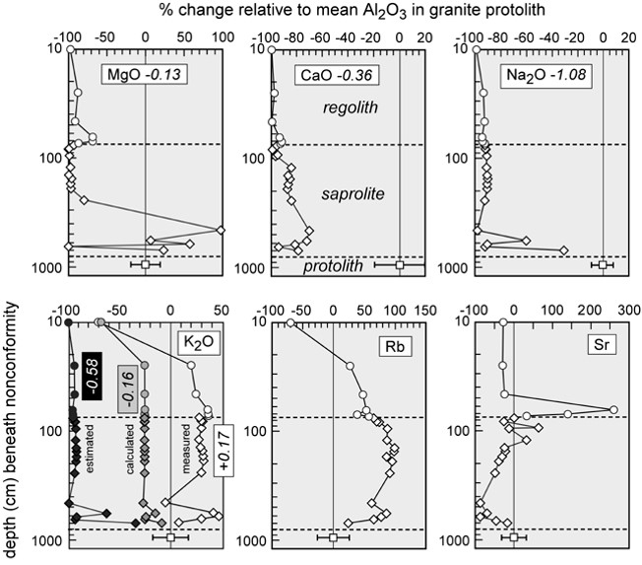
% Net Gains (+)/Losses (-)
Medaris et al., in review, Precambrian Research
(Total Mass Fluxes: mol cm⁻²)

Slide 12
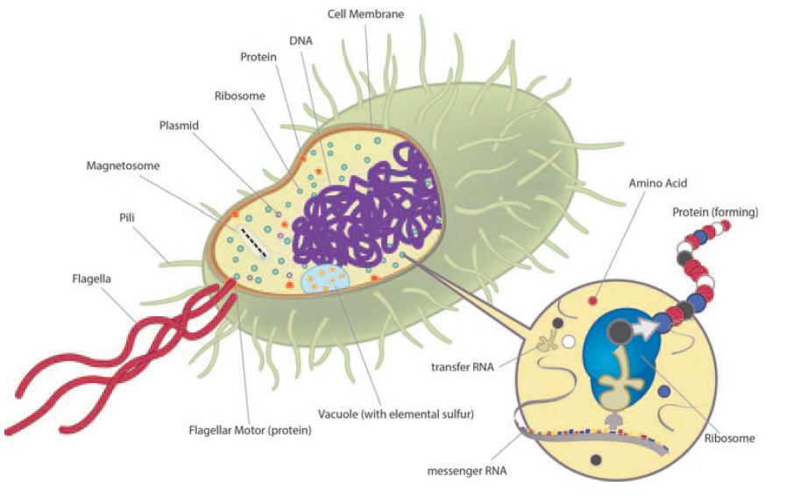
Generalized Microbial Structures
Nanometers to a few microns
Drischel and Kappler (2015) Elements

Slide 13
Metabolic Needs of Microbes (?)
cm
Aerobic Fe (II) Oxidation:
2Fe²⁺ + 0.5O₂ + 2H+ = 2Fe³⁺ + H₂O
aerobic
Anaerobic Fe (III) Reduction:
CH₃COO⁻ + 8Fe(OH)₃ = 8Fe²⁺ + 2HCO₃⁻ + 15OH⁻ + 5H₂O
anaerobic
Anaerobic Fe (II) Oxidation:
10Fe²⁺ + 2NO₃⁻ + 24 H₂O = 10Fe(OH)₃ + N₂ + 18H⁺
cm
P bio-removal for metabolic processes
P bio-concentration + Aluminum-Phosphate-Sulphate (APS) mineral ppt (svanbergite)
Medaris et al., in review, Precambrian Research

Slide 14
Paleoprecipitation and Paleotemperature Estimates

Slide 15
pH (AlCa): Lukens et al. (in review)
Low-pH microbial “soils” probably characterized many Precambrian paleosol profiles

Slide 16
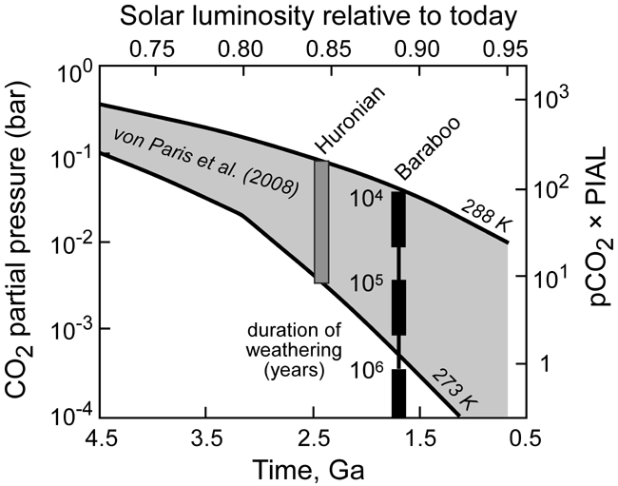
Paleoatmospheric pCO₂ Estimates
Medaris et al., in review, Precambrian Research

Slide 17


Summary and Conclusions
Precambrian paleoweathering profiles examined using bulk geochemistry & mass-balance (tau) assuming immobile Al₂O₃ focusing on Fe and P
Baraboo (1.7 Ga) profile shows distinctive tau_{Fe} and tau_{P} patterns explicable in terms of microbial processes (upper aerobic, lower anaerobic weathering zones)
MAP 1177(658-1695) mm yr⁻¹, MAT 14.3 (9.4-19.2) ºC; pH 4.8 (3.9-5.6); pCO₂ 4.8 PIAL, for 100,000 yr weathering duration

