Slide 1
GROUNDWATER SUSTAINABILITY RESOURCE:
Conceptual Evolution, Opportunities, & Challenges
John M. Sharp
The University of Texas
Austin, Texas, USA

Slide 2
“The nation behaves well if it treats the natural resources as assets which it must turn over to the next generation increased, and not impaired, in value.”
Theodore Roosevelt

Slide 3
SUSTAINABILITY IMPLIES A MUTUAL DEPENDENCE BETWEEN THE HUMAN ECONOMY AND THE NATURAL ENVIRONMENT

Slide 4
One (i.e., my) definition of sustainability
The rates and methods of Earth resource utilization that can support a reasonable human population indefinitely at an acceptable standard of living and maintain an acceptable environment.

Slide 5
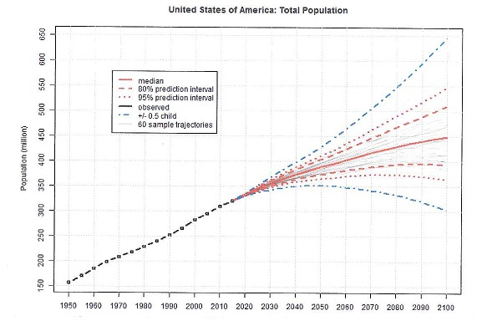
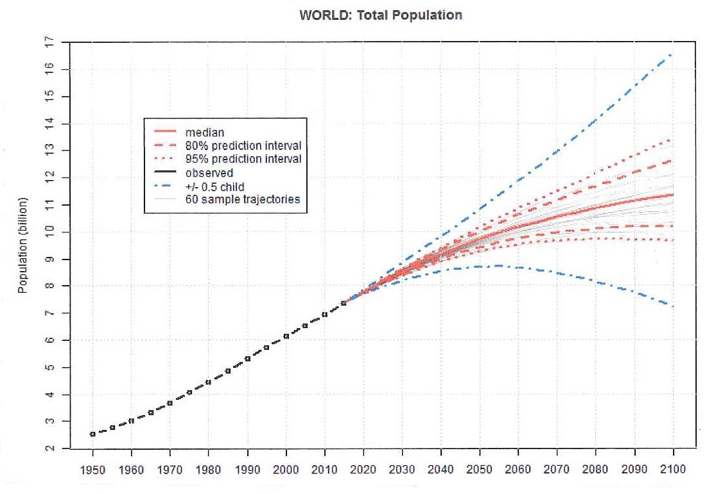
U.S.A.
Ireland
World
Source:
United Nations

Slide 6
•Have we have already passed the level of a reasonable population in both the USA and globally (over 7 billion globally), and, if so, what can be done about it?
•Must our standard of living drop to global levels to achieve sustainability?
•How much environmental degradation can we tolerate and achieve sustainability?
•What environment are we to preserve and for whom or what?

Slide 7
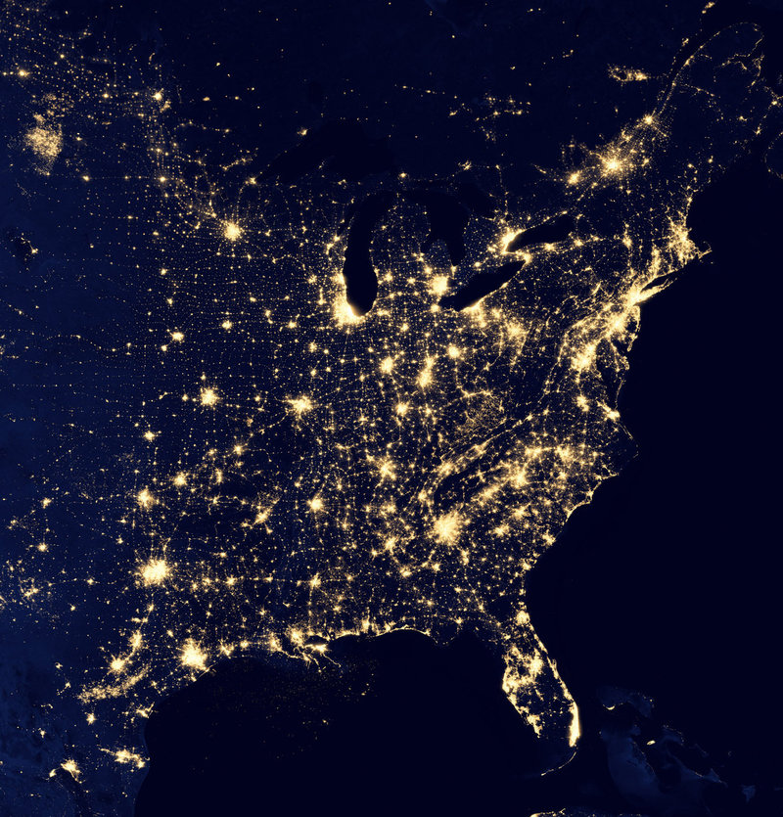
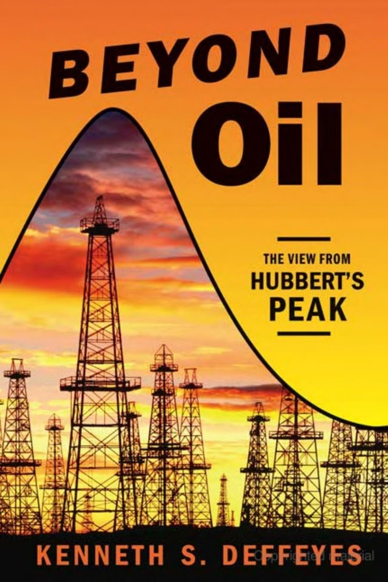

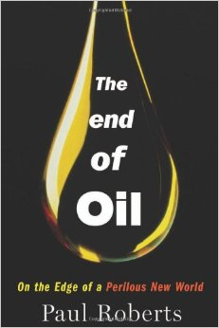
Our predictions on another important fluid resource have not been good.
Predictions are always difficult when they involve the future.

Slide 8
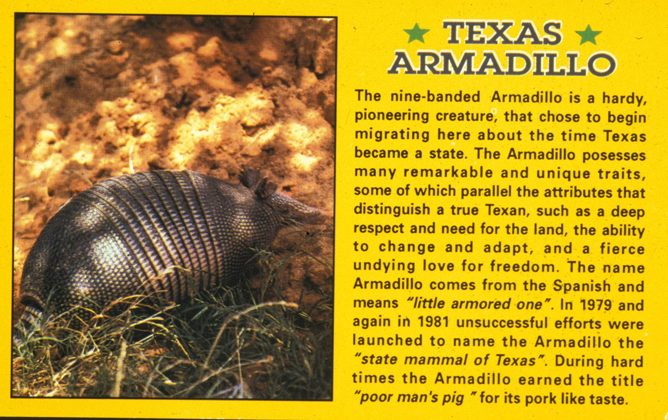
Should we save the Texas armadillo?
1836

Slide 9
We cannot maintain the natural environment of today or of a century past, even if human activities cease!

Slide 10
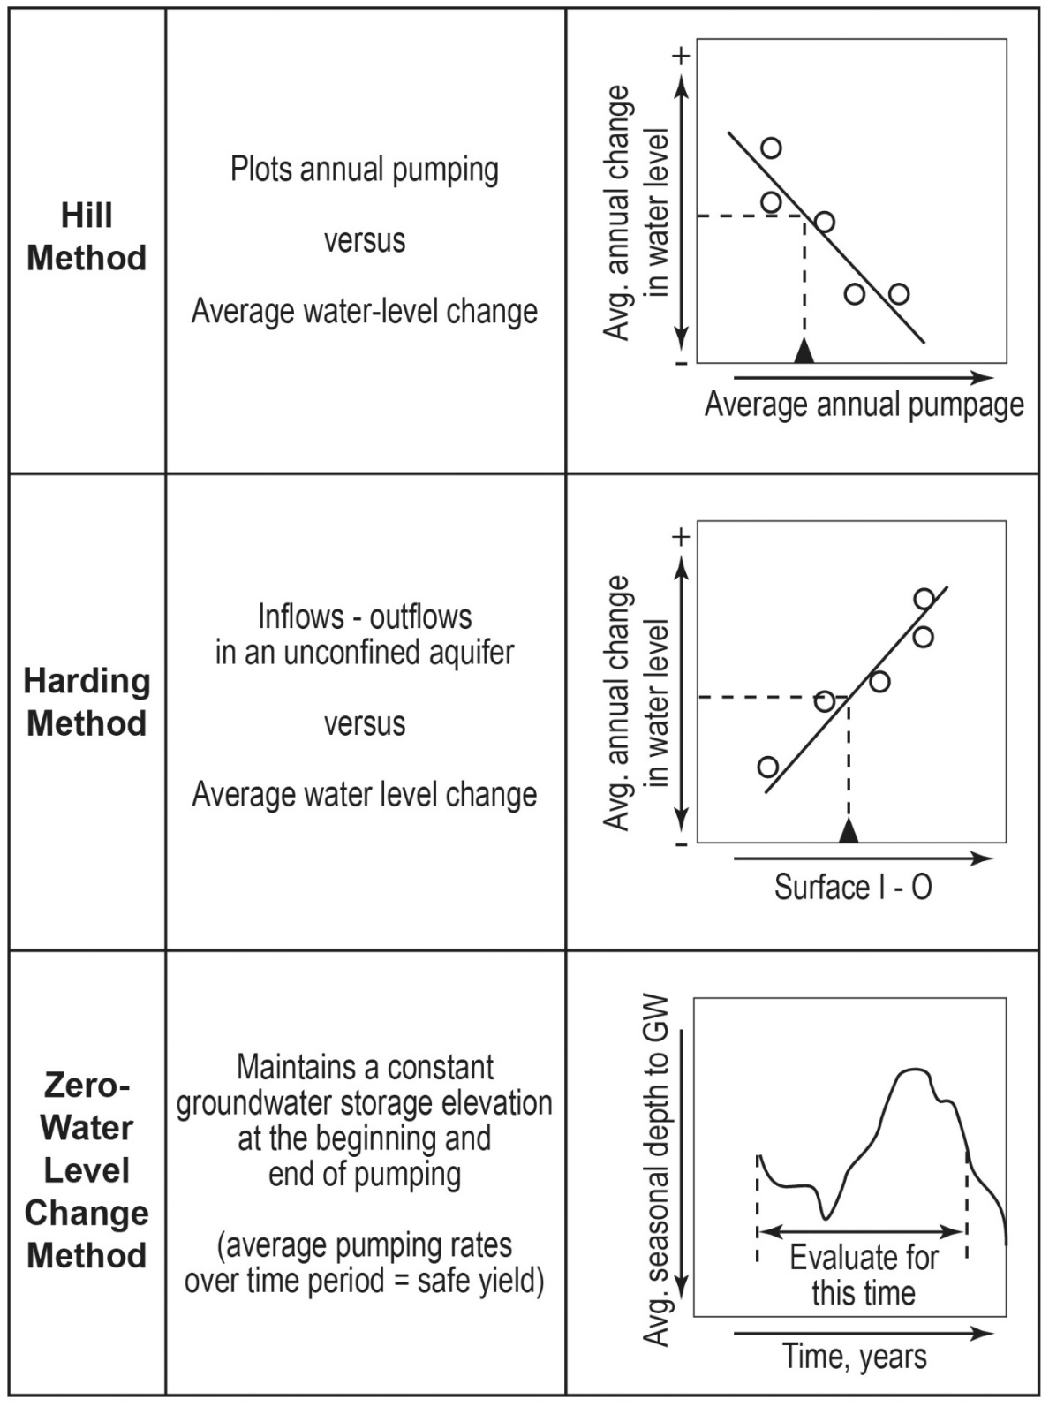
SAFE YIELD
ESTIMATES
Estimating safe yield is conceptually simple, but some models are extremely complicated numerical procedures.
The models on the left are simple & demonstrate the process.

Slide 11
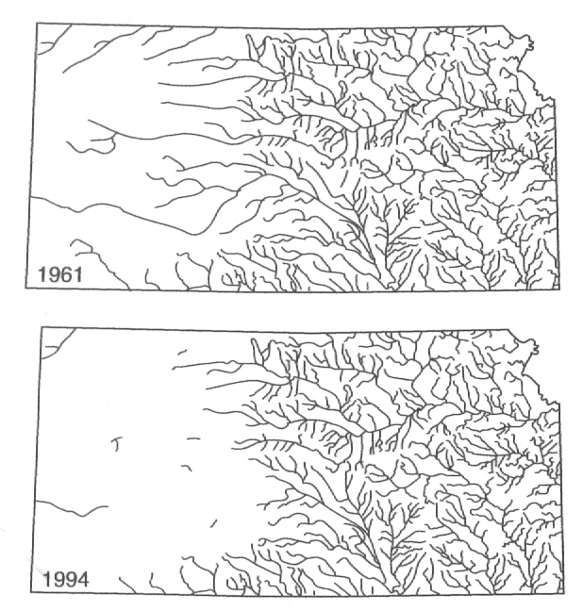
Safe Yield
dS/dt = I(t) – O(t)
The aquifer discharge that:
Doesn’t exceed natural average annual recharge rates,
Is not used to damage adjoining properties maliciously,
Avoids negative water quality impacts,
Preserves economic viability,
Doesn’t cause undesirable subsidence,
& Complies with existing legal constraints.
Perennial streams in Kansas (Sophocleus, 2000)
But is safe yield sustainable?
Notes:
The image above is a graphic depiction of how the two components intersect in the case of calculating groundwater availability. The decision is the amount of allowable pumping, while the left axis shows the remaining storage
in the aquifer and the right-hand axis shows the relative position that a stakeholder may select during
a negotiation session.
Human judgment can be separated into two components approaches, deliberative and affective.
Logical decision making is guided by rational or deliberative thinking processes, while affective
decision making is guided by emotional responses to a situation. Each component influences the
ultimate outcome of a decision process. Using the methodologies and tools developed for
CADRe, both aspects of human decision making can be incorporated. By explicitly recognizing
the elements of a problem both the scientific and objective components can be analyzed
within the context of the perceptions and priorities of participants in the decision making
process. CADRe identifies the elements of each component and their influence on the
robustness of a decision outcome, while melding the two in support of insight
building group dialogue about the problem.

Slide 12
Sustainable Yield
dS/dt = I(t) – O(t)
The aquifer discharge that :
Meets all safe yield criteria,
Maintains environmental streamflows and groundwater dependent ecosystems,
& Protects intergenerational equity
(Lee, 1915; Meinzer, 1923; Todd, 1959; Kazmann, 1968; NRC, 1997: Loaiciga, 1997; Alley, 1999; Sophocleous, 2000; Alley & Leake, 2004; Zhou, 2009)
Notes:
The image above is a graphic depiction of how the two components intersect in the case of calculating groundwater availability. The decision is the amount of allowable pumping, while the left axis shows the remaining storage
in the aquifer and the right-hand axis shows the relative position that a stakeholder may select during
a negotiation session.
Human judgment can be separated into two components approaches, deliberative and affective.
Logical decision making is guided by rational or deliberative thinking processes, while affective
decision making is guided by emotional responses to a situation. Each component influences the
ultimate outcome of a decision process. Using the methodologies and tools developed for
CADRe, both aspects of human decision making can be incorporated. By explicitly recognizing
the elements of a problem both the scientific and objective components can be analyzed
within the context of the perceptions and priorities of participants in the decision making
process. CADRe identifies the elements of each component and their influence on the
robustness of a decision outcome, while melding the two in support of insight
building group dialogue about the problem.

Slide 13
THE OBVIOUS PROBLEM
Most discussions of sustainability are very qualitative.
We want ‘firm’ yields and solutions that are permanent, easy, and cheap!
Our frame of reference is too short!
Solutions may be economically, ethically, or politically unacceptable!

Slide 14
WE HAVE SEEN THE EFFECTS OF AQUIFER OVEREXPLOITATION
IN THE U.S.A. & TEXAS
Loss of special habitats or environments
Aquifer depletion
Subsidence
Salt-water intrusion or encroachment
Declining groundwater quality

Slide 15
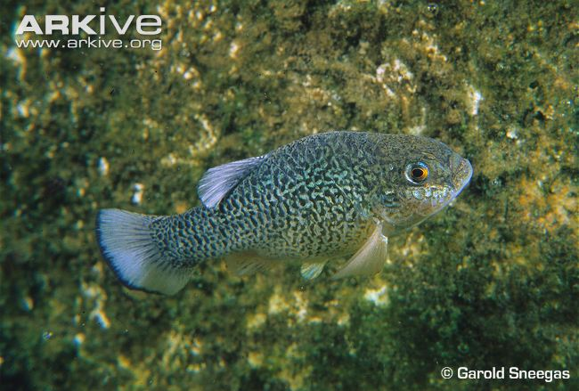
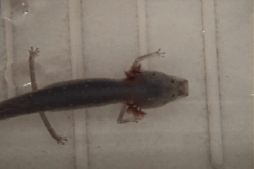
Endangered species
Pumpage has reduced spring flows that are also important recreationally, esthetically, and for certain species native to the springs.
Comanche Springs Pupfish (Cyprinodon elegans)
Austin Blind Salamander (Eurycea waterlooensis)
Notes:
Video of Austin Blind Salamander provided by:
City of Austin Watershed Protection and Development Review Department
DeeAnn Chamberlain
All Rights Reserved

Slide 16
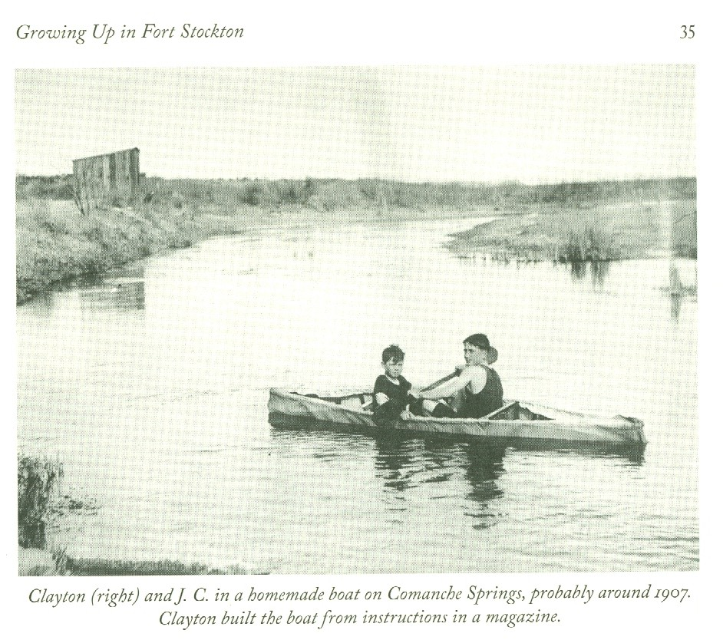
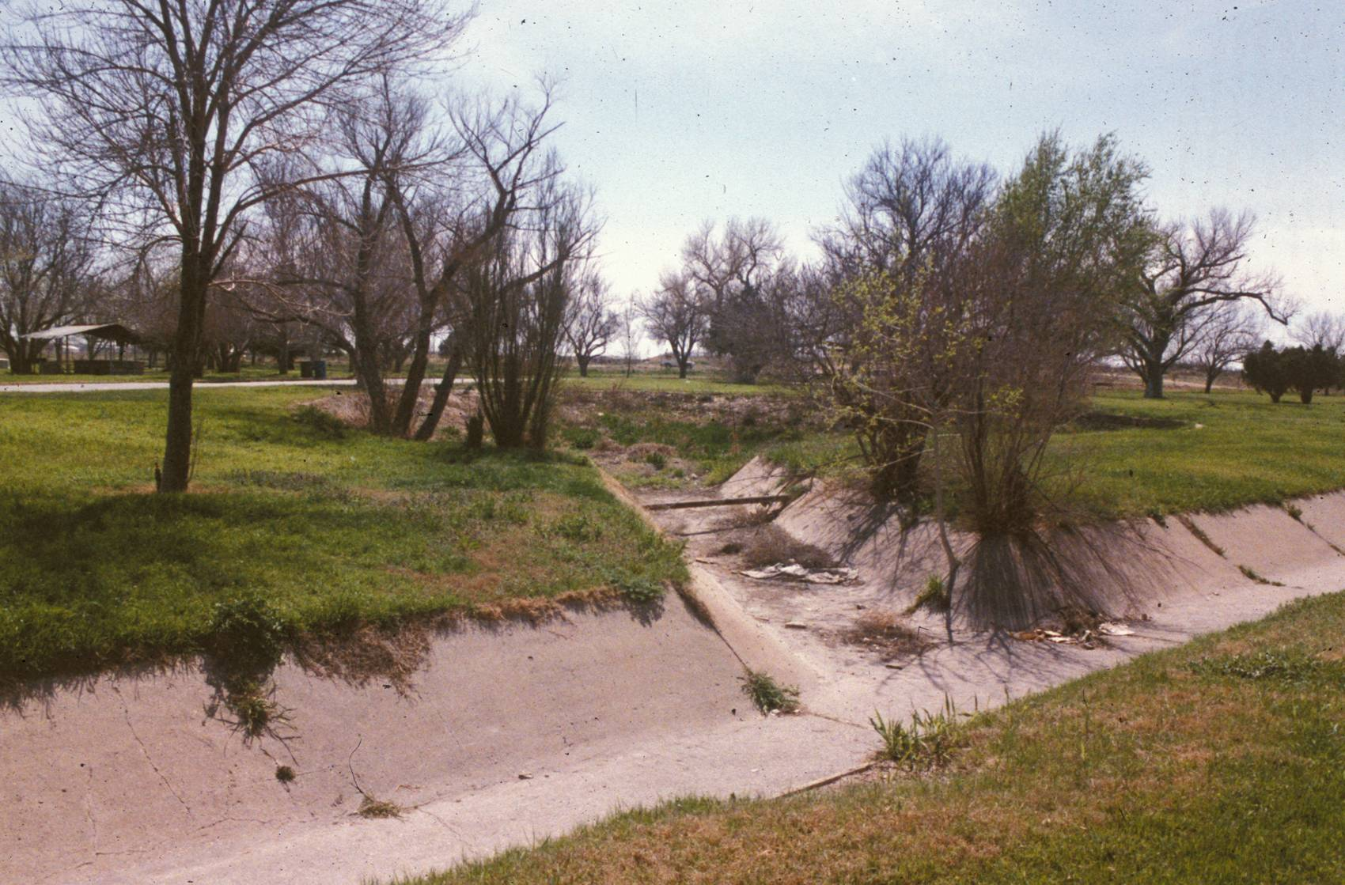
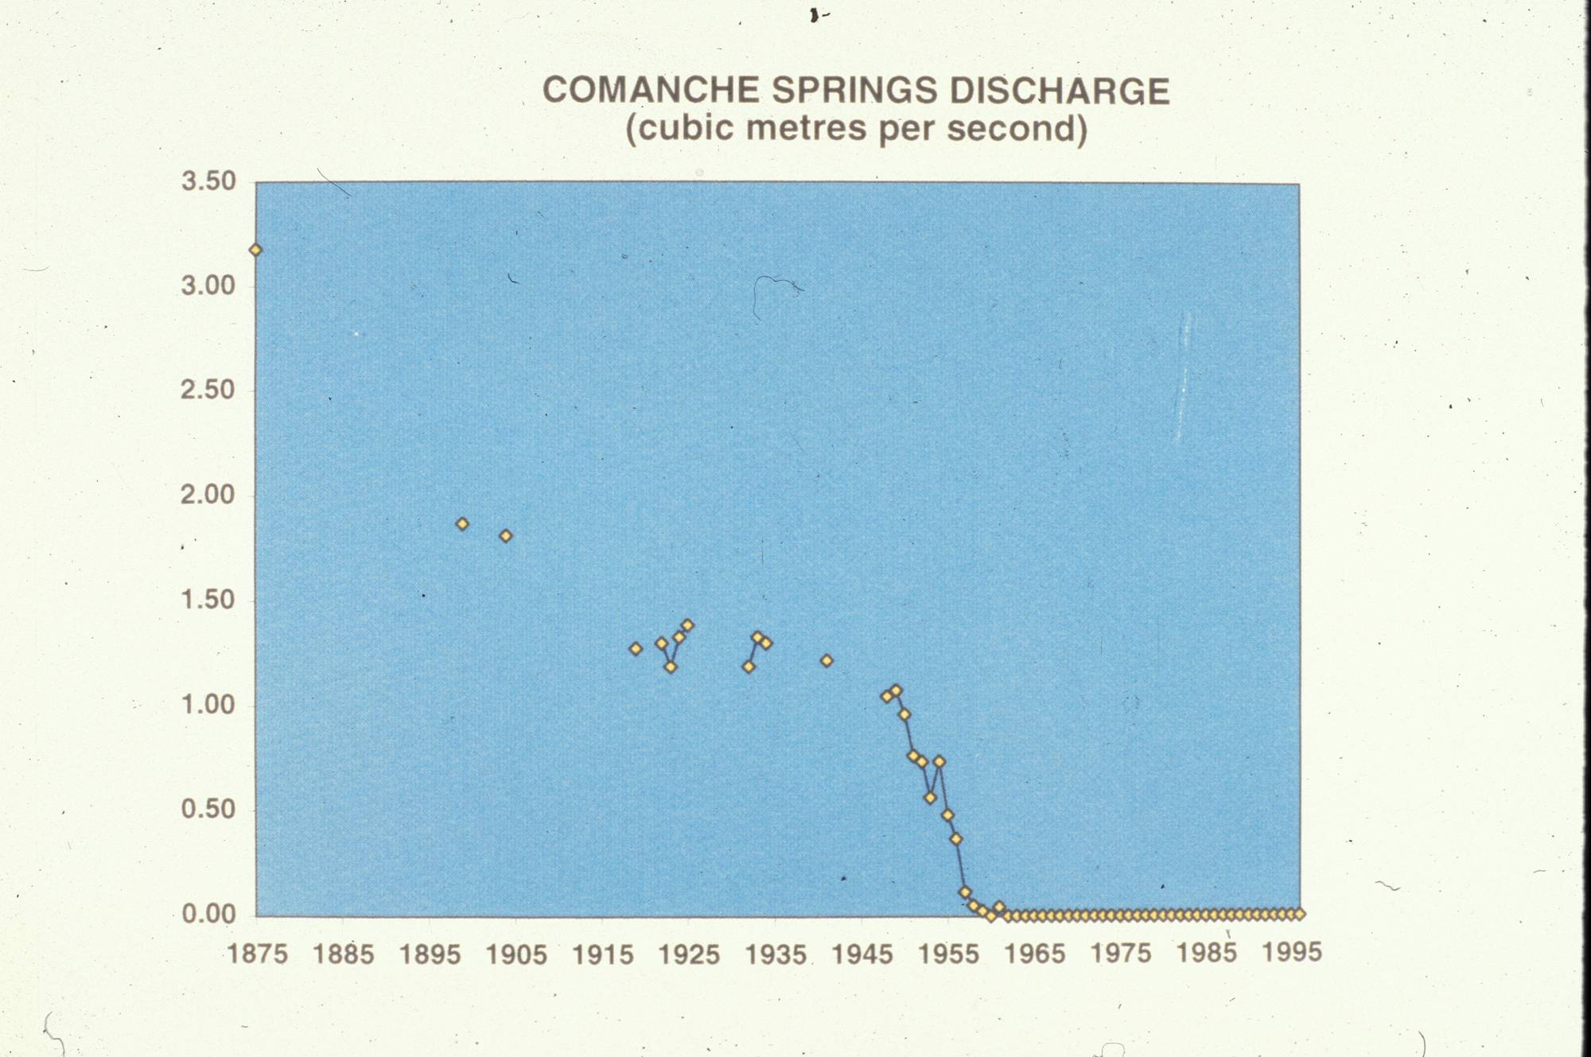
Beautiful Comanche Springs

Slide 17
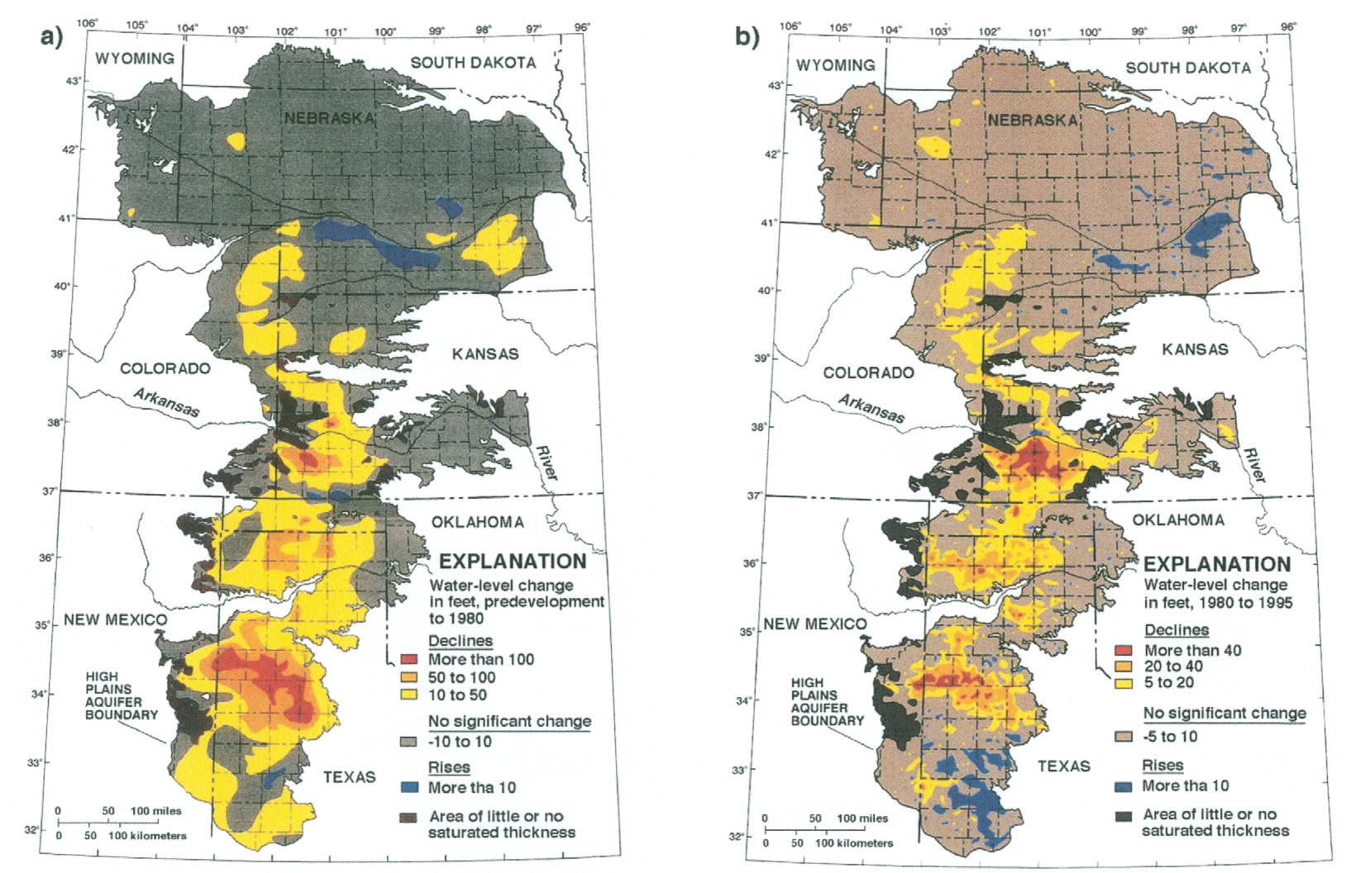
Predictions are always difficult when they involve the future.
The Ogallala Aquifer is yet producing!
Sophocleous, 2000

Slide 18
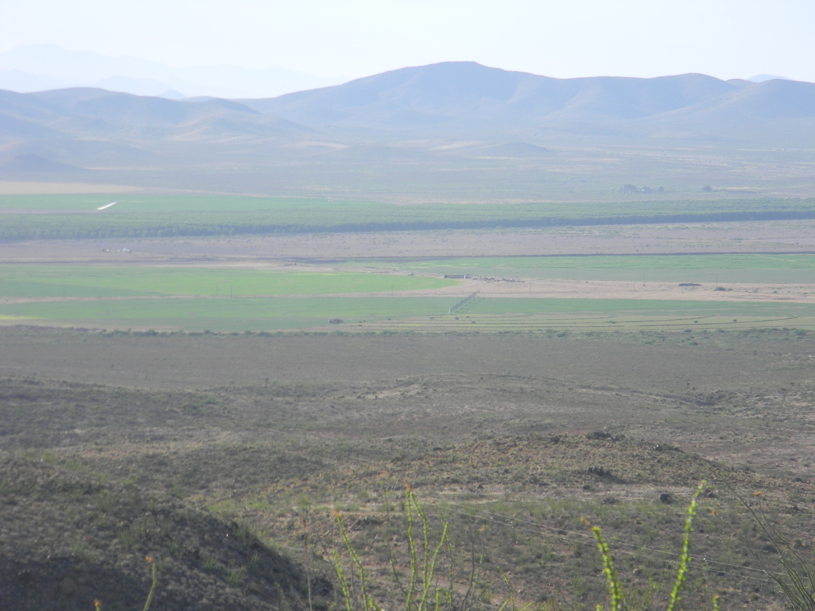
Lobo Flat, Texas

Slide 19
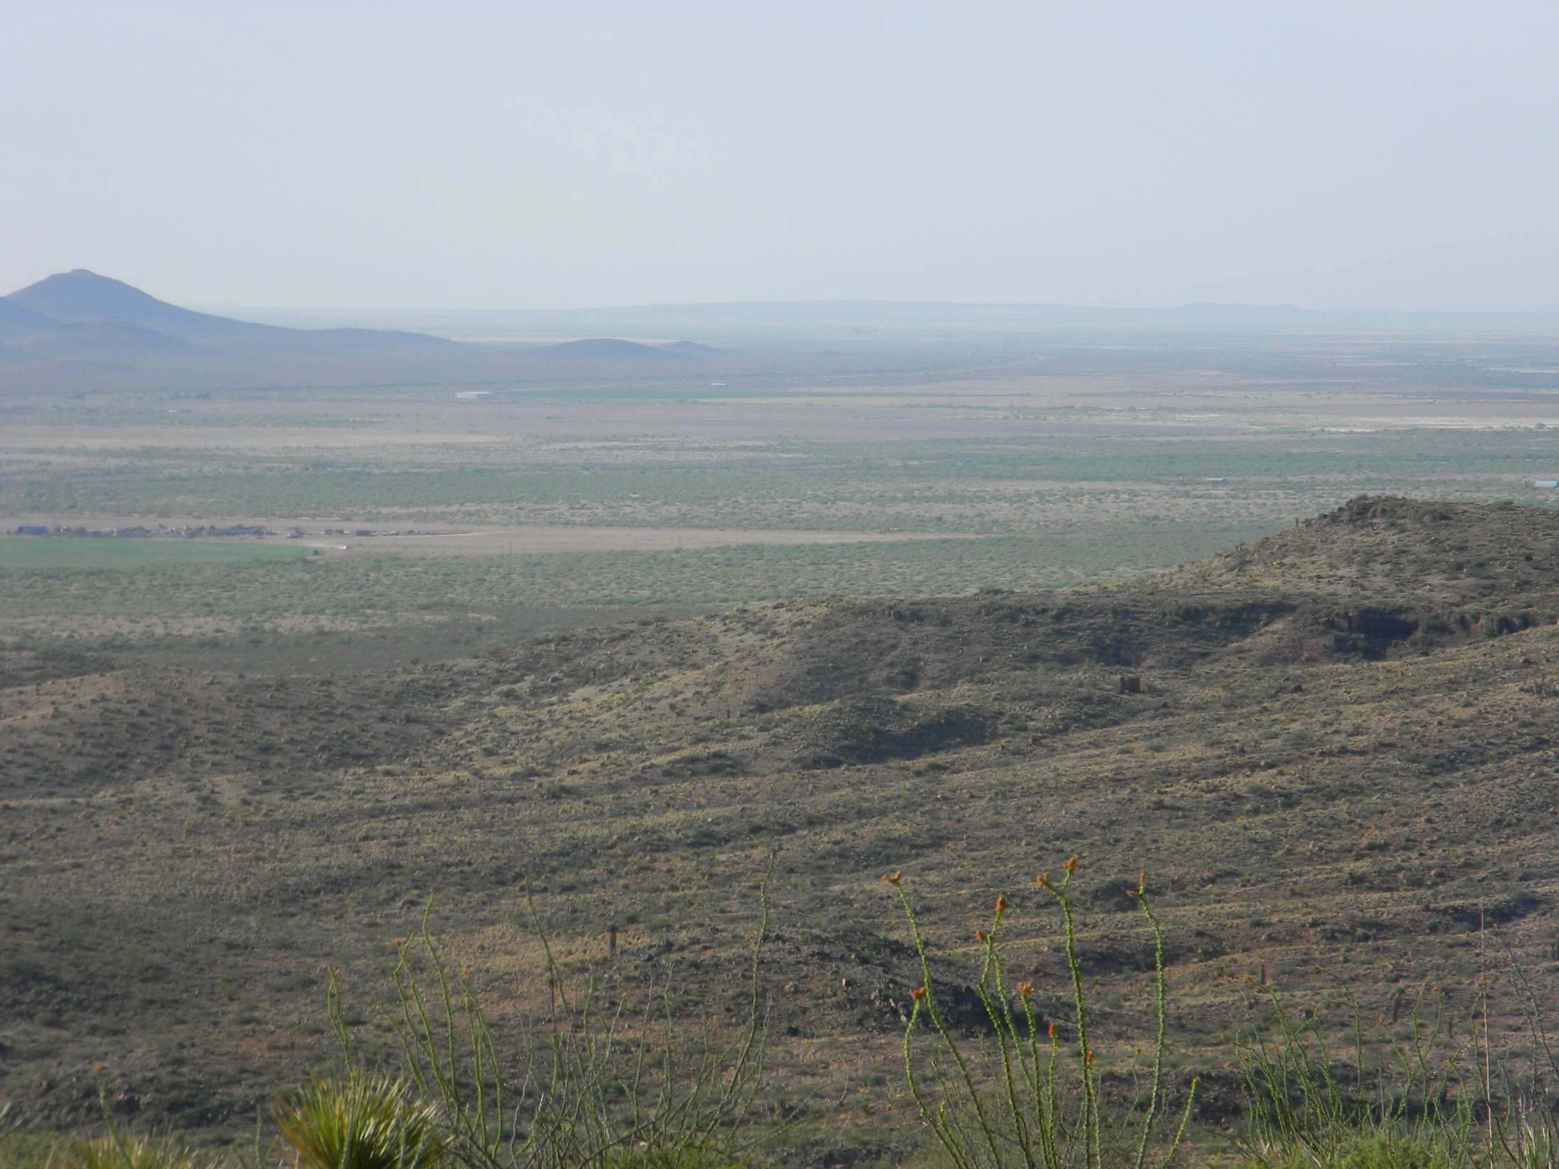
Lobo Flat, Texas – Much of this area has gone out of irrigated agricultural production. Water tables have dropped significantly, but economics rule!

Slide 20
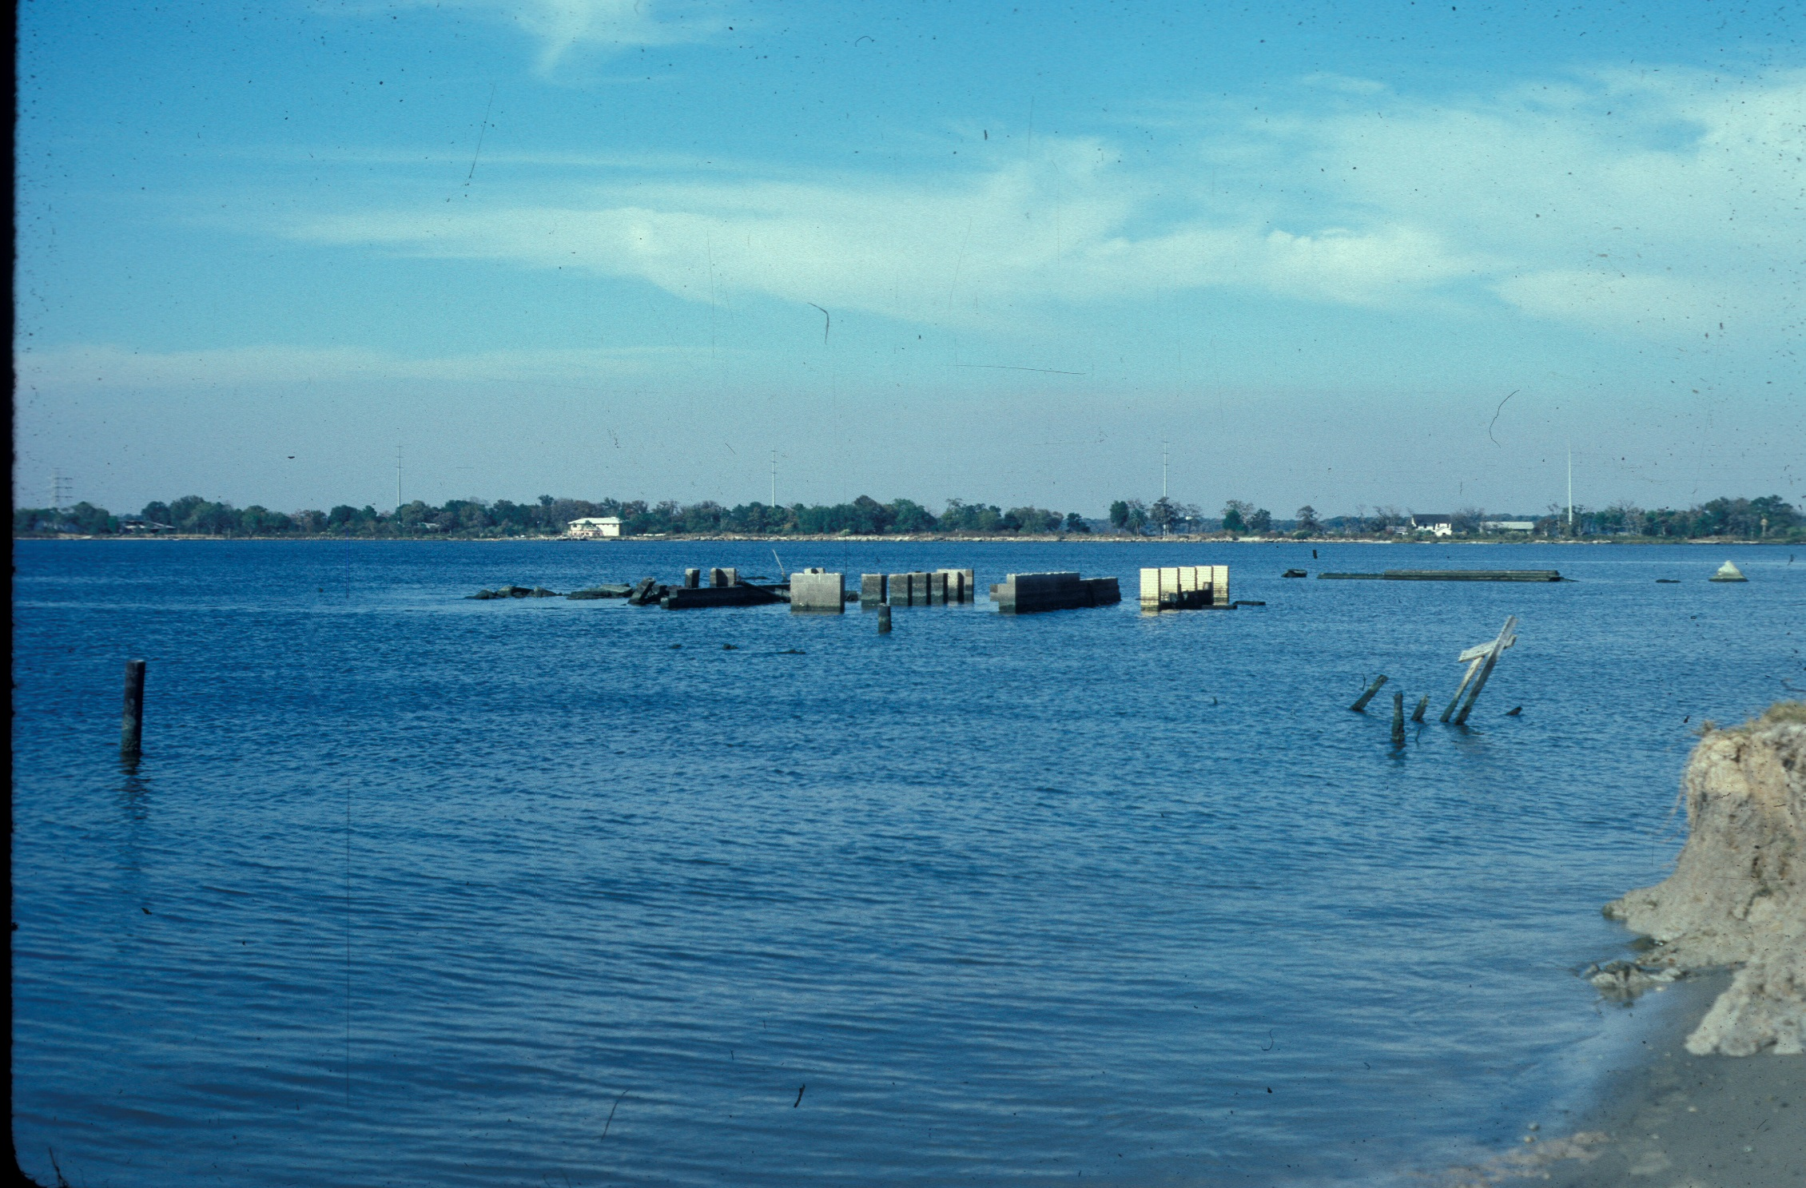

Slide 21
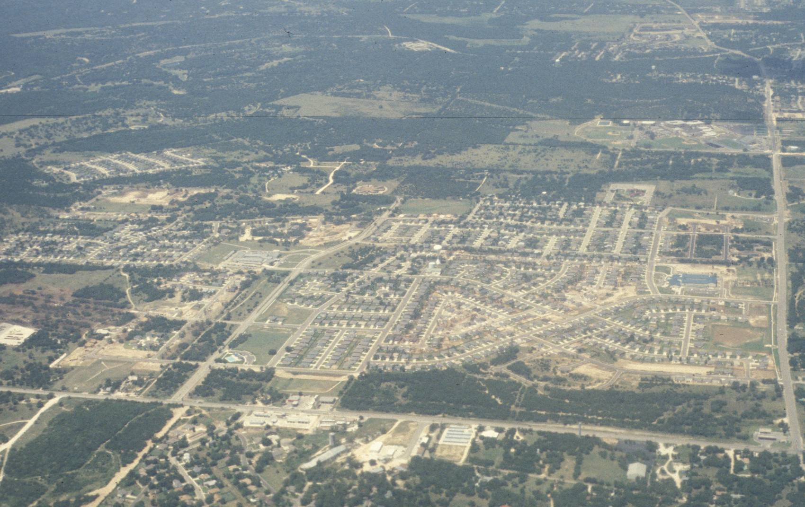
Population growth means more water demands and more urbanization
Urbanizing Texas

Slide 22
How urbanization affects groundwater systems
Increase of “impervious” cover
Increase in “conduits” and “fractures” (e.g. drains, utility lines, backfilled areas, etc.)
Different vegetative cover
Possible increased irrigation
Altered evapotranspiration
Altered surface water systems
Increase point sources for recharge and contamination (e.g.; leaky utility lines, buried debris, industrial accidents)

Slide 23
CONCEPTUALIZING THE PROBLEM
Sustainable Yield
Science-based
Community
Preferences
Effective Yield
Consensus Yield
Notes:
The image above is a graphic depiction of how the two components intersect in the case of calculating groundwater availability. The decision is the amount of allowable pumping, while the left axis shows the remaining storage
in the aquifer and the right-hand axis shows the relative position that a stakeholder may select during
a negotiation session.
Human judgment can be separated into two components approaches, deliberative and affective.
Logical decision making is guided by rational or deliberative thinking processes, while affective
decision making is guided by emotional responses to a situation. Each component influences the
ultimate outcome of a decision process. Using the methodologies and tools developed for
CADRe, both aspects of human decision making can be incorporated. By explicitly recognizing
the elements of a problem both the scientific and objective components can be analyzed
within the context of the perceptions and priorities of participants in the decision making
process. CADRe identifies the elements of each component and their influence on the
robustness of a decision outcome, while melding the two in support of insight
building group dialogue about the problem.

Slide 24
The Yield Continuum
Available Yield
No
Pumping
Permissive Sustained Yield
Safe
Yield
Maximum
Mining
Sustainable Yield
Notes:
The image above is a graphic depiction of how the two components intersect in the case of calculating groundwater availability. The decision is the amount of allowable pumping, while the left axis shows the remaining storage
in the aquifer and the right-hand axis shows the relative position that a stakeholder may select during
a negotiation session.
Human judgment can be separated into two components approaches, deliberative and affective.
Logical decision making is guided by rational or deliberative thinking processes, while affective
decision making is guided by emotional responses to a situation. Each component influences the
ultimate outcome of a decision process. Using the methodologies and tools developed for
CADRe, both aspects of human decision making can be incorporated. By explicitly recognizing
the elements of a problem both the scientific and objective components can be analyzed
within the context of the perceptions and priorities of participants in the decision making
process. CADRe identifies the elements of each component and their influence on the
robustness of a decision outcome, while melding the two in support of insight
building group dialogue about the problem.

Slide 25
HOW TO MEET THE WATER DEMANDS OF THE EARTH (GROWING HUMAN POPULATIONS AND URBANIZATION) – INCREASE SUPPLIES
Developing new groundwater or surface- water resources (the traditional method)
Harvesting rain water or fog – small scale
Use of currently “unpotable” waters:
  Desalination (could be a “game changer”)
  Direct use for bathing, washing, irrigation, sewage treatment, industry, etc. – dual distribution systems (public perception)

Slide 26
HOW TO MEET THE WATER DEMANDS OF THE EARTH (GROWING HUMAN POPULATIONS AND URBANIZATION) - DECREASE DEMAND
Conservation (the “low hanging fruit”)
Limiting population growth (no longer discussed!) *
Public appeals to reduce consumption
Raising the price of supplied water*
Rationing*
Fines or penalties for excessive water use*
* Politically & economically unpopular

Slide 27
HOW TO MEET THE WATER DEMANDS OF THE EARTH (GROWING HUMAN POPULATIONS AND URBANIZATION) – GREATER EFFICIENCY
Conjunctive use of groundwater and surface water
Use of treated waste water –irrigation or in dual distribution systems
Artificial recharge and ASR
Implementation of more water efficient systems

Slide 28
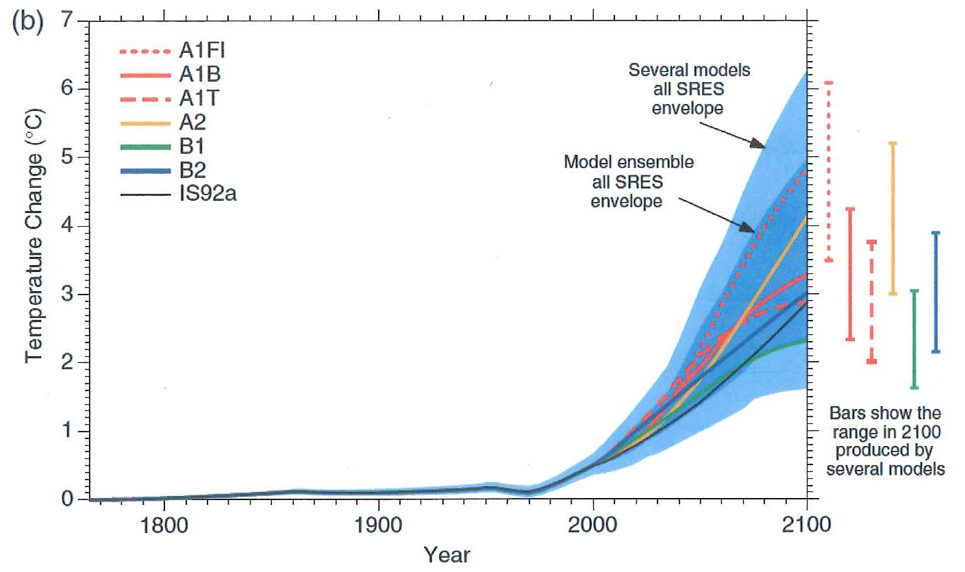
Global projected temperatures

Slide 29
U.S.A. projected precipitation changes to 2099
(U.S. Global Change Research Program)

Slide 30
Challenges in achieving sustainable use of our water resources.
Understanding the hydrogeological system
Climate change
Urbanization and growing populations
Predicting technological advances
Changing political/economic/management systems

Slide 31
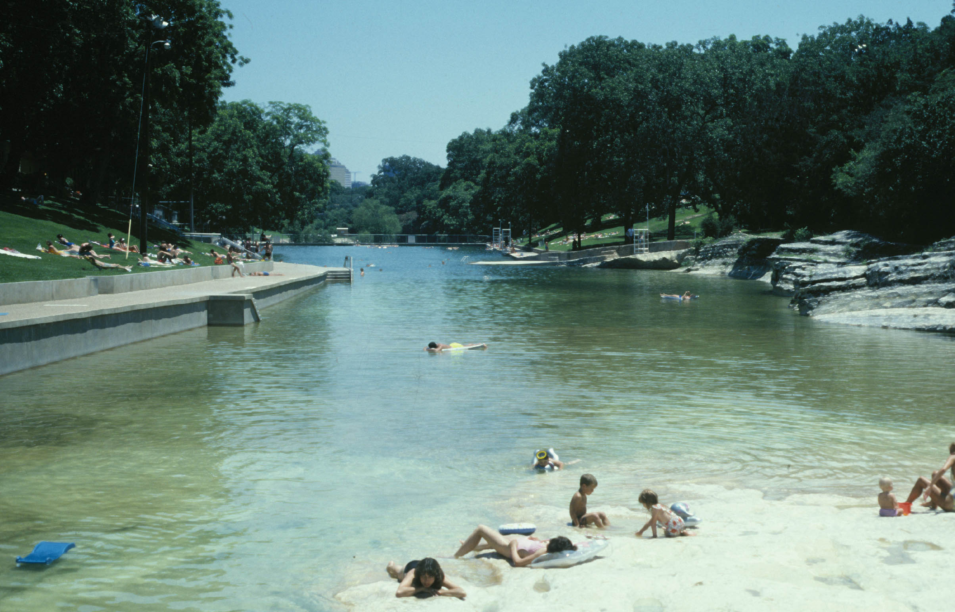
Barton Springs
Notes:
REFERENCES CITED
Austin-American Statesman, 1996, Houses sprouting in Williamson: September 9, p. 1.
Clement, T. J., and Sharp, J. M., Jr., 1988, Hydrochemical facies in the bad-water zone of the Edwards aquifer, Central Texas, in Proceedings of the Ground Water Geochemistry Conference: Dublin, Ohio, National Water Well Association, p. 127–149.
Crowe, J., and Sharp, J. M., Jr., 1997, Hydrogeologic delineation of habitats for endangered species: The Comal Springs/River system: Environmental Geology, v. 30, p. 17–28.
Hauwert, N., 1997, Geological map of the Barton Springs segment of the Edwards aquifer: Austin, Texas, Barton Springs/Edwards Aquifer Underground Water Conservation District, 1 sheet.
HDR Engineering, Inc., 1993, Recharge enhancement study: Guadalupe–San Antonio River Basin: San Antonio, Texas, Volume 1, Executive Summary, 44 p.
Hovorka, S. D., Ruppel, S. C., Dutton, A. R., and Yeh, J., 1993, Edwards aquifer storage assessment, Kinney County to Hays County, Texas: San Antonio, Texas, Edwards Aquifer Underground Water Conservation District Report No. 93-04-F0, 101 p.
Hovorka, S. D., Mace, R. E., and Collins, E. W., 1995, Regional distribution of permeability in the Edwards aquifer: San Antonio, Texas, Edwards Aquifer Underground Water Conservation District Report No. 93- 17-F0, 128 p.
Larkin, R. G., and Sharp, J. M., Jr., 1992, On the relationship between river basin geomorphology, aquifer hydraulics, and ground-water flow direction in alluvial aquifers: Geological Society of America Bulletin, v. 104, p. 1608–1620.
Lesser, J. M., and Lesser, G., 1988, Region 9, Sierra Madre Oriental, in Back, W., et al., eds., Hydrogeology: Boulder, Colorado, Geological Society of America, Geology of North America, v. O-2, p. 89–92.
Livingston, p., 1942, A few interesting facts regarding natural flow from artesian well 4, owned by the San Antonio Public Service Company, San Antonio, Texas: U.S. Geological Survey Open-File Report, 7 p.
Longley, G. 1981, The Edwards aquifer—Earth’s most diverse groundwater ecosystem?: International Journal of Speleology, no. 11, p. 123–128.

Slide 32
An aboriginal saying
The Earth belongs to our cousins and brothers.
Our children and grandchildren are its protectors!

Slide 33
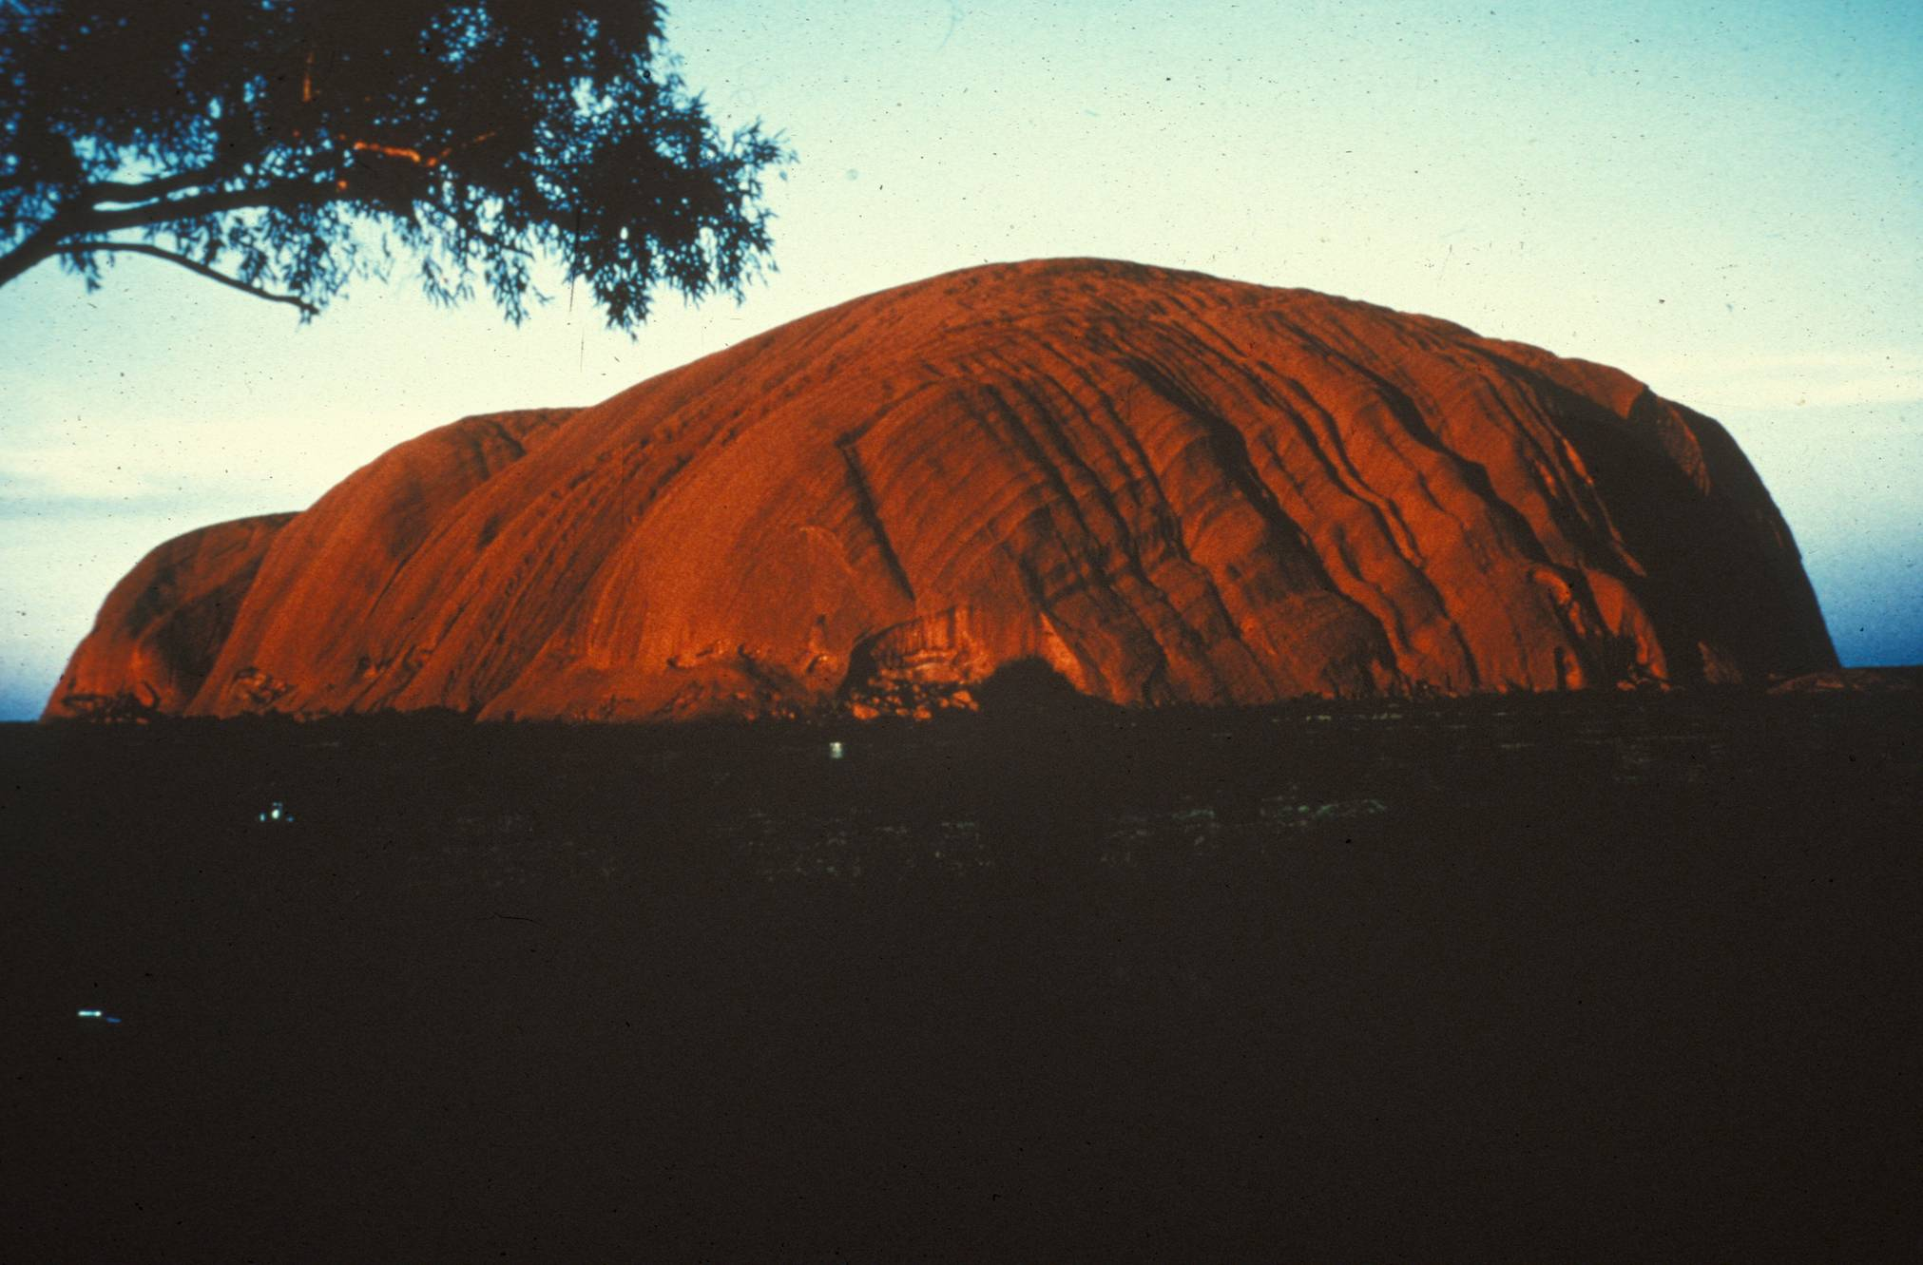

Slide 34
RESEARCH NEEDS
A priori collection of needed data.
Continued hydrogeological studies.
Projections on the effects of:
  Past and future climatic changes and “normal’ climate variability,
  Ecological patterns and trends
  Urbanization and new technologies, and
  Water policies

Slide 35
• Geology Foundation of The University of Texas, the Barton Springs/Edwards Aquifer Conservation
District & Sandia National Laboratory for their support of this research.
• Suzanne Pierce, David Eaton, Marcel Dulay, Tom
Wiles, Mike Passarello, Jay Banner, and the IAH.
Thanks to:

Slide 36


Slide 37
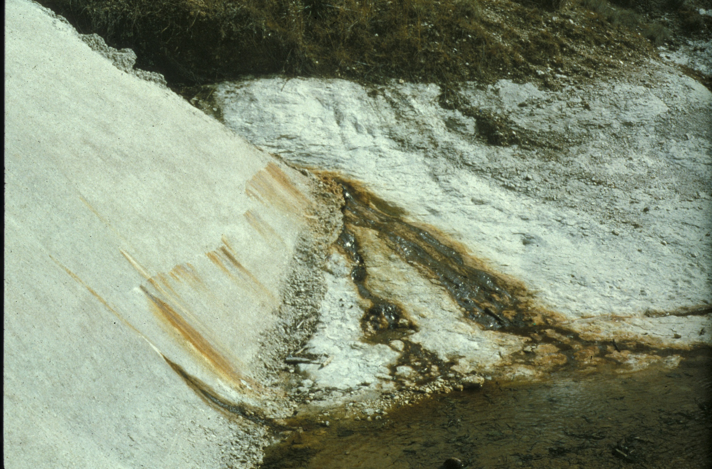

Slide 38
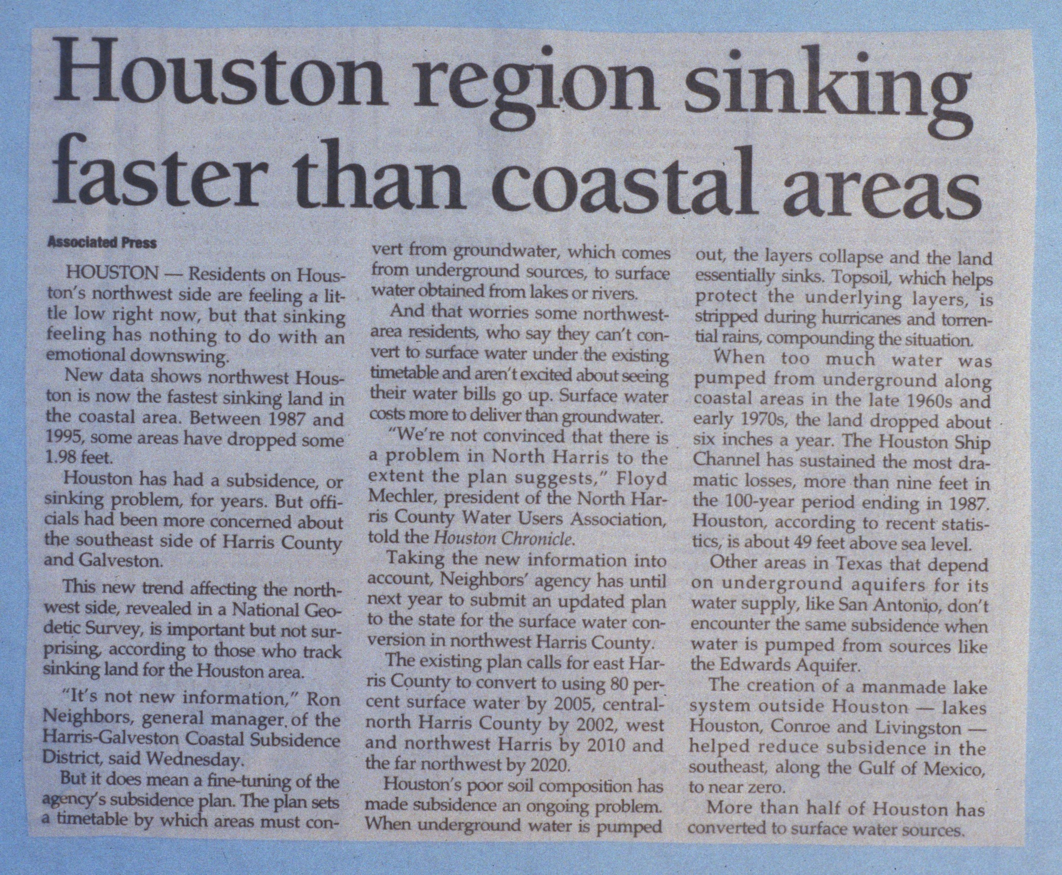

Slide 39
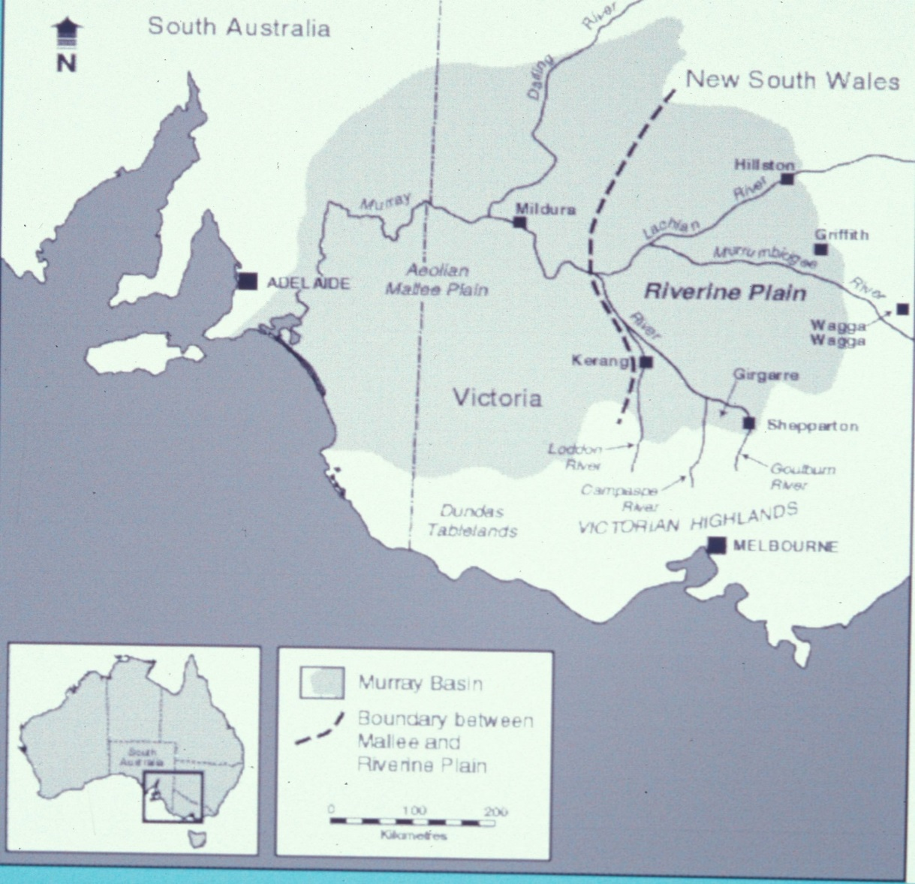
These issues are global

Slide 40
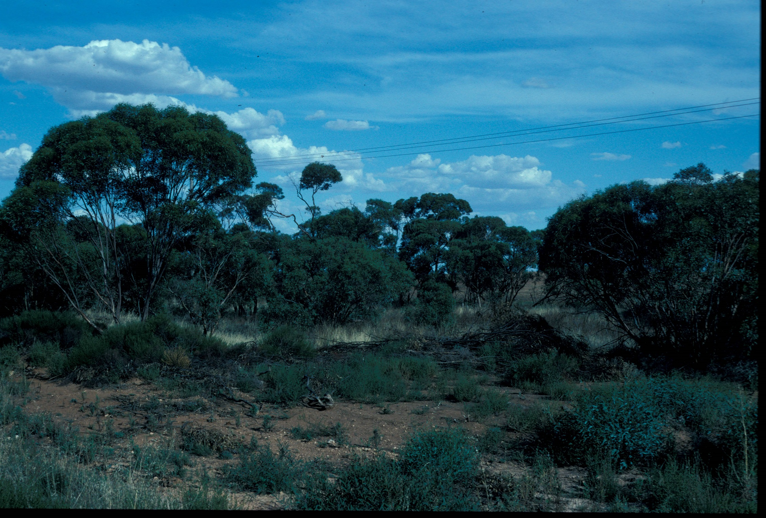

Slide 41
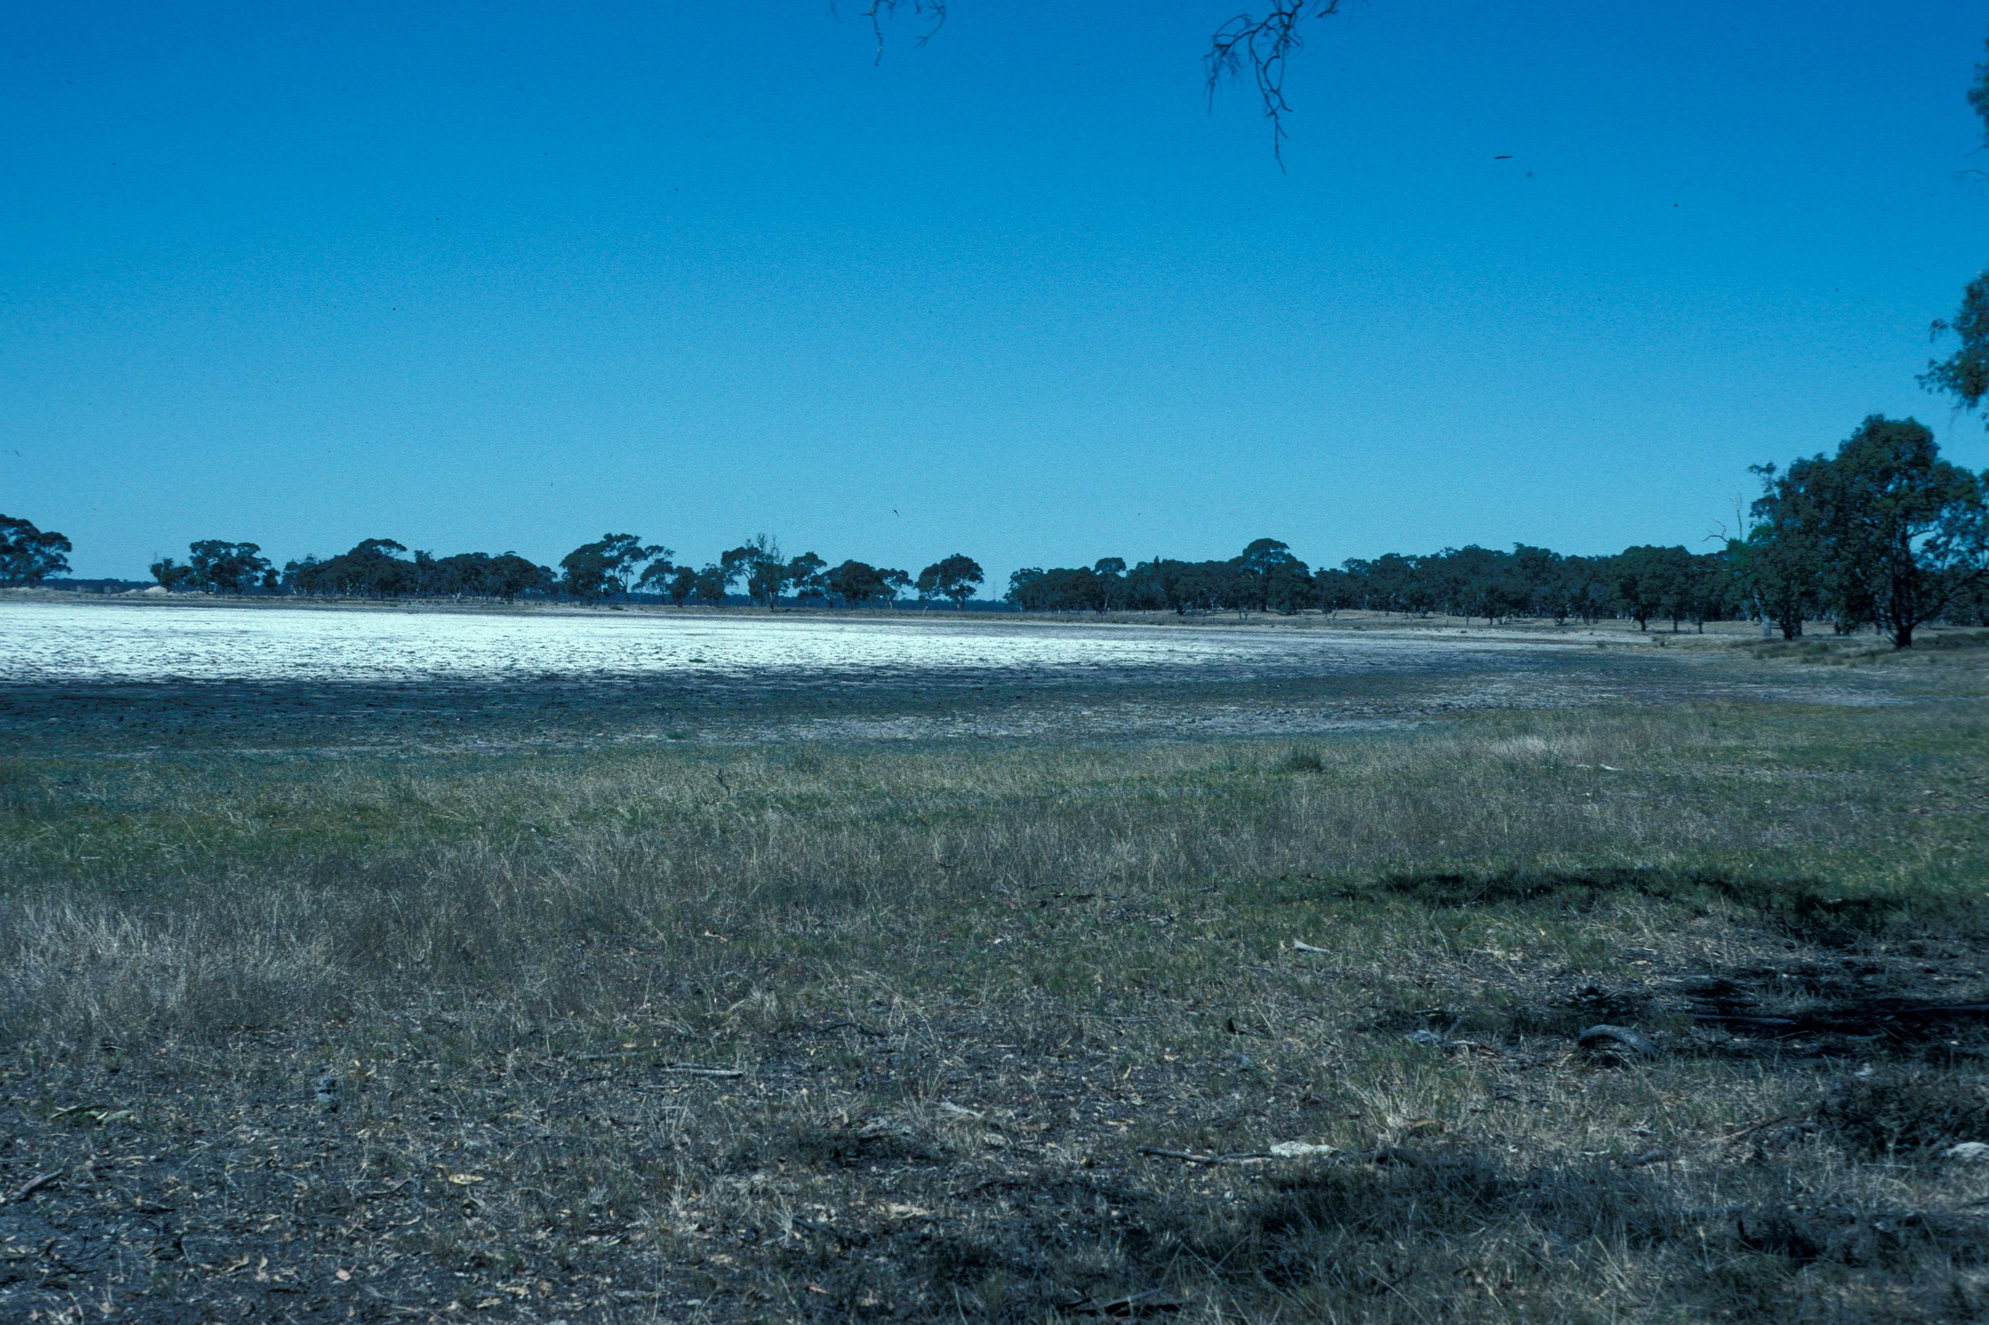

Slide 42
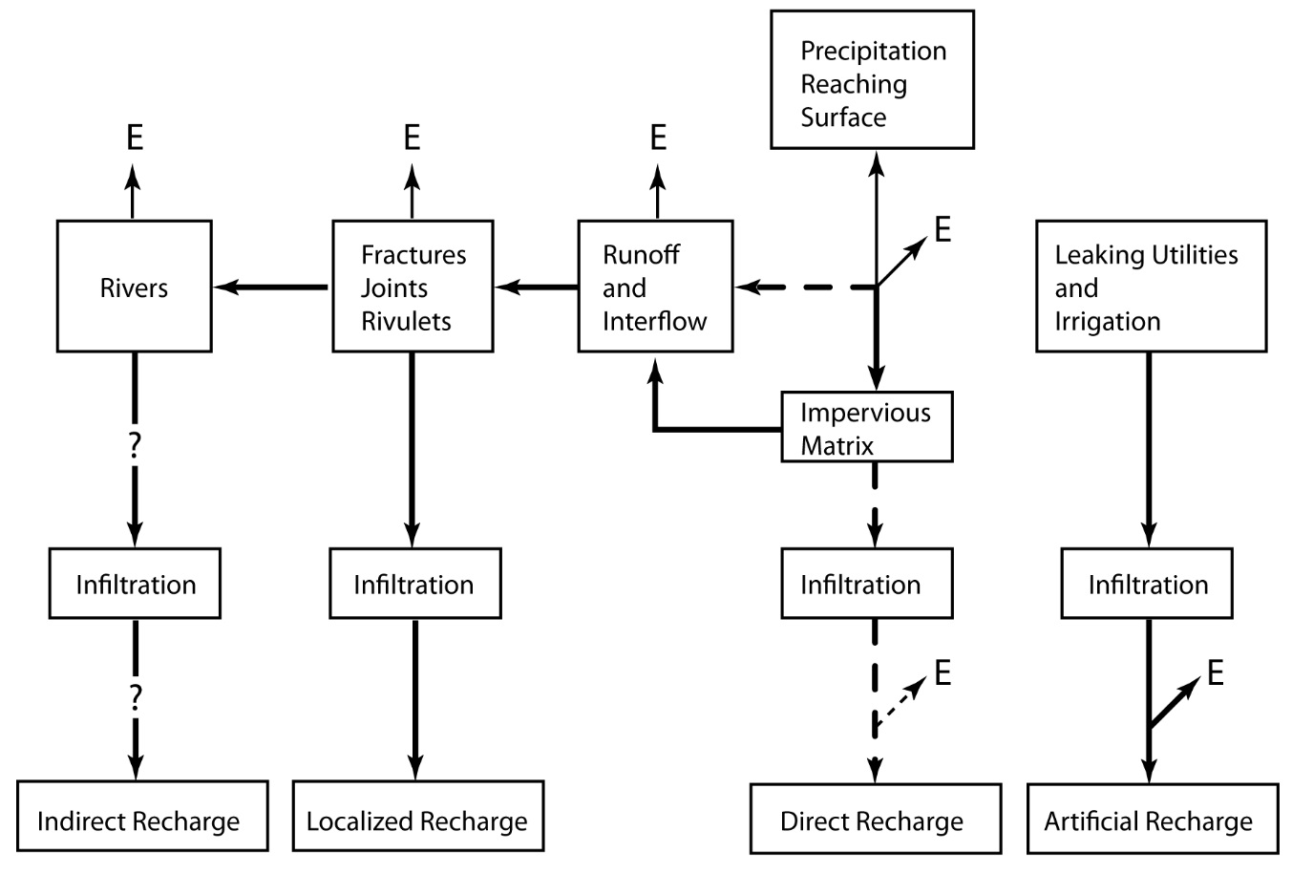
Wiles and Sharp, 2008

Slide 43
HOW TO MEET THE WATER DEMANDS OF THE EARTH (GROWING HUMAN POPULATIONS AND URBANIZATION)
Increase supplies
Decrease demands
Use existing and future resources more efficiently.

Slide 44
EVOLUTION OF SAFE YIELD
Lee (1915) - Safe yield is…”the limit of water which can be withdrawn regularly and permanently without dangerous depletion of the storage reserve.
Meinzer (1923) – Safe yield is…”the rate at which water can be withdrawn from an aquifer without depleting the supply to an extent that withdrawal at this rate is no longer economically feasible.
Todd (1959) – Safe or perennial yield is…”the amount of water which can be withdrawn annually (from a groundwater basin) annually without producing an undesired result.”

Slide 45
EVOLUTION OF SUSTAINABLE YIELD
Todd (1959) – Sustainable yield is…“the use of a resource in such a way that it is passed on to future generations without loss of value.”
Loaiciga (1997) – “Sustainable aquifer management occurs when:
  The rate of aquifer exploitation that maintains aquifer storage within pre-specified and adequate levels;
  Groundwater quality meets acceptable criteria
  Negative long-term environmental impacts associated with groundwater pumping are avoided.”

Slide 46
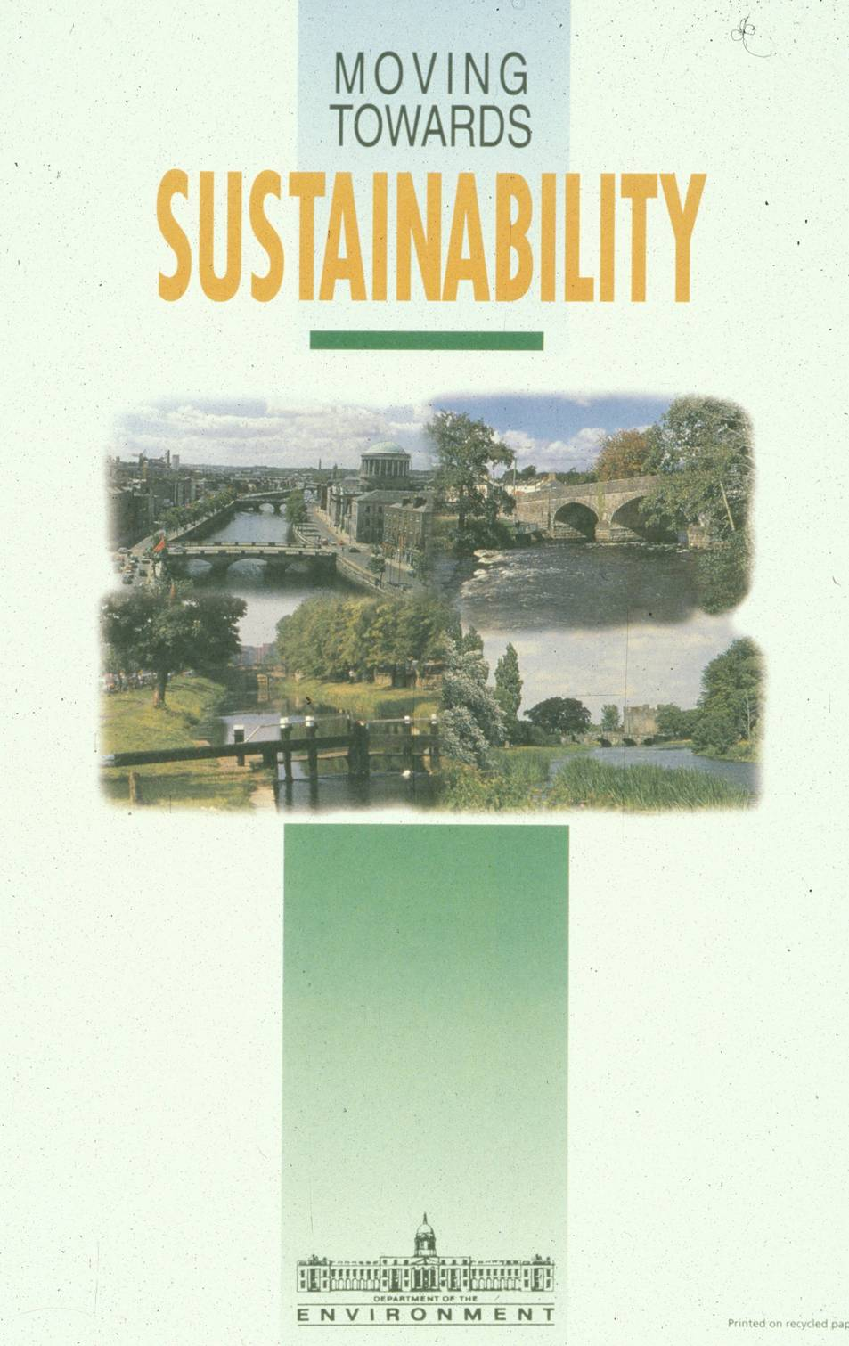
SUSTAINABILITY IS A WORLDWIDE ISSUE!
Courtesy of Bob Aldwell, Ireland

Slide 47
•What is a reasonable reasonable human population?
•What is a reasonable standard of living?
•What does this imply about the future of our environment?

Slide 48

CONCEPTUAL FRAMEWORK:
THE AQUIFER YIELD CONTINUUM &
THE LINK TO POLICY AND PEOPLE
Unobtainable
Risk Seeking
Minable
Ideal condition response to pumping
Total Aquifer Storage
Community Tolerance for Risk
(Utility)
Stakeholder position
Consensus space
Risk Averse
Replenishable
Increased Pumping
Permissive sustained yield
Safe yield

