Slide 1
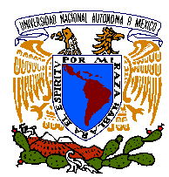

VERTICAL FLOW AND EARLY ALERT IN LOW HYDRAULIC CONDUCTIVITY MEDIA
A Cardona B
Earth Sciences
Universidad Autónoma de San Luis Potosí, México
JJ Carrillo-Rivera
Institute of Geography
Universidad Nacional Autónoma de México
GSA South-Central Section
13th & 14th, March 2017
San Antonio, Texas, USA

Slide 2
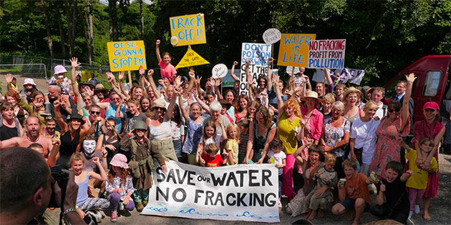

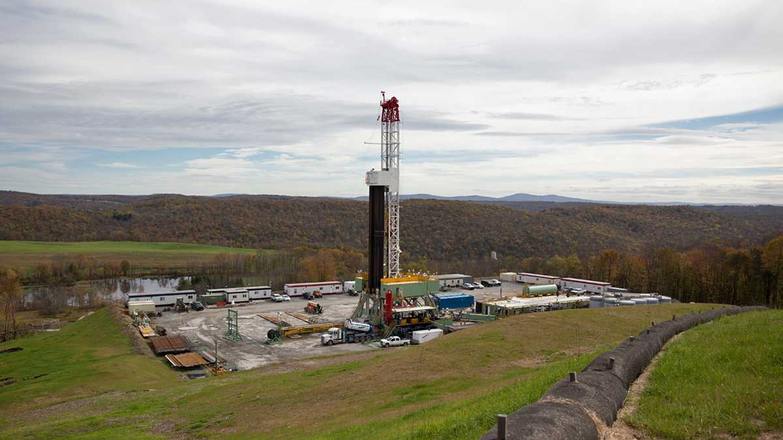
VERTICAL FLOW AND EARLY ALERT IN LOW HYDRAULIC CONDUCTIVITY MEDIA
Content
- Introduction
- Objectives
- Early Alert
- Concluding Remarks

Slide 3
INTRODUCTION
Deep oil and gas recovery by means of water-based fluid injection into traditional low hydraulic conductivity shale strata provides unique economic opportunities...
Low hydraulic conductivity where gas/oil are present, proposes natural flow conditions for groundwater in the order of tens of thousands years along, a usually, deep strata, which appears to provide protection towards contamination of shallow groundwater sources…

Slide 4
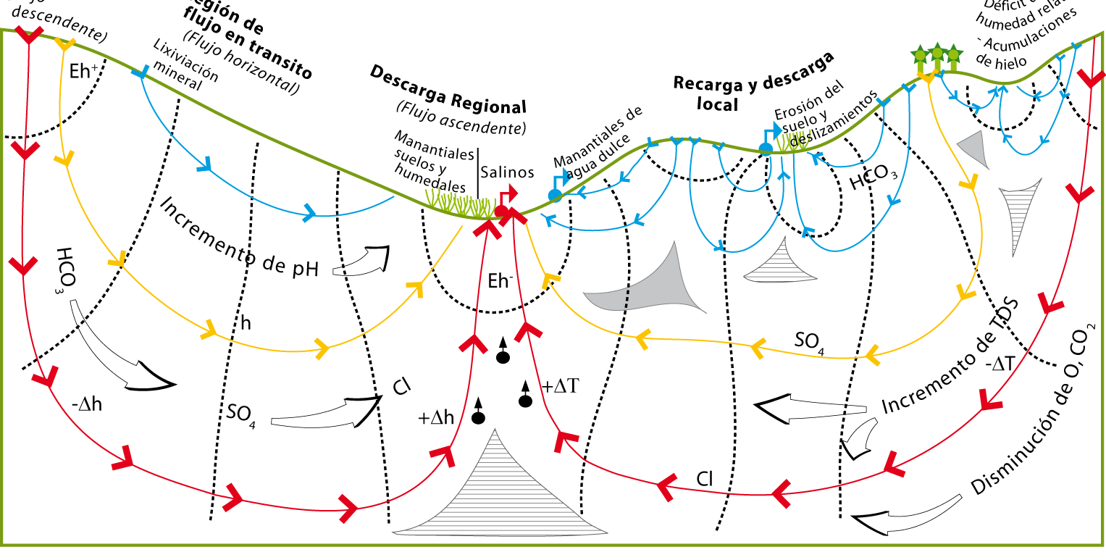
Would the boundaries among the various groundwater flows prevail under human intervention, as to avoid contamination at shallow levels?
Scale: dependent on geological framework
Local flow
Intermediate flow
Regional flow
Injection site
Basement Rock
TÓTH (1963, 1971, 1984, 1999, 2012) theoretical groundwater flow functioning

Slide 5
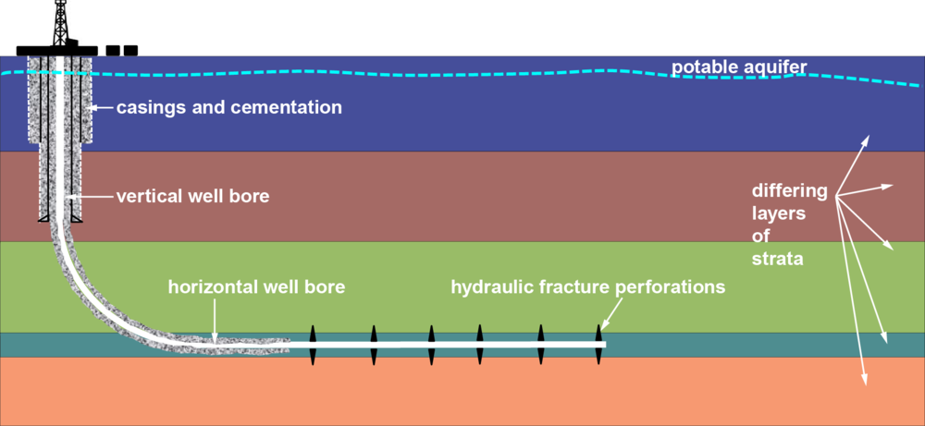
GW Protection
leakage?
leakage?
leakage?
Temperature Gradient
Based on: Chemistryviews.org/details

Slide 6
OBJECTIVES
- How safe is deep injection in terms of resulting water quality changes at shallow levels?
- What to do before, during and after deep injection actions?

Slide 7
EARLY ALERT WARNING
Early Alert is defined as a system of inspection, surveillance, determination and interpretation engaged in preventing undesirable response to a groundwater supply caused by the alteration of prevailing hydrogeological conditions implicit in the natural groundwater flow systems due to: i) a continuous and important drawdown, lowering of spring discharge, area reduction of wetlands, increase of subsidence rate; ii) the arrival of pollutants; iii) or any other evidence of an undesirable alteration of the flow systems.
In the case of water quality, it would be desirable to have evidence acquired in an easy manner through prompt field determinations (ie, water temperature) to propose/apply a set of correction measures by concerning residents and willing developers.

Slide 8
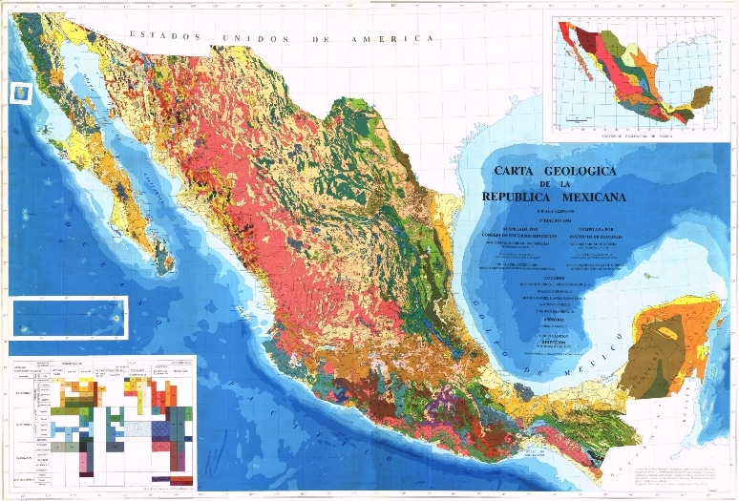
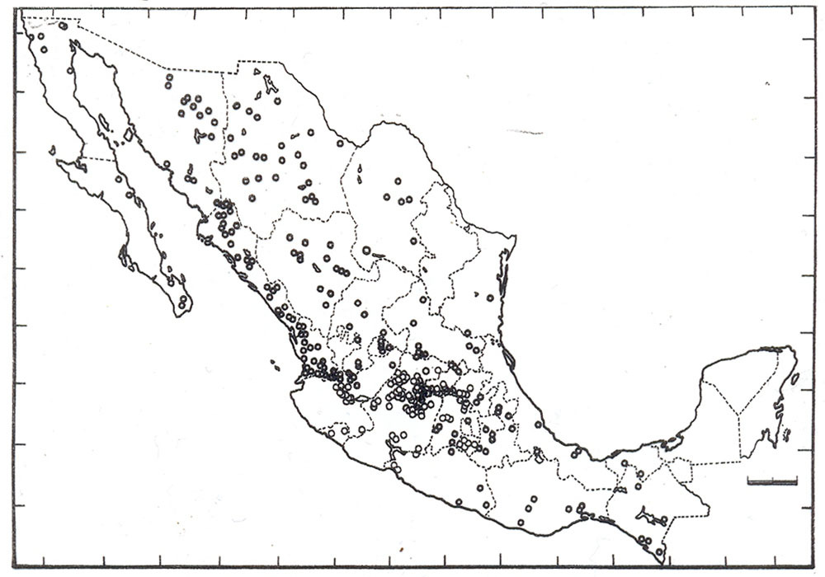
Study Area & MAJOR OUTCROPPING GEOLOGICAL FORMATIONS
DISTRIBUCIÓN NATURAL DE FLÚOR EN AGUA DE CONSUMO HUMANO EN EL PAIS
Major thermal springs

Slide 9
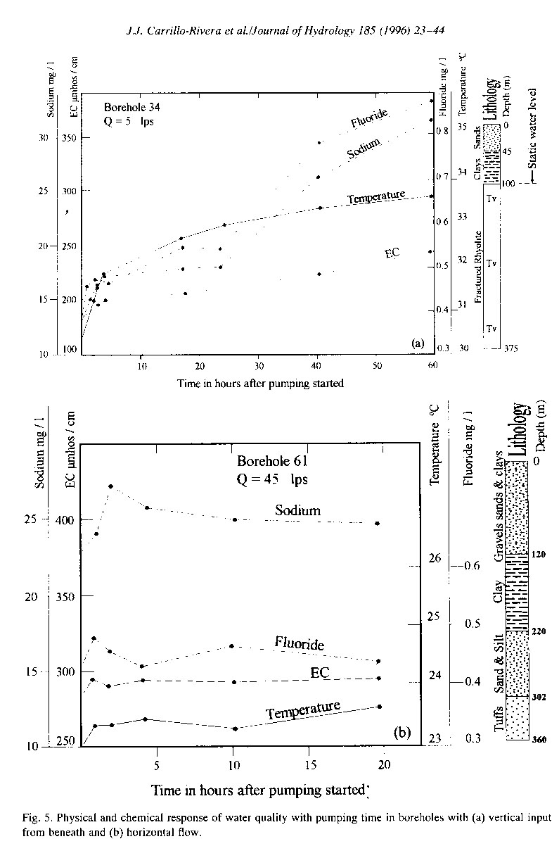
Temperature and chemical response with extraction time
Horizontal flow component
Slow GW Flow, no change
GW from ≈ 1.8 km deep arrived in ≈2 hours
Vertical flow component
Source: Carrillo-Rivera, JJ; Cardona, A y Moss, D, 1996. Importance of the vertical component of groundwater flow: a hydrochemical approach in the valley of San Luis Potosí, Mexico, Journal of Hydrology 185 (23-44), Elsevier Science. DOI: 10.1016/S0022-1694(96)03014-4; ISSN: 0022-1694; Impact factor 2.964; (Selected Publication in Ground Water V 35, p 376. March-April, 1997).

Slide 10
In the Groundwater Law proposal for Mexico, the early warning alert is included in:
Article 3, definitions,
Article 12, as alert warning and safety measure that are in agreement with other existing laws (ie, General Law on Climate Change)
Article 42, .... The establishment of economic and taxation incentives to protect the aquifer (ie, flow system), mainly when the early warning alert suggests the risk of contamination of the obtained groundwater
Article 58, to regulate trans-boundary aquifers, the joint (USA-Mex) authorities will coordinate regarding the establishment procedure to early warning actions (frac, IX)
Article 85, the application of the early warning alert will control: i) saline water intrusion, ii) changes in water quality, temperature and radioactivity, iii) continuous and important drawdown, iv) the cone of depression of two or more wells interfere, v) subsidence and impacts to springs, wetlands, vegetation and rivers.

Slide 11
CONCLUDING REMARKS
Natural groundwater movement might speed up several orders of magnitude under human intervention, ie. Hydraulic fracturing. Therefore, access to good quality water in the northern-eastern semiarid region of Mexico and south-eastern USA requires involving groundwater protection measures, directing the concerns of residents and developers.
Experience on fractured hydrogeology in Mexico has increased recently under the basis of the Tóthian flow systems theory. The response of groundwater flow from kilometres distance below the ground may be traced at surface within hours after pumping started in an abstraction well

Slide 12
This response usually termed up-conning, deteriorates obtained water quality by ascending deep flow to the extraction level; thus, the concept of Early Alert needs to be developed according to the Hydrogeological nature of the geological media and the expected nature of arrival contaminants.
Due to the nature of the flow to be involved, geochemical tools as well as water temperature could prove adequate for a sound Early Alert definition, from which other readily and simple tools for well users could be formulated. Monitoring and research on variables before, during and after deep injection is to be encouraged.

Slide 13
Thanks, Gracias, for the attention,
Any questions, comments….

