Slide 1

Detection of Shallow Karst Features with Geophysical Techniques: Ground Truthing the Results
Evelynn J. Mitchell, Ph.D.
Department of Physics and Environmental Sciences

Slide 2

Geologic Setting
San Antonio and the Hill Country to the north of the city are well known karst areas.
  Austin Chalk – Outcrops to the west of town
  Edwards Limestone – Outcrops north of San Antonio
  Glenrose Limestone – Outcrops in much of the Hill Country north of San Antonio
Figure taken from Wheeler et al. (2001) Living with Karst: A Fragile Foundation

Slide 3
Resistivity vs. GPR
Resistivity
  Pros:
    Can change the depth of the survey based on spacing of the electrodes
    Can get integrated 3-D data
    Can set up in variable terrains and vegetation settings.
  Cons:
    Time consuming set up
    Need to stay clear of metal objects
    Can be difficult to make good contact in some settings
GPR
  Pros:
    Quick set up
    Immediate feedback
    Can set up and process 3-D survey
  Cons:
    Need a flat(ish) surface to survey
    Depth is limited by frequency of the system
    The deeper you go, the lower the resolution
    Feature detection may be limited by saturation conditions
But, they can also be used in tandem to confirm findings

Slide 4
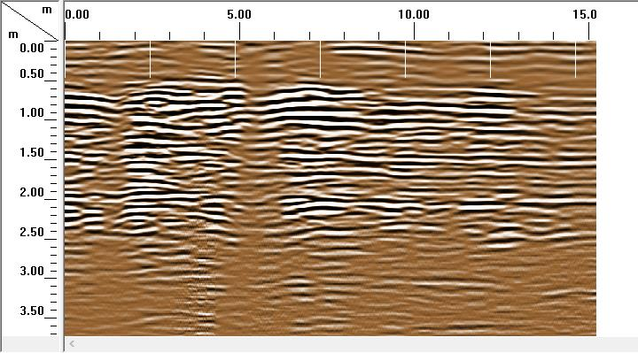
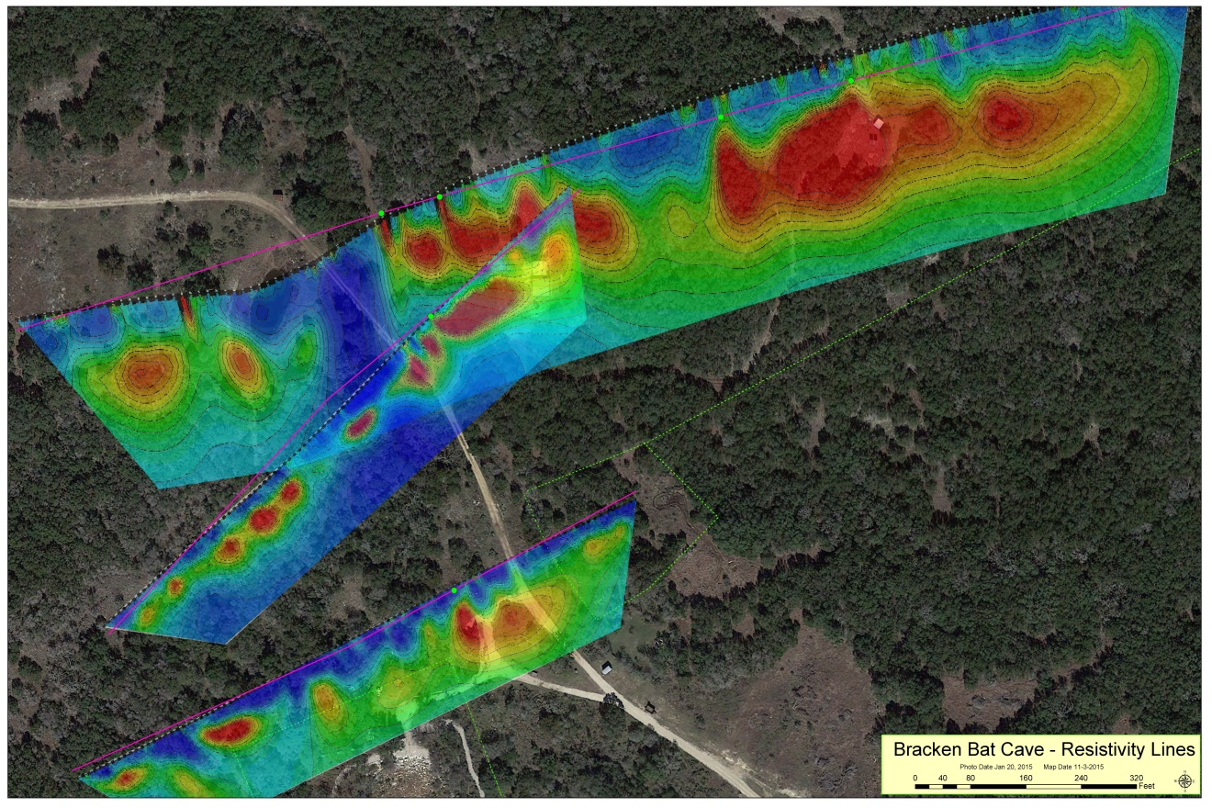
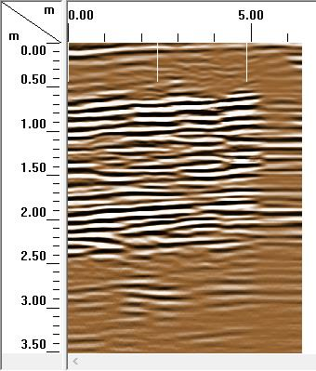
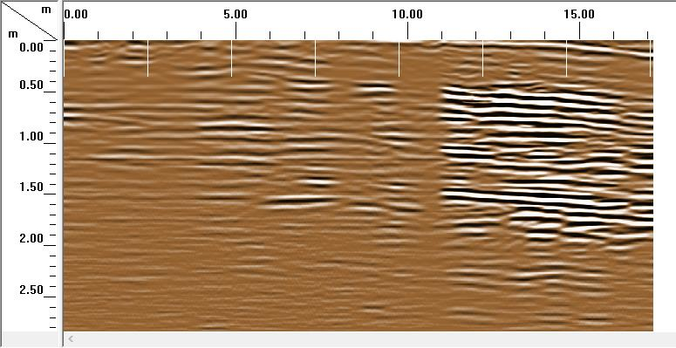
Bracken Bat Cave Property – Edwards Limestone
Volume of approximately 5 m x 12 m x 2m
Resistivity Survey by Ron Green
Perpendicular to Transect
Downhill
Uphill from Bypass Road 1

Slide 5
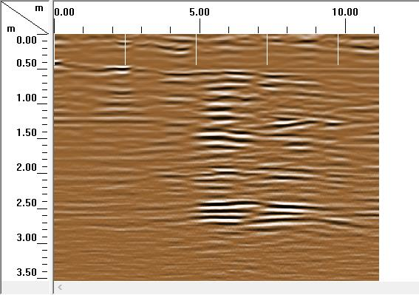
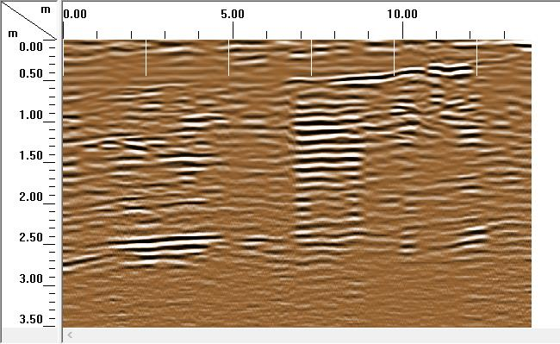
Bracken Bat Cave Property – Edwards Limestone
Resistivity Survey by Ron Green
Uphill at Site 2
Downhill at Site 2

Slide 6
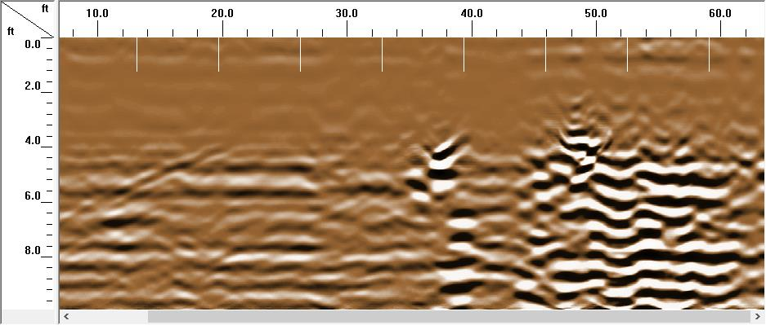
Glen Rose Limestone - Detection of a Large Void
GPR was used to determine if the highest room in the cave could be detected.
  Significant feature shown approximately 3 ft. below the surface

Slide 7
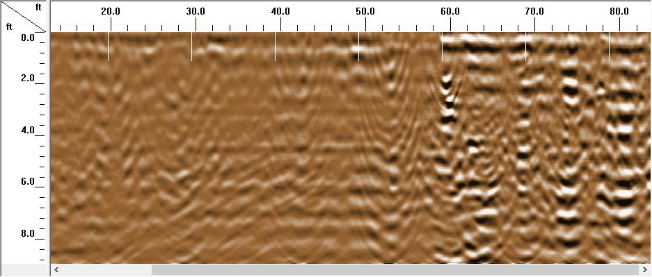
Glen Rose Limestone –Detection of a Large Void
In Dry conditions, large voids were easy to detect, but the saturation of surface soils made it a challenge in saturated conditions.

Slide 8
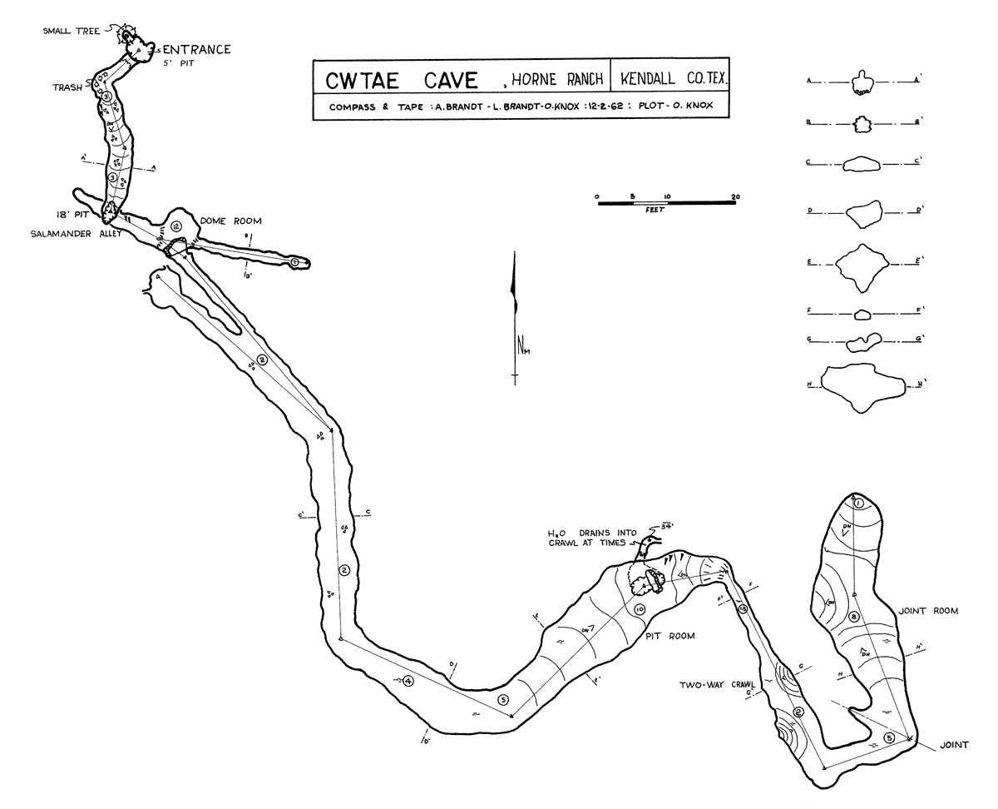
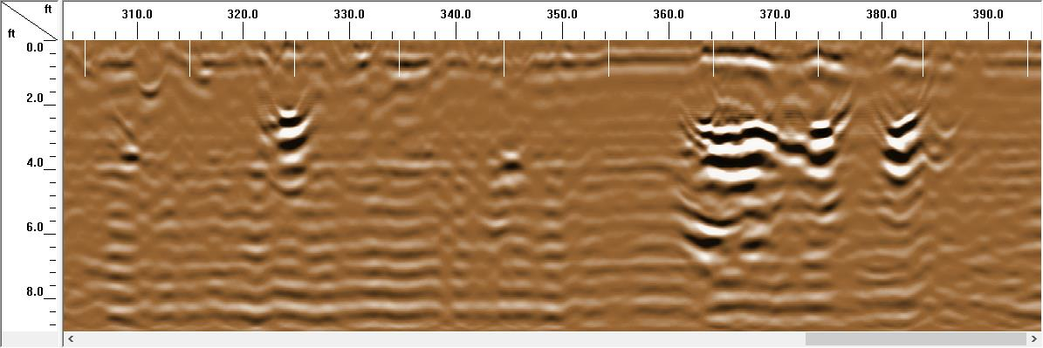
Cricket Cave
Explorations of Cricket Cave Began as part of a GPR Class
  First interesting feature showed an area where water seemed to be infiltrating into the ground during a rain storm
  Correlated with a feature in the cave
Interesting cave with a shallow section and a deep section
  Ideal for comparing resistivity and GPR measurements
But what about ground truthing?
Noted area where water can exist
Saturated Conditions

Slide 9
3D LIDAR Map of Cricket Cave
3.08 m
3.85 m
http://caveatron.com/resources/Cricket-Cave-Cloud-Animation.mp4
Image by Joe Mitchell
http://caveatron.com/resources/Cricket-Cave-Animation.mp4
Image by Joe Mitchell

Slide 10
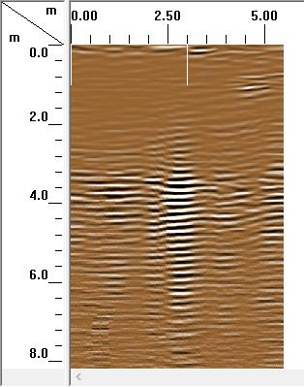
Cricket Cave GPR Survey Compared to LIDAR
270 MHz GPR at 250 ns
  Anomaly at approx. 4 m deep
  Passage width approx. 1 m wide
  Passage height hard to distinguish due to reverberations
LIDAR
  Point cloud analysis shows the passage in this area to be
  1.14+/-0.03 m
  3D rendering on a 4m grid shows the passage to be approximate 1m tall and 2m wide
Image by Joe Mitchell

Slide 11
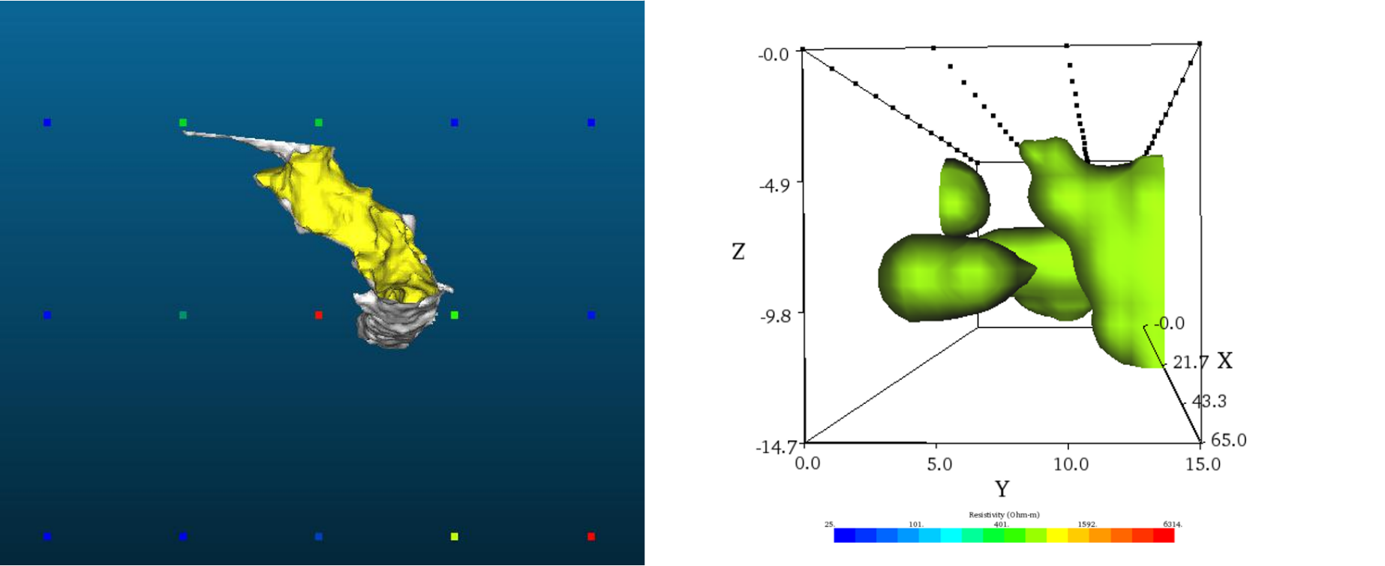
Cricket Cave Resistivity Comparison
3D Resistivity Contour Plot feature in the EarthImager 3D software
  799.03 ohm-m contour
  Outer surface of the passage appears to be a similar shape to the LIDAR model
  Depths do not agree

Slide 12
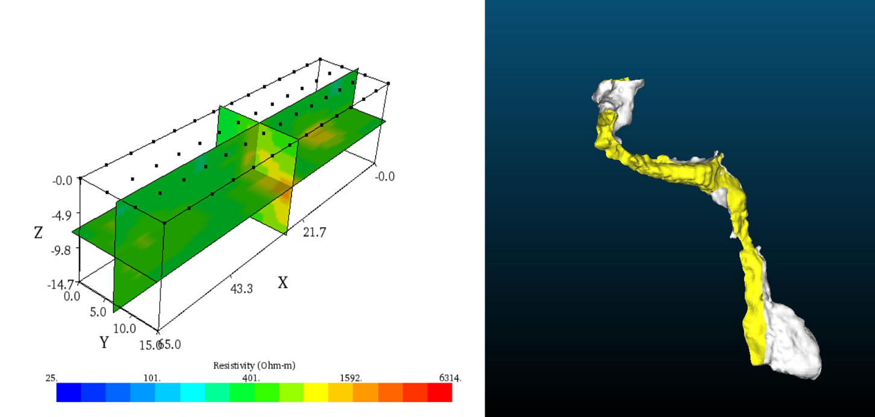
Cricket Cave Resistivity Comparison
The Dynamic Slices feature in the EarthImager software allowed a look at the cross sections of the area where the cave passages were detected by the resistivity survey
  Main chamber
    Resistivity - 7.80 m high x 6.75 m x 4.76 m (250 m³)
    LIDAR - 6.10 m high x 1.90 m x 1.00 m (11.6 m³).
  Crawlway
    Resistivity - 5.57 m long x 4.67m wide x 2.08 m (54.1 m³)
    LIDAR - 5.70m long x 1.00 m wide x 0.80 m (4.56 m³)

Slide 13
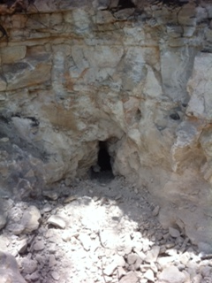
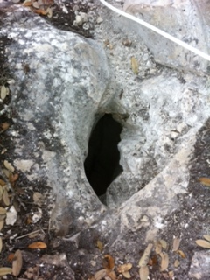
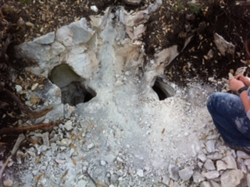
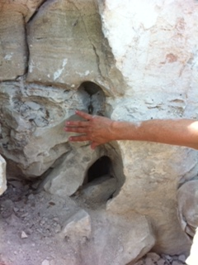
Schubert’s Hole – Edwards Limestone
Feb 23, 2011 - Small Hole (9”x3.5”) Blowing at 2.2 mph
Continued digging led to a crawlway (0.7 m tall) with a dirt floor approx. 2.4 meters below the edge of the sinkhole and 4.57 meters long

Slide 14
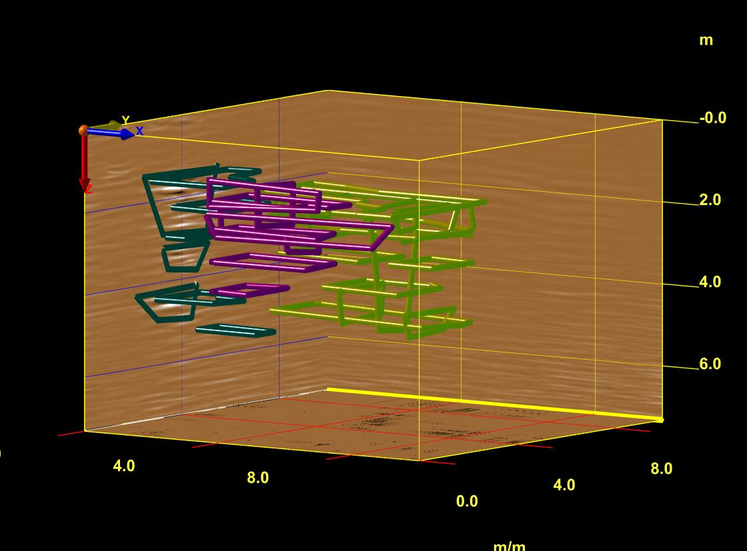
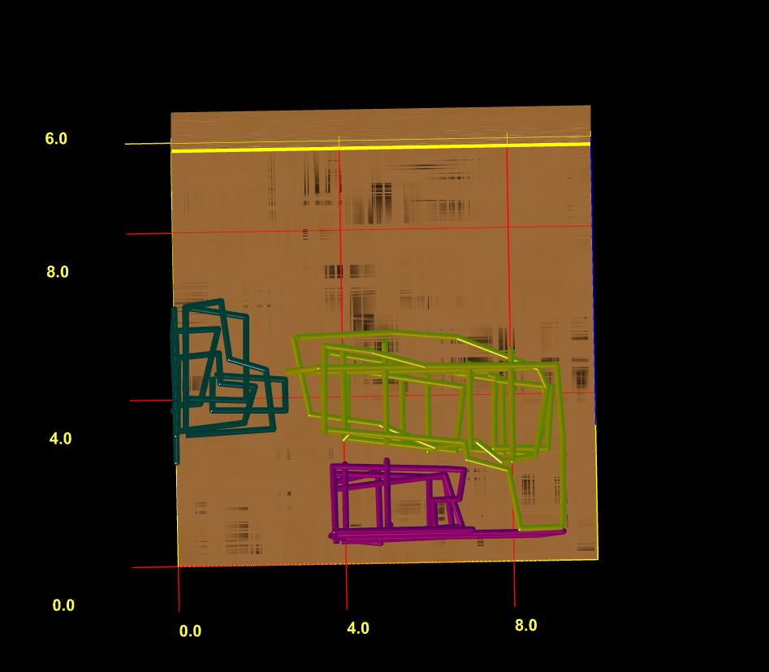

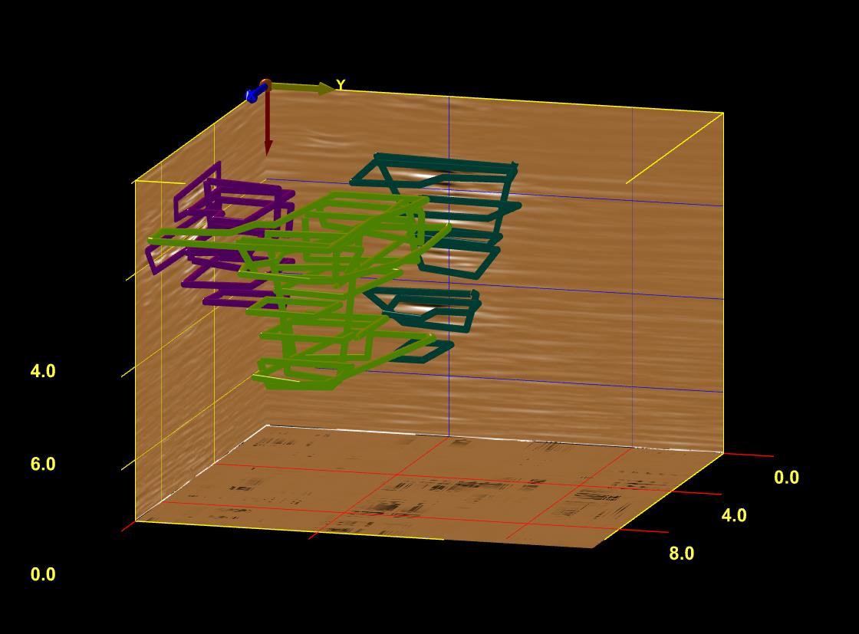
GPR Results –Schubert’s Hole
Void shows to be about
1 meter below the surface and extends to almost 4 meters.
Bulk of passage is about 2 meters wide.
End of Crawlway
Potential Void Space
3.15 m
Sinkhole

Slide 15
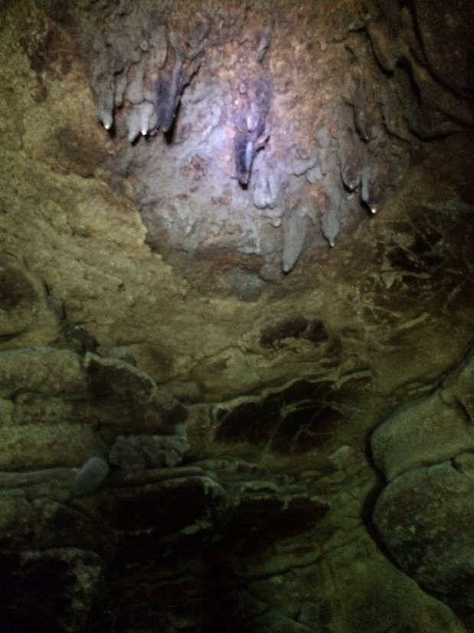
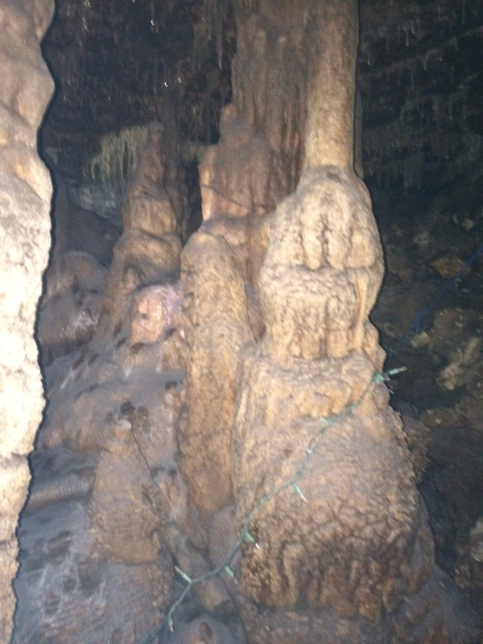
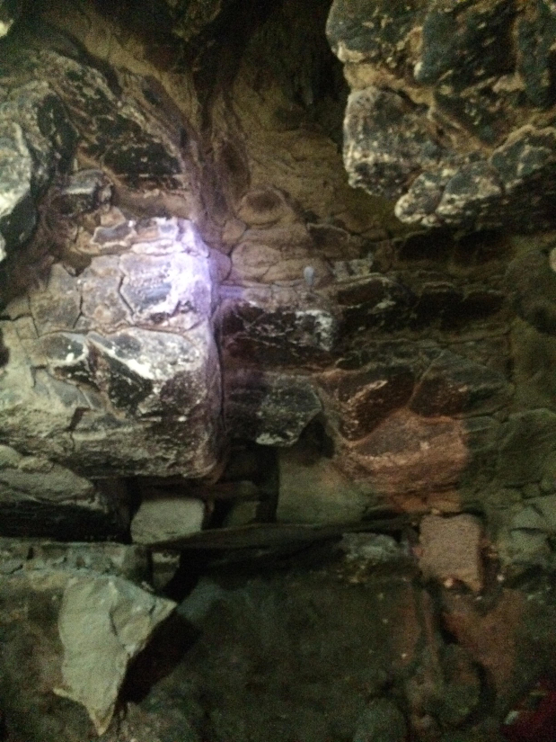
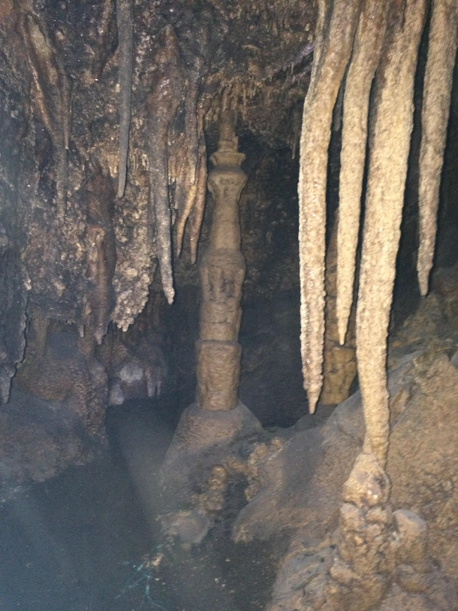
Schubert’s Hole becomes
Park Cave
Upper Chamber – The Red Room
Lower Chamber – Highly Decorated

Slide 16
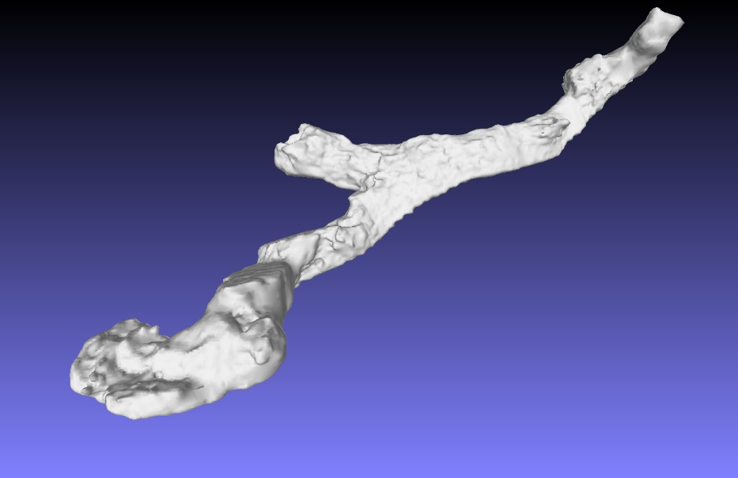
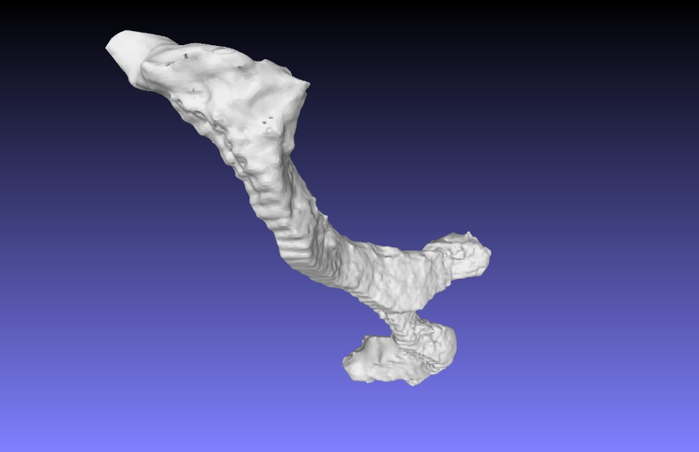
Park Cave LIDAR Measurements
Red Room Dimensions
  Middle of room is 4 meters deep
  Height – 2.2 m
  Width – 2.5 m
  Length – Approx. 2.2m (After Break through into room)
Image by Joe Mitchell
Image by Joe Mitchell

Slide 17
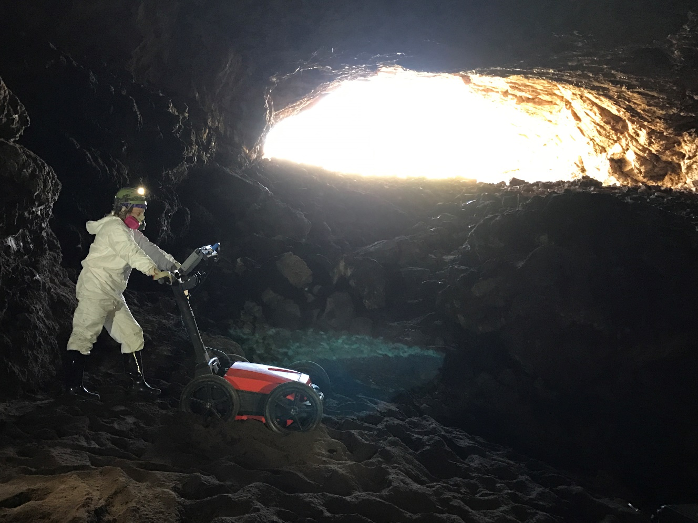
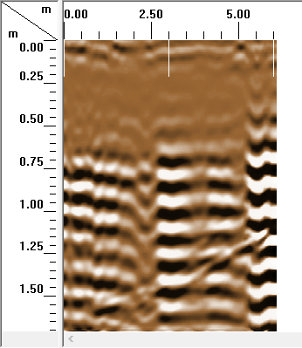
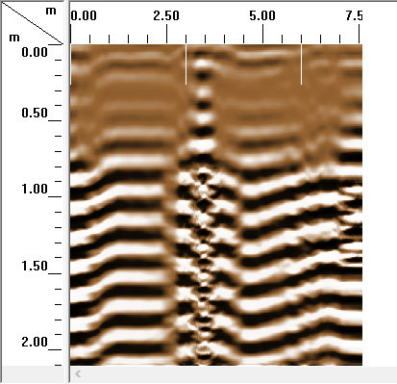
Just for fun, GPR in Bracken Cave
What is the dielectric constant of Bat Guano?
κ = 35
κ = 23

Slide 18
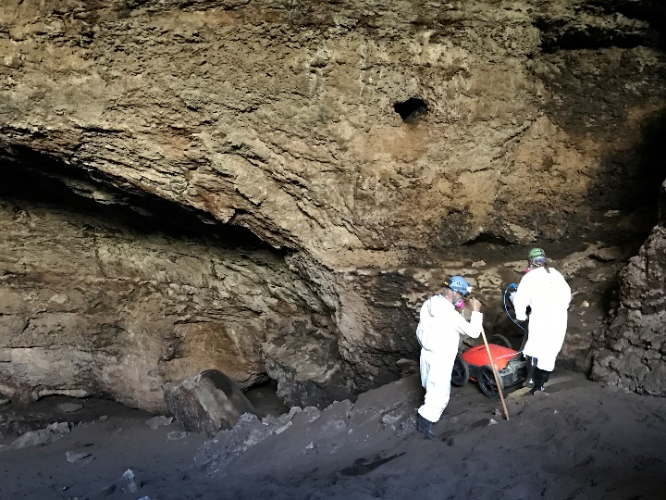
Conclusions
GPR and Resistivity are both useful tools for identifying subsurface voids
  GPR has depth limitations, but has fairly good accuracy in width measurements
  From what I’ve seen, resistivity seems to be able to show the overall shape of the passage, but the dimensions may not reflect the actual dimensions of the void
Early results – The dielectric constant of bat guano appears to be between 23 and 35.
  More study needed

Slide 19
Acknowledgements
The Albert and Margaret Alkek Foundation for funding for the GPR System Purchase
Mike Burrell at Cave Without a Name for assistance with the project and access to the property. http://www.cavewithoutaname.com/
Ron Green for the Bracken Resistivity Images
Joe Mitchell for the 3D LIDAR Images and animations of Cricket Cave
Harold Campbell, Michael Cunningham, Jen Espinosa, James Ford, Liz Hoffman, John Lopez, Wade McDaniel, Joe Schaertl, Ben Schwartz and Gregg Williams for help with the Cricket Cave Resistivity Comparisons
Tom Brown, Allan Cobb, Kurt Menking, and Linda Palit for help with the Bracken Cave survey
The Texas Speleological Association for the cave maps

