Slide 1
Physical volcanology of Cambrian basalts and rhyolites in the Southern Oklahoma Aulacogen from surface exposures and deep drilling penetrations
Robert E. Puckett Jr., Richard E. Hanson, Matthew E. Brueseke, Amy M. Eschberger Chelsea E. Toews, Joseph R. Boro

Slide 2
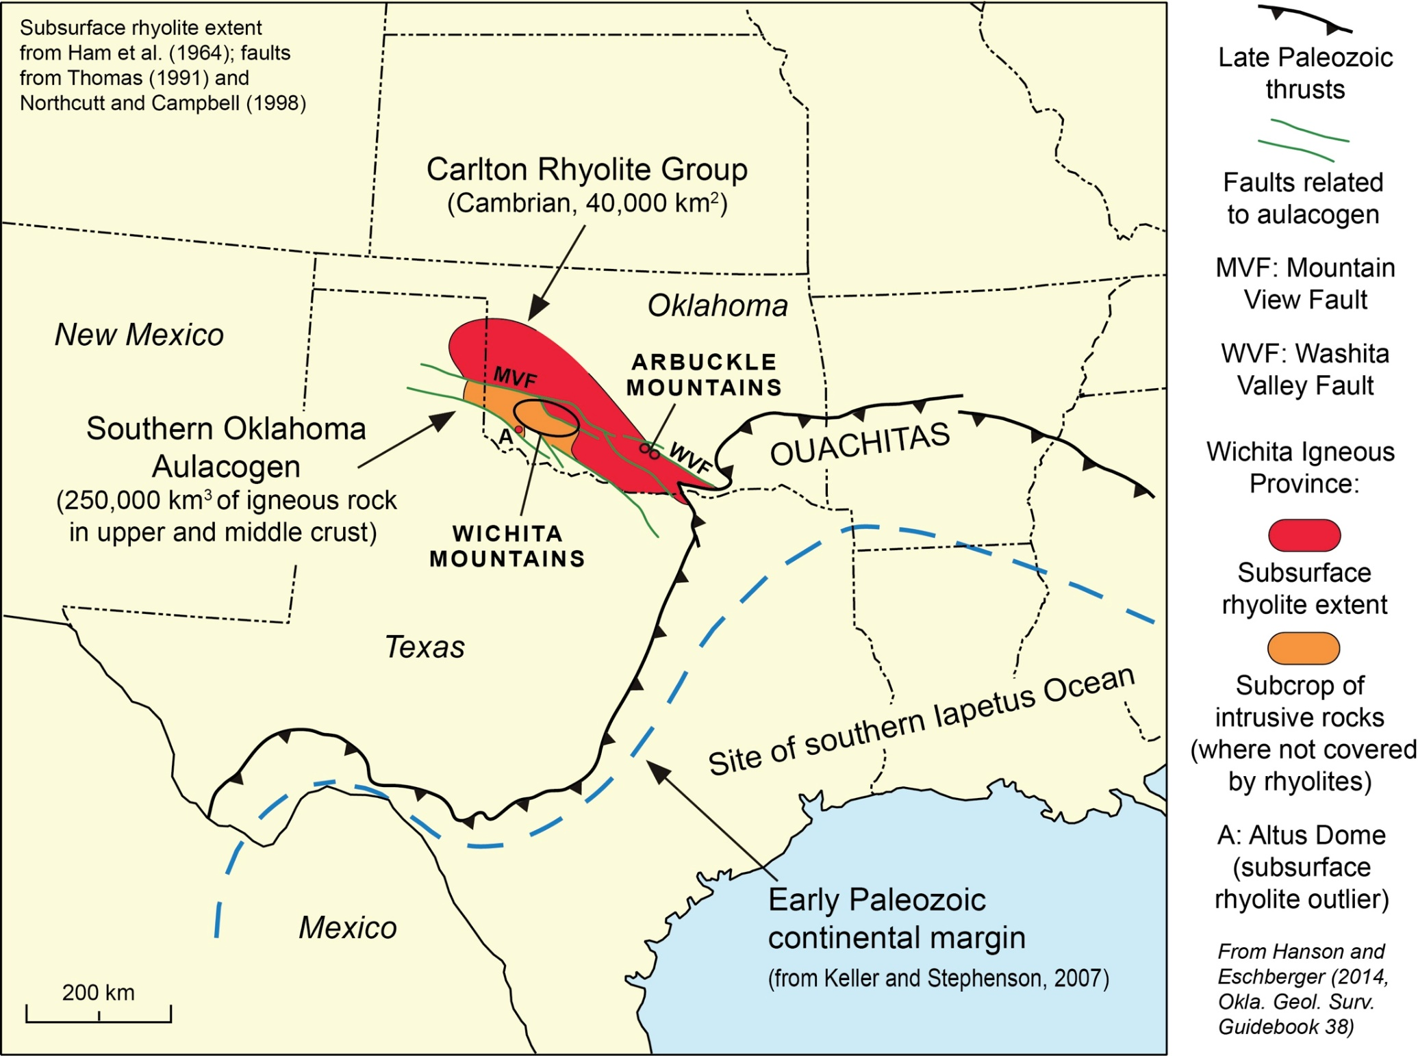

Slide 3
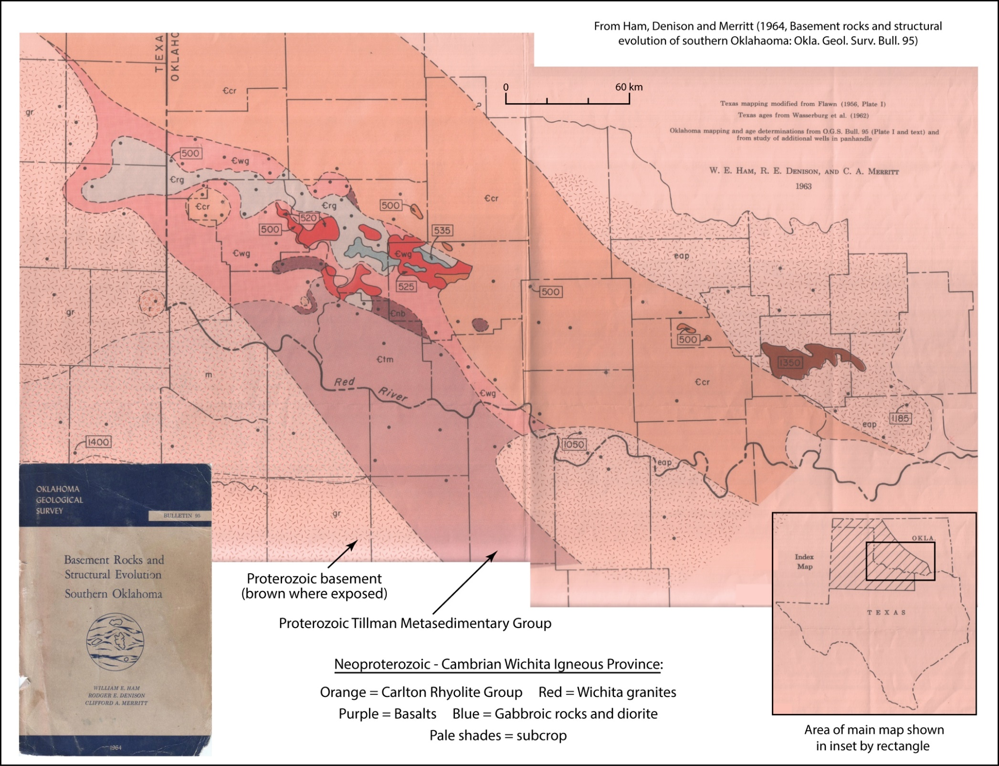
Notes:
Everything we have done rests on the pioneering work of William Ham, Tim Denison, and Clifford Merritt summarized in their landmark 1964 study of basement rocks in southern Oklahoma. Their work shows a band of rhyolite extending across southern Oklahoma, bimodal plutonic rocks outcropping in the Wichita’s, and rhyolite in the Arbuckles. We are not changing the basic detail, but we are extending it with wells drilled after 1964 and drill cuttings unavailable to them at that time.

Slide 4
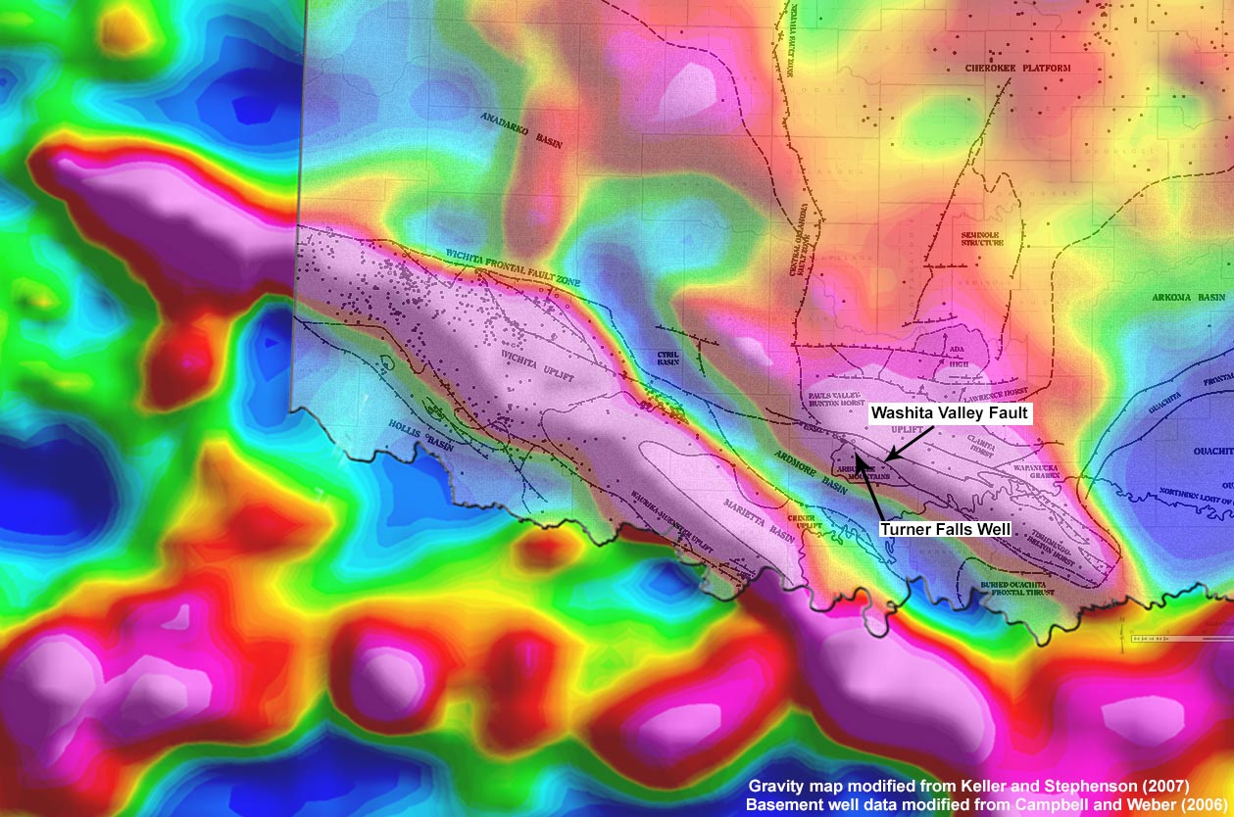
Gravity Map with Basement Wells & Southern Oklahoma Fault System Overlay
Notes:
This is a gravity map with an overlay plotting major faults plus drilled well locations that penetrated basement rock. This gravity high represents the body of rift-related volcanic and plutonic rocks emplaced in the rift. Using Randy Keller’s velocity profile from seismic data, a mafic complex extending at least 10 km deep can be modeled calculating a minimum volume of 250,000 km³ of rift-related igneous rock. The Washita Valley Fault is thought to be the north bounding fault of the rift, reactivated in Pennsylvanian tectonics as a regional thrust fault. The limited outcrops of rift-related rocks in the Arbuckle Mountains were emplaced on this northern anomaly by the fault. The Hamilton Turner Falls well, 1-km south of the fault, drilled a 4.8-km thickness of rift related igneous rocks before crossing the fault at depth. The area of the anomaly north of the fault is thought to be Proterozoic granites of the craton.

Slide 5
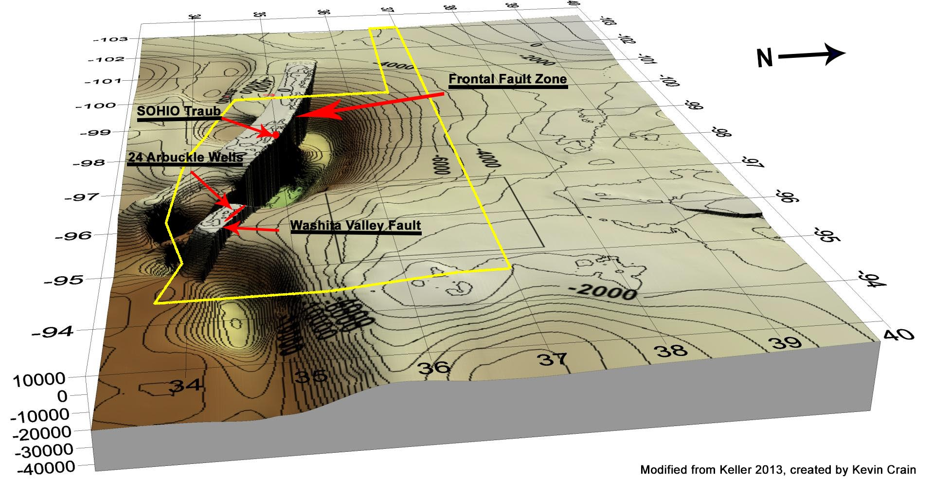
3D Projection of Cambrian & Proterozoic Basement Rock Geometry
Uncorrelated Igneous Section Documented
Arbuckle Mountains - 31 km Wichita Mountains - 9.6 km
Notes:
This is a projection of the sub-unconformity crystalline rock surface as it exists today. This band is the Cambrian rift assemblage uplifted by Pennsylvanian tectonics. From the central Arbuckle’s westward the rift-rocks are the hanging wall of north-vergant regional thrusts. They were originally extensional faults bounding the rift and were re-activated to thrust the rift-related rocks over younger, Paleozoic, sedimentary oil-bearing rocks. The red areas are where the overthrust igneous rocks were penetrated to reach deeper petroleum reservoirs. In the Arbuckle’s these wells give us access to 31 km of uncorrelated igneous rift section. In the Wichita Mountain’s we have worked through 9.6 km of igneous rift section. We will spend most of our time today in the Arbuckle’s where we have more data grouped closely together.

Slide 6
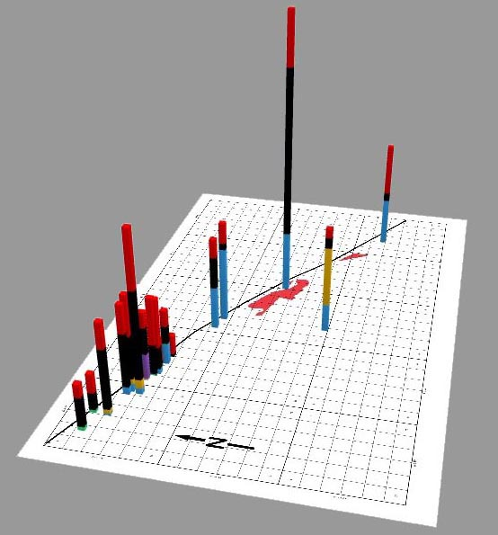
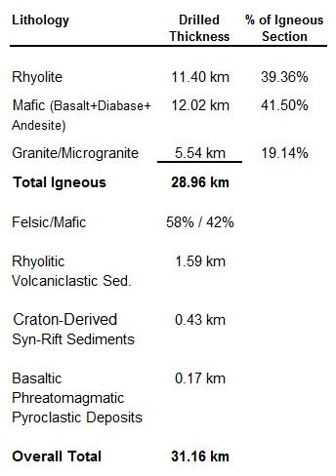
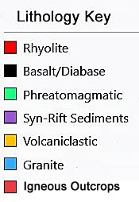
22 Arbuckle Wells
Cumulative Lithology
Fault
Valley
East Timbered Hills
Washita
West Timbered Hills
43 km
Notes:
We have located the drill cuttings for 22 wells along a 43 km-long band westward from the central Arbuckle’s. Together these wells contain 31 km of uncorrelated igneous section. The well locations shown here are not stratigraphic columns but are scaled summaries of cumulative lithology for each of the rock types. The height of the plot correlates to the thickness on the rift-related rocks in each borehole. The red map areas are Rhyolite outcrops in the Arbuckle Mountains.
The Arbuckle wells drilled large amounts of tholeiitic to alkaline basalt with some intermediate flows and diabase. Overall the igneous assemblage is strongly bimodal with cumulative totals of 58% felsic-rocks and 42% mafic-rocks. The deepest well in this area drilled 4.87 km of igneous rocks including 2.8 km of basalt.
Notice a couple of trends here. Rhyolite and basalt are found together in every well with over 100 m of igneous section. Also, eastern wells have much more granite than western wells. A little more difficult to see is that phreatomagmatic deposits occur along a band in the western wells, with anomalously thick amounts occurring in the two westernmost wells.

Slide 7
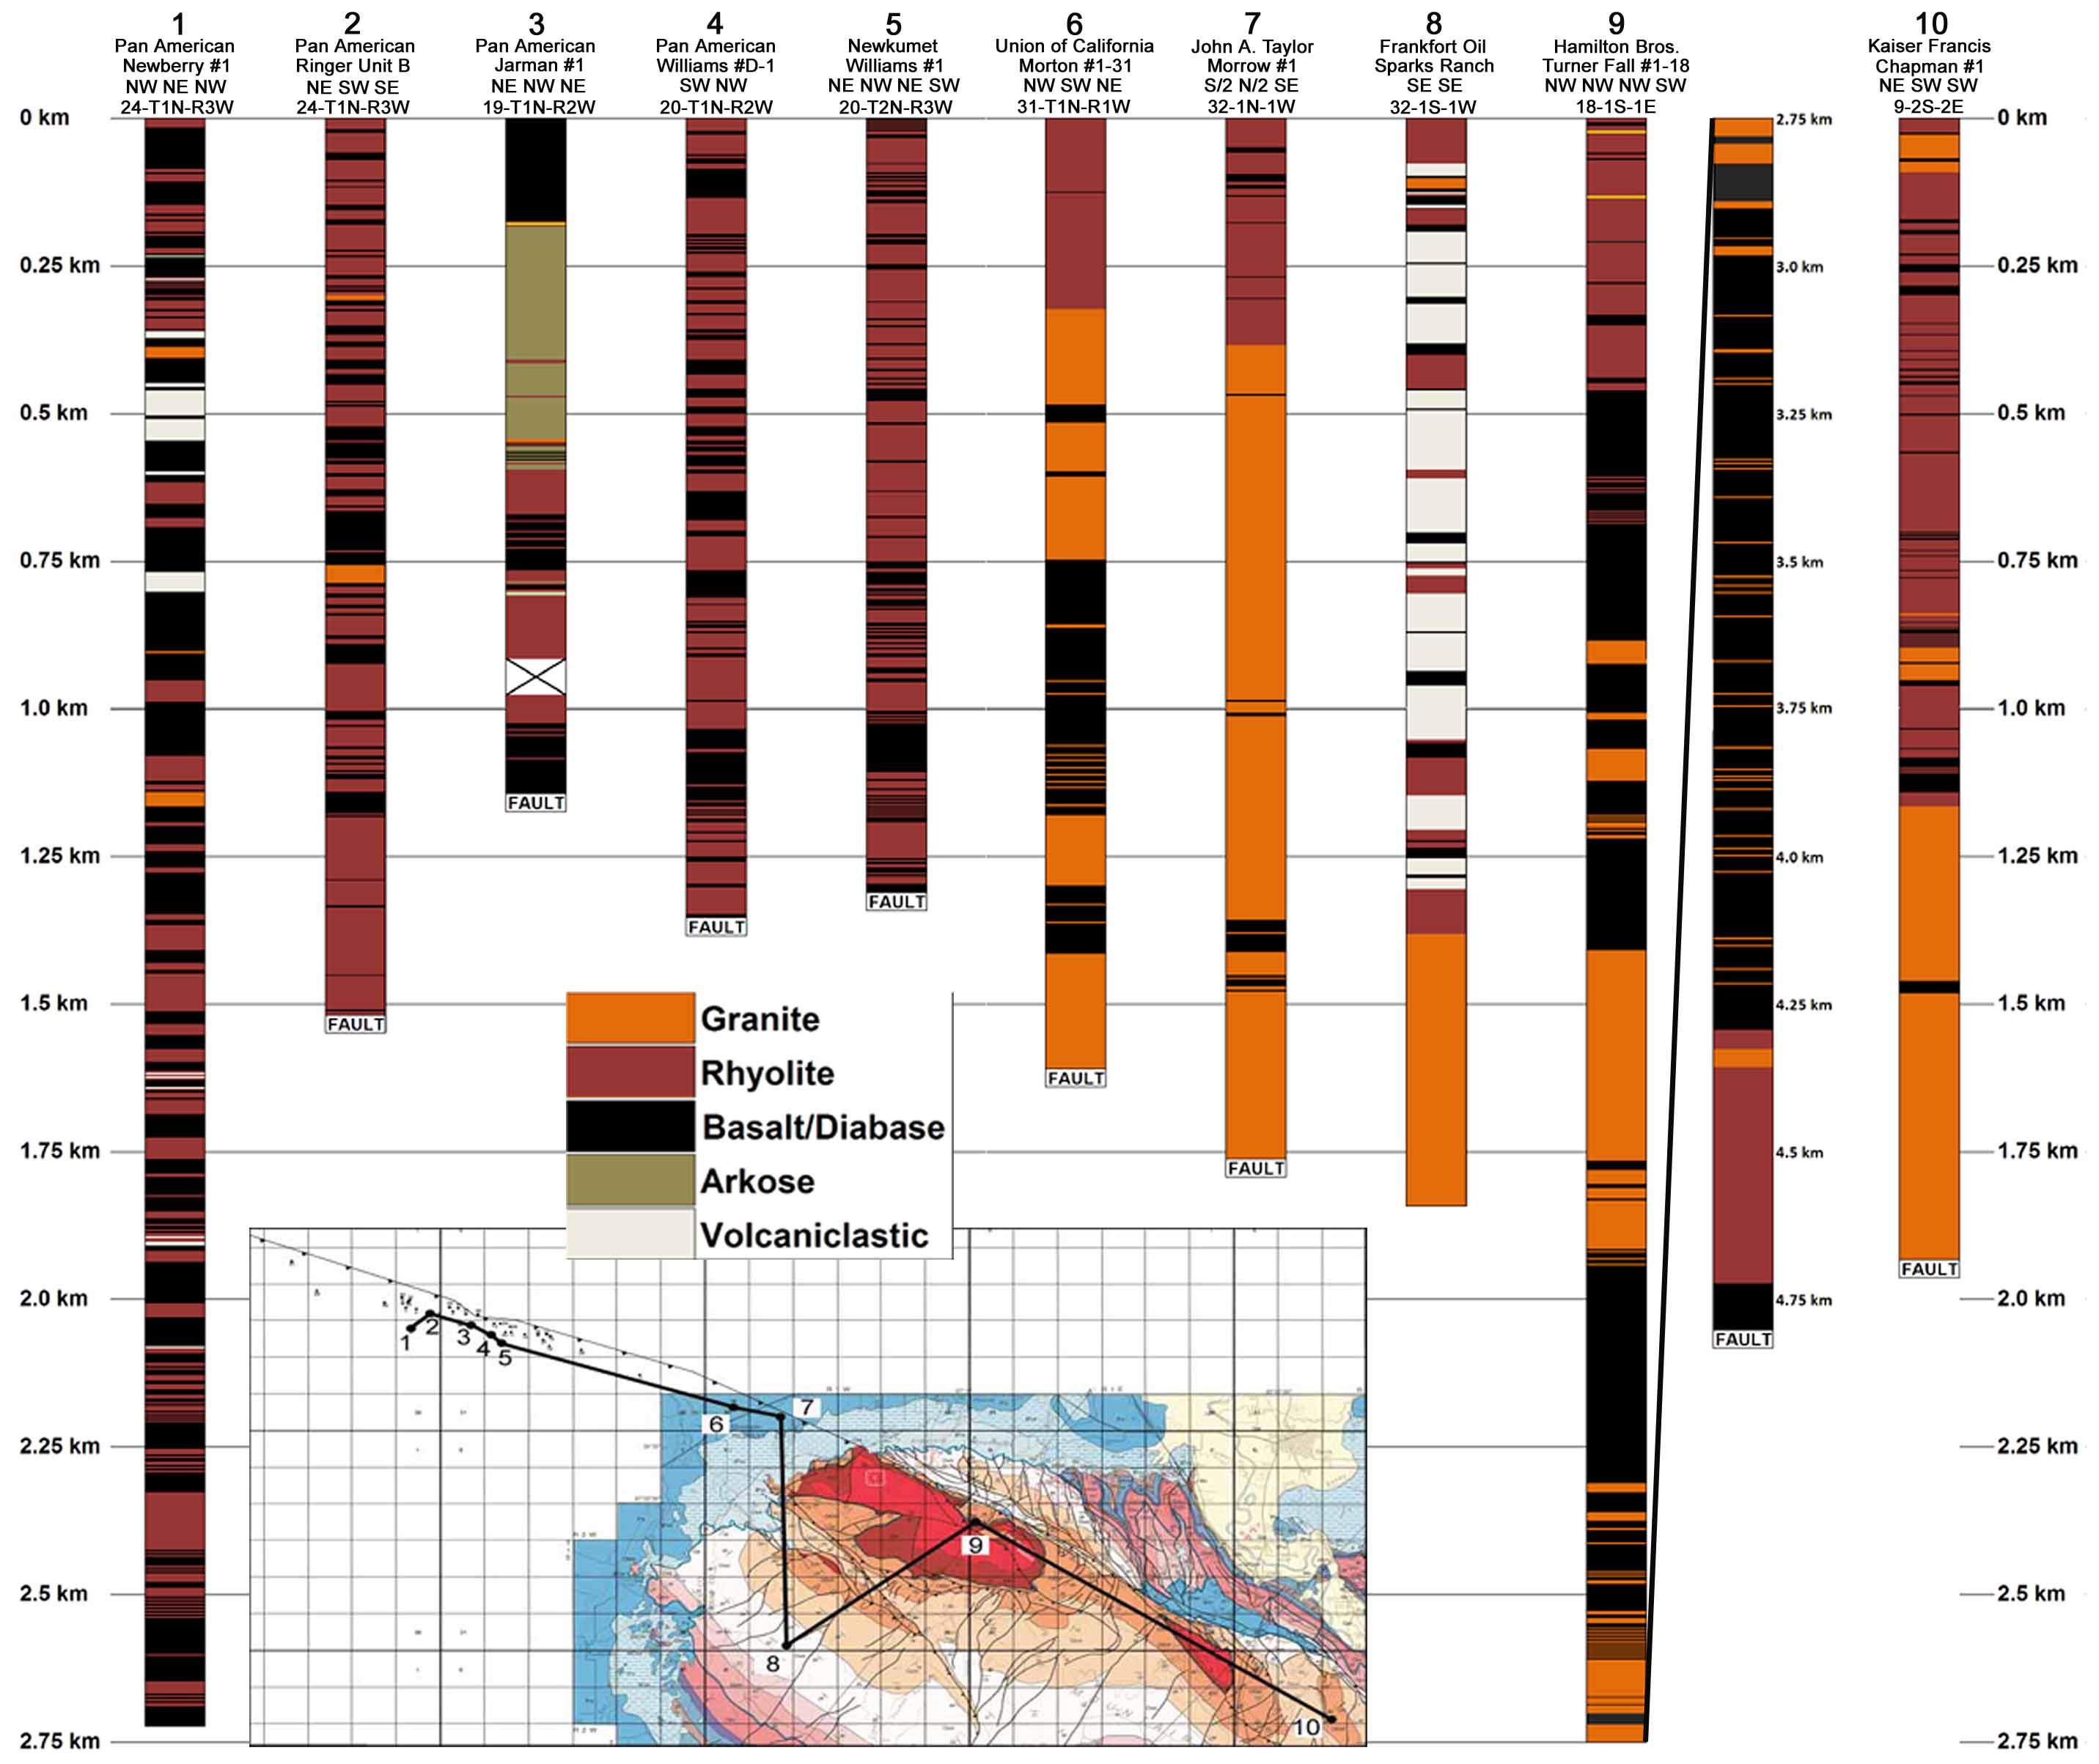
Notes:
These are some of the more representative wells we will be referring to. The most prominent feature of the eruptive suite in the Arbuckle’s is the extensive intercalation of basaltic and A-Type rhyolitic lavas. Felsic pyroclastic deposits are very limited and there is no evidence for caldera-style volcanism in southern Oklahoma. These lavas were likely erupted from fissure vents, although this is difficult to prove based on the subsurface data.

Slide 8
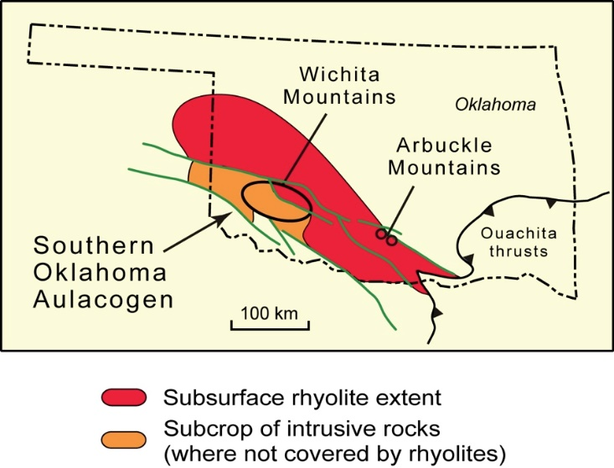
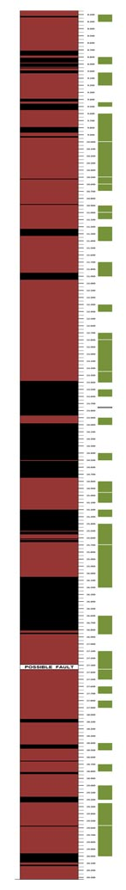
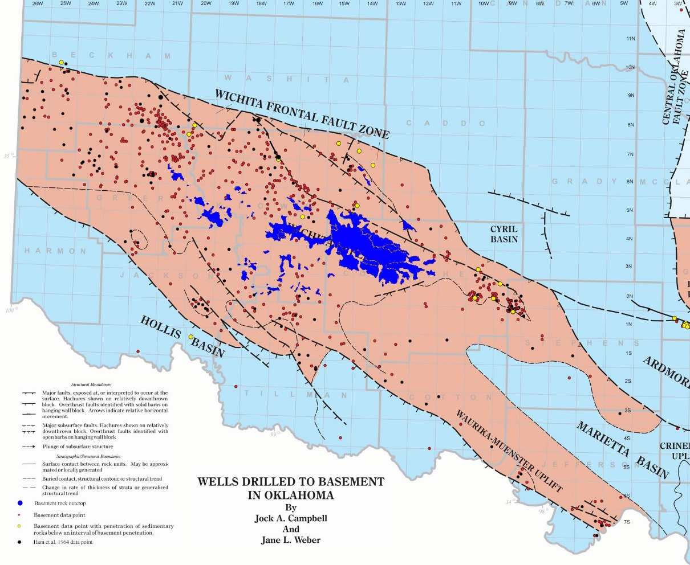
Intercalated Rhyolite & Basalt, Wichita Mountains
2.48 km beneath surface
SOHIO Traub #1-3
Sec. 3-T6N-R14W
6.8 km NNE of Bally Mountain
Missing Samples
415 m thick basalt interval with 35 m rhyolite dike/sill
104 m thick basalt interval
229 m thick basalt interval
6.19 km beneath surface
Notes:
Looking at the Wichita Mountains to the west, there are fewer wells that have drilled basalt sections. Up until this study the maximum basalt penetration was 300-m and assigning the basalts a position in the eruptive sequence was problematic. One well, drilled after the 1964 study, did encounter a significant amount of basalt intercalated with rhyolite. There are several other new wells along the north flank of the uplift that have penetrated rhyolite sections at 3000-4000 m deep, but the operators will not give us access to the igneous-section drill cuttings.

Slide 9
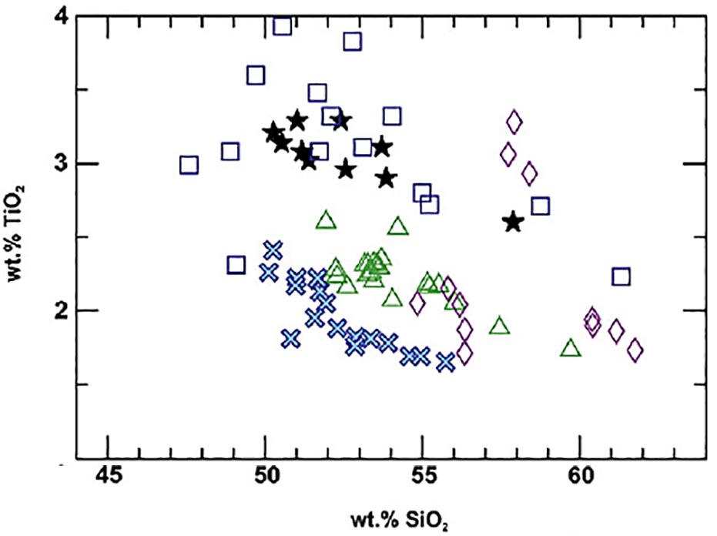
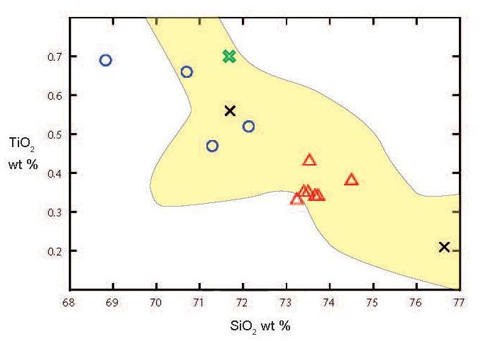
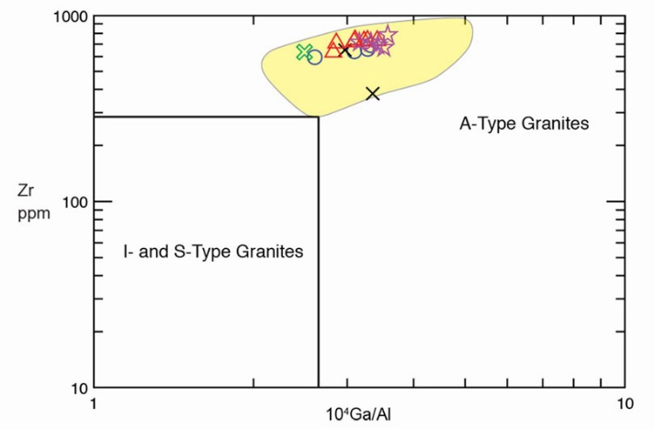
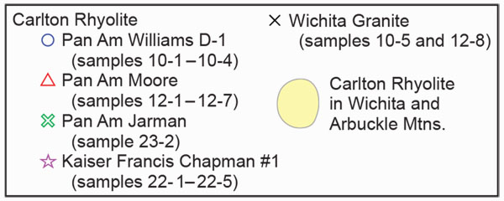

Hanson and Eschberger (2014)
Brueseke et al. (
Brueseke et al. (2016)
Notes:
Turning briefly to the geochemistry of these rocks, the Harker diagrams for TiO2 in the top of this slide illustrate the compositional ranges shown by the mafic and felsic volcanic rocks. Note that the more mafic lavas show a compositional range from basalts into andesites (cut-off is 52 wt. % SiO2), but this is not unusual for these kinds of intraplate basaltic provinces, which in many cases show this kind of spread. Note also that there is still a significant gap in silica between the intermediate and rhyolitic lavas.
In these standard trace-element discrimination diagrams, the mafic volcanics show both subalkaline and alkaline affinities, whereas all the felsic rocks both from outcrops and in the subsurface have A-type compositions characteristic of many felsic magmas emplaced in intraplate rift settings.

Slide 10
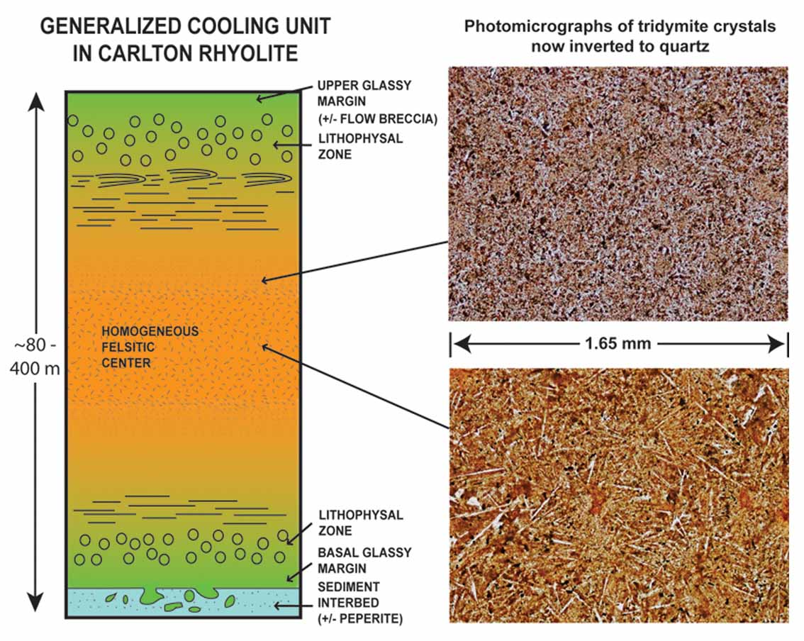
Notes:
This is the cooling unit model developed by Richard Hanson and students for thick rhyolite flows outcropping in the Wichita Mountains. The more rapidly cooled margins feature Perlites, spherulites, and lithophysae, and tridymite needles, now converted to quartz, increase in length as you approach the more slowly cooled interior. The thickest flow mapped on the surface is in the Arbuckle’s area and is at least 600 m thick.

Slide 11
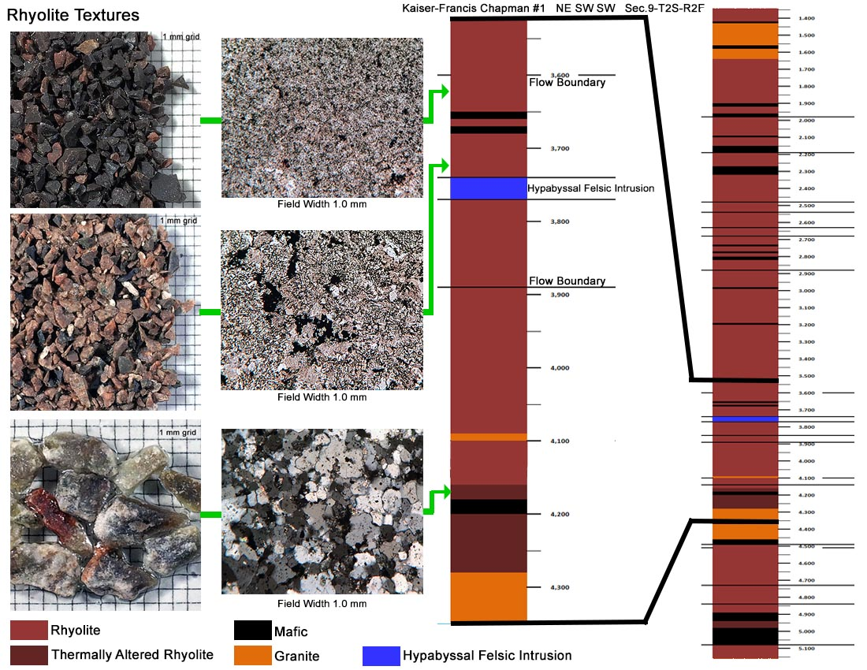
Notes:
This is a rhyolite flow sequence from the easternmost Arbuckle’s well, the Kaiser-Francis Chapman. The top sample is a formerly glassy margin exhibiting fine-grained low-temperature devitrification products. These margins have very distinctive textures and can be up to 40-45 m thick. Higher -temperature devitrification in the flow interior results in a courser texture in the middle sample. The last sample is contact-metamorphosed and silicified, thermally altered by the diabase and granite intrusions below.

Slide 12
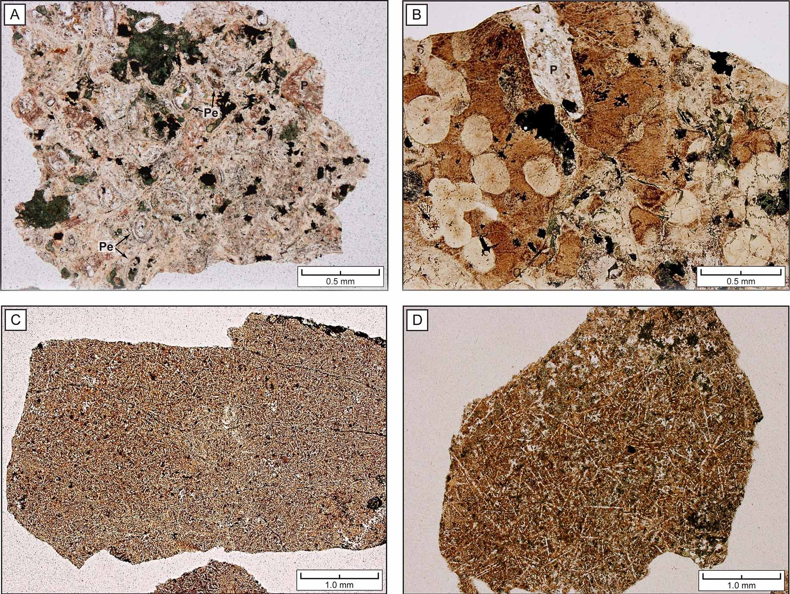
Rhyolite Textures
Notes:
Changes in groundmass textures in rhyolite drill cuttings are consistent with penetration of a series of lava flows with originally glassy chilled margins having perlitic and spherulitic textures, as you see in upper two photos, and more slowly-cooled, microlite-rich flow interiors in which original tridymite needles increase in size inward, as is also seen in the surface outcrops. Abrupt and dramatic changes in texture and color in un-weathered subsurface samples are very useful in identifying flow boundaries.

Slide 13
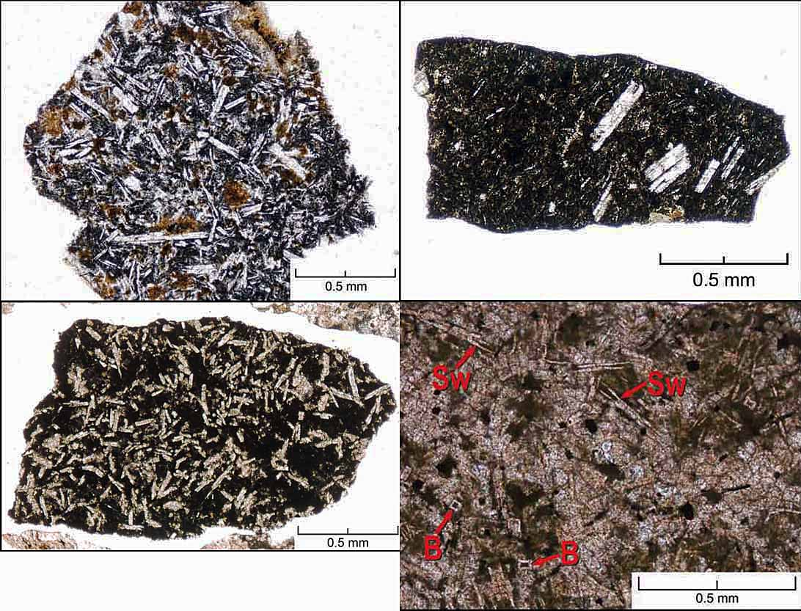
Basalt Textures
Notes:
Basalts show a range of textures typical of subaerial lava flows, with randomly oriented to flow aligned plag microlites and phenocryts, and in some cases quench textures are present, as seen in slide in lower right, with characteristic swallow-tail and belt-buckle plag, indicating aqueous quenching against external water, perhaps during eruptions into lakes.

Slide 14
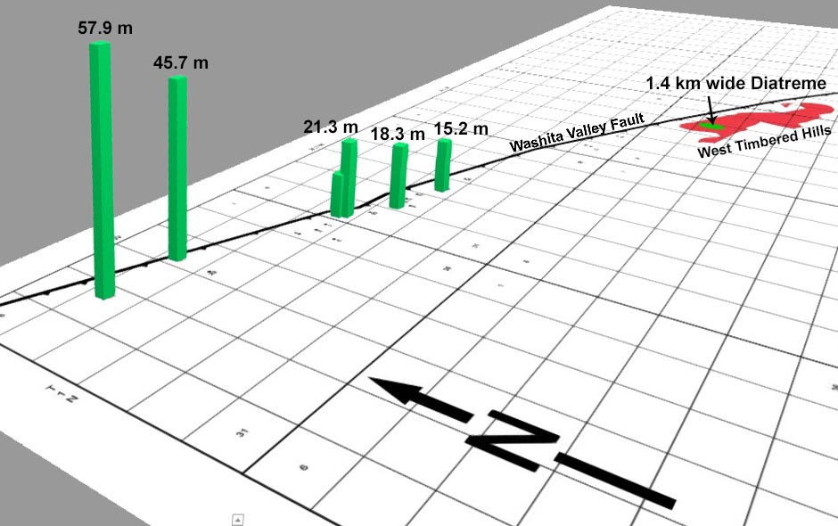
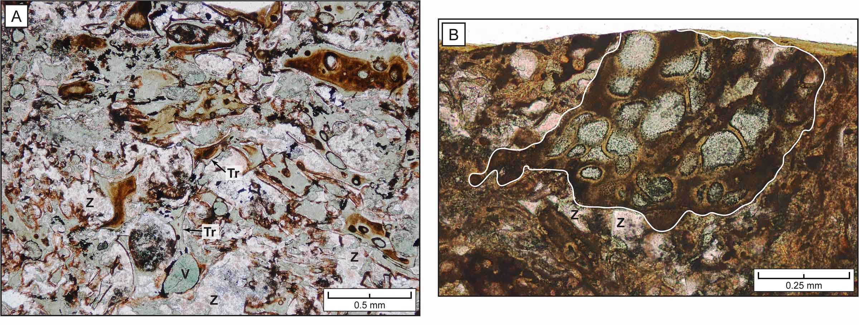
Basaltic PhreatomagmaticPyroclastic
Intervals
Plus two known basaltic phreatomagmatic intervals in the Wichita Mountains with thicknesses of 70 m (Ham et al. 1964) and 12 m (current project).
V
V
V
V
V
Tr : Tricuspate bubble wall shards V: Vesicles filled with green clay Z: Zeolite Cement
Notes:
This 3D image shows the location of a quarry in the West Timbered Hills, mapped surface exposures, and two groups of wells with some significant basaltic pyroclastic deposits. The photomicrographs are from drill cuttings in these intervals, and show basaltic shards made of rapidly quenched sideromelane glass, now replaced by green clay and brown palagonite and showing some vesicularity and angular to fluidal shapes. As discussed by Richard these are diagnostic shapes for pyroclasts generated during explosive phreatomagmatic eruptions.

Slide 15
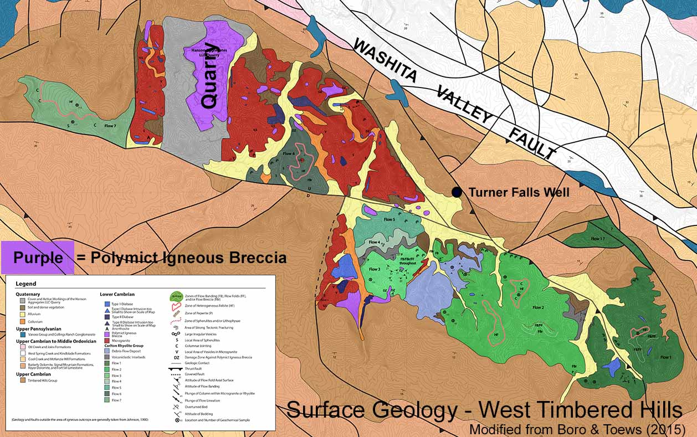
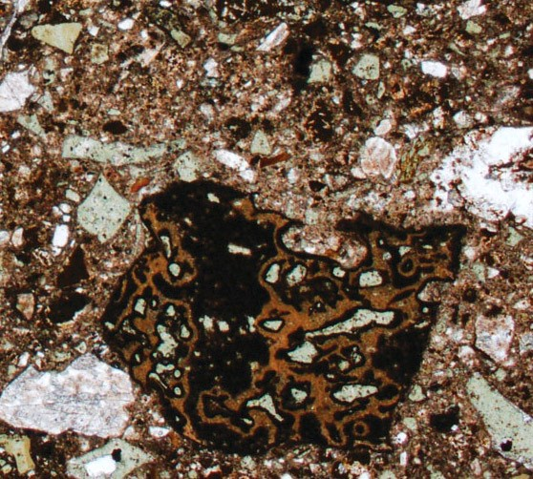
Phreatomagmatism: Rising Magma Encounters Shallow Lake or Groundwater
Field Width 2.5 cm
Field Width 20 cm
Vent model modified from Befus et al. (2009)
Photographs modified from Eschberger and Hanson (2014)
Notes:
As Richard discussed in his talk, identical types of basaltic pyroclasts replaced by green sideromelane and brown palagonite are found within polymict igneous breccias found on outcrop in the West Timbered Hills and interpreted to represent diatreme feeder conduits to small phreatomagmatic volcanoes. Similar vents likely supplied the phreatomagmatic pyroclasts found in the subsurface, suggesting that this style of explosive basaltic volcanism may have been relatively common within the rift.

Slide 16
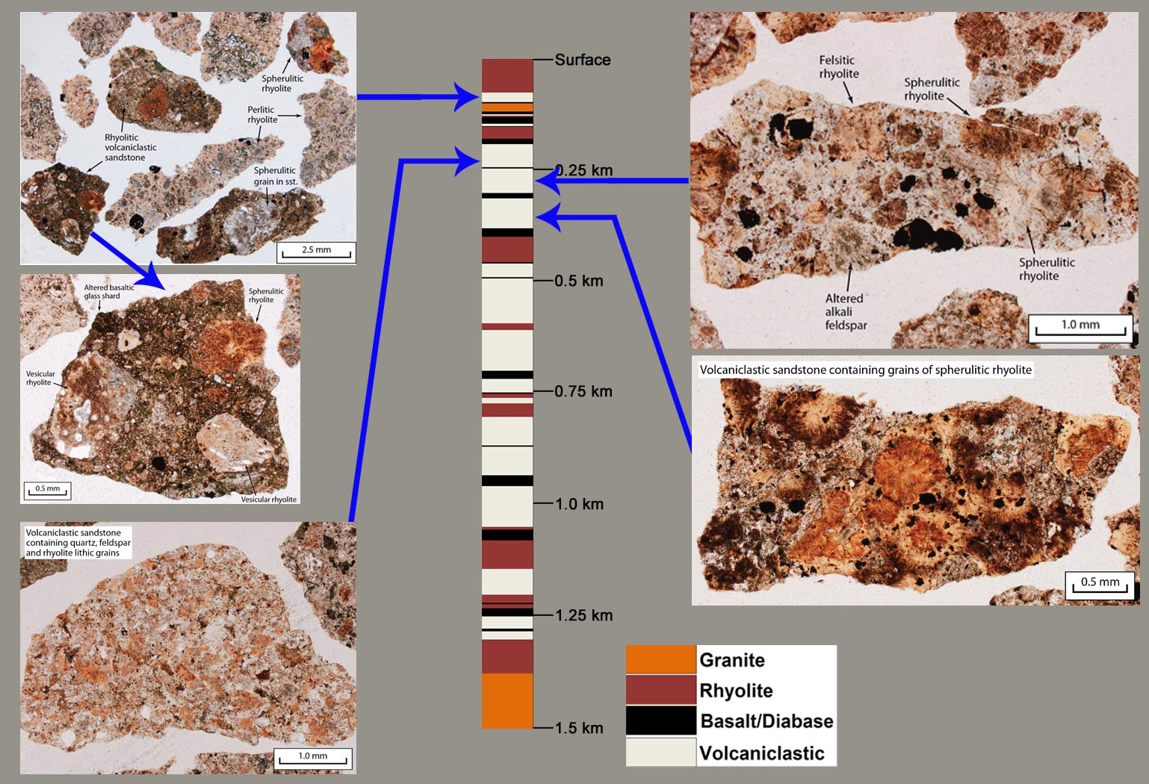
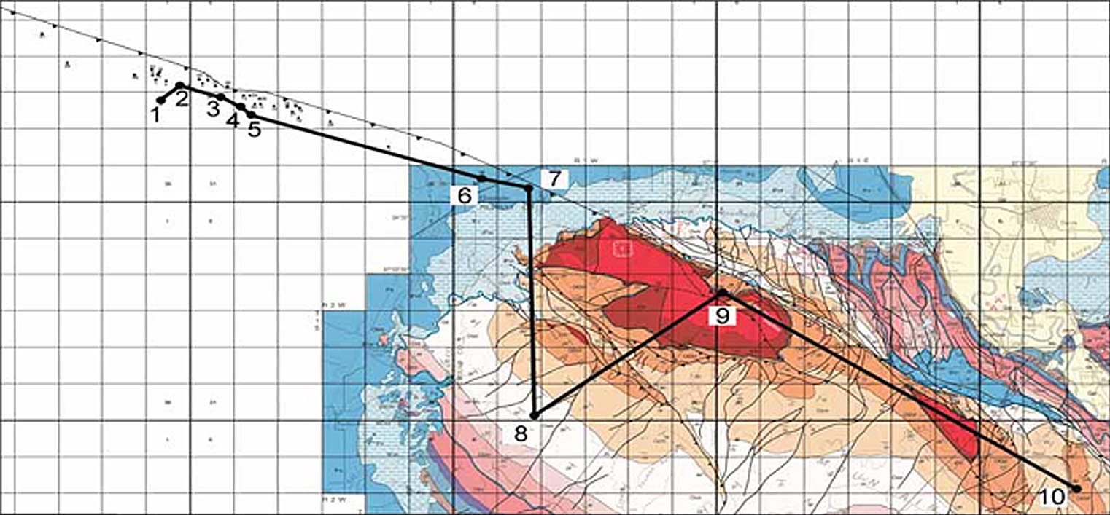
1.2 km Cumulative Volcaniclastic Interval Intercalated with Rhyolite
Notes:
Rhyolitic volcaniclastic deposits are common in the subsurface, although the only place they form a significant thickness is in this well, which is about 9-km closer to the rift axis than the wells drilled along the fault. The white section is a 1.2-km-thick accumulation of volcaniclastics. These are texturally immature, variably rounded silt-to gravel-sized polymict volcanic clasts plus loose grains of quartz and feldspar. This material was eroded from parts of the rhyolitic volcanic pile and may be evidence of thick volcaniclastic aprons supplied from volcanic centers within the rift.

Slide 17
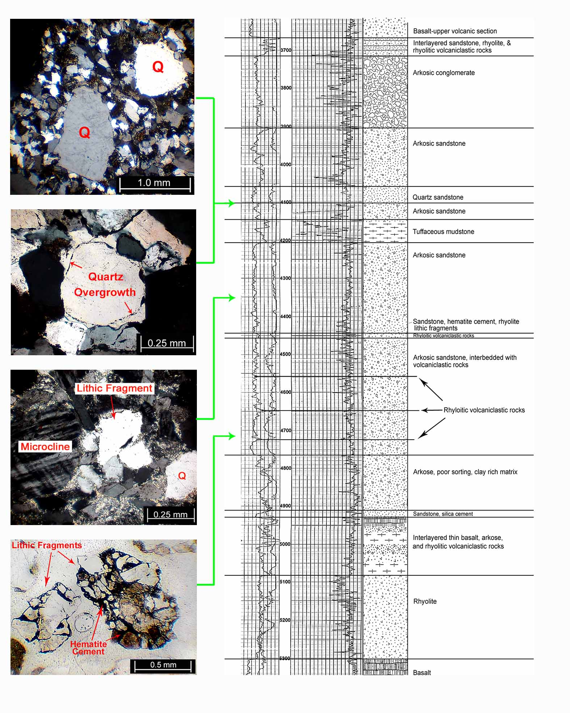

Craton-Derived Clastic Section
within Volcanic Succession
Pan AM Jarman #1
19-1N-2W
426 m
1.14 km
Notes:
One well drilled several kilometers into the rift penetrated a 432-m sequence of arkosic sandstone derived from Proterozoic granites outside the rift. The sequence was deposited on rhyolite and was later covered by basalt. Thin beds of rhyolitic volcaniclastic sandstone and tuffaceous mudstone are intercalated with it.

Slide 18
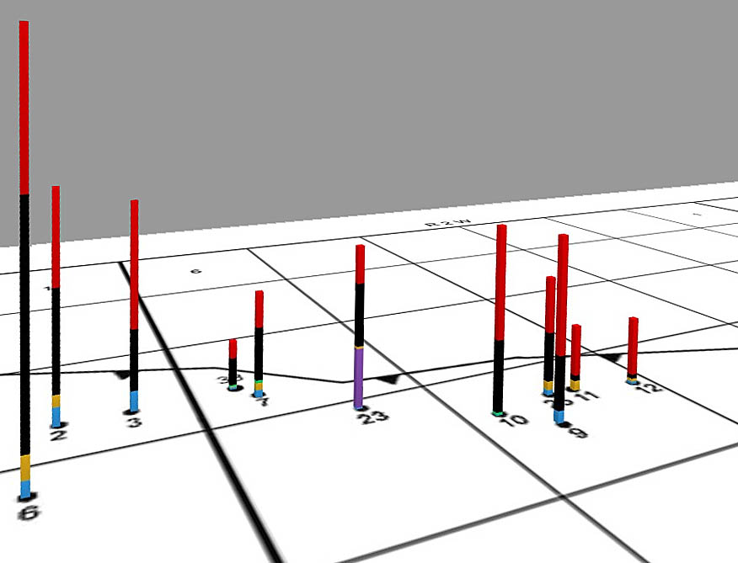
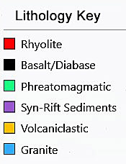
430-m-Thick Section of Craton-Derived Detritus
Notes:
This is the position of the well with the arkosic clastic section. This section occurs only in this well and is absent from wells less than 1 km to each side. We interpret the clastic section to have accumulated by fluvial processes either in a major erosional channel or perhaps in a low-standing area between constructional volcanic topographic features. This is the only instance of sediment flow into the rift we have encountered.

Slide 19
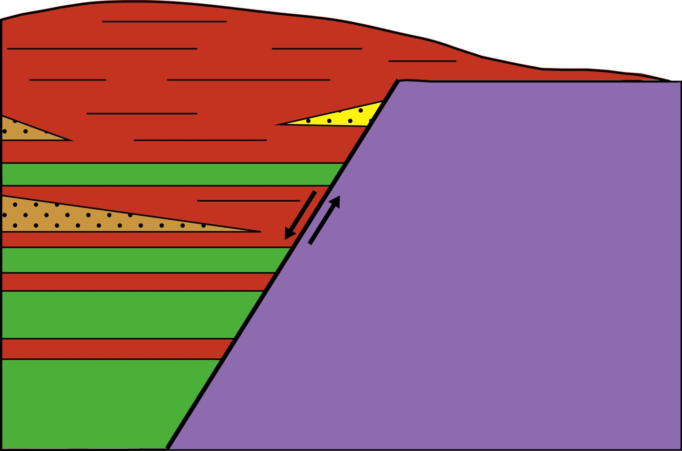
Model for Rift-Margin Volcanic Deposits
Arbuckle Mountains Area
Terrigenous Clastics
Rhyolite Flows
Volcaniclastics
Proterozoic Granites
Basaltic Flows
Notes:
These different lines of evidence lead to the model we have developed for volcanism in the Arbuckle Mountains area. It depicts a magmatically active rift generating thick sequences of intercalated bimodal volcanic flows with effusive volcanism generally keeping pace with subsidence, multiple small phreatomagmatic volcanoes, some intercalations of locally derived reworked rhyolitic material, and with almost no input of terrigenous detritus from older basement except for the one example I just showed you.

