Slide 1
Reducing the Uncertainty of Site Characterization Studies in Karst Settings through the use of Near-Surface Geophysics
Klar, Richard V., McCoy, Zaneta, and Prikryl, James D.
GSA South-Central Section Meeting
March 14, 2017
Notes:
Subsurface conditions along the west side of IH-35 corridor generally consist of limestone terrain with varying degrees of karst formation.
Karst features can have a significant impact on the performance of foundation systems and negatively affect or delay construction activities. It is prudent to evaluate for the presence of karst prior to construction.
Geophysical survey can provide for rapid, accurate, cost-effective characterization. In particular, Direct-Current Electrical resistivity imaging has proven to be effective as this technique can delineate areas in the subsurface where large air-filled voids or zone of weathering (limestone dissolution) are present.

Slide 2
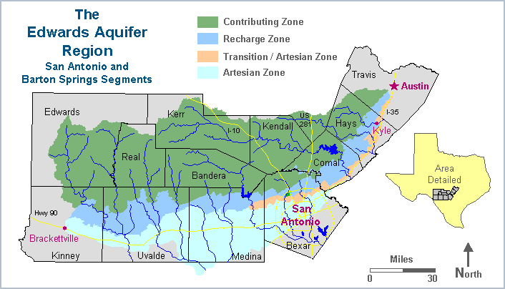
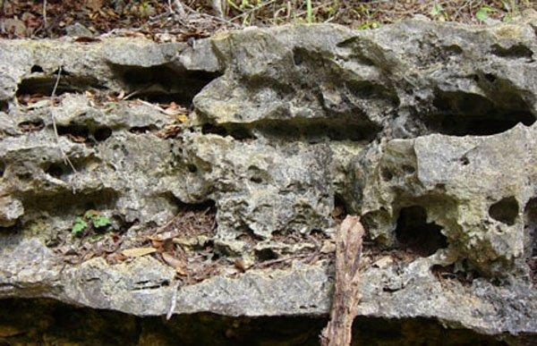
Introduction
Characterization of subsurface conditions is an integral part of most environmental and geotechnical engineering studies.
Traditional approaches relying on exploratory borings or test pits are often inadequate, with numerous pitfalls. Accuracy dependent on assumptions that subsurface conditions are uniform and laterally continuous across project footprint………..typically not the case.
Karst limestone setting prevalent in northern Bexar County and along the west side of IH 35 corridor. As presence of karst features can have significant impacts on projects, non-conventional assessment using geophysics is often prudent.
Notes:
Characterization of subsurface soil and rock conditions is an integral part of most environmental and geotechnical engineering studies.
Traditional approaches to subsurface field investigations have often been inadequate, relying upon the placement of exploratory borings or test trenches.
The accuracy and effectiveness of such an approach is greatly dependent upon the assumption that subsurface conditions are uniform, and that regional trends are consistent throughout the extent of the project site.
Much to the chagrin of project engineers and geologists tasked with site characterization activities, these assumptions are frequently invalid, resulting in the discovery of unexpected conditions during the construction phase of the project, which can contribute to significant project delays and cost overruns.
It has been our experience that subsurface conditions along the west side of the IH 35 corridor connecting the metropolitan areas of San Antonio and Austin generally consist of limestone terrain, containing strata exhibiting varying degrees of karst formation.
Because karst features can have a significant impact on the performance of foundation systems and negatively affect or delay construction activities, it is generally prudent to evaluate the presence of significant karst features at proposed project sites in conjunction with the geotechnical engineering study, or other phases of project planning, prior to construction.
Geophysical surveys can provide for rapid, accurate, cost-effective characterization of subsurface environments. With respect to karst evaluations, direct-current (DC) electrical resistivity imaging has proven to be particularly effective as this technique can delineate areas in the subsurface where large air-filled voids or zones of weathering (i.e., limestone dissolution) are present.
This presentation highlights the use of geophysical technologies to enhance the subsurface site characterization process. Specifically, the presentation will discuss benefits associated with the use of surface geophysical surveys in support of environmental/geotechnical engineering evaluations with emphasis on a supporting case study.

Slide 3
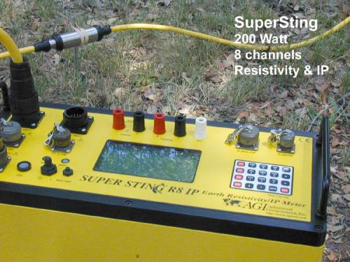
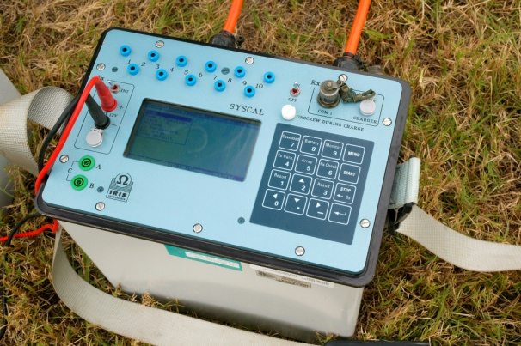
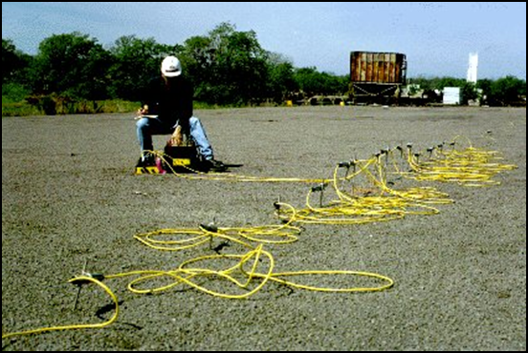
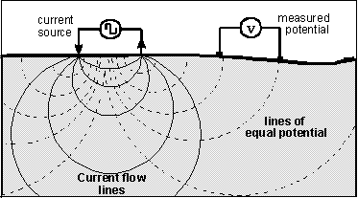
Direct Current (DC) Electrical Resistivity
Surface-based geophysical technique used to measure geo-electric variations in the subsurface
Induce a current directly into the earth using a pair of electrodes and measure the potential of the induced current (i.e., voltage) at a second pair of electrodes
Notes:
Direct Current Electrical Resistivity is a surface-based geophysical technique used to measure geo-electric variations in the subsurface.
DC Electrical Resistivity is basically measured by injecting a current directly into the earth using a pair of electrodes and measuring the potential of the induced current at another pair of electrodes
R-K uses State-of-the-science AGI SuperSting or IRIS Equipment (smart cables, multi-channel data collection, efficient modeling software)
Typically use Schlumberger or dipole-dipole electrode arrays to generate two-dimensional vertical profiles
Provides depth of penetration of ~20% cable length (dipole-dipole array) or 1/3 AB/2 (Schlumberger array)
Affected by cultural noise grounded to earth (i.e., pipelines, fences, overhead power lines, etc.)
BENEFITS
Highly versatile
Non-Invasive
Fairly robust with regard to cultural noise
Can generate 2-D images or cross sections depicting subsurface conditions – NOT exactly the same as cross-section though. Variations in measured electrical resistivity can therefore be utilized to directly infer geologic properties of the shallow subsurface.
LIMITATIONS
Cultural Noise (fence lines, metal objects, utilities, etc.)
Pavements

Slide 4
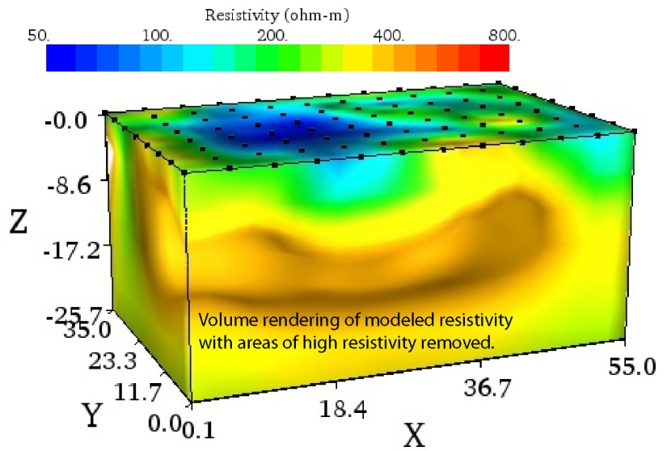
DC Electrical Resistivity Imaging
Measures how strongly geologic media opposes the flow of electric current
Function of soil/rock type, porosity and permeability, fluid composition in pore spaces
2D cross-section
3D block image
Notes:
Electrical resistivity is basically measuring how strongly a given material opposes the flow of electric current. Therefore, when applied to geologic media, electrical resistivity is a function of soil and rock type, porosity and permeability, and the composition of fluids that occupy pore space. Natural variations in subsurface resistivity may be the result of changes in soil moisture content, groundwater specific conductance, depth of soil cover over rock, and thickness of soil and rock layers. Changes in basic soil or rock types, and structural features such as faults, fractures, or voids may also produce significant variations in measured resistivity.
As a result of these variations in the subsurface, an image is produced
2D survey image provides a continuous cross-sectional representation of a geologic media along a linear transect
3D survey image provides an interpretation of geologic media in a defined 3D volume block by combining measurements along and transverse to evenly spaced transects
* Most effective method for detecting and mapping true geometry of karst features!

Slide 5
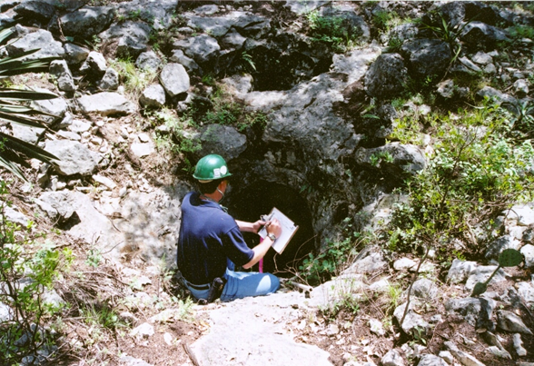
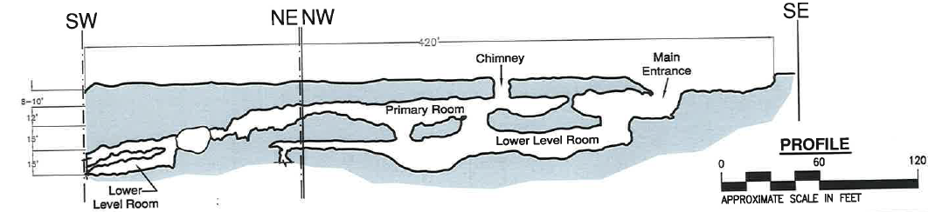
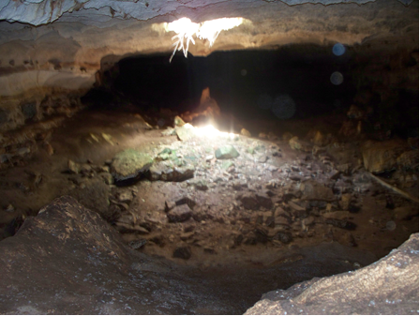
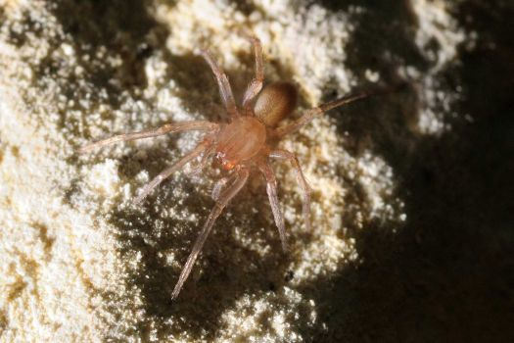
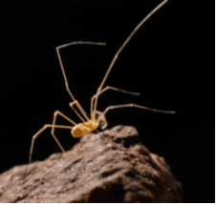
DC Electrical Resistivity Imaging – Karst Applications
The Braken Bat Cave meshweaver
Caused BIG PROBLEMS for SH-151 Interchange at Loop 1604!!
Notes:
DC Electrical Resistivity imaging is effective in evaluating subsurface conditions in areas where karst features are prevalent. It is possible that karst features (e.g., caves, cavities, and sinkholes) with no visible surface expression are present in the shallow subsurface below a site – as many of us that work on land development projects are painfully aware…
Karst features found throughout northern Bexar County at large land development sites. Discovery of karst features can pose significant concern for projects due to construction delays, regulatory coordination costs, and additional engineering time and cost to address features and continue work.
Examples of caves that RK has encountered. Required to define appropriate zones of protection with respect to water quality pursuant to Edwards Aquifer Protection Program (EAPP) rules
Karst is regulated in Bexar County by 2 programs:
EAPP rules
US Fish and Wildlife Service (USFWS) Rules – more pervasive and includes part of west Bexar County because of Austin Chalk
In general, DC Electrical Resistivity Imaging can:
Delineate areas in the subsurface where large air-filled voids or zones of weathering may be present
Distinct electrical signals between voids, clay-filled voids, and limestone rock
Voids are more resistive, clay filled voids are more conductive
Provides for greater site coverage when compared to conventional site characterization techniques such as drilling boreholes or trenching
The remainder of this presentation will discuss benefits associated with the use of surface geophysical surveys in support of environmental/geotechnical engineering evaluations with emphasis on supporting case studies.

Slide 6
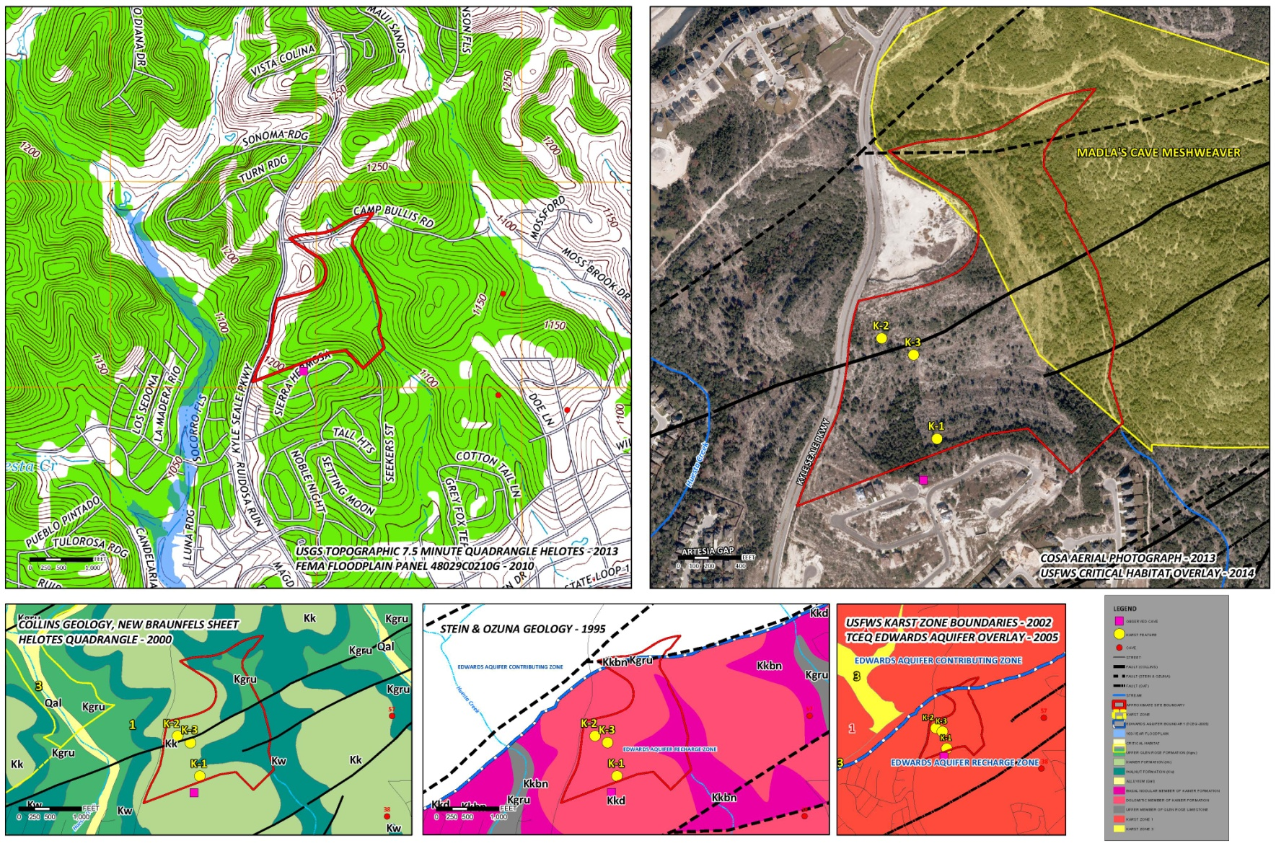
Project Example 1 – Sonoma Verde
Notes:
Sonoma Verde Project
Site comprises approximately 62.9 acres of land located northwest Bexar County
Site under consideration for land development
Geophysical Survey conducted to support the ongoing engineering feasibility study
Topography = hilltop to hillside topography, surface runoff drains to unnamed tributary of Huesta Creek
Subsurface geology of Site and vicinity consists of :
Kainer Formation = consists of the lowermost members of the Edwards Limestone
Walnut Formation = limestone, marl, and dolomitic limestone (designated the basal nodular member of the kainer formation)
Glen Rose Formation = limestone, dolomitic limestone, argillaceous limestone, and marl
Site is located along the southern edge of the Balcones Fault Zone – northeast-southwest trending en echelon normal fault system (upper Cretaceous in the SE with lower cretaceous in the NW)
Entire site is located within the Edwards Aquifer Recharge Zone – any karst features encountered are capable of transmitting recharge.
Additionally, the site is fully located within Karst Zone 1 – which are areas known to contain federally-listed invertebrate karst species.
Karst Features K-1, K-2, K-3 mapped within SITE boundaries

Slide 7
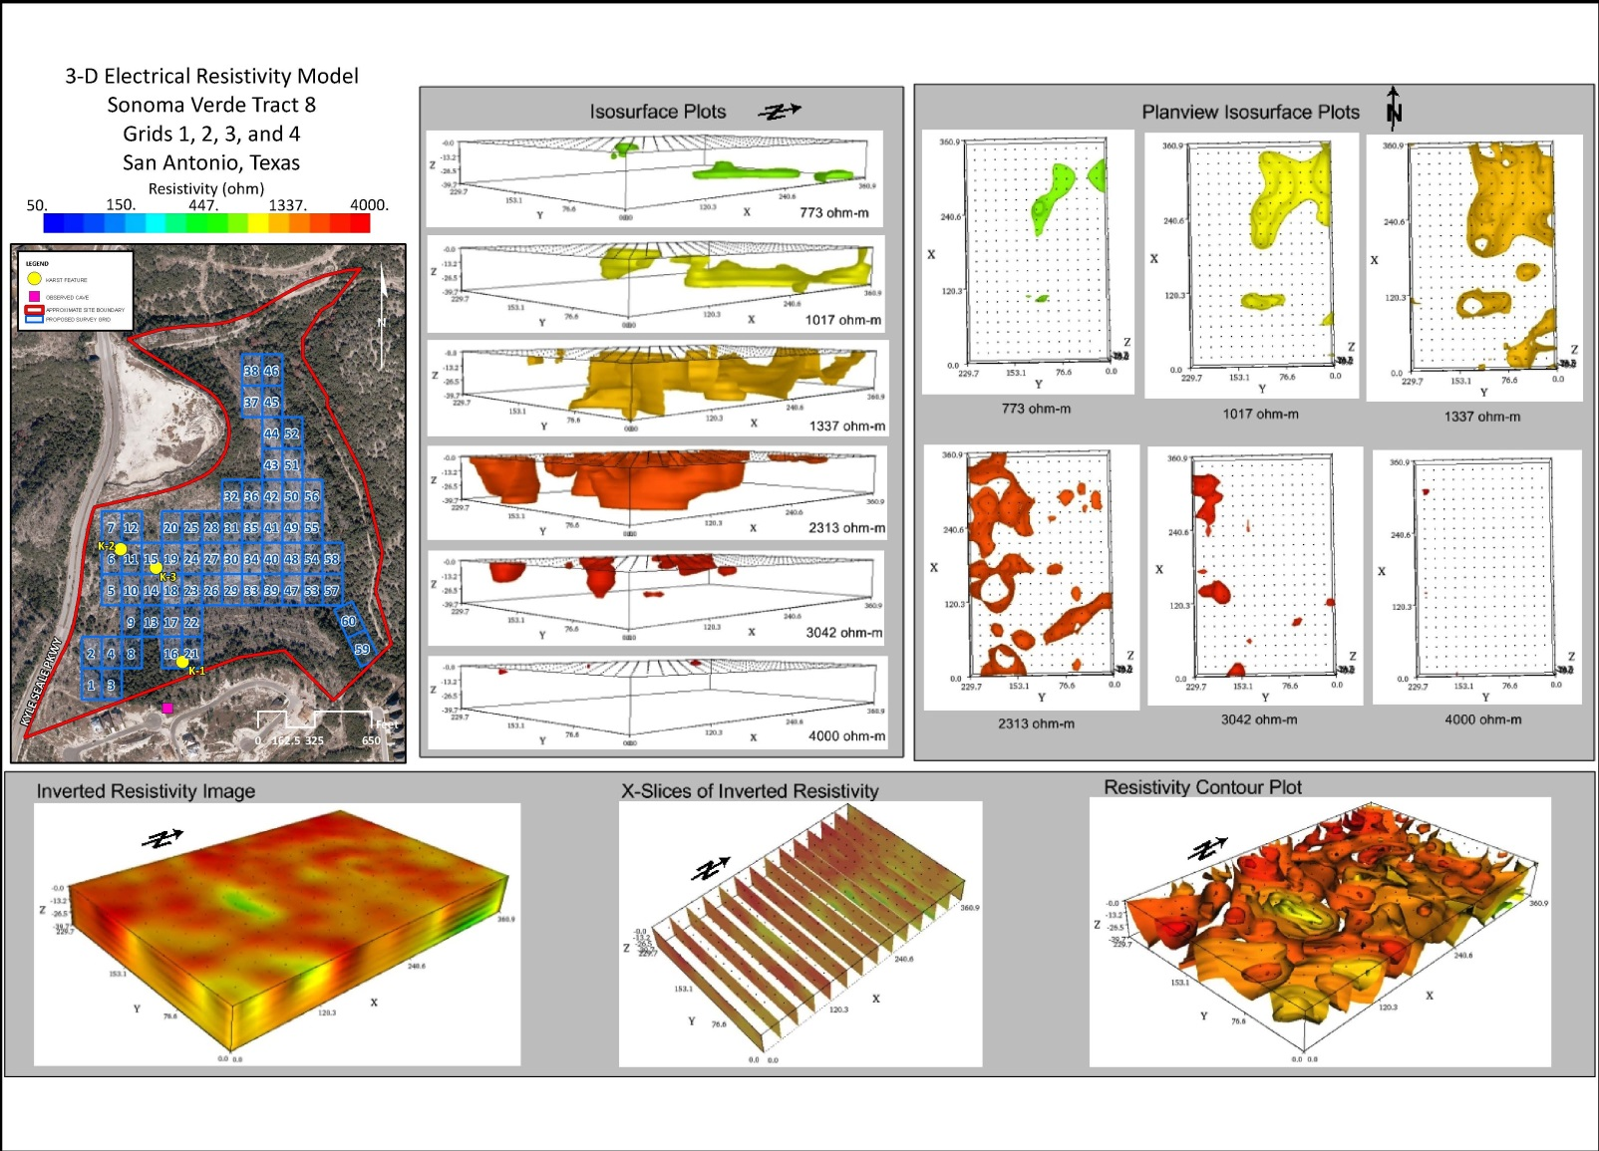
Project Example 1 – Sonoma Verde
Notes:
DC Electrical Resistivity survey was conducted at the site.
Contiguous grid placement of Grid-1 through Grid-60 allowed for combined 3D geophysical survey data reduction and modeling
Within individual survey grids, electrodes were placed along cleared transect lines and spatially distributed to provide an interpretation of subsurface conditions
Electrical properties of geologic media were measured to an approximate depth of 30-40 feet below existing grade – produced 2D profiles and 3D block models
(Above) Example of modeling for Grid-1 through Grid-4
Color coded blocks to depict variations in electrical resistivity
Resistivity values ranged from less than 50 to greater than 4,000 ohm-m = great heterogeneity in geologic media

Slide 8
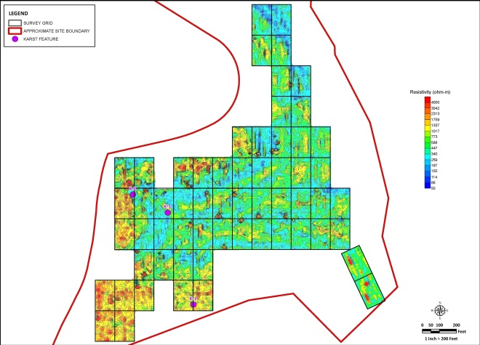
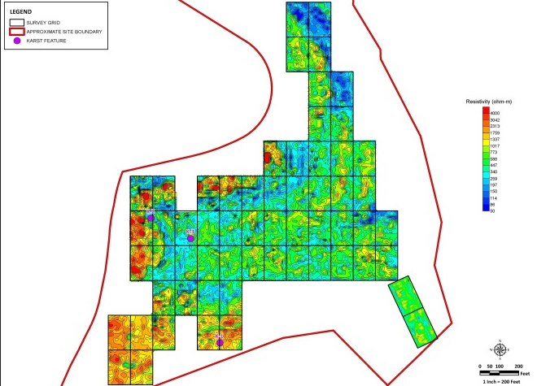
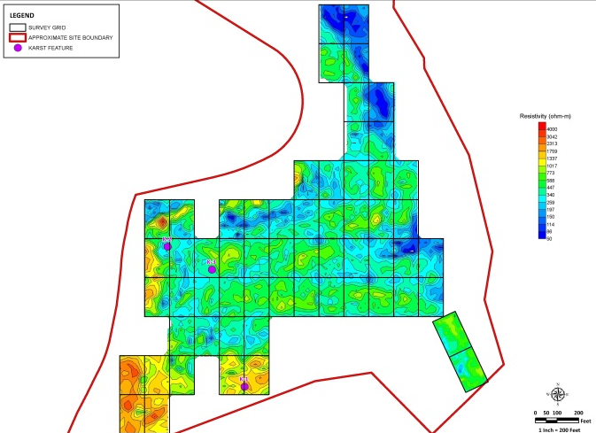
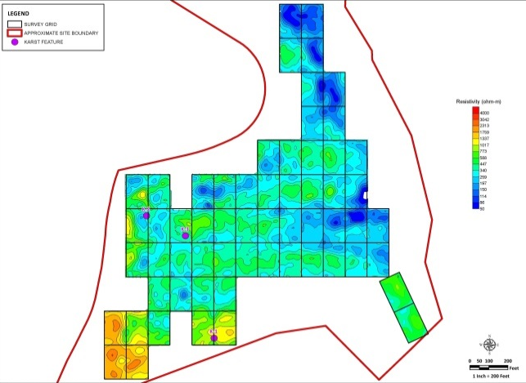
Project Example 1 – Sonoma Verde
4 feet
12 feet
22 feet
34 feet
Notes:
Individual plan-view plots were developed from the composite 3D geophysical model to further evaluate lateral and vertical changes in electrical resistivity throughout the study area, especially locations of the mapped karst features K-1, K-2, and K-3
Pictured are the plan-view depth slices obtained from the 4-foot, 12-foot, 22-foot, and 34-foot depth intervals.
Karst features consisting of large voids or linear lateral/vertically-extensive dissolution features can be expected to generally correlate to high resistivity anomalies exhibiting values greater than 1,700 ohm-m

Slide 9
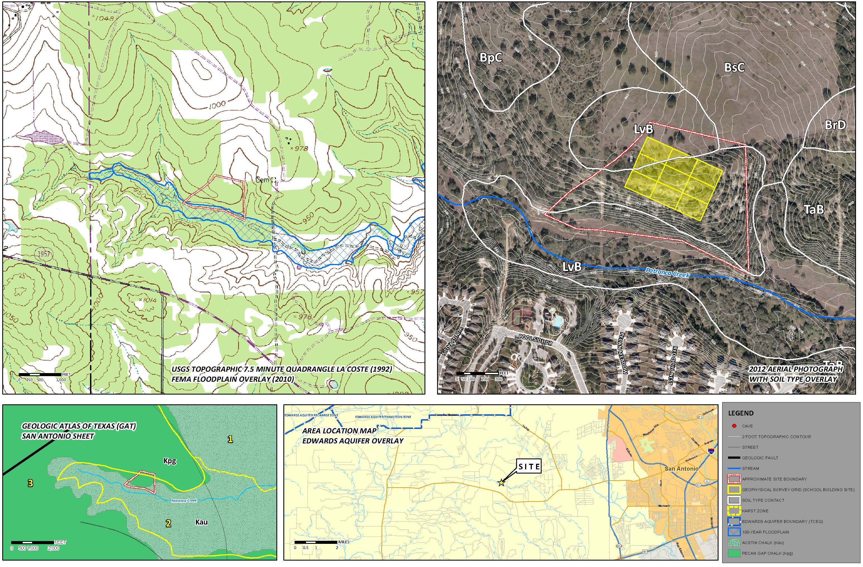
Project Example 2 – Redbird Ranch
Notes:
Redbird Ranch Project
Approximately 18.86 acres of land located in west Bexar County
Site under consideration for land development
Subsurface geology consist of limestone strata exhibiting varying degrees of karst formation, which can negatively impact foundation systems and significantly delay construction, if encountered
Site is generally comprised of hilltop to hilllside topography with drainage occurring primarily to the south/southeast and the northeast
Potranca Creek and an unnamed tributary does not cross the site, however, the southernmost portion of the site lies within the 100-year floodplain
Greatest potential for karst development – likely along the margins of the ridge feature within the low-lying and more steeply sloping southern and eastern portions of the property
Subsurface geology of the SITE consists of Cretaceous-age Pecan Gap Marl and/or Austin Chalk.
Pecan Gap Marl: calcareous shale and marl with some interbedded bentonitic or clayey zones – NOT typically prone to signficant karst development
Austin Chalk: chalk, marl, and limestone – Prone to varying degrees of karst development, particularly in areas adjacent to fault zones or along natural drainage features. Austin Chalk has been reported to have some of the most diverse caves in Texas.
A total of 3 large karst features, consisting of 2 caves and 1 vertical solution cavity) were identified within site boundaries
The surface expression of karst features in addition to the site specific topography and geology indicate the possibility of additional karst features the within the planned development footprint of the site.
Ground geophysical survey was recommended to evaluate for indications of large voids in the subsurface below planned construction area

Slide 10
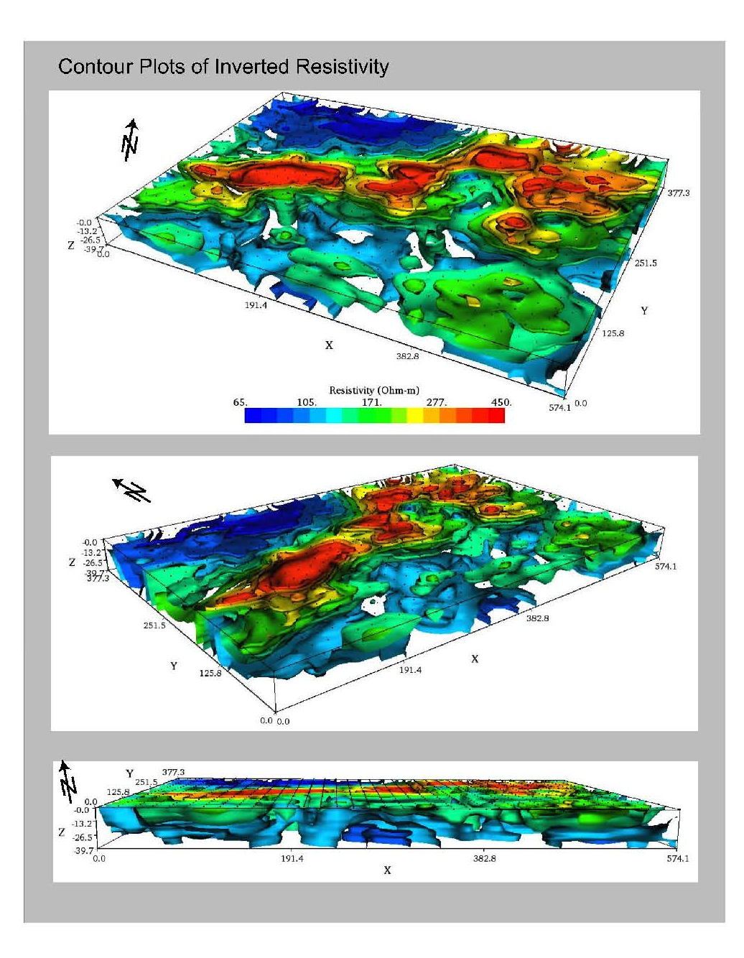
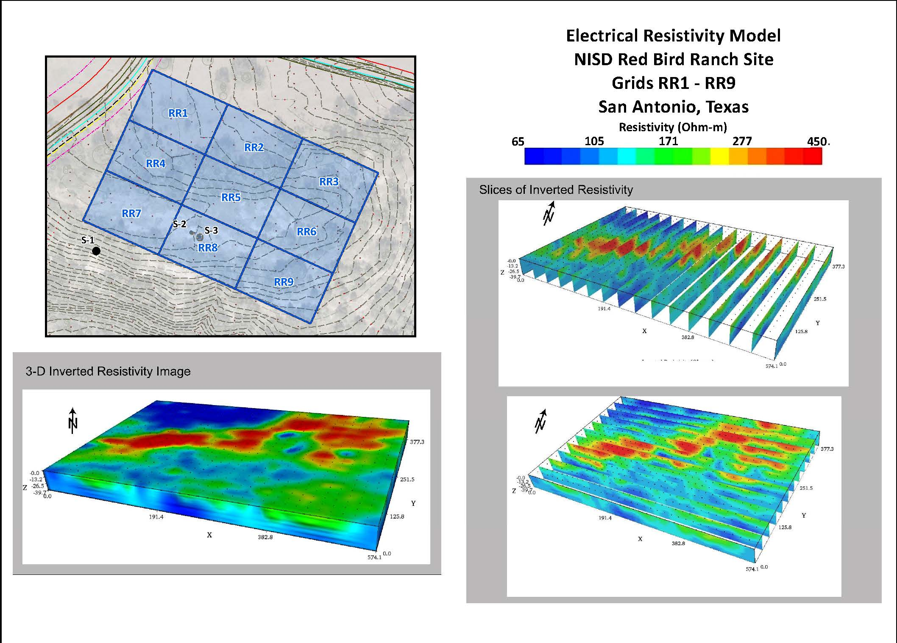
Project Example 2 – Redbird Ranch
Notes:
Grids RR-1 through RR-9, each measuring 55 meters by 35 meters were surveyed
Continuous geophysical data was collected along interconnected closely-spaced parallel survey lines (or grid boxes) placed within construction footprint.
contiguous grid placement allowed from combined geophysical survey data reduction and modeling
Measured electrical resistivity values in the shallow subsurface at the Site range from less than 65 to over 450 ohm-meters
very low resistivity values (less than 100 ohm-m) are interpreted to represent clay and clay-rich marl strata present within the northwest corner of the study area (dark blue) – uppermost weathered bedding unit of the Pecan Gap marl
low to intermediate resistivity (100 to 245 ohm-m) are interpreted to represent two distinct bedding units within the Austin Chalk as follows (light blue and green colors):
an upper weathered, hard, clayey marl and marly clay bedding unit
a lower weakly-cemented hard but clay-rich limestone bedding unit
high resistivity values (245 to 450 ohm-m) are interpreted to represent the relatively hard competent limestone bedding unit within the Austin Chalk that forms the prominent topographic ridge feature at the site (yellow, orange, and red colors)
laterally continuous zone of high resistivity (yellow to red) trending from the west central to the northeast portion of the site.
2-D profiles (left)
3-D block models (right)

Slide 11
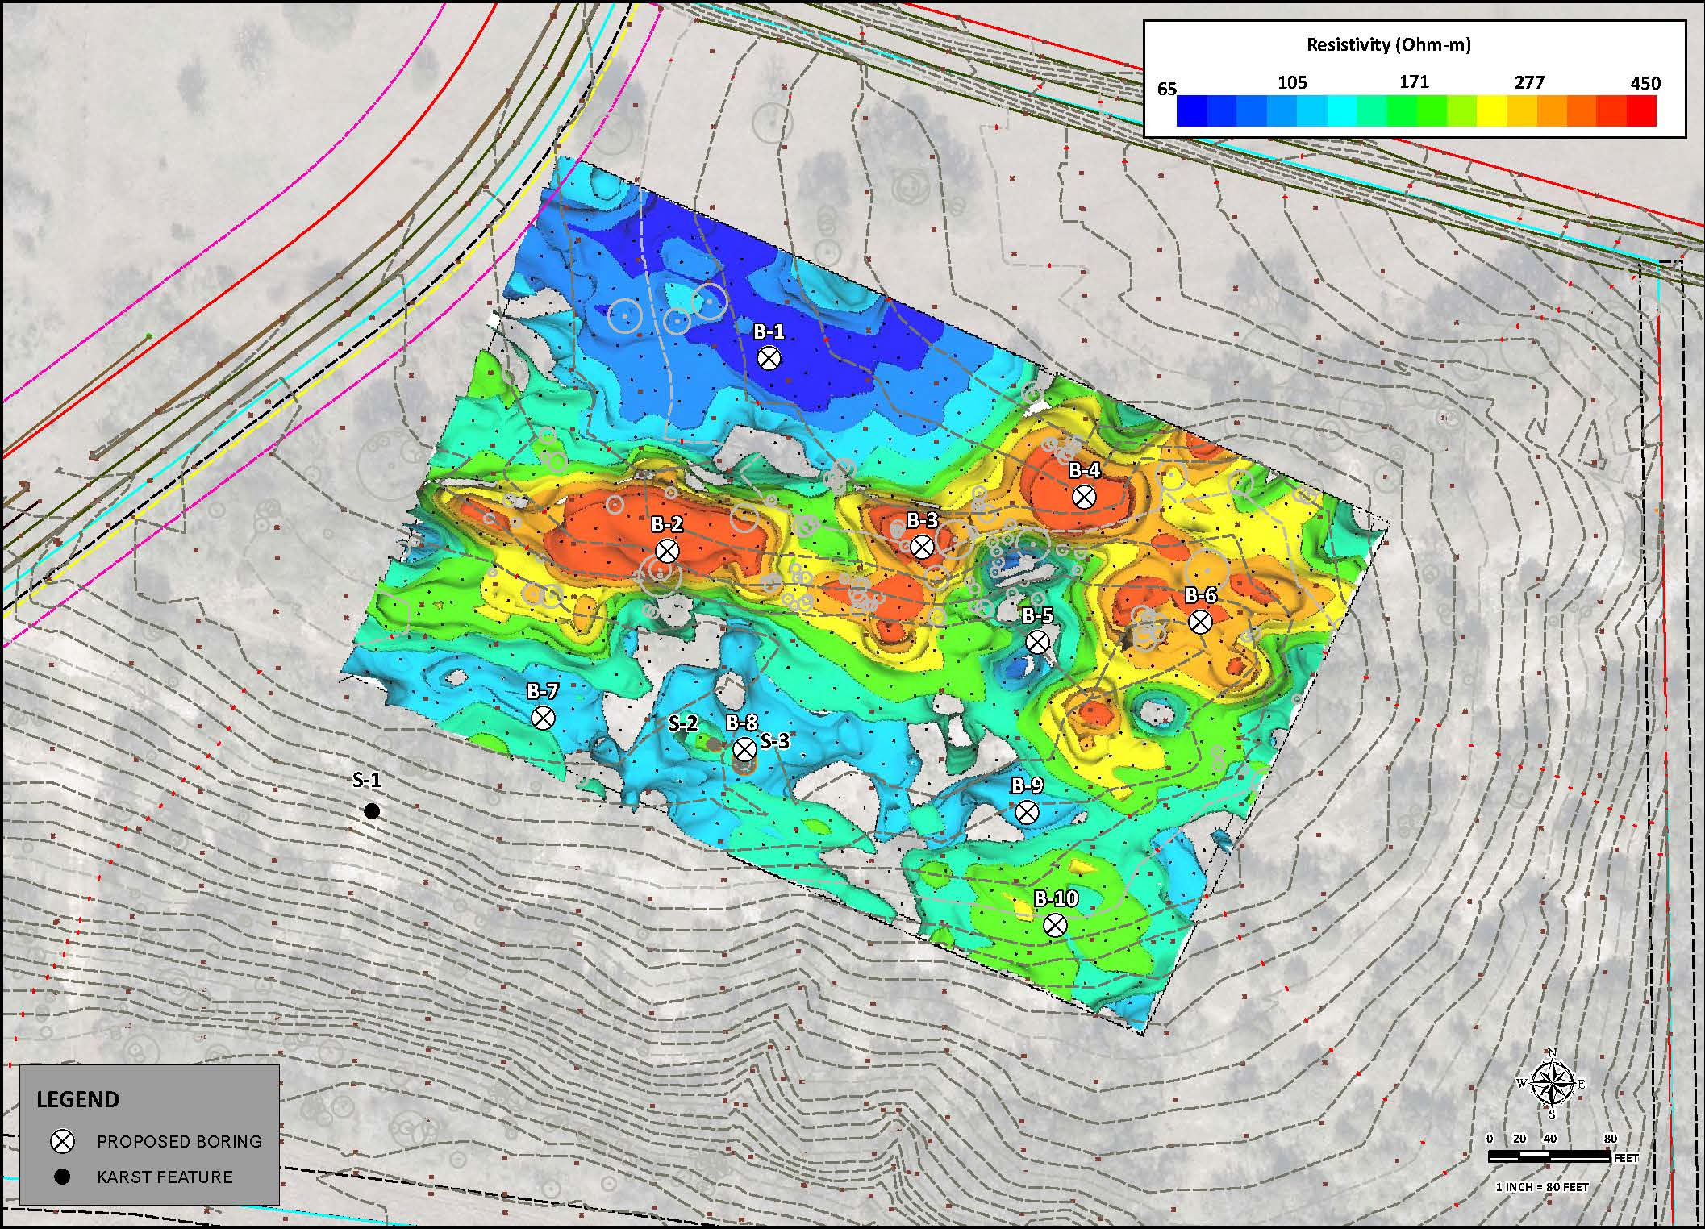
Project Example 2 – Redbird Ranch
Notes:
3-D Composite Plan View
Areas prone to karst development may be associated with areas of intermediate resistivity (light blue and green)
close proximity to karst features S-2 and S-3

Slide 12
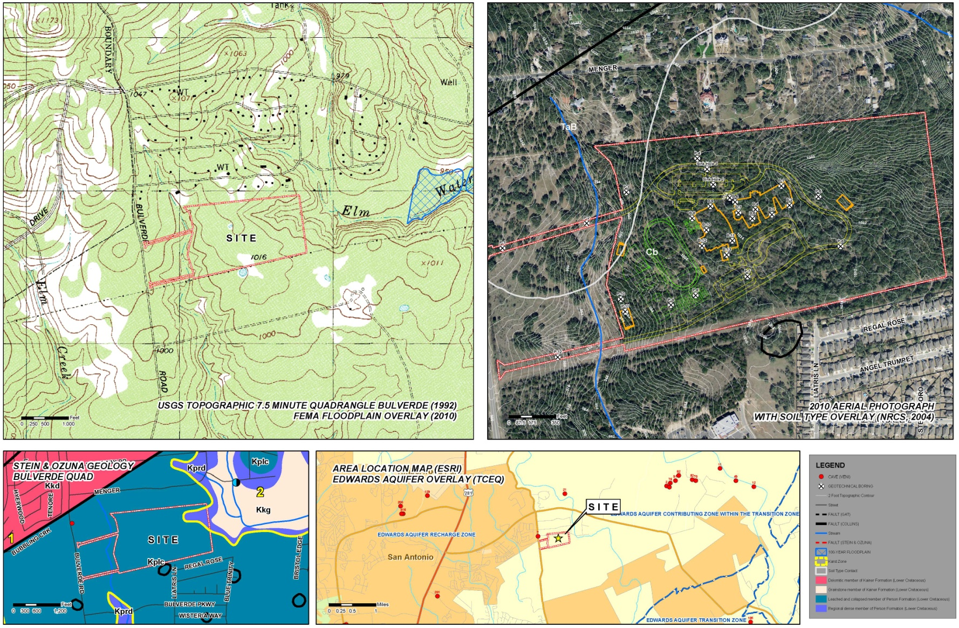
Project Example 3 – Bulverde Road
Notes:
Bulverde Road Middle School Project
SITE located in northern Bexar County, Texas
Site located fully within the Edwards Aquifer Recharge Zone
Subsurface geology of the SITE and vicinity consists of the Leached and Collapsed Member of the Edwards Limestone (map unit Keplc), which is comprised of leached and recrystallized limestone which include vuggy and honeycombed limestone bedding units
Keplc is described in literature as having open fractures and cavernous zones and is considered the most porous and permeable member of the Edwards limestone = high potential for karst development
Caves and sinkholes have been mapped in close proximity to the Site
Geophysical survey conducted over a rectangular area centered over the location of the cave feature encountered during previous geotechnical study efforts

Slide 13
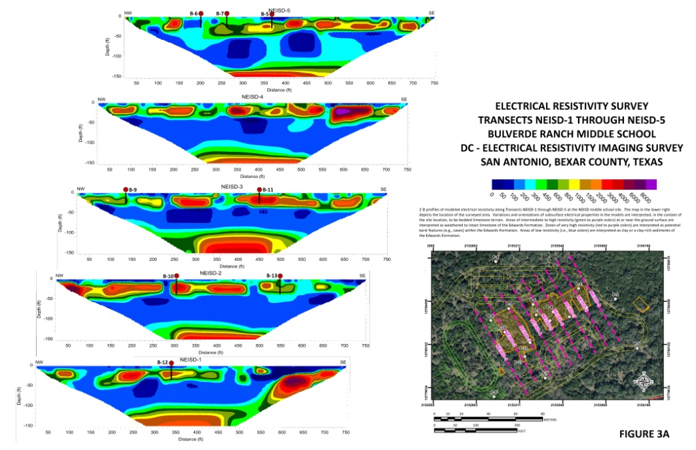
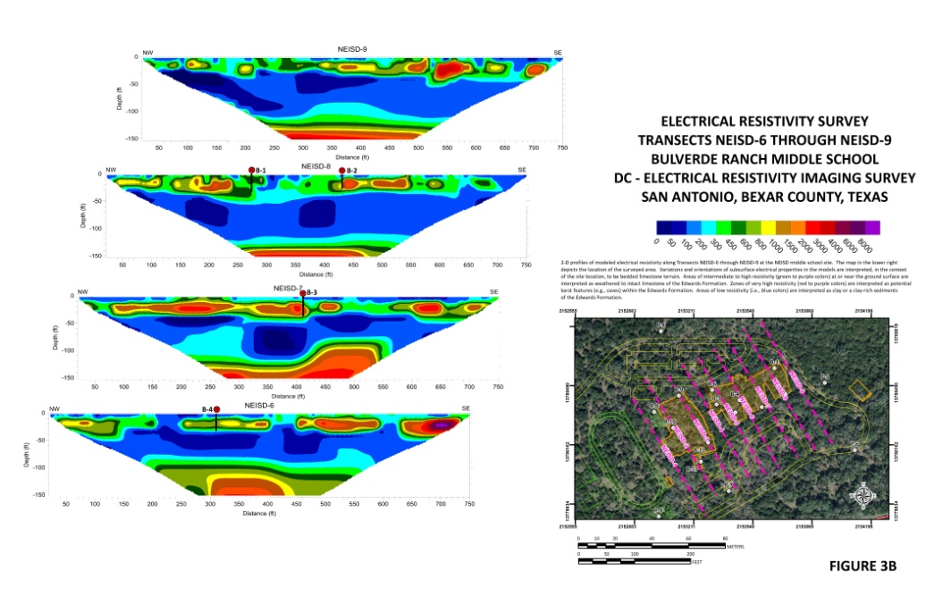
Project Example 3 – Bulverde Road
Notes:
Continuous measurements at a 5-meter electrode spacing were collected along parallel transect lines using a Syscal Pro electrical resistivity system and corresponding multi-electrode array
Measured to approximate depths of 80 to 100 feet
Screening results for individual transect lines are illustrated in 2-D vertical profiles (above)
Electrical resistivity values range from less than 50 to over 8,000 ohm-meters
very low to low resistivity (less than 300 ohm-meters) = interpreted associated with clay surface soils or clay-filled karst openings/voids or pervasive fracture zones containing increased moisture conditions
low to intermediate resistivity (300 to 1,000 ohm-m) = interpreted associated with fractured, vuggy, but otherwise intact limestone within areas typically devoid of significant karst features
high resistivity (greater than 1,000 ohm-m) = interpreted to be associated with air-filled voids (caves, solution cavities, enlarged fractures), areas of signficant weathering or limestone dissolution, or intact limestone possessing lithologic properties that favor high electrical resistivity (fractured, dry, porous, crystalline limestone)
low resistivity values associated with thin clay surface soils or enhanced moisture conditions observed within the upper limestone surface along all survey transects
discontinuous zones of high resistivity (orange to purple) at or near the ground surface encased in zones of intermediate resistivity (green to yellow) are interpreted as resistant to weathered limestone of the Leached and Collapsed Member. Isolated very high resistivity zones (red to purple) within this interval are interpreted as potential karst features and/or zones of enhanced limestone dissolution and weathering
underlying continuous zone of very low resistivity (blue) starting at depths of 30 feet is interpreted as the shaley (clayey) Regional Dense Member; laterally continous high resistivity zone beneath the Regional Dense Member is interpreted as the uppermost portion of the Grainstone Member.
Areas of high to very high resistivity are considered to represent the greatest potential for signficant karst development - likely associated with dissolution along vertical fractures and/or bedding surfaces

Slide 14
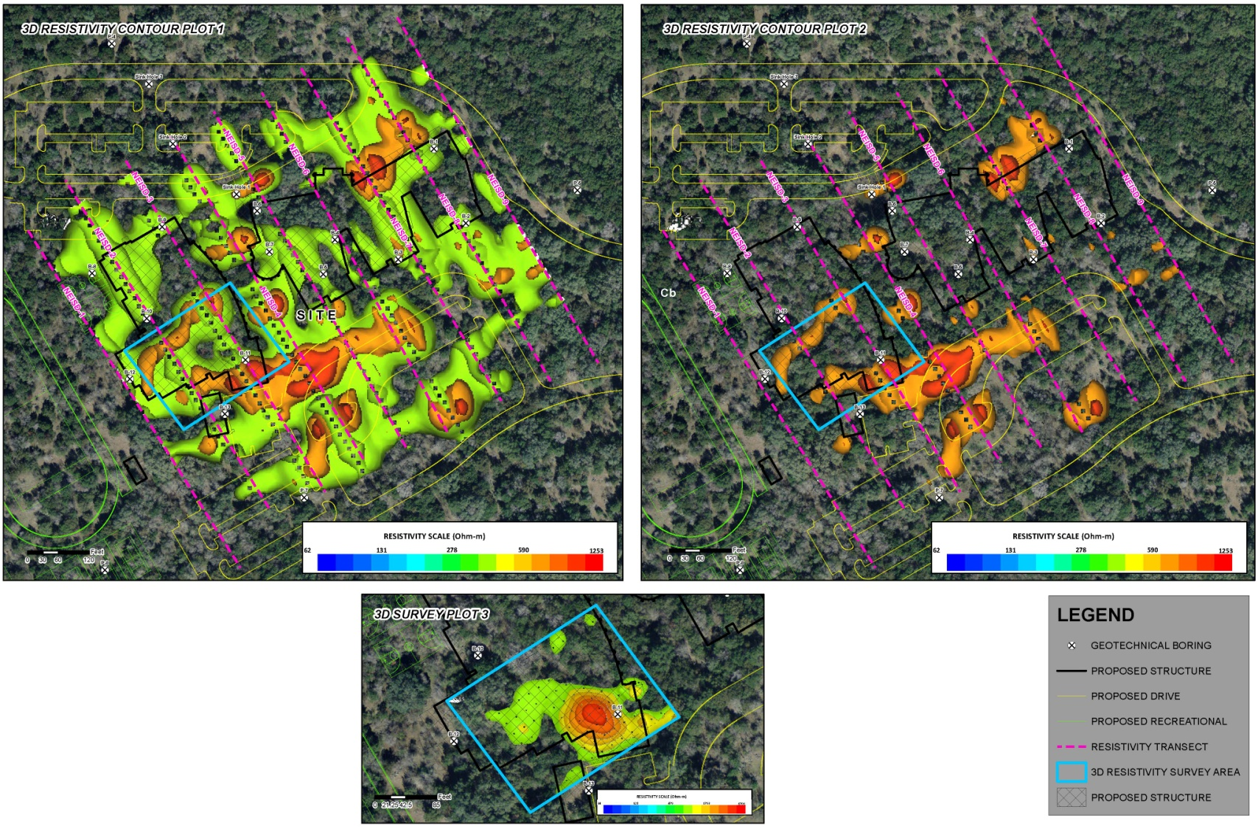
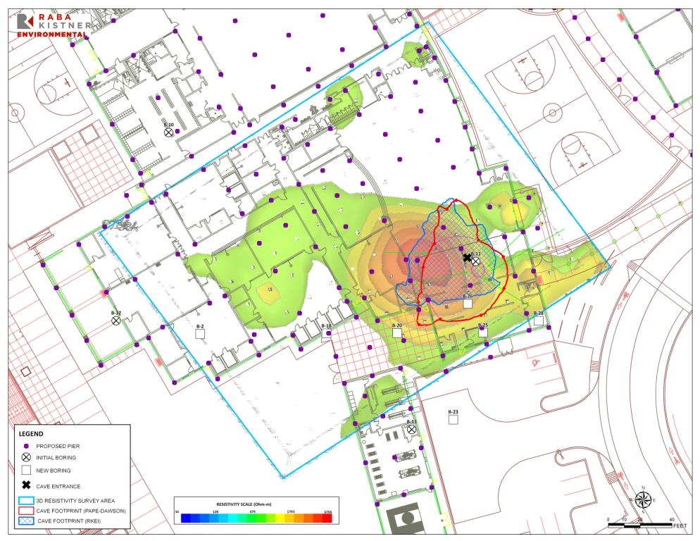
Project Example 3 – Bulverde Road
Notes:
3-D Survey Plot
Detailed survey data collected at the Site indicates a prominent zone of high resistivity in the southeast quadrant of the grid at a depth of 10 to 40 feet below ground surface.
location is consistent with the location of the cave feature encountered during the previous geotechnical study
intermediate resistivity zones surrounding the high resistivity zone trend to the east, suggesting additional karst features may occur east of the grid

Slide 15
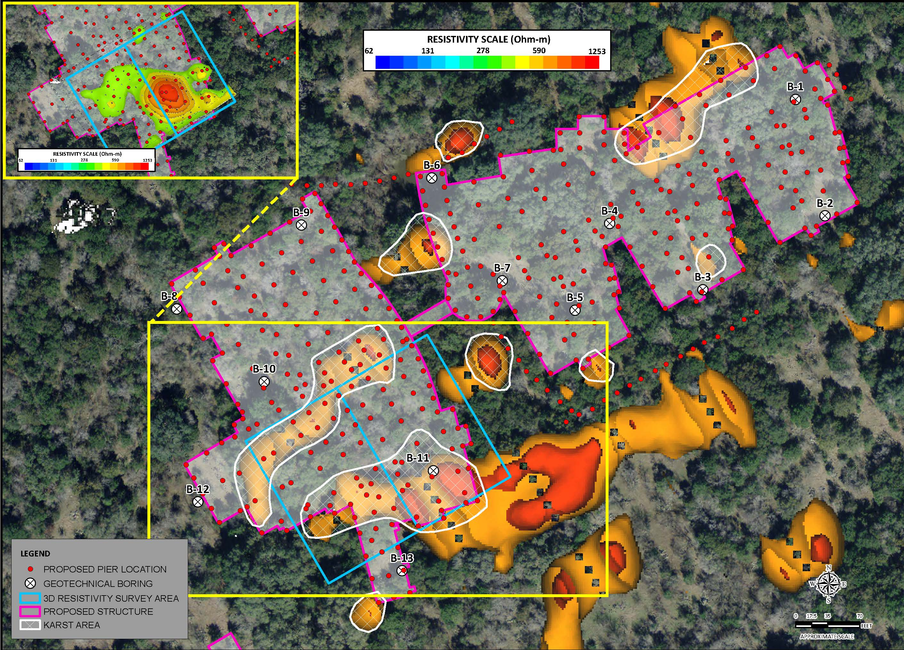
Project Example 3 – Bulverde Road
Notes:
3-D Survey Location Map
9 discrete areas of inferred significant weathering or karst development within the project footprint are identified (hatched areas)
Exploratory borings are recommended to evaluate geophysical survey results
Options –
Exploratory drilling
Contractor allowance for potential to encounter karst in select pier holes

Slide 16
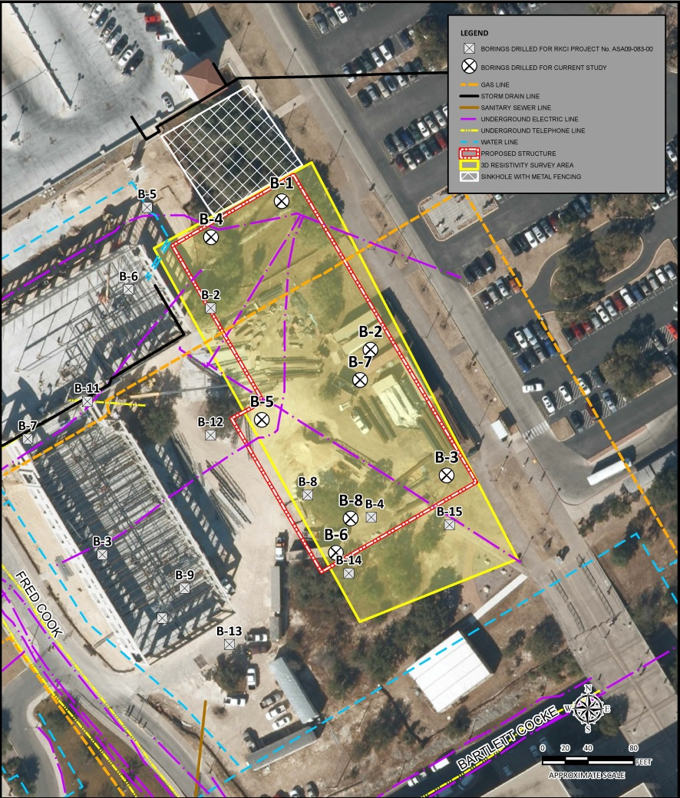
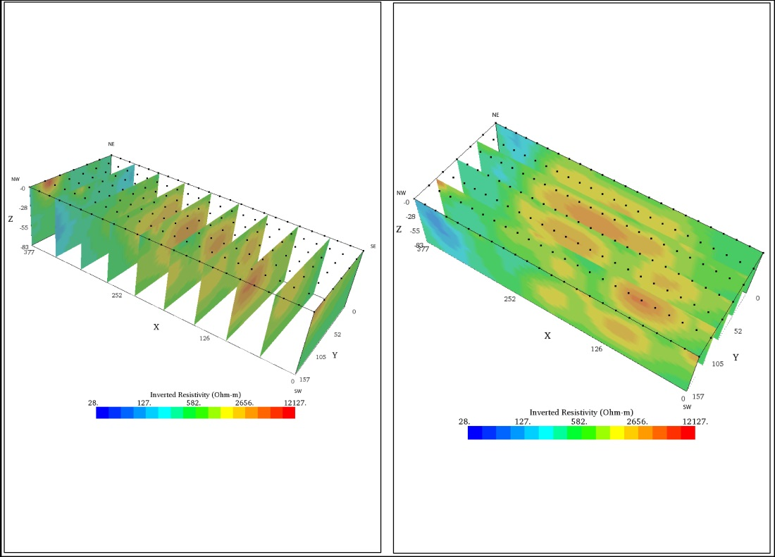
Project Example 4 – UTSA Multifunction Building
Notes:
UTSA Project
Site is located fully within the Edwards Aquifer Recharge Zone in an area prone to karst development
Subsurface geology of the Site is the Person Formation, the uppermost portion of the Edwards Limestone
one sinkhole exposed at the surface located adjacent north of the proposed construction area
Continuous geophysical data was collected along interconnected closely-spaced parallel survey lines survey lines (grid boxes) placed within proposed construction site.
(Right picture) Survey results were interpreted and initially developed as a series of 2D profiles depicting spatial variations in subsurface resistivity
Electrical resistivity for the Site ranged from less than 127 to over 5,686 ohm-m

Slide 17
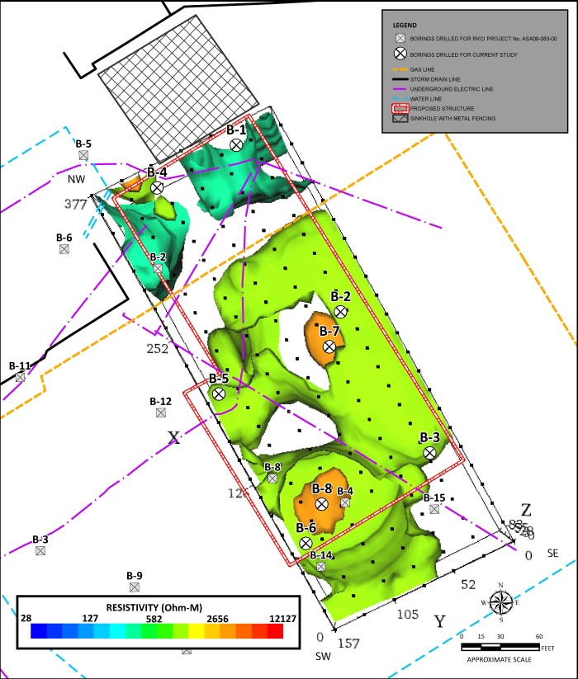
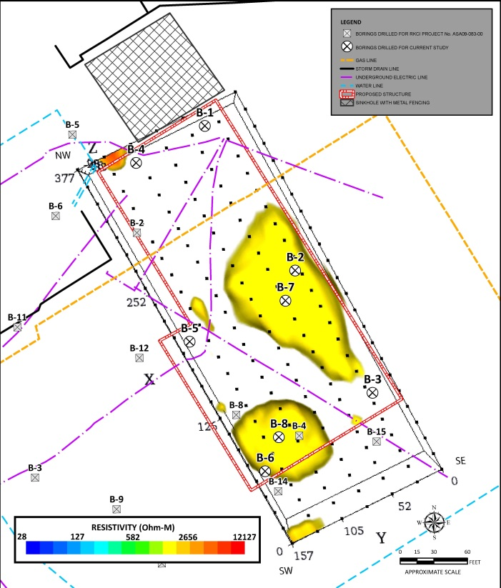
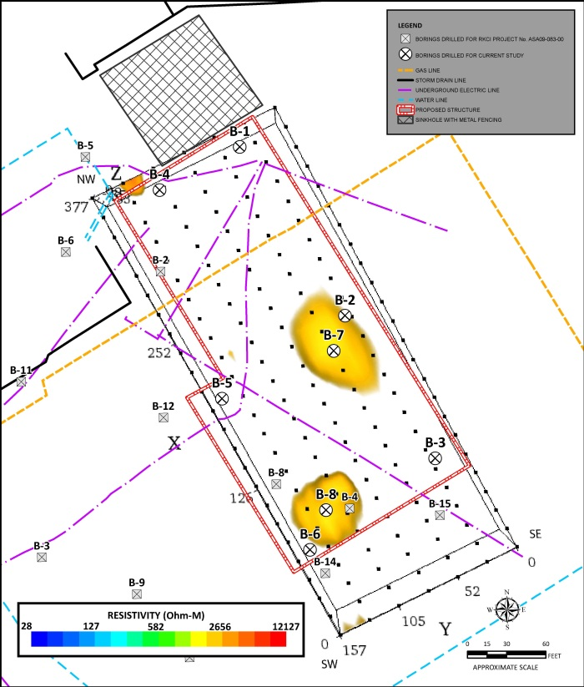
Project Example 4 – UTSA Multifunction Building
3D Electrical Resistivity Plan View
3D Electrical Resistivity Map
> 2,656 ohm-m
3D Electrical Resistivity Map
> 3,882 ohm-m
Notes:
Left picture: plan view composite image of all resistivity data collected within the geophysical survey area
Middle picture: discrete high resistivity areas and primary area of concern
Right picture: discrete high resistivity areas and primary area of concern
Very low to intermediate resistivity less than 400 to 600 ohm-m (blue to dark green) = interpreted to be associated with clayey or argillaceous limestone strata exhibiting relatively minor fracture development and/or karst dissolution
High resistivity greater than 600 to 4,000 ohm-m (yellow to red) = interpreted to be associated with either dense crystalline limestone or zones of significant weathering, enhanced dissolution that may include air-filled voids
Possible that karst features exist within the overall development site, but it is not considered likely that significant features are present within the shallow subsurface based on drilling data obtained at discrete high-resistivity locations considered most likely to exhibit significant karst development.

Slide 18
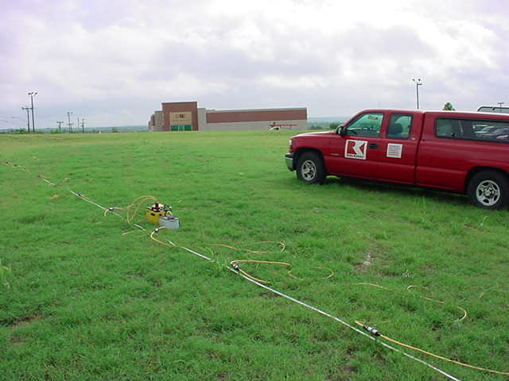
Geophysical Survey Benefits
Continuous vs. Discrete Data Collection
Non-Invasive Survey Methods
Rapid Data Collection
Enhances Geotechnical Engineering Studies
Reduced Uncertainties = Reduced Risk
Reduces Change Orders
Reduces Overall Project Costs
** Limestone terrain prone to karst development can have a significant impact on land development
Notes:
Development of geophysical capabilities has given R-K the ability to apply new and innovative solutions to existing geosciences/engineering problems. Geophysical investigations can effectively, expediently, and economically provide valuable insight into a broad class of geological investigations.

Slide 19

Questions?
CONTACT INFO
RICHARD V. KLAR, P.G.
VICE PRESIDENT
12821 W. Golden Lane
San Antonio, TX 78249
P 210 :: 699 :: 9090
F 210 :: 699 :: 6426
rklar@rkci.com
Raba Kistner Purpose: To provide professional consulting services with passion and integrity, to help build a better world for our employees, their families, our clients, and the communities we serve.

