Slide 1

Using Videography, 3D photorealistic models and an Inexpensive Drone to Help Improve Geoscience Research and Education at the University of Texas at Dallas
Ning Wang and Robert J Stern
UTD Geoscience Studio

Slide 2


Brief Intro of UTD Geoscience Studio
The University of Texas at Dallas, Geoscience Department.
Now we have 3 regular members (filming and editing, animation and director) and 6 students who are under training to produce their own videos based on their research.
We explore how to produce research-based/class-based geoscientific videos and study the best way for researchers to produce this kind of videos.

Slide 3
Videos?
‘Reading a paper and watching a video
activate separate cognitive functions.’
(cited from Video vs Text: The Brain Perspective, Liraz Margalit)
We have peer-reviewed articles, why don’t we have peer-reviewed videos?
Notes:
Passive (unintentional visitors) versus Active (Goal Orientation).

Slide 4
Do we need good scientific videos?
Researchers give talks, show posters, publish papers to show their research, to communicate with others.
Video-making is harder than writing, takes more time.
Copyright Issue.
Nobody is expecting researchers show their works in the form of videos
And people may not believe these videos.
Isn’t peer-reviewed journals enough?
Would good scientific videos worth the time and energy of researchers?

Slide 5
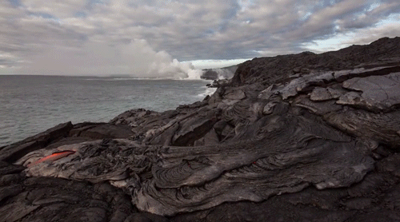
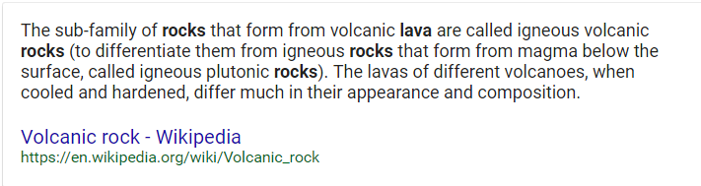
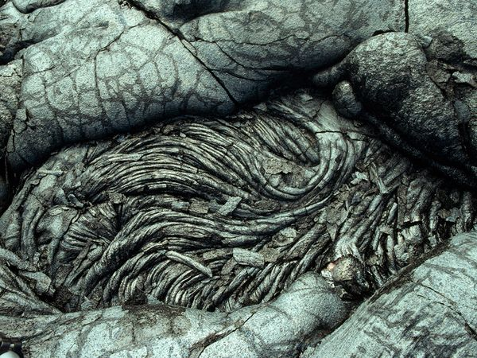
Videos are processed by the brain 60,000 times faster than text!
How Lava Rocks formed?
From http://www.deccanchronicle.com/gallery/world/190816/lava-meets-the-sea-puts-on-fire-spitting-show-in-hawaii.html

Slide 6
Benefit of GOOD Videos
Saving learning time. Videos are processed by the brain 60,000 times faster than text!
Easier understanding. Students and other researchers
3. Less Language Barrier. Internationals, especially less developed area
4. More Entertaining. Public, improve understanding of our world

Slide 7
Major Problem of Scientific Videos
Not good enough (we haven’t take serious about videos as much as research papers in science. Videos need to define uncertainty and to be more accurate)
Not so many (Most scientists and researchers don’t know how to make videos, and most film producers don’t do scientific research)
So can researchers make good videos? What will a good scientific video cost a researcher?

Slide 8
What you need to make a good video?
A story. (And any valuable research could be a good story)
Learn some basic knowledge of drones, cameras, software, video-making concepts and procedures.

Slide 9



Researchers are Storytellers
Videos are all about stories. (Cause and Effect Circle gives the dynamic of a film)
Jerry supports to be afraid of Tom BECAUSE Jerry is a mouse and Tom is a cat.
BUT Tom would never win Jerry BECAUSE Jerry is more clever than Tom.
BUT Tom won’t give up chasing Jerry BECAUSE Jerry makes fun of him all the time…….
Research papers are all about stories too. (Challenge and Solution Circle / Problems and Hypotheses Circle gives the dynamic of research)

Slide 10
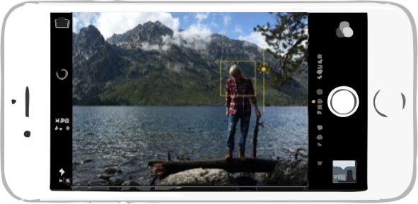
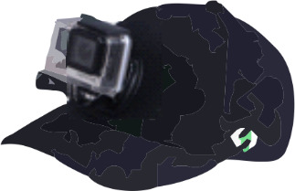
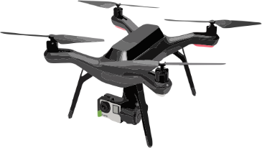
Technology development makes possibilities
Good cameras are everywhere (Phone Cameras). Smartphone cameras can do really decent video work now. Sports camera such as GoPro gives flexibility for amateurs.
Drones are relatively cheap, smart and reliable. (any drone more than $800)
Media Software for basic animation and film editing is user-friendly and easy-to-use now.
Notes:
User friendly

Slide 11
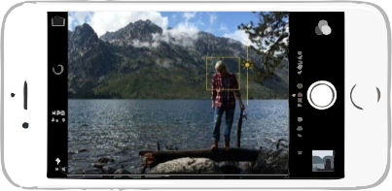
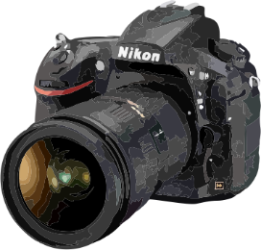
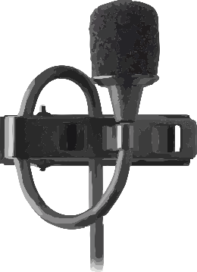
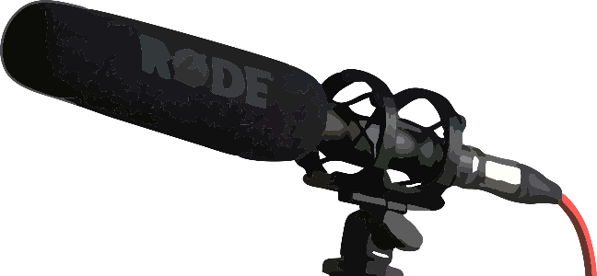



What we have used
DJI Solo Drone (now less than $800) with GoPro ($400).
Camera (Smartphones, Digital Single Lens Reflex)
Microphones (lavalier and shotgun) [voice quality is very important for a video]
Accessories (Tripods, Monopods, Lighting equipment, and so on)
Software (Adobe Photoshop, Premiere Pro, After Effects, Audition, Movie Maker, Davinci Resolve)
You can get started for $2,500, less if you already have some equipment

Slide 12

A recent work
https://www.youtube.com/watch?v=elr-AmaY_Dg&t=4s
It took us 3 months, about 150 hrs.
Dr. William Griffin’s Field Stratigraphy Class (junior level majors course)
Notes:
7mins

Slide 13

https://utdgss2016.wixsite.com/utdgss
Thank you 谢谢

