Slide 1



Reproducible Groundwater Science Workflows for the Future: A case for Texas Groundwater Availability Models
Nalbeat “Sonny” Kwon, M.S.
The University of Texas at Austin
GSA South-Central Meeting 2017
March 13th, 2017

Slide 2
Data and Models
The best tools we have to understand our critical Earth resources
However, information contained within data and models is often misunderstood or misinterpreted by people who need to use it to make group decisions.

Slide 3
Environmental Decision Support
Decision Support Systems (DSS) use the best available science to aid users in making informed choices.
DSS can be a major bridge between science and policy.

Slide 4
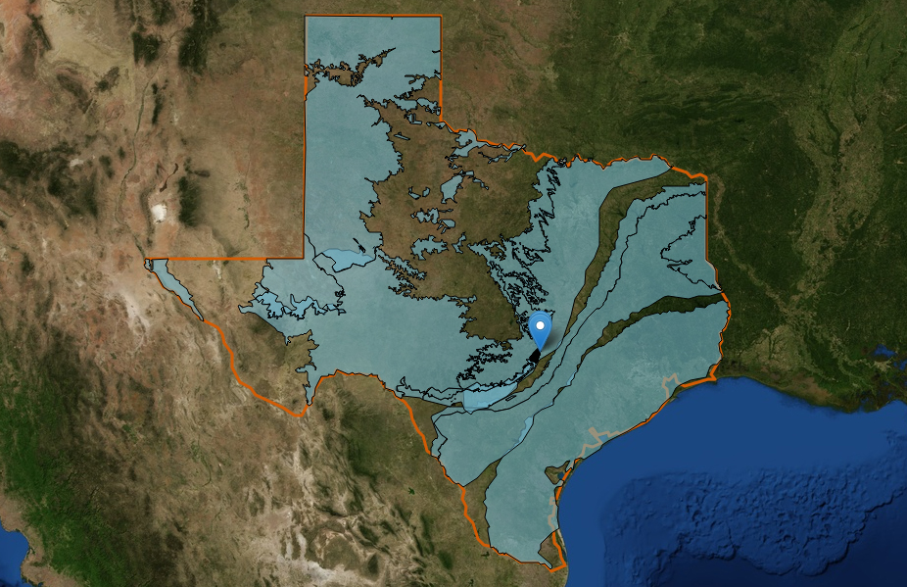
Texas Groundwater Availability Models (GAMs)
Unique policy setting
  Establishes science-vetted groundwater models
  Engages stakeholders and planners to develop Desired Future Conditions (DFCs)
  Requires use of models in DFC planning
    Mandated by the Texas Legislature and approved by TWDB
    Numerical simulation code used is MODFLOW (USGS)

Slide 5
Challenges to Creating DSS
Must be capable of fast and powerful computations
Need to integrate various knowledge realms
Need to be flexible and easy to use
Very few off-the-shelf tools to design DSS

Slide 6
Toward Reproducible Science
Reproducibility, a cornerstone of science
Difficult to uphold in computer-assisted research
Hindering reproducibility:
  Lack of backward compatibility
  Undocumented workflows
  Data with no provenance (origin and processing history)
  Restricted access to needed data/software
Reproducibility of science can only be achieved after reusability of the tools has been established.

Slide 7
(Unintentional) Abandonment of Research Software
Multiple reasons:
  Paper makes it to publication
  Researcher Retires
  Graduate student finishes defense
  Funding is cut
Hinders widespread reusability and causes significant effort to be lost

Slide 8
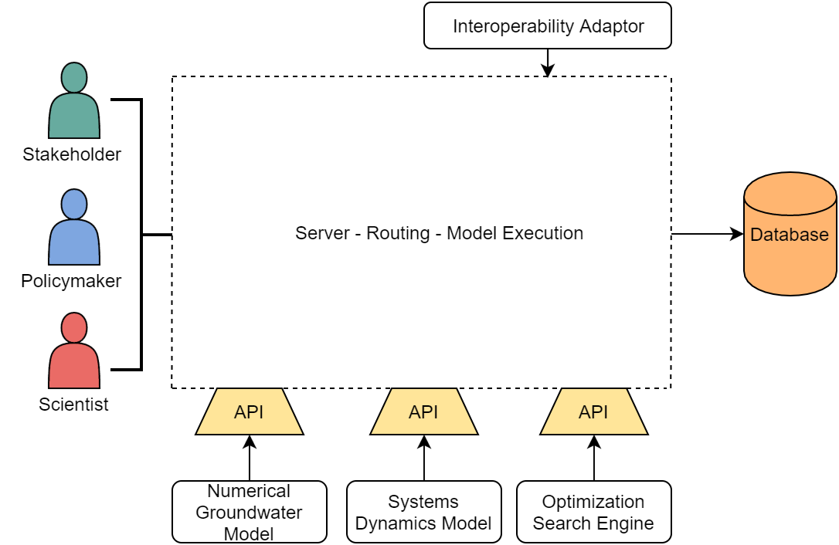
Case Study: GWDSS
  Developed for participatory decision making
  Barton Springs segment of the Edwards Aquifer as alpha test case (well studied with abundant historical data)
  Architecture: MODFLOW-96 + optimization + systems dynamics + database + visualization + GUI
Groundwater Decision Support System (Pierce, 2006)
Detailed model for research purposes; simpler model for real-time negotiation settings

Slide 9

Resurrection History of GWDSS
Active work paused couple of years after development.
When revisited in 2014, ran into problem of outdated and unsupported dependencies
In 2015, an attempt to replicate old development settings within a virtual machine (VM)
  Could freeze a working state of the software
  Unsuccessful for a number of reasons

Slide 10
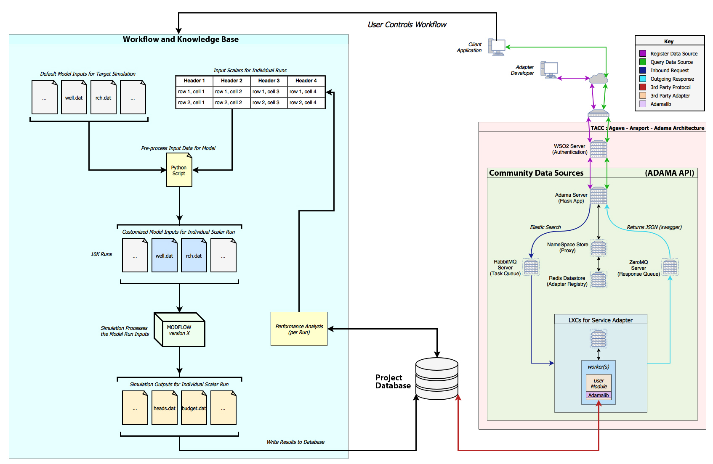
New Approach to Create GWDSS-Descendent
New architecture aims to replicate and improve original features
Leverages High Performa-nce Computing (HPC) and modern web-based technologies

Slide 11
The Need for High Performance Computing
Brute force approach not only feasible but scalable to larger and more complex simulations
Job name | Quantity generated | CPU time per file | Total CPU time | Total file size
Input generation | 9,382 files | 3 minutes | 470 hours | 120 gigabytes
Input assembly | 37,528 files | 50 milliseconds | 30 minutes | 1.36 terabytes
Output execution | 150,112 files | 0.3 seconds | 13 hours | 4.12 terabytes
*stats extrapolated using a 2015 MacBook Pro Retina laptop

Slide 12
GAM Version Compatibility
Vital for adaptable research
Currently most are outdated
USGS conversion utilities?
  MF96toMF2K
  MF2KtoMF05UC

Slide 13
Best Practices to Preserve Software Reusability: Or, Lessons Learned (the Hard Way)
Backed up on non-local persistent storage
Openly accessible in a public repository under version control
Curation and documentation

Slide 14
Questions?

