Slide 1
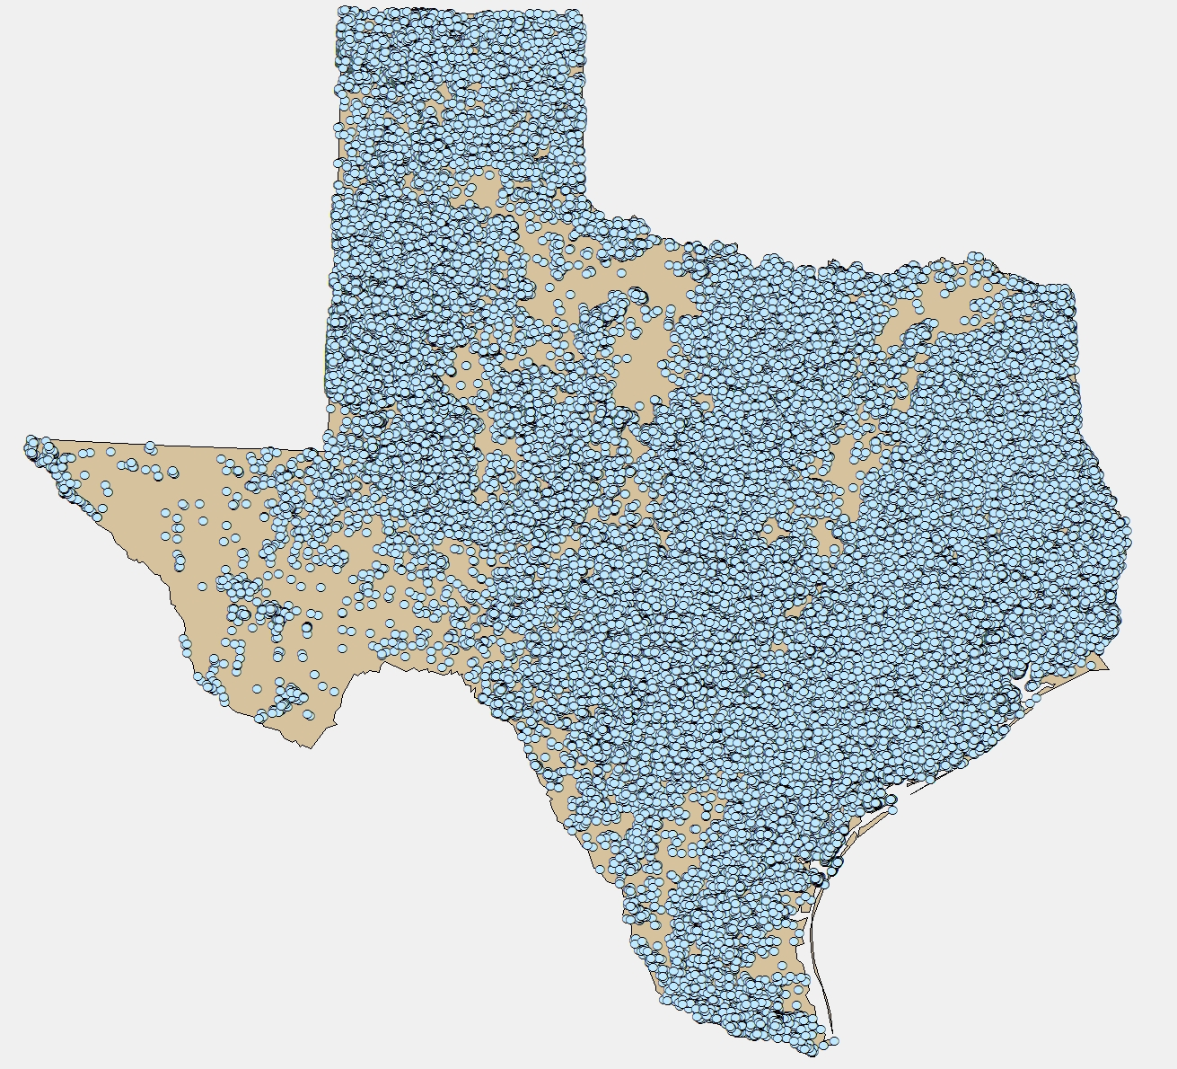

Statewide Water Well Drilling Trends
Robin Gary, BSEACD

Slide 2
Submitted Well Drillers Reports
Online submission since 2003
Texas Water Development Board curates data
Provides general location, proposed use and date installed

Slide 3
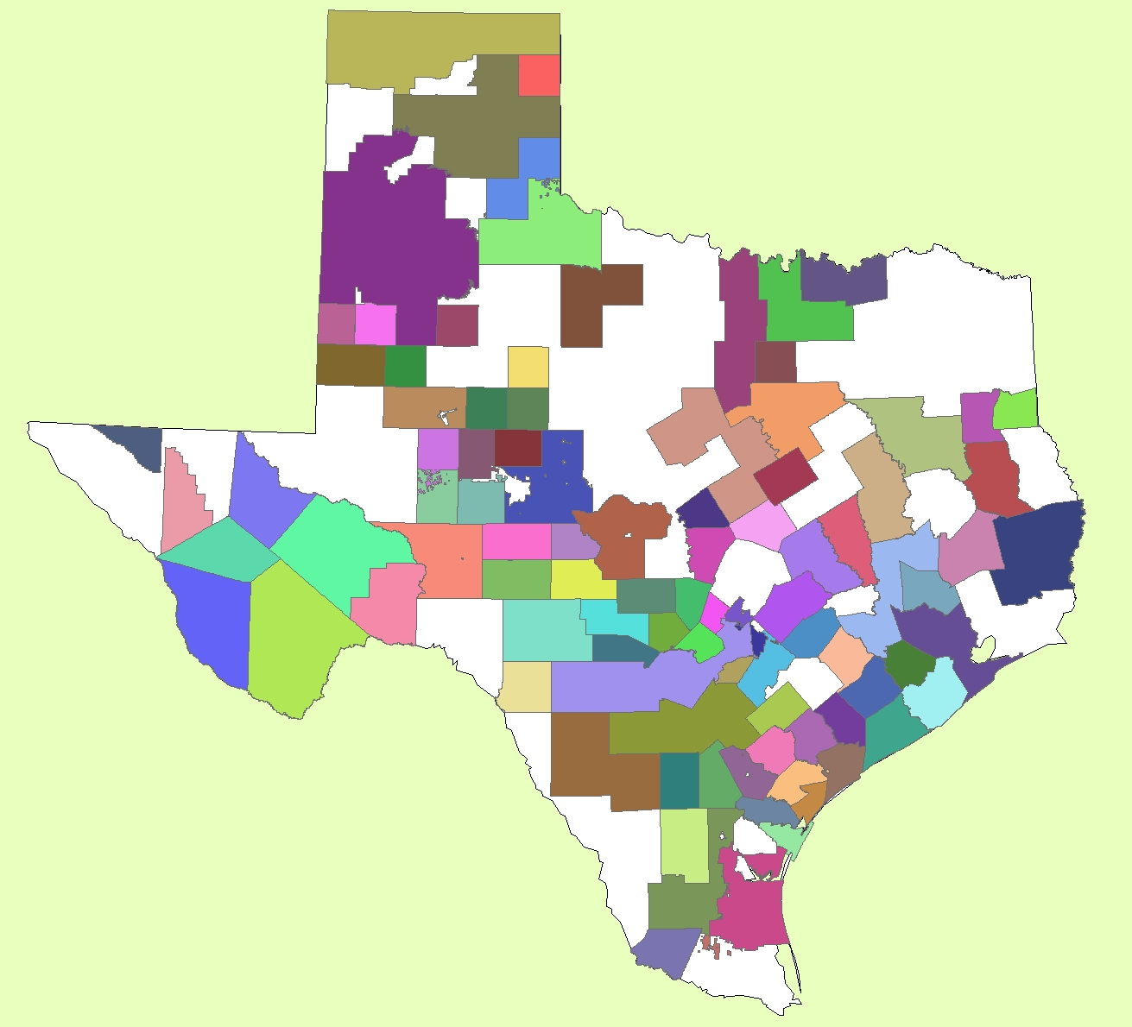
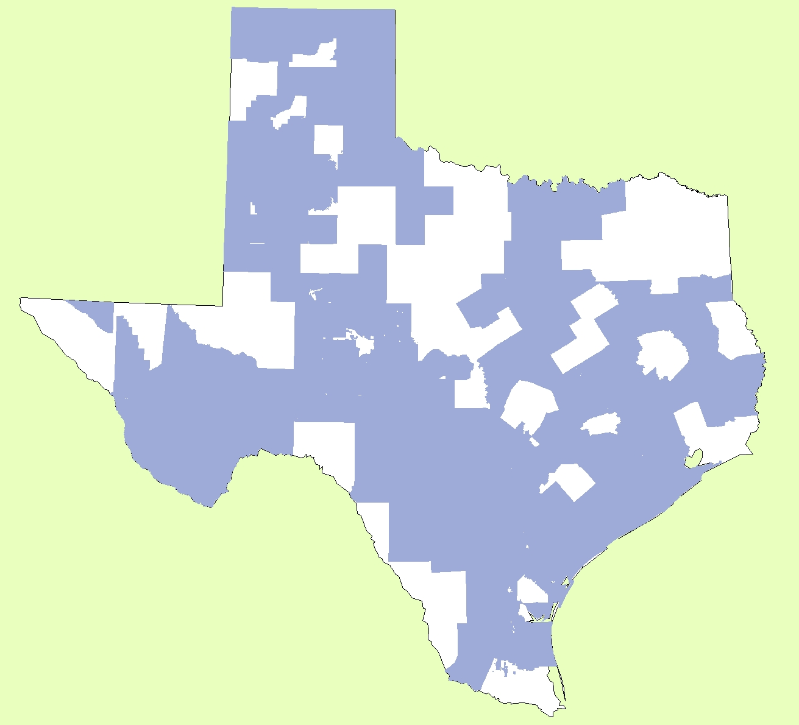
Groundwater Conservation Districts (GCDs)
101 Statewide
Preferred method of groundwater management (Tx Legislature)
Allows for local voice to groundwater issues

Slide 4
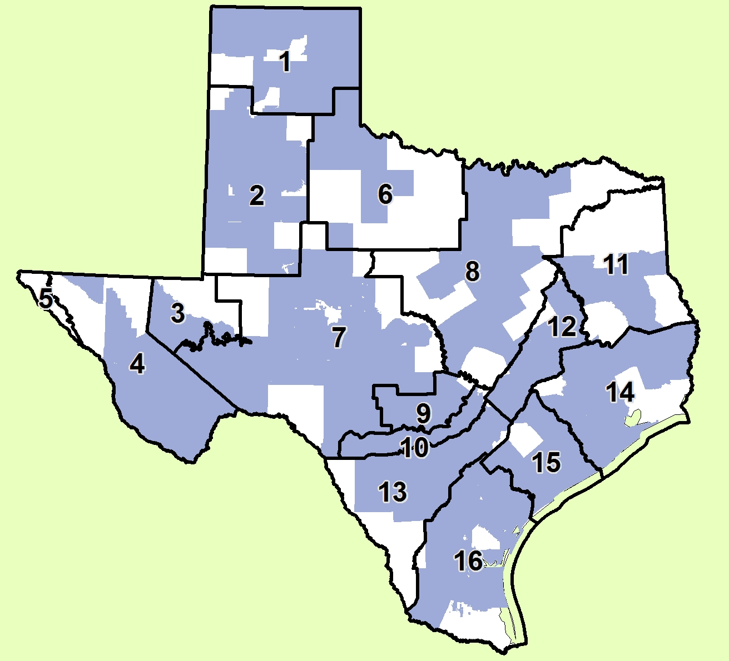
Groundwater Management Areas (GMAs)
16 Statewide
Addressed need to coordinate groundwater management strategies in similar aquifers

Slide 5
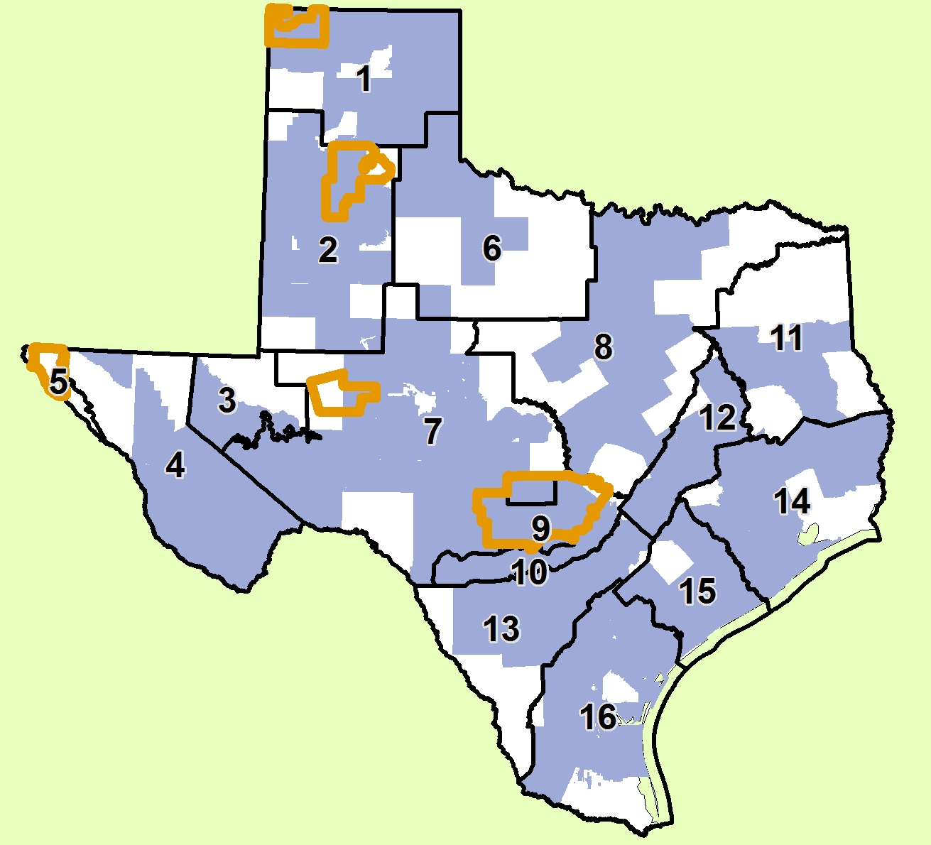
Priority Groundwater Management Areas (PGMAs)
Designated by TCEQ
High reliance on groundwater
Limited groundwater supply

Slide 6
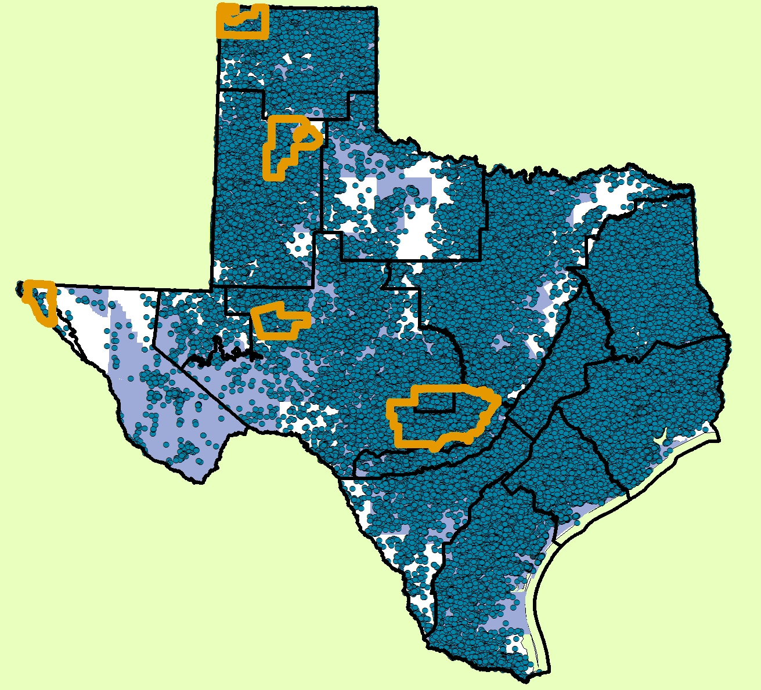
Analyze this

Slide 7
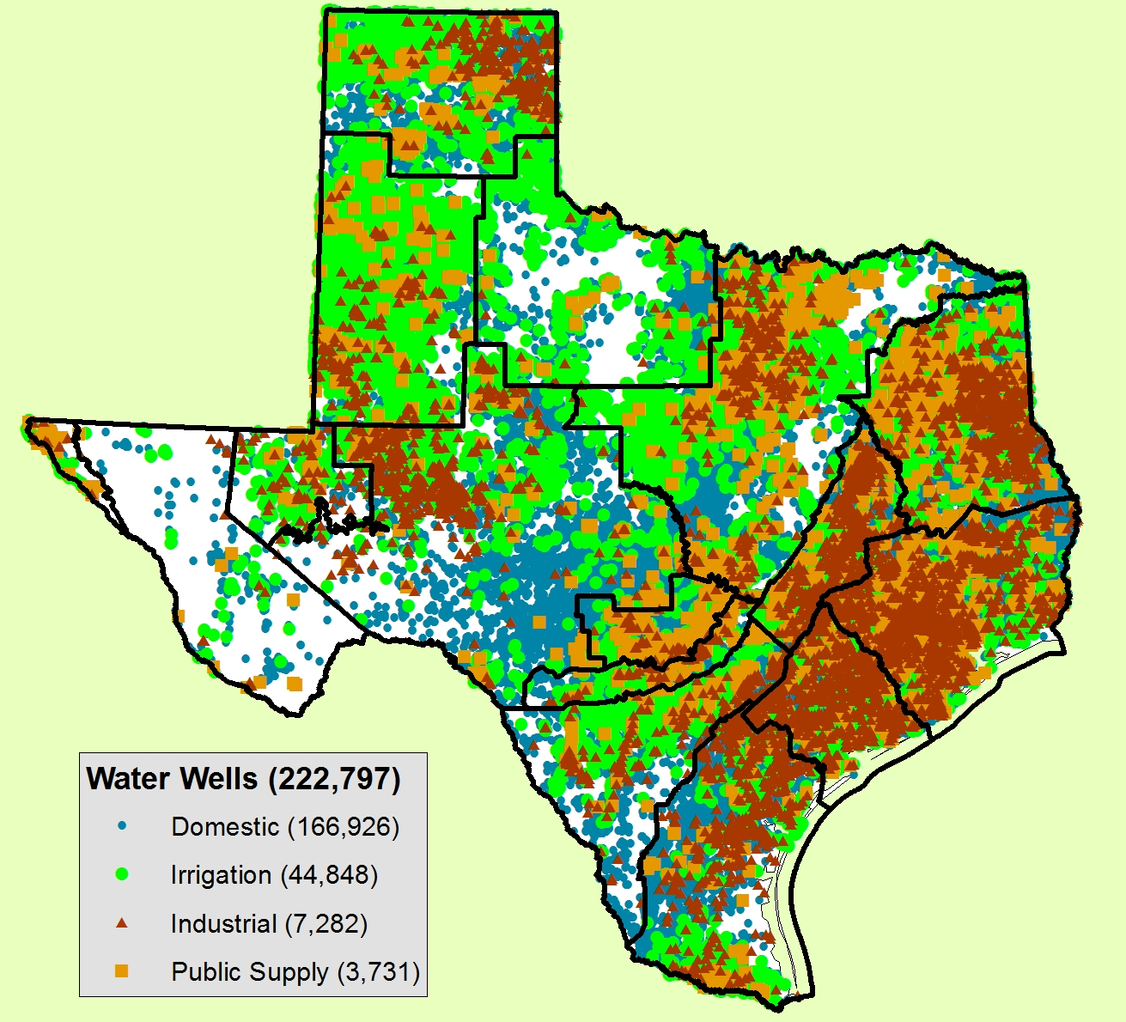
Statewide Proposed Use

Slide 8
GMAs provide a more regional scale
GMA | % area outside GCD | % large capacity wells outside GCD
1 | 17 | 2
2 | 18 | 2
3 | 46 | 65
4 | 26 | 9
5 | 100 | 100
6 | 60 | 39
7 | 26 | 47
8 | 43 | 30
9 | 5 | 51
10 | 3 | 5
11 | 52 | 57
12 | 7 | 8
13 | 34 | 7
14 | 21 | 12
15 | 9 | 7
16 | 26 | 58

Slide 9
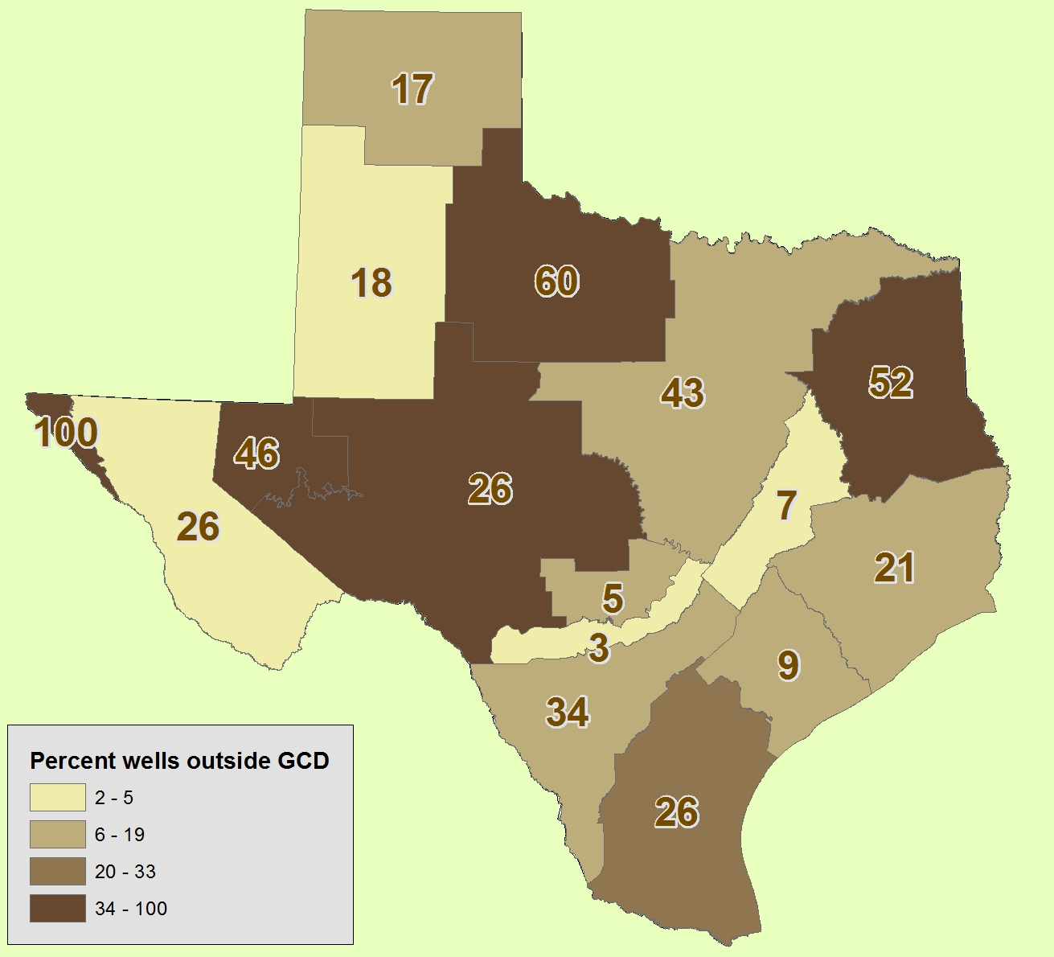
Percent area outside a GCD
GMA | % area outside GCD | % large capacity wells outside GCD
1 | 17 | 2
2 | 18 | 2
3 | 46 | 65
4 | 26 | 9
5 | 100 | 100
6 | 60 | 39
7 | 26 | 47
8 | 43 | 30
9 | 5 | 51
10 | 3 | 5
11 | 52 | 57
12 | 7 | 8
13 | 34 | 7
14 | 21 | 12
15 | 9 | 7
16 | 26 | 58

Slide 10
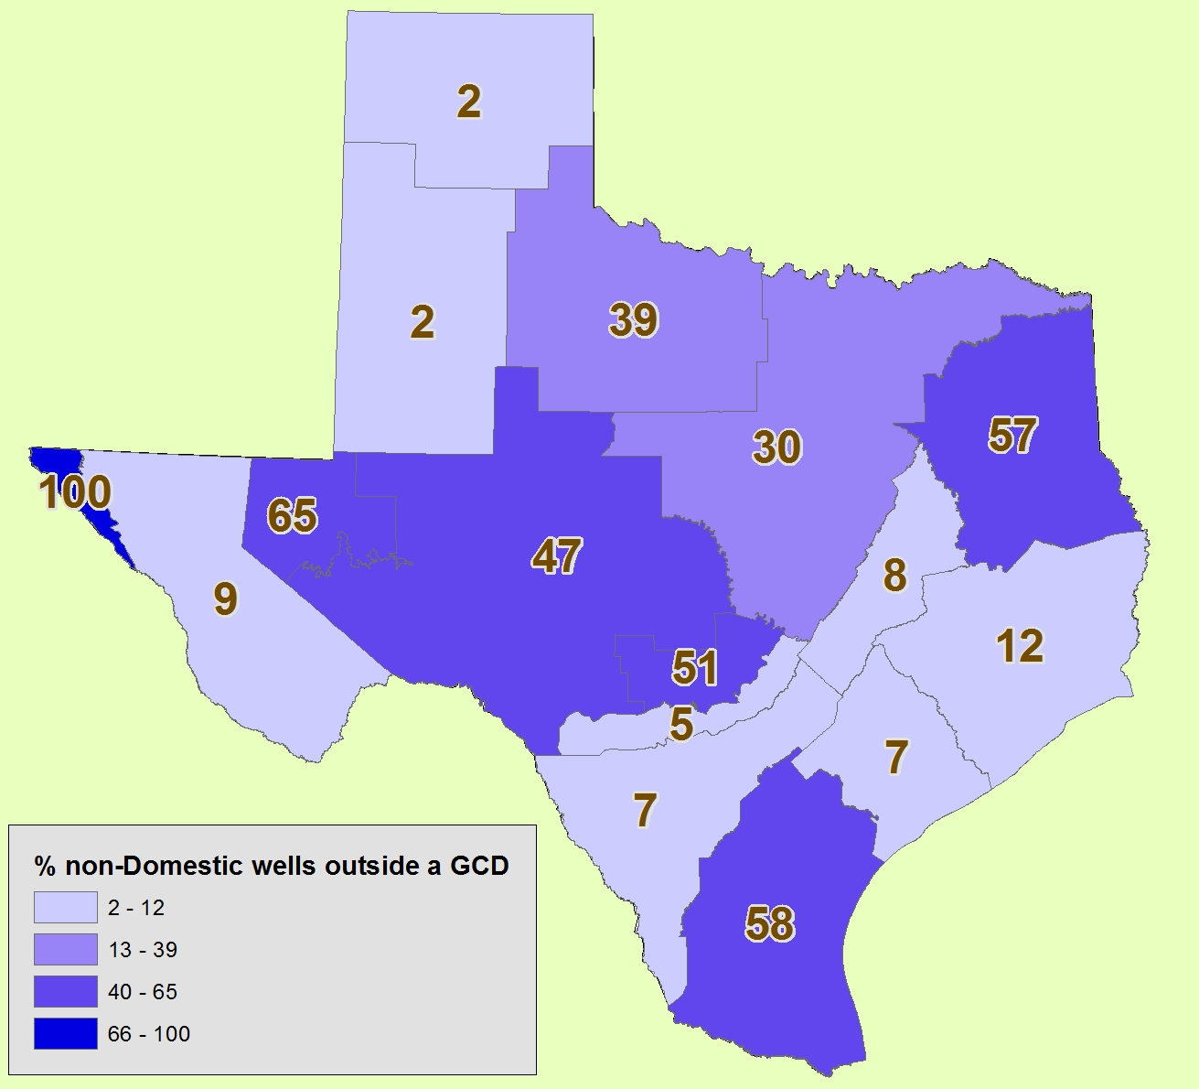
Percent non-Domestic wells outside a GCD
GMA | % area outside GCD | % large capacity wells outside GCD
1 | 17 | 2
2 | 18 | 2
3 | 46 | 65
4 | 26 | 9
5 | 100 | 100
6 | 60 | 39
7 | 26 | 47
8 | 43 | 30
9 | 5 | 51
10 | 3 | 5
11 | 52 | 57
12 | 7 | 8
13 | 34 | 7
14 | 21 | 12
15 | 9 | 7
16 | 26 | 58

Slide 11

Normalize… high water use wells by area
GMA 9: 5% of the area has 51% of the high water use wells
GMA 16: 26% of the area has 58% of the high water use wells

Slide 12
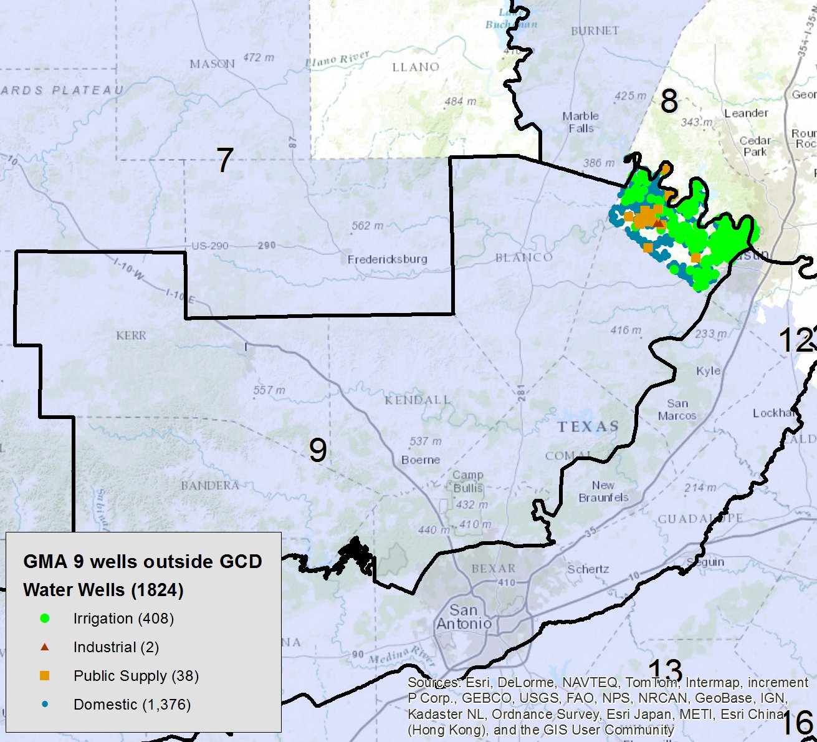
GMA 9
5% of the area has 51% of the high water use wells
PGMA because of reliance on GW, limited resources

Slide 13
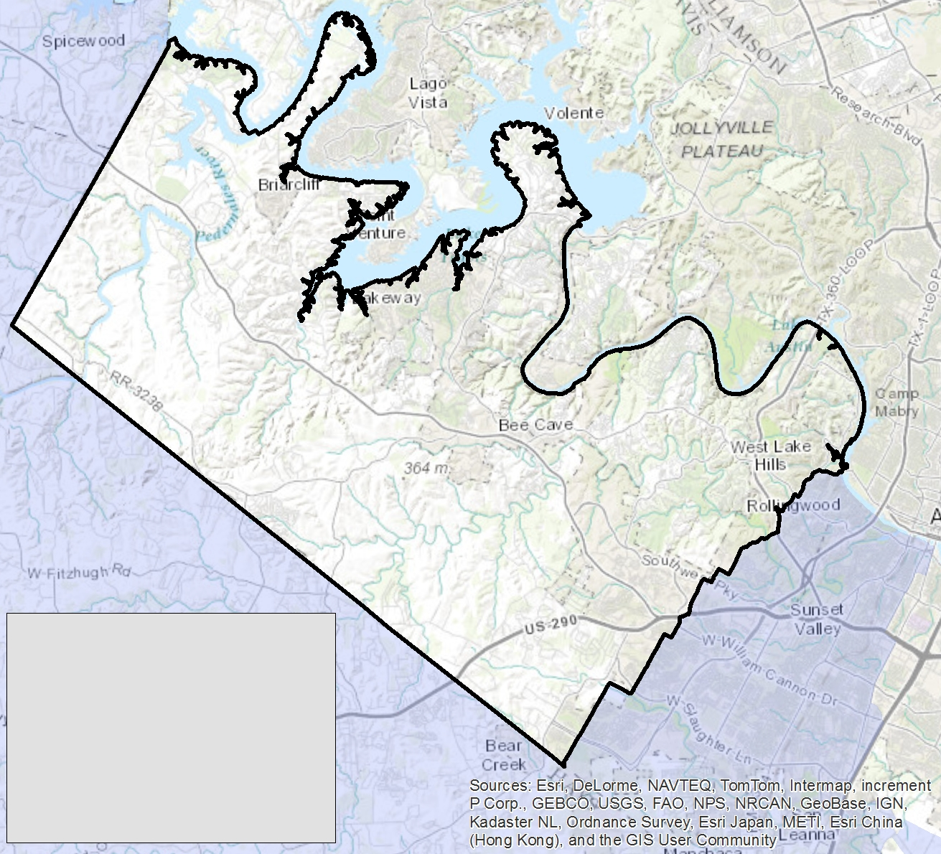
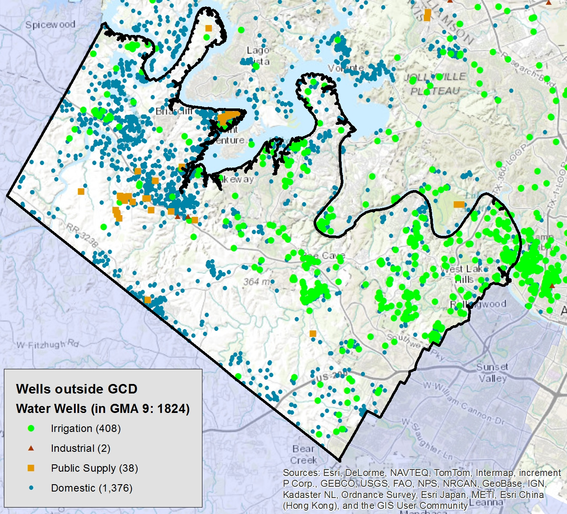
GMA 9

Slide 14
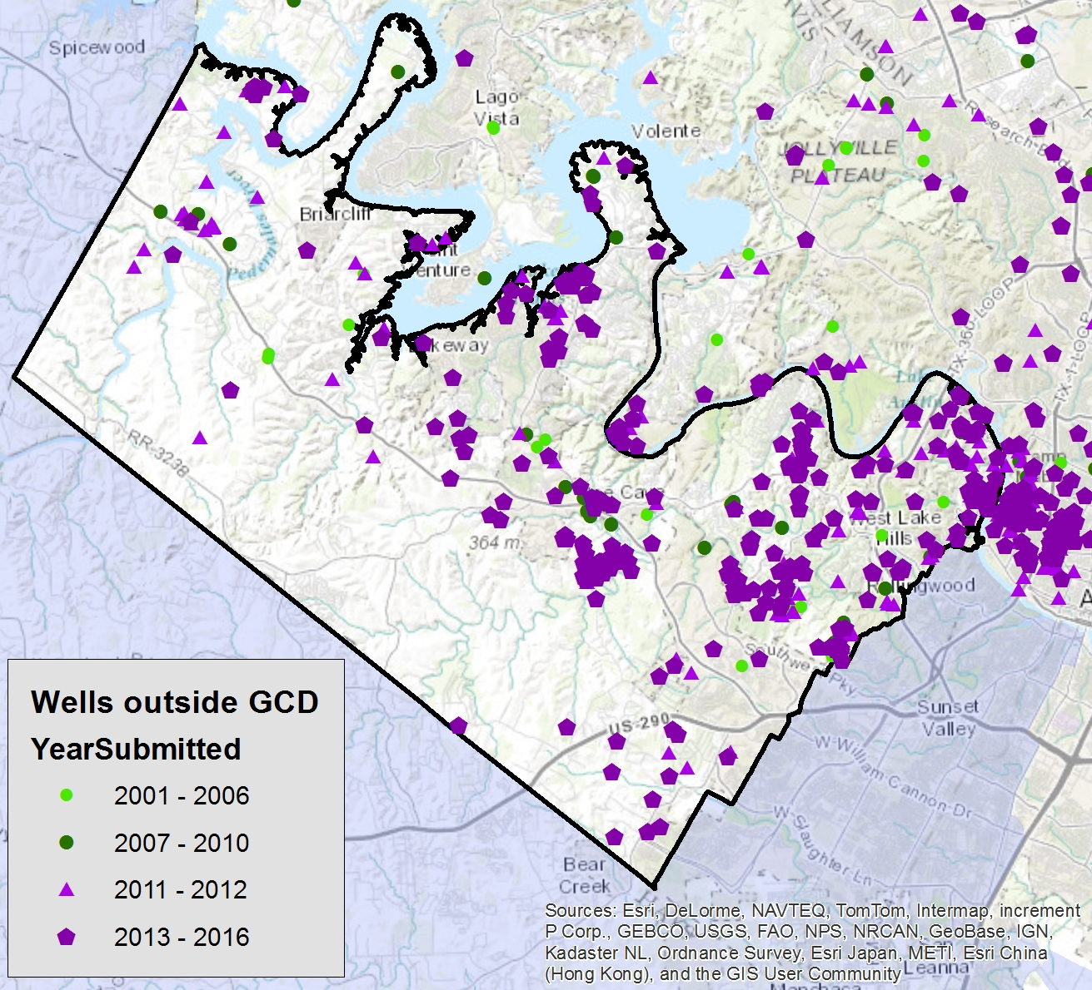
GMA 9 Irrigation Wells

Slide 15
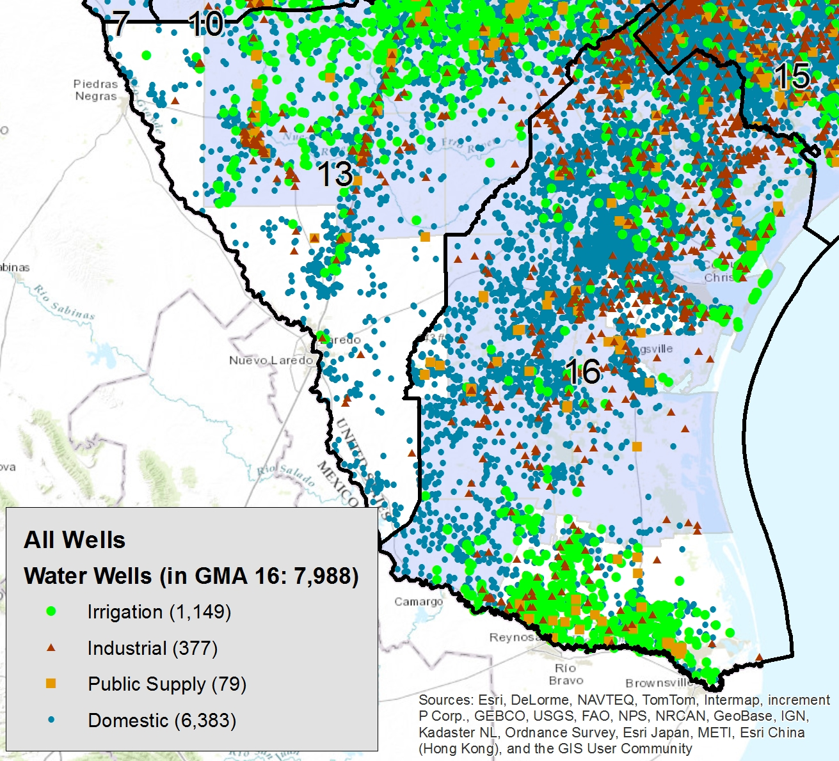
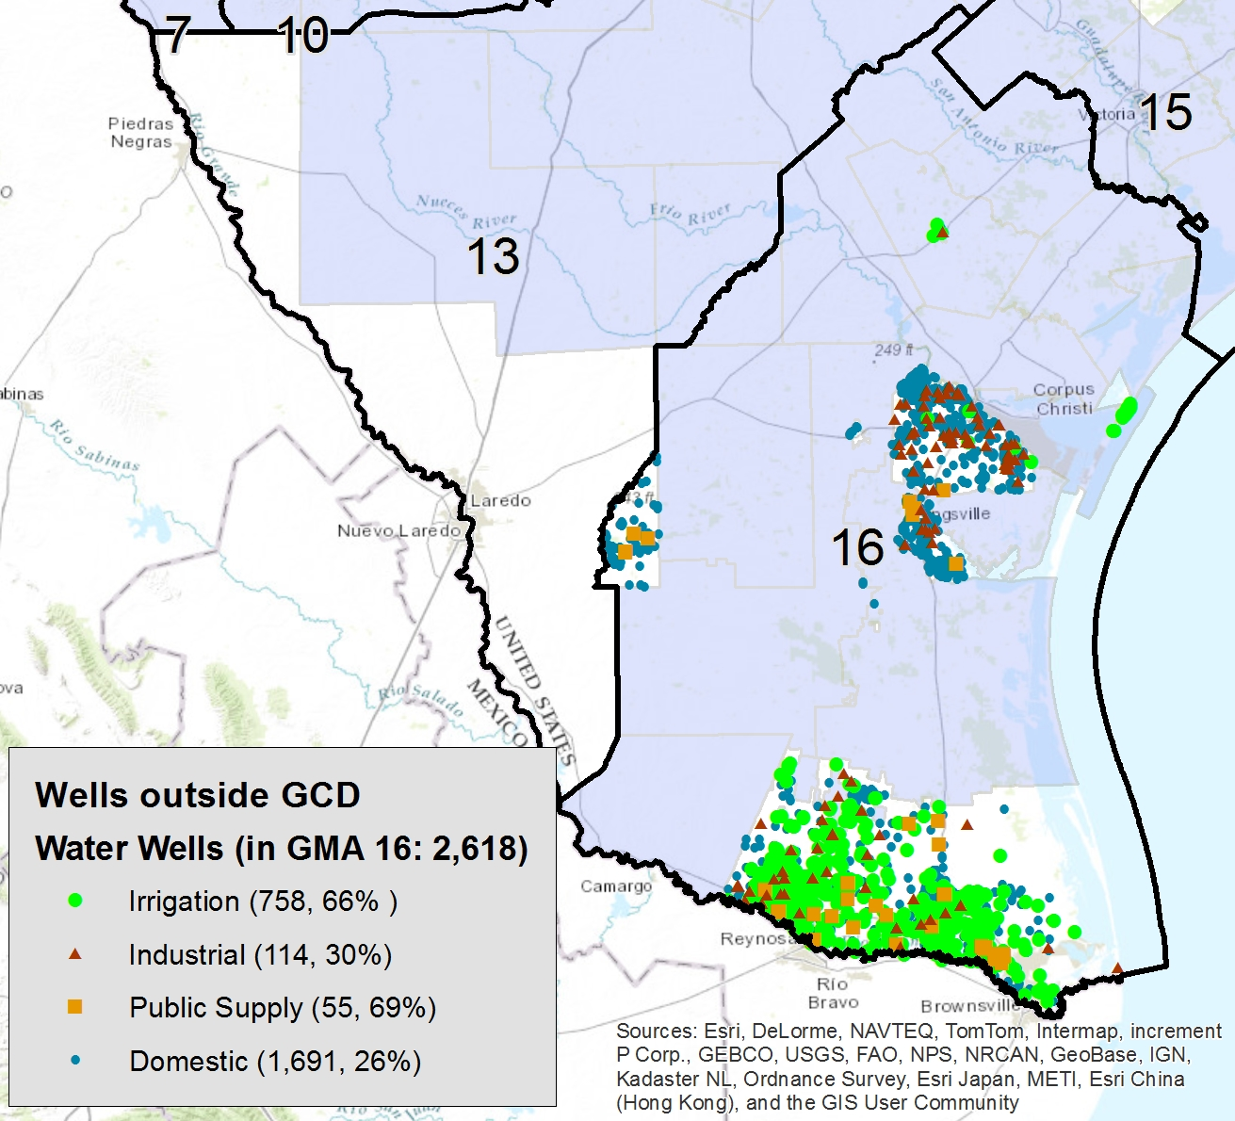
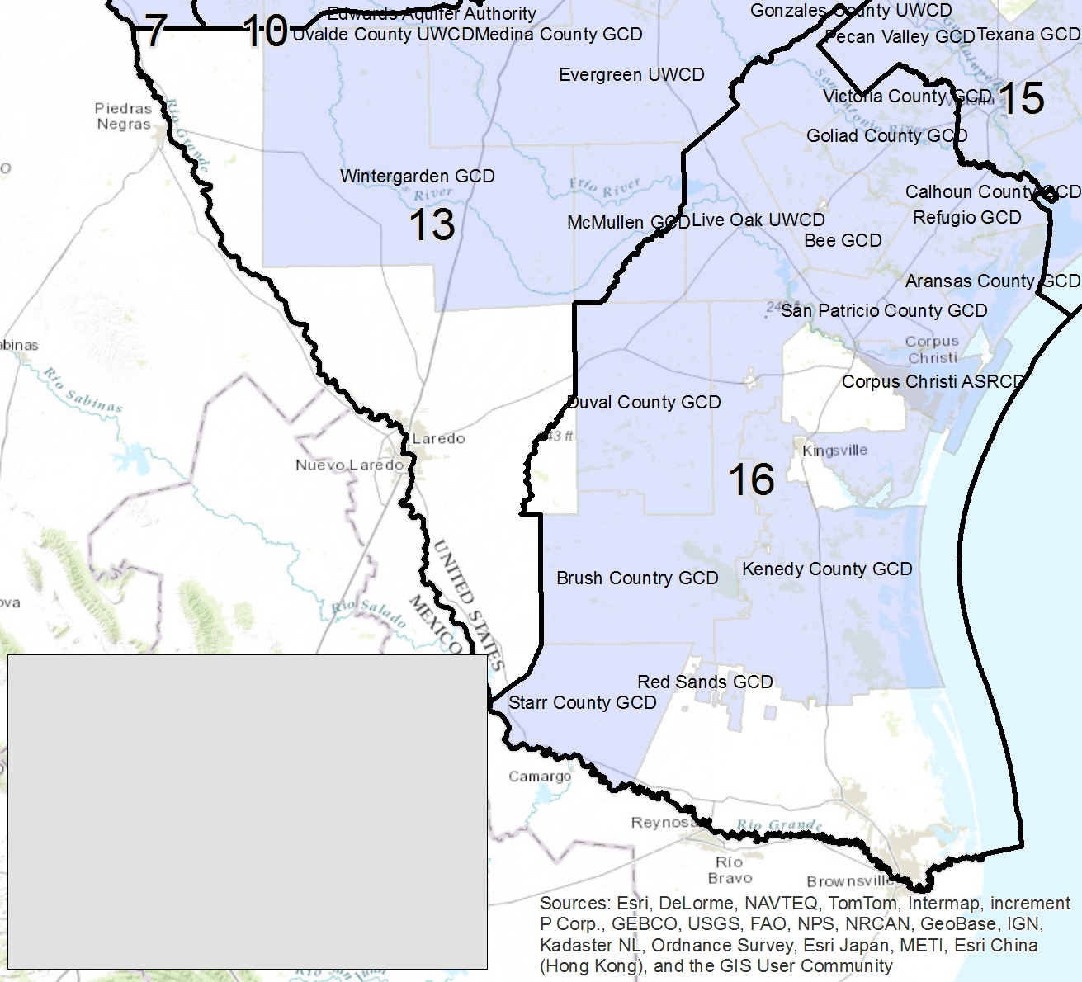
GMA 16
26% of the area has 58% of the high water use wells

Slide 16
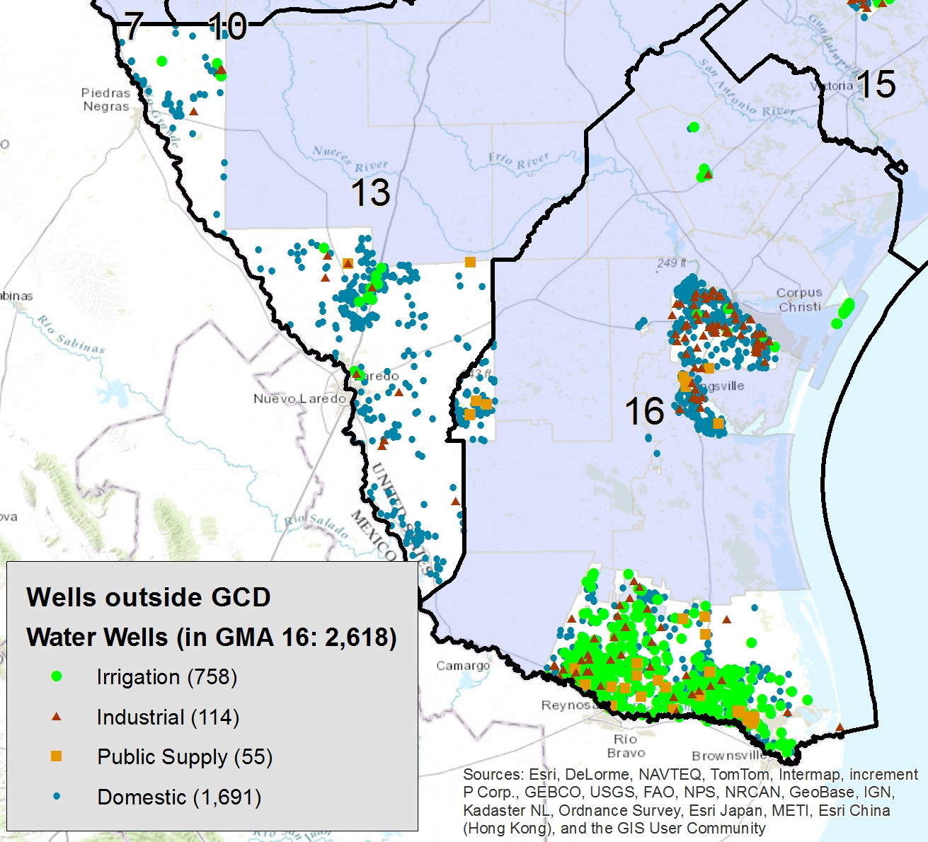
GMA 16

Slide 17

By the numbers… % outside a GCD
GMA | % Area | % Domestic | % Industrial | % Irrigation | % Public Supply
1 | 17 | 23 | 4 | 2 | 7
2 | 18 | 8 | 14 | 2 | 4
3 | 46 | 73 | 63 | 51 | 97
4 | 26 | 4 | 63 | 4 | 8
5 | 100 | 100 | 100 | 100 | 100
6 | 60 | 73 | 87 | 38 | 65
7 | 26 | 59 | 43 | 48 | 41
8 | 43 | 16 | 19 | 33 | 16
9 | 5 | 11 | 5 | 65 | 18
10 | 3 | 1 | 4 | 6 | 1
11 | 52 | 55 | 30 | 70 | 56
12 | 7 | 4 | 11 | 2 | 8
13 | 34 | 11 | 18 | 3 | 2
14 | 21 | 13 | 15 | 13 | 6
15 | 9 | 14 | 9 | 4 | 6
16 | 26 | 26 | 30 | 66 | 70

Slide 18
Statewide Water Well Drilling Trends
Robin Gary, BSEACD
rhgary@bseacd.org

