Slide 1
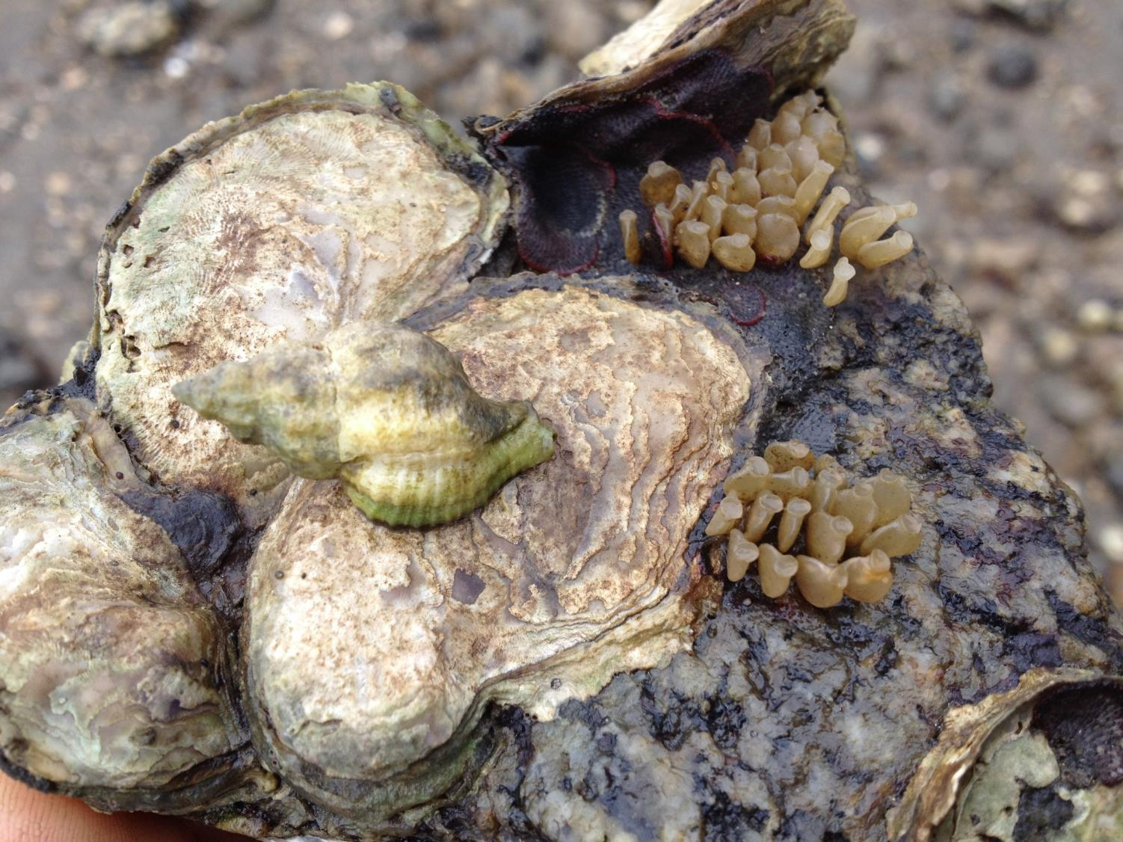
Possible Omnivory in the Muricid Gastropod Urosalpinx cinerea from Long Island Sound, USA
Michelle M. Casey

Slide 2
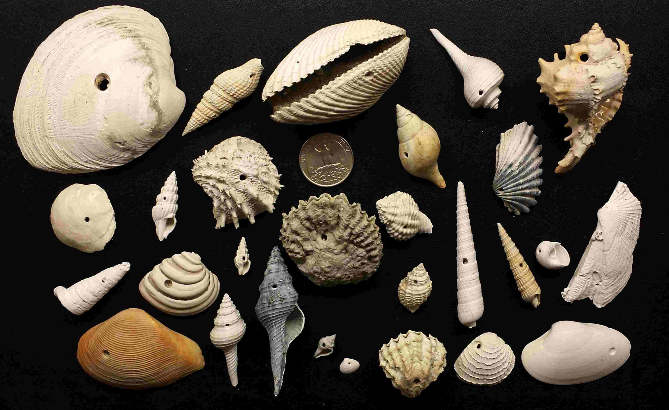

Slide 3
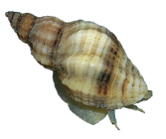
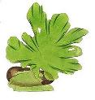



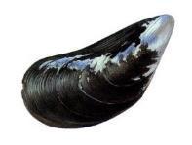
Potential vs Realized Trophic Position
Potential Trophic Position
Only meat: TP = 3
Realized Trophic Position
Only meat: TP = 3
Omnivore: TP < 3
X
Trophic position based on everything it could eat
Trophic position based on what is actually eats and in what proportions

Slide 4
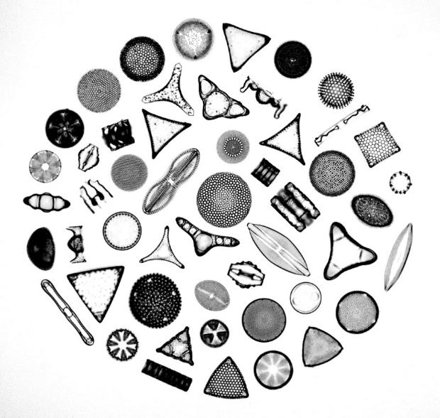


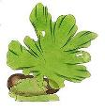
Marine Hypothetical Example
δ¹⁵N
3
Carnivorous Snails
?
2
Bivalves
Herbivorous Snails
2
?
1
Phytoplankton
Benthic Algae
1
-δ¹³C

Slide 5
Marine Hypothetical Example
δ¹⁵N
3
Carnivorous Snails
3
Herbivorous Snails
2
2
Bivalves
Benthic Algae
1
1
1
Phytoplankton
-δ¹³C

Slide 6
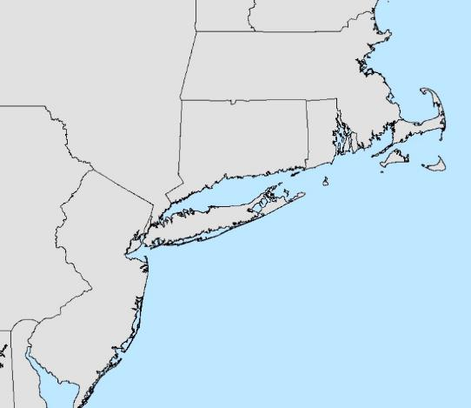
Food Web Sampling
Casey et al., 2016

Slide 7



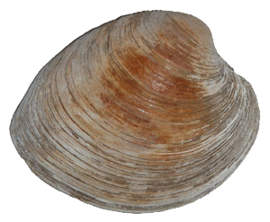


Milford, CT
α = [δ¹³C_{sc} - δ¹³C_{base2}] / (δ¹³C_{base2} - δ¹³C_{base1})
TP= λ+(δ¹⁵N_{sc}- [δ¹⁵N_{base1} x α + δ¹⁵N_{base2} x (1- α)])/3.4

Slide 8
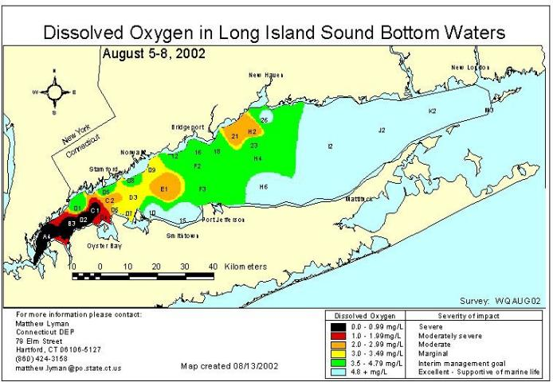
Littoral Proxy
Pelagic Proxy
δ¹⁵N (‰)
δ¹⁵N (‰)

Slide 9
Milford, CT
TP = 3
Avg. TP = 2.5

Slide 10
Trophic Position Estimates by Site
Location | Minimum TP | Maximum TP | Average TP
Rye, NY | 2.4 | 2.6 | 2.5
Bridgeport, CT | 2.2 | 2.4 | 2.3
Milford, CT | 2.5 | 2.7 | 2.6
Guilford, CT | 2.3 | 2.6 | 2.5
Westerly, RI | 2.3 | 2.7 | 2.4

Slide 11
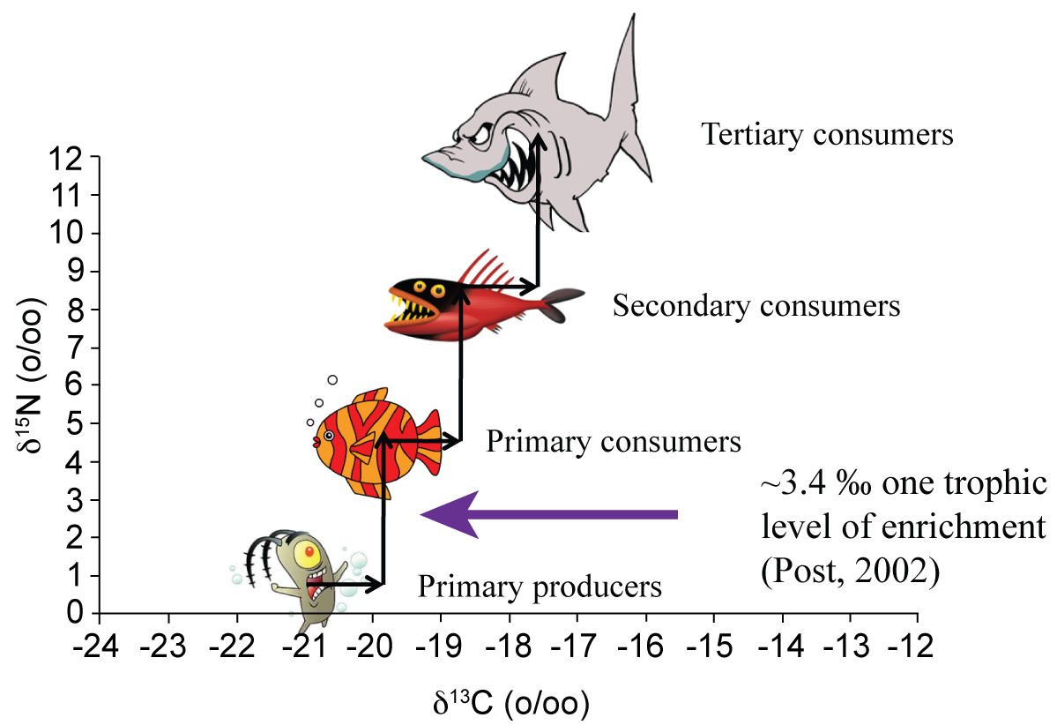
Average Nitrogen Fractionation Factor
TP=4
δ¹⁵N ‰
TP=3
TP=2
TP=1
δ¹³C ‰
From Sara Terrebonne (2009)

Slide 12
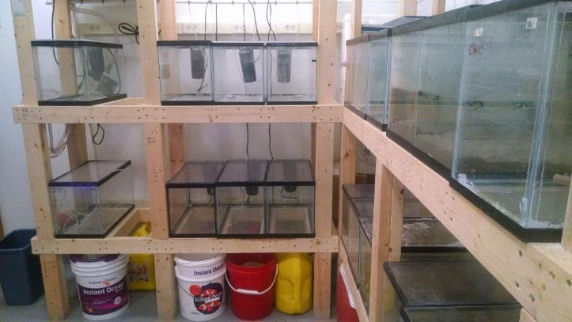
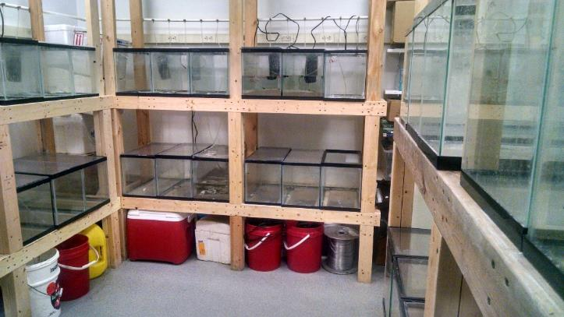
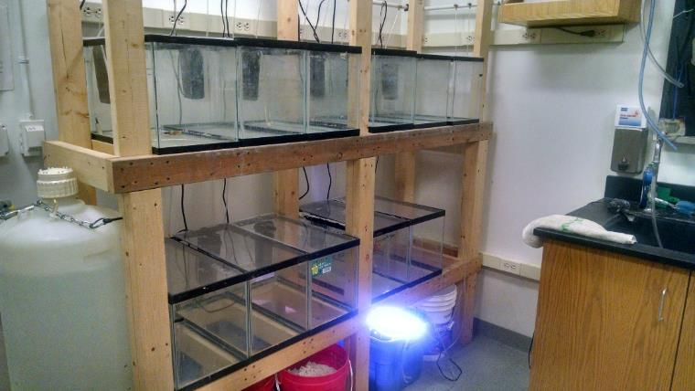
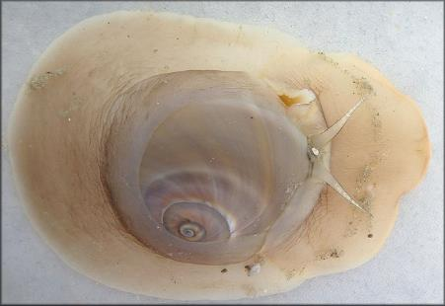
Laboratory experiment
clams
clams
LIS 1
clams
LIS 4
LIS 10

Slide 13

Laboratory experiment
Nitrogen discrimination factor
Nitrogen signature
6
median = 2.89 ‰
median = 3.58 ‰
16
15
5
14
Δ¹⁵N
13
δ¹⁵N
4
12
3
11
10
2
9
Pre-experiment
Post-experiment
Pre-exp.
Post-exp.
M. mercenaria
Casey et al., 2016

Slide 14

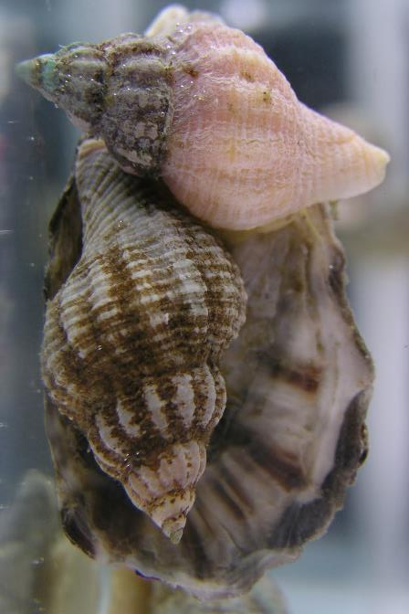
Reliance on Pelagic Carbon
α = 0.0 means that the diet is 0% pelagic (or 100% littoral)
Estimates of α
Estimates of α
Δ¹³C = 0.0 ‰
Δ¹³C = 0.0 ‰

Slide 15
Preliminary Conclusions
Low trophic positions estimates indicate that LIS U. cinerea may be an omnivore
Carbon signatures are consistent with a diet of filter-feeding mussels and oysters, plus pelagic primary producers
Minimal reliance on littoral plants
Plants included in diet remain unknown
Additional information from feeding experiments or compound-specific stable isotope analysis are necessary to preclude an unusual nitrogen fractionation factor
Unsure how taxonomically or geographically widespread omnivory might be amongst drillers

Slide 16
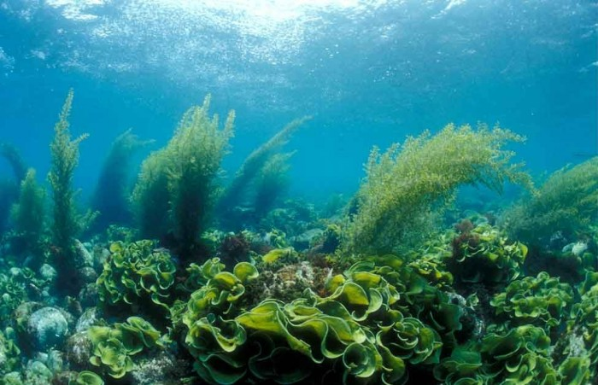
Future Work – Diet Analysis
Immunoassys (e.g., Feller, 1984)
Radiometric carbon labelling (e.g., Wetzel, 1977)
DNA barcoding (e.g., Saunders and McDevit, 2012)

Slide 17
Future Work - CSIA
Compound-specific stable isotope analysis
Glutamic acid shows large fractionation factors – up to 10 ‰
Phenylalanine shows little change
Does not require independent estimate of baseline
“trophic” amino acid
“source” amino acid
Chikaraishi et al., 2009

Slide 18
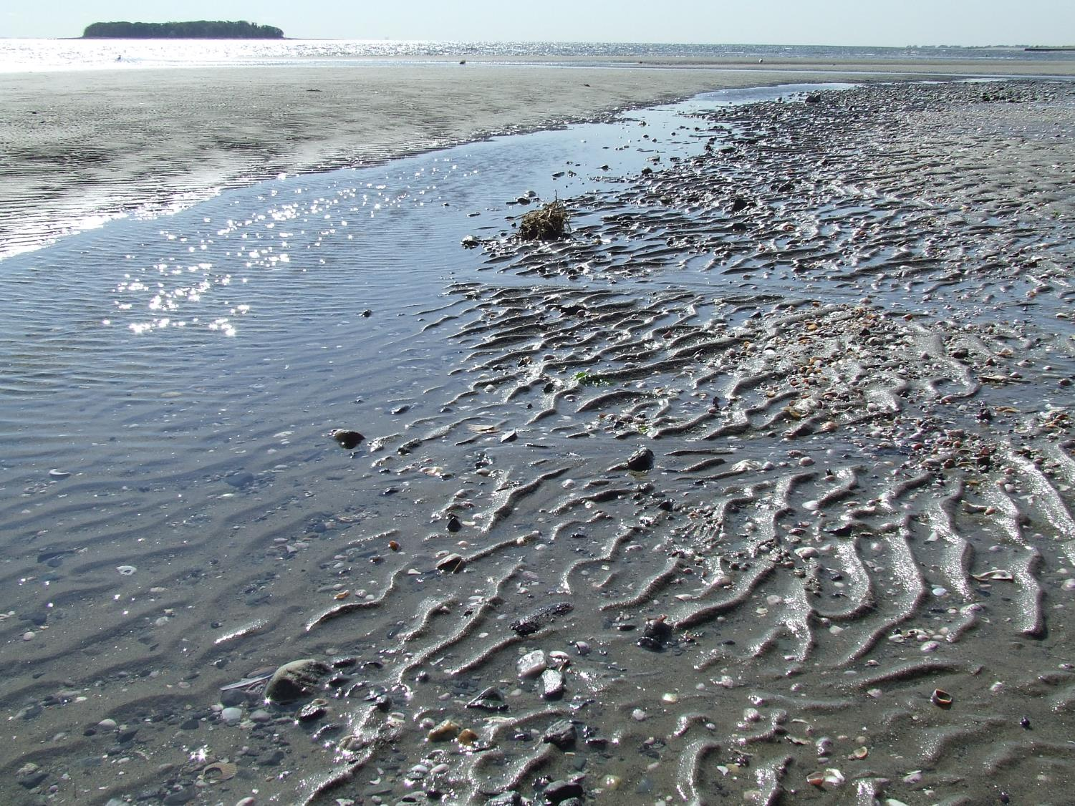



Acknowledgments
Gerry Olack (Yale) for laboratory assistance
Daniel Casey, Emily Einstein, Úna Farrell, and Joanna Wolfe for help with field collections
Geological Society of America Graduate Student Research Grants and Paleontological Society Richard Osgood Student Research Award

