Slide 1
Potential for Underground Facilities in Granites of the Southeastern U.S.
Geological Society of America
2017 Southeastern Section Meeting
30–31 March, 2017, Richmond, VA
C. W. Myers
Former Division Director, Earth and Environmental Sciences Division—Retired
Los Alamos National Laboratory, Los Alamos, N. M.

Slide 2
Outline
Background on Underground Facilities
Advantages and Disadvantages
Reducing the Capital Cost of Underground Construction
Why Granite?
Examples of Possible Underground Facilities in Granites of the Southeastern U.S. Refrigerated Natural Gas Storage
Specialized Manufacturing/Commercial
Underground Data Center
  Regional FEMA and DHS Equipment and Supply Depots
Preliminary Analysis of an Underground versus Aboveground Cold Storage Facility
Summary and Conclusions

Slide 3
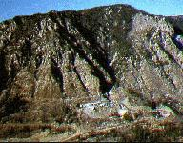
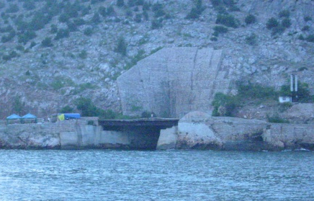
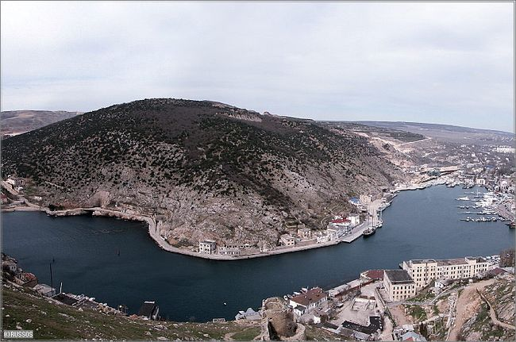
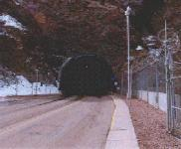
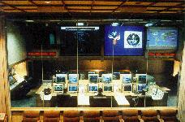
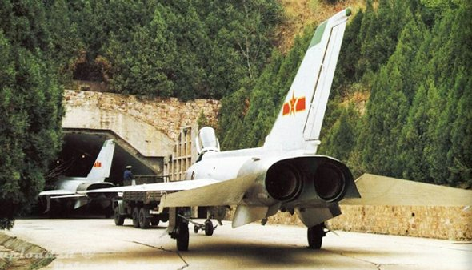
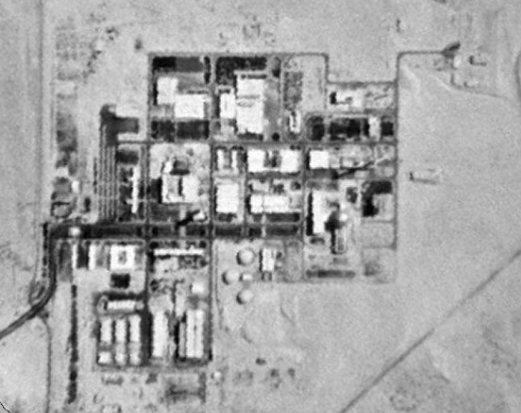
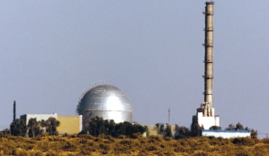
Underground Facilities---Military Use Examples
North American
Air Defense
Command
Cheyenne Mtn, CO
Former USSR Underground
Submarine Base
Dimona
(Negev Nuclear
Research Center )
Underground Hanger

Slide 4
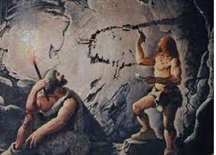
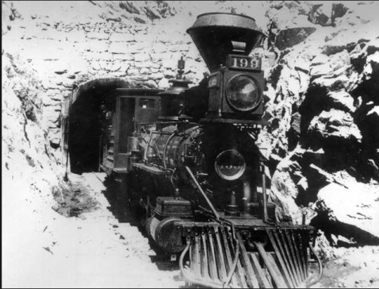
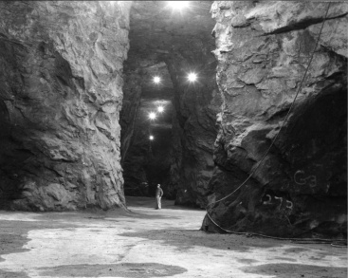
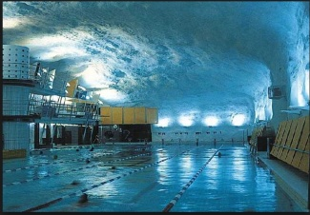
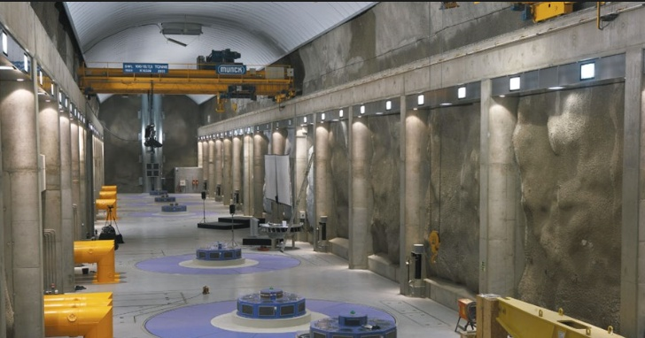
Underground Facilities—Civil Use Examples
Shelter and Protection
Transportation: Tunnels
Energy: Oil and Gas Storage
Recreation: Swimming Pool
Energy: Hydropower Station
http://bableenstimeline.weebly.com/..... http://www.megaliths.org/waterm/watermark.php?image=http://www.megaliths.org/photos/1457340597.jpg&watermark=watermark1.png

Slide 5

Advantages and Disadvantages
Lower Life-Cycle Cost
--lower utility cost
--lower insurance cost
--lower “exterior” maintenance
Protection/Security
--terrorist and enemy attack,
--theft, sabotage,
--earthquakes
--electromagnetic pulse
--opacity
--access control
Benign Environment
--constant temperature and humidity
--reduced vibration
--severe weather isolation
Landscape Aesthetics
Containment (hazardous materials)
Shaft Entry ?
Low Flood Risk
Siting is key, engineered measures might be needed
Tunnel Entry ?
High Quality Rock Mass:
Underground Facility
Capital Cost
Generally high relative to an equivalent above-ground structure
Constraints
  Geology
  Geography
Generic Underground Risks
Psychological Aversion
Misperceptions are Common

Slide 6
Advantages and Disadvantages
Lower Life-Cycle Cost
--lower utility cost
--lower insurance cost
--lower “exterior” maintenance
Protection/Security
--terrorist and enemy attack,
--theft, sabotage,
--severe weather, earthquakes
--electromagnetic pulse
--opacity
--access control
Benign Environment
--constant temperature and humidity
--reduced vibration
--severe weather isolation
Landscape Aesthetics
Containment (hazardous materials)
Shaft Entry ?
Tunnel Entry ?
Low Flood Risk
Siting is key, engineered measures might be needed
High Quality Rock Mass:
Underground Facility
Capital Cost
Generally high relative to an equivalent above-ground structure
Generic Underground Risks
Psychological Aversion
Common Misperceptions
Constraints
  Geology
  Geography
Generic Underground Risks
Psychological Aversion
Misperceptions are Common
Minimize Underground Construction Cost to Minimize Capital Cost
6

Slide 7
Outline
Background on Underground Facilities
Advantages and Disadvantages
Reducing the Capital Cost of Underground Construction
Why Granite?
Examples of Possible Underground Facilities in Granites of the Southeastern U.S. Refrigerated Natural Gas Storage
Specialized Manufacturing/Commercial
Underground Data Center
  Regional FEMA and DHS Equipment and Supply Depots
Preliminary Analysis of an Underground versus Aboveground Cold Storage Facility
Summary and Conclusions

Slide 8
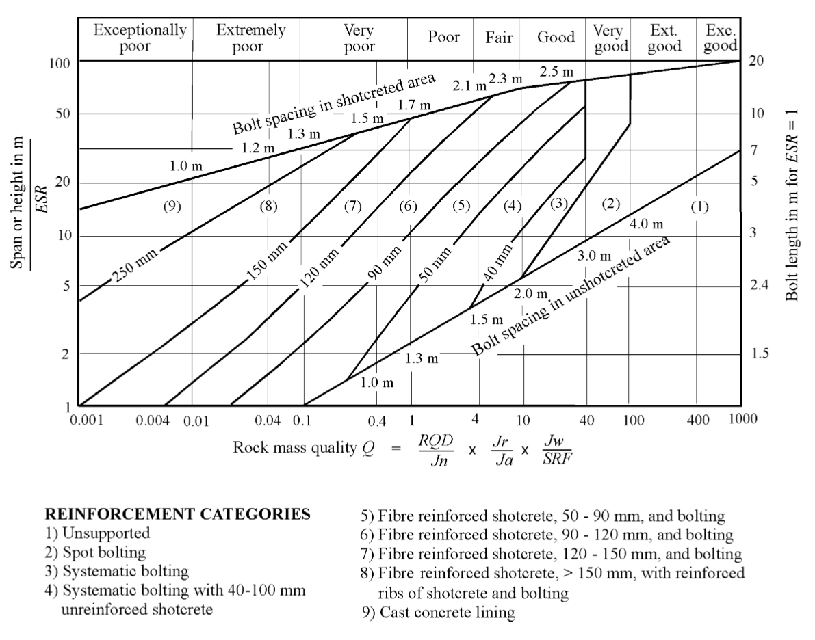
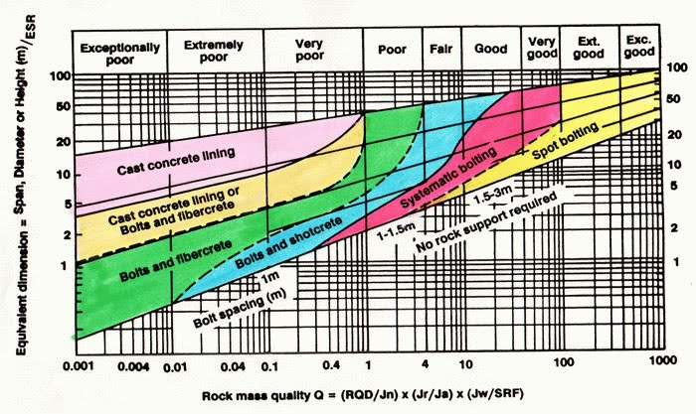
Reduce Construction Cost: 1. Use Locations with High Quality Rock…
Ground Support Requirements
~Opening Span,
or Height (meters)
Rock Mass Quality
…..minimize ground support cost by using high-quality rock masses
Figure from: AGH University of Science and Technology (home.agh.edu.pl/~cala/hoek/Chapter3.pdf)

Slide 9
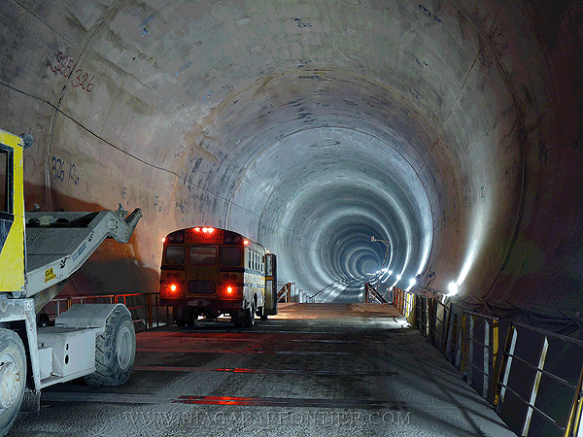
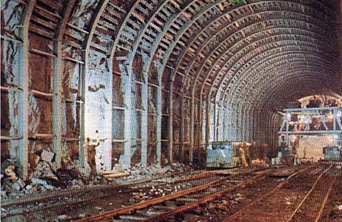
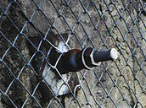
Reduce Construction Cost: 1. Use Locations with High Quality Rock…
$$$$$
20m
$$$
$

Slide 10
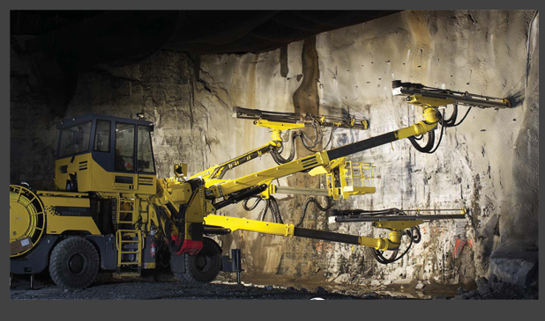
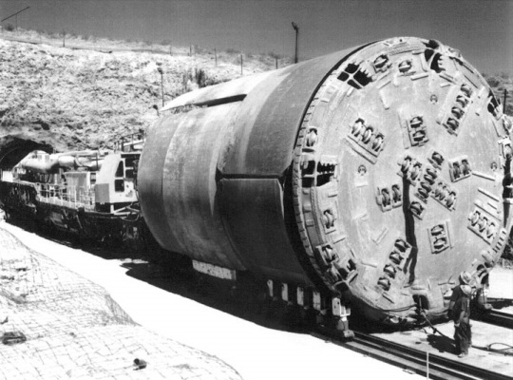
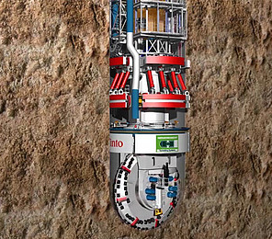
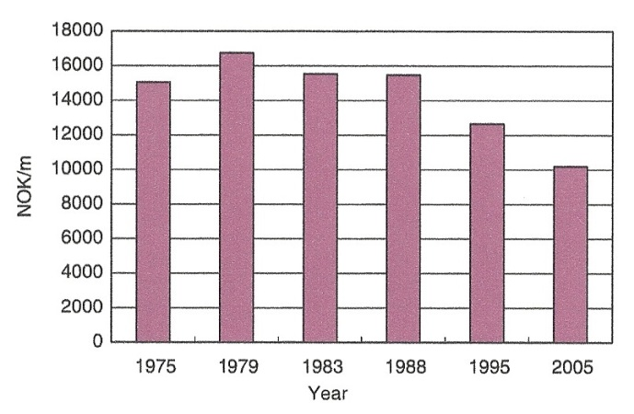
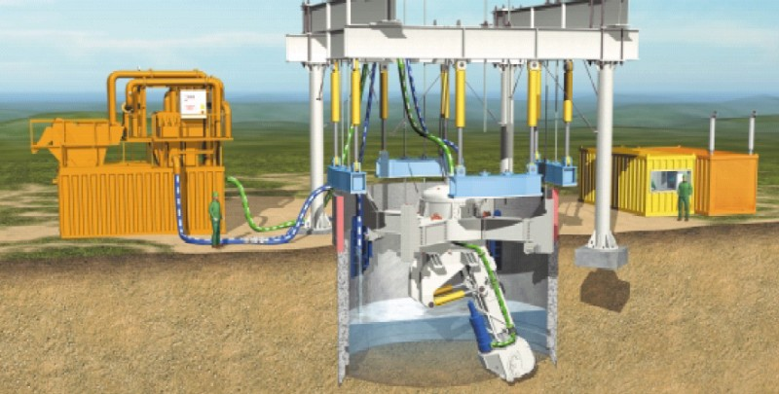
Reduce Construction Cost: 2. Use modern excavation technology
Drill-and-Blast
Tunnel Boring Machine
Shaft Boring Machine
--automated, computerized drilling jumbos,
--more durable drill steel,
--advanced rock support,
--improved explosives, improved ventilation
36% cost reduction—
(Study of 60m² road tunnels
In Norway)
Vertical Shaft
Sinking Machine
(S. Zare and A. Bruland, 2007)
Photo sources: Dirlling.kr and Herrenknecht.com

Slide 11
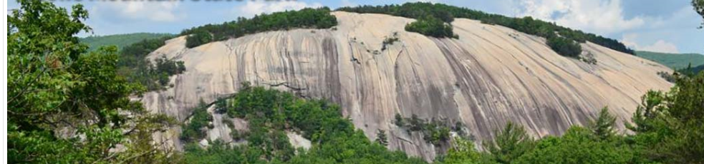
Reduce Construction Cost: 3. Tunnel (horizontal) entry might be possible if topographic relief is sufficient.
x
x
Avli
Avoid shaft entry if possible. Shaft sinking cost are usually higher
than tunneling cost….all other things being equal.

Slide 12
Outline
Background on Underground Facilities
Advantages and Disadvantages
Reducing the Capital Cost of Underground Construction
Why Granite?
Examples of Possible Underground Facilities in Granites of the Southeastern U.S. Refrigerated Natural Gas Storage
Specialized Manufacturing/Commercial
Underground Data Center
  Regional FEMA and DHS Equipment and Supply Depots
Preliminary Analysis of an Underground versus Aboveground Cold Storage Facility
Summary and Conclusions

Slide 13
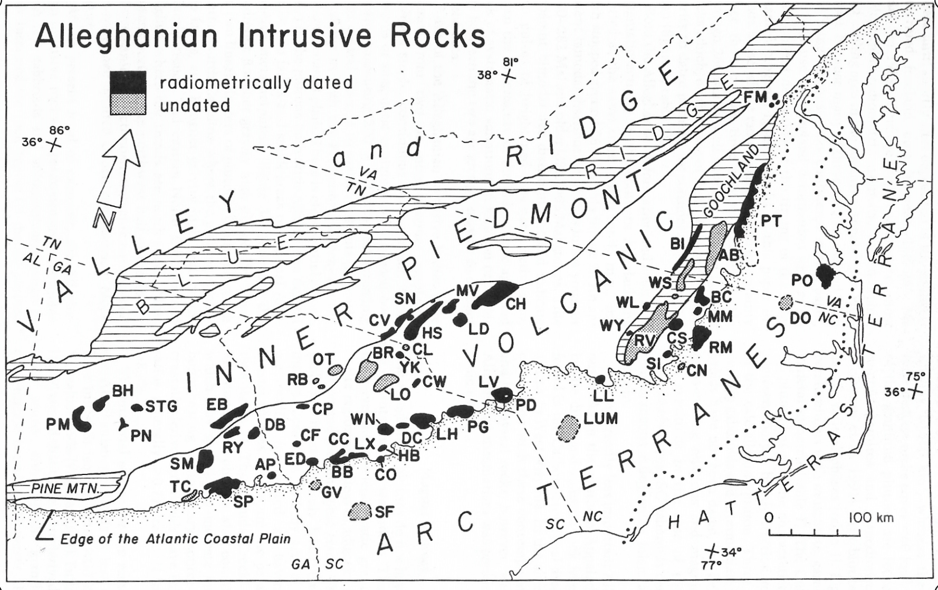
1. Large Granite Rock Masses are Relatively Abundant….
Figure 1 from I. A. Speer, H.Y. McSween, Jr., and A.E. Gates, 1994, “Generation, Segregation, Ascent, and Emplacement of Alleghanian Plutons in the Southern Appalachians,” Journal of Geology, vol. 102, p. 249-267.

Slide 14
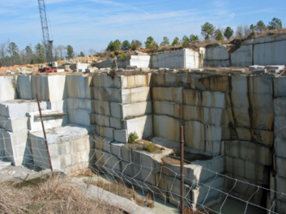
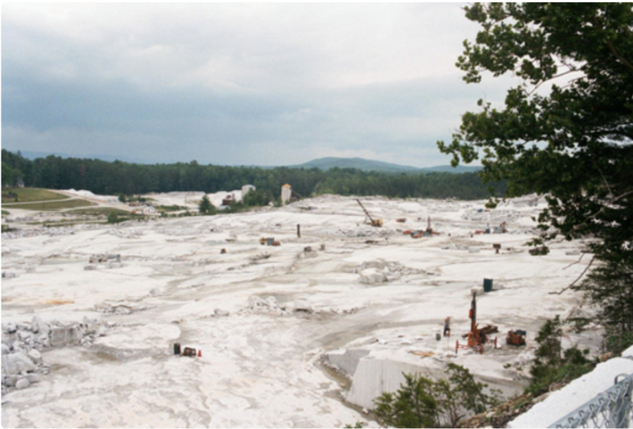
2. Variety of Landforms and Exposures…
Domes and Dome-Like
Quarries (shallow subsurface exposures)
Low-Relief

Slide 15
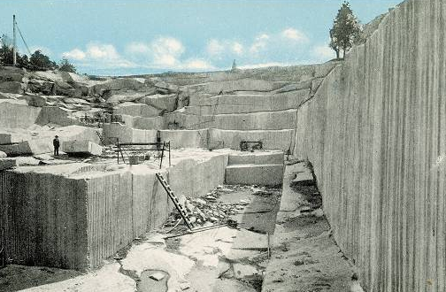
Favorable Geotechnical Properties as Revealed
by Dimension Stone Quarries
Dimension-stone quarries in the southeastern U.S. provide direct evidence of the presence of large, granite rock masses, some with favorable geotechnical and geohydrological properties.
Favorable Geotechnical Properties
  Compressive strength:*
  Granite: 130,000kPa (19,000psi)
  Concrete: 43,000kPa (5,000psi)
2. Favorable Rock Mass Properties
    Potential for good to excellent geohydrological properties: massive, low permeability rock masses are known to exist.
  3. Large, Stable, Dry Underground Caverns
  Large-span (>15m)
  Largely self-supporting
  Relatively low unit-cost per cubic meter of underground space
___________
*Intact rock values from www.engineeringtoolbox.com

Slide 16
Outline
Background on Underground Facilities
Advantages and Disadvantages
Reducing the Capital Cost of Underground Construction
Why Granite?
Examples of Possible Underground Facilities in Granites of the Southeastern U.S. Refrigerated Natural Gas Storage
Specialized Manufacturing/Commercial
Underground Data Center
  Regional FEMA and DHS Equipment and Supply Depots
Preliminary Analysis of an Underground versus Aboveground Cold Storage Facility
Issues, Summary, and Conclusions
To be described in a presentation by Carpenter and others at this meeting

Slide 17
Outline
Background on Underground Facilities
Advantages and Disadvantages
Reducing the Capital Cost of Underground Construction
Why Granite?
Examples of Possible Underground Facilities in Granites of the Southeastern U.S. Refrigerated Natural Gas Storage
Specialized Manufacturing/Commercial
Underground Data Center
  Regional FEMA and DHS Equipment and Supply Depots
Preliminary Analysis of an Underground versus Aboveground Cold Storage Facility
Summary and Conclusions

Slide 18
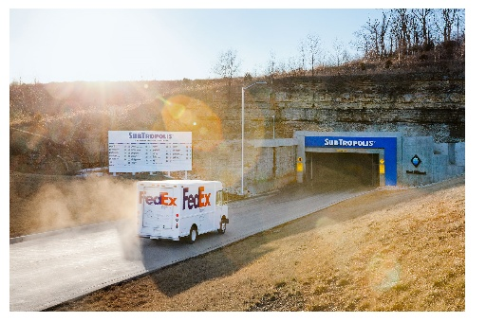
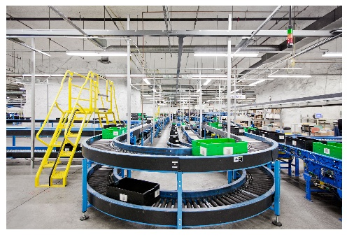
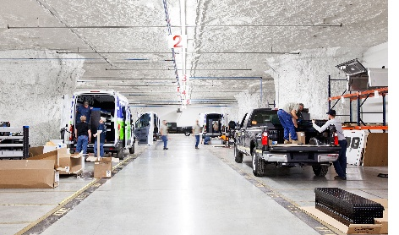
Underground Business Complex:
SubTropolis, Kansas City, MO*
World’s Largest Underground Business Complex – Former Underground Limestone Mine.
Tenant benefits
  6,000,000 square feet of industrial space
  Low lease rates---30% to 50% less than above-ground facilities
  Low utility costs---50% to 70% savings in total energy costs
  Constant temperature and humidity levels
  On-site services---management, maintenance, and 24/7 security.
Fed Ex and UPS
Upfitting Ford Transit and F-150 Vehicles
Source: http://huntmidwest.com/industrial-space-for-lease/ and URL links.

Slide 19
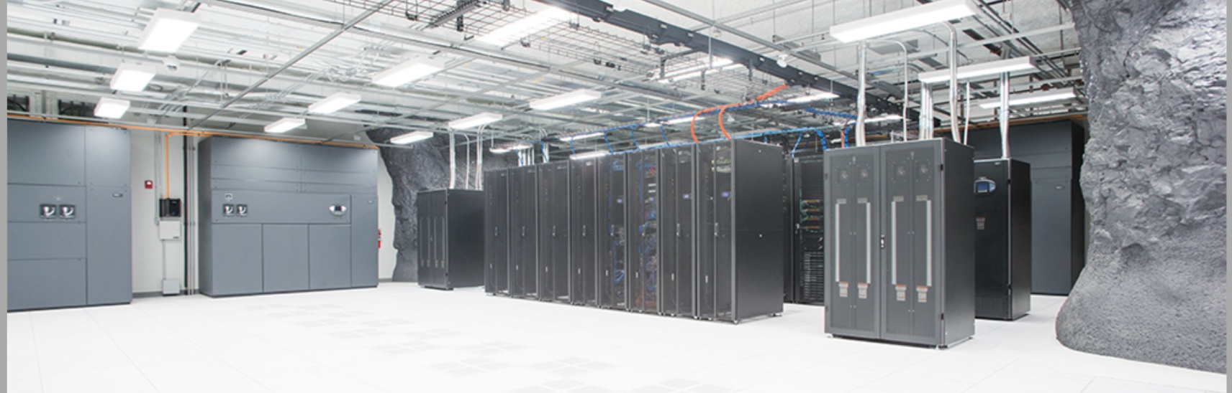
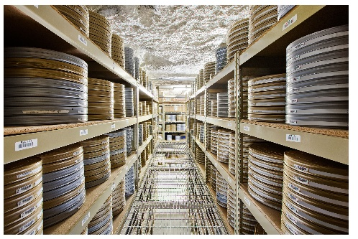
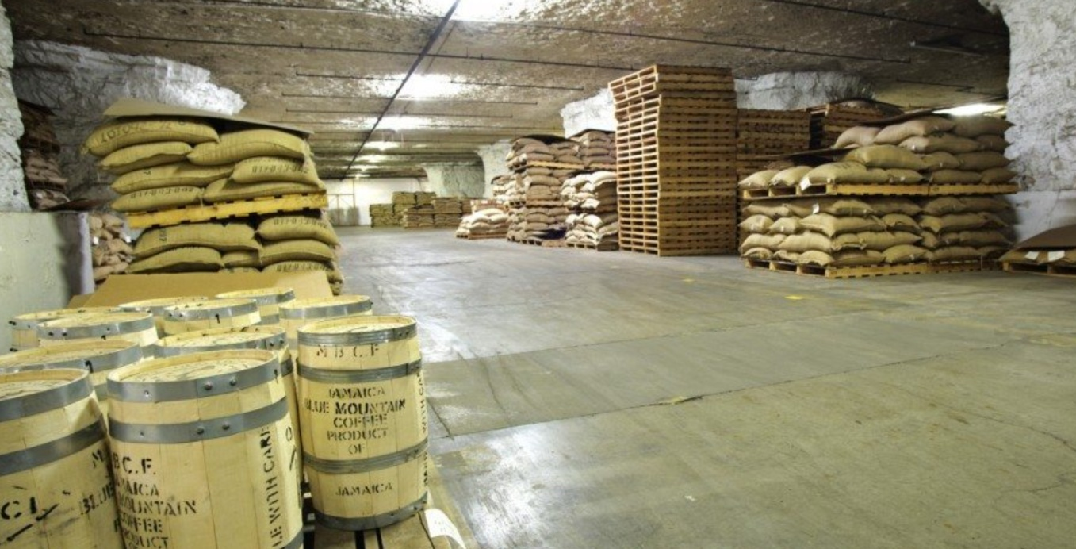
SubTropolis (Continued)
Data Center
Archive Storage
Food and Commodity Storage

Slide 20
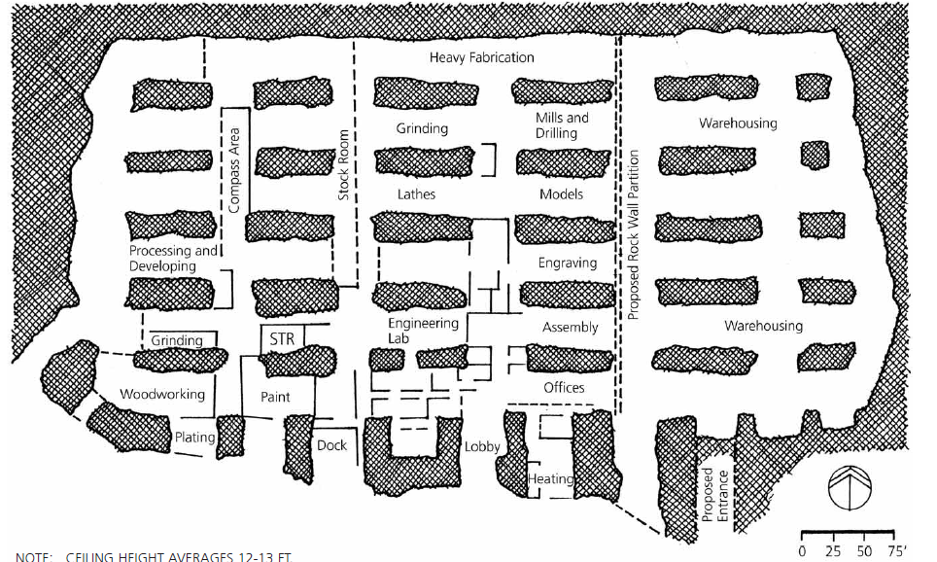
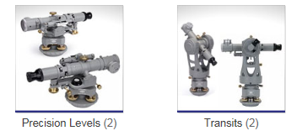
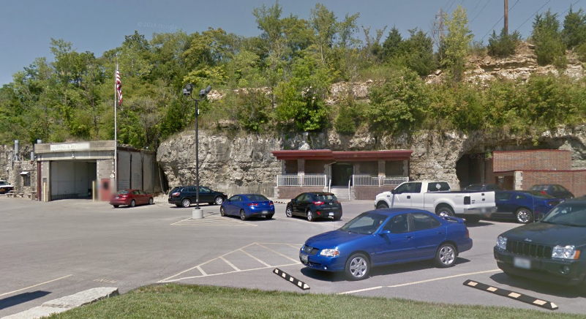
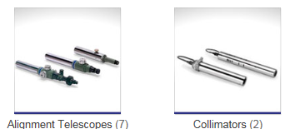
Underground Specialized Manufacturing Facility:
Brunson Instrument Company, Kansas City, MO
(high-precision, large-scale measurements)
Depth Below Surface | 77 feet
Ceiling Height | 12-13 feet
Factory and Office | 220,000 sq. ft
Examples of Brunson Instruments

Slide 21
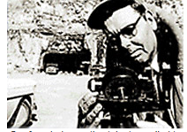
Quotes from Brunson Instrument Co. History* are Instructive
“N. Brunson formed the company in 1927 … business grew [but] vibrations from local street traffic and fluctuations in temperature became an increasing problem for the precise machining and adjustment processes…
…Mr. Brunson discovered that local geological
formations were nearly perfect for mining out
a vibration-free, temperature-stable space for
Manufacturing
….[Beginning in 1960] took 5 years to do the blasting and excavation needed to create this 220,000-square-foot underground facility…ideal setting for the production of high-precision instruments…
“The company has thrived in this environment ever since…. “
____________
*http://www.brunson.us/metrology-optical-measurement-products-alignment-about-brunson/metrology-optical-measurement-products-alignment-brunson-history/ 12/08/2016

Slide 22
Outline
Background on Underground Facilities
Advantages and Disadvantages
Reducing the Capital Cost of Underground Construction
Why Granite?
Examples of Possible Underground Facilities in Granites of the Southeastern U.S. Refrigerated Natural Gas Storage
Specialized Manufacturing/Commercial
Underground Data Center
  Regional FEMA and DHS Equipment and Supply Depots
Preliminary Analysis of an Underground versus Aboveground Cold Storage Facility
Issues, Summary, and Conclusions

Slide 23
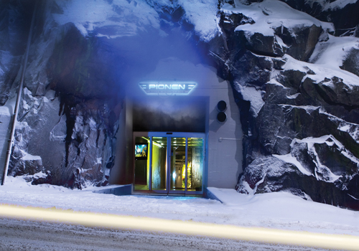
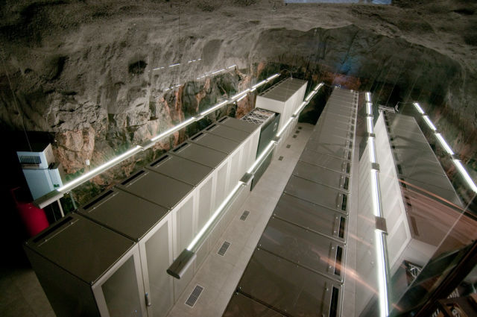
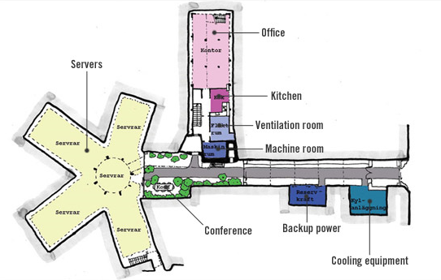
Example 3: Underground Data Centers (ultra-secure data centers are growing in number)
Bahnhof’s Data Center in Stockholm
“…it resides in a former nuclear bunker about 100 ft. (30 m) below ground, sheltered behind 15.7 in. (40 cm) thick metal doors…”

Slide 24
Outline
Background on Underground Facilities
Advantages and Disadvantages
Reducing the Capital Cost of Underground Construction
Why Granite?
Examples of Possible Underground Facilities in Granites of the Southeastern U.S.
Refrigerated Natural Gas Storage
Specialized Manufacturing/Commercial
Underground Data Center
  Regional FEMA and DHS Equipment and Supply Depots
Preliminary Analysis of an Underground versus Above-Ground Cold Storage Facility
Issues, Summary, and Conclusions

Slide 25
Outline
Background on Underground Facilities
Advantages and Disadvantages
Reducing the Capital Cost of Underground Construction
Why Granite?
Examples of Possible Underground Facilities in Granites of the Southeastern U.S. Refrigerated Natural Gas Storage
Specialized Manufacturing/Commercial
Underground Data Center
  Regional FEMA and DHS Equipment and Supply Depots
Preliminary Analysis of an Underground versus Above-Ground Cold Storage Facility
Summary and Conclusions

Slide 26
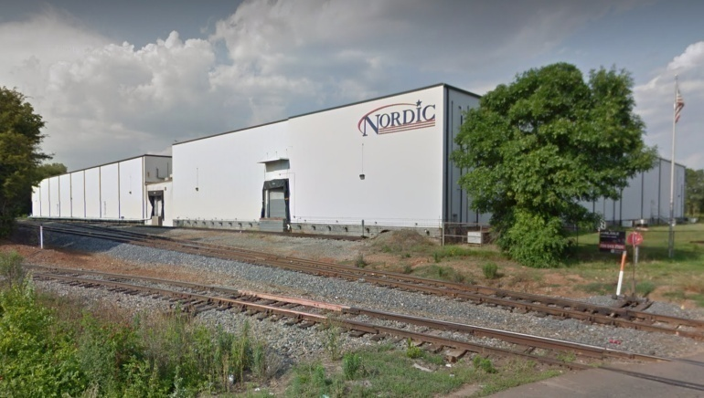
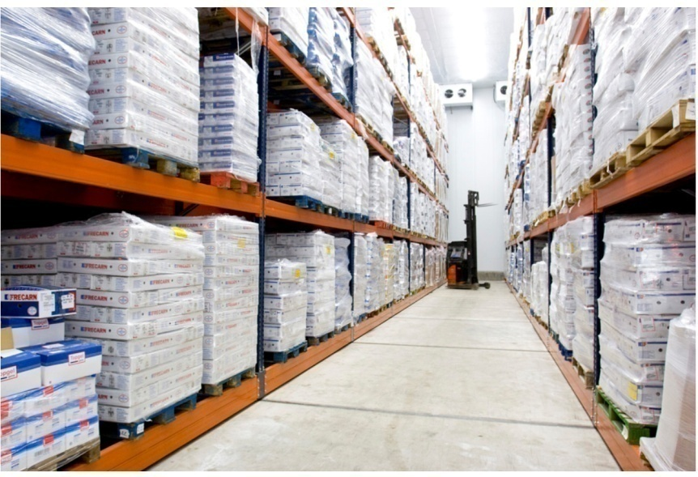
Cold Storage Facility = Specialized Warehouse
Work in Progress….
In the US, 88% used for food storage
Demand > Supply
Capital Cost
--$150 – $175/sq ft---cold storage w/house
--$50 - $60/sq ft ---conventional w/house
Ceiling Height
--22 ft. --20 years ago
--36 – 40 ft. --currently
Operating Cost
--25% is power cost for cooling
-------------------------------------------------------------------------------------------------------------------
Preliminary Result: Over time, the operations savings in lower cost for power, maintenance, etc. could possibly offset (partially? entirely?) the increased capital cost associated with underground construction.
Overview*
Above-Ground Cold Storage Facility
*“Perspectives on Cold Storage Investment Opportunities,” 2014, JLL, available at ww.cold-storage-investment-perspectives-jll-nov2014.pdf

Slide 27
Summary and Conclusions
Underground facilities for specialized energy, commercial, and regional/national security applications can possibly be constructed in granites of the southeastern U.S.
---Capital cost: almost certainly higher
---Life cycle cost: almost certainly lower
Specialized needs examples:
  High levels of hardening, physical protection, and security
  Constant temperature and humidity
  Vibration-free environment
    Viability will depend critically on…
      Geology and hydrology
      Overall commercial viability
      Infrastructure availability and proximity
      Environmental risks, zoning restrictions, and public support
Local and regional economic benefits could be considerable

Slide 28
Thank you for your attention
For additional information
myerswes@msn.com
Acknowledgements: ….highly useful discussions and input from:
  R. H. Carpenter
  J. C. Reid
  R. H. Cook
  W. H. McLemore

