Slide 1
The early Paleozoic (Taconic) Dadeville arc complex, southernmost Appalachians of Alabama and Georgia: Implications for the crustal growth of eastern North America
Dane S. VanDervoort¹, Chong Ma², Mark G. Steltenpohl², Joshua J. Schwartz³
¹Geologic Investigations Program, Geological Survey of Alabama, Tuscaloosa, Alabama 35486
²Department of Geosciences, Auburn University, Auburn, Alabama 36849
³Department of Geological Sciences, California State University-Northridge, Northridge, California 91330, USA
Notes:
The Taconic orogeny is the first in a series of Paleozoic events responsible for the formation of the Appalachian Mountain chain. In the northern and central Appalachians, the Taconic event is heralded by the accretion/obduction of exotic (i.e., Iapetan and peri-Gondwanan) terranes onto the early Paleozoic eastern Laurentian margin; however, its presence in the southern Appalachians has long been disputed. In the southernmost Appalachians of Alabama and Georgia, the Dadeville Complex (DC) (i.e., Inner Piedmont) comprises a suspect terrane of high-grade bimodal meta-igneous and minor metasedimentary rocks cradled between Laurentian units of the eastern Blue Ridge (EBR) (e.g., Jacksons Gap Group and Opelika Complex) and Pine Mountain window. U-Pb age-dating (using LA-SF-ICP-MS) of magmatic and detrital zircons from the DC, in conjunction with previously reported geochemical, lithotectonic, and structural data, reveals that this terrane is an exotic (i.e., containing non-Laurentian ca. 880-680 Ma zircons) Late Cambrian- to Early Ordovician-aged volcanic arc complex (Dadeville arc (DA) herein) formed during Taconic orogenesis. Following its Taconic beaching, the DA was translated along Late Devonian to early Carboniferous (390-350 Ma) strike-parallel dextral shear zones. Some EBR footwall rocks yield dominant ca. 1100 Ma and sparse Ordovician detrital zircons, suggesting a minor source from the DA. The depositional ages of those footwall rocks, therefore, could constrain the timing of approachment and emplacement of the DA. Middle Ordovician (ca. 460 Ma) magmatic and/or metamorphic (Th/U= 0.001-0.48) detrital zircons in the DA overlap with high-grade metamorphism reported in the Lick Ridge eclogite and Winding Stair Gap granulite in the EBR of western North Carolina, the nearest documented outcrops containing peak-Taconic metamorphism northeast of those we report from the DC. If those Taconic events were spatially associated, a minimum of ~220 km of right-slip displacement along the Brevard zone is required. The position of the DC is tectonostratigraphically equivalent to that of the Taconic event found throughout much of the Appalachian orogen but its peculiarly internal and structurally high position make it a unique setting in which to examine the Paleozoic evolution of the southern Appalachians.

Slide 2
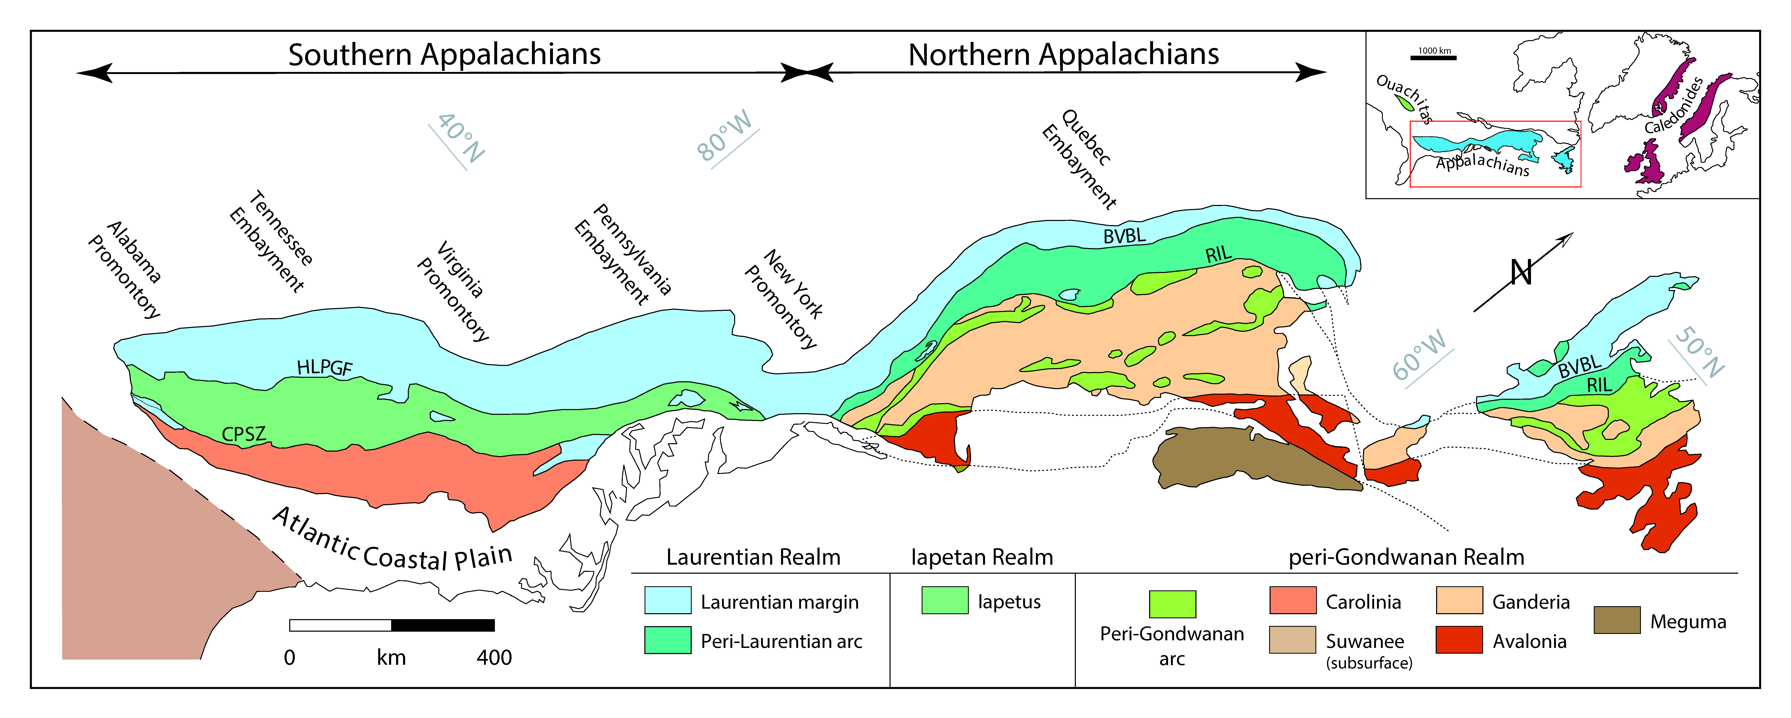
Introduction
The Taconic orogeny is the first in a series of Paleozoic events responsible for the formation of the Appalachian Mountains (Drake et al., 1989; Hatcher, 2005, 2010; Hibbard et al., 2007)
First-order architecture of the Appalachian orogen depicting the distribution of major, mainly pre-Silurian, lithotectonic divisions (modified after Hibbard and Waldron, 2009, and Hibbard and Karabinos, 2013); BVBL = Baie Verte–Bromton line ; CPSZ = central Piedmont shear zone; HLPGF = Hollins Line–Pleasant Grove fault; RIL = Red Indian Line.

Slide 3
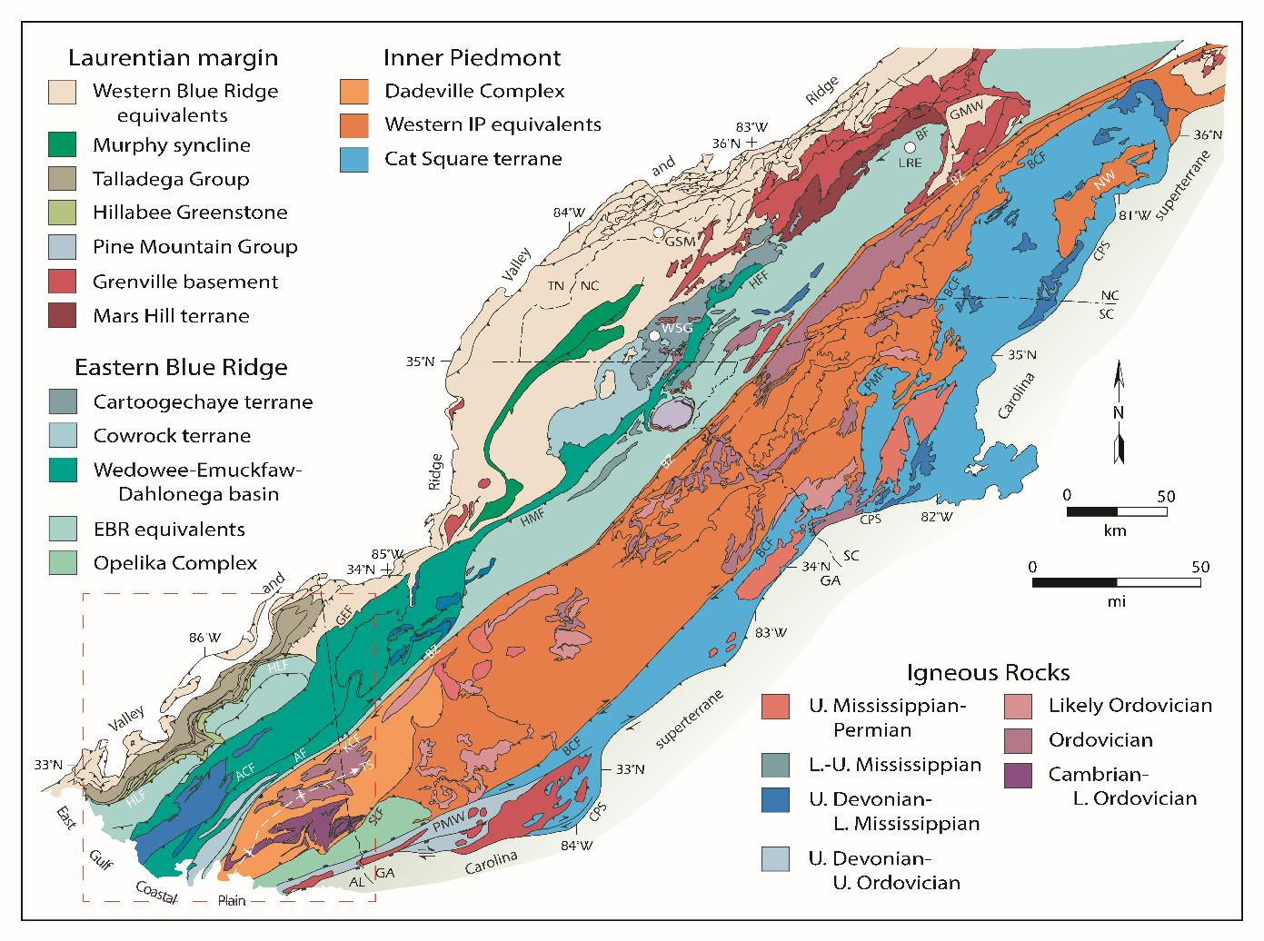
Geologic map of the southern Appalachians (modified after Merschat et al., 2010). AF = Abanda fault; ACF = Alexander City fault; BCF = Brindle Creek fault; BF = Burnsville fault; BZ = Brevard shear zone; CPS = Central Piedmont shear zone; GEF = Goodwater-Enitachopco fault; GMW = Grandfather Mountain Window; GSM = Great Smokey monzonite; HFF = Hayesville-Fries fault; HLF = Hollins Line fault; HMF = Holland Mountain fault; KCF = Katy Creek fault; LRE = Lick Ridge eclogite; NW = Newton Window; PMW = Pine Mountain Window; SLF = Stonewall Line fault; TS = Tallassee synform; WSG = Winding Stair Gap granulite.

Slide 4
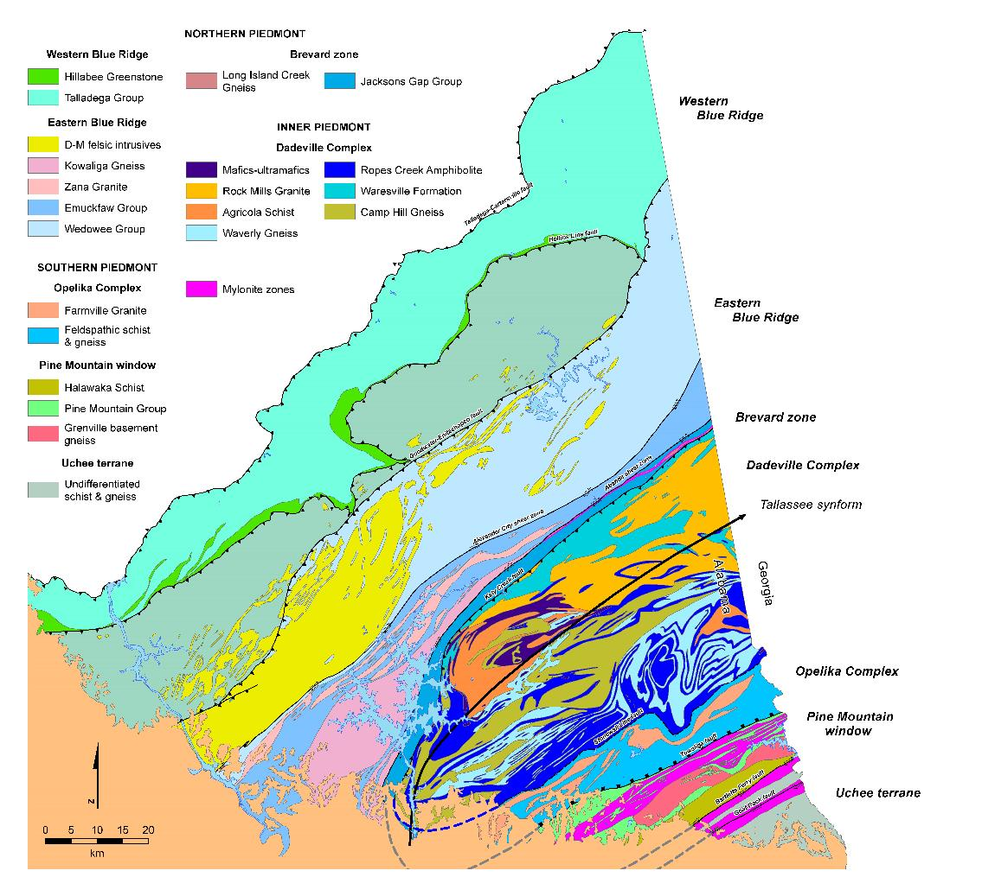
Western Blue Ridge:
Lower Cambrian–Middle Carboniferous rift-drift and successor basin carbonates and clastics (Tull et al., 1988; Gastaldo et al., 1993)
Most outboard preserved portion of the ancient Laurentian margin (Tull, 1982, 2002)
Eastern Blue Ridge:
Neoproterozoic–Lower Ordovician distal slope- rise metasiliciclastics, orthoamphibolite, and Upper Ordovician–Mississippian felsic intrusives (Steltenpohl et al., 2013; Tull et al., 2014)
Dadeville Complex:
Suspect terrane of bimodal metavolcanic, metaplutonic, and minor metasedimentary rocks (Bentley and Neathery, 1970; Steltenpohl et al., 1990)
Only previously reported age is a Rb-Sr isochron age of 462 ± 4 Ma (MSWD = 1.9) (Seal and Kish, 1990)
Geologic map of the southern part of the Alabama Piedmont Upland (modified after Osborne et al. 1988, and Steltenpohl, 2005).
Dashed gray lines are geophysical lineaments from Horton et al. (1989). Dashed blue line represents the base of the Dadeville Complex from White (2008)

Slide 5
Opelika Complex:
Aluminous and graphitic schist, quartzite, feldspathic and biotite-rich metagraywacke, and metagranite (Bentley and Neathery, 1970; Steltenpohl et al., 1990)
Interpreted to be a continuation of the EBR around the hinge of the Tallassee synform (Steltenpohl et al., 2005; Ma et al., 2016)
Pine Mountain window:
Grenville basement massif and it’s attached metasedimentary cover (Steltenpohl et al., 2010)
Geologic map of the southern Appalachians (modified after Merschat et al., 2010). AF = Abanda fault; ACF = Alexander City fault; BCF = Brindle Creek fault; BF = Burnsville fault; BZ = Brevard shear zone; CPS = Central Piedmont shear zone; GEF = Goodwater-Enitachopco fault; GMW = Grandfather Mountain Window; GSM = Great Smokey monzonite; HFF = Hayesville-Fries fault; HLF = Hollins Line fault; HMF = Holland Mountain fault; KCF = Katy Creek fault; LRE = Lick Ridge eclogite; NW = Newton Window; PMW = Pine Mountain Window; SLF = Stonewall Line fault; TS = Tallassee synform; WSG = Winding Stair Gap granulite.
Geologic map of the southern part of the Alabama Piedmont Upland (modified after Osborne et al. 1988, and Steltenpohl, 2005).
Dashed gray lines are geophysical lineaments from Horton et al. (1989). Dashed blue line represents the base of the Dadeville Complex from White (2008)

Slide 6
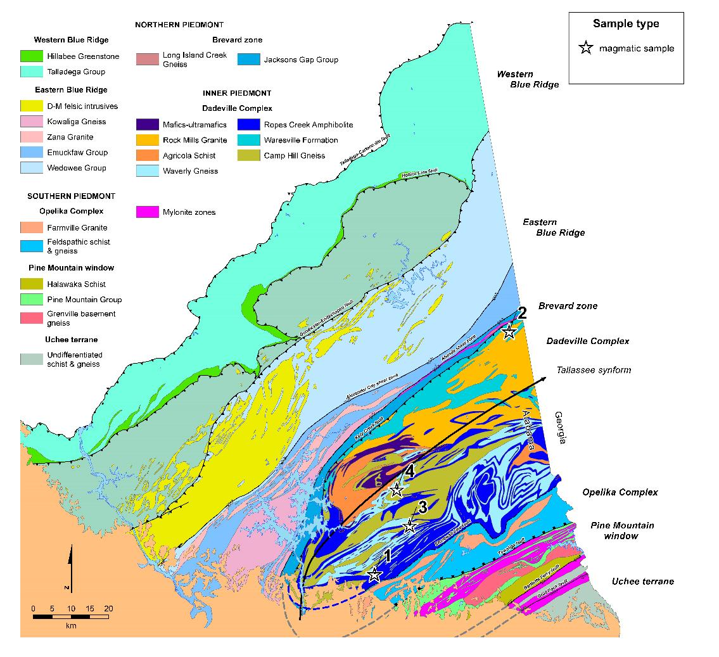
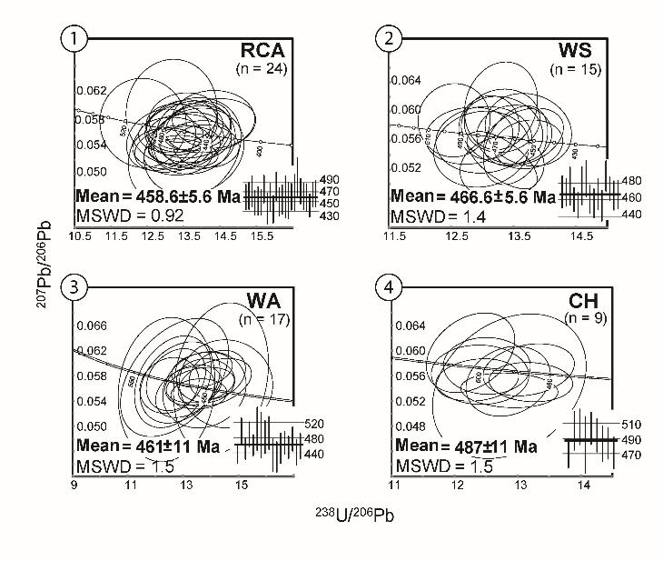
Magmatic ages from the
Dadeville Complex:
Ropes Creek Amphibolite: 458.6±5.6 Ma (2σ)
Waresville Formation: 466.6±5.6 Ma (2σ)
Waverly Gneiss: 461.0±11.0 Ma (2σ)
Camp Hill Gneiss: 487.0±11.0 Ma (2σ)
Geologic map of the southern part of the Alabama Piedmont Upland (modified after Osborne et al., 1988, and Steltenpohl, 2005).
Dashed gray lines are geophysical lineaments from Horton et al. (1989). Dashed blue line represents the base of the Dadeville Complex from White (2008)

Slide 7

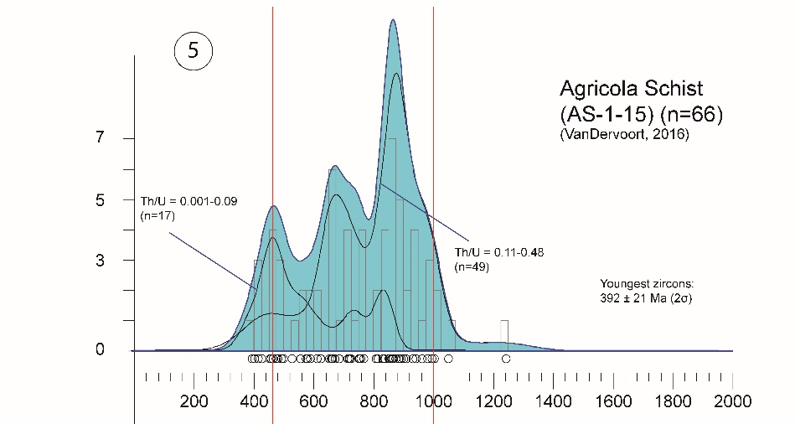

Detrital ages from the
Dadeville Complex:
Ages spanning 1050 ± 31 to 392 ± 21 Ma (2σ), with one outlier grain at 1242 ± 31 Ma (2σ)
Prominent populations at ca. 880, 680, and 460 Ma
Grenville-age zircons conspicuously sparse (10.6%)
~26% of grains have Th/U < 0.1, with groupings at ca. 840 and 460 Ma
Geologic map of the southern part of the Alabama Piedmont Upland (modified after Osborne et al., 1988, and Steltenpohl, 2005).
Dashed gray lines are geophysical lineaments from Horton et al. (1989). Dashed blue line represents the base of the Dadeville Complex from White (2008)

Slide 8
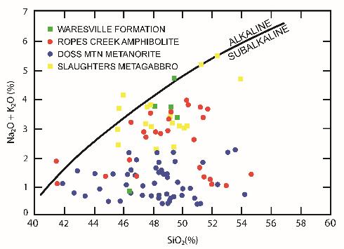
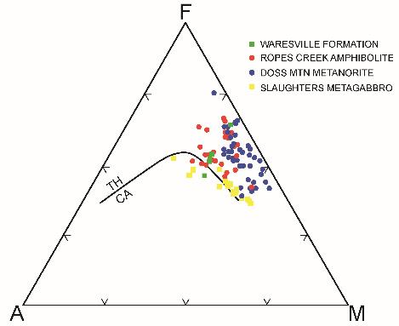
Discussion
The ages of the Ropes Creek Amphibolite, Waresville Formation, and Waverly Gneiss all overlap within error
472-453 Ma is considered to be main magmatic phase of the Dadeville Arc
The older age from the Camp Hill Gneiss is interpreted to be an older magmatic pulse within the evolving Dadeville Arc
The bulk of the Dadeville Complex (>50%) is composed of metamorphosed mafic and intermediate volcanic and volcanoclastic rocks (Bentley and Neathery, 1970)
Intercalated with andesitic, dacitic, and granitic gneisses, minor metasedimentary rocks, and local mafic/ultramafic bodies (Bentley and Neathery, 1970; Steltenpohl et al., 1990)
Closely associated with iron/maganese-rich cherts, potentially representative of an accreted ophiolitic mélange (Sears et al., 1981; Higgins et al., 1988; Spell and Norrell, 1990)
Alkali-SiO₂ diagram for amphibolites from the Dadeville Complex (from Stow et al., 1984, and Neilson et al., 1986). Alkaline-subalkaline dividing line is (from Irvine and Barager, 1971).
AFM diagram for amphibolites from the Dadeville Complex (from Stow et al., 1984, and Neilson et al., 1986). TH/CA represents the boundary between tholeiitic and calc-alkaline rocks (from Irvine and Barager (1971).

Slide 9
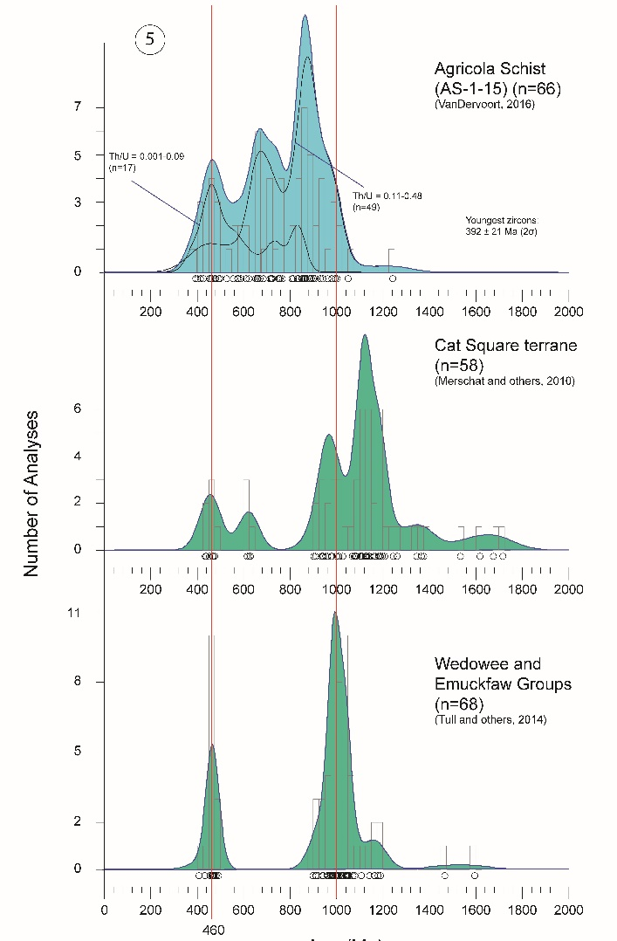

Detrital ages from the
Dadeville Complex:
Paucity of Late Neoproterozoic and rare Paleozoic populations suggests a non- Laurentian source
Ca. 460 Ma population probably derived from DA itself
Spectra suggests a non-Laurentian affinity and common 460 Ma populations
Geologic map of the southern part of the Alabama Piedmont Upland (modified after Osborne et al., 1988, and Steltenpohl, 2005).
Dashed gray lines are geophysical lineaments from Horton et al. (1989). Dashed blue line represents the base of the Dadeville Complex from White (2008)

Slide 10

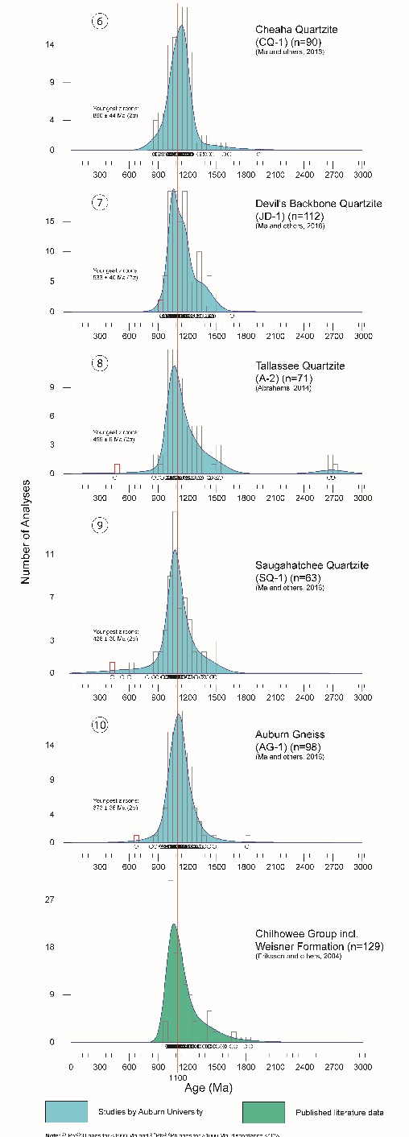
Geologic map of the southern part of the Alabama Piedmont Upland (modified after Osborne et al. 1988, and Steltenpohl, 2005).
Dashed gray lines are geophysical lineaments from Horton et al. (1989). Dashed blue line represents the base of the Dadeville Complex from White (2008)

Slide 11
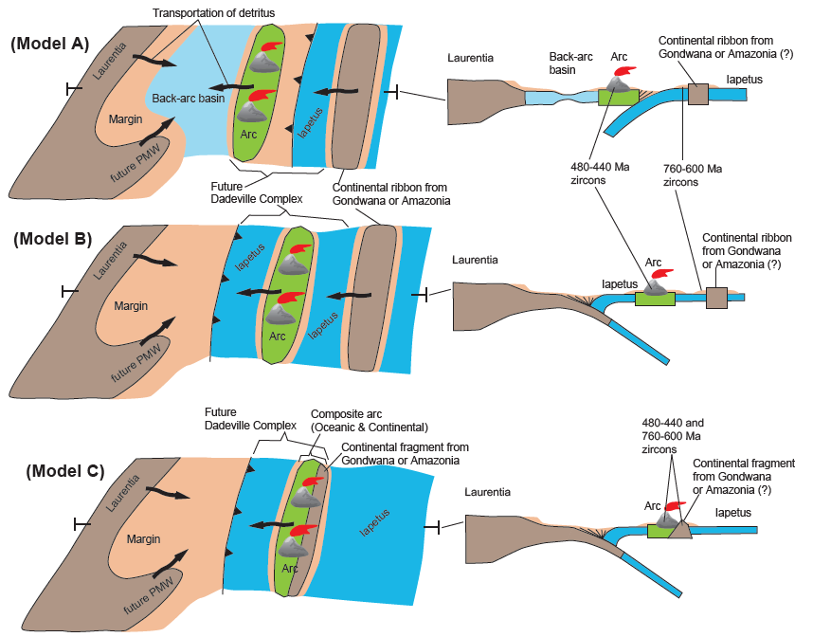
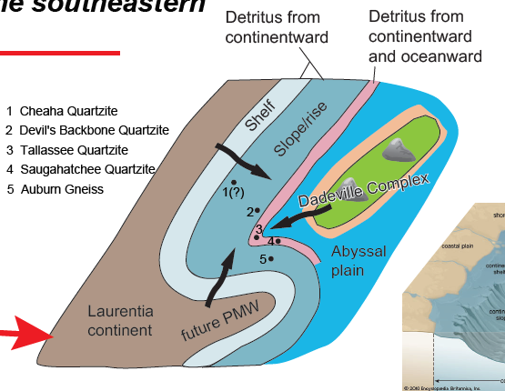
The Alabama-Georgia Laurentian margin might have originated as an embayment with marginal strata to the west and basement/cover rocks to the east, a shape roughly corresponding to the regional Tallassee synform

Slide 12
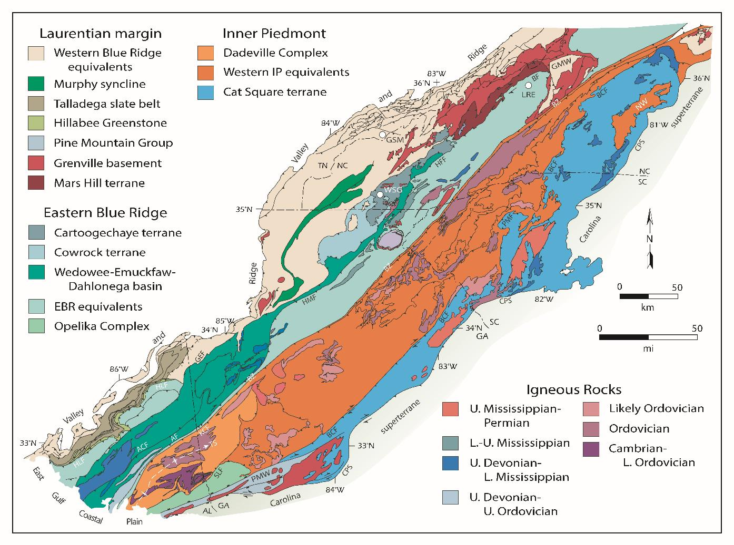
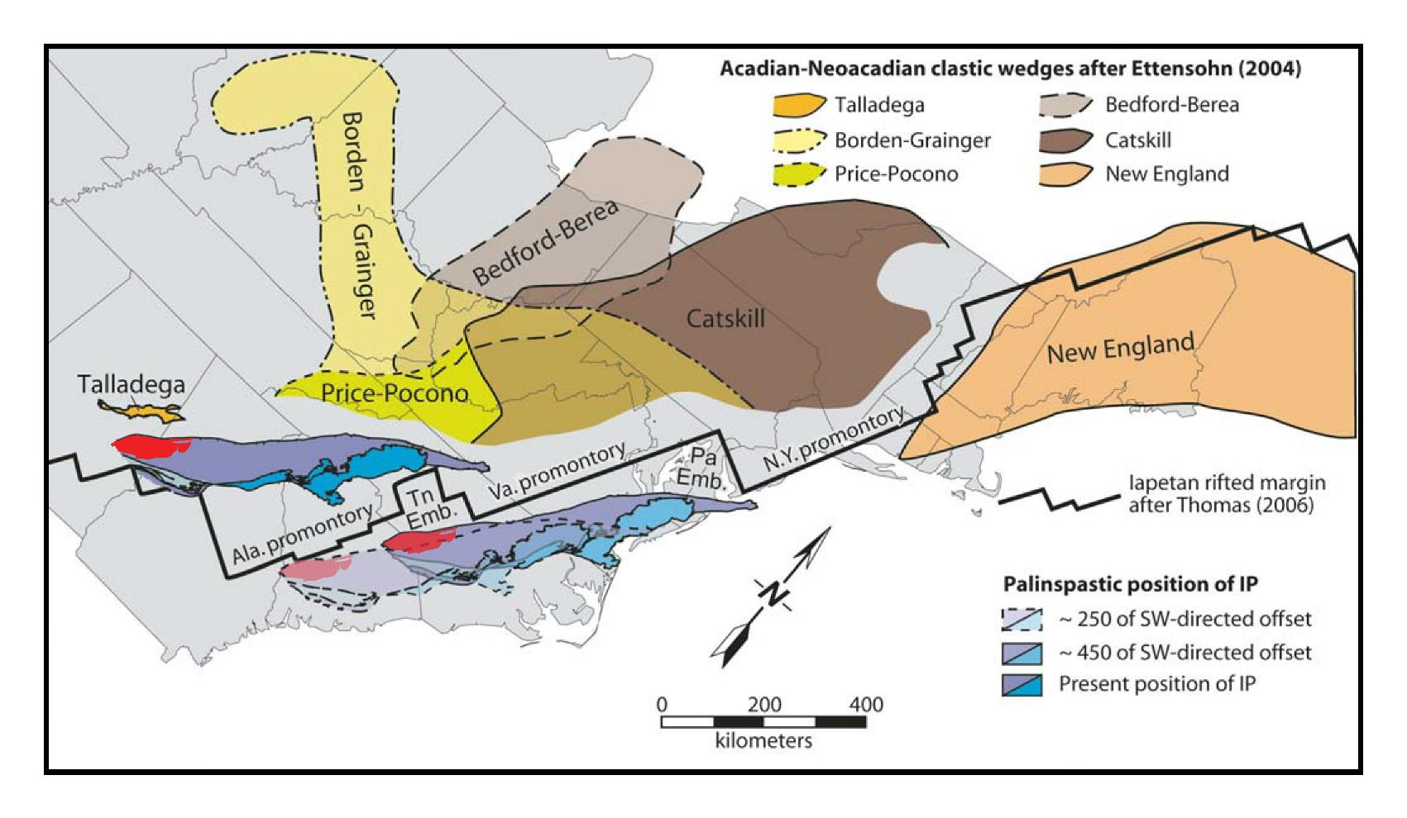
Geologic map of the southern Appalachians (modified after Merschat et al., 2010). AF = Abanda fault; ACF = Alexander City fault; BCF = Brindle Creek fault; BF = Burnsville fault; BZ = Brevard shear zone; CPS = Central Piedmont shear zone; GEF = Goodwater-Enitachopco fault; GMW = Grandfather Mountain Window; GSM = Great Smokey monzonite; HFF = Hayesville-Fries fault; HLF = Hollins Line fault; HMF = Holland Mountain fault; KCF = Katy Creek fault; LRE = Lick Ridge eclogite; NW = Newton Window; PMW = Pine Mountain Window; SLF = Stonewall Line fault; TS = Tallassee synform; WSG = Winding Stair Gap granulite.
Geologic map of the southern Appalachians (modified after Merschat et al., 2010). AF = Abanda fault; ACF = Alexander City fault; BCF = Brindle Creek fault; BF = Burnsville fault; BZ = Brevard shear zone; CPS = Central Piedmont shear zone; GEF = Goodwater-Enitachopco fault; GMW = Grandfather Mountain Window; GSM = Great Smokey monzonite; HFF = Hayesville-Fries fault; HLF = Hollins Line fault; HMF = Holland Mountain fault; KCF = Katy Creek fault; LRE = Lick Ridge eclogite; NW = Newton Window; PMW = Pine Mountain Window; SLF = Stonewall Line fault; TS = Tallassee synform; WSG = Winding Stair Gap granulite.
Possible palinspastic location of the Inner Piedmont and distribution of major delta complexes of the Acadian-Neoacadian clastic wedge (modified after Merschat and Hatcher, 2007). Red polygon within the Inner Piedmont denotes the approximate location of the Dadeville Arc. Location and shape of clastic wedges are after Ettensohn (2004), and Iapetan rifted margin is from Thomas (2006). Emb.–embayment.

Slide 13
Conclusions
U-Pb zircon geochronology reveals ca. 467-459 and 487 Ma magmatism in the Dadeville Complex of the Alabama Inner Piedmont
The detrital spectrum of the Dadeville Complex yields Proterozoic and Paleozoic zircon populations atypically of those found along the Laurentian margin
Proterozoic grains were likely sourced from a Gondwana terrane, and were likely deposited in an environment that received only a limited amount of Laurentian detritus
A low Th Ordovician zircon populations overlap with high-pressure metamorphism reported in the Blue Ridge of North Carolina and Tennessee, and likely results from Taconic regional metamorphism
This information combined with previously reported geochemical, lithotectonic, and structural data, reveals that the Dadeville Complex is an exotic Taconic arc terrane emplaced following subsequent Paleozoic orogenic processes

Slide 14
Acknowledgments
We thank Meghann Decker and Mike Cho at California State University, Northridge and Paul Mueller as the University of Florida for assistance with the U-Pb zircon dating
This project was primarily funded by a National Cooperative Geologic Mapping Program (NCGMP) EDMAP grant awarded by the United States Geologic Survey (USGS) to Dr. Mark G. Steltenpohl
Additional funding in support of this project was provided by a Graduate Student Research Grant awarded by the Southeastern Section of the Geological Society of America

Slide 15
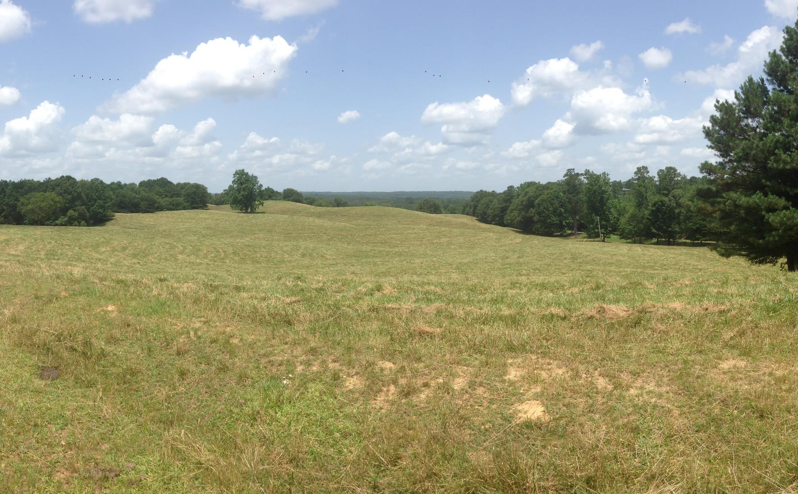
Questions?

Slide 16
References
Bentley, R. D., and Neathery, T. L, 1970, Geology of the Brevard fault zone and related rocks of the Inner Piedmont of Alabama: Alabama Geological Society Field Trip Guidebook, n. 8, 119 p.
Drake, A. A., Jr., Sinha, A. K., Laird, J., and Guy, R. E., 1989, The Taconic orogen, in Hatcher, R. D., Jr., Thomas, W. A., and Viele, G. W., eds., The Appalachian–Ouachita Orogen in the United States: Boulder, Colorado, Geological Society of America, Geology of North America, v. F-2, p. 101-177.
Ettensohn, F. R., 2004, Modeling the nature and development of major Paleozoic clastic wedges in the Appalachian basin, USA: Journal of Geodynamics, v. 37, p. 657-681
Gastaldo, R. A., Guthrie, G. M., and Steltenpohl, M. G., 1993, Mississippian fossils from southern Appalachian metamorphic rocks and their implications for Late Paleozoic tectonic evolution: Science, v. 262, p. 732-734.
Harstad, R. P., Whitmore, J. P., Steltenpohl, M. G., Kath, R. L., Tefend, K. S., and Schwartz, J. J., 2017, Geological investigations of the Long Island Creek Gneiss within the southernmost Brevard shear zone, Alabama and Georgia: Geological Society of America Abstracts with Program, v. 49, n. 2, doi: 10.1130/abs/2017SE-291621.
Hatcher, R. D., Jr., 2005, Southern and central Appalachians, in Selley R.C., Cocks, L. R. M., and Plimer, I. R., eds., Encyclopedia of Geology, Elsevier Academic Press, Amsterdam, p. 72-81.
Hatcher, R. D., Jr., 2010, The Appalachian orogen: A brief summary, in Tollo, R. P., Bartholomew, M. J., Hibbard, J. P., and Karabinos, P. M., eds., From Rodinia to Pangea: The Lithotectonic Record of the Appalachian Region: Geological Society of America Memoir 206, p. 1-19.
Hawkins, J. F., 2013, Geology, petrology, and geochronology of rocks in the Our Town, Alabama quadrangle: Unpublished M.S. thesis, Auburn University, Auburn, Alabama, 106 p.
Hibbard, J. P.,, and Waldron, J. W. F., 2009, Truncation and translation of Appalachian promontories: Mid-Paleozoic strike-slip tectonics and basin initiation: Geology, v. 37, n. 6, p. 487-490.
Hibbard, J. P., and Karabinos, P., 2013, Disparate Paths in the Geologic Evolution of the Northern and Southern Appalachians: A Case for Inherited Contrasting Crustal/Lithospheric Substrates: Geoscience Canada, v. 40, n. 4, p. 303-317.
Hibbard, J. P., van Staal, C. R., and Rankin, D. W., 2007, A comparative analysis of pre-Silurian crustal building blocks of the northern and southern Appalachian orogen: American Journal of Science, v. 307, p. 23-45.
Higgins, M. W., Atkins, R. L., Crawford, T. J., Crawford, R. F., Brooks, R., and Cook, R. B., 1988, The structure, stratigraphy, tectonostratigraphy and evolution of the southernmost part of the Appalachian orogen: U.S. Geological Survey Professional Paper 1475, 173 p.
Horton, J. W., Drake, A. A., Jr., and Rankin, D. W., 1989, Tectonostratigraphic terranes and their boundaries in the central and southern Appalachians, in Dallmeyer, R. D., ed., Terranes in the Circum-Atlantic Paleozoic orogens: Geological Society of America Special Paper 230, p. 213-245.
Irvine, T. N. and W. R. A. Baragar, 1971, A guide to the chemical classification of the common volcanic rocks: Canadian Journal of Earth Sciences, v. 8, p. 523-548.
Ma, C., Steltenpohl, M. G., Schwartz, J. J., Mueller, P. A., and VanDervoort, D. S., 2016, Detrital-zircon geochronology of metasiliciclastics from the southernmost Appalachian orogen: Implications for the configuration of the southeastern Laurentian margin, Alabama and Georgia: Geological Society of America Abstracts with Program, v. 48, n. 7, doi: 10.1130/abs/2016AM-287546.
Merschat, A. J., and Hatcher, R. D., Jr., 2007, The Cat Square terrane: Possible Siluro-Devonian remnant ocean basin in the Inner Piedmont, southern Appalachians, USA, in Hatcher, R. D., Jr., Carlson, M. P., McBride, J. H., and Martínez Catalán, J. R., eds., 4-D Framework of Continental Crust: Geological Society of America Memoir 200, p. 553-565.
Merschat, A. J., Hatcher, R. D., Jr., and Davis, T. L., 2005, The northern Inner Piedmont, southern Appalachians, USA: Kinematics of transpression and SW-directed mid-crustal flow: Journal of Structural Geology, v. 27, p. 1252-1281.
Merschat, A. J., Hatcher, R. D., Jr., Bream, B. R., Miller, C. F., Byars, H. E., Gatewood, M. P., and Wooden, J. L., 2010, Detrital zircon geochronology and provenance of southern Appalachian Blue Ridge and Inner Piedmont crystalline terranes, in Tollo, R. P., Bartholomew, M. J., Hibbard, J. P., and Karabinos, P. M., eds., From Rodinia to Pangea: The Lithotectonic Record of the Appalachian Region: Geological Society of America Memoir, v. 206, p. 661-699.
Neilson, M. J. and Stow, S. H., 1986, Geology and geochemistry of the mafic and ultramafic intrusive rocks from the Dadeville Belt, Alabama: Geological Society of America Bulletin, v. 97, p. 296-304.
Osborne, W. E., Szabo, M. W., Neathery, T. L., and Copeland, C. W., Jr., compilers, 1988, Geologic map of Alabama, northeast sheet: Alabama Geological Survey Special Map 220, scale 1:250,000.
Seal, T. L., and Kish, S. A., 1990, The geology of the Dadeville Complex of the western Georgia and eastern Alabama Inner Piedmont: Initial petrographic, geochemical, and geochronological results, in Steltenpohl, M. G., Neilson, M. J., and Kish, S. A., eds., Geology of the southernmost Inner Piedmont Terrane, Alabama and southwest Georgia: Tuscaloosa, Alabama, Geological Society of America, Southeastern Section Meeting, Field Trip Guidebook, p. 65-77.
Sears, J. W., Cook, R. B., Jr., and Brown, D. E., 1981, Tectonic evolution of the Pine Mountain Window and adjacent Inner Piedmont province, in Sean, J. W., ed., Contrasts in Tectonic Style between the Inner Piedmont Terrane and the Pine Mountain Window: Alabama Geological Society Guidebook 18, p. 1-13.
Steltenpohl, M. G., 2005, A primer on terranes of the southernmost Appalachians of Alabama and Georgia, in Steltenpohl, M. G., ed., New Perspectives on Southernmost Appalachian Terranes, Alabama and Georgia: Geological Society, Southeastern Section of the Geological Society of America Feld Trip guidebook, p. 1-18.
Steltenpohl, M. G., Kish, S. A., and Neilson, M. J., eds., 1990, Geology of the southern Inner Piedmont terrane, Alabama and southwest Georgia: Southeastern Section of the Geological Society of America Field Trip Guidebook, 139 p.
Steltenpohl, M. G., Schwartz, J. J, and Miller, B. V., 2013, Late to post-Appalachian strain partitioning and extension in the Blue Ridge of Alabama and Georgia: Geosphere, v. 9, n. 3, p. 647-666.
Steltenpohl, M. G., Cook, R. B., Grimes, J.E., Keefer, W. D., Heatherington, A., and Mueller, P., 2005, Geology of the Brevard zone in the hinge of the Tallassee synform, Alabama fall line: Implications for southern Appalachian tectonostratigraphy, in Steltenpohl, M.G., ed., 2005, New Perspectives on Southernmost Appalachian Terranes, Alabama and Georgia: Geological Society, Southeastern Section of the Geological Society of America Feld Trip guidebook, p. 125-148.
Steltenpohl, M. G., Hatcher, R. D., Jr., Mueller, P. A., Heatherington, A. L., and Wooden, J. L., 2010, Geologic history of the Pine Mountain window, Alabama and Georgia: Insights from a new geologic map and U-Pb isotopic dates, in Tollo, R.P., Bartholomew, M.J., Hibbard, J.P., and Karabinos, P.M., eds., From Rodinia to Pangea: The Lithotectonic Record of the Appalachian Region: Geological Society of America Memoir 206. Boulder, Colorado, p. 837-858.
Stoddard, P. V., 1983, A petrographic and geochemical analysis of the Zana Granite and Kowaliga Augen Gneiss: Northern Piedmont, Alabama: Unpublished M.S. thesis, Memphis State University, Memphis, Tennessee, 74 p.
Stow, S. H., Neilson, M. J., and Neathery, T. L., 1984, Petrography, geochemistry, and tectonic significance of the amphibolites of the Alabama Piedmont; mafic and ultramafic rocks of the Appalachian orogen: American Journal of Science, v. 284, p. 414-436.
Thomas, W. A., 2006, Tectonic inheritance at a continental margin: GSA Today, v. 16, no. 2, p. 4-11.
Tull, J. F., 1982, Polyphase late Paleozoic in the Appalachian thrust belt and Piedmont of Alabama; The Geological Society of America, 95th annual meeting: Geological Society of America Abstracts with Programs, v. 14, p. 634.
Tull, J. F., 2002, Southeastern margin of the middle Paleozoic shelf, southwesternmost Appalachians: Regional stability bracketed by Acadian and Alleghanian tectonism: Geological Society of America Bulletin, v. 114, p. 643-655.
Tull, J. F., Harris, A. G., Repetzki, J. E., McKinney, F. K., Garrett, C. B., and Bearce, D. N., 1988, New paleontologic evidence constraining the age and paleotectonic setting of the Talladega slate belt, southern Appalachians: Geological Society of America Bulletin, v. 100, p. 1291-1299.
Tull, J. F., Holm-Denoma, C. S., and Barineau, C. I., 2014, Early to Middle Ordovician back-arc basin in the southern Appalachian Blue Ridge: Characteristics, extent, and tectonic significance: Geological Society of America Bulletin, v. 126, n. 7/8, p. 990-1015.
White, T. W., 2008, Geology of the 1:24,000 Tallassee, Alabama, quadrangle, and its implications for southern Appalachian tectonics: Unpublished M.S. thesis, Auburn University, Auburn, Alabama, 74 p.

