Slide 1


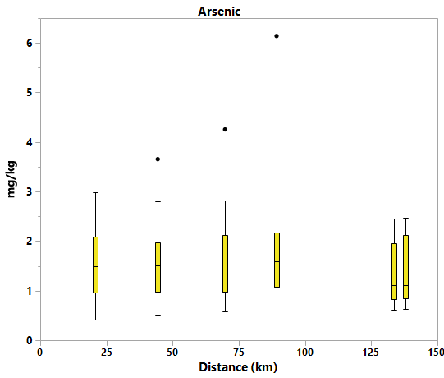
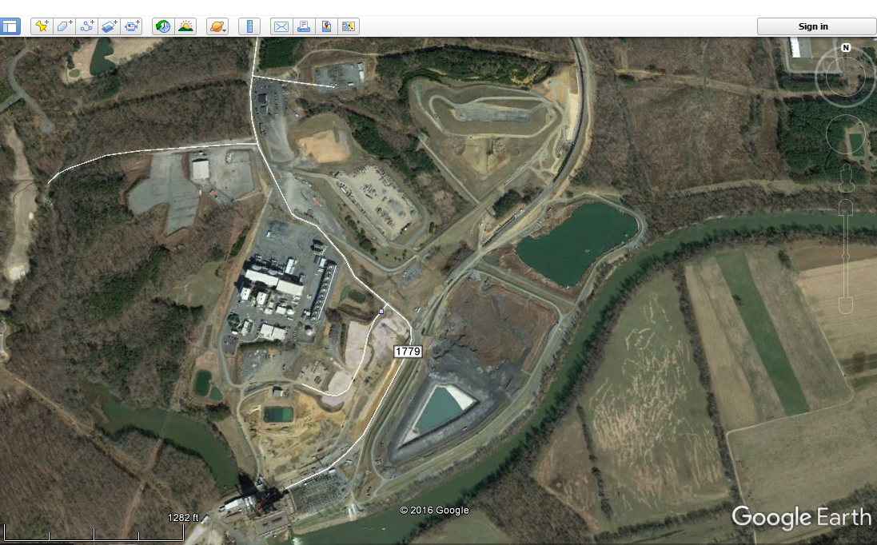
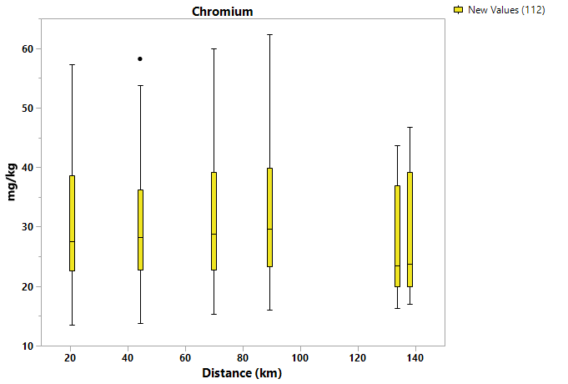
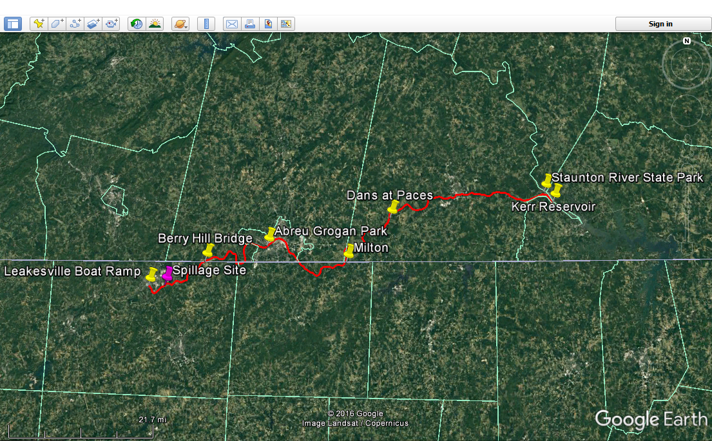
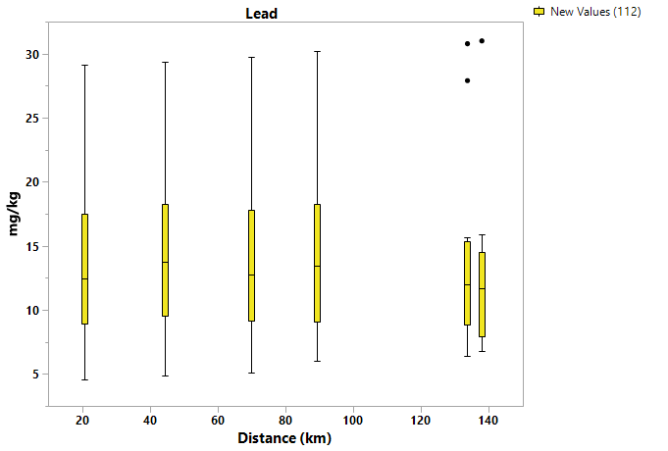
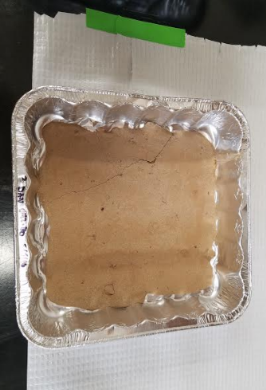
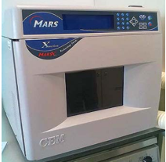
Trace Elements in Dan River Sediment after the 2014 Coal Ash Spill
Ricardo P. Fernandez, Caleb Shockley, and Madeline E. Schreiber
Department of Geosciences, Virginia Tech; Blacksburg, VA 24060
On February 2, 2014, an estimated 82,000 tons of coal ash and 27 million gallons of contaminated water were released into the Dan River from a ruptured storm drainage pipe underneath the ash pond at the Duke Energy Stream Station in Eden, NC. Coal ash contains elevated concentrations of trace elements, some of which are toxic, prompting a concern that the ash spill could adversely impact human, aquatic, and environmental health over time.
Results
Background
Results, continued
Results are shown as concentration over time (Figure 5, 7, 9) or concentration over distance (Figures 6, 8, 10). We present results for three example trace elements: arsenic (As; Figure 5, 6), chromium (Cr; Figures 7, 8) and lead (Pb; Figures 9, 10).
Concentration vs. Time
Concentration vs. Distance
Figure 11. Scatter matrix plot from JMP (SAS) showing correlations between trace elements in river sediment.
Figure 1. Google Earth image of Duke Energy Coal plant. In the red circle is the ash pond that leaked. The orange dot indicates the source point of the leak due to a breakage of the storm water pipe.
Figure 5. Time series of sediment As concentrations (mg/kg) from April 2014-February 2016. Only one sample is over the Threshold Effect Limit (TEL) of 5.9 mg/kg in August 2014.
Figure 6. Arsenic concentration versus distance from the Leakesville boat ramp (LBR) to the Kerr Reservoir (2014-2015). The spill occurred at 6.22km. The Wildlife Access Boat Ramp (2km from LBR) registered 1.12 and 1.05 arsenic concentrations in 2014 and 2015 respectively.
Research Objective
Results of a correlation analysis (Figure 11) show that most of the trace elements are correlated with each other and with Fe.
The objective of the study was to identify coal ash derived trace element signatures in Dan River sediment over space and time.
Discussion
Materials and Methods
Results of our study on trace elements in sediment of the Dan River after the Feb 2014 coal ash spill reveals several important trends:
Arsenic, Cr and Pb concentrations in sediment were higher in 2014 than in 2015.
The Threshold Effects Limit (TEL) was only exceeded once for As and was not exceeded for Pb, but 25% of our samples exceeded the TEL for Cr.
The correlation analysis shows two trends for several trace elements, including As. The “enriched” trend may be indicative to the presence of coal ash in the sample, as coal ash can be enriched with respect to As (Deonarine et al., 2015). Previous work on the Dan River coal ash spill found nanoparticles containing As in river water; the As was associated with Fe minerals (Yang et al., 2015).
Future work includes conducting additional statistical analyses and comparison with background samples to evaluate if trace elements in sediment is related to the coal ash spill, to other human influences, or to background conditions.
Dan River sediment samples were collected by our research group and the Virginia Department of Environmental Quality (DEQ) over a two year period (2014-2016) from sites along the river from Berry Hill Bridge to the Kerr Reservoir (Figure 2).
Figure 7. Time series of sediment Cr concentrations (mg/kg) from April 2014 -February 2016. 25% of samples are over the TEL for Cr of 37.3 mg/kg.
Figure 8. Cr concentration versus distance from the Leakesville boat ramp (LBR) to the Kerr Reservoir (2014-2015). The spill occurred at 6.22km. The Wildlife Access Boat Ramp (2km from LBR) registered 37.7 and 33.5 Cr concentrations in 2014 and 2015 respectively.
Figure 2. Dan River (red). Yellow pins are sample sites with the exception of the starting point. The spillage occurred at the pink pin.
References
The samples (Figure 3) were microwaved in a CEM Mars Express microwave (Figure 4), digested using EPA Method 3051, and analyzed for trace elements using ICP-MS.
Figure 9. Time series of sediment Pb concentrations (mg/kg) from April 2014-February 2016. No samples exceeded the TEL of 35 mg/kg.
Figure 10. Pb concentration versus distance from the LBR to the Kerr Reservoir (2014-2015). The spill occurred at 6.22km. The Wildlife Access Boat Ramp (2km from LBR) registered 12.0 and 9.1 Pb concentrations in 2014 and 2015 respectively.
Deonarine, Amrika,. et al. Trace Elements in Coal Ash. United States Geological Survey (USGS), 2015, https://pubs.usgs.gov/fs/2015/3037/pdf/fs2015-3037.pdf.
NOAA, Screening Quick Reference Tables, http://response.restoration.noaa.gov/environmental-restoration/environmental-assessment-tools/squirt-cards.html
Yang, Yi, et al. "Importance of a Nanoscience Approach in the Understanding of Major Aqueous
Contamination Scenarios: Case Study from a Recent Coal Ash Spill." Environmental Science & Technology 49.6 (2015): 3375-3382.
We compared the concentration data to the Freshwater Sediment Threshold Effects Limit (TEL) from the U.S. Screening Quick Reference Table for Inorganics in Sediment (SQUIRT). Results of the comparison show exceedances for one sample for As (TEL is 5.9 mg/kg) and 25% of the samples for Cr (TEL is 37.3 mg/kg). There were no exceedances for Pb (TEL 35 mg/kg), although several samples in 2014 came close.
Acknowledgments
Special thanks to the Virginia Department of Environmental Quality for providing the sediment samples and to the NSF RAPID program for supplying partial funding.
Figure 3. Picture of sediment.
Figure 4. CEM Microwave

