Slide 1
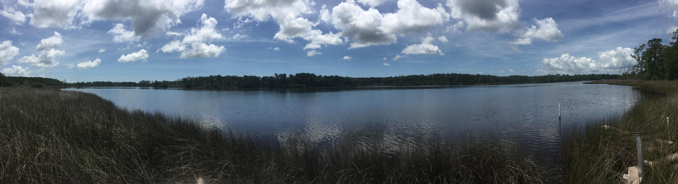
Temperature Effects on the Carbon Content of Marsh Core Subsamples through Time
Anna Atencio, Antonio Rodriguez, Brent McKee
University of North Carolina at Chapel Hill
Geology and Marine Sciences

Slide 2

Introduction
Blue Carbon
Salt marshes, mangroves, and seagrasses
46.9% of total C burial in ocean sediments (Duarte et al 2005)
Bury C at a rate 30 to 50 times that of terrestrial forests (McLeod et al 2011, Duarte et al 2013)
Loss of these habitats at critical rates
No universal method of marsh core sample handling
Minimize field to lab time and freeze the core (Blue Carbon Initiative 2014)
Some use CHN, some use LOI converted to %OC with Craft’s 1991 conversion equation

Slide 3
Questions
Does storage temperature effect the carbon content in a marsh core over time?
Does depth of the sample in the core affect the above result?
Labile versus Recalcitrant carbon
How does propagated error in loss on ignition (LOI) compare to CHN analysis?
CHN analytical error is an order of magnitude lower than LOI analytical error
How do the 2 compare in reproducibility?

Slide 4
Hypothesis

Slide 5
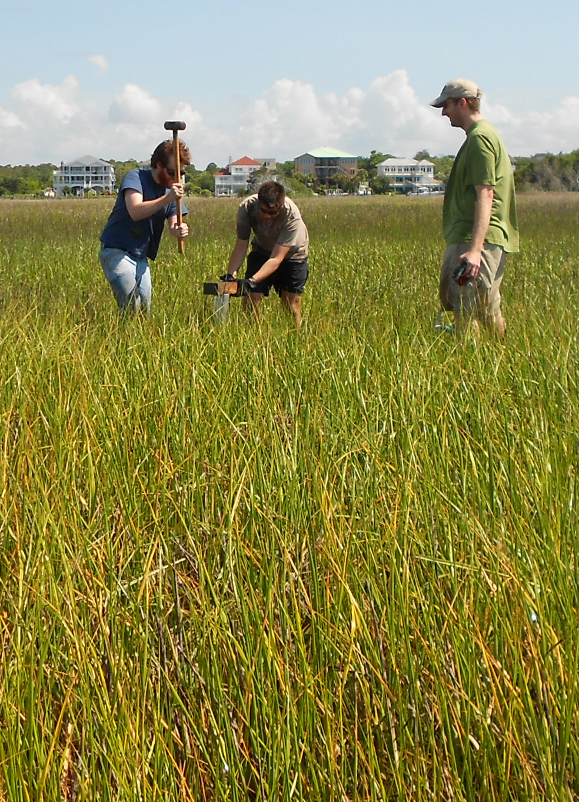
Methods

Slide 6
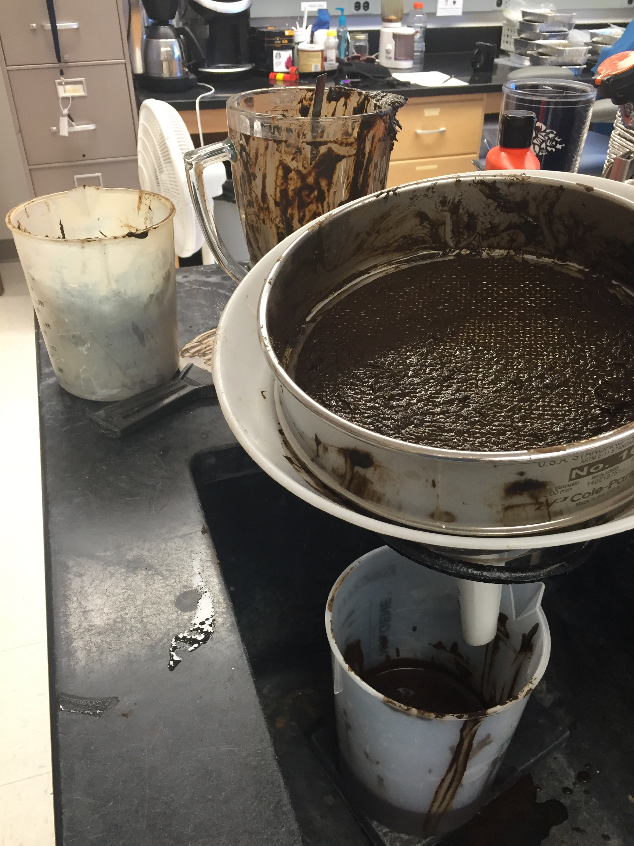
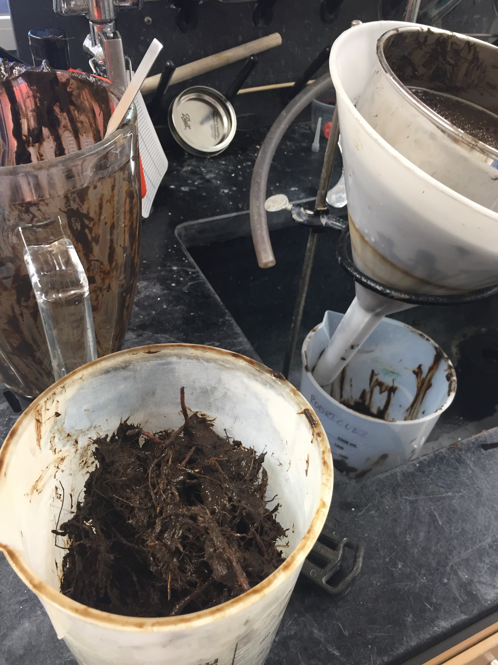
Methods
Core
5-15
cm
Upper
Sieved & Homog
Sieved & Homog
65-75
cm
Lower

Slide 7
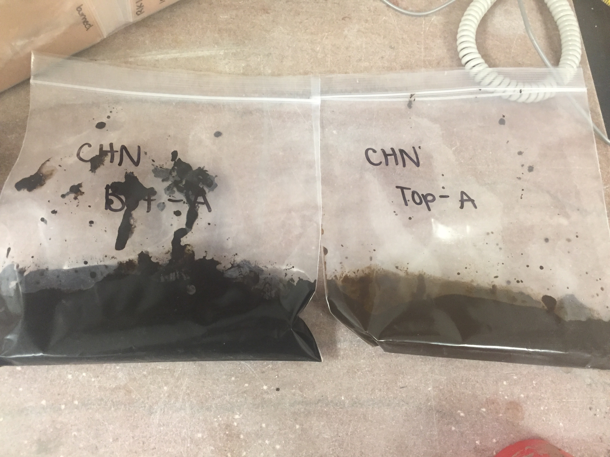
Methods
Core
Temperature
Ambient 24˚C
Upper
UA
Sieved & Homog
Refrigerator 1.5˚C
UR
Sieved & Homog
Freezer -20˚C
UF
Lower

Slide 8
Methods
Core
Temperature
Ambient 24˚C
Upper
UA
Sieved & Homog
LA
Refrigerator 1.5˚C
UR
LR
Sieved & Homog
Freezer -20˚C
UF
Lower
LF

Slide 9
Methods
Core
Temperature
Subsampling
Subsampling:
3 subsamples per bag per sample day.
Oven dried on low heat for 24 hours
Ambient 24˚C
Upper
UA
Sieved & Homog
Sampling Days:
0
1
2
4
8
16
32
64
128
LA
Refrigerator 1.5˚C
UR
LR
Sieved & Homog
Freezer -20˚C
UF
Lower
LF

Slide 10
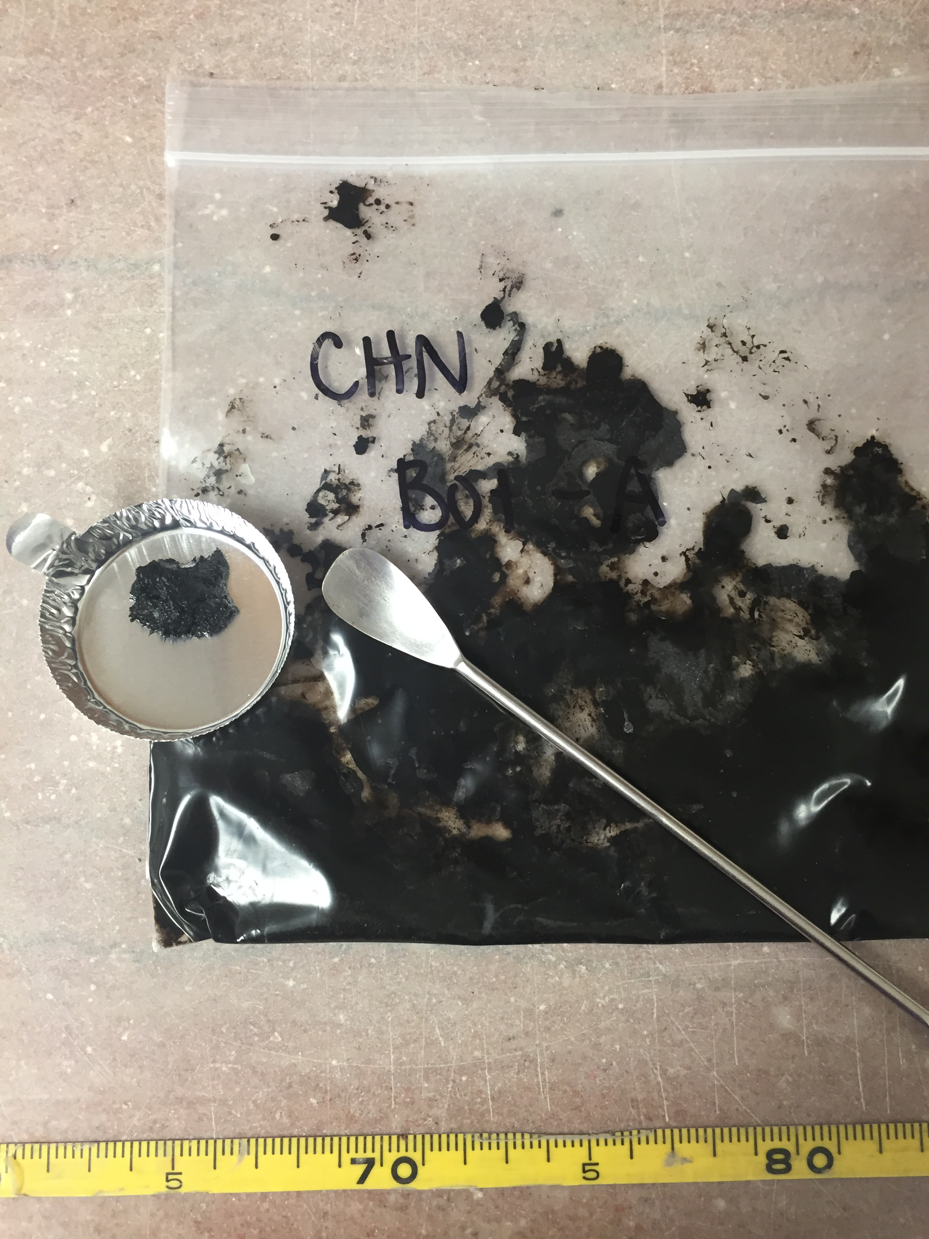
Methods
Core
Temperature
Subsampling
Ambient 24˚C
Upper
UA
Sieved & Homog
LA
Refrigerator 1.5˚C
UR
LR
Sieved & Homog
Freezer -20˚C
UF
Lower
LF

Slide 11
Methods
Core
Temperature
Subsampling
Subsampling:
3 subsamples per bag per sample day.
Oven dried on low heat for 24 hours
Ambient 24˚C
Upper
UA
Sieved & Homog
Sampling Days:
0 – 3 subsamples for each section
1
2
4
8
16
32
64
128
LA
Refrigerator 1.5˚C
UR
LR
Sieved & Homog
Freezer -20˚C
UF
2 sections→ 3 treatments → 8 sampling days→
3 subsamples + 6 initial subsamples
150 Subsamples
Lower
LF

Slide 12
Methods
Core
Temperature
Subsampling
Analysis
Ambient 24˚C
Upper
CHN
UA
Costech Analytical Instruments
Elemental Combustion System 4010
Sieved & Homog
LA
Refrigerator 1.5˚C
UR
150 Subsamples for
each analysis
LR
Sieved & Homog
Freezer -20˚C
UF
LOI
550˚C for 4 hours
Lower
LF
Notes:
Costech Analytical Instruments Elemental Combustion System 4010

Slide 13
Methods
Core
Temperature
Subsampling
Analysis
Ambient 24˚C
Upper
CHN
UA
STDEV
Sieved & Homog
LA
Refrigerator 1.5˚C
AVG
UR
LR
Sieved & Homog
Freezer -20˚C
STDEV
UF
LOI
Lower
LF

Slide 14
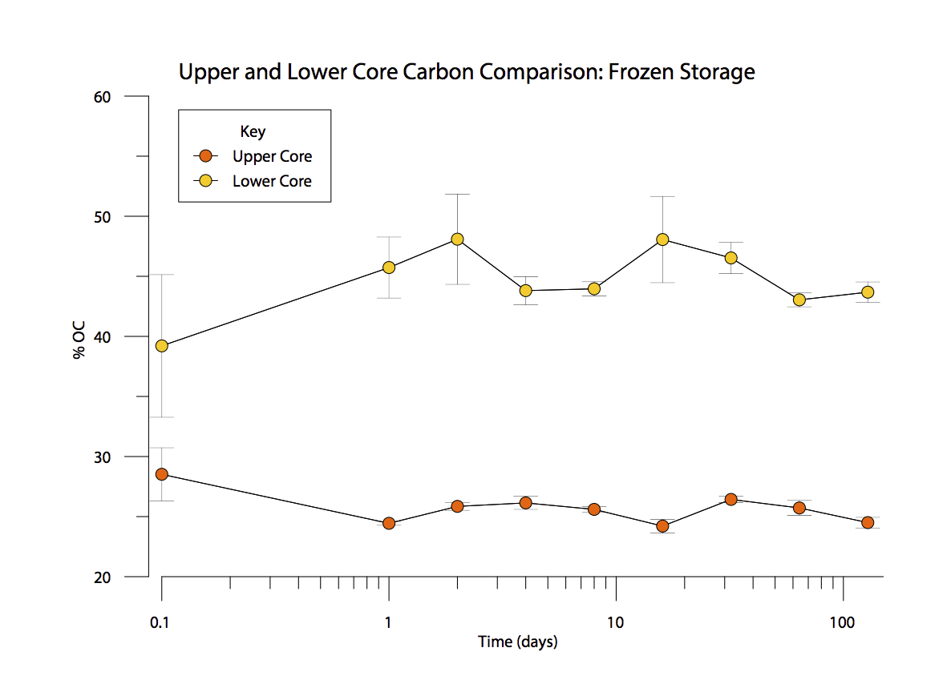
Results: Carbon Content
Core
Upper
Lower

Slide 15
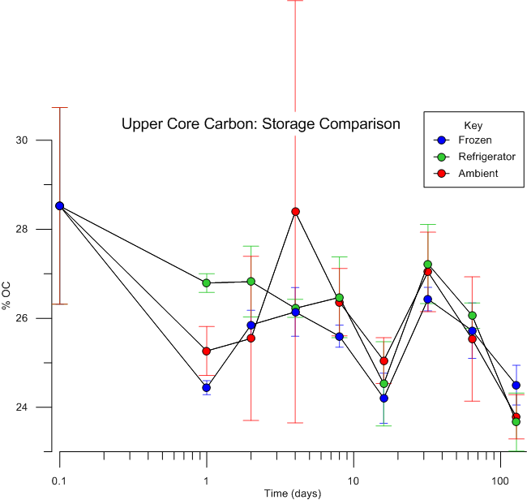
Results: Upper Core

Slide 16
Results: Upper Core
Carbon Hotspots
and Coldspots
24.8 %
25.2 %
35.1 %
Notes:
Ambient: of the triplicates, 2 were very similar, and a third was far off. It’s impossible to make the whole thing homogenized, which is why larger sample size is important. Small hot spots or cold spots of C may still remain. These are diluted with larger sample size.

Slide 17
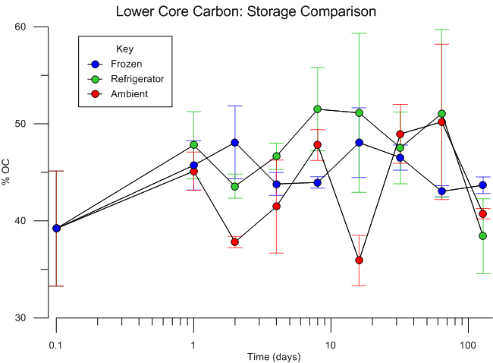
Results: Lower Core

Slide 18
Discussion
Marsh cores may be stored from -20˚C to 24˚C for up to 128 days and the carbon concentration will be representative of the marsh carbon
Within error, one cannot distinguish a difference in C in this temperature zone or time limit.

Slide 19
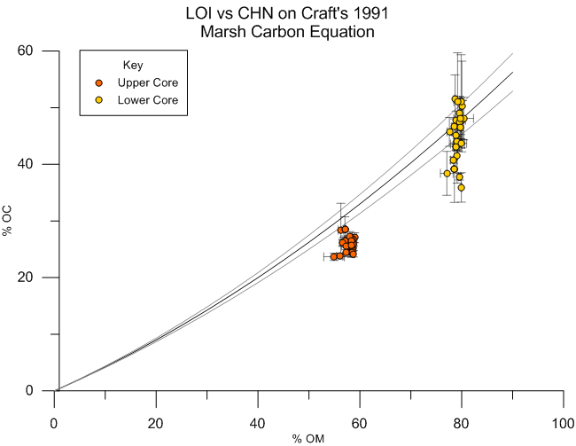
Results
Notes:
Craft used 250 samples from 10 salt and brackish marshes around NC looking at both young and old marsh soils ranging from 0% OM to 80%.
Clearly CHN error is greater than LOI error.

Slide 20
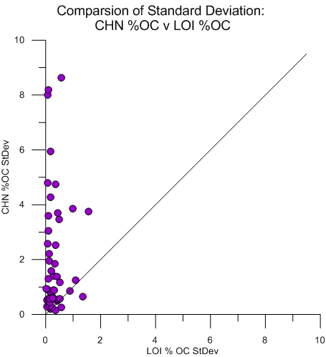
Results
LOI Standard Deviation
does not surpass 2% of
organic carbon.
CHN Standard Deviation
almost reaches 9%.
Notes:
Average LOI Sed mass used = 250 mg
Average CHN Sed mass used = 7 mg

Slide 21
Discussion
LOI should be used to measure marsh carbon because it has lower error in subsampling compared to CHN
LOI has larger sample size than CHN
CHN may over or undervalue the marsh’s ability to sequester carbon
Notes:
In Marshes and depositional environments with large sample size CHN subsampling error is too large. CHN analytical error is small, but the sample size is also small, and you can’t achieve full homogeneity in a sample, so the small subsampling size allows for possible carbon hotspots and coldspots. LOI is better suited for the larger volumes. CHN uses 6-7mg while LOI needs at 250 grams.

Slide 22
Implications
Interest in quantifying OC burial in marshes
No universal method of sampling for marsh C
We found that temperature treatment can vary
The carbon can be sampled within about 4 months of taking the core
LOI should be used rather than CHN because it is more representative of the marsh

Slide 23
Final Thoughts
How did we get the data for all the global carbon budget? If its calculated using CHN, the numbers may be different than what has been presented.
Blue Carbon
46.9% of total C burial in ocean sediments (Duarte et al 2005)

Slide 24
Final Thoughts
How did we get the data for all the global carbon budget? If its calculated using CHN, the numbers may be different than what has been presented.
Blue Carbon
46.9% of total C burial in ocean sediments (Duarte et al 2005)
Duarte et al 2005 says that blue carbon areas are responsible for 46.9% of carbon burial in ocean sediments. The marsh carbon part of this was calculated from Chmura et al 2003, who used LOI converted to % OC.
These numbers are reliable and reproducible

Slide 25



Acknowledgments
Chancellor’s Science Scholars Program
Defense Coastal/Estuarine Research Program (DCERP2) funded by the Department of Defense
The Rodriguez and McKee Labs and all the people who worked with me through this project
UNC Marine Sciences and UNC Geology Departments
Geological Society of America

Slide 26
Works Cited
Craft, C. B., Seneca, E. D., & Broome, S. W. (1991). Loss on ignition and Kjeldahl digestion for estimating organic carbon and total nitrogen in estuarine marsh soils: calibration with dry combustion. Estuaries and Coasts, 14(2), 175-179.
Duarte, C. M., Middelburg, J. and Caraco, N. (2005) “Major role of marine vegetation on the ocean carbon cycle.” Biogeosciences. Vol 2. Pages 1 - 8.
Duarte, C. M., Losada, I. J., Hendriks, I. E., Mazarrasa, I., & Marbà, N. (2013). The role of coastal plant communities for climate change mitigation and adaptation. Nature Climate Change, 3(11), 961-968.
Howard, J., Hoyt, S., Isensee, K., Telszewski, M., & Pidgeon, E. (2014). Coastal blue carbon: methods for assessing carbon stocks and emissions factors in mangroves, tidal salt marshes, and seagrasses.
Mcleod, E., Chmura, G. L., Bouillon, S., Salm, R., Björk, M., Duarte, C. M., ... & Silliman, B. R. (2011). A blueprint for blue carbon: toward an improved understanding of the role of vegetated coastal habitats in sequestering CO2. Frontiers in Ecology and the Environment, 9(10), 552-560.

Slide 27
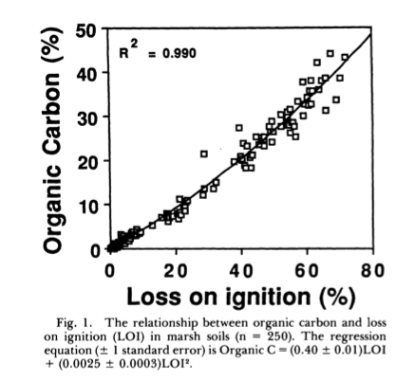
Craft’s Marsh Carbon Equation

Slide 28
Upper %OC with LOI

Slide 29
Lower %OC with LOI

