Slide 1
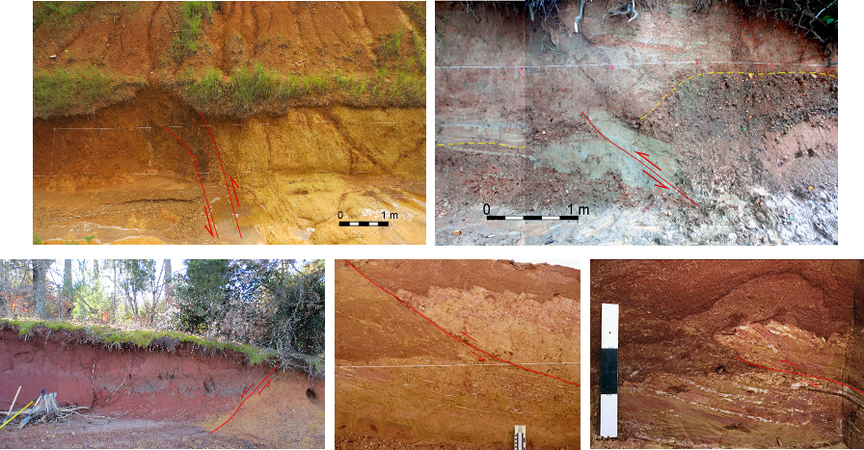



A SEISMICITY/QUATERNARY FAULTING CORRIDOR IN THE EASTERN TENNESSEE SEISMIC ZONE: AN UPDATE
Randel Tom Cox
Eric Gamble
Ronald Counts
Robert D. Hatcher, Jr.
Jacob C. Glasbrenner
Kathleen Warrell

Slide 2
OR: The Dandridge-Vonore fault zone
Randel Tom Cox
Eric Gamble
Ronald Counts
Robert D. Hatcher, Jr.
Jacob C. Glasbrenner
Kathleen Warrell

Slide 3

OR: The Dandridge-Vonore fault zone
Funding provided by
Randel Tom Cox
Eric Gamble
Ronald Counts
Robert D. Hatcher, Jr.
Jacob C. Glasbrenner
Kathleen Warrell

Slide 4
OUTLINE:

Slide 5
OUTLINE:
Regional setting

Slide 6
OUTLINE:
Regional setting
Seismicity alignments

Slide 7
OUTLINE:
Regional setting
Seismicity alignments
Quaternary faulting

Slide 8
OUTLINE:
Regional setting
Seismicity alignments
Quaternary faulting
Paleoseismic chronology

Slide 9
OUTLINE:
Regional setting
Seismicity alignments
Quaternary faulting
Paleoseismic chronology
Conclusions

Slide 10
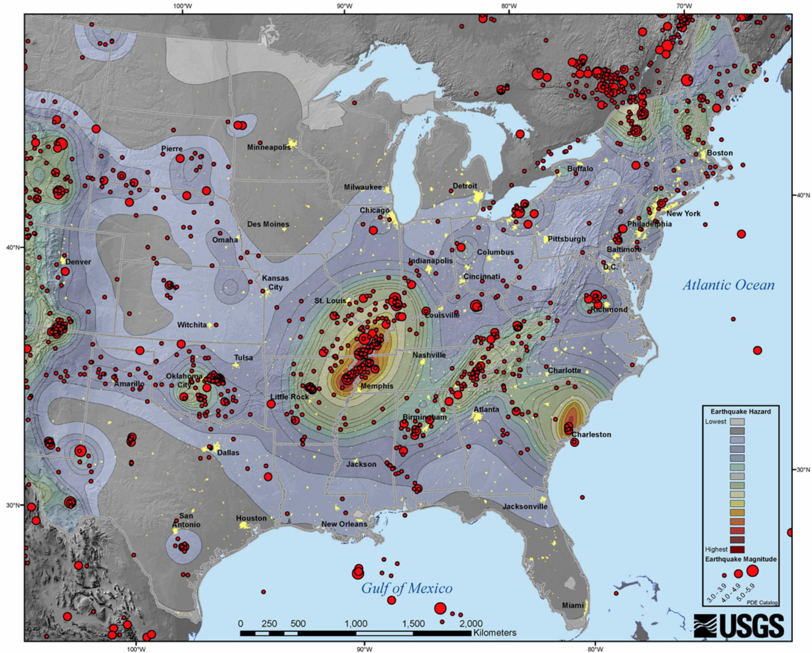
C-EUS (& S Canada) Earthquakes

Slide 11
C-EUS (& S Canada) Earthquakes
EASTERN
TENNESSEE
SEISMIC ZONE

Slide 12
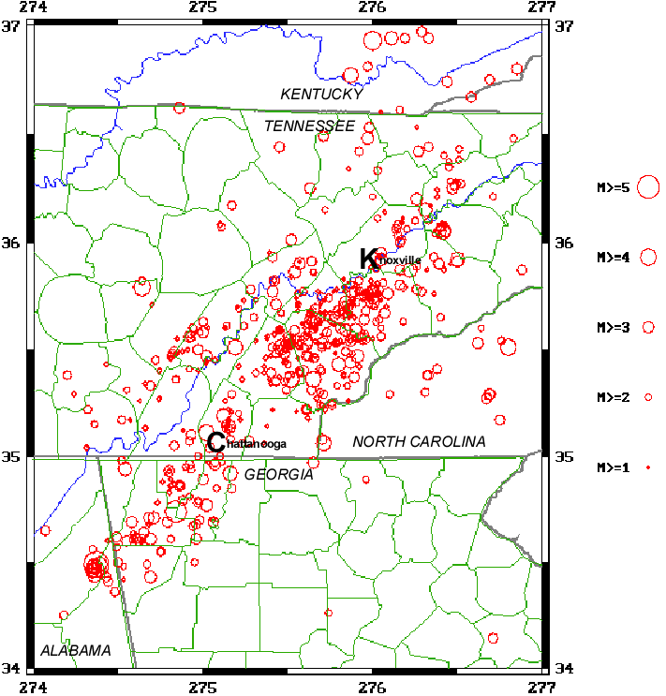

Slide 13

ETSZ seismicity
Alignment 045º

Slide 14
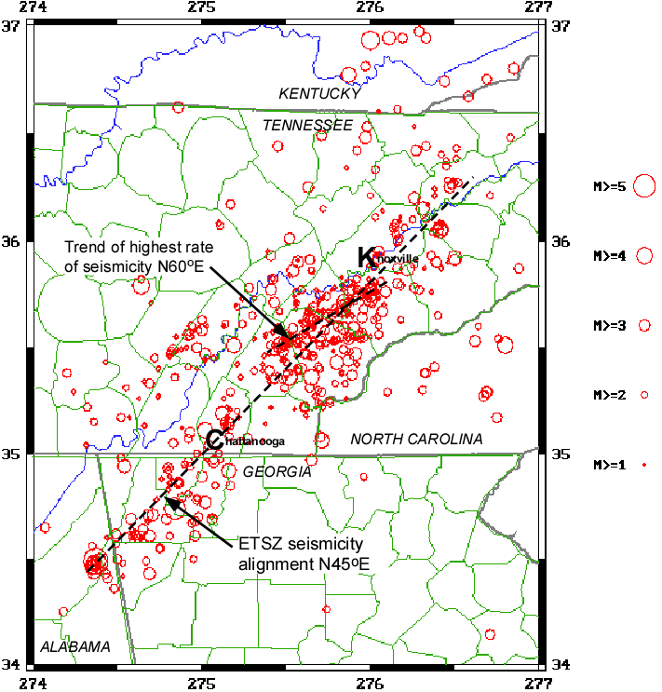
Trend of highest rate
of seismicity 060º
ETSZ seismicity
Alignment 045º

Slide 15
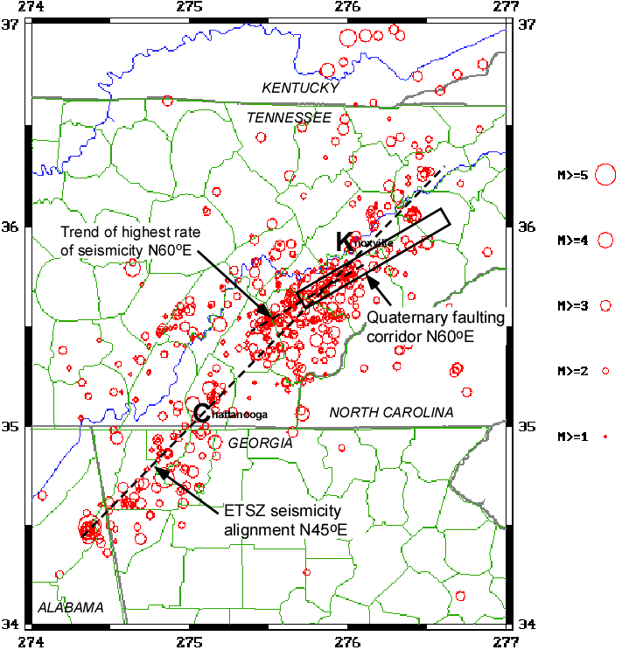
Trend of highest rate
of seismicity 060º
Dandridge-Vonore fault zone 060º
ETSZ seismicity
Alignment 045º

Slide 16
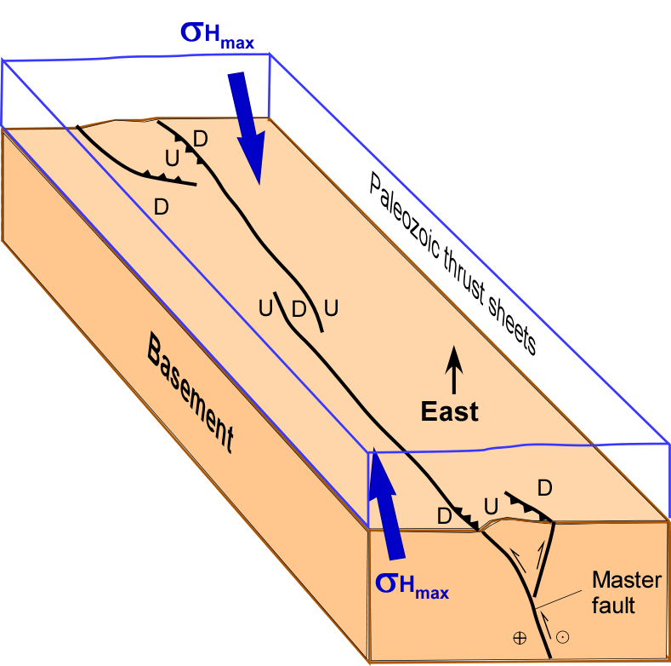
Speculative Model

Slide 17
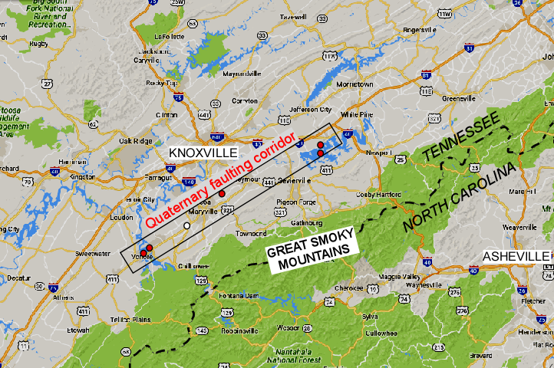
Map of corridor showing field sites labeled
0 100 km

Slide 18
Dandridge sites
Map of corridor showing field sites labeled
0 100 km

Slide 19
Map of corridor showing field sites labeled
Alcoa site
0 100 km

Slide 20
Map of corridor showing field sites labeled
Vonore sites
0 100 km

Slide 21
Dandridge
Map of corridor showing field sites labeled
0 100 km

Slide 22
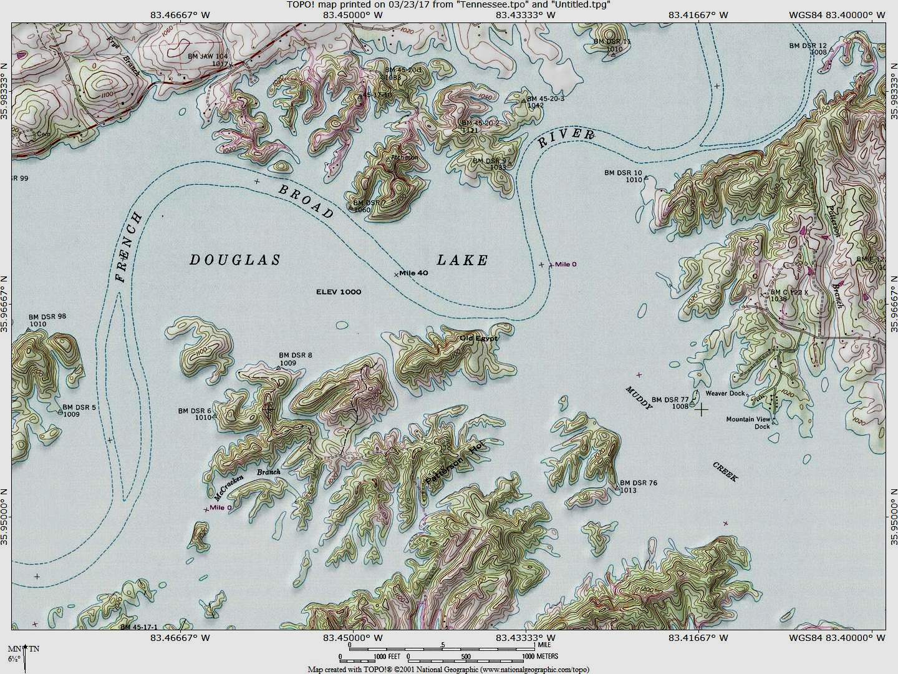
Quaternary thrust

Slide 23
Dandridge Quaternary thrust fault exposure
WEST
EAST
Next slide

Slide 24
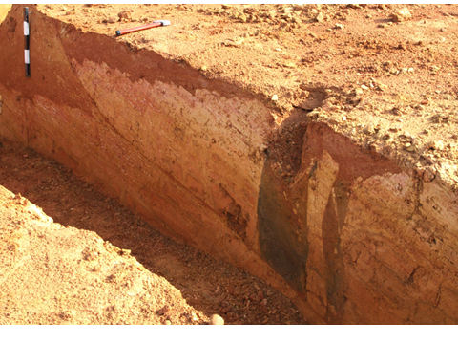
DOUGLAS LAKE, NORTH SHORE
THRUST
WEST
EAST
ALLUVIUM
ALLUVIUM-FILLED FISSURES
PLEISTOCENE
ORDOVICIAN SHALE
SAPROLITE

Slide 25
DOUGLAS LAKE, NORTH SHORE
THRUST
WEST
EAST
ALLUVIUM
ALLUVIUM-FILLED FISSURES
PLEISTOCENE
ORDOVICIAN SHALE
SAPROLITE
Strike 055º

Slide 26
Map of corridor showing field sites labeled
Alcoa

Slide 27
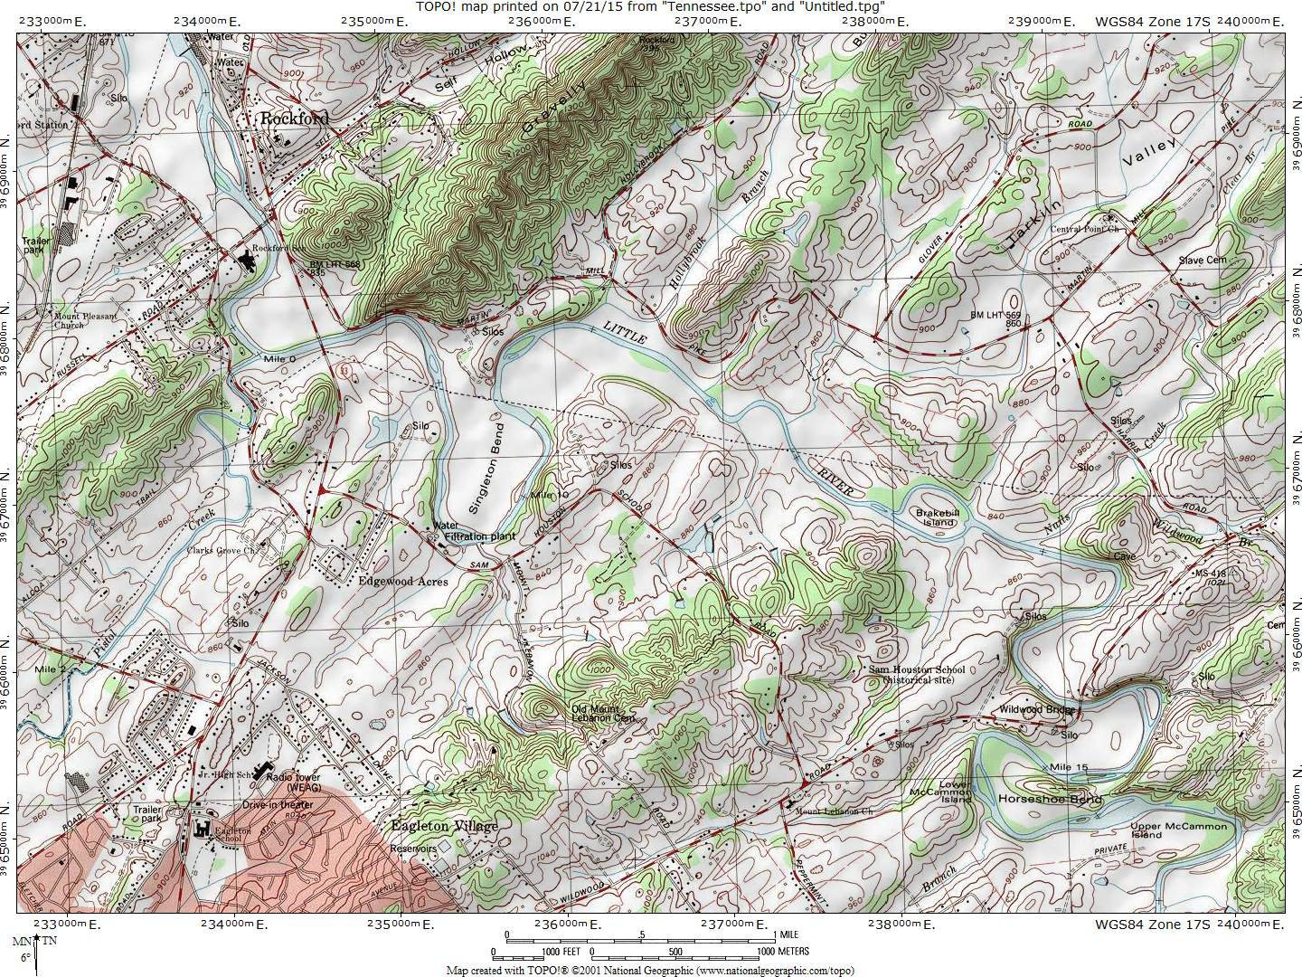
Quaternary thrust
Little River
Alcoa, TN

Slide 28
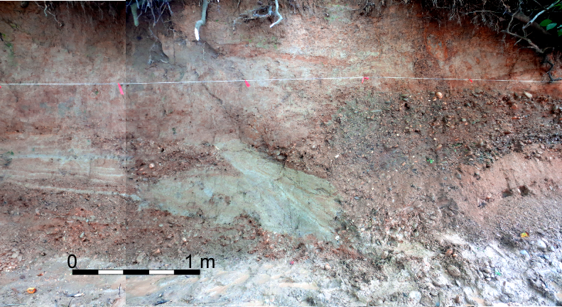
WEST
EAST

Slide 29
WEST
EAST
Strike 060º

Slide 30
Deformation steps

Slide 31
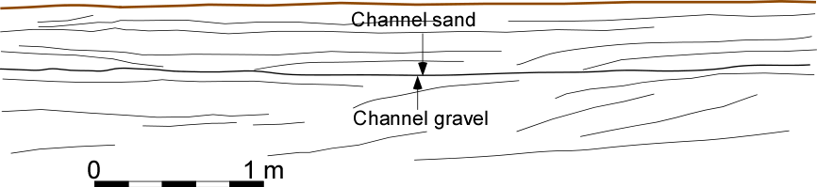
Pre-faulting

Slide 32
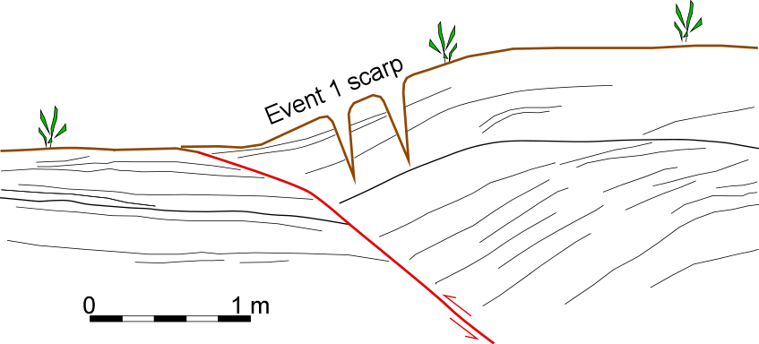
Event 1

Slide 33
55 cm
Event 1

Slide 34
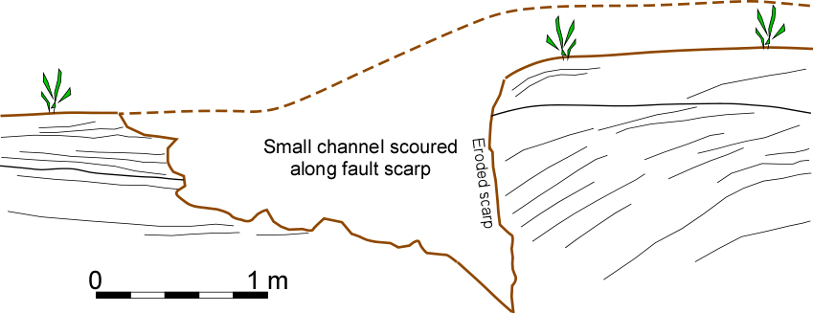

Slide 35
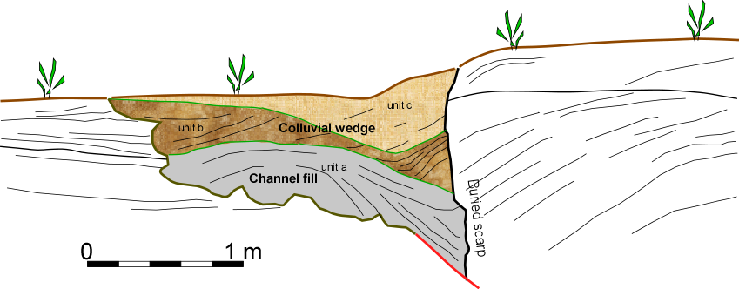
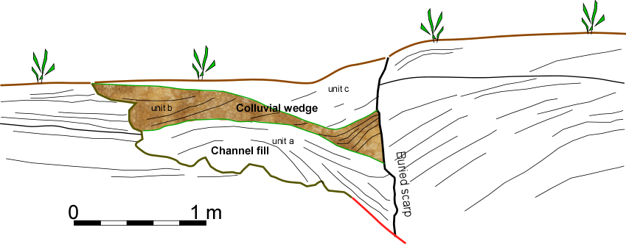
Small channel is filled

Slide 36
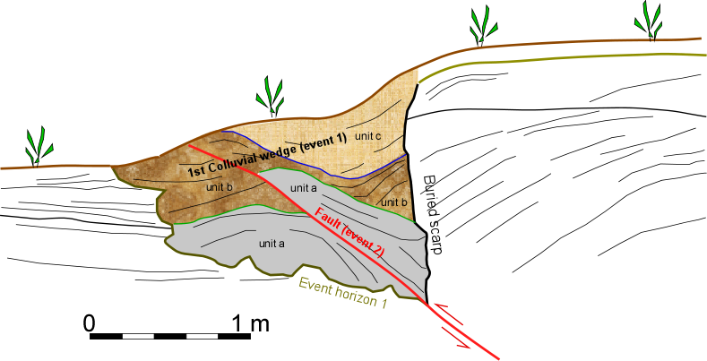
Event 2

Slide 37
30 cm
Event 2

Slide 38
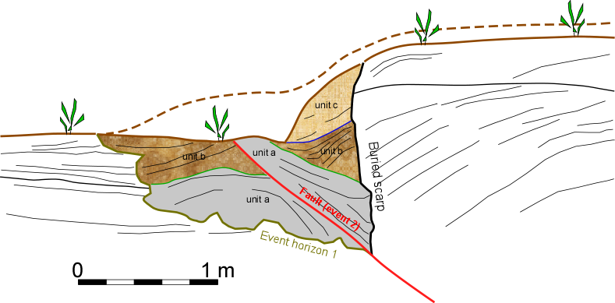
Erosion of event 2 scarp

Slide 39
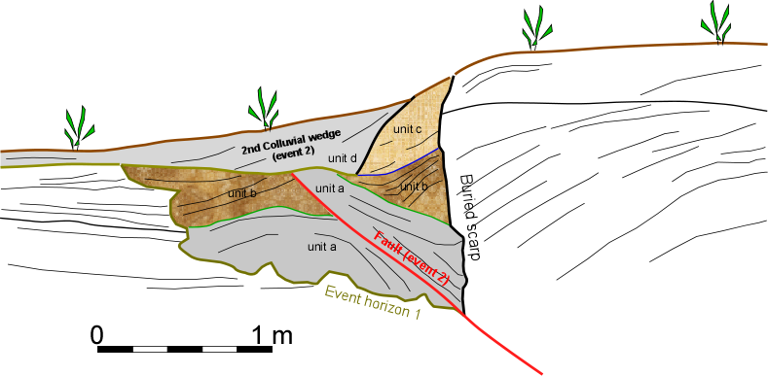
Event 2 colluvial wedge

Slide 40
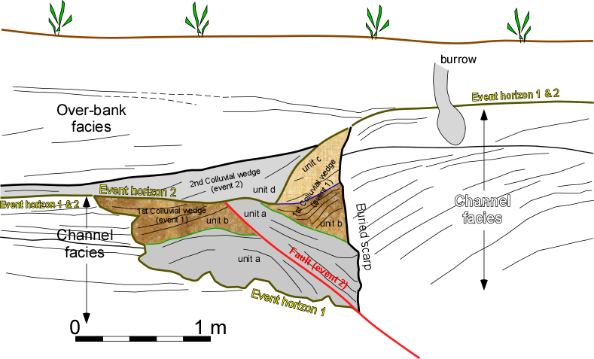

Slide 41
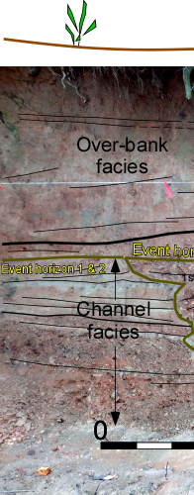
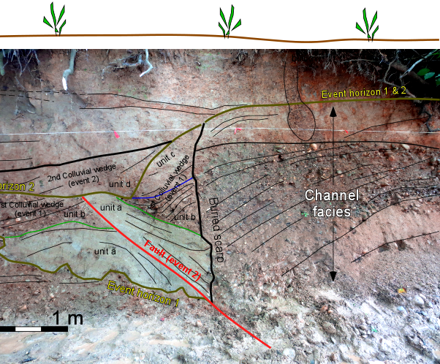

Slide 42
Map of corridor showing field sites labeled
Vonore

Slide 43
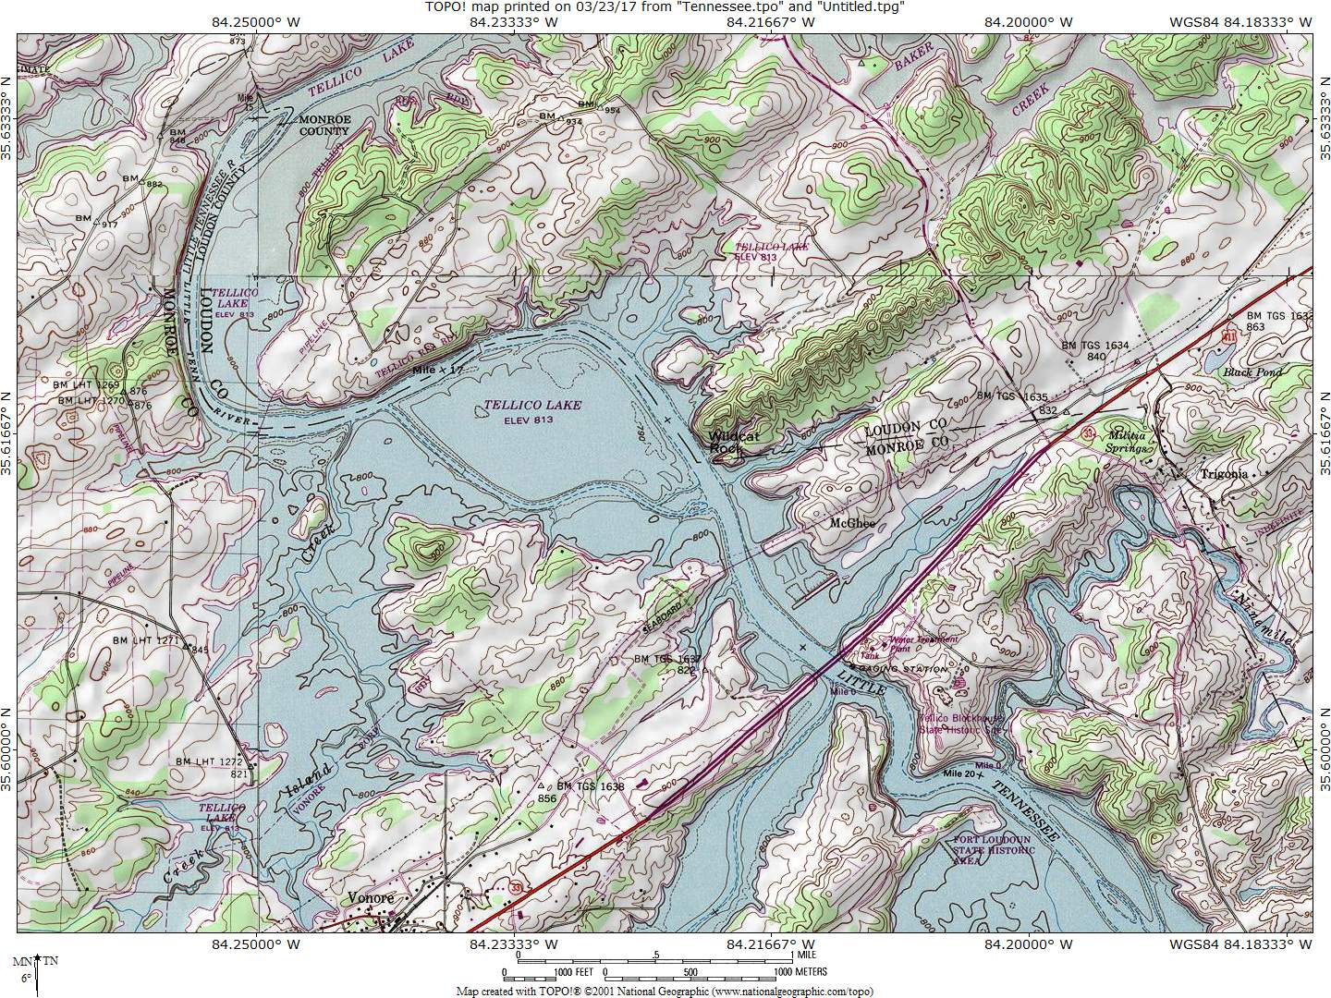
Quaternary
normal fault

Slide 44
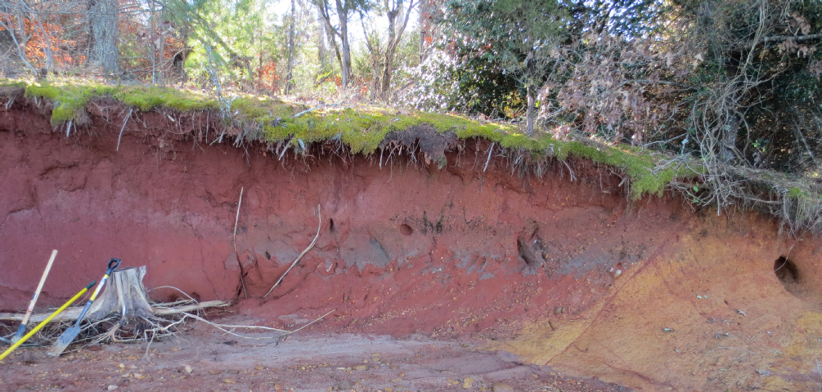
EAST
NORMAL FAULT AT VONORE SOUTH
WEST
Pleistocene alluvium
Cambrian shale
saprolite

Slide 45
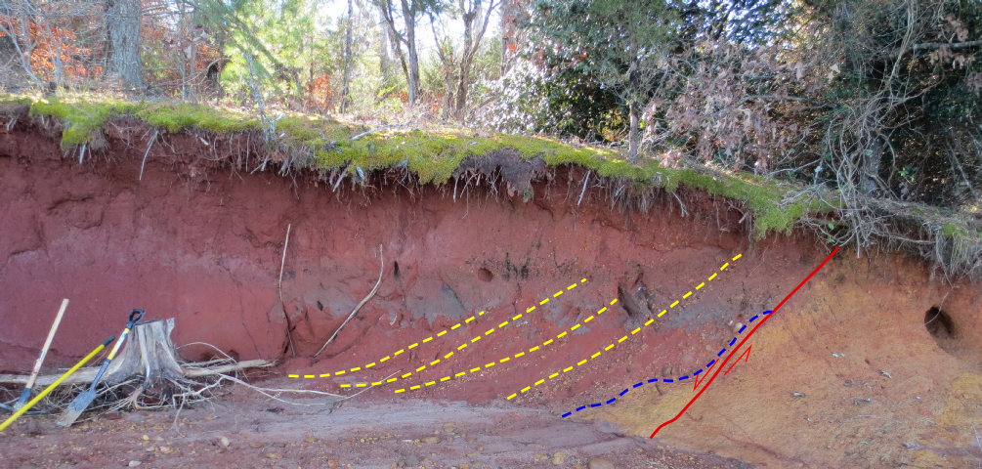
EAST
NORMAL FAULT AT VONORE SOUTH
WEST
Pleistocene alluvium
Cambrian shale
saprolite
Strike 042º

Slide 46
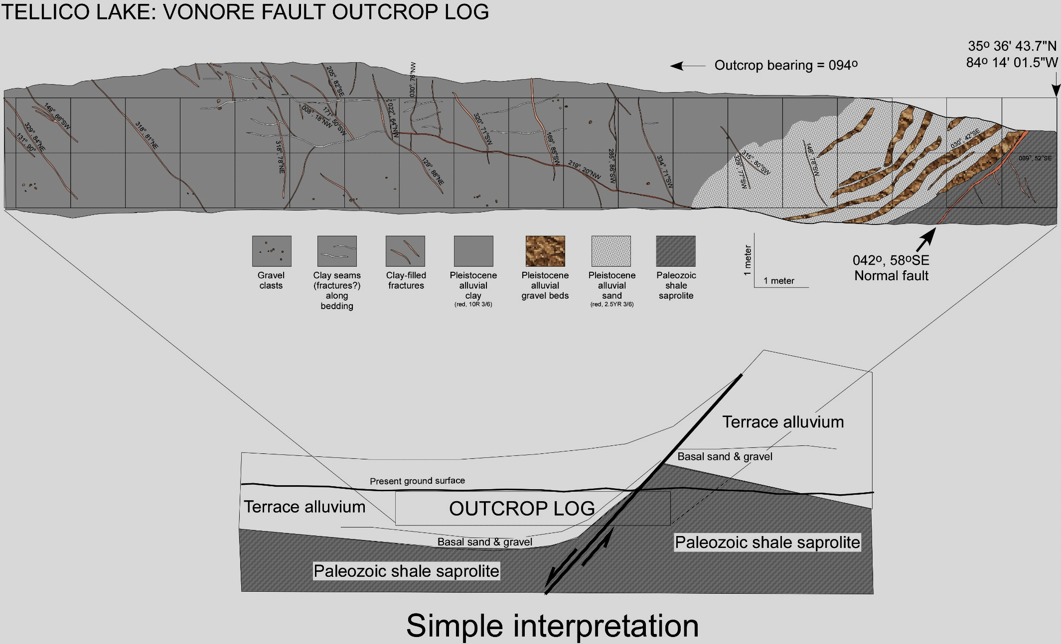

Slide 48
Quaternary thrust

Slide 49
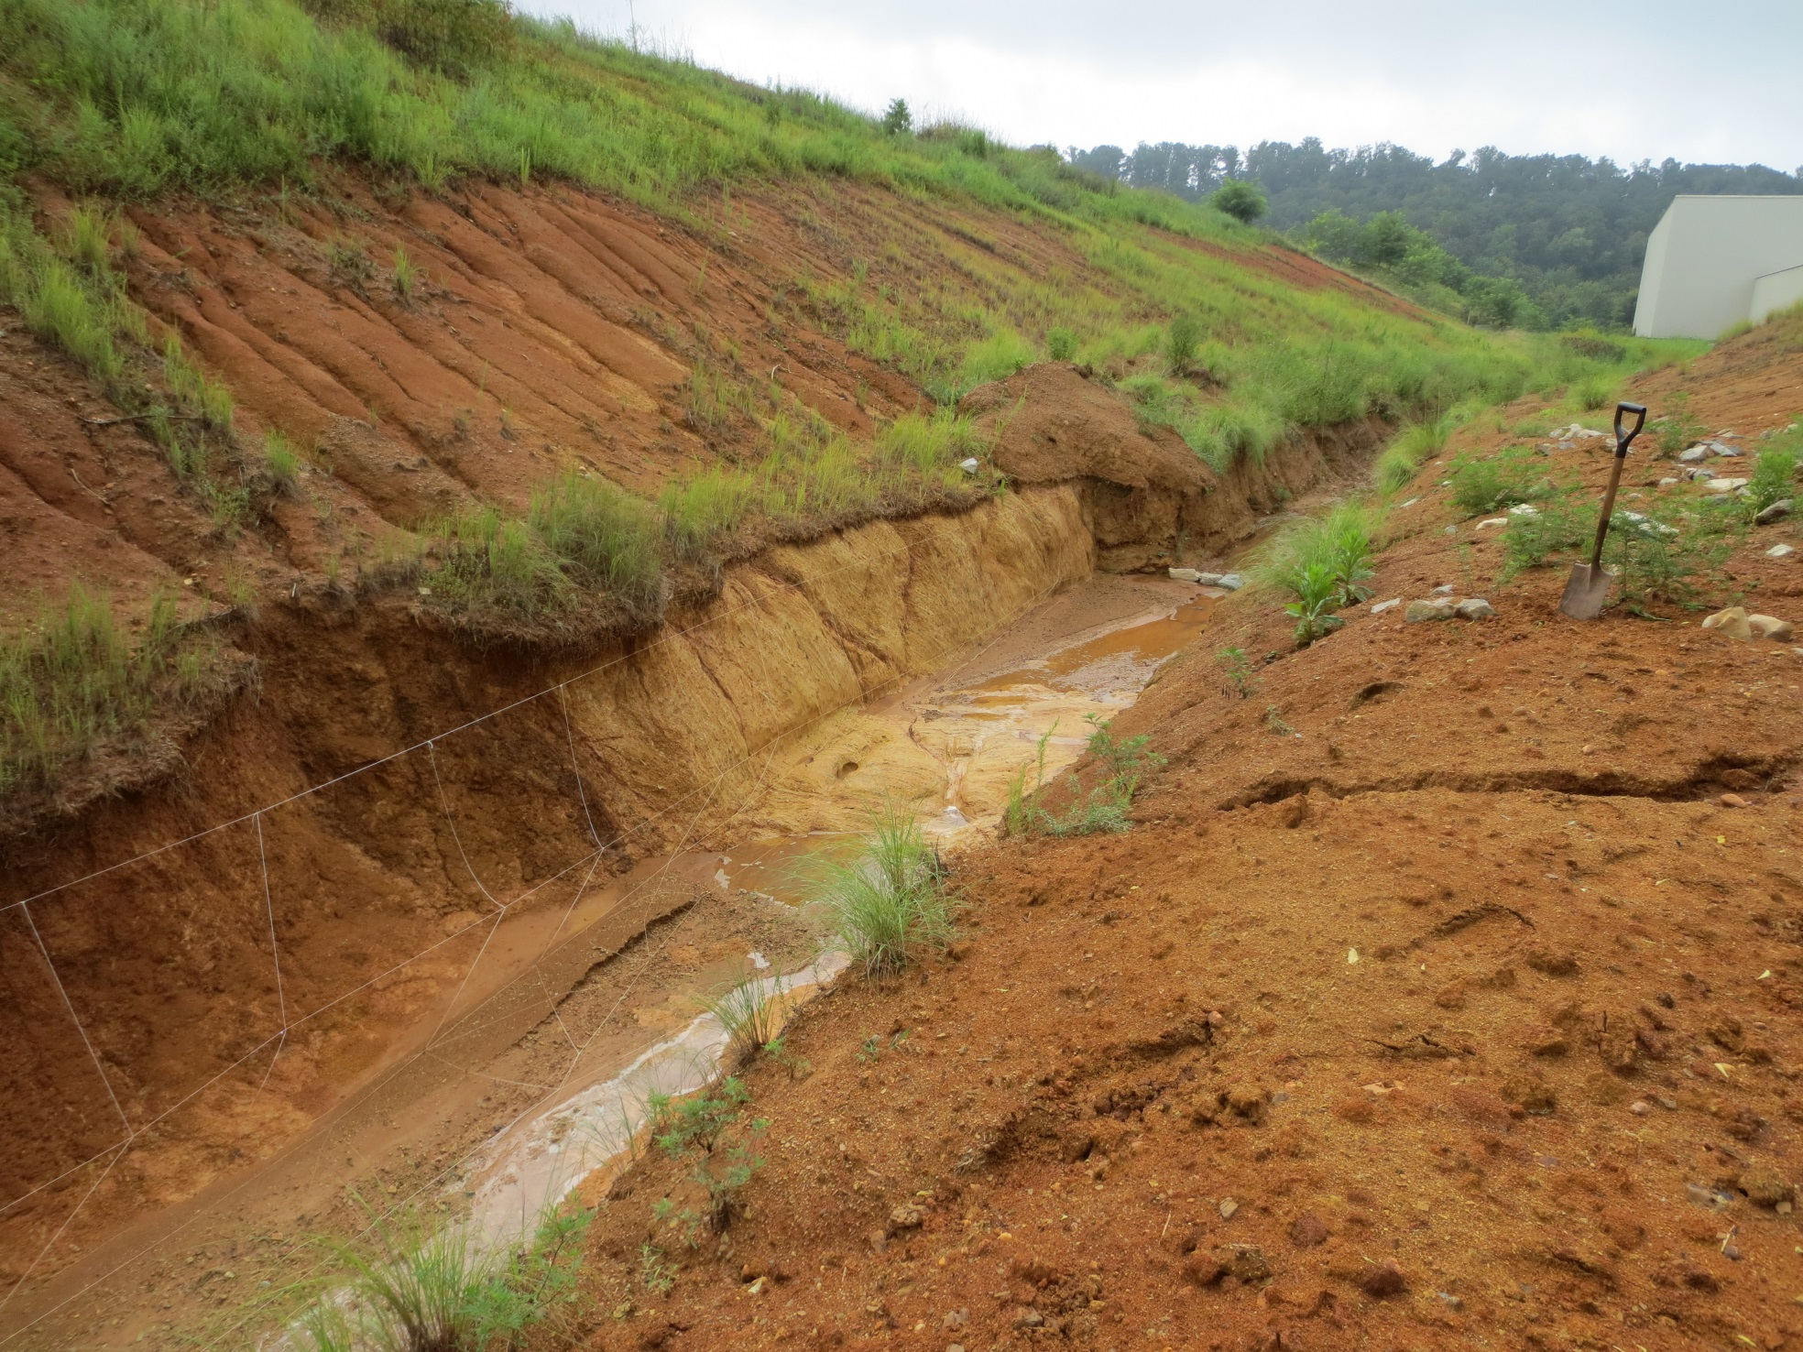
Looking east
THRUST FAULT AT VONORE NORTH
CAMBRIAN SHALE
SAPROLITE
PLEISTOCENE? COLLUVIUM

Slide 50
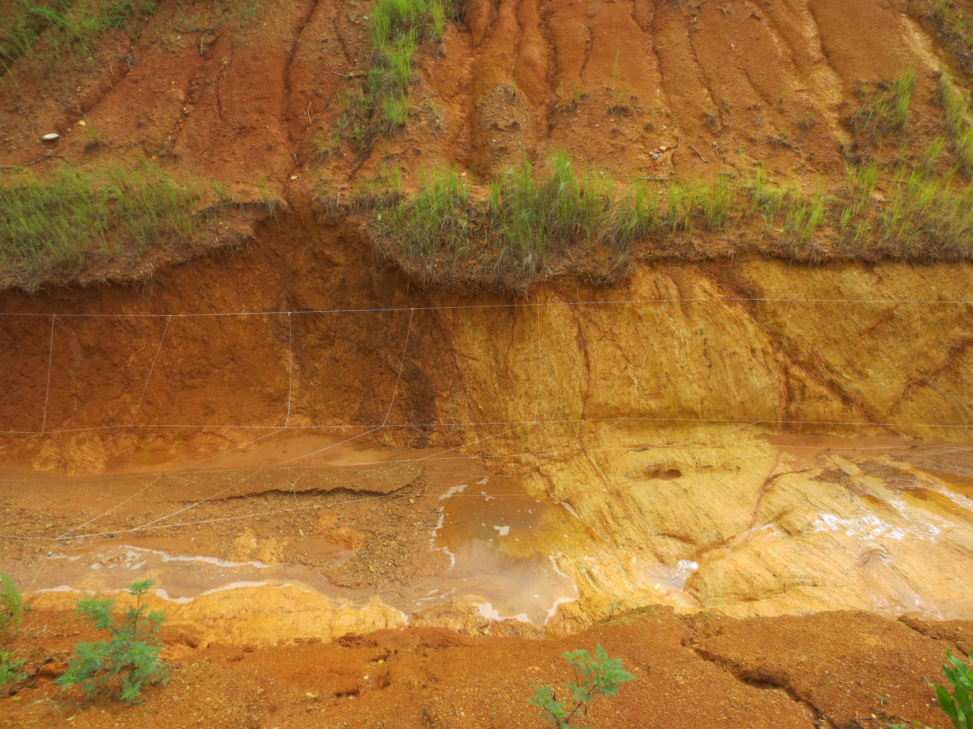
WEST
EAST
TRANSPRESSIONAL? FAULT AT VONORE NORTH
PLEISTOCENE COLLUVIUM
CAMBRIAN SHALE
SAPROLITE
1 m

Slide 51
WEST
EAST
TRANSPRESSIONAL? FAULT AT VONORE NORTH
PLEISTOCENE COLLUVIUM
CAMBRIAN SHALE
SAPROLITE
1 m
Strike 057º

Slide 52
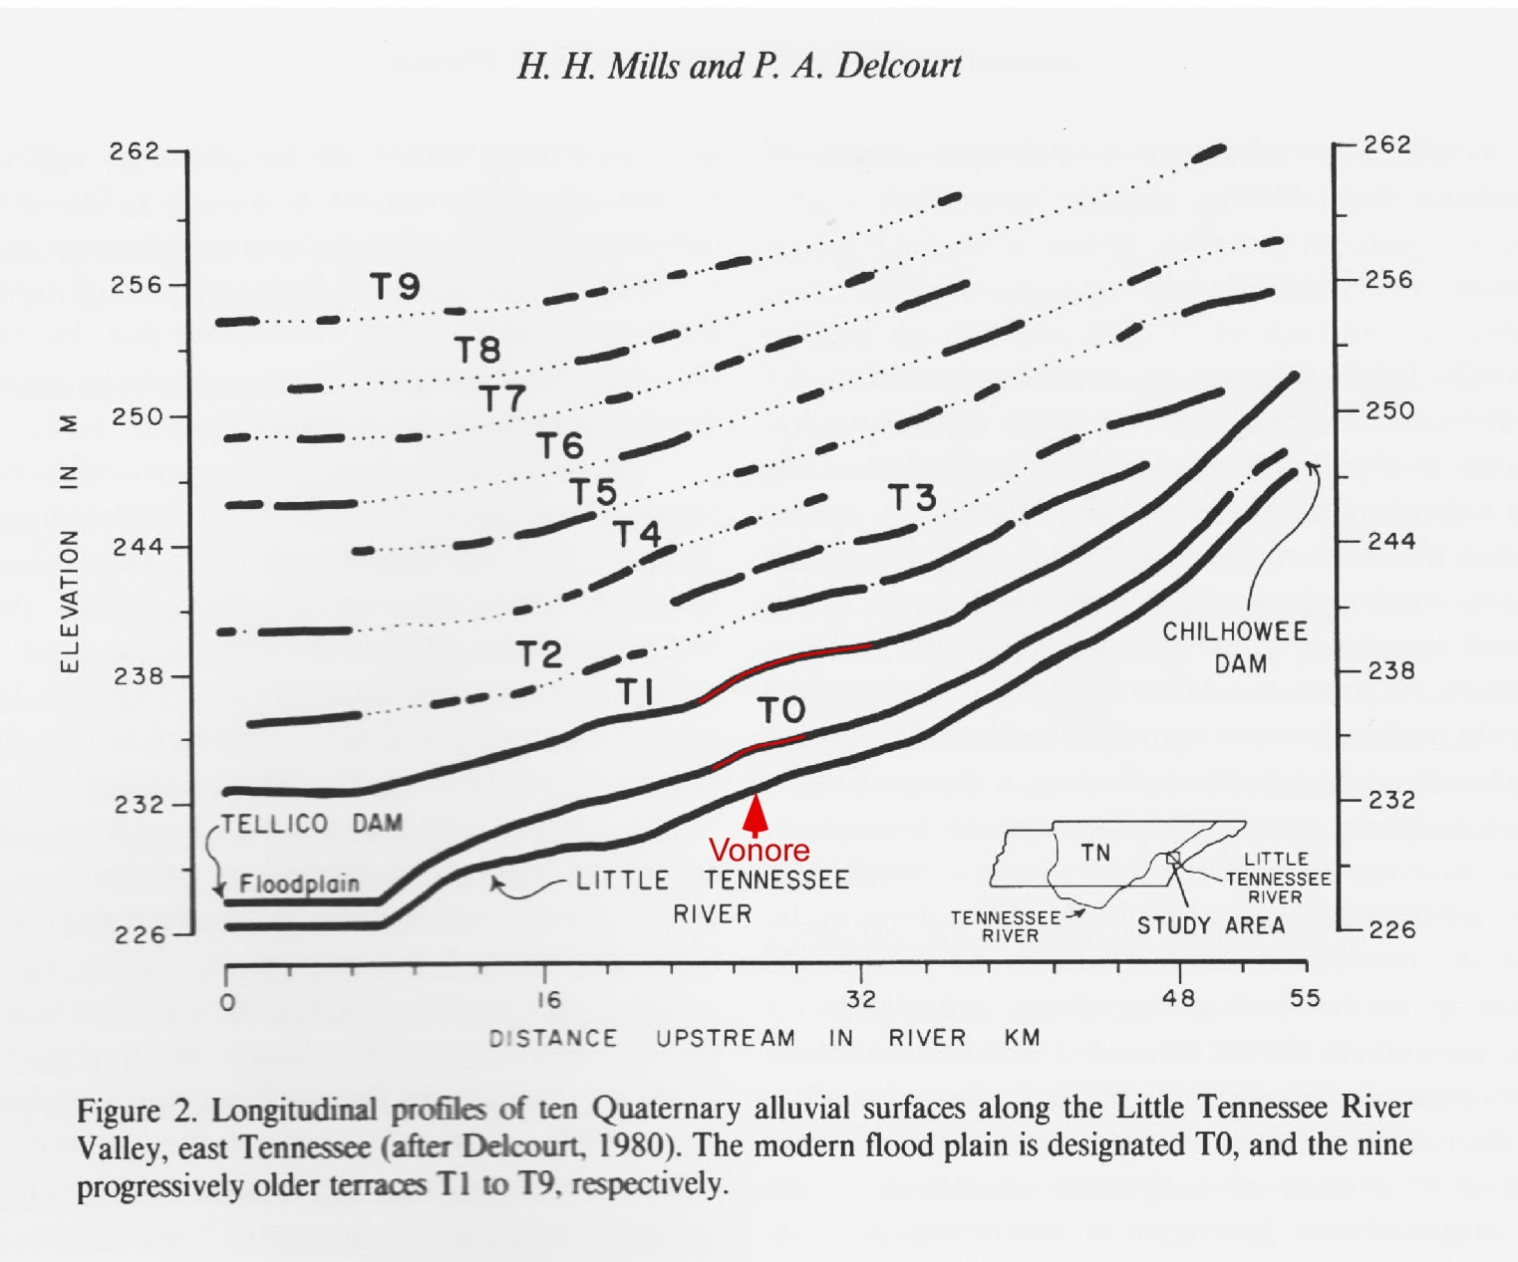
(1991)

Slide 53
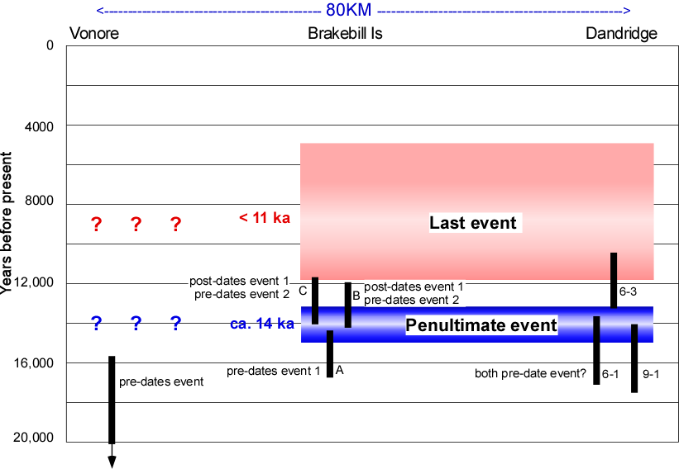
TIMING
TIMING/locality chart

Slide 54
TIMING
M6.5
TIMING/locality chart

Slide 55
Speculative Model

Slide 56
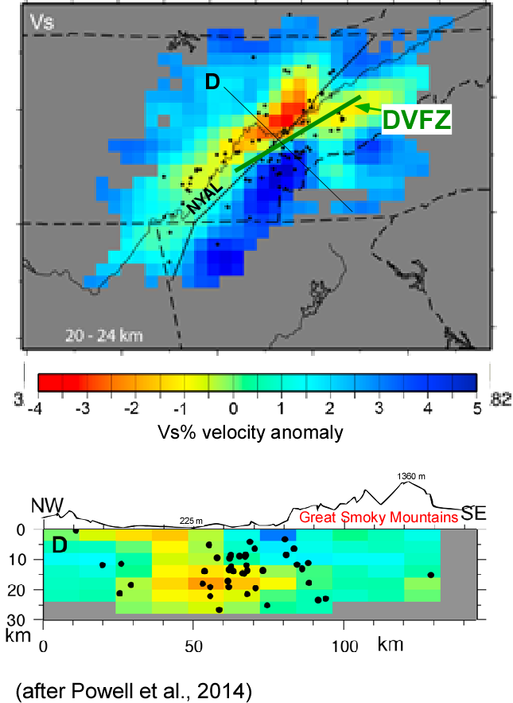
Valley & Ridge

Slide 57
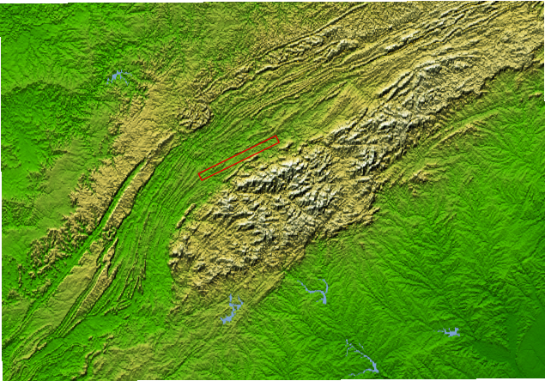
QUATERNARY FAULTING CORRIDOR
SMOKY MOUNTAINS

Slide 58
APPALACHIAN REJUVENATION?
QUATERNARY FAULTING CORRIDOR
SMOKY MOUNTAINS

Slide 59
Summary:

Slide 60
Summary:
An 80 km-long, 060º corridor of Quaternary faulting is collinear with an alignment of concentrated seismicity.

Slide 61
Summary:
An 80 km-long, 060º corridor of Quaternary faulting is collinear with an alignment of concentrated seismicity.
Together this seismicity alignment and faulting corridor are >100 km long.

Slide 62
Summary:
An 80 km-long, 060º corridor of Quaternary faulting is collinear with an alignment of concentrated seismicity.
Together this seismicity alignment and faulting corridor are >100 km long.
A 100 km-long rupture on a possible master fault at depth could generate a M7+ earthquake.

Slide 63
Summary:
An 80 km-long, 060º corridor of Quaternary faulting is collinear with an alignment of concentrated seismicity.
Together this seismicity alignment and faulting corridor are >100 km long.
A 100 km-long rupture on a possible master fault at depth could generate a M7+ earthquake.
The Dandridge-Vonore fault zone may be an important element in rejuvenation of the southern Appalachians.

Slide 64

?’s

Slide 67
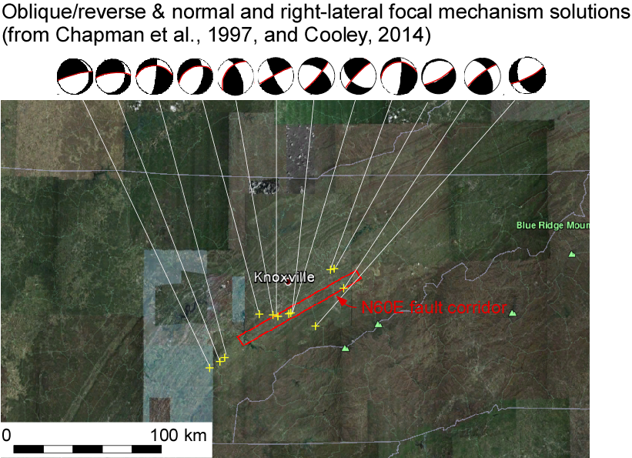

Slide 68
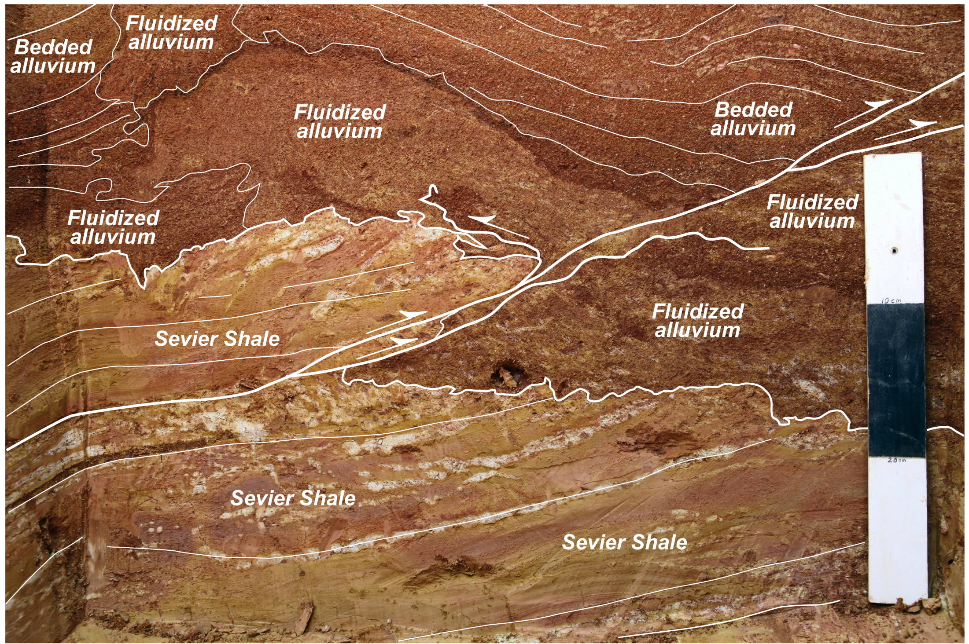
Trench 1, W Wall
Trench corner

Slide 69
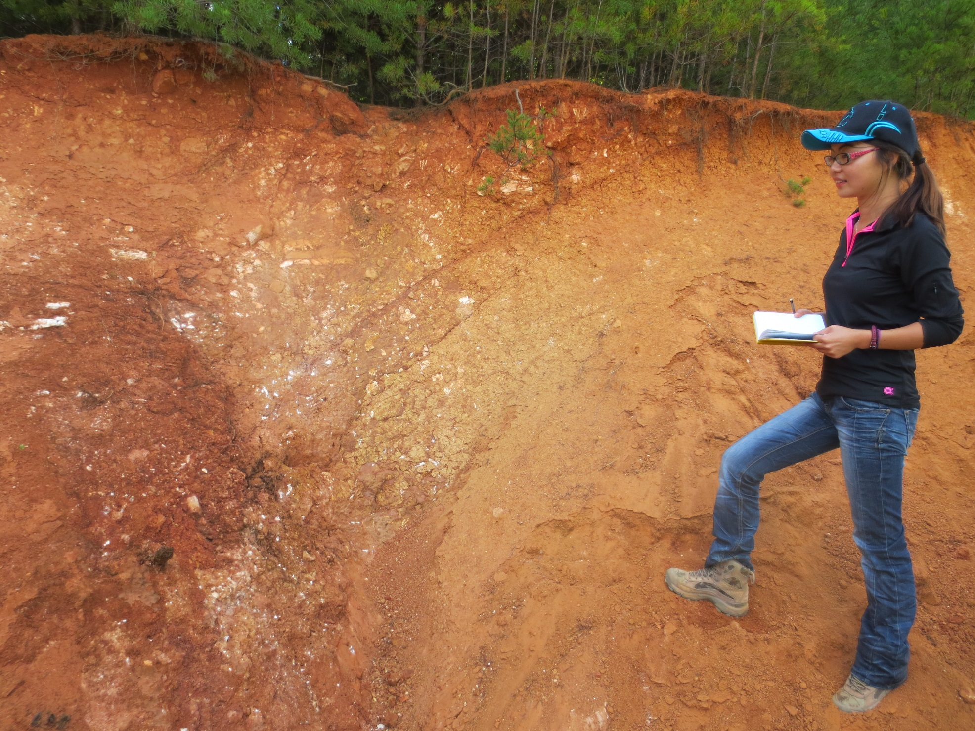
EAST
POSSIBLE FAULT AT MARYVILLE
WEST
CHERT-POOR
RESIDUUM
CHERT-RICH
RESIDUUM
CHERT-POOR
RESIDUUM
Maryville pit fault photo?
CHERT-RICH
RESIDUUM
COLLUVIUM
COLLUVIUM

Slide 70
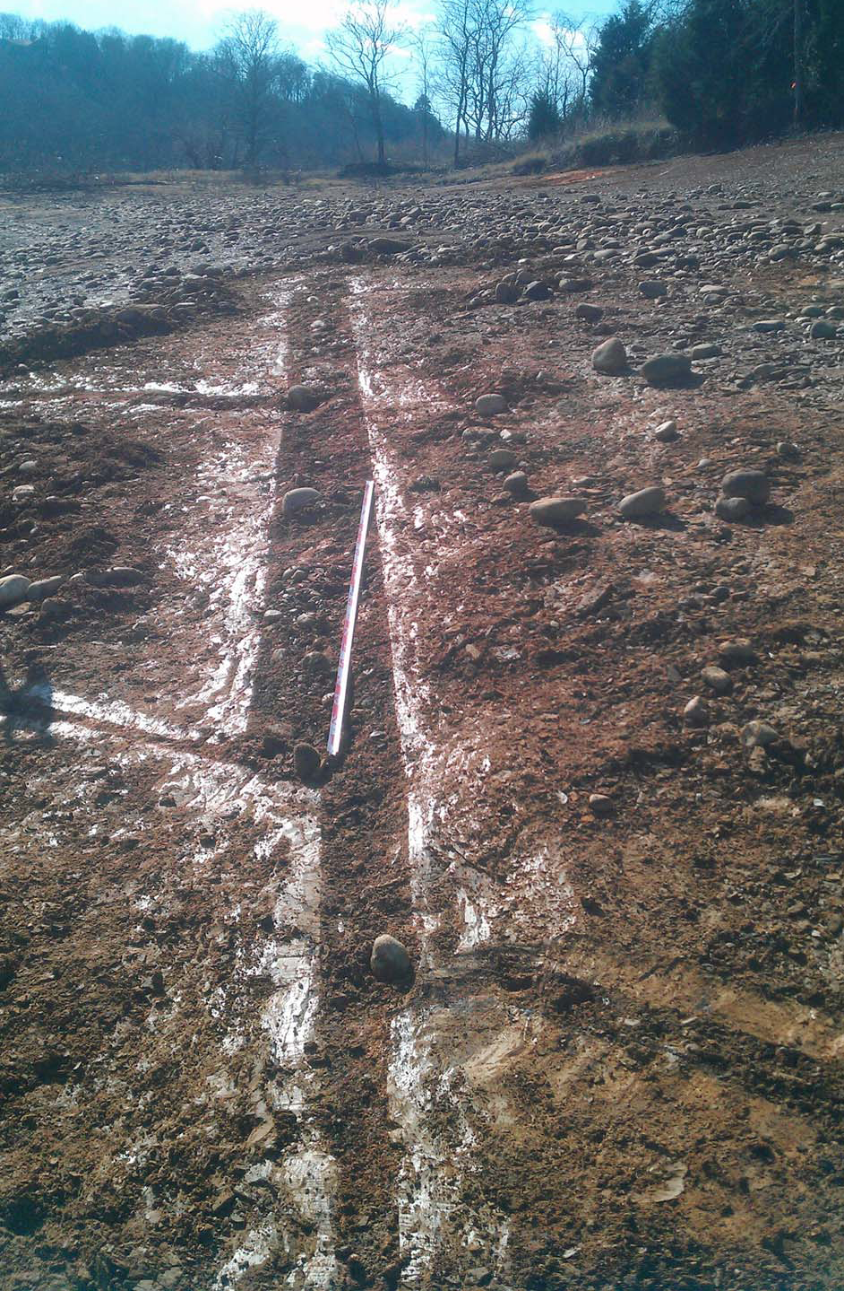
DOUGLAS LAKE,
SOUTH SHORE
ALLUVIUM-FILLED
FISSURE

