Slide 1
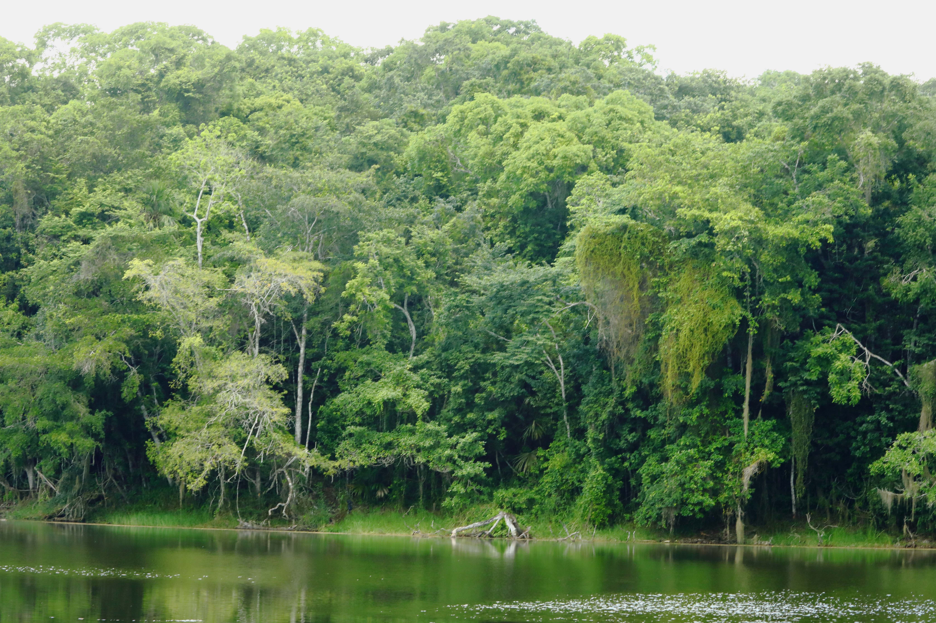
Bank of Lake Om (18.293∘N, 89.084∘W)

Slide 2
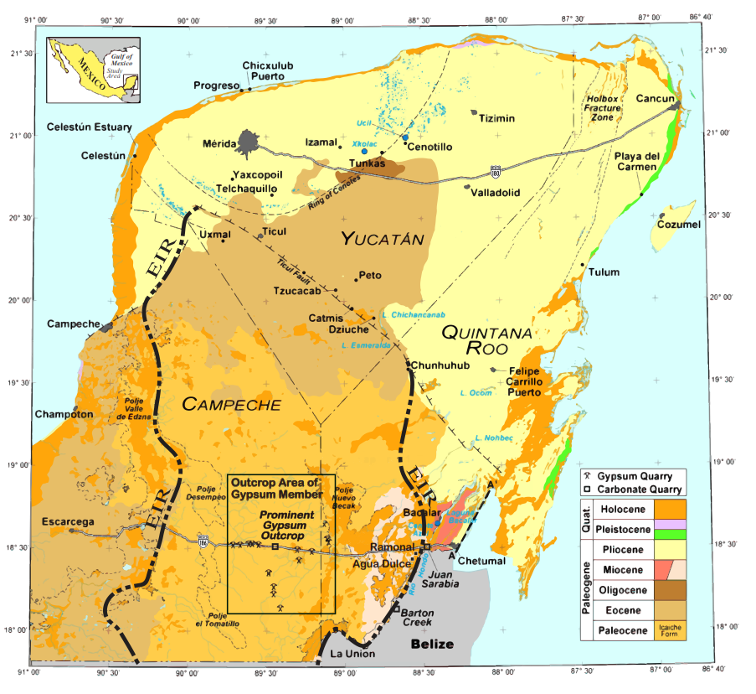
THE ICAICHE FORMATION:
UNACKNOWLEDGED CONTRIBUTOR
TO YUCATÁN
HYDROGEOLOGY
AND
GEOMORPHOLOGY
For more than 40 years ”Yucatan” + “karst” has meant the flat northern coastal plain that has given us the words cenote and aguada. This talk is about a different place: a wild region known to archeologists as the “Elevated Interior Region,” EIR, once occupied by technologically adept Mayas, then abandoned for 1000 years.
Evidence of Recharge Occurs in Real Time
Newspaper Article on August 21, 2018 Reports Disappearance of Lake Om Adjacent to Gypsum Outcrops
Eugene C. PERRY, NIU, Emeritus;
Rosa Maria LEAL-BAUTISTA, CICY, Cancun, Mexico;
Guadalupe VELAZQUEZ-OLIMAN,, CIIDES,
Puerto Morelos, Mexico, &
Niklas WAGNER, Chemtech Services, Inc.,
Lockport, IL

Slide 3
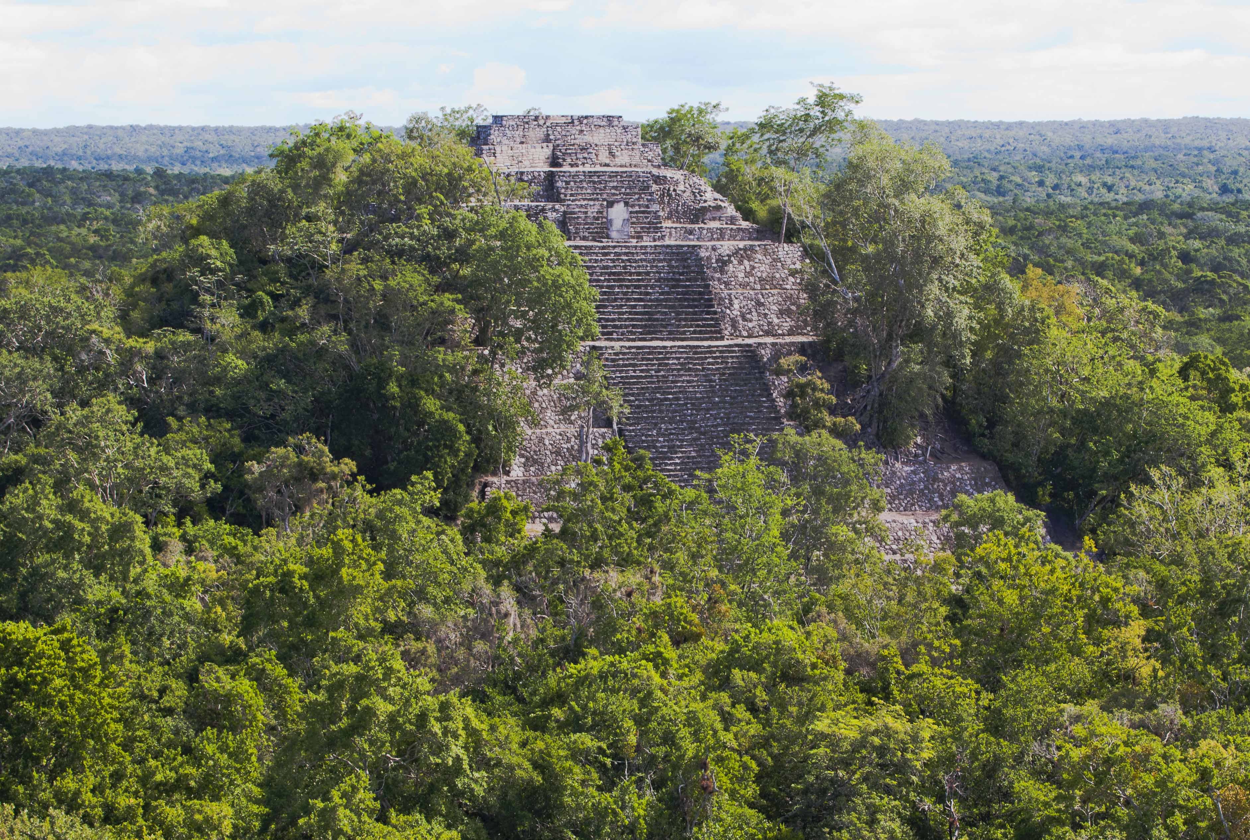
Elevated Interior Region (EIR)
Dominant Rock Type: Paleocene/Eocene Icaiche Fm
Not Well Studied: Most Thorough Geologic Work Was
by Butterlin & Bonet between 1958-1960
(Under Difficult Conditions)
Not Well Studied: Most Thorough Geologic Work Was
by Butterlin & Bonet between 1958-1960
(Under Difficult Conditions)
Most Identifiable Unit: Extensive 25-35 m
Thick Beds of Massive Gypsum
the formation also contains
Carbonate Rocks & and Abundant Argillite
The EIR,
Not an Easy Place to Do Fieldwork!
Other: Unconfirmed K-Pg Impact Breccia
& Barton Creek Ls
Post Eocene
Paleogene-
Eocene
Thin Exposed
Carbonate
Albion Fm (K-Pg)
For 2 Millenia a Large, Technologically Advanced Maya Population Occupied the EIR. A Thousand Years Ago They Left. Few People Have Returned.
K-Pg
Weathered
K Surface
Cretaceous

Slide 4
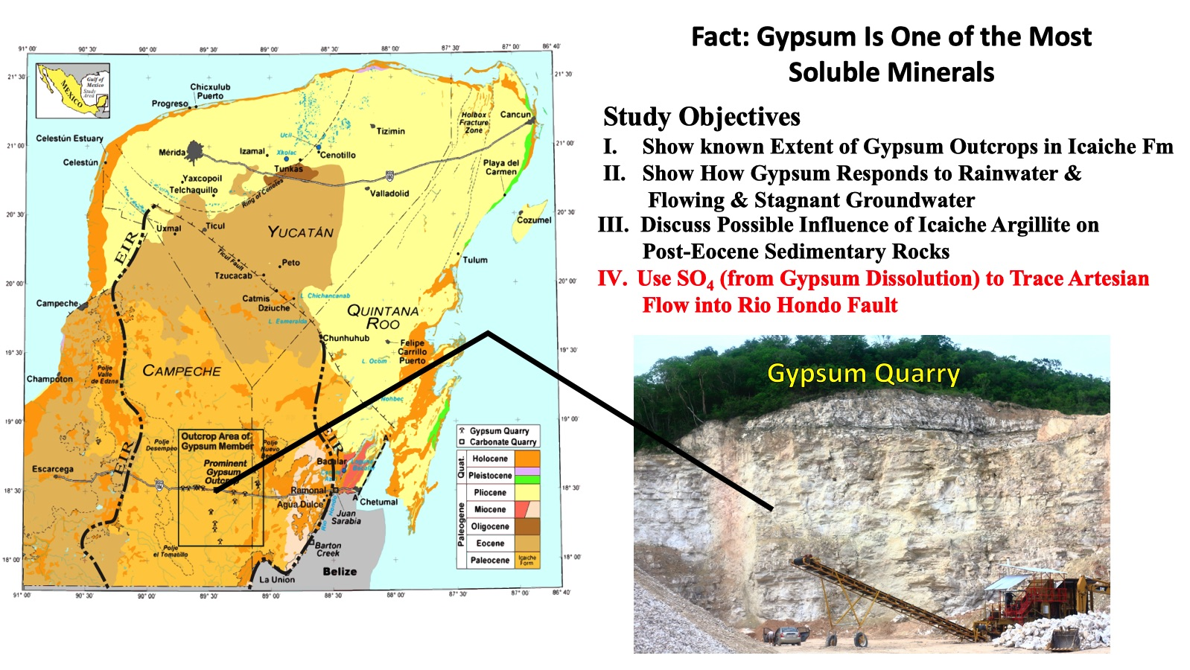

Slide 5
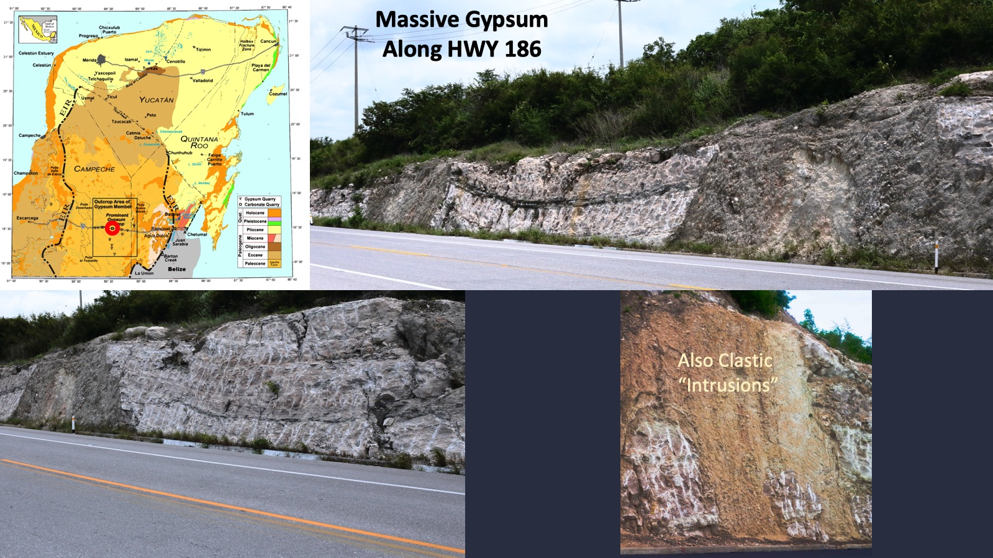
Massive Gypsum
Along HWY 186

Slide 6
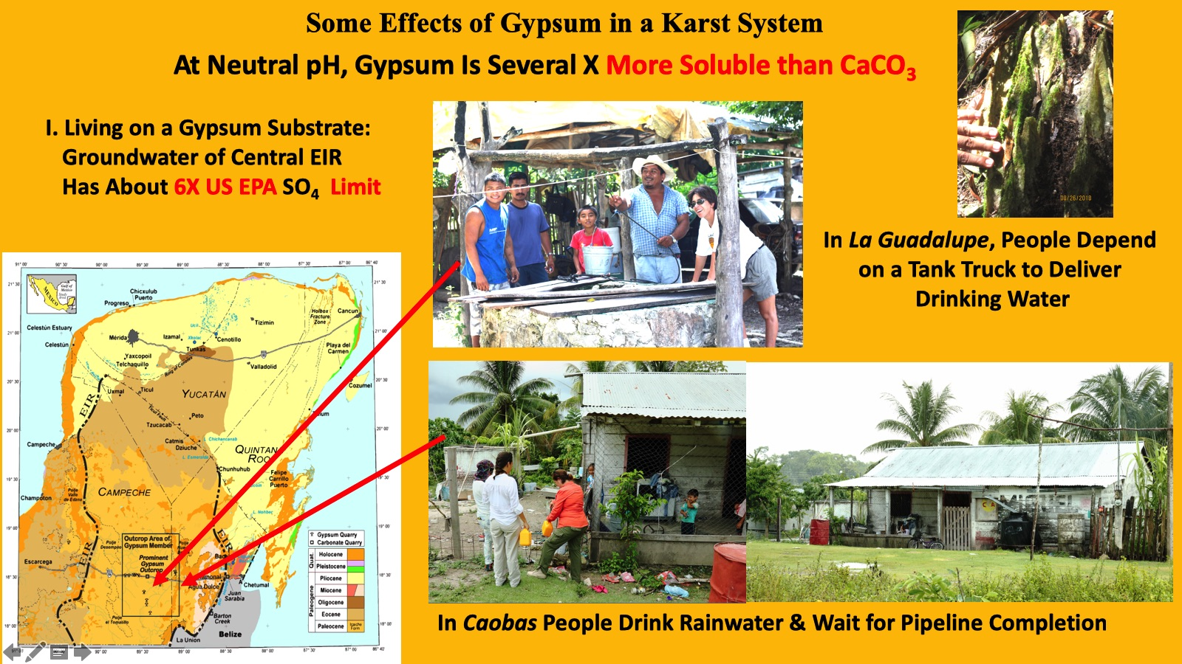

Slide 7
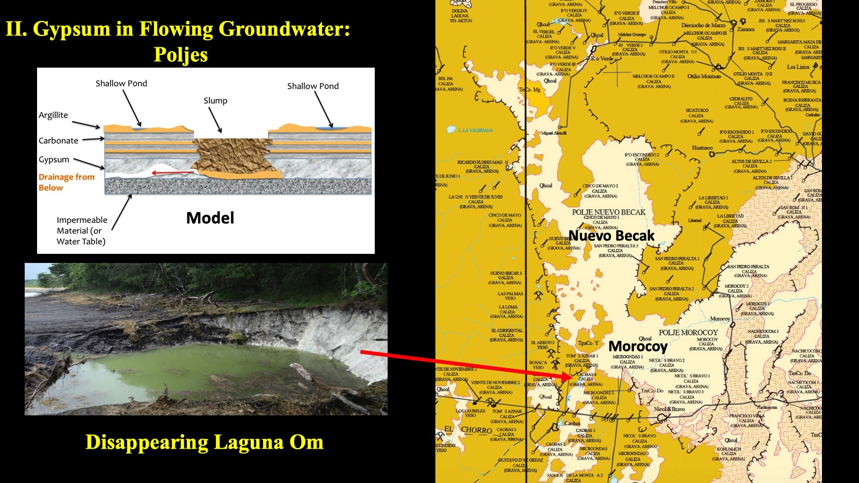
Model

Slide 8
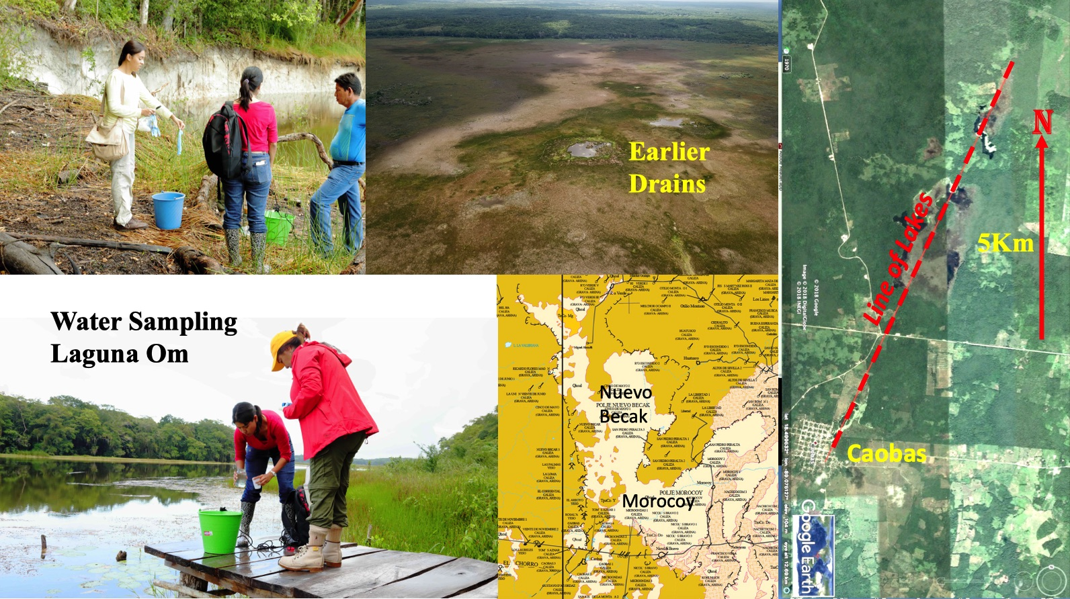

Slide 9
Subsurface Gypsum Karst Produced by
Dissolution of Icaiche Gypsum
A
“Pockmarked Terrain”/
Rejollada Zone
(140 km from Nearest Icaiche Outcrop)
A’
A
Plio
Eocene
Icaiche Fm, Paleocene-Eocene
B’
B’
Eocene
Post-Eocene
Icaiche
B
Schematic Cross Sections
B
A’

Slide 10
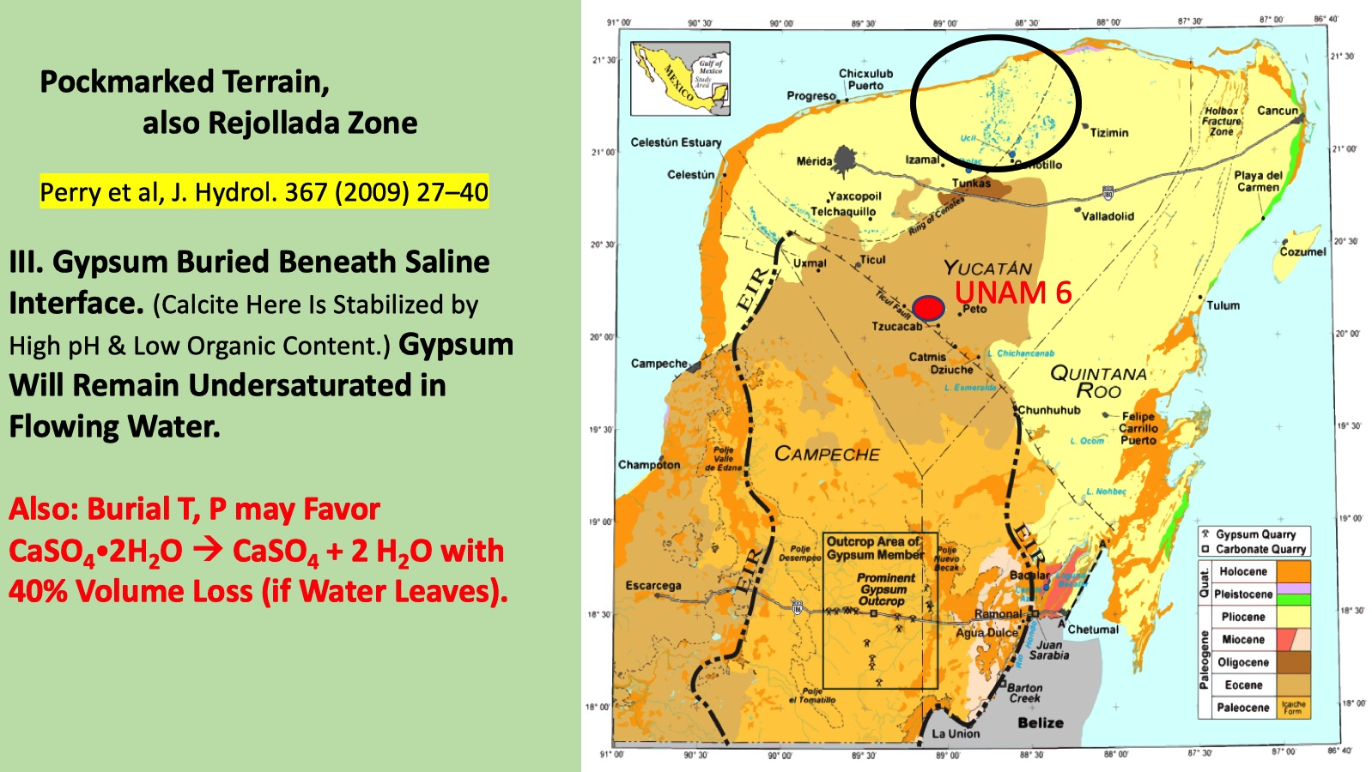

Slide 11
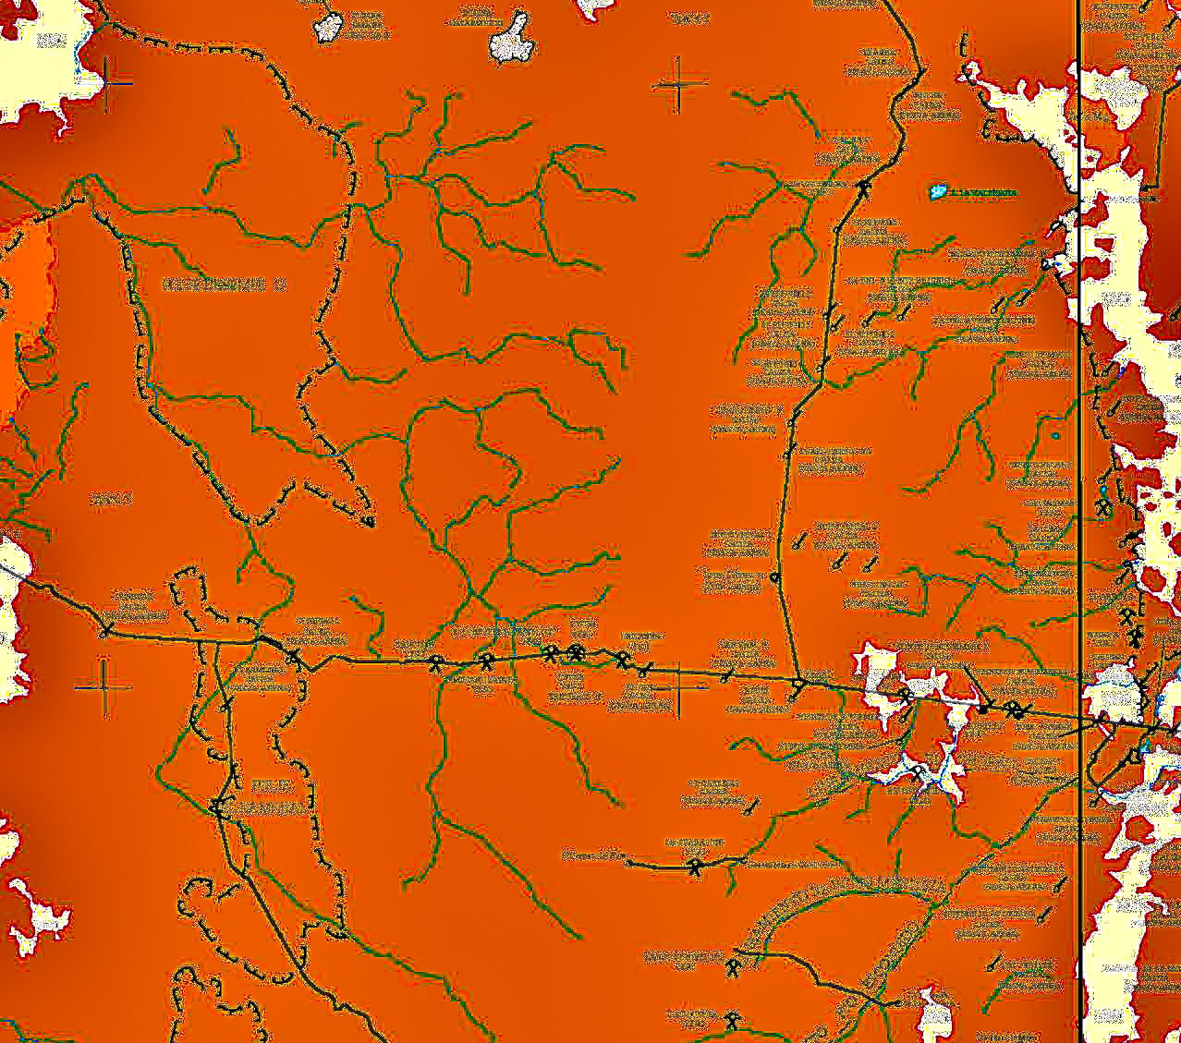
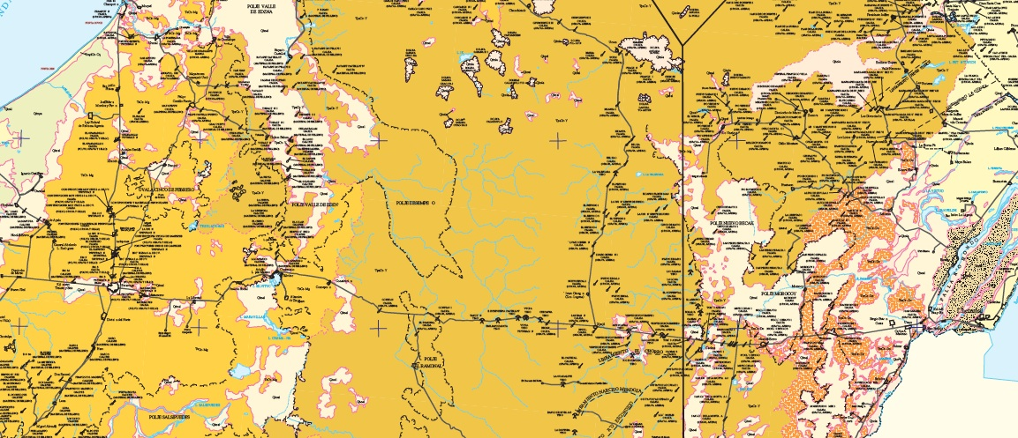
The EIR as a Major Recharge Zone
For Bacalar & the Rio Hondo

Slide 12
Water from the EIR is nearly saturated wrt GYPSUM…
(Circle Size Proportional to Approach to Saturation)
& has Hi SO₄
(Circle Size = f(Concentration))

Slide 13
50 Km gap
Gap
Gap

Slide 14
Higher Cl in the Northeast (Seawater Influence)

Slide 15
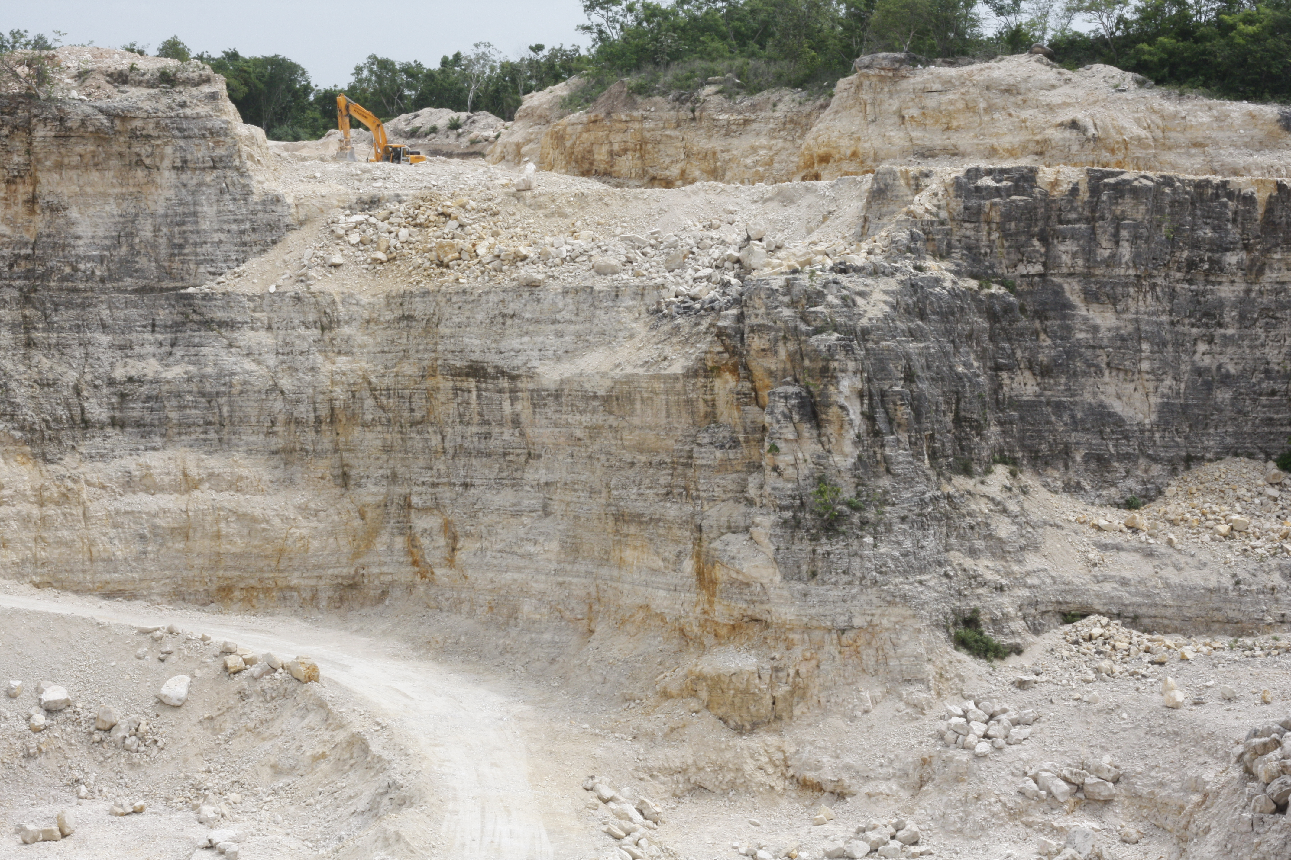
Late Cretaceous Barton Creek Limestone
(In Mexico Present only along the Rio Hondo Fault)
K-Pg Impact Breccia
Cretaceous Weathering Surface

Slide 16
Recharge Area
Schematic Cross Section of
Proposed Barton Creek Aquifer
Barton Creek Fault Block

Slide 17
Complex Region of Transition
A Homogeneous Karst Aquifer is Present
North of the Ticul Fault

Slide 18
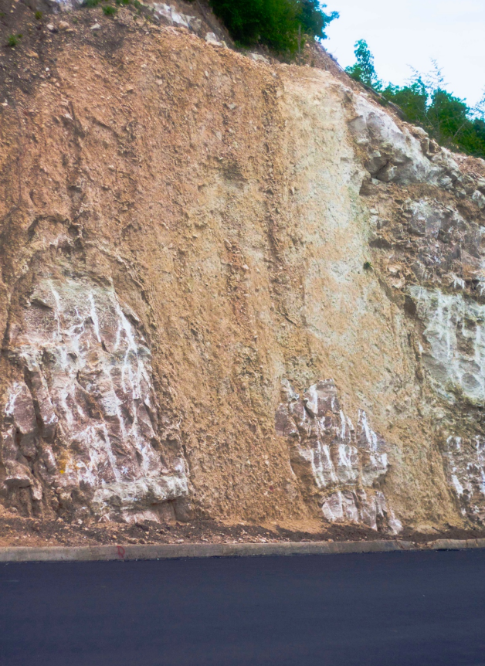
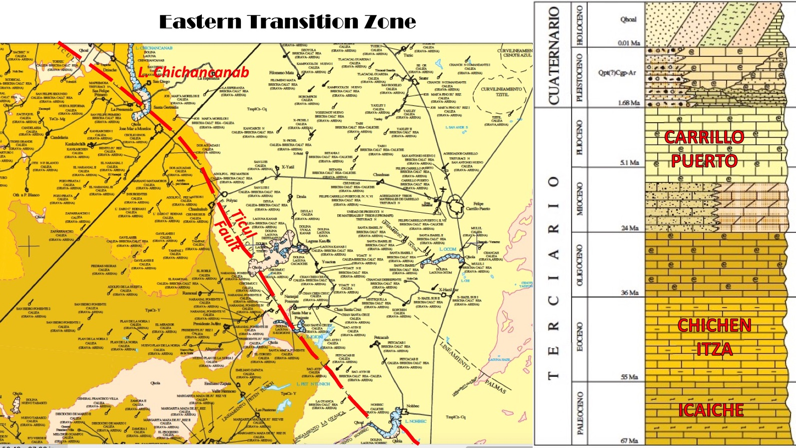
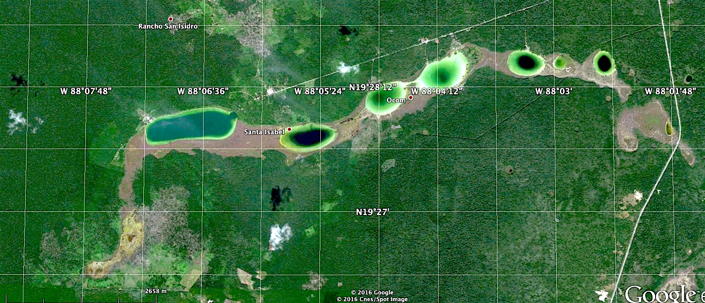
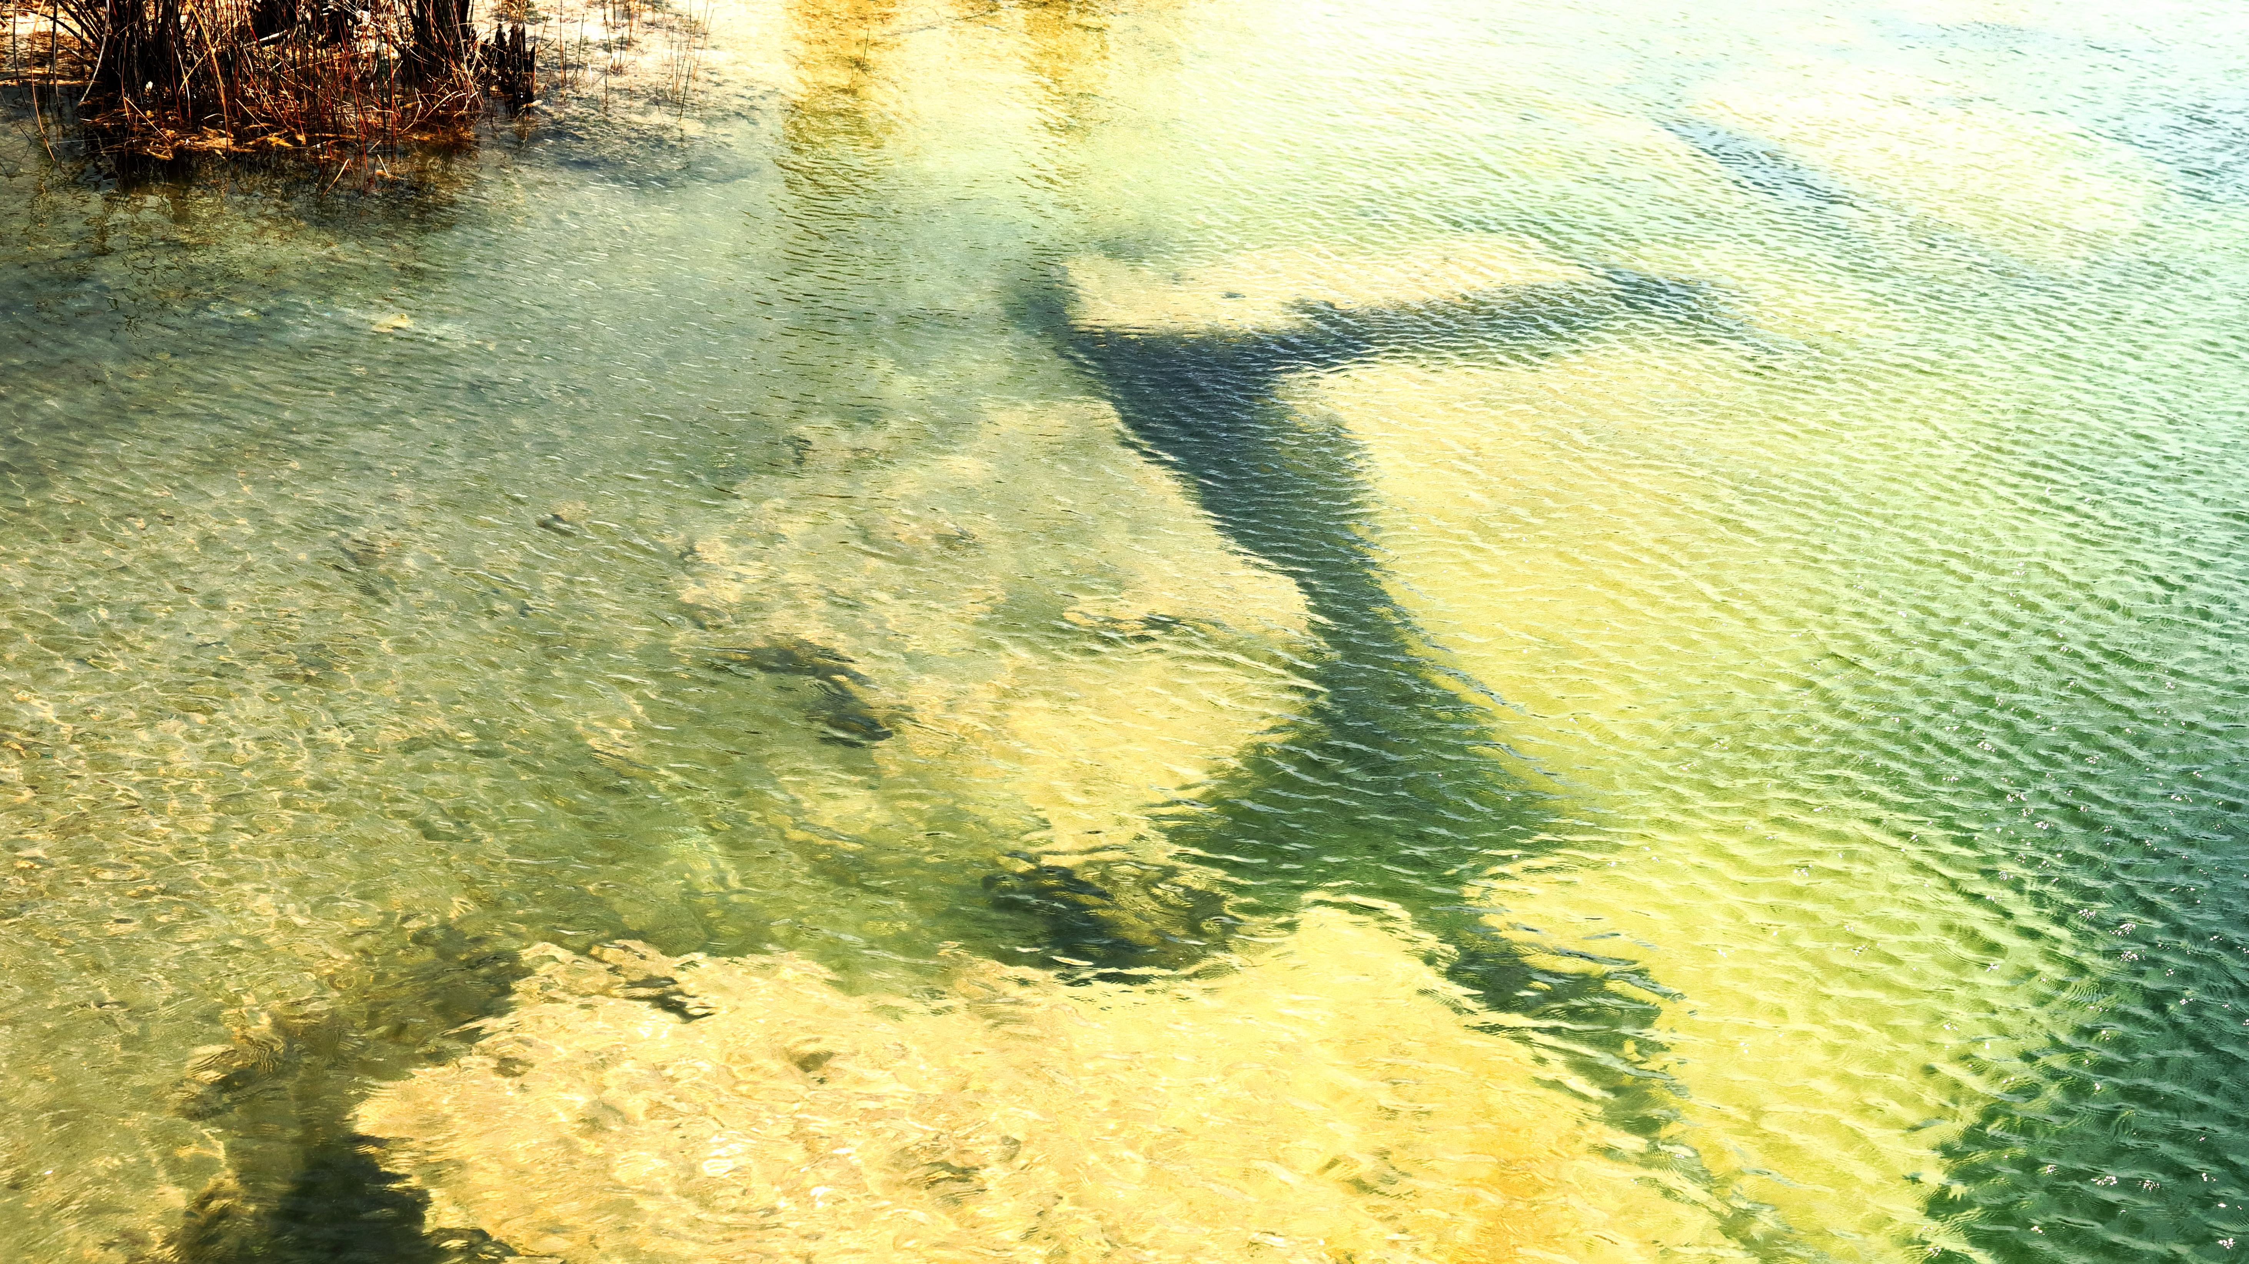
√
We Assert that Erosion of Icaiche Fm & Impact Debris Is a Source of Clays Producing Impermeable Post-Eocene Sediments
Carrillo Puerto Fm
5my
“Fossil” Streams
ICAICHE FM
60my
Collapse to
Base Level
(msl)

Slide 19
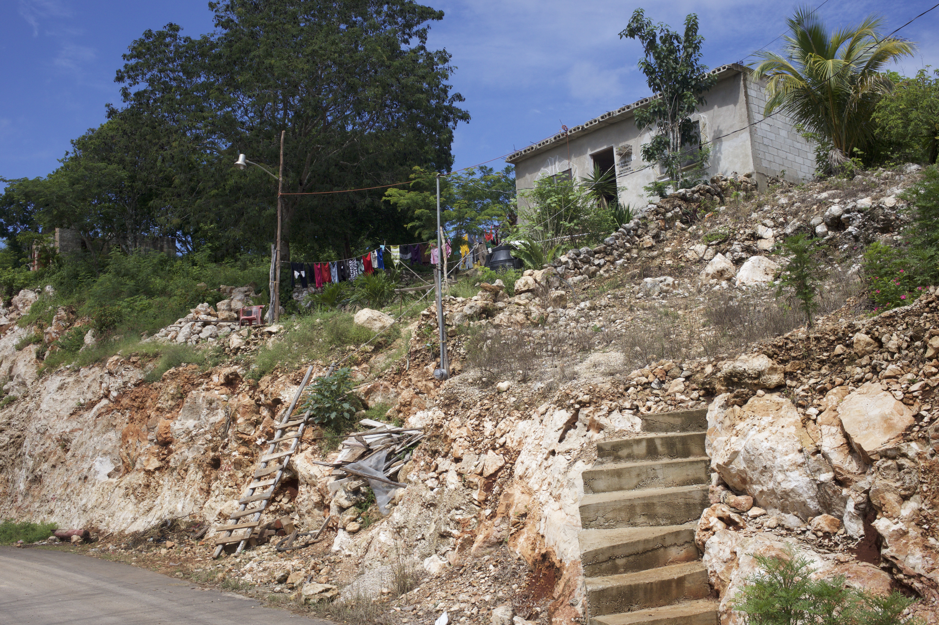
CHEMICAL INFLUENCE OF THE ICAICHE FM IN
THE EAST-CENTRAL PENINSULA
Here the Gypsum Member of Icaiche Fm lies within the Water Table – Solubiity Is Enhanced in Moving Water.
Result:
a) Production of Hi-SO₄ Groundwater
b) Abundant Collapse Breccia

Slide 20
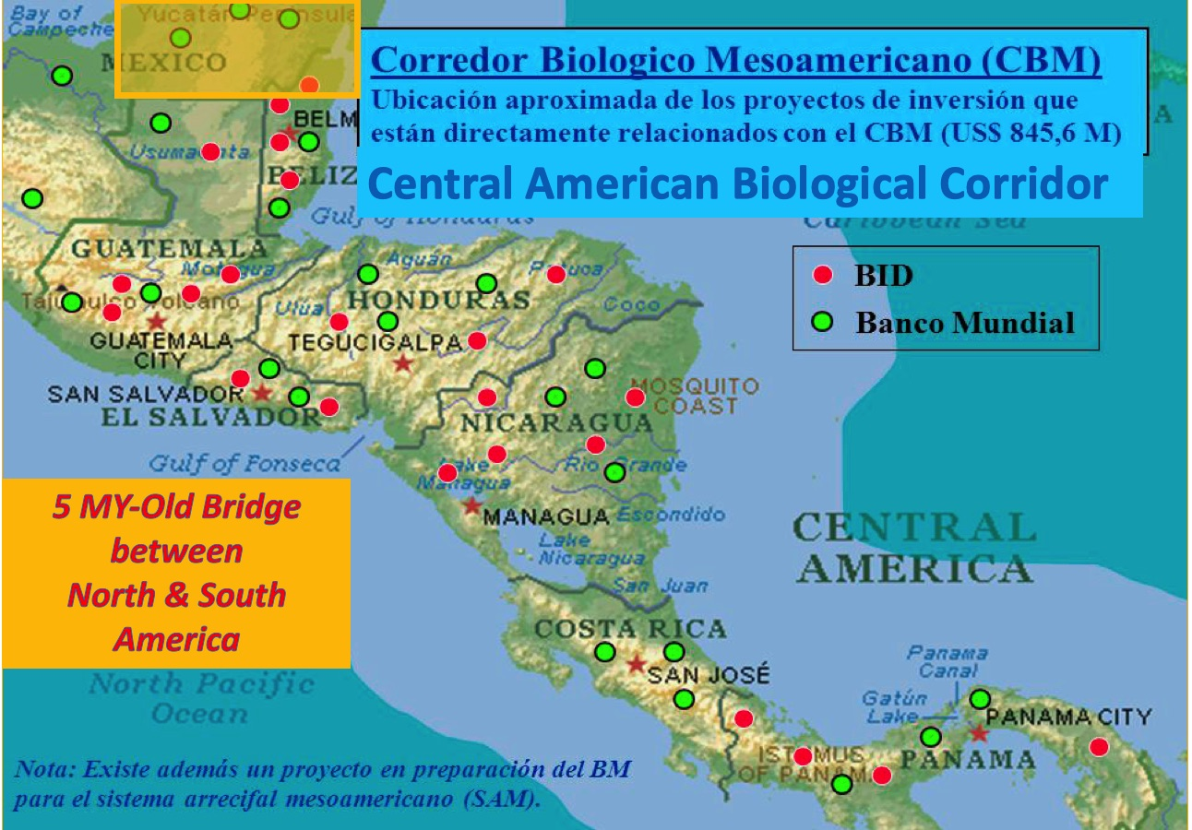
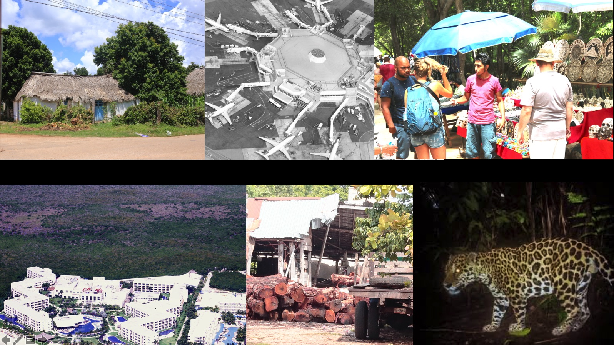
Farming
Tourism
Logging
Tourism
Habitat

Slide 21
