Slide 1
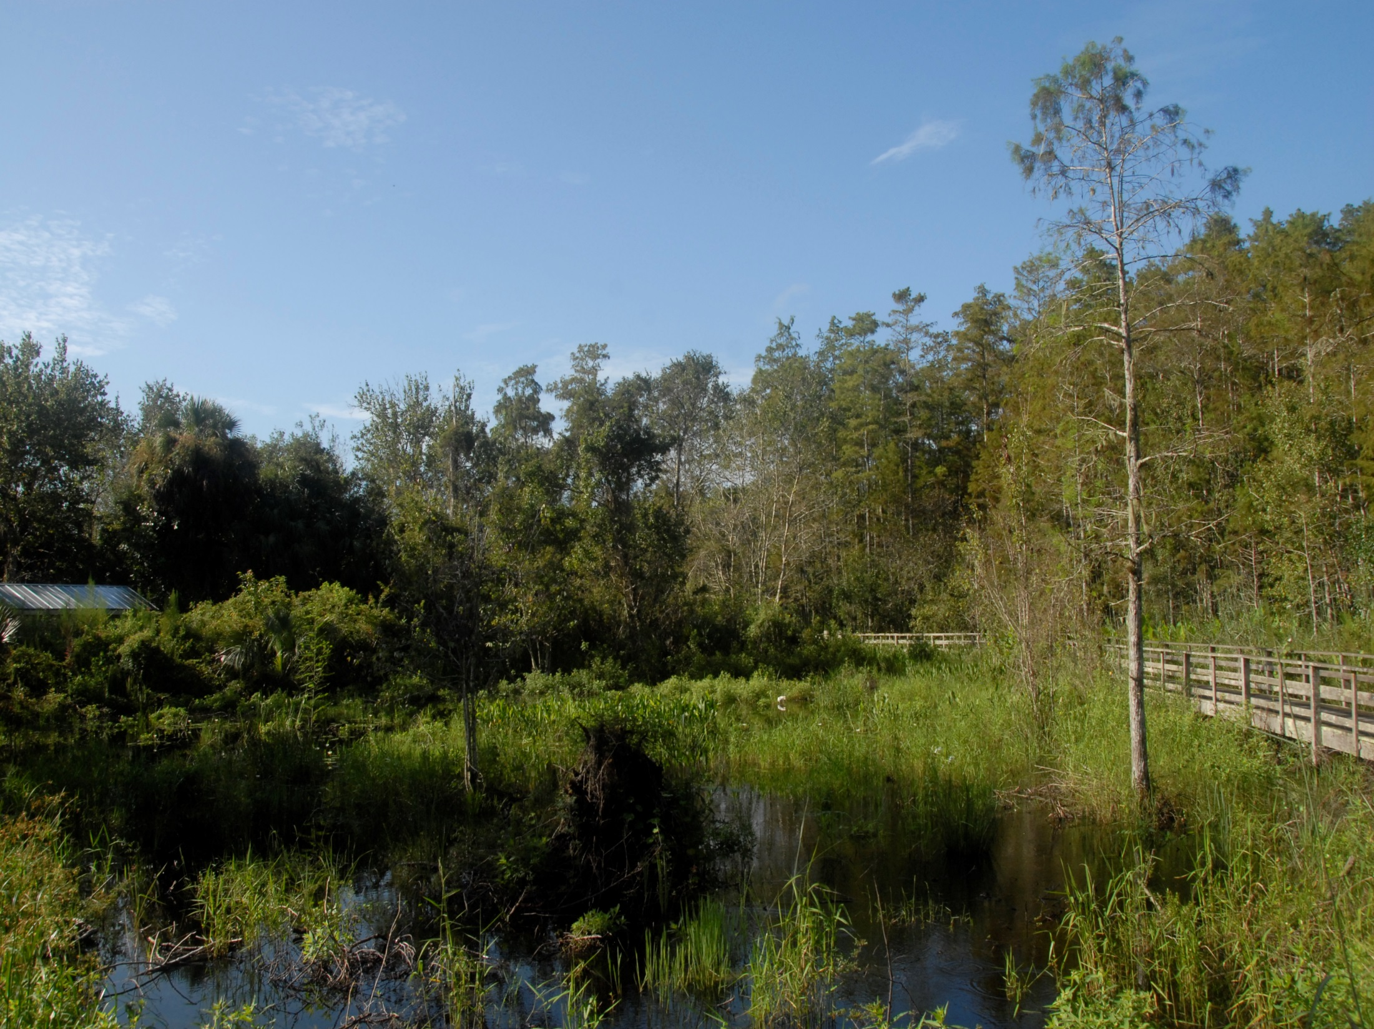
Linking Geothermal Electricity Generation with Multiple Desalination Processes and Aquifer Storage and Recovery: A method to reduce fossil fuels use and the carbon footprint of many global regions
Thomas M. Missimer¹, Peter Michael¹, Kim Choon Ng²
¹Florida Gulf Coast University
U. A. Whitaker College of Engineering
Emergent Technologies Institute
²King Abdullah University of Science and Technology
Water Desalination and Reuse Center
Geological Society of America
Indianapolis, Indiana
November 3-7, 2018
Renewable Energy Electricity Generation and Desalination

Slide 2
Introduction
Herein we introduce links between geothermal energy use, electricity generation, and seawater desalination to achieve sustainable energy and freshwater production at a competitive cost.
Primary goals of seawater desalination research are to reduce energy consumption of the process and encourage use of renewable energy.
While other renewable energy sources are available (e.g., solar PV, and wind), effective desalination requires continuous base load power that can be provided by geothermal energy.

Slide 3
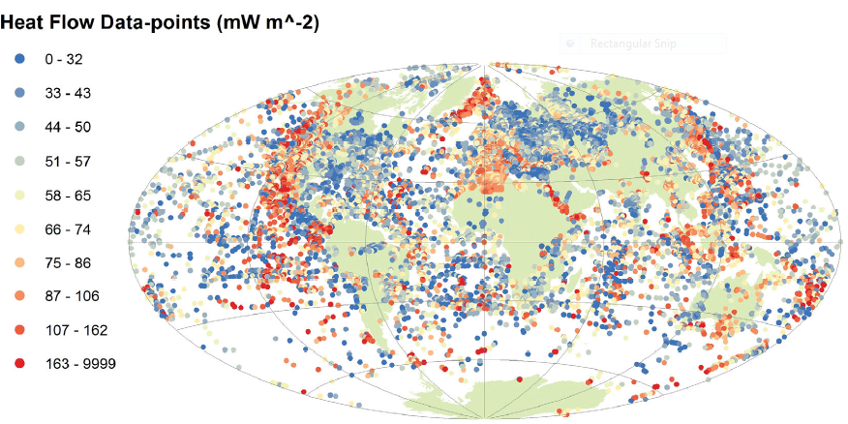
Global Heat Flow Measurements on the Surface of the Earth
From Davies (2013) Doi: 10.10.1002/gggge.20271

Slide 4
Matching Desalination Needs with Geothermal Energy Development Potential
Water shortage areas with matching high geothermal energy resources include southern California, North Africa, Southern Europe, and the Red Sea region.
Japan currently has extensive electricity generation needs and desalination could be an added benefit.

Slide 5
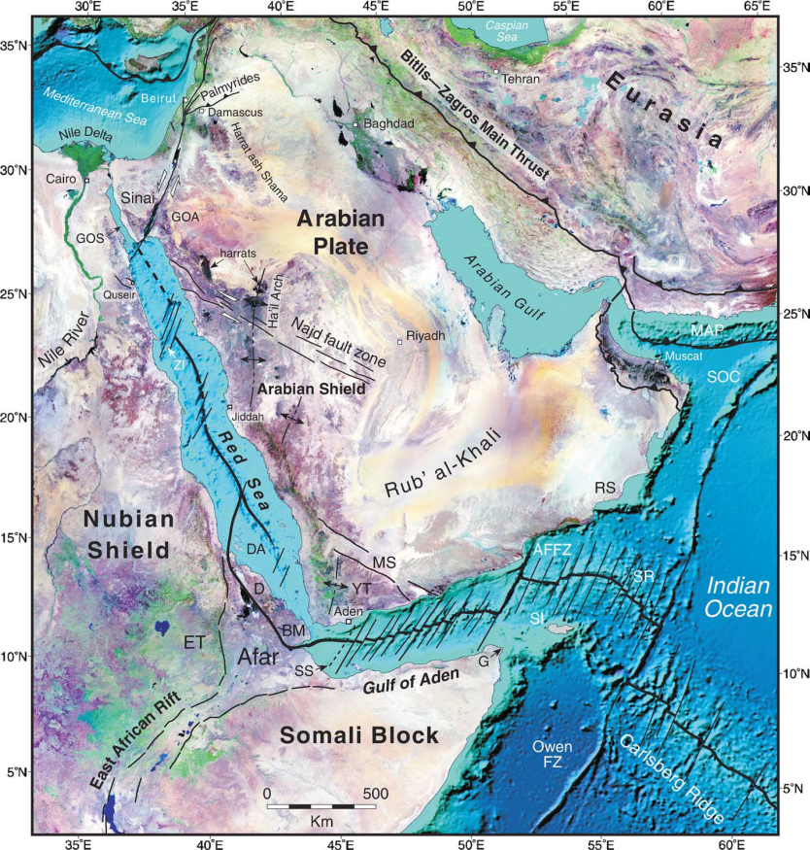
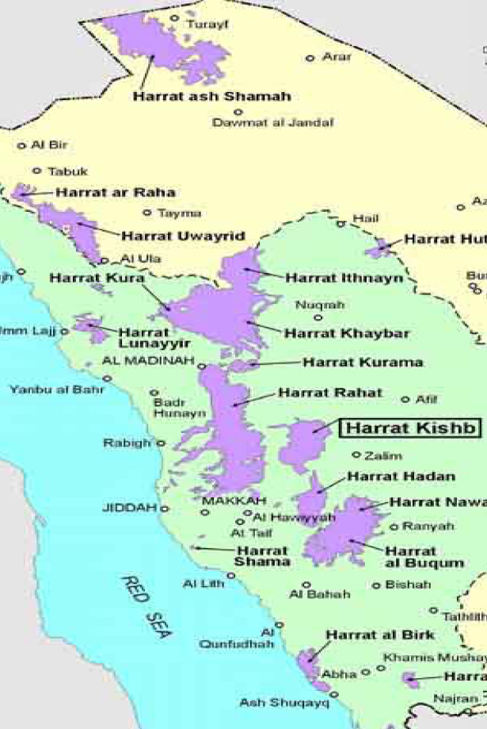
Saudi Arabia Example
The Red Sea is an active spreading center with high heat flow along the margins. The purple areas represent Holocene lave flows or Harrats which have the highest heat flow levels.

Slide 6
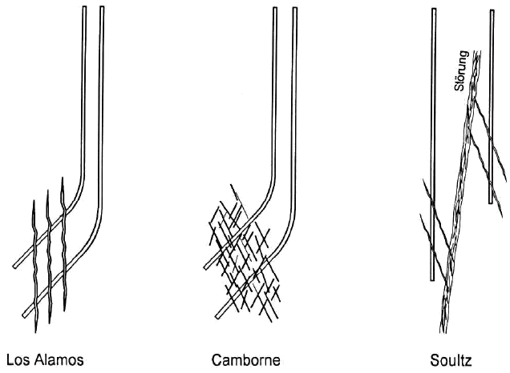
Heat Extraction Method- Hot Dry Rock
Subsurface fracture patterns of some hot dry rock geothermal development sites that use pressurized water below the supercritical temperature of water at 394° C. Note that the water pumped into these system is under high pressure.
From Tenzer (2001) Development of hot-dry rock technology, GHC Bulletin

Slide 7
Heat Extraction Method- Hot Dry Rock Harvesting
Hot-dry rock heat harvesting can also be developed using hydraulic fracturing of the rock reservoir. This reduces the operating pressure of the system and reduces the potential for induced seismicity.
From Missimer et al. (2014) Desalination and Water Treatment

Slide 8
High Grade Geothermal Electricity Generation with Seawater Desalination
Optimum steam temperature development for electric generation
150-200 ⁰C
Electricity generation
one or two cycles
Desalination
multiple thermal process trains with full integration
(new patent pending)
Energy/desalination campus concept with SWRO and ASR

Slide 9
Integrated Geothermal Energy Development, Electricity Generation and Desalination

Slide 10
Full Process Integration with Side Streams of Steam
Key design aspects conclude optimal water temperatures recovery at 180° C and injection at 65° C.

Slide 11
Maximum Efficiency Geothermal-Powered Electric Generation , Desalination, and Water Storage
The aquifer storage and recovery component of the system allows the facility to operate at the most efficient level by storing water during low demand periods and for plant maintenance down time. In addition storage enable higher plant utilization factor. Higher utilization factor means the overall plant size can be lowered by 10-20%.
The electricity generation-desalination-water storage campus

Slide 12
Cost of Hot-Dry Rock Electricity Development (Stand Alone)
One of the objections to hot-dry rock electricity development has been the cost which is higher in stand-alone facilities compared to use of fossil fuel powered plants.
Linking desalination of seawater with electricity generation provides a higher cost-benefit ratio for the combined processes.
Exhaust gas and greenhouse gas generation for the combined facilities is very low compared to conversion processes using fossil fuels and even solar electricity generation with battery storage.

Slide 13
Conclusions
Geologists and engineers can work together to create new and exciting concepts to reduce fossil fuel use and improve the environment.
Large portions of the Earth contain areas of high heat flow with a corresponding high geothermal gradients conducive to hot dry rock heat harvesting.
Key regions include Red Sea region, Southern California, North Africa, and Southern Europe, all of which have needs for electrical power and fresh water from desalination.

Slide 14
Conclusions
Maximizing the efficiency of electric generation and desalination can be achieved by improved designs.
These designs utilize latent heat discharge from geothermal electric generation to provide desalination and thus does not waste typical steam (heat) release to ambient.
Additional efficiency can be obtained by adding SWRO and aquifer storage and recovery to the same location.

