Slide 1
Radium mobility and the age of groundwater in public-drinking-water supplies from the Cambrian-Ordovician aquifer system, north central USA
Paul Stackelberg, U.S. Geological Survey, Troy, NY
Zoltan Szabo, U.S. Geological Survey, Lawrenceville, NY
Bryant Jurgens, U.S. Geological Survey, Sacramento, CA
The Geological Society of America
North-Central Section 2018
Ames, IA
National Water Quality Assessment (NAWQA) Project

Slide 2
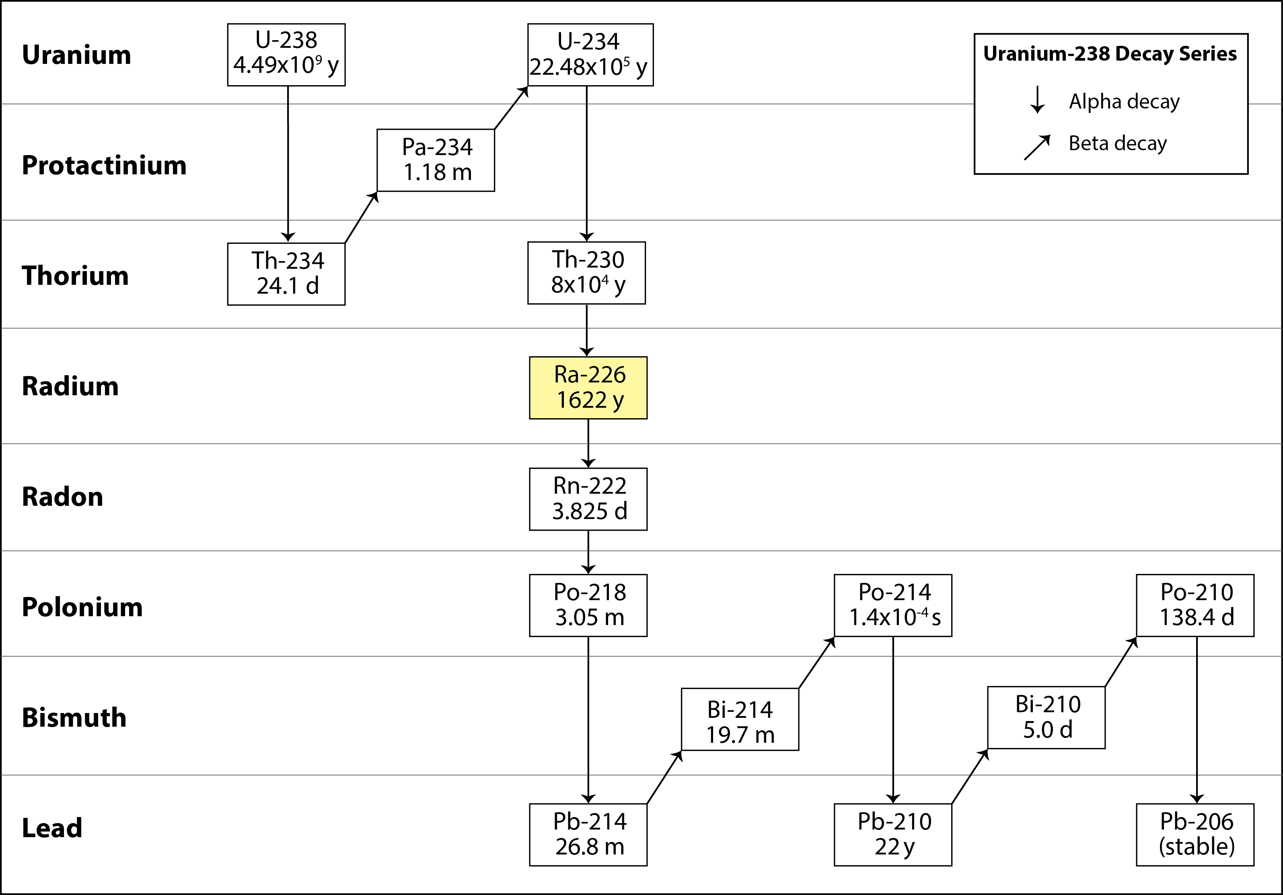
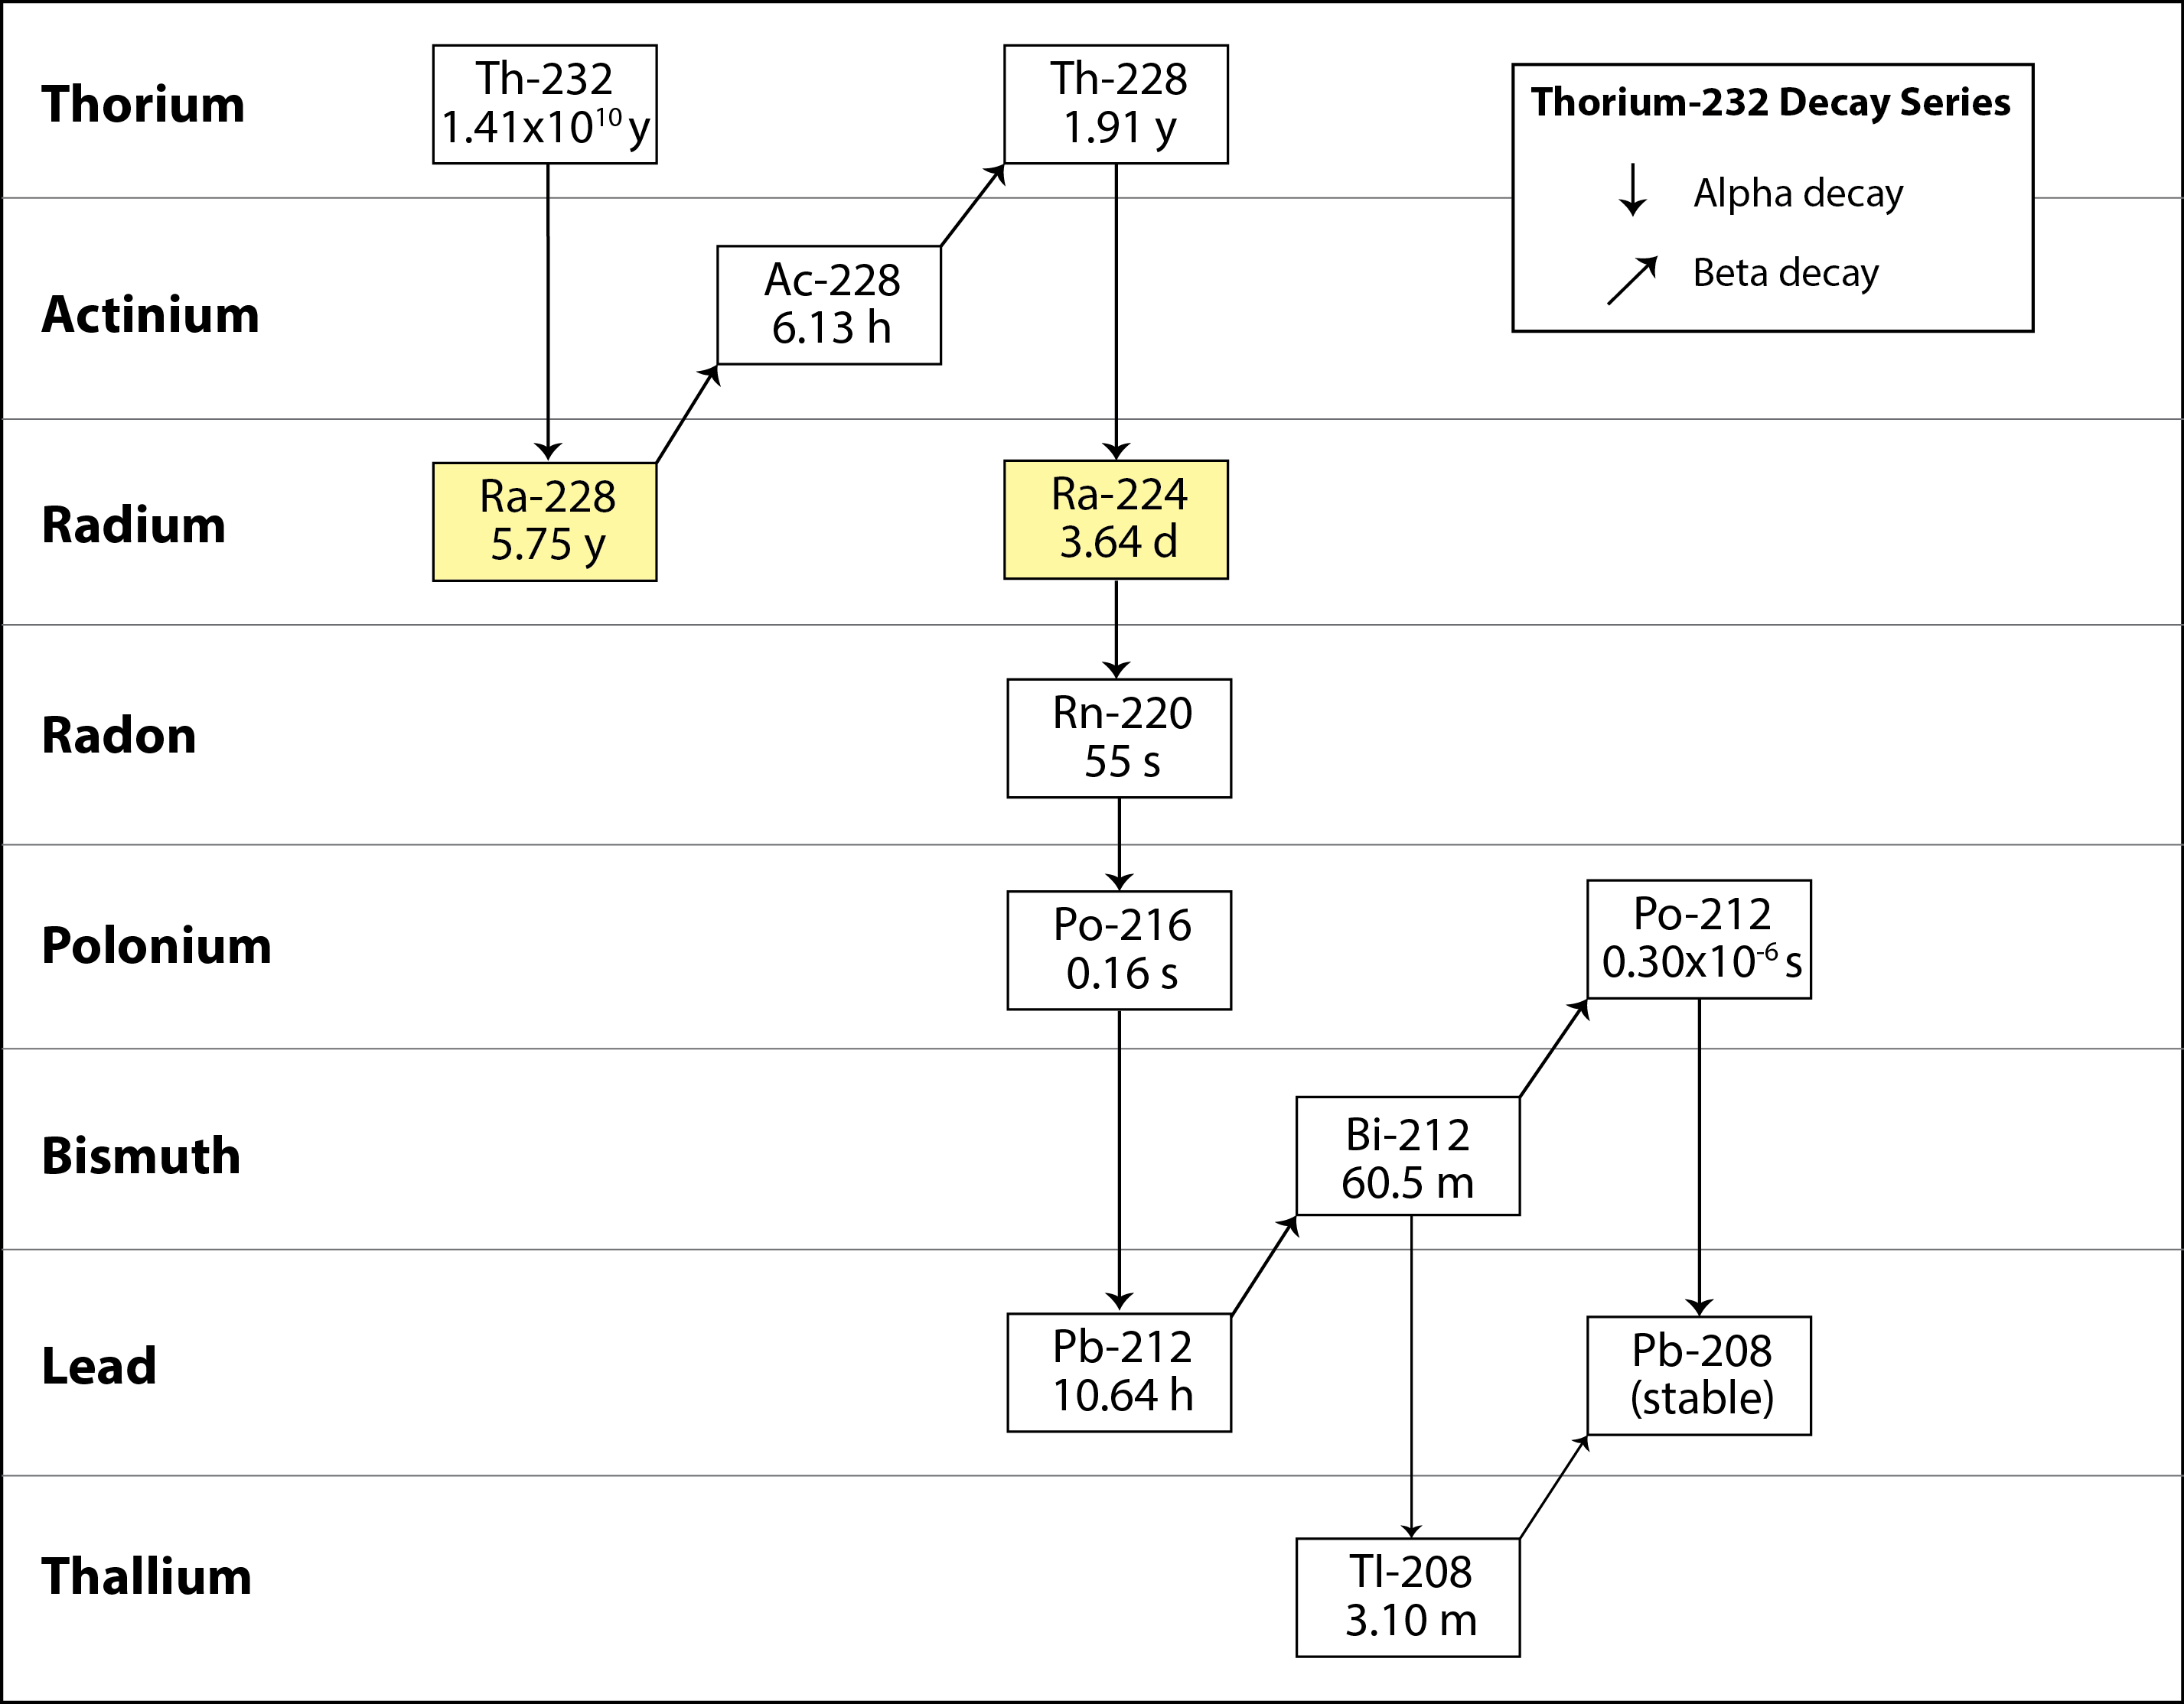
²³⁸U and ²³²Th Decay Series

Slide 3
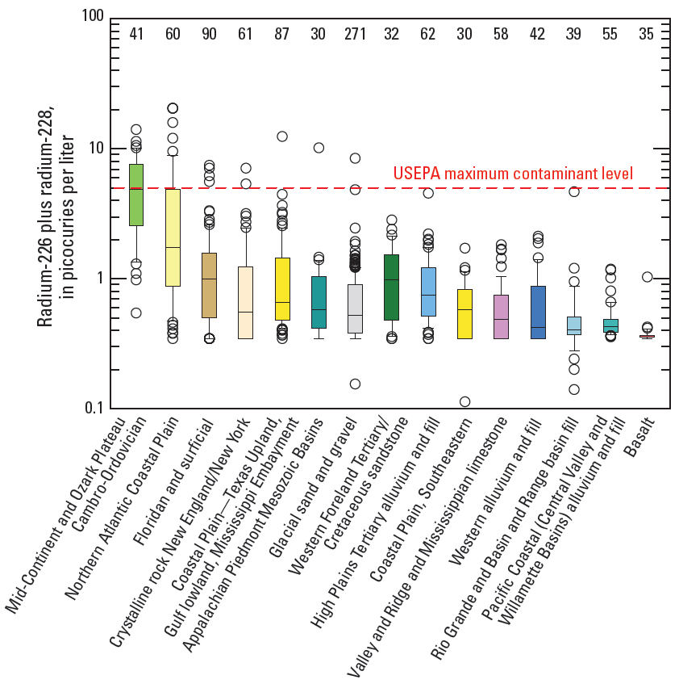
Background
from Szabo et al (2012)
MCL = ²²⁶Ra + ²²⁸Ra = 5 pCi/L
²²⁴Ra not regulated in drinking-water supplies
²²⁴Ra not routinely sampled by NAWQA prior to 2013

Slide 4
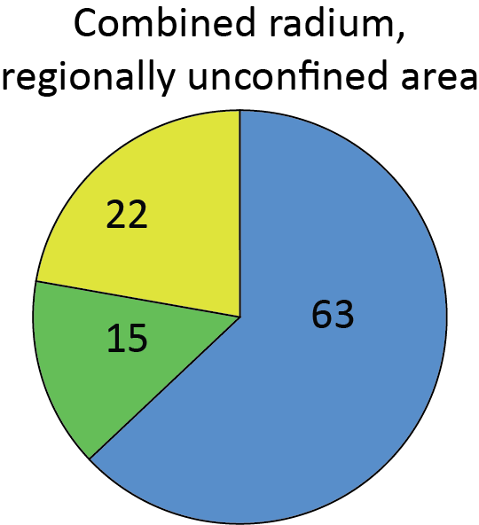
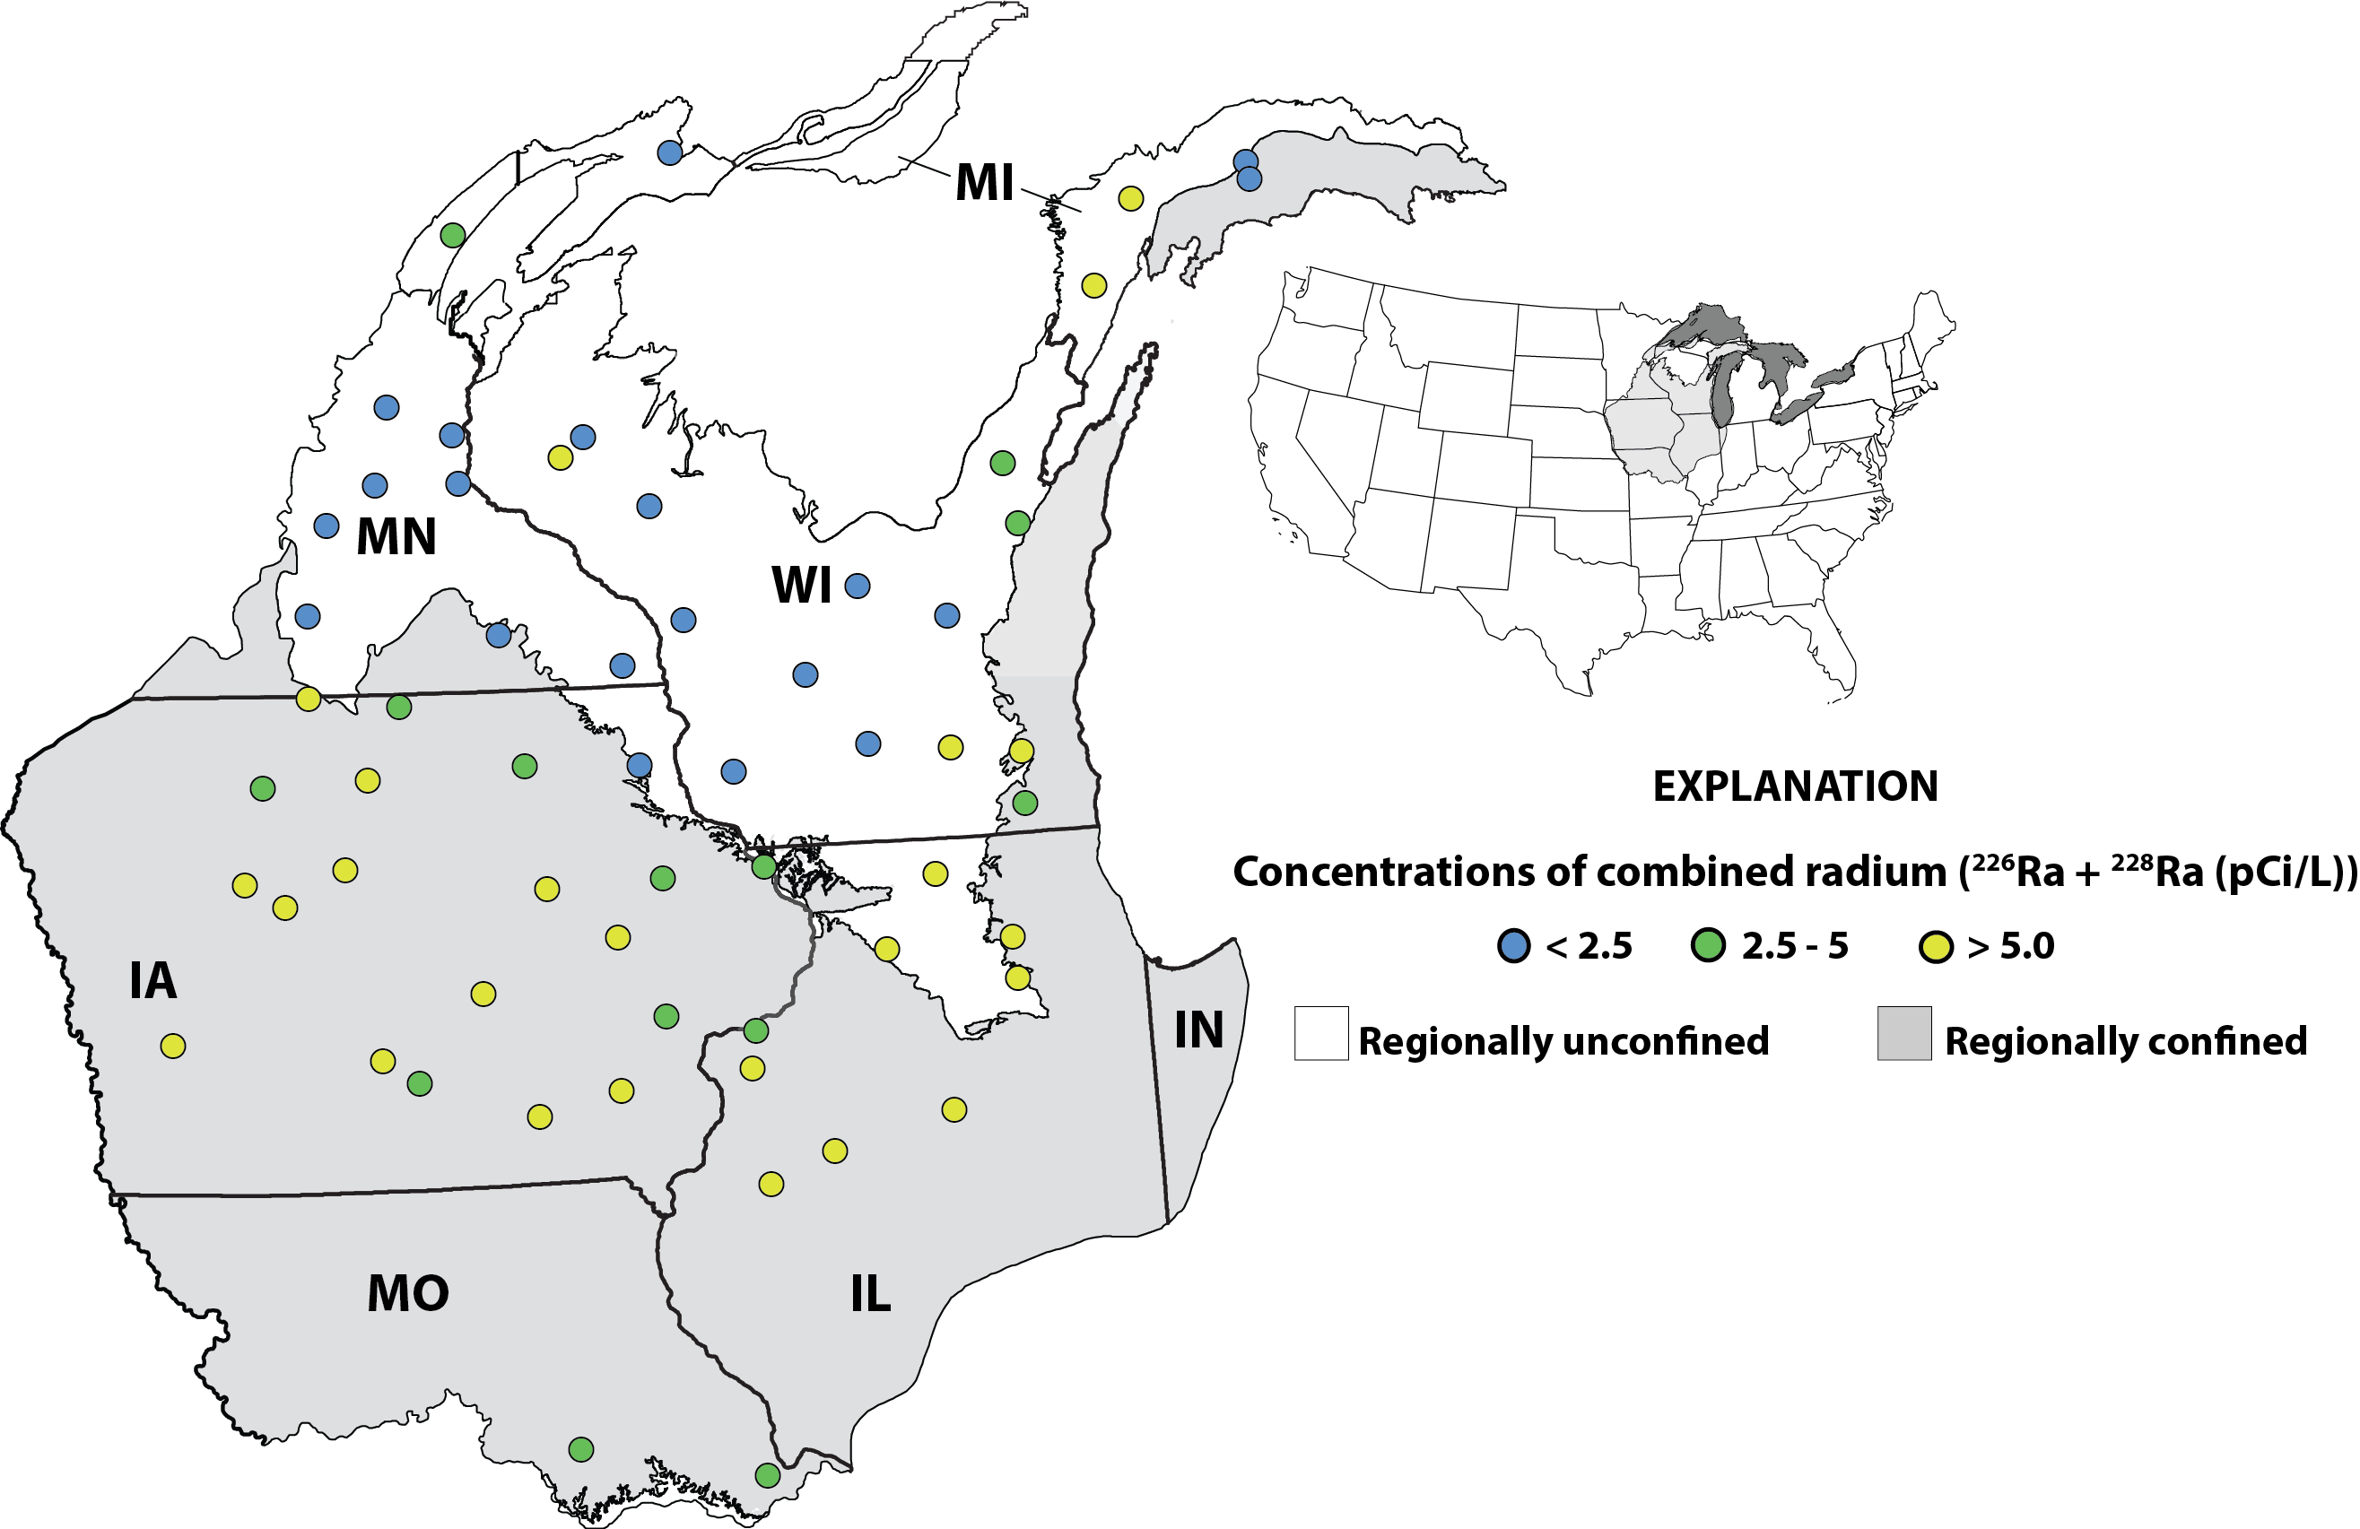
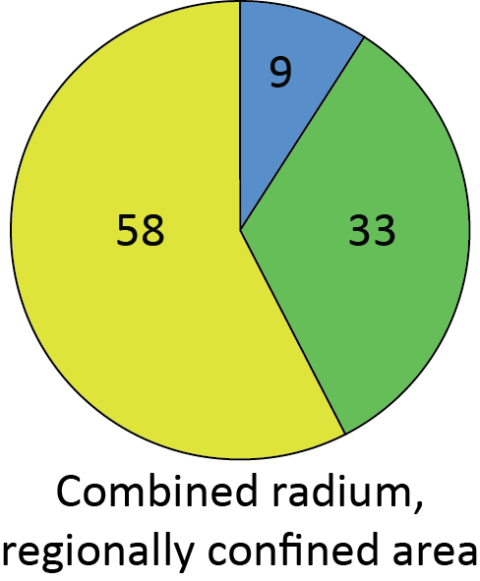
Sampling locations & combined Ra (²²⁶Ra + ²²⁸Ra)
Aquifer-wide, systematic assessment of ²²⁴Ra, ²²⁶Ra and ²²⁸Ra from public-supply wells
60 PSW’s selected using a stratified, randomized sampling design
20 PSW’s targeted to high GAA
Samples collected prior to any treatment

Slide 5
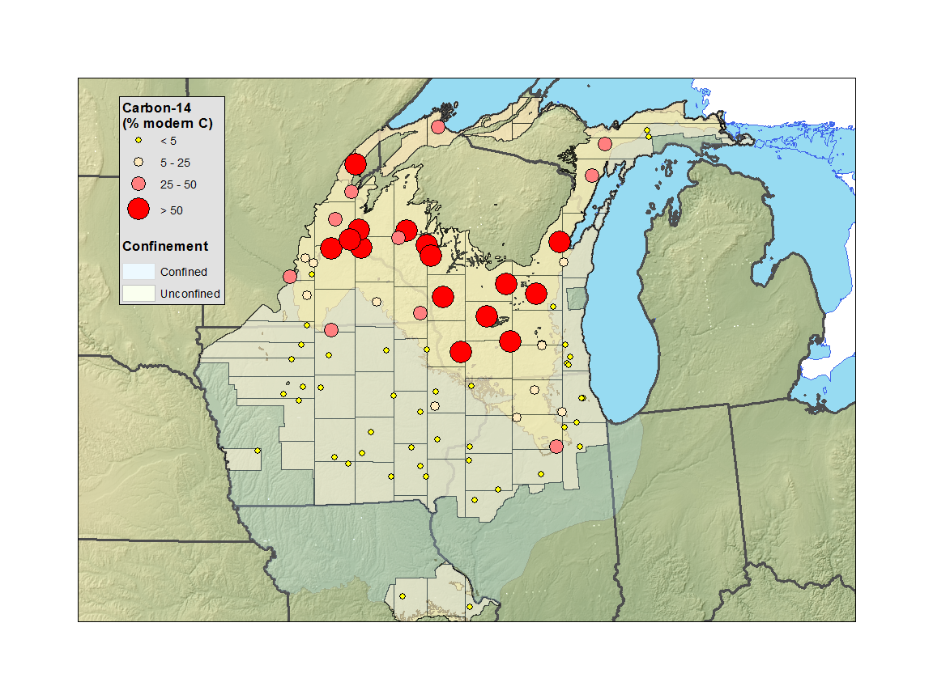
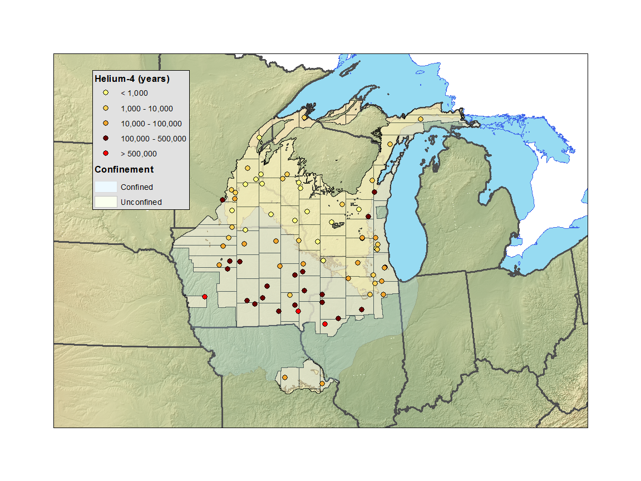
Mean Groundwater Age
¹⁴C indicates young water in regionally unconfined area and water ≥ 30,000 yrs. in the regionally confined area
⁴He indicates residence times > 100,000 yrs in regionally confined area
GW ages correspond to flow system

Slide 6
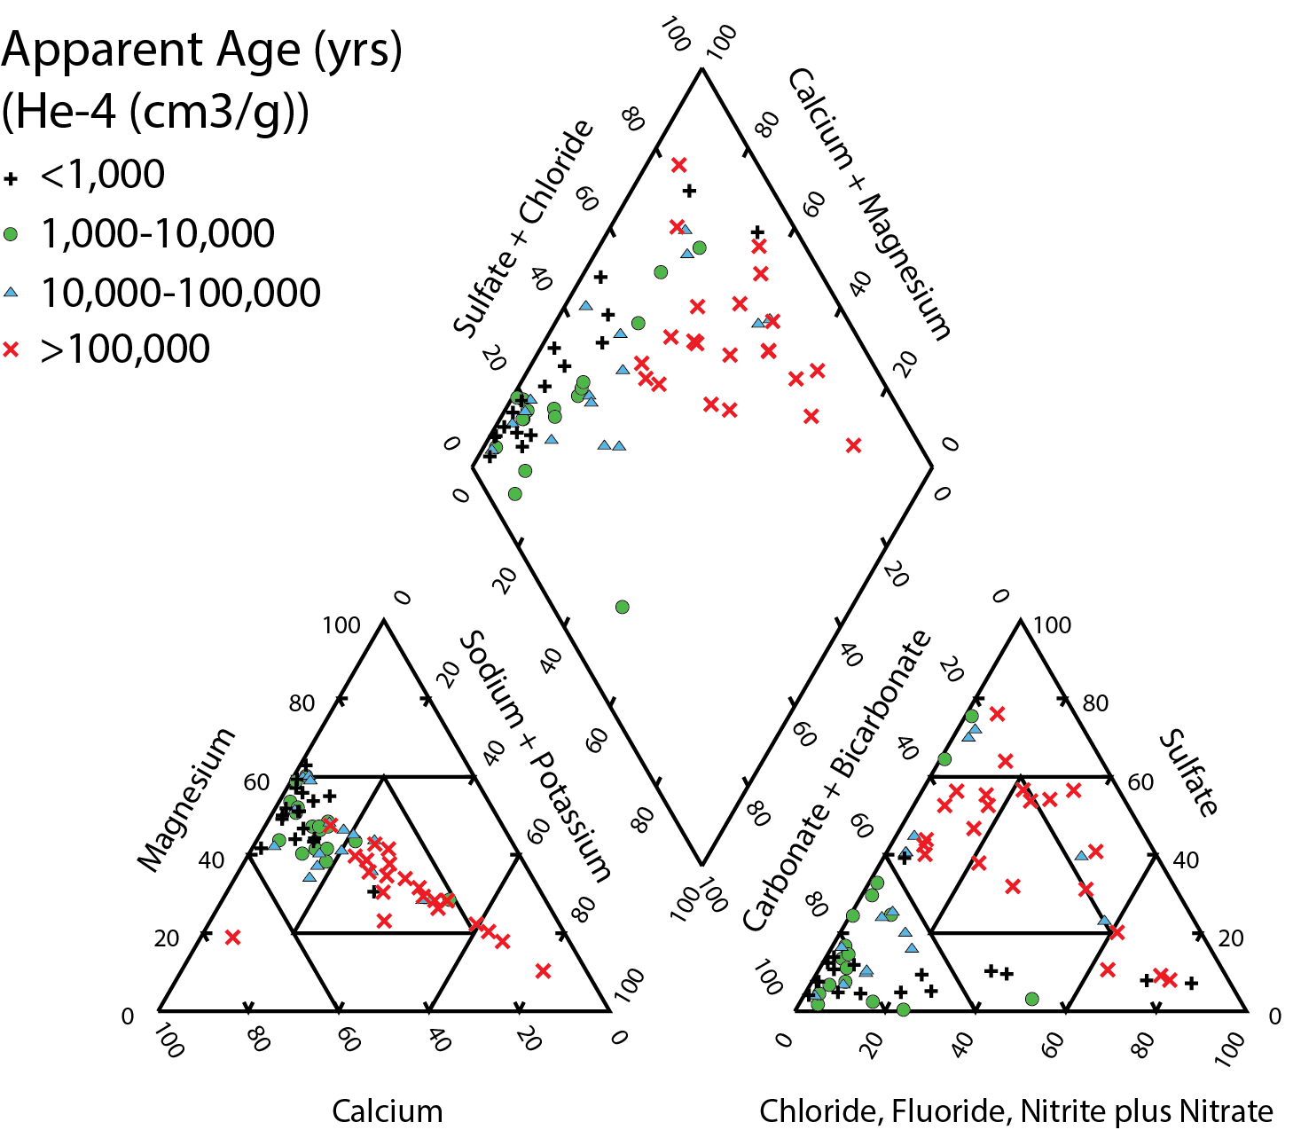
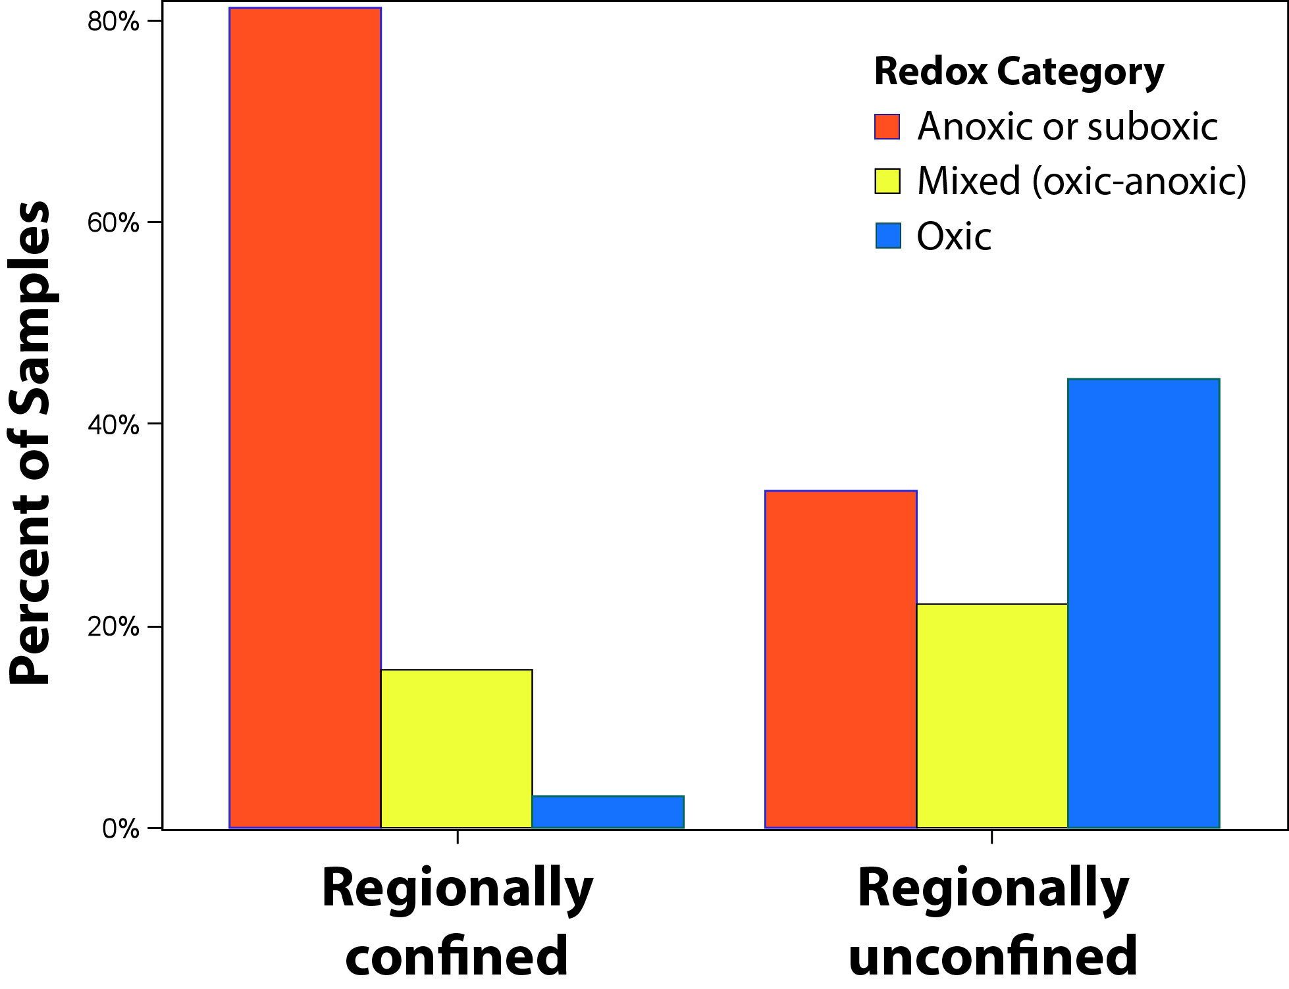
Water Type and Redox Condition Evolve with GW Age

Slide 7
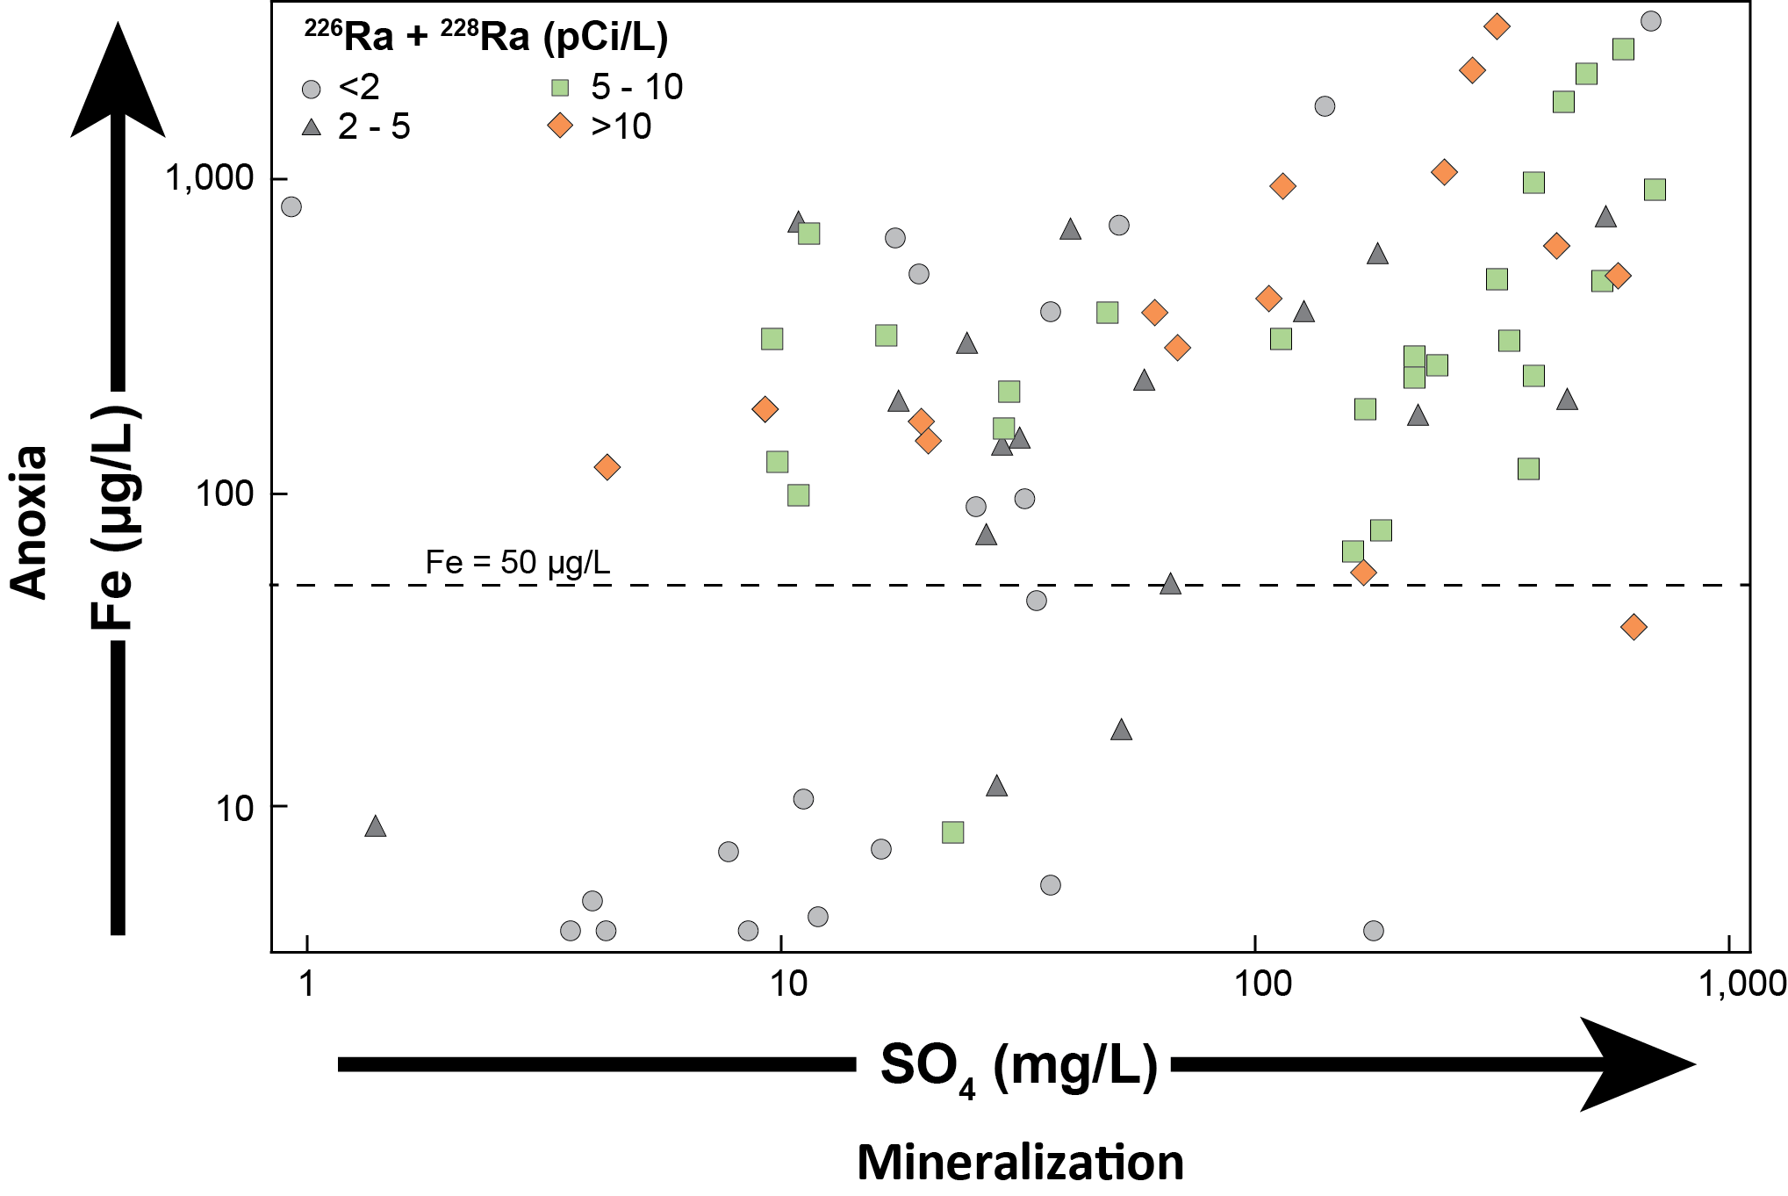
Combined Ra (²²⁶Ra + ²²⁸Ra) increases with anoxia and mineralization
Under oxic conditions, Ra sorbs to Fe-hydroxide coatings
Under reducing conditions, Fe-hydroxide coatings dissolve:
  Releasing Ra into solution,
  Decreasing sorption capacity,
  Increasing competitive exchange

Slide 8
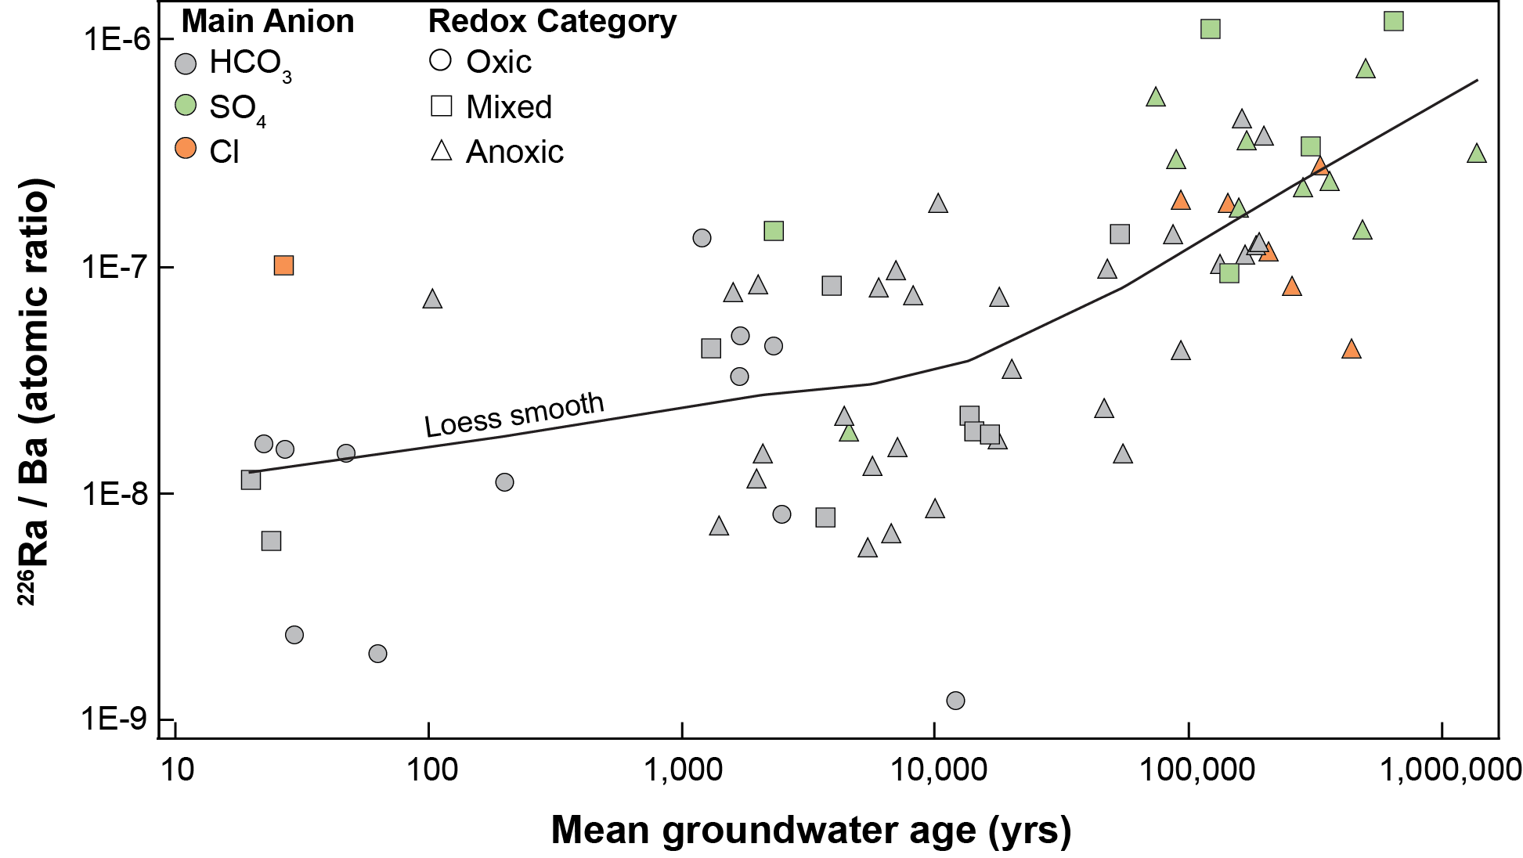
²²⁶Ra:Ba ratios illustrate change in ²²⁶Ra sorption with increasing anoxia and mineralization
Ra and Ba are close chemical analogs
Ba concentrations do not differ across the aquifer system
Ratios are lowest for “oxic, HCO3” and highest for “anoxic, SO₄/Cl” samples
²²⁶Ra is sorbed on Fe-hydroxide coatings under “oxic” conditions and becomes mobilized under reducing, mineralized conditions due to decreased sorption capacity and increased competitive exchange

Slide 9
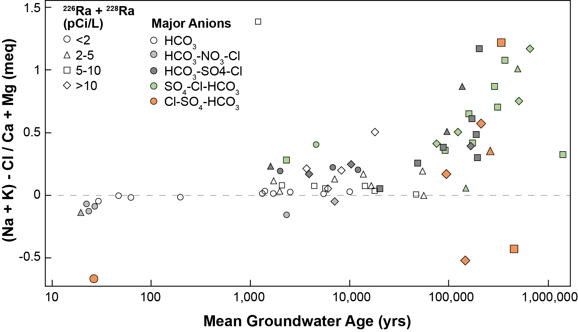
Exchange processes do not reduce ²²⁶Ra concentrations
If cation exchange was a dominant process, these ratios would exceed 5
As a minor process, Ra is not efficiently removed
The amount of Ra released to solution increases relative to the amount sequestered by cation exchange
Carbonate rocks do not provide abundant exchange capacity

Slide 10
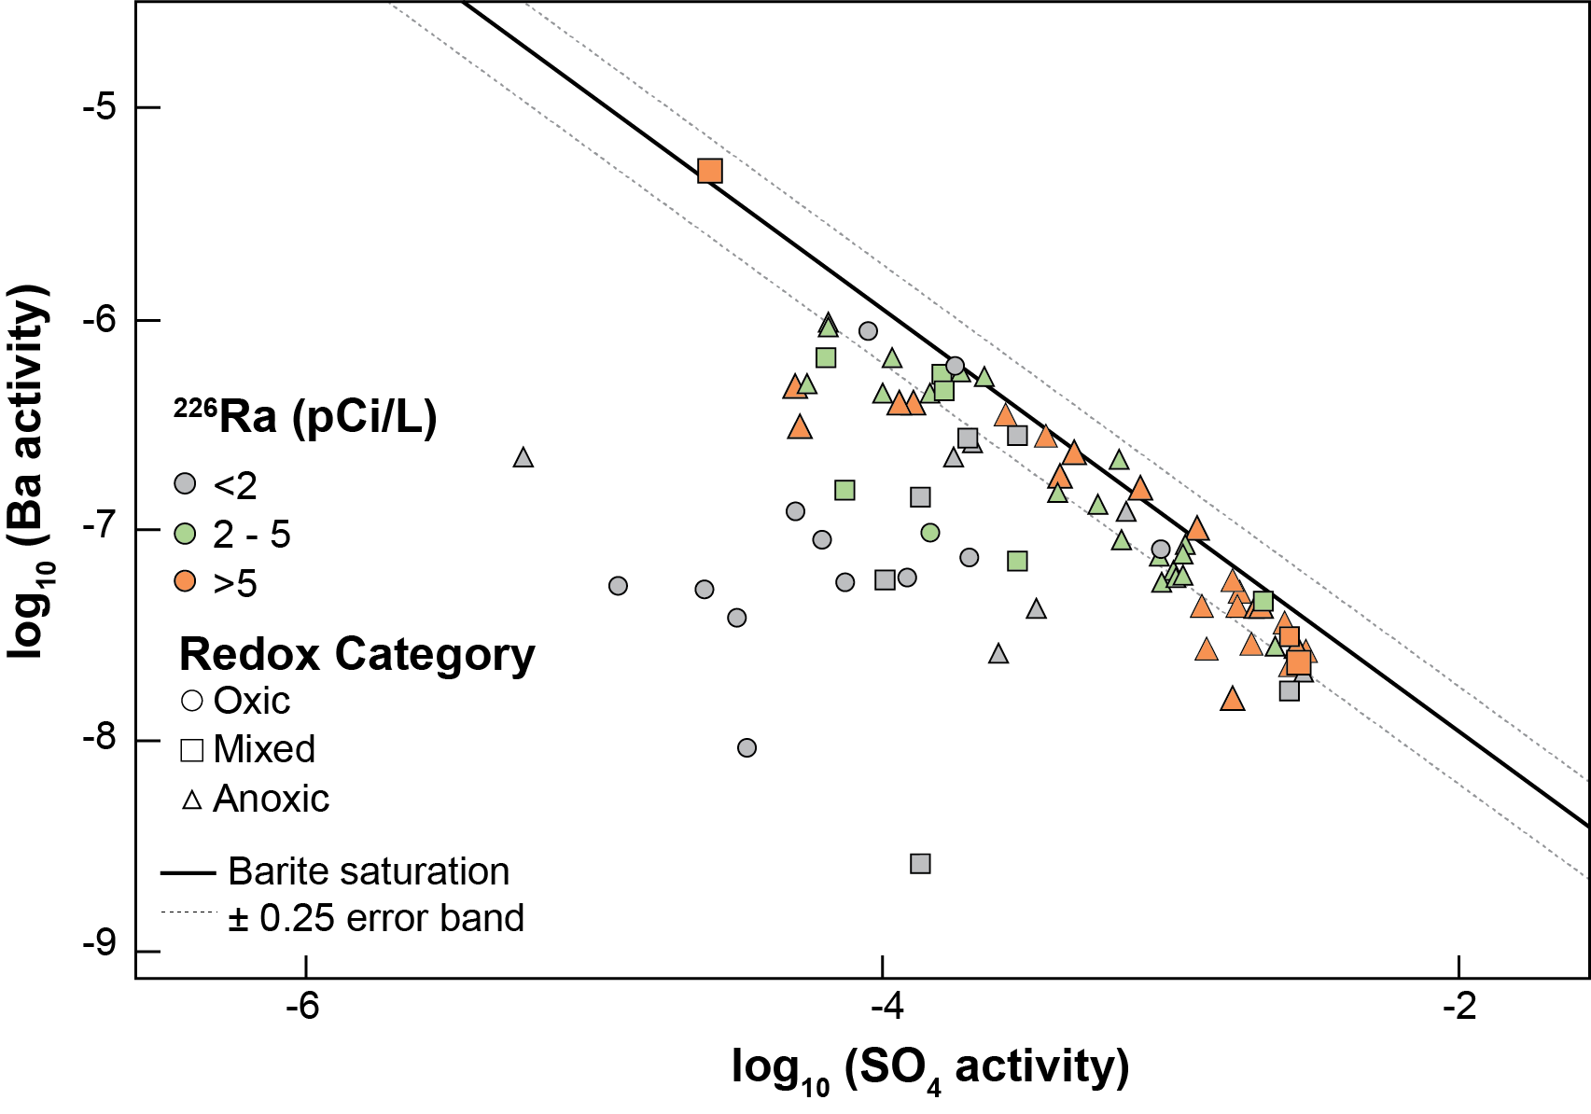
Co-precipitation with barite (BaSO₄) does not reduce ²²⁶Ra concentrations
oxic samples are under-saturated with respect to barite
As SO₄ increases, GW becomes saturated with respect to barite and Ba decreases
²²⁶Ra concentration increases with increasing SO₄ and decreasing Ba
The amount of ²²⁶Ra released to solution increases relative to the amount sequestered by co-precipitation

Slide 11
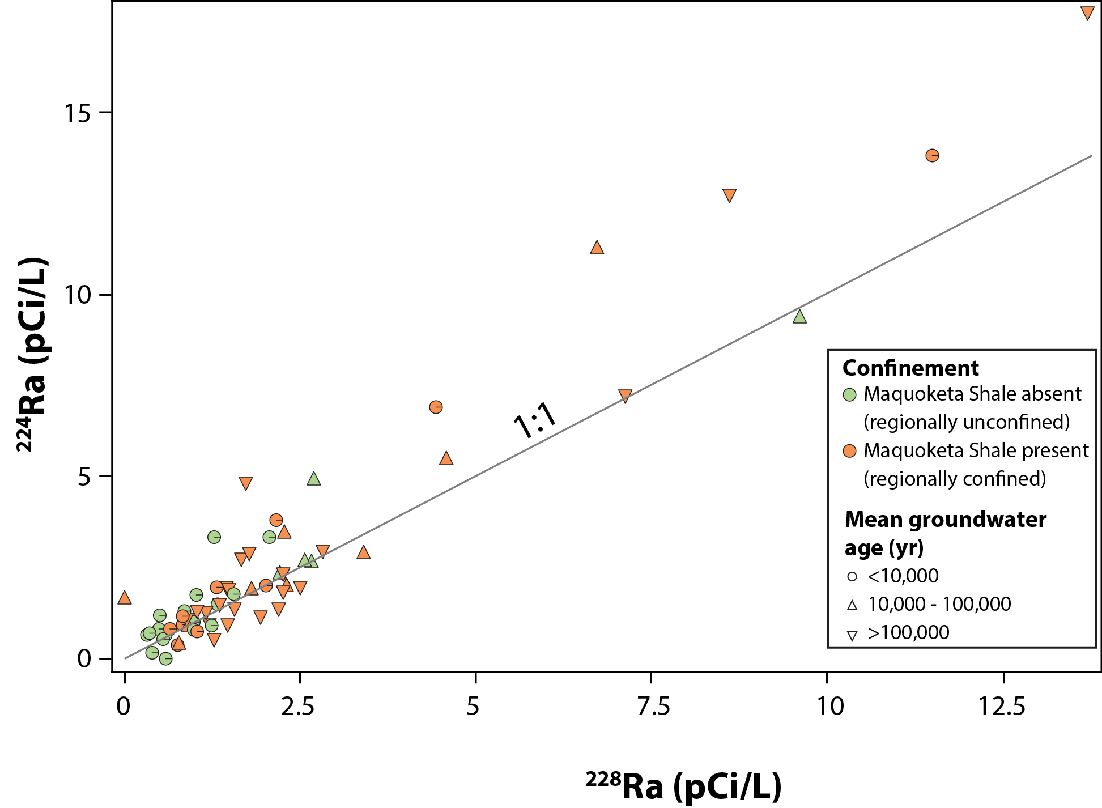
²²⁴Ra and ²²⁸Ra occur in a 1:1 ratio
Progeny in the same decay series
²²⁴Ra adds α-particle activity to drinking-water supplies at concentrations similar to β-particle activity from ²²⁸Ra
²²⁸Ra can be used to identify areas where ²²⁴Ra should be measured and where GAA measurements should be made within 72 hrs of sample collection

Slide 12
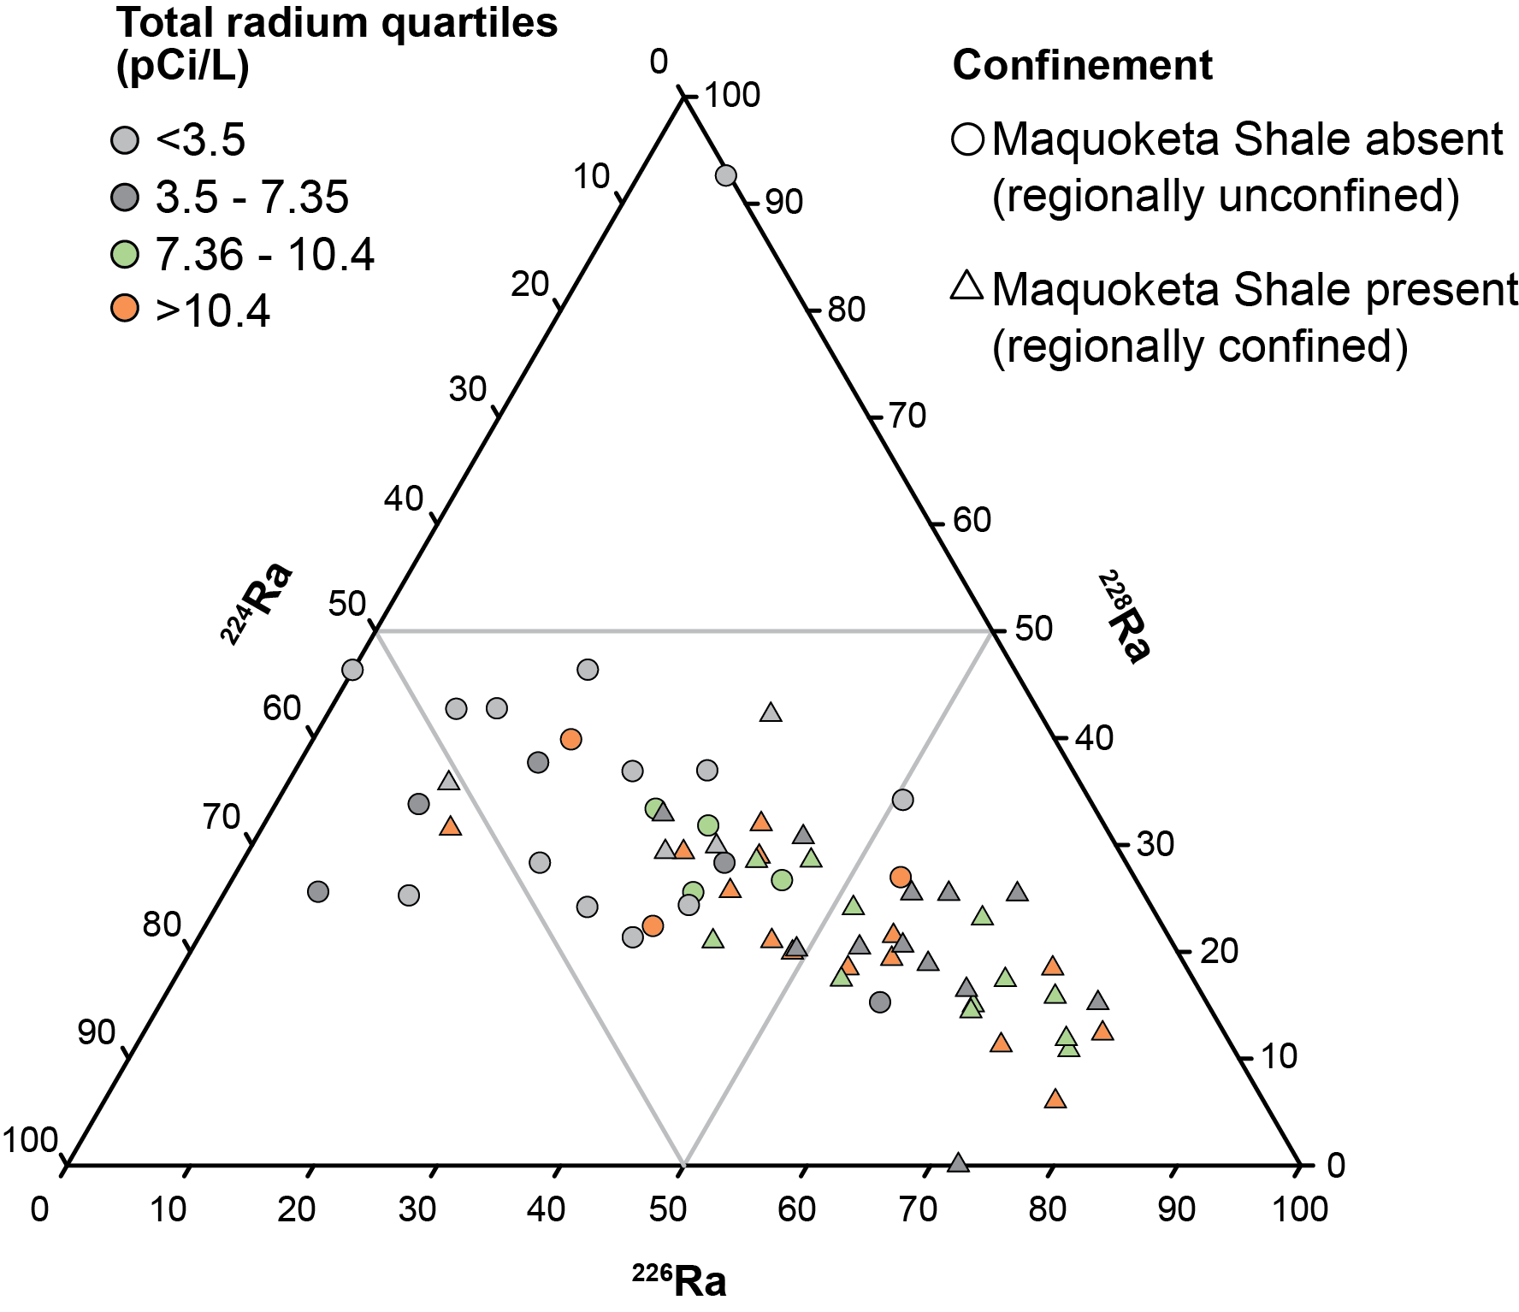
The relative proportion of the 3 Ra isotopes differed across the aquifer system
Arkosic sandstones in the regionally unconfined area provide an enhanced source for ²³²Th progeny such as ²²⁴Ra & ²²⁸Ra
Carbonates in the regionally confined area provide an enhanced source for ²³⁸U progeny such as ²²⁶Ra

Slide 13
Summary
Long residence times result in increasingly anoxic and mineralized conditions
Ra is mobilized to solution by decreased sorption capacity and increased competition for exchange sites
The amount of Ra mobilized increases relative to the amount sequestered by cation exchange or co-precipitation
²²⁴Ra occurs at nearly equal concentrations as that of ²²⁸Ra
²²⁶Ra becomes enriched relative to ²²⁸Ra & ²²⁴Ra in confined regions
GW age is a surrogate for causative factors

Slide 14
Limitations
Study not designed to assess the evolution of geochemical conditions along flow paths
  Samples recharged at differing locations and times and traveled along differing flow paths
Long open intervals produce waters that are mixed from multiple productive zones
  Confounds the identification of end-member geochemical conditions that might be associated with high Ra
Quantification of mean GW ages coupled with spatial patterns in water composition provides insight into the sequence of conditions that favor Ra mobilization

Slide 15
Acknowledgements
Well owners
USGS colleagues:
  Kymm Barnes (IA) Paul Brendon (MO) Brian Engle (SD)
  Lindsay Hastings (MN) Krista Hood (WI) Michael Menheer (MN)
  Shannon Meppelink (IA) Tyler Meyer (SD) William Morrow (IL)

Slide 16

Questions?
pestack@usgs.gov
(518) 285-5652
Published in Applied Geochemistry 89C (2018) pp. 34-48

