Slide 1

Trends in GW Use and Ethanol Production in Iowa (2004-2016)
GSA
North Central Meeting
Iowa State University
April 17, 2018
Michael K. Anderson, P.E.
Water Supply Engineering;
Prof. William W. Simpkins, Iowa State Univ.

Slide 2
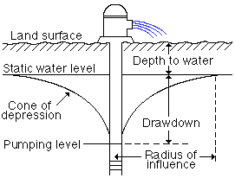
Agenda
Ethanol Water Use trends
Why IS it a Concern? Is it still a concern after thirteen years?
Conservation, planning

Slide 3

OVERVIEW
Ethanol in Iowa
#1 producer of U.S. ethanol
---43 refineries produce ~ 4.3 BGY capacity
Groundwater is preferred source
---Consistent quality, but most competition
---31 use own water
23 confined, 8 unconfined aquifers
---12 use other source (municipal)

Slide 4
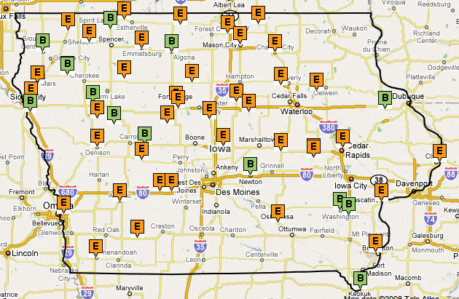
Ethanol (43) and Biodiesel (12)
Cellulosic
Cellulosic
http://www.dailyyonder.com/files/u2/iowabiofuelsmap.jpg

Slide 5
Corn Ethanol
47% (1.3 billion bushels) of corn grown in Iowa produces 4 BGY of corn ethanol at 43 biorefineries
Most corn within a 30-mile radius of a refinery goes to that plant
Water quality effects of continuous corn, decrease of CRP land, etc.

Slide 6
Early Concern About Groundwater Withdrawals
City Pages
Vol. 28, Issue 1387
July 4, 2007

Slide 7
Why is Groundwater Use an Issue?
Perception of peril remains
Attention to Iowa DNR Jordan aquifer work
DSM REGISTER 2/23/2018 (“Bales of Worry Over Stover”)
Fire liability
1,000 gallons of water to douse a bale

Slide 8
Gallons of Water to produce a gallon of ethanol
Previous Work on Gw/Ge
Libra (Iowa Geological Survey, 2006)
–--IA: Gw/Ge = 6.3 (15 plants, permits)
Keeney and Muller (IATP, 2006)
–--MN: Gw/Ge decreased 5.8 to 4.2 from
1998 to 2005 (data from 13 plants)
Wu et al. (2009 Argonne Report)
–--Gw/Ge “Consumptive use” reported to be 2.8.

Slide 9
Groundwater Supply and Demand not Equally Distributed
GOOD
FAIR
POOR

Slide 10
Groundwater Use in Iowa
Ethanol 15%
45 BGY
113 BGY
Total 237 BGY
US Geological Survey, November 2014 report on 2010 water use.
http://www.ngwa.org/Documents/States/Use/ia.pdf

Slide 11
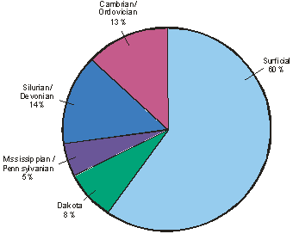
Aquif. breakdown
pie chart
Notes:
For discussion purposes & display purposes only

Slide 12
Aquifers Used for Ethanol
Source: IDNR

Slide 13
Iowa Corn Ethanol Production
Ethanol Production in Iowa
Source: http://iowarfa.org/resource-center/statistics/

Slide 14
Groundwater For Ethanol Plants
Notes:
Only 24 because I count only the dry mill plants and the ones that need a high cap well permit. If you intend to use 25,000 gallons per day or more, you must obtain a Water Allocation and Use Permit.

Slide 15
Jordan Stakeholder Group Purpose
Make recommendations to better manage Jordan Aquifer
Old restrictions:
Water users may not lower water table more than 200’ from 1977 baseline
Industrial withdrawals < 2,000 gpm
Restrictions may not be appropriate for all - Jordan varies greatly across state

Slide 16
Stakeholder Concerns
Difficult for permittees to figure out where the 200’ pumping limit is at in their well(s)
No example of IDNR limiting Jordan pumping except for recent City of Marion restriction on drilling new Jordan well
IDNR not receiving all information needed to manage Jordan/not issuing all permits

Slide 17
Stakeholder Concerns (contd.)
Jordan Aquifer is limited resource
Groundwater is increasingly contaminated or susceptible to contamination
Over-pumping aquifer can cause permanent damage – could lead to water quality declines
Economic development depends on reliable, clean water supply
Long-term impacts of current actions must be considered

Slide 18
Jordan Aquifer
Prestage Foods
400-450 ft
Source: Bob Libra, IGS
Notes:
Prestage foods – 2.2 MGD – 10,000 hogs/day

Slide 19
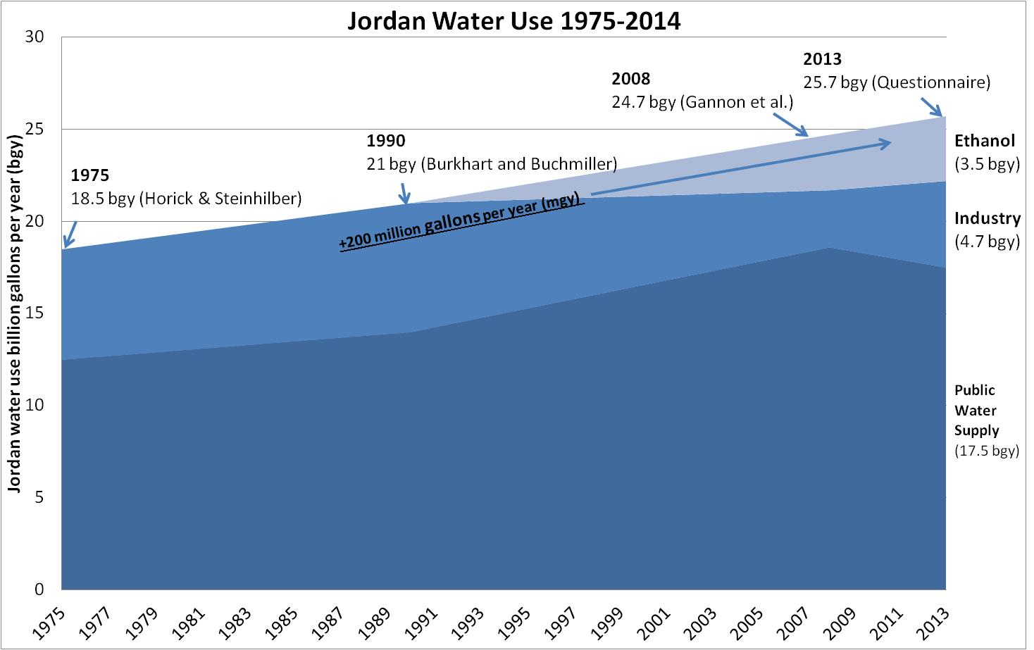
Jordan Water Use Over Time

Slide 20
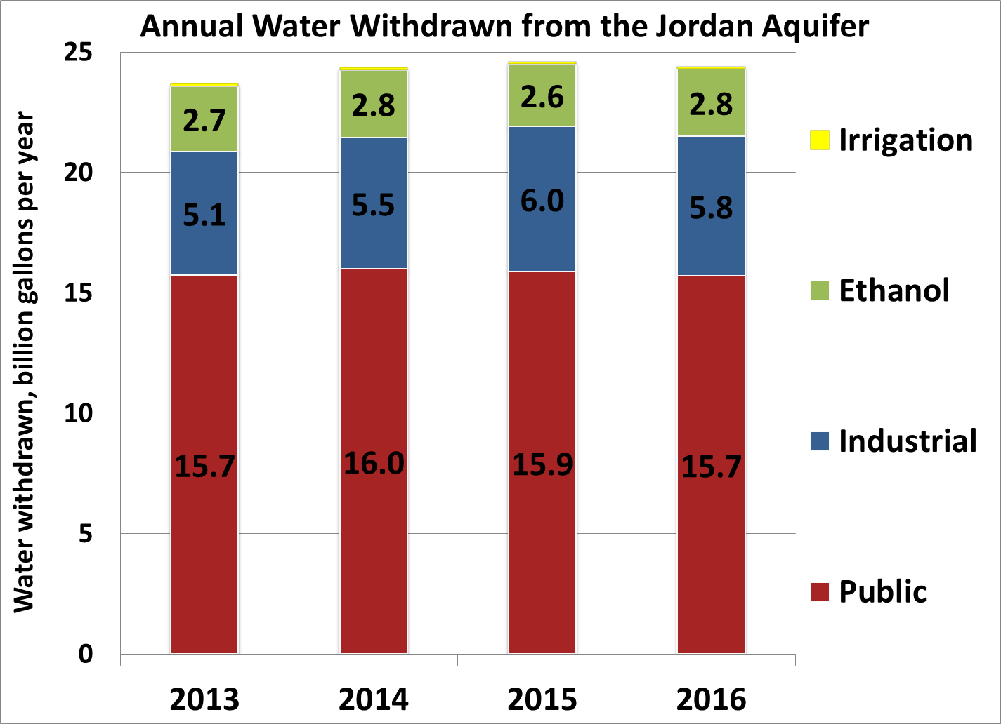
Jordan Aquifer Water Use
Water Use Program’s
Annual Reports
Water Use categories
are rough estimates. Many PWS systems sell water to businesses.
Total Jordan aquifer use in Iowa increases roughly 200 million gallons per year.
Ethanol use has stabilized

Slide 21
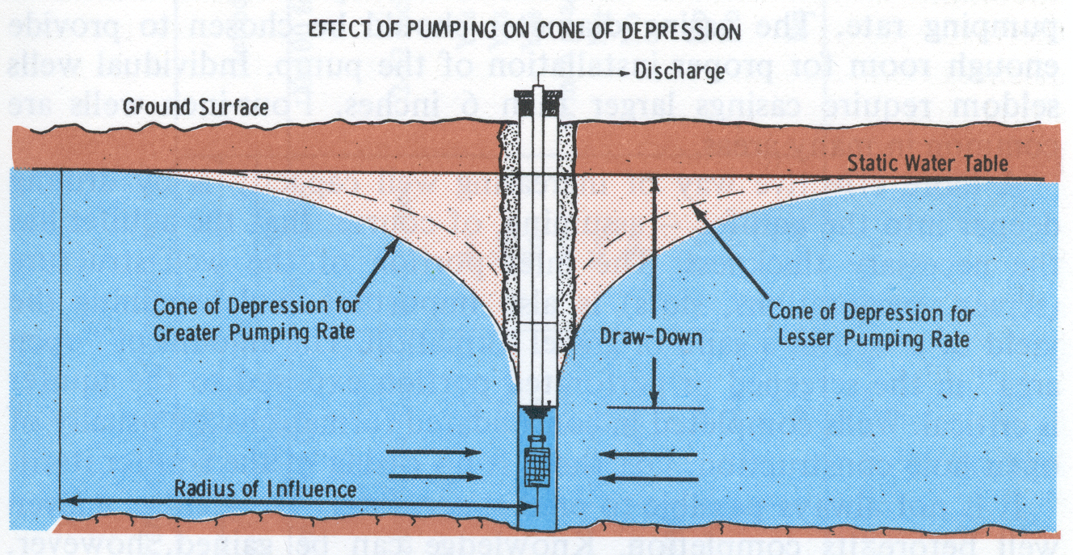
SWL - Static Water Level
PWL - Pumping Water Level
Example is in an unconfined, shallow aquifer.

Slide 22
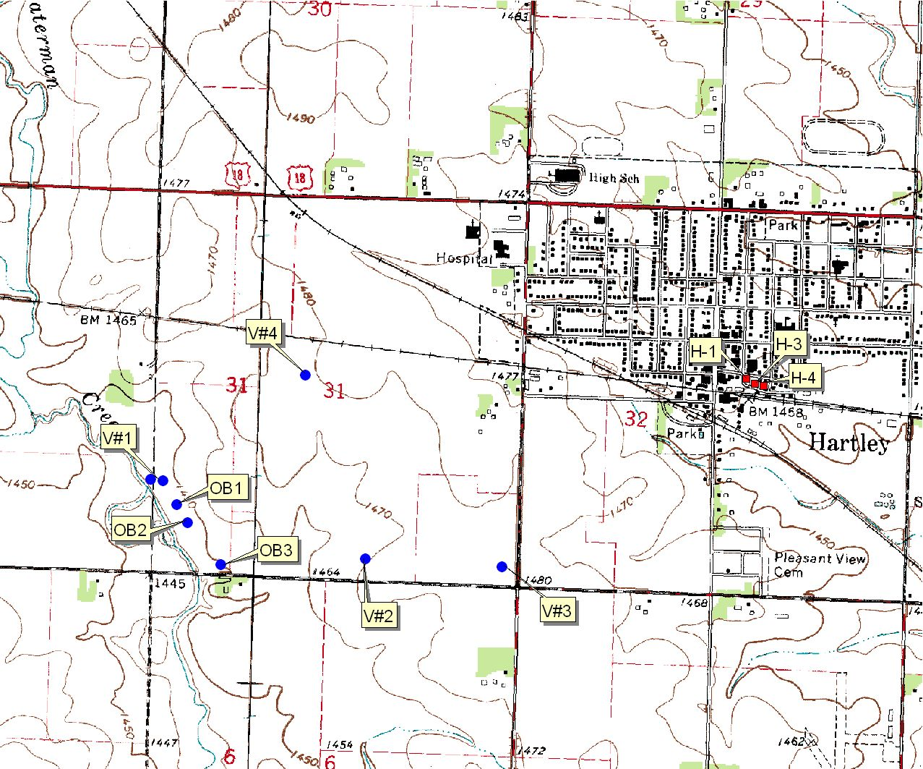
Hartley VeraSun Ethanol Water Use Permit

Slide 23
City Concerns
Balancing Economic Benefits with Protection of their water supply
Layne Christensen Company conducted a 3-day pump test.
City wells were run to make a new steady state head input.
Pump Test data was used to calibrate local scale (MODFLOW) model.
Permit called for 1,100 gpm divided between 4 production wells.
Once Calibrated, it was run for 1-year and 10-year time periods using VeraSun’s 4 production wells.

Slide 24
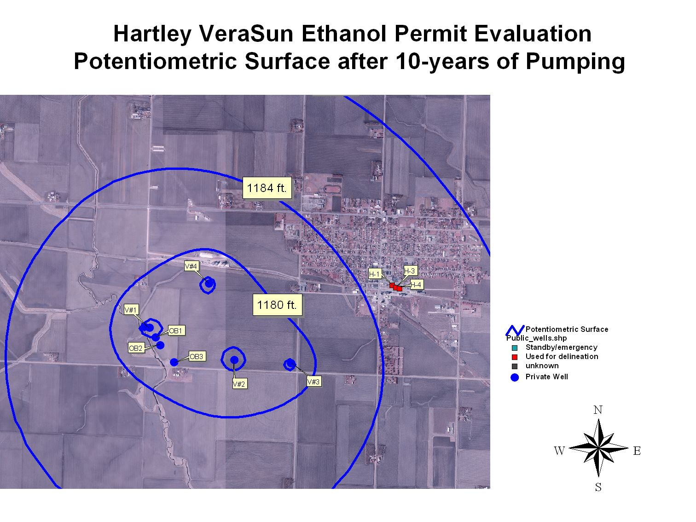

Slide 25
Addtl drawdown in city wells ~ 17 feet
City wells have about 60 ft of head above the pumps (during summer operations)
So 43 foot margin of safety…..

Slide 26
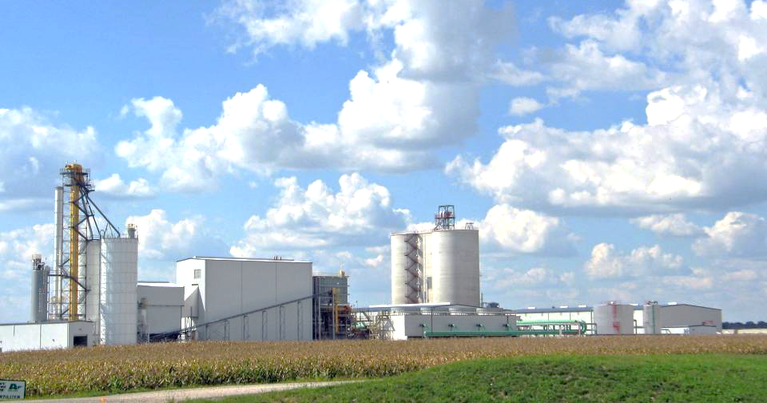
Corn Ethanol
Photo by WWS
Lincolnway Energy Plant in Nevada, Iowa

Slide 27
External Process Water Balance
5,952 Gal/ Hr
Ethanol
Ethanol
Plant
18.5 Gal/ Hr
Corn
2,233 Bu/ Hr
2,248 Gal/ Hr
20.92 Tons/ Hr
DDGS
502 Gal/ Hr
Water In = 2,248 GPH
Water Out = 520 GPH
Basis: 50 mmgpy Typical Corn-Based Dry Mill ethanol Plant

Slide 28
Overall Water Balance
Evaporation & Drift = 9,420 gph
14,700 gph
Cooling
Tower
Deaerator & Leaks = 140 gph
300 gph
Blowdown = 5,280 gph
Boiler
Blowdown = 120 gph
13,860 gph
13,860 gph
Water Vapor = 8,398 gph
Fresh
Makeup
Water
6,631 gph
Ethanol Plant
Dryer
System
2,248 gph
DDGS =
502 gph
Ethanol =19 gph H2O
Corn
Gal Water/ Gal Ethanol = 3.63
Water In = 23,860 gph
Water Out = 23,860 gph
Basis: 50 mmgpy Typical Corn-Based Dry Mill ethanol Plant

Slide 29
Water Conservation Opportunities
Reduce Energy Consumption (less cooling tower evaporation & blowdown)
Recycle waste and blowdown streams
Treat makeup water (less blowdown)
Use air or groundwater to reject heat (less evaporation and less blowdown)

Slide 30
Water Conservation Opportunities
Gallons Fresh Water/ Gallon Ethanol less than:
<3 – Current Best Practice. Appears to be around 2.8
1.5 – Achievable with proven technology at extra capital cost
0 – Possible in future with new technologies

Slide 31
Conclusions?
Gw/Ge improving
Jordan and alluvial remain most popular
Capacity available
Conflicts are always possible
Planning, planning, planning (models, data……)

Slide 32
Michael K. Anderson, P.E. 515/725-0336 michael.anderson@dnr.iowa.gov Website: www.iowadnr.gov Prof. William W. Simpkins, ISU 515-294-7814 https://enscigrad.iastate.edu/directory/ william-simpkins/
Questions?

