Slide 1
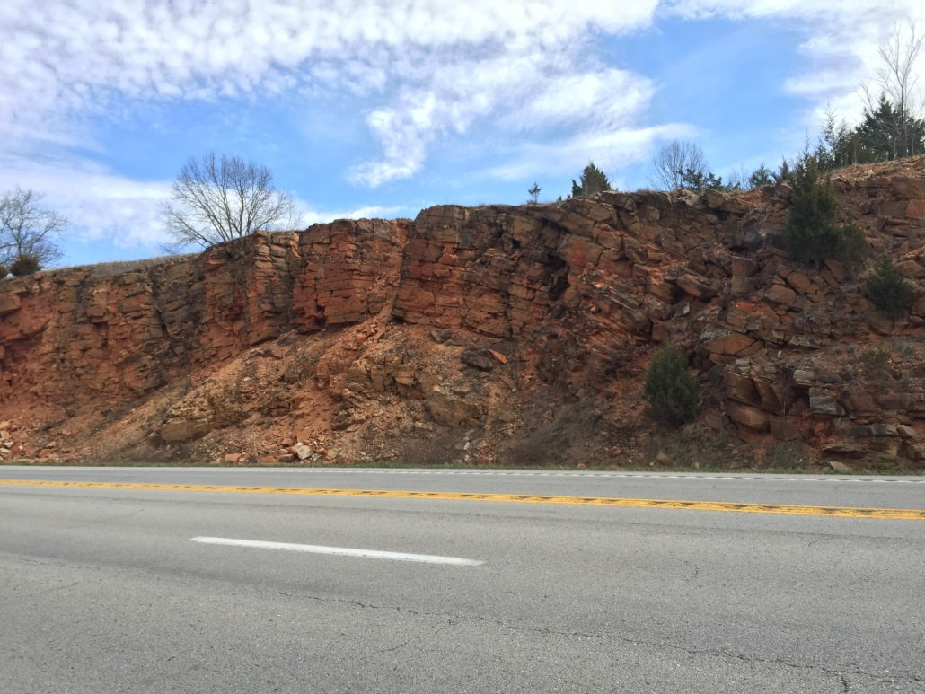
TECTONIC DEFORMATION IN THE MID-CONTINENT OF UNITED STATES:
Evidence for Periclinal Buckle Folding in the Ozark Plateau
Chao Liu*
John P. Hogan
Andreas Eckert
Avery Welker
Geosciences & Geological & Petroleum Engineering *clryc@mst.edu

Slide 2
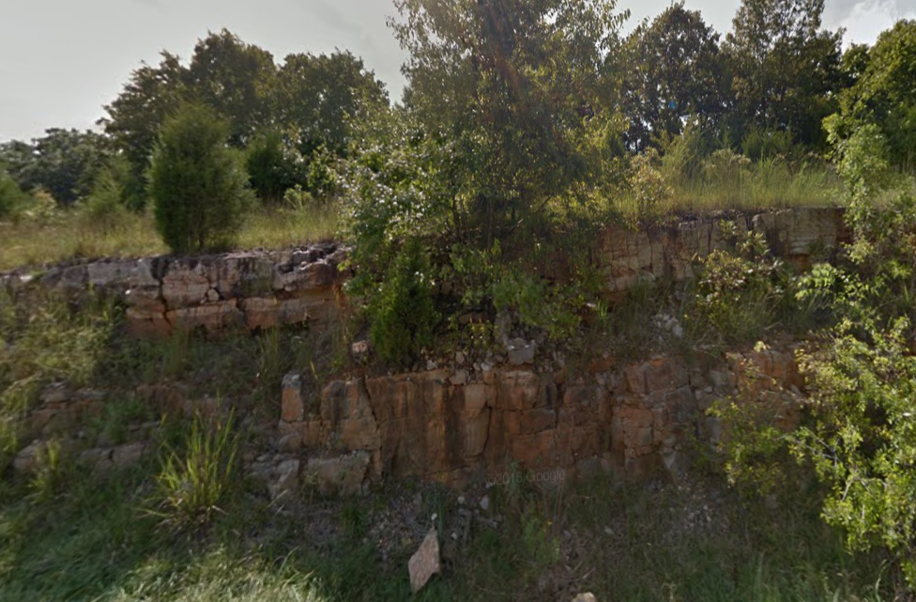
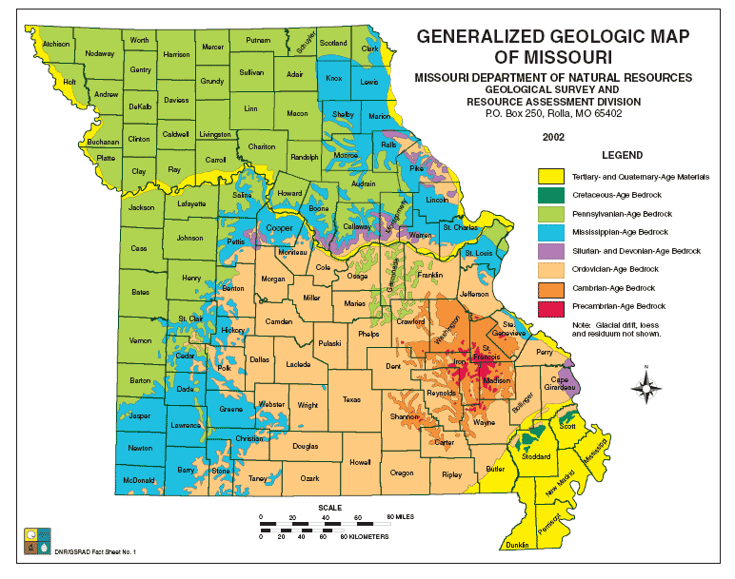
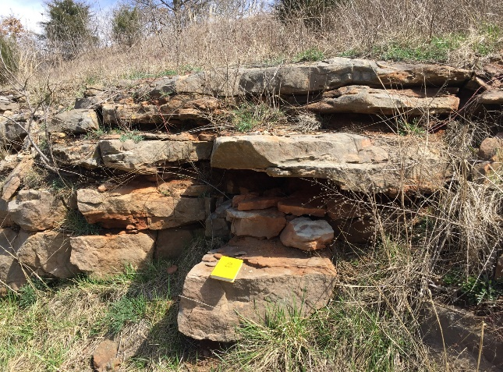
Geologic Setting
2

Slide 3

N
S
Upper Roubidoux
Lower Roubidoux
3

Slide 4
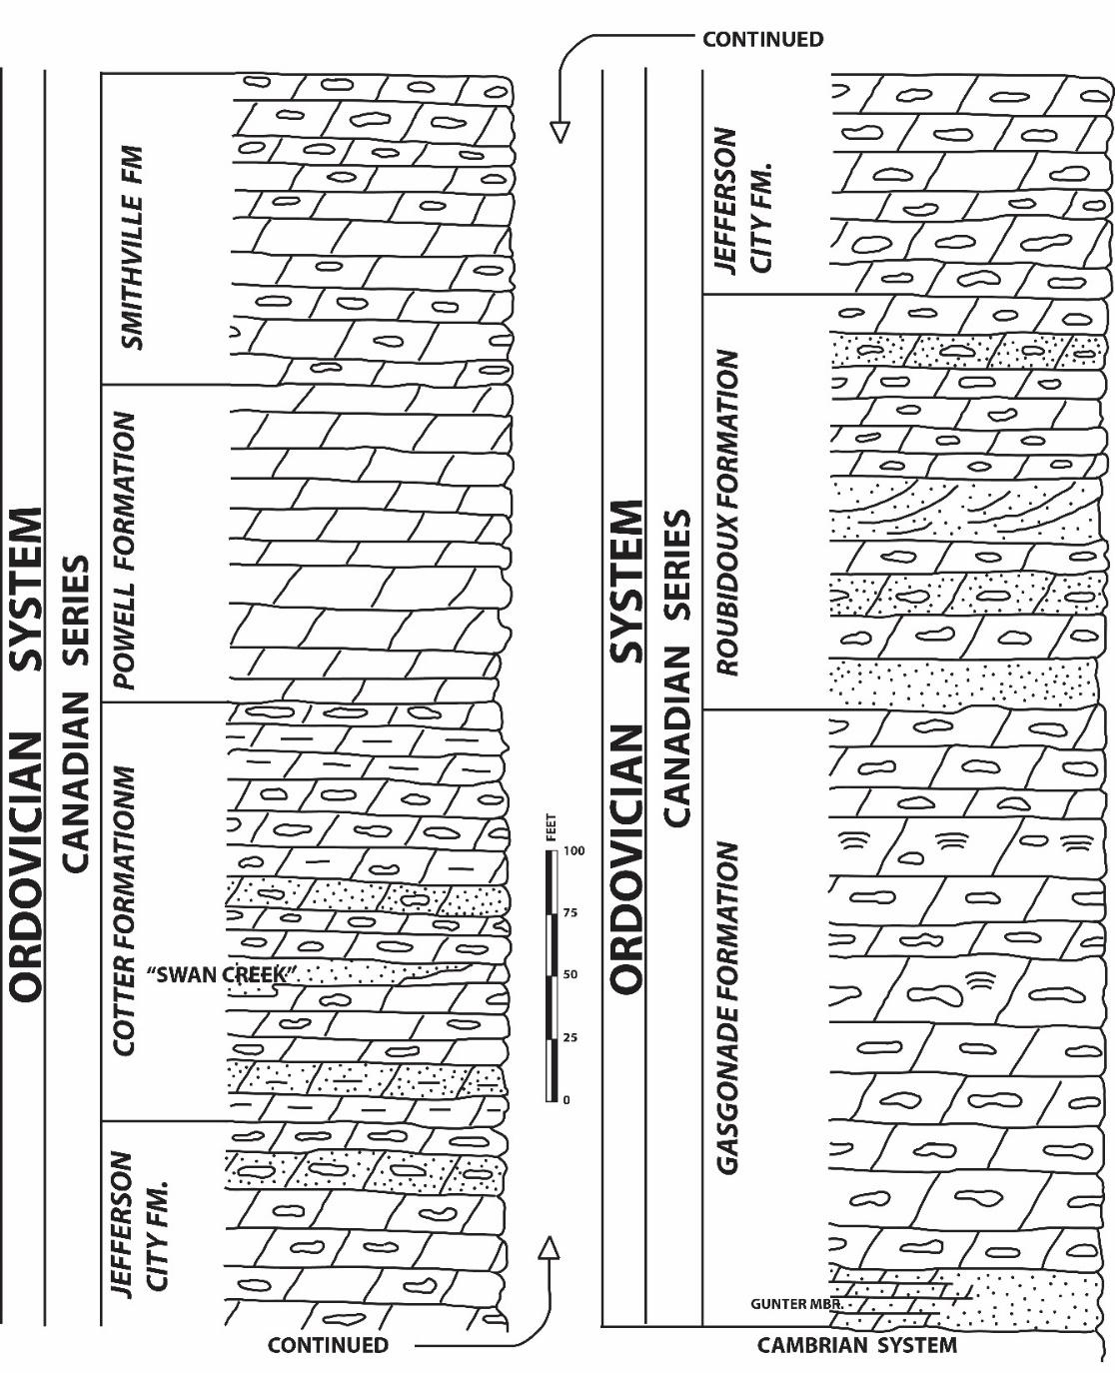
Jefferson City Formation- Fine crystalline, silty, cherty dolomite, and oolitic chert with local sandstone beds
Roubidoux Formation-Sandstone, chert, and interbedded dolomite.
Gasconade Formation-Coarse-crystalline cherty dolomite with a basal Gunter Sandstone Member

Slide 5
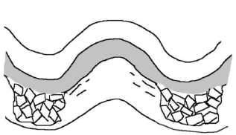
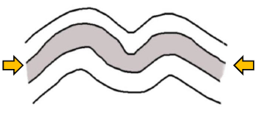
Initial Hypotheses
Karst Collapse Folds
Buckle Folds
Model sketch
Dissolve of underlying Gasconade Dolomite
Driving Source
Far-field tectonic stress
Experimental Test
(Stereographic plot)
Random fold
orientations
Systematic fold
orientations
4

Slide 6
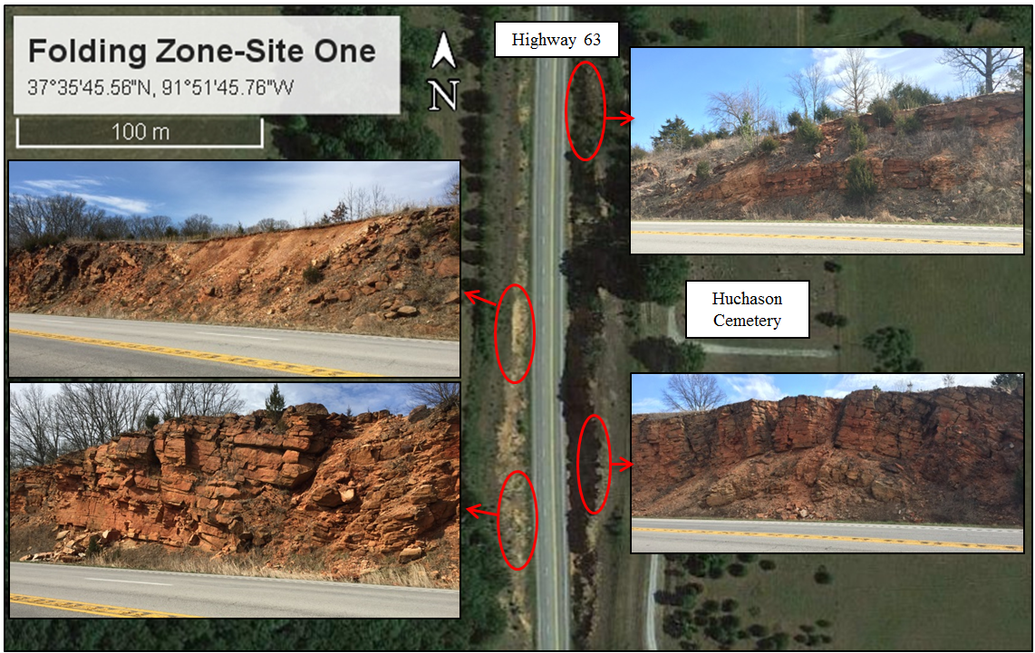
Symmetric syncline
Symmetric syncline
Symmetric syncline
Symmetric syncline
5

Slide 7
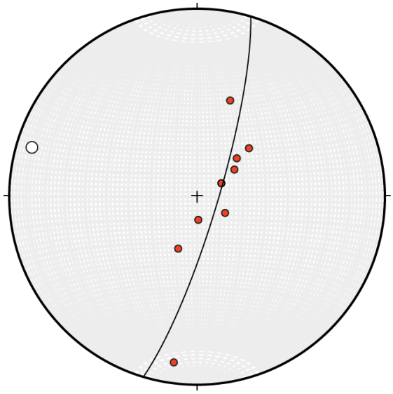
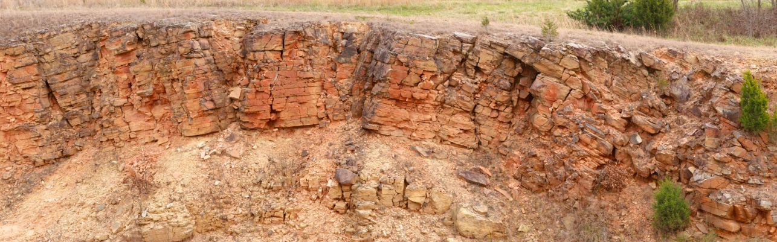
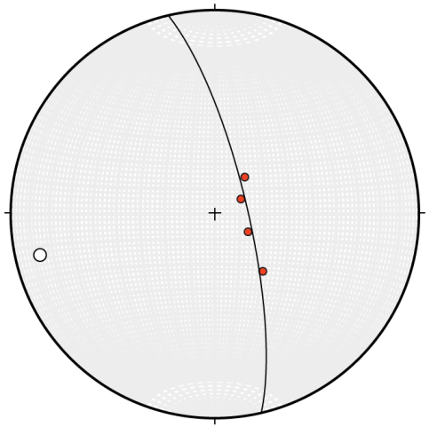
Upper
Field Observations
S
At both ends, folds have wider inter-limb angles, lower amplitude, longer wavelengths.
Asymmetric & symmetric folds observed.
“Near - Cylindrical” folds
Lower
…but wait…
6
Notes:
….but wait…
….but wait…

Slide 8
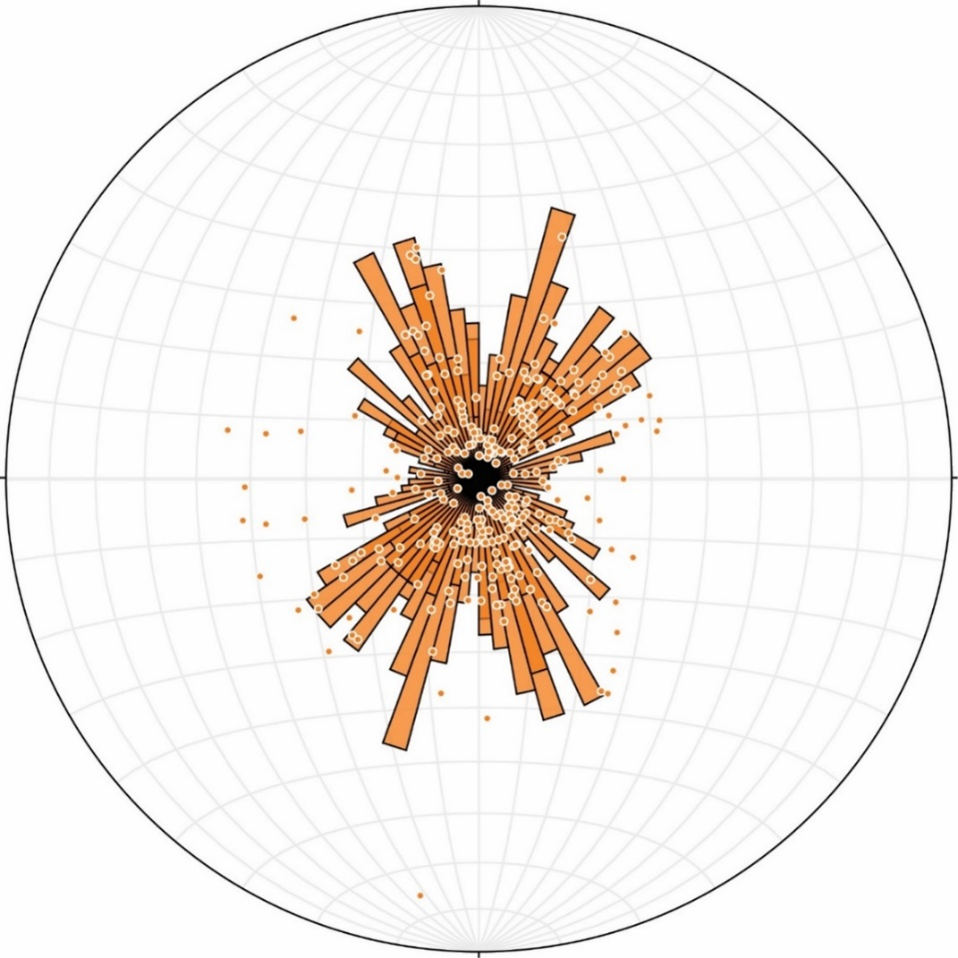
What’s is the driving force?
Poles to the bedding plane;
Rose diagram (strike direction only)
A tectonic origin by buckling is favored over karst collapse
“Basin and Dome”— typically suggests multiple deformation events
Roubidoux Folds are periclines
7

Slide 9


“Basin and Dome” Periclines
Multiple deformation events;
Two orthogonal (Marinin and Sim, 2015)
Non-orthogonal directions (Treagus and Treagus, 1981)
Singe deformation event
Uni-directional compression
(Ghosh et al., 1995; Schmalholz, 2008;
Liu, 2016; Steinbeck, 2016)
$$σ_{1}$$
$$σ_{1}$$
(Steinbeck, 2016)
8

Slide 10
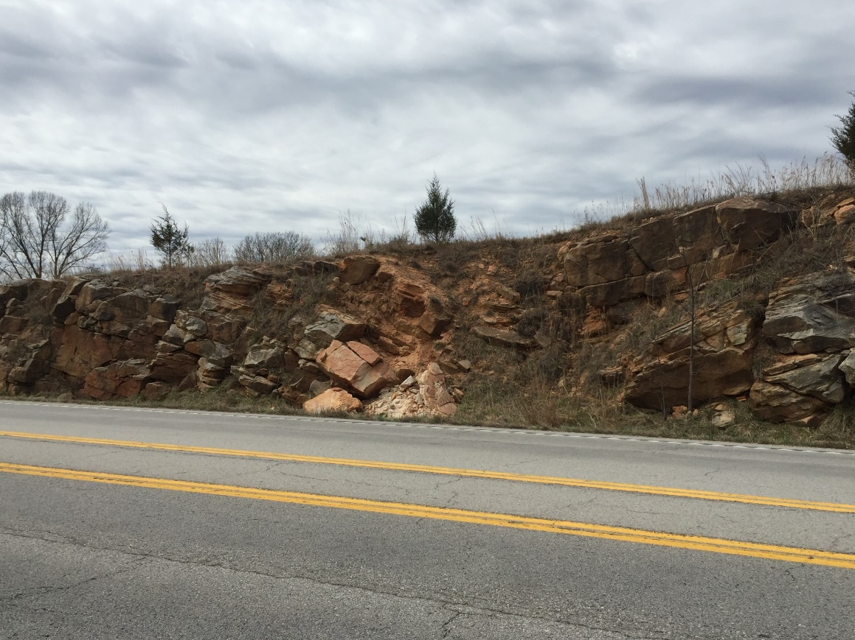
“Basin and Dome” Periclines
Stereographic Patterns for Periclines Welker et al., this session)
(Steinbeck, 2016)
8

Slide 11
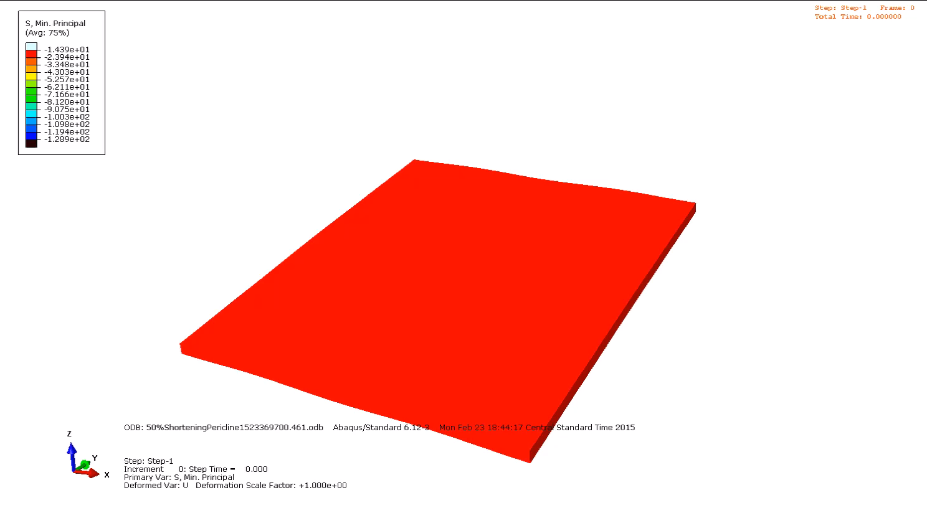
“Basin and Dome” Periclines
“Basin and Dome” Periclines
Can form in a Single Deformational Event
(Steinbeck, 2016)
Notes:
Why don’t we see periclines across the entire Ozark Plateau?

Slide 12
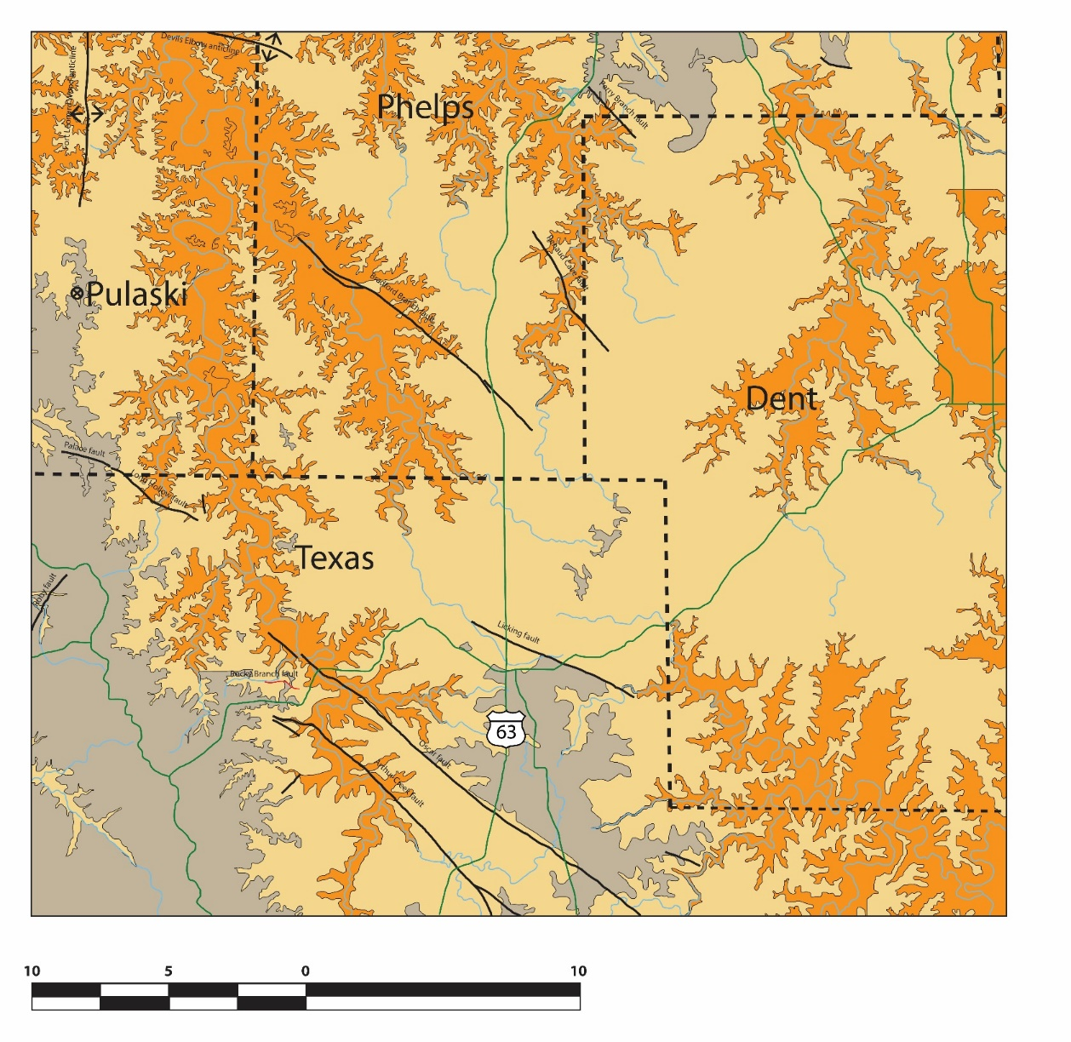


Transpression Zone Hypothesis
Two near parallel faults bound this folding area:
Left-lateral strike slip motions:
Transpressional zone
Localized shortening direction:
from a single deformation event
$$σ_{1}$$
$$σ_{1}$$
(Modified from Middendorf, 2003)
9

Slide 13
Model Sketch – 2D Map View
5 mm /per 10,000 years
Bradford Branch fault
Licking fault
10

Slide 14
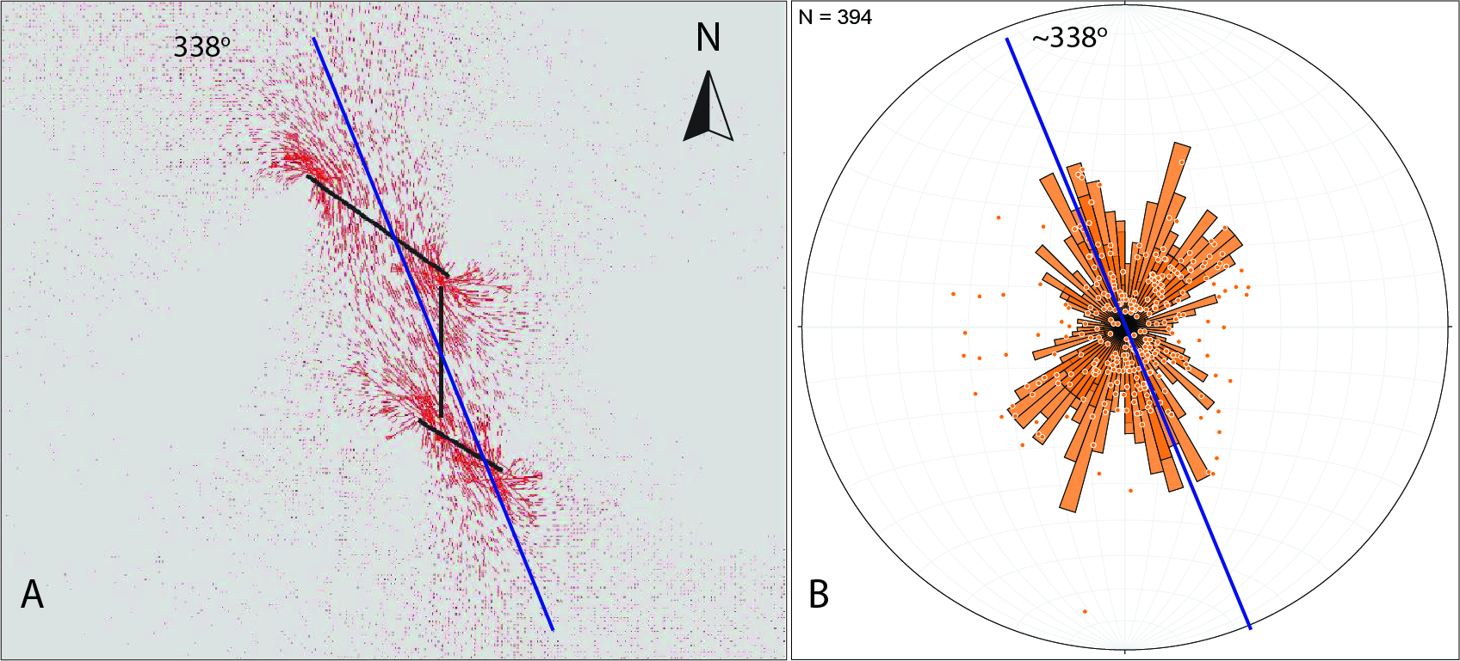


2D Numerical Model Result
$$σ_{1}$$
$$σ_{1}$$
A good agreement on maximum principal stress $σ_{1}$ direction at 338º
11

Slide 15
Conclusions
Roubidoux folds are “basin and dome” periclines.
Complex Stereographs (near-cylindrical; small-circles；“hooks”) confirm the Pericline Geometry (Welker et al., this session).
Tectonic Buckle-folds related to Transpression.
Timing of deformation - poorly constrained but likely to be late Paleozoic (e.g., Ouachita Orogeny).
13

Slide 16
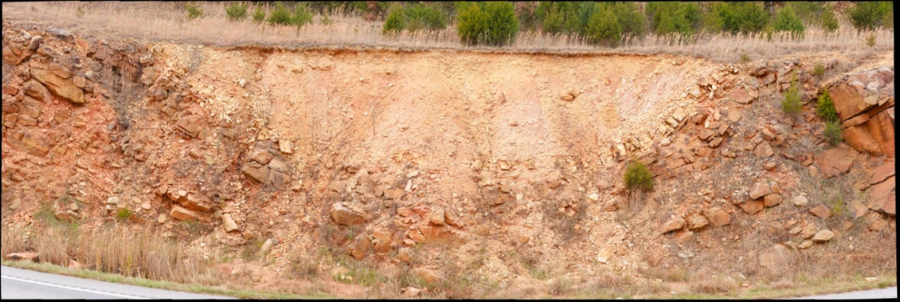
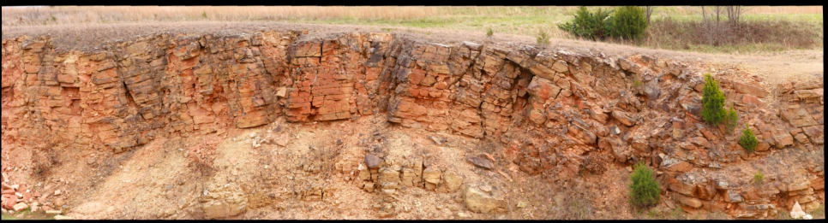
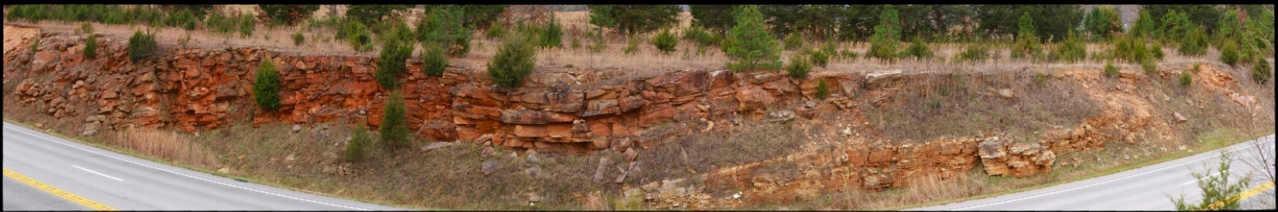
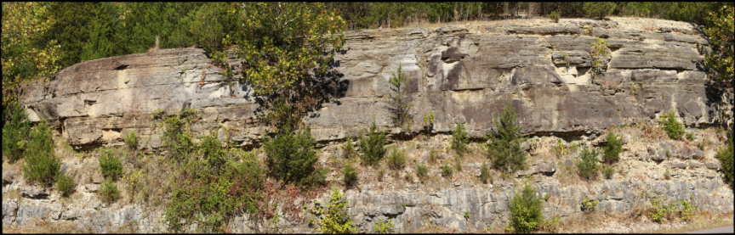
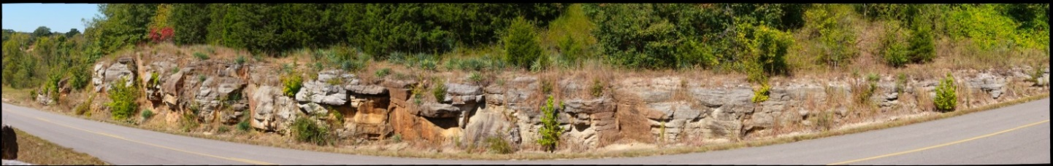
GigaPan High-resolution Photographs
http://gigapan.com/gigapans/181456
(330 input images)
http://gigapan.com/gigapans/181502
(200 input images)
http://gigapan.com/gigapans/181460
(506 input images)
Roubidoux Folds, Licking, MO
Roubidoux Formation, Rolla, MO
http://gigapan.com/gigapans/181270
(420 input images)
http://gigapan.com/gigapans/181266
(450 input images)
4

