Slide 1
PROTECTING PRIVATE WELLS FROM ARSENIC
USING GEOLOGY AND GIS
52nd Annual GSA North-Central Section Meeting
April 16-17, 2018
Iowa State University
Chad Fields
Iowa Department of Natural Resources

Slide 2
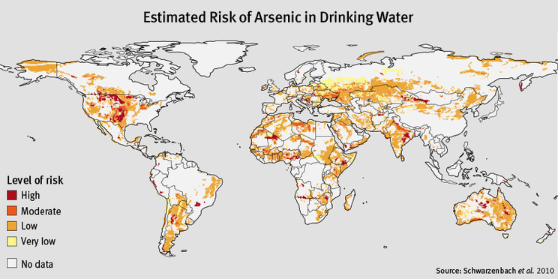
Arsenic in Groundwater

Slide 3
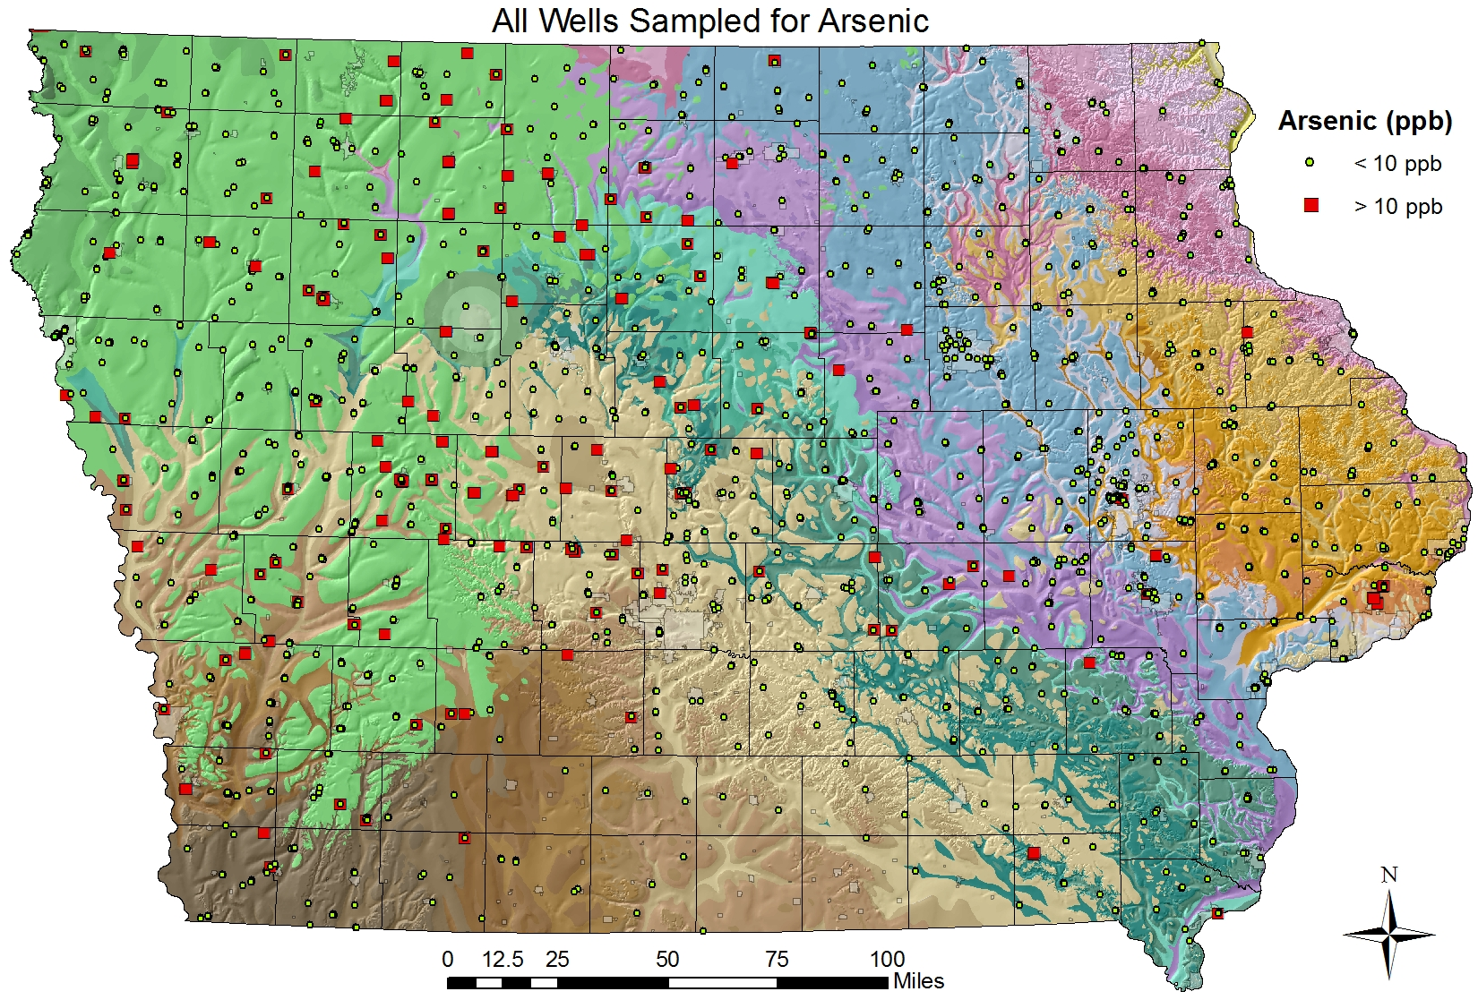
Arsenic in Iowa’s Groundwater
Statewide Arsenic Data
EPA Arsenic MCL = 10 µg/L (ppb)
Iowa groundwater sampling program(s) circa. 1912-2011
Well Water Quality gdb
223/2,220 total sampled wells with >10 µg/L Arsenic (10%)
Not all groundwater sources are created equal.
% As MCL exceedance by aquifer:
  Alluvial: 6%
  Buried Sand: 24%
  Dakota: 17%
  Mississippian: 15%
  Silurian-Devonian: 4%
  Jordan: 2%

Slide 4
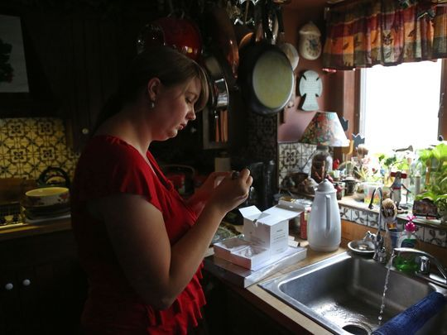
Arsenic in Cerro Gordo County
In 2010, due to noted high levels of arsenic noted in private wells (record highest recorded in Iowa at the time) Cerro Gordo County received a CDC grant to study groundwater arsenic in private wells.
Project goals:
  distribution of groundwater arsenic concentration
  identification of arsenic sources
  establish best practices for well construction
“Elevated Arsenic in Private Wells of Cerro Gordo County, Iowa-Causes and Policy Changes” Schnoebelen, et al., 2017 JEH
Photo: Des Moines Register
(Sophia Walsh, Cerro Gordo County Public Health)

Slide 5
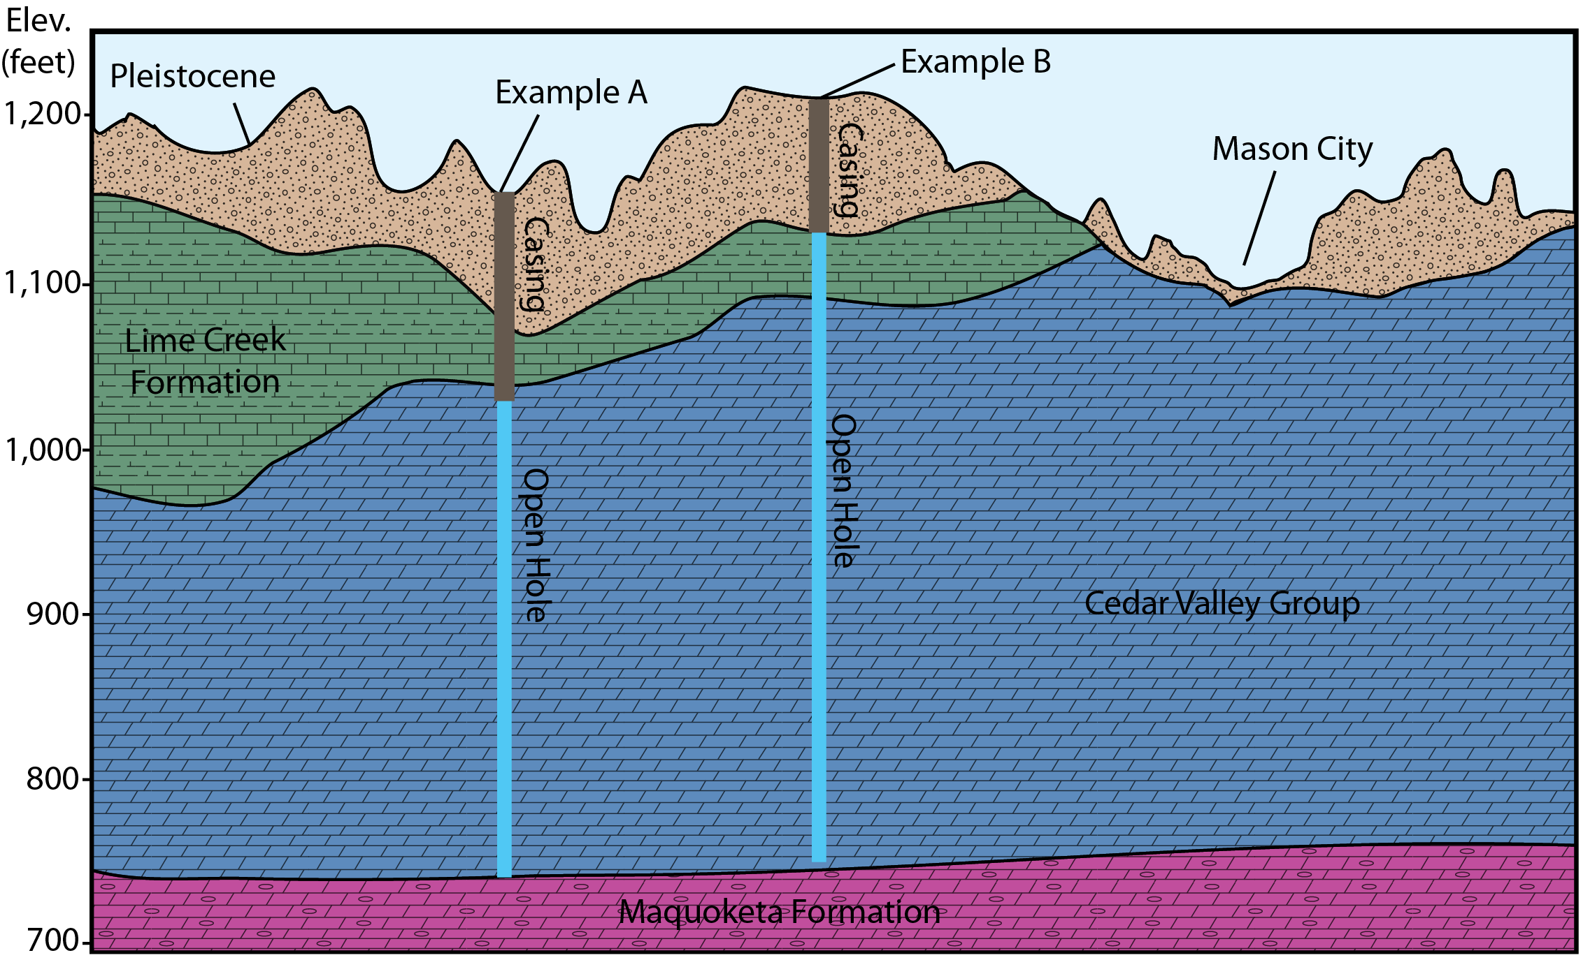
Arsenic in Cerro Gordo County
“Cedar Valley” Well
“Lime Creek” Well

Slide 6
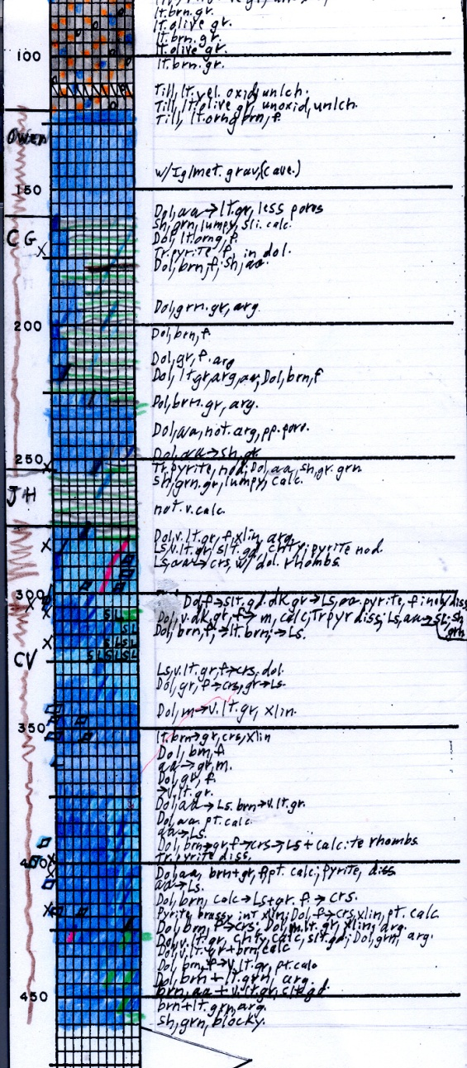
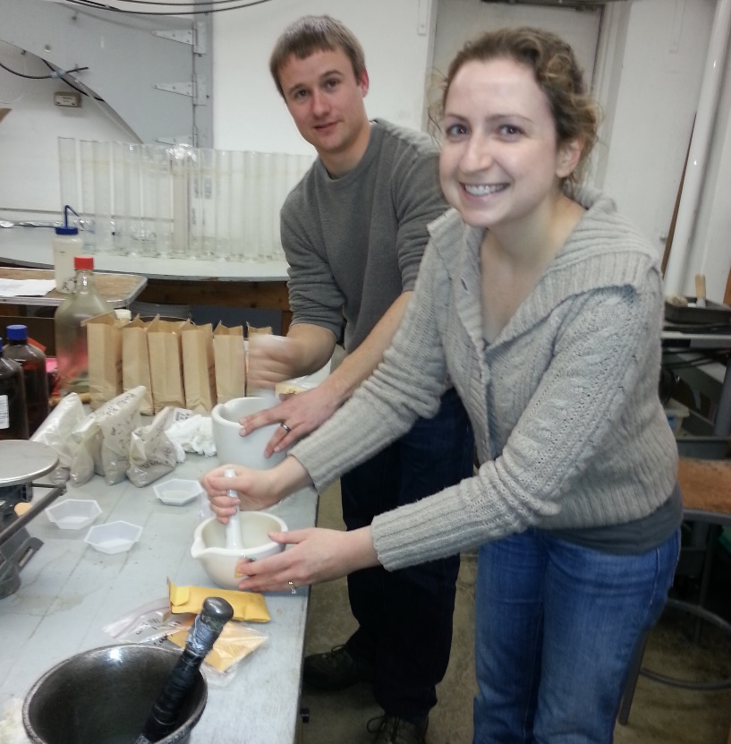
Devonian Rock Chip Samples and Arsenic
GeoSam Geologic Strip Log
Lime Creek
Fm.
As in rock = 2.9 mg/kg
As in rock = 12 mg/kg
As in rock = 11 mg/kg
Cedar Valley Gp.
As in rock = <1 mg/kg
Jason Vogelgesang and Amy Sabin,
Iowa Geological Survey

Slide 7
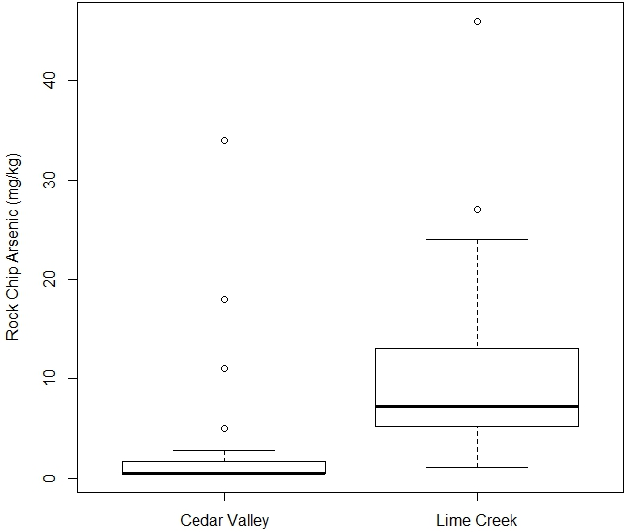
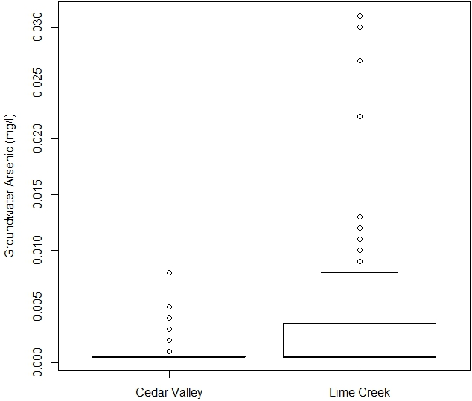
Arsenic in Cerro Gordo County
EPA MCL

Slide 8
Arsenic in Cerro Gordo County – Science to Policy
A goal of the CDC funded project: “establish best practices for well construction”
  Would like a straightforward and simple method for geologic forecasting.
  Geologic formations vary in thickness and extent throughout the county.
  Private wells can be drilled anywhere in the county.
  Must have predictions for everywhere in the county.
Why not create 3-D hydrogeologic forecast model for the entire county?

Slide 9
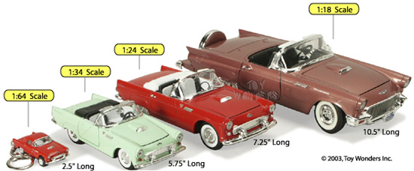
Creating the Model
Model Data
Model Design
ArcGIS Process
  Topo to Raster
  Raster Calculator
  Extract by Mask
Check/Update the Model

Slide 10
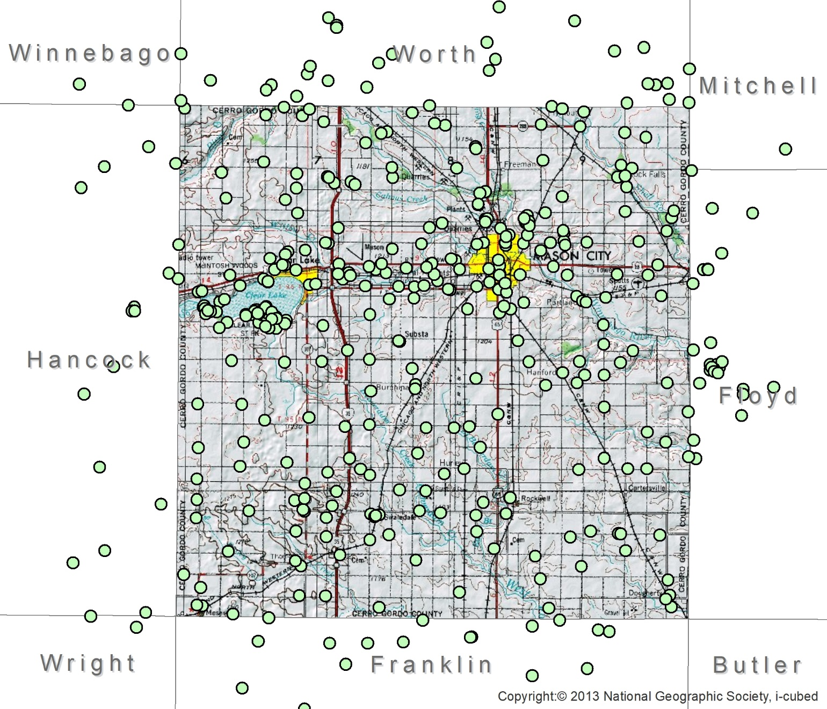
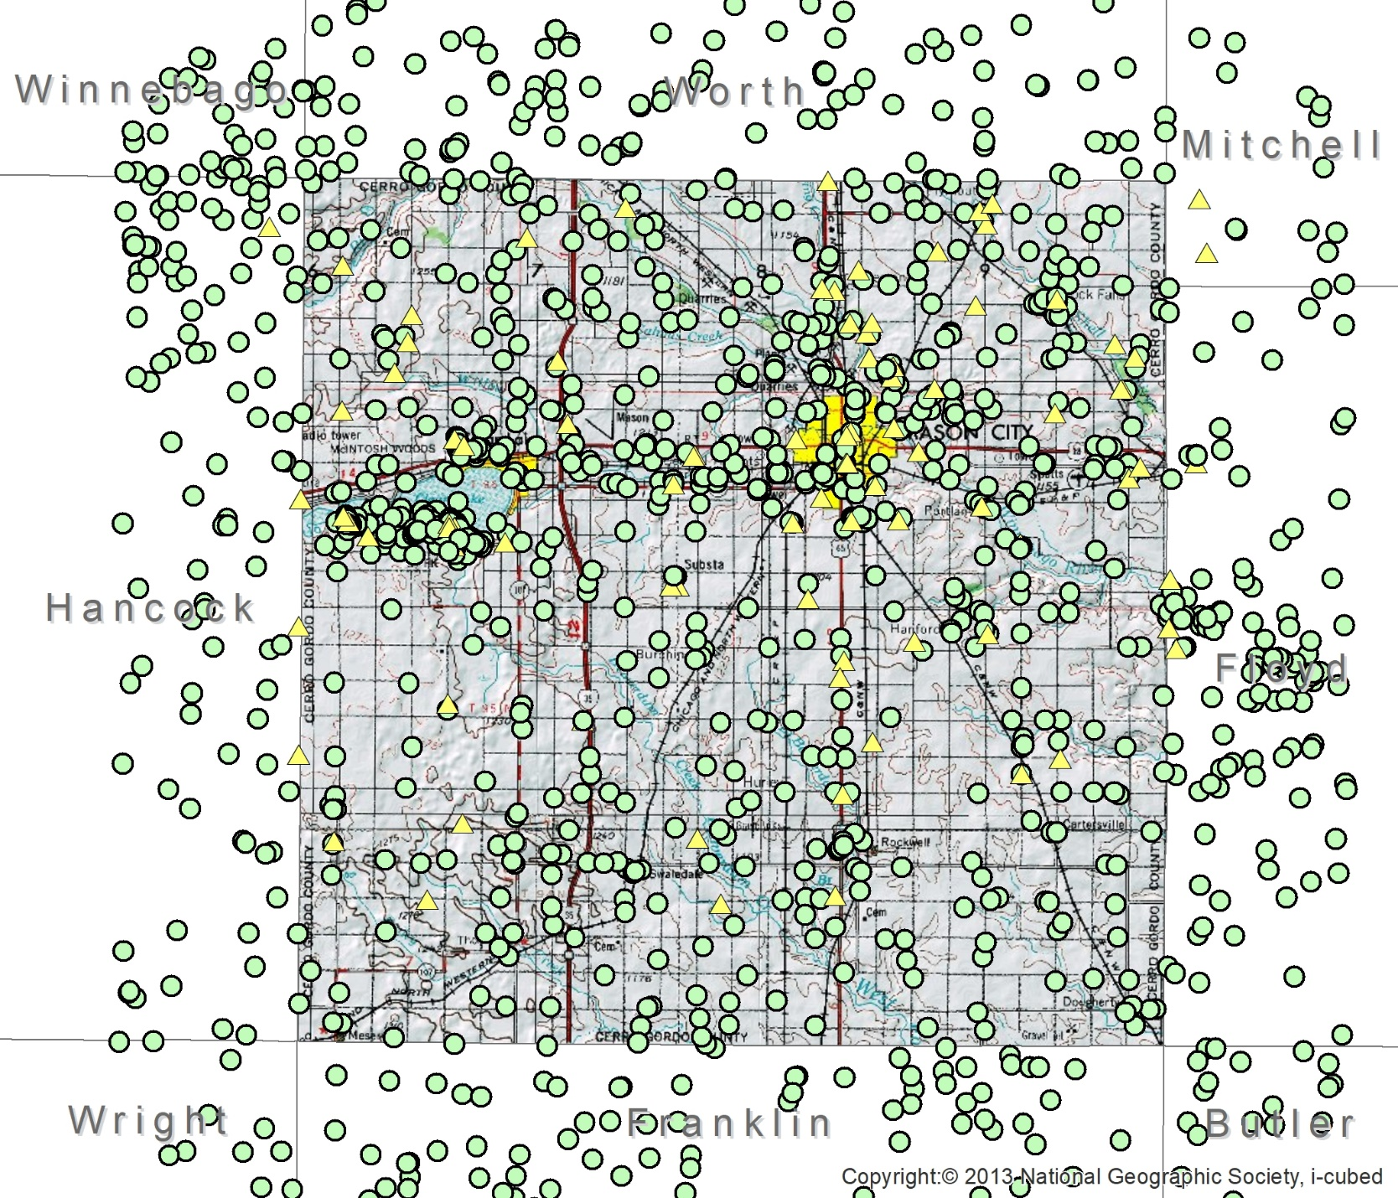
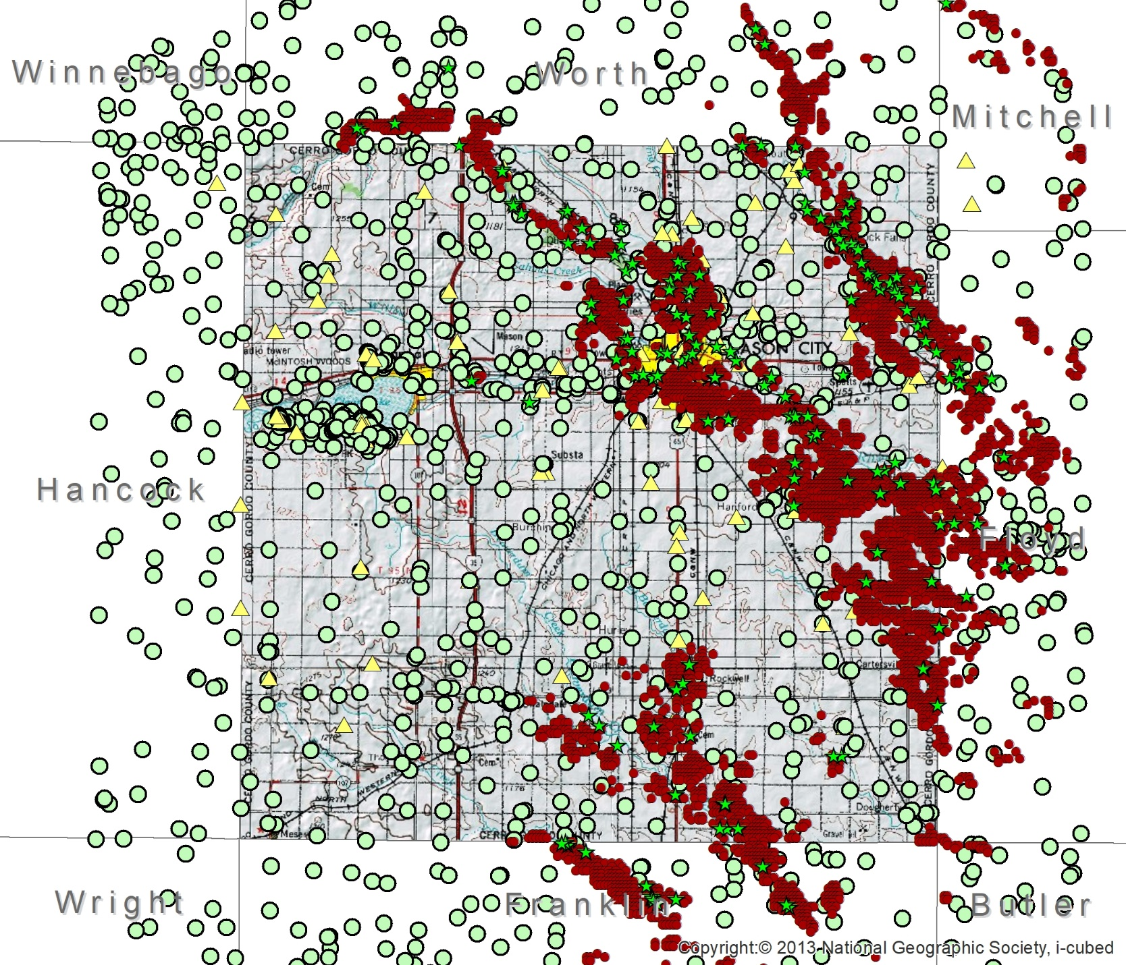
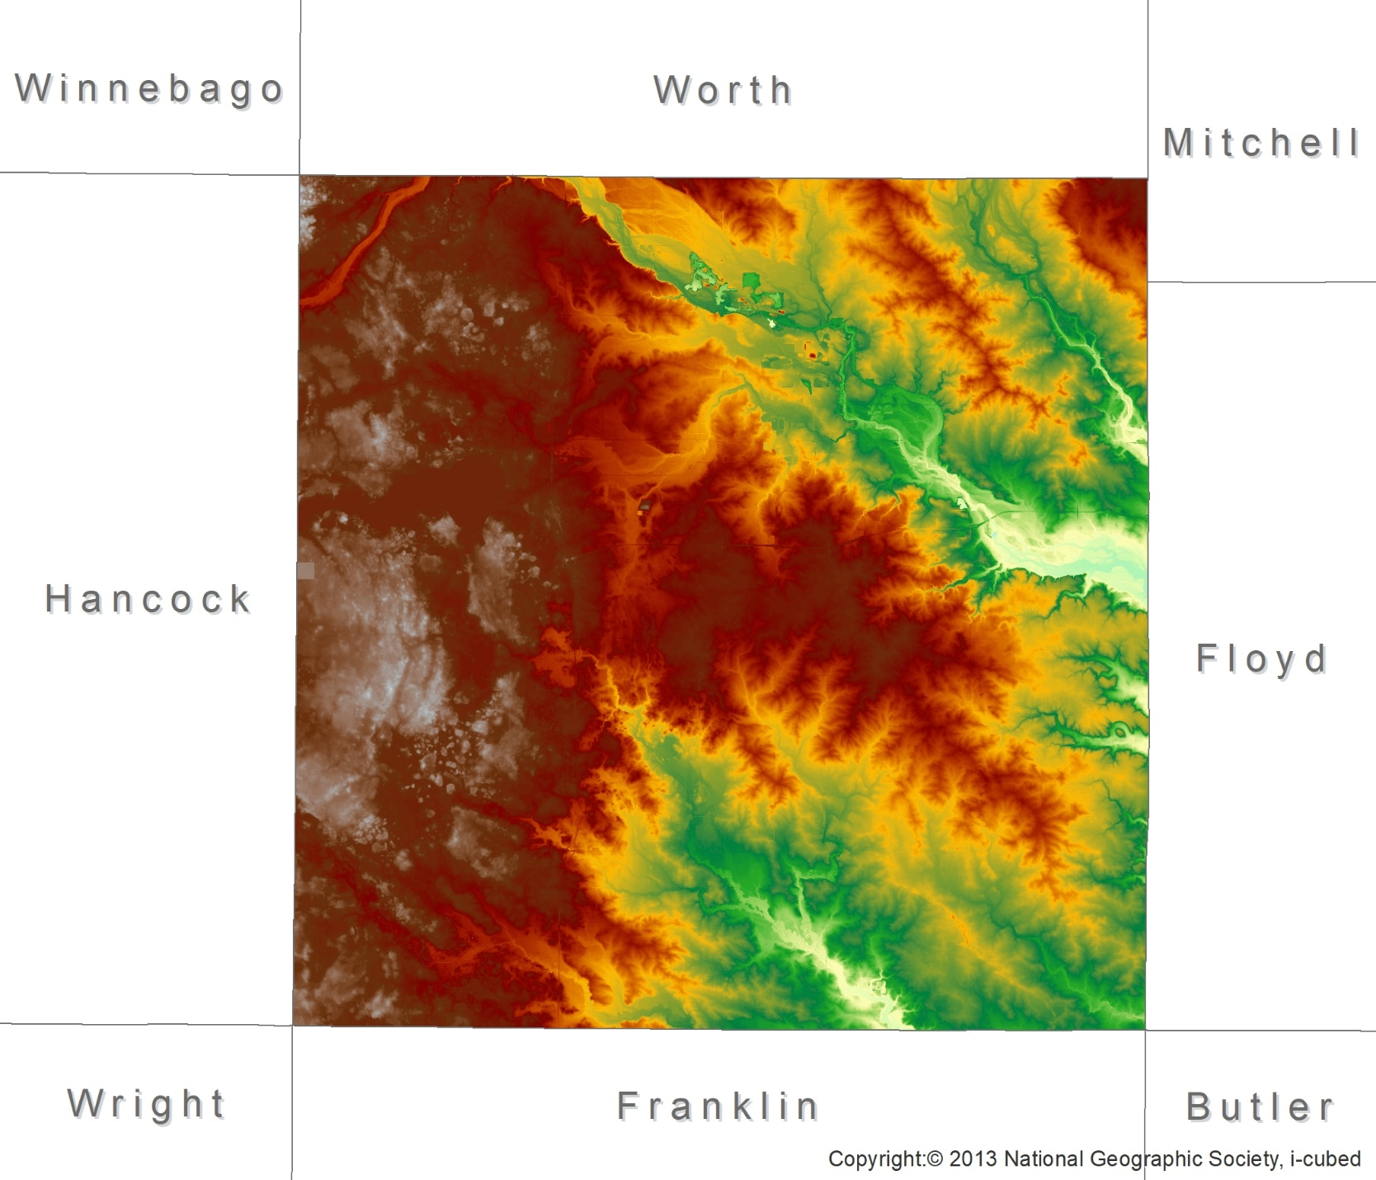
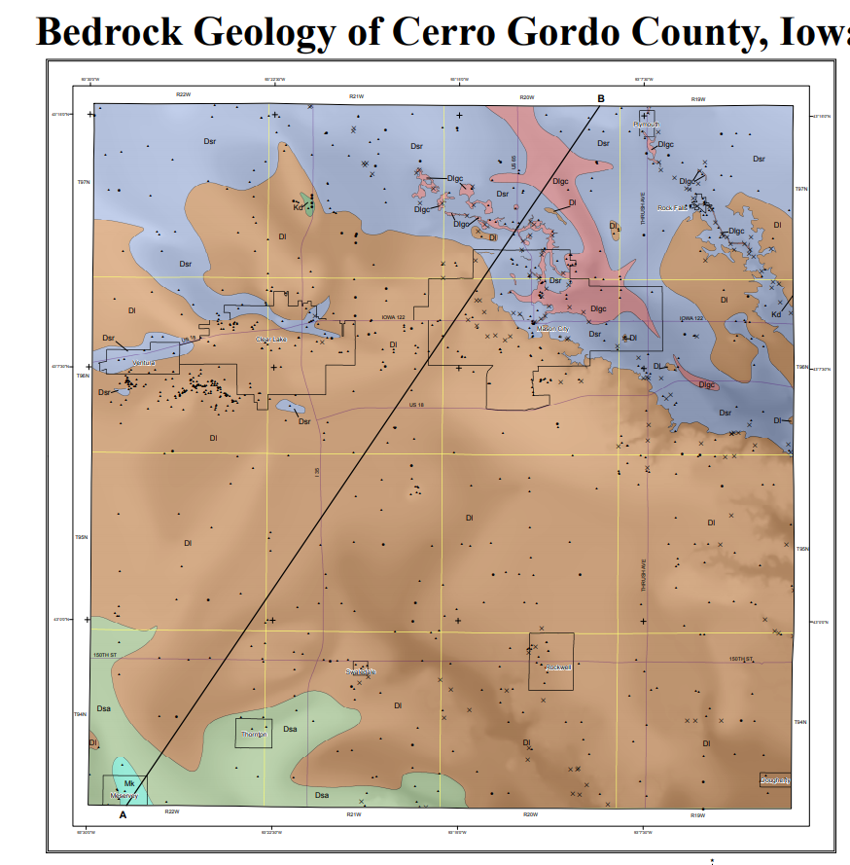
Model Data
“Quantity has a quality all its own.” – Joseph Stalin (…the internet)
Model Data (BR surface example)
Published Maps (StateMap, GW Resources, etc.)
GeoSam (412 data points)
PWTS (100 data points)
NRCS Soils, survey points, (>1,000)
LiDAR!

Slide 11
Model Design
What is needed?
  Forecasting model that is usable and understandable by County staff
  Forecasts everywhere in the County for important geologic units
  Base of model is Ordovician-age Maquoketa Formation (aquitard)
  Model should be updatable w/new wells/data (about +20/year drilled)
  “Lightweight” for computing needs and processing power
    ArcMap Coverage Geodatabase (16-bit raster)
    Pixels = feet integers, asl
    Model minimum geologic thickness = 5 feet.
    All data ‘snapped’ to 30m x 30 m

Slide 12
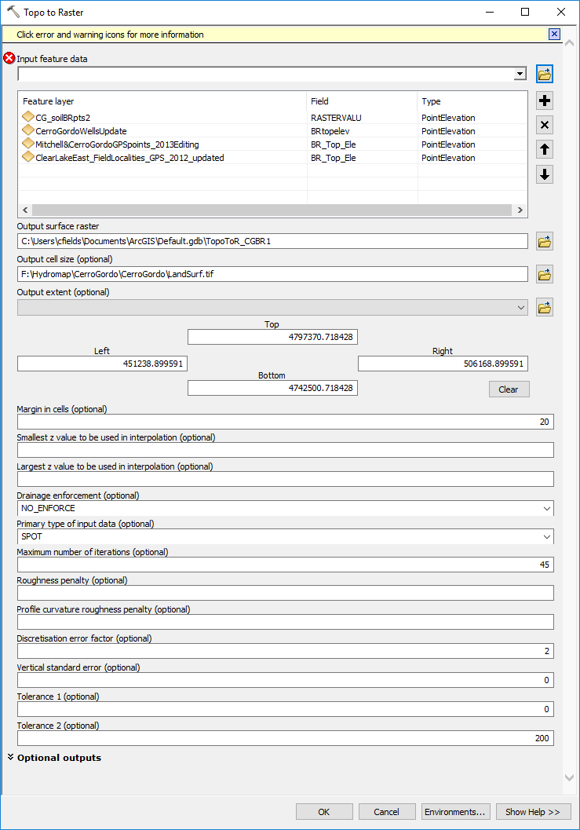
Model Process
“Topo to Raster” used to initially create the surface
Clean up point data.
Simplify point data.
Clean up again.
Check with geologists (…optional?)
Process the points to raster
…Start over?

Slide 13
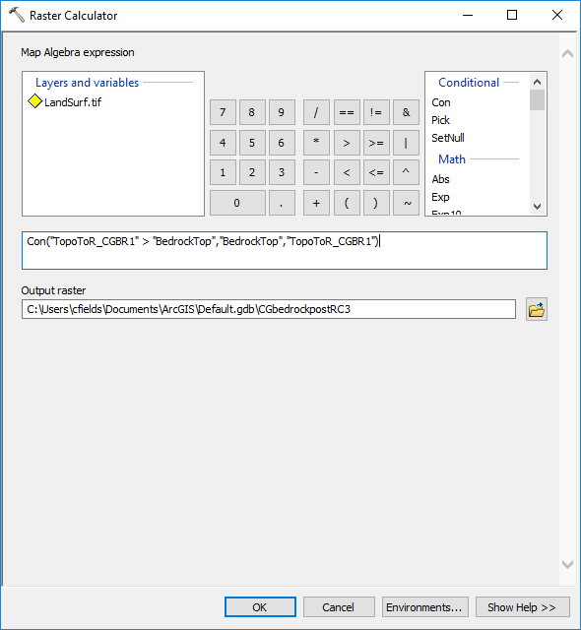
Model Process
“Raster Calculator” used to enforce vertical constraints on surfaces
Conditional statements using both your model design and common sense rules:
  Example: no geologic surface can go above LiDAR land elevation.
  All mapped surfaces have minimum five feet thickness.
  This only works with “snapped” raster data.

Slide 14
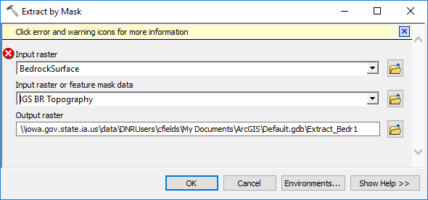
Model Process
“Extract by Mask” used to enforce horizontal constraints on surfaces.
  Area where stratigraphic unit is mapped/eroded.
  Also can mosaic higher resolution data (units at bedrock surface)

Slide 15
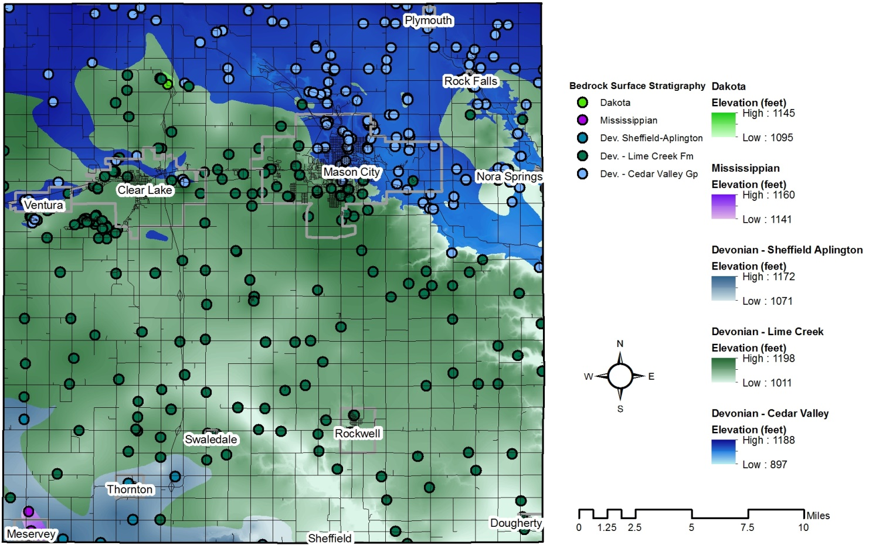
Geologic Units – Map View

Slide 16
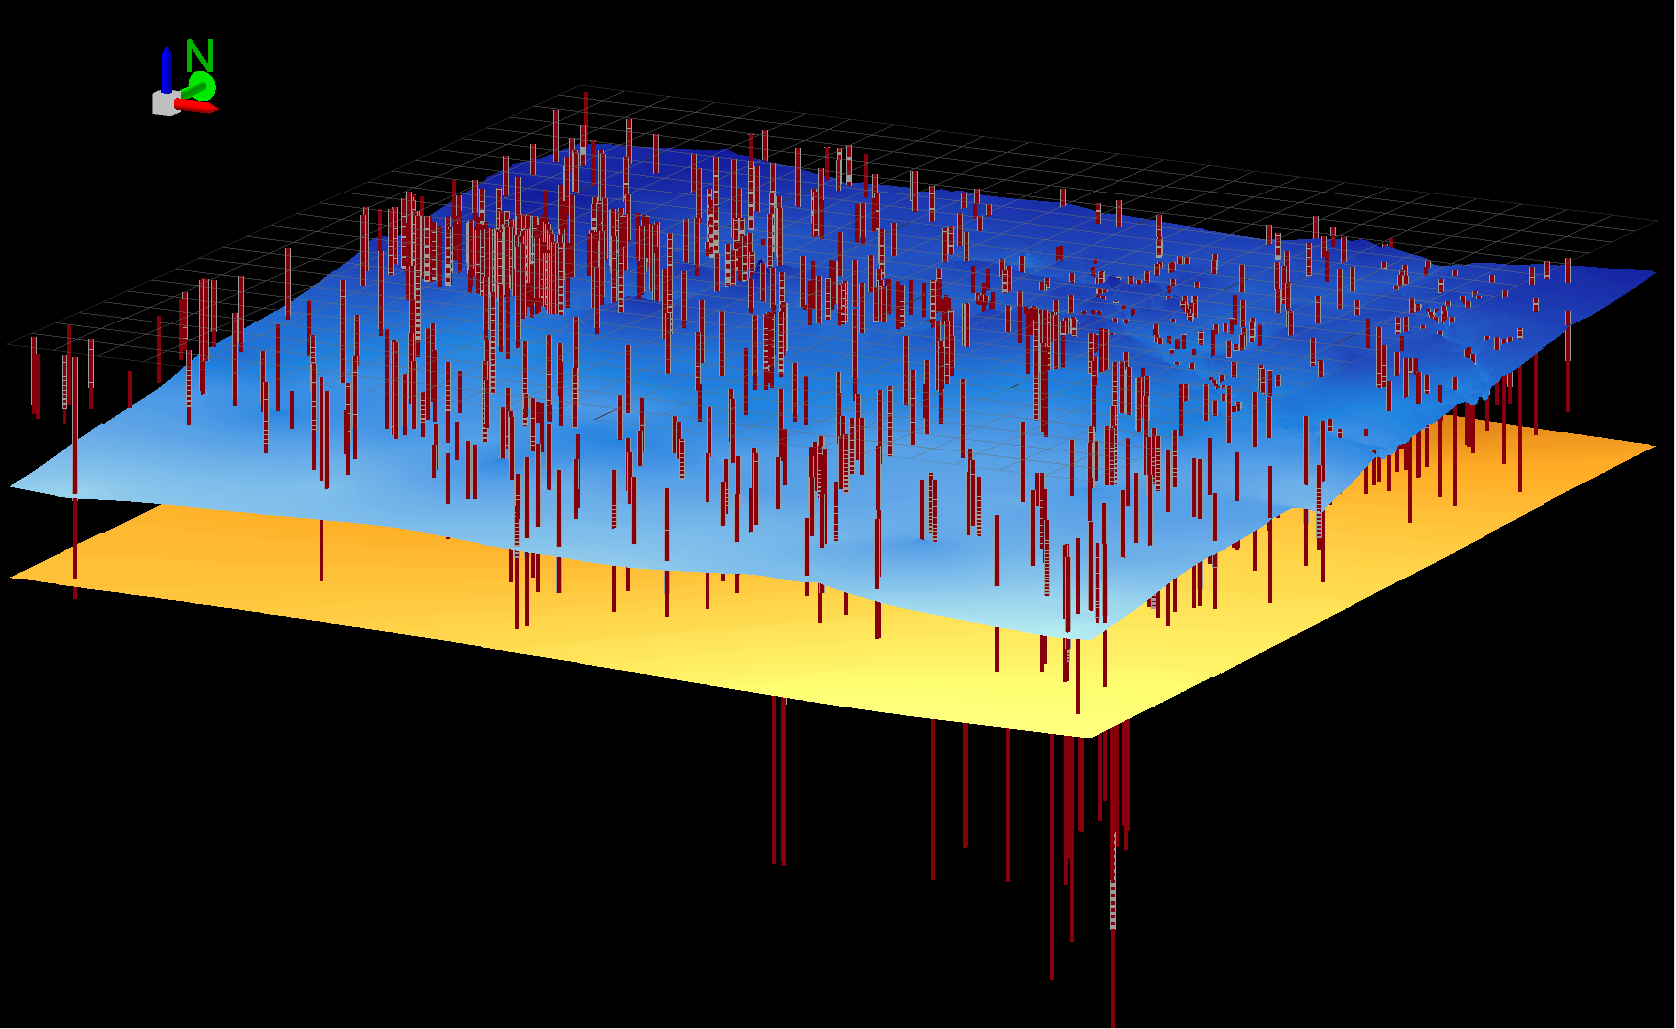
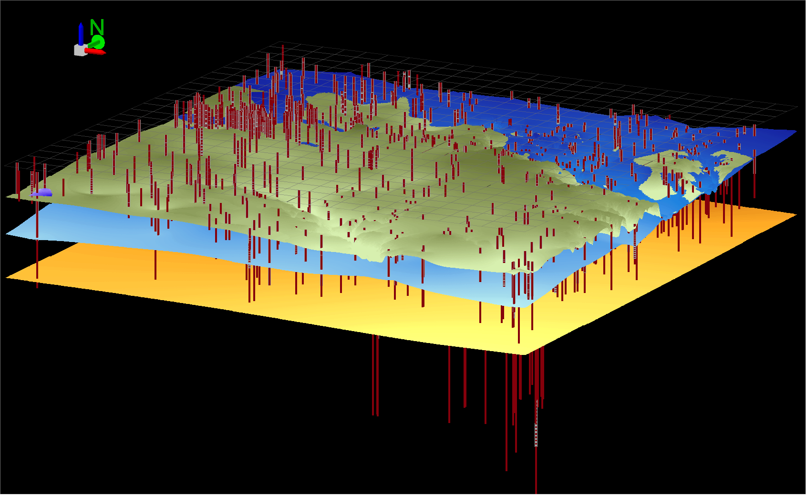
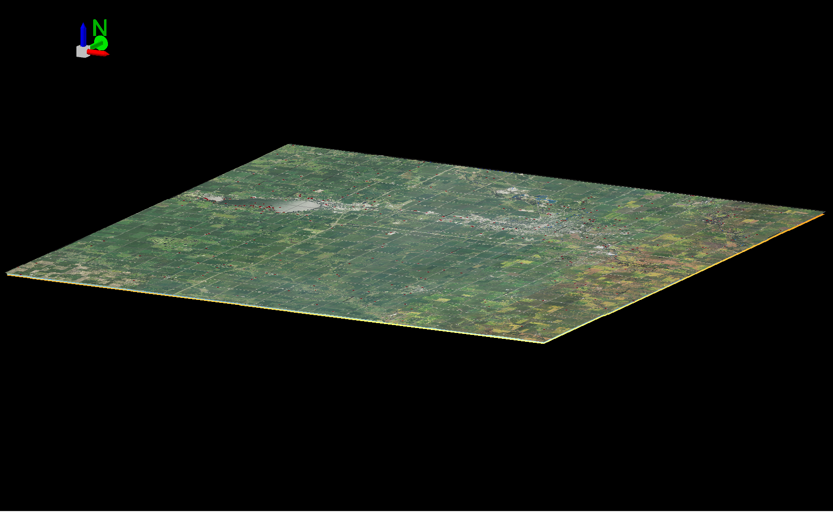
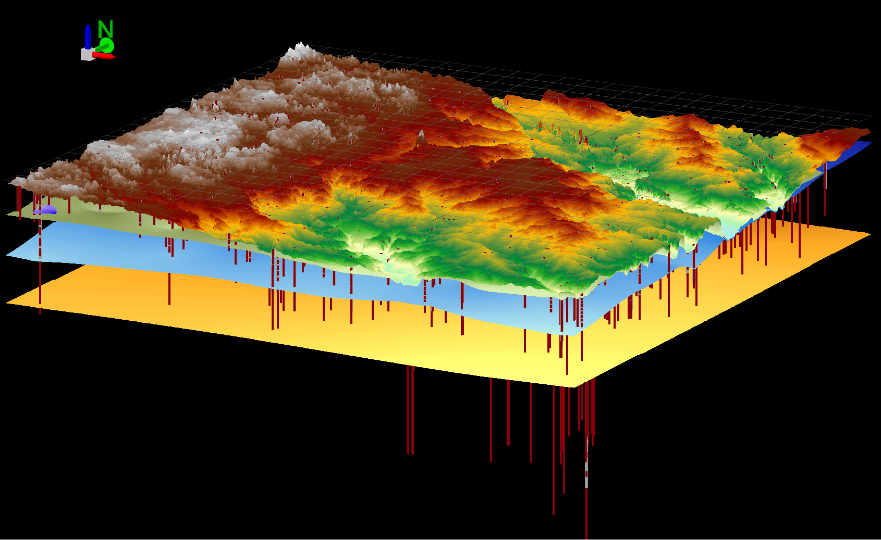
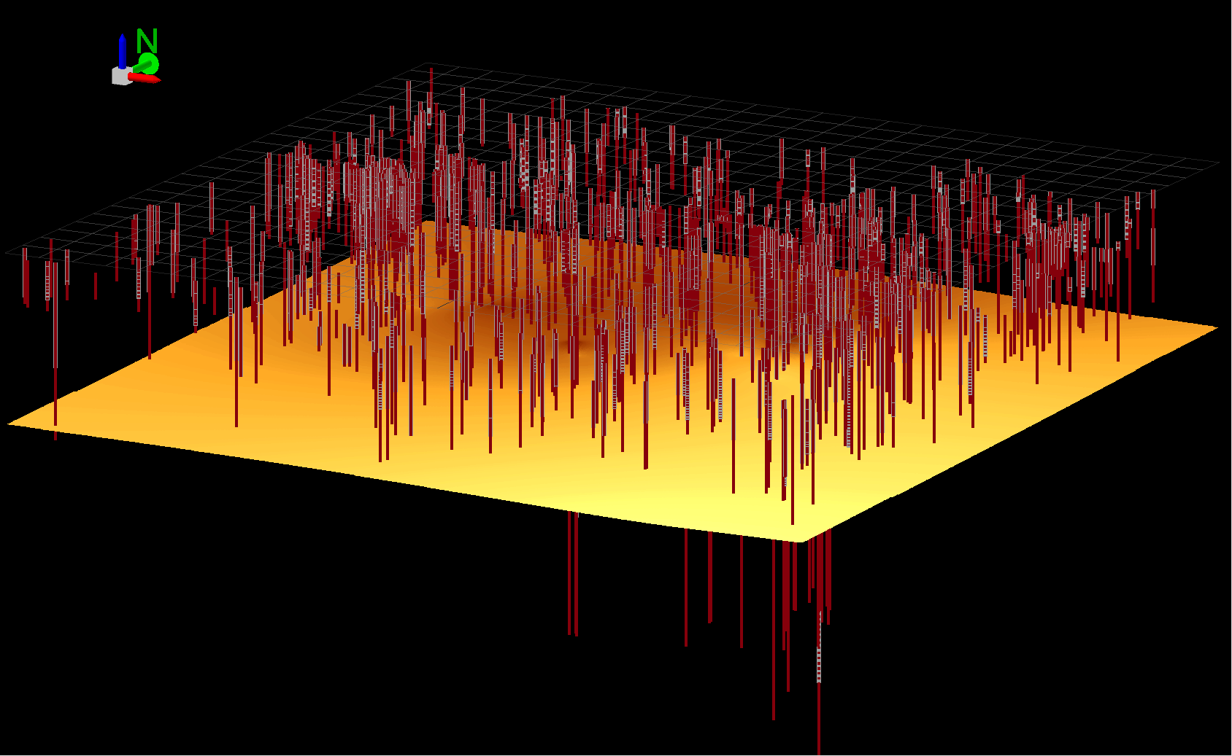
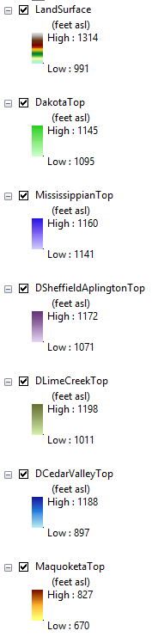
Model in 3-D

Slide 17
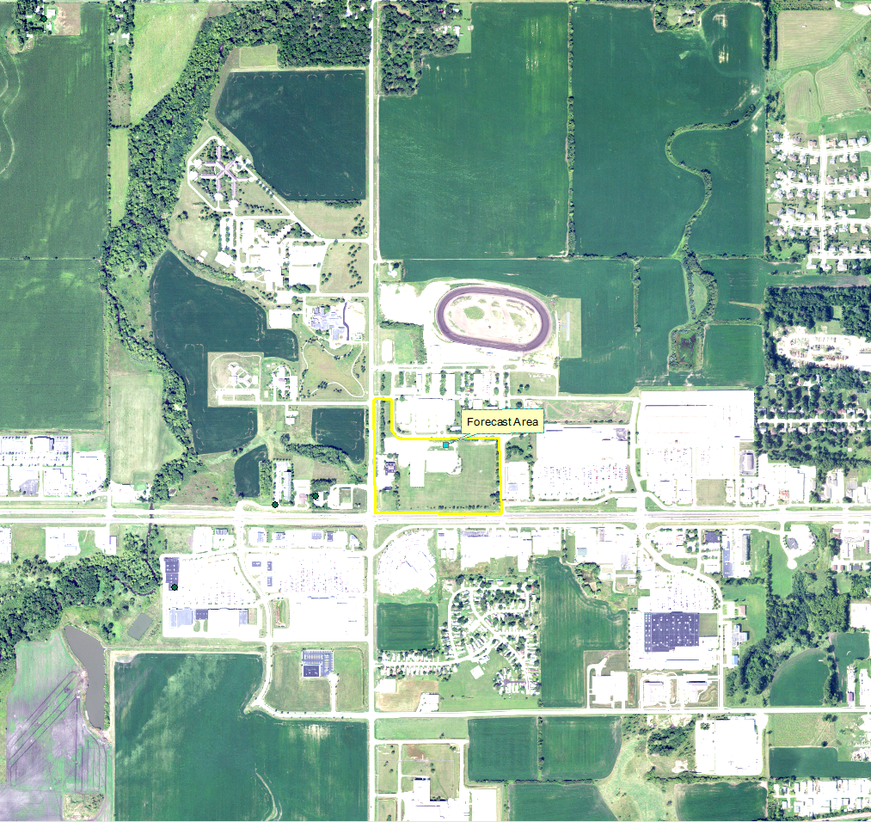
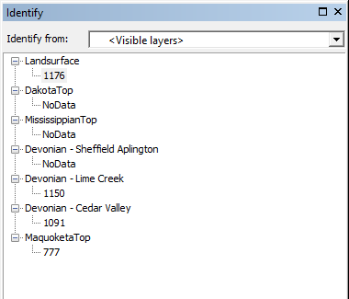
Model In Use

Slide 18
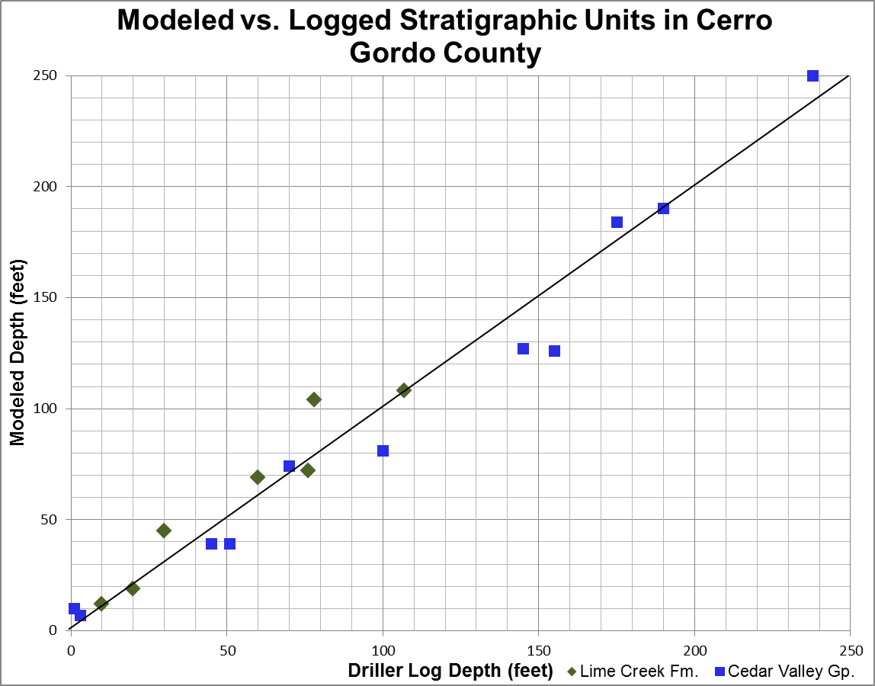
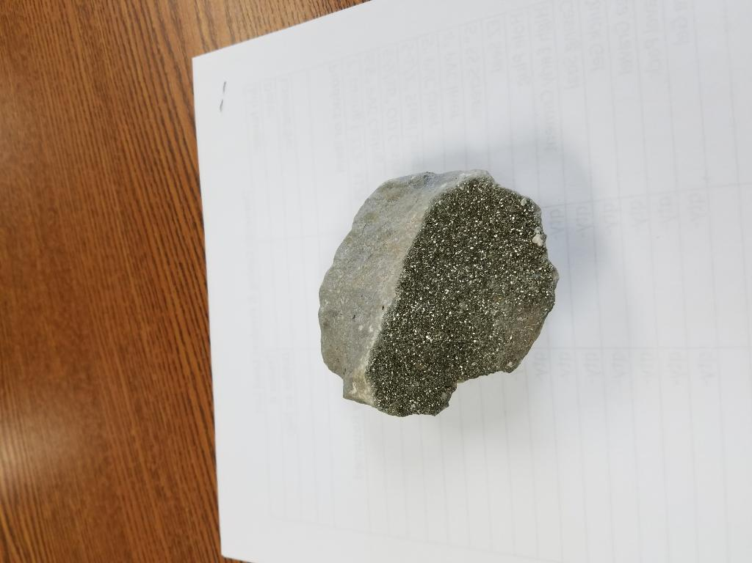
Checking and Updating the Model
**12 wells drilled in Cerro Gordo County
between model creation and analysis
Shawver Well Company sent this picture on April 9th, 2018
Cedar Valley Group unit – no WQ test yet

Slide 19
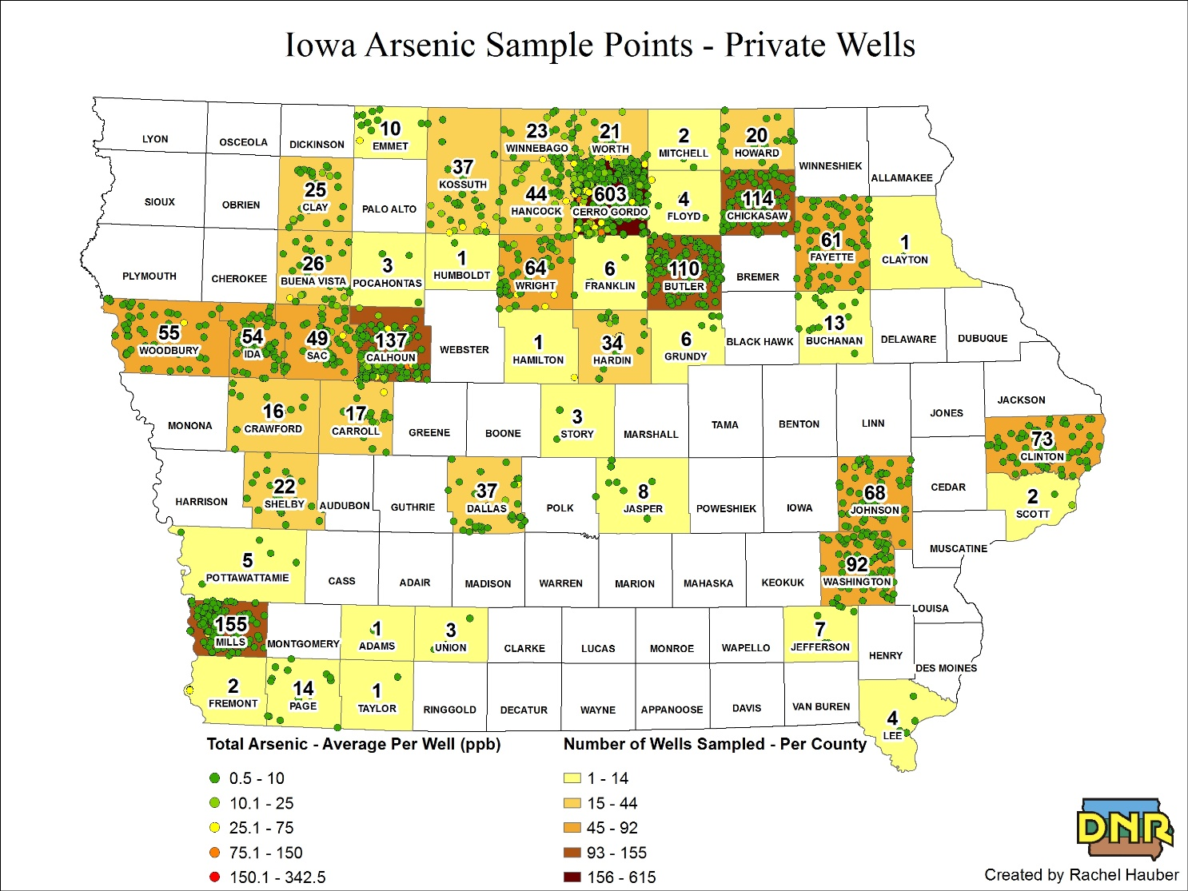
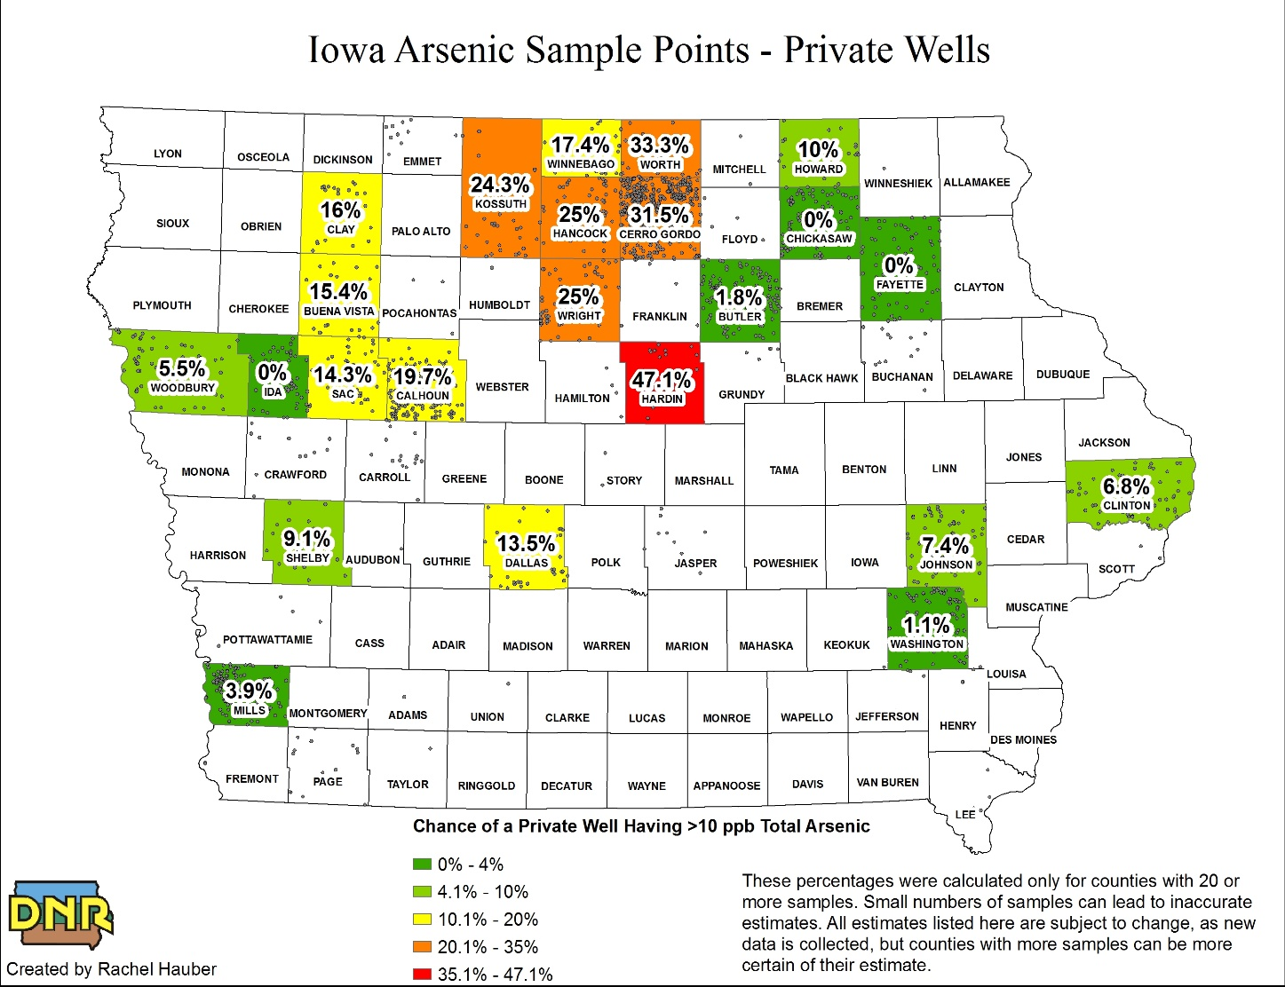
Private Well Arsenic Sampling in Iowa

Slide 20
Results and Discussion
Groundwater arsenic at concentrations higher than the EPA maximum contamination level (MCL) of 10 µg/l occurs in all aquifers in Iowa.
Statewide, BSG and Dakota aquifers have the highest potential of elevated arsenic, though local “hotspots” in all aquifers are common.
Arsenic is commonly from natural/geologic sources.
When local geologic sources of arsenic are accurately defined, those units can be mapped and modeled using common GIS tools to help establish a solid geologic framework for arsenic ‘zones’ and also establish best practices for well construction.
Science on groundwater arsenic in Iowa is changing fast. Groundwater models and maps need to be quickly updatable with new data and technology.

Slide 21
Thank you.
Questions?

