Slide 1
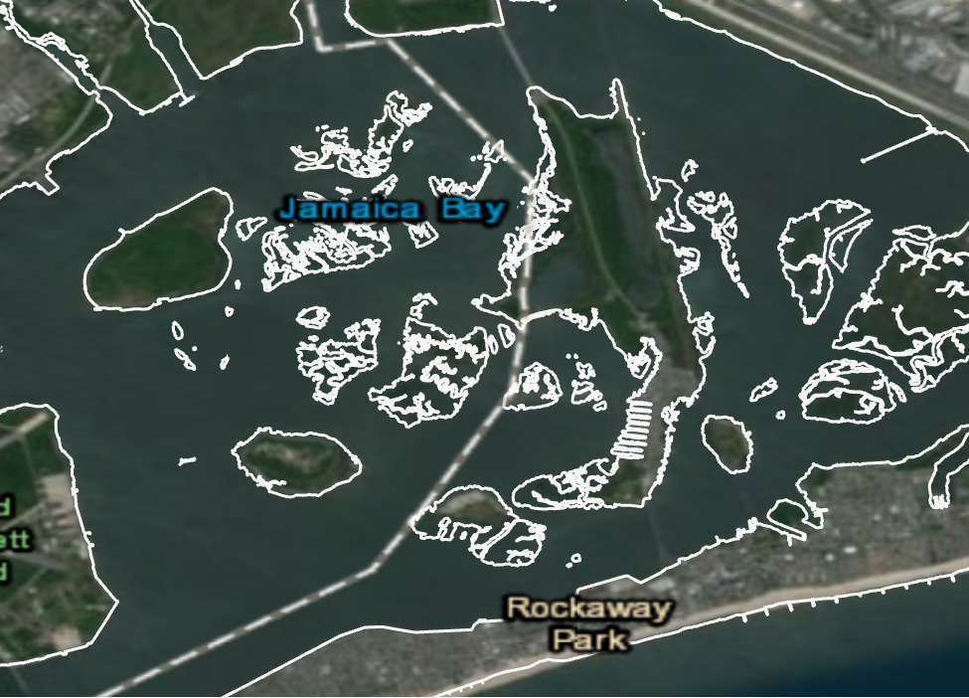
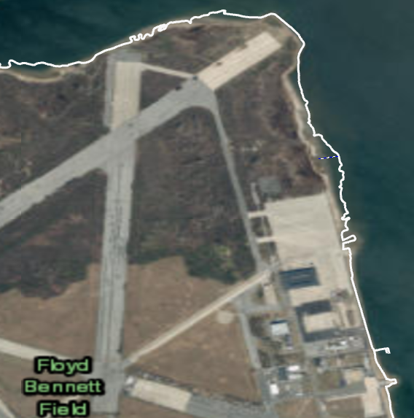
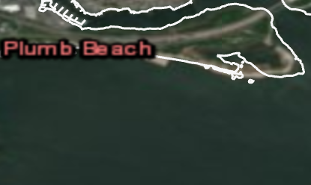
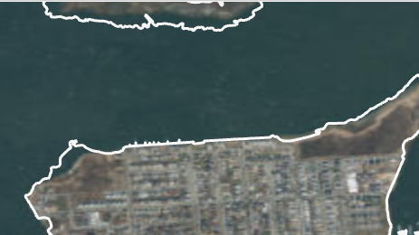
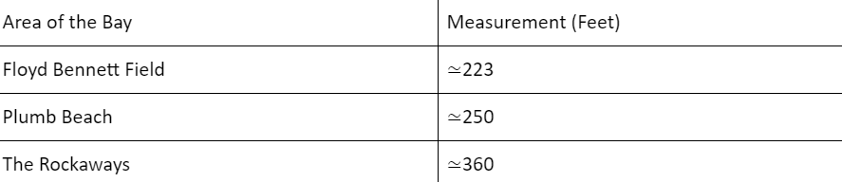
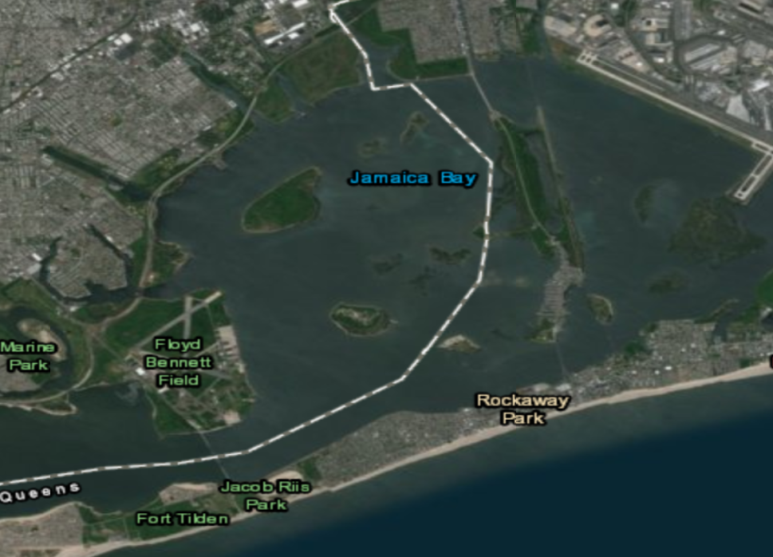
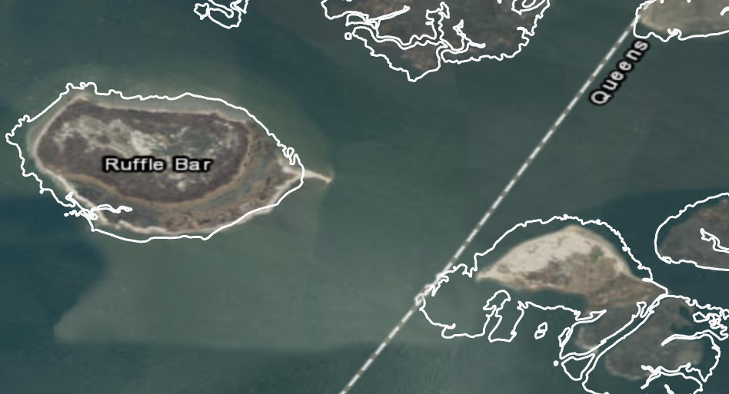
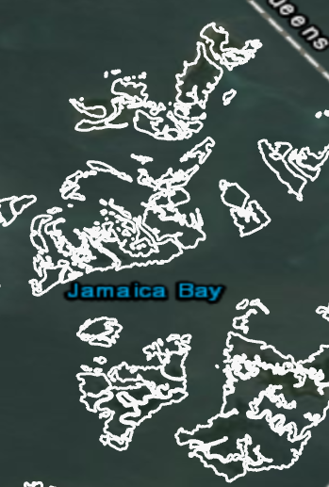
Shoreline Erosion, Biodiversity Loss, and Salt Marsh Depletion in Jamaica Bay, NY after Hurricane Sandy
Santina Benincasa - CUNY:Brooklyn College & Kingsborough Community College
MS in GIST
Figure 1: Overview of Jamaica Bay, New York.
Salt Marsh Analysis
Figure 2: Overview of what is left of Jamaica Bay’s salt marshes.
Figures 2.1-2.2: Areas of significant
salt marsh loss.
Biodiversity Loss
Due to Spartina Alterniflora’s reliance on wetlands for colonization, the species’ population within the area faced a general decrease.
Shoreline Analysis
Figures 3.1-3.3: Areas of significant shoreline erosion. (Measurements recorded in table below.)
Abstract
Jamaica Bay, New York consists of several areas in Brooklyn and Queens. This Gateway National Recreation Area is comprised of beaches, forests, and marshes. In 2012, Superstorm Sandy severely damaged the bay and presently, much of the bay remains damaged; through analysis of collected data, noticeable amounts of shoreline erosion, salt marsh depletion and loss of biodiversity have been observed. The loss of biodiversity in the area can be seen by the steady decline in Spartina Alterniflora, a form of vegetation that exists throughout the entire bay.These trends have increased over the past decade but were exacerbated by Superstorm Sandy. By mapping areas with various levels of shoreline erosion, salt marsh depletion, and decline in indicator species before and after Superstorm Sandy, this project identifies the degree to which different areas were damaged by the storm. By understanding how these variables intersect, restoration efforts can be dedicated to the areas that remain the most vulnerable.
Study Area
Conclusion
As the frequency of superstorms serve as an effect of climate change, Jamaica Bay serves as a prime example of just how real of a threat it is. Superstorm Sandy left Jamaica Bay in a critical state of disrepair. The bay has endured a substantial amount of salt marsh depletion which has negatively affected the bay’s Spartina Alterniflora population. The bay has also dealt with a significant amount of shoreline erosion. The various parts of the bay have generally lost anywhere from 200-400 feet of shore. Therefore, efforts should be made to rebuild the bay. Possible efforts include beach nourishment, the installment of seawalls, to not only restore the bay but to also protect it from further damage that might occur in the future.
Acknowledgements
Data was collected from NOAA, NYSDEC, and FWS.
Contact: sbeninca@usc.edu
Jennifer Bernstein* & Jennifer Swift*
*Dornsife Spatial Sciences Institute, University of Southern California

