Slide 1
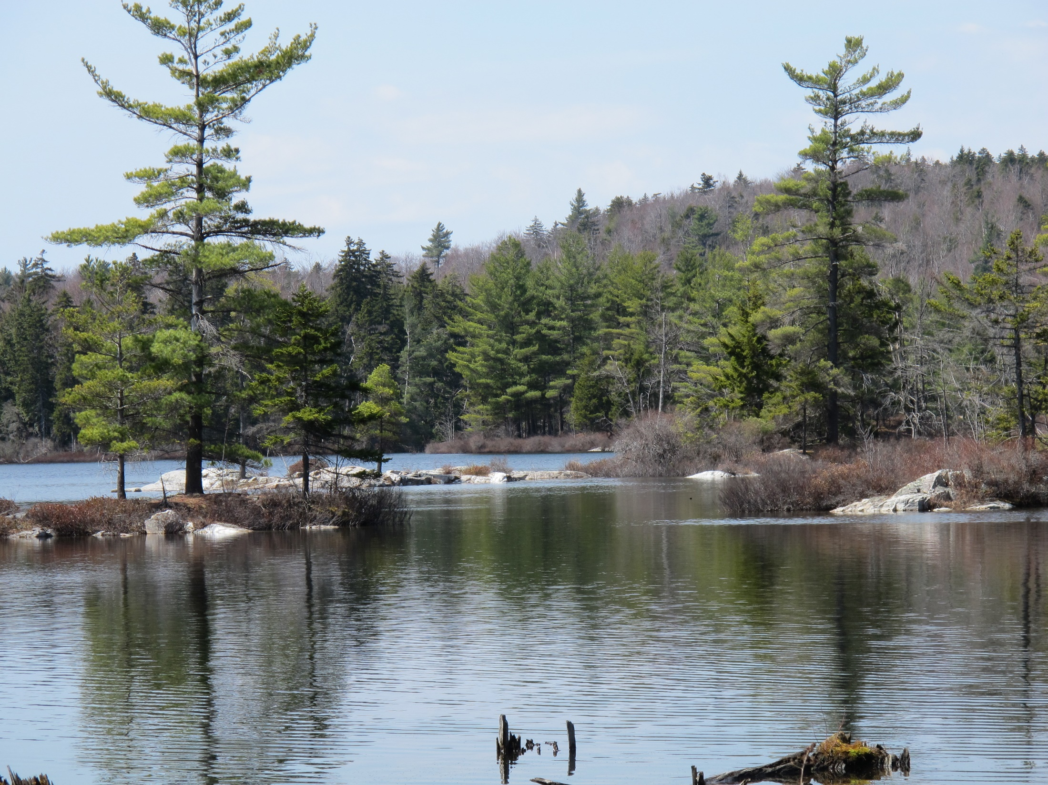
REEVALUATION AFTER 50 YEARS OF NAPPES IN WESTERN NEW HAMPSHIRE: ARE THE SKITCHEWAUG AND CORNISH NAPPES ONE AND THE SAME?
Peter J. Thompson and Justin V. Strauss
with help from Edward Meyer
TITLE SLIDE
Mapping supported by Statemap 2016,
USGS and New Hampshire Geological Survey
Notes:
Before I get started I’d like to thank my collaborators Justin Strauss and Ed Meyer, who helped collect and analyze samples in what I hope will become an ongoing effort to pin down ages and geochemistry of some of the rock units in the region.

Slide 2
CHESHAM POND THRUST NAPPE
FALL MOUNTAIN THRUST NAPPE
FALL MOUNTAIN NAPPE
SKITCHEWAUG NAPPE
BERNARDSTON NAPPE
CORNISH NAPPE
AUTOCHTHONOUS ROCKS ABOVE OLIVERIAN DOMES
Notes:
I’ll start with a brief review of the nappe story in New Hampshire. In t Jim Thompson proposed the Skitchewaug nappe in an NEIGC trip article, whereby rocks of the Bronson Hill sequence had been transported west into Vermont.
In the 1968 paper, Nappes and Gneiss Domes in West-Central New England, Thompson and others added two more nappes, Cornish and Fall Mountain, and in 1979 Thompson and Rosenfeld proposed an additional nappe below the Skitchewaug: the Bernardston nappe.
In 1985 my mapping in the Monadnock quadrangle discovered the Chesham Pond thrust above the Fall Mountain nappe. By this time it was also recognized that Fall Mountain was floored by a thrust fault, with its root zone at the Brennan Hill thrust to the east.
More recent mapping has got me rethinking the order of the nappes.

Slide 3
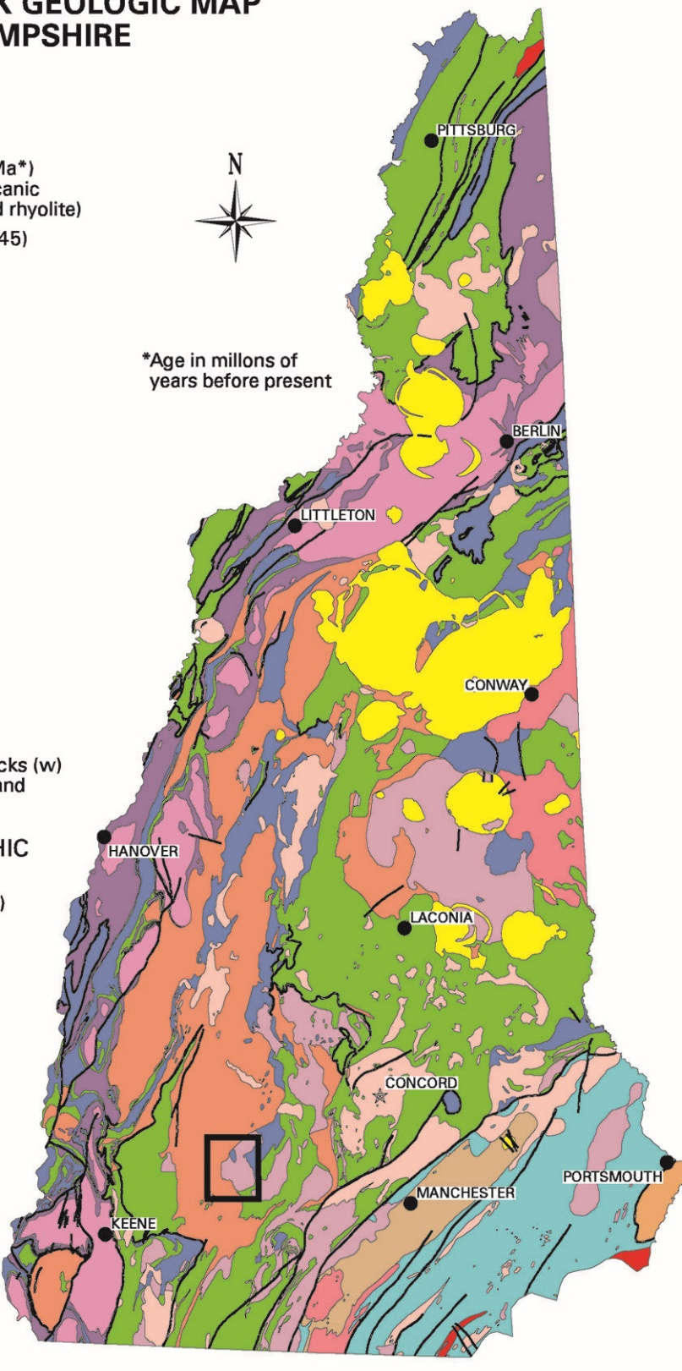
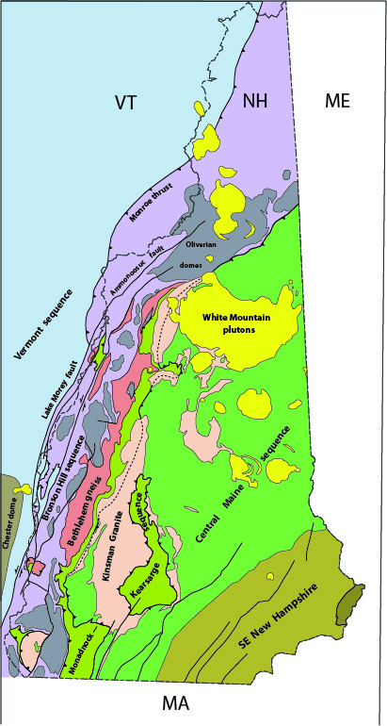
Geologic Map of New Hampshire
Lyons et al., 1997
Notes:
I’ve taken a generalized version of the NH state map and simplified it further by focusing on the structural levels in NH.

Slide 4
Context for the Bronson Hill anticlinorium:
Central Maine sequence and Kinsman granite
Monadnock sequence and Bethlehem gneiss
Bronson Hill sequence and Oliverian domes
Vermont sequence
Chesham Pond thrust
Brennan Hill thrust/Fall Mtn. nappe
Monroe thrust/various nappes
Notes:
The nappes were emplaced during the Acadian Orogeny, stacking hot rocks onto cooler rocks and setting up conditions for inverted metamorphic isograds in western NH. Nappes in the Bronson Hill sequence, in purple, were displaced west over the Vermont sequence, in blue; above that the Monadnock sequence and Bethlehem gneiss were displaced westward along the Brennan Hill thrust as the Fall Mtn nappe and Piermont allochthon. And finally the Central Maine sequence and Kinsman granite were emplaced above all that. Deformation by backfolds and domes makes for a very complicated map pattern.
We’ll start our discussion in this area of West-Central New Hampshire near Enfield.

Slide 5
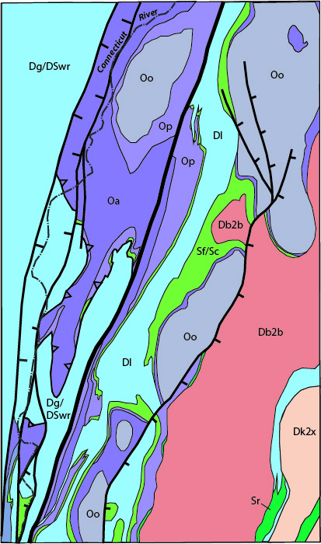
ANTICLINORIUM
CORNISH NAPPE
Garnet Hill Syncline
Meriden anticline
BRONSON HILL
Notes:
So here’s the Cornish nappe and Bronson Hill anticlinorium, displaced by late steep faults: the Lake Morey fault, the Ammonoosuc fault, the Northey Hill shear zone, and the Grantham fault. In gray are the Oliverian domes: the Lebanon dome, Mascoma dome and Croydon dome. Here in the axial depression between two domes we have a flap of the overlying Bethlehem Gneiss preserved above deformed rocks of the Bronson Hill sequence. Now we’ll zoom in to that area.

Slide 6
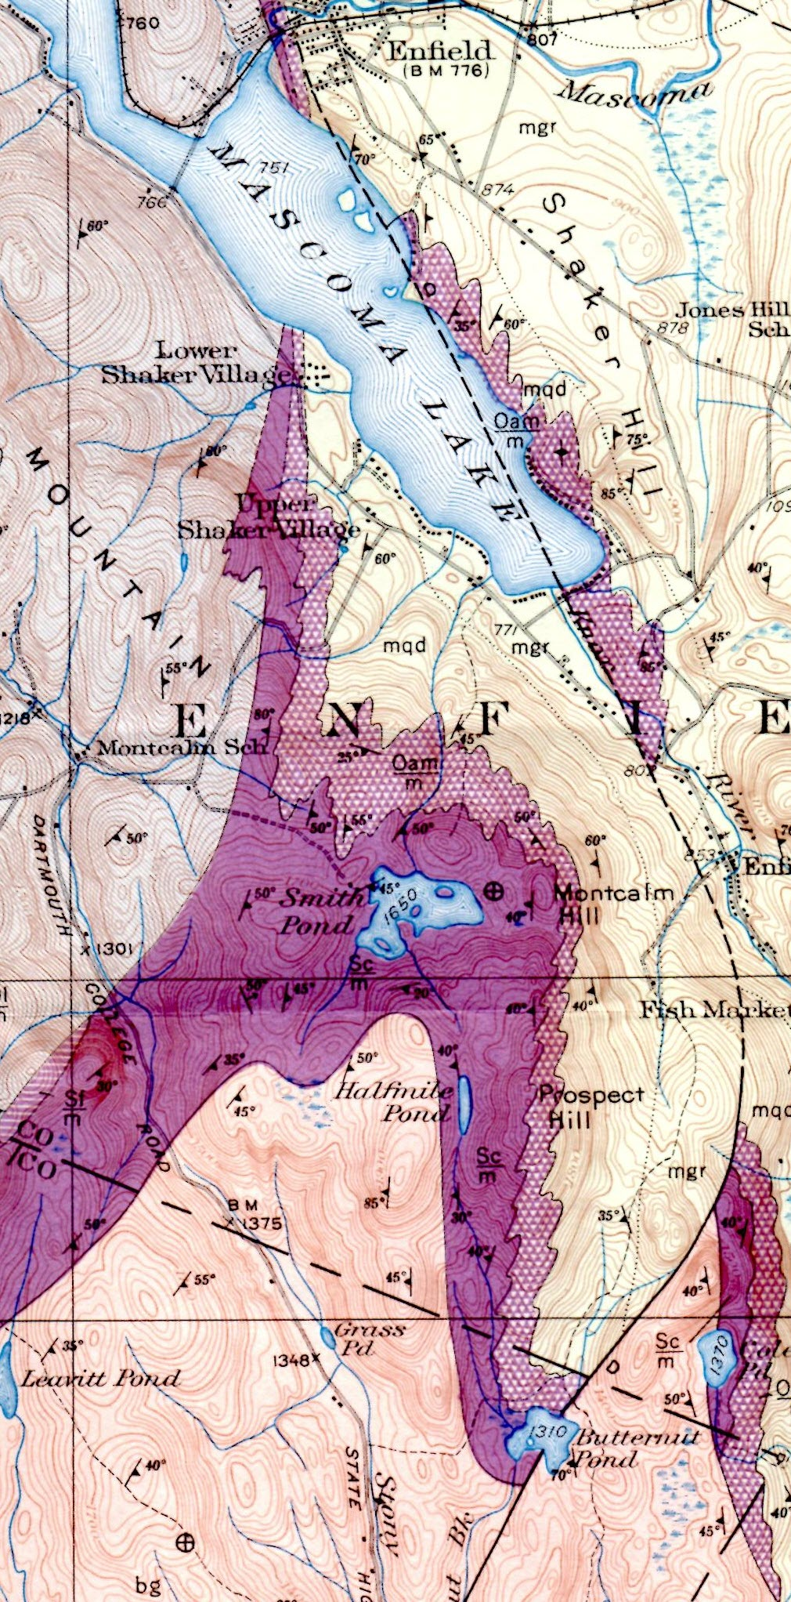
Mascoma dome
Stratigraphic column:
Dl Littleton Formation
Sf Fitch Formation
Sc Clough Quartzite
Oa Ammonoosuc Volcanics
Oo Oliverian Gneiss
Oo
Dl
Oa
Portion of Mascoma 15’ quadrangle
Chapman, 1939
Sc
Sf
Db2b
Grantham fault
Bethlehem gneiss
Notes:
Overlying the south end of the Mascoma dome, Chapman mapped all the area around Smith Pond as Clough Quartzite, with Fitch and Littleton to the west, and nearly flat-lying Bethlehem Gneiss overlying them to the south.

Slide 7
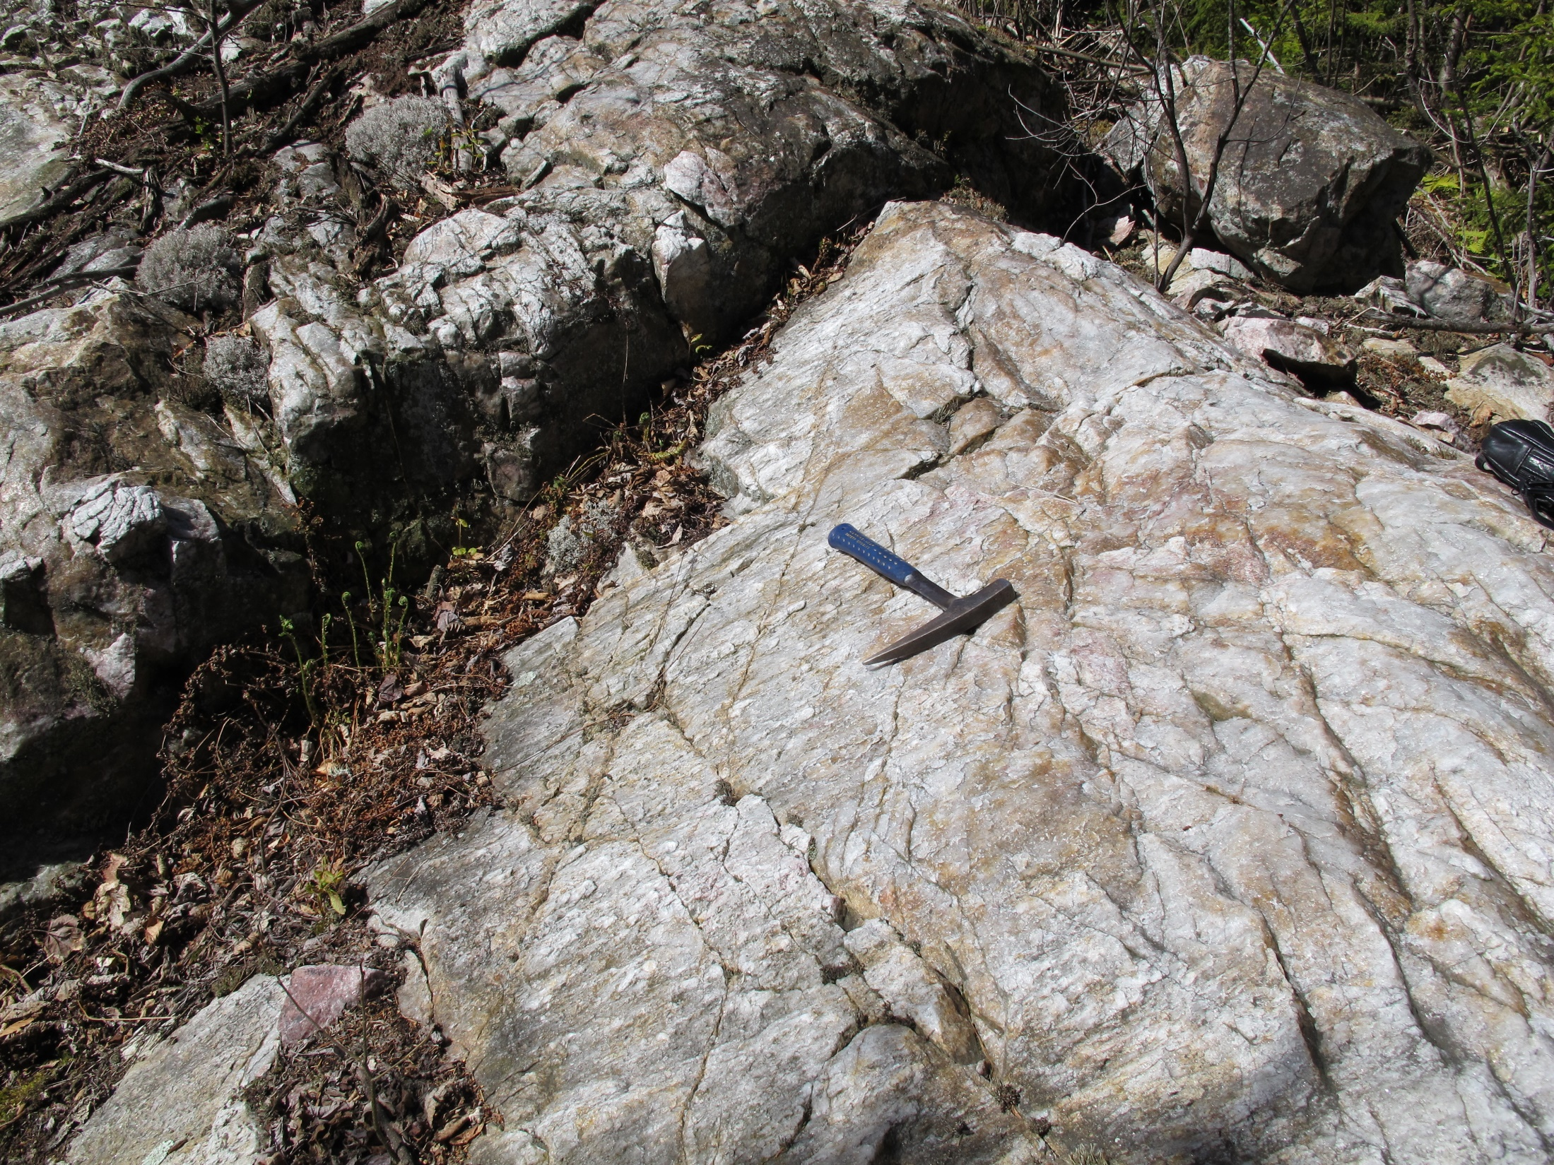
Notes:
Here is typical massive quartz conglomerate in the Clough.

Slide 8
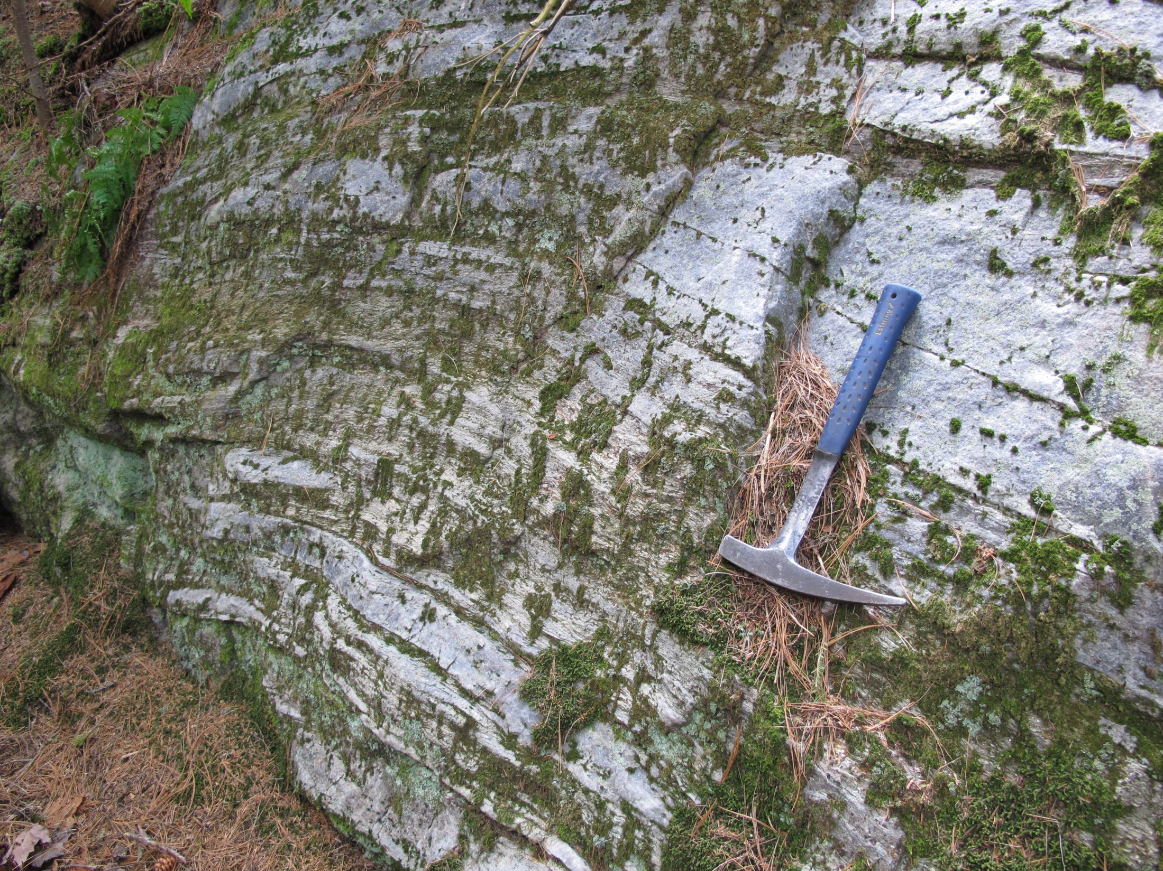
Notes:
Other facies are more thinly bedded.

Slide 9
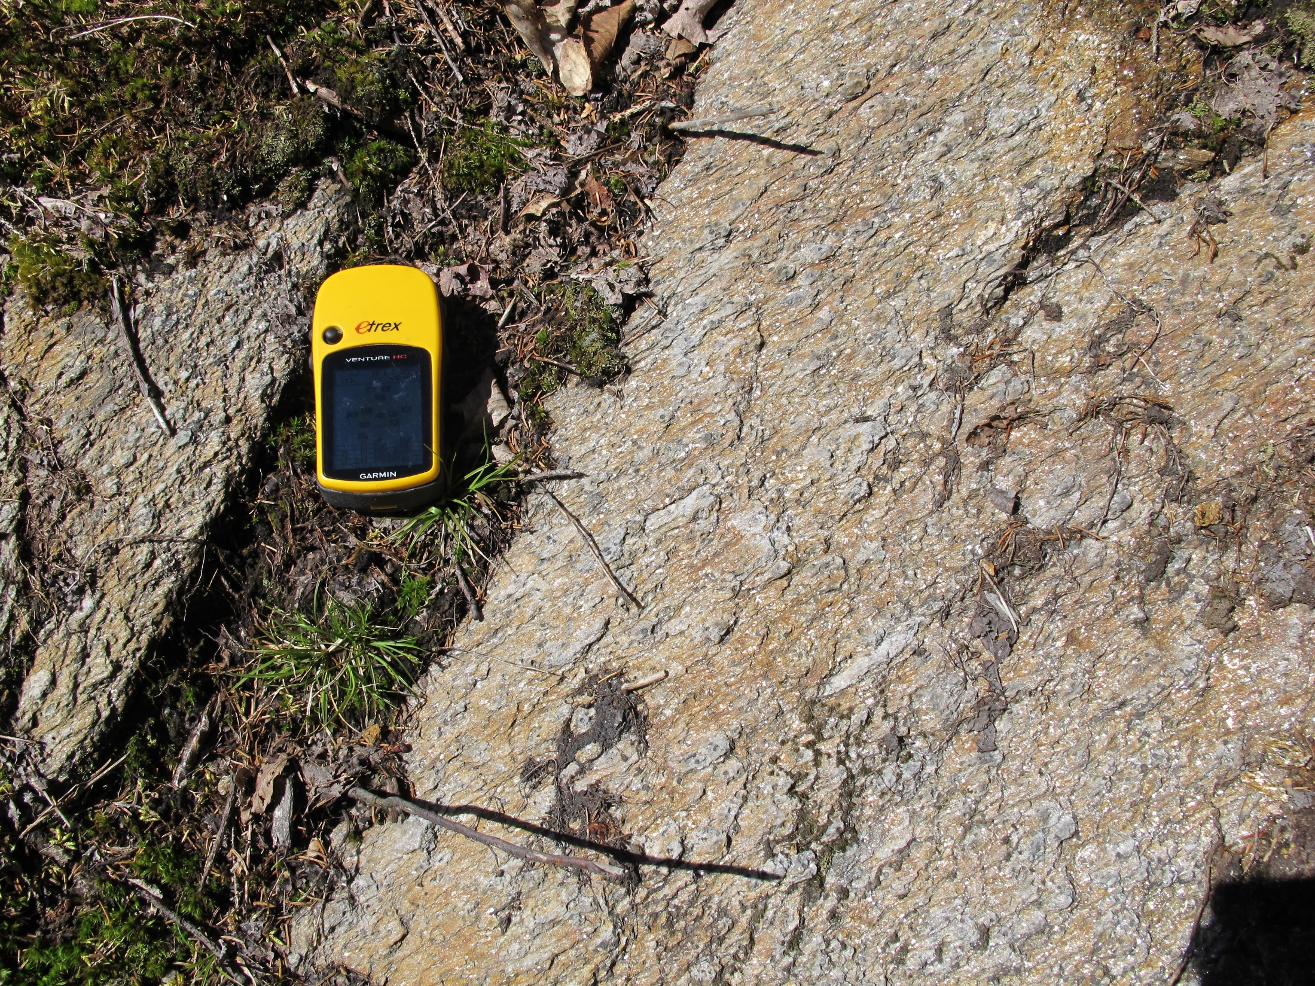
Notes:
There are also sillimanite schists within the Clough, which tend to be much more aluminous than those in the Littleton.

Slide 10
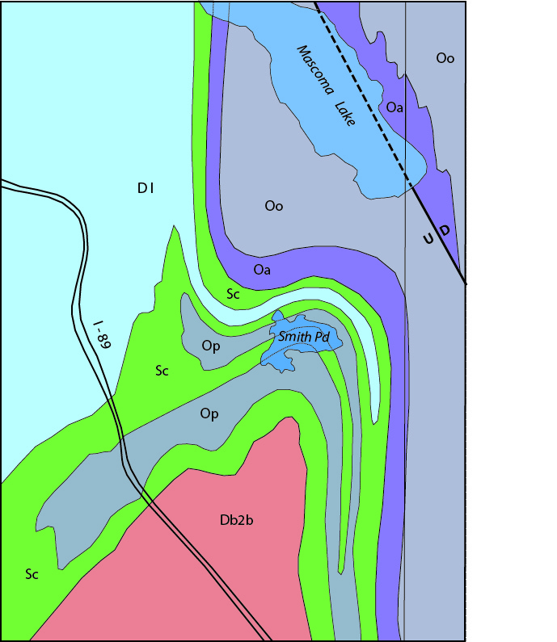
Smith Pond area
Thompson, J.B., Jr., 1988
and Lyons et al., 1997
Notes:
Jim Thompson mapped the same area, interpreting schist layers within the Clough as isoclines of Littleton and Partridge Formations. He suggested that the Partridge anticlines might be the “root zone” for the Skitchewaug nappe. This is also how the geology is shown on the ‘97 state map.

Slide 11
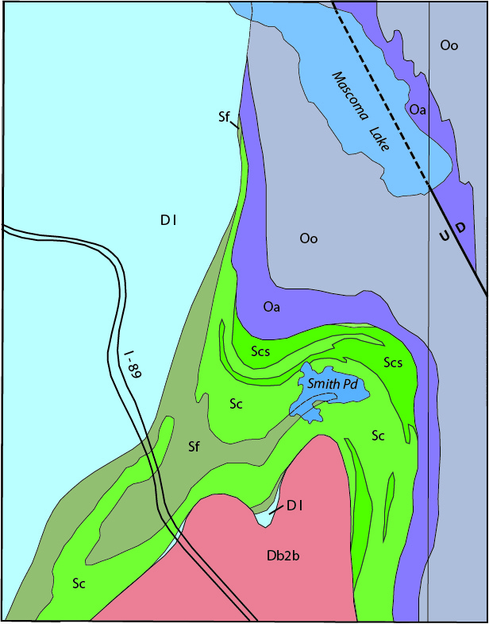
Smith Pond area
Thompson, P.J., 2016
Notes:
My mapping two years ago is more in agreement with Chapman’s interpretation.
Some of the schists are within the Clough, and some belong to the lower part of the Fitch.

Slide 12
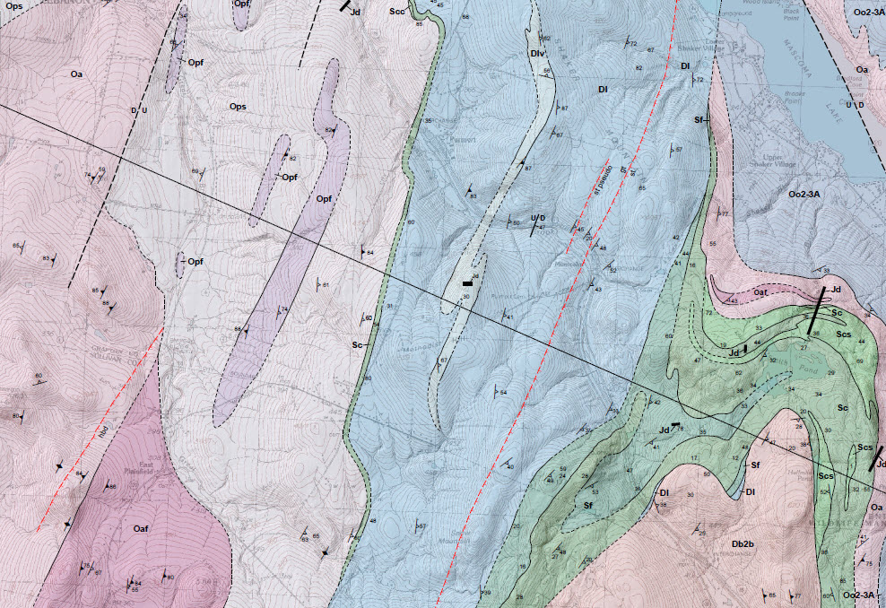
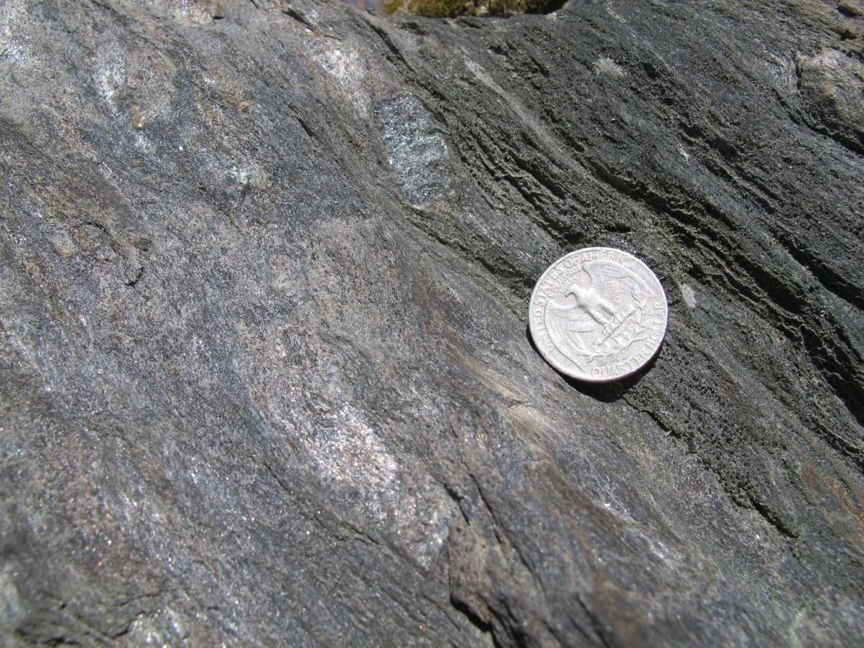
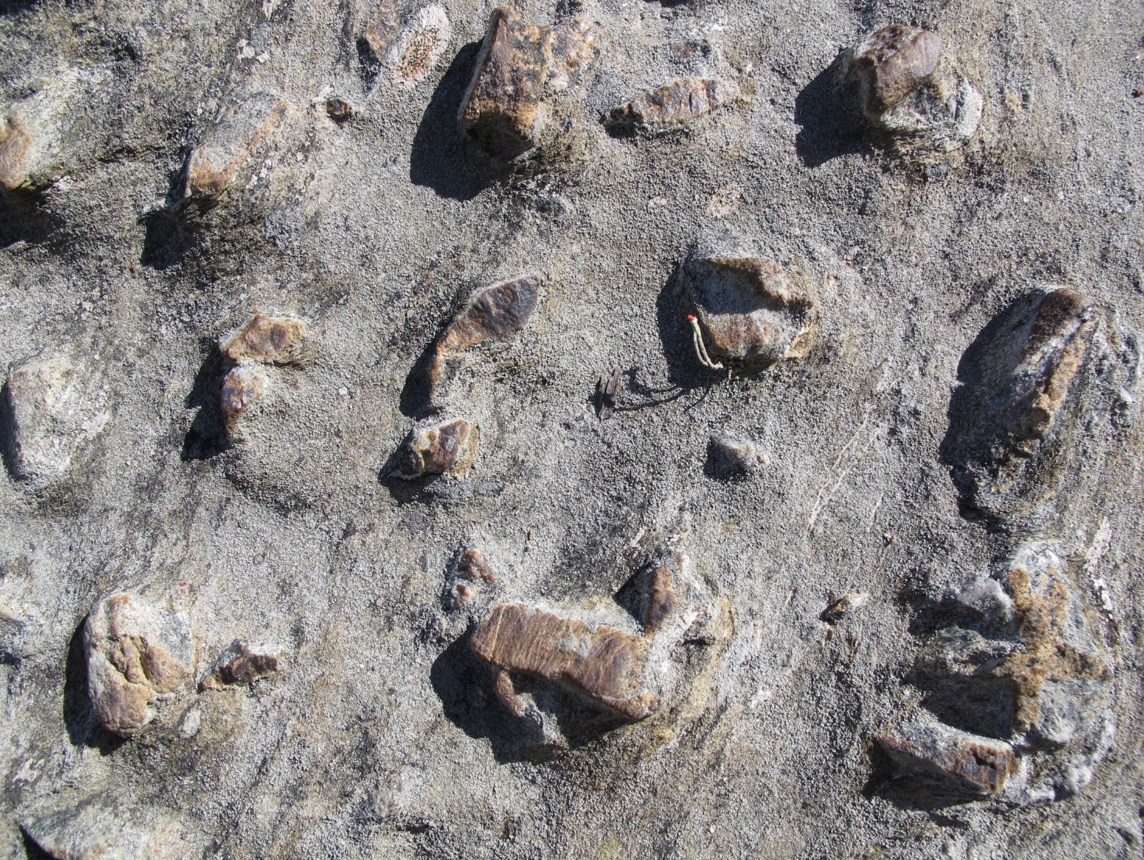
staurolite
biotite
garnet
sillimanite
Smith Pond
chlorite
hornblende
Notes:
Here is part of the North Grantham 7 ½’ quad that includes Smith Pond. Metamorphic grade decreases structurally downward toward the west from sillimanite through staurolite and garnet to biotite. You may have seen the beautiful staurolites at Exit 15 on I-89, and the 200-meter-wide pseudomorph zone to the west along the bike path.

Slide 13
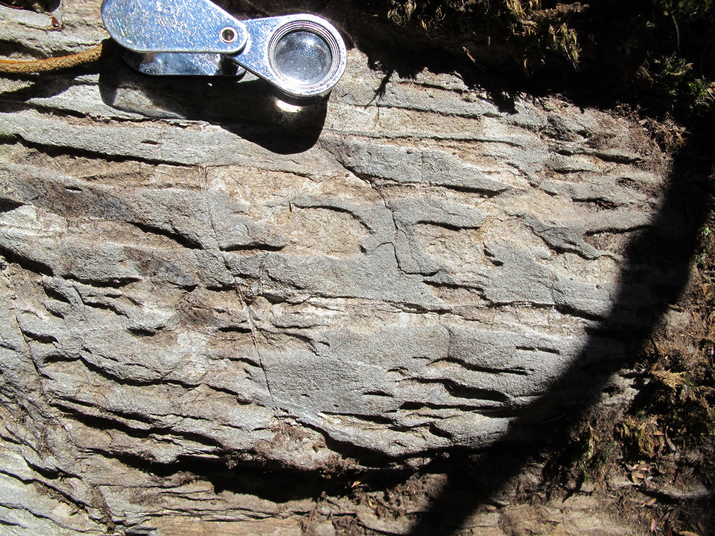
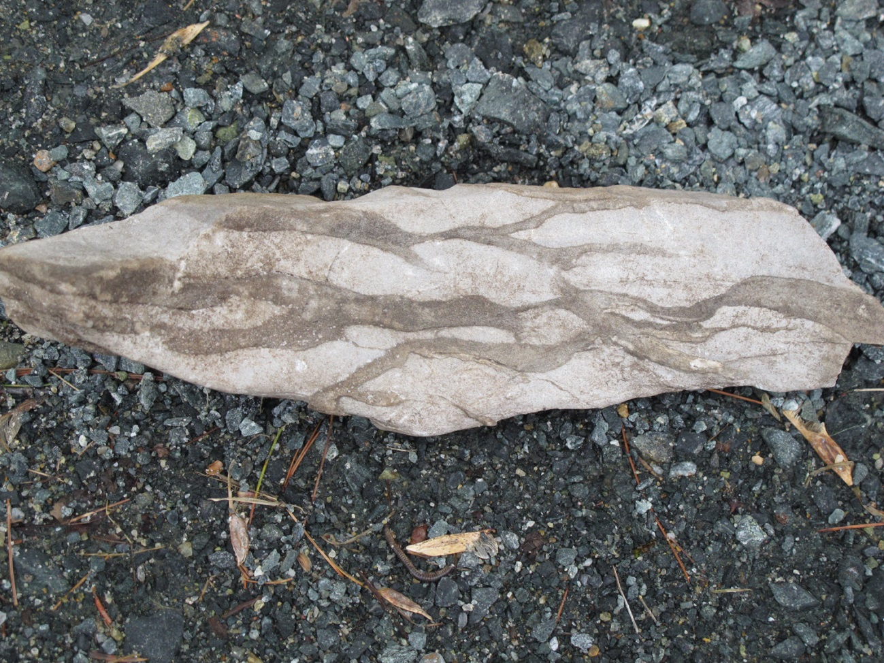
Smith Pond
Notes:
One of the arguments against a D1 syncline of Littleton here north of Smith Pond is that the Fitch Formation crops out almost continuously across the critical area where it would have to connect with the main body of Littleton. The upper Fitch is a distinctive calc-silicate granofels reminiscent of the Warner Fm in the Monadnock sequence. Some outcrops show a curdled texture much like that seen in Champlain Valley carbonates. The lower Fitch is more like the Francesown: rusty schists and quartz-rich granofels.

Slide 14
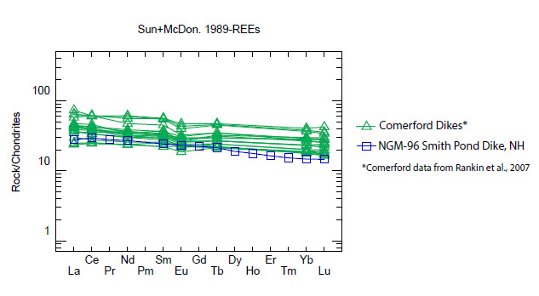
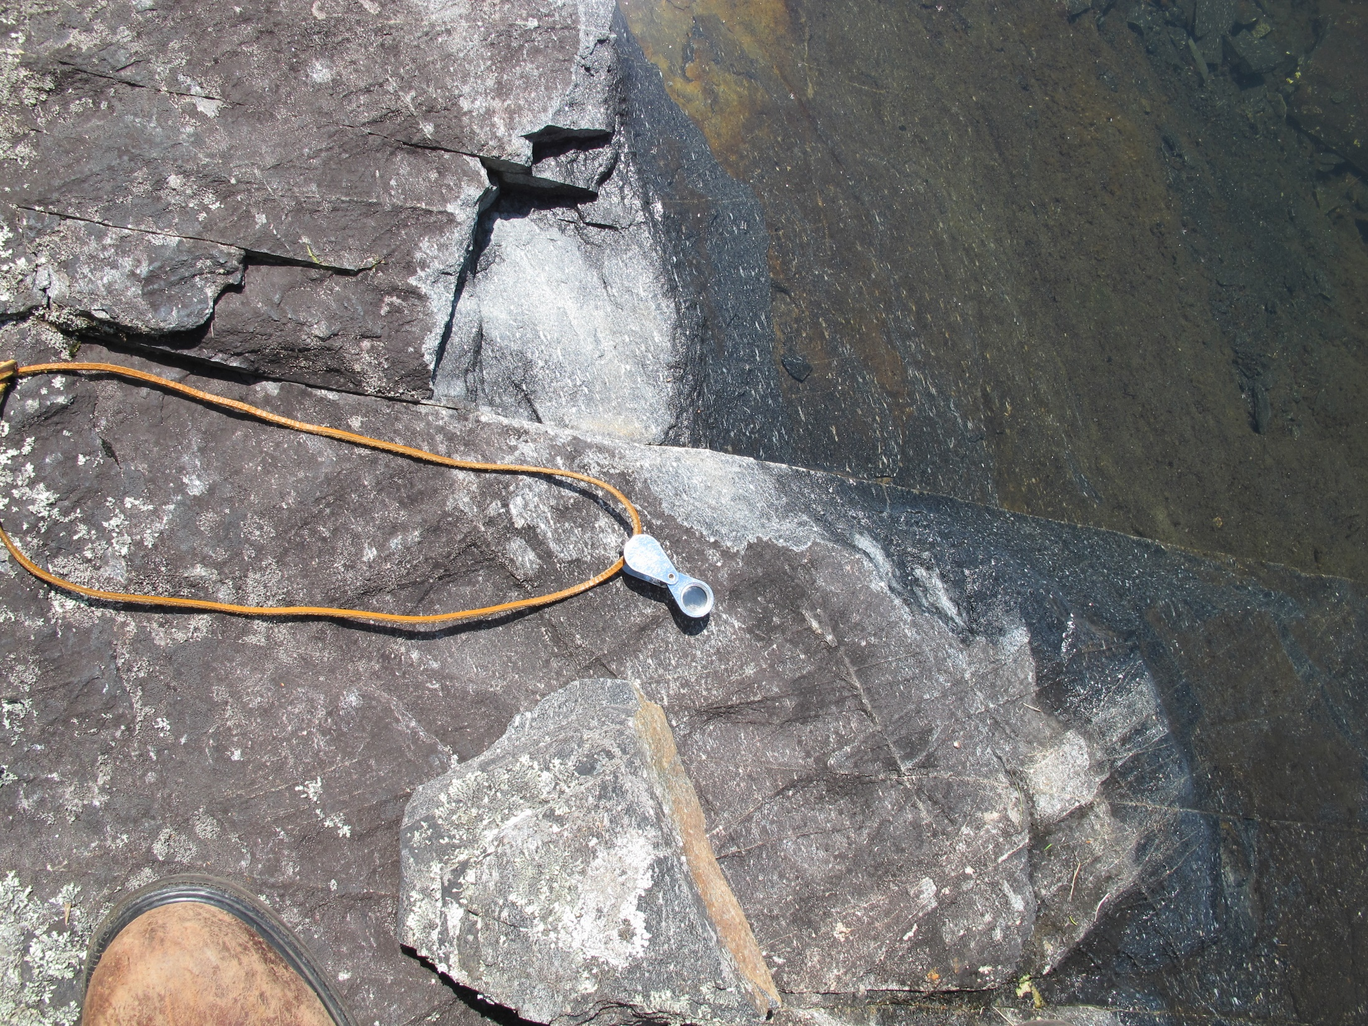
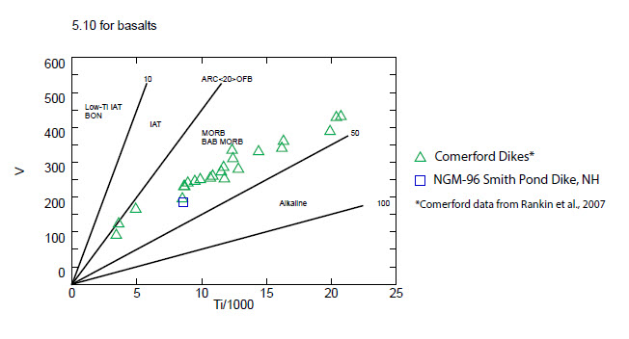
Analyses and plots by
Ed Meyer, Dartmouth College.
Notes:
A second line of evidence is that the Fitch and Clough quartzite. AND the supposed Littleton schists around Smith Pond. are all cut by metadiabase sills and dikes, but the Littleton itself is not. We suspect the dikes are Silurian, similar to the Comerford dikes near Littleton, NH. This preliminary plot of rare earth elements for just one sample shows quite a good match. The V/Ti discrimination diagram shows the metadiabase in the same rift volcanics field as Comerford dikes. Ed Meyer plans more work on these rocks.

Slide 15
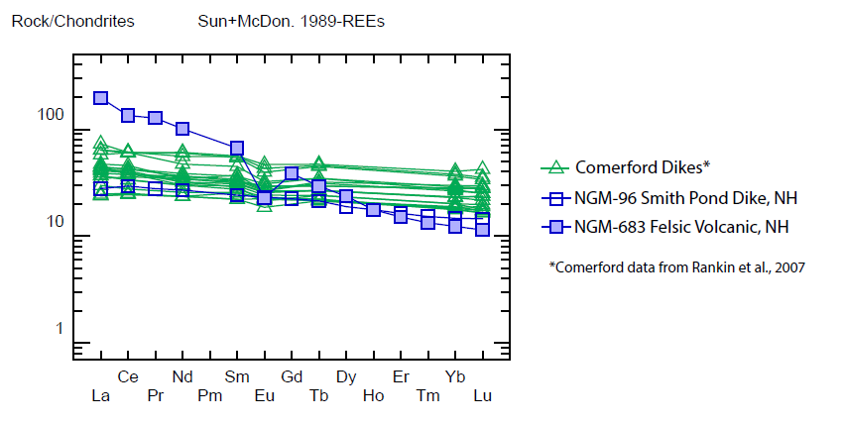
staurolite
biotite
garnet
sillimanite
Smith Pond
chlorite
hornblende
Notes:
For comparison, we sampled felsic metavolcanics from the Littleton at the Montcalm Golf Course, and they show a very different rare earth pattern.

Slide 16
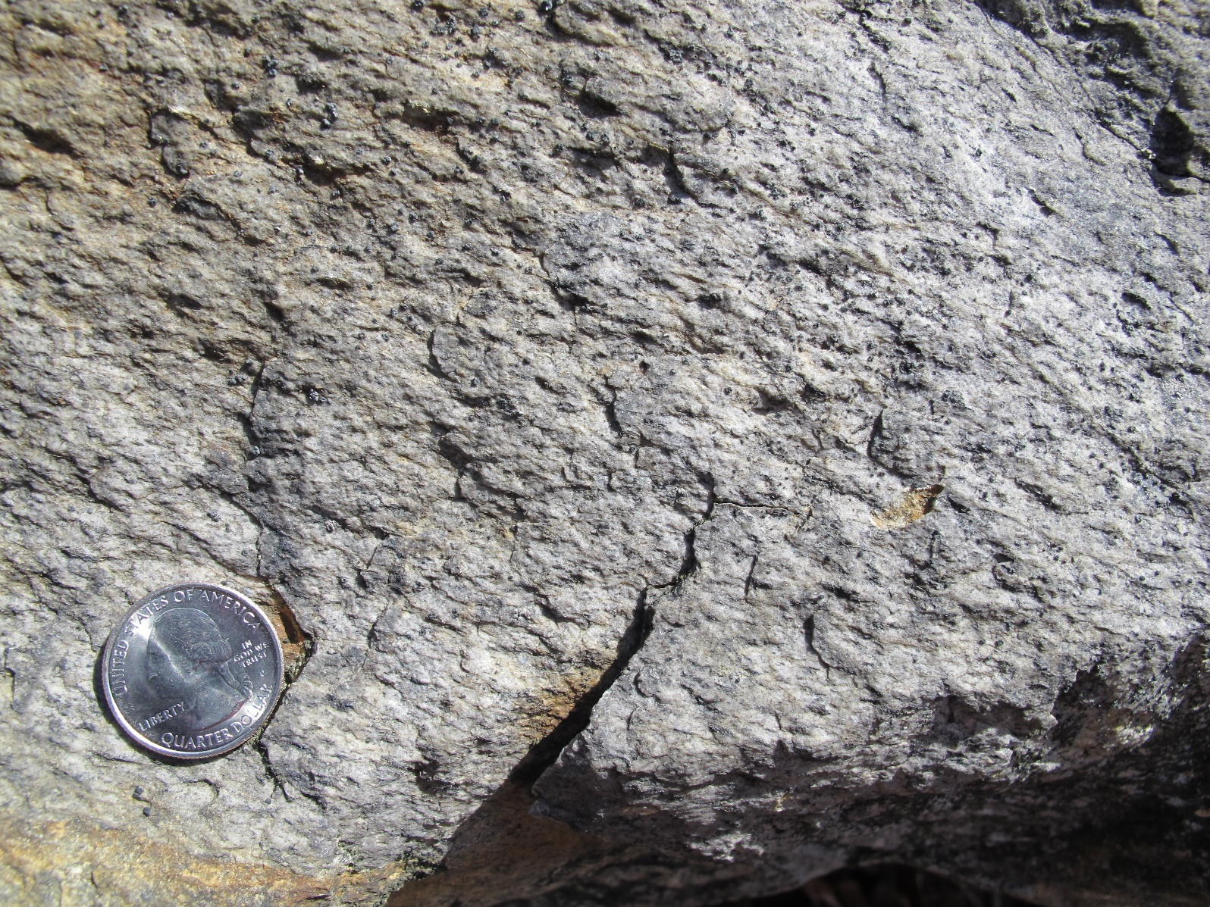
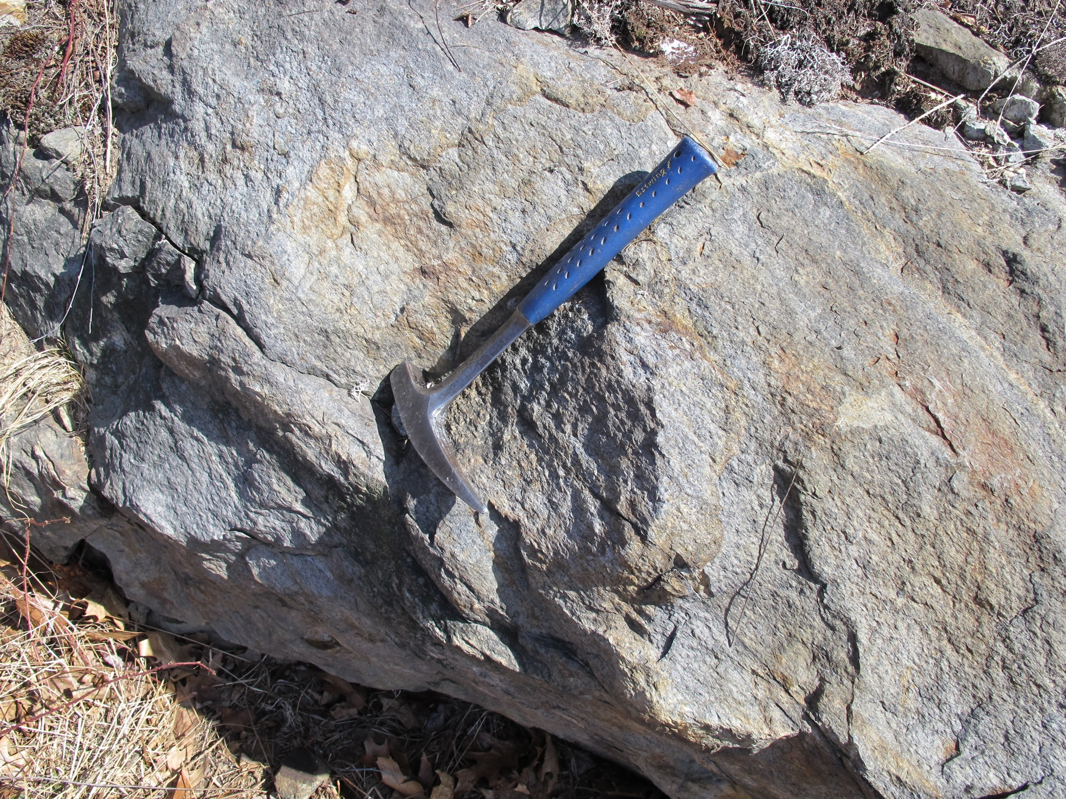
Dlv metarhyolite NGM 683
Notes:
Here is the metarhyolite, which we also sampled for zircon separation.

Slide 17
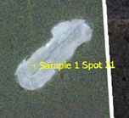
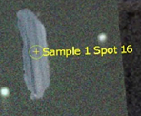

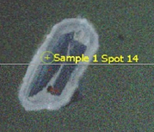
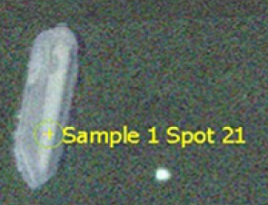
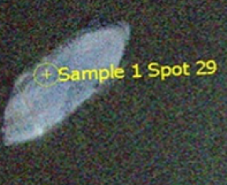
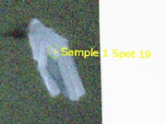
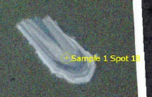
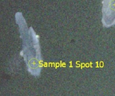
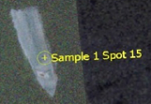
Thanks to Bill McClelland (U of Iowa) and George Gehrels for help with ICPMS analyses at Arizona Laserchron Center.
Notes:
13 of the euhedral, igneous-looking zircons gave U/Pb ratios that plot on Concordia, They yield a weighted mean age of about 404 million years, which is similar to estimates for volcanics in the Littleton elsewhere.

Slide 18
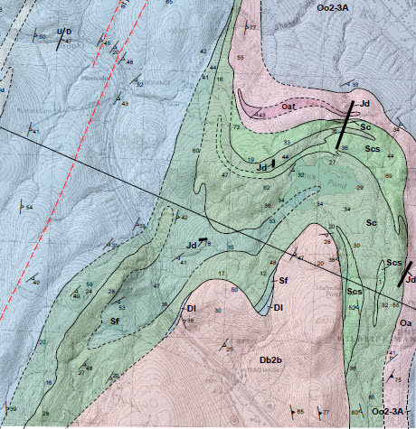
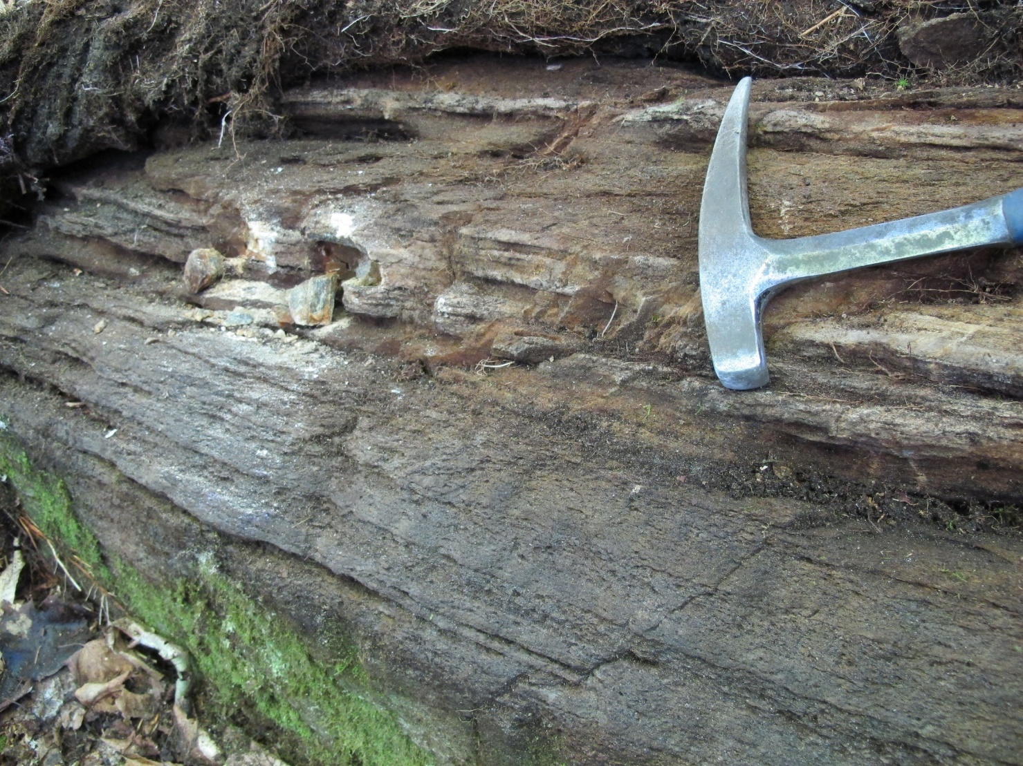
Smith Pond
Notes:
Back to the Smith Pond area.
Bedding is deformed by a large, SE-plunging D2 fold, whose axial trace is shown here. In the north, beds are overturned to the east, they go through the vertical, dip SE, S and then W. Graded beds at several places in the Clough argue against isoclines of Littleton and Partridge around Smith Pond. For example, here, near the contact of Clough and supposedly overlying Partridge, tops are up toward the south.

Slide 19
JBT Smith Pond
Notes:
When we look at the graded bed locations on Jim Thompson’s map, his pattern of isoclines doesn’t hold up.

Slide 20
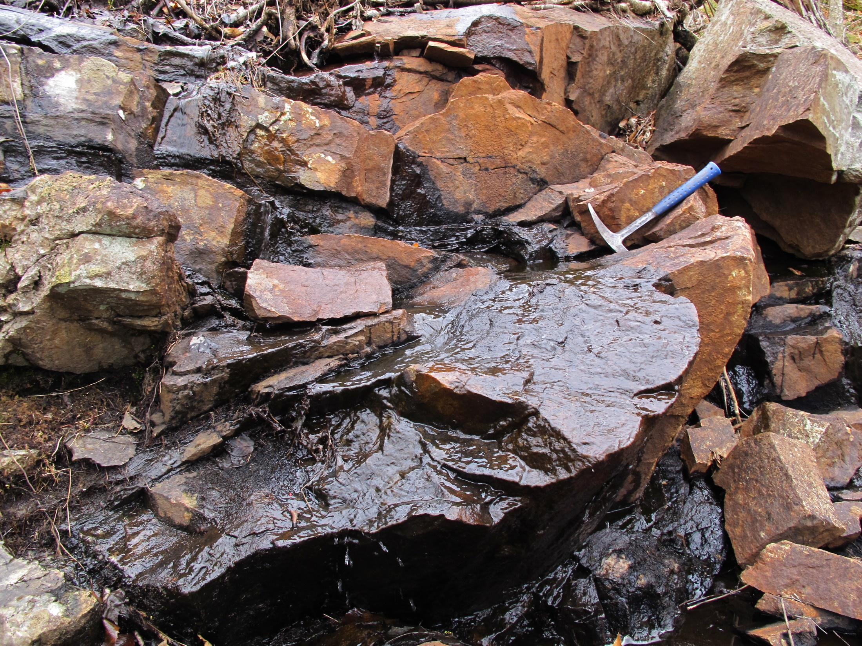
Notes:
Here is an outcrop-scale D1 fold in Clough, south of Smith Pond. The atypical rusty color is due to water coming from a beaver dam upstream.

Slide 21
Place holder for Thompson 1988
Notes:
That last photo was taken about here. Although I disagree with Jim Thompson’s interpretation in the area, he was correct in recognizing a pattern of refolded folds. There IS a refolded D1 syncline, cored by rocks that I’ve interpreted as Fitch, including the rocks that he called Partridge on the I-89 bike path in Enfield. Justin and I sampled a quartz-rich layer for detrital zircons, but the analysis is not yet complete. Stay tuned.

Slide 22
Notes:
A D1 anticline cored by Clough lies between the D1 syncline and the overlying Bethlehem Gneiss. What’s this look like in cross section?

Slide 23
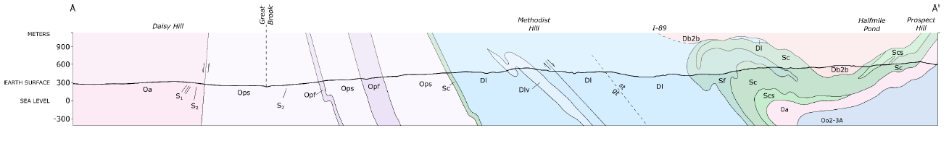
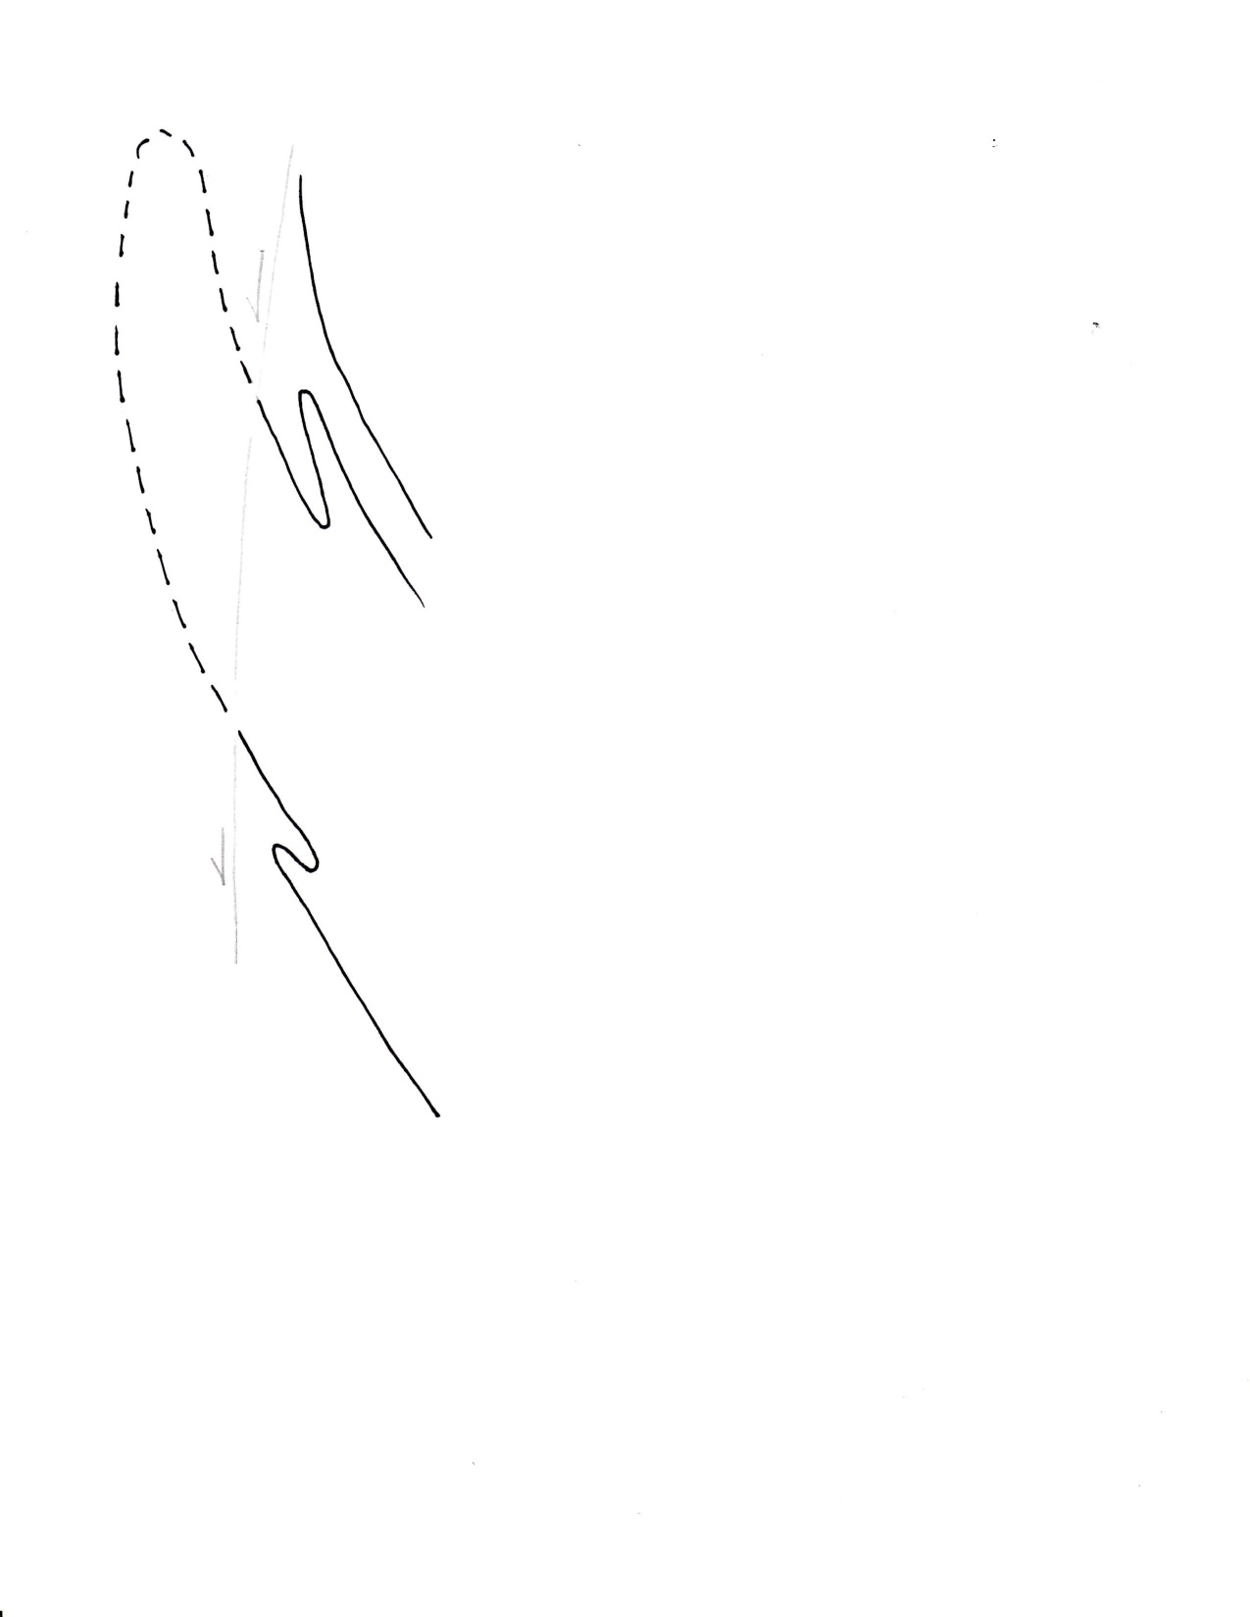
Cross section
NW
SE
CORNISH NAPPE
GARNET HILL SYNCLINE
BRONSON HILL
DOME
Bethlehem gneiss and Fall Mountain nappe
overturned limb of the Cornish nappe
Garnet Hill syncline
Garnet Hill syncline
autochthonous dome
Notes:
This over-turning is a local phenomenon; farther north the rocks all dip west. Here we have the inclined D2 anticline deforming the isoclines south of Smith Pond, with Bethlehem Gneiss above. When we undo the D2 anticline, we see that the isocline pair suggests minor folds on the limb of a bigger syncline opening downwards.
Now we can retrodeform the dome-stage overturning, and add labels. The Garnet Hill syncline opens toward the west.

Slide 24
CORNISH NAPPE
CORNISH NAPPE
Garnet Hill Syncline
Garnet Hill Syncline
Meriden anticline
BRONSON HILL ANTICLINORIUM
BRONSON HILL
Notes:
If the Garnet Hill syncline opens westward, that suggests that the Cornish nappe must be rooted EAST of the BHA.

Slide 25
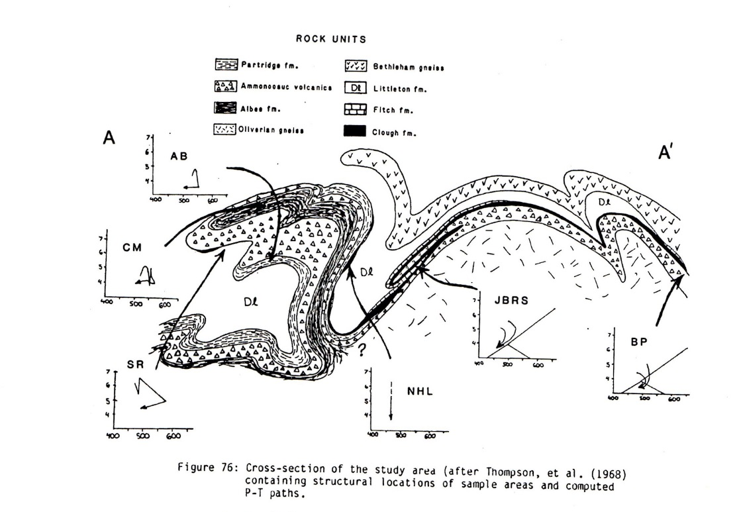
Cornish nappe
GHS
Dg
From Orange, 1985
Notes:
Rather than being rooted somehow west of the Garnet Hill syncline. The link between Littleton and Gile Mountain Formations takes place beneath the Cornish nappe.

Slide 26

Notes:
Let’s look now to the north. The Littleton Formation we’ve just been talking about is continuous on the state map, although intruded by Bethlehem Gneiss, all the way to Garnet Hill near Littleton.

Slide 27
Albee Hill
Piermont allochthon
Notes:
Moench reinterpreted Billings’ Albee Formation as allochthonous Central Maine rocks. Although the Piermont allochthon DOES exist farther south at Piermont, in the Littleton area most geologists prefer the original Albee assignment.

Slide 28
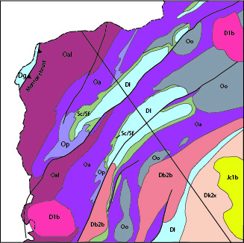
B
GHS
Notes:
So here we are with Billings’ classic stratigraphic sequence: Albee, Ammonoosuc, Clough, Fitch, Littleton. The Walker Mountain syncline is indeed a syncline. However, the Garnet Hill syncline and its continuation on the downthrown side of the Northey Hill fault is actually an antiform, plunging NE and SW under the older rocks. I propose that it is a D2 fold that deforms a D1 syncline closing downward. Lets look at this in cross section.

Slide 29
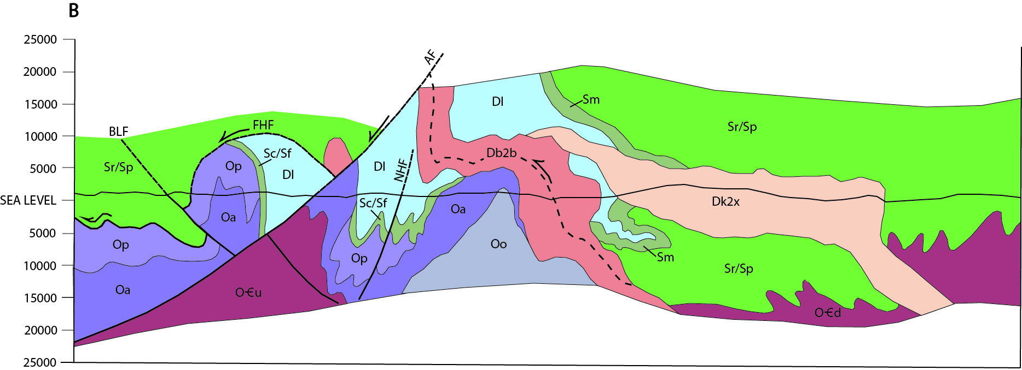
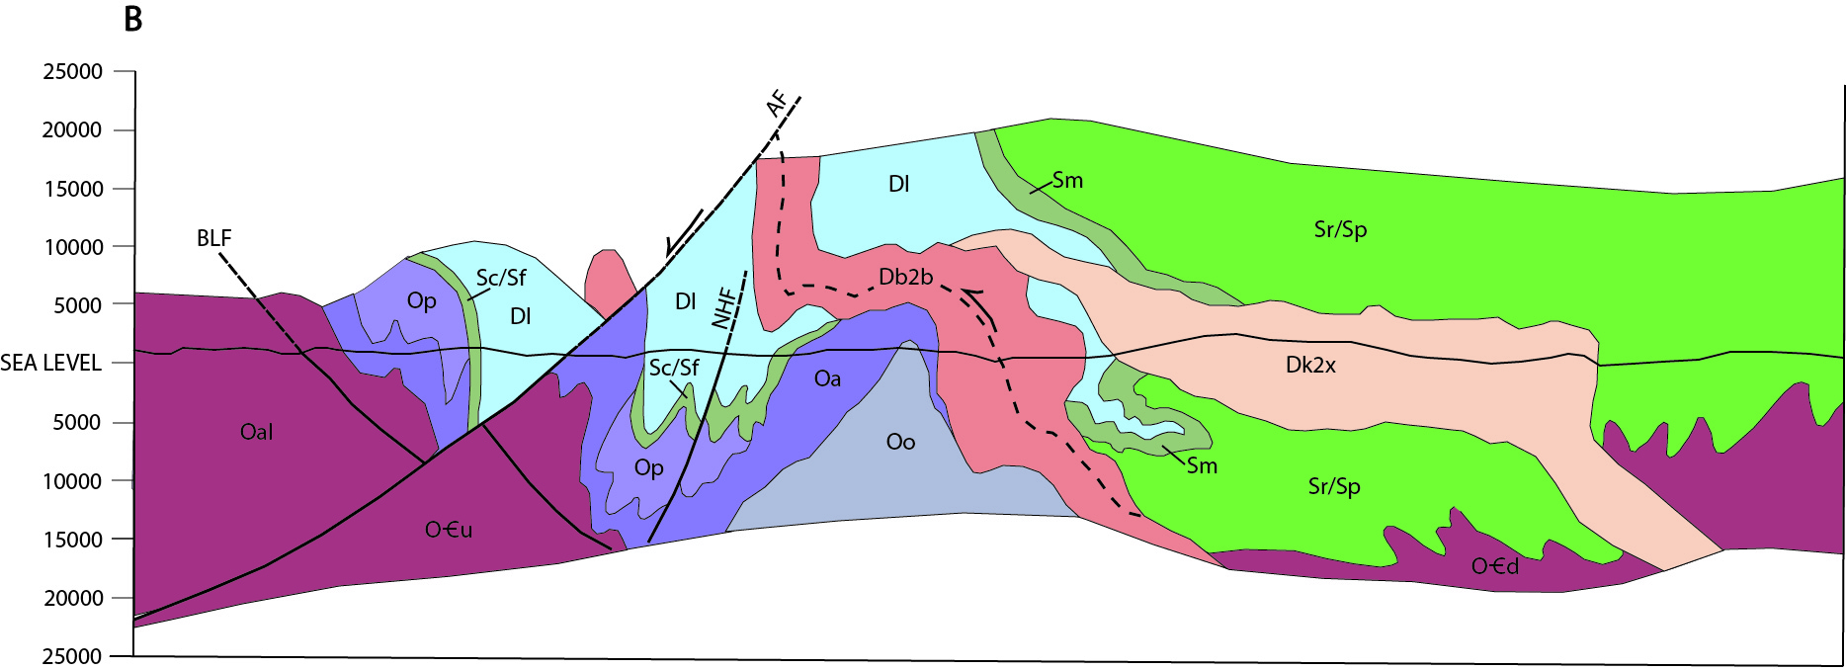
Notes:
Here is the cross section through the area from the ‘97 state map. First lets get rid of the Piermont allochthon, and restore Billings’ interpretation.

Slide 30
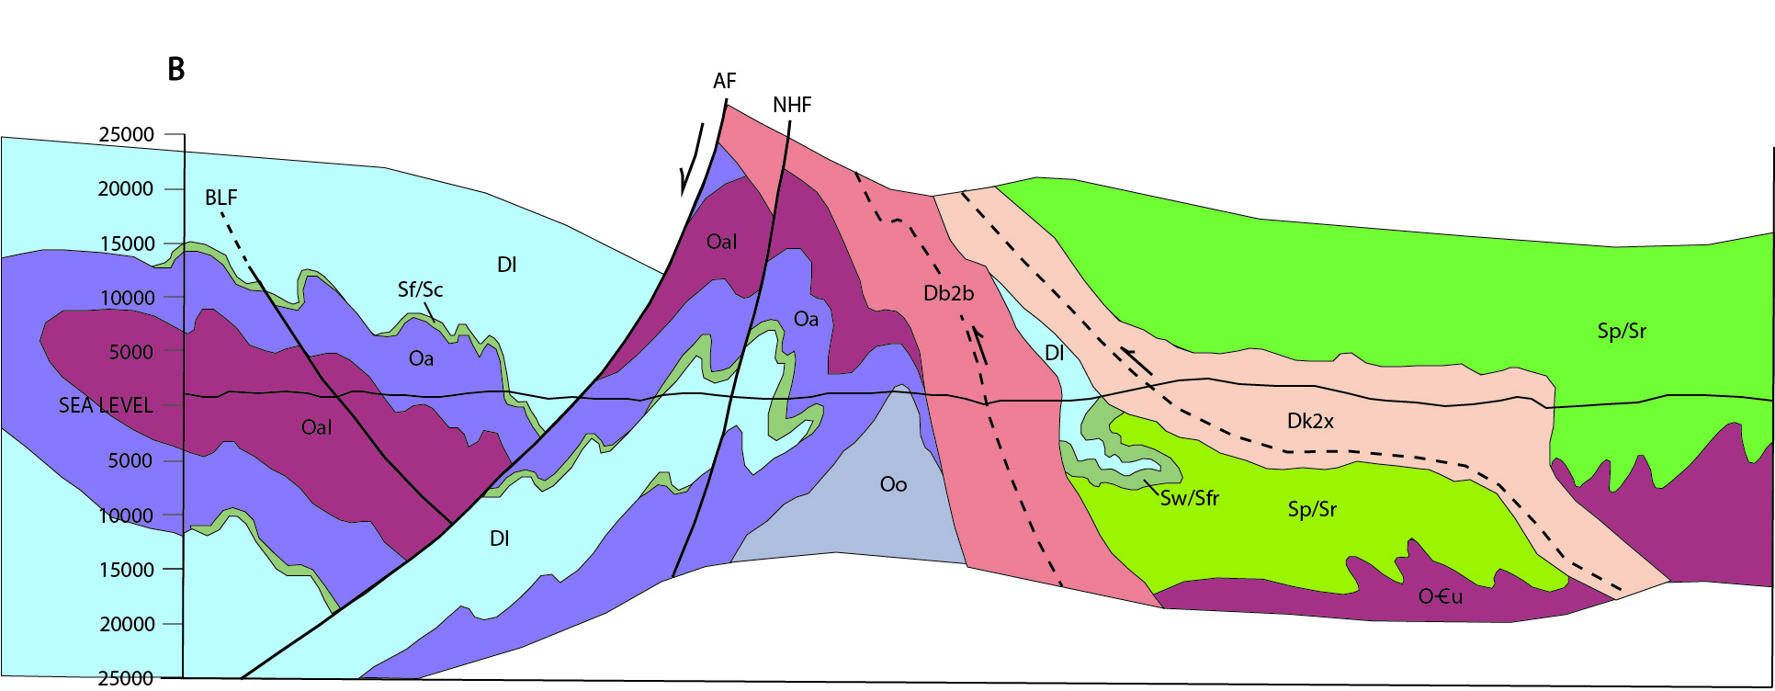
Walker Mtn syncline
Garnet Hill syncline
Garnet Hill
antiform
Walker Mtn syncline
Notes:
Notice that both the Walker Mtn and Garnet Hill structures are shown as synclines. But what if Garnet Hill is really an antiform?

Slide 31
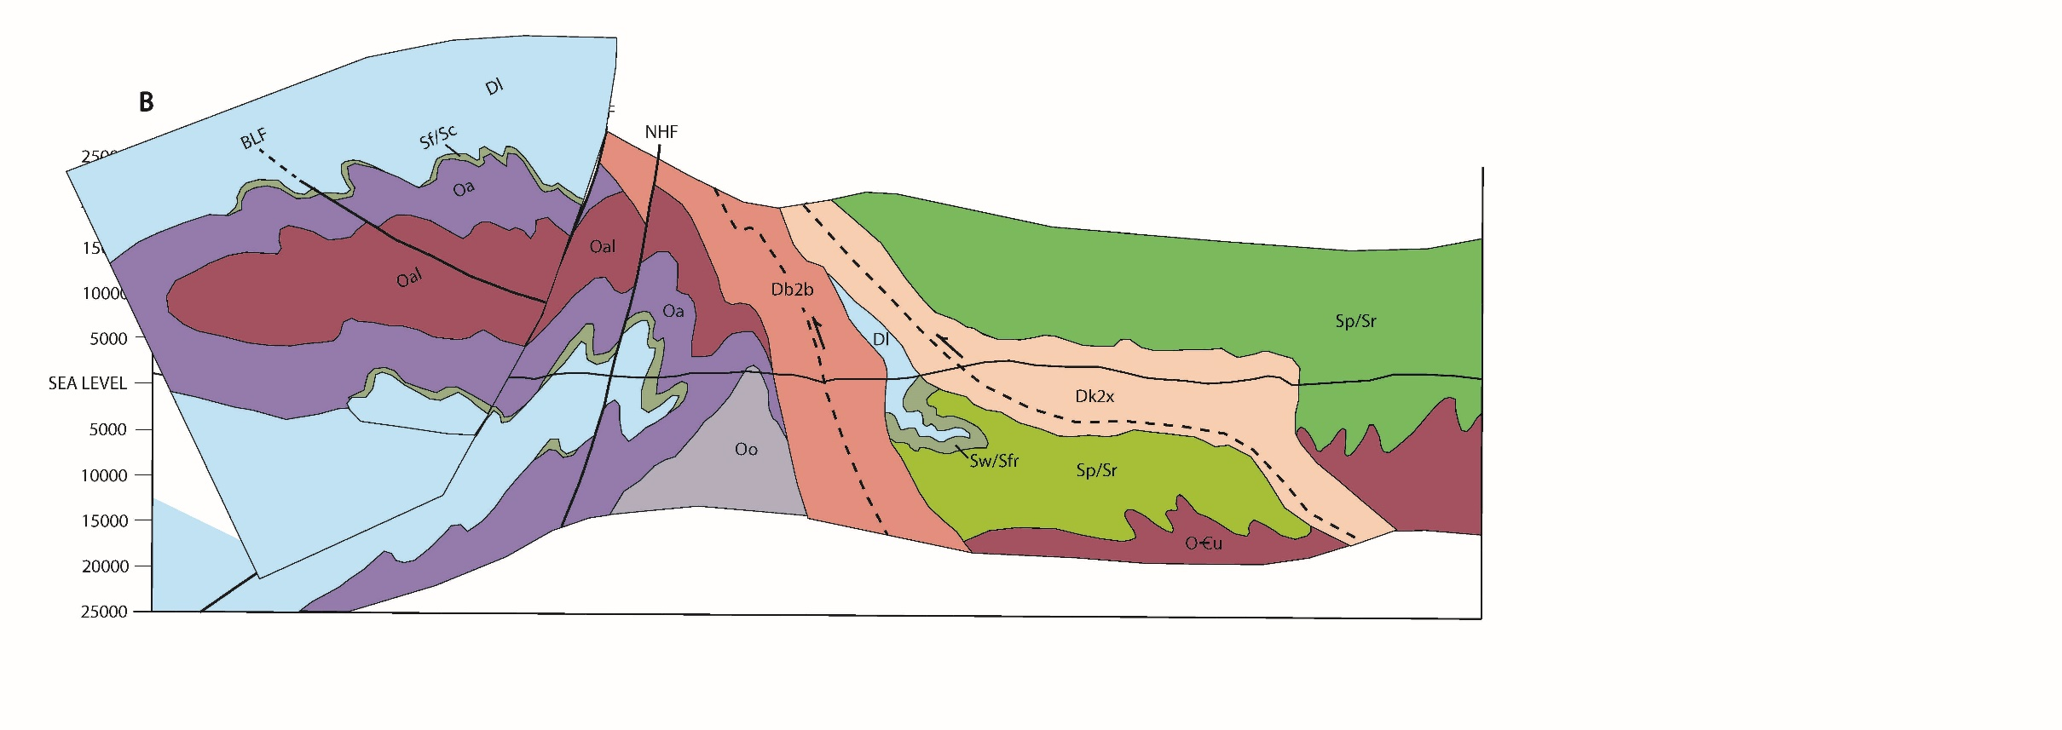
Garnet Hill
antiform
Walker Mtn syncline
Cornish nappe
Garnet Hill syncline
Notes:
Restoring motion on the Ammonoosuc fault completes the picture. That allows for a westward-opening D1 syncline with the Cornish nappe above it.

Slide 32
Fall Mtn nappe
Cornish nappe
Chesham Pond thrust
Garnet Hill syncline
Brennan Hill thrust
Notes:
The Cornish nappe is rooted east of the anticlinorium, under the overriding Fall Mtn nappe.

Slide 33
Notes:
We’ve just been looking at this area near Littleton. Now we’ll go south to the Skitchewaug area.

Slide 34
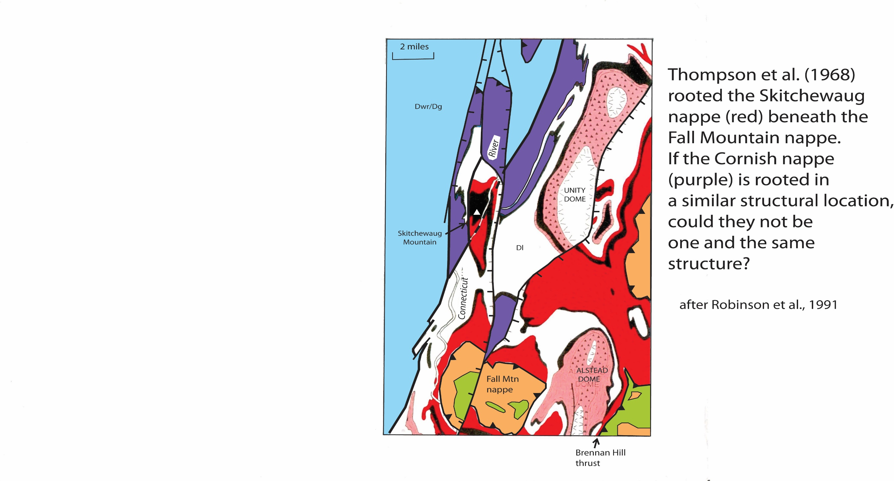
Notes:
This is where Jim Thompson first proposed the Skitchewaug nappe, showing that the Bronson Hill sequence rocks at Skitchewaug Mountain could be part of a nappe rooted here to the east of the Oliverian domes. Note that the overturned limb lies directly below the Fall Mountain nappe, in a similar position to what I’m proposing for the Cornish nappe near Littleton. Perhaps they are one and the same structure.

Slide 35
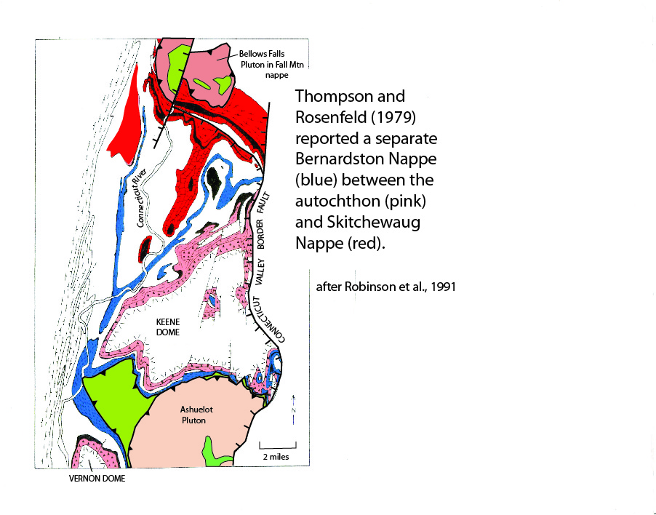
Notes:
To the south of Fall Mountain, Thompson and Rosenfeld proposed the Bernardston nappe (blue) between the authochthonous rocks (in pink) and the Skitchewaug nappe (in red).
Its map pattern is a strange elongated body of supposed Partridge Formation with Littleton on either side. Since Littleton and Partridge are hard to tell apart, the argument hinges on metavolcanic horizons. I’ve often wondered if the volcanics interpreted as Partridge might actually belong to the Littleton. We sampled a felsic volcanic at Watkins Hill for dating.

Slide 36
Thanks to Bill McClelland (U of Iowa) and George Gehrels for help with ICPMS analyses at Arizona Laserchron Center.
Notes:
Our initial results suggest an Ordovician age. So far only 5 zircons from the Watkins Hill sample have been analyzed. Three of the grains yield a weighted mean age of around 448 Ma. The other two grains yielded older and younger ages, which are currently interpreted as reflecting inheritance and younger metamorphic rims. More grains from this sample are being selected as we speak, and further work may be done on individual grains to refine our understanding. So again, stay tuned: we are just beginning to unscramble the eggs.

Slide 37
The main implication for stratigraphy if Skitchewaug = Cornish is that the depositional setting for
the type localities of the Bronson Hill sequence, which lie within the Cornish nappe,
would be EAST of the anticlinorium.
West East
Vermont sequence Bronson Hill autochthon Skornish nappe Monadnock sequence Central Maine sequence
Dg Gile Mountain Dl upper Littleton upper Littleton upper Littleton upper Littleton
Dwr Waits River Dl lower Littleton lower Littleton lower Littleton lower Littleton
Sf Fitch upper Fitch Warner Madrid
lower Fitch Francestown Smalls Falls
Ss Shaw Mtn Sc Clough Clough upper Rangeley Rangeley C
middle Rangeley Rangeley B
lower Rangeley Rangeley A
Ordovician rocks Op Partridge Partridge
Oa Ammonoosuc Ammonoosuc
Cambrian-Ordovician Albee
Notes:
Read caption

