Slide 1
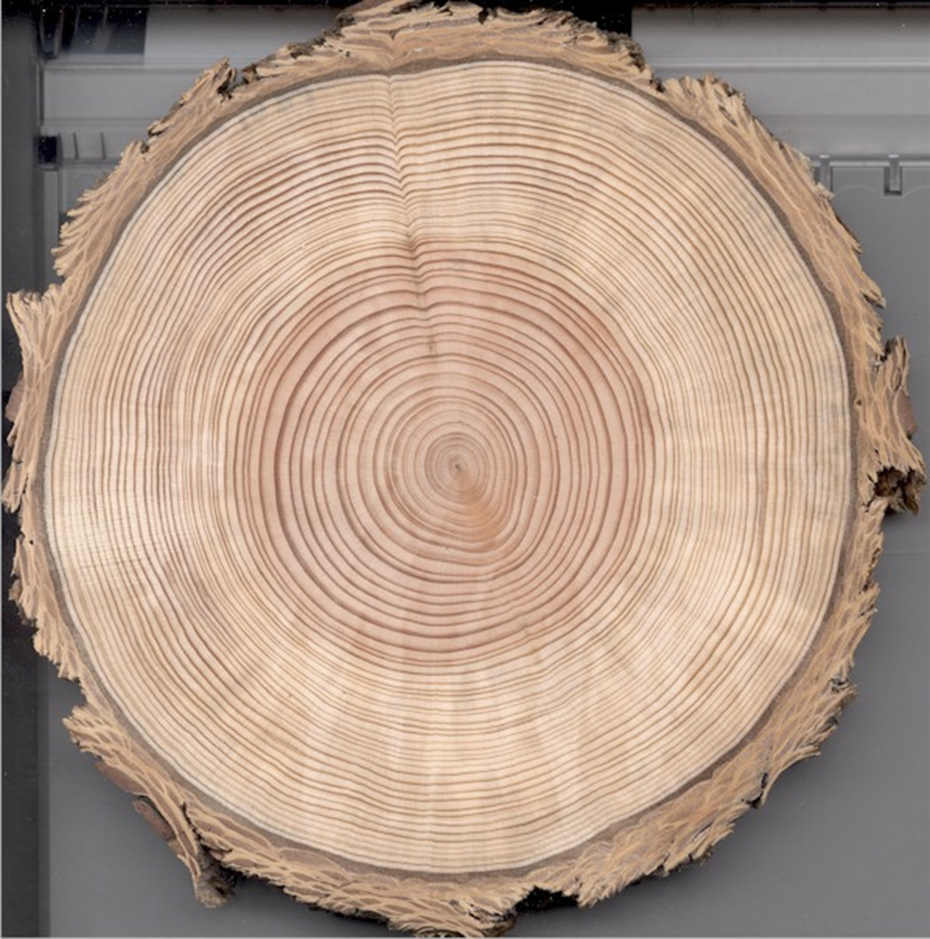



Dendroecologically Understanding Chamaecyparis thyoides Resiliency to Salinity Intrusion
By: Olivia Gulledge

Slide 2
Introduction
1.7 mm/year average global sea level rise
3.35 mm/year average Delaware sea level rise
Subsidence
Sea level rise
By 2100, 8 to 11% of DE land will be submerged
Delaware freshwater wetlands include 11,000 acres
84 to 98% predicted to be inundated by 2100
Notes:
Delaware’s Chesapeake Interagency Workgroup. DNREC. 2012. Delaware’s Phase II Chesapeake Bay Watershed Implementation Plan.
Page 15 (section 1.1.1)

Slide 3
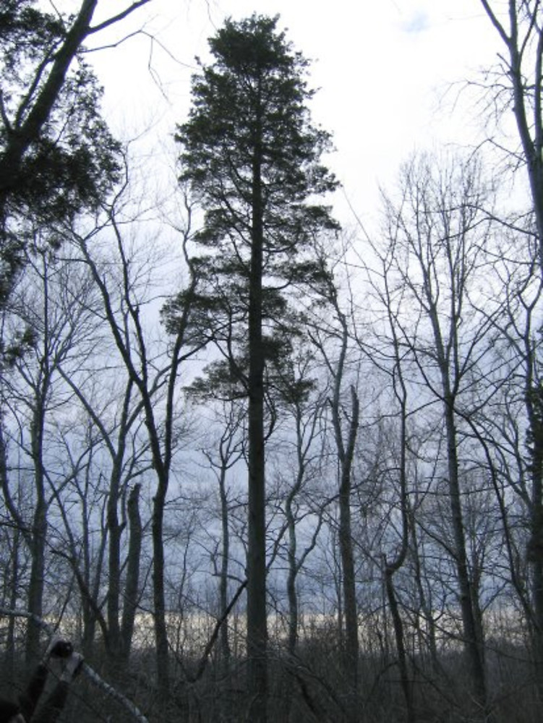
Importance
Why are wetlands important?
Habitat
Natural disasters
Why are Atlantic white cedars important?
Wood features
Outdoor furniture
Shingles
Notes:
specifically talking about freshwater tidal wetlands
Very rare community in DE
AWC are rare in DE used to be everywhere
History stuff,
Evidence that they were logged 100 years ago
Freshwater wetlands aide in water purification, streamflow stability, and flooding events
In the case of Hurricane Sandy, Coastal wetlands are estimated to have saved $625 million in flood damages.

Slide 4
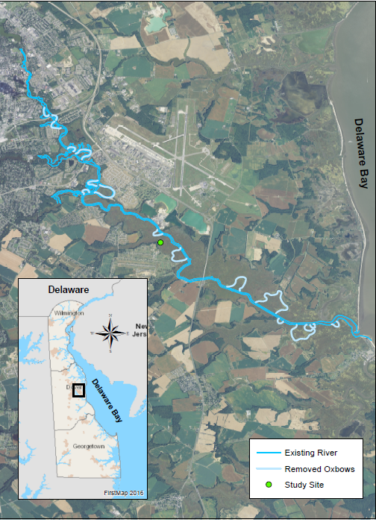



Study Site and History
St. Jones River, near Dover Delaware
Dredged/Straightened 1930s
Natural Simulation
Notes:
The st jones went through a series of dredging and straightening projects for ship trafficking mainly from philly to dover ending in 1933. this map shows the straightening activities
This caused a natural simulation of sea level rise giving us the perfect opportunity to study how rising sea levels affect coastal communities

Slide 5
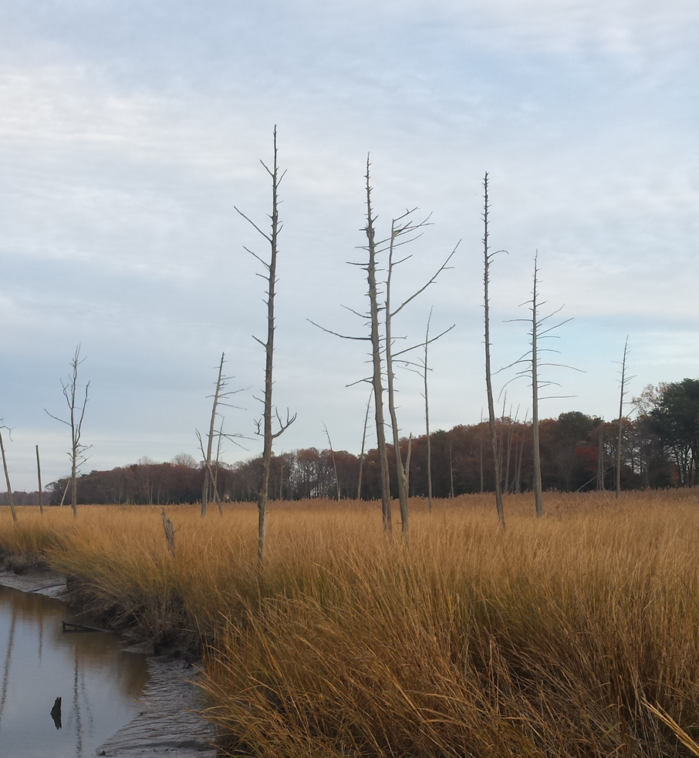
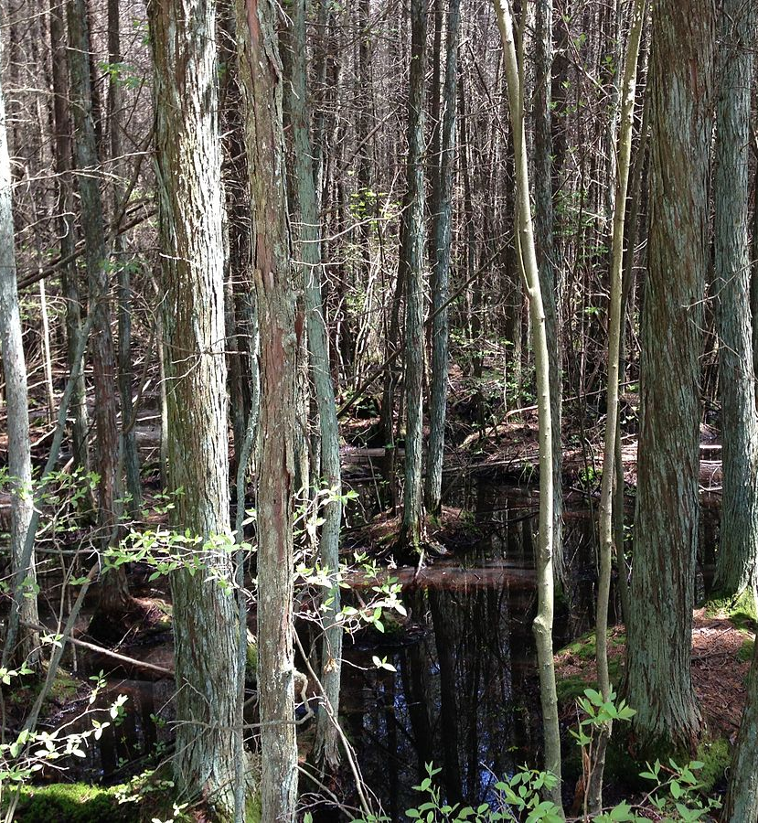
https://upload.wikimedia.org/wikipedia/commons/8/8e/2013-05-10_13_55_05_Atlantic_White_Cedar_swamp_along_the_Mount_Misery_Trail_in_Brendan_T._Byrne_State_Forest.JPG
Notes:
Left: a healthy atlantic white cedar swamp from a state park in NJ.
Right: aerial view near our study site, if you look closely you can only make out about 15 standing dead trees.

Slide 6
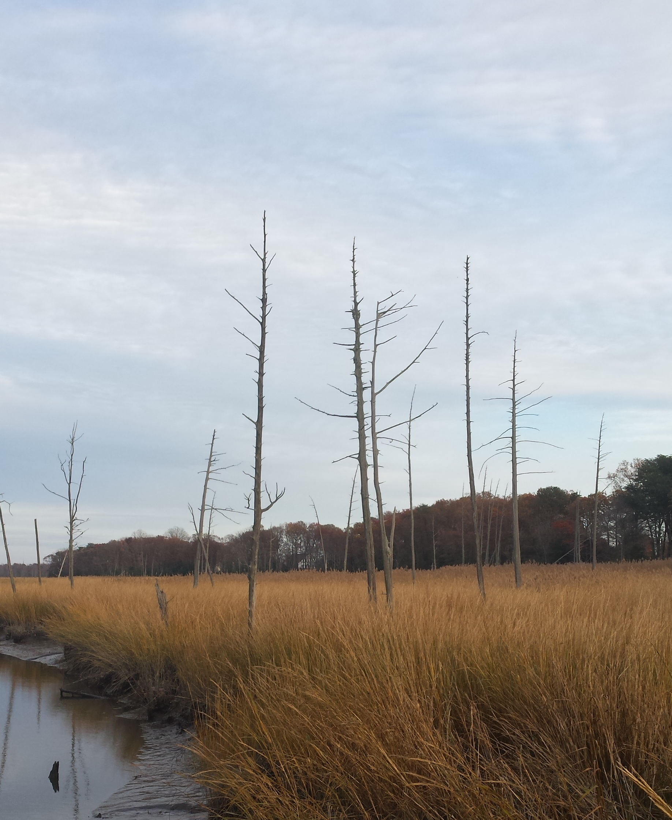
Field Methods
Collected cross sections from 10 snags
Dried cross sections
Immobilized cross sections
Planed and sanded cross sections

Slide 7
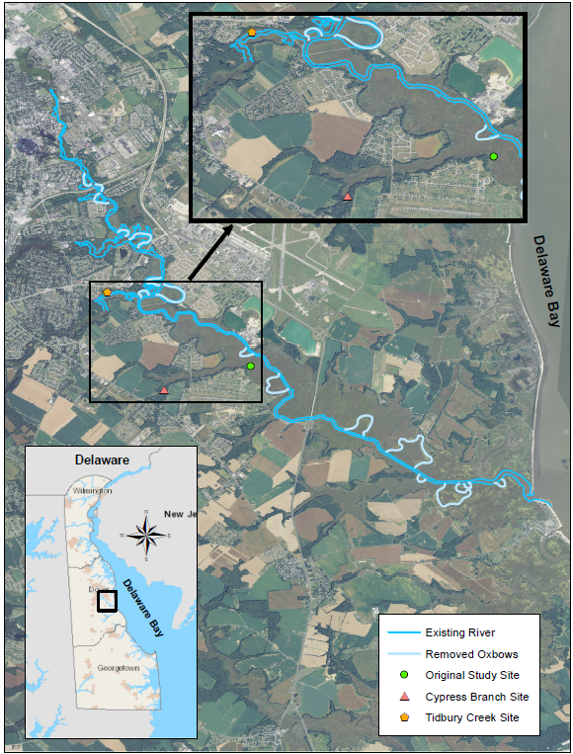
Field Methods Part 2
Collected cores from 13 alive Atlantic white cedars along the St. Jones River
Dried cores
Mounted cores
Sanded down cores
Notes:
Further upstream in the same tributaty
DE state botanist (Bill McAvoy) went out, found all the alive AWC were located

Slide 8
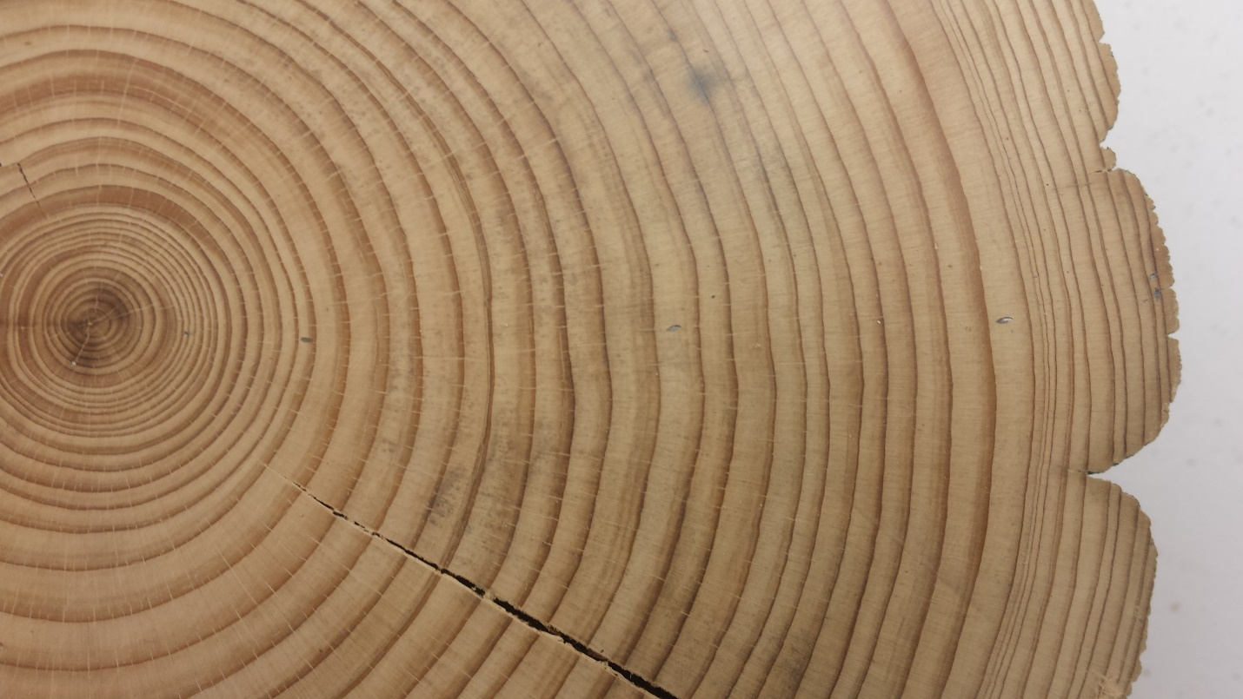
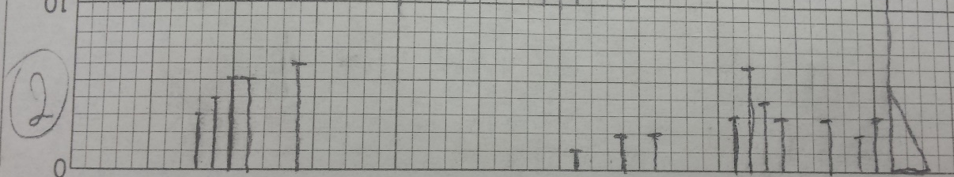
Lab Methods
Skeleton plots
Linear encoder
COFECHA
ARSTAN
Notes:
Linear encoder= accurate to .01mm

Slide 9
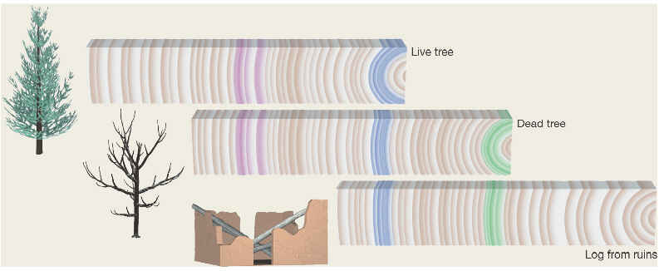
Chronology
http://www.geo.hunter.cuny.edu/tbw/ncc/Notes/chap4.wc/14.climate.change/tree_ring_analysis.htm

Slide 10
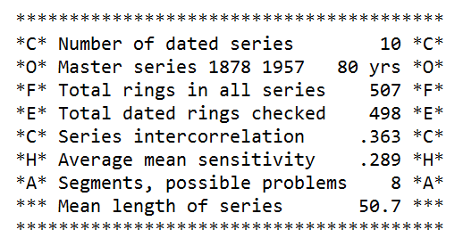
COFECHA Results
Notes:
Talk about how I measured over 500 rings
How old the trees were (and how that is short)
Know what mean sensitivity means and if that’s a good number

Slide 11
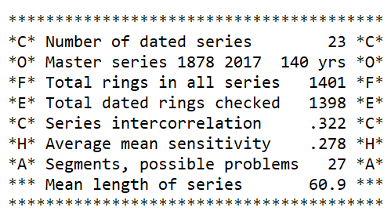
COFECHA Results

Slide 12
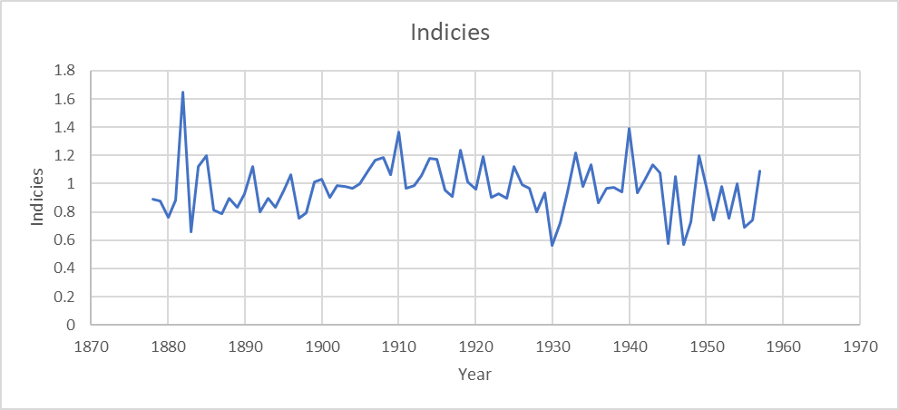
ARSTAN Results
Large descending spike in residuals after detrending.
First tree death.
Notes:
7 of my 10 trees died within 15 years of the first descending spike

Slide 13
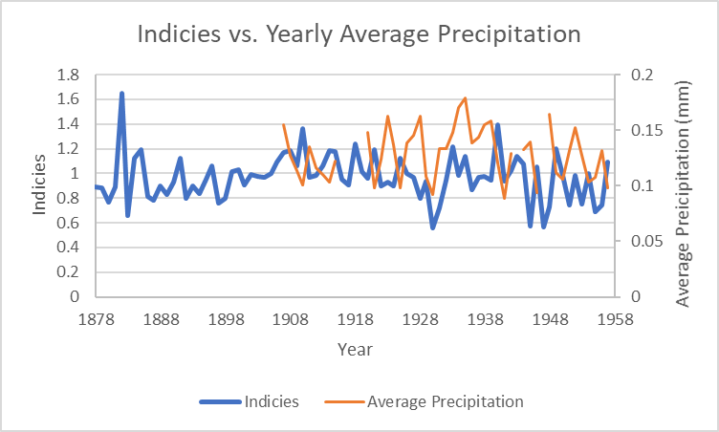
Indices vs. Precipitation
Notes:
No significant correlation
Confident these changes we are seeing in the ring widths are not due to precip

Slide 14
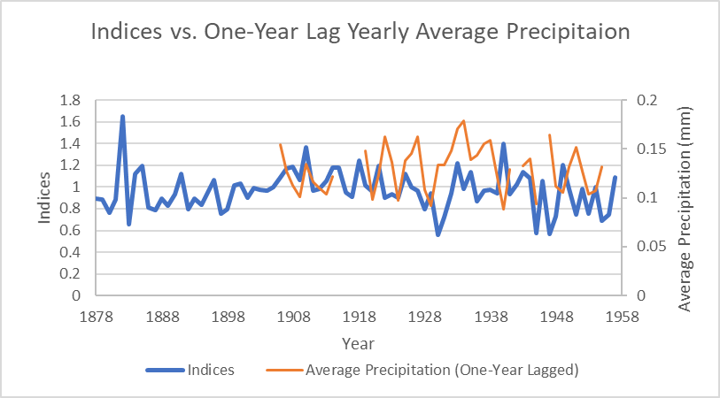
One Year Lag and Precipitation
Notes:
R2=.0023

Slide 15
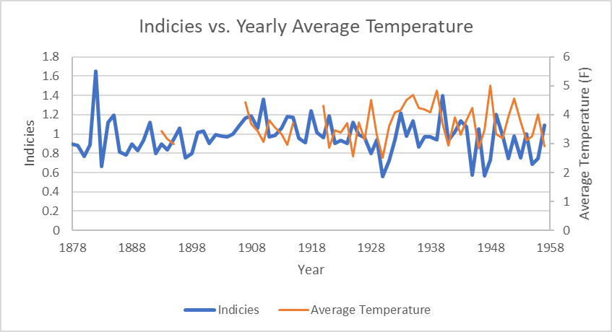
Indices vs. Temperature
Notes:
No significant correlation
Confident these changes we are seeing in the ring widths are not due to temps

Slide 16
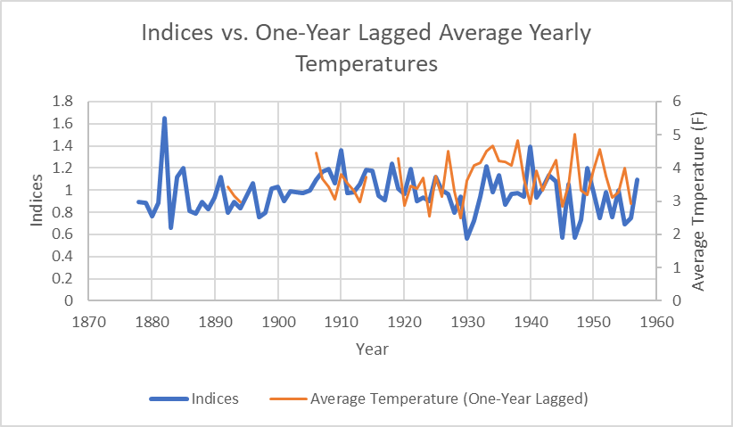
One Year Lag and Temperature
Notes:
R2=.0013

Slide 17
Conclusions
Tree ring widths decreased dramatically
Trees died very young
Notes:
Died far too early than they should

Slide 18
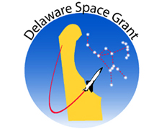


Acknowledgements
Dr. Stephanie Stotts, Kassie Rodriguez, Michael Skivers, William McAvoy, Michael Mensinger, Henri Grissino-Mayer, Timothy Block, Dr. William Kroen, Kathlene Curran, Del-Homes, Wesley College
Financial support was provided through the NASA DESGC (Delaware Space Grant Consortium) program funded by the National Aeronautics and Space Administration under grant number NNX15AI19H.
Financial support was provided through the Delaware EPSCoR (Experimental Project to Stimulate Competitive Research) program funded by the National Science Foundation and the State of Delaware DEDO (Delaware Economic Development Office) program under grant number IIA EPS-1301765.

