Slide 1
Surficial Geology Map & Recharge Potential
of the
North Bennington Through Old Landfill Region
David J DeSimone, PhD
DeSimone Geoscience Investigations
Petersburg, NY 12138
hawkeye272david@yahoo.com
Vermont Geological Survey open file report VG2017-1
Vermont Agency of Natural Resources Contract #32310
submitted 26 December 2016

Slide 2
Goals
> Complete 1:12,000 surficial geologic mapping of designated area largely within Bennington quad but edging into Hoosick Falls, Pownal and North Pownal quads.
> Interpret the Late Pleistocene through Holocene landscape evolution.
> Analyze ChemFab borings and work with Jon Kim, Emmet Norris & Peter Ryan to construct a fence diagram of that contaminated site.
> Use well logs to construct cross sections in the Old Landfill area & through any other places of interest.
> Generate aquifer recharge potential maps of the ChemFab & Old Landfill areas to aid in understanding downward movement of PFOA through overburden.

Slide 3
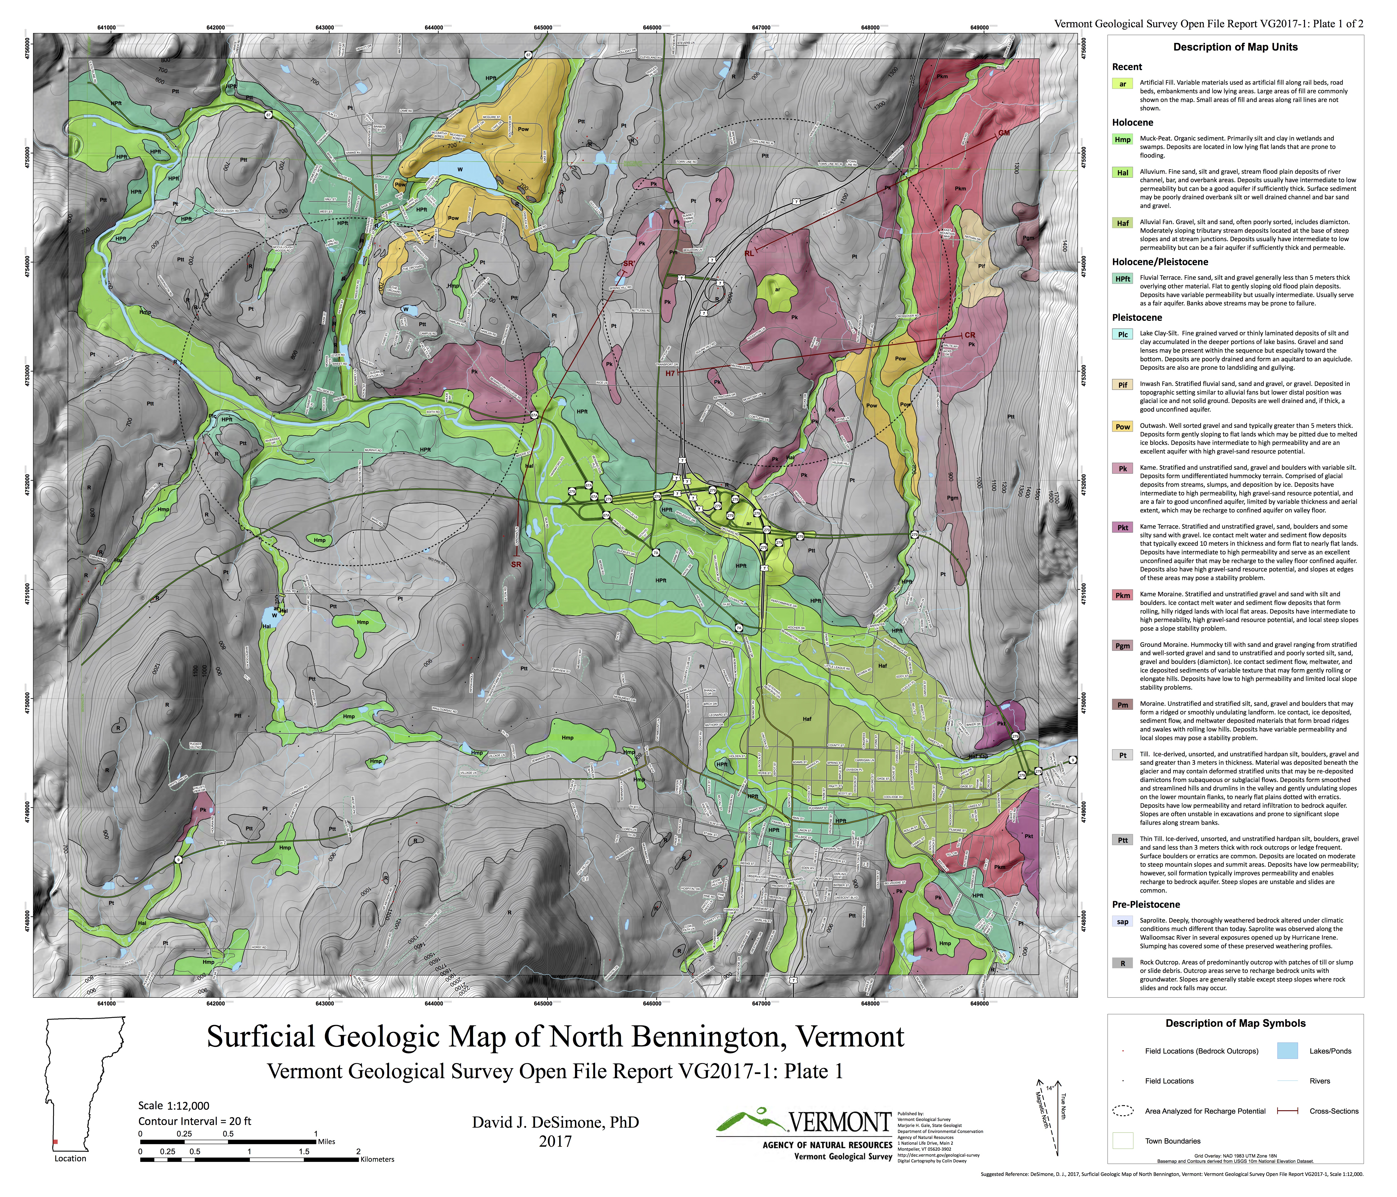
Basic Map Elements
Flood plain = apple green
Alluvial fans = olive green
Fluvial terraces = mint green
Lake clay-silt = blue
Outwash = yellow
Ice contact sediments =
      shades of red-brown-pink
Till = grays
Bedrock = darkest gray
*See the map on poster*

Slide 4
Landscape Elements & Pleistocene History
  > Pre-glacial landscape with probable trellis-rectangular drainage network
  > Walloomsac Valley cuts across lithologies/structures = antecedent
  > Deep pre-glacial Furnace Brook valley at foot of Green Mountains with thick overburden
  > Prominent ice contact sediments in Furnace Brook valley
  > Hale Mountain ridge constrained retreating ice northwest of Old Landfill
  > Shaftsbury ice margin records lowering of Lake Bascom & retreat from it left local lakes (Small & DeSimone, 1993; Libbey & Pierson, 1994)

Slide 5
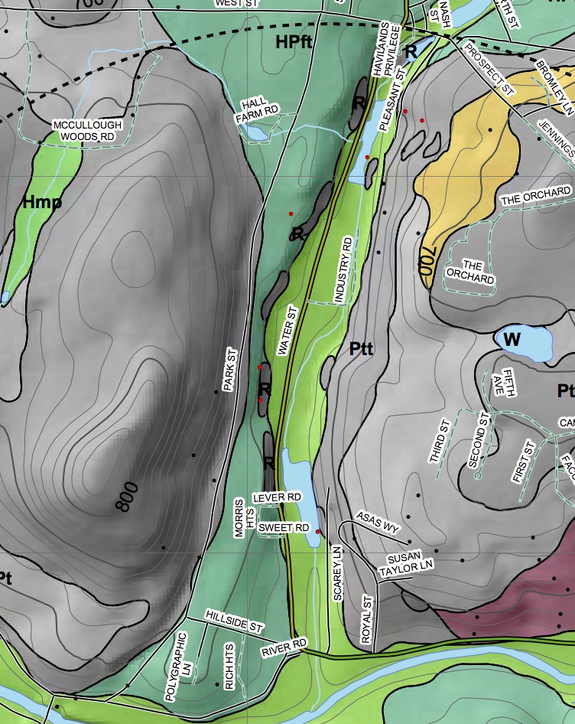
Paran Creek Detail
    > Scoured valley walls, till with outcrop
    > Remnant 700ft outwash
    > Valley floor terraces & flood plain alluvium
    > No residual lake clay-silt
    Landscape Evolution
    > Ice margin to north in Shaftsbury
    > Lake Bascom drops from 900ft to lower levels including 700ft with outwash
    > Drainage of Lake Bascom causes valley floor erosion
    > Minor glacial lakes to the north drain and scour channel. (Lake Flat Top of Libbey & Pierson, 1994; Lake Emmons of Small & DeSimone, 1993)
    Stratigraphy ? …

Slide 6
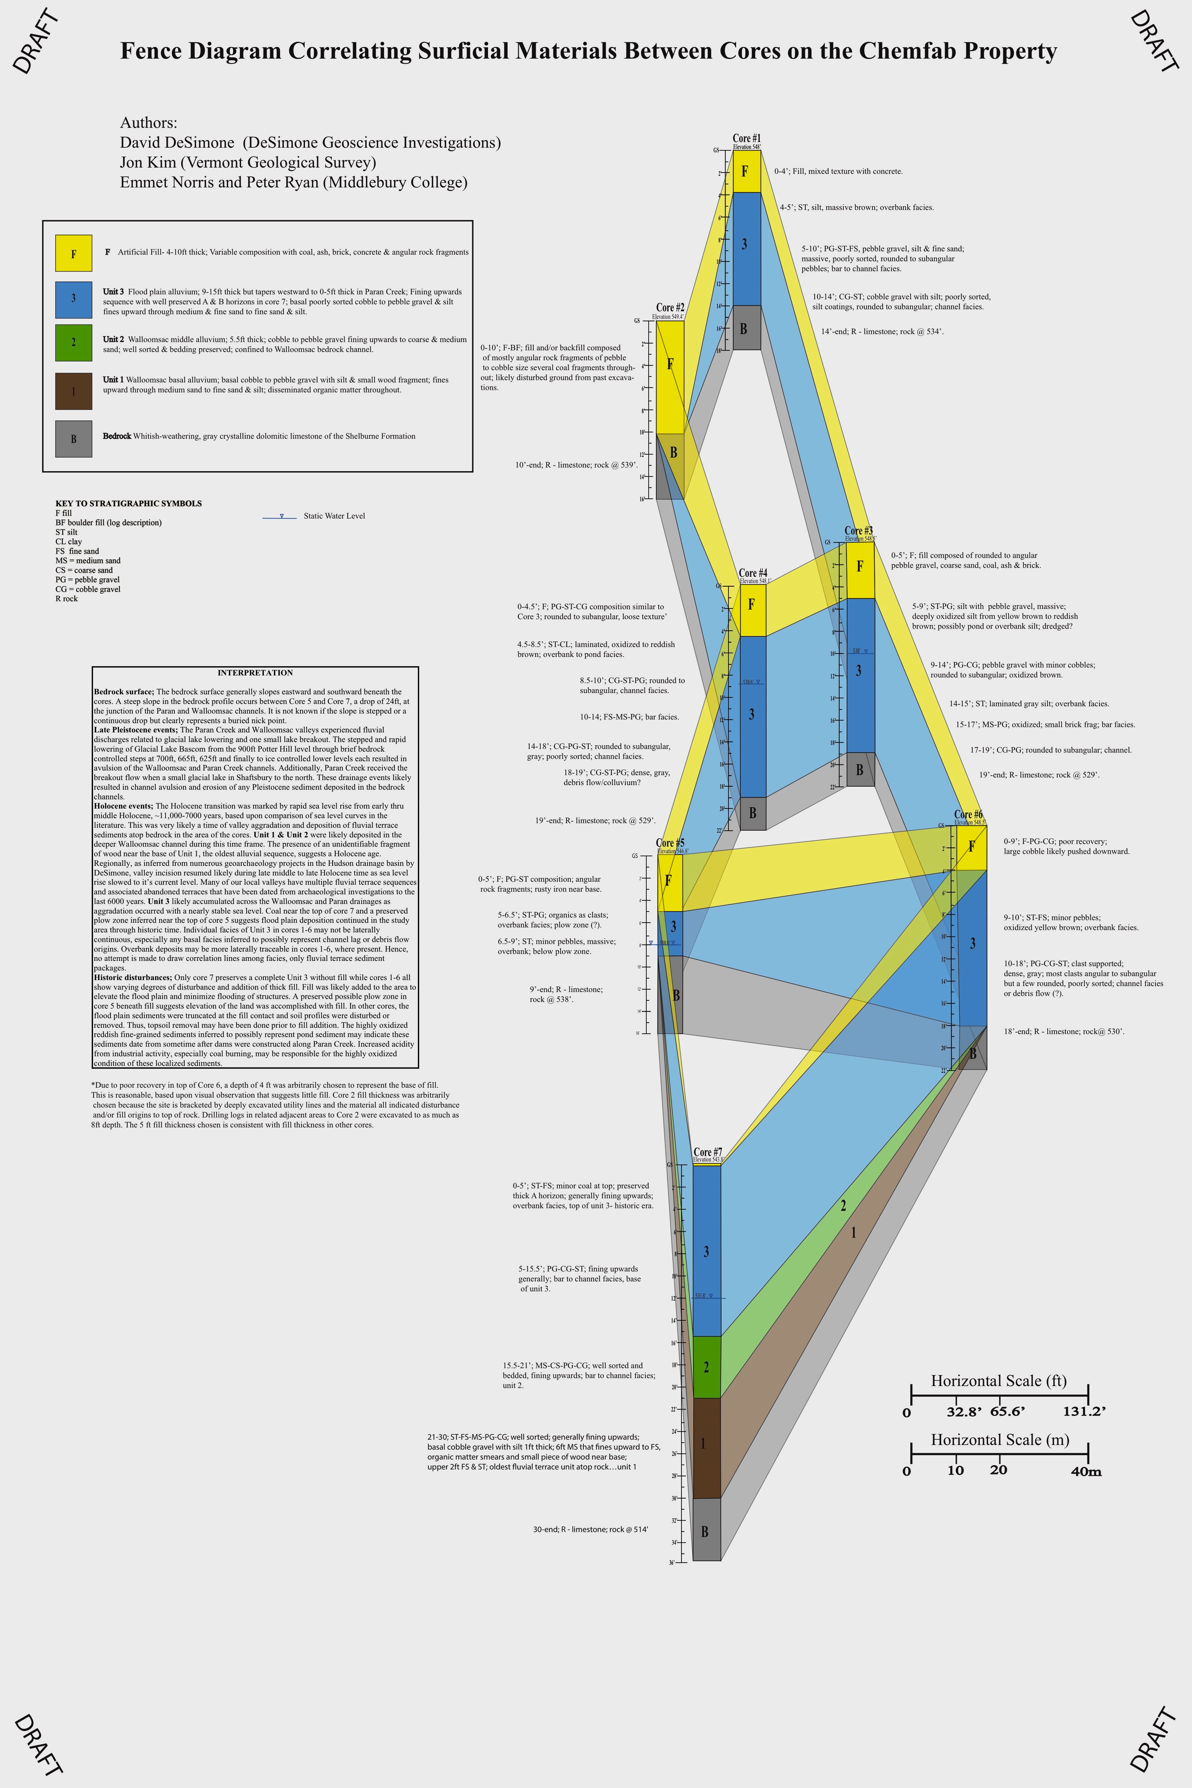
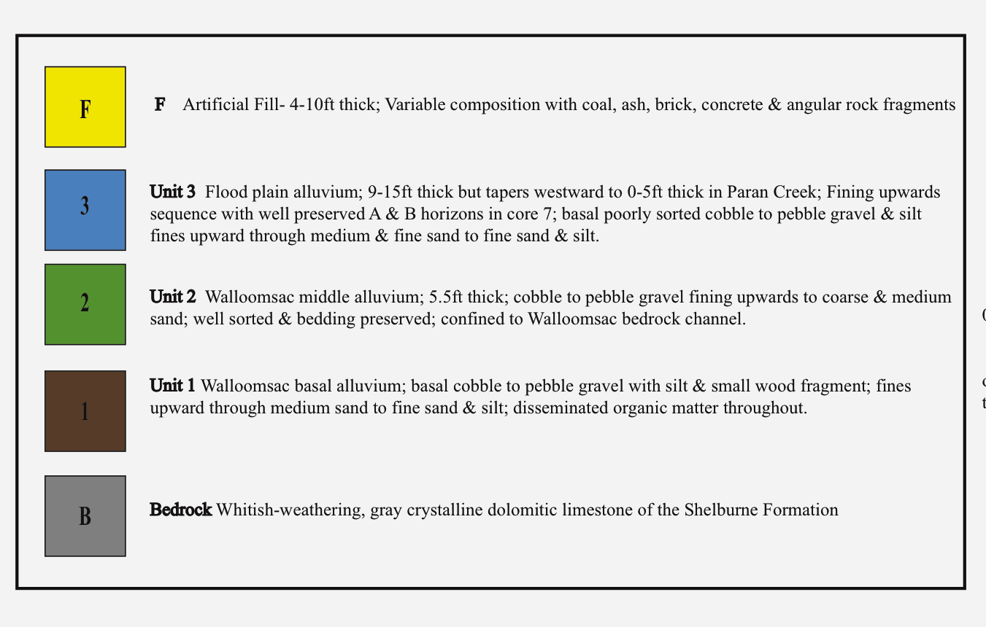
ChemFab Fence Diagram
  > Thin alluvium over bedrock in Paran Creek…Unit 3.

Slide 7
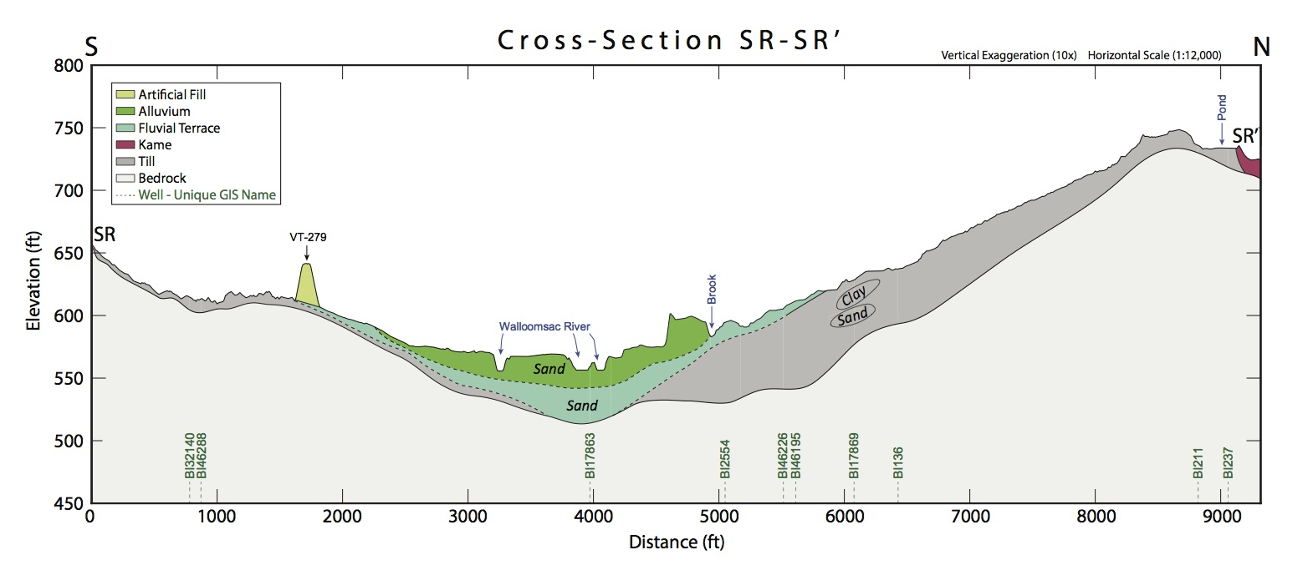
Walloomsac Valley section also reveals 2 sandy terrace sequences that may correlate to Units 1 & 2 in the ChemFab fence diagram.
Draft

Slide 8
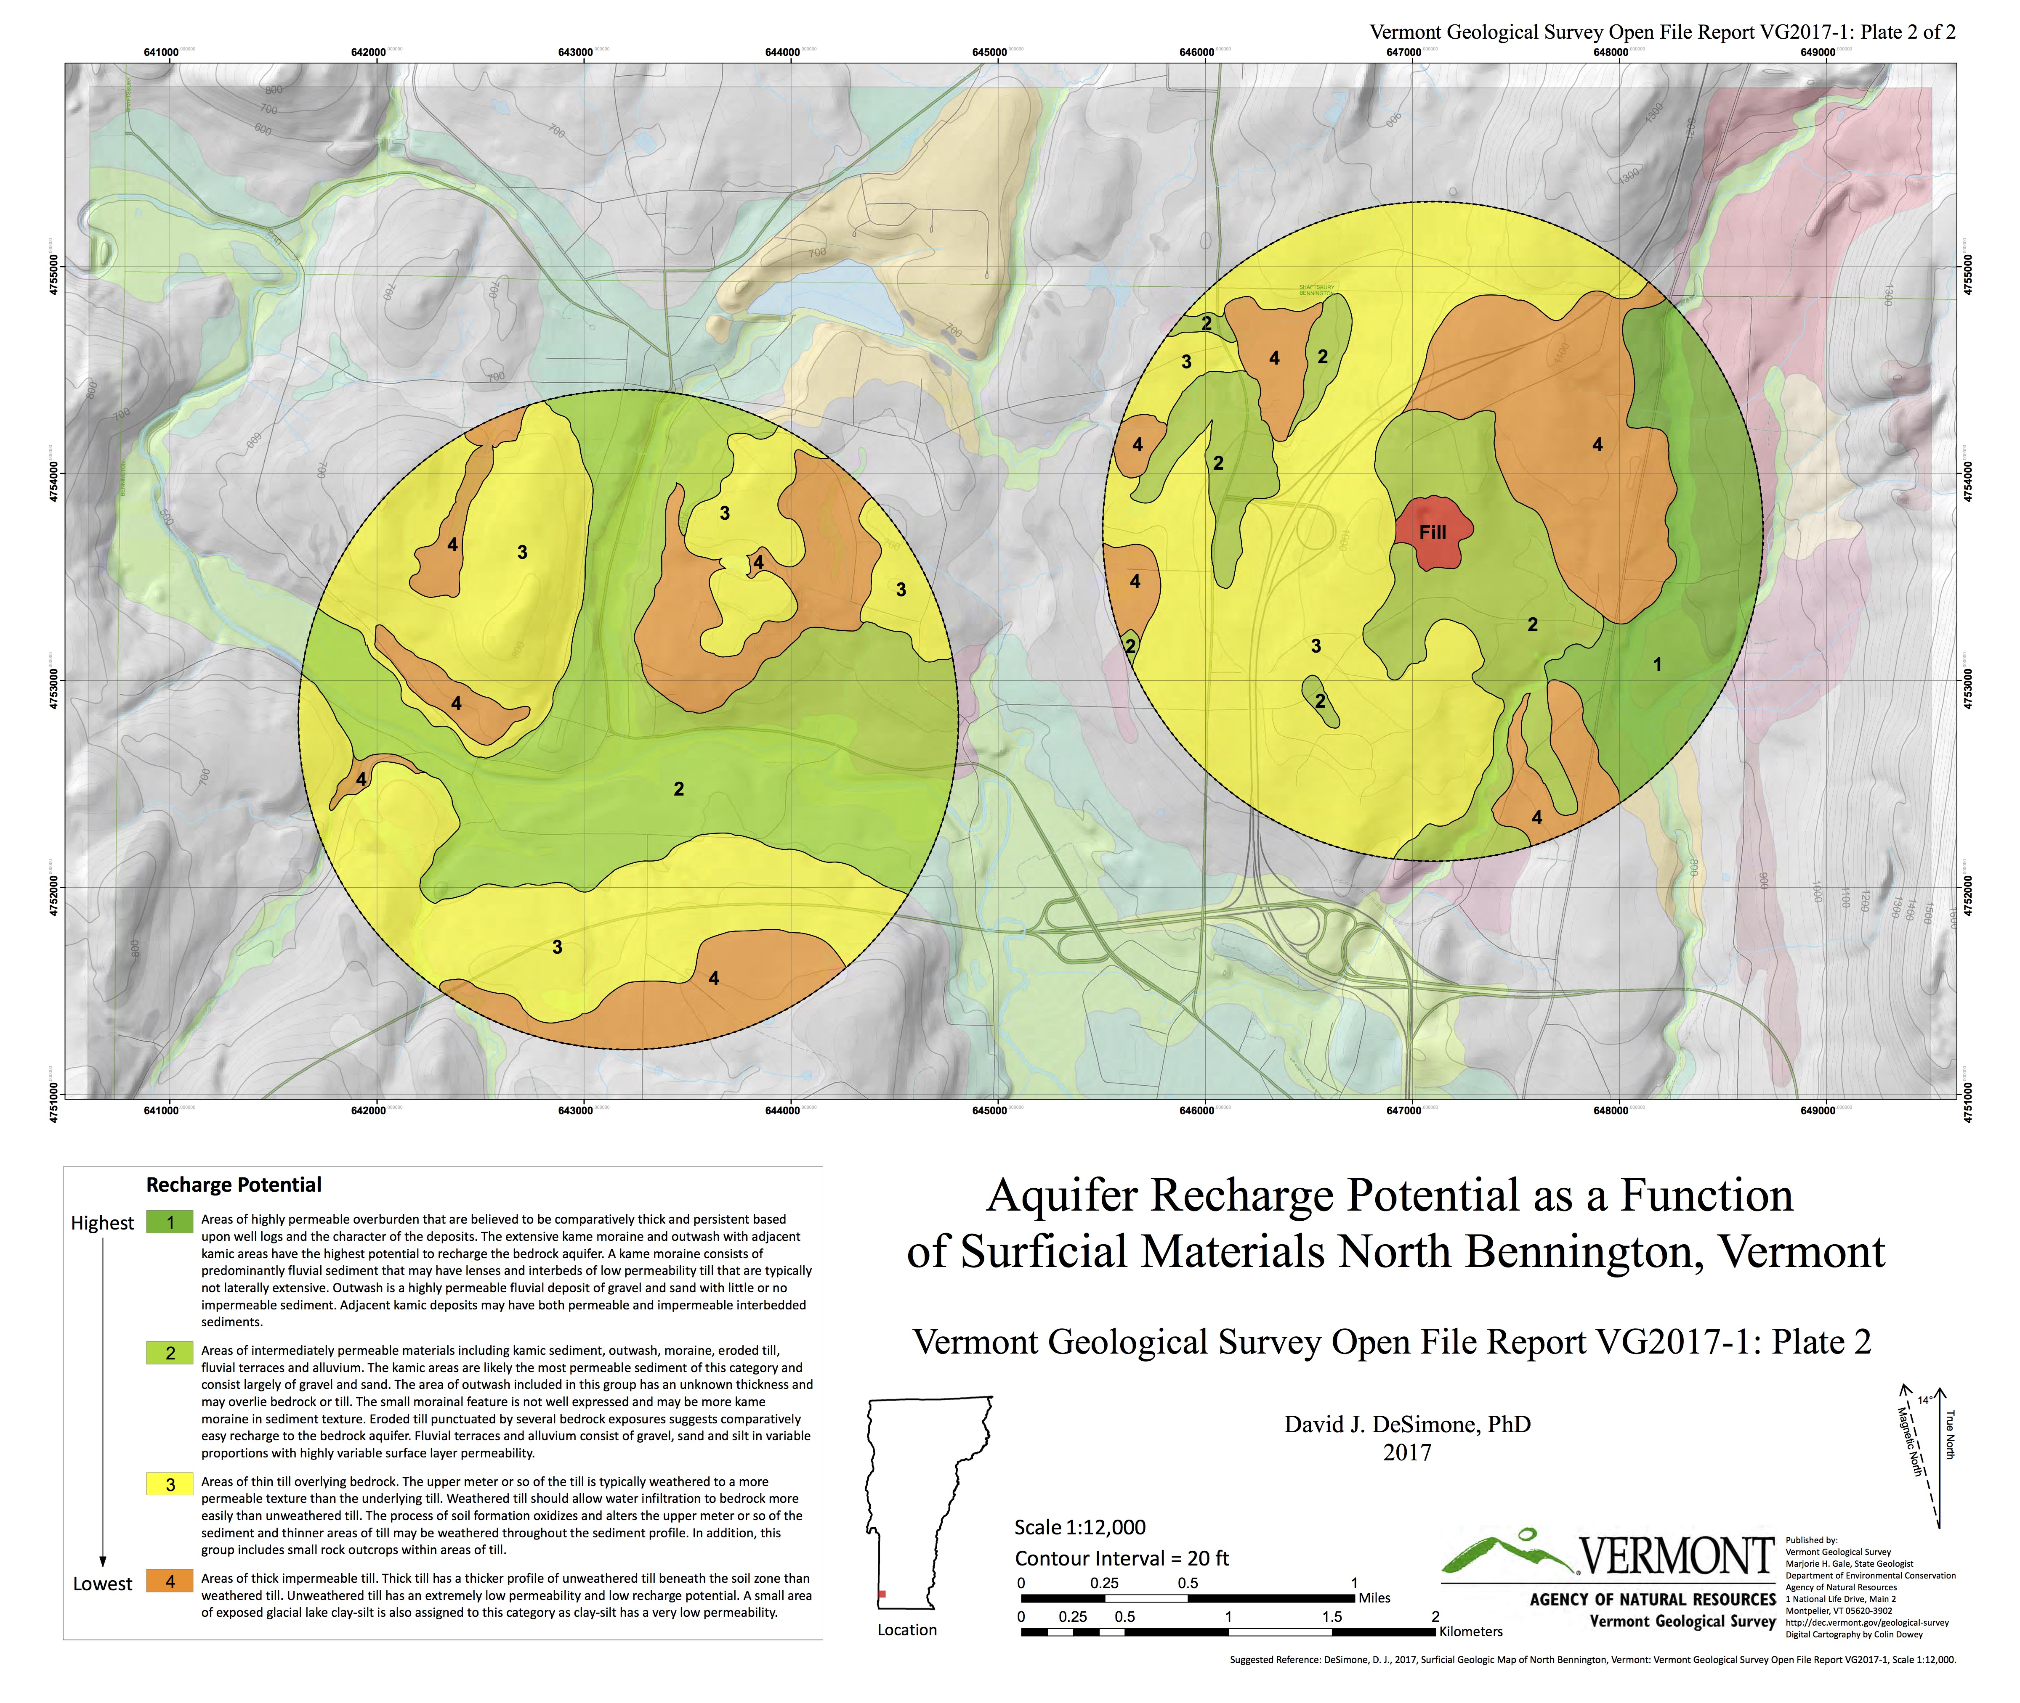
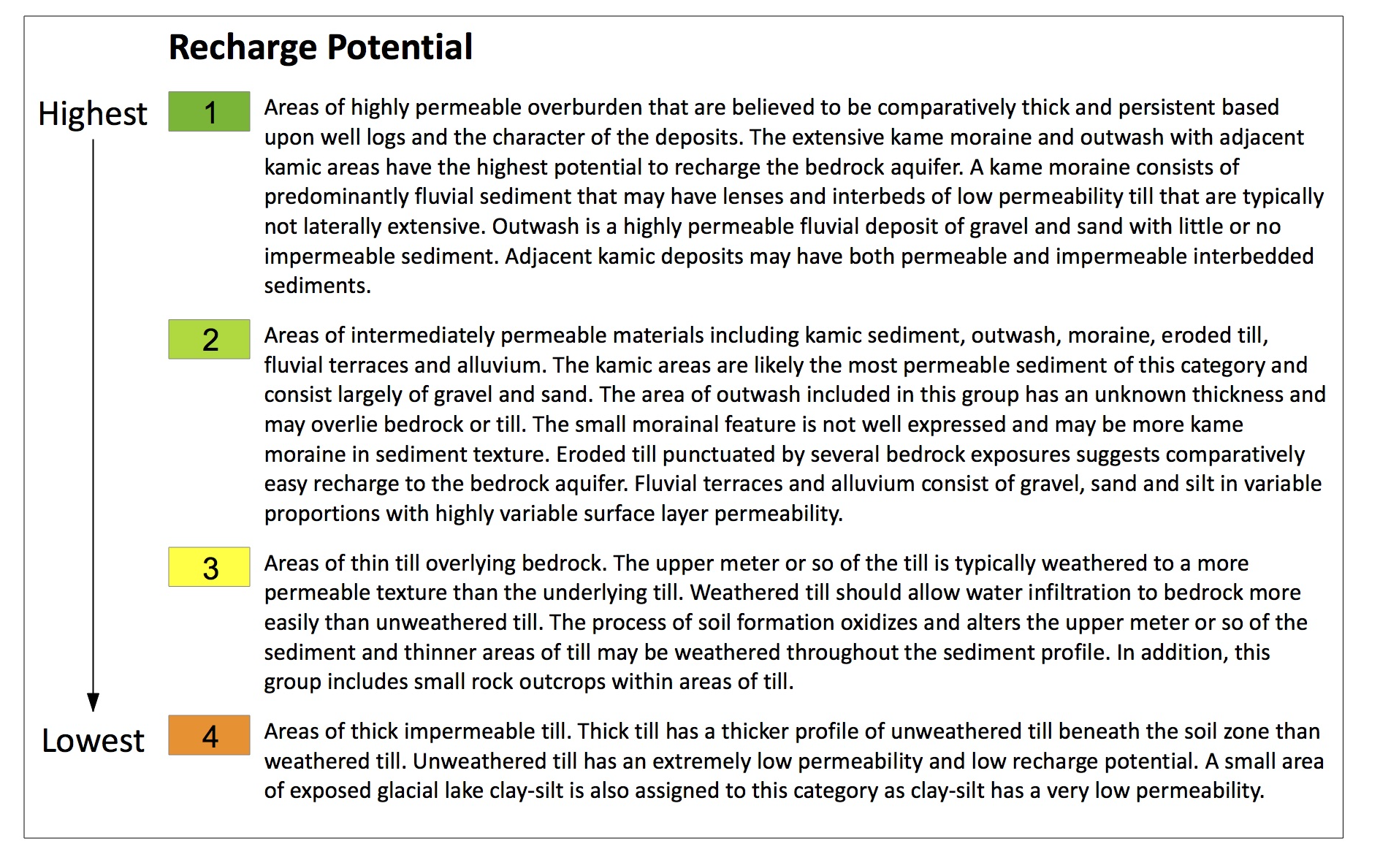
Aquifer Recharge Potential
  > Paran Creek alluvium does not inhibit downward flow of contaminants to bedrock aquifer.

Slide 9
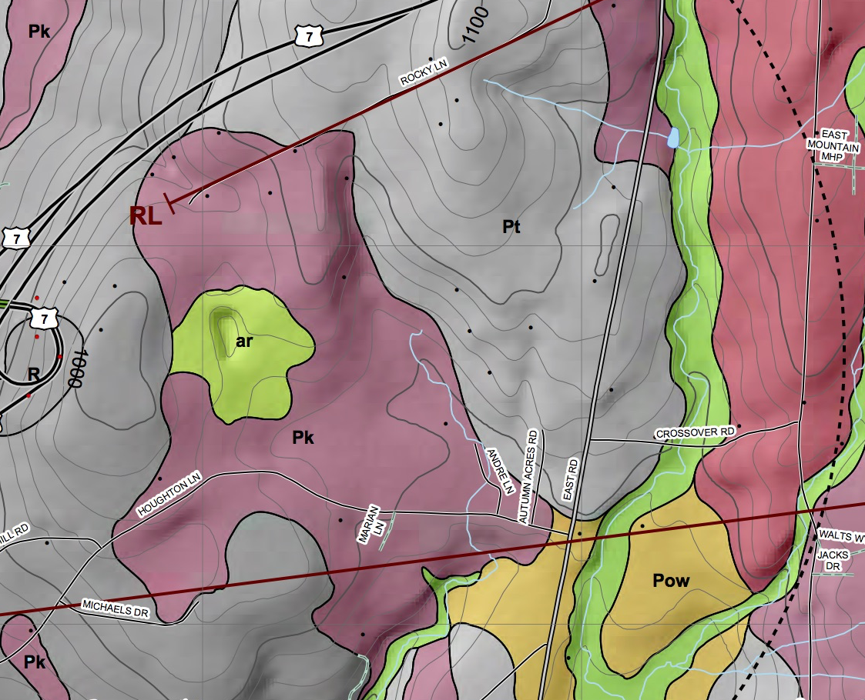
Old Landfill Detail
  > Ice margin on NW side of ridge
  > Stagnant ice to lee of ridge
  > Typical landfill from half a century ago

Slide 10
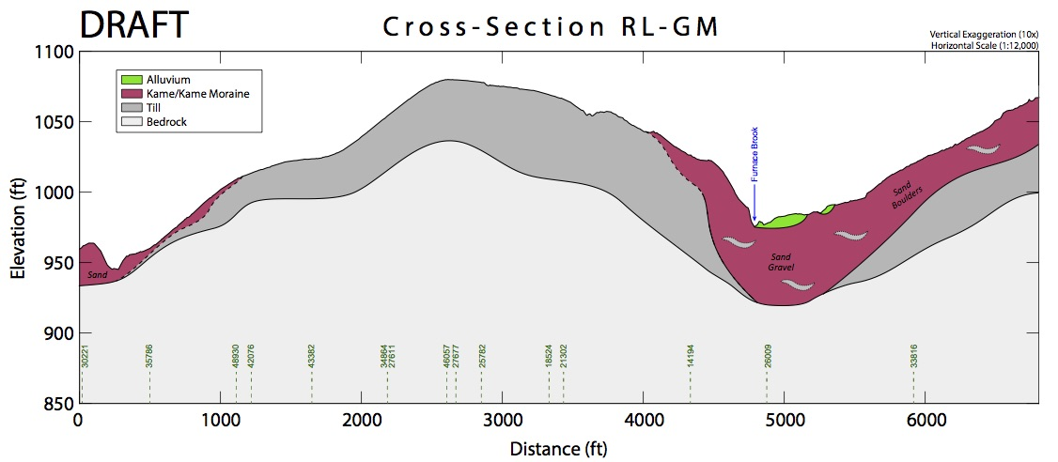
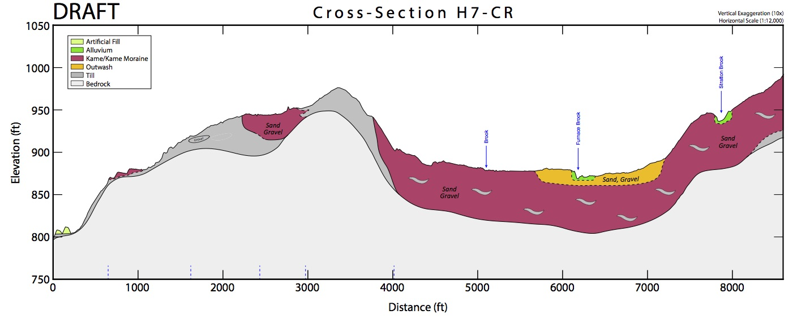
Two Cross Sections
  > North & south of Old Landfill
  > Thick sand & gravel
  > Easy infiltration of PFOA into the subsurface
  > Probable valuable overburden aquifer

Slide 11
Conclusions
  > Role of the surficial/Quaternary geologist in these investigations - geomorphology matters
  * Interpret landscape evolution
  * Interpret overburden stratigraphy
  * 3-D distribution of sediments and their textures must fit the interpretation of landscape development
  * Generate aquifer recharge maps for infiltration to either/both overburden and bedrock aquifers
  * Identify possible pathways of waste migration
  * Wind deposition of airborne contaminants & pattern of contaminated wells may be better understood if permeability of overburden is evaluated
  > Synergy of having both surficial and bedrock expertise involved is invaluable
  * We help each other…bounce ideas…even off the wall ones
  * Modelers of bedrock aquifer flow must consider recharge through overburden

