Slide 1
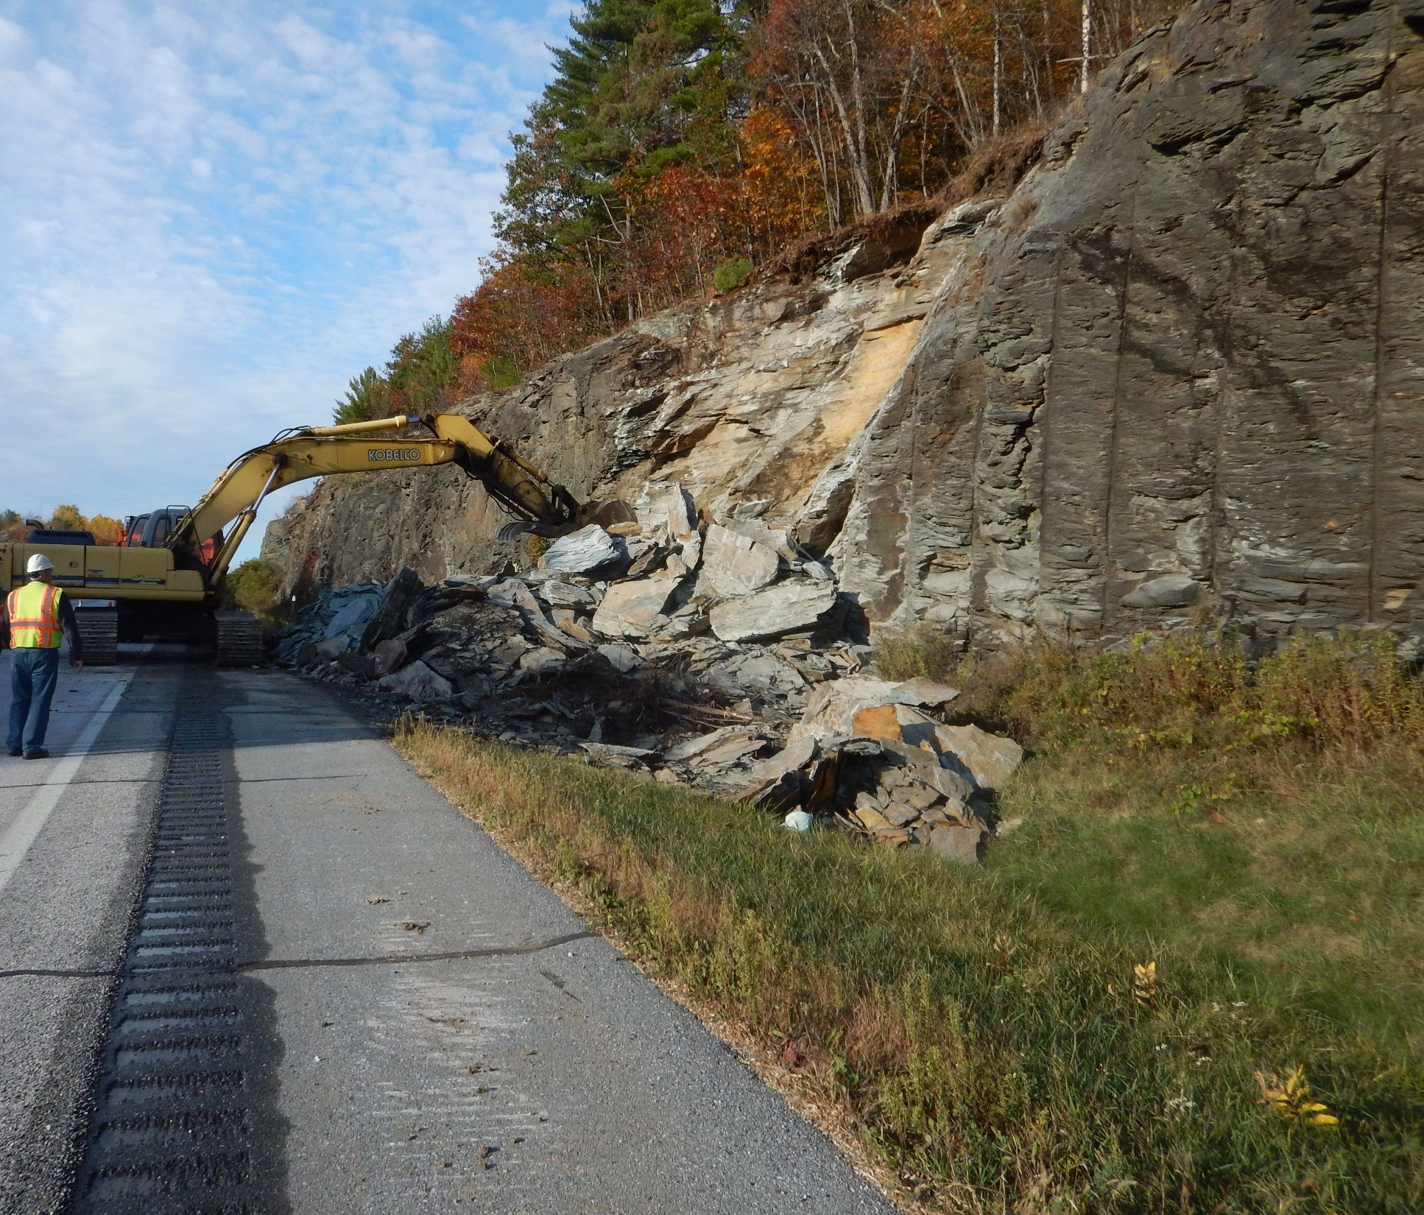

VERMONT’S ROCKFALL HAZARD RATING SYSTEM
Ethan Thomas
Vermont Agency of Transportation
Geotechnical Engineering Section
U.S.-4, Castleton
E. Thomas, Vermont Agency of Transportation

Slide 2
WHAT IS A ROCKFALL HAZARD RATING SYSTEM?
The Rockfall Hazard Rating System (RHRS) is a tool which VTrans uses to proactively prevent/react to rockfall events.
The RHRS consists of multiple components including:
  Details on a Ranking System to determine the potential for rockfall to reach the roadway.
  An inventory/catalogue of Ranked Rock Cuts.
  For “High Hazard” Rock Cuts it provides detailed scoring categories that are evaluated to differentiate the “High Hazard” Rock Cuts from each other.

Slide 3
HISTORY OF VERMONT’S RHRS
1977 – Vermont Chief Transportation Geologist Frank Lanza and State Geologist Charles Ratte conducted Phase I study of rockfall areas along Vermont’s Interstate System.
Early 1990’s – The Agency used Lanza/Ratte report to program remediation of some hazardous rock cuts identified within the report.
1995 – Agency Transportation Geologist Alan McBean initiated a RHRS that followed the FHWA/Oregon DOT criteria.

Slide 4
HISTORY OF VERMONT’S RHRS
2005 – Former Agency Transportation Geologist Tom Eliassen began work expanding on Alan McBean’s work and implementing Vermont’s own RHRS.

Slide 5
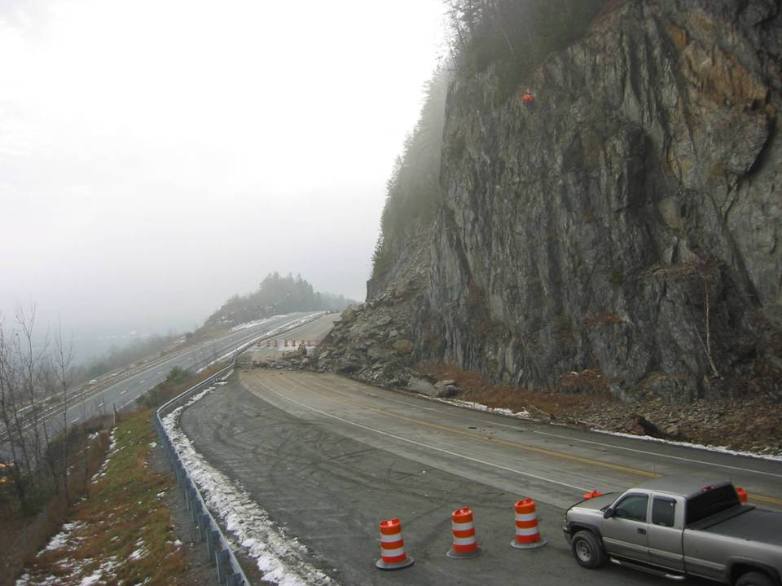
  ROCKFALL HAZARD ASSESSMENT OF HIGHWAYS IN VERMONT
Thomas D. Eliassen, Vermont Agency of Transportation, Materials and Research Section
George E. Springston, Norwich University Dept. of Geology
Laurence R. Becker, Vermont Geological Survey, Agency of Natural Resources
U.S.-5, Barnet
T. Eliassen, Vermont Agency of Transportation
Notes:
In 2005, VTrans initiated a Rockfall Hazard Rating Study in order to identify, catalog and rate existing rock exposures along the states federal and state highways. This work was performed as a collaboration between Vtrans, Norwich University, and The Vermont Geological Survey. The photo above shows a major rockfall that occurred in Barnet in 2002.
RHRS Re-evaluated every 4 to 5 years.

Slide 6
POTENTIAL FOR ROCKFALL REACHING ROADWAY
A
HIGH ROCKFALL IS EXPECTED TO OCCUR AND REACH ROADWAY
SIGNIFICANT ROCKFALL IS LIKELY TO OCCUR AND REACH ROADWAY
ELEVATED ROCKFALL IS POSSIBLE AT THIS LOCATION AND MAY REACH ROADWAY
LOW ROCKFALL POTENTIAL IS NOT LIKELY TO OCCUR.
B+
B
C
Notes:
The first task in this study was to physically locate each rock exposure over 10’ high and assign to each one a ranking of the degree of hazard these exposures might present to the traveling public. Rankings were determined based on the above criteria.

Slide 7
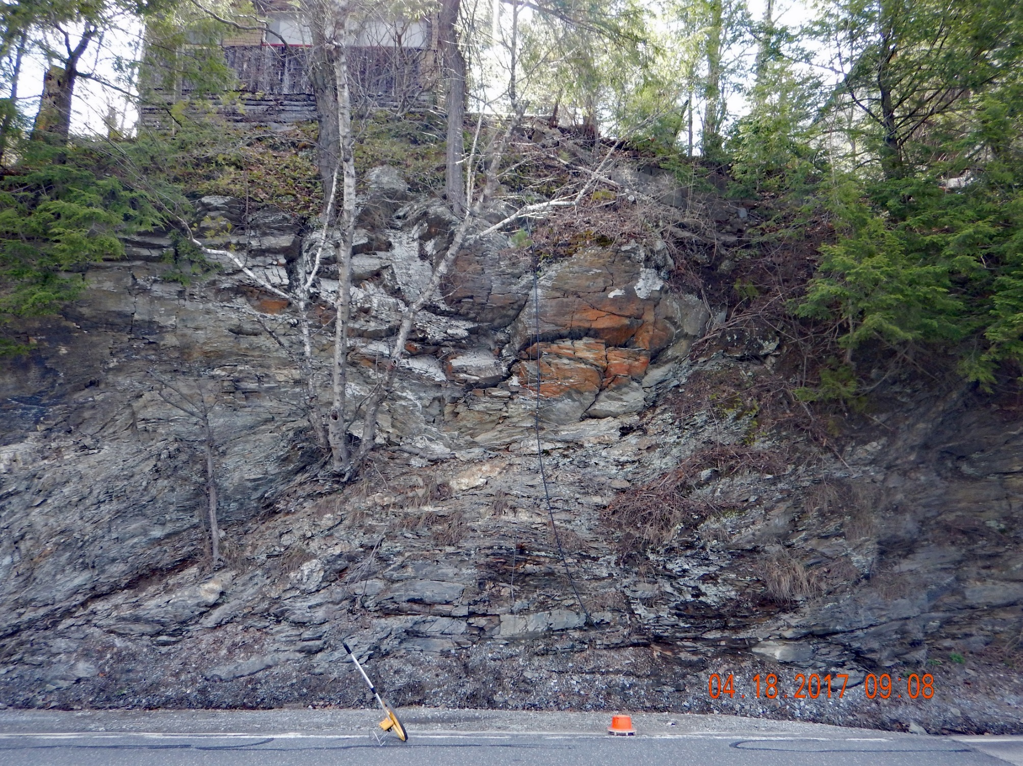
“A” RANKED ROCK SLOPE
VT-30, Castleton
E. Thomas, Vermont Agency of Transportation
Notes:
This is an example of an “A” ranked rock slope.

Slide 8
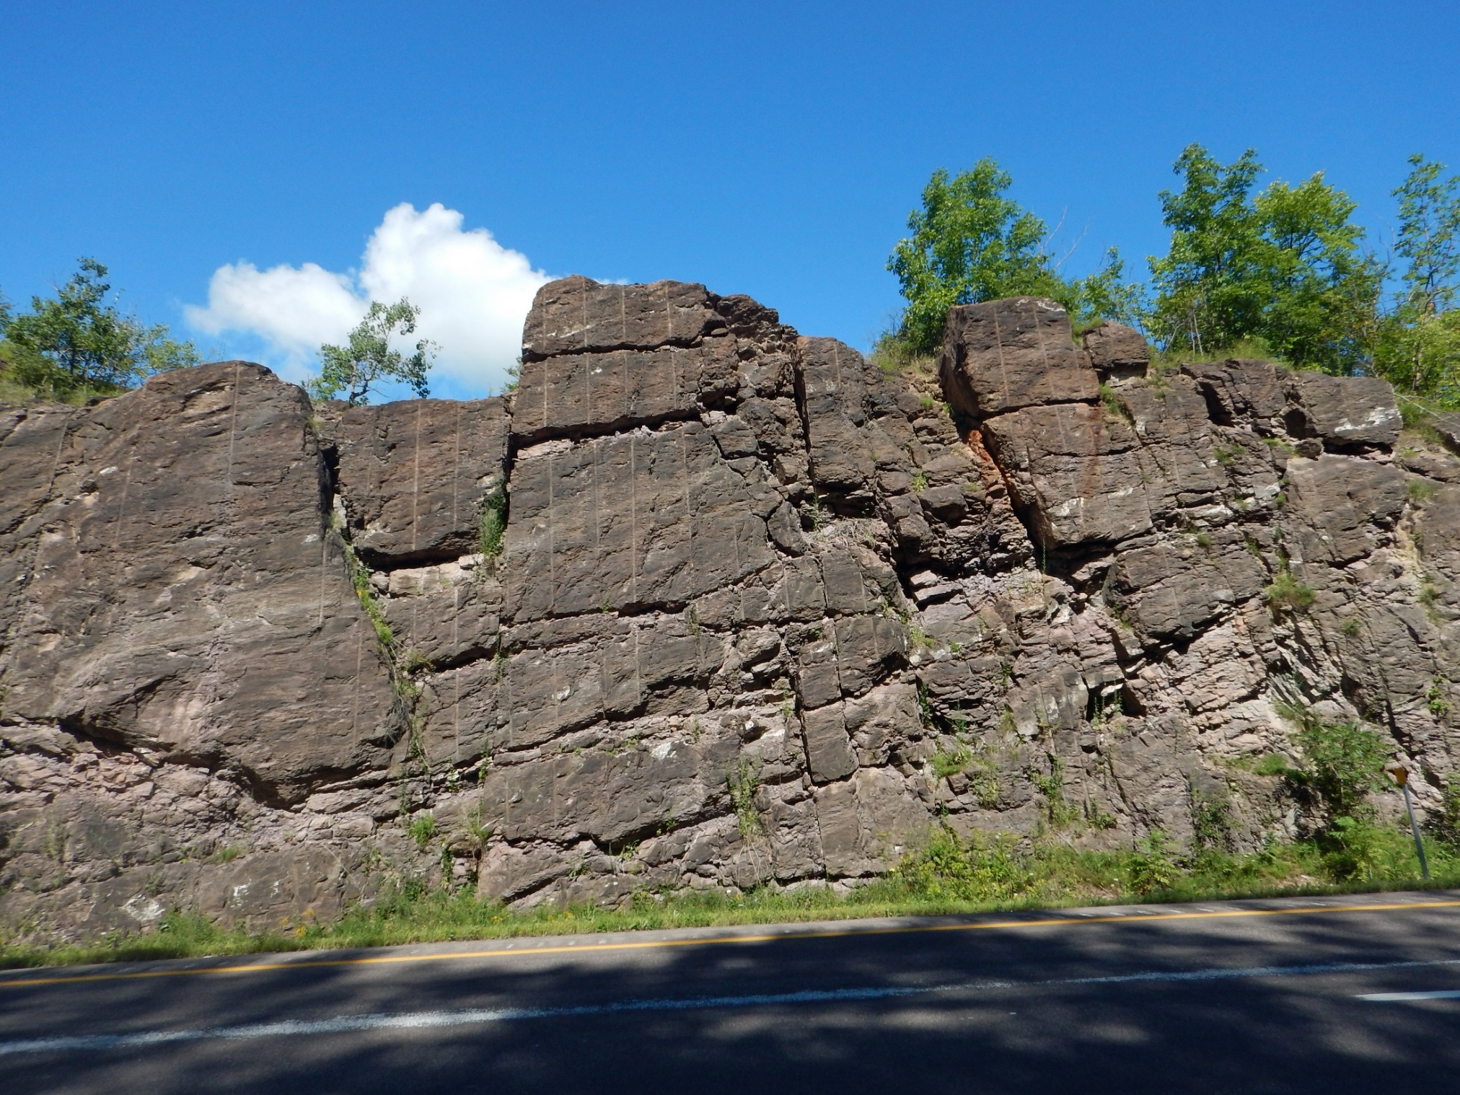
“B+” RANKED ROCK SLOPE
I-89 NB Median, Georgia
E. Thomas, Vermont Agency of Transportation
Notes:
B+ Ranked rock cut

Slide 9
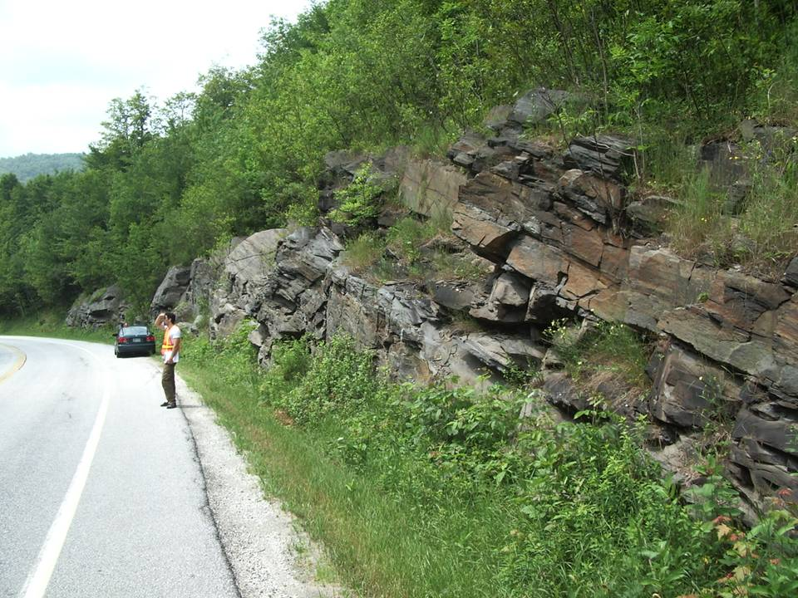
“B” RANKED ROCK SLOPE
VT-12, Barnard
G. Springston, Norwich U. Dept. Geology
Notes:
This is a “B” ranked rock slope. There is little ditch width here, however the rock is dipping away from the roadway. There is little chance of a massive failure at this rock slope and rockfall will be characterized as small blocks dropping out of the slope and likely landing in the ditch.

Slide 10
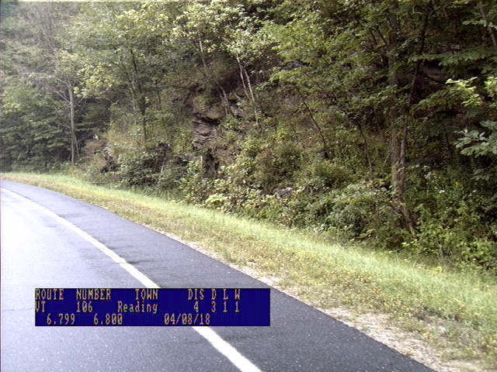
“C” RANKED ROCK SLOPE
Notes:
This is a “C” ranked rock slope. There is a fairly steep dipping ditch here and the rock slope itself also dips away from the roadway. The rock slope is also short ~10-20ft tall and it is likely that even if rockfall occurred here it would not make it into the roadway,.

Slide 11
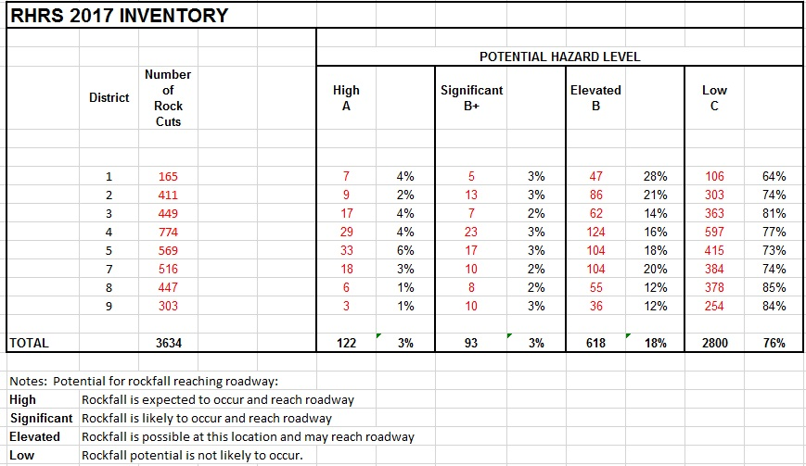
CURRENT RHRS INVENTORY
Notes:
So, in 2005 to 2007 Vtrans visited over 3,500 rock exposures which were located and ranked.

Slide 12
“A” RANKED ROCK CUTS
All “A” ranked rock cuts receive a detailed evaluation consisting of the following information:
  Roadway
  Slope
  Geologic
  Historical
  Within each of the categories listed above, there are further fields, which depending on the information entered into them produces a score for each field.
These scores are then added together to produce a Rockfall Hazard Rating (RHR) Score
Notes:
Roadway Form

Slide 13
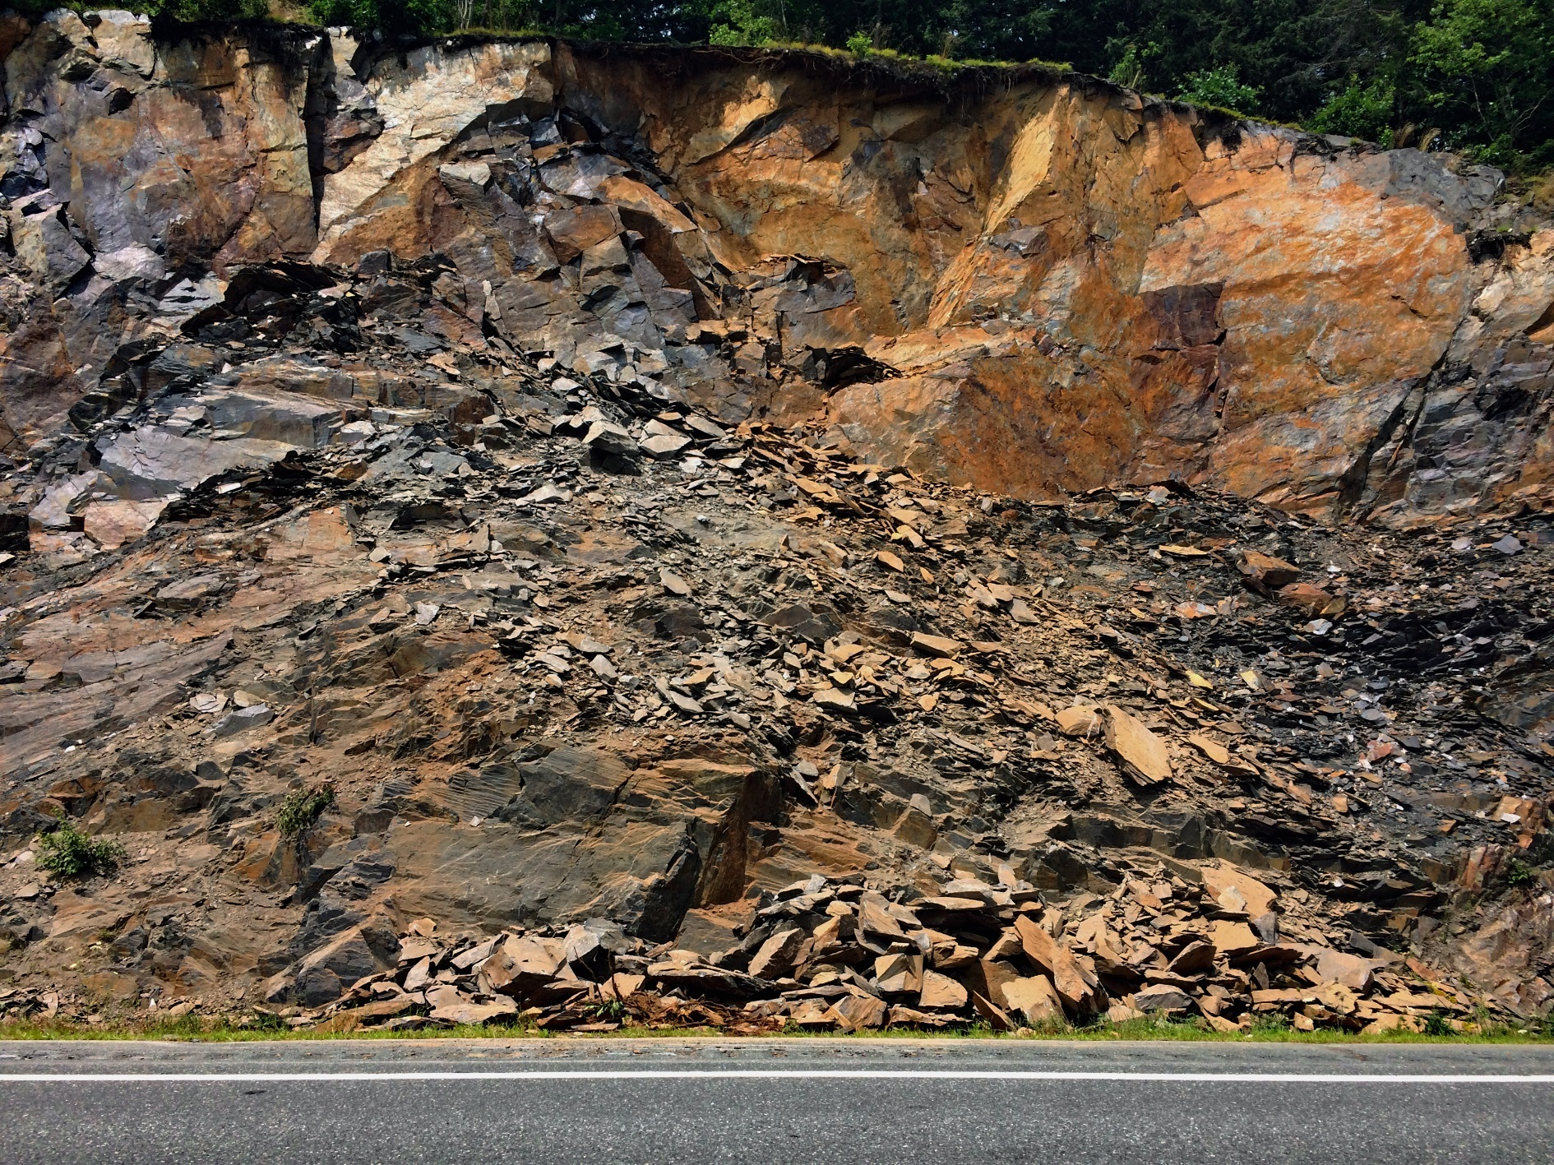
I-91 SB, Rockingham
E. Thomas, Vermont Agency of Transportation

Slide 14
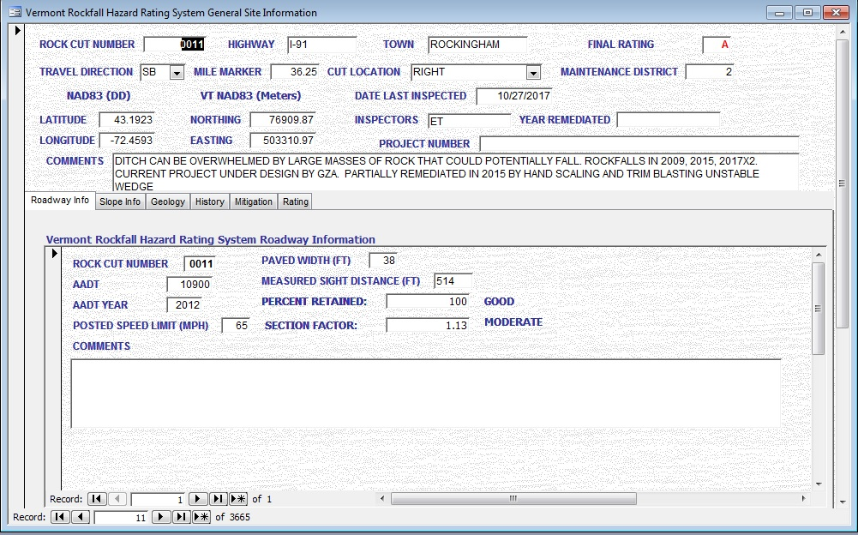
ROADWAY INFORMATION
Notes:
Slope Information Form

Slide 15
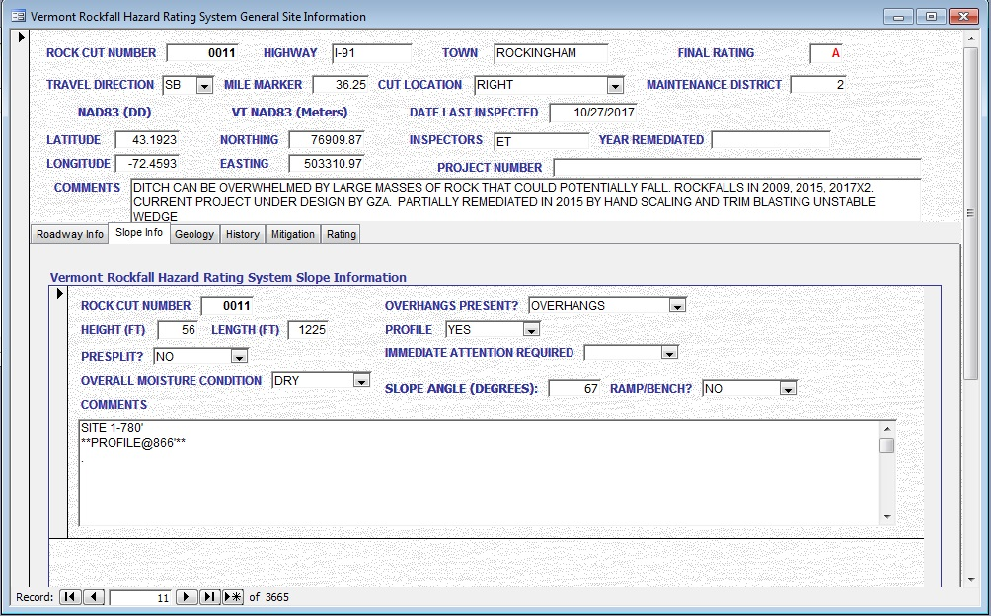
SLOPE INFORMATION
Notes:
Geologic Information Form & Sub Geology Form

Slide 16
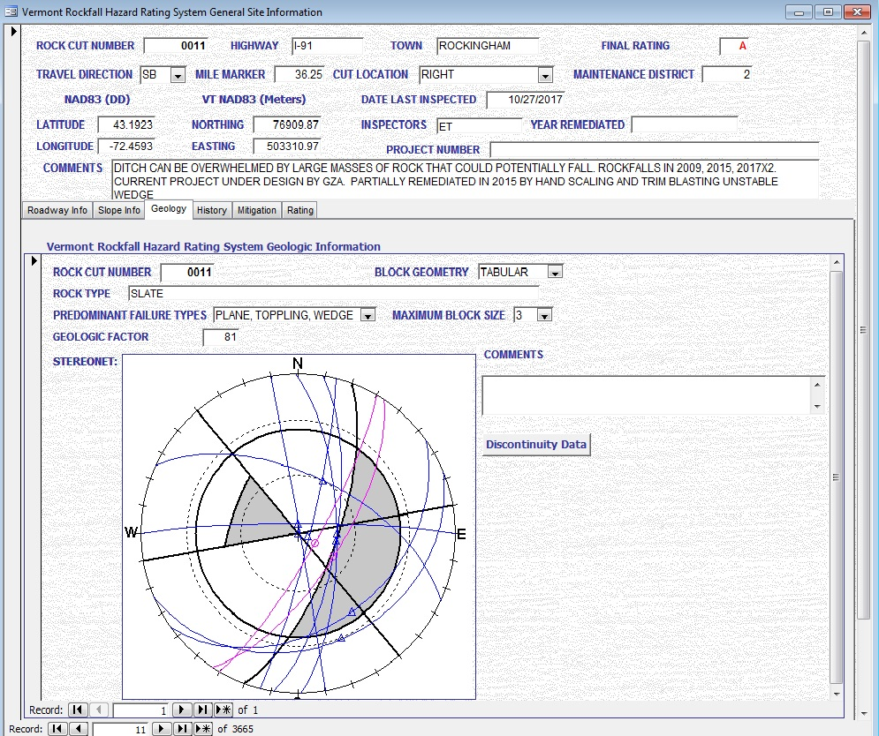
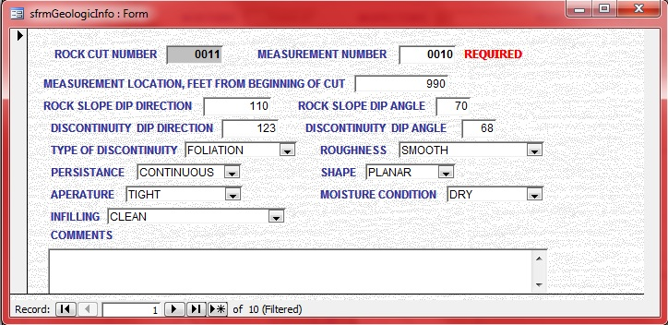
GEOLOGIC INFORMATION
Notes:
History Form

Slide 17
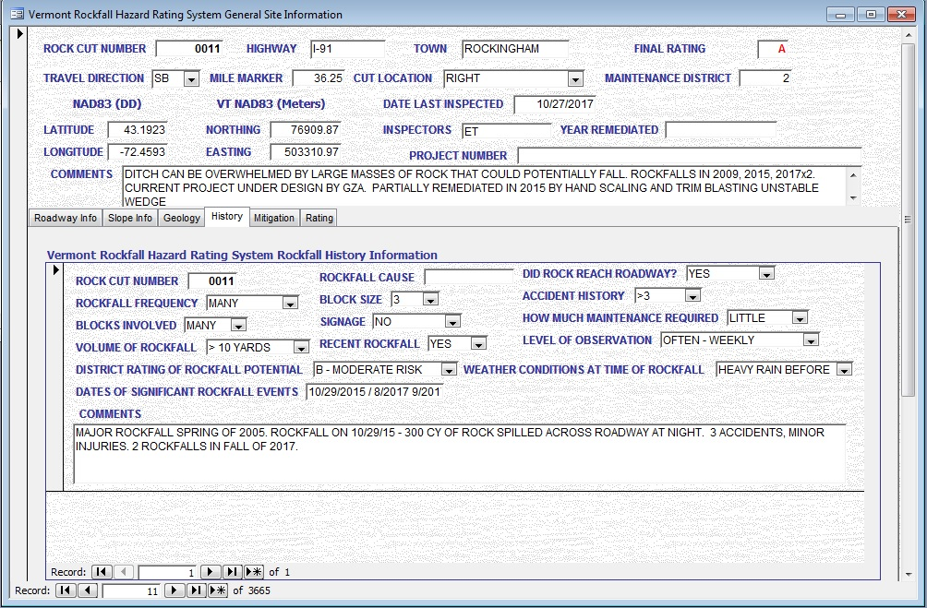
HISTORICAL INFORMATION

Slide 18
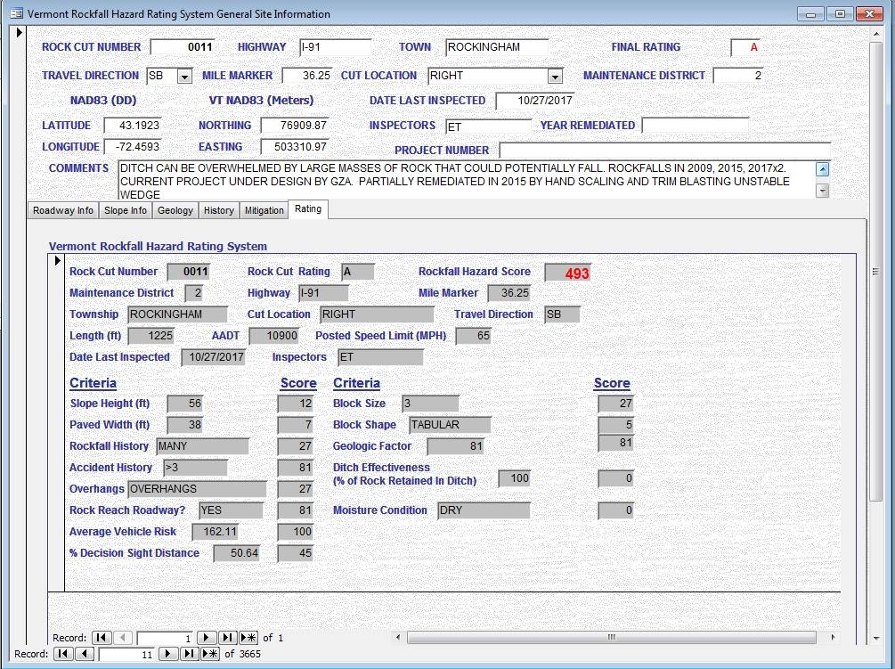
ROCKFALL HAZARD RATING
Notes:
The exposures with the highest potential hazard (“A”) rock exposures were chosen and for each exposure detailed information was gathered and measurements performed in order to help rate each exposure as to the degree of hazard. This rating was performed in general conformance with the FHWA Rockfall Hazard Classification and Mitigation System manual published in 1993.
150 “A” ranked sites were evaluated and numerical RHR scores were calculated based on roadway, slope, geologic and historical criteria.

Slide 19
2017 RHR SCORE DISTRIBUTION
Notes:
A large majority of the slopes rated in the 300 to 600 score range.

Slide 20
THE FUTURE OF THE RHRS
Re-evaluation of all “A” and “B+” ranked rock cuts is performed on a 5-year interval.
  Next re-evaluation planned for 2020.
Transferring Microsoft Access database to ArcGIS map layer and ArcCollector Field Application.
Incorporating the RHRS within VTrans Asset Management Program.

Slide 21
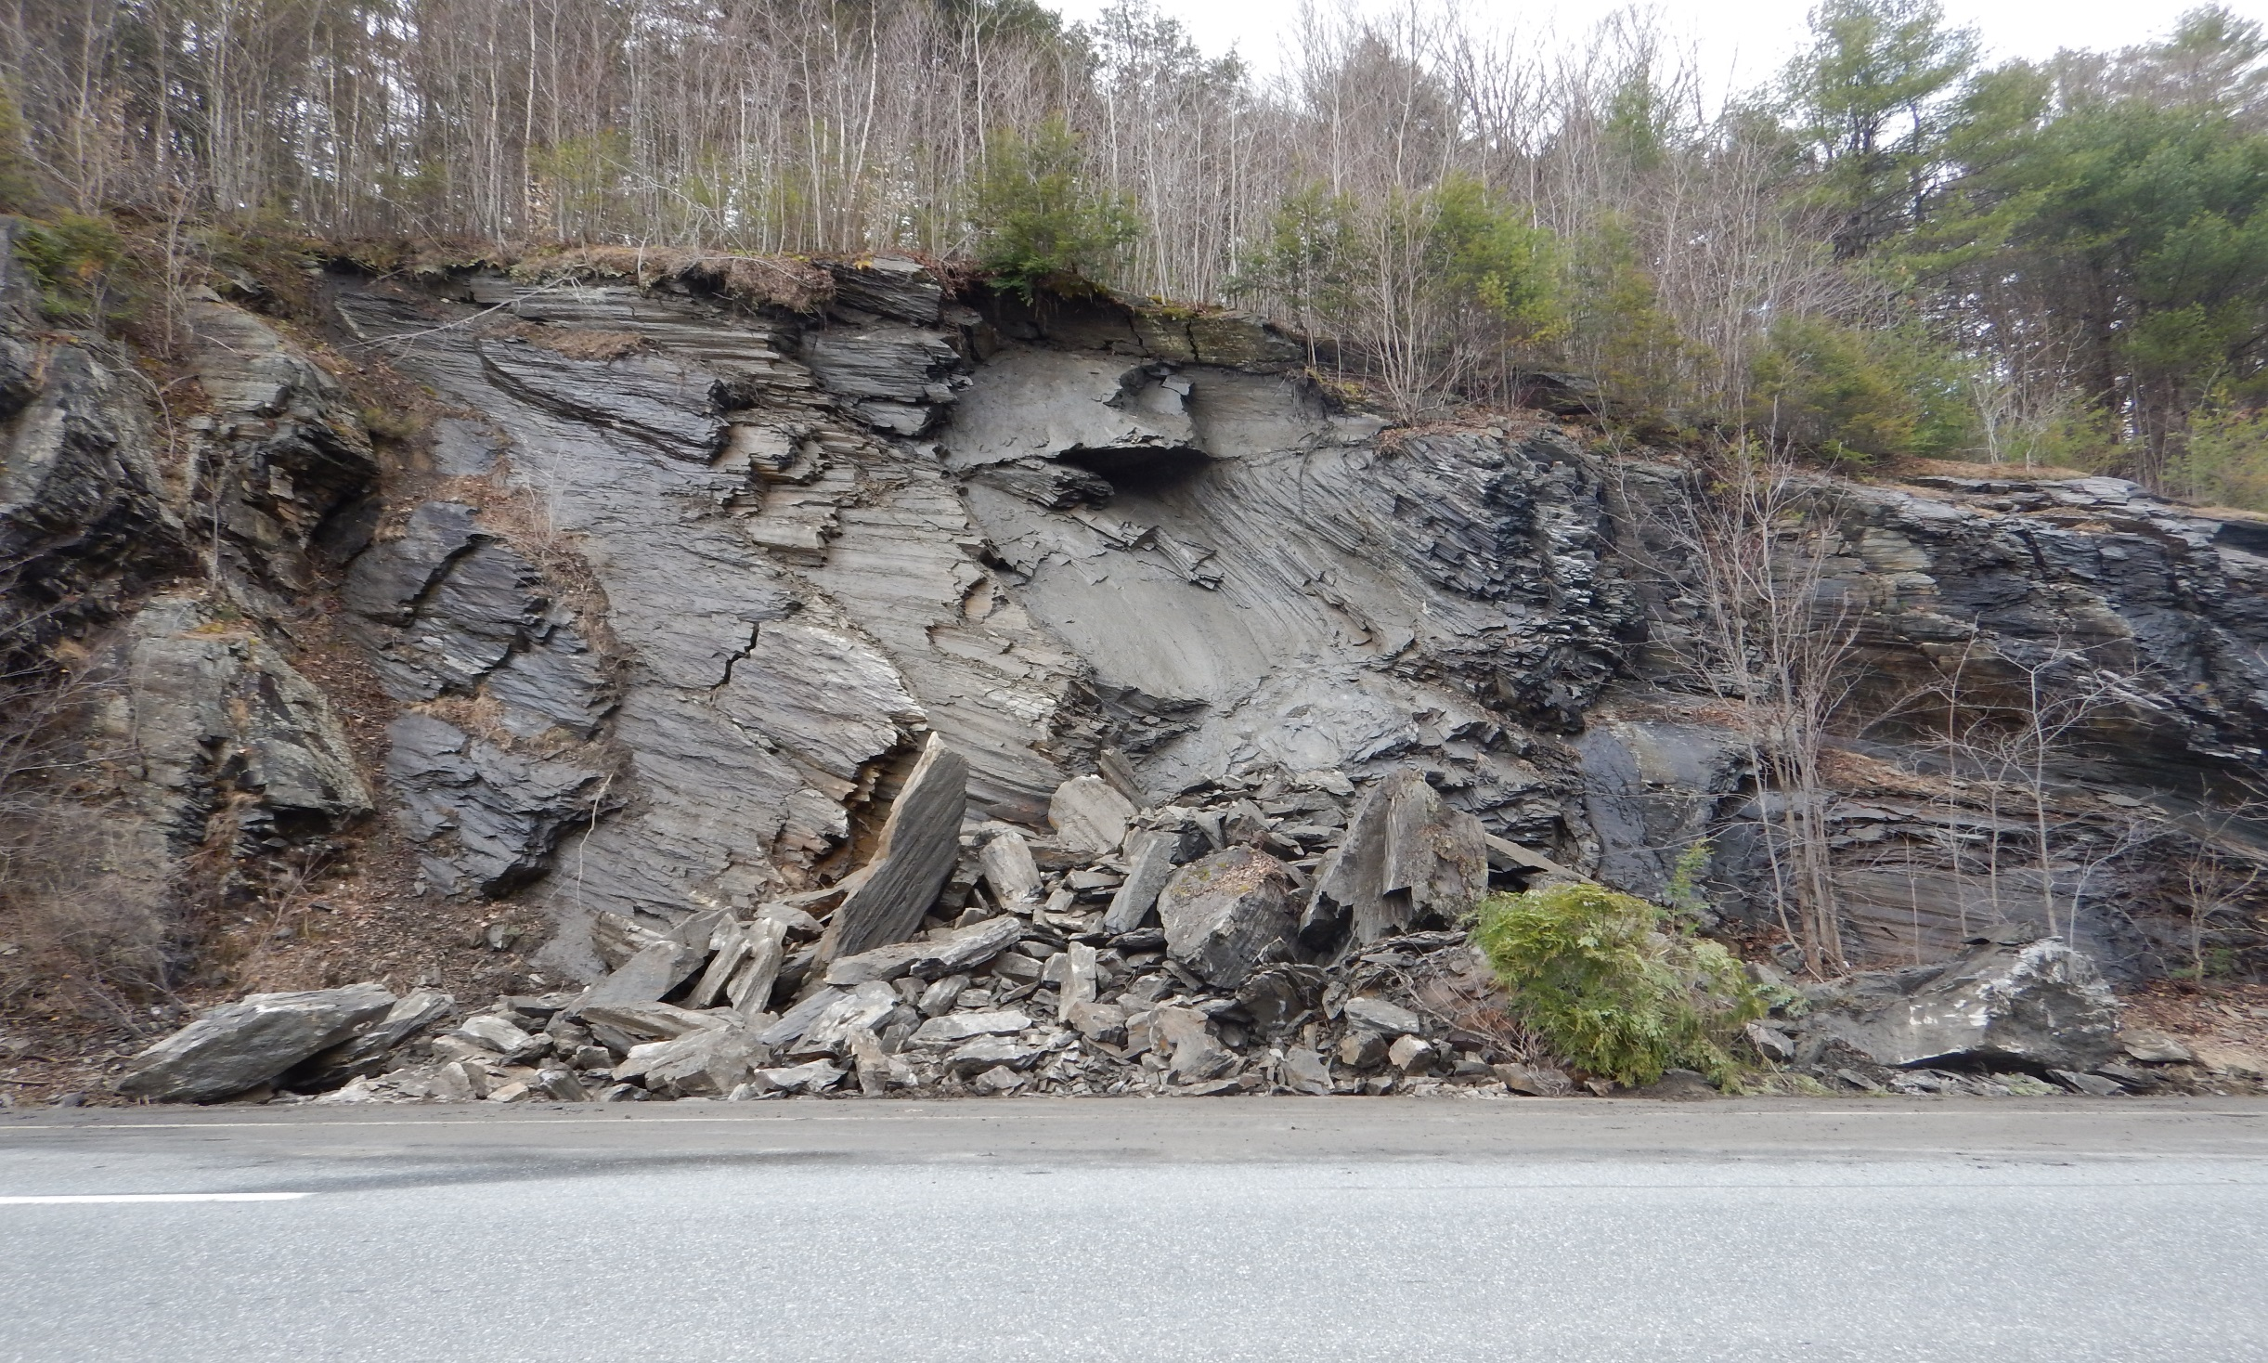
QUESTIONS?
I-89 SB, Royalton
E. Thomas, Vermont Agency of Transportation

