Slide 1
Significance of elevated iridium and platinum group element ratios in Upper Triassic-Lower Jurassic continental strata of the Newark Supergroup
Lawrence H. Tanner, Le Moyne College
Frank T. Kyte, UCLA
John H. Puffer, Rutgers University

Slide 2
Previous Work: Ir enrichment Newark Basin

Slide 3
Previous Work: Ir enrichment Fundy Basin

Slide 4
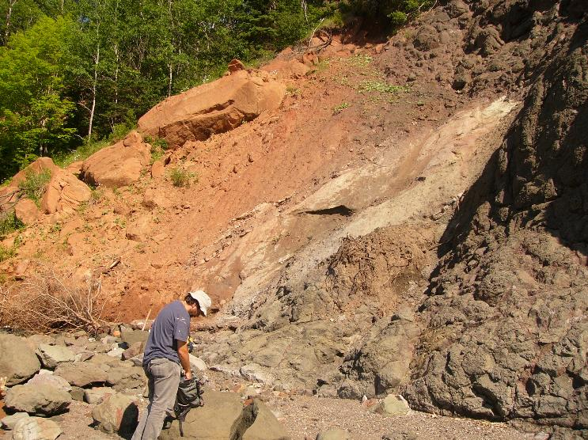
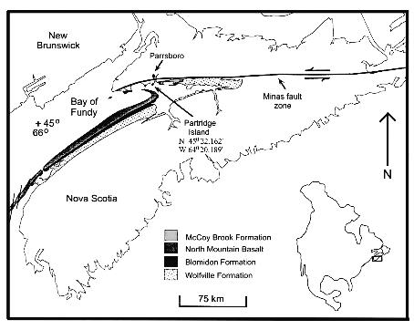

New Data: Fundy Basin
MBF
NMB
Au | Ir* | Pd | Pt
6.2 | 0.17 | 2.03 | 1.55
9.3 | 0.41 | 2.38 | 2.29
Lead fire assay by Geoscience Labs
Scots Bay Mbr, McCoy Brook Fm lake beds

Slide 5
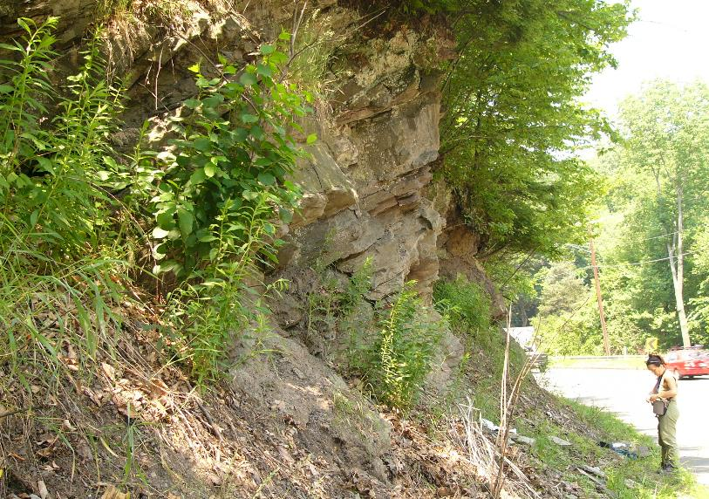
New Data: Deerfield Basin
DB
SF (FRB)
Sc
Au | Ir* | Pd | Pt
7.4 | 0.09 | 1.62 | 0.72
Turners Falls, Fall River Beds

Slide 6
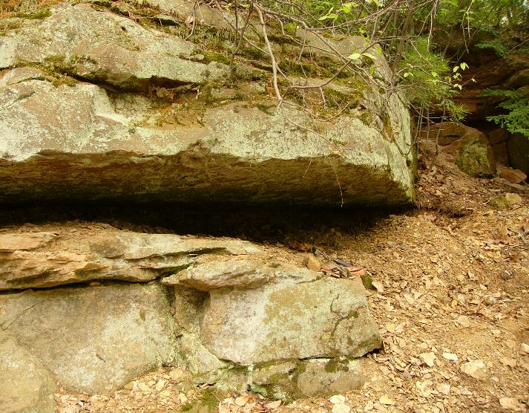
New Data: Hartford Basin
Sc
Holyoke Clathopteris locality, New Haven Fm (?)

Slide 7
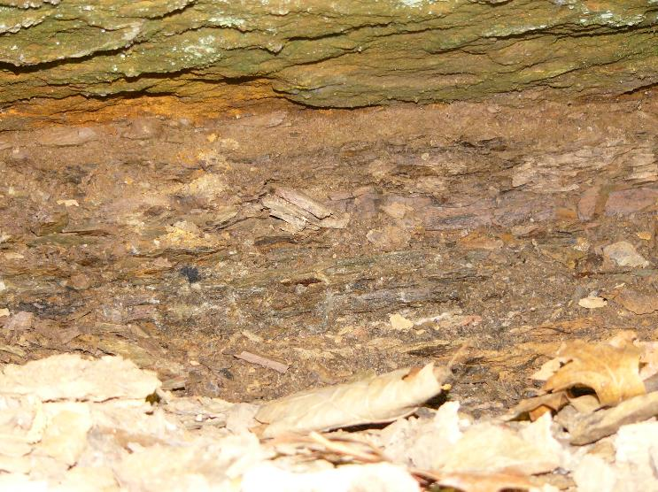
New Data: Hartford Basin
Au | Ir* | Pd | Pt
15.1 | 0.39 | 1.83 | 0.94
8 | 0.23 | 0.86 | 0.7
Sc

Slide 8
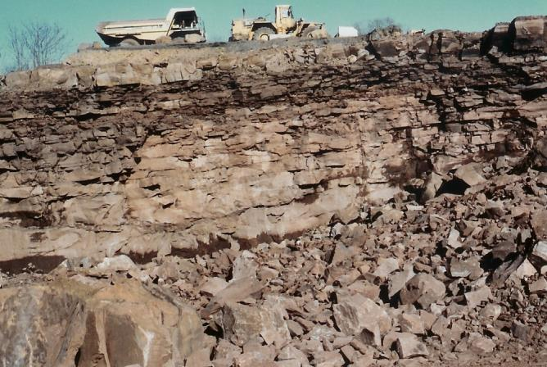
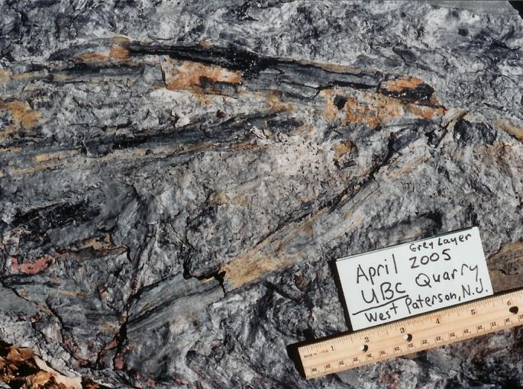
New Data: Newark Basin
________
OMB
PF
Former UBC/Tilcon Quarry, West Paterson, NJ

Slide 9
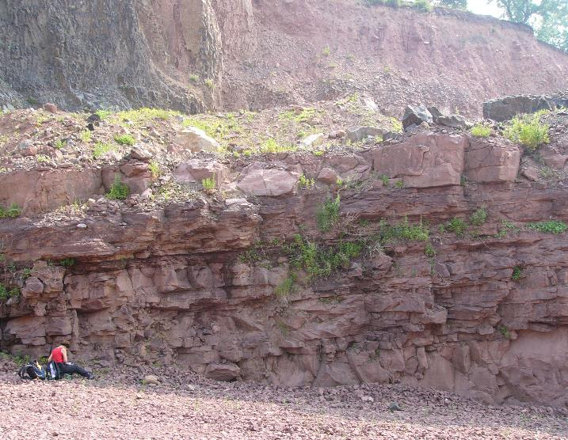
New Data: Newark Basin
OMB
PF
Au | Ir | Pd | Pt | Rh | Ru
9 | 0.78 | 2.77 | 5.38 | 0.43 | 1.47
4.3 | 0.51 | 1.81 | 2.98 | 0.29 | 0.92
Nickel sulfide fire assay analysis
Upper Passaic Fm

Slide 10
New Data: Newark Supergroup

Slide 11
New Data: Newark Supergroup
 | Pt/Pd | Pt/Ir | Pd/Ir | Ru/Ir
Blomidon | 0.22 | 4.74 | 14.74 | 0.68
Passaic | 1.91 | 6.43 | 3.37 | 1.85
Scots Bay | 0.89 | 6.62 | 7.52
Deerfield | 0.44 | 8.00 | 18.00
New Haven | 0.61 | 2.56 | 4.22
CI | 1.7 | 2.03 | 1.19 | 1.52
Newark Int | 2.48 | 15.07 | 6.08 | 0.45
Stevns Klint | 0.57 | 1.43 | 2.47 | 0.85
(Blomidon data – Tanner & Kyte, 2005)

Slide 12
New Data: Newark Supergroup

Slide 13
New Data: Newark Supergroup
Newark data – Olsen et al., 2002

Slide 14
Conclusions
PGE profile for Passaic parallels CI (sort of)
PGE ratios for Passaic between chondrite and Newark intrusives
PGE ratios for all other sections differ widely (sedimentary
environment?)
REE profiles for the Jacksonwald syncline data and Deerfield Basin
similar to Newark intrusives or continental shale profile
Derivation of PGEs in sediments of the Newark Extrusive Zone from
CAMP (airfall, fluid mobilization), not extraterrestrial (lack of ejecta)

