Slide 1
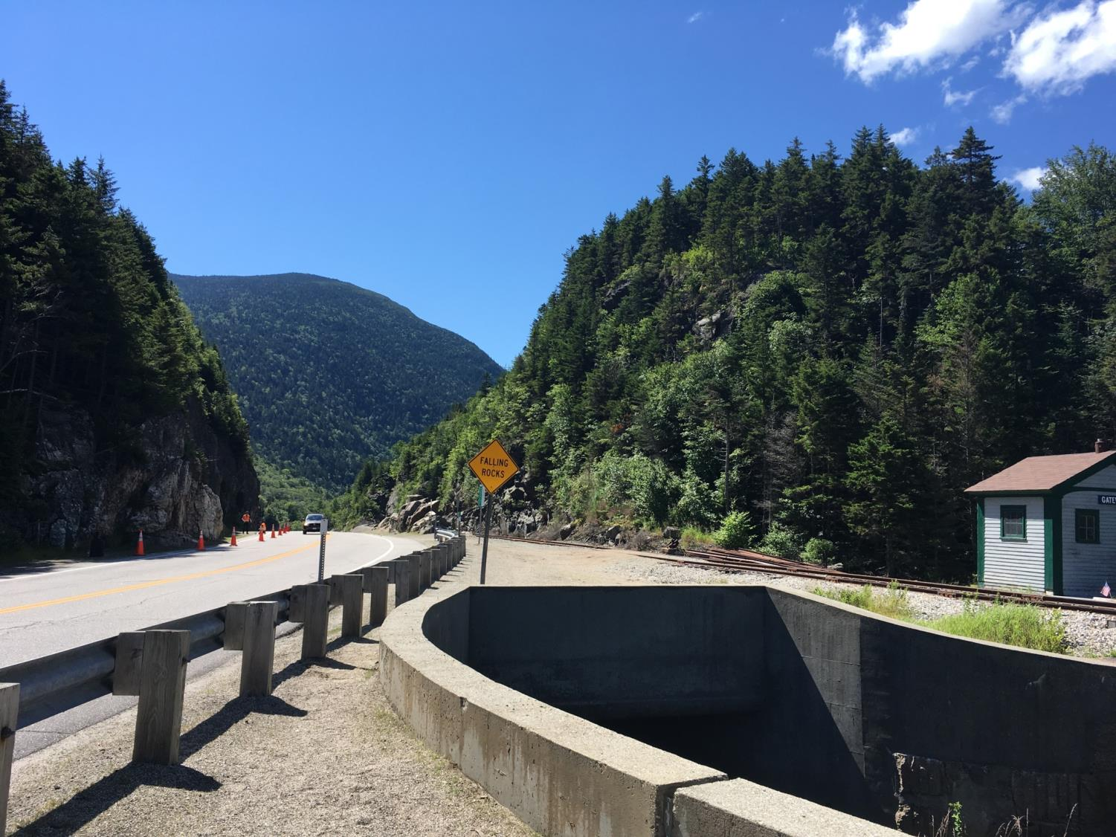

Use of 3D Point Cloud Data for Rock Slope Assessment
Neil Olson¹, Corinne Disenhof¹, Krystle Pelham¹, Tayler Engel², Jarlath O’Neil-Dunne²
¹New Hampshire DOT, ²University of Vermont
NEGSA
March 18, 2018

Slide 2
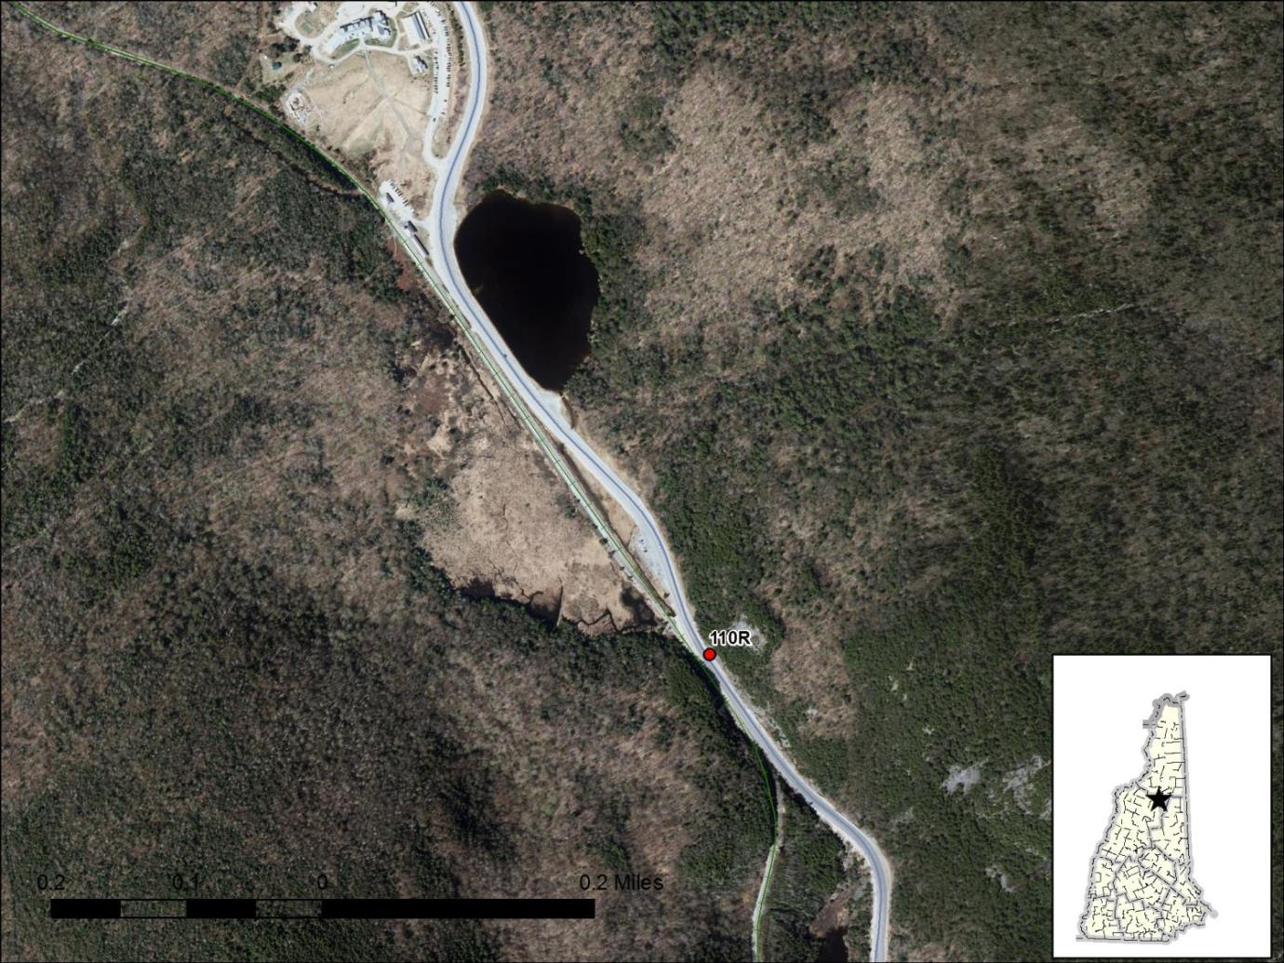
Crawford Notch
Survey/Data/Analysis
Warner
Survey/Data/Analysis
Conclusions
Comparison/Pros/Cons

Slide 3
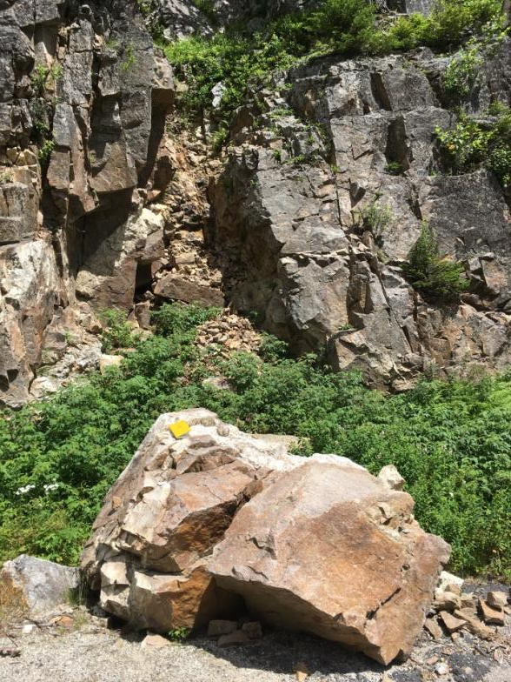
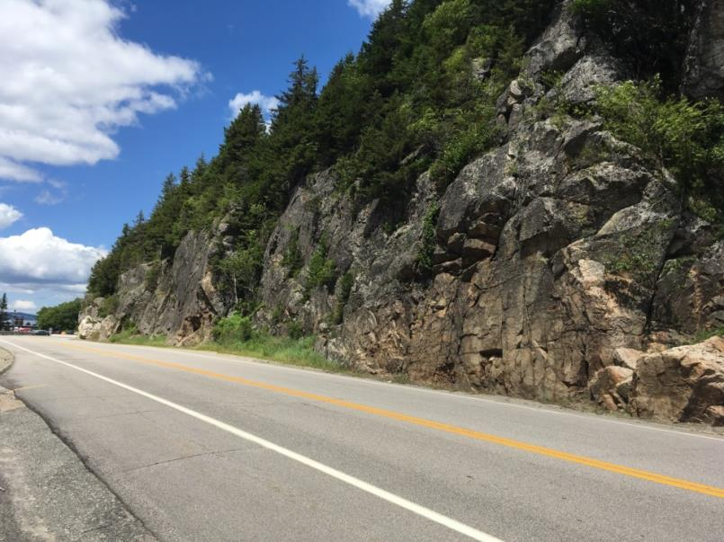
Crawford Notch
Survey/Data/Analysis
Warner
Survey/Data/Analysis
Conclusions
Comparison/Pros/Cons
Highest hazard in our rating system
High (100 ft)
Constructed in present form in 1961
Little shoulder/ditch width

Slide 4
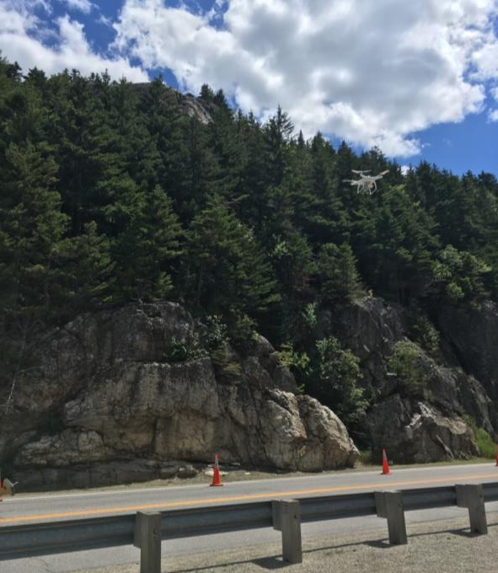
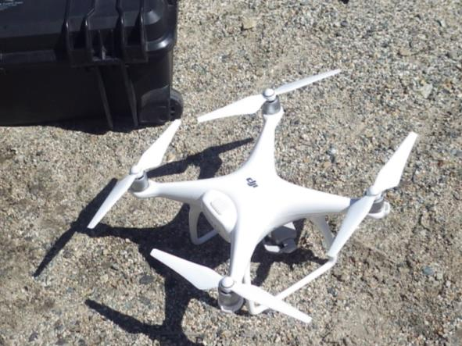
Crawford Notch
Survey/Data/Analysis
Warner
Survey/Data/Analysis
Conclusions
Comparison/Pros/Cons
SPR2 funded project
DOT Contact: Rita Hunt, Aeronautics
PI: Prof. Jarlath O’Neill-Dunne, UVM SAL
Pilot: Tayler Engel, UVM
Instrument: DJI Phantom 4, data processed with Pix4D
Purpose: Compare a rock cut assessment using UAS data to that from data collected manually
Flight: July 26, 2017

Slide 5
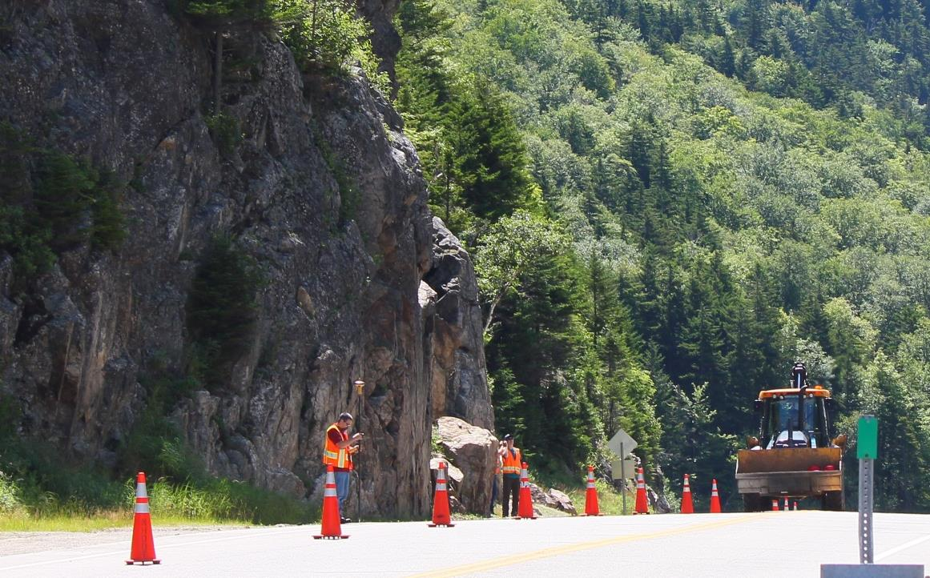
Crawford Notch
Survey/Data/Analysis
Warner
Survey/Data/Analysis
Conclusions
Comparison/Pros/Cons
Coordination with maintenance: Work on a catch basin the same day necessitated the closure of a passing lane and allowed for room to fly UAS

Slide 6
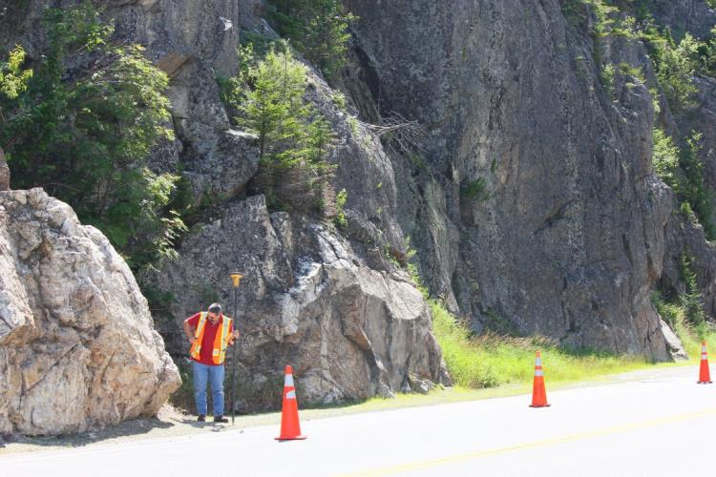
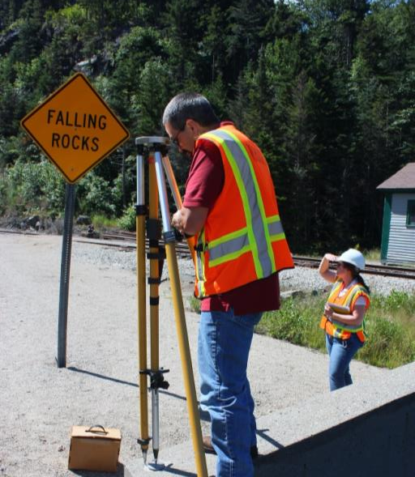
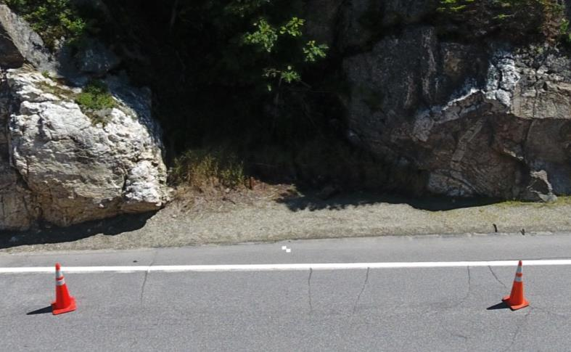
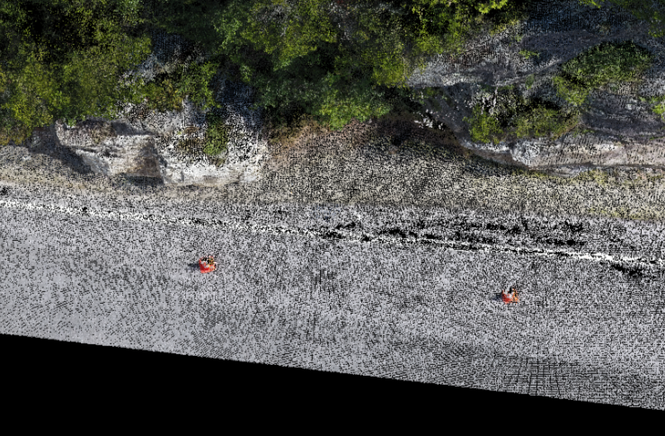
Crawford Notch
Survey/Data/Analysis
Warner
Survey/Data/Analysis
Conclusions
Comparison/Pros/Cons
X,Y,Z
X,Y,Z

Slide 7
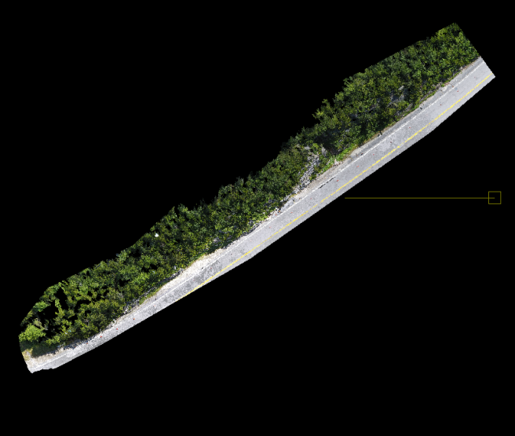
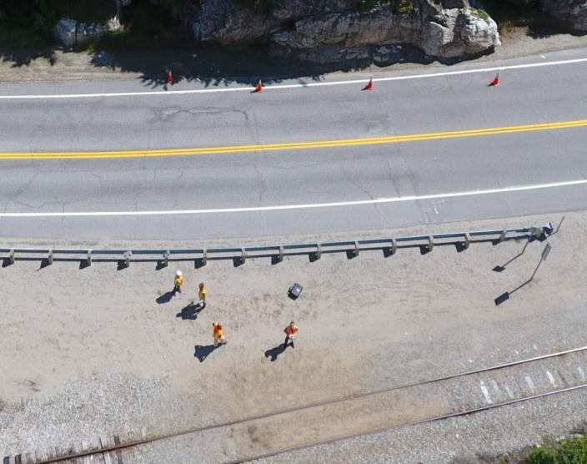
Crawford Notch
Survey/Data/Analysis
Warner
Survey/Data/Analysis
Conclusions
Comparison/Pros/Cons
UVM acquired 3828m² area and processed the data using Pix4D
Oriented point cloud 1.82x10⁷points
310 high-resolution images (and 2 videos)
4754 points/m²

Slide 8
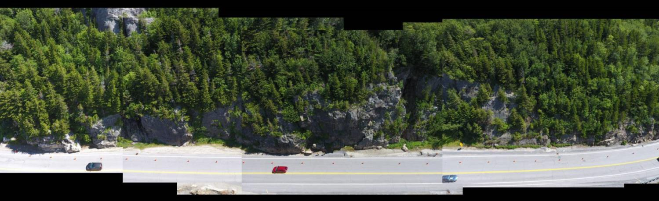
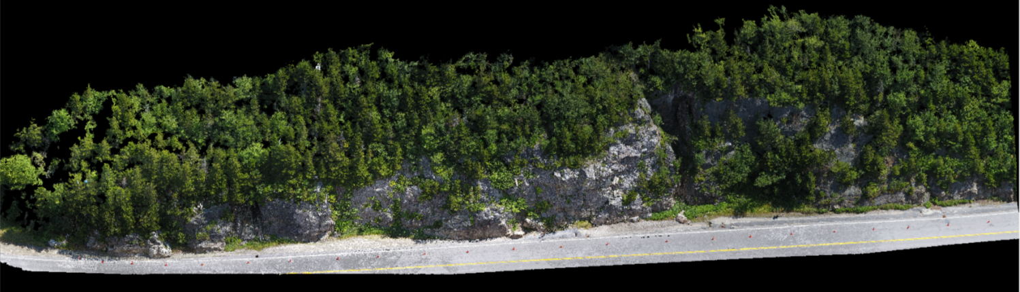
Crawford Notch
Survey/Data/Analysis
Warner
Survey/Data/Analysis
Conclusions
Comparison/Pros/Cons
Photo panorama (top) and point cloud (bottom)

Slide 9
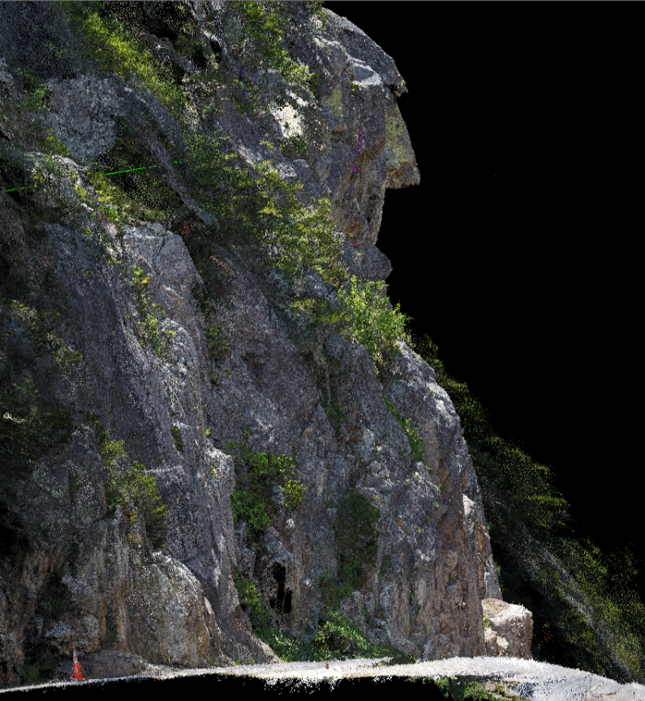
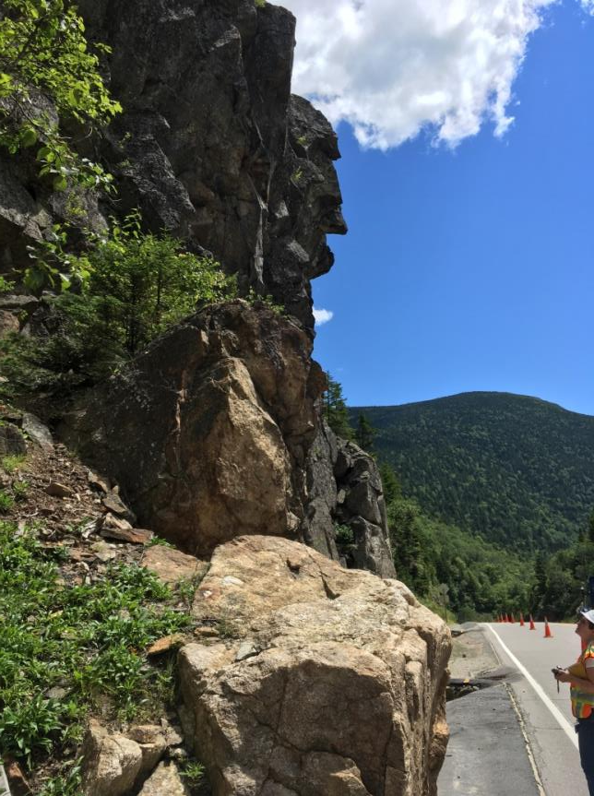
Crawford Notch
Survey/Data/Analysis
Warner
Survey/Data/Analysis
Conclusions
Comparison/Pros/Cons
Original image (left) and point cloud (right)

Slide 10
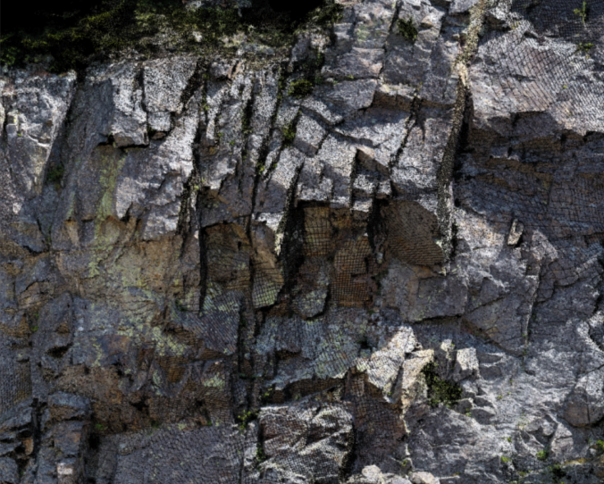
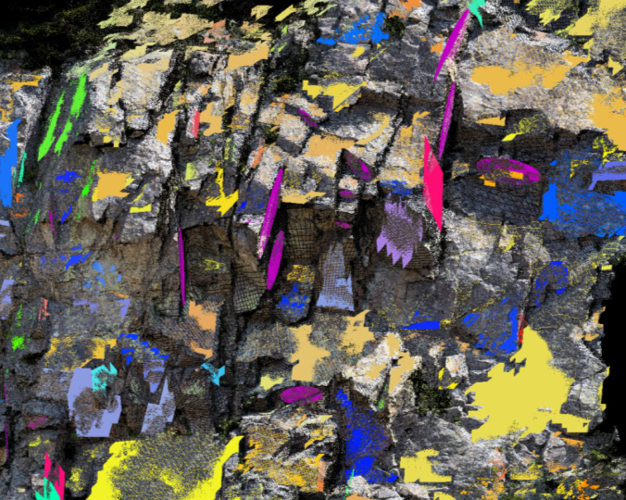
Crawford Notch
Survey/Data/Analysis
Warner
Survey/Data/Analysis
Conclusions
Comparison/Pros/Cons
DOT used Split-FX and Stereonet for fracture analysis
Orient point cloud in Split-FX
Create mesh
Find patches (auto)
Inspect and edit patches
Add traces
Stereonet analysis
Top: Point cloud
Bottom: Auto-identified fracture surfaces (multi-colored) and manual fracture traces (pink)

Slide 11
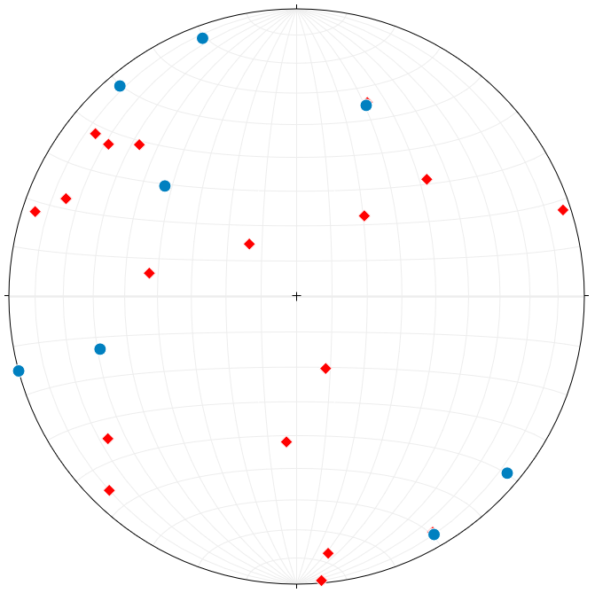
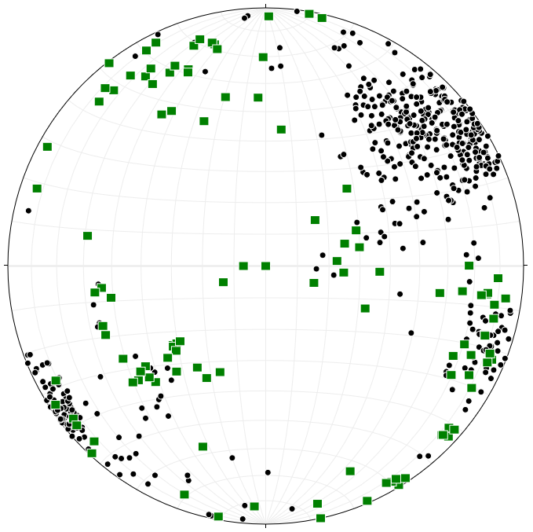
Crawford Notch
Survey/Data/Analysis
Warner
Survey/Data/Analysis
Conclusions
Comparison/Pros/Cons
Collected with Compass (27)
Generated on Point Cloud (615)
Previously gathered
Same time as drone
Manually delineated
Auto generated

Slide 12
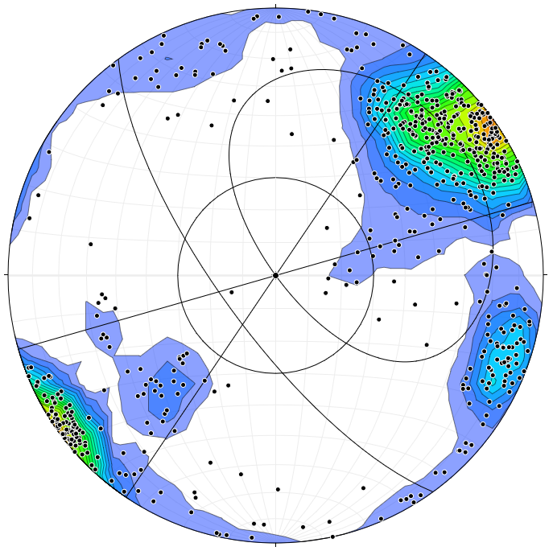
Planar Sliding
Crawford Notch
Survey/Data/Analysis
Warner
Survey/Data/Analysis
Conclusions
Comparison/Pros/Cons

Slide 13
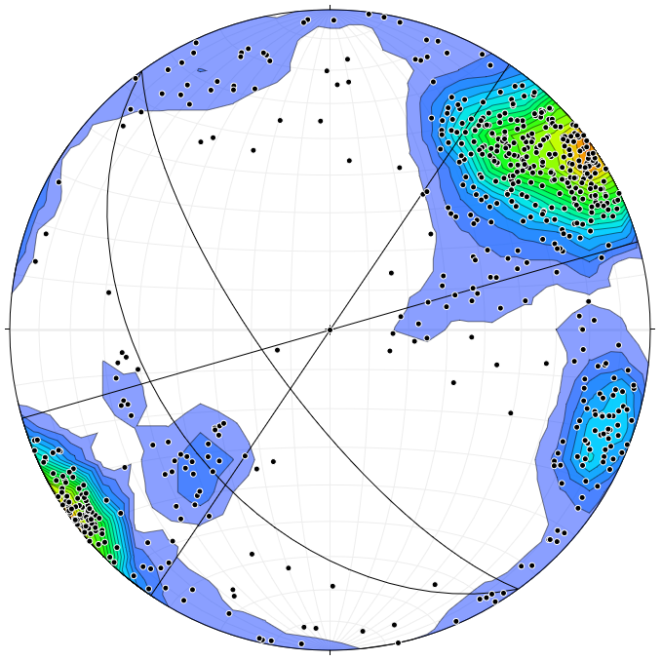
Flex Toppling
Crawford Notch
Survey/Data/Analysis
Warner
Survey/Data/Analysis
Conclusions
Comparison/Pros/Cons

Slide 14
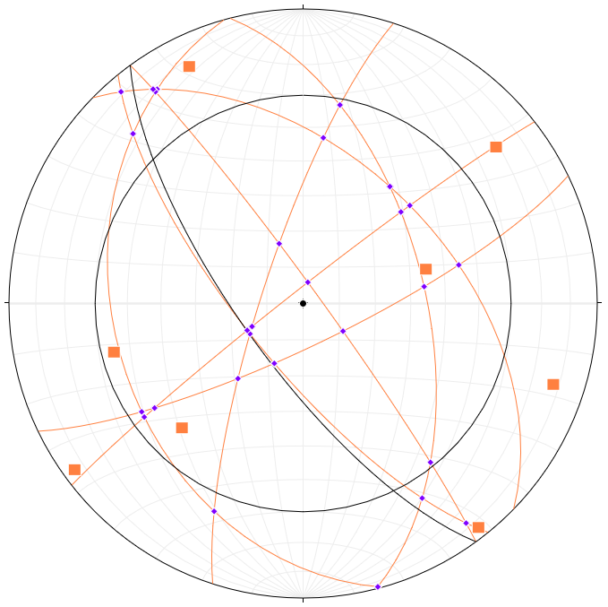
Wedge
Crawford Notch
Survey/Data/Analysis
Warner
Survey/Data/Analysis
Conclusions
Comparison/Pros/Cons

Slide 15
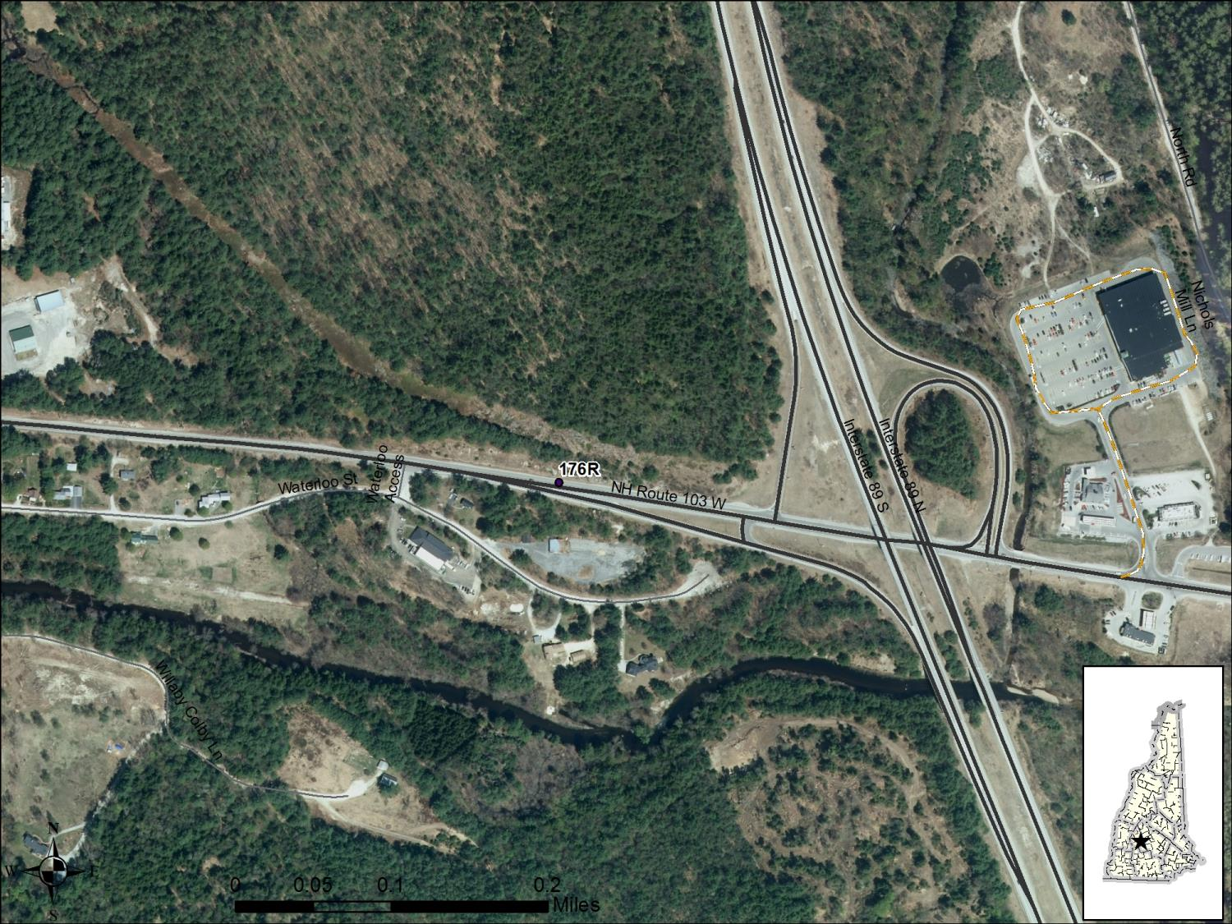
Crawford Notch
Survey/Data/Analysis
Warner
Survey/Data/Analysis
Conclusions
Comparison/Pros/Cons

Slide 16
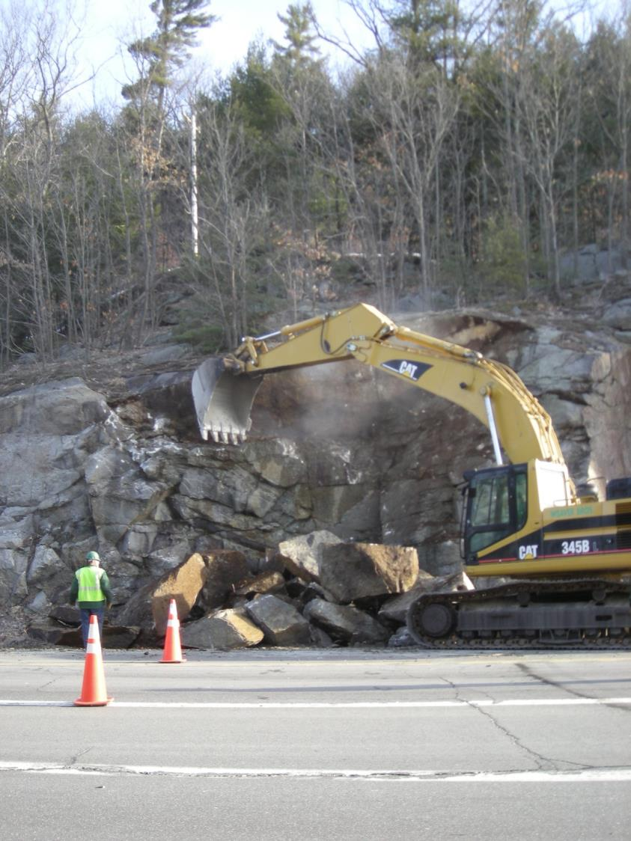
Crawford Notch
Survey/Data/Analysis
Warner
Survey/Data/Analysis
Conclusions
Comparison/Pros/Cons
9th Highest Rank in RHRS
Constructed in 1968
Machine scaled in 2008

Slide 17
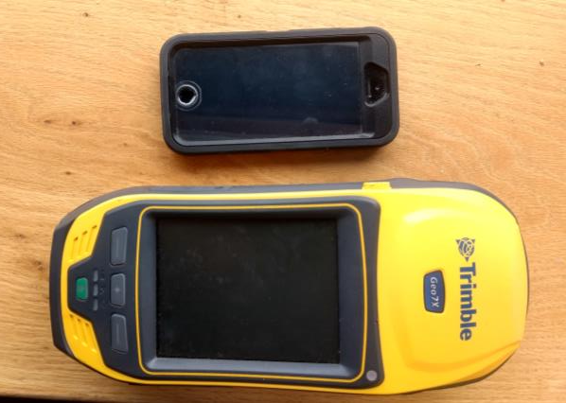
Crawford Notch
Survey/Data/Analysis
Warner
Survey/Data/Analysis
Conclusions
Comparison/Pros/Cons
82 pictures taken with iPhone SE
Ground Control Points collected with mapping grade GPS (Trimble 7x)
Data processed in VisualSFM and georeferenced in SfM Georef
3.76X10⁶ points
2612 m² area
1439 pts/m²

Slide 18
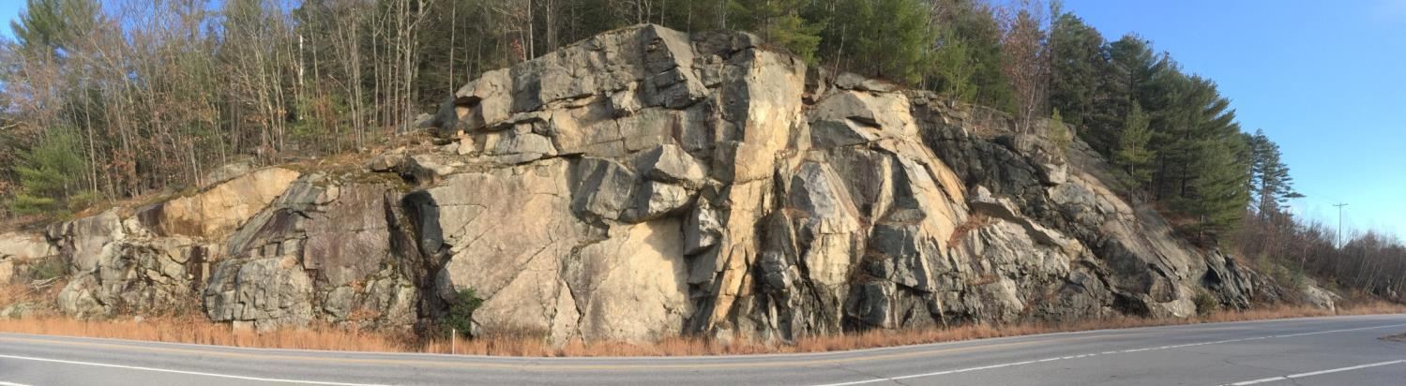
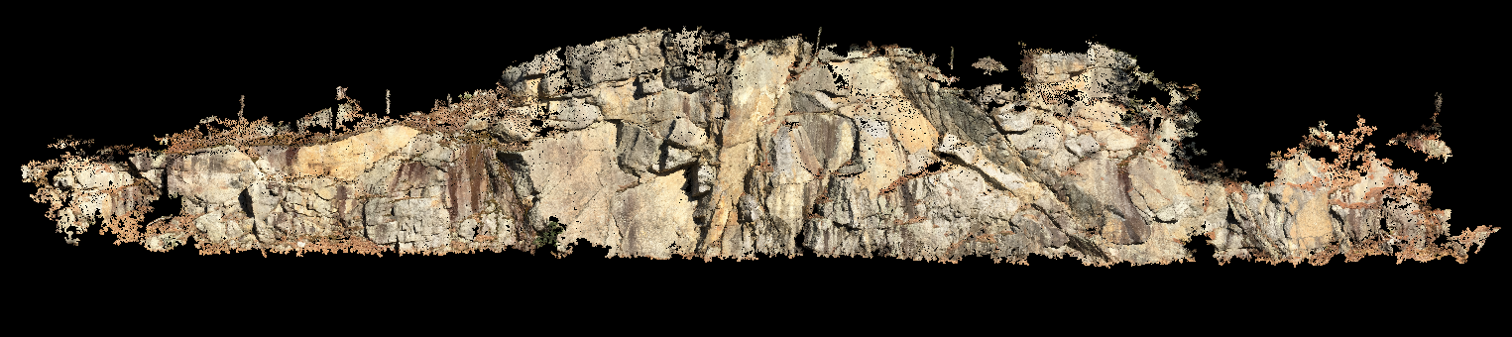
Crawford Notch
Survey/Data/Analysis
Warner
Survey/Data/Analysis
Conclusions
Comparison/Pros/Cons

Slide 19
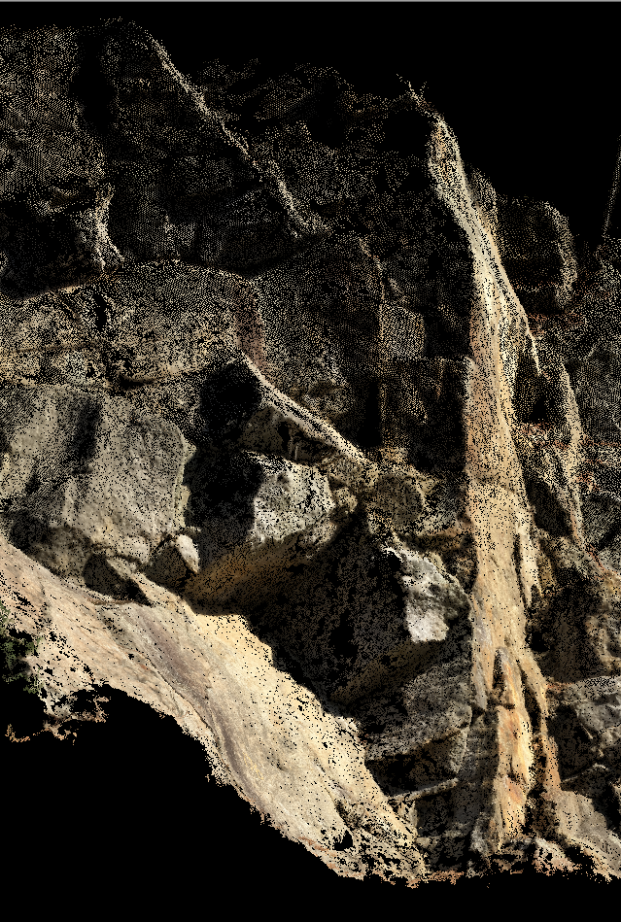
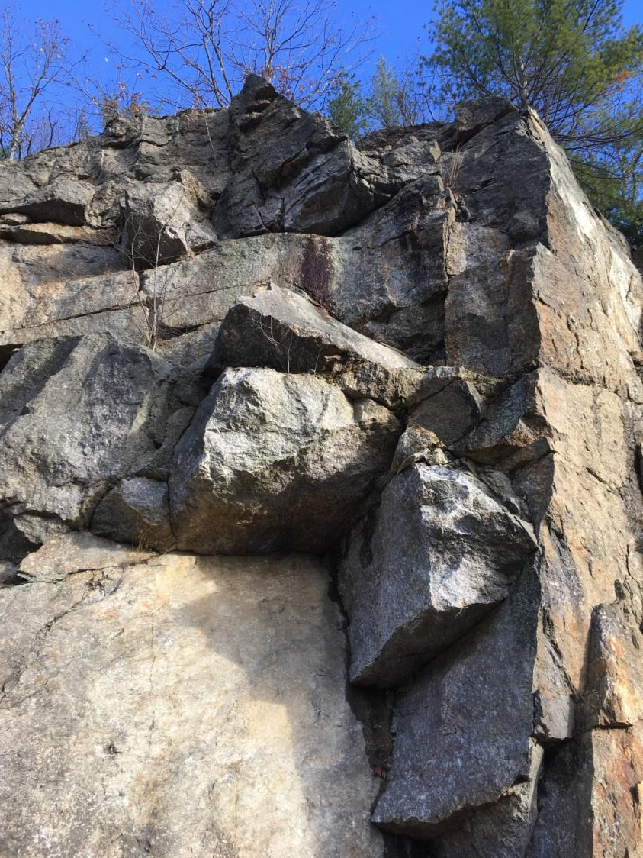
Crawford Notch
Survey/Data/Analysis
Warner
Survey/Data/Analysis
Conclusions
Comparison/Pros/Cons

Slide 20
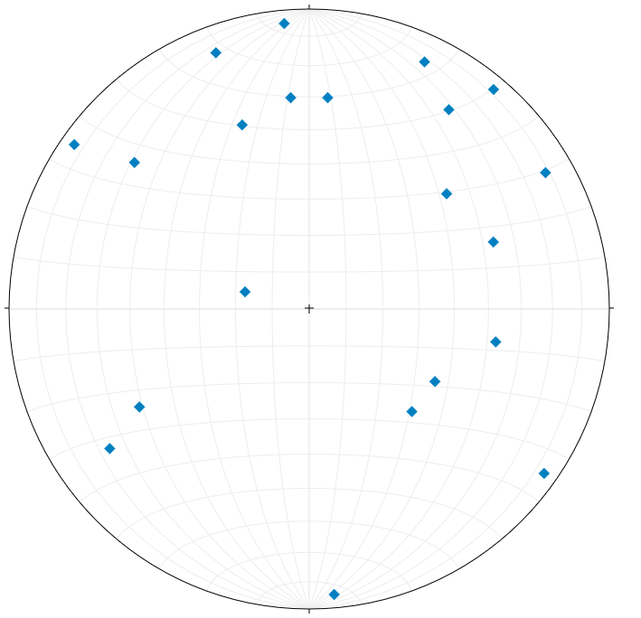
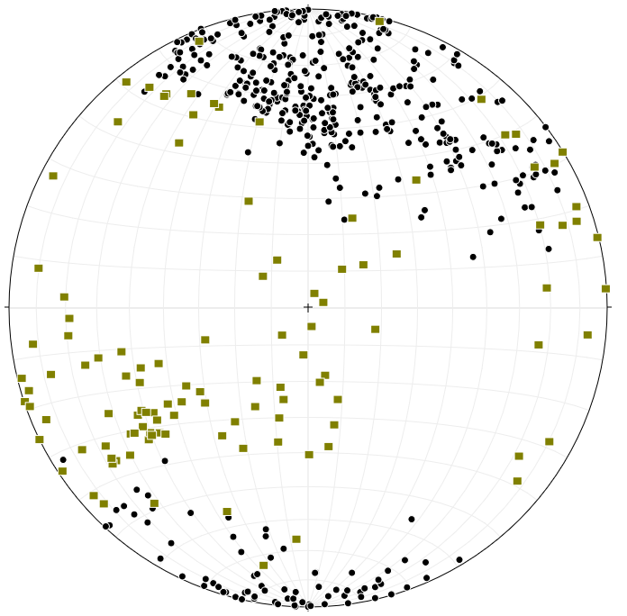
Crawford Notch
Survey/Data/Analysis
Warner
Survey/Data/Analysis
Conclusions
Comparison/Pros/Cons
Collected with Compass (9)
Generated on Point Cloud (834)
Manually delineated
Auto generated
Previously gathered

Slide 21
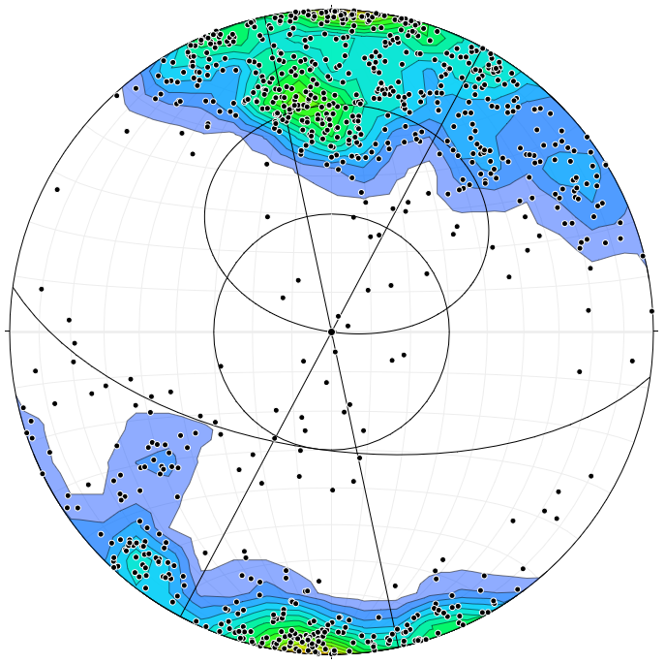
Plane Sliding
Crawford Notch
Survey/Data/Analysis
Warner
Survey/Data/Analysis
Conclusions
Comparison/Pros/Cons

Slide 22
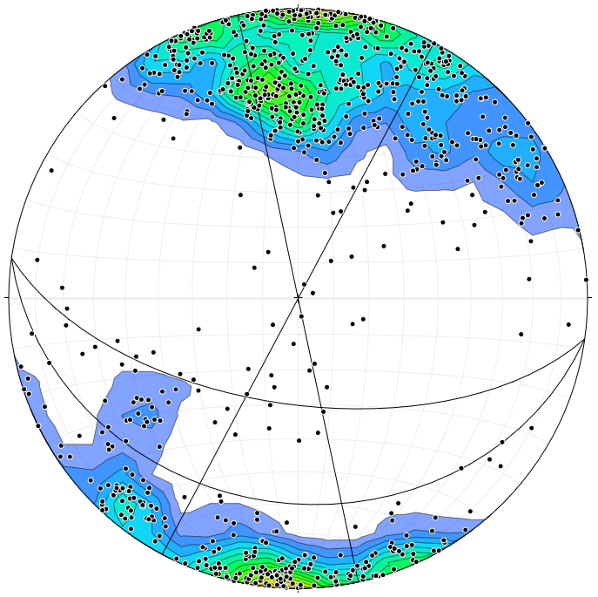
Flex Toppling
Crawford Notch
Survey/Data/Analysis
Warner
Survey/Data/Analysis
Conclusions
Comparison/Pros/Cons

Slide 23
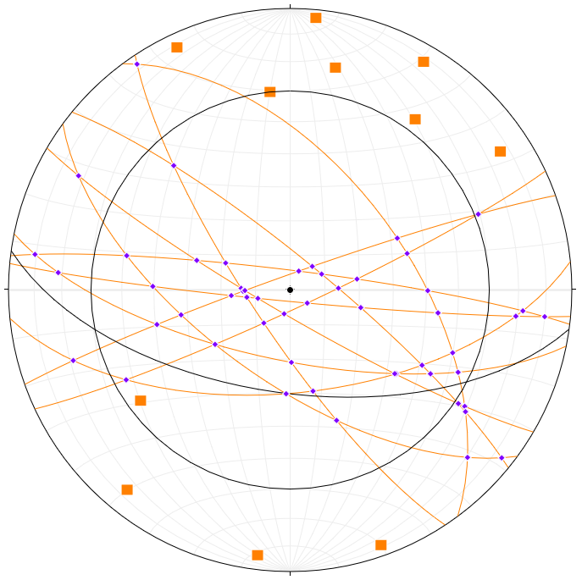
Wedge
Crawford Notch
Survey/Data/Analysis
Warner
Survey/Data/Analysis
Conclusions
Comparison/Pros/Cons

Slide 24
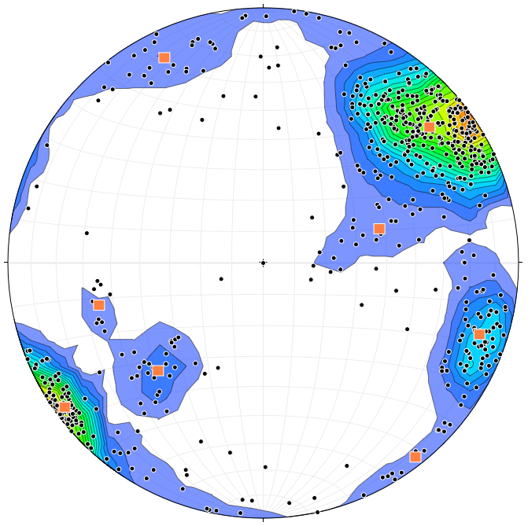
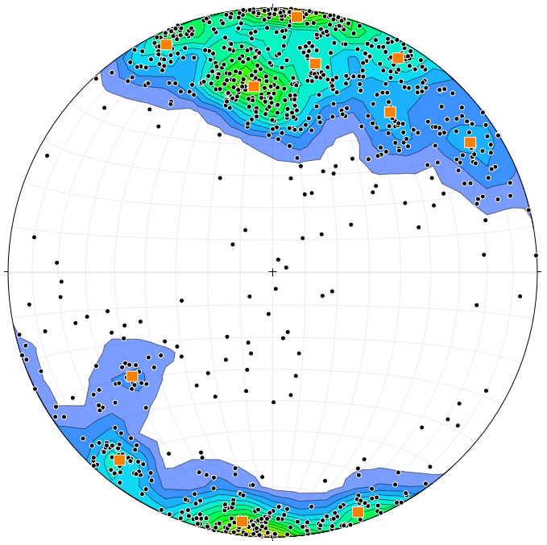
Crawford Notch
Survey/Data/Analysis
Warner
Survey/Data/Analysis
Conclusions
Comparison/Pros/Cons
Crawford Notch
Warner

Slide 25
Crawford Notch
Survey/Data/Analysis
Warner
Survey/Data/Analysis
Conclusions
Comparison/Pros/Cons

Slide 26
Crawford Notch
Survey/Data/Analysis
Warner
Survey/Data/Analysis
Conclusions
Comparison/Pros/Cons
More than just a pretty picture (but they are pretty)
Photogrammetry allows measurement of many more structural measurements than possible by hand
Increased coverage, time by bringing into the office
Ability to measure heights, volumes, profiles of otherwise unreachable spots
Potential to quantify change
Detailed profiles

Slide 27
Crawford Notch
Survey/Data/Analysis
Warner
Survey/Data/Analysis
Conclusions
Comparison/Pros/Cons
UAS has higher level of entry, needs more space
Ground based can be prone to line of sight issues
Automated methods biased to slope face
Vegetation can be an issue
Unknown accuracy/repeatability
Z values from GPS can be inaccurate
Freeware has some limitations

Slide 28
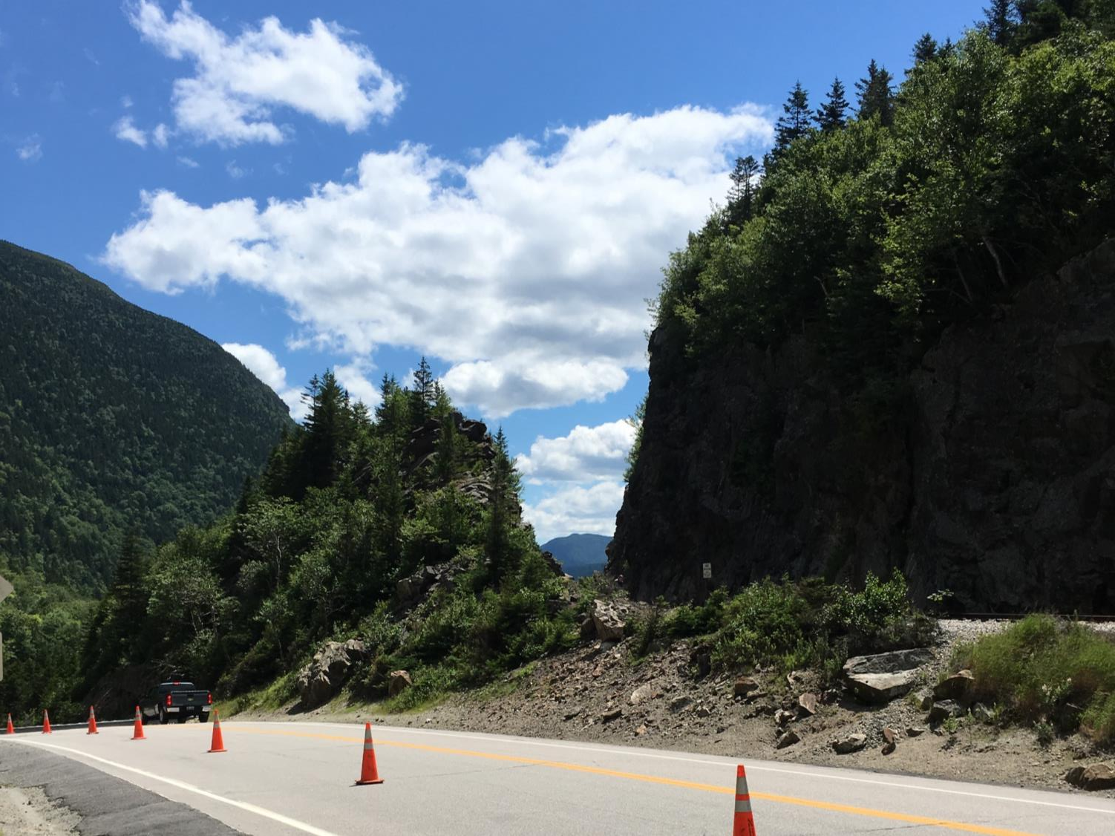
Questions?
Changchang Wu, "Towards Linear-time Incremental Structure From Motion", 3DV 2013
Changchang Wu, Sameer Agarwal, Brian Curless, and Steven M. Seitz, "Multicore Bundle Adjustment", CVPR 2011
Changchang Wu, "SiftGPU: A GPU implementation of Scale Invaraint Feature Transform (SIFT)", http://cs.unc.edu/~ccwu/siftgpu, 2007
James, M. R. and Robson, S. (2012) Automated image-based 3-D surface reconstruction for the geosciences: Accuracy and application, J. Geophys. Res., 117, F03017, doi:10.1029/2011JF002289

