Slide 1
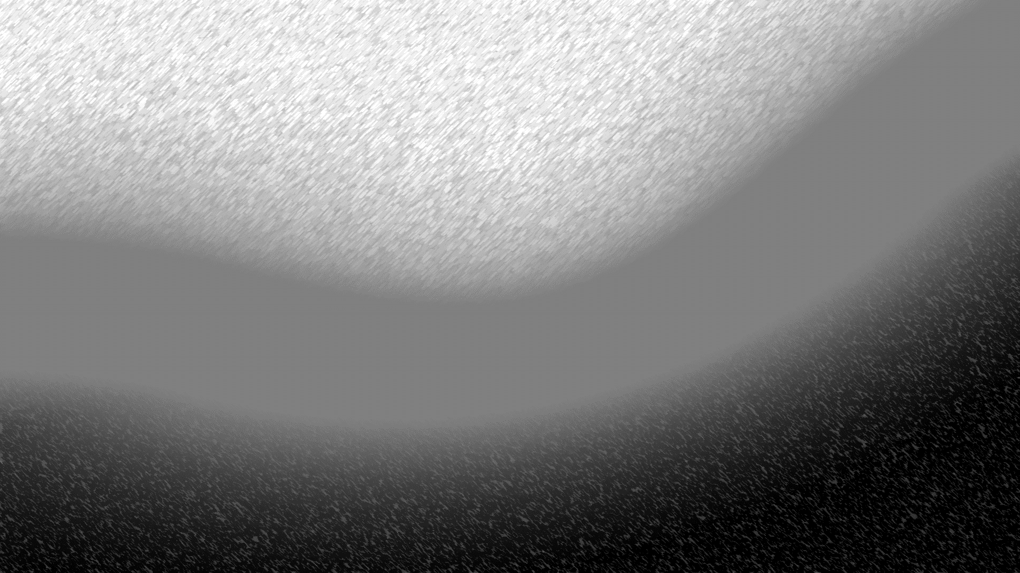


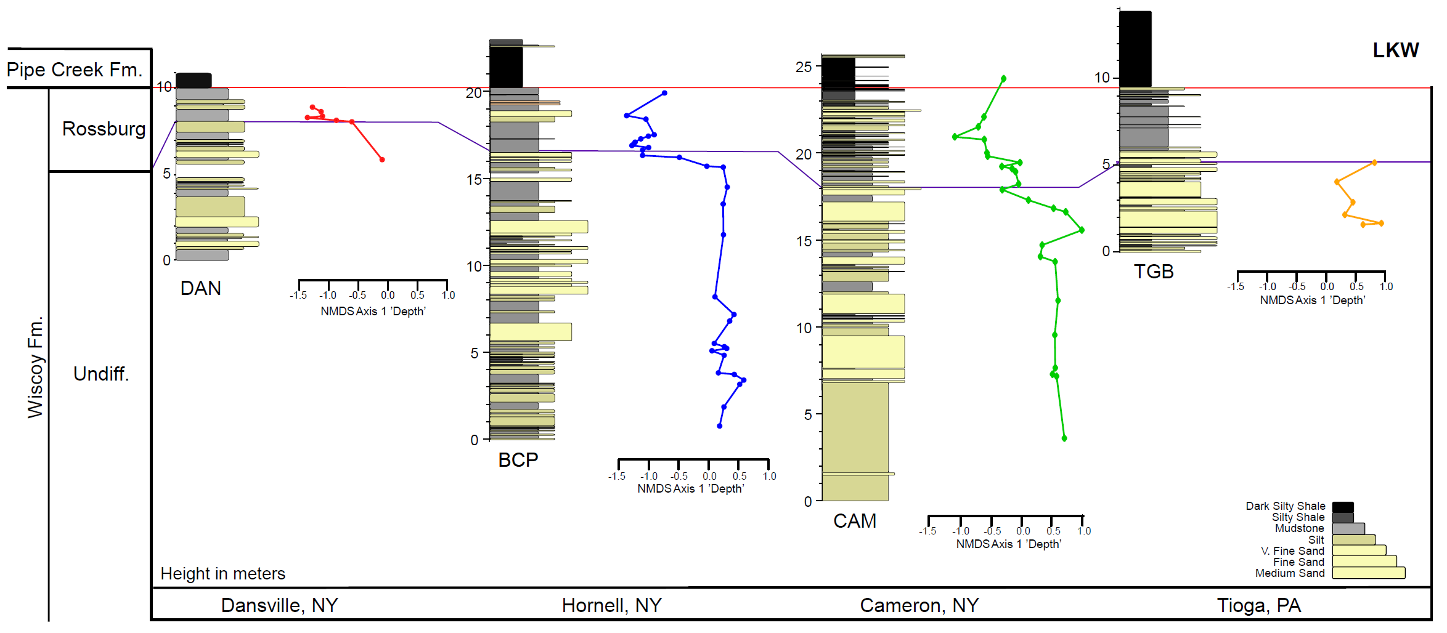
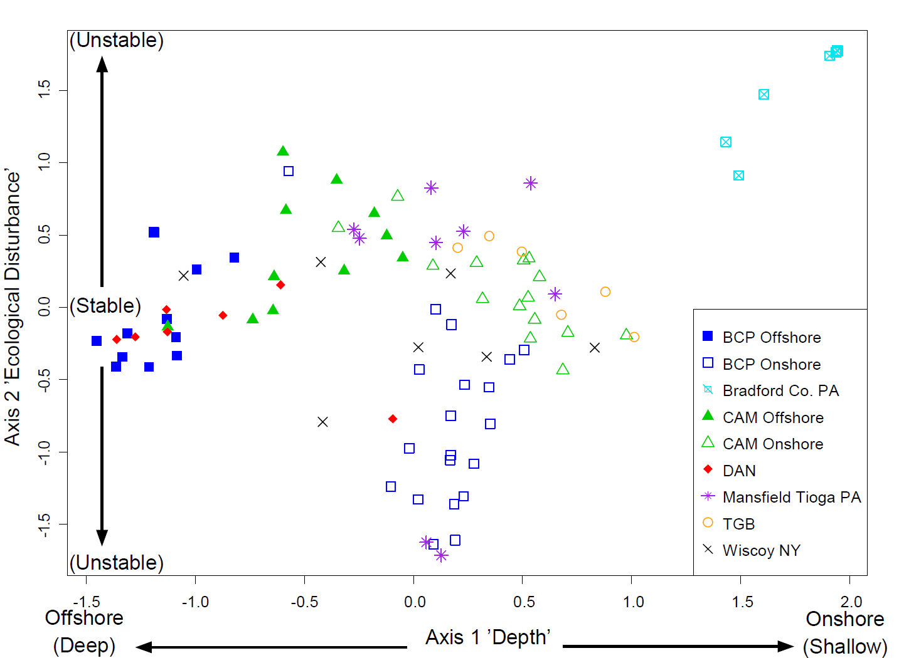
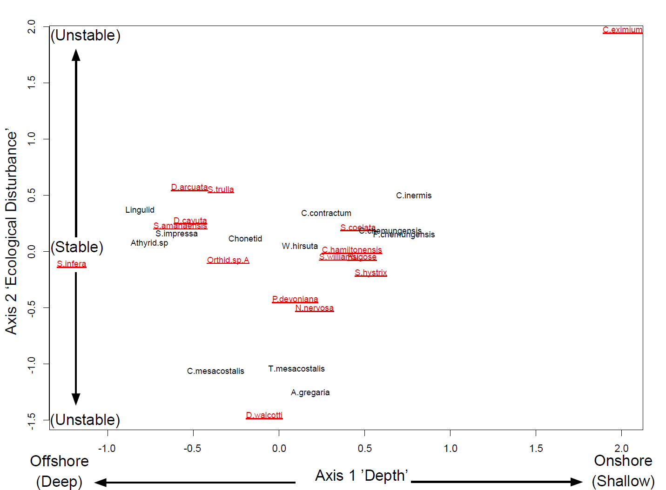
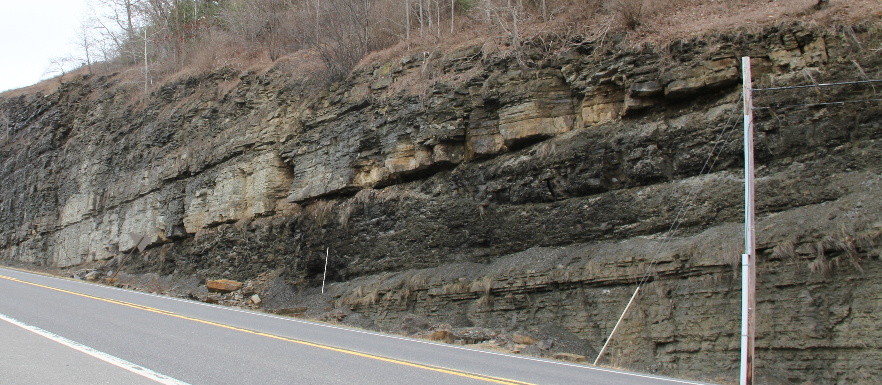
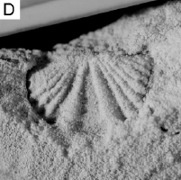
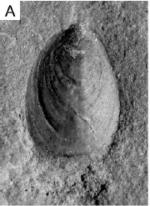
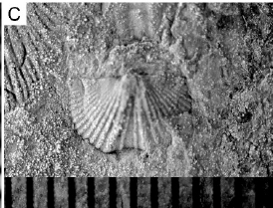
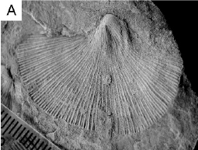

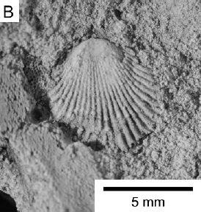
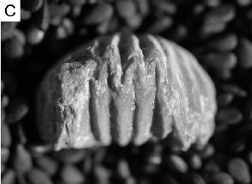
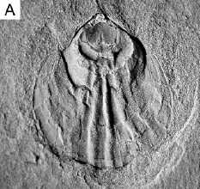
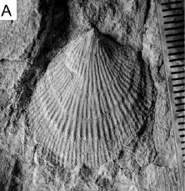
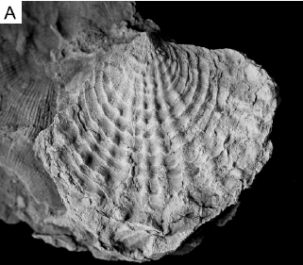
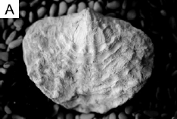
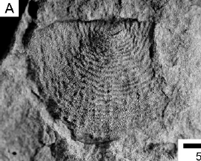
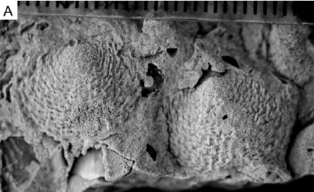
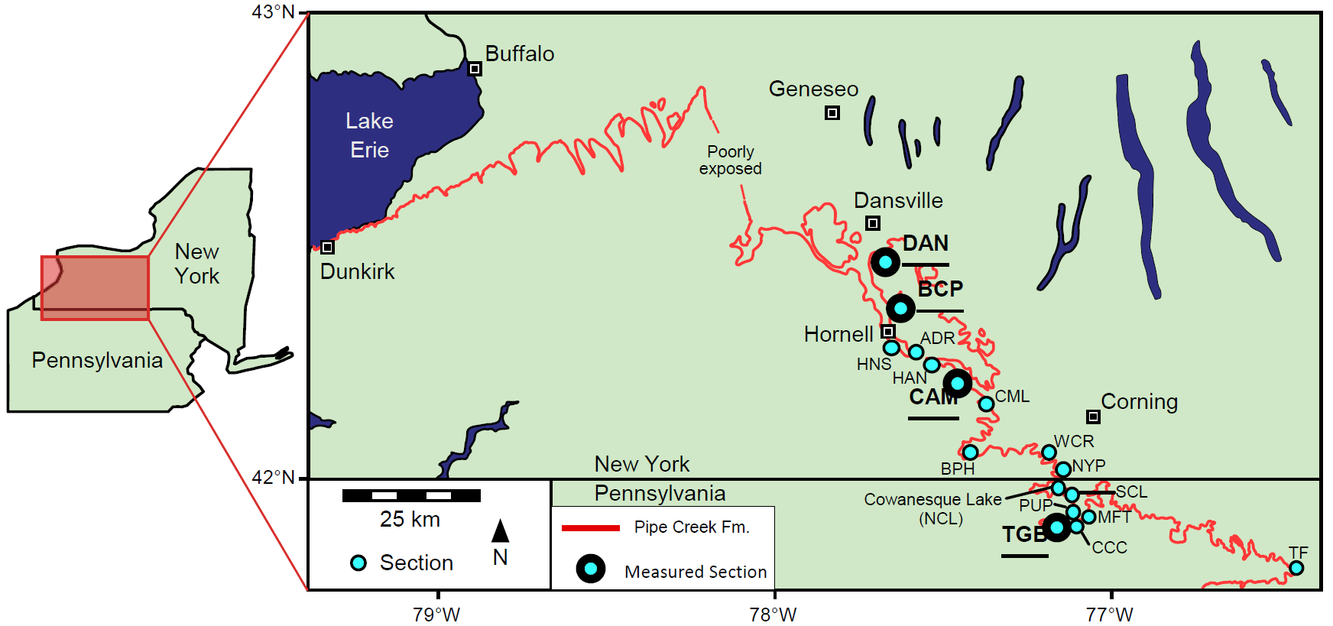
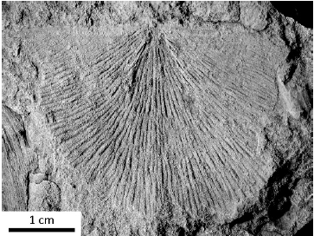
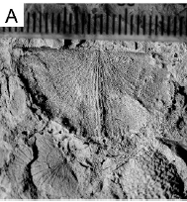
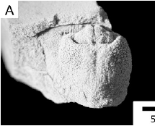
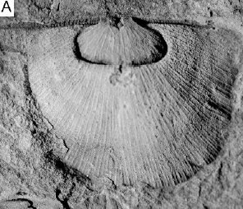
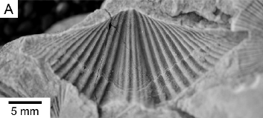
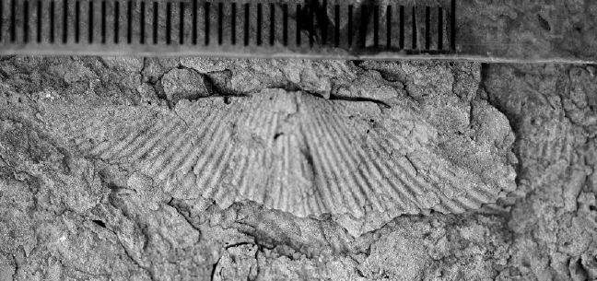
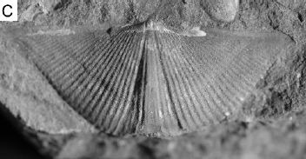
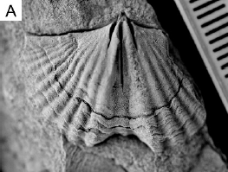
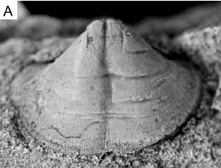
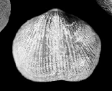
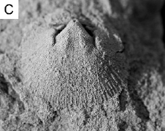
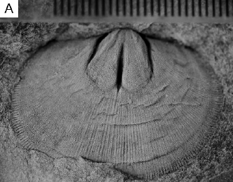
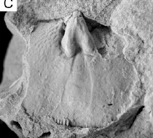
PALEOENVIRONMENTAL SELECTIVITY OF THE LOWER KELLWASSER MASS EXTINCTION EVENT (LATE DEVONIAN) IN NEW YORK AND PENNSYLVANIA
PIER, Jaleigh Q.¹, BRISSON, Sarah², BUSH, Andrew M.^{1,2}
¹Ecology and Evolutionary Biology, University of Connecticut, 75 N Eagleville Road, Unit 3043, Storrs, CT 06269
²Center of Integrative Geosciences, University of Connecticut, Storrs, CT Jaleigh.pier@uconn.edu
Introduction
The Frasnian-Famennian Extinction (Late Devonian, ~374 Ma), one of Raup and Sepkoski’s (1982) ‘Big Five’ mass extinctions, included two extinction pulses, the Lower and Upper Kellwasser Events. Potential kill mechanisms include a global cooling pulse, ocean acidification, and widespread anoxia in marine environments (Carmichael et al., 2014; Joachimski and Buggisch, 1993, 2002; Lash, 2017). Numerous clades were affected, including brachiopods, ammonoids, placoderms, rugose and tabulate corals, and stromatoporoids (Copper, 1998, 2002; House, 1985).
In many mass extinction events, certain traits correlate with survival, whereas other traits appear to have increased sensitivity to climatic and environmental changes (Clapham and Payne, 2011; Finnegan et al. 2016). Assessing mass extinction selectivity can help constrain which environmental changes were the most effective kill mechanisms. Here, we test whether extinction intensity varies across paleoenvironments for brachiopods during the Lower Kellwasser Event, the first pulse of the Frasnian-Famennian extinction, in the Appalachian Basin. By testing selectivity, we hope to better constrain which kill mechanisms were most closely associated with this event.
Results and Discussion
TF
Other NY
Figure 5. NMDS Axis 1 scores (‘depth’) compared with stratigraphy from measured sections TGB, CAM, BCP, and DAN. For locations refer to Fig. 2.
Figure 3. NMDS showing sample scores labeled by site location.
Figure 4. NMDS showing species scores. Each species location approximates their preferred paleoenvironment. Red text = extinct.
The upper Wiscoy Formation records a transition from primarily sandy to primarily muddy sediments (the “Rossburg Member” of Bush et al. in review), indicating a basin-wide deepening event leading into the Pipe Creek. Fossil samples record a shift from high to low NMDS Axis 1 values across this transition at four sections (Fig. 5), which supports our ‘depth’ gradient interpretation for NMDS Axis 1. The four measured sections span much of the offshore-onshore gradient. Within the undifferentiated Wiscoy Formation and within the “Rossburg”, NMDS 1 scores are slightly more positive in the onshore localities, again supporting our interpretation of this axis.
NMDS Axis 1 describes a gradient in species composition, with offshore localities to the left and onshore localities to the right; this interpretation is based on inferred depositional environments of the samples based on lithology and sedimentary structures (Beard et al. 2017). Each individual species preferred a specific paleoenvironment, which may have depended on depth and a series of correlated factors such as food availability, temperature, oxygenation, storm frequency, ocean chemistry, and habitat structure (‘depth’ for convenience) (Holland et al., 2001). Several species that diverge from the ‘depth’ gradient on the vertical axis are interpreted as opportunistic species, or at least as species that thrive in environments that others cannot tolerate. Ambocoelia gregaria has been previously described as an opportunistic species due to its gregarious blooming behavior in disturbed muddy to sandy areas (Bush and Brame, 2010; Goldman and Mitchell, 1990). Cupularostrum eximium fits a similar high-dominance pattern within nearshore, tidally influenced environments where other species were rare. We interpret NMDS Axis 2 as reflecting environmental disturbance; stable environments are found in the middle of the axis and unstable/unfavorable environments are at either extreme.
Anoxia could preferentially affect deep-water species (Finnegan et al. 2016) because shallow waters are better mixed with the atmosphere. However, species that go extinct span the entire ‘depth’ gradient (Fig. 4). There does seem to be selectivity associated with taxonomic order, with strophomenids and atrypids strongly affected (see below). This pattern could be related to climate change according to Copper (1986), who noted that the atrypids are a tropical group.
Geologic Setting
During the Late Devonian, a thick fossiliferous package of siliciclastic sediments was deposited in the Appalachian Foreland Basin. An offshore-onshore paleoenvironmental gradient stretches from Western New York southeastward into northern Pennsylvania. Recent stratigraphic revisions have correlated the Upper and Lower Kellwasser Events throughout the region (Beard et al., 2017; Bush et al., 2015). This paleoenvironmental gradient serves as the perfect setting to test for extinction selectivity with respect to environmental preference among brachiopod species. Brachiopod fossils are abundant and generally well preserved, though often moldic, and previous studies have shown that species vary in depth preference (Bush and Brame, 2010; McGhee and Sutton, 1981; 1983). To reconstruct species’ preferred environments prior to environmental perturbations, samples were analyzed from the Wiscoy Formation, which immediately predates the Lower Kellwasser Extinction (Beard et al., 2017; Bush et al., 2015).
Conclusions
We examined brachiopods from a paleoenvironmental gradient to test for selective extinction during the Lower Kellwasser Event. Species extinction does not seem to correlate with preferred ‘depth’, with victims spread across the entire gradient. Based on these results we cannot conclude that anoxia associated with depth was a primary driver for extinction selectivity. However, extinction may have been selective with respect to taxonomic order, which deserves further analysis. Continuing work will include a quantitative test of selectivity using multiple logistic regression that incorporates depth preference, endemism, proportional abundance, taxonomic order, and other factors.
Canaseraga Fm.
(Post-Extinction)
Victims:
Orders
Survivors:
Pipe Creek Fm.
EXTINCTION
Other
Acknowledgments
Wiscoy Fm.
(Pre-Extinction)
Cyrtina hamiltonensis
Lingulids
Chonetids
Floweria chemungensis
Thank you to the 2017 EEB Department Zoology Award, the National Science Foundation (EAR-0922186, EAR-1738121), Morgan Tingley, Lisa Park Boush, Andrew Beard, Michael Hren, Anjali Fernandes, and the UConn EEB Department.
2 m
Rhynconellida
Figure 1. Extinction interval at Tioga, PA (TGB). PC: Andy Bush
Cupularostrum eximium
Cupularostrum contractum
Camarotoechia mesacostalis
Methods
Bulk samples were collected from 17 localities along the paleoenvironmental gradient. We have identified 8,400 brachiopod fossils from 26 species based on the illustrations in Bush et al. (2017). Species can be distinguished, although some genus-level placements require revision. Abundance data were assembled for 95 samples, each consisting of at least 30 identifiable brachiopod individuals. Non-metric multidimensional scaling was used to quantify variation in species composition.
Atrypida
Literature Cited
Beard, J.A., Bush, A.M., Fernandes, A.M., Getty, P.R., and Hren, M.T., 2017, Stratigraphy and paleoenvironmental analysis of the Frasnian-Famennian (Upper Devonian) boundary interval in Tioga, north-central Pennsylvania: Palaeogeography, Palaeoclimatology, Palaeoecology.
Bush, A.M., and Brame, R.I., 2010, Multiple paleoecological controls on the composition of marine fossil assemblages from the Frasnian (Late Devonian) of Virginia, with a comparison of ordination methods: Paleobiology, v. 26, p. 573–591.
Bush, A.M., Csonka, J.D., DiRenzo, G. V., Over, D.J., and Beard, J.A., 2015, Revised correlation of the Frasnian–Famennian boundary and Kellwasser Events (Upper Devonian) in shallow marine paleoenvironments of New York State: Palaeogeography, Palaeoclimatology, Palaeoecology, v. 433, p. 233– 246.
Bush, A.M., Beard, A.J., Baird, G., Over, J.D., Tuskes, K., Brisson, S.K., and Pier, J.Q., 2017, A2 and B2: Upper Devonian Kellwasser Extinction Events in New York and Pennsylvania: Offshore to Onshore Transect Across the Frasnian-Famennian Boundary on the Eastern Margin of the Appalachian Basin in Muller, O.H., ed., New York Geological Association 89th Annual Meeting Field Trip Guidebook: New York State Geological Society, p. 74-116.
Carmichael, S.K., Waters, J.A., Suttner, T.J., Kido, E., and DeReuil, A.A., 2014, A new model for the Kellwasser Anoxia Events (Late Devonian): Shallow water anoxia in an open oceanic setting in the Central Asian Orogenic Belt: Palaeogeography, Palaeoclimatology, Palaeoecology, v. 399, p. 394–403.
Clapham, M.E., and Payne, J.L., 2011, Acidification, anoxia, and extinction: A multiple logistic regression analysis of extinction selectivity during the Middle and Late Permian: Geology, v. 39, p. 1059–1062.
Copper, P., 1986, Frasnian-Famennian mass extinction and cold water oceans: Geology, v. 14, no. 10, p. 835-839.
Copper, P., 1998, Evaluating the Frasnian-Famennian mass extinction: Comparing brachiopod faunas: Acta Palaeontologica Polonica, v. 43, p. 137–154.
Copper, P., 2002, Reef development at the Frasnian/Famennian mass extinction boundary: Palaeogeography, Palaeoclimatology, Palaeoecology.
Finnegan, S., Rasmussen, C.M.Ø., Harper, D.A.T., 2016, Biogeographic and bathymetric determinants of brachiopod extinction and survival during the Late
Ordovician mass extinction: Proceedings of the Royal Society B, v. 283, p. 20160007.
Goldman, D., and Mitchell, C.E., 1990, Morphology, Systematics, and Evolution of Middle Devonian Ambocoeliidae (Brachiopoda), Western New York: Journal of Paleontology, v. 64, p. 79–99.
Holland, S.M., Miller, A.I., Meyer, D.L., and Dattilo, B.F., 2001, The detection of subtle biofacies within a single lithofacies: The Upper Ordovician Kope Formation of the Cincinnati, Ohio Region: PALAIOS, v. 16, no. 3, p. 205-217.
House, M.R., 1985, Correlation of mid-Palaeozoic ammonoid evolutionary events with global sedimentary perturbations: Nature, v. 313, p. 17-22.
Joachimski, M.M., and Buggisch, W., 1993, Anoxic events in the Late Frasnian—Causes of the Frasnian-Famennian faunal crisis? Geology, v. 21, p. 675– 678.
Joachimski, M.M., and Buggisch, W., 2002, Conodont apatite δ¹⁸O signatures indicate climatic cooling as a trigger of the Late Devonian mass extinction: Geology, v. 30, p. 711–714.
Lash, G.G., 2017, A multiproxy analysis of the Frasnian-Famennian transition in western New York State, U.S.A: Palaeogeography, Palaeoclimatology, Palaeoecology, v. 473, p. 108–122.
McGhee, G.R., and Sutton, R.G., 1983, Evolution of late Frasian (Late Devonian) marine environments in New York and the central Appalachians: Alcheringa, v. 7, p. 9–21.
McGhee, G.R., and Sutton, R.G., 1981, Late Devonian marine ecology and zoogeography of the central Appalachians and New York: Lethaia, v. 14, p. 27-43.
Raup, D.M., and Sepkoski, J.J., 1982, Mass extinctions in the marine fossil record: American Association for the Advancement of Science, v. 215, no. 19, p. 1501-1503.
Pseudoatrypa devoniana
Spinatrypa hystrix
Spinatrypa trulla
Productida
Devonoproductis walcotti
Whidbornella hirsuta
Nervostrophia nervosa
Strophomenida
Strophonelloides coelata
Douvillina arcuata
Douvillina cayuta
(Images from NYSGA Guidebook 2017)
Spiriferida
Spirifer williamsi
Cyrtospirifer chemungensis
Cyrtospirifer inermis
Tylothyris mesacostalis
Ambocoelia gregaria
Figure 2. Map of sample locations and study area.
Orthida
Stainbrookia infera
Orthid sp. A
Schizophoria impressa
Schizophoria amanaensis

