Slide 1

Geochemical variation in metasedimentary rocks adjacent to the Palisades Sill – metamorphic influence or original sediment composition?
Jane Alexander, Sean Thatcher and Victoria Rivelli

Slide 2
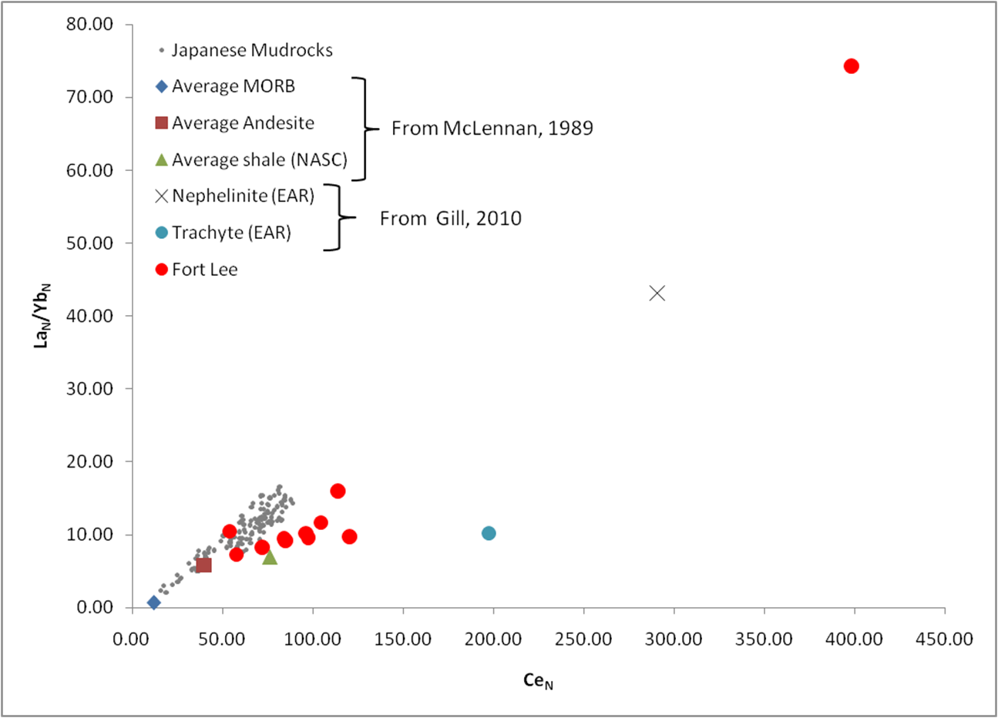
Purpose
Previous work suggested the presence of a volcanic ash in this area (site no longer accessible)
Some questions remain about the influence of contact metamorphism on the geochemistry, so current work was undertaken
To determine whether proximity to the contact with the sill influences geochemistry
To determine whether sediments that were visibly remobilized show any difference in geochemistry compared to regularly bedded sediments
To examine any anomalies

Slide 3
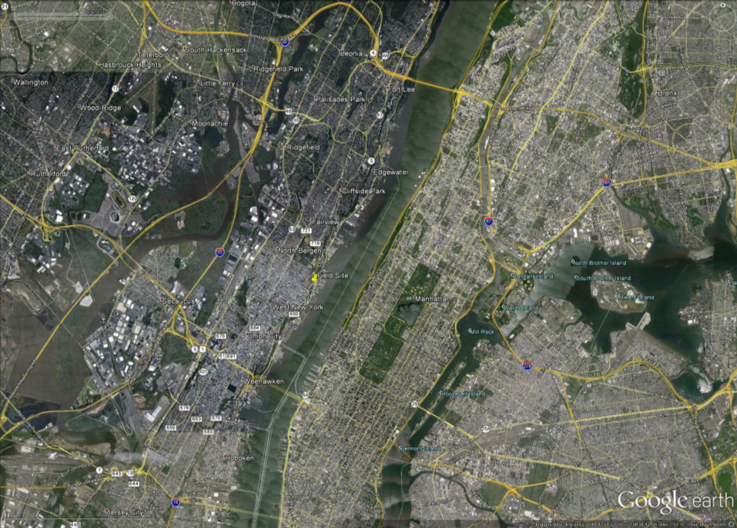
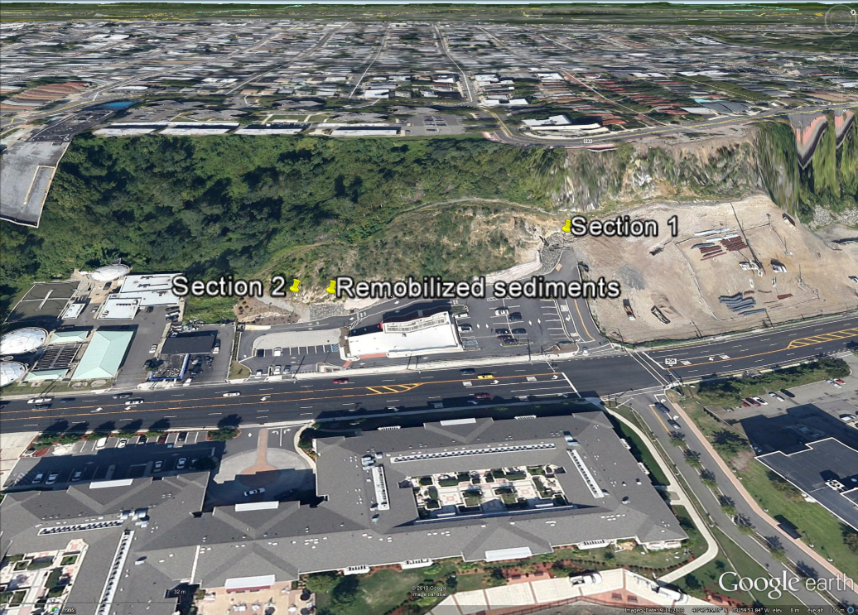
Location

Slide 4
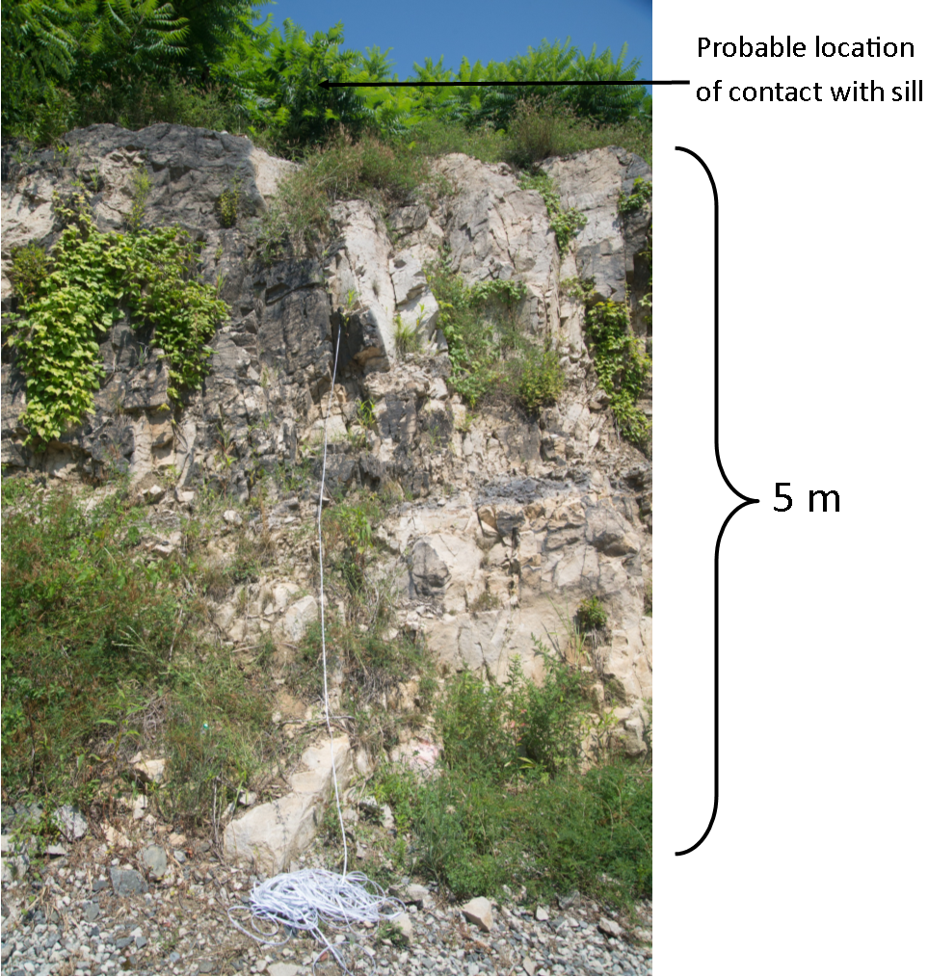
Sampling
Transect (section 2) with samples collected at measured distance from contact with base of sill
Samples from an area with obvious sediment remobilization (clastic dike)
Samples from area with many dark minerals, but otherwise similar to section 2

Slide 5
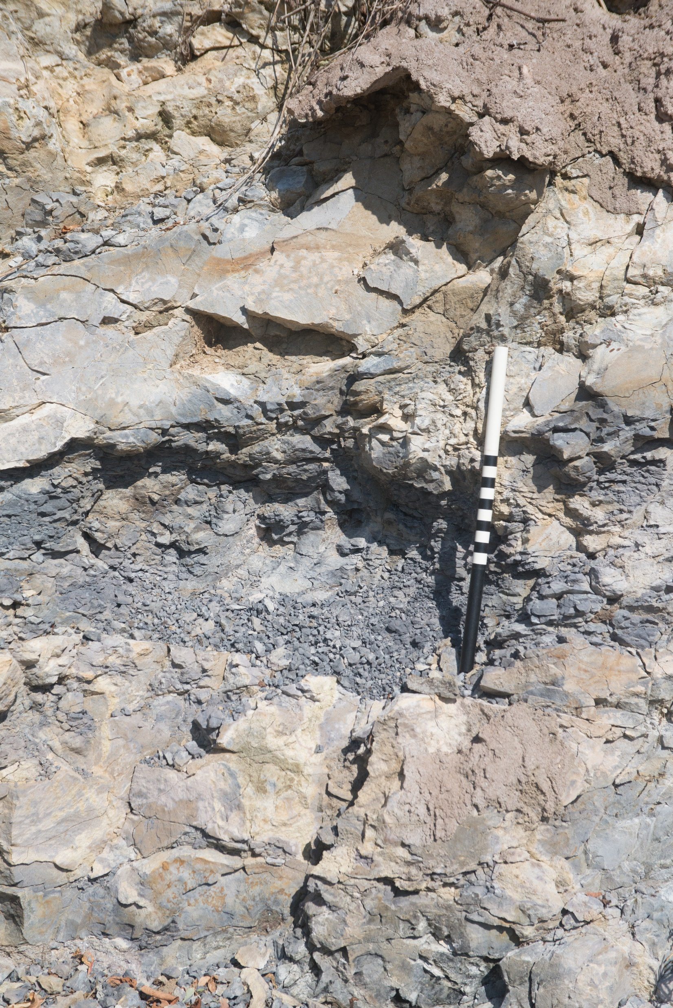
Mineralogy and petrology
Most samples plot in quartzose provenance (of Roser and Korsch, 1986)
Mostly metapsammites with 2 metapelites
Thin sections show evidence of recrystallization
Some clay matrix metamorphosed to biotite and cordierite

Slide 6
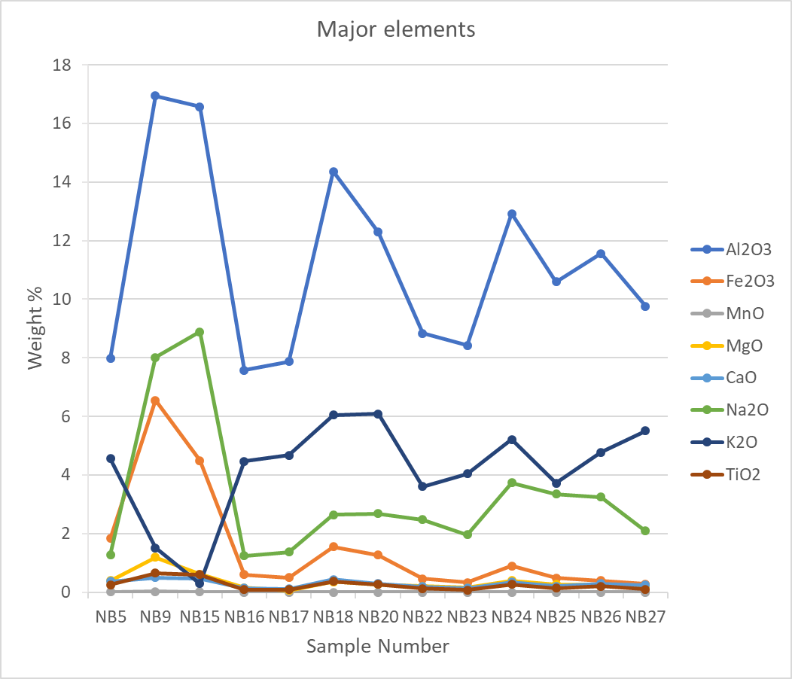
Major element composition
Shale
NB9, NB15
Subarkose
NB16, NB17
Subarkose/arkose
NB5, NB22, NB23
Arkose
NB18, NB20, NB25, NB26, NB27
Arkose/litharenite
NB24
From Herron 1988

Slide 7
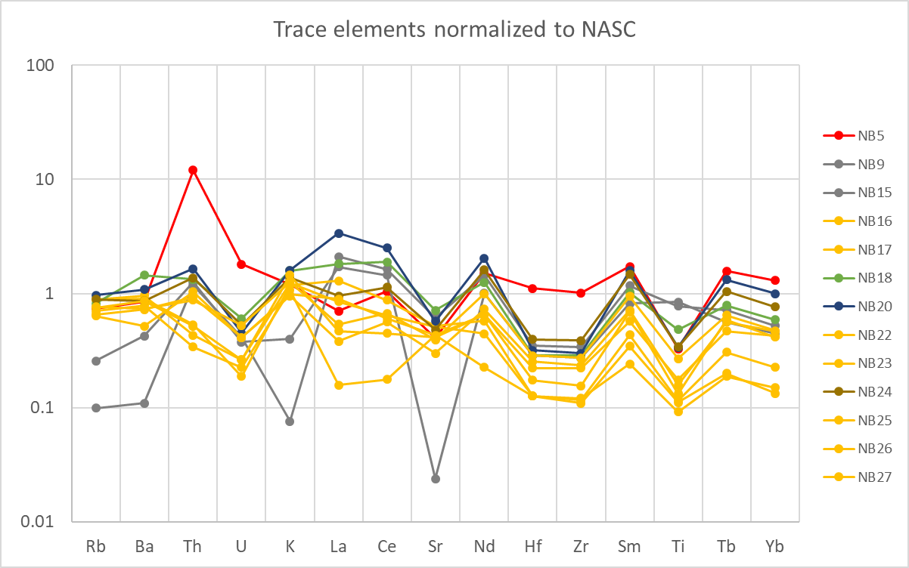
Trace elements
Most metapsammites are depleted in trace elements compared to NASC
Sample with smoky quartz (NB5) has >10 time more thorium than any other sample.
Also enriched in Hf and Zr compared to other samples

Slide 8
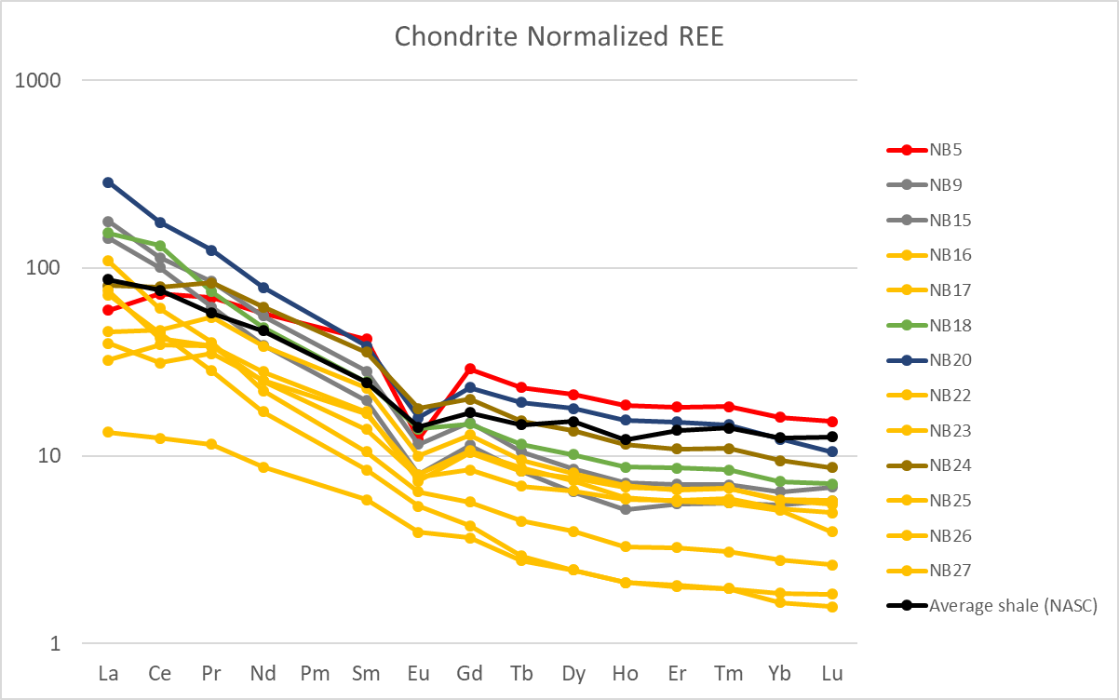
Rare earth elements
Metapsammites depleted in all REE compared to NASC
Metapelites depleted in heavy REE
Remobilized sediment is enriched in REE
Sample with smoky quartz is enriched in heavy REE and has a strong negative europium anomaly

Slide 9
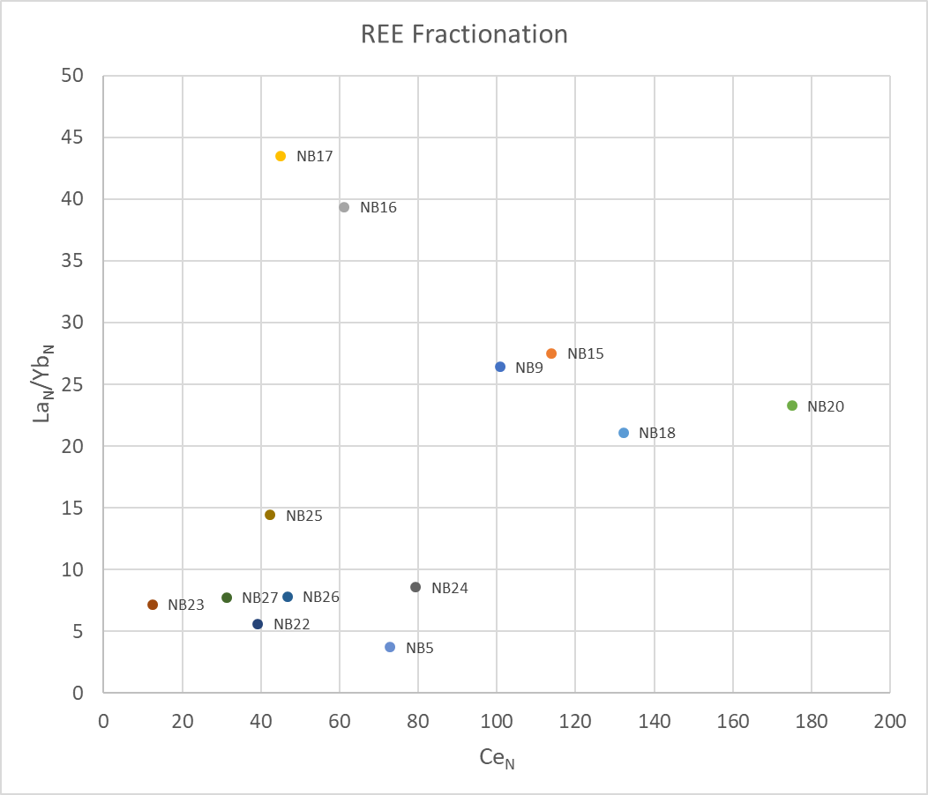
Rare earth elements
Most metapsammites plot in a similar region to previous samples from the area
Metapelites (NB9 and NB15) are more fractionated
Metapsammites from the channel deposit (NB16 and NB17) are very fractionated, and may have lost heavy REE when sediments were remobilized

Slide 10
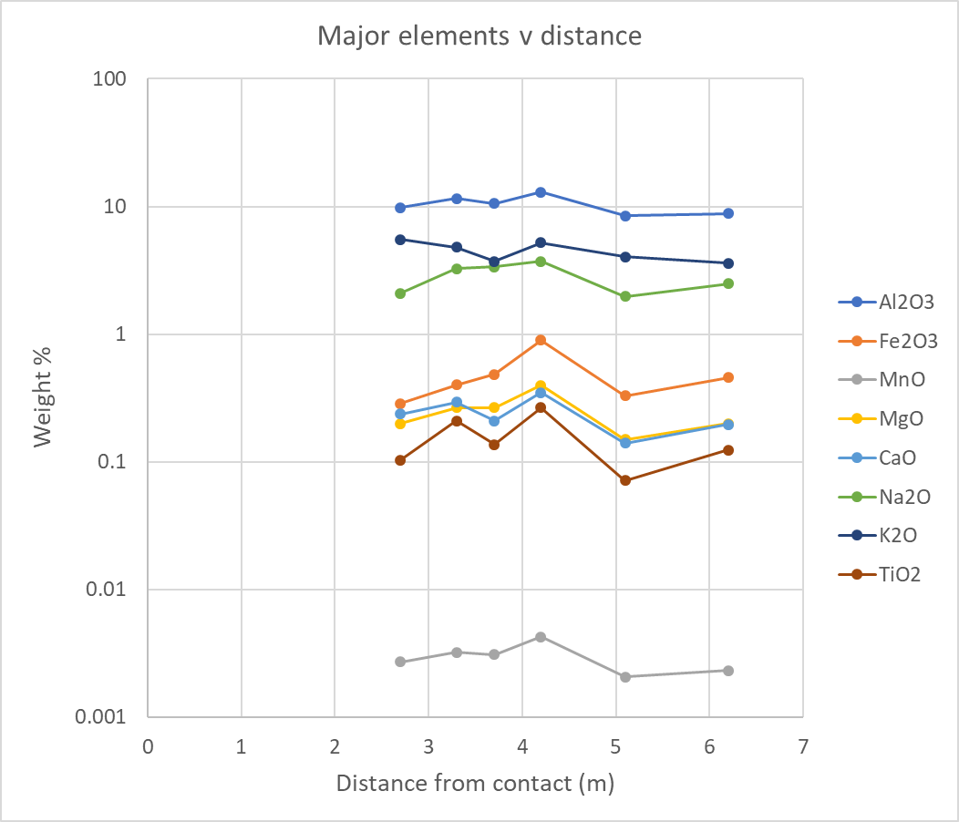
Transect – major elements
No consistent variation in concentration with distance from contact
No increase in Na (from metasomatism) with proximity to the contact
Variation is due to variation in original lithology

Slide 11
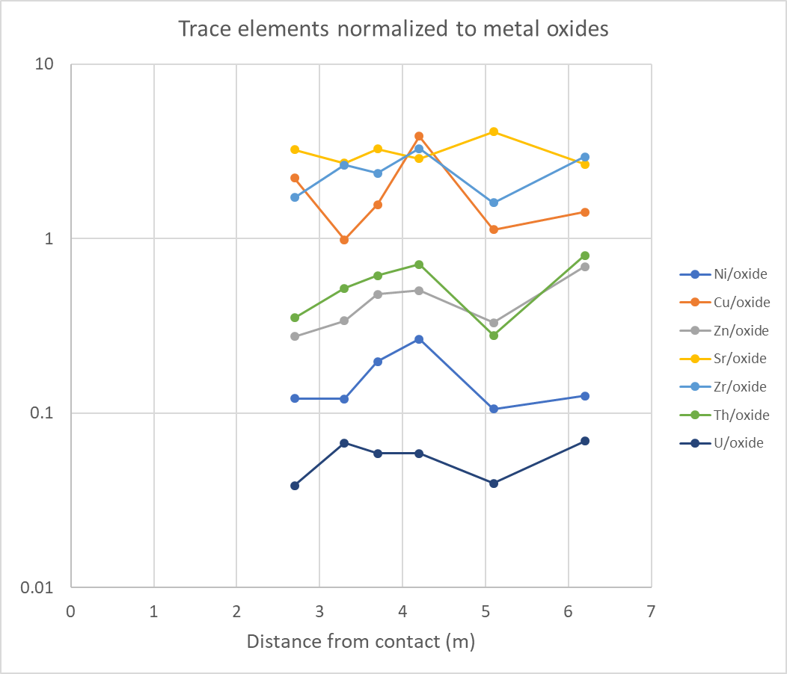
Transect – trace elements
Normalized to total non-silica oxides to remove variation quartz dilution
No consistent variation with distance from contact

Slide 12
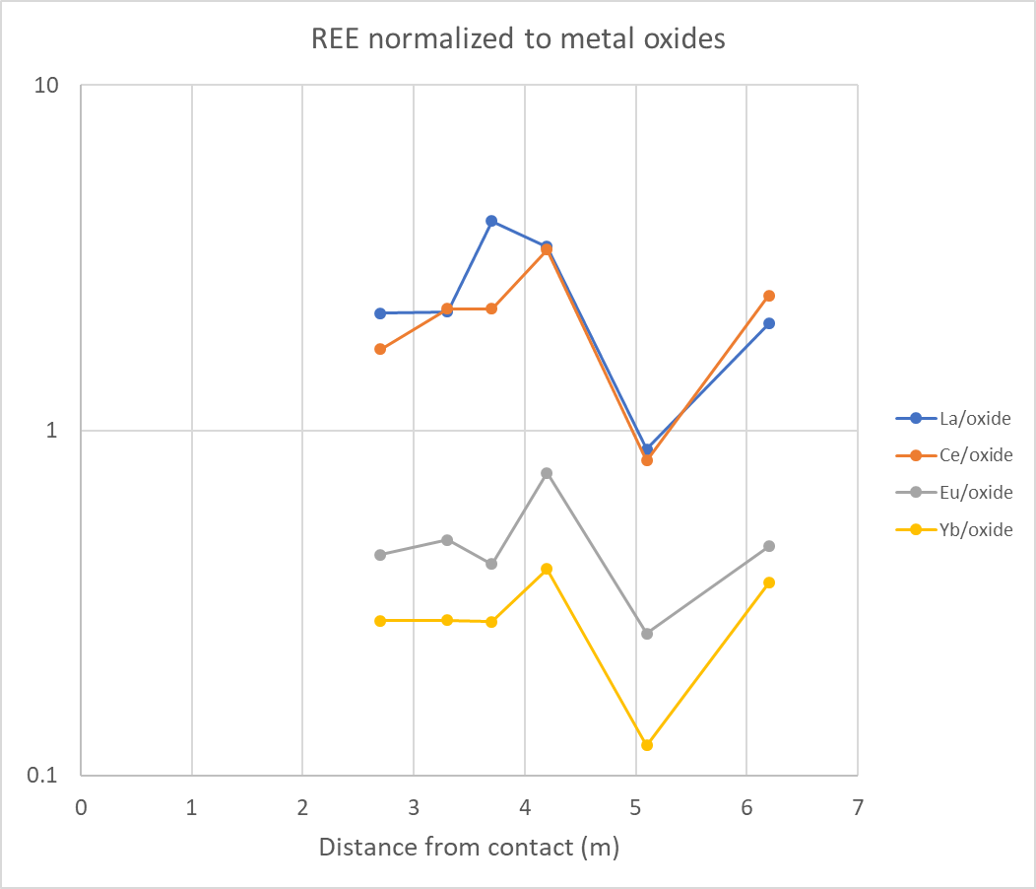
Transect - REE
Normalized to total non-silica oxides to remove variation quartz dilution
No consistent variation with distance from contact

Slide 13
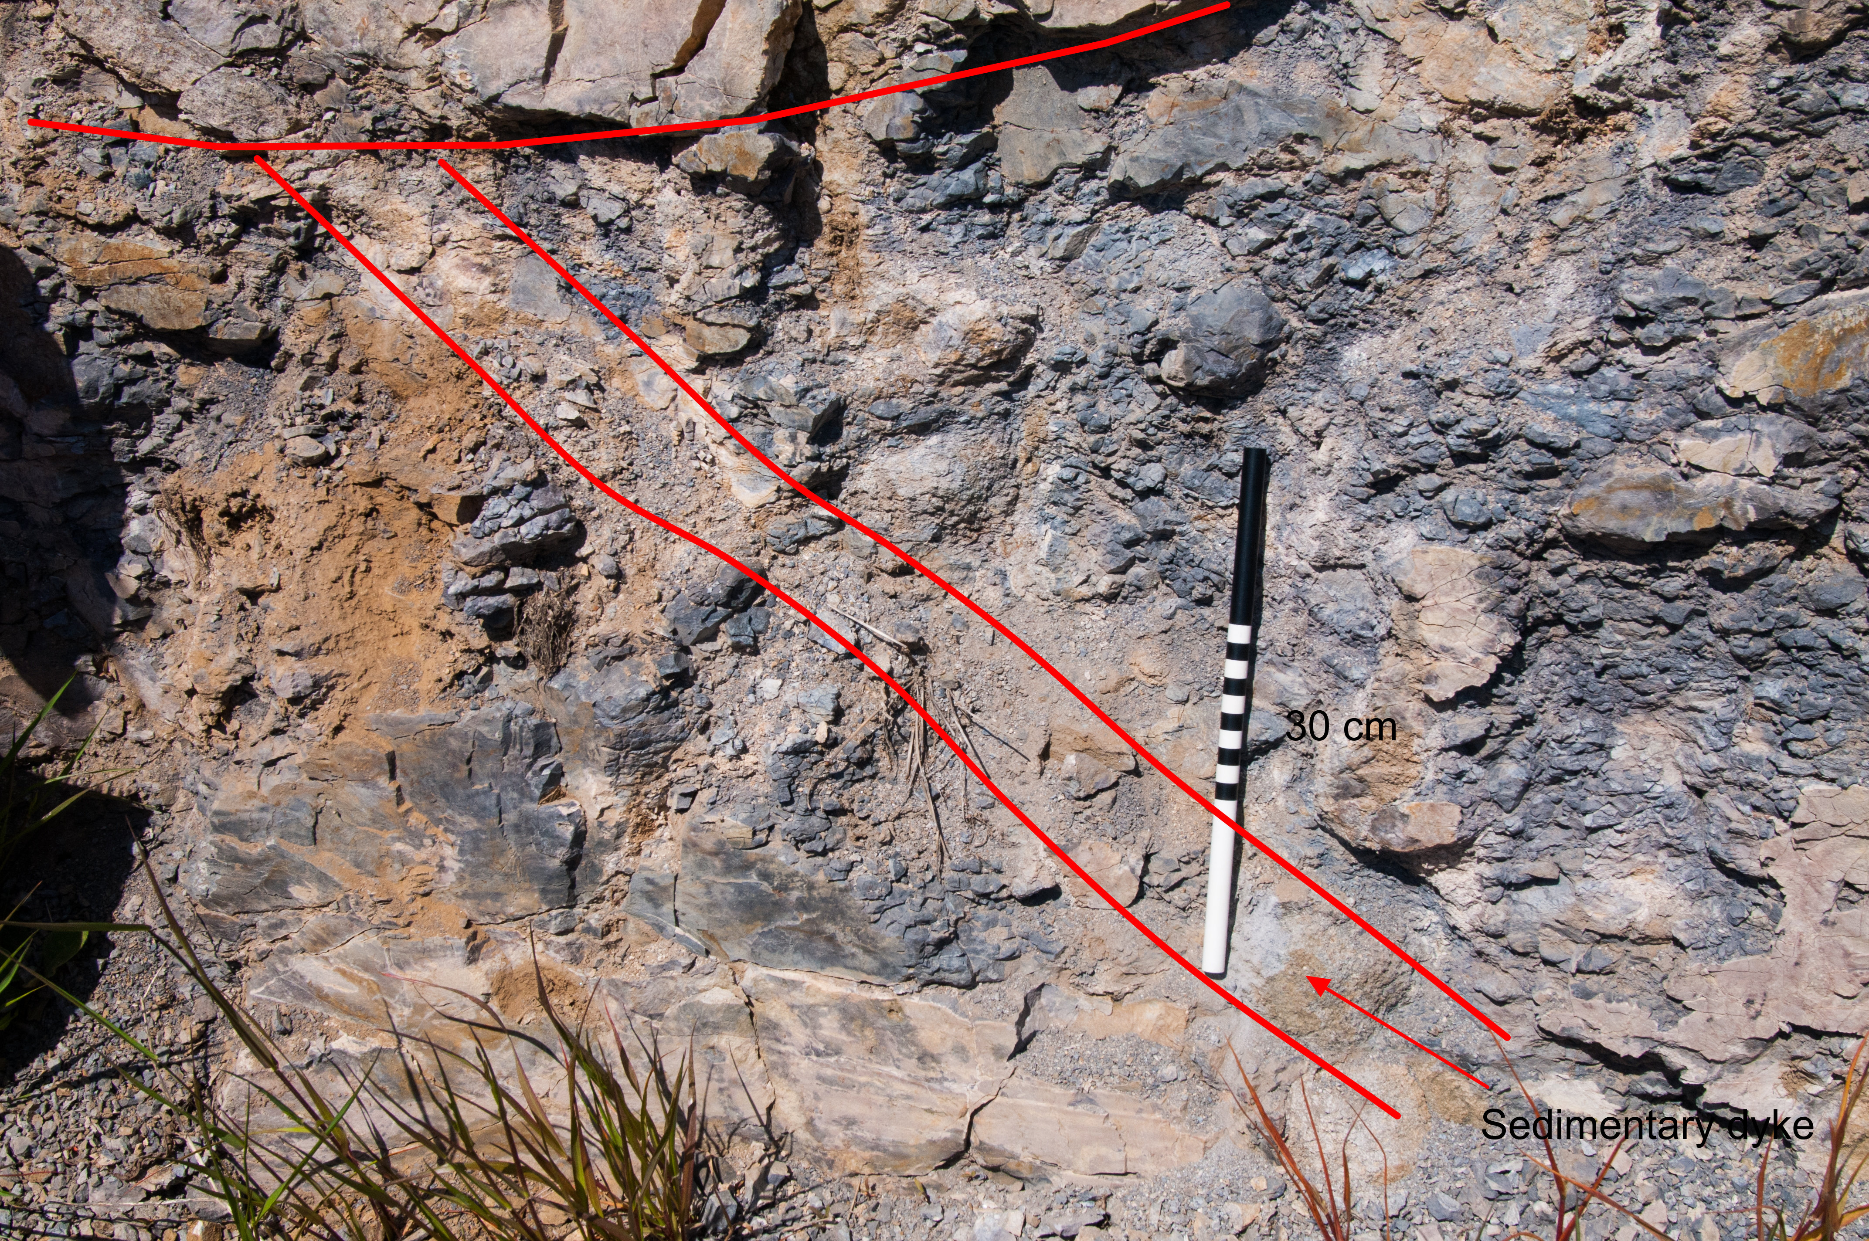
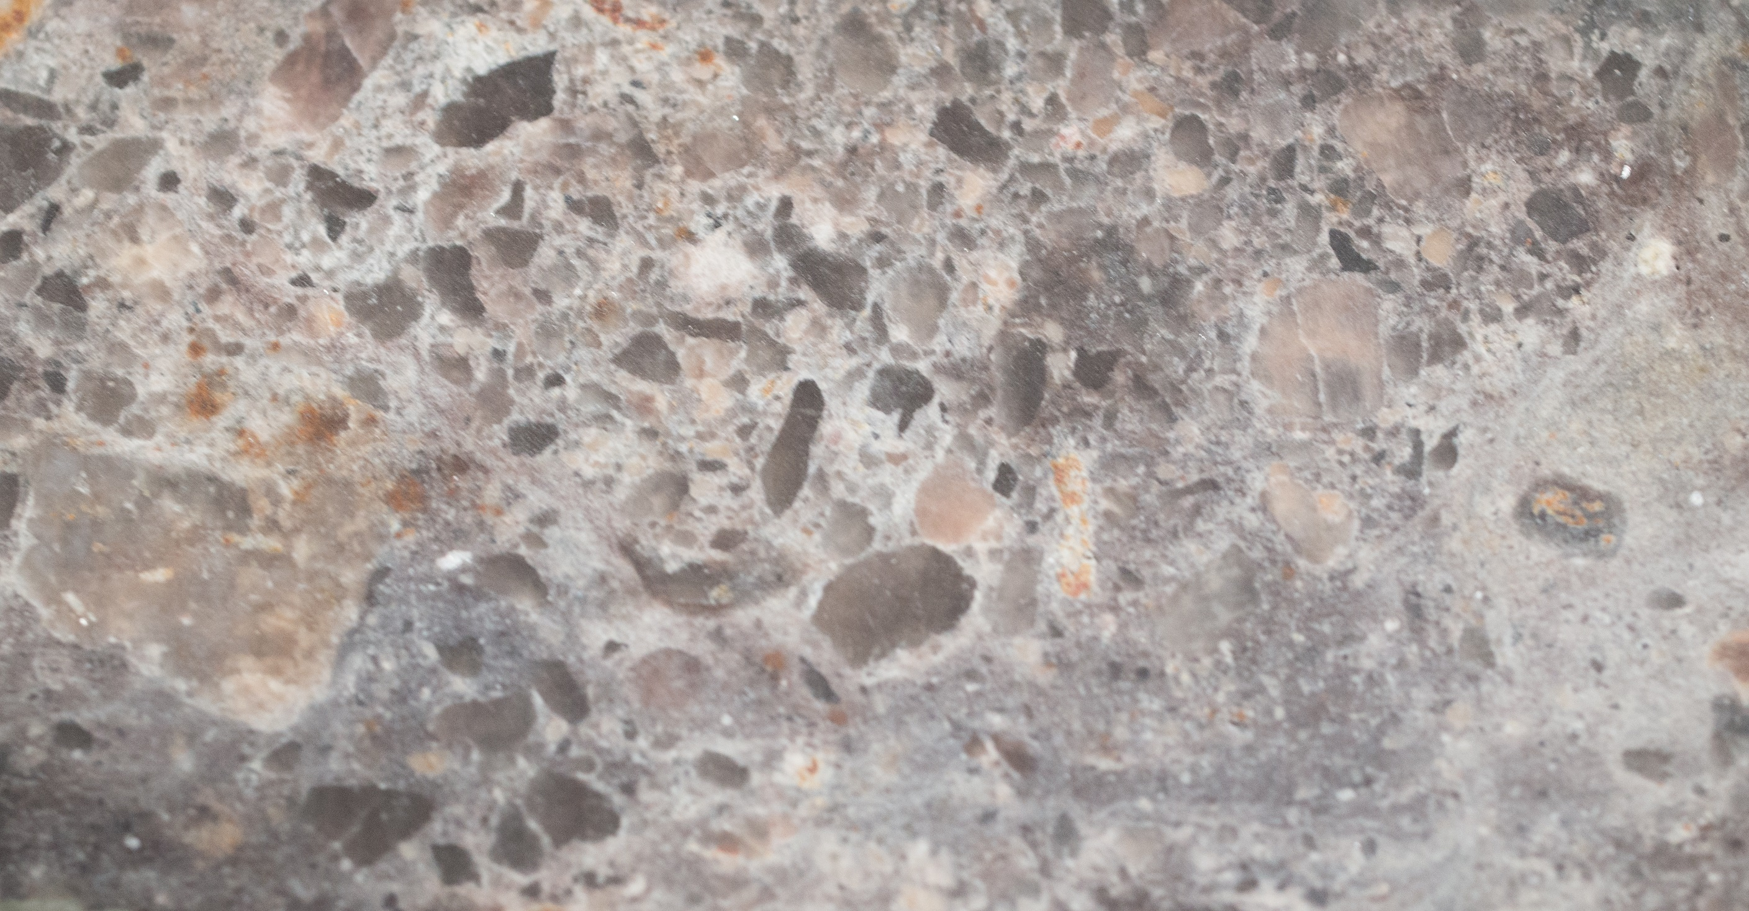
Sample of remobilized sediment
Overall major element chemistry is similar to other metapsammites
Enriched in REE compared to other samples
Also slightly enriched in Th, Sc and Y
Heavy REE may have been removed from channel deposit that supplied the sediment to the clastic dike

Slide 14
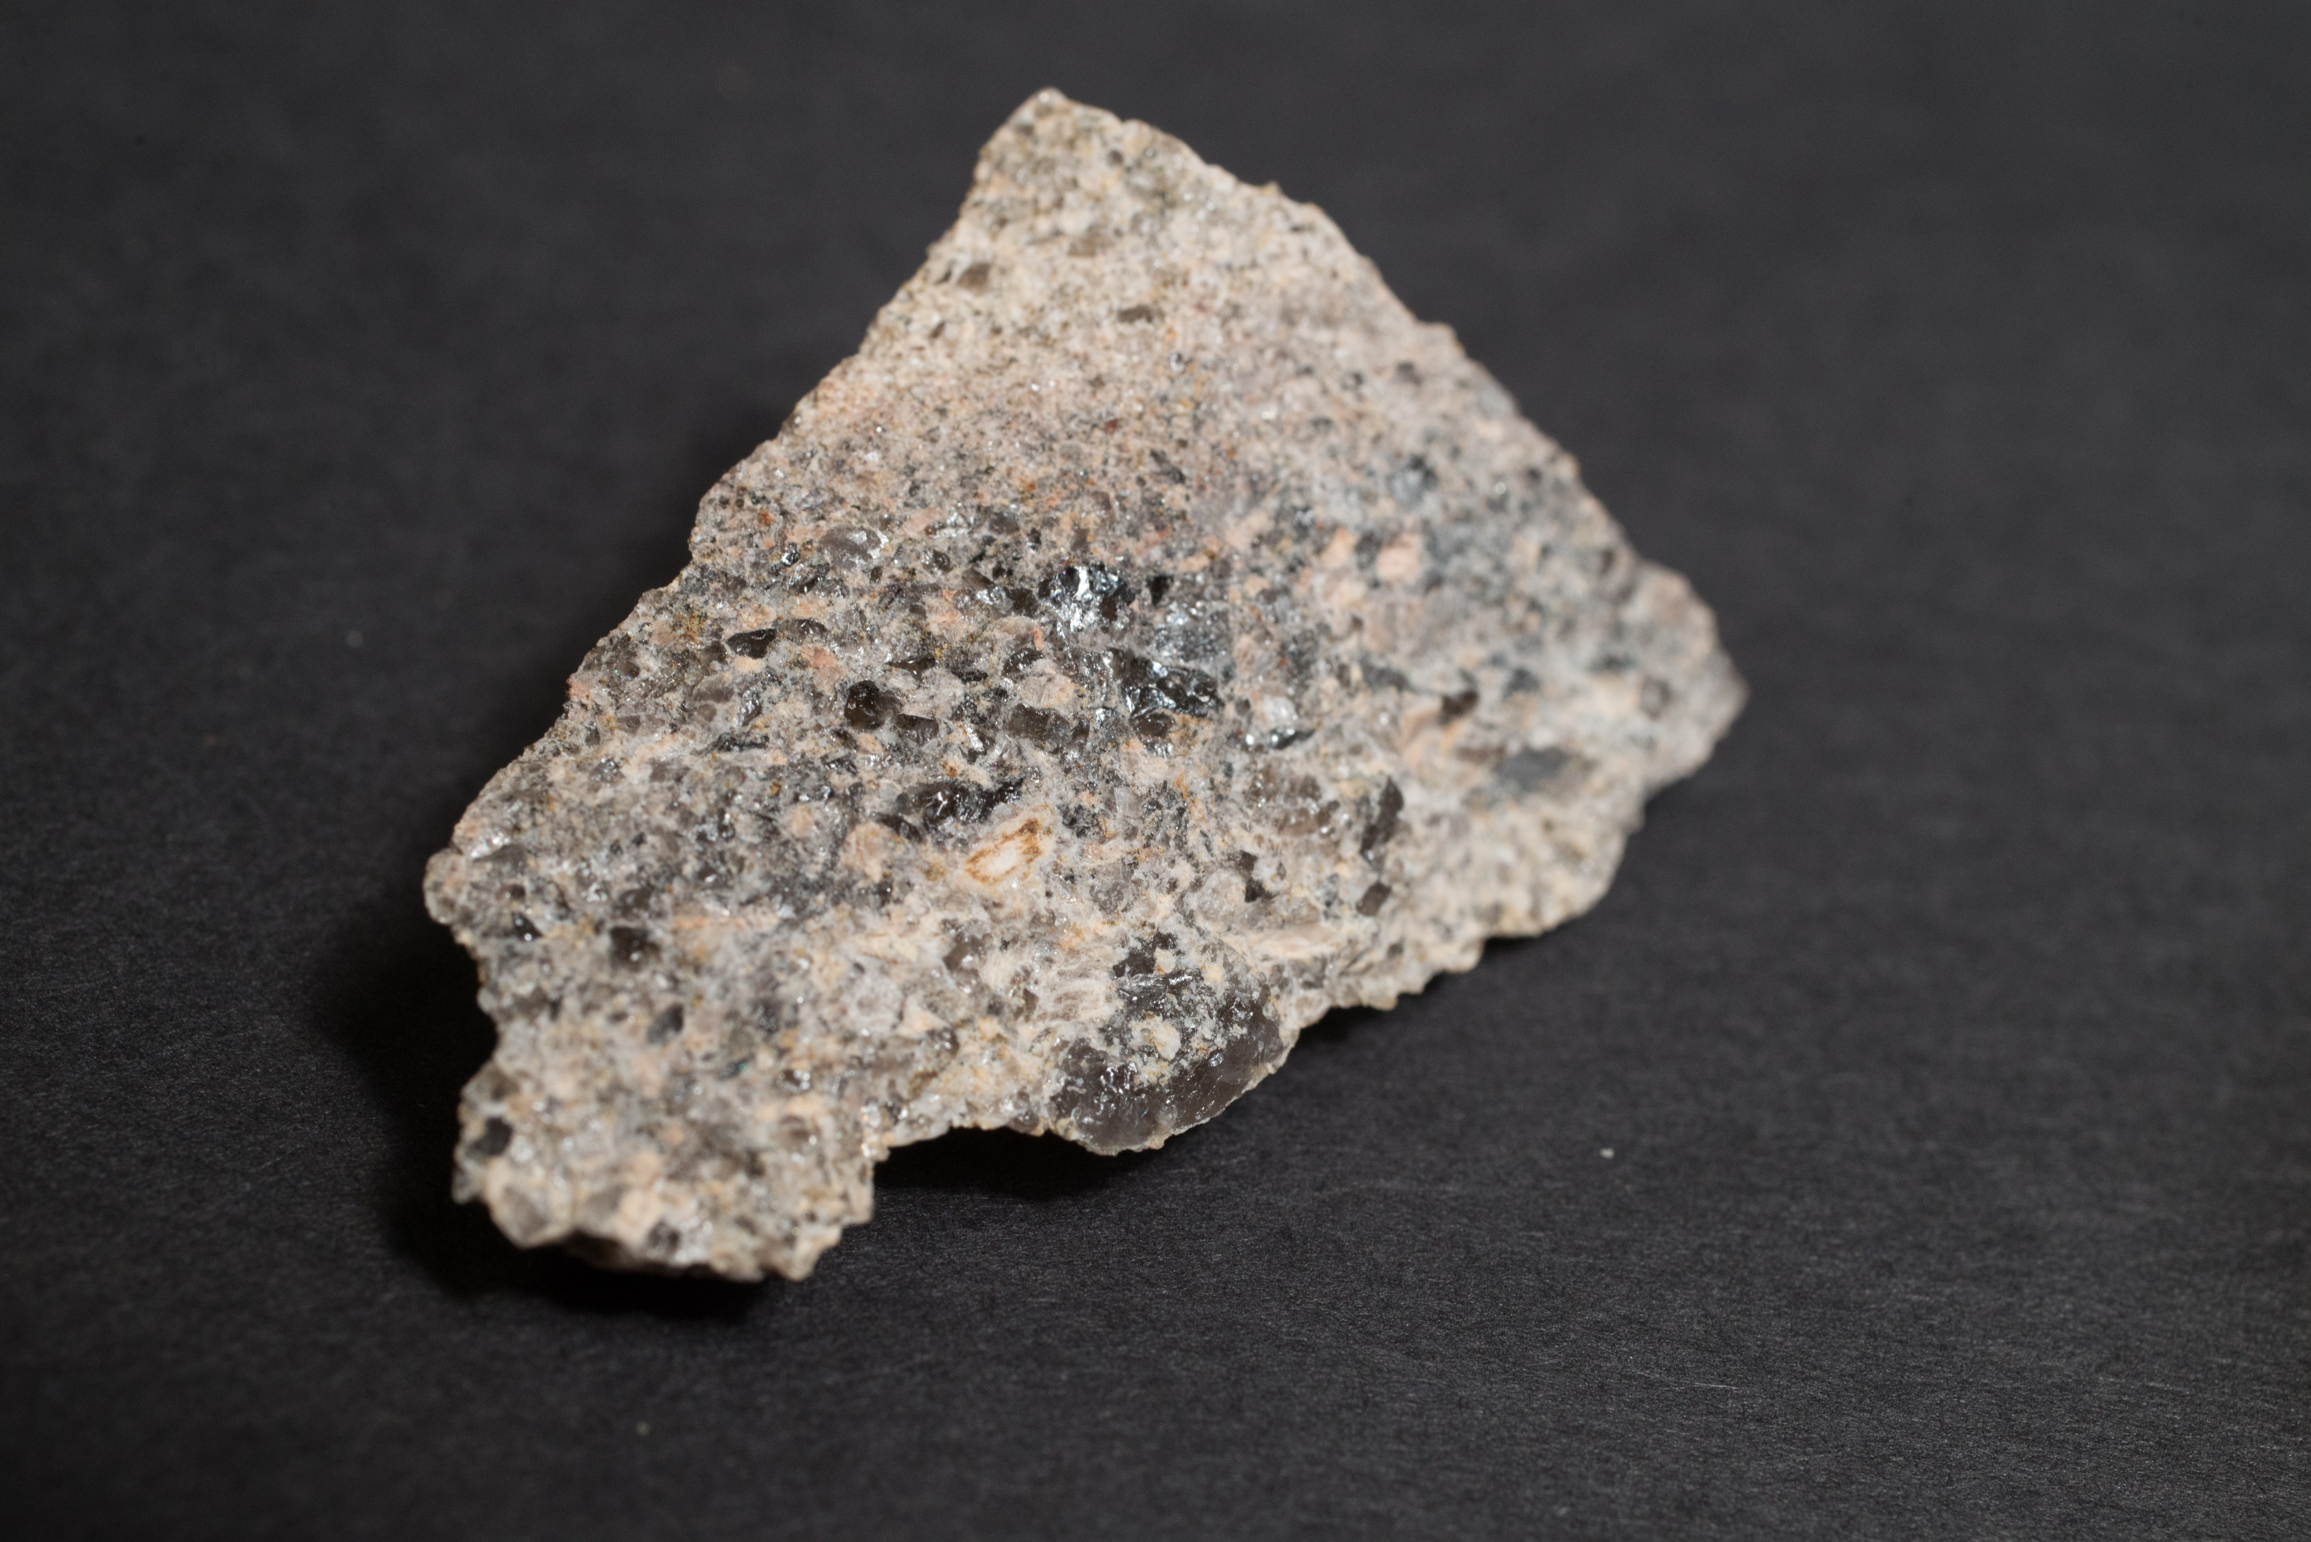
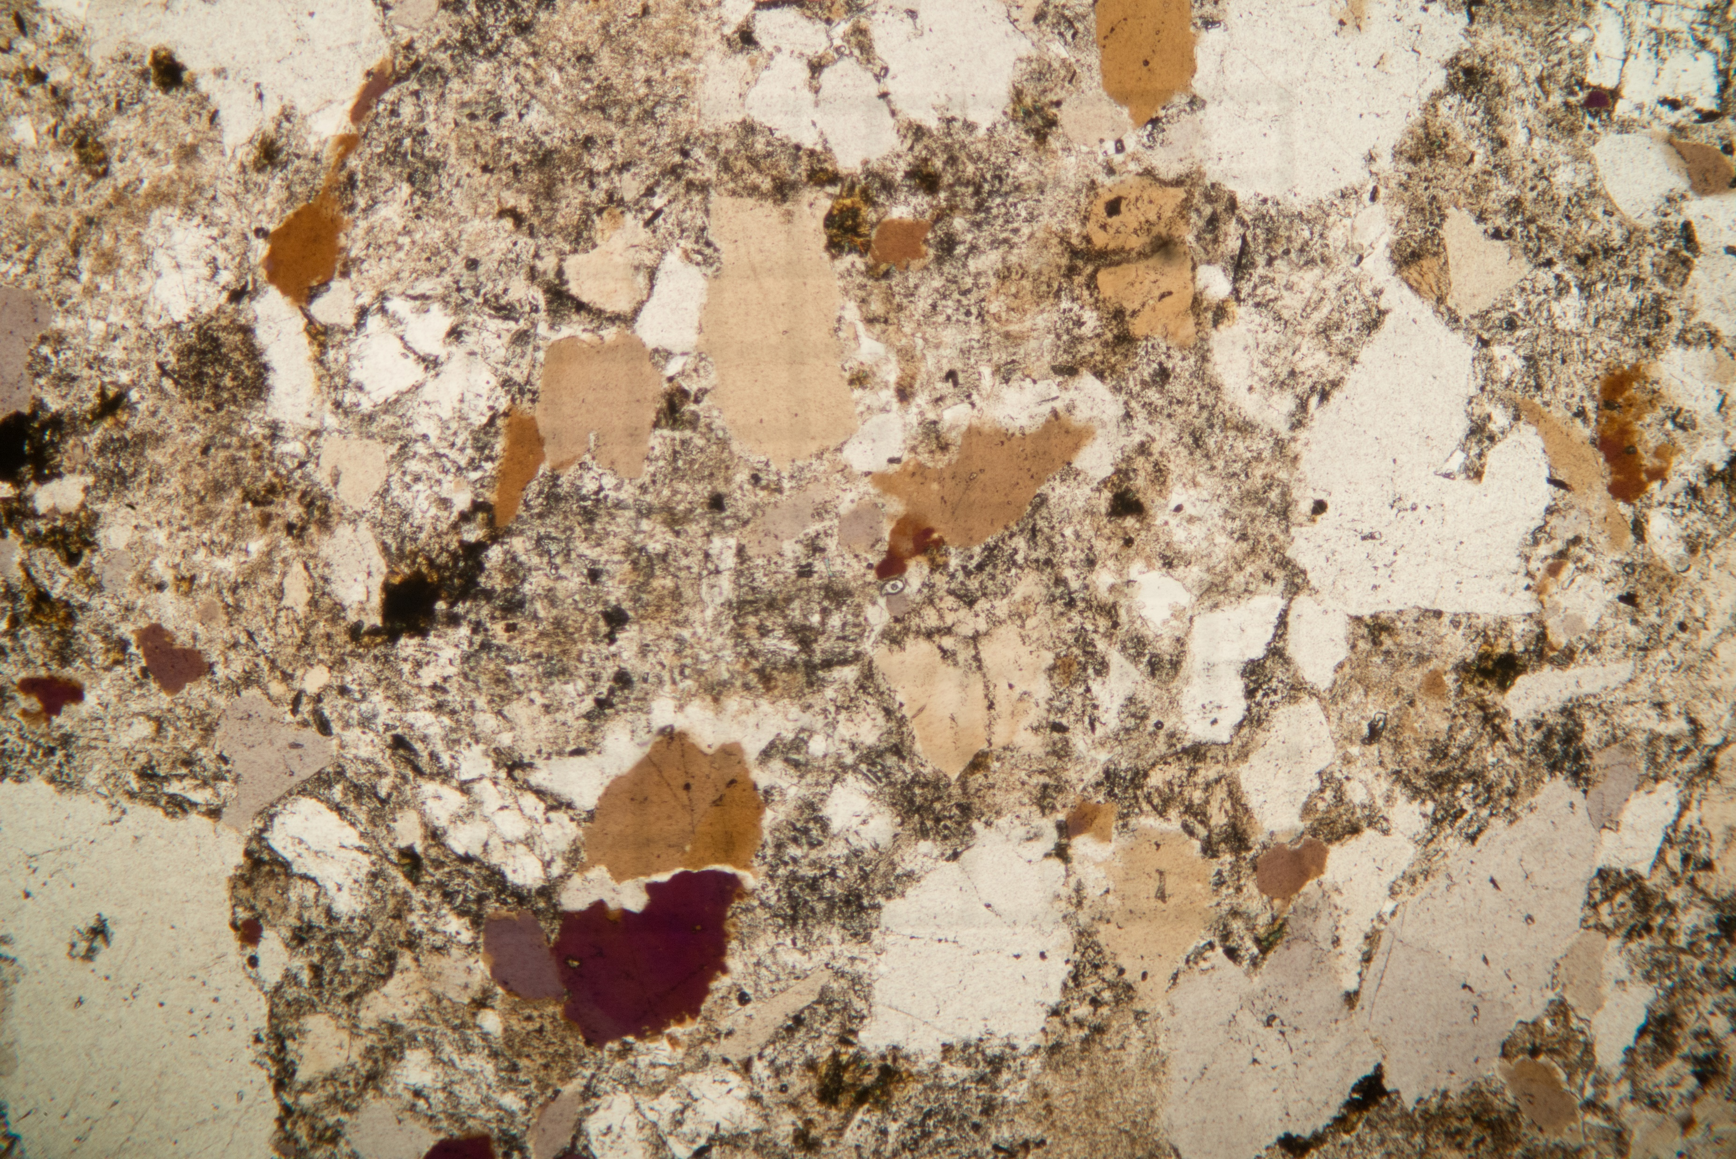
Sample with smoky quartz
Located 8 m below contact
Overall major element chemistry is similar to other metapsammites
Enriched in Th, Cu, Hf, Zr and heavy REE
Smoky quartz forms when Al is incorporated into the quartz
Probably when quartz recrystallized
Then the quartz is subject to radiation
Most likely source is high thorium concentration

Slide 15
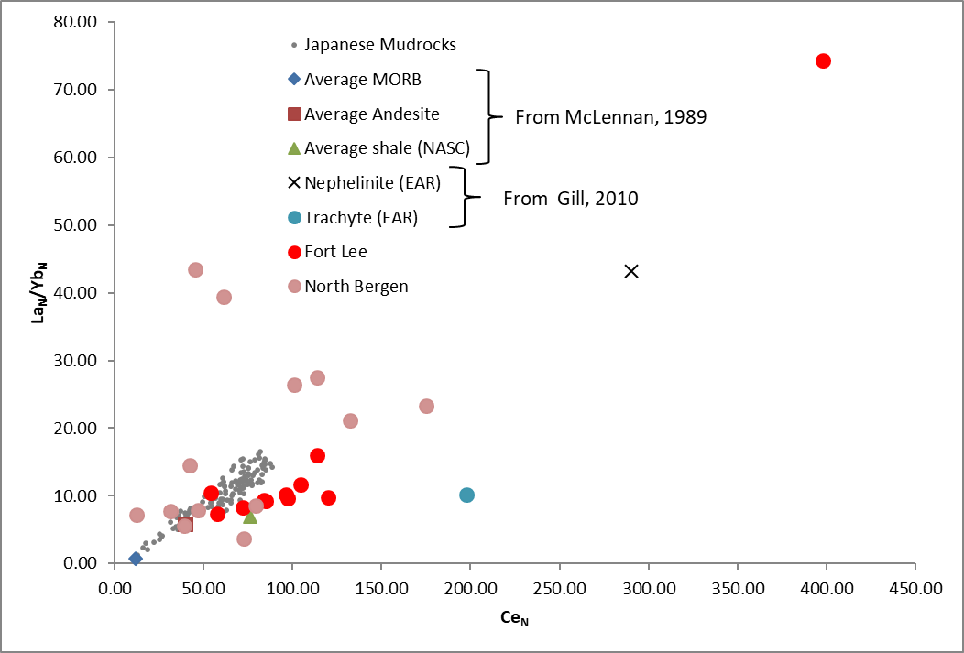
Summary
Transect through metasedimentary arkose, lithic arkose and subarkose rocks shows no influence of the sill on geochemistry
Variations in major, trace and rare earth elements are related to lithology
Remobilized sediment in clastic dike shows no change in major elements, however trace and rare earth elements indicate alteration
Sample with smoky quartz has similar major elements concentrations to other arkose samples, but has strong enrichment of Th and heavy REE
Probably related to lithology not from influence of sill
May indicate presence of volcanic ash??

