Slide 1
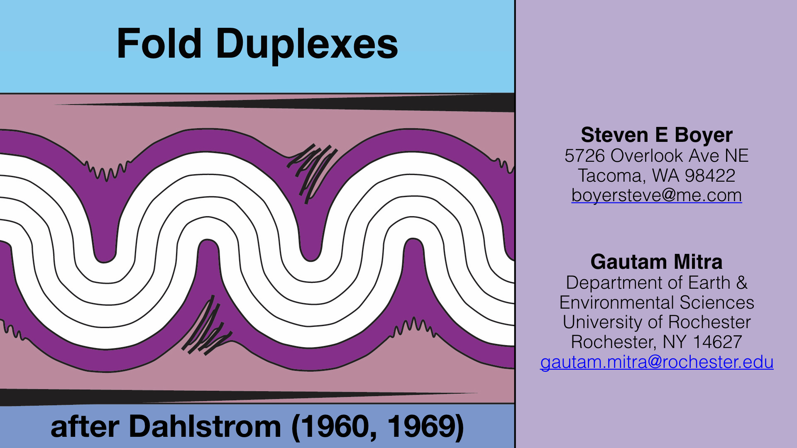

Slide 2
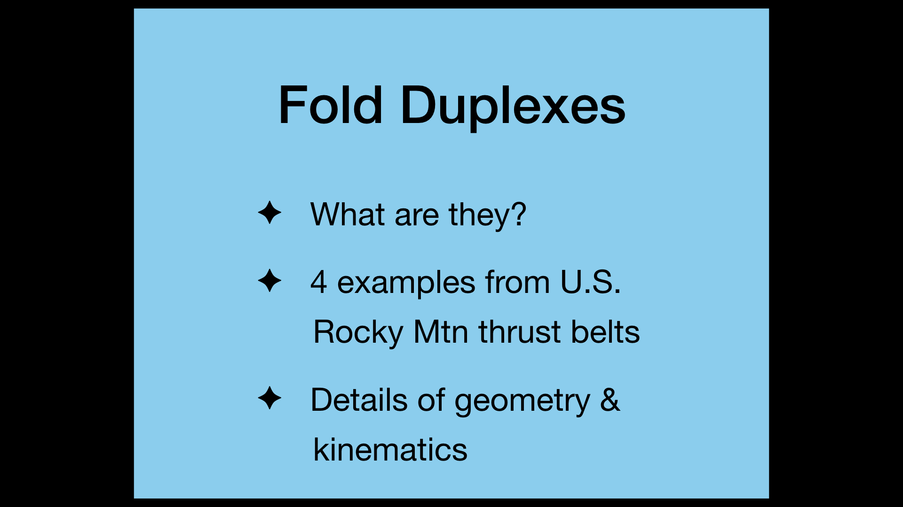
Notes:
What are fold duplexes? I will begin by explaining what fold duplexes are & then provide 3 examples from the U.S. Rockies. The final third of the talk will deal with details of the geometry & kinematics of fold duplexes.

Slide 3
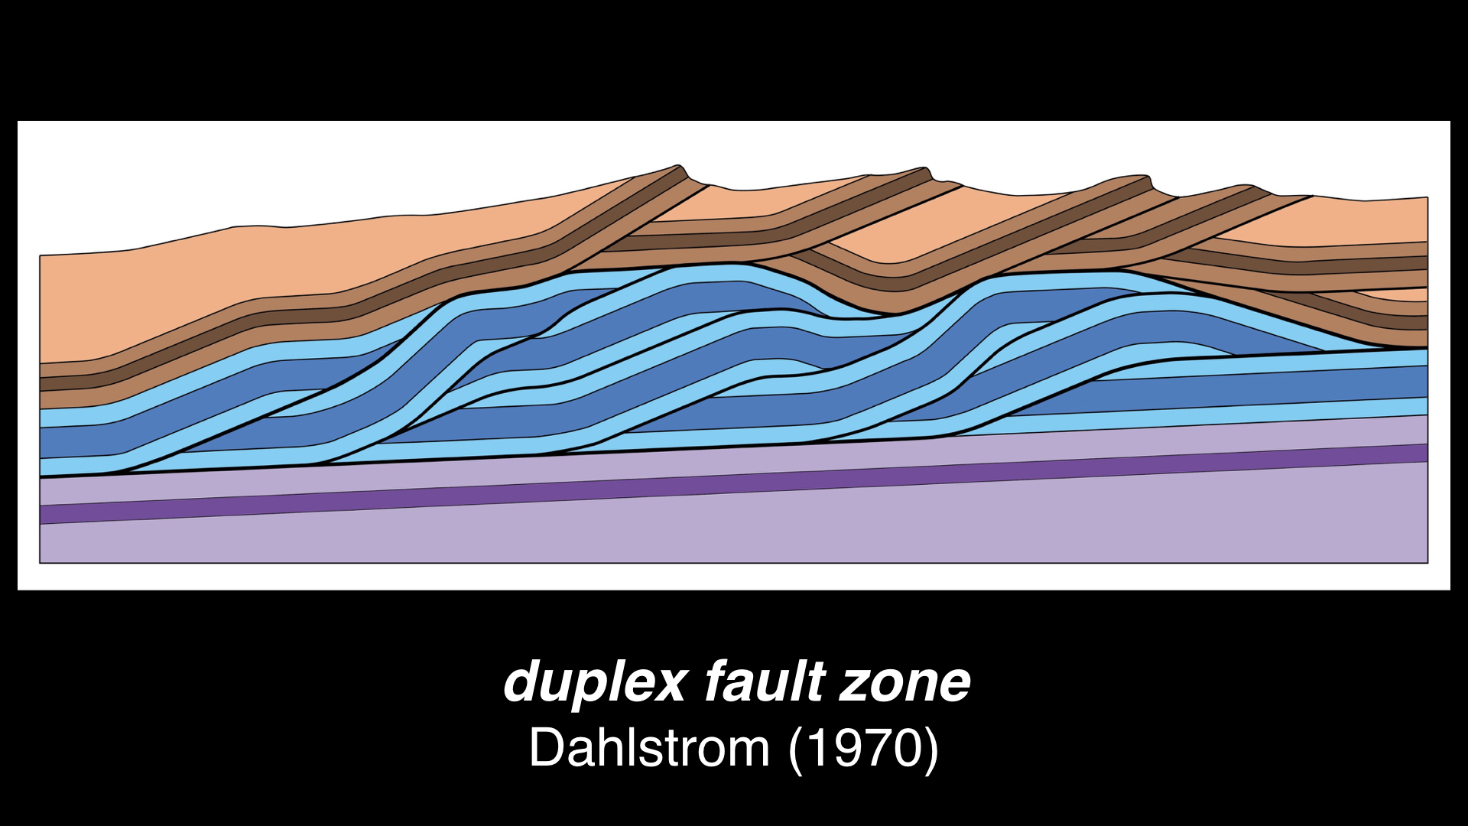
Notes:
Many of us are familiar with the term “duplex fault zone,” which was introduced into the “modern” literature by Clint Dahlstrom in a landmark 1970 paper. However, these structures were first observed in the late 1800s & early 1900s in the Scottish Highlands, the Alps, & in the Lewis thrust sheet of Montana by Bailey Willis.

Slide 4
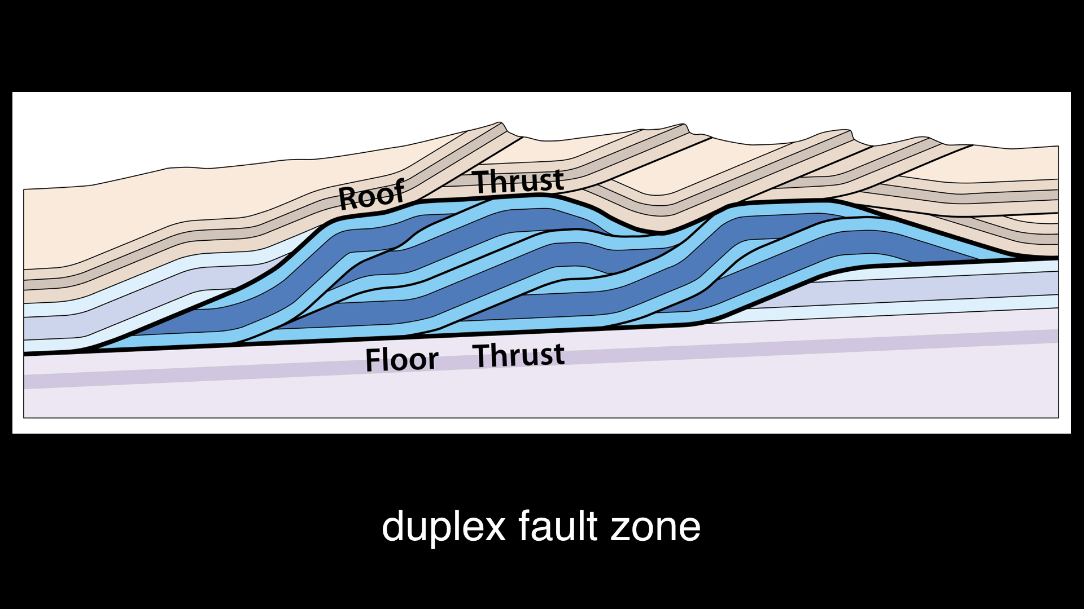
Notes:
The term duplex derives from the existence of two major faults, that envelope a zone of deformation. There is a “roof thrust” above & a “floor thrust” below. Between the roof & floor thrusts is a zone of imbricate faults.

Slide 5
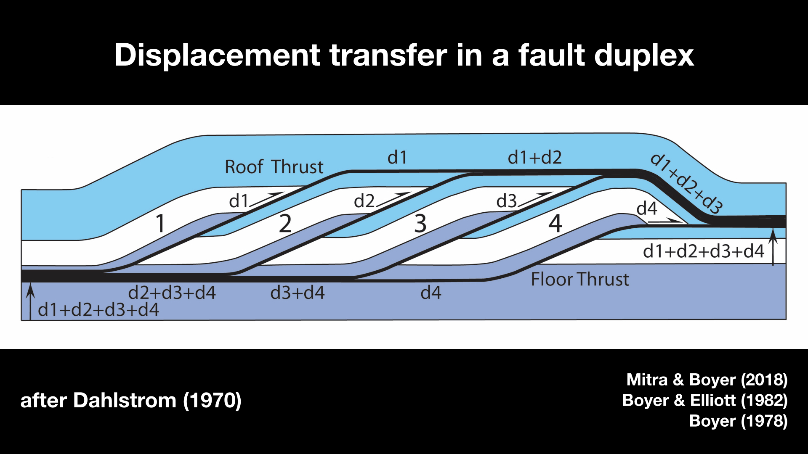
Notes:
The imbricate faults of the duplex transfer displacement from a lower detachment, the floor, to an upper detachment, the roof. As displacement decreases on a floor thrust, it is taken up by the imbricates, which in turn transfer the displacement to the roof. The displacement on the roof increases as the displacement on the floor decreases. Maximum displacement on the floor thrust equals total shortening within the duplex equals the maximum displacement on the roof thrust.

Slide 6
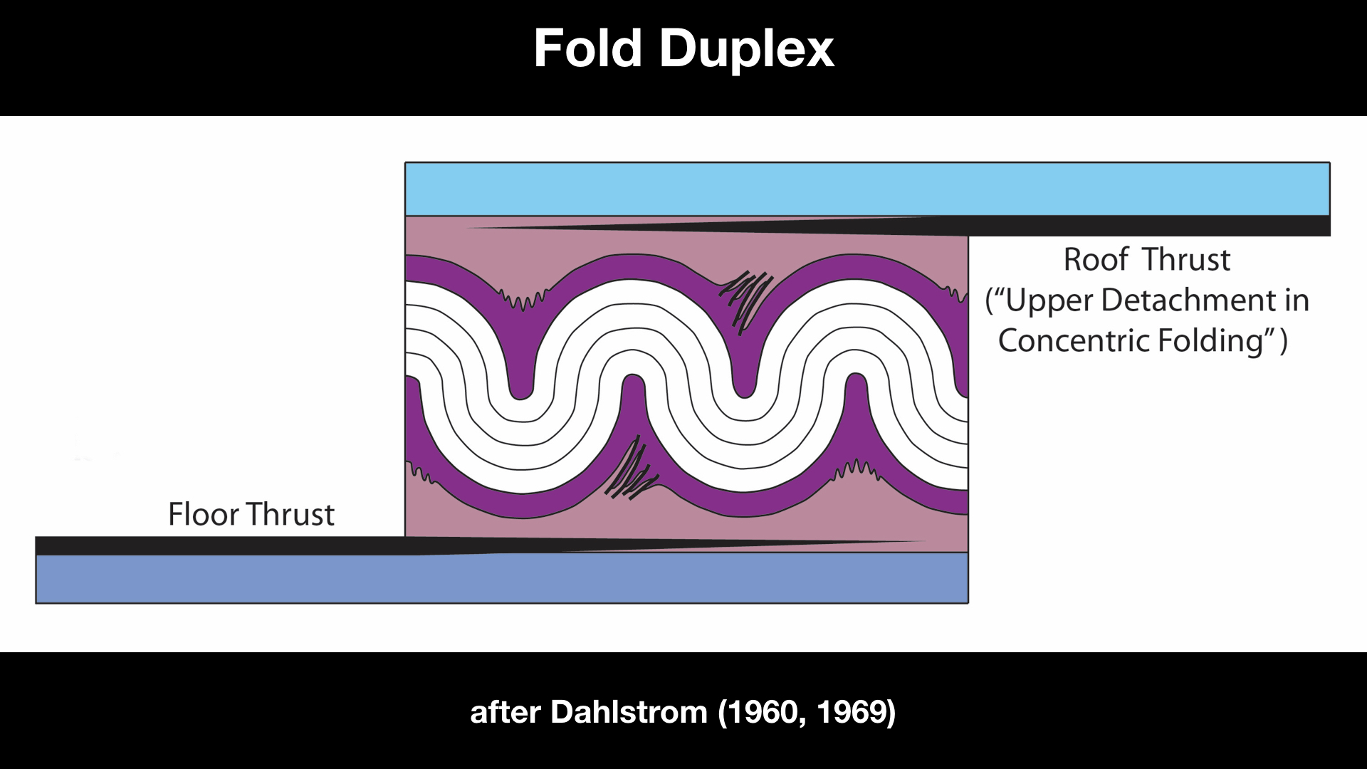
Notes:
The notion of a fold duplex derives from Dahlstrom’s observation that detachment folds require an upper detachment. It had long been known from work in the Alpine foreland that concentric folds form above detachments. However, the tight synclines are simply mirror images of the anticlines. So if the anticlines require an underlying detachment, then the synclines require a similar detachment above. This led to Clint Dahlstrom’s paper on the upper detachment in concentric folding. We consider this to be a duplex, as it plays the same role as a fault duplex. Duplexes transfer slip from a lower detachment to an upper detachment, but in this case the transfer mechanism is a train of detachment folds. The displacement on the roof increases toward the foreland as the displacement on the floor decreases.

Slide 7
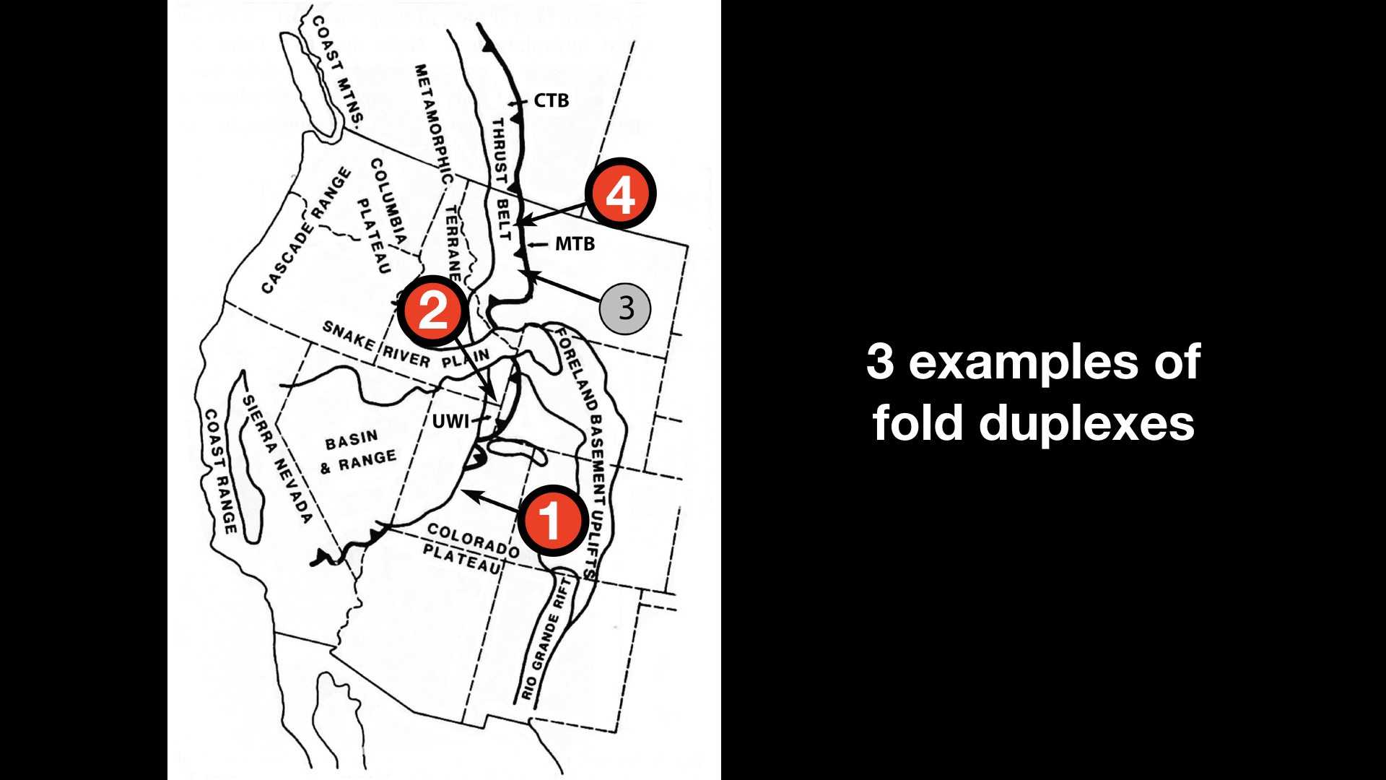
Notes:
I will now describe 3 examples of fold duplexes from various areas in the greater Rocky Mtn thrust belt of the western U.S. I will omit my example #3 for now but if time permits we will examine the folds in the Gates of the Mountains on the Missouri River.

Slide 8
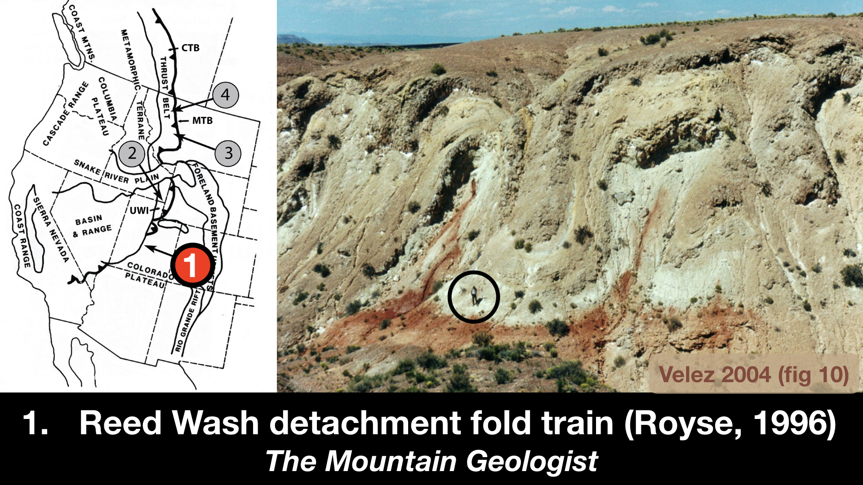
Notes:
Perhaps the best example of a fold duplex is the Reed Wash detachment fold train in central Utah. Frank Royse described this structure in a 1996 issue of The Mountain Geologist. The photo is from a follow-up study by Velez published in 2004.

Slide 9
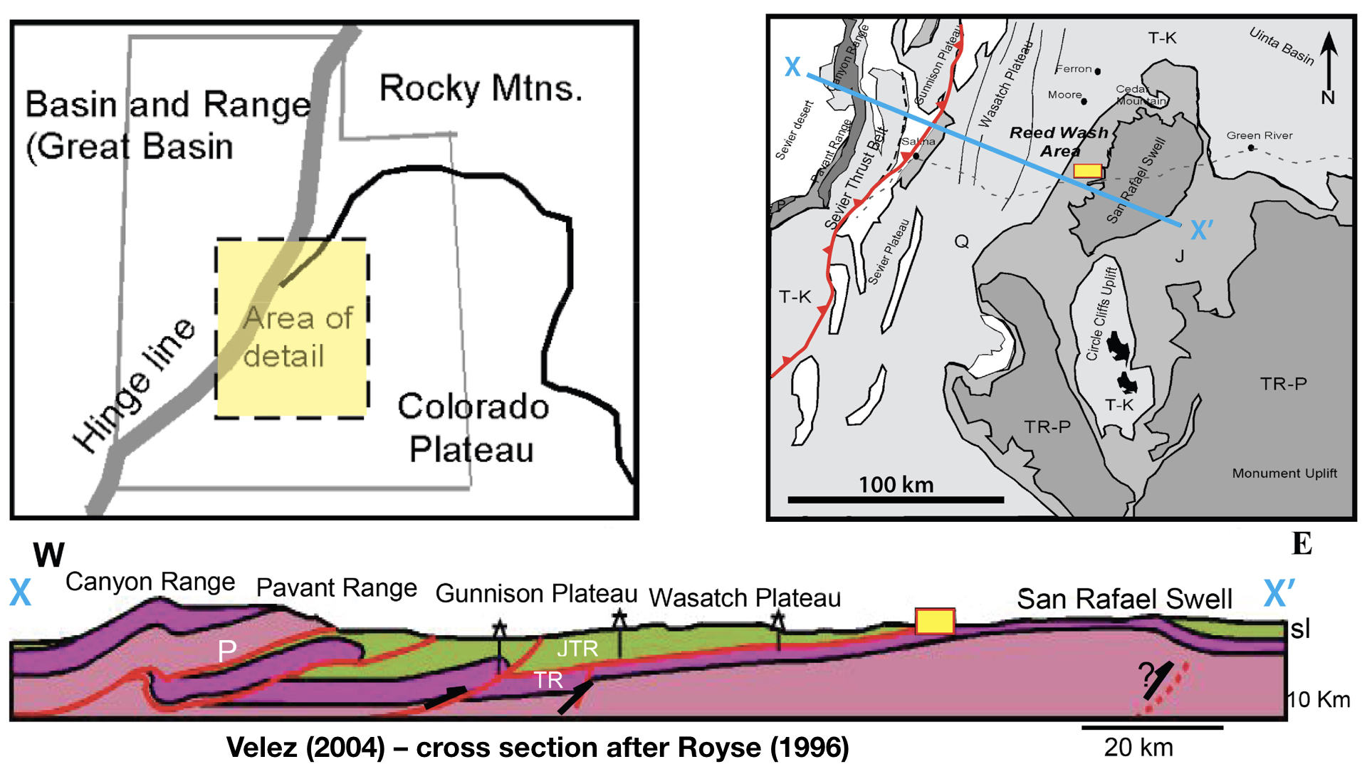
Notes:
The Reed Wash detachment fold train is located in central Utah. As shown in the simplified geologic map at upper right, the detachment fold train is exposed on the west flank of the San Rafael Swell. The cross section illustrates that the fold train, inside the yellow box, is the easternmost limit of the Late Cretaceous to early Paleocene thrusting. As noted by Frank Royse, the identification of this compressional fold train extends the thrust belt 60 kilometers east of what has normally been thought of as the eastern limit of the thrust belt.

Slide 10
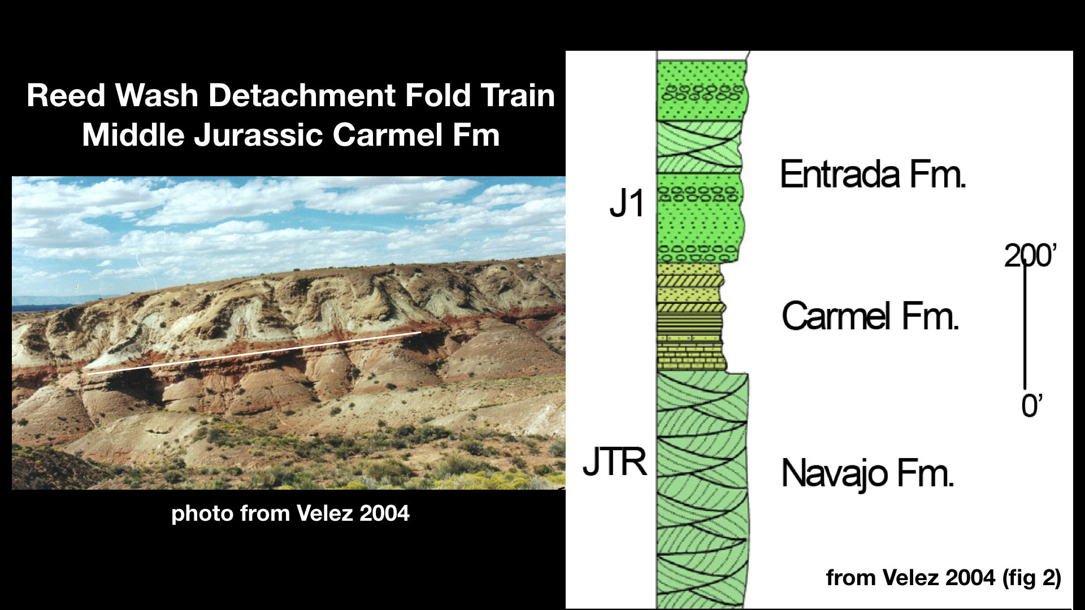
Notes:
This is a photo of the fold train. This fold duplex involves a gypsum-rich layer, 24 m thick, within the Middle Jurassic Carmel Formation. The underlying detachment is within the red shales, which are ~1m thick. The fold train is underlain by the Navajo sandstone and overlain by the Entrada Formation.

Slide 11
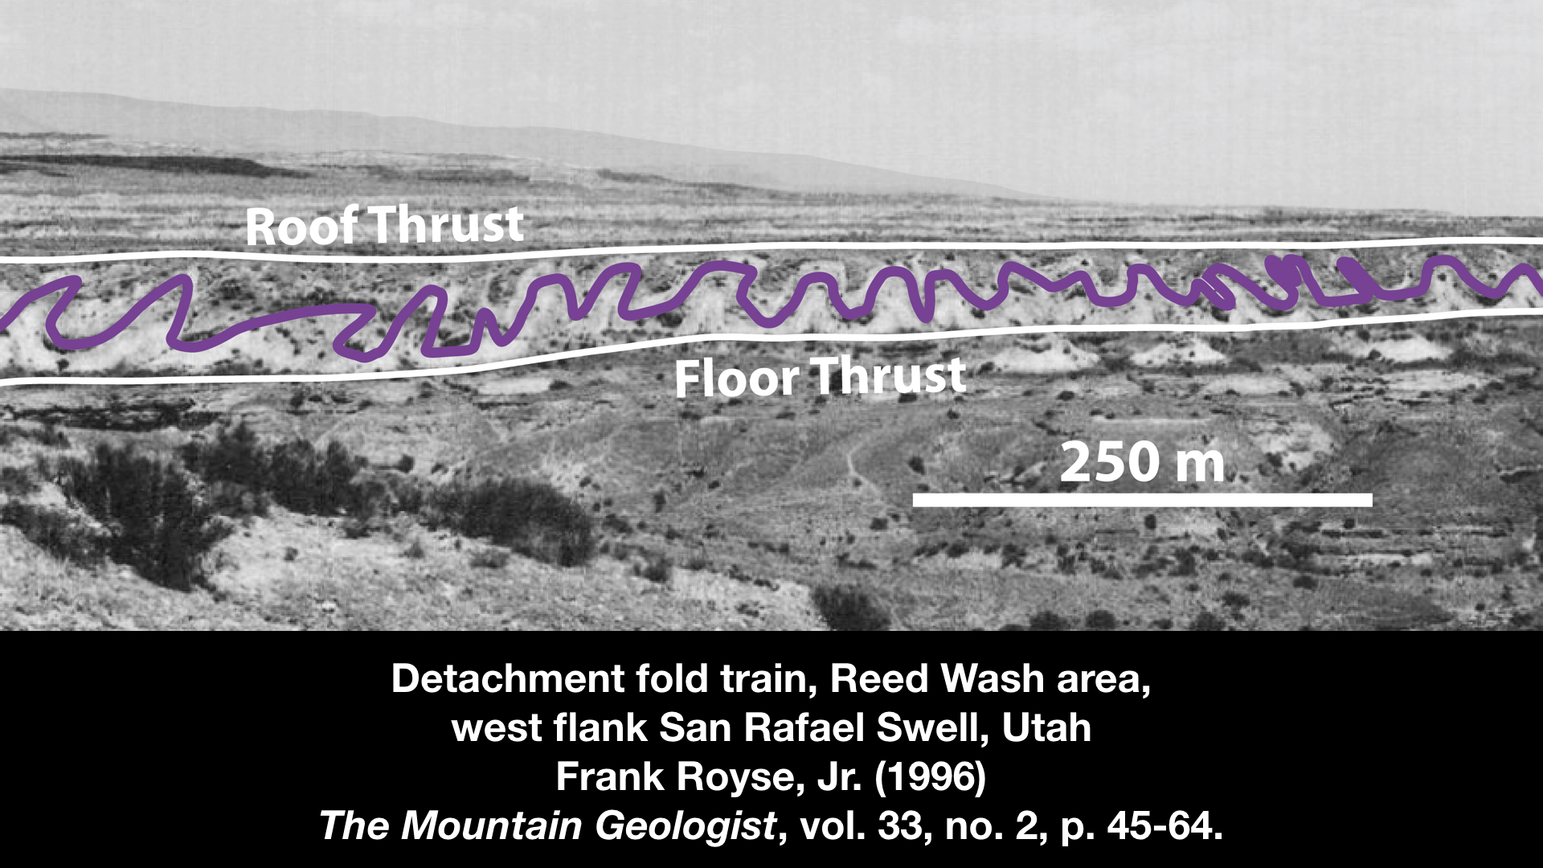
Notes:
As shown in the previous photos, the floor thrust is a discrete detachment. In this photo from Frank Royse’s paper, you can see that the strata above the fold train dip gently to the west & are not folded. This suggests the presence of an upper detachment, forming what we will call a fold duplex.
This figure from Frank Royse shows 20 of the folds from this fold train. There are actually over 60 folds in this zone of folding. From this photo it is easy to envision the need for two thrusts, one underlying the folds & the second overlying the folds.

Slide 12
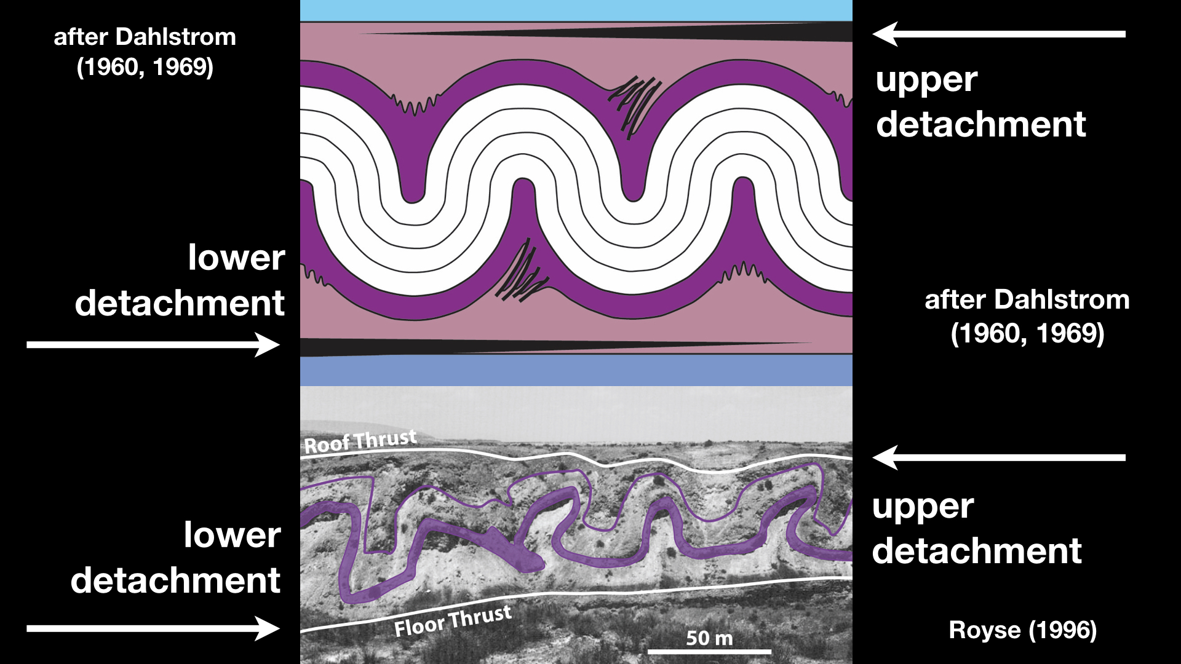
Notes:
So the detachment fold train of Frank Royse appears to be match Dahlstrom’s model for an upper detachment in concentric folding, with distinct upper & lower detachments. We will return to Royse’s fold train a bit later, as it is actually much more complicated that I have just portrayed.

Slide 13
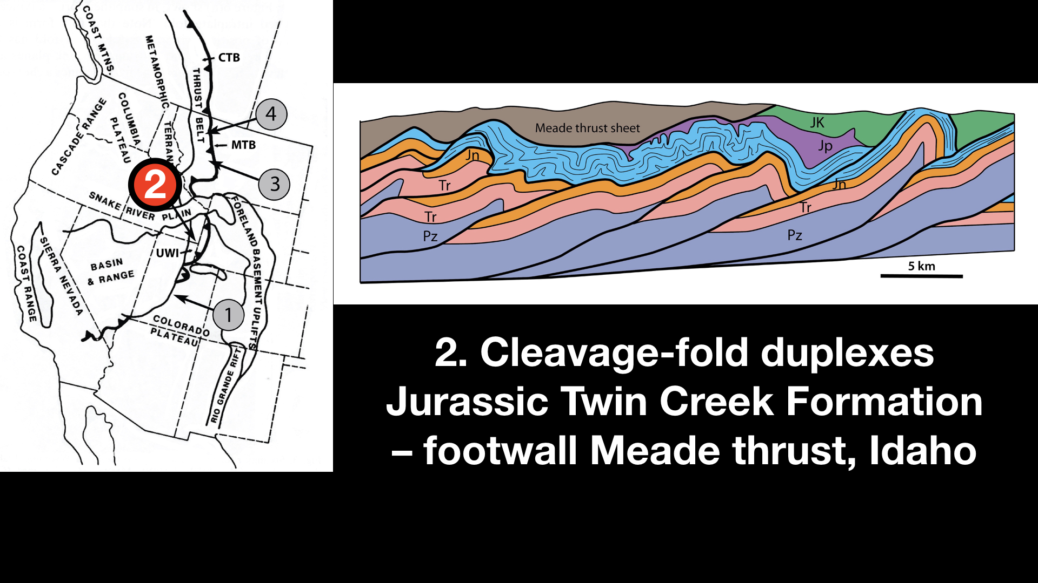
Notes:
I’d like to describe now a fold duplex that has a geometry comparable to the detachment fold train of Frank Royse. It is a train of folds in the footwall of the Meade thrust in SE Idaho.

Slide 14
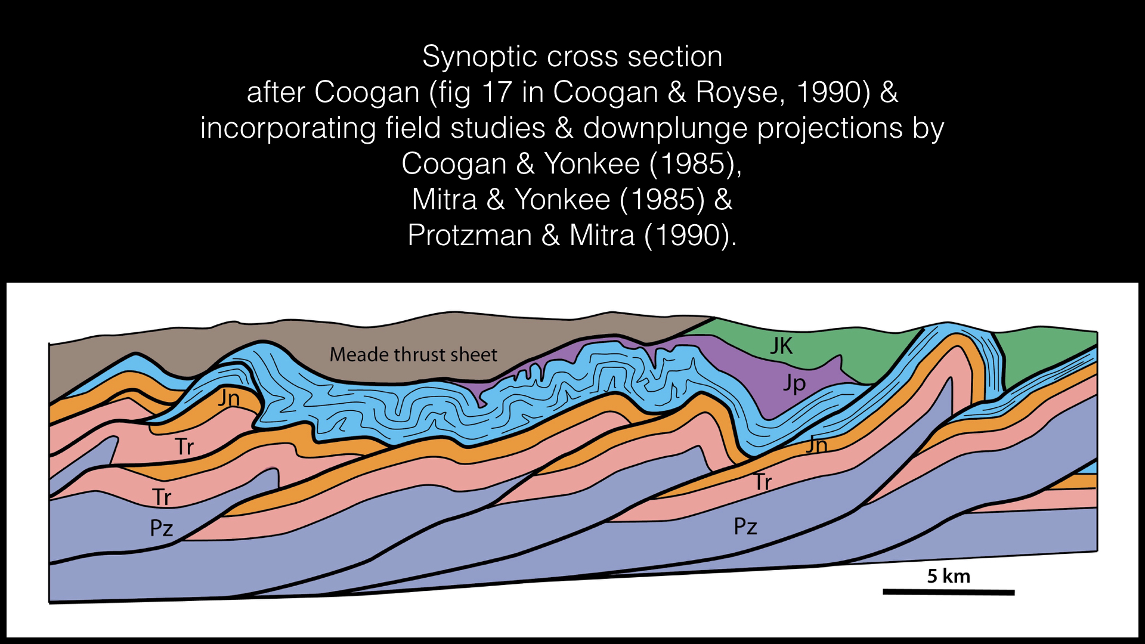
Notes:
The Meade thrust sheet, shown in brown is comprised of Paleozoic & Mesozoic strata. Underlying the thrust are Jurassic Twin Creek limestones have shortened into a series of tight folds to form a fold duplex. There is a detachment at the base of the Twin Creek Formation, and beneath that detachment are large thrust sheets of Paleozoic & Mesozoic strata that form a fault duplex. This generalized cross-section is based on the mapping & analysis of Jim Coogan, Adoph Yonkee, Gretchen Protzman, & Gautam Mitra.
Coogan, J.C., and Royse, F.R., Jr., 1990, Overview of recent developments in thrust belt interpretation: in S. Roberts (ed.), Geologic Field Tours of Western Wyoming and parts of adjacent Idaho, Montana, and Utah: Public Information Circular No. 29, p. 89 - 124.
Coogan, J.C., and Yonkee, W.A., 1985, Salt detachments in the Jurassic Preuss redbeds within the Meade and Crawford thrust systems, Idaho and Wyoming: Utah Geological Association publication 14, Orogenic Patterns and Stratigraphy of North-central Utah and southeastern Idaho, p. 75 - 82.
Mitra, G., and Yonkee, W.A., 1985, Relationship of Spaced Cleavage to folds and thrusts in the Idaho-Utah-Wyoming thrust belt. Journal of Structural Geology 7, 361-373.
Protzman, G. M., and Mitra, G., 1990, Strain fabric associated with the Meade thrust implications for cross-section balancing. Journal of Structural Geology 12, 403-417.

Slide 15
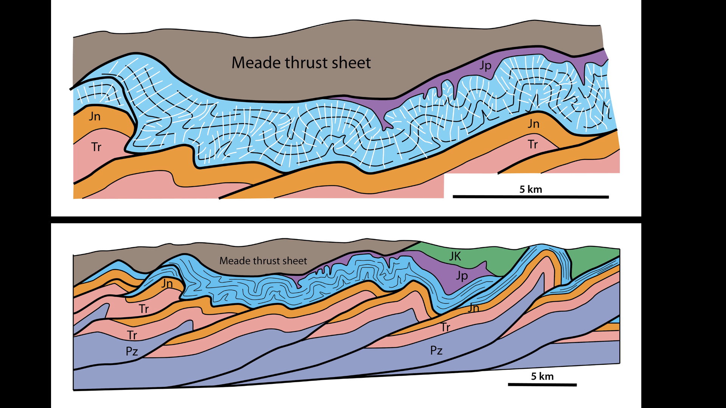
Notes:
The upper section is a close-up view of the Twin Creek duplex. The black lines are traces of bedding & the white lines are pressure solution cleavage. The Meade thrust is riding in Jurassic evaporites, which forms the roof of the duplex. The Jurassic Twin Creek limestones are the stratigraphic equivalent of the gypsum beds of the Carmel Formation, which we have previously described. We consider this to be a fold duplex similar to the one developed in the Carmel Formation.

Slide 16
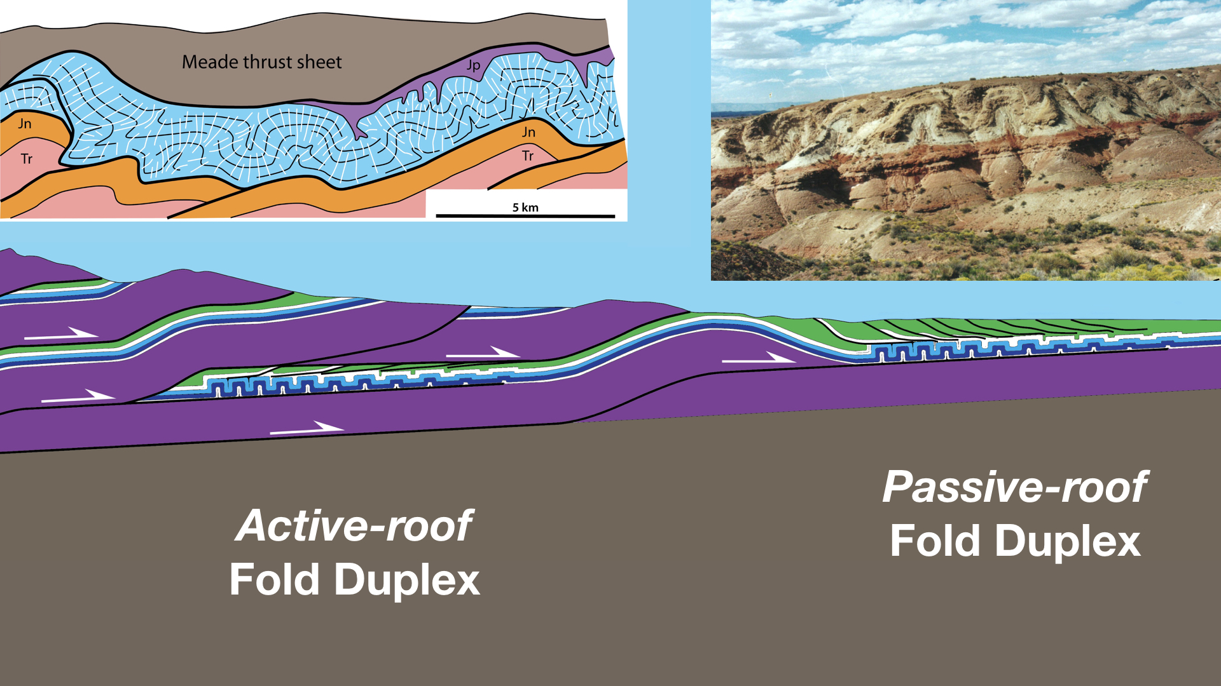
Notes:
These two fold duplexes developed in stratigraphically equivalent units but in different structural settings within the thrust belt. The Twin Creek fold duplex formed in the footwall of a major active thrust, the Meade, & thus it would be termed an active-roof duplex. The Reed Wash duplex in the Carmel is termed a passive-roof duplex because there is not overriding master thrust.

Slide 17
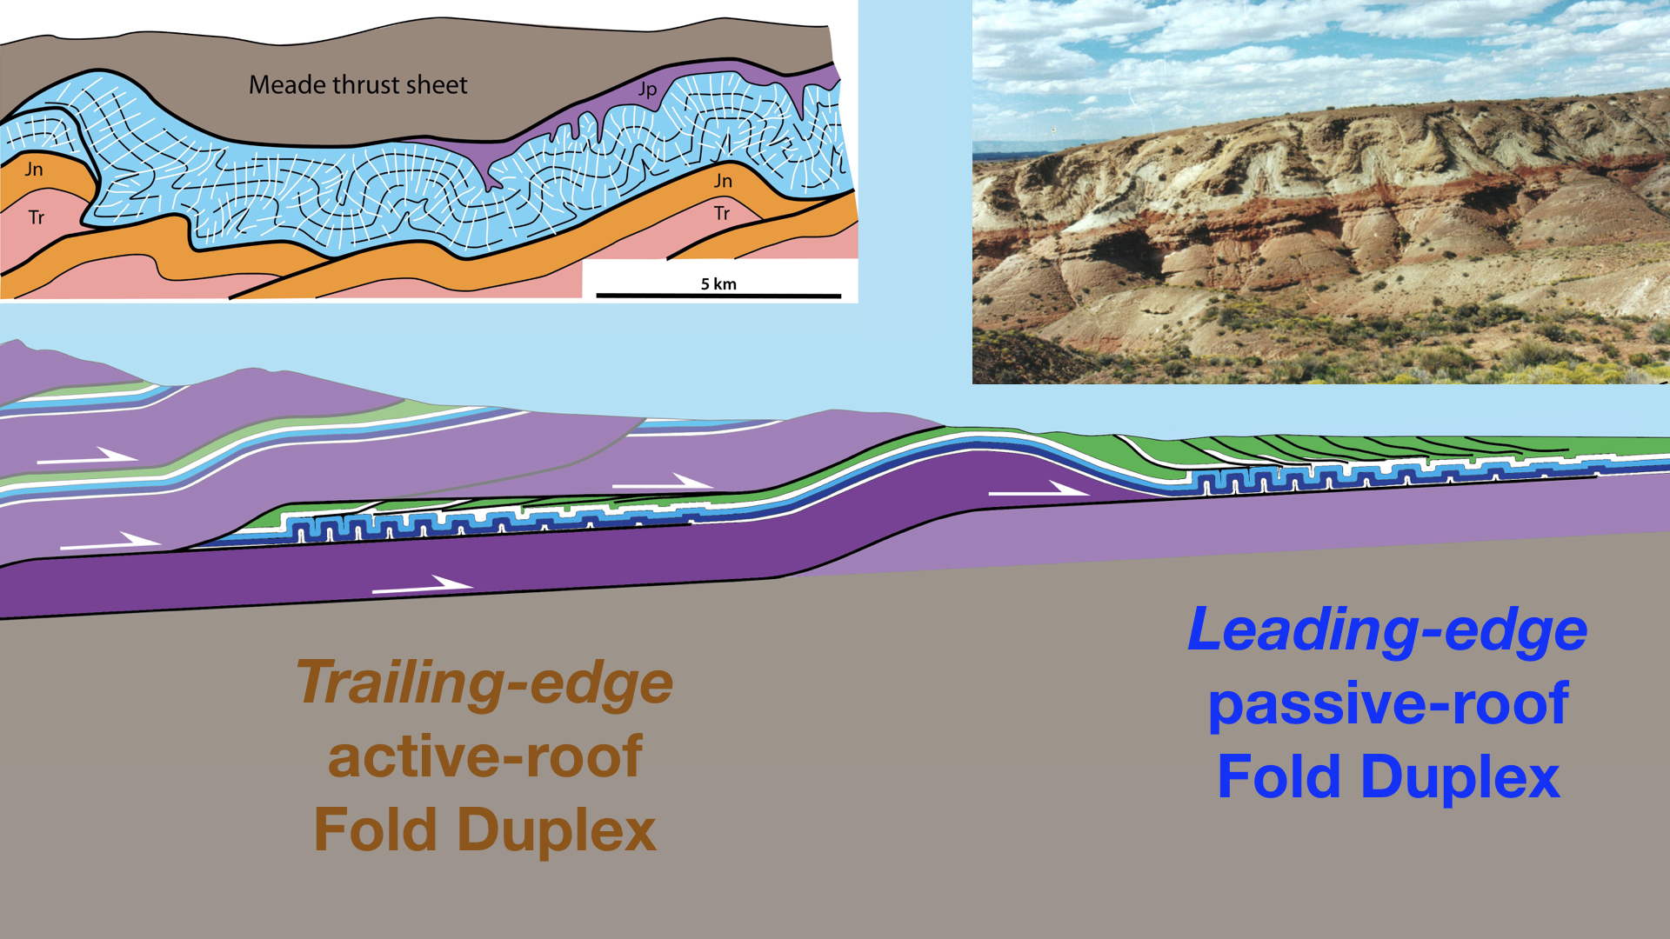
Notes:
The Twin Creek duplex is also a trailing-edge duplex, because it developed at the hinterland portion of a thrust sheet, whereas the Carmel duplex in Utah is a leading-edge duplex, because it formed at the foreland end of the thrust sheet. So we would say that the Twin Creek structure is a trailing-edge, active-roof fold duplex, whereas the Carmel structure is a leading-edge, passive-roof duplex.

Slide 18
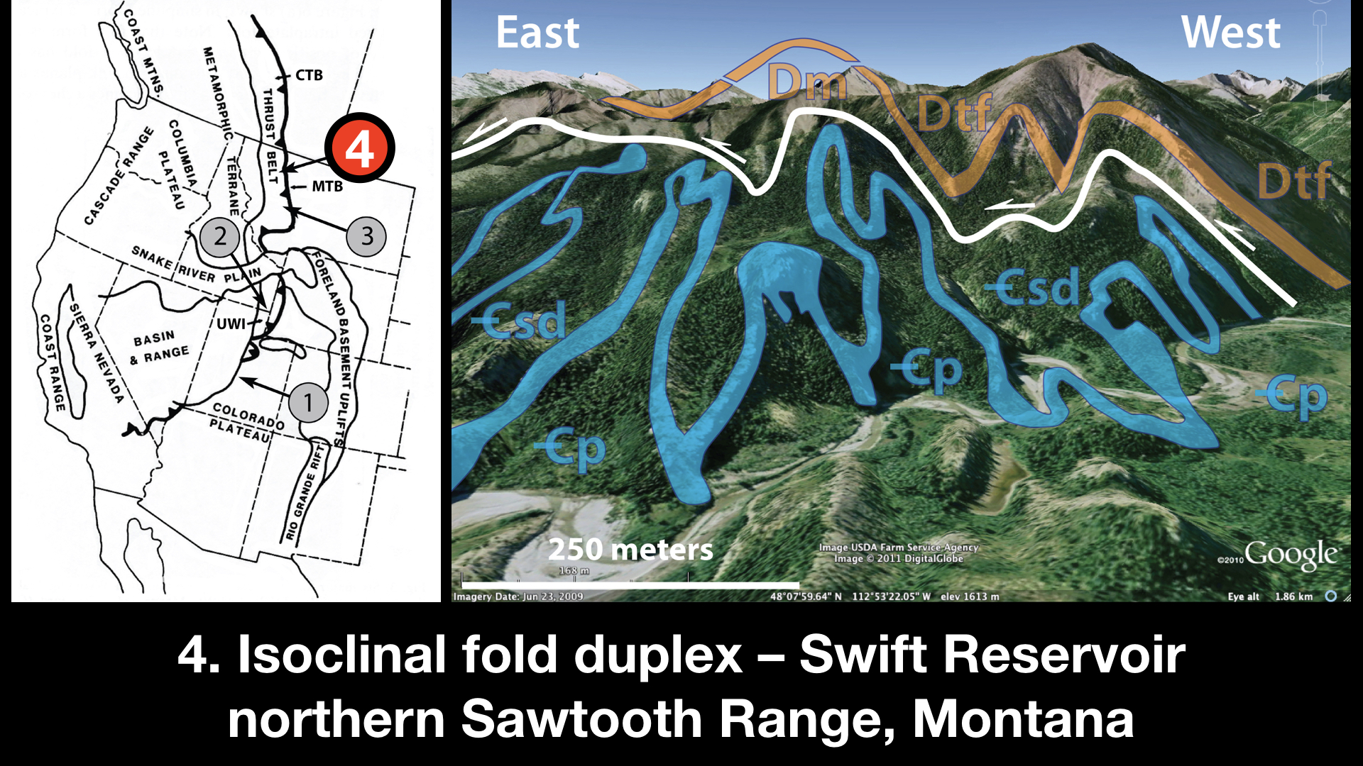
Notes:
I am ommitting example 3 from the Gates of the Mountains. My final example is a duplex comprised of vertical isoclinal folds exposed at Swift Reservoir in the northern Sawtooth Range of NW Montana, just south of Glacier National Park.

Slide 19
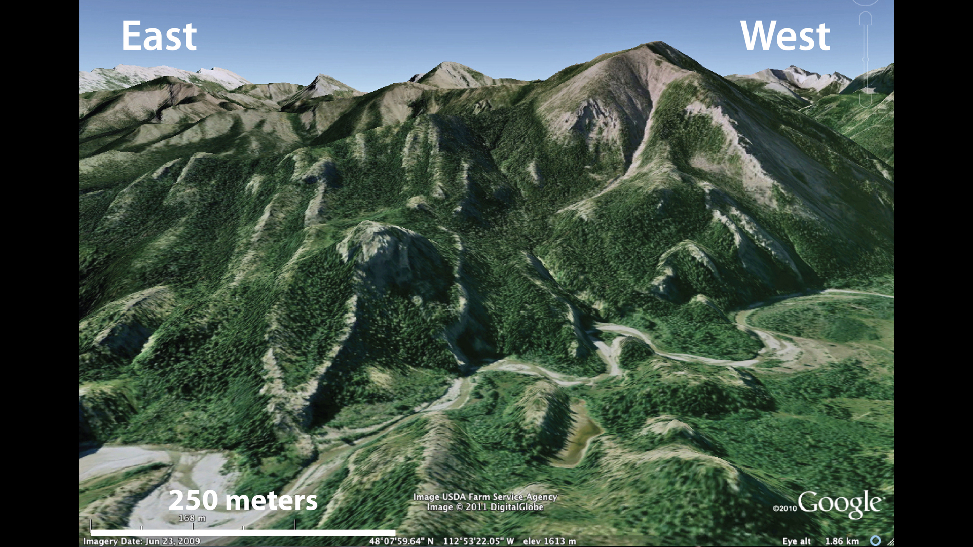
Notes:
This is an unannotated Google image of the folds in Cambrian carbonates. The prominent outcropping unit is the Steamboat Limestone.

Slide 20
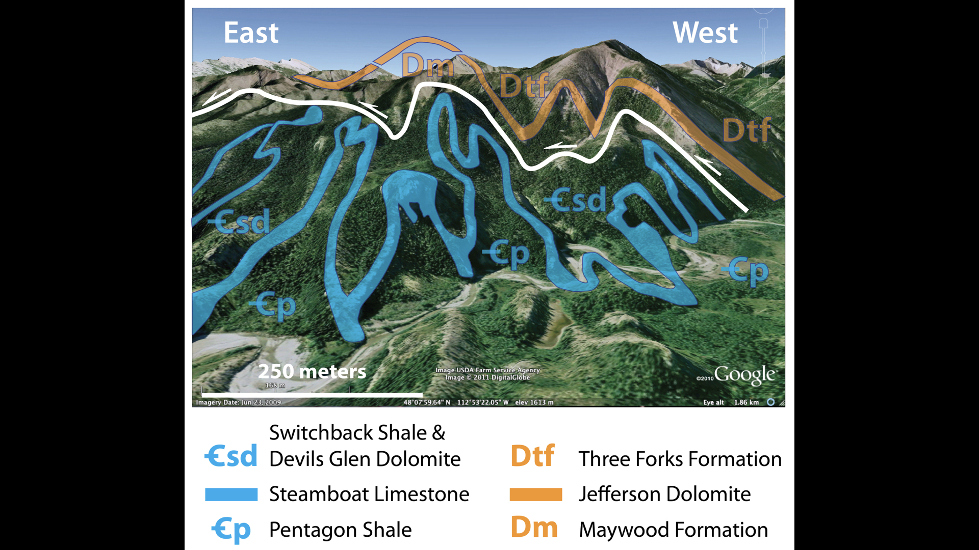
Notes:
This is the stratigraphy of the fold duplex. Overlying the duplex are the Devonian Three Forks Formation and Jefferson Dolomite. The upper roof detachment, shown by white, is in the Maywood Formation and Cambrian Switchback shale. The highlighted blue unit is the Cambrian Steamboat Limestone. The floor thrust, which probably lies in the Pentagon Shale, is not exposed.

Slide 21
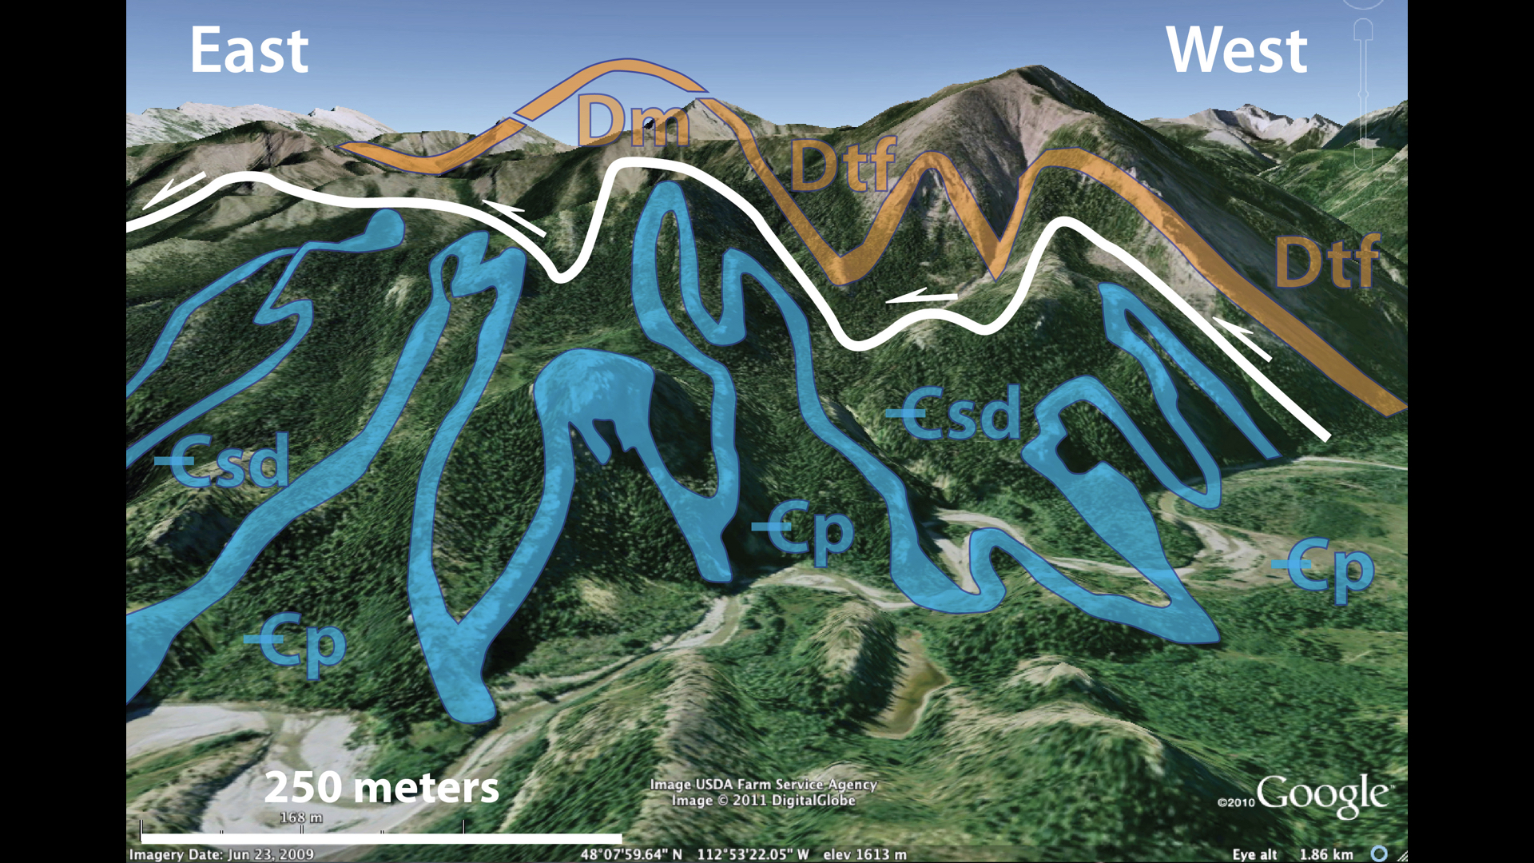
Notes:
We would consider this to be duplex of vertical isoclinal folds.

Slide 22
Notes:
I would like to now return to the detachment fold train of Frank Royse to discuss some complexities of fold duplexes. From this photo one has the impression of a simple fold duplex with a roof and floor.

Slide 23
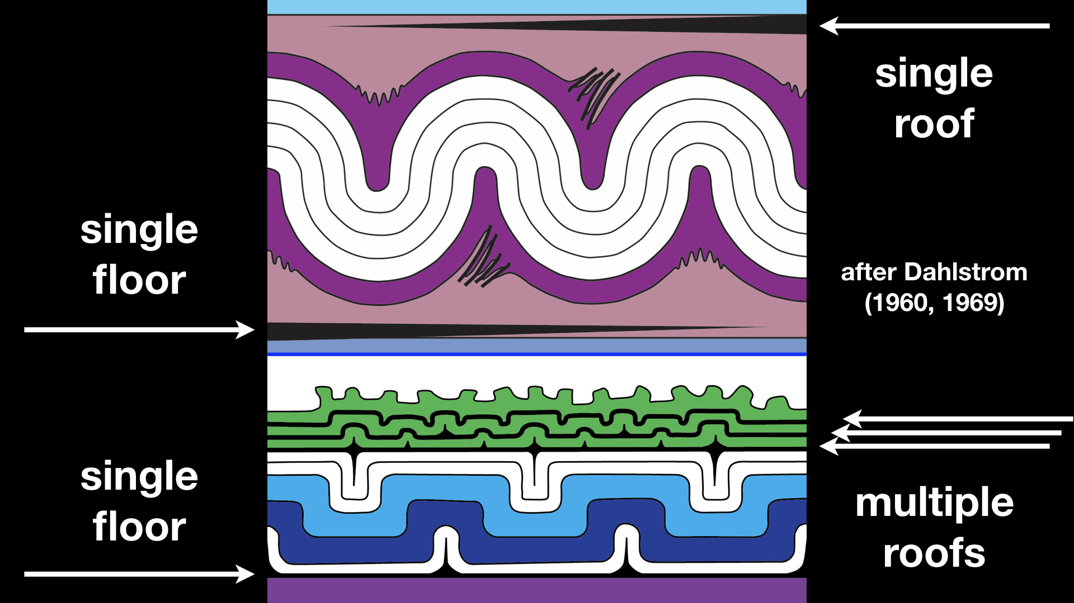
Notes:
Also, Dahlstrom’s model suggested there should be a single upper detachment for the fold train. However, in his 1996 paper, Frank noted that in the Reed Wash fold train there are multiple upper detachments, as shown in the lower figure. So rather than there being a single roof thrust, as in the Dahlstrom model, there are actually multiple roof thrusts.

Slide 24
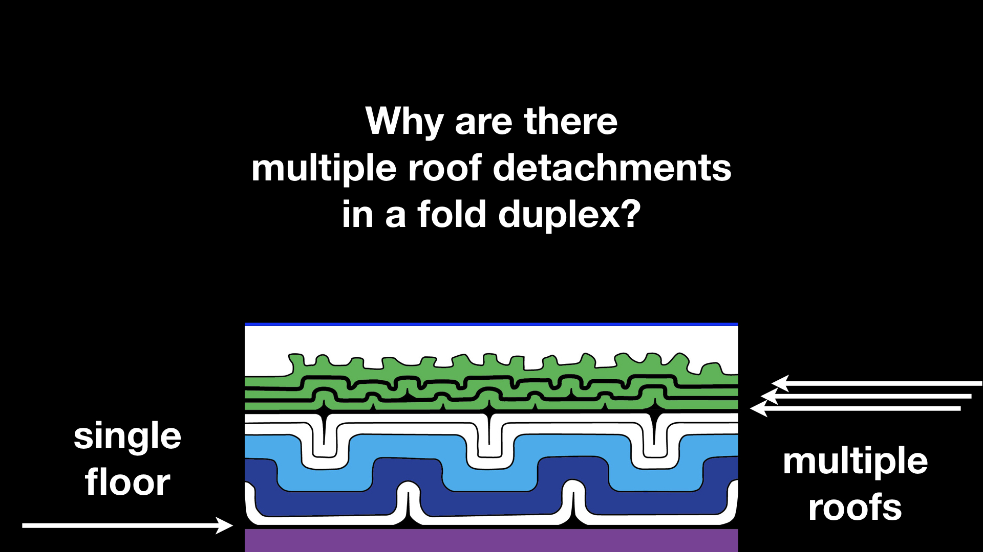
Notes:
In fact, I will argue with some models that multiple roofs should be the norm for fold duplexes.

Slide 25
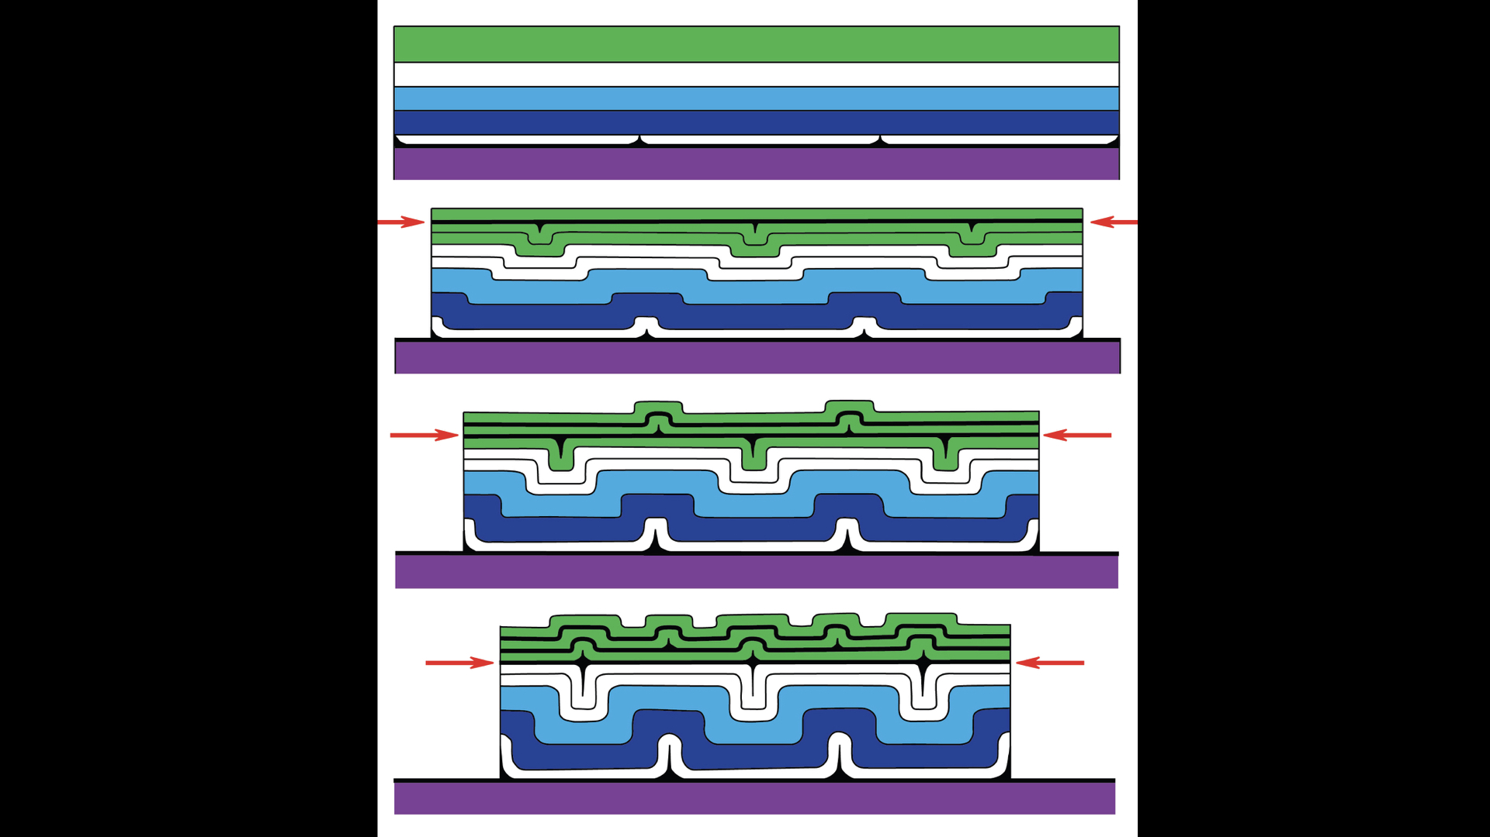
Notes:
This model shows the evolution of a fold duplex in which the folds grow at the same rate. At their cores, these folds are vertical isoclines, what John Suppe has termed “lift-off” folds. Note the roof detachment started out near the top of the green unit at the outset of shortening, but as shortening continued, the roof thrust continuously dropped to lower levels, eventually to the base of the green unit. The upper detachment level changed through time, creating multiple roof detachments.

Slide 26
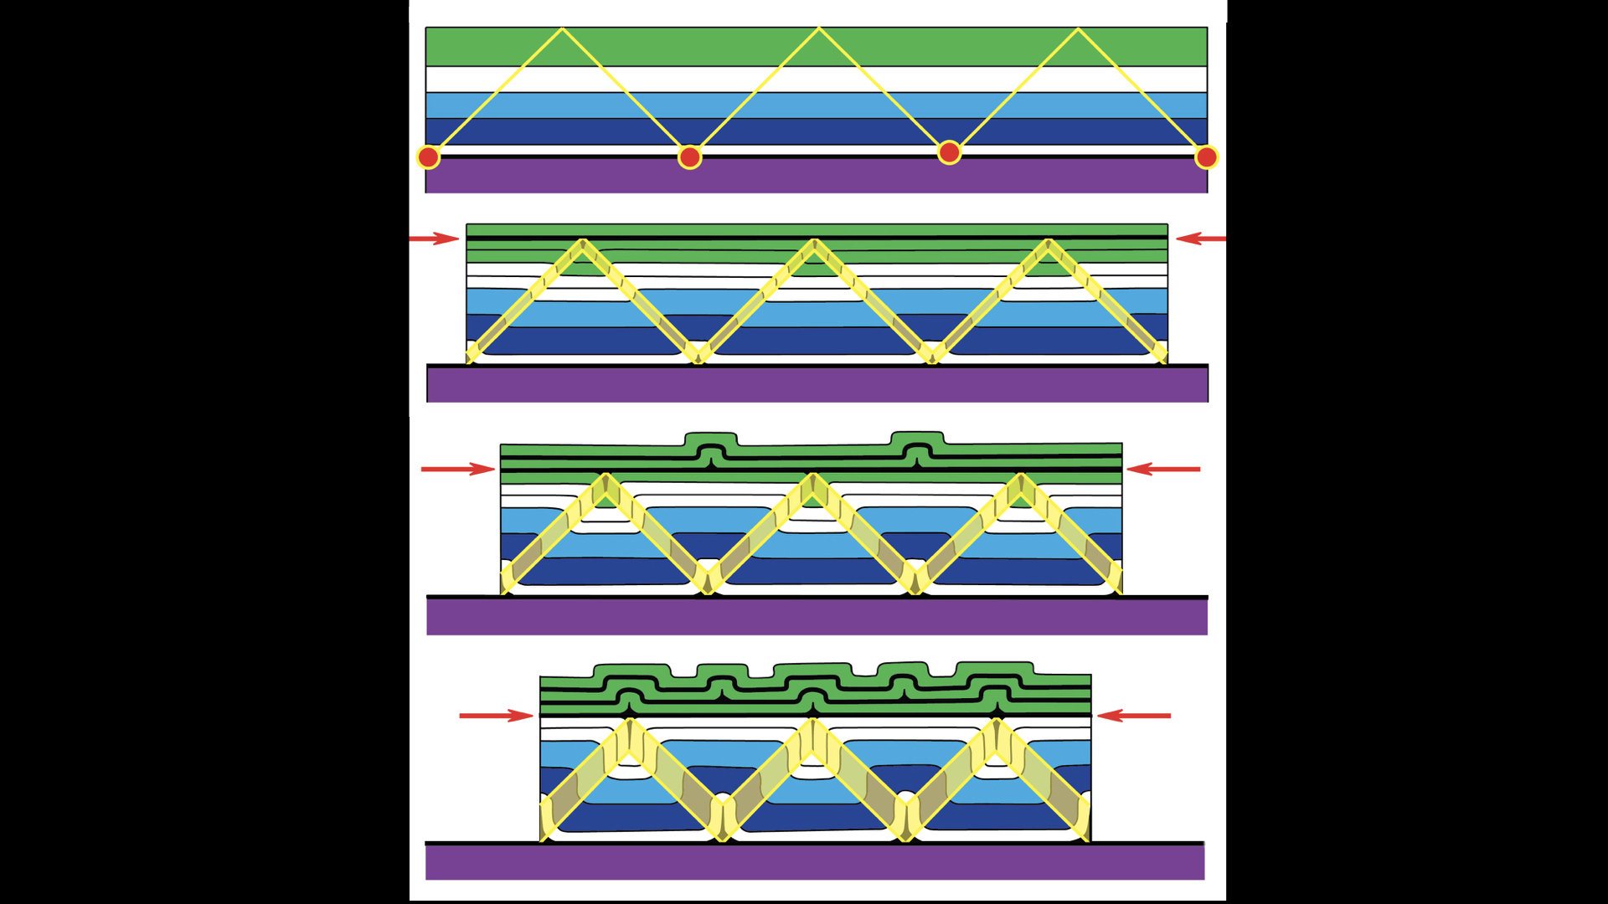
Notes:
Perhaps, you can see this better if I highlight the kink bands. The folds initiate at a particular spacing indicated by the red dots. As shortening proceeds, the kink bands widen & the fold spacing narrows. Note that the kink bands merge upward. The upward intersection of opposing kink bands denotes the position of an upper detachment, the roof thrust for a fold duplex. – In this model, I have assumed that in the first phase of deformation the roof sequence has shortened by 10% of subresolution strain, such as intergranular compaction. So there is no folding in the hanging wall of the roof. – The roof thrust however drops to lower stratigraphic levels as shortening continues. This produces multiple upper detachments & disharmonic folding in the roof.

Slide 27
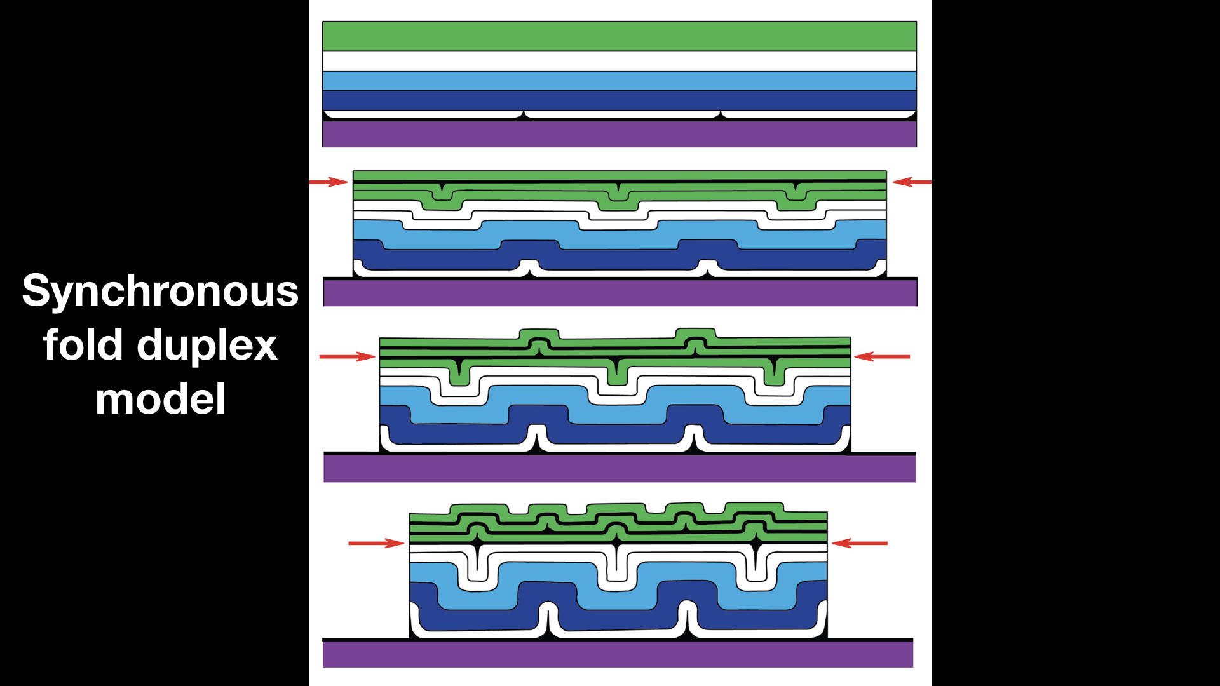
Notes:
This is a synchronous fold model – all folds initiate at the same time and grow at the same rate. However, this is unlikely to be the case for real fold trains in nature.

Slide 28
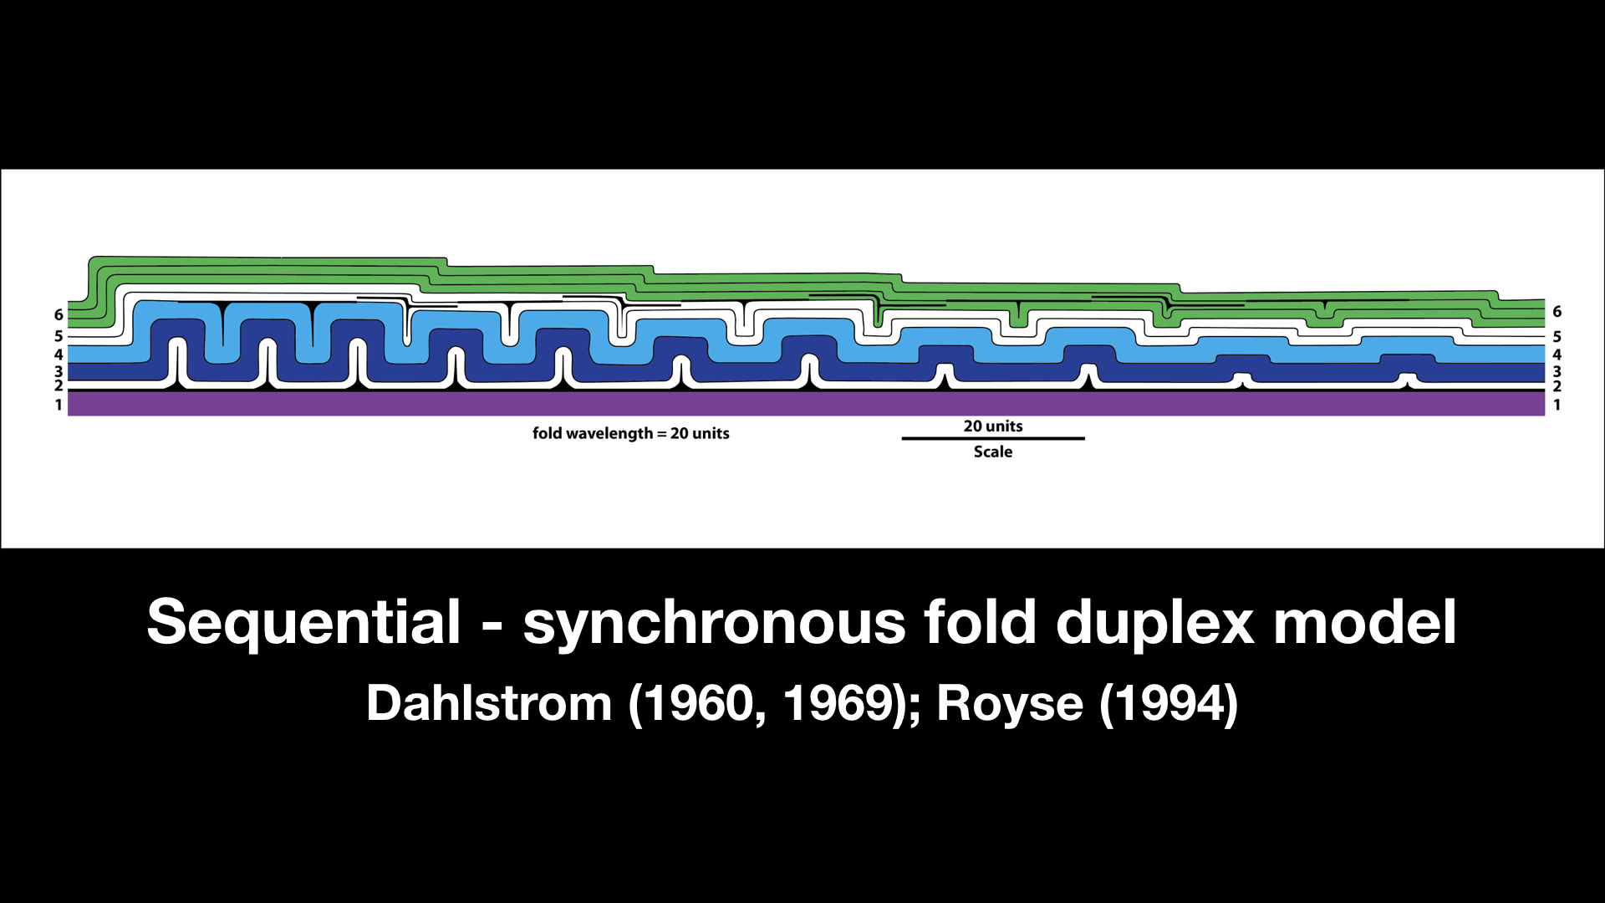
Notes:
Clint Dahlstrom & Frank Royse both noted that the geometry of folds within such a fold train indicate that initiated in sequential fashion. Folds at the leading edge of such a fold train are more open and widely spaced, but toward the hinterland the folds tighten, become more closely spaced, & increase in amplitude. The geometric variations suggests that the folds initiated from hinterland to foreland, much as thrust sheets develop. As new folds developed, older existing folds continued to develop and tighten.

Slide 29
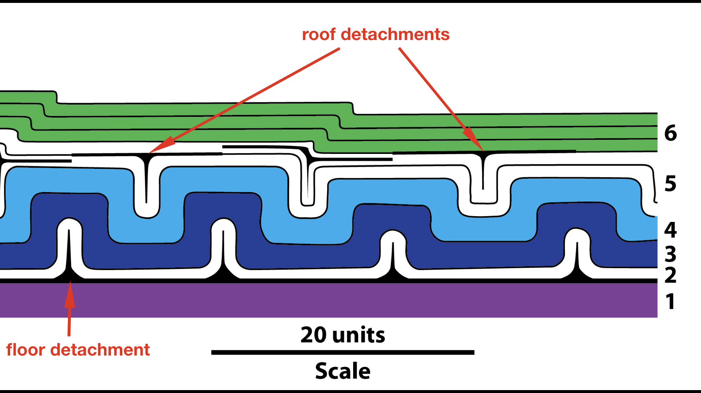
Notes:
Remember that as folds tighten the upper detachment drops to lower stratigraphic levels. In this figure note that the roof thrust lies at the base of the green unit (6) at right & drops into the white unit (5) to the left as the folds tighten. So, throughout the fold train the position of the roof detachment changes. The upper detachment is stratigraphically higher above the younger folds.

Slide 30
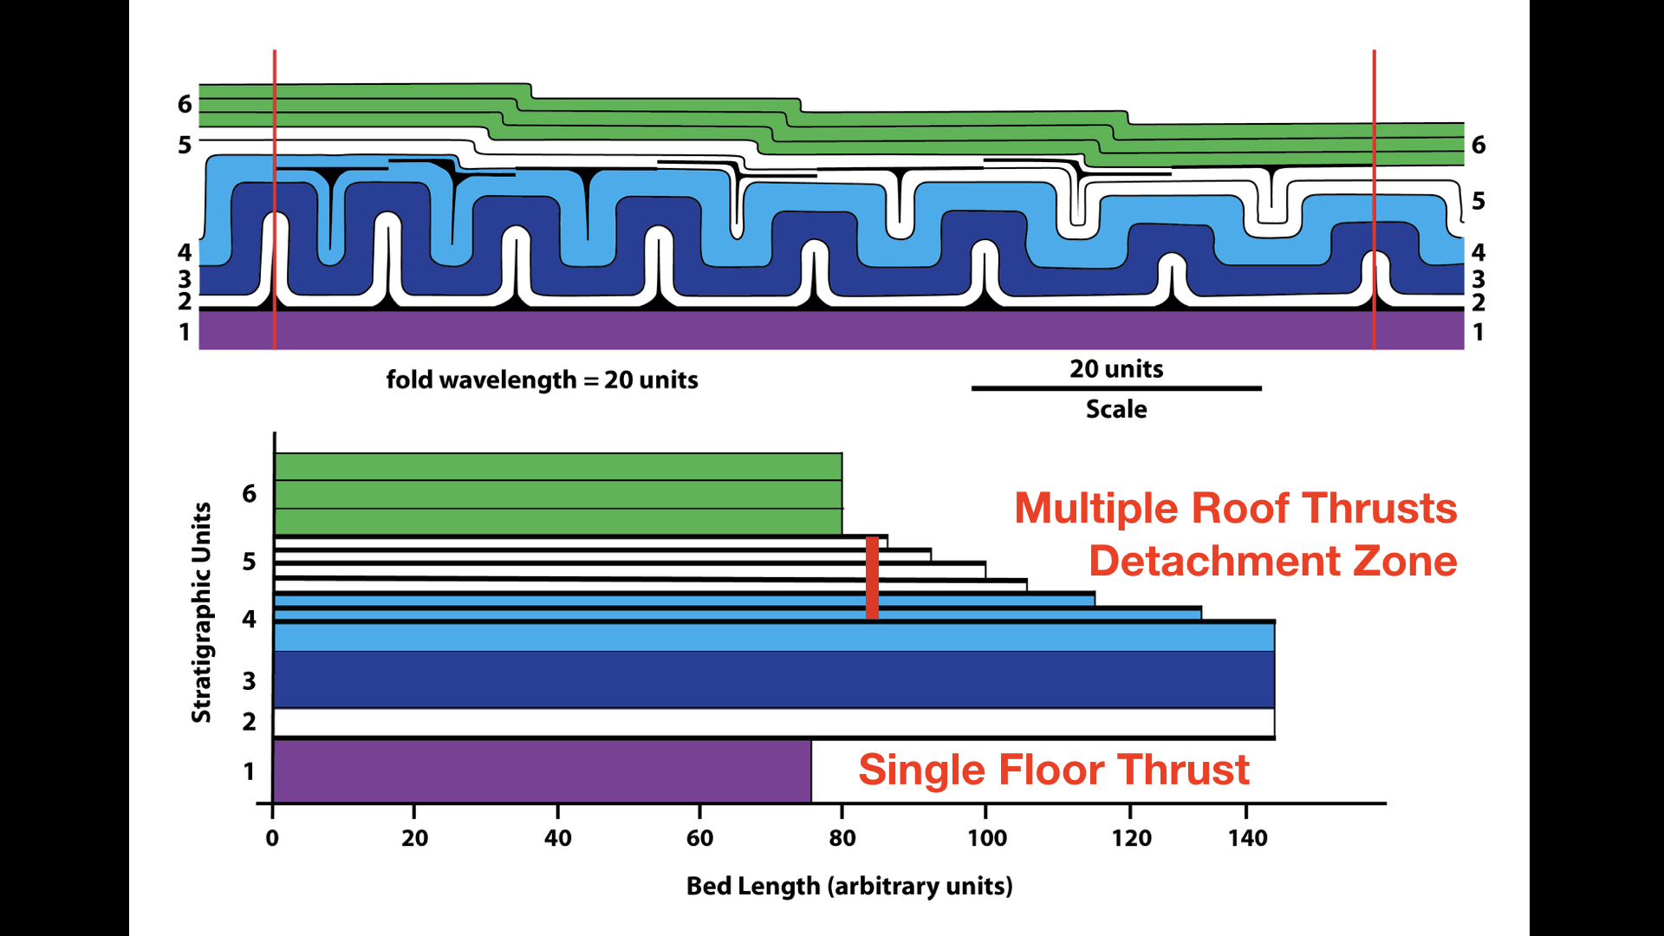
Notes:
If one measures line lengths and restores this cross section, discrepancies among line lengths reveal the positions of the multiple roof detachments. So, how does one account for the lack of line-length balance? The roof sequence (green) is far shorter than strata in the body of the duplex (blue).

Slide 31
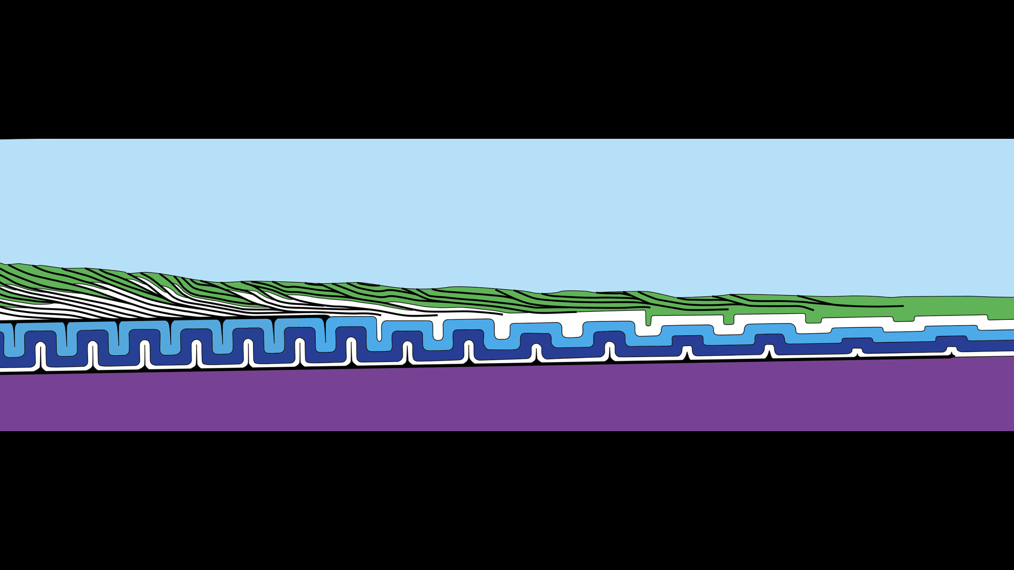
Notes:
The only possible answer is that the shortening is absorbed into the roof sequence, either by folding, tectonic compaction, or by backthrusting, as shown in this model.

Slide 32
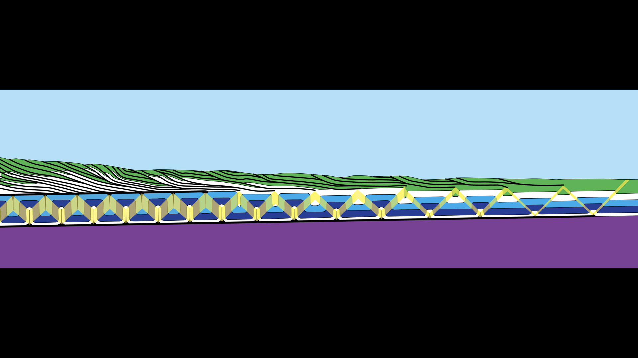
Notes:
I have highlighted the kink bands in this model.

Slide 33
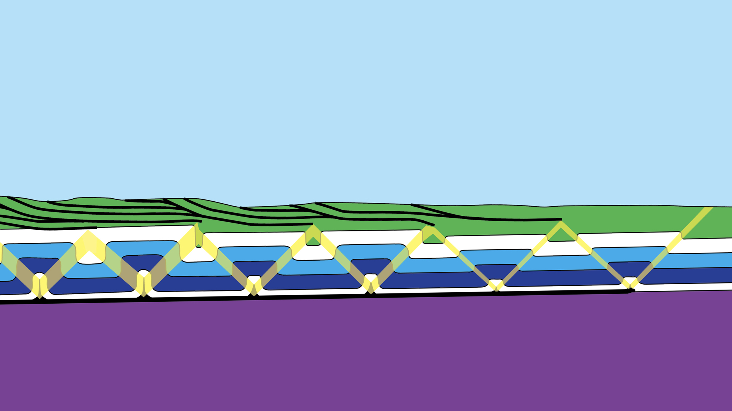
Notes:
This is the leading edge of the fold train. Note that at this stage, this is not a fully formed fold duplex. There is no through-going roof thrust. Isolated detachments initiate where kink bands converge upward. Deformation in the roof sequence becomes more complex toward the hinterland, as the folds toward the hinterland have been active for a longer time.

Slide 34
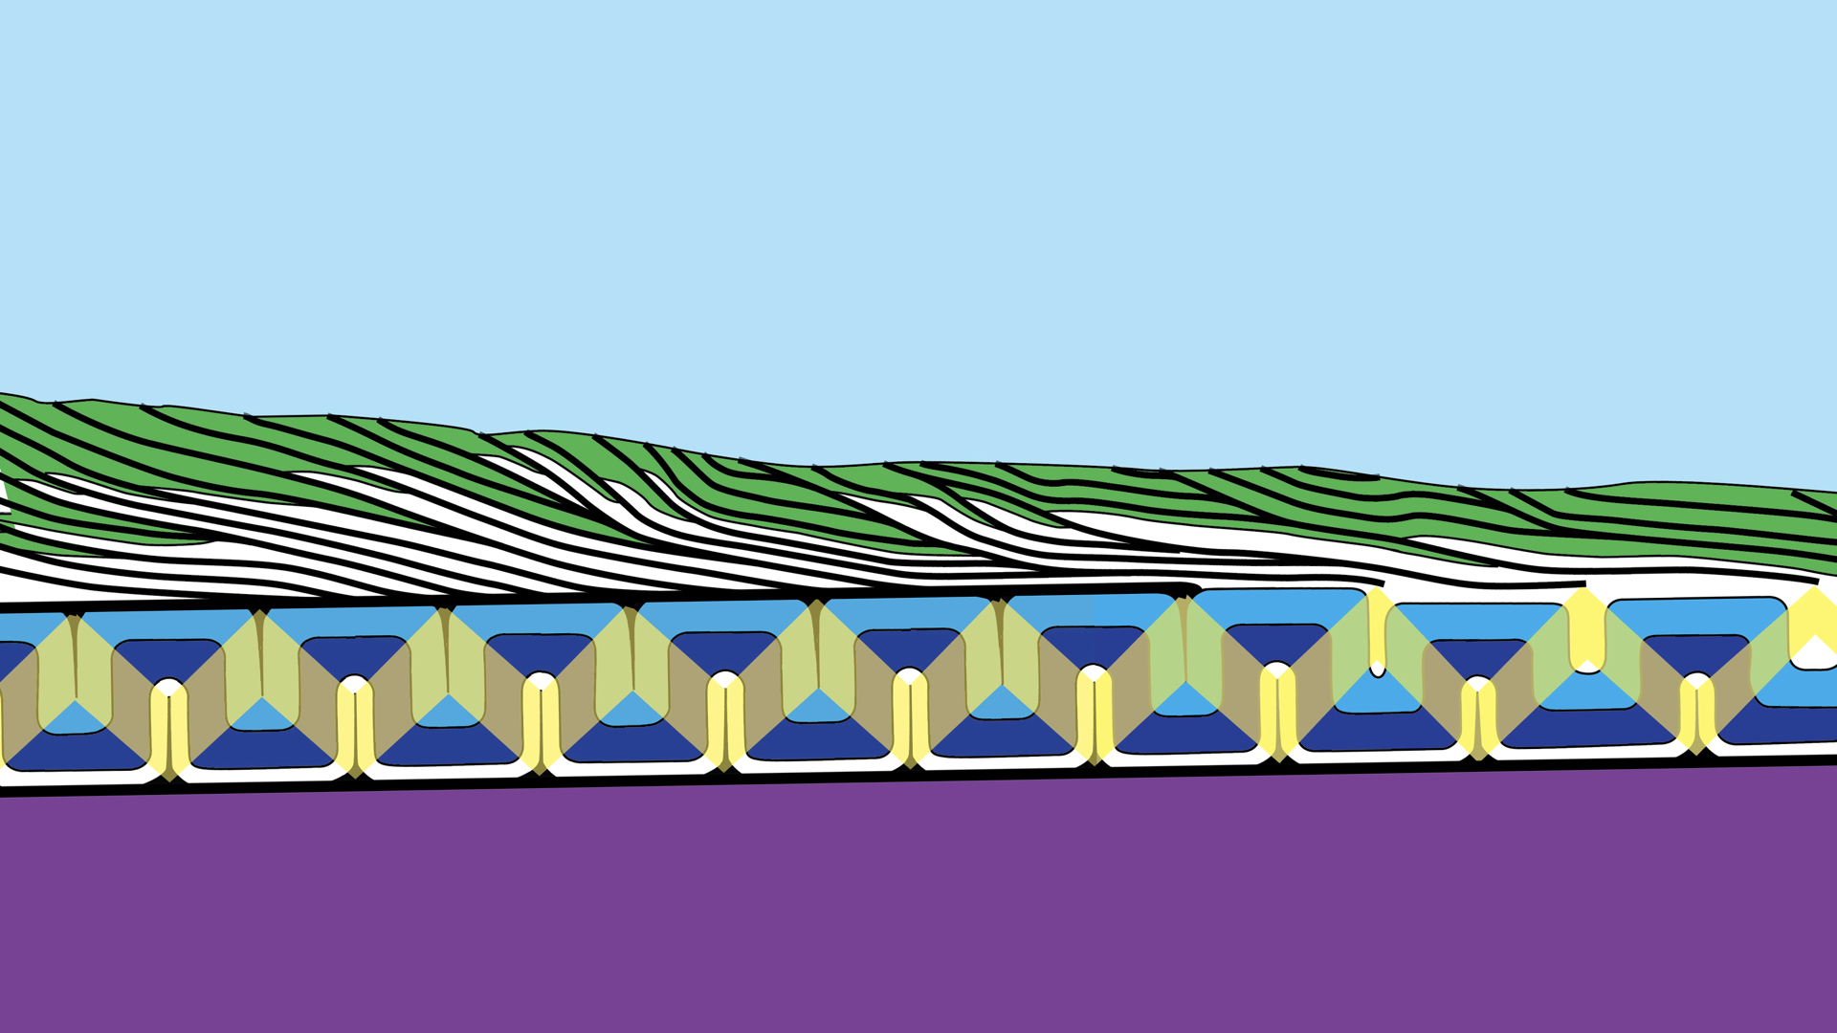
Notes:
Toward the hinterland, as folds tighten, a through-going roof thrust emerges, and now the fold train becomes a true fold duplex.

Slide 35
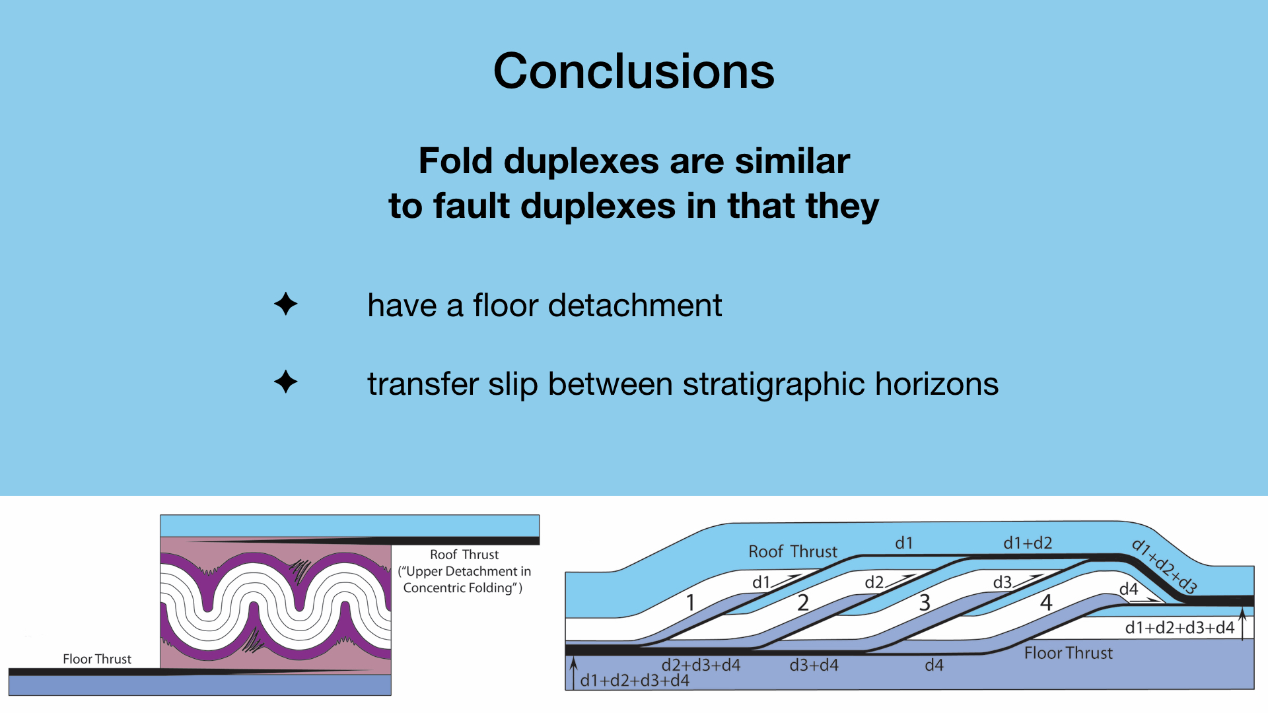
Notes:
In conclusion, fold duplexes are similar to fault duplexes in that they have a single floor thrust. Also, like fault duplexes, fold duplexes transfer slip from a lower floor thrust to an upper roof thrust.

Slide 36
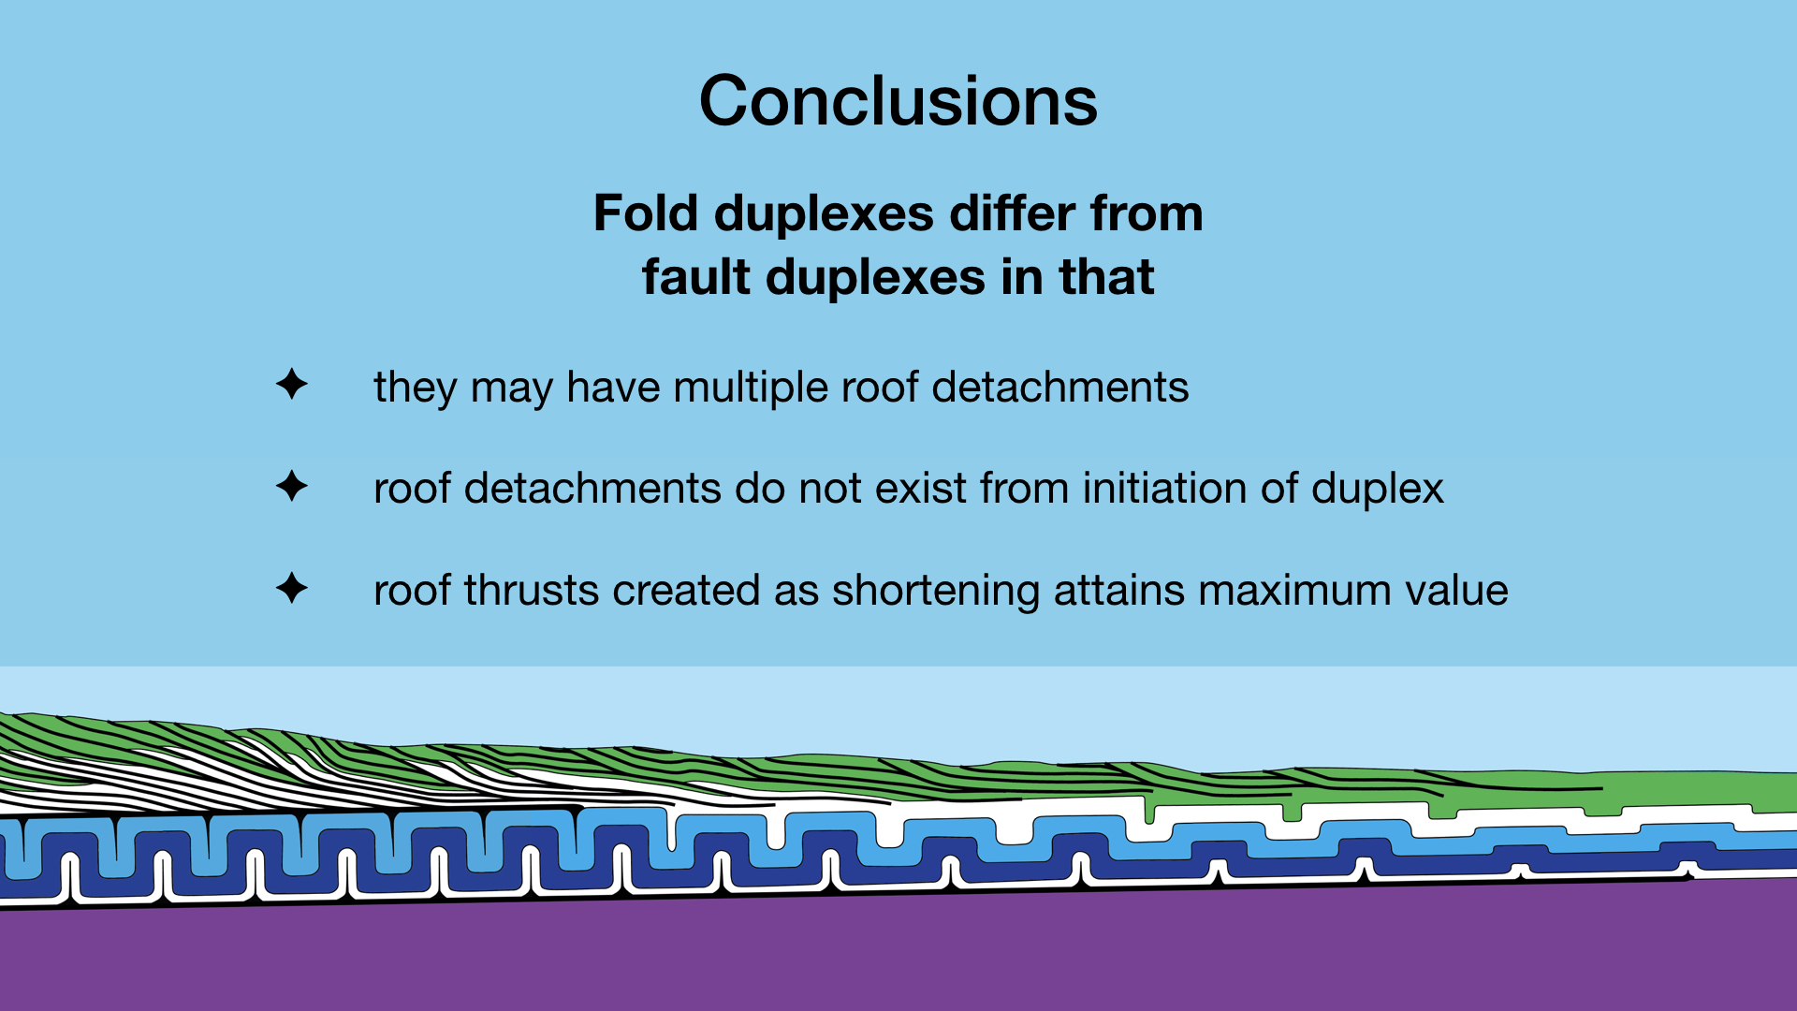
Notes:
However, in fold duplexes, kinematic models and field observations suggest there should be multiple roof detachments in a fold duplex, whereas there is only a single roof thrust in a fault duplex. Also the roof thrust does not exist at the initiation of a fold duplex. The roof thrust of a fold duplex is created when shortening reaches a critical value.

Slide 37
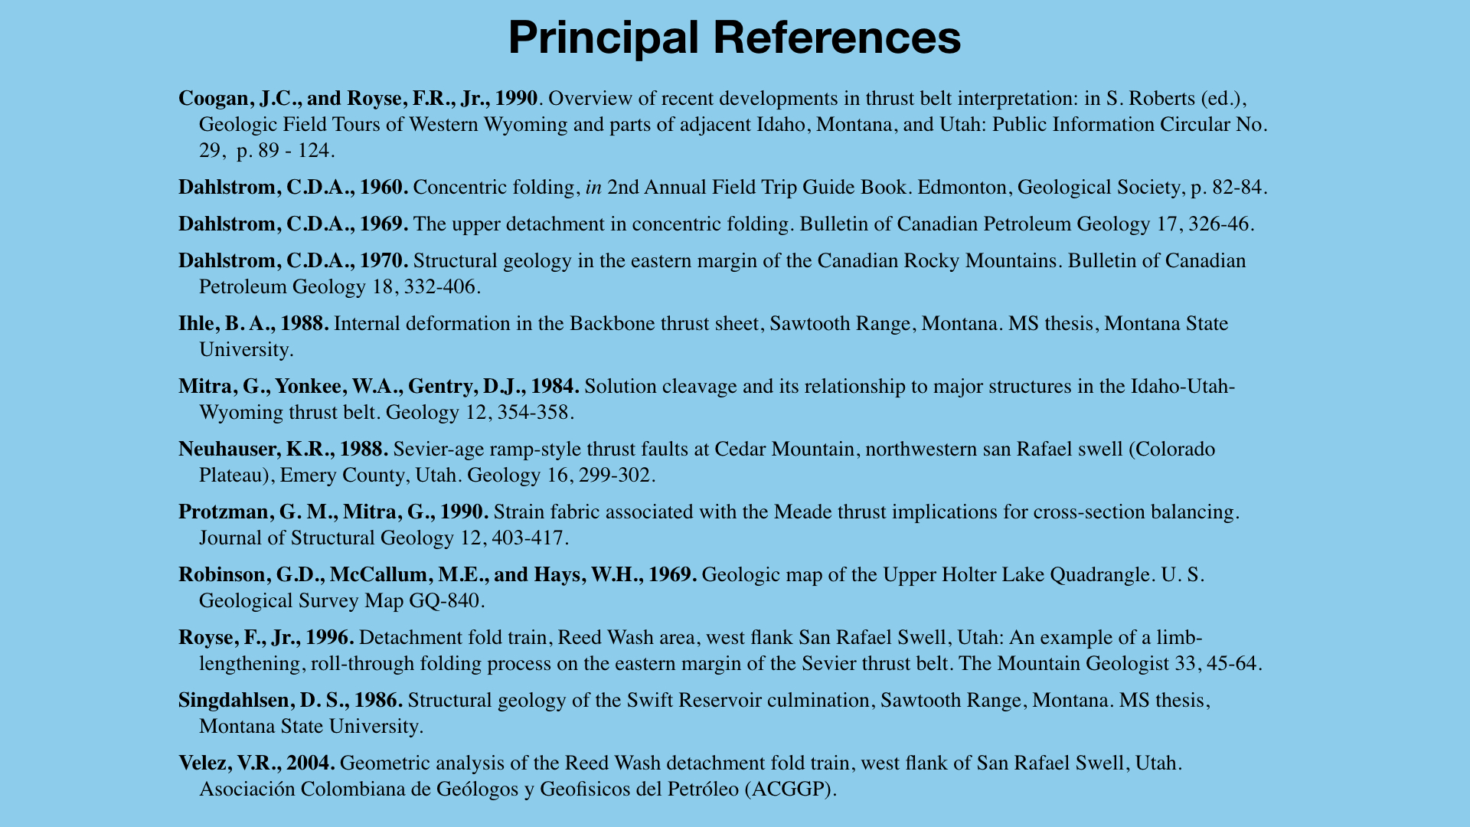

Slide 38
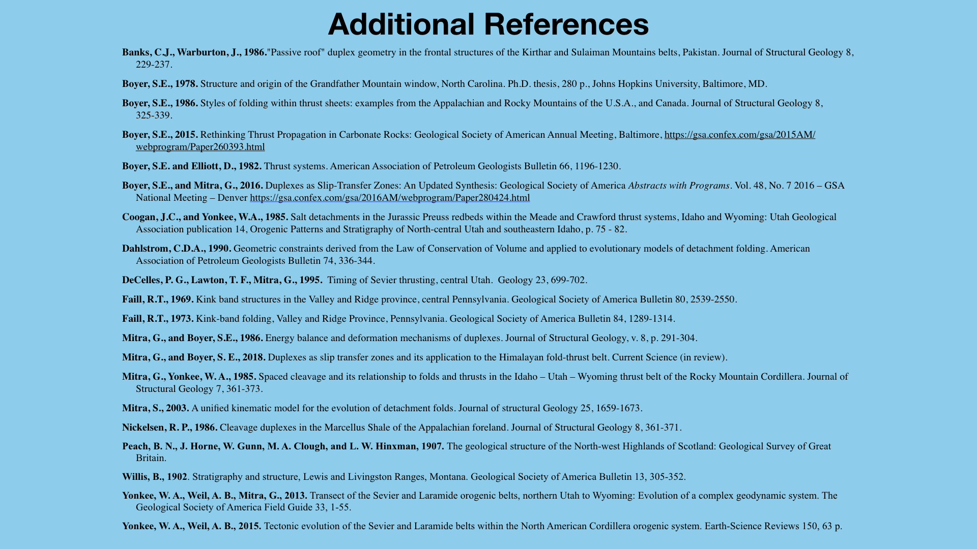

Slide 39
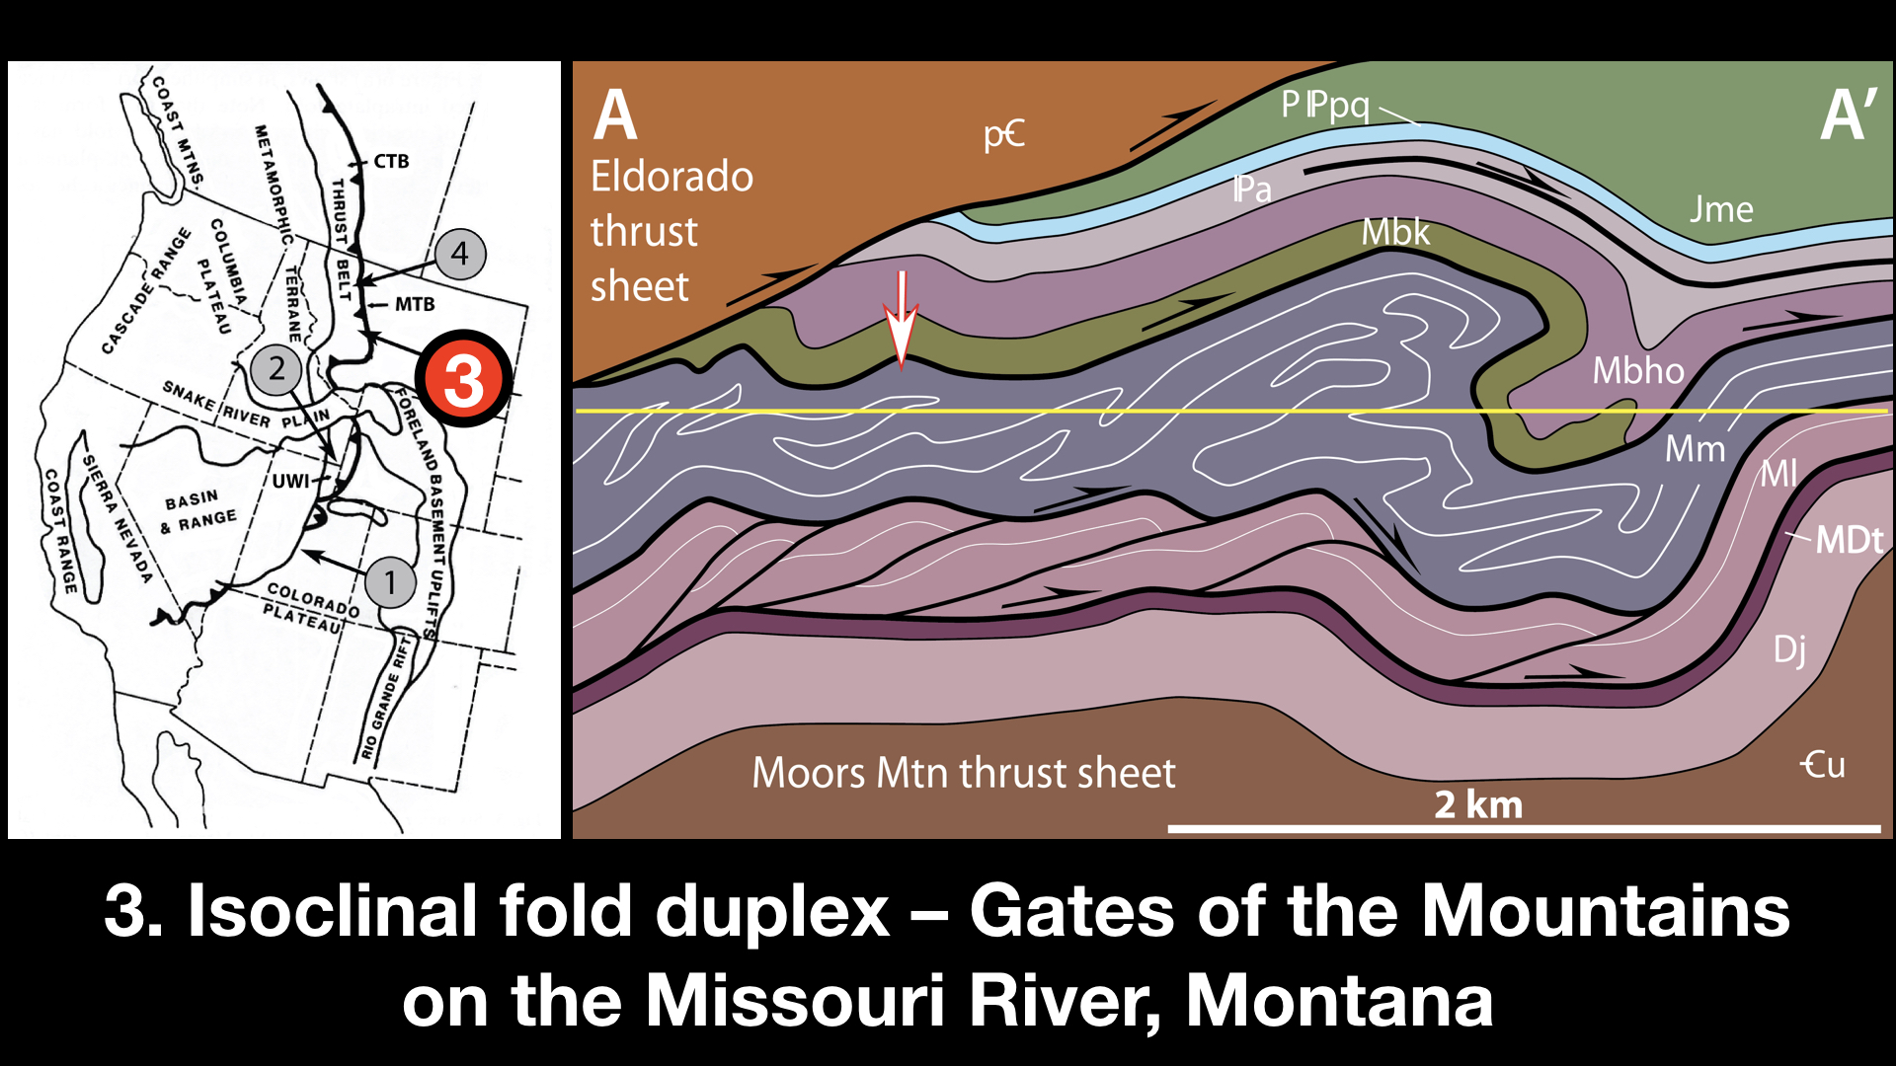
Notes:
The final example is a more exotic fold duplex exposed on the Missouri River at the Gates of the Mountains. Limestones of the Mississippian Mission Canyon Formation have been thrown into a series of recumbent isoclinal folds in the footwall of the Eldorado thrust sheet. The Mission Canyon limestones are shown in gray with white lines to highlight folds. The Eldorado thrust sheet, shown in brown, consists of Precambrian Belt Supergroup metasedimentary rocks.

Slide 40
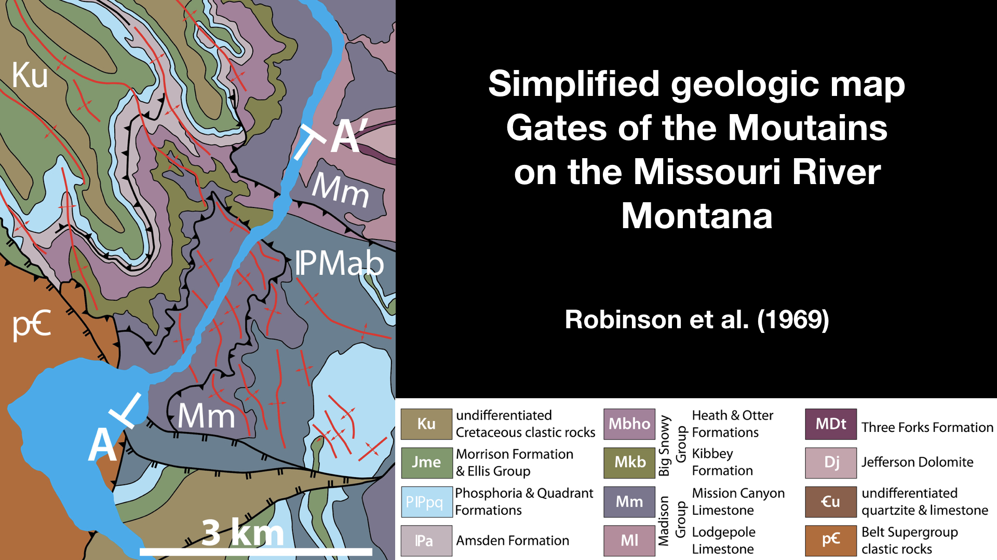
Notes:
This is a simplified geologic map of the Gates of the Mountains on the Missouri River. The Missouri River is in blue. The Eldorado thrust sheet of Precambrian Belt outcrops in the lower left. The formation of the canyon has formed a tectonic window into the fold duplex. The fault rimming the canyon to west & east is the roof thrust of the fold duplex.
Robinson, G.D., McCallum, M.E., and Hays, W.H., 1969. Geologic map of the Upper Holter Lake Quadrangle. U. S. Geological Survey Map GQ-840.

Slide 41
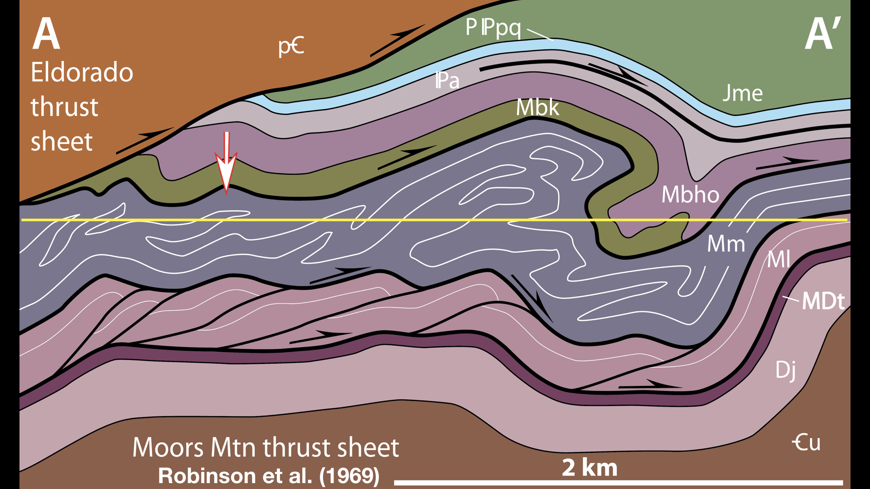
Notes:
The roof thrust probably lies along the contact between the Mission Canyon and the overlying Kibby formation. The floor thrust probably lies between the Lodgepole formation, the flesh color Ml, & the overlying Mission Canyon, as there are no Lodgepole limestones exposed in the folds. I’d like to show you a photo of one isoclinal fold of the fold duplex, indicated by the arrow.

Slide 42
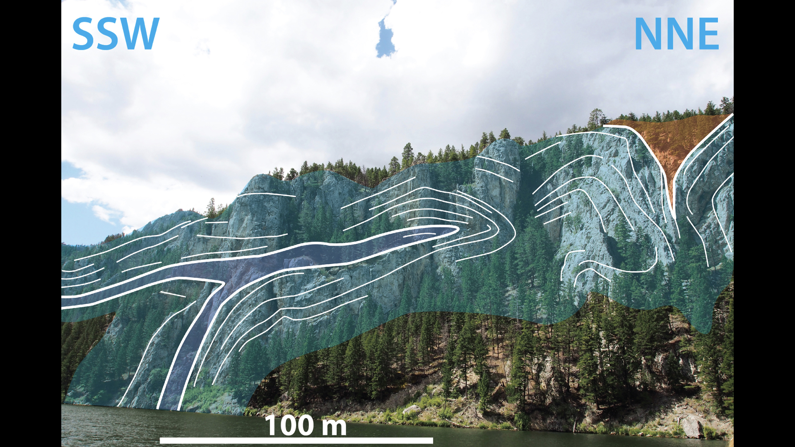
Notes:
This is one of several recumbent isoclinal folds exposed along the walls of the Gates of the Mountains.

