Slide 1
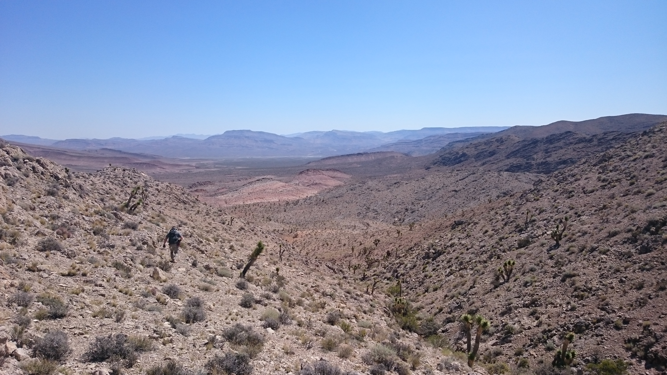




KINEMATICS OF APPARENT REVERSE FAULTS WITHIN EXTENSIONAL TECTONICS: CASE STUDY FROM THE PAHRANAGAT SHEAR ZONE, BASIN AND RANGE, NEVADA, USA
Introduction
Research Questions
Structure and Dataset
Interpretations and Analysis
Conclusions
Mahmud Muhammad Wanda J. Taylor
Muhamm1@unlv.Nevada.edu
Wanda.taylor@UNLV.edu
Partial funding from: the U.S. Geological Survey EDMAP program

Slide 2
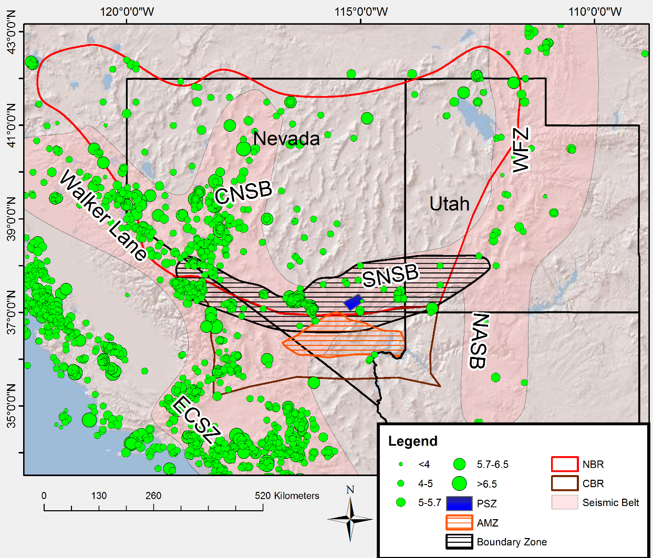
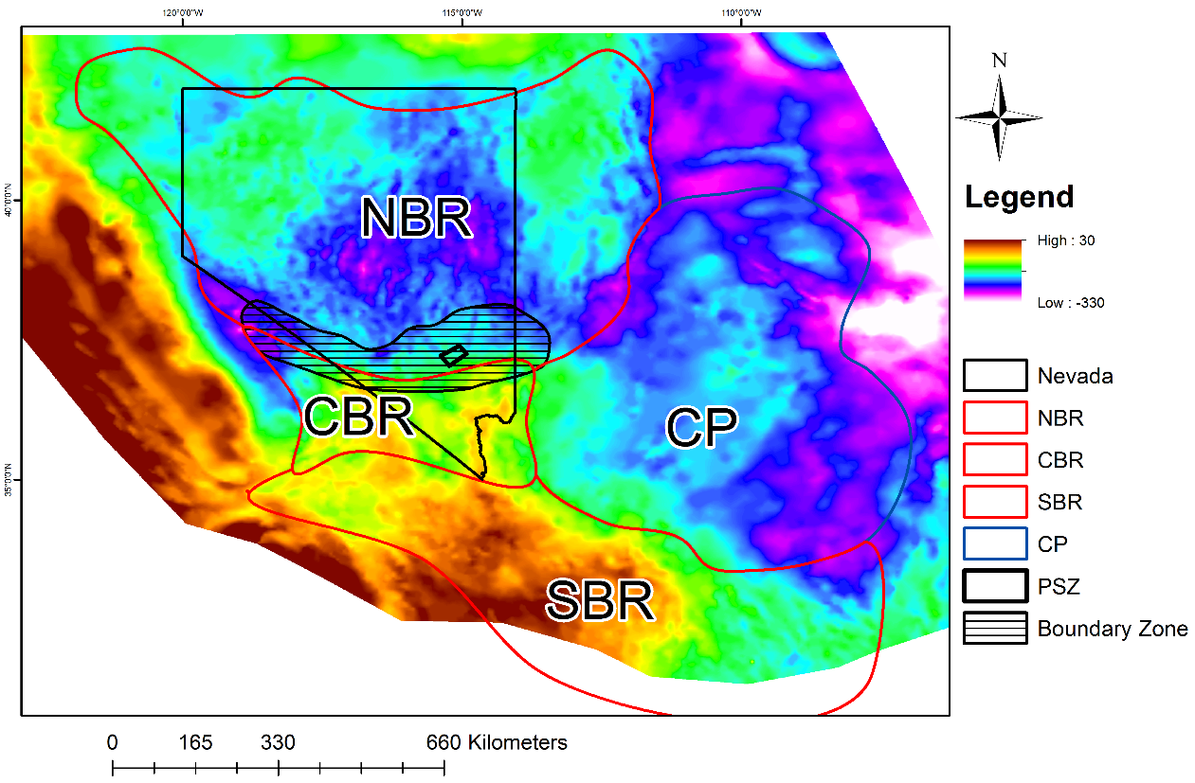
Why is the PSZ there?
NWBR
Bouguer gravity map
Gravity data downloaded from http://gis.utep.edu/subpages/GMData.html.
Seismicity
Earthquake data taken from USGS earthquake database.

Slide 3
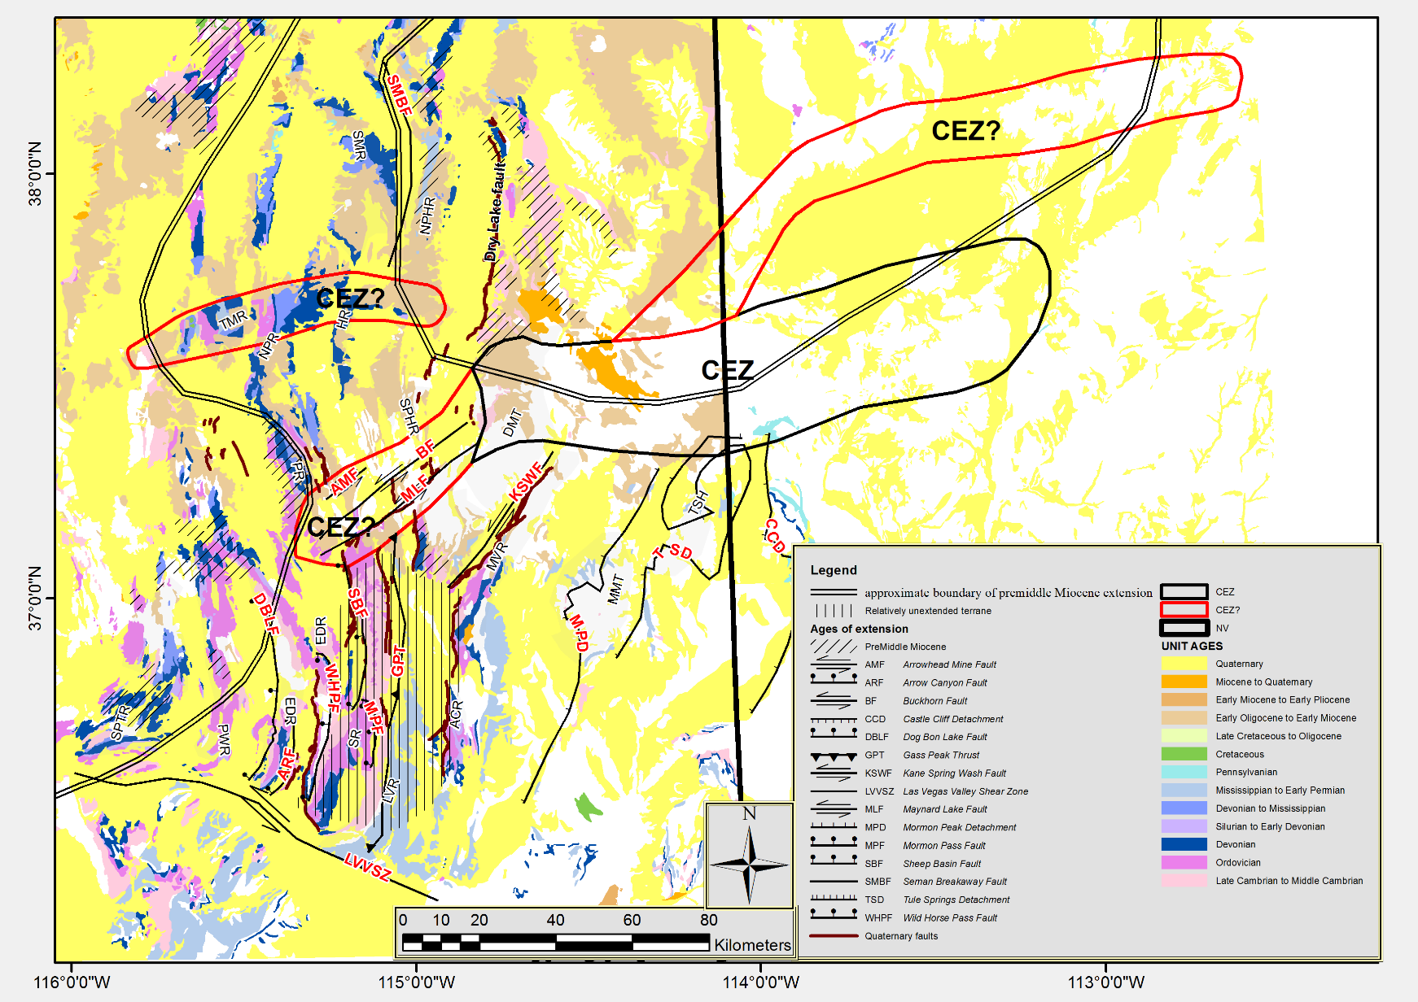
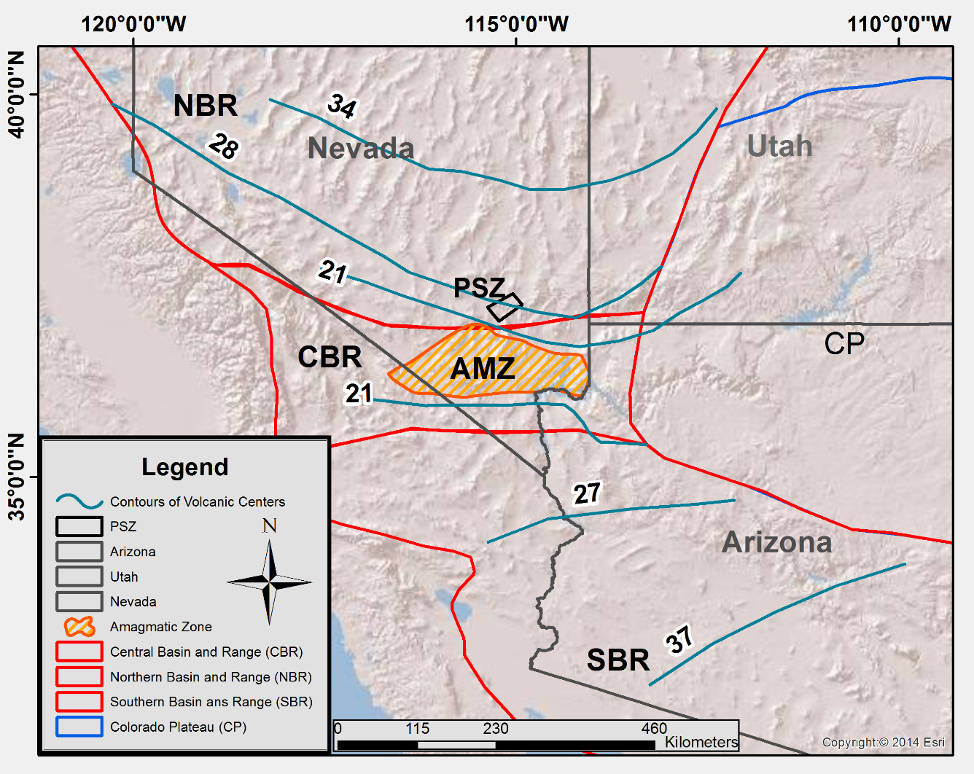
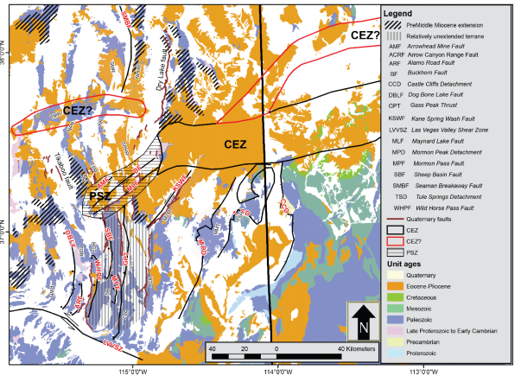
Why is the PSZ there?
Timing of Magmatism and Extension
Zone of no magmatic activity
E-Domain→ Lake Meade system
W-Domain→ between the mildly extended Sheep Range block and the normal fault system west of the Sheep Range
Regional Geology Map
Basin & Range
PSZ
Colorado Plateau
* Timing of Magmatism. * Timing of initial extension: NBR ~ 50 Ma SBR ~ 40 Ma CBR ~ 16 Ma

Slide 4
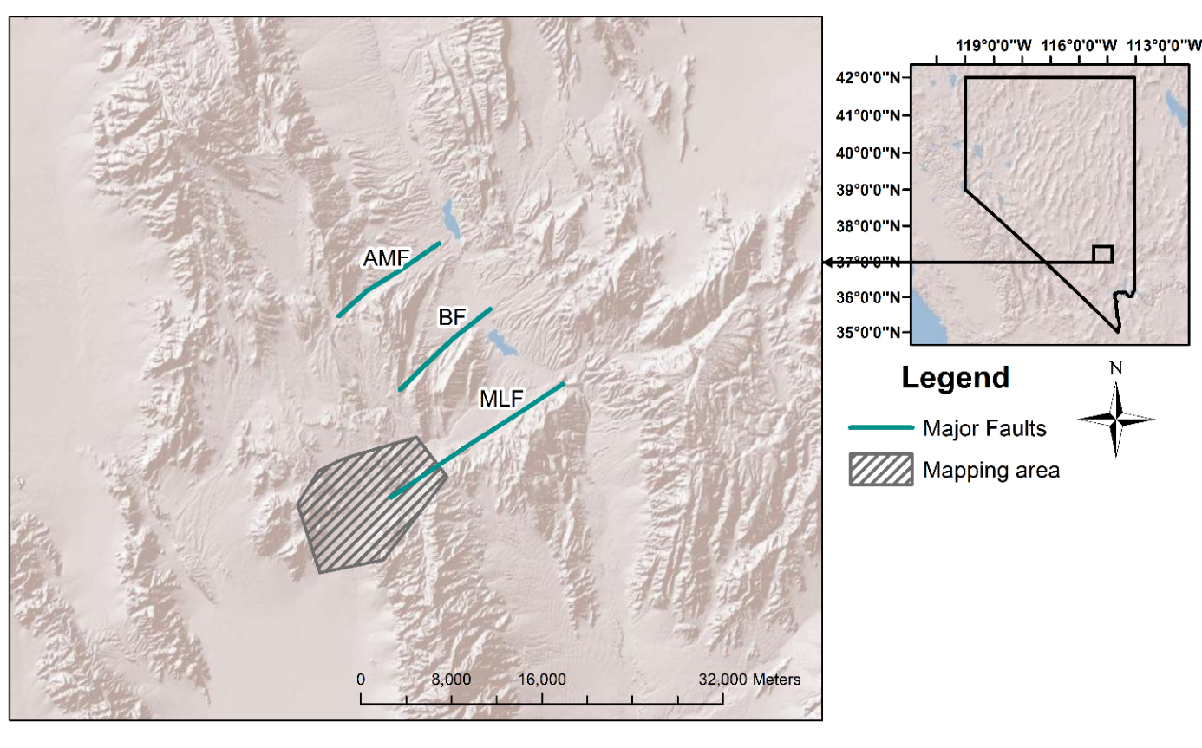
Mapping History of the PSZ & Methods
Regional work Tschanz and Pampeyan (1970) 1:250,000
Ekren et al. (1977) 1:250,000 scale
Jayko (2007) 1:100,000
Local work 1:24000 scale maps
Jayko (1990)
Scott et al. (1991)
Byron (1995)
This study→ 1:12000 scale map
Geologic cross-sections
Stereographs→ fold and fault orientations
Kinematic compatibility test of structures
Major strike-slip faults of PSZ
Scott et al.
Byron
?
Sheep Range
East-Desert Range

Slide 5
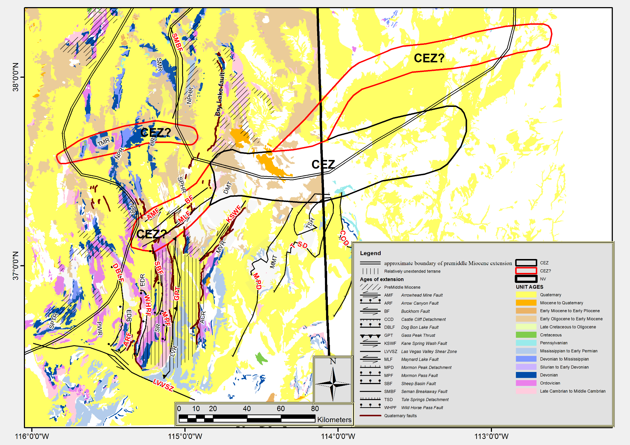
Research goals
NV UT
1. Define the structural geometry and kinematics of the PSZ to contribute to understanding the development of the Basin and Range sub-province boundaries.
Basin & Range
PSZ
Colorado Plateau

Slide 6
Research goals
The geometry and style of deformation along the western end of the MLF was examined to evaluate how local contractional structures are related to the formation of a duplex structure within the current strike-slip system.
Major strike-slip faults of PSZ
?
Sheep Range
East-Desert Range

Slide 7
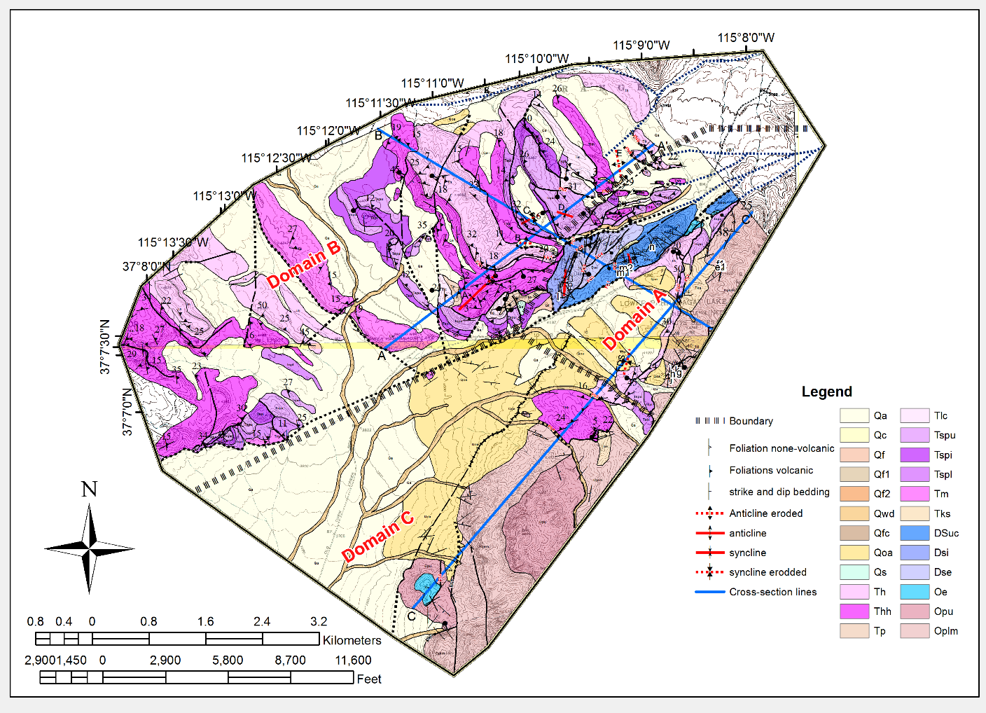
Geologic Map
B
Three domains identified based on complexity and geometries of structures
A
C

Slide 8
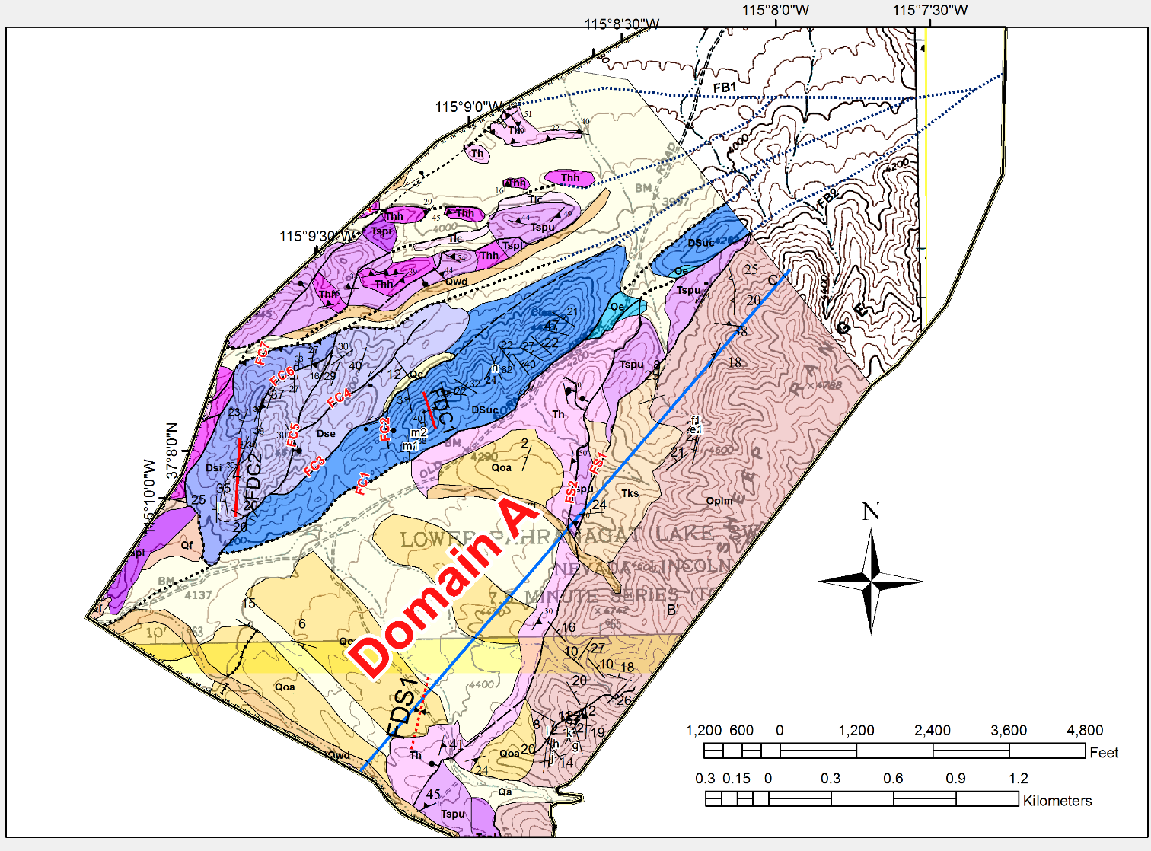
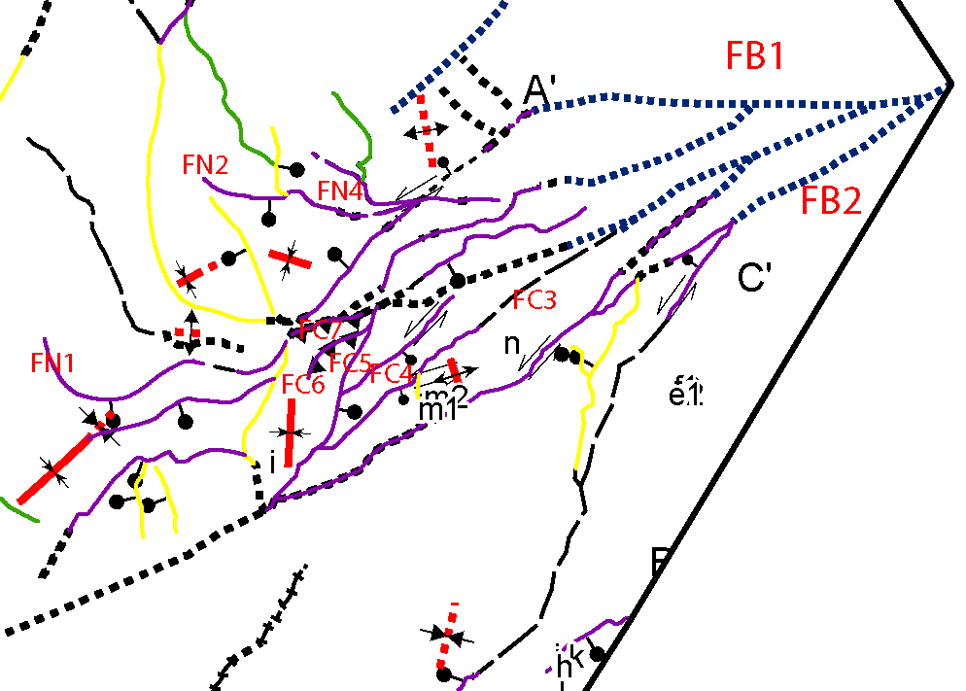
Domain A
Extensional duplex/Releasing bend
Duplex structure
Three folds
13 minor folds
Three fault sets include
ENE-striking oblique and strike-slip
N-striking normal
NW-striking normal
The Duplex Includes normal and reverse faults: we will explain kinematics and geometry of the reverse faults in later slides

Slide 9
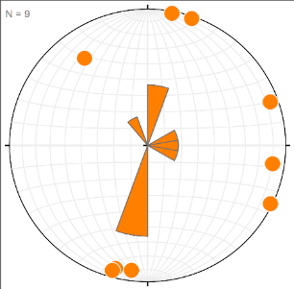
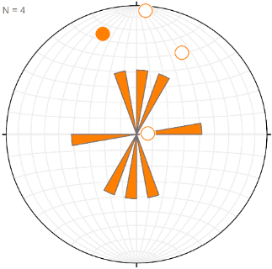
Domain A Stereographs of Folds within the duplex structure
14⁰, 340⁰
20⁰, 355⁰
04⁰, 037⁰
FDC1
FDC2
FDS1
Folds are Trending NW,N and NE
Stereographs of major folds
(B)
(A)
Rose diagrams of trends of minor folds

Slide 10
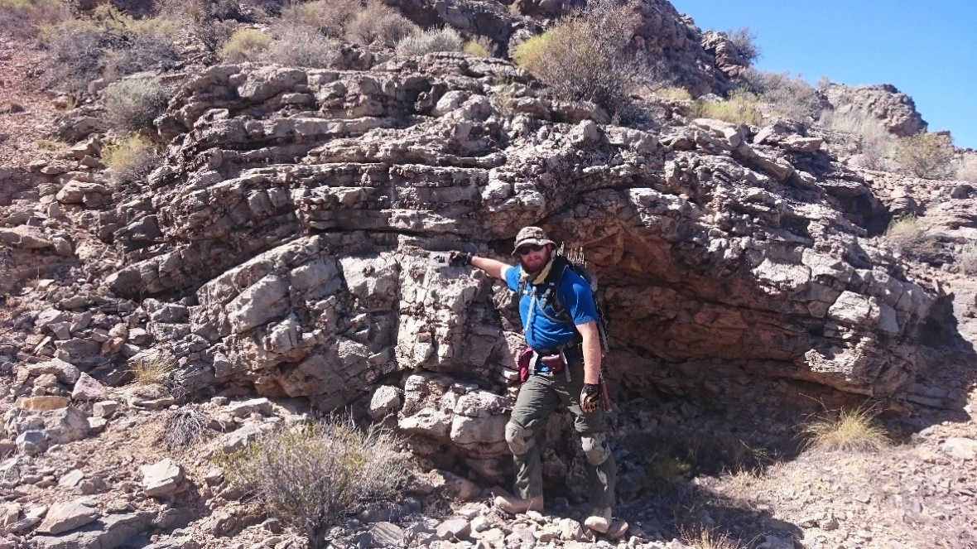
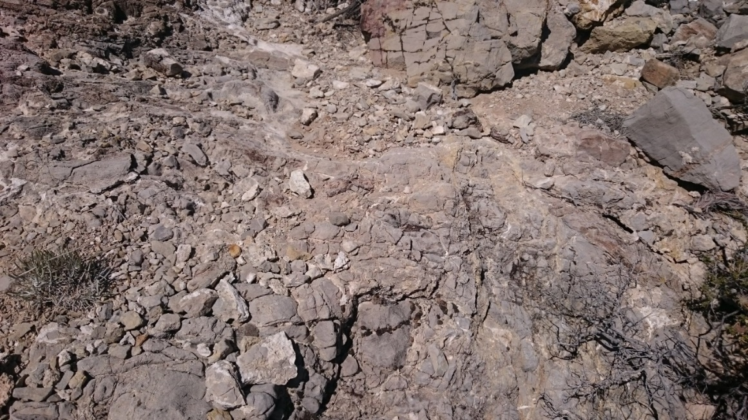
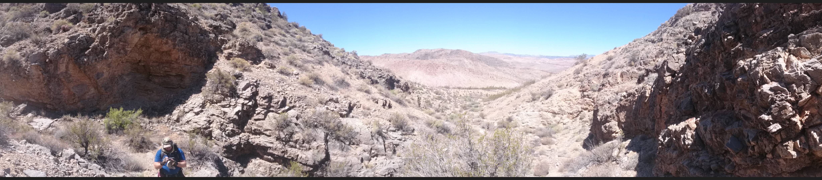
Field photos of minor folds
West
East

Slide 11
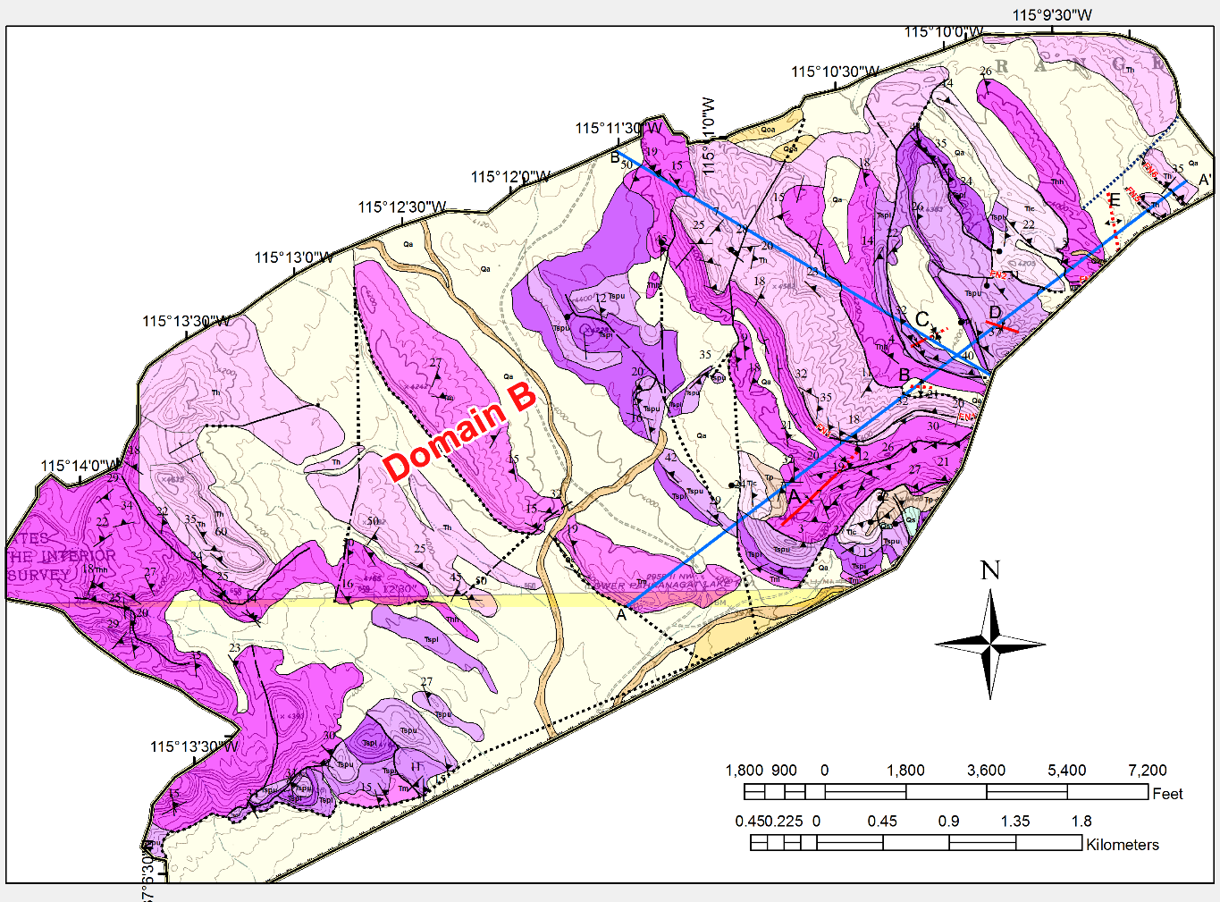
Domain B
Three fault sets
Five folds
A’
ENE-striking oblique and strike-slip
N-striking normal
A
NW-striking normal

Slide 12
Domain B
07⁰, 052⁰
02⁰, 284⁰
29⁰, 058⁰
E
C
D
A
B
C
B
14⁰, 330⁰
02⁰, 341⁰
A
D
E
Stereographs of folds
2 folds trend NW, 2 NE and 1 WNW.

Slide 13
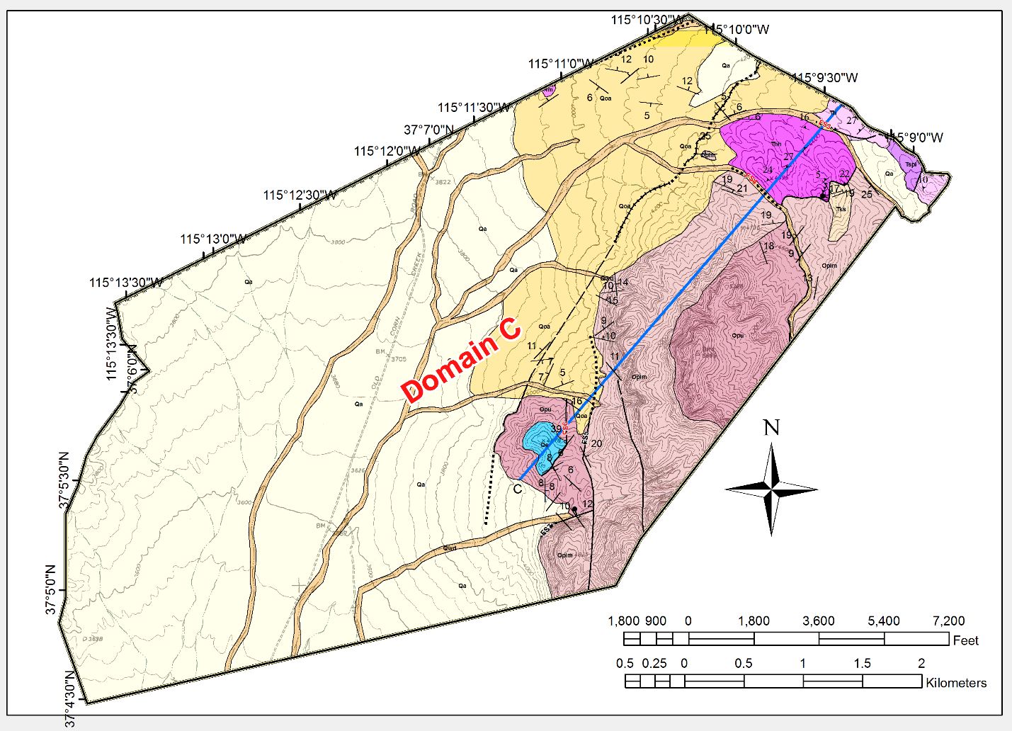
Domain C
Three fault orientations
No folds
Quaternary fault scarp
ENE-striking oblique and strike-slip
N-striking normal
NW-striking normal

Slide 14
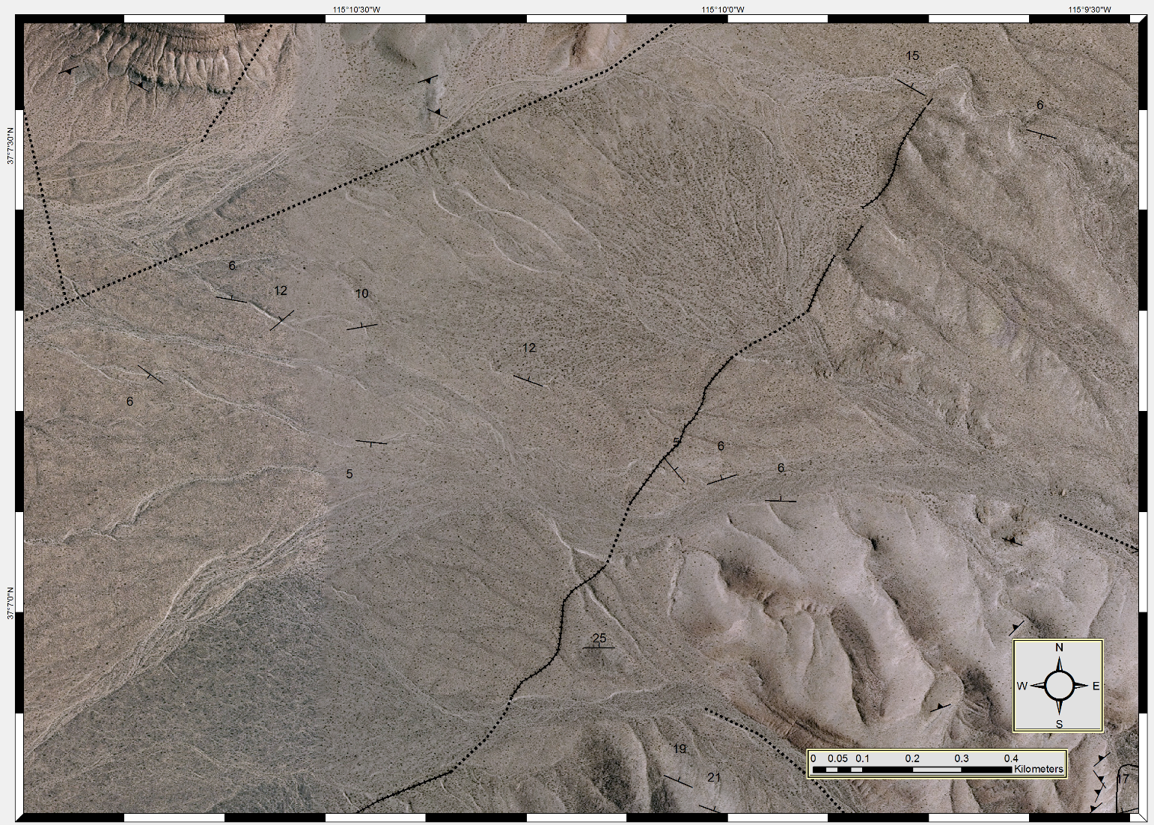
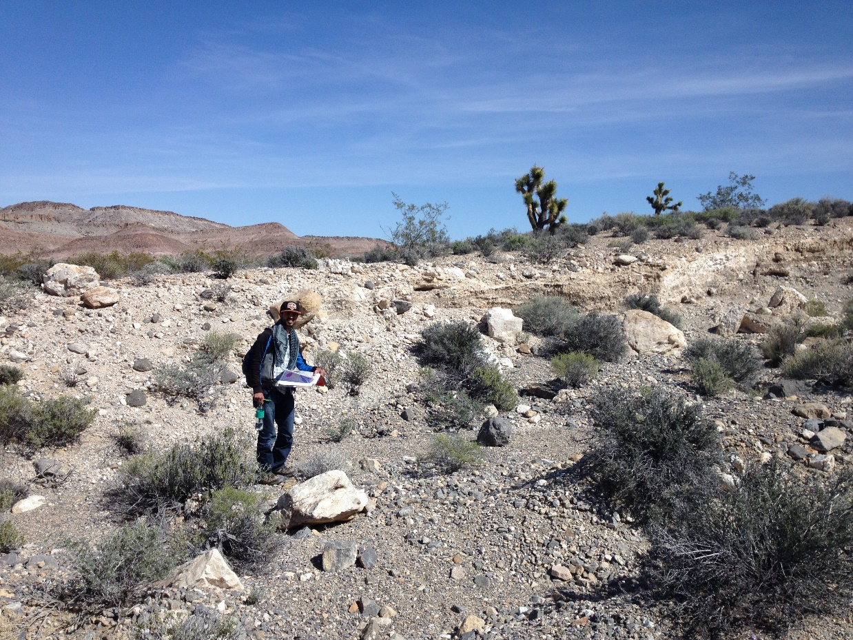
Domain C
Quaternary
Quaternary
Tuff
Quaternary fault scarp

Slide 15
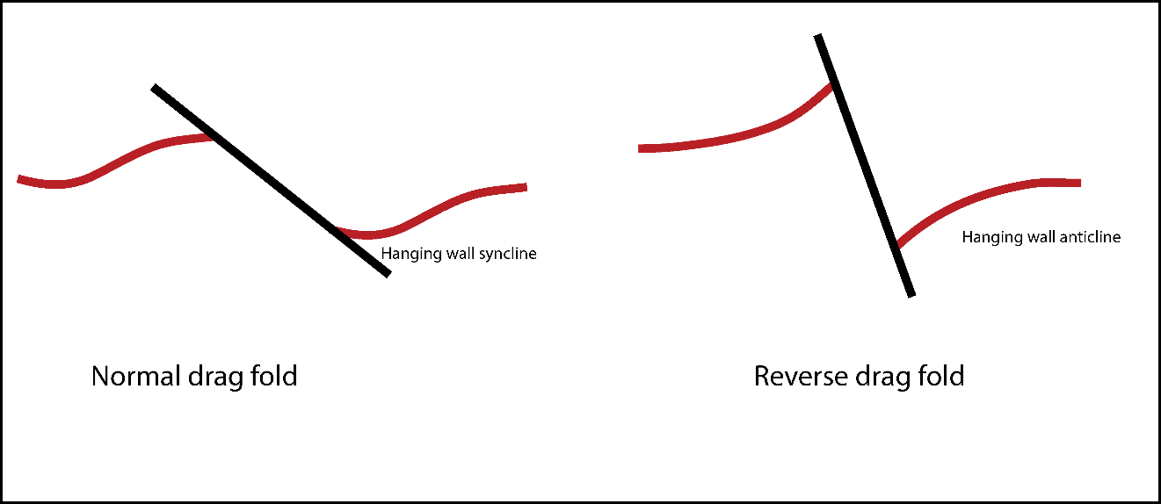
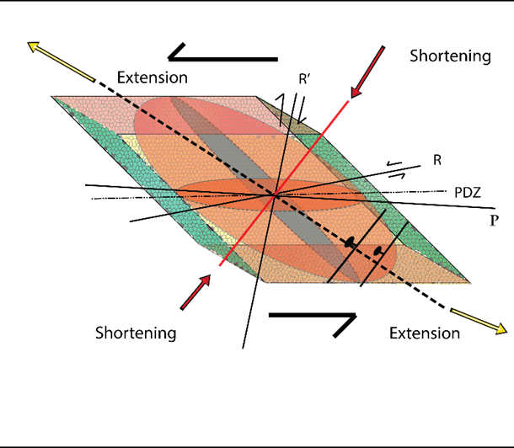
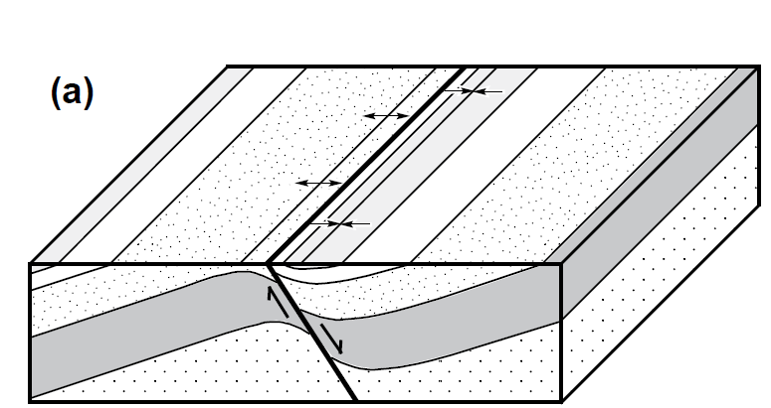
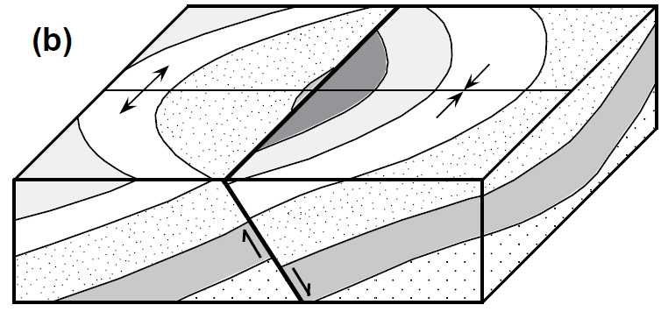
Folds
Folds → Kinematic indicator within the S-S zones
Interested → Fold orientation rather than origin
1. Folds form at 45º to S-S faults (simple shear)
2. Transverse fold
3. Drag Fold
(Normal or Reverse drag)
4. Change in volume with depth among fault sets
Modified (Graseman et al., 2005)
Not rollover anticline
A
Drag
(After Schlische, 1995).
Transverse

Slide 16
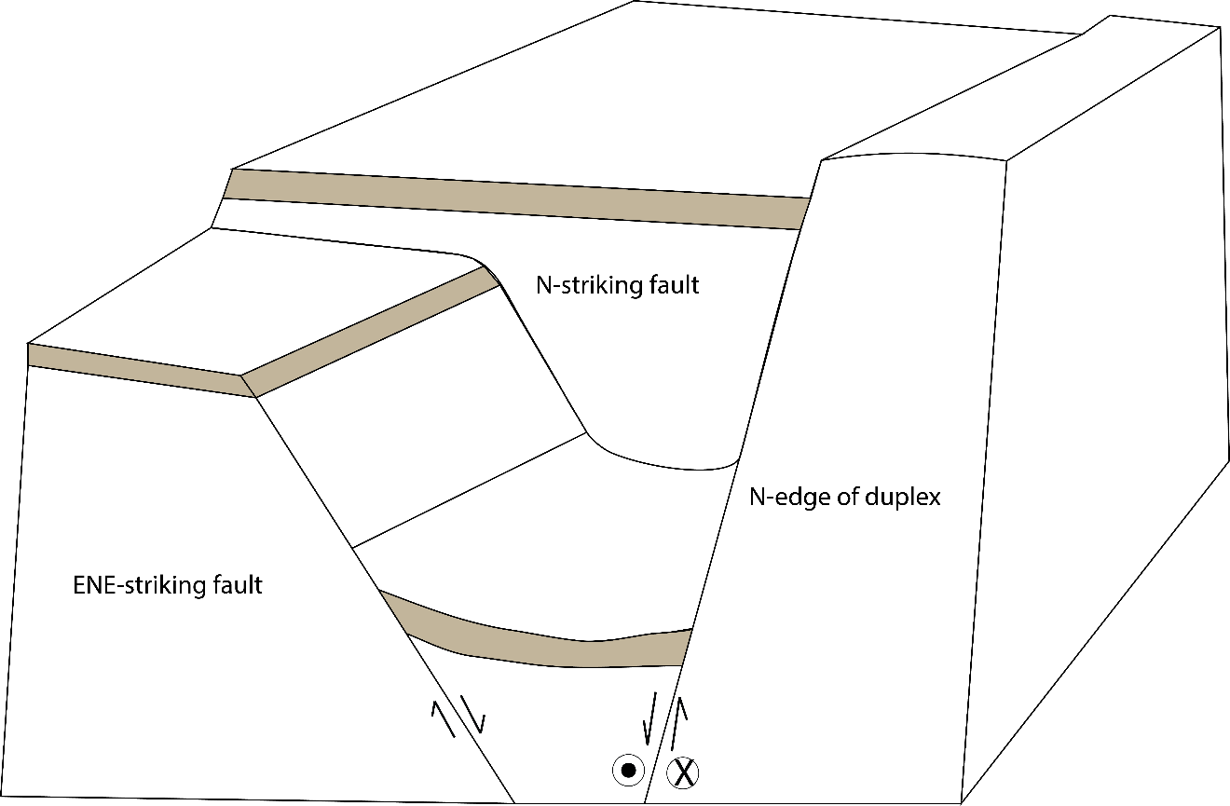
Folds
Example of folds related to volume change with depth
North
D

Slide 17
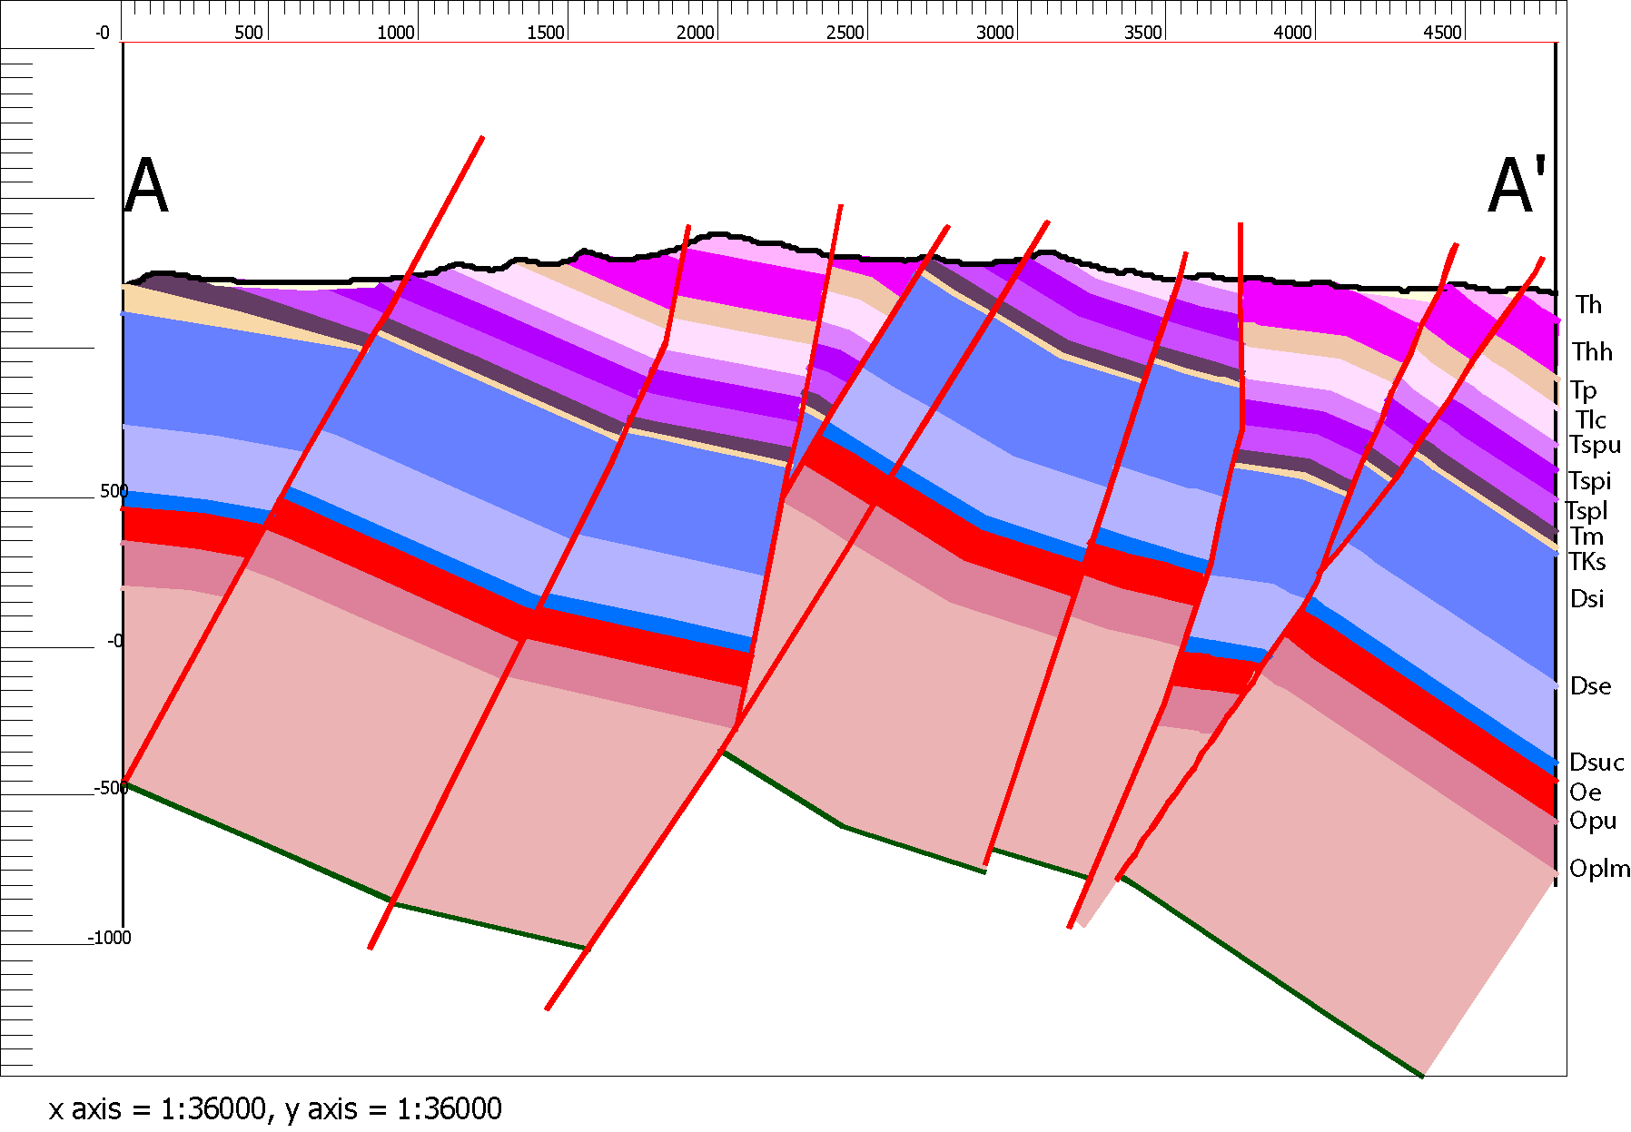
Folds
Example→ Reverse drag or folds related to volume change with depth
FN5
Fold E
Fold E
FN5
A

Slide 18
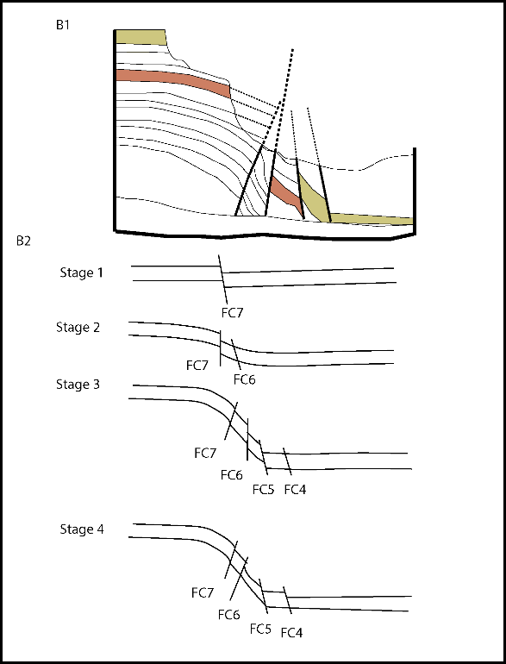
Reverse Faults
Conceptual model
The Duplex along the MLF contains both Normal and apparent reverse faults
Faults inside the duplex structure controlled by the bounding faults rather than regional stress
Hence, bounding faults should form first; eventually faults inside the duplex will form
As the duplex grows, it causes rotation and tilting of the beds and faults inside the duplex
B1
B2
After Fossen (2010)

Slide 19
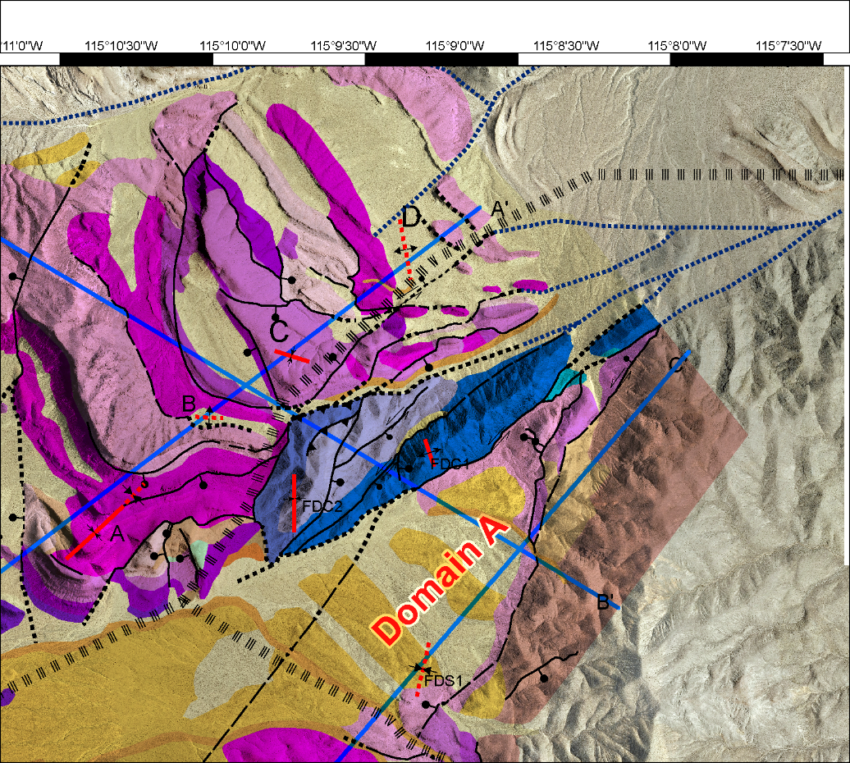
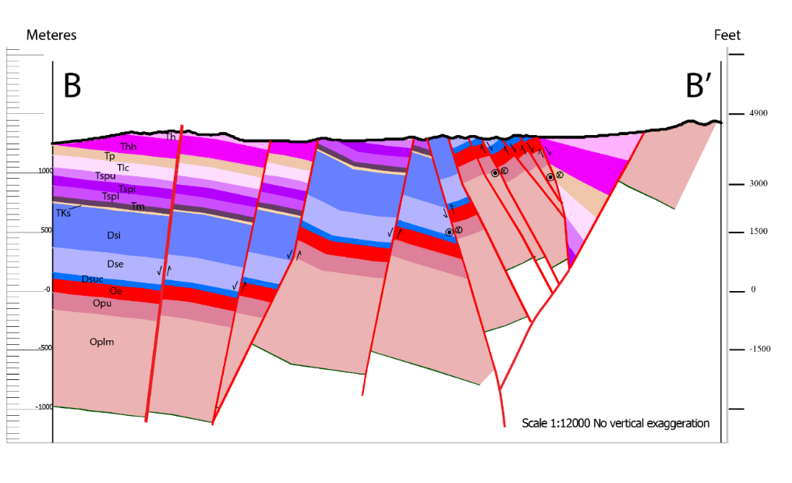
Duplex Structure
In map pattern the duplex has a skewed diamond shape, wide in the center and narrow at the ends.
Consequently, the rock volume within the duplex changed shape as it translated along bends in the bounding faults.
Triaxial deformation occurred dominantly within a restricted region (duplex zone)
Simple shear deformation occurred across the MLF outside the duplex.
Meters
Duplex
FC7
FC4
FC6
FC5
B’

Slide 20
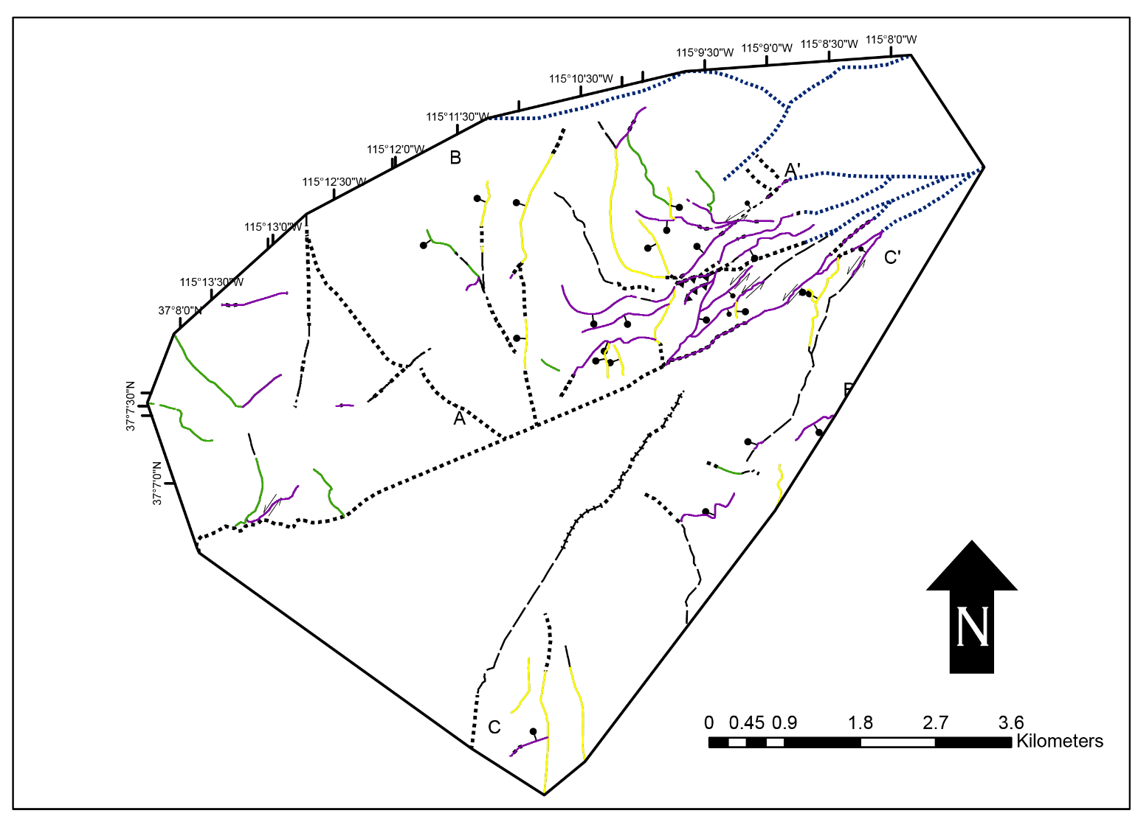
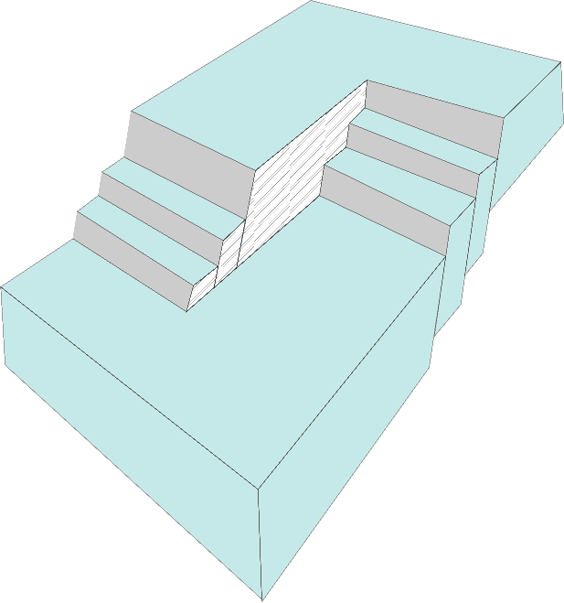
Transfer Zone
NW and N-striking normal and oblique faults terminate at ENE-trending strike-slip and oblique-slip faults that are most likely parallel to 45º to the extension direction, or along pre-existing crustal heterogeneities
Suggests that
the PSZ is a transfer zone.

Slide 21
Transfer Zone
NV UT
Also, PSZ including MLF connect areas of differential extension
Magnitude
Timing
PSZ and Caliente-Enterprise zone are adjacent left-lateral transfer zone so I suggest they are related
PSZ transfers strain to the west on the faults of the western Sheep Range
Basin & Range
PSZ
Colorado Plateau

Slide 22
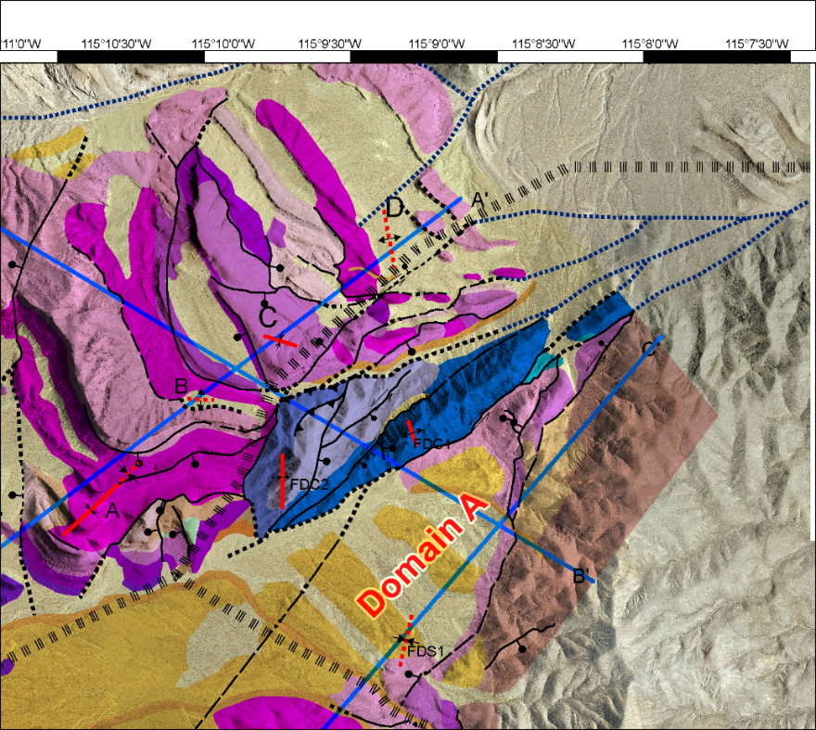
Conclusions
Left-lateral strike-slip faulting with dominant simple shear is documented for the MLF and the PSZ, but triaxial deformation most likely happened within the duplex zone of the MLF
Contractional features within the extensional duplex are explained as
Apparent reverse faults by progressive development with tilting and perhaps rotation of the early formed faults within the duplex.
Folds formed by drag, volume changes, and simple shear
The PSZ is a transfer zone that connects two different extensional domains: the domain characterized by the Mormon Peak, Tule Springs, and Castle Cliffs detachments on the east and the Sheep Range detachment system on the west.
B1
PSZ
B2

Slide 23
Thanks for your Interest! Questions?

Slide 24
Extra Slides

Slide 25
Timing of Deformation
Fault set and cross-cutting relationships
Documented reginal and local LPS direction were used
Regional stress field (e.g., Zoback, 1981; Best, 1988; Taylor and Switzer,2001)
LPS→NNW to ENE at about 50 Ma to 30 Ma
Almost, for the entire Oligocene a NNW LPS direction
Average ENE direction is identified for the entire Miocene
LPS changed around 10 Ma ENE→ E-W (Basin and Range)
Fault set and cross-cutting relationships
Documented reginal and local LPS direction were used (e.g., Zoback, 1981; Best, 1988; Taylor and Switzer,2001)
LPS average ENE direction is identified for the entire Miocene
LPS changed around 10 Ma ENE→ E-W (Basin and Range)

Slide 26
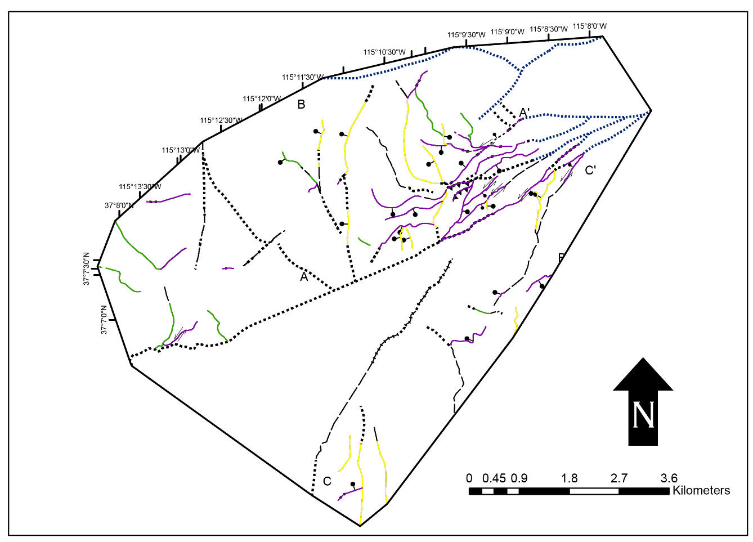
Timing of Deformation
NW-striking normal fault set is cut by N-S and ENE strike fault sets normal oblique and strike-slip.
NW-striking fault set cuts 22 Ma rocks
Thus, NW-striking fault set is compatible with LPS in Miocene
N-S fault set is compatible with post 10 Ma E-W LPS
ENE and N-S are synchronous
Quaternary fault scarp documents young deformation

Slide 27
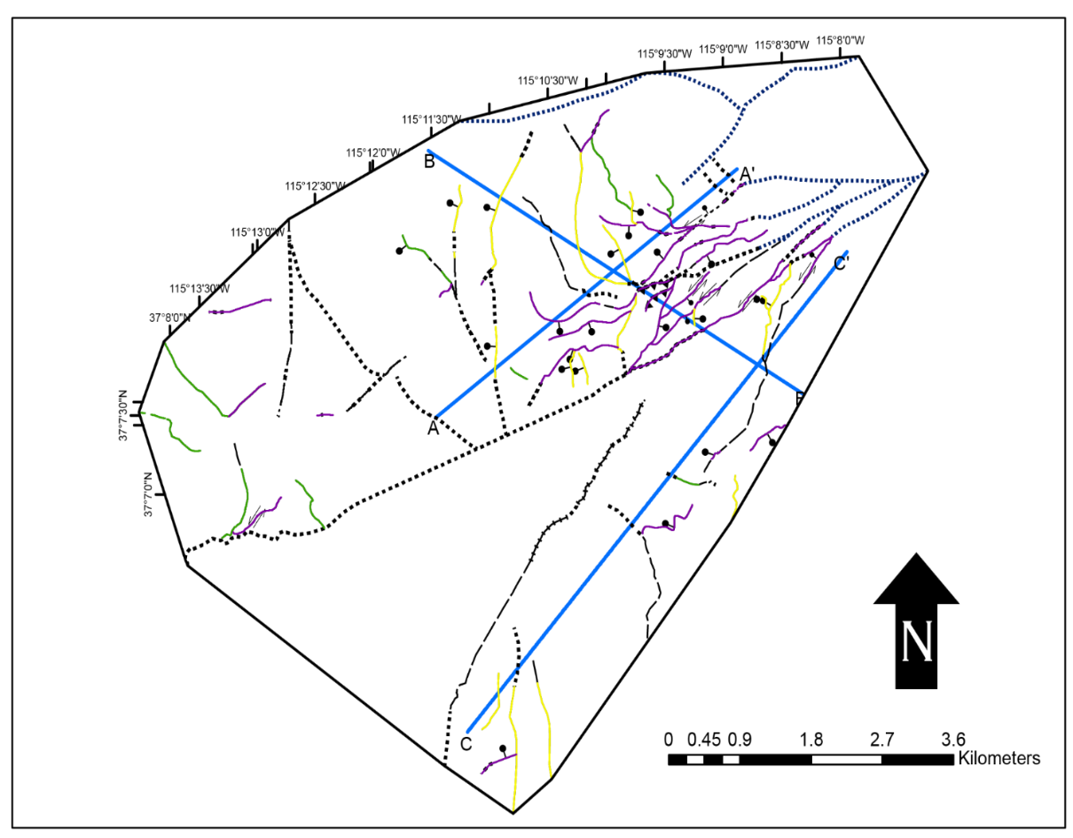
Conclusions
At least three episodes of deformation are documented within the MLF zone:
A. Pliocene to Quaternary deformation documented by the Quaternary fault scarp exposed within domain C.
B. Late Miocene to Pliocene deformation is documented by the N-S and ENE striking synchronous fault sets that cut the youngest volcanic rocks and are covered by oldest Quaternary alluvium.
C. Early middle Miocene deformation is documented by NW-striking normal faults which cuts rocks as young 22 Ma and is cut by the N-S normal and ENE-striking strike-slip fault sets.

