Slide 1
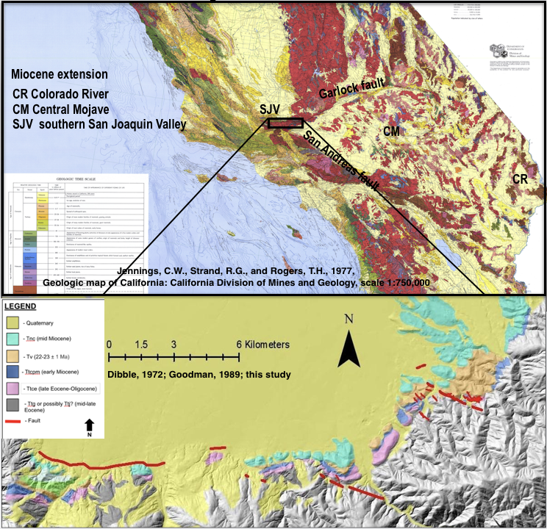
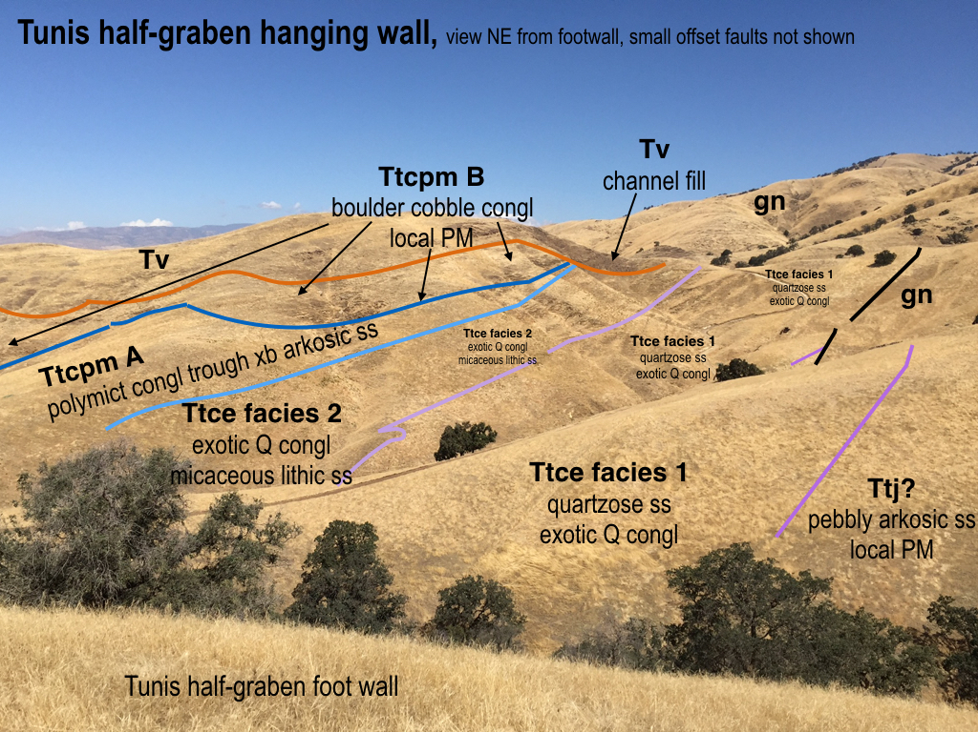

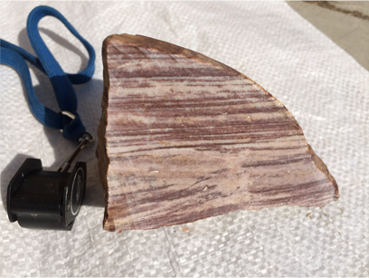
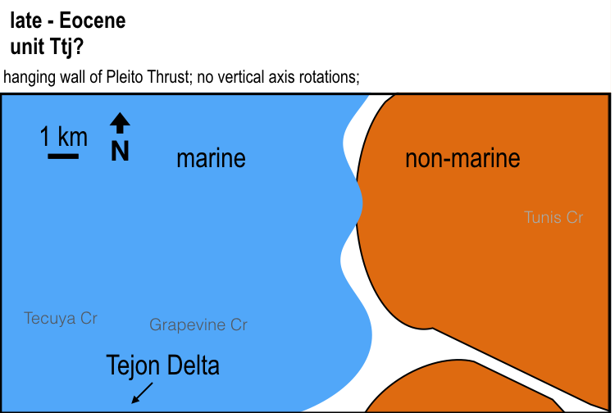
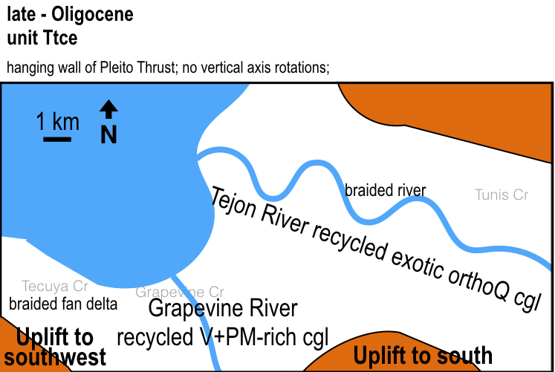
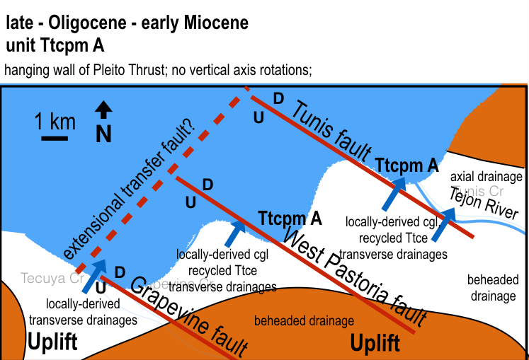
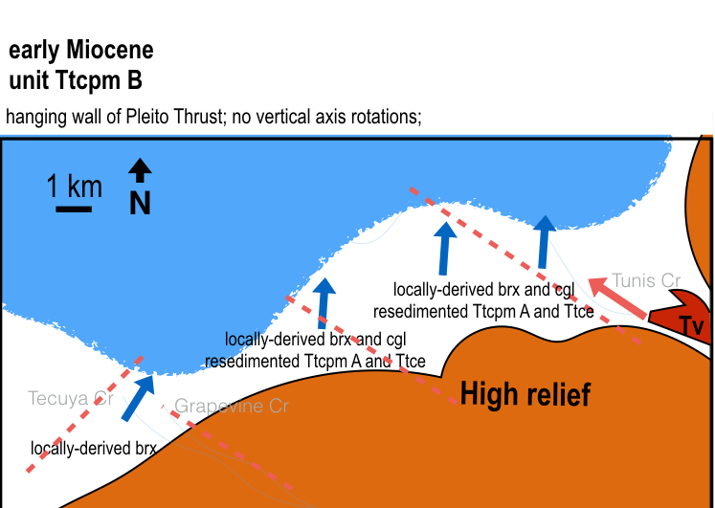
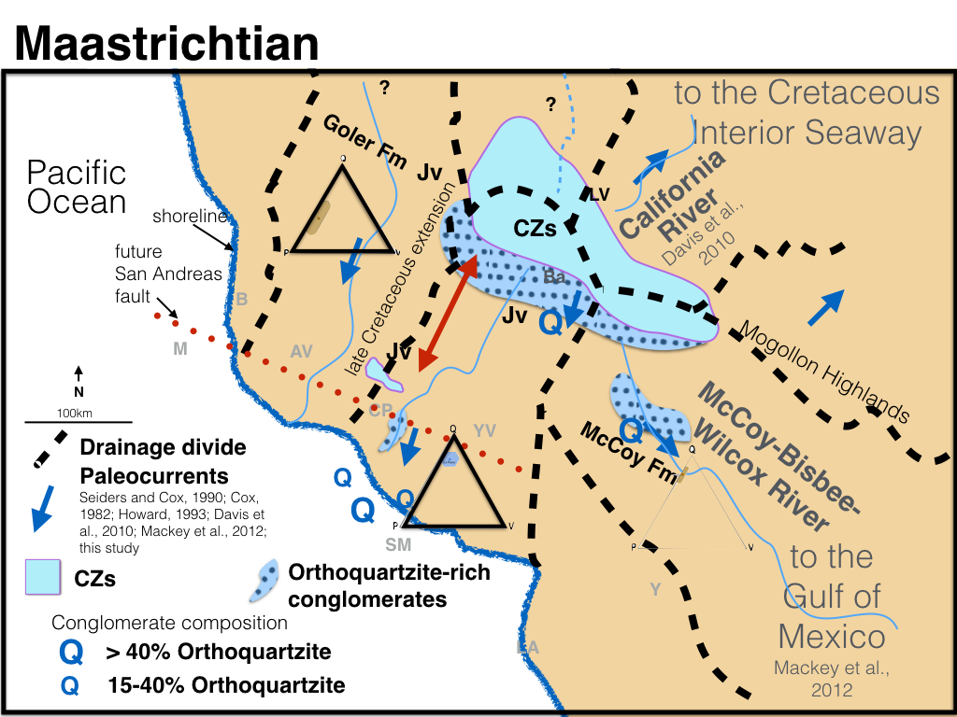
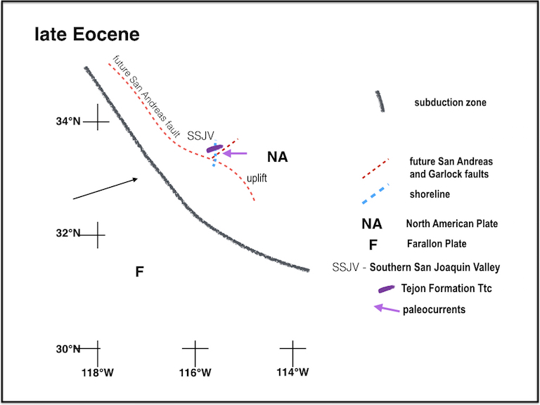
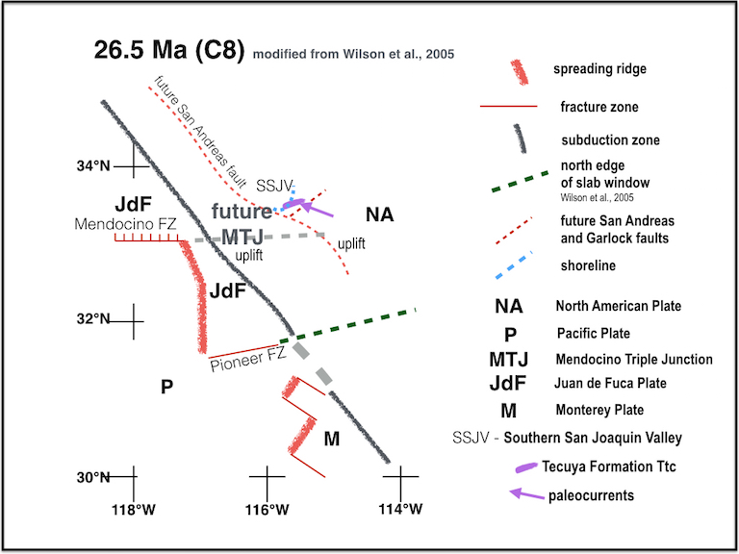
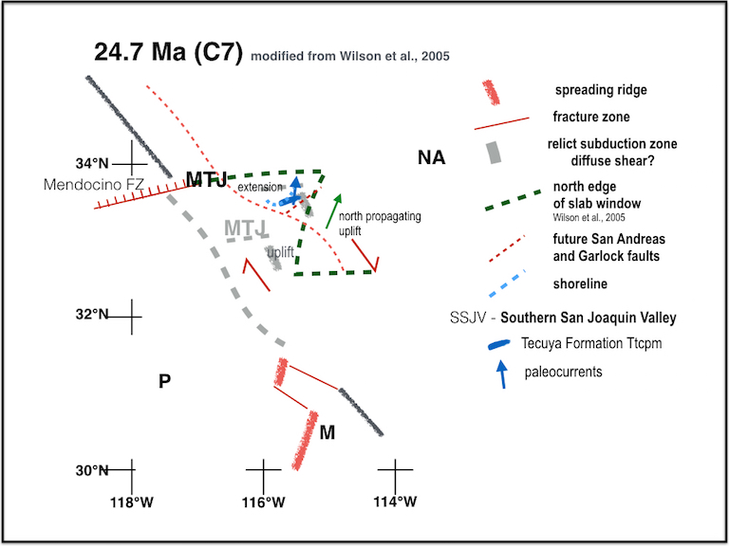
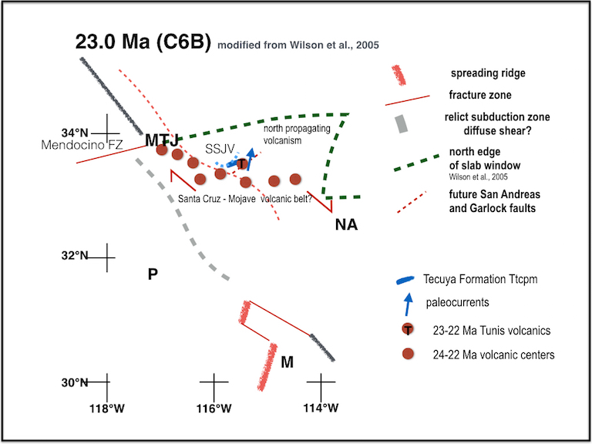
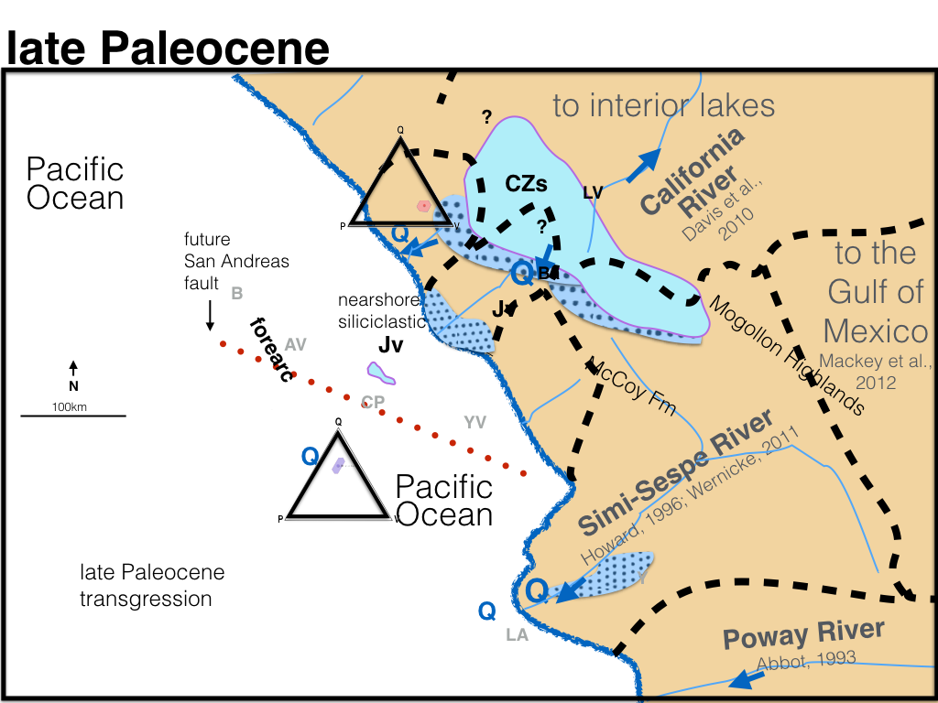
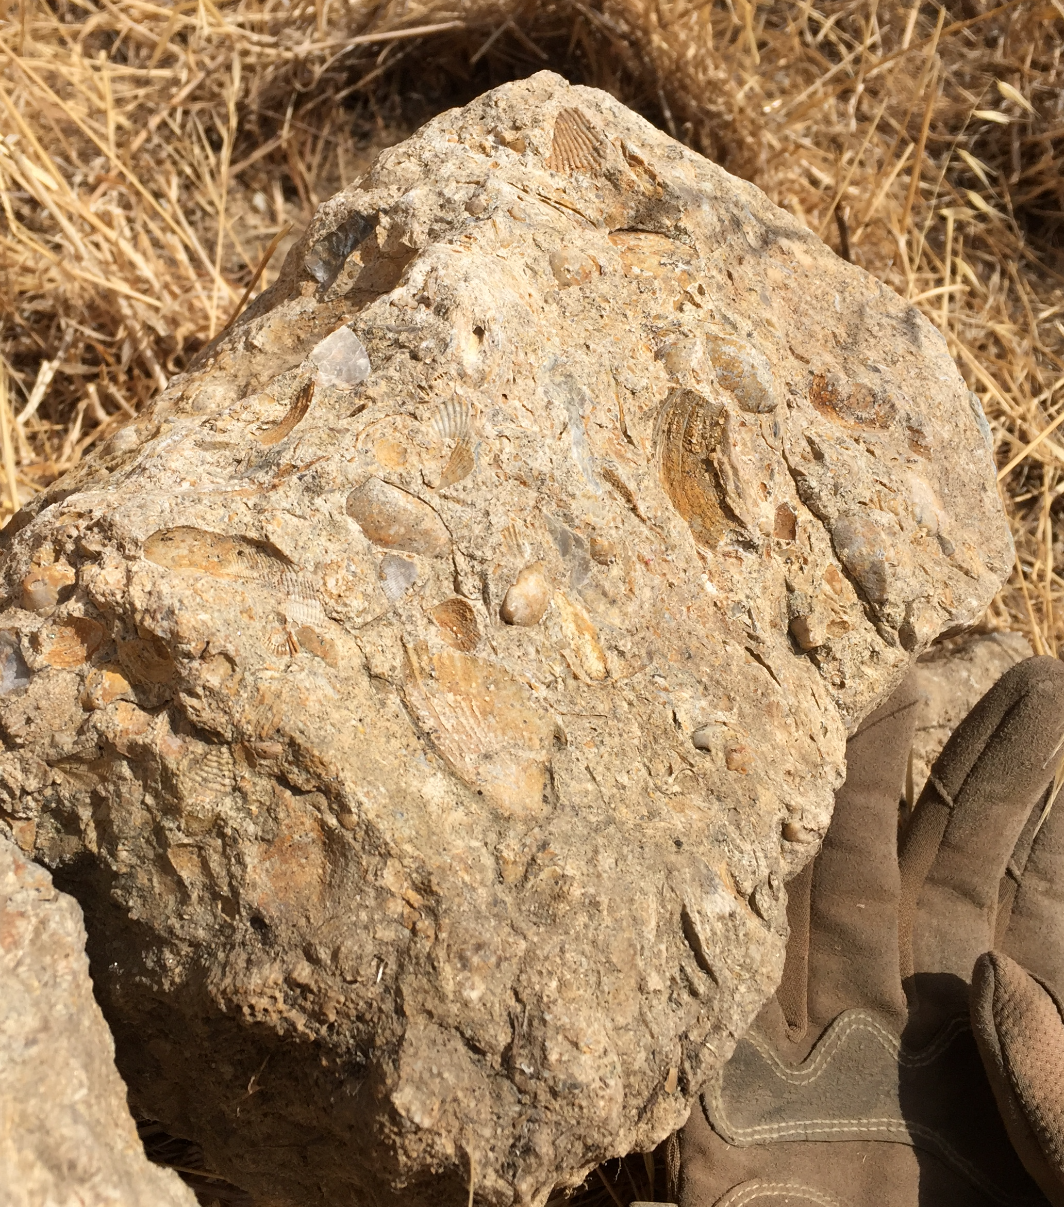
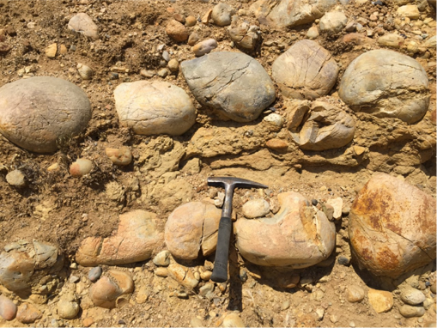
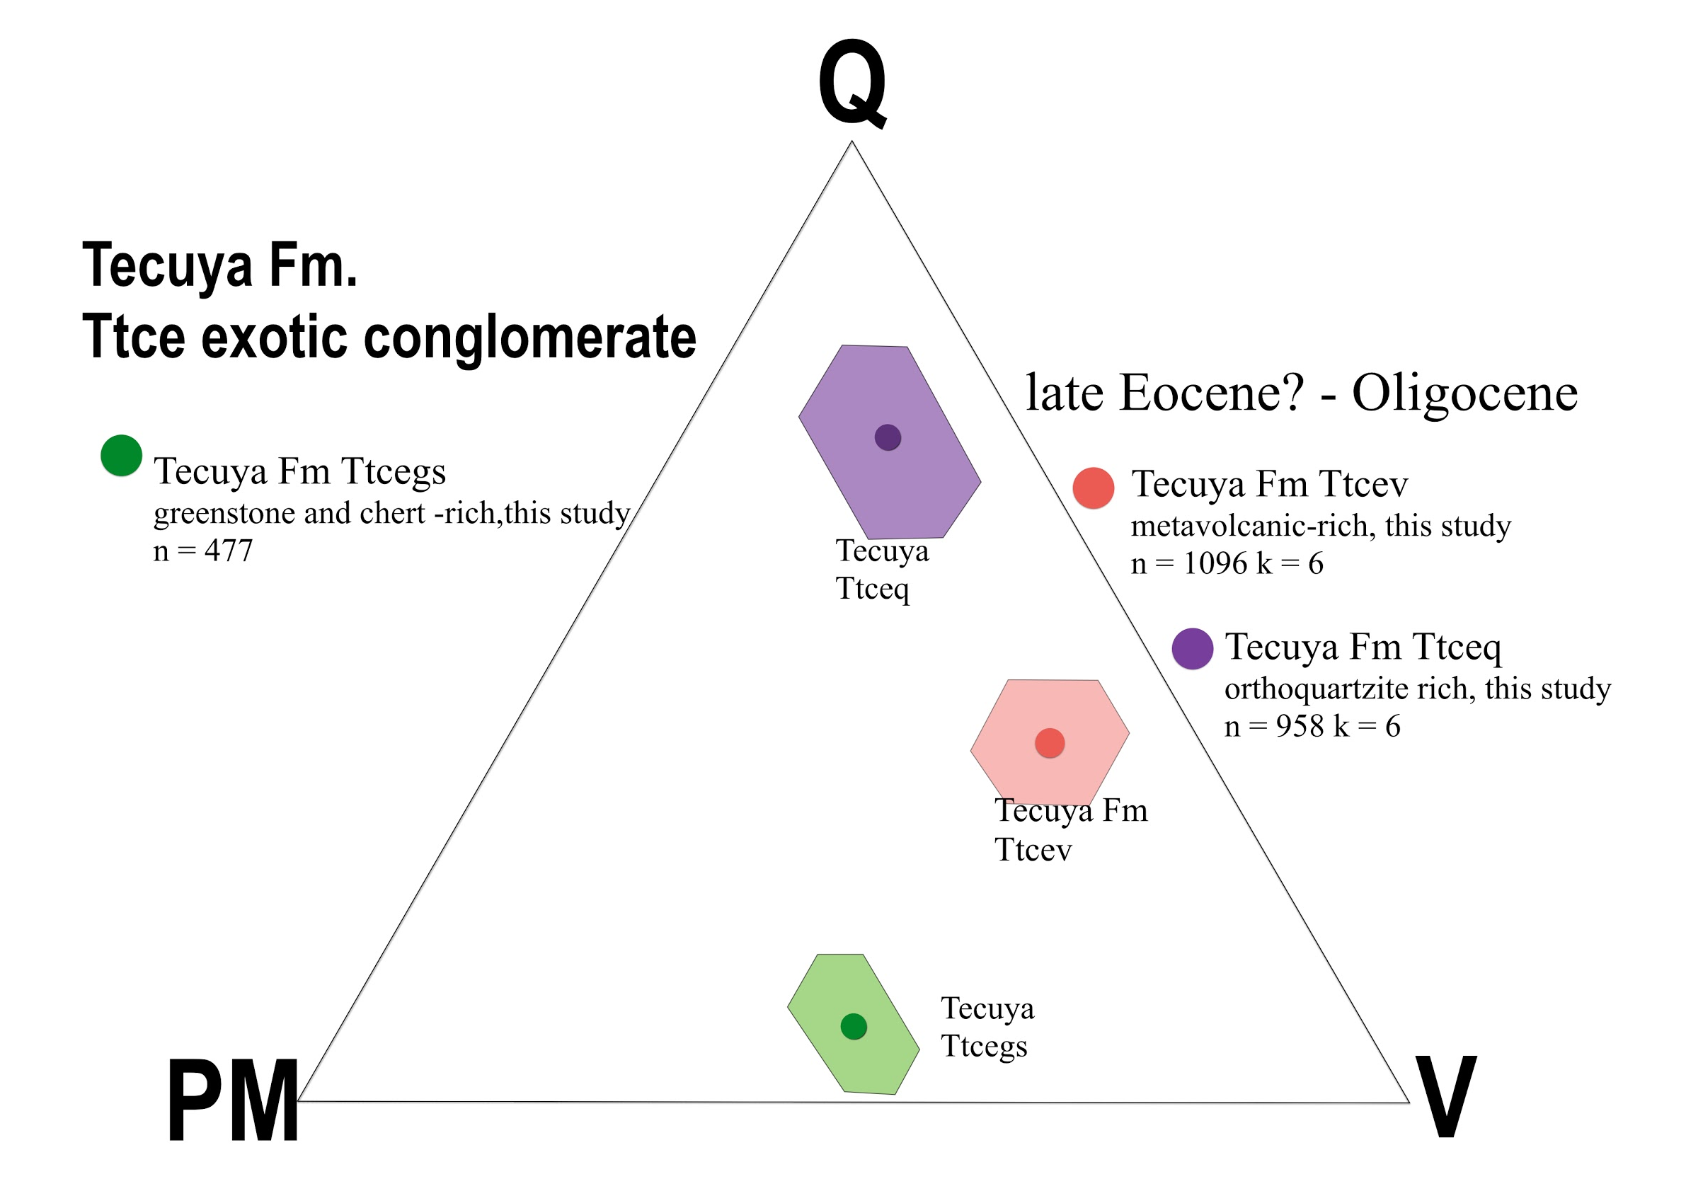
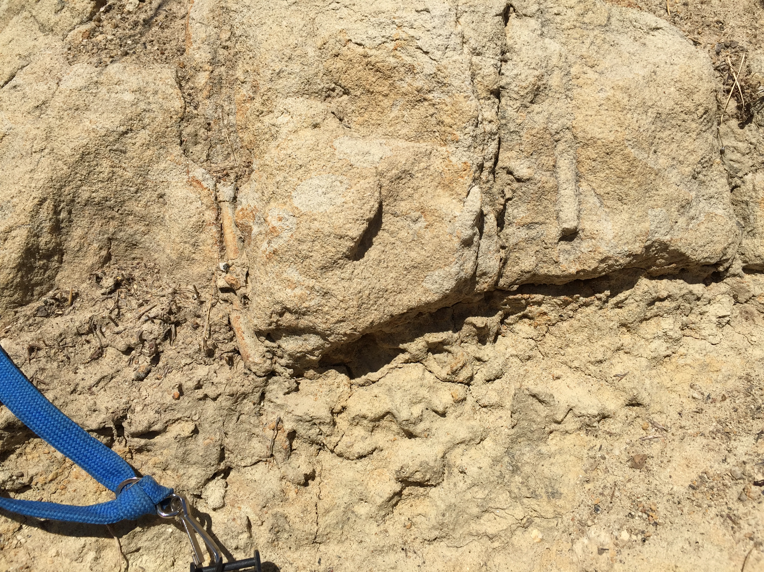
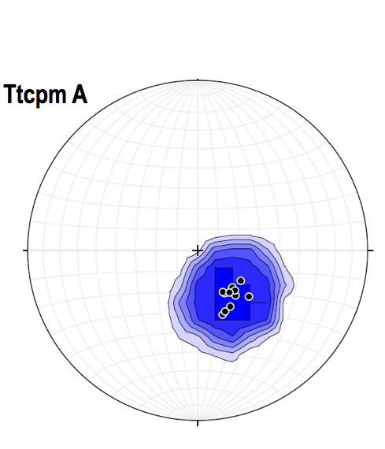
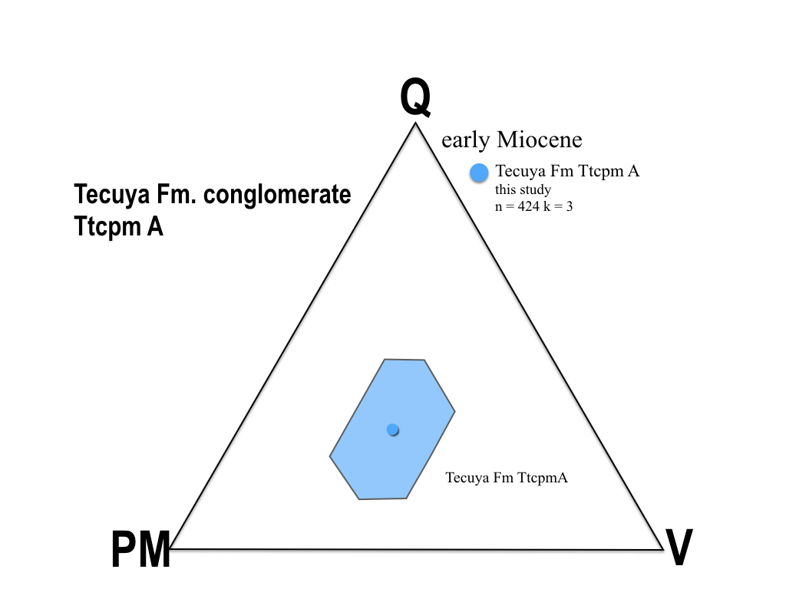
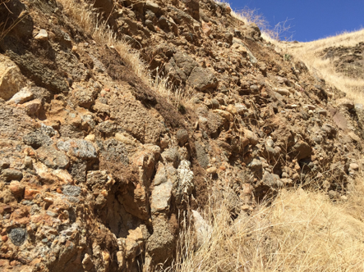
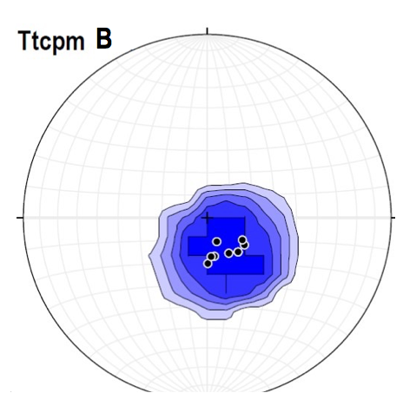
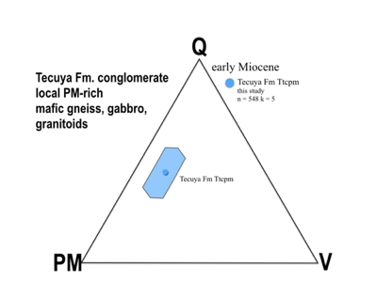
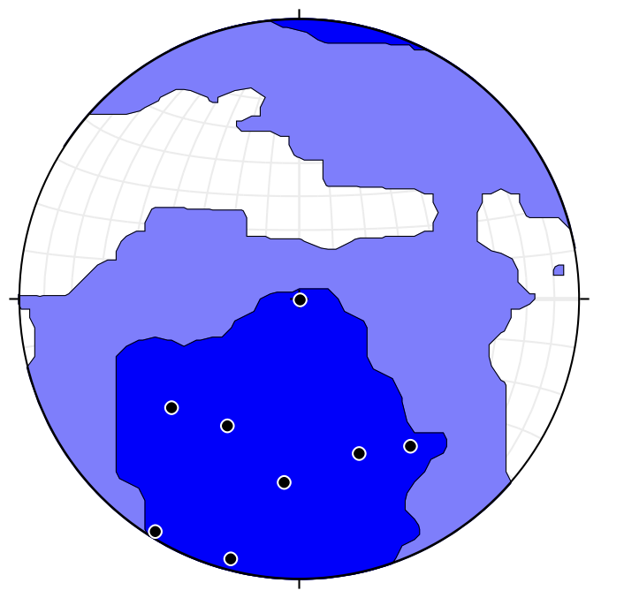
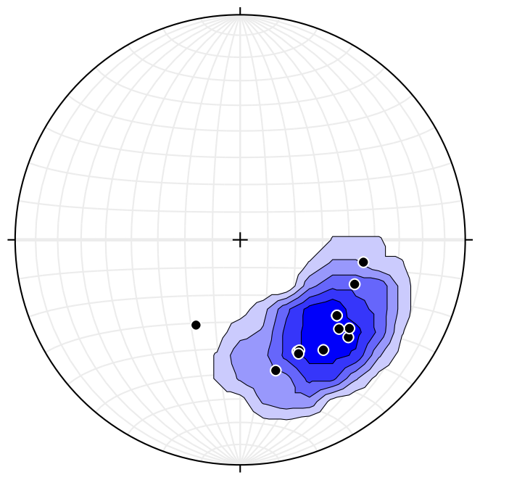
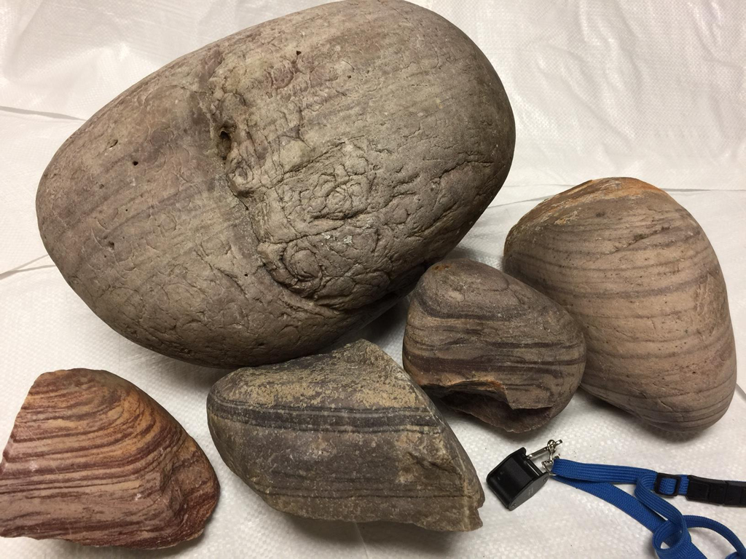
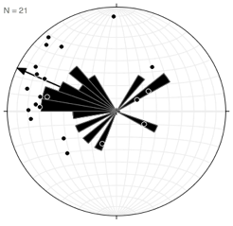
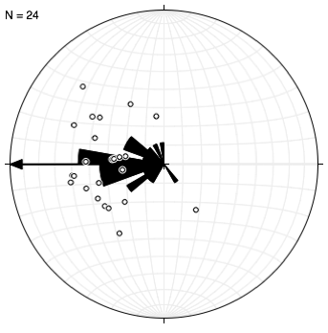
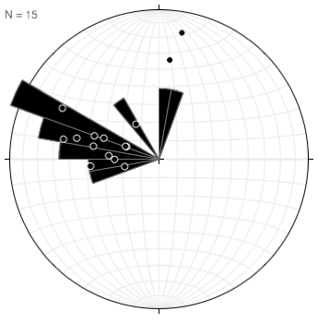
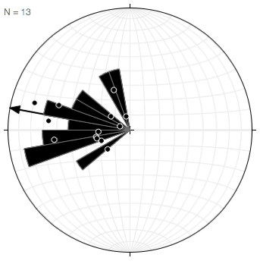
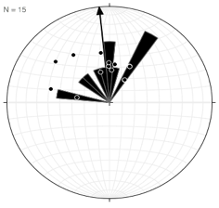
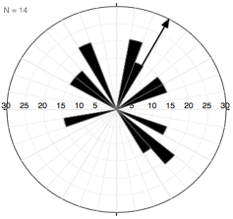
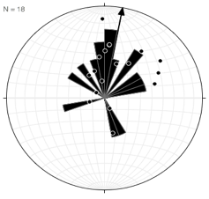
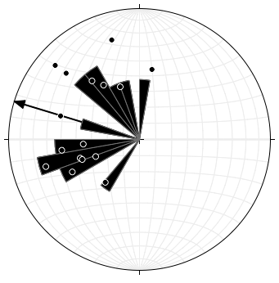
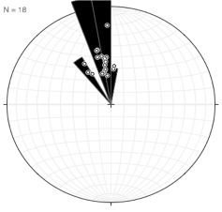
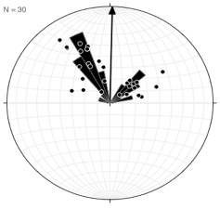
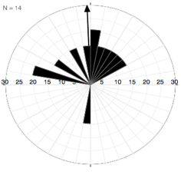
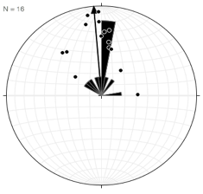
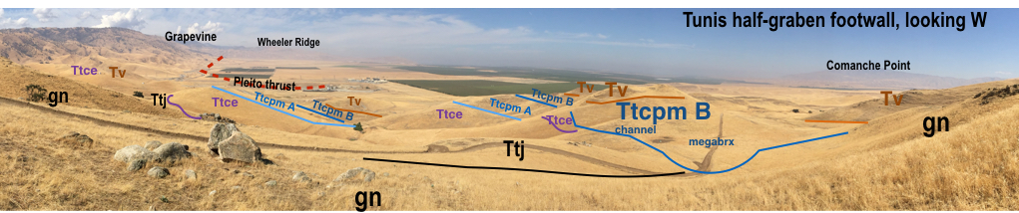
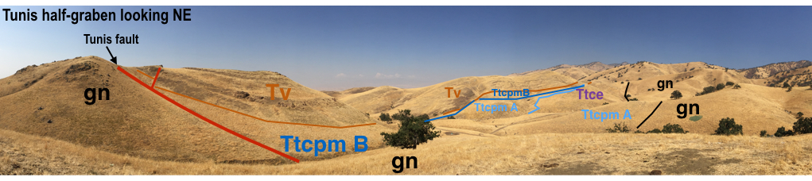
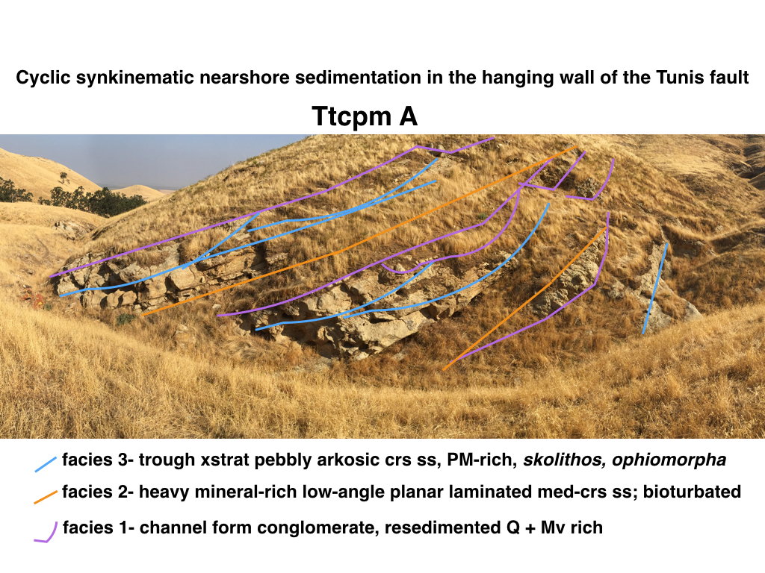
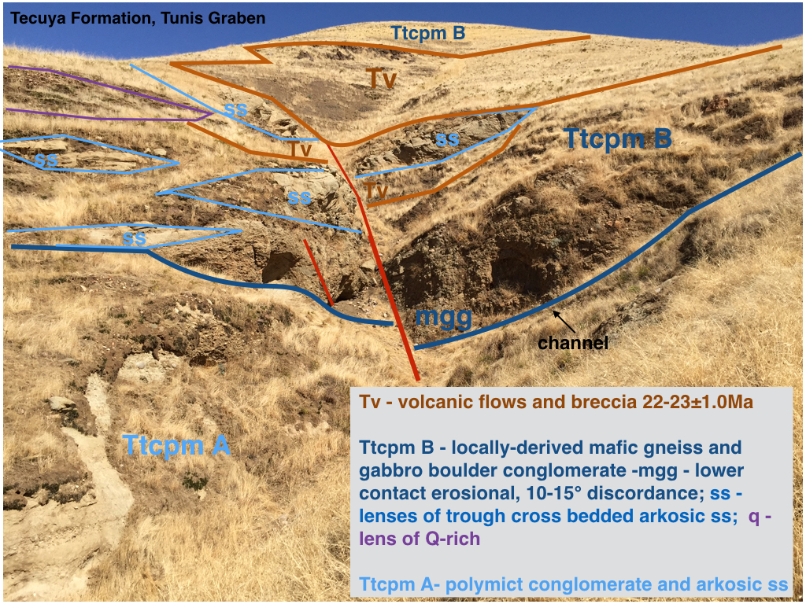
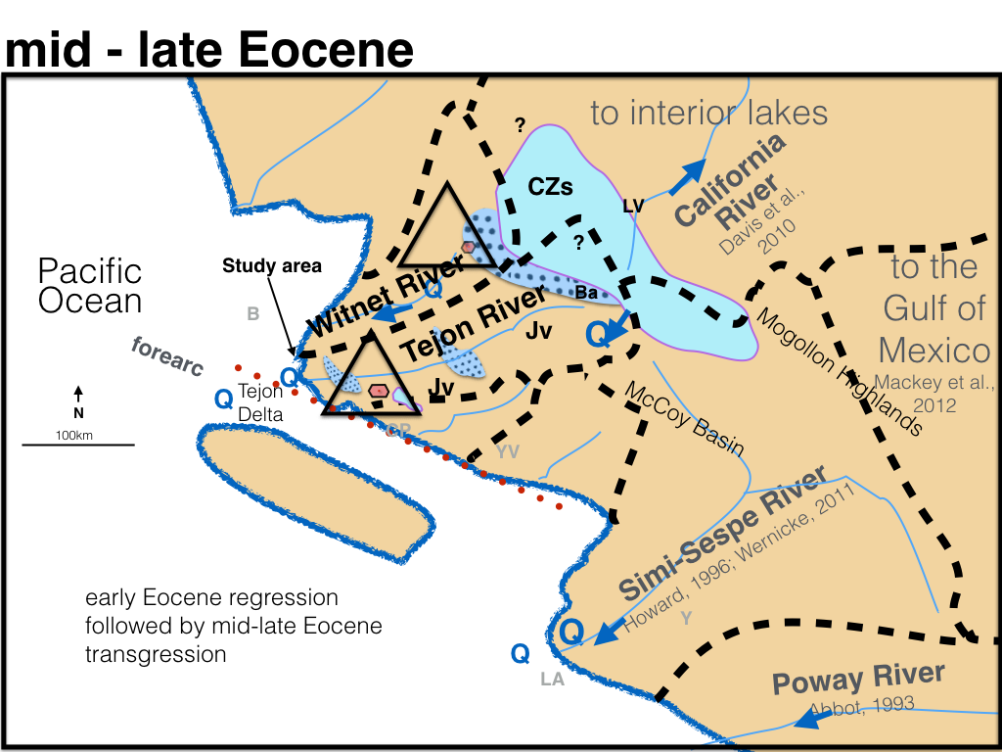
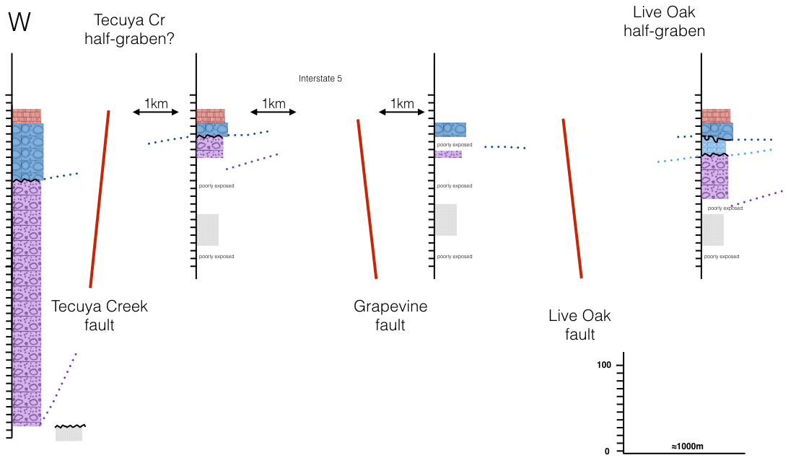
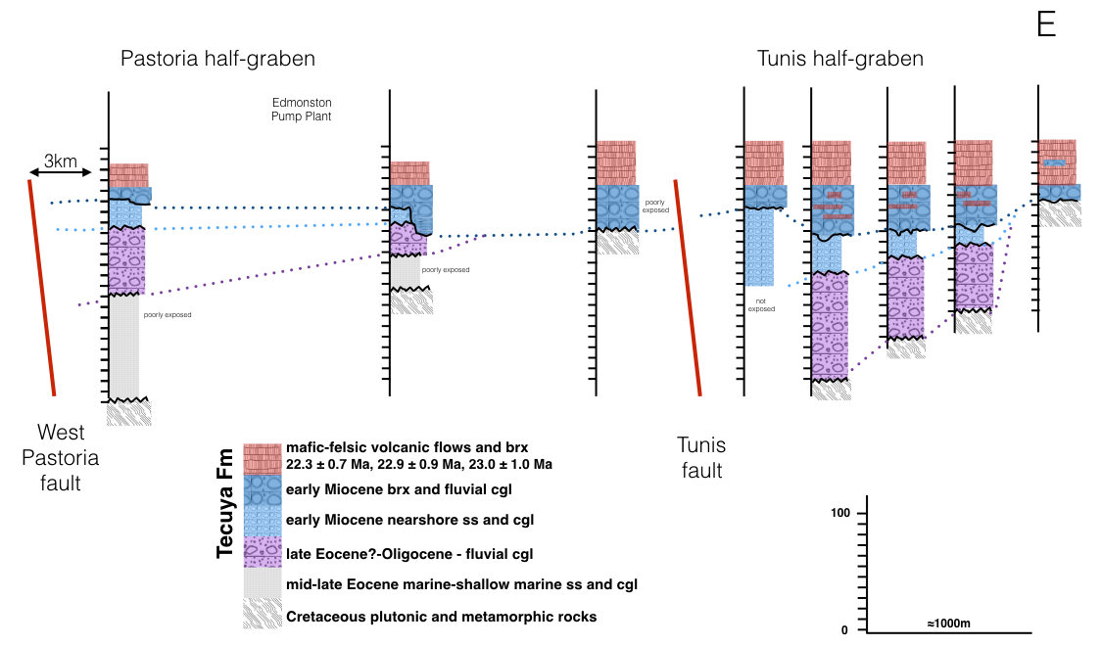
SEDIMENTOLOGIC AND STRATIGRAPHIC EVIDENCE FOR EARLY MIOCENE PASSAGE OF THE MENDOCINO TRIPLE JUNCTION UNDER THE SOUTHERN SAN JOAQUIN VALLEY
MORENO, Jesus Eduardo1, MCKINNEY, Samuel2, BUEHLER, Jeffrey2, JAMES, Robert N.2, LEVINSON, Zachary2 and MILLER, D.E.2, (1)
Geology, California State University of Bakersfield, CSUB Stockdale Highway, Bakersfield, CA 93311, (2)Department of Geological Sciences, California State University, Bakersfield, 9001 Stockdale Highway, Bakersfield, CA 93311
Abstract
Recent published plate reconstructions indicate that the Mendocino Triple Junction (MTJ) and associated slab window migrated northward under the southern San Joaquin Valley (SSJV) between Chron C7 (24.7Ma) and Chron C6b (23.0Ma). Along the rim of the SSJV, ≈200-700m of nearshore/non-marine coarse-clastic strata (Ttc) and interbedded volcanic flows and breccias (Tv) (21-24Ma) of the Tecuya formation have been uplifted, tilted to the N, and exposed semi-continuously for 10 km. We describe detailed sedimentologic and stratigraphic data from Ttc that underlies and is interbedded with Tv. The base of Ttc consists of 50-100m of exotic resedimented conglomerates (Ttce) with WNW flowing paleocurrents that unconformably overlies gneissic basement or Eocene sediments. Exotic composition, broken rounds, and clasts of resedimented conglomerates indicate erosion and resedimentation of pre-existing conglomerates from a cryptic source somewhere in the W Mojave. Down to the N movement on the WNW trending Tunis fault cut Ttce and caused erosion of 10-50m from the footwall and deposition in the hanging wall of nearshore and fluvial conglomerates that thicken towards the fault, show decreasing stratal dip up section, contain local rocks, and paleocurrents to the NE. An intraformational unconformity cuts all older rocks and is overlain by a megabrx containing 1-5m clasts of gneiss, schist, marble, and underlying sediments and a locally sourced gneiss boulder conglomerate. Channels cut into this conglomerate are filled with 21-24Ma lava flows. The sedimentary record shows the following sequence: uplift and erosional rejuvenation to the S; initiation of N-S extension on WNW trending, north-dipping normal faults; northward migration of uplift and erosion with associated change from W to N flowing paleocurrents, short local drainages, and exposure and erosion of local basement; development of a regional erosional unconformity as northward migrating uplift crossed the field area; eruption of lava flows on the erosional unconformity. We interpret this sequence as recording the northward movement of the MTJ fracture zone followed by volcanism generated by slab window processes. A similar signature of triple junction migration may be recognizable in the stratigraphic record of continental margins.
Location of Study Area
Future work
Zircon and other heavy mineral separates from matrix of Tertiary conglomerates and orthoquartzites clasts.
Thin section analysis of schist clasts for POR schists
Thin section analysis of potential Mojave source rocks
Count conglomerates in well core from the Tejon Embayment
Collect additional mesostructural data
Pre-Oligocene dispersal of orthoquartzite,
Mojave-Coast Ranges
Mid-Tertiary paleogeography of the Tecuya Fm., Tejon Embayment
Ttj - Tejon Fm
Ttce
Well-rounded exotic cobble-boulder conglomerate and sandstone;, resedimented cgl
Ttcpm A
Polymict locally derived congl, pebbly ss, arkosic ss, ophiomorpha, skolithos
Ttcpm B
Locally derived boulder conglomerate, brx, resedimented cgl, minor volcanic flows/brx
Fossiliferous arkosic sandstone and locally derived conglomerates
Tunis half graben
Tunis half graben
Tunis half graben
Boulders of exotic orthoquartzite from Paleogene conglomerates. Note well preserved sedimentary structures such as planar heavy mineral lamination, cross-bedding, burrows, chattermarks.
Acknowledgements
This study was supported by the Minority Science and Engineering Improvement Program (MSEIP), Dept. of Education, Louis Stokes Alliances for Minority Participation (LSAMP), National Science Foundation, the Dept. of Geological Sciences, Research Council of California State University, Bakersfield, and the Tejon Ranch Conservancy. We would especially like to thank Elizabeth Powers, Sue Holt, and Dirk Baron of the Dept of Geological Sciences and Dodie Hyatt, Charles Lam, Eduardo Montoya, Andrea Medina and the excellent support for undergraduate research at CSUB. Mike White, Ellery Mayence, Laura Pavliscak at the Tejon Ranch Conservancy provided crucial help that made much of this study possible. Support for multiple internships at Tejon Ranch was provided by an anonymous donor. Melissa Dabulamanzi and Tony Fernandez at the Wind Wolves Conservancy helped provide access to Tecuya Creek. The lead author would like to personally thank the many students who have contributed their time and enthusiasm over many months including Jake Jackson, Deandra Alvear, Cindy Rodriguez, Toni Ramirez, Zach Levinson, Estefania Olaya, Sam McKinney, Kenneth Watson, Jeff Buehler, Favour Epuna, Peyton Herrera, Elizabeth Fogerson, Beni Missidimbazi, and Erika Woods.
References
DeCelles, Peter G. Middle Tertiary Depositional Systems of the San Emigdio,Southern California. Middle Tertiary Depositional Systems of the San Emigdio,Southern California.
DeCelles, Peter G. “Variable Preservation of Middle Tertiary, Coarse-Grained, Nearshore to Outer-Shelf Storm Deposits in Southern California.” GeoScienceWorld, Journal of Sedimentary Research, 1 Mar. 1987, pubs.geoscienceworld.org/sepm/jsedres/article-abstract/57/2/250/97954/variable-preservation-of-middle-tertiary-coarse.
Dibblee, T. W., Jr., (1973) Geologic maps of the Santiago Creek, Eagle Rest Peak, Pleito Hills, Grapevine, and Pastoria Creek quadrangles, Kern County, California Open-File Report 73-57
Goodman, E. D., and P. E. Malin (1992), Evolution of the southern San Joaquin Basin and mid-Tertiary transitional tectonics, central California, Tectonics, 11, 478–498, doi:10.1029/91TC02871.
HOWARD, JEFFREY L. “The Statistics of Counting Clasts in Rudites: a Review, with Examples from the Upper Palaeogene of Southern California, USA.” Sedimentology, vol. 40, 1993, pp. 157–174., onlinelibrary.wiley.com/doi/10.1111/j.1365-3091.1993.tb01759.x/abstract.
Nilsen, Tor Helge. “Stratigraphy and Sedimentology of the Eocene Tejon Formation, Western Tehachapi and San Emigdio Mountains, California.” Journal of Coastal Research, 1987, pubs.er.usgs.gov/publication/pp1268.

