Slide 1
47-5: REVIEWING AND REVISING THE PROTEROZOIC HISTORY OF THE FIVE POINTS SHEAR ZONE:
A MULTIPLY DEFORMED PALEOPROTEROZOIC SHEAR THAT FORMED PRIOR TO 1.67 GA
Bart T. Cubrich, University of Wyoming; Kevin R. Chamberlain, University of Wyoming; Ernest M. Duebendorfer, Northern Arizona University; Matt Cochrane, Northern Arizona University

Slide 2
The Five Points Shear Zone (FPSZ)
Summary:
Located in the Wet Mountains, CO, just west of Cañon City.
Northwest Striking (mean attitude is 338°, 58°NE).
Cut by ~1.4 Ga intrusive rocks (e.g. Jones, 2005, Jones et al., 2010).
Very complex geologic history with intense regional metamorphism (>500° C).

Slide 3
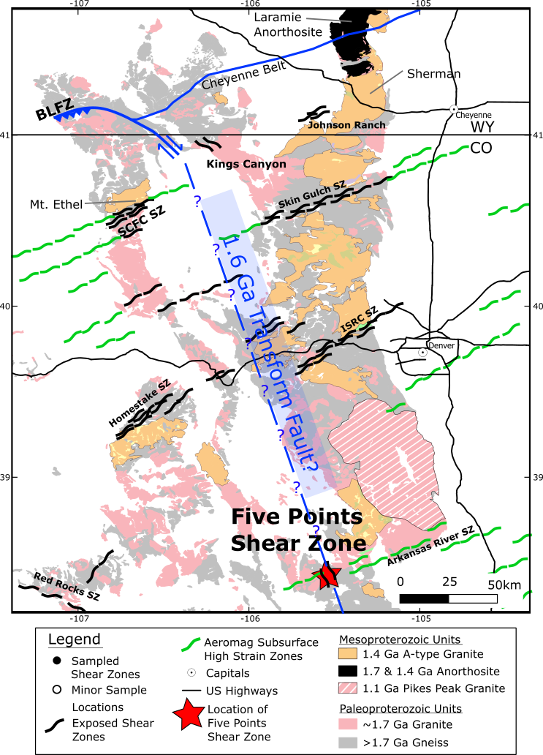
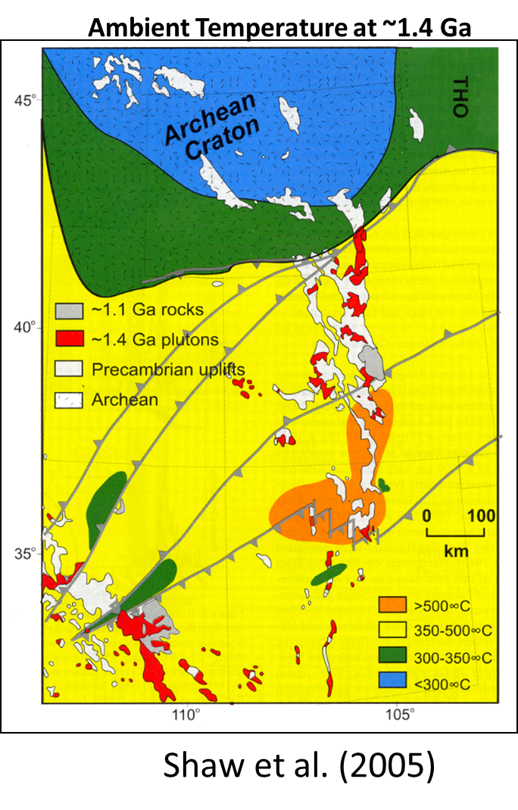
Ambient Temperature at ~1.4 Ga

Slide 4
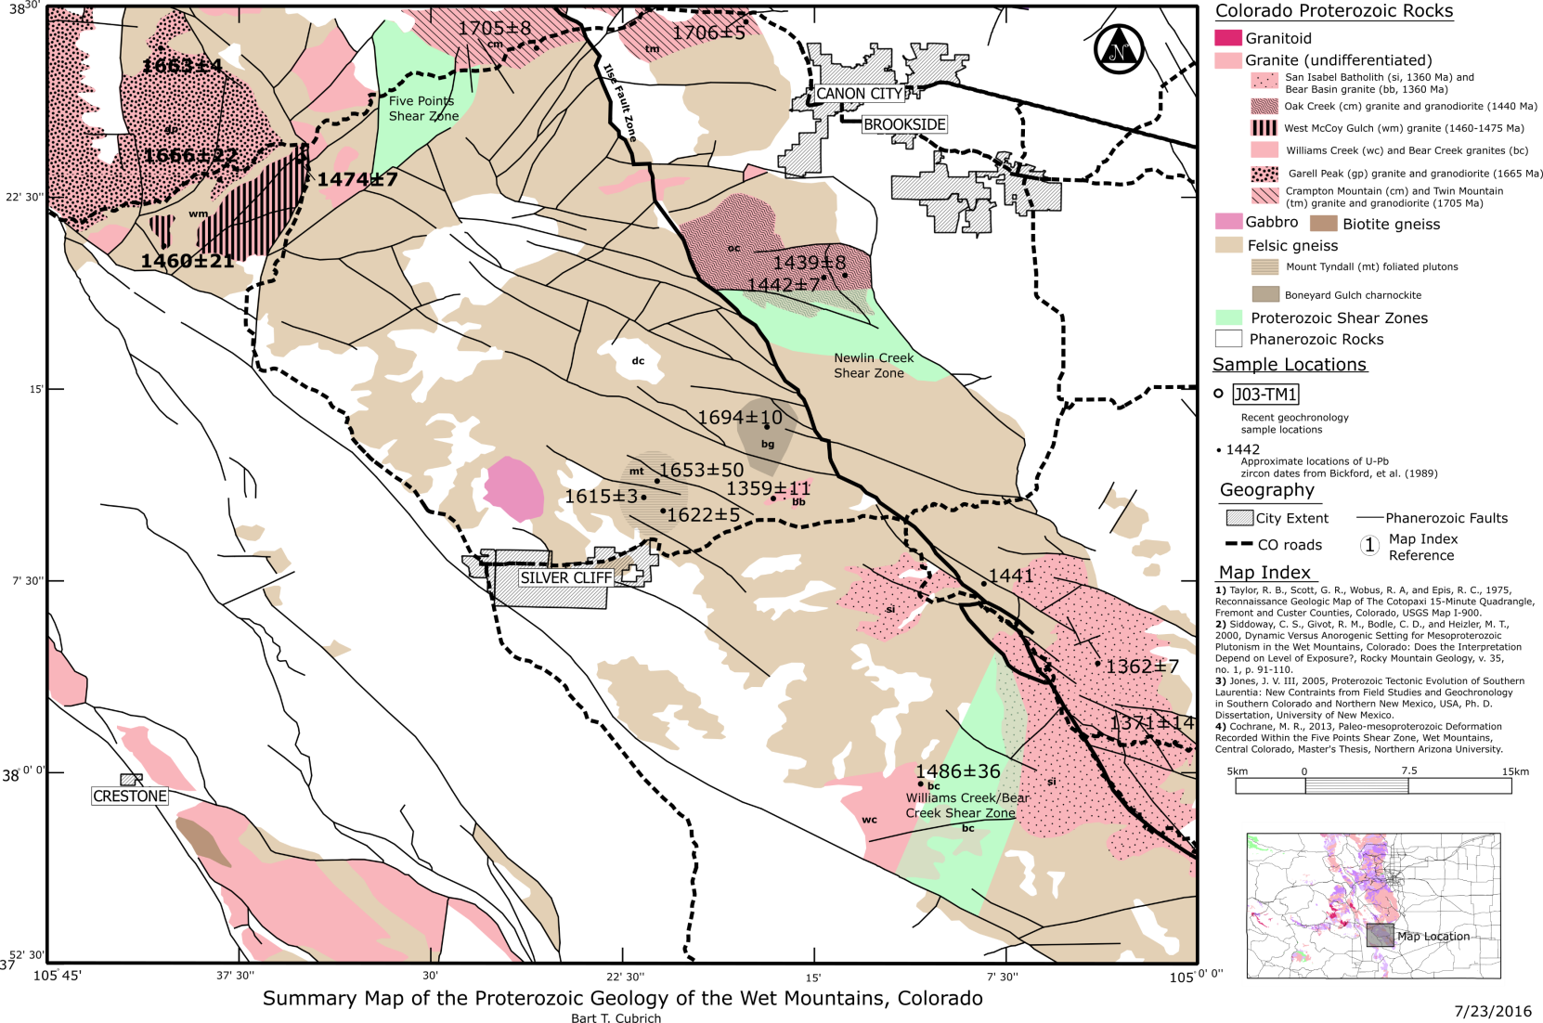

Slide 5
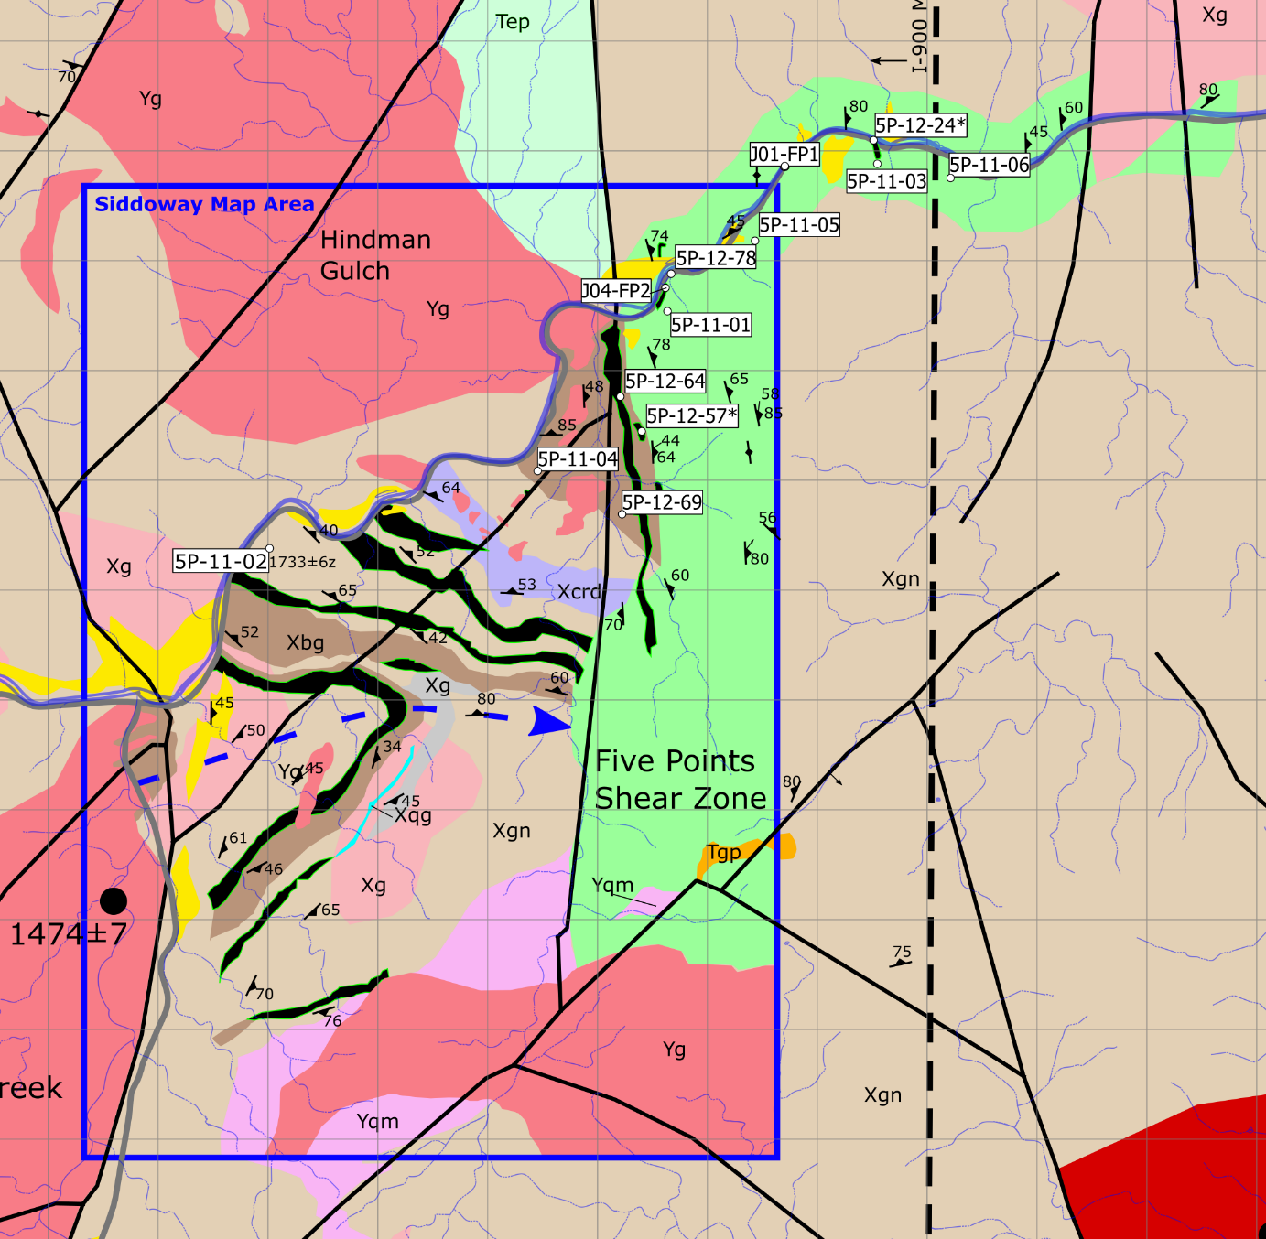



Slide 6
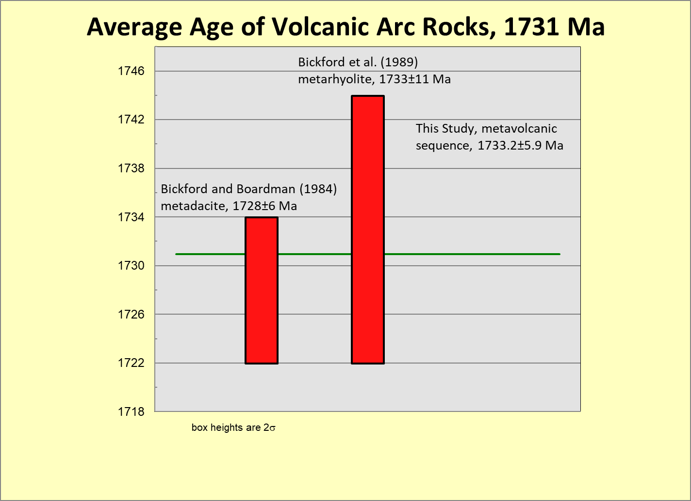
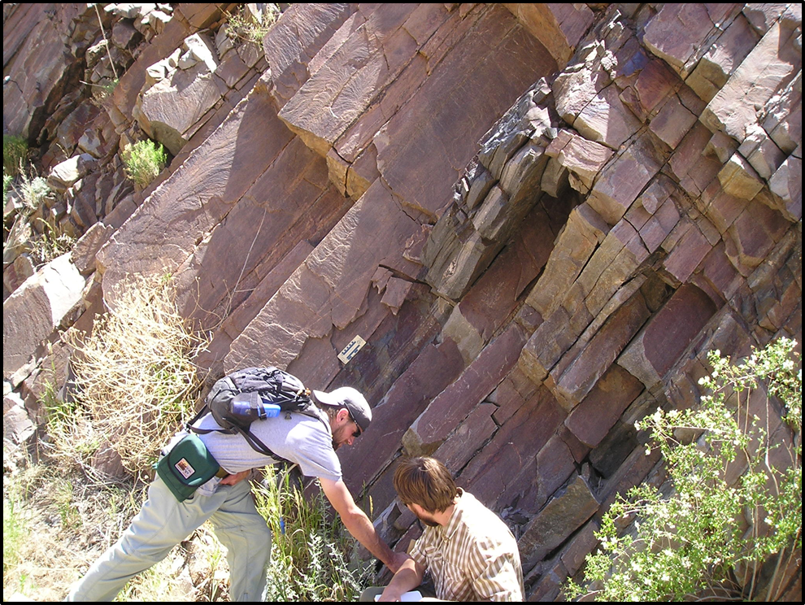
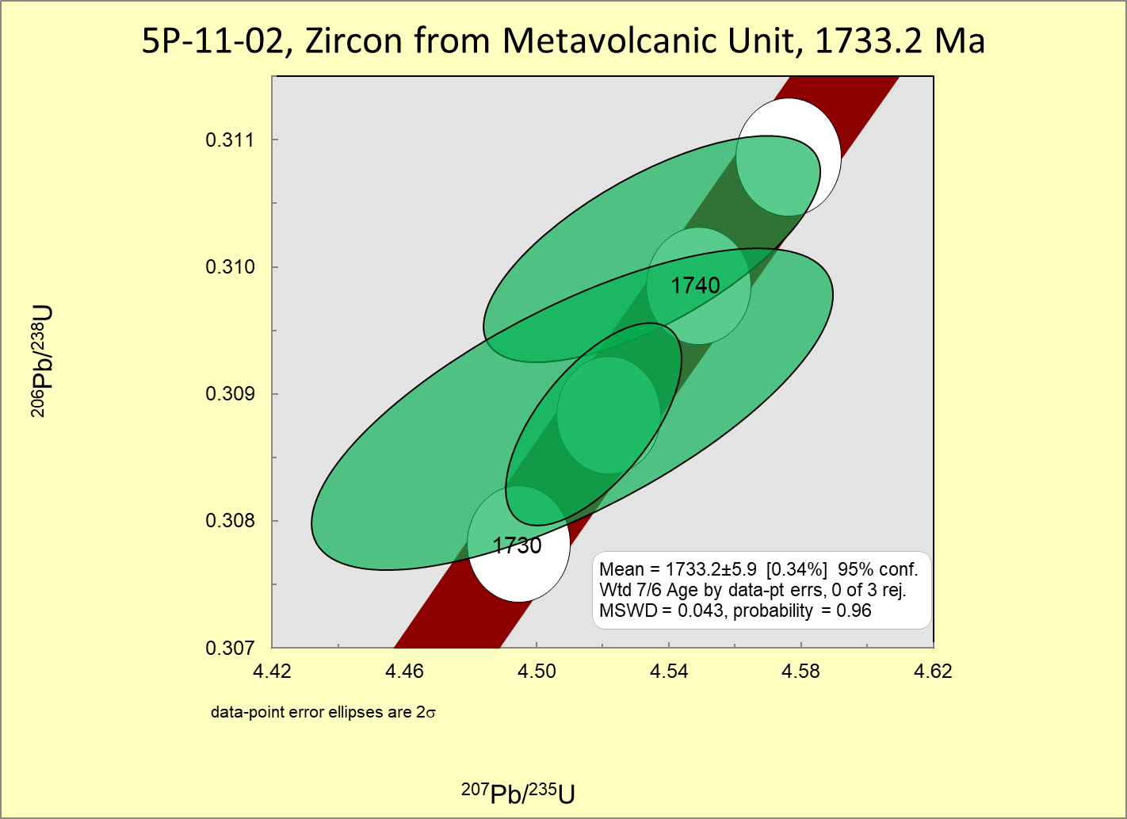
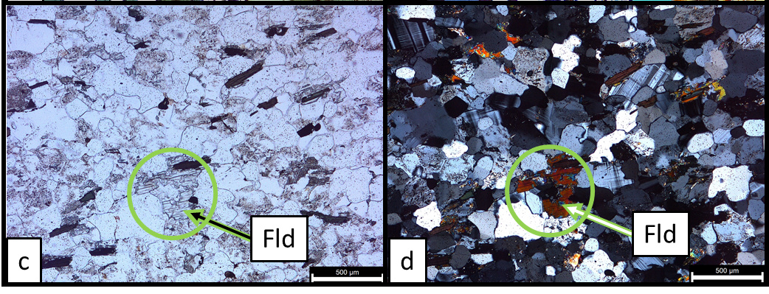
Timing Constraint 1 on Shearing: Age of Wet Mtn. Volcanic Arc Rocks

Slide 7
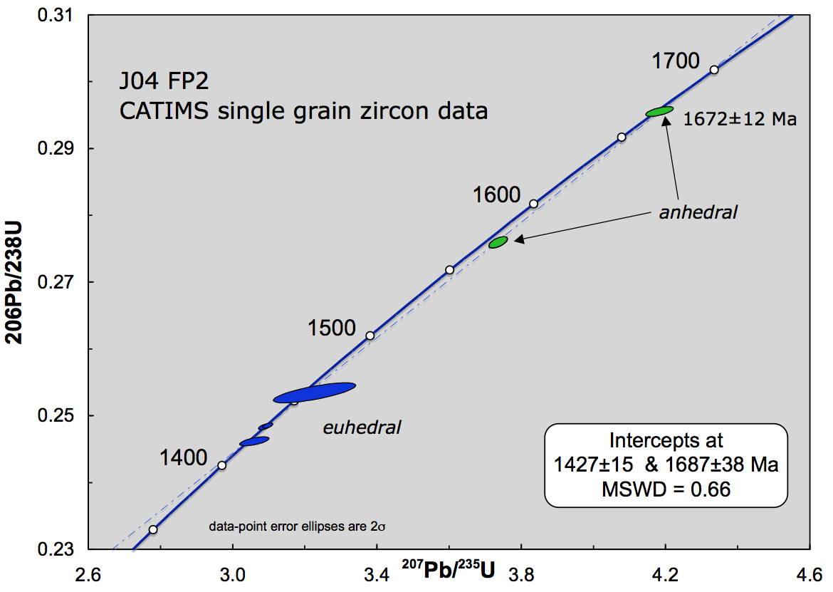
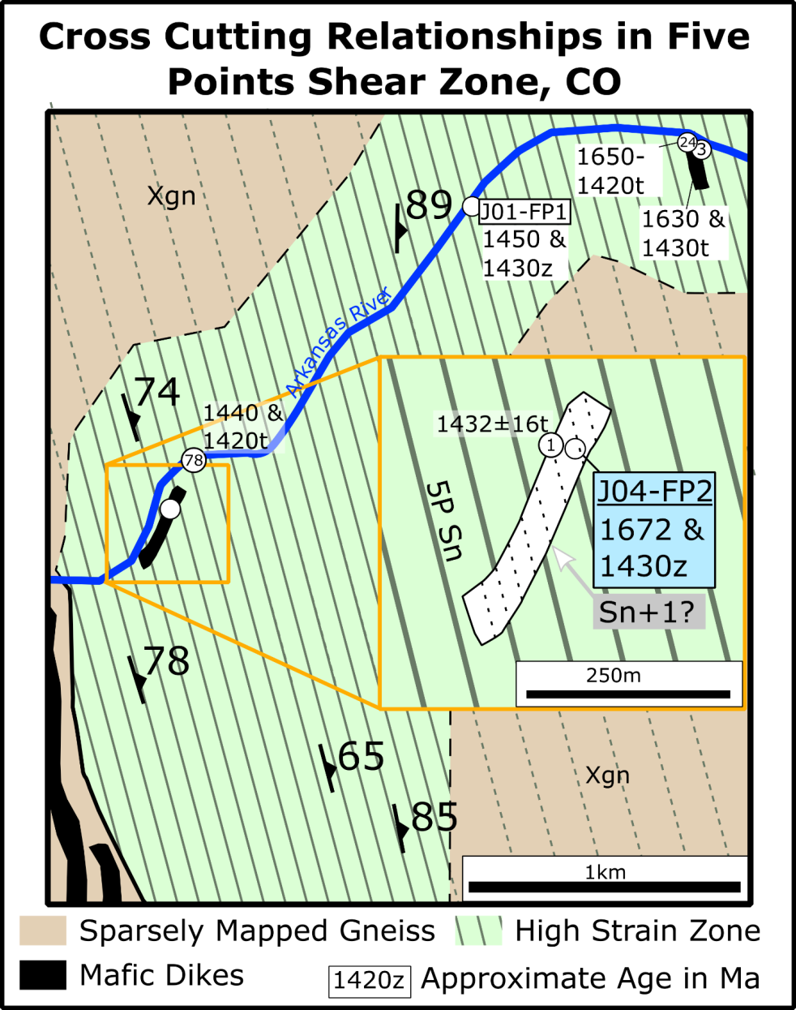
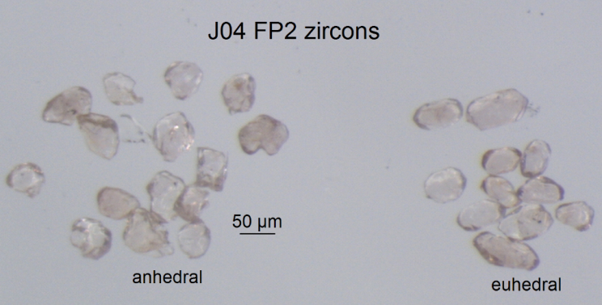
Timing Constraints Part 2, Crosscutting Dikes

Slide 8
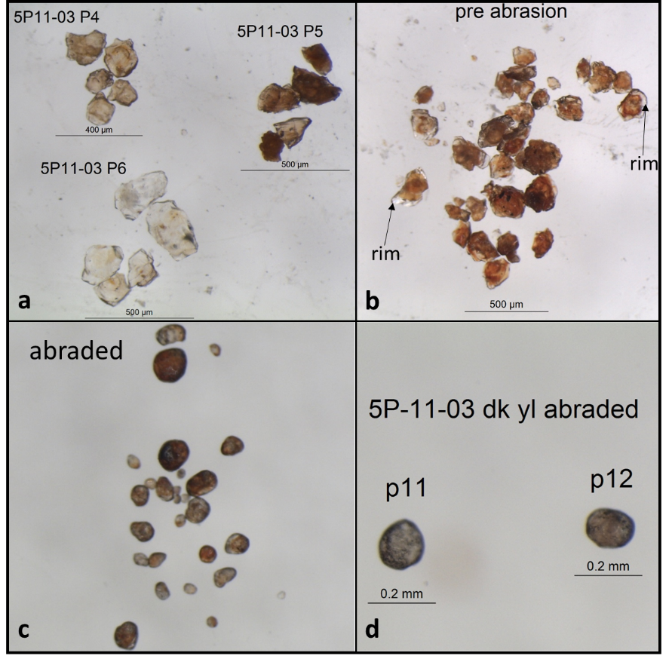
Timing Constraints Part 3, Titanite

Slide 9
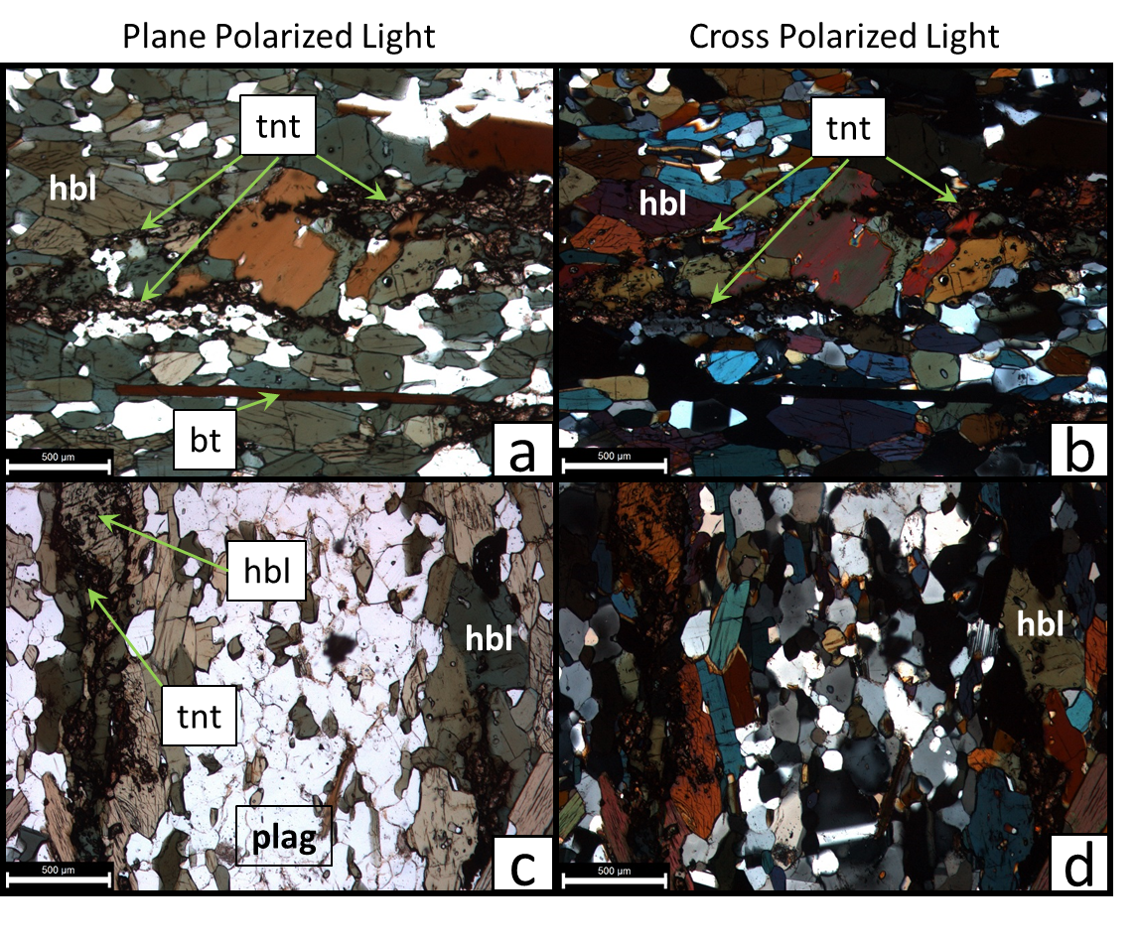
Timing Constraints Part 3, Titanite Envelope

Slide 10
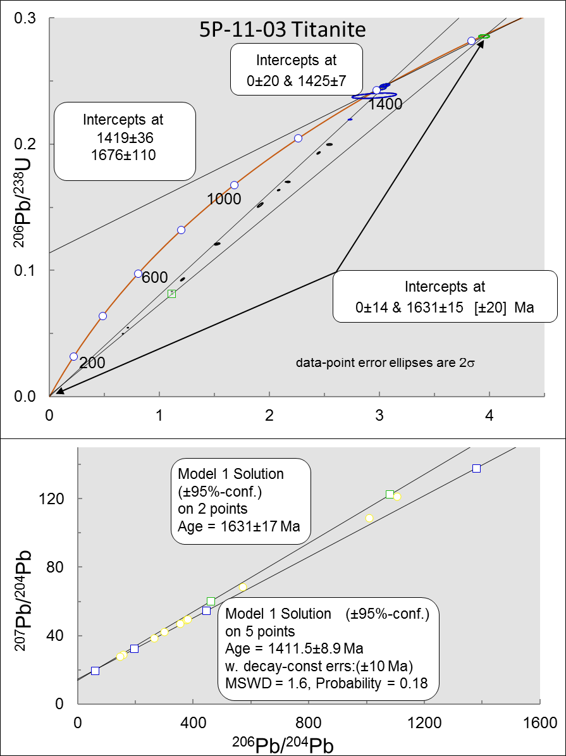
Timing Constraints Part 3, Titanite Envelope
Discordant
Dark Titanite
Intercepts at
1631 ± 17 Ma
0 ± 14 Ma
Discordant
Pale Titanite
Intercepts at
1425 ± 7 Ma
0 ± 20 Ma
Mixed Ages

Slide 11
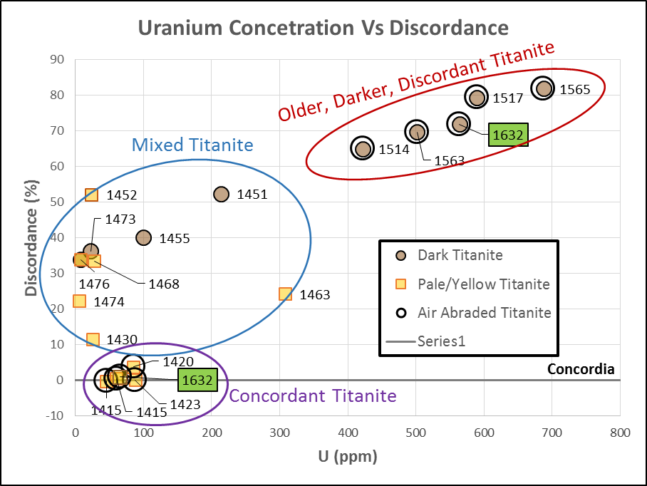
Timing Constraints Part 3, Titanite Envelope
Uranium Concentration Vs. Discordance
Air Abraded
% Discordance
Concordant
Titanite
Uranium Concentration (ppm)

Slide 12
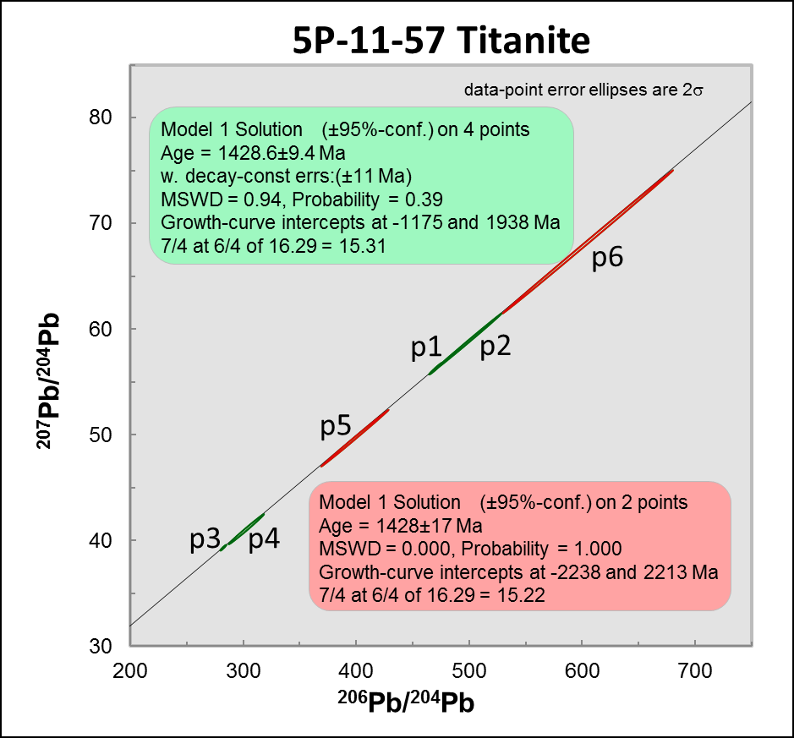
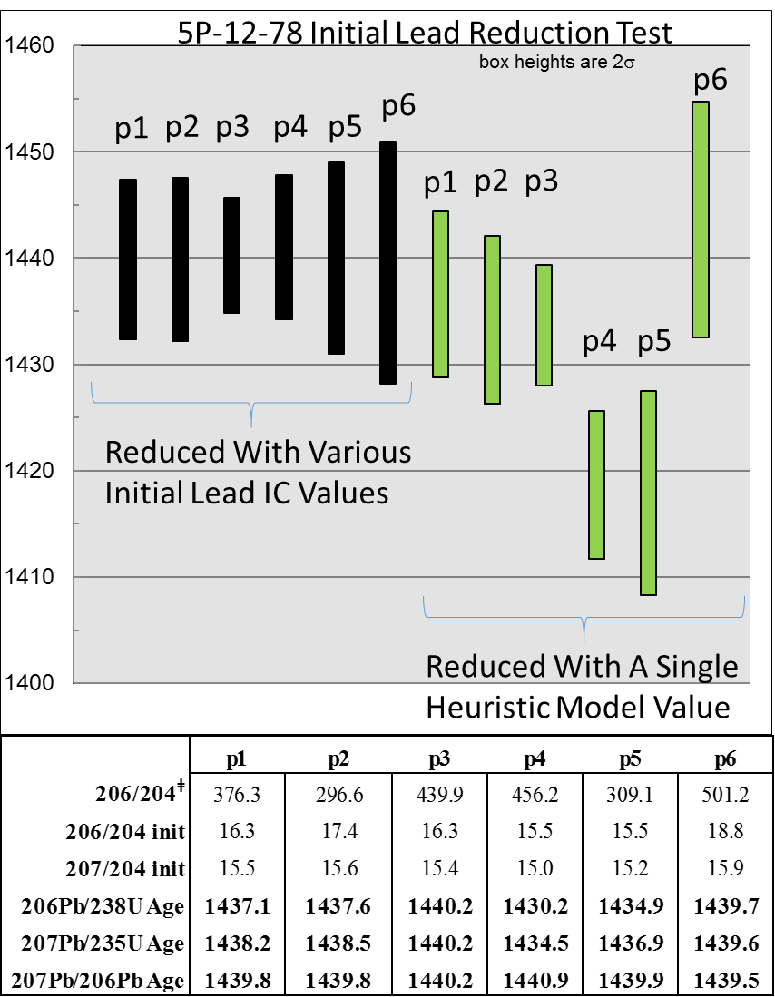
Late Titanite Overgrowths
1428.6 ± 9.4 Ma Titanite
1440 – 1420 Ma Titanite

Slide 13
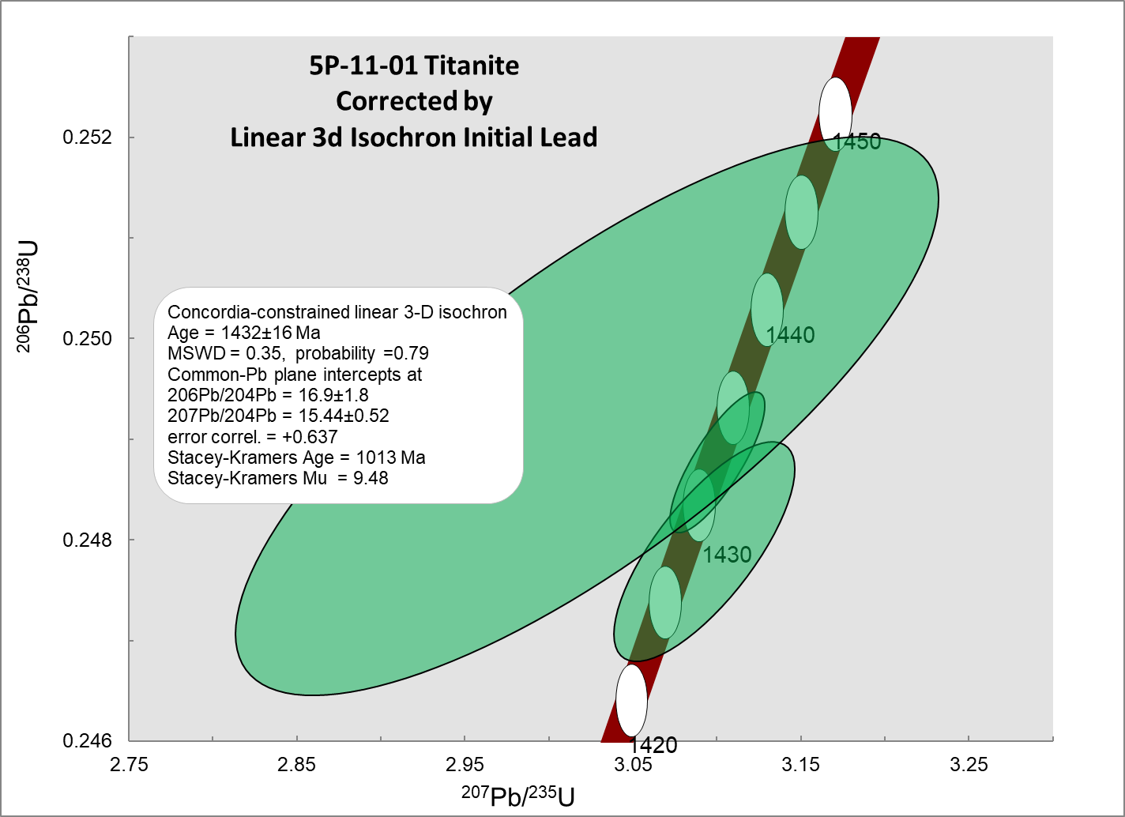
Late Titanite Overgrowths
1432 ± 16 Ma Titanite

Slide 14
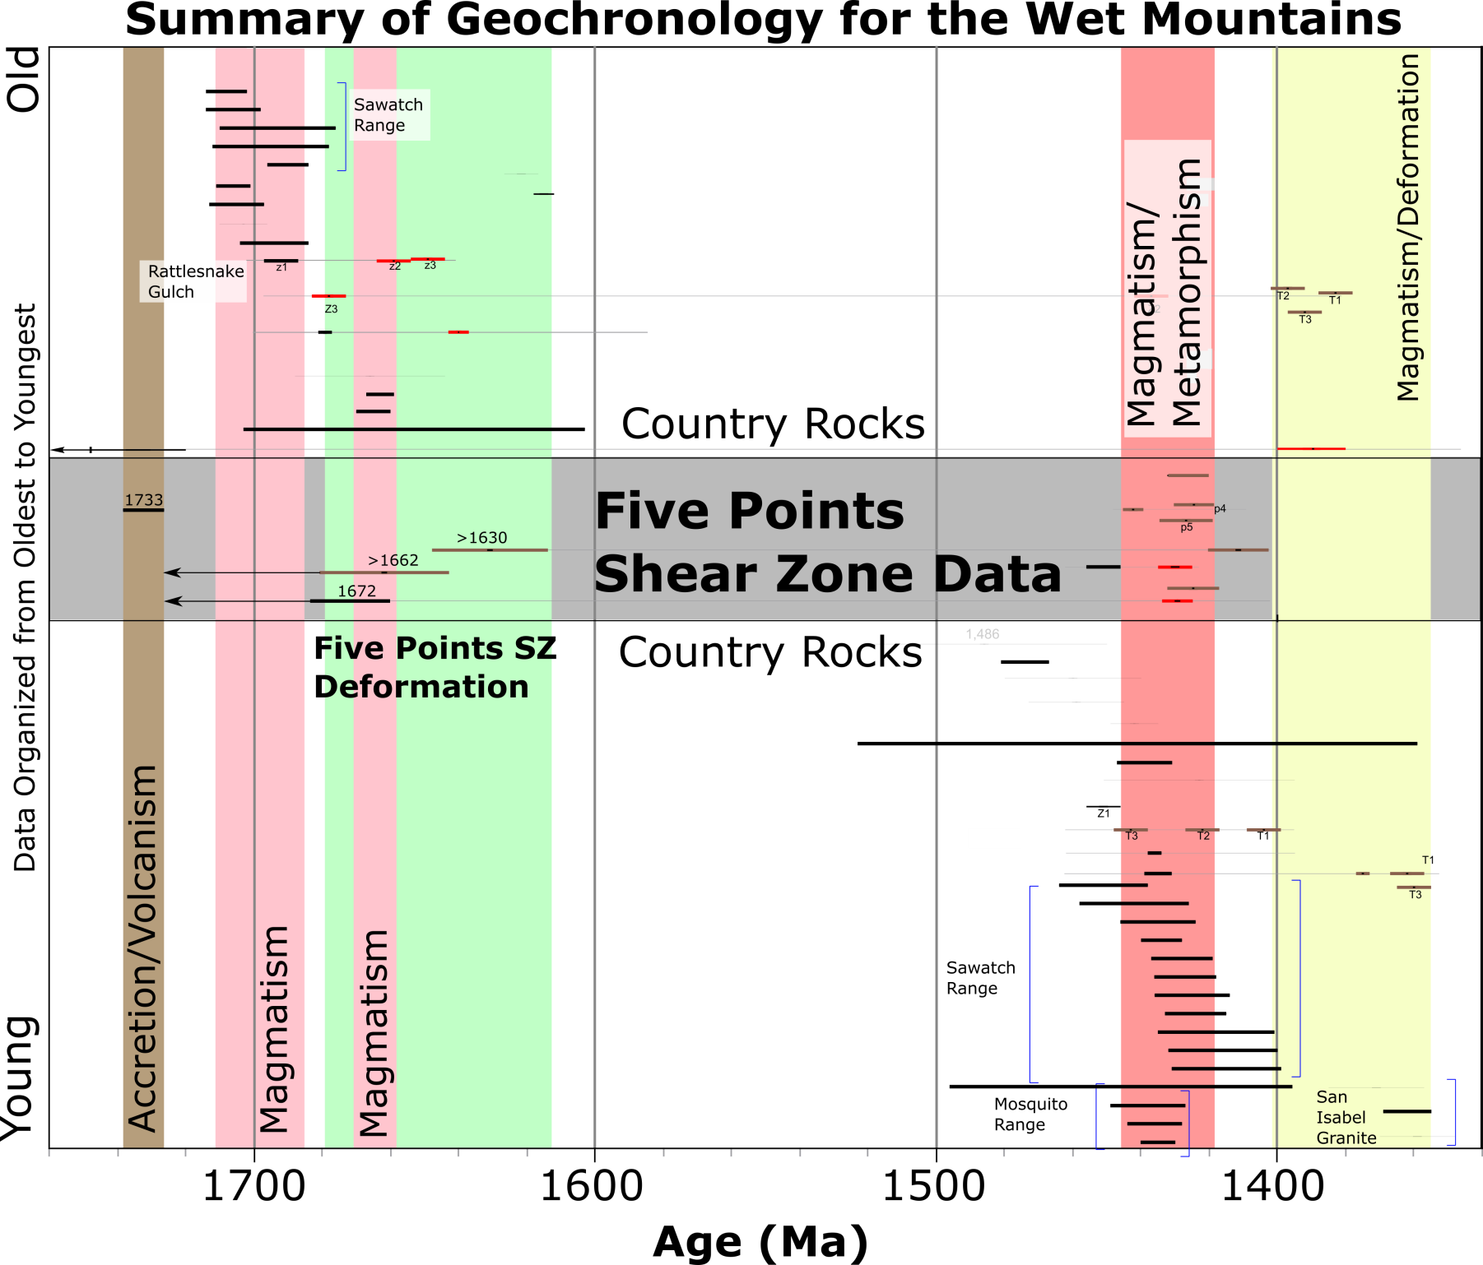
Regional intrusions that match
timing of crosscutting dikes within
Five Point Shear Zone (FPSZ)
1450-1420 Ma
Intrusion of Granites and Mafic Dikes w/
Massive Thermal Overprinting
Evidence of Deformation
1) >1670 Ma &
2) ~1630 Ma
Sources:
Cubrich (2017)
Moscati et al. (2017)
Jones (2005)
Bickford et al. (1989)

Slide 15
Summary of Geologic History
1730 Ma Volcanic Arc Formation
>1670 Ma Deformation
~1670 Ma Magmatism
1630 Ma Deformation
-------------------------------------------------------------------------
1440-1420 Ma Magmatic Pulses (minor deformation?)
1380 Ma Deformation (e.g. Jones, 2005)
1360 Ma Magmatism (e.g. Jones, 2005)

Slide 16
Regional Synthesis
Between 1680 and 1580 Ma (supposed “tectonic gap” there was progressive deformation of newly formed and newly accreted crust.
Analysis of kinematic histories of shear zones has lead to this model, and has implications for
  progressive deformation,
  evolution of continental lithosphere, and
  stabilization of this new continental lithosphere.
Notes:
During supposed tectonic gap…

Slide 17
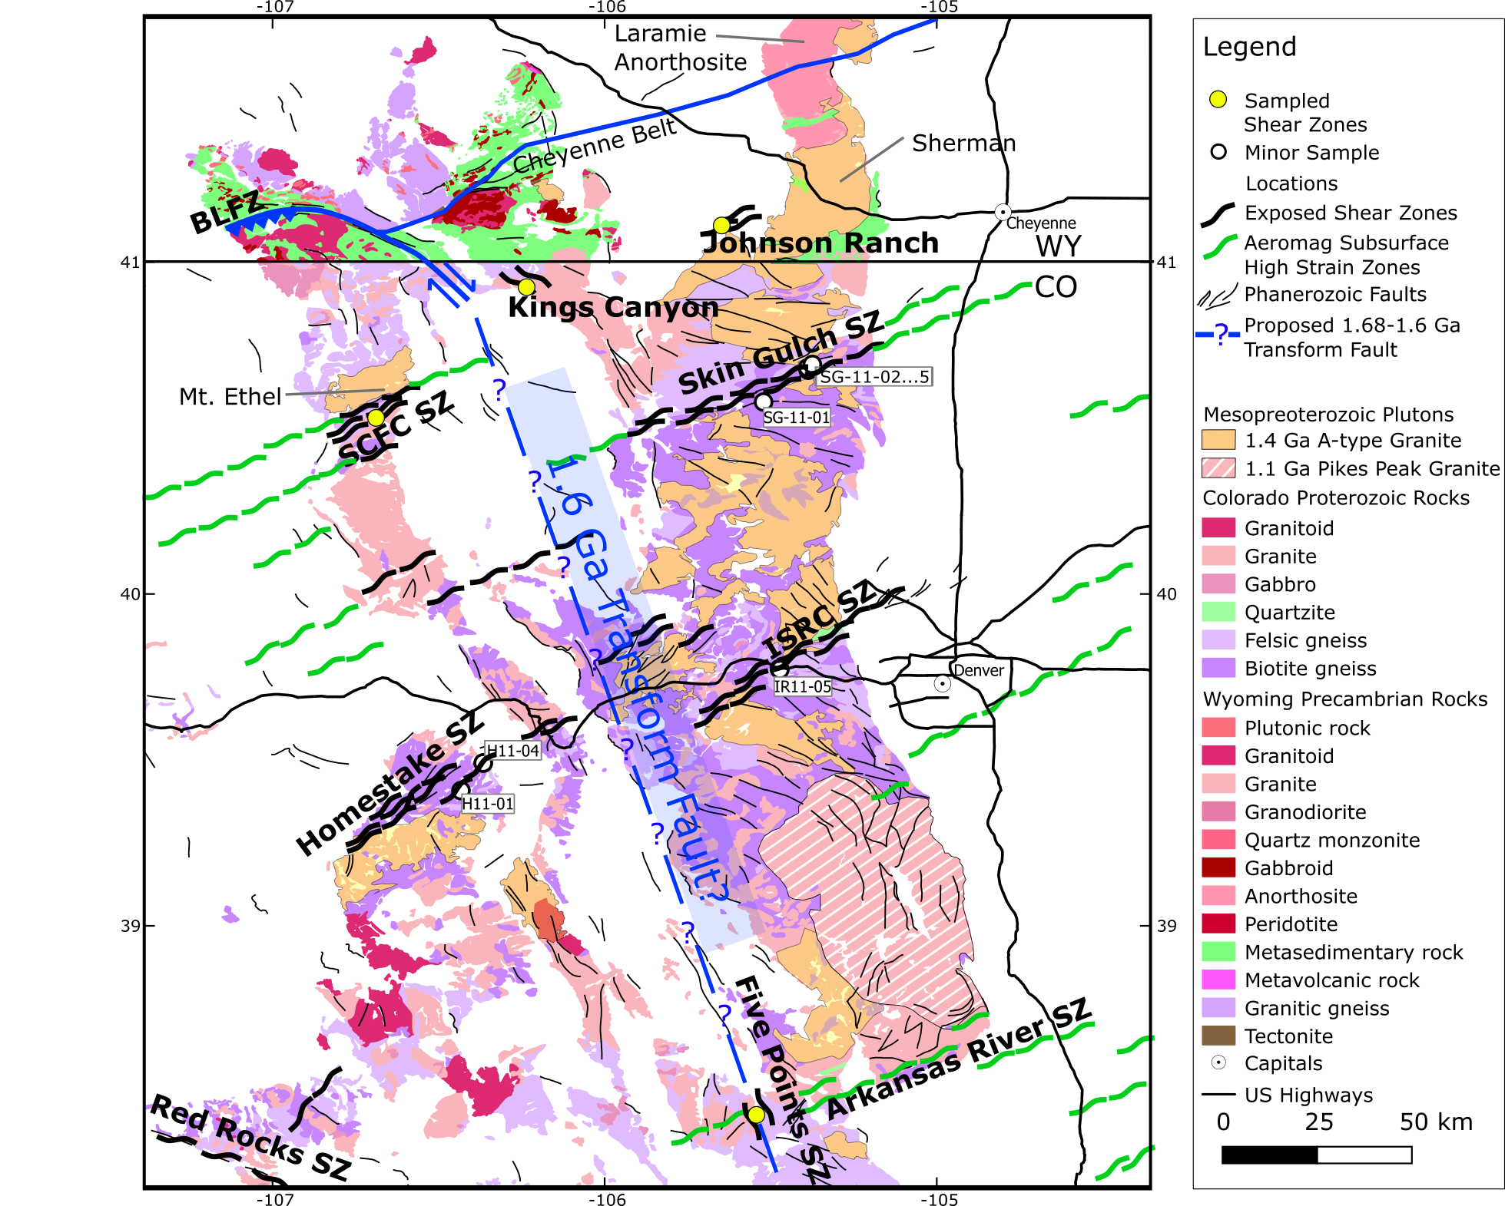
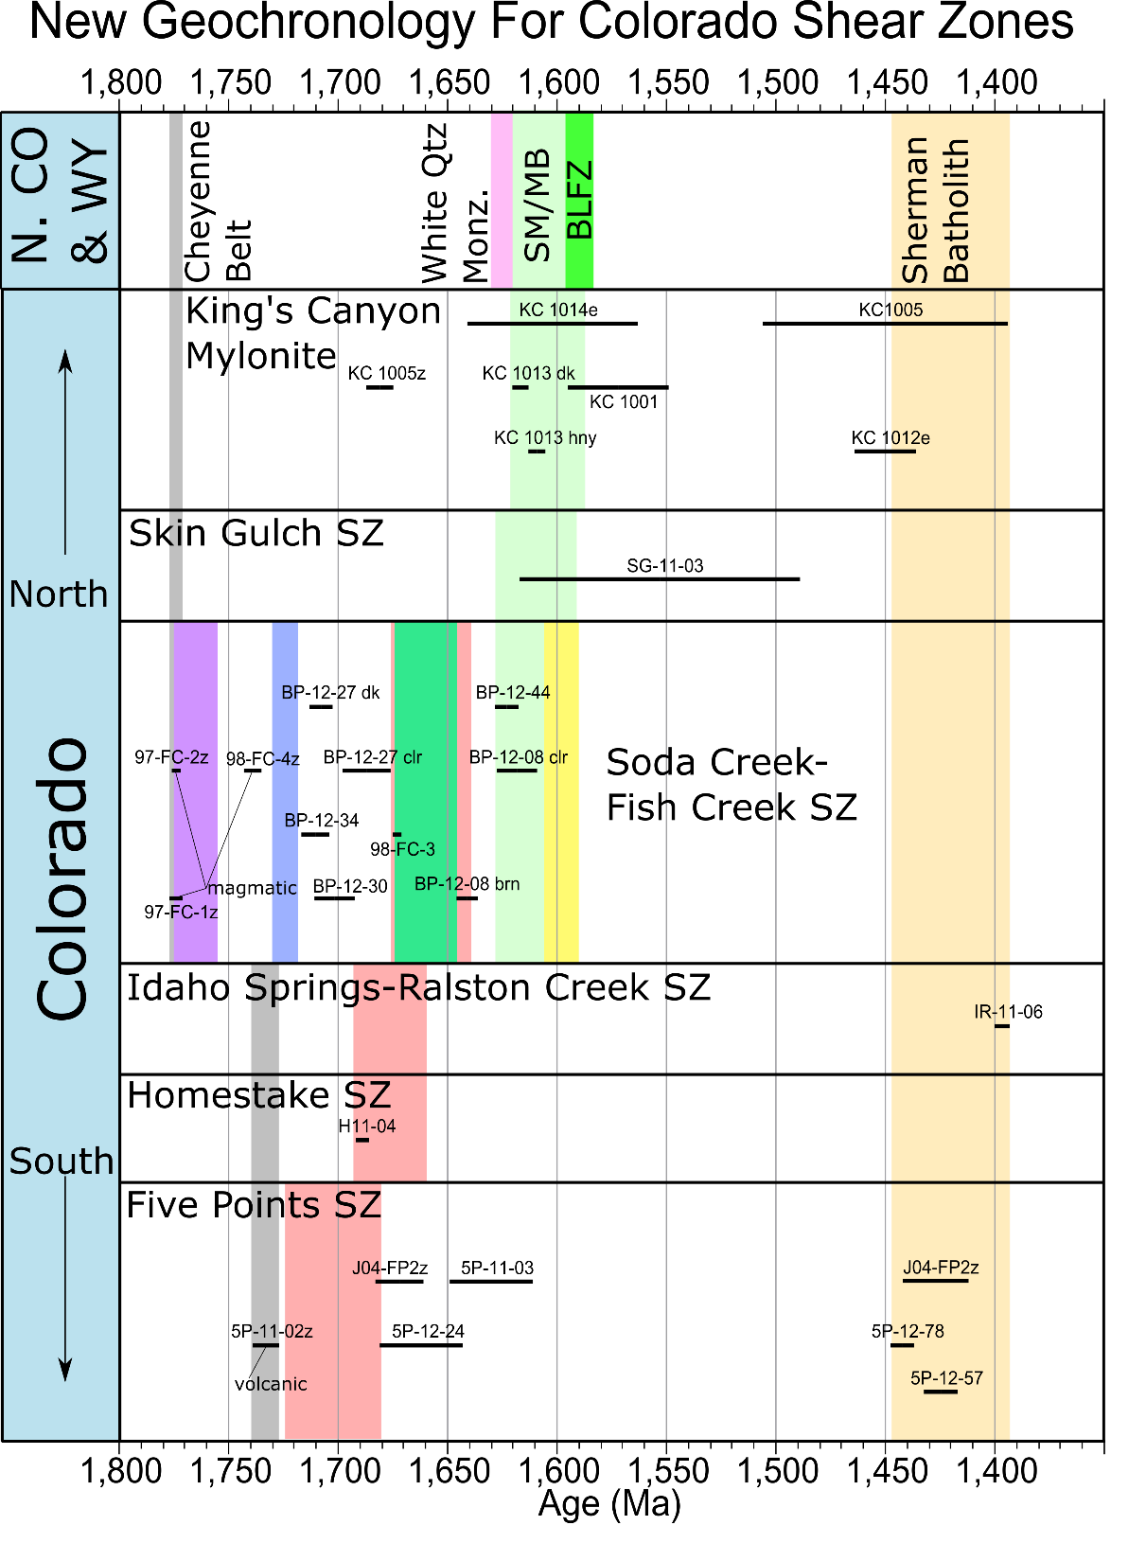
`1
S-N Younging Deformation Front Ages
N-S Younging Accretion Ages
Notes:
Add E-W color coded arrows from each sz on geochron to
Delete

Slide 18
Greenschist Grade
Amphibolite Grade
Shaw et al. (2005)
Notes:
Just to let people see it without the arrows.

Slide 19
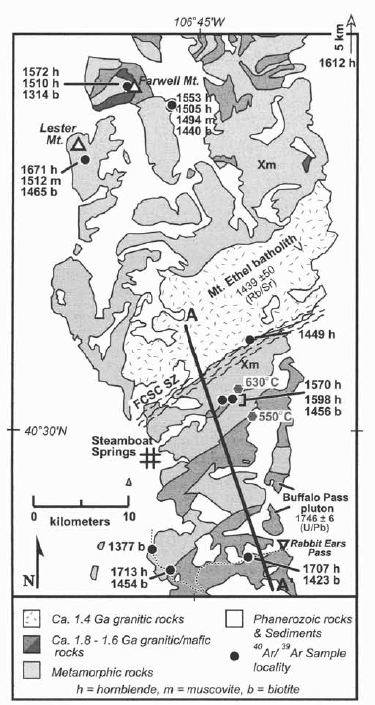
Shaw et al. (2005)
Notes:
Just to let people see it without the arrows.

Slide 20
~
~
~
~
~
~
~
~
~
~
~
~
~
~
~
~
Notes:
Just to let people see it without the arrows.

Slide 21
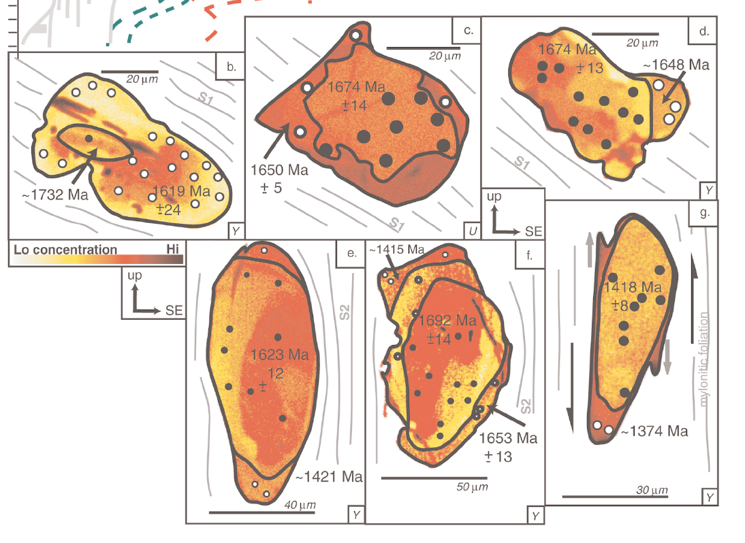
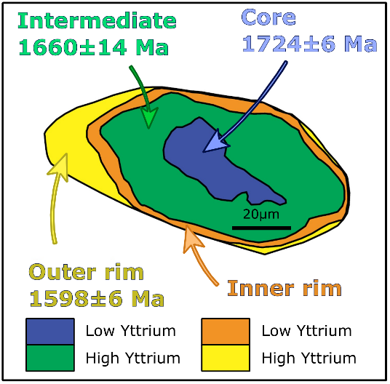
Comparison of Monazite Dates
Soda Creek – Fish Creek
Shear Zone
Idaho Spring – Ralston Creek Shear Zone
1720 Ma
1680 Ma
Duebendorfer et al. (2015)
1600 Ma
McCoy et al. (2005)

Slide 22
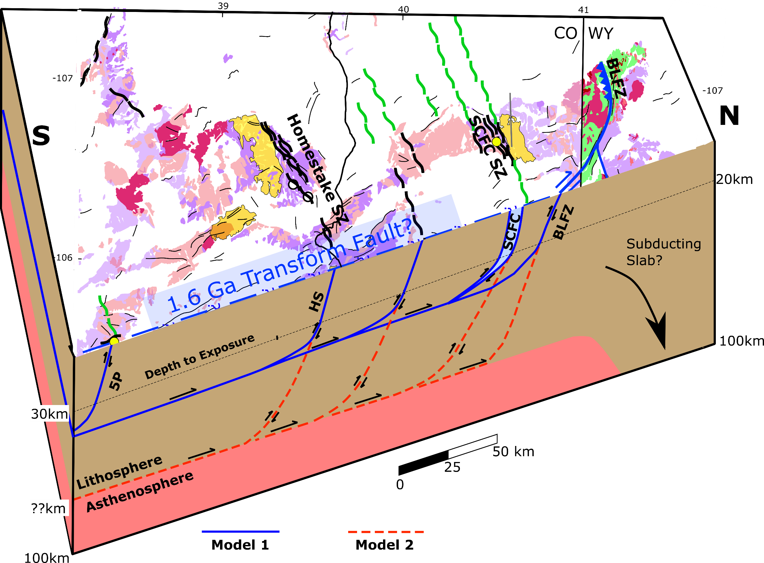
Piggy Back Structure During Progressive Shortening
1.61-1.59 Ga BLFZ
1.68-1.66 Ga SCFC SZ
1630 Ma
Subducted Slab?
1630 Ma
~1.69-1.64 Ga Homestake SZ
>1.67 Ga Five Points SZ
Questions?

Slide 23
Full Evidence for Transform
1) Widespread 1.6 Ga from Mexico to Wyoming (Duebendorfer et al., 2015)
2) The BLFZ—north-vergent, thrust-tear fault with at least 30km of offset at ~1.6 Ga (Duebendorfer et al, 2006a).
3) Oceanic slab of Yuan and Dueker (2005) is 150-200km in length, occurs onlywest of the BLFZ, has geophysical anisotropy that indicates olivine (subducted slab).
4) 150-200km strike slip fault corrects apparent misfit of CO shear zones (Chamberlain and Duebendorfer, 2005).
5) Offset may explain offset in the Jemez lineament in New Mexico
6) Explains large aeromagnetic low between the front and back ranges of Colorado (Finn and Sims, 2005).
7) U-Pb TIMS dates for epidote in the SM and MB range from 1611±36 Ma to 1533±63 Ma (Strickland, 2004).
8) SM and MB epidote fracture have different kinematics and orientation on either side of transform.
9) Nd isotopes indicate Archean under MB (east side), but SM require post 1.78 Ga modification (Chamberlain, 1998).
10) Aeromagnetic anomaly traces of shear zones in Colorado do not extend past the proposed transform on either side, with the exception of the Arkansas River shear zone (Figure 4).
11) The aeromag extension of the SCFCSZ does not extend east of the proposed transform, and the extension of the SGSZ does not extend west of it.
New Evidence:
1) The Five Points Shear Zone (FPSZ) is shown to have initiated prior to 1.67 Ga, and is on strike with the strike slip portion of the BLFZ, which was active as a north vergent thrust tear fault at 1.59-1.55 Ga. Thus, the FPSZ is a potential exposure of the proposed 1.6 Ga transform shown at the beginning of this thesis.
2) On the east side of the proposed transform evidence for greenschist grade reactivation is less extensive, and not present at all in some places (e.g. Johnson Ranch, this study), whereas it is abundant on the west side (SCFCSZ, BLFZ, Beaver Creek, White quartz monzonite).

Slide 24
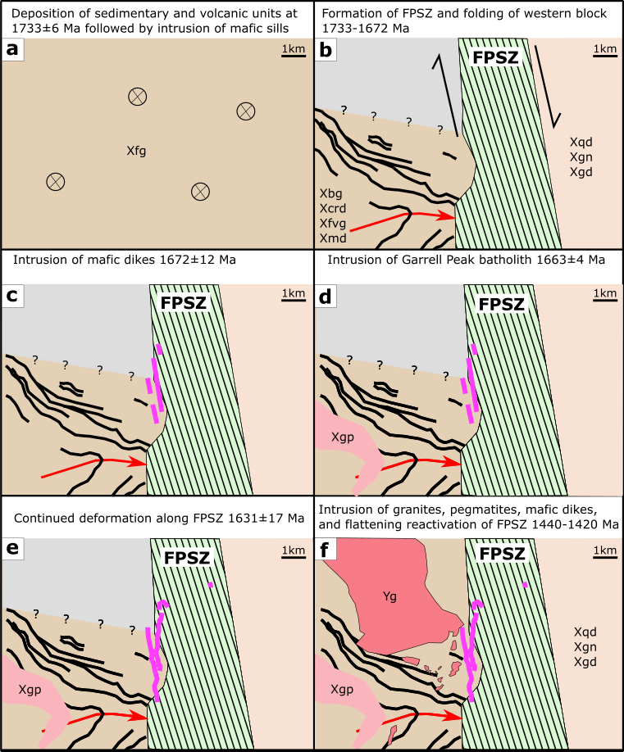
Summary
1730 Ma Volcanism
> 1672 Ma Deformation
1672 Ma Magmatism
1663 Ma Magmatism
1630 Deformation?
1430 Ma Magmatism

