Slide 1

Understanding the late-stage evolution of Shatsky Rise using transdimensional acoustic impedance Inversion
Sireesh Dadi, Department of Geology and Geophysics
Texas A&M University
2018 GSA South-Central Section
52nd Annual Meeting

Slide 2
Summary
Introduction
Shatsky Rise in the NW pacific. Consists of TAMU, Ori and Shirshov Massives.
Data:
- Multichannel seismic data acquired during IODP 324
Objective:
Apply a global optimization to invert for acoustic impedance and obtain uncertainty.
Results:
Higher percentage of massive flow basalts at TAMU Massif compared to Ori Massif.
The percentage of pillow basalts and geochemically altered basalts is higher at the summit compared to that at the anks of the volcanoes.
Notes:
A 2016 study concluded that the Tamu Massif formed at a mid-ocean ridge that interacted with a plume head and that the Ori Massif formed off-axis probably from a plume tail.

Slide 3
Introduction | Data | Objective | Results
The Shatsky Rise is Earth's third largest oceanic plateau. The TAMU Massif may be the largest volcano discovered on Earth.
Location: approx 1600 km from Japan
Three volcanoes: TAMU Massif, Ori Massif
and Shirsov Massif.
Lithology: Massive basalt flows, Pillow basalt flows and volcanoclastics.
Massive Basalts: Higher rate of effusion
Pillow Basalts: Lower rate of effusion, lower impedance compared to Massive basalts.
Formation: Near triple junction, deep
Mantle source or shallow mantle source
below the lithosphere, Meteor impact
Notes:
A 2016 study concluded that the Tamu Massif formed at a mid-ocean ridge that interacted with a plume head and that the Ori Massif formed off-axis probably from a plume tail. After its formation Shatsky Rise was uplifted 2,500–3,500 m (8,200–11,500 ft) and it then subsided 2,600–3,400 m (8,500–11,200 ft), which, in both cases, is considerably more than in the case the Ontong-Java Plateau. There was least subsidence at the centre of the Tamu Massif (c. 2,600 m (8,500 ft)), subsidence increased at the northern flank of the Tamu Massif and at the Ori Massif (c. 3,300 m (10,800 ft)), and it becomes greatest at the flank of Ori Massif.

Slide 4
Introduction | Data | Objective | Results
80 traces at 1 km on each line.
~ 1 sec traces from water bottom

Slide 5
Introduction | Data | Objective | Results
Ori Massif
TAMU Massif

Slide 6
Introduction | Data | Objective | Results

Slide 7
Introduction | Data | Objective | Results
Perform 1-D stochastic bayesian inversion using Reversible jump Markov Chain Monte Carlo (rjMCMC) to obtain acoustic impedance profiles from individual seismic traces.
The model parameters used during sampling include the number of layers, layer boundary depths, and acoustic impedance values.
Acoustic impedance depends on the type of basalt present, the results allow estimation of lithology.
Calibration points: Well log and lithology from cores.

Slide 8
Introduction | Data | Objective | Results
Why rjMCMC?
The vertical resolution of seismic is approximately a quarter wavelength, which for Shatsky Rise is about 44 m for the data frequency of 30 Hz.
Thickness of different basalt layers is often less than vertical resolution of seismic data at the Shatsky Rise
Grid size of 50 m thick or less to perform an inversion to include potentially thin layers of lithologies of interest, but this leads to a very large parameter set.

Slide 9
Introduction | Data | Objective | Results
Before Inversion
After Inversion

Slide 10
Introduction | Data | Objective | Results

Slide 11
Introduction | Data | Objective | Results
Wavelet comparison

Slide 12
Introduction | Data | Objective | Results

Slide 13
Introduction | Data | Objective | Results
Convergence parameters for inversion

Slide 14
Introduction | Data | Objective | Results
Comparison of real data with initial model seismograms
Initial impedance model for TAMU Massif

Slide 15
Introduction | Data | Objective | Results
Comparison of real data with best model seismograms
Best impedance model for TAMU Massif

Slide 16
Introduction | Data | Objective | Results
Comparison of real data with initial model seismograms
Initial impedance model for Ori Massif

Slide 17
Introduction | Data | Objective | Results
Comparison of real data with best model seismograms
Best impedance model for Ori Massif

Slide 18
Introduction | Data | Objective | Results
Std Dev of impedance model for Ori Massif
Std Dev of impedance model for TAMU Massif

Slide 19
Introduction | Data | Objective | Results
Avg impedance with distance for Ori Massif
Avg impedance with distance for TAMU Massif
Conclusions:
rjMCMC algorithm provides parameter estimates and also quantifies the uncertainty in impedance.
Inversion results suggest higher percentage of massive flow basalts at TAMU Massif compared to Ori Massif.
The percentage of pillow/altered basalts is higher at the summit compared to that at the flanks of the volcanoes. This might be due to higher level of localized explosive volcanism and/or geochemical alteration at the summit.

Slide 20
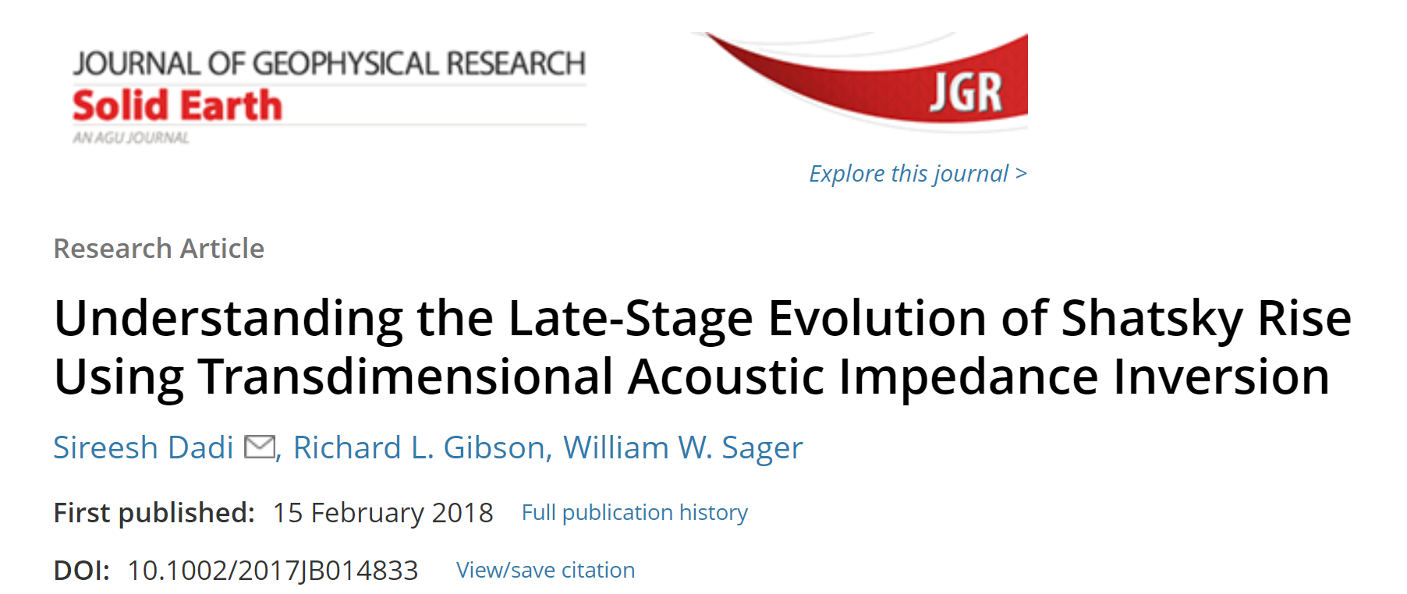
Acknowledgements
Co- Authors: Dr. Richard Gibson, Dr. Will Sager.
Dr. Jinchang Zhang and Dr. Jun Korenaga for processing the data.
Publication:

