Slide 1
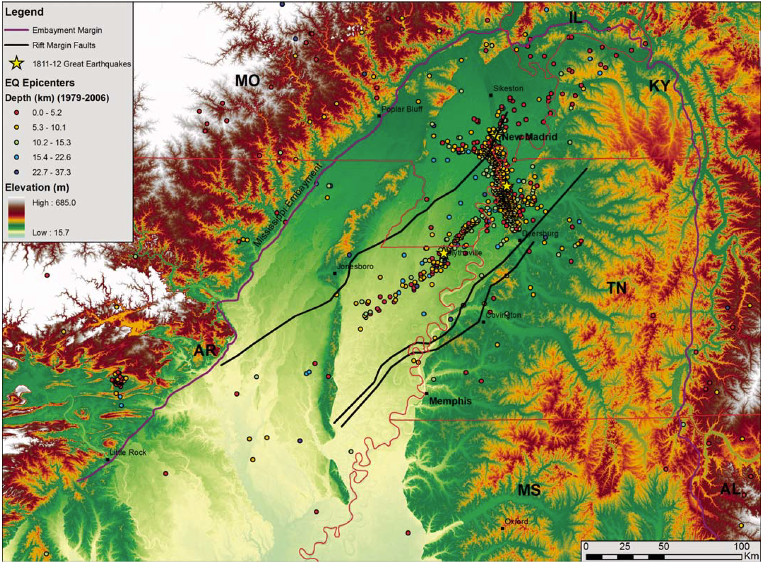
Geological Mapping in Lake County, Tennessee
Taylor Weathers
Roy Van Arsdale
David Arellano
University of Memphis
Notes:
Greetings
Regional Study Area
Reelfoot Rift
Mississippi Embayment
New Madrid seismic zone defined by seismicity
Earthquakes represented by color classed depths
State the Purpose with regards to Lake County’s position within the NMSZ
The purpose of this project is to provide geological information to seismologists and engineers for the purpose of developing seismic hazard maps.

Slide 2
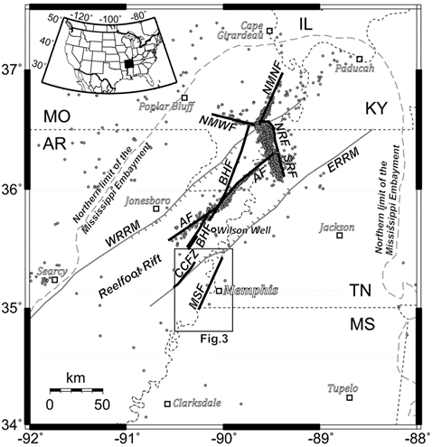
Purpose
The purpose of this research was to supply geological information to seismologists and engineers for the purpose of creating seismic hazard maps for Lake County, TN which lies within the heart of the New Madrid seismic zone (NMSZ)
We did this by:
Compiling the data into large spreadsheets
Creating structure contour maps
Creating a 3-D Lithologic Model
Constructing cross-sections from the structure contour maps
Modified from Hao et al. 2013
Notes:
Greetings
Regional Study Area
Reelfoot Rift
Mississippi Embayment
New Madrid seismic zone defined by seismicity
Earthquakes represented by color classed depths
State the Purpose with regards to Lake County’s position within the NMSZ
The purpose of this project is to provide geological information to seismologists and engineers for the purpose of developing seismic hazard maps.

Slide 3
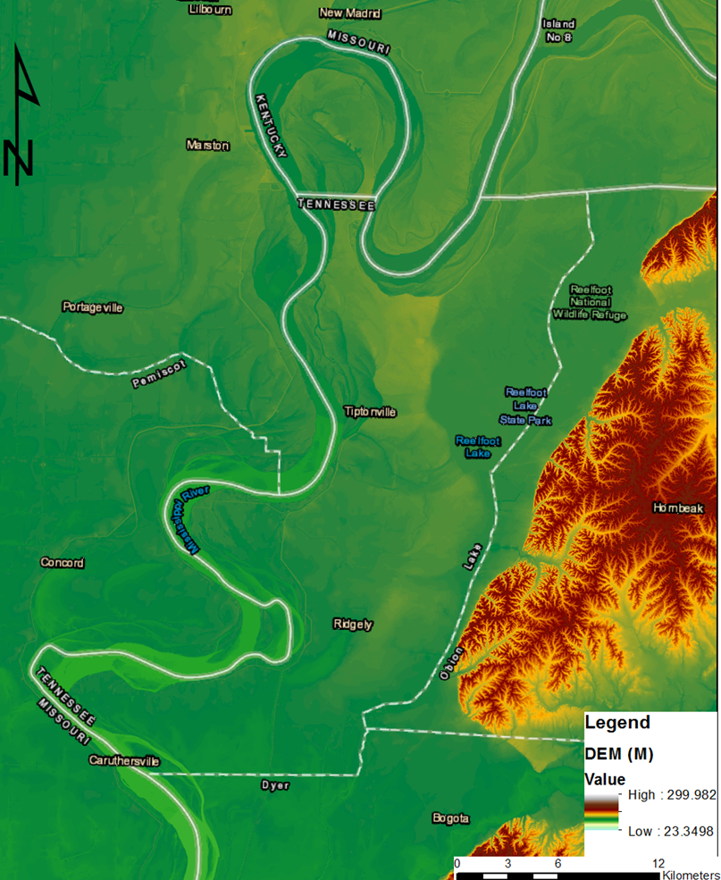
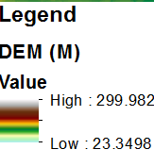
Study Area
Notes:
The immediate study area (within the red box)
Several faults within the immediate study area including:
Both the Axial Fault and the New Madrid North Fault – Dextral sense of motion
New Madrid West Fault (aka Risco Fault) – Sinistral sense of motion
Reelfoot Fault – Reverse, segmented
Geography
Map of Lake County
The entirety of Lake County lies within the MS River floodplain
We have the towns of Ridgely and Tiptonville
Reelfoot Lake
MS River and the Kentucky Bend
Bluffs of Western TN just to the east of the county

Slide 4
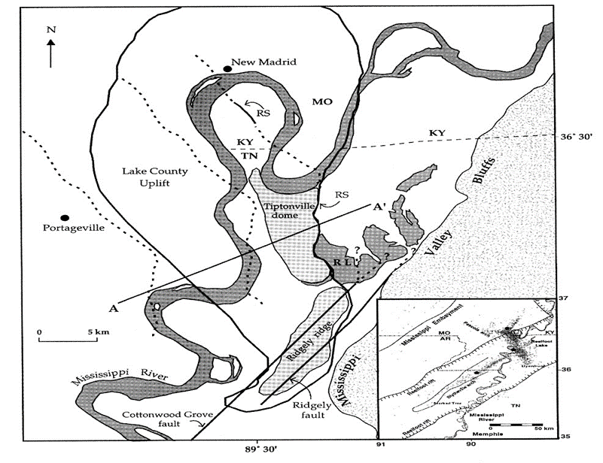
BT-1
Background
BT-2
Modified from Purser and Van Arsdale, 1998
Axial fault
Notes:
The structure of Lake County is shown in this figure
Lake County Uplift (LCU) and its west-bounding backthrust (dashed, BT-2)
Tiptonville dome and its west-bounding backthrust (dashed, BT-1)
Ridgely ridge with its west-bounding Cottonwood Grove fault and its east-bounding Ridgely fault
Axial fault which is defined by ongoing seismicity
East-facing Reelfoot scarp monocline (RS) along the Reelfoot North fault.
Cross-section A-A’ (next slide) cuts across the LCU and Tiptonville dome into the Reelfoot Lake basin just east of the RS (modified from Purser and Van Arsdale, 1998).

Slide 5
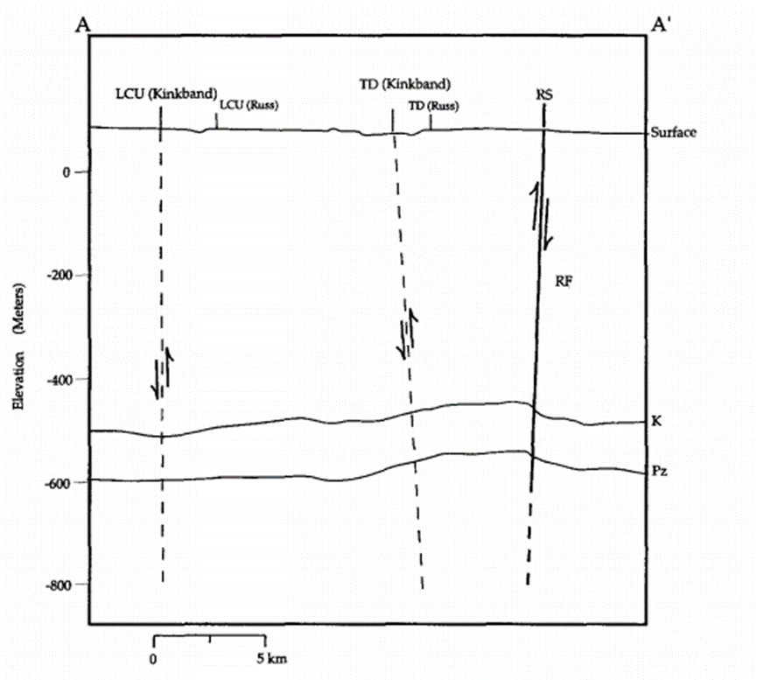
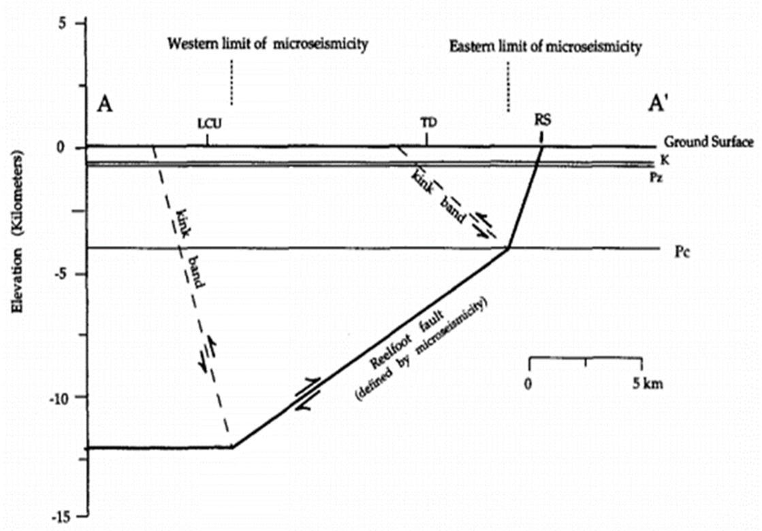
BT-2
BT-1
BT-2
BT-1
Cross Section A-A’ (left) and Fault-Bend Fold model (right) taken from Purser and Van Arsdale (1998)
Notes:
If we take a look at Cross-Section A-A’ from Purser and Van Arsdale (1998), we see that it captures the Reelfoot scarp, BT-1, and BT-2 and shows the Reelfoot Fault as it changes dip at depth (72 SW - > 35 SW), extent of seismicity is where the fault goes horizontal

Slide 6
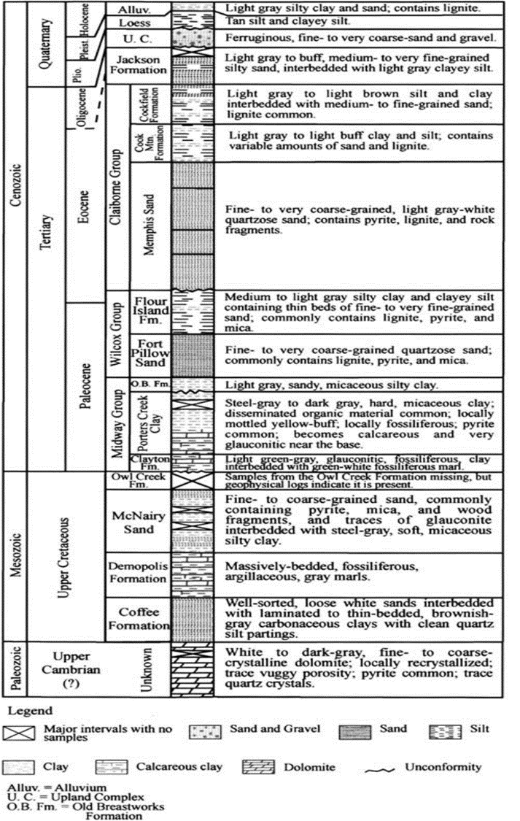
Modified from Crone, 1981
Notes:
Generalized stratigraphic column for the northern Mississippi Embayment
The three major tops used for this project
Top of the Paleozoic
Top of the Cretaceous
Top of the Eocene

Slide 7
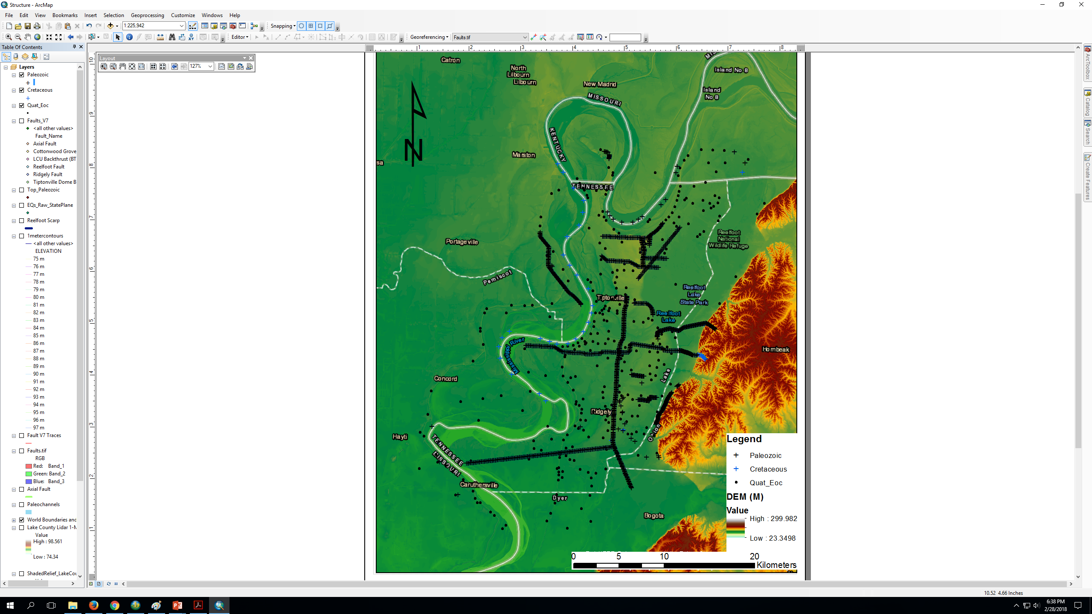
DATA
Notes:
Lignite Logs (Lithology 0-300 ft. depth)
Includes some electrical logs
Phillips Coal Company (now known as North American Exploration, INC)
Water Well Logs
Includes Municipal Wells
Tennessee Department of Environmental Conservation (TDEC)
Oil Exploration Logs
Geotechnical and Engineering Logs
United States Army Corps of Engineers (USACE) and the Tennessee Department of Transportation (TDOT) along with other data providers
Previously interpreted Seismic Reflection Lines

Slide 8
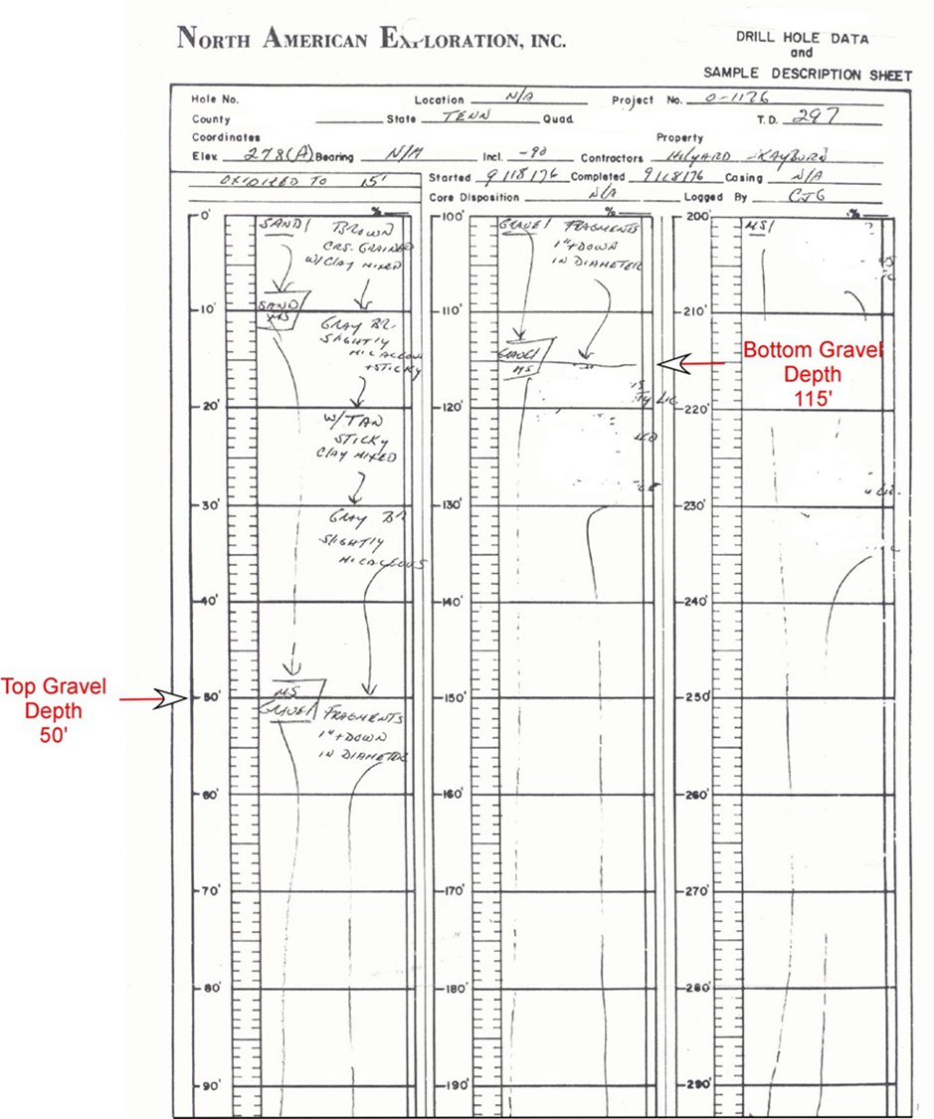
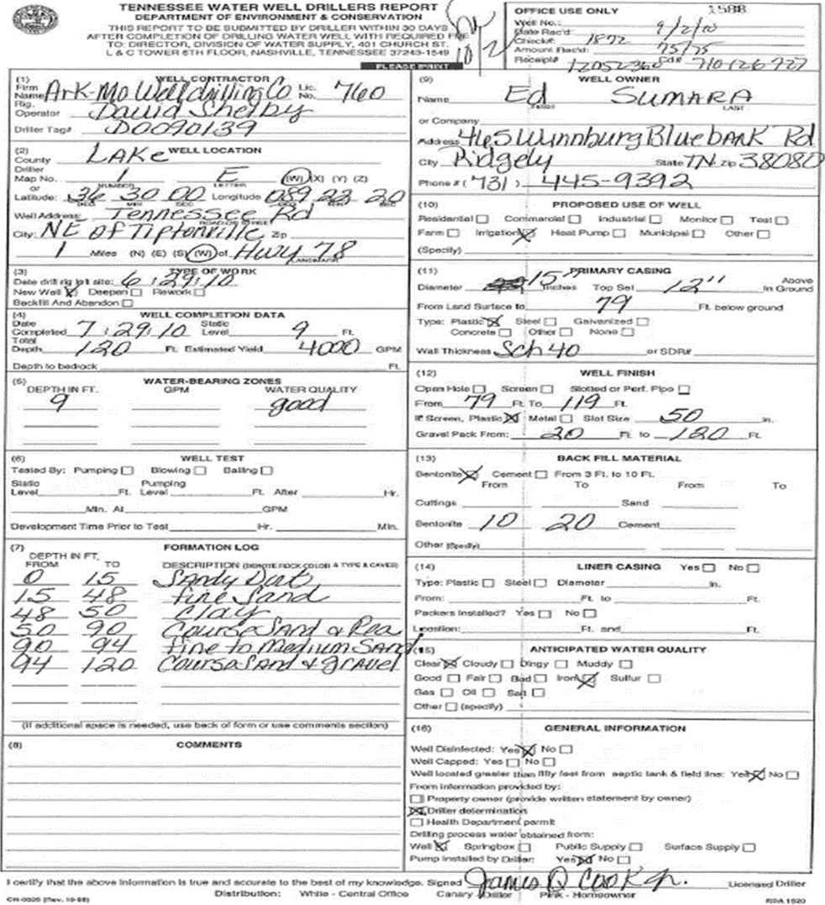
Notes:
Example of a lignite log
Base of the gravel used for Top of Eocene pick
Example of a water well log

Slide 9
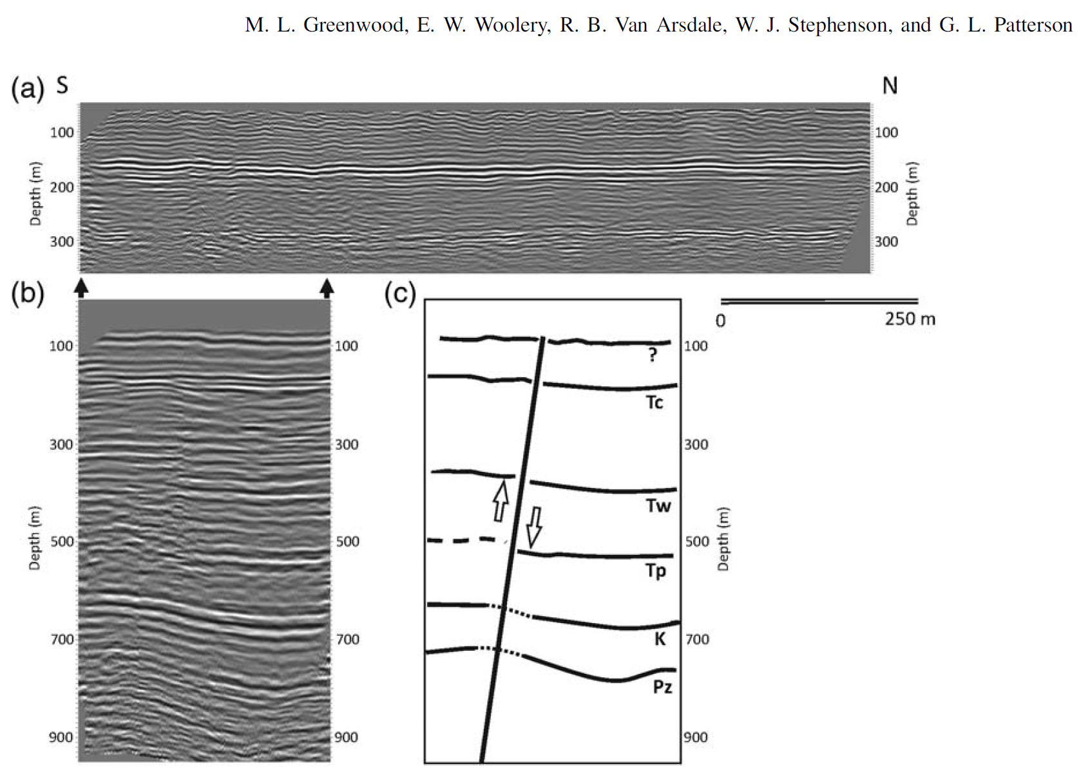
SRF
Greenwood et al. 2016
Notes:
Example of seismic data used in the study from Greenwood et al. 2016
Geologic interpretation of seismic line B with lines representing stratigraphic tops.
K, Cretaceous
Pz, Paleozoic.

Slide 10
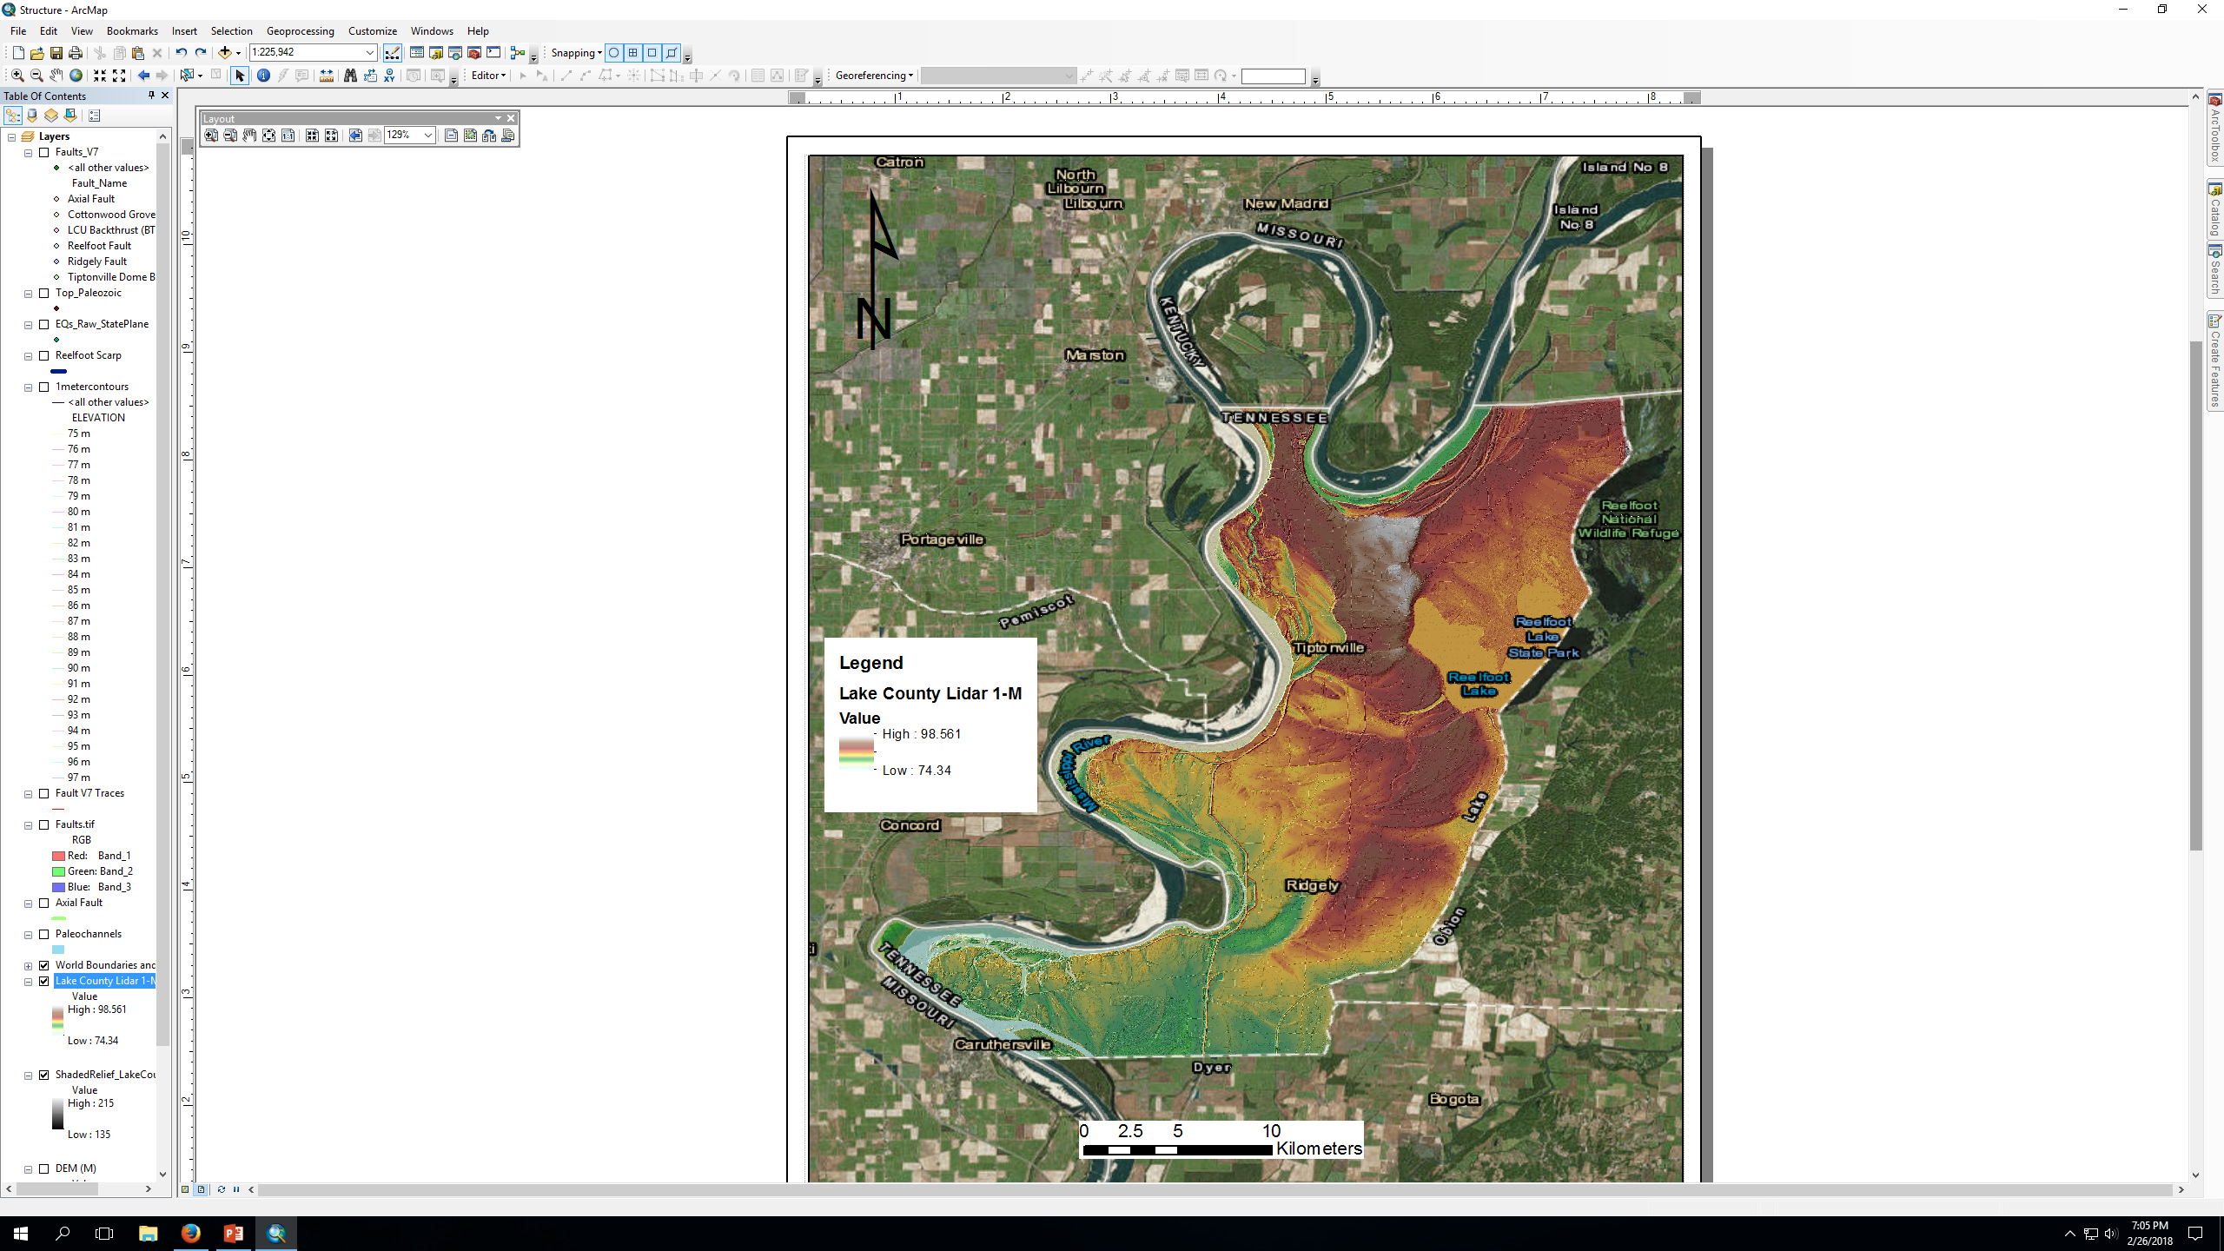
Other Data
Lidar 1-m resolution
USGS
Aerial Photography
USACE
Soil Maps
United States Department of Agriculture (USDA) National Resource Conservation Service (NRCS)
Notes:
Other types of data used include:
Lidar
Aerial Photography
Soil Maps
1-meter resolution Lidar draped over shaded relief map

Slide 11
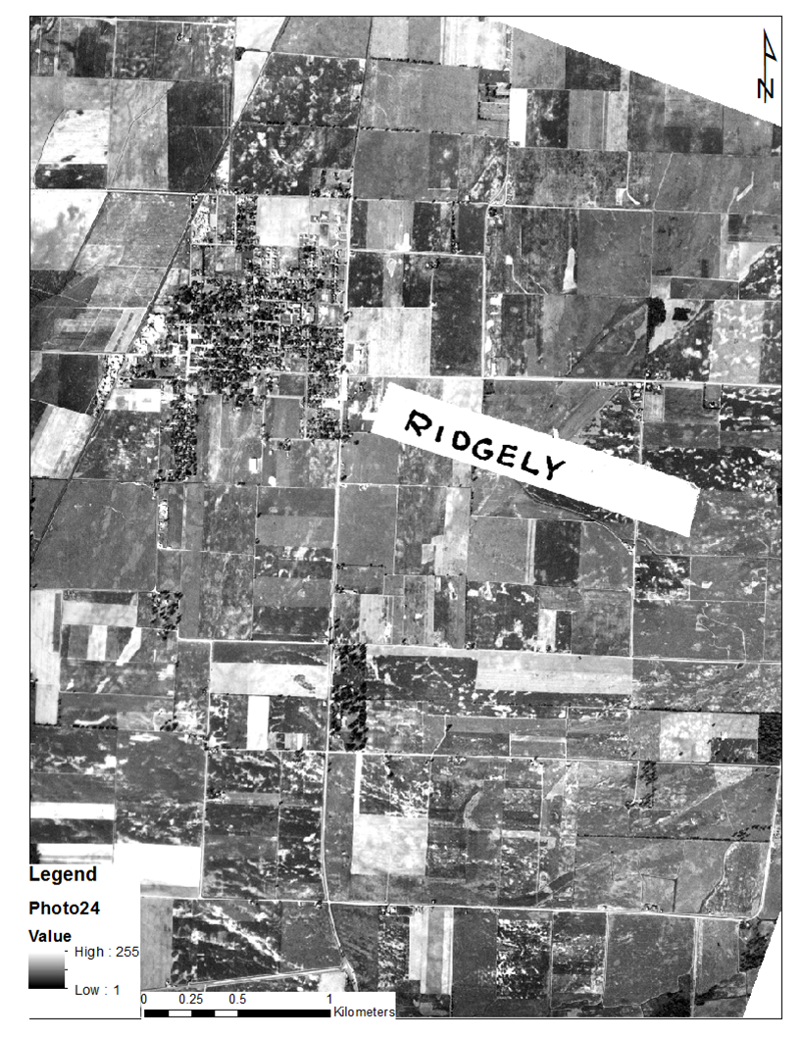
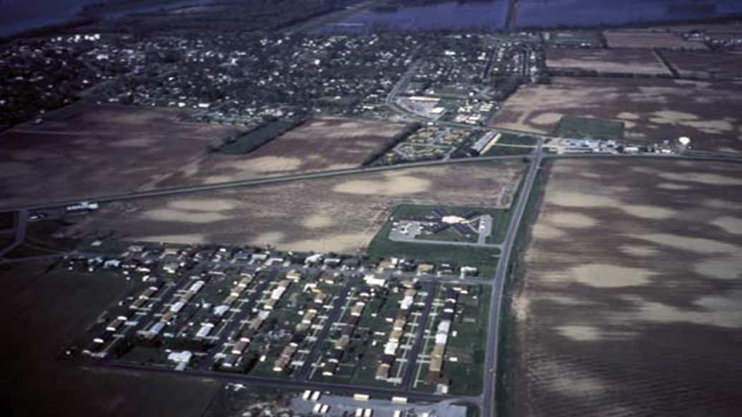
Stewart and Knox, 1995
Notes:
Aerial Photography
(Left) Town of Ridgely, TN, with sand blows and fissures to the southeast seen as light colors against the darker ground layer. This contrast is due to white sand that is overlying darker gray to brown clayey and silty soil. The pattern of the sand blows and fissures follows the extent of an abandoned meander of the Mississippi River in a southwest to westerly direction (Aerial Photograph taken in 1957, USACE)
(Right) Liquefaction near the town of New Madrid Missouri (Stewart and Knox, 1995).

Slide 12
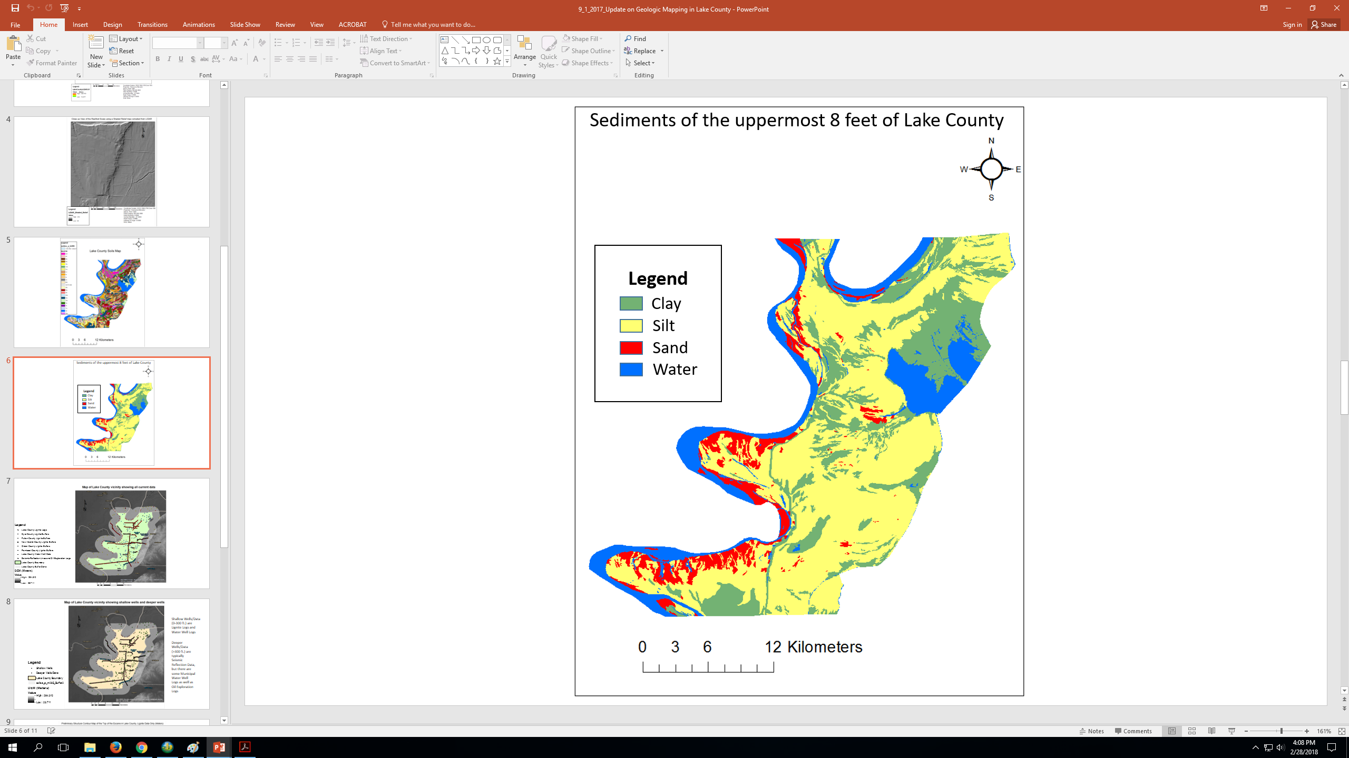
Geologically Interpreted Soil Map of Lake County
The purpose of this project is to provide geological information to seismologists and engineers for the purpose of developing seismic hazard maps.
Tiptonville
Ridgley
Notes:
Soil Maps from the NRCS in which I have reclassed soil units into a sediment map based off of the highest % lithology within each of the original soil units
Clay - Overbank
Silt - Overbank
Sand - Crevasse Splays

Slide 13
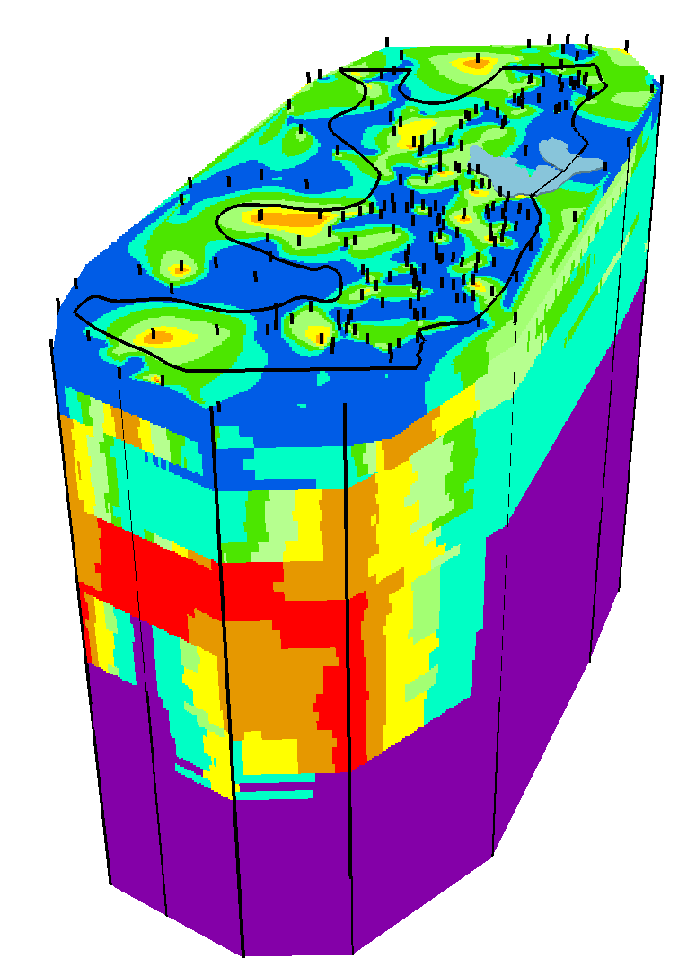
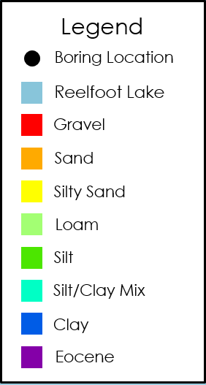
3-D Lithological Model
Results
N
3-D Lithological Model of the Quaternary to the top of the Eocene
0-300 ft. in 5-ft. intervals
0
150
Depth (ft.)
300
Notes:
3D Lithological Model of the Quaternary
Depths from the surface down to 300 ft. incrementally split up into 5-ft. intervals.
Colors (Red, Orange, Yellow) representing the coarse grain sediments such as gravel and sand
Colors (Green, Blue) representing fine grain sediments such as clay and silt
Color (Purple) representing the Eocene

Slide 14
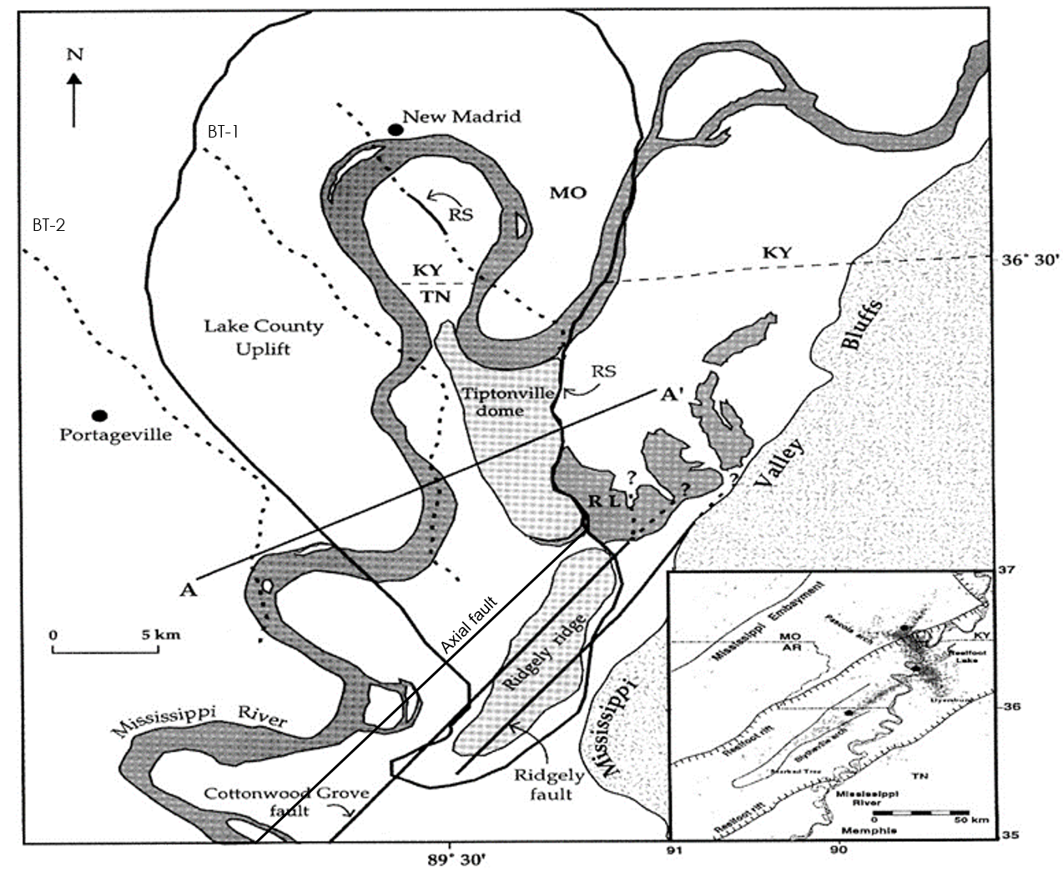



AF
CGF
RF
Notes:
Shown in the upper lefthand corner is the structure contour map for the top of the Eocene with the data distribution represented as dots, lighter shades of gray represent higher elevations while the darker shades represent lower elevations
On the right-hand side, we introduce the faultlines to get our general structure
Discuss the extensions of BT-2, BT-1, and RS
Ridgely Ridge and Tiptonville Dome (Horsts)
Reelfoot Lake Basin and unidentified graben SW of Ridgely Ridge (Grabens)

Slide 15



Notes:
Ridgely Ridge and Tiptonville Dome more apparent in deeper section
General sloping to the southwest
Graben to the southwest of Ridgely Ridge

Slide 16

Results
RS
Notes:
Ridgely ridge and Tiptonville dome once again expressed at depth
Graben to the southwest of Ridgely Ridge

Slide 17
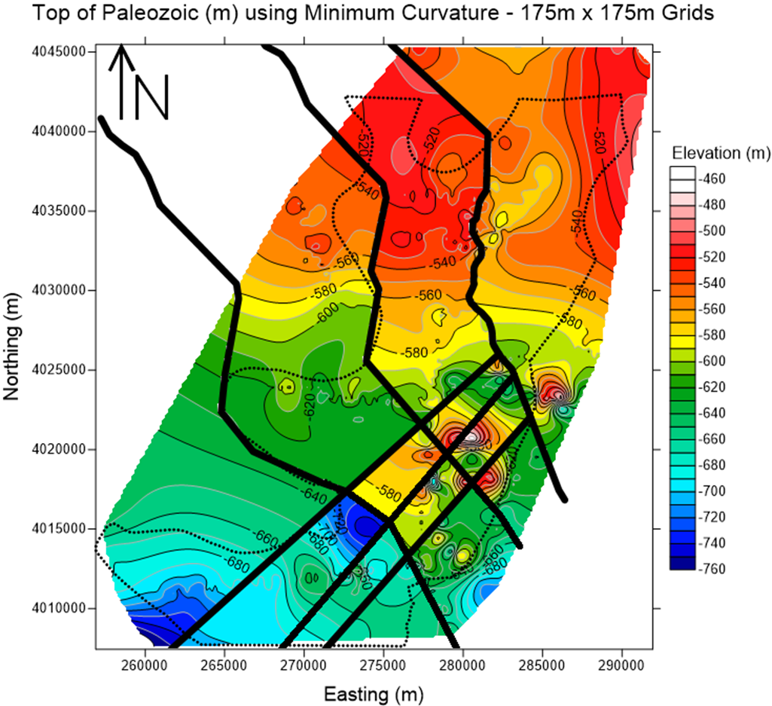
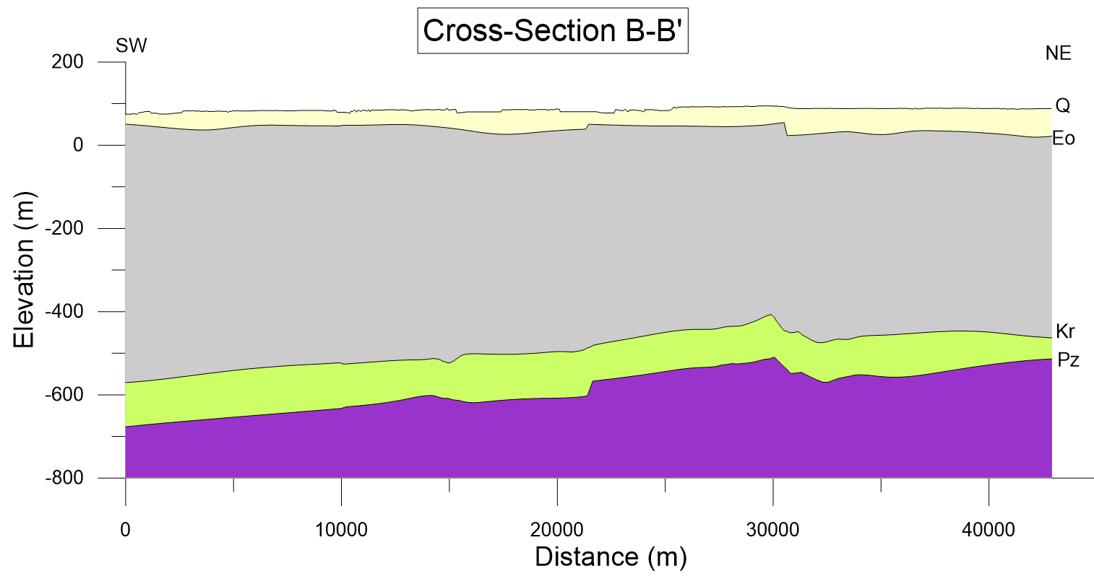
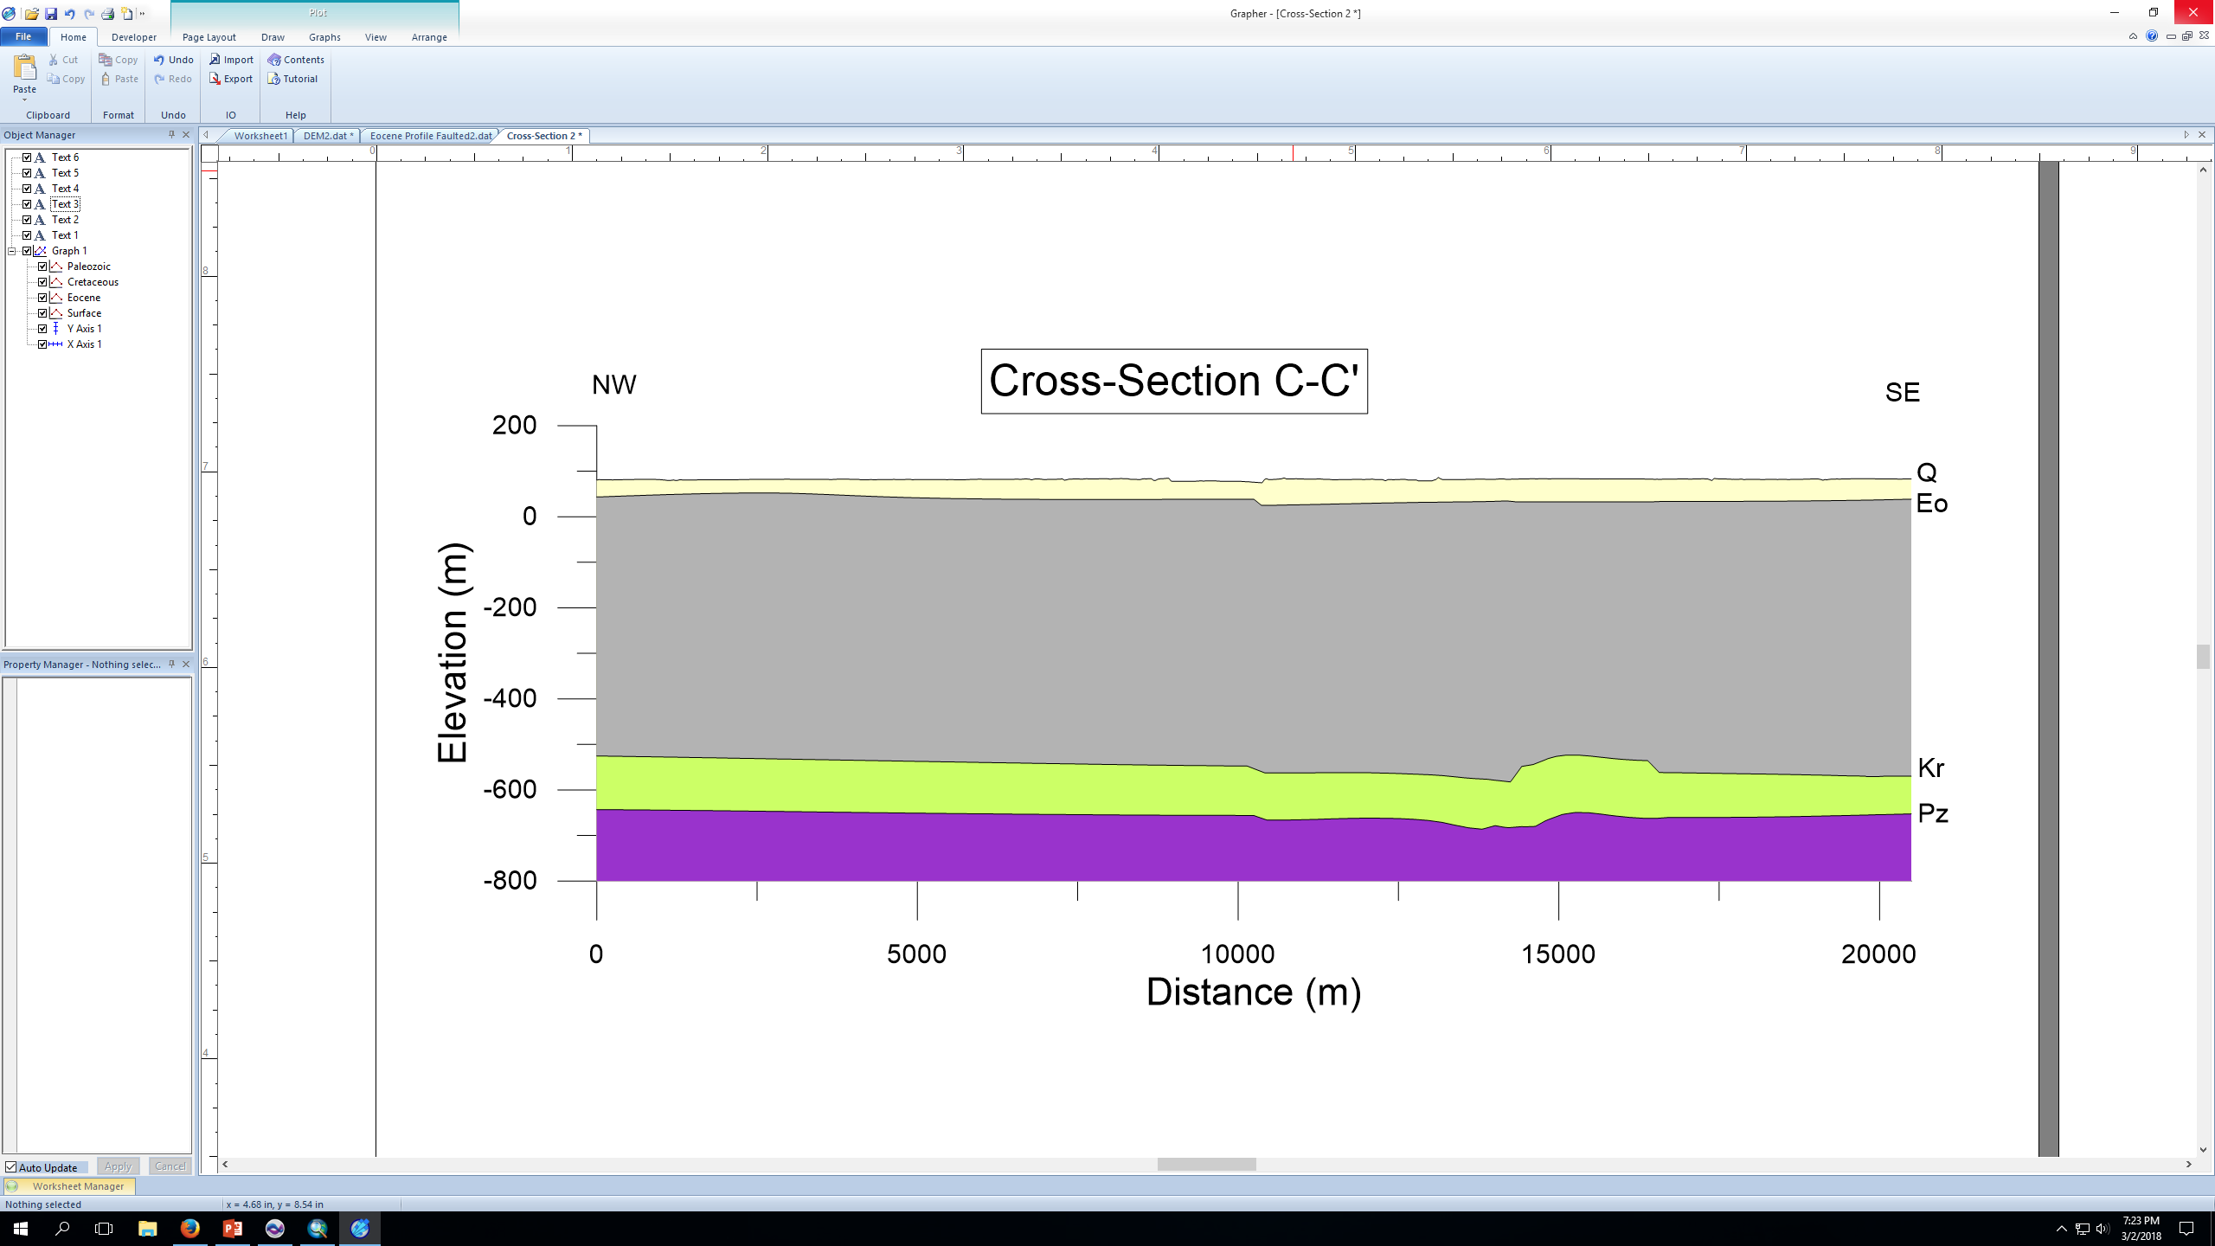
BT-2
BT-1
RS
B’
V.E. = 20
AF
CGF
RF
C
RS
B
BT-1
AF
CGF
RF
C’
BT-2
V.E. = 10
Notes:
Two Cross-Sections B-B’ and C-C’
Cross-Section B-B’ captures the effects of BT-2, BT-1, and the Reelfoot scarp
Tiptonville Dome high, displacement through the Quaternary
We do not feel that the data resolution is sufficient enough to resolve BT-2’s status
Cross-Section C-C’ captures the effects of the Axial Fault, Cottonwood Grove Fault, and the Ridgely Fault
Ridgely Ridge high, no apparent influence on top of the Eocene

Slide 18
Conclusions
What we conclude:
The data resolution is not sufficient enough to determine the status of BT-2 as we do not see apparent vertical displacement of the geologic formations at the location at its projected location.
There is a previously unidentified graben structure trending SW that is adjacent to the Ridgely ridge horst according to the cross-sections and to the structure contour maps.
Notes:
Two Cross-Sections B-B’ and C-C’
Cross-Section B-B’ captures the effects of BT-2, BT-1, and the Reelfoot scarp
Tiptonville Dome high, displacement through the Quaternary
We do not feel that the data resolution is sufficient enough to resolve BT-2’s status
Cross-Section C-C’ captures the effects of the Axial Fault, Cottonwood Grove Fault, and the Ridgely Fault
Ridgely Ridge high, no apparent influence on top of the Eocene

Slide 19
Any Questions??
Acknowledgements
Housing and Urban Development National Disaster Resilience Competition(HUD NDRC) Grant #B-13-DS-47-0002 for funding the project work and my thesis.
Luke Ewing of the Tennessee Department of Environmental Conservation (TDEC) for providing access to the water well logs for Lake County.
Dr. Arellano for providing the geotechnical and engineering logs for Lake County and surrounding counties.
To the members of the HUD project group for the assistance and insight provided throughout the project’s progression.
The Center for Applied Earth Science and Engineering Research (CAESER) for providing access to computers, lithological logs, and electrical logs for the project.
Notes:
I would like to thank the Housing and Urban Development (HUD NDRC) for funding this research
Are there any questions?

