Slide 1
MAKING AND ASSESSING A SHORT VIDEO TO TEACH UPPER DIVISION UNDERGRADUATE GEOSCIENCE MAJORS ABOUT THE PERMIAN BASIN OF TEXAS AND NEW MEXICO
Ning Wang¹, Robert J Stern¹ and Lowell Waite²
1.The University of Texas at Dallas
2.Pioneer Resources
Notes:
Good Morning, I am Ning, I am a graduate student at UT Dallas. I am working with Dr. Robert J Stern on geoscience video education research. Today, I am going to talk about our most recent research - making and assessing a short video to teach our upper division undergraduate students about Permian Basin. My presentation would start with our motivation and philosophy to design geoscience videos. After that, I would show you the video we made and our assessments of its educational effectiveness.

Slide 2
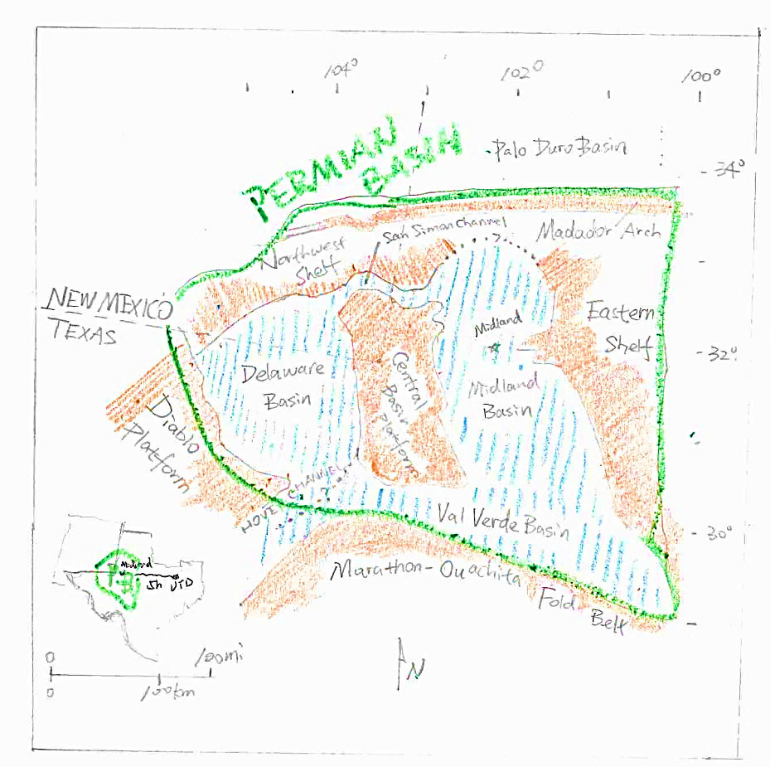
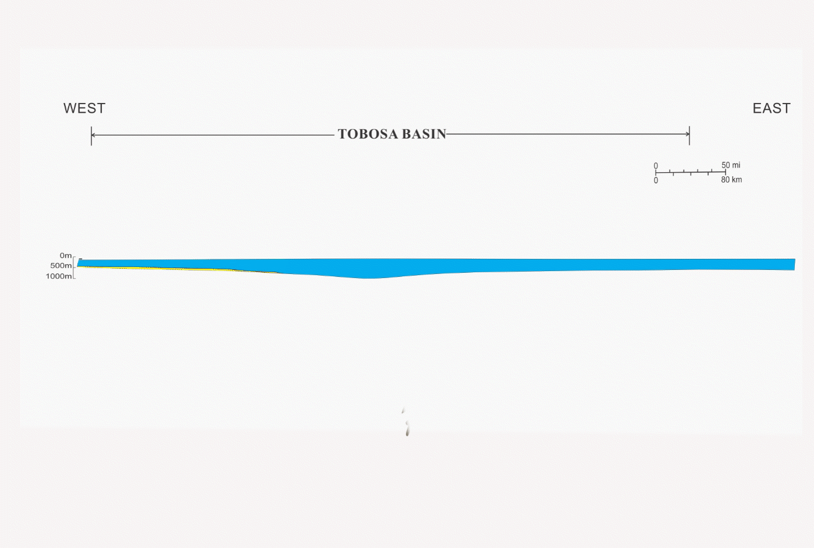
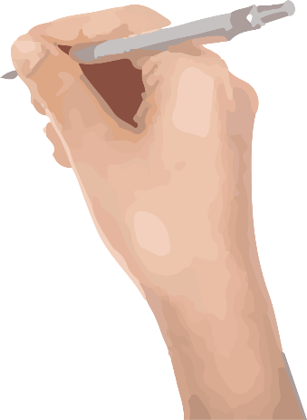
Motivation
Geology of Permian Basin Class
My Class Research Project
Notes:
My motivation of doing this research started from a graduate class given by Dr. Stern and Lowell Waite, called Geology of Permian Basin. In this class, except coursework, we were also asked to do a class research project on a topic related to the geology of the Permian Basin. And my topic is to make and assess a geoscience educational video about Permian Basin.

Slide 3
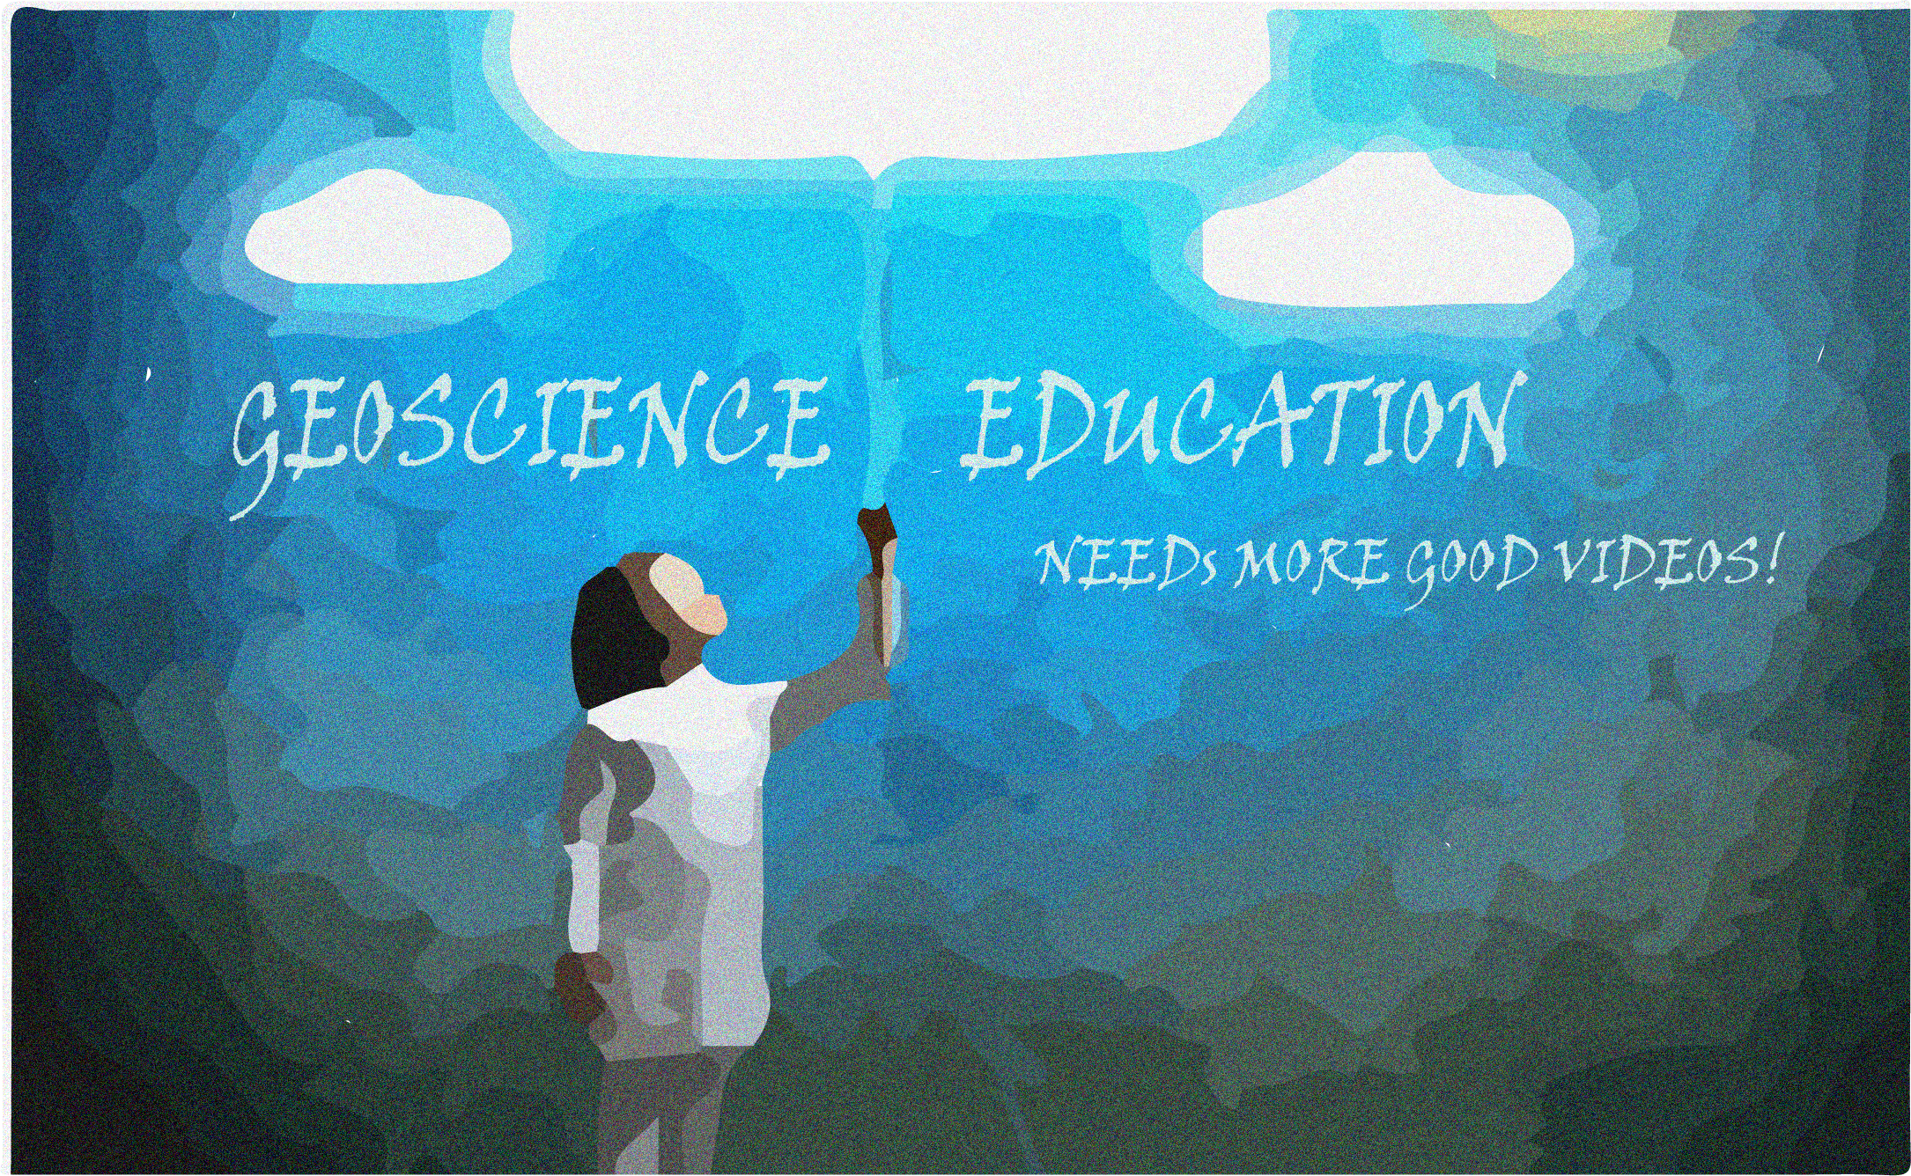
Video Bloom
Good Video Shortage
Needs to Change
Permian Basin Video
Notes:
So why do we want to make geoscience videos? Video is not a new thing, especially for the current generation of undergraduates, they grew up with videos. Today, Three Billion Videos are watched on YouTube every day, and 300 hours videos are uploaded to YouTube Server every hour. It is an amazing number. However, In spite of this great demand for videos and the fact that it is easier than ever to make videos, there are far too few high-quality geoscience educational videos that we want to use in the classroom. This needs to change. (2nd click). And we try to make such a video on a topic of increasing importance to the south-central area: The Permian Basin.

Slide 4
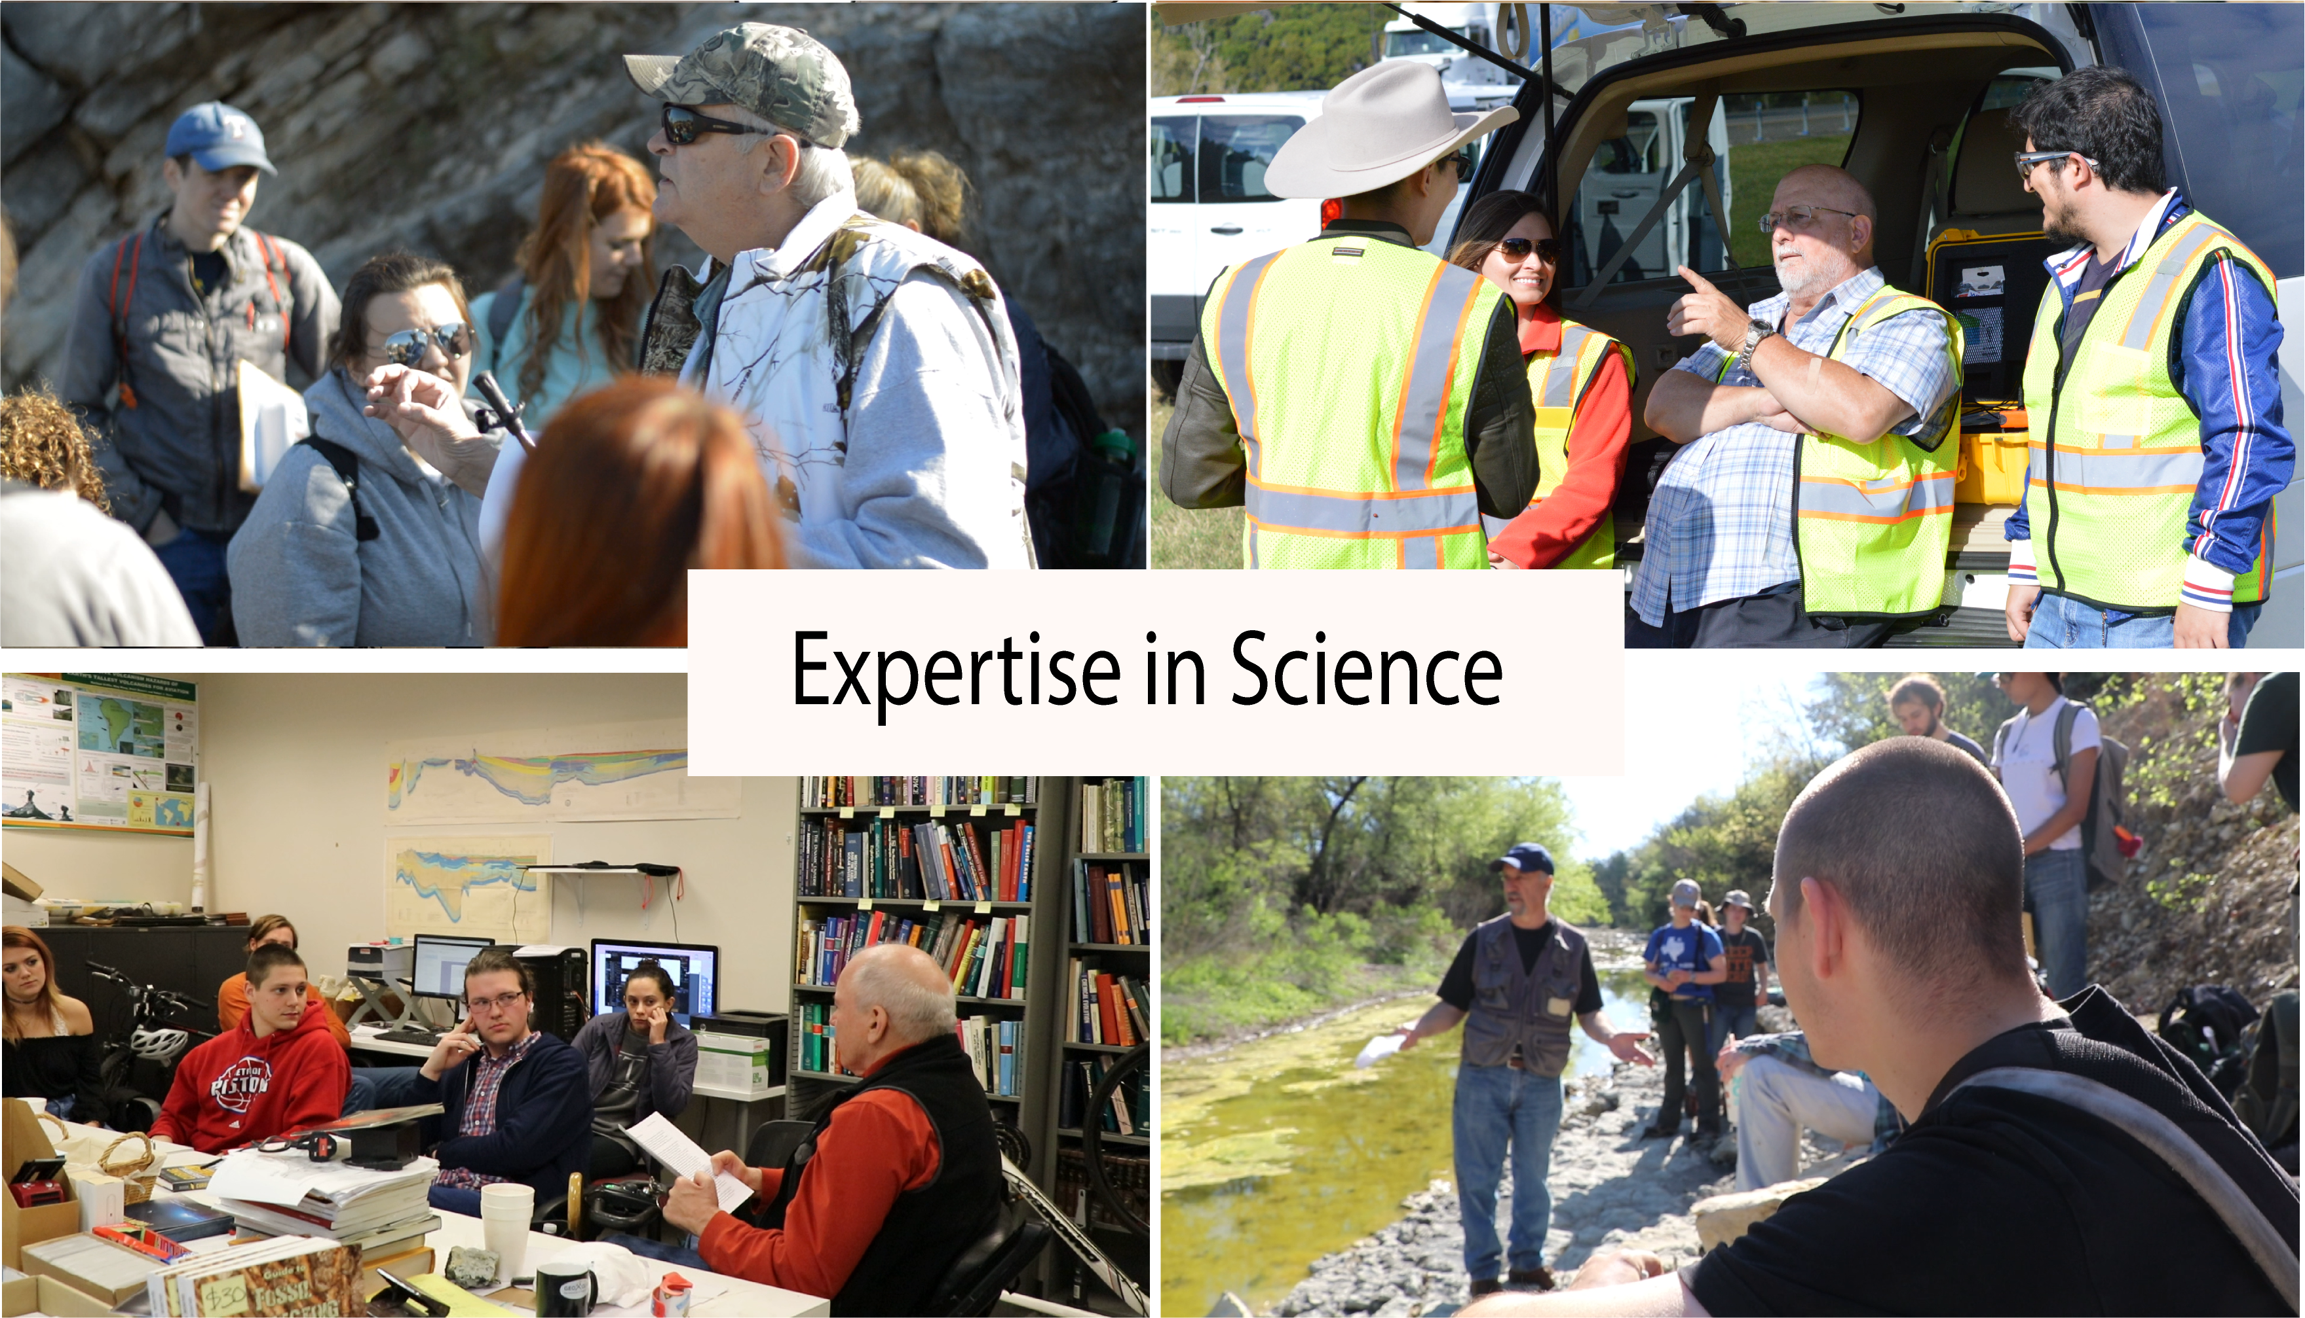

Slide 5
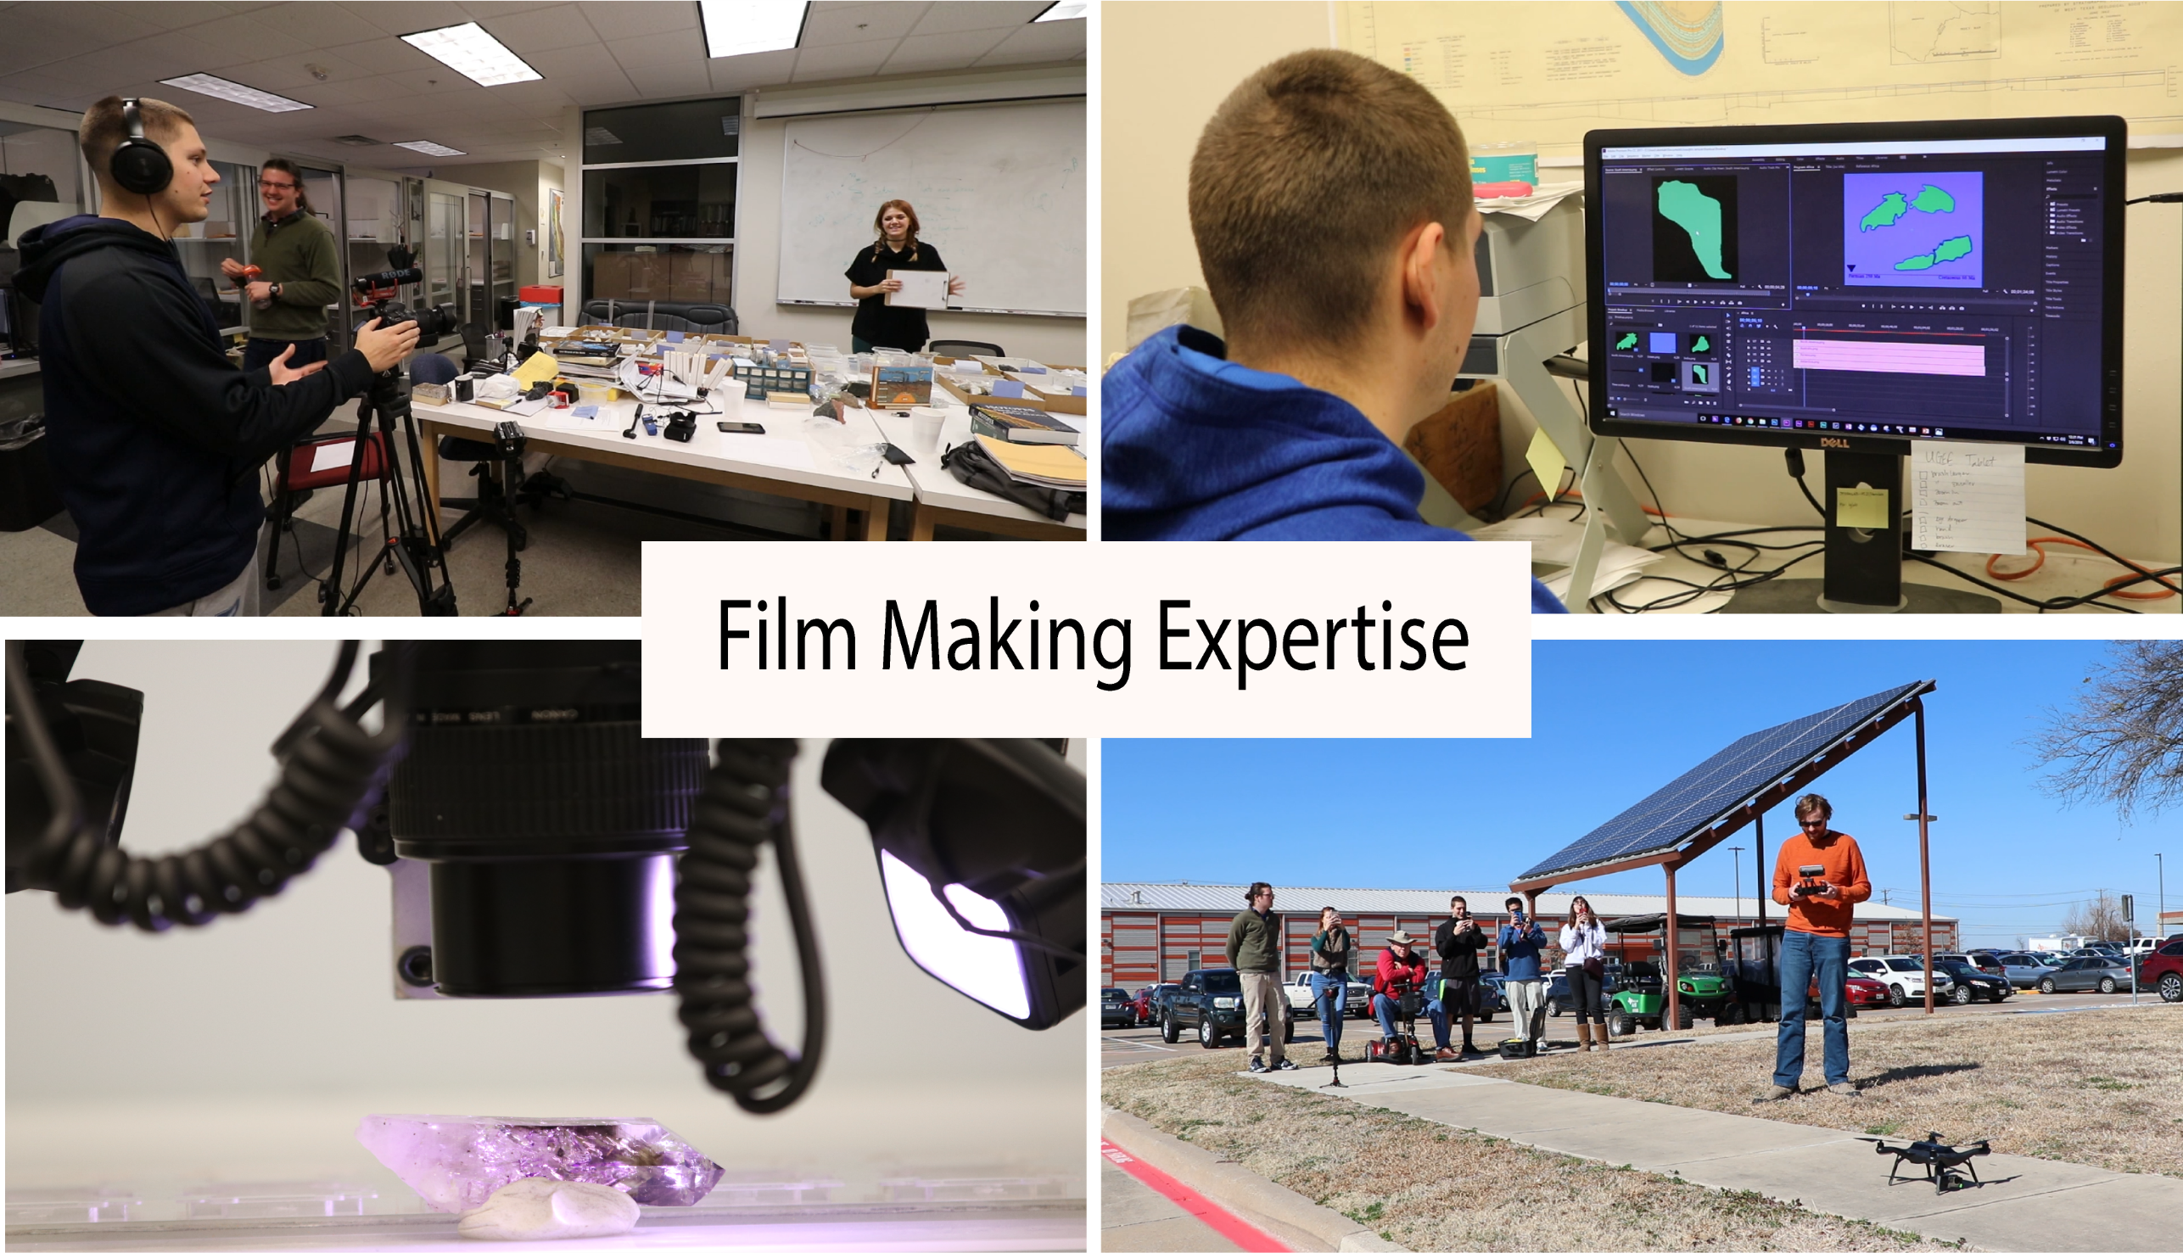

Slide 6

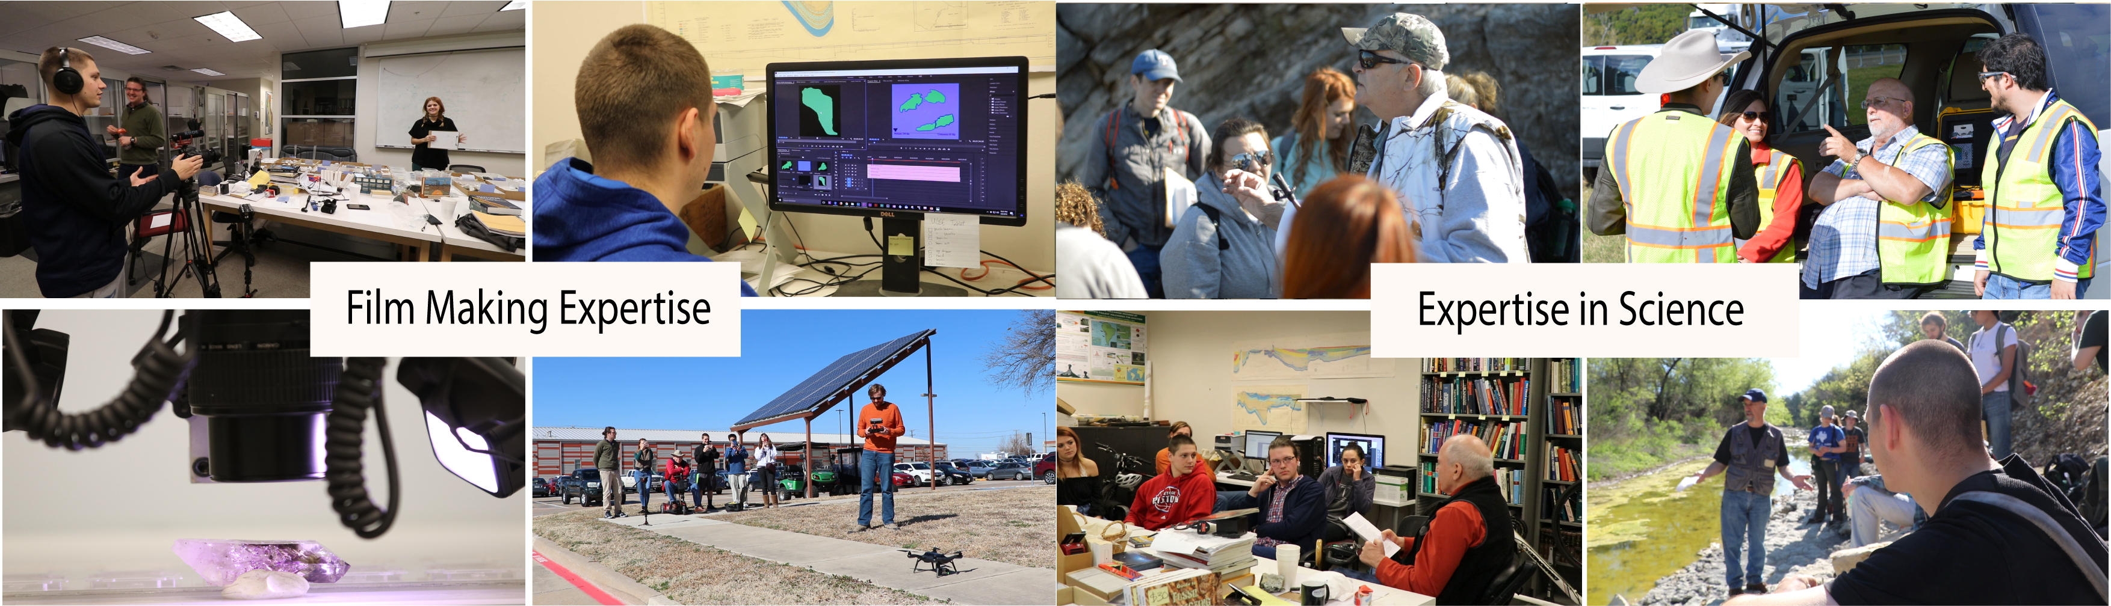
Generating Good Geoscience Ed Videos Require Two Kinds of Expertise
Graduate Students (Bridging Role)
Undergraduates
(making Video)
Professors
(Provide Content)
Notes:
So how can we make good geoscience educational videos? We believe it requires two different kinds of expertise: (1st click) the technical expertise in video making and (2nd click)expertise in the topic. (3rd click)Very few people have both sets of skills. (4th click)For this reason, it is very advantageous to make video-making teams of students and professors: they can work together on choosing the topic and working out the story to be told. With the professor providing most of the content and the students making the video. (5th click) In this process, Graduate students can play a bridging role between these two teams.

Slide 7
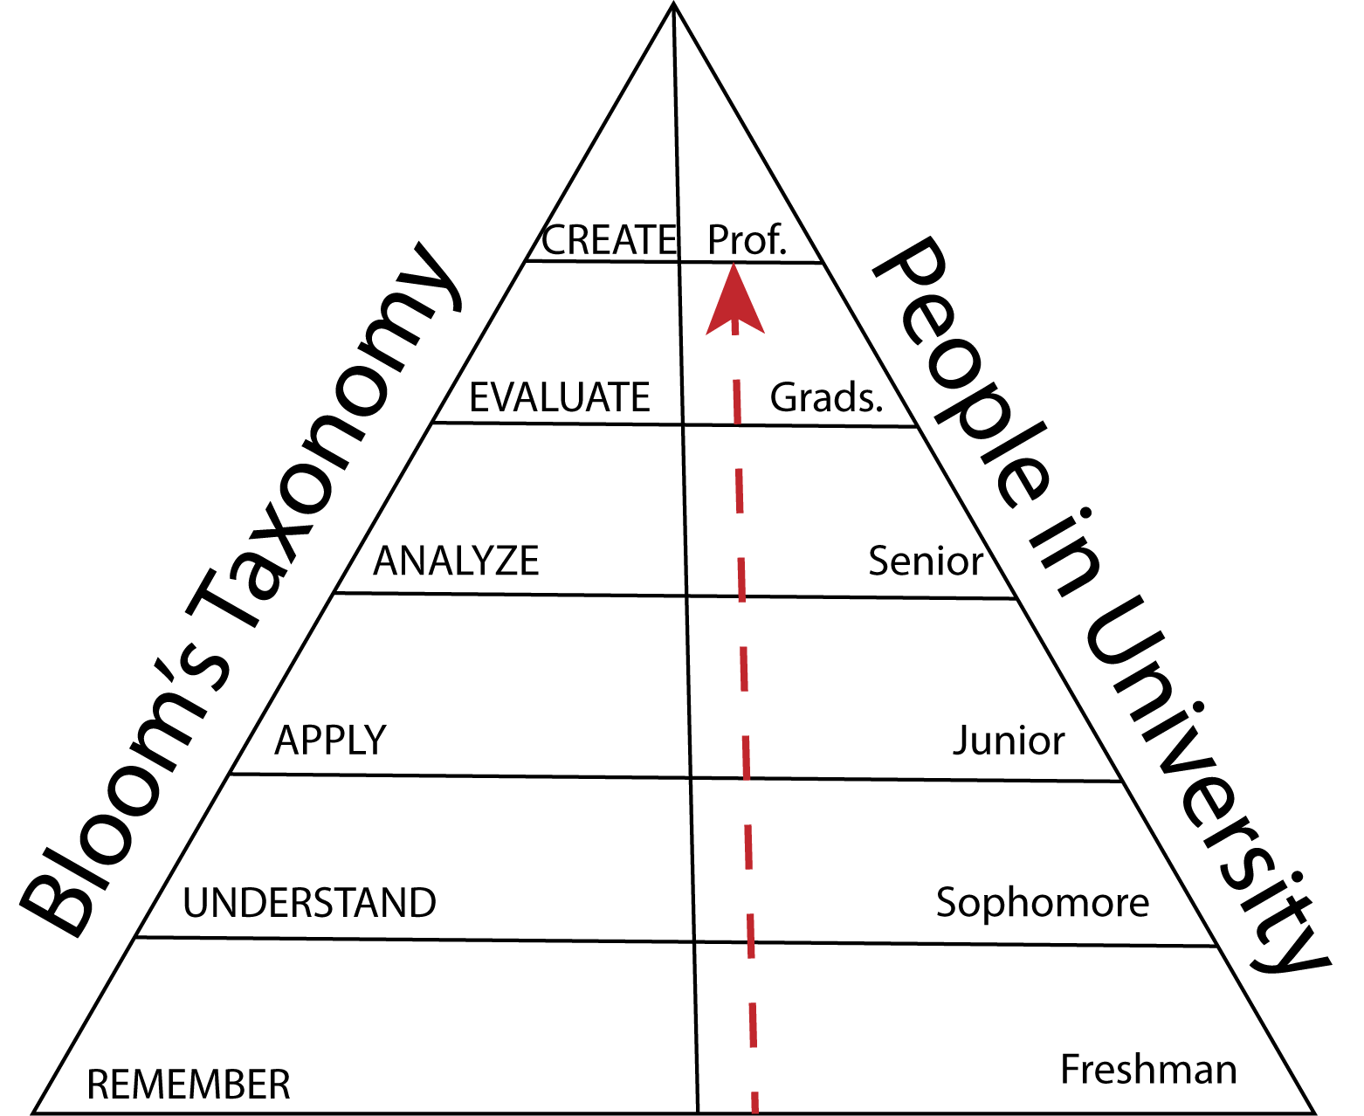
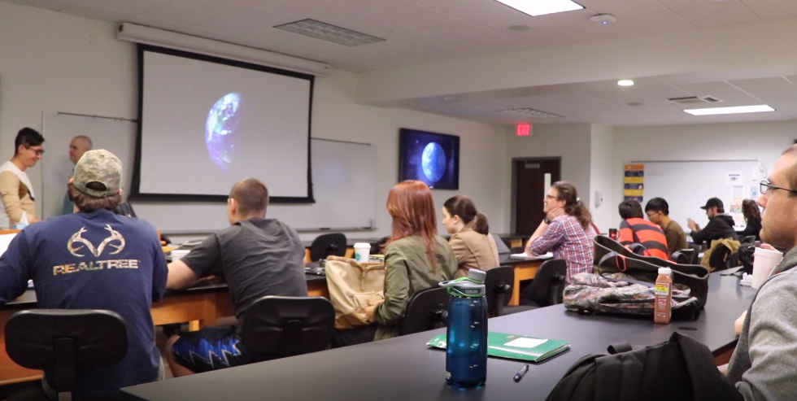
Design Videos with Certain Audiences in Mind
Sediments and Stratigraphy Class
There is a vast difference between material appropriate for
freshman Geology 101 and upper division Geoscience major audiences
Notes:
Another key in our philosophy to make good geoscience educational video is to focusing on certain audience. For university professor-student teams, it makes most sense to target the undergraduate audience. But one thing we need to keep in mind is that there is a vast difference between material appropriate for a freshman Geology 101 audiences and a junior or senior level geoscience major audiences! These differences need to be kept clearly in mind for a successful geoscience educational video to be constructed. In our case, the video we made was designed for an audience of junior- or senior-level geoscience major course in sediments and stratigraphy. They should have essential background about geologic time and sedimentary belts.

Slide 8
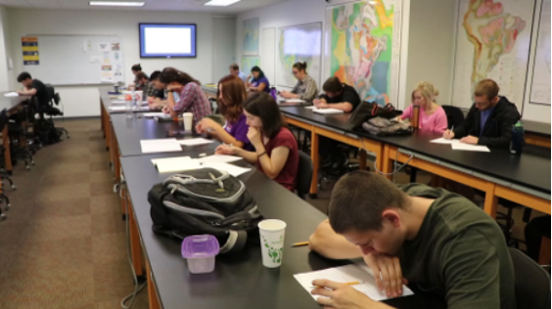
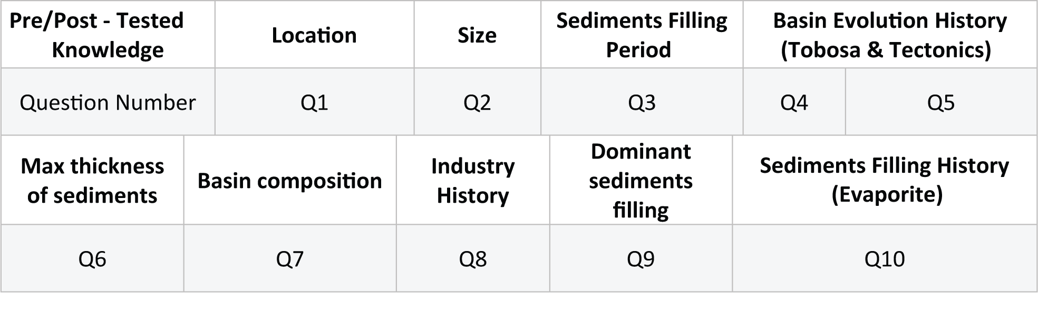
How much do they know Permian Basin?
Pre-Video Test (Oct, 2017)
Notes:
So, to probe how much our target students know about the Permian Basin, we gave a Pre-video test with 10 questions about the Permian Basin. (2nd click)There are 19 students in the class and 16 took the pre-video test. Only one student got a score higher than 60, and only four student got higher than 50. (3rd click). An interesting fact is that Only 2 students know the location of the Permian Basin. So we know they don’t know much about the Permian Basin and we start to generate our Permian Basin video. It took us about one month to finished the video and we showed the video to the same class one month after the pre-video test.

Slide 9
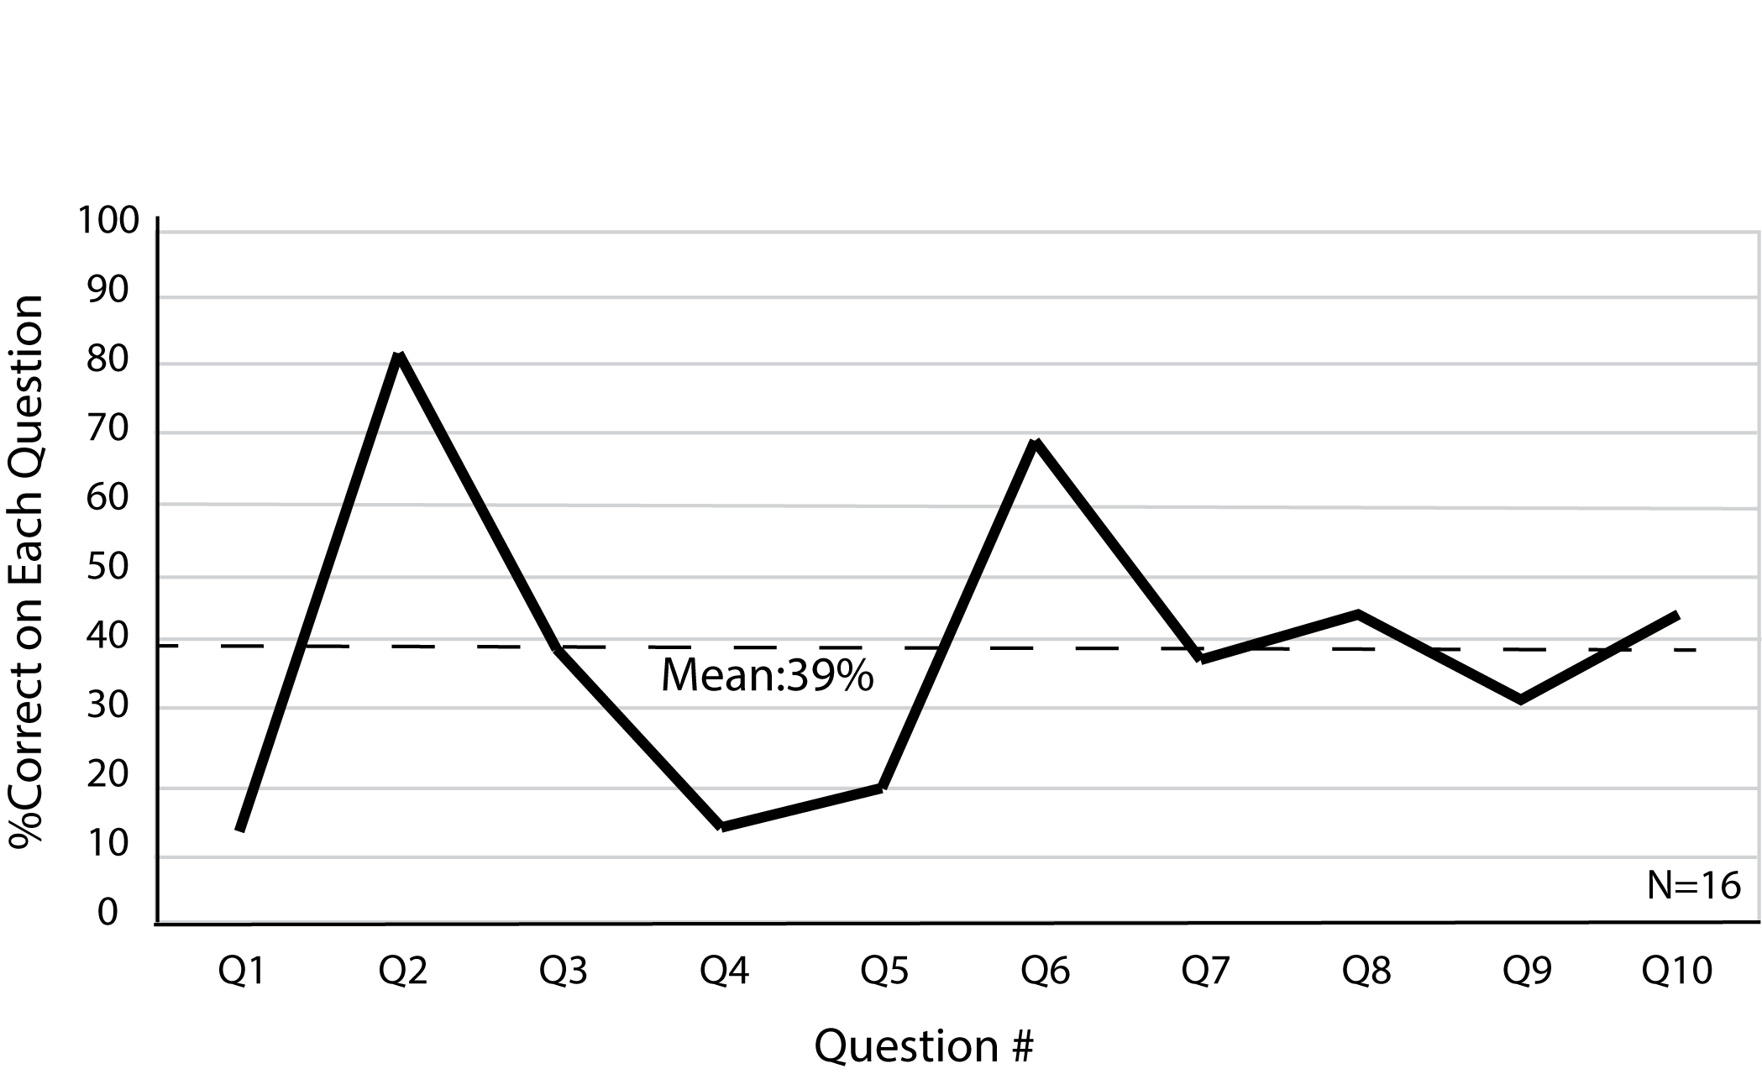
Pre-Video Result

Slide 10
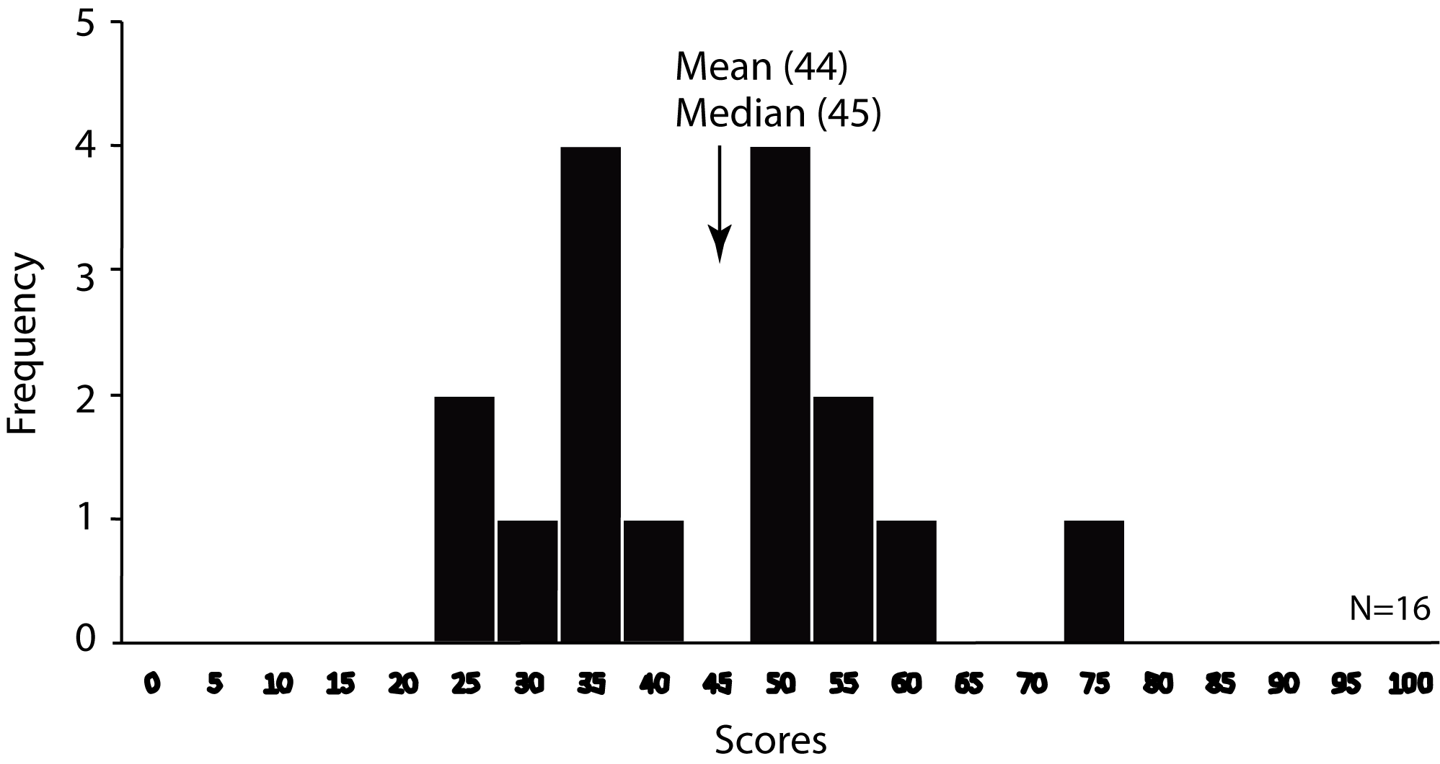
Pre-Video Result

Slide 11
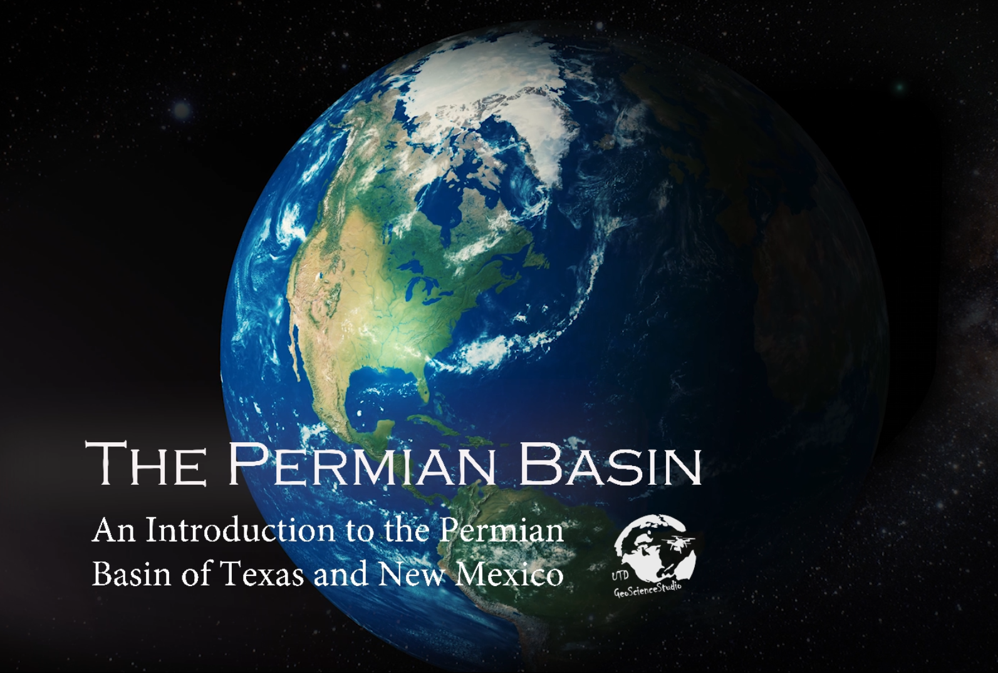
Search ‘UTD GSS Permian Basin’
On Google or Youtube to watch the video.
Notes:
Now I want to invite you to watch the video with me.

Slide 13
Notes:
Right after watching the video, the students took the same test again. The class showed a big improvement. The total mean increased from 39% to 75% correct on each question. It means in the post-video test 75% of the whole class students got correct answer on each question on average. (1st click)They got significant increased scores on three topics (location, major tectonic event, and dominant sediments in Permian basin), and almost no change happened on three other topics . (size, thickness of sediments and evaporite in Permian Basin). So why did some knowledge they learned so well from the video while some others not?

Slide 14
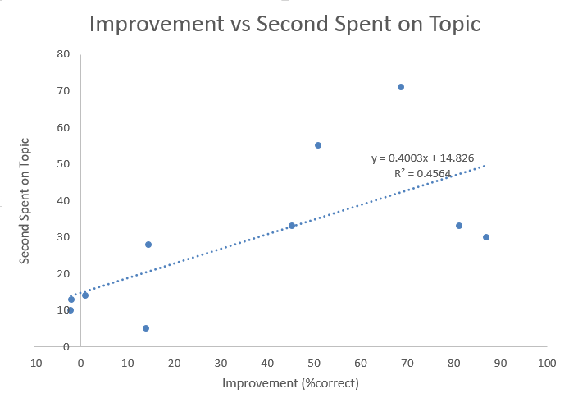
Improvement vs Seconds Spent on Topic
30S or More
Seconds Spent on Topic
Interesting Trend
30S or Less
Improvement (%correct)
Notes:
One thing we think is pretty interesting is the relationship between the time we spent on each knowledge in the video and the improvement of students’ learning. The figure shows that all topics we showed more than 30s in the video, there would be at least 45% correct rate increase on the topic. And the topics we showed less than 30s, no more than 15% correct rate increased. The correlation coefficient r square is 0.46, not strong. But we think there may be some relationship between the time we spent and students’ improvement on certain types of the questions. Such as the topics that students having enough prior knowledge to understand the new knowledge. This gives us some insights for our future research, and we want to do more work to understand this relationship in the future.

Slide 15

Use of geoscientific videos can greatly improve student learning!
Learn to make geoscientific videos,
Use them in the classroom,
Share them with other educators.
Search ‘UTD GSS’
On Google or Youtube to watch our videos.
Notes:
Our experience with the Permian Basin video shows that use of geoscientific videos can greatly improve student learning. We encourage you to learn to make geoscientific videos, use them in the classroom, and share them with other educators. The video technology development has already given a powerful tool and a new way to all researchers and experts to provide their insights to the larger geoscientific community. We have established Geoscience Studios at UTD and are seeking cooperation with projects, feel free to contact us and visit our website.
If you want to find us, you can search ‘utd gss’ on google and you would find our website there.

