Slide 1
WHAT WAS BETWEEN THE YUCATAN PENINSULA AND THE OUACHITA MOUNTAINS AT THE END OF THE PALEOZOIC?: HISTORIES OF PRESENT STRUCTURES OFFER CLUES
Gary L. Kinsland
University of Louisiana at Lafayette

Slide 2
A few years ago satellite gravity became available which imaged the oceanic spreading centers in the Gulf of Mexico, demonstrated how the Yucatan Peninsula rotated away from Laurentia and located the position of the Peninsula prior to rifting. The pre-rift location of the northern edge of the Peninsula was about 300 km (450 km) from the early Paleozoic rift passive margin of southern Laurentia in Arkansas. What lay in that gap at the end of the Paleozoic?: 1) portions of the Peninsula, 2) island arc complexes, 3) micro-continental terranes, 4) thickened oceanic crust (ophiolites) or 5) some combination of the above.
The Sabine Uplift, Angelina-Caldwell Flexure, LaSalle Arch and the Monroe Uplift are structural features which lie in the area of the “gap” stretching from northeastern Texas across northern Louisiana to northwestern Mississippi. From the early Mesozoic to the present these features have complex histories of structural activity which are not easily explained with typical plate tectonic concepts. Recent understanding that dynamic topography, caused by the foundering of the Farallon Plate and of the Hess Conjugate (eastern portion of a Pacific spreading center volcanic accumulation which split into the Hess Rise on the Pacific Plate and its conjugate on the, now subducted, Farallon Plate), has strongly influenced elevations in the eastern United States, may offer explanations for the complex structural histories. It is likely that these explanations will contain clues to what lies in the “gap.”

Slide 3
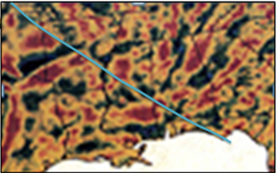
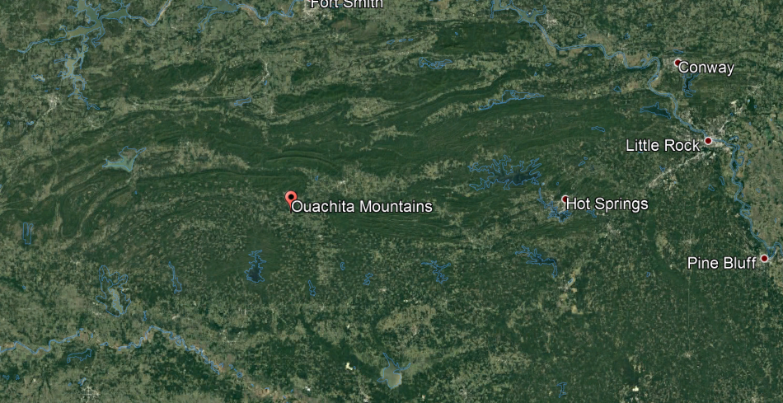
Sequence of events in the Northern Gulf of Mexico Basin (NGoMB)
1. Late Precambrian rifting: Rift Passive Margin in Arkansas…transform margin forming northeastern boundary of the NGoMB
Interpreted Transform Boundary
Rift Passive Margin Signature
Filtered Gravity Hildenbrand et al. (1982)
2. Late Paleozoic Orogeny: Ouachita Mountains

Slide 4
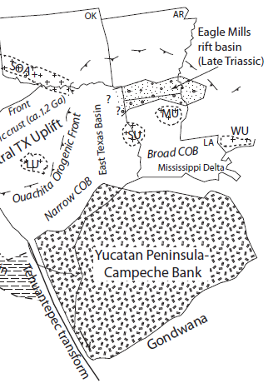

Complex Mesozoic Rifting: Triassic/Jurassic rifting and salt basins in the north,
Yucatan rifting in the south and consequent salt basin there
This reconstruction precedes the knowledge of Yucatan rotational motion resulting from satellite gravity.
Mickus et al. (2009)

Slide 5
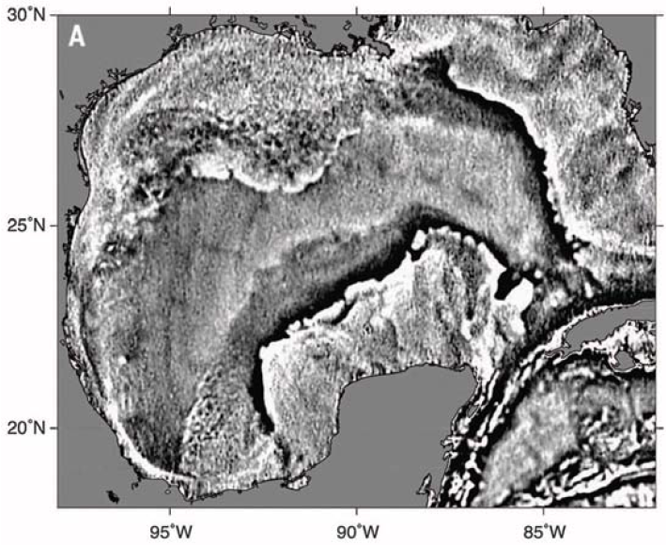
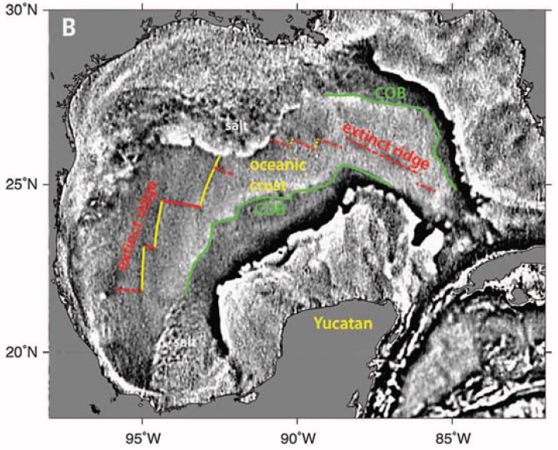
Sandwell et al. (2014)

Slide 6
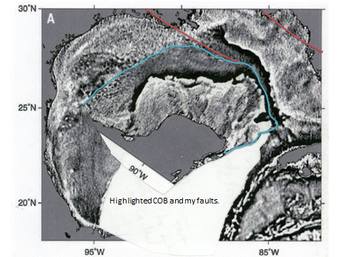
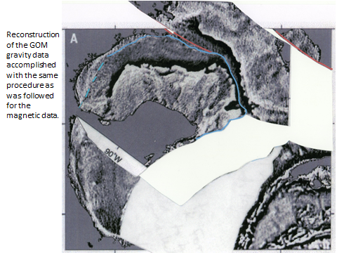

Today we know the geometry of the rotation of the Yucatan block so using scissors I have rotated the block along the transforms
Using the already interpreted northeastern GoMB bounding strike slip fault I palinspastically reconstruct the location of the Yucatan block to the pre-rifting location proposed by Mickus et al. (2009). This requires another fault and implies faulting/rifting/stretching of northern Louisiana and Mississippi as the slab attached to the Yucatan block pulls out with the Yucatan prior to the Yucatan rotating and forming most of the Gulf.

Slide 7
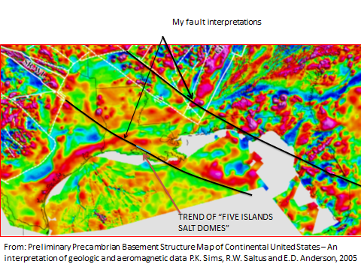
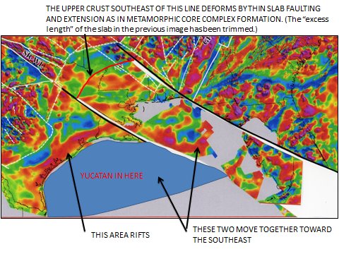
Magnetic data
Palinspastically Reconstructed to pre-rift position.
Present Day
Note continuation of magnetic anomaly

Slide 8
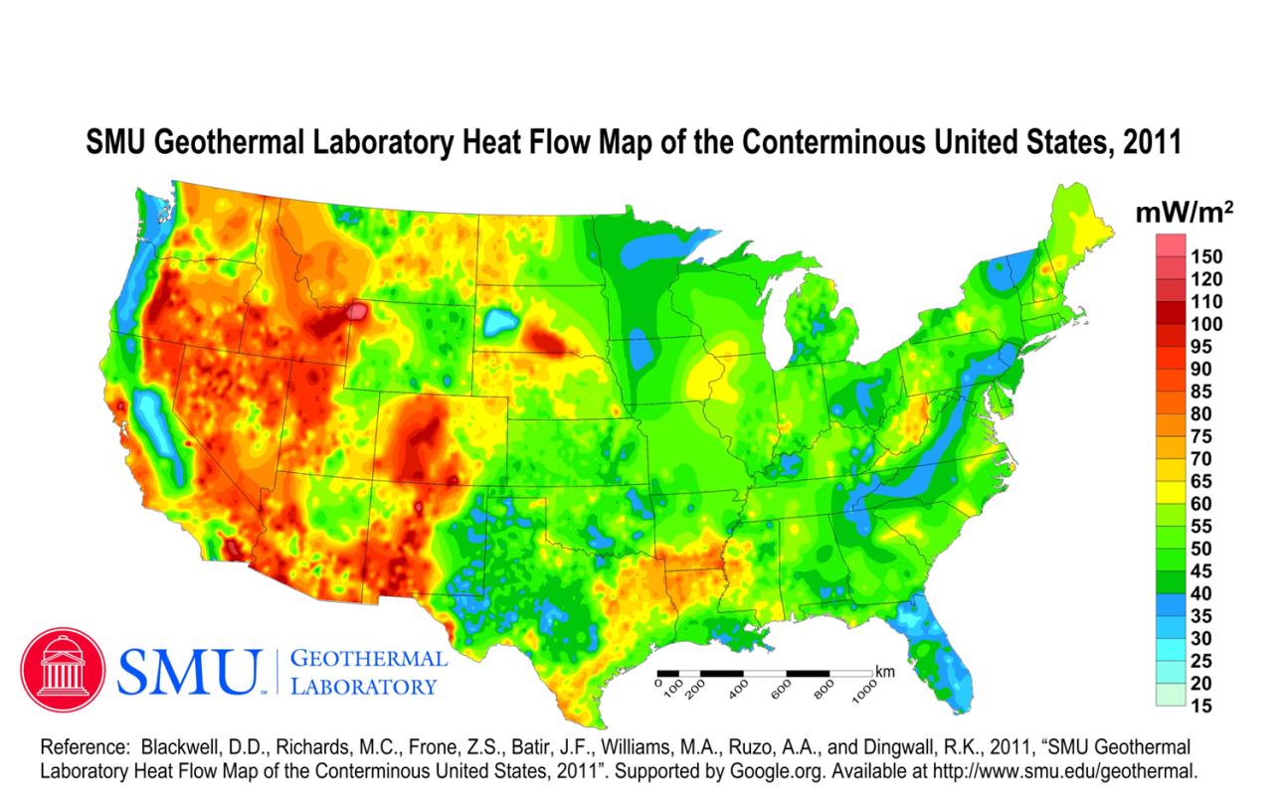
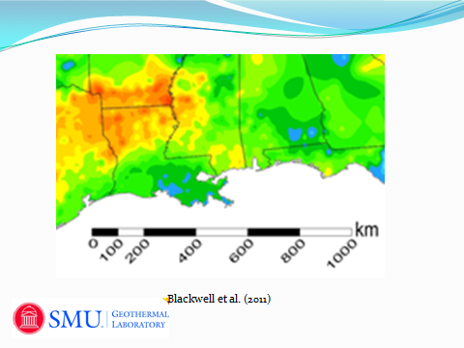
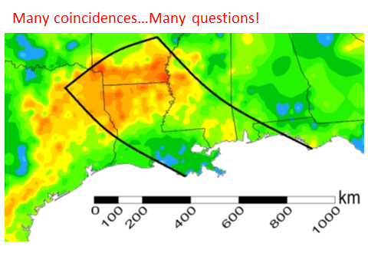

This extended/thinned area is a heat flow anomaly.

Slide 9
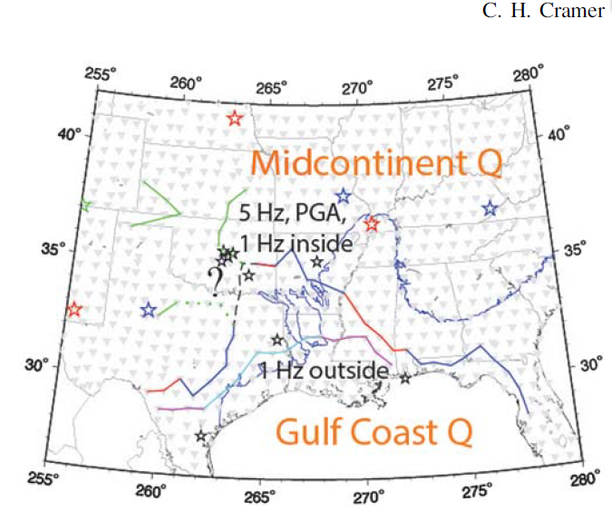

(2017)
I have discussed this figure with Cramer. He finds two crustal boundaries from crustal waveguide seismic signals. The lower boundary is found only in 1 hz data for sources outside of the area between the two boundaries. The upper boundary is found in both 1 and 5 hz data for sources both inside and outside of the area.
Note that the area between boundaries is nearly coincident with the high heat flow anomaly.

Slide 10
What is in this anomalous area? Why did it stretch/rift so far from the main Gulf rifting event (i.e. rotation of the Yucatan block)?
Possibilities:
Piece of Laurentia that rifted away during the late Pre-Cambrian rifting and was re-implanted in the Paleozoic when Gondwana (Yucatan block) docked.
Island arc material from the leading edge of the incoming Yucatan block.
Oceanic plateau from between Laurentia and the Yucatan block.
Continental piece of the Yucatan block.
Comments:
This might fit with the Clift et al. (2017) suggestion that the Iapetus Ocean suture is to the south…perhaps the southern seismic boundary of Cramer (2017).
Seems that there must be subduction zone material somewhere from the closing of the Iapetus Ocean.
Such pieces, suspect terranes, were implanted along the west coast of North America.
Perhaps the Yucatan block impacted close to the rift passive margin forming the Ouachitas but part of the block stretched and split resulting in the anomalous area.

Slide 11
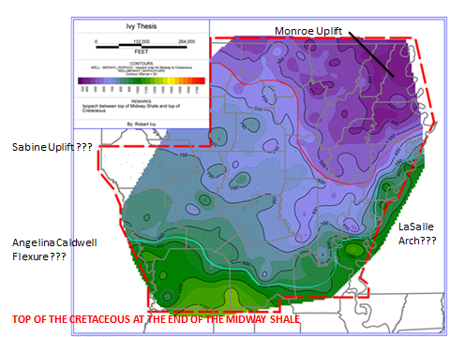
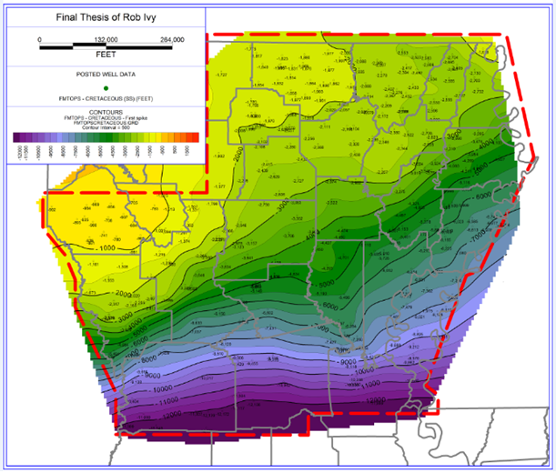
This is the isochore from the top of the Paleocene Midway Shale which is several hundred feet of marine shale, the top of which is “originally horizontal.”
Monroe Uplift
Previous to the Cretaceous the Sabine had been elevated with respect to the East Texas and Northern Louisiana Salt Basins but is lower than at least the Northern Louisiana Salt Basin at the end of the Cretaceous.
Sabine Uplift
LaSalle
Arch
Since end Cretaceous: Sabine up, Monroe down, Angelina Caldwell flexure developed (nearly along southern seismic boundary), LaSalle Arch formed.
Angelina Caldwell
Flexure
TOP OF CRETACEOUS TODAY
Both figures: Ivy (2017)

Slide 12
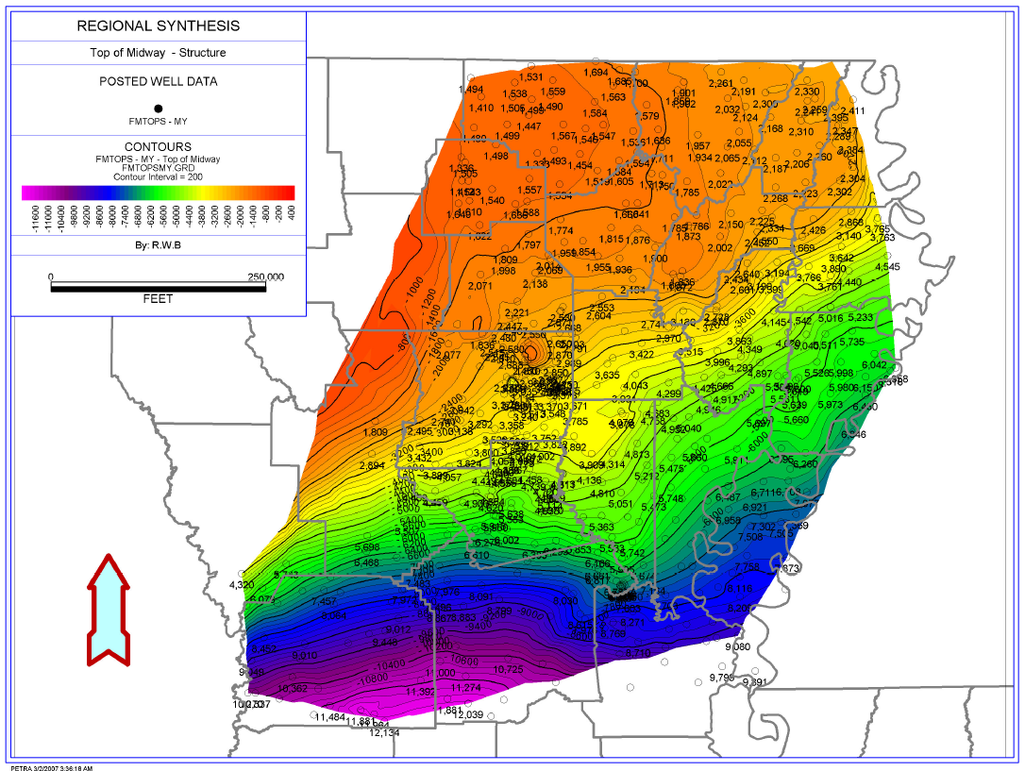
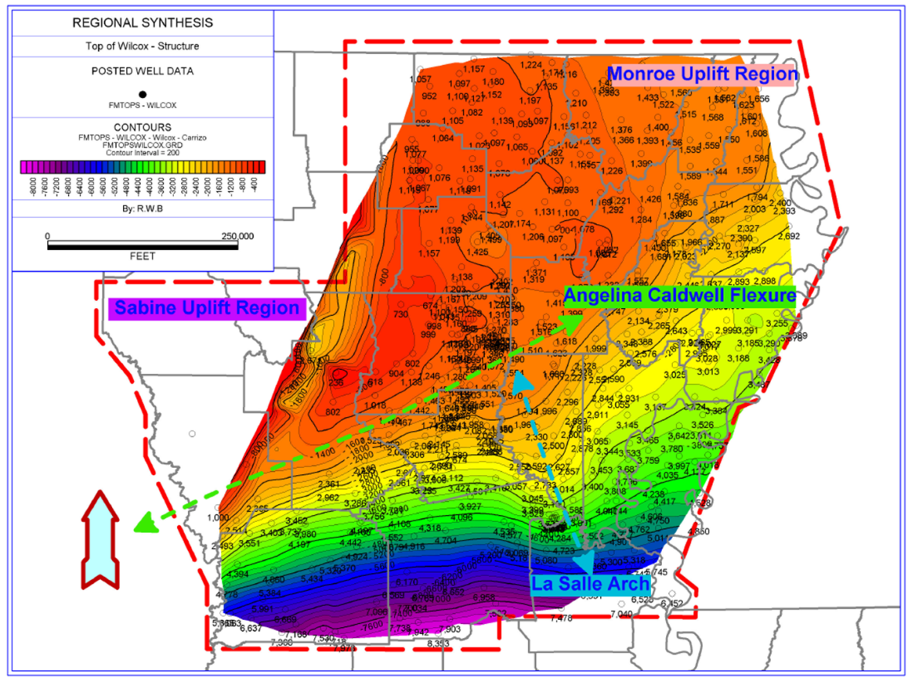
Early Eocene
Paleocene
Since the Top of the Cretaceous, Top
of the Midway Shale and Top of the
Wilcox all exhibit very similar structure
the conclusion is that most of the
structural deformation is Early Eocene
or younger.
Both maps from Ball (2007)

Slide 13
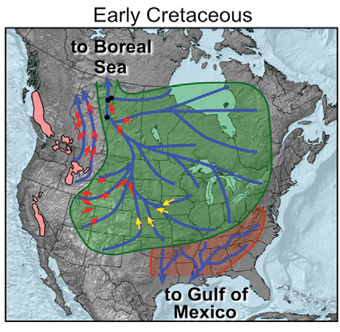
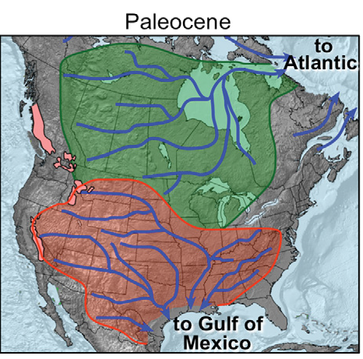
Drainage reorganization brought the strong pulse of coarse clastics into the Northern Gulf of Mexico Basin in the Paleocene…the Wilcox Group fluvial deposits.
M. Blum and M. Pecha (2014)

Slide 14
What caused these “ups and downs” and other structural features? The Early Eocene or younger age of the structures argues against anything related to rifting or to the Laramide Orogeny.
What caused the drainage reorganization?
AN 800 POUND GORILLA…
DYNAMIC TOPOGRAPHY!

Slide 15
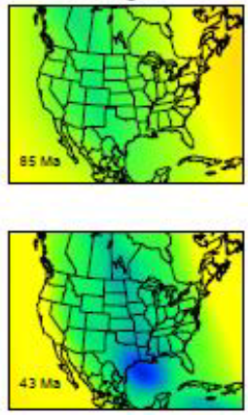
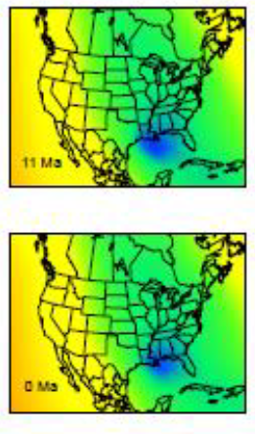
Dynamic topography generated by both the low-temperature Farallon slab and the ecologitized Hess conjugate at different ages. H. Wang et al. (2017).
Dynamic topography of Farallon slab resulted in drainage reorganization.
I hypothesize that dynamic topography from the Hess conjugate is at least partially responsible for the history of structural activity in the Northern Gulf of Mexico Basin.

Slide 16

Within the South Central GSA we have a working group dedicated to trying to understand better the origins of these structural features…particularly the Sabine Uplift. A long term goal is to deep drill the Sabine Uplift. Our interest in drilling has been communicated to the Continental Scientific Drilling Coordination Office (University of Minnesota). We have much work to do prior to formally proposing to drill. If interested
contact anybody on this list.

Slide 18
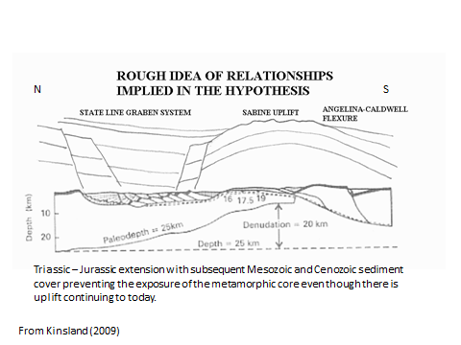

Slide 19
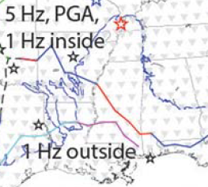

Slide 20
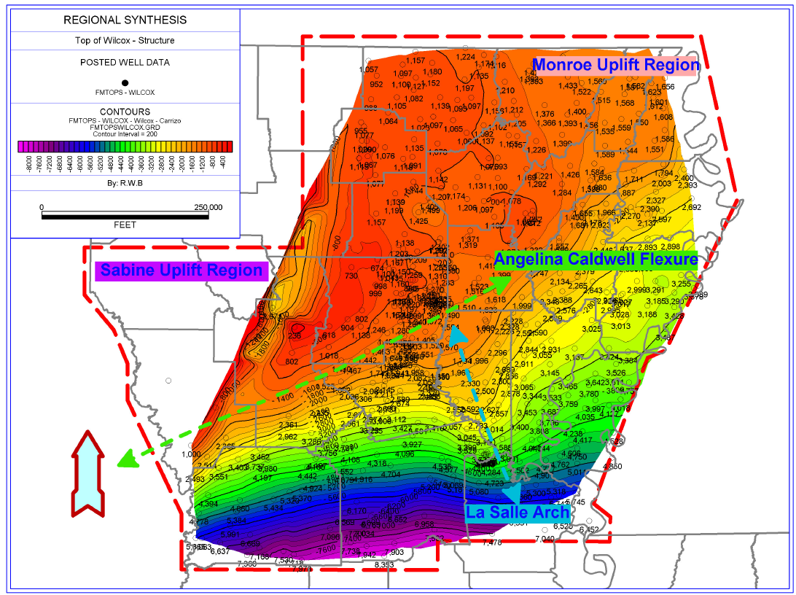

Slide 21
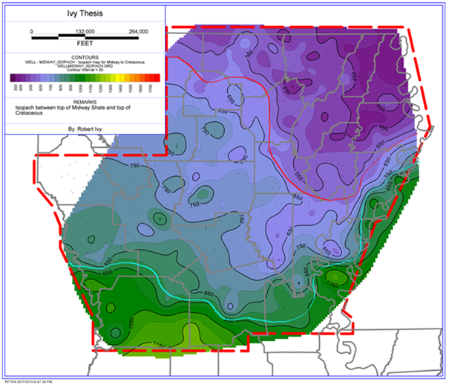
Monroe Uplift
Sabine Uplift ???
LaSalle Arch???
Angelina Caldwell Flexure ???
TOP OF THE CRETACEOUS AT THE END OF THE MIDWAY SHALE

