Slide 1
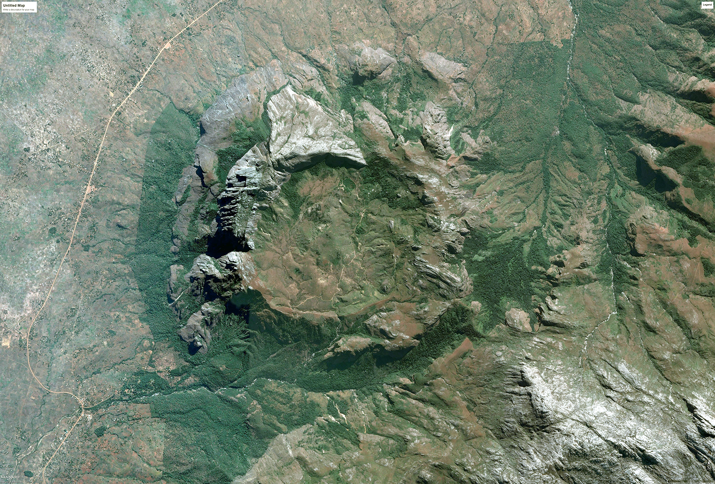
Lithospheric Structure Beneath the Mesozoic Chilwa Alkaline Province in Southern Malawi and Northeastern Mozambique
Victor Nyalugwe
Mohamed G. Abdelsalam
Andrew Katumwehe
Oklahoma State University
Estella A. Atekwana
University of Delaware
Geological Society of America – South Central Meeting
Little Rock, Arkansas
March 13, 2018

Slide 2
Acknowledgements
We thank the Geological Survey of Malawi for providing the aeromagnetic data.
The MS study of Victor Nyalugwe at Boone Pickens School of Geology I Oklahoma State University is supported by the Geological Survey of Malawi through funding from the World Bank.

Slide 3
Summary
The Chilwa Alkaline Province (CAP) is a nested igneous ring complex made up of granite, syenite, nepheline syenite, and basanite igneous rocks.
It was fed from a magma chamber at ~ 8 km depth now preserved as broad batholiths.
It is underlain by a thicker (~45 km) continental crust.
It is underlain by a thinner (~125 - 150 km) sub-continental lithospheric mantle.
It might have formed from mantle and lower crustal melt.

Slide 4
Outline
Tectonic setting geochemical evolution of the Chilwa Alkaline Province (CAP).
Surface expression of CAP.
  Landsat Thematic Mapper (TM) image.
  Shuttle Radar Topography Mission (SRTM) Digital Elevation Model (DEM).
  Modified geological map.
Near surface structure of CAP.
  Enhanced aeromagnetic data.
  Upward continued Bouguer gravity data from the World Gravity Model 2012 (WGM 2012).
Moho and Lithosphere-Athenosphere Boundary (LAB) beneath CAP.
  Two-dimensional radially-averaged power spectral analysis of the Bouguer anomaly of the WGM (2012)
Sorry! We don’t have a conceptual model for the evolution of CAP yet. We are working on it. Would love to hear from you if you would like to help.

Slide 5
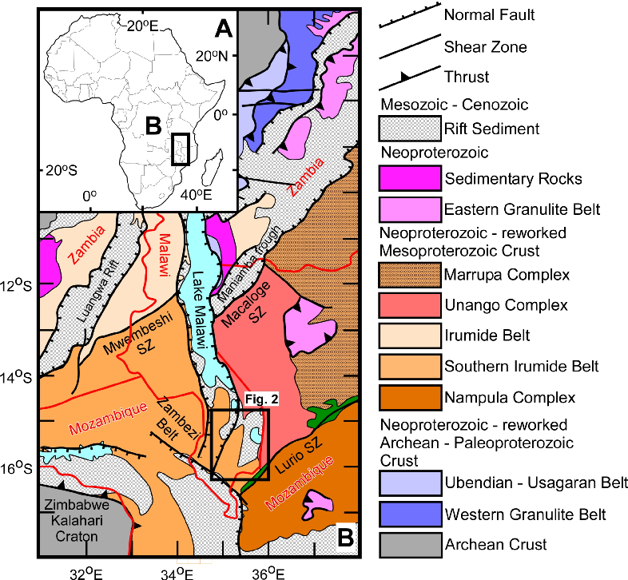
Cretaceous Basanite + nepheline syneite (138 – 132 Ma), Nepheline syenite + syenite (129 – 123 Ma), syenite + granite (115 – 111 Ma) alkaline province.
Located at the boundary between the Mesoproterozoic – Neoproterozoic Southern Irumide and Mozambique orogenic belts.
Crops out on the northeastern footwall of the Mesozoic Shire graben.
Intrusive bodies in the western side of the province are offset by the eastern border fault of the Cenozoic Malawi rift.

Slide 6
Geochemical evolution
The CAP was sourced from a depleted mantle geochemical reservoir.
Its geochemistry is suggestive of Oceanic Island Basalt (OIB) source.
Younging of intrusive bodies is positively correlated with silica enrichment possible due to increased crustal contamination of the magma with time.
http://faculty.uml.edu/Nelson_Eby/Research/Chilwa/IGC%20Chilwa.pdf

Slide 7
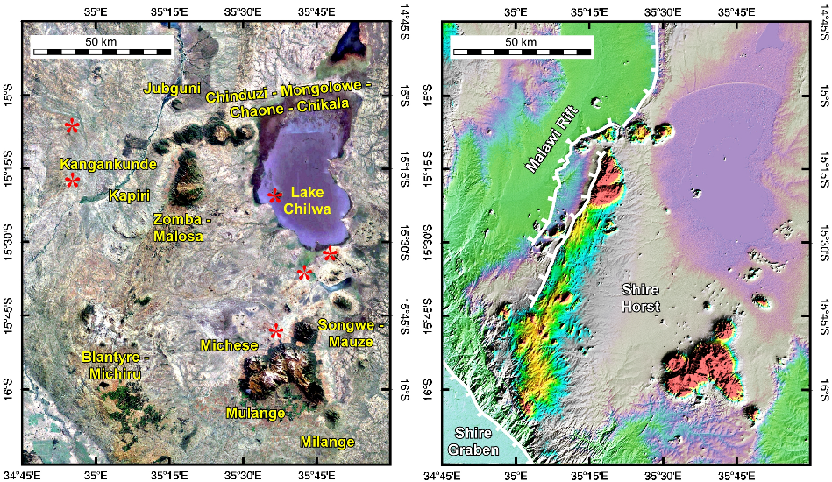
Landsat TM and SRTM DEM of the CAP
  5 – 10 km across individual intrusions
  Less than 1 km across carbonatite intrusions
  Mulange Mountain is ~3000 m high

Slide 8
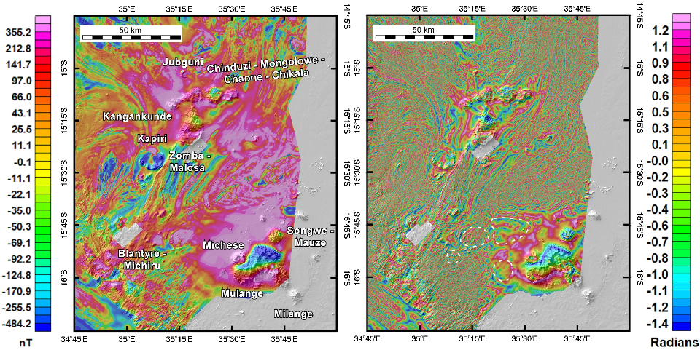
Enhanced aeromagnetic data of the CAP
  Some of CAP intrusions are characterized by low Total Magnetic Intensity (TMI).
  The CAP is characterized by longer wavelength anomaly in the tilt derivative of the TMI compared to the Precambrian basement.
  Possible presence of two batholiths at depth.

Slide 9
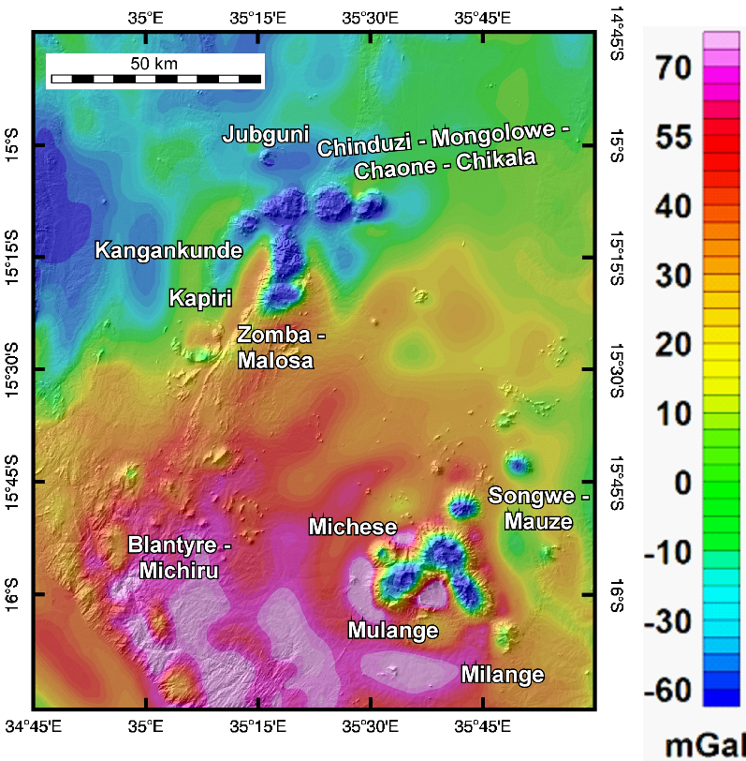
Bouguer gravity anomaly of the WGM 2012
  Most of CAP intrusions are characterized by gravity low anomalies.

Slide 10
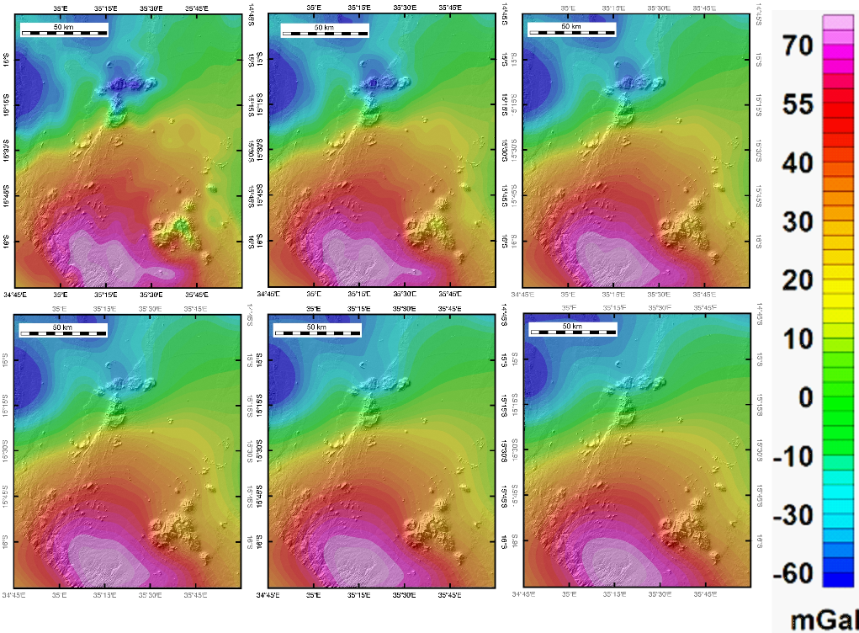
Upward continuation of the Bouguer gravity anomaly of the WGM 2012
  Possible continuation of the northern batholith to a depth of ~ 8 km.
  Sallower depth to the base of the southern batholith.

Slide 11
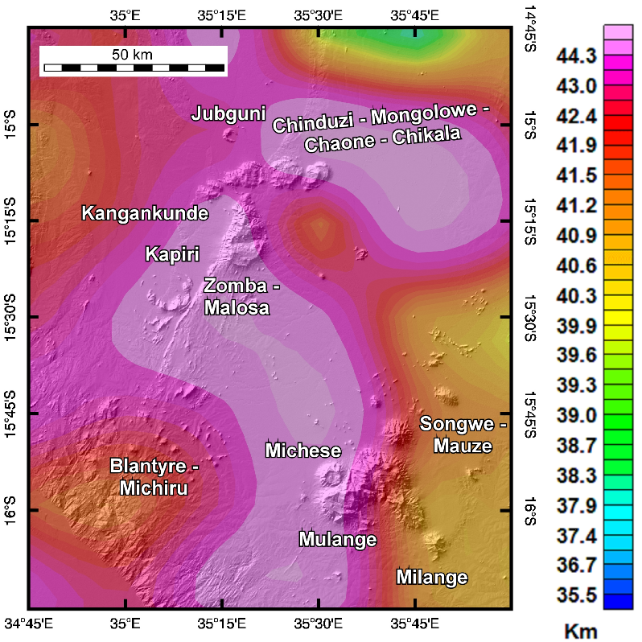
Moho depth from the 2D radially-averaged power spectral analysis of the Bouguer gravity anomaly of the WGM 2012
  The CAP is underlain by an up to ~45 km thick crust.

Slide 12
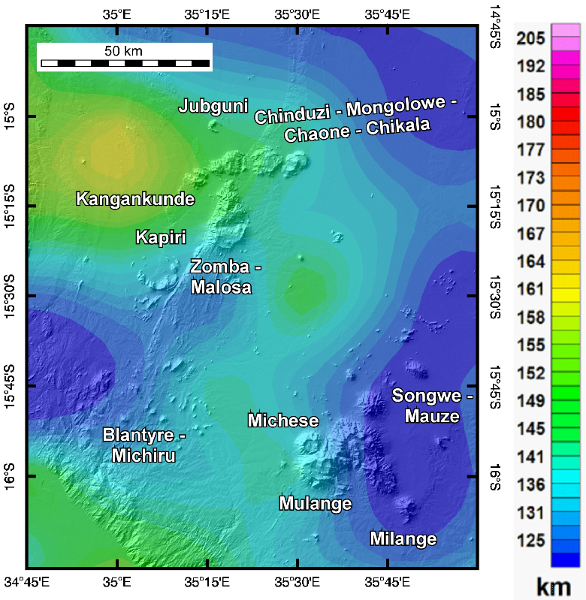
LAB depth from the 2D radially-averaged power spectral analysis of the Bouguer gravity anomaly of the WGM 2012
  The CAP is underlain a relatively thin (125 – 150 km) lithosphere.

Slide 13
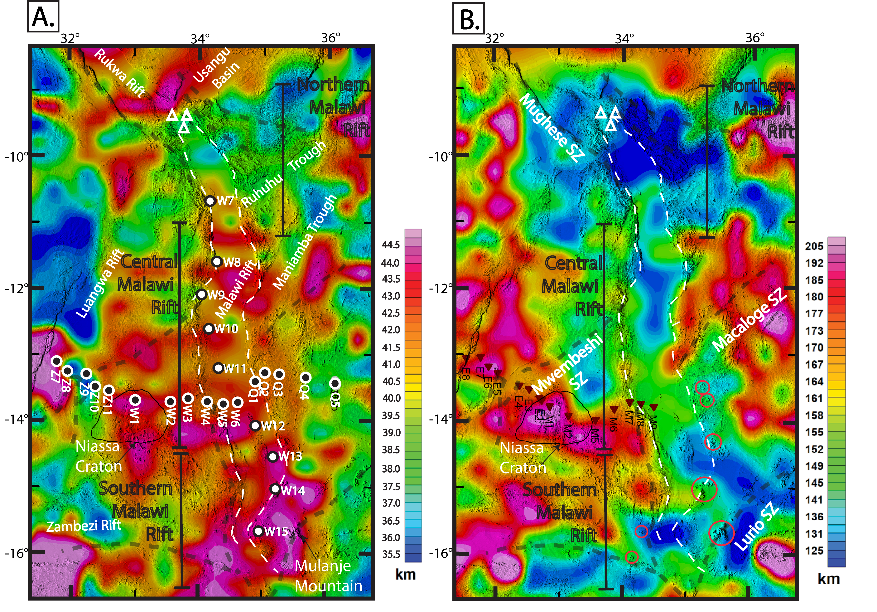
Njinju et al. (In Preparation)

