Slide 1
Late Devonian Organic-Rich Woodford Shale Deposits and The Frasnian/Famennian (F/F) and Devonian Carboniferous (D/C) Global Anoxic Events
MOLINARES BLANCO, Carlos E.¹, TURNER, Bryan W.², SLATT, Roger M.¹, KOZIK, Nevin P.³, YOUNG, Seth A.³, PHILP, Richard P.¹, ELMORE, Douglas¹, MICELI-ROMERO, Andrea⁴ and ETAYO-CADAVID, Miguel F.⁵
1) ConocoPhillips School of Geology & Geophysics, The University of Oklahoma
2) Morrison Natural History Museum
3) Department of Earth, Ocean, and Atmospheric Sciences, Florida State University
4) Department of Geology and Geophysics, Texas A&M University
5) BP Lower 48, Houston Tx.
cmolinares@ou.edu
South-Central Section - 52nd Annual Meeting - 2018
Paper No. 19-3
Little Rock, Arkansas 03-13-2018

Slide 2
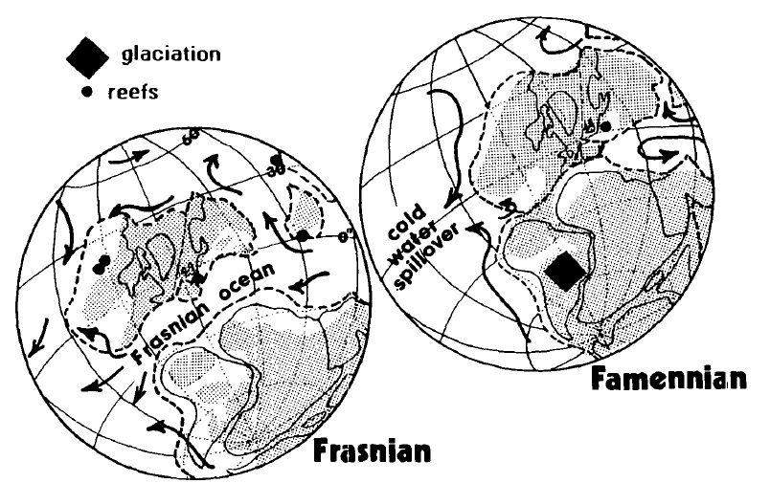
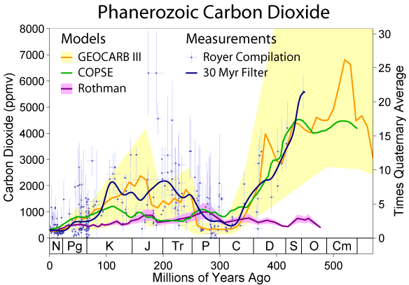
Late Devonian atmospheric CO₂ drop
F/F Crisis
Copper 1986, Geology
Changes in carbon dioxide concentrations during the Phanerozoic from Rothman 2001, Berner and Kothavala 2001 (GEOCARB III), Bergmann et al., 2004 (COPSE), and Royer et al., 2004. Frasnian/Famennian (F/F) crisis, ~370 Ma (After Robert A. Rohde, Global Warming Art).
Famennian glacially striated pavement from
Cabezas Formation of the Parnaiba Basin, northern Brazil
Streel et al., 2000. 3Palaeo

Slide 3
Outline
Late Devonian Anoxic events and global crisis
Woodford Shale and North America Late Devonian epicontinental sea
Woodford Shale Wyche -1 well
Location – age control
Lithofacies distribution
TOC - Biomarkers analysis
XRF element compositional analysis
SEM – EDX analysis
Palynological analysis
Conclusions

Slide 4
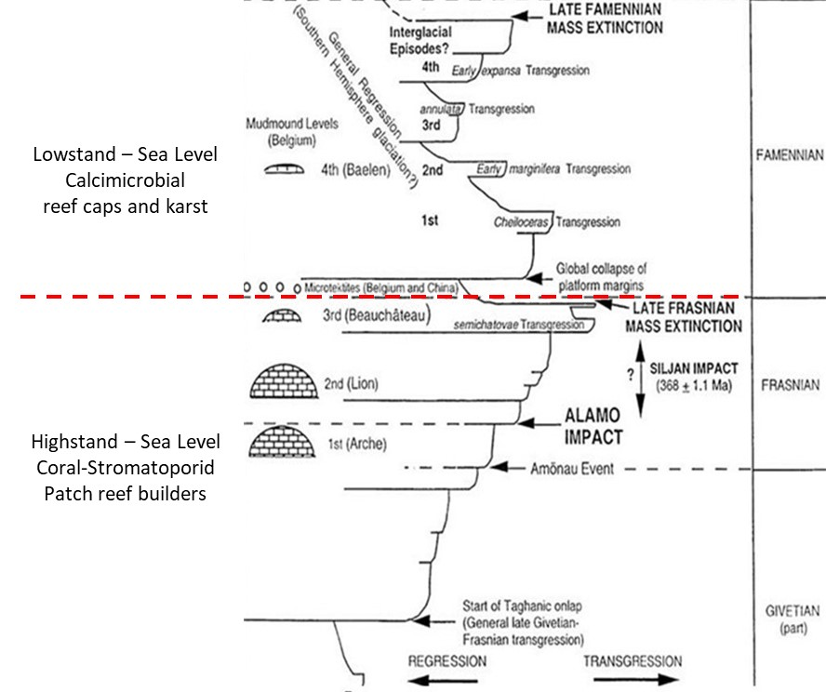
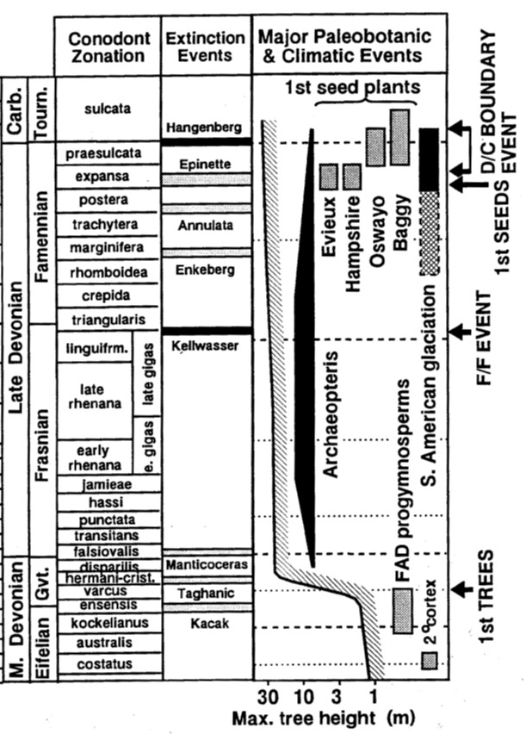

Late Devonian marine and terrestrial changes
1 m
After Algeo et al., 2001
Marine events After Racki, 2005
Sea level After Johnson et al., 1985
Notes:
Figure 1A. Late Devonian paleogeography of North America. Paleo-equator after Miller and Kent, 1986. Oklahoma state boundaries highlighted in red color. Geographic abbreviations: AM = Acadian Mountains, TCA = Trans-Continental Arch, CMU= Central Montana Uplift, ZDU =Zuni-Defiance Uplift, OU = Ozark Uplift, BS = Bakken Shale, AS = Antrim Shale, AB = Appalachian Basin, NAS = New Albany Shale, NMS = Maple Mill Shale, CS = Chattanouga Shale, WS = Woodford Shale, CN = Caballos Novaculite. (After Algeo et al., 2007). B) Upwelling model for triggering Late Devonian anoxic black shales. (After Parrish, 1982; Barron and Ettensonh, 1981). C) Low density (stagnant) quasi-estuarine circulation model for Late Devonian anoxic shales (After Witzke, 1977).

Slide 5
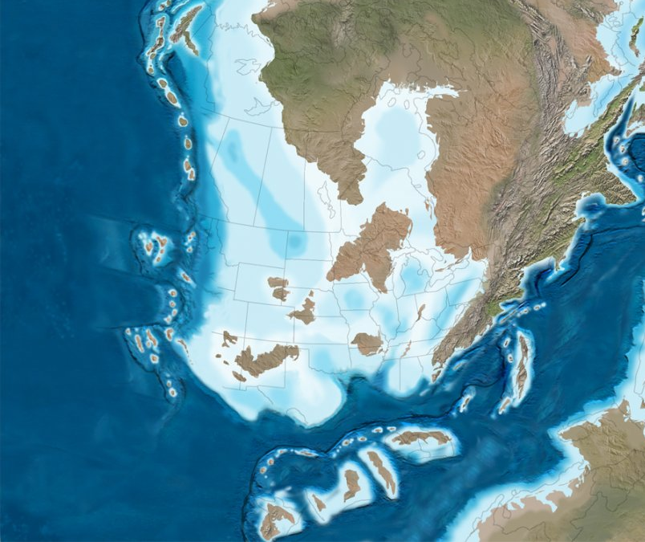
Late Devonian epicontinental seas in North America
A
OPEN
OCEAN
Water
Density
Wind-Driven
Cells
SHORE
Panthalassic
Ocean
Upwelling
Phosphate-Rich
Oxygen-Poor
Oxygen-Rich
Moderate
Detrital Input
After Parrish, 1982
Paleo-equator
BS
CMU
AS
TCA
AM
MMS
NAS
AB
OU
B
OPEN
OCEAN
Water
Density
SHORE
ZDU
WS
CS
WS
Oxygen-Rich
Poor Nutrient
HIGH PRODUCTIVITY
Seasonal
Detrital Input
CN
Sill
North America Late Devonian paleogeography from Blakey (After Algeo et al., 2007)
Paleo-equator
(After Miller and Kent, 1986)
Anoxic bottom
After Witzke, 1987
AM = Acadian Mountains, TCA = Trans-Continental Arch, CMU= Central Montana Uplift, ZDU =Zuni-Defiance Uplift, OU = Ozark Uplift, BS = Bakken Shale, AS = Antrim Shale, AB = Appalachian Basin, NAS = New Albany Shale, NMS = Maple Mill Shale, CS = Chattanouga Shale, WS = Woodford Shale, CN = Caballos Novaculite (After Algeo et al., 2007, 3Paleo).

Slide 6
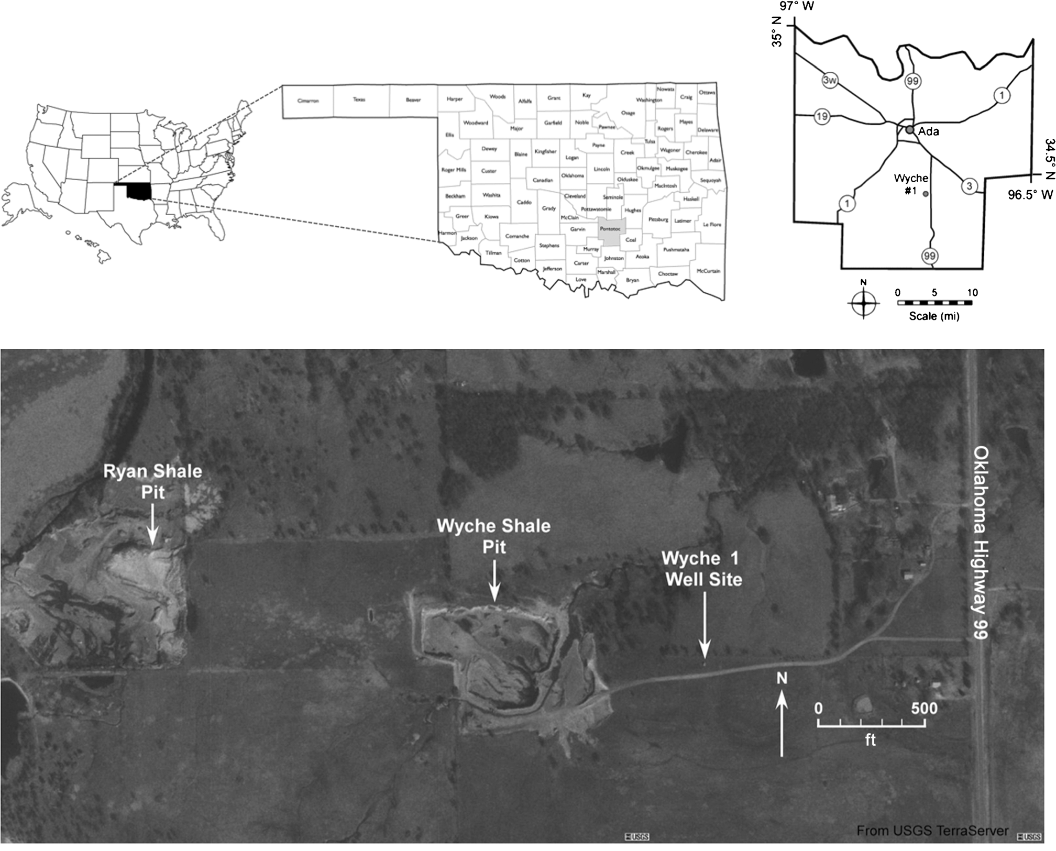
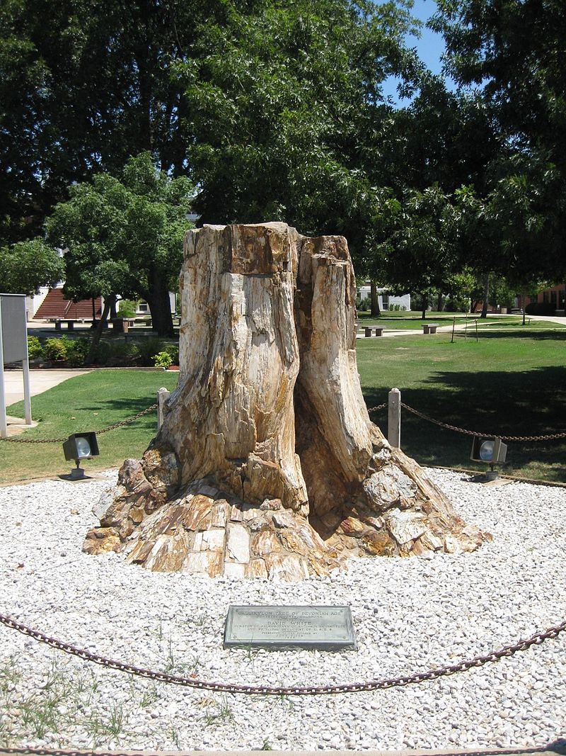
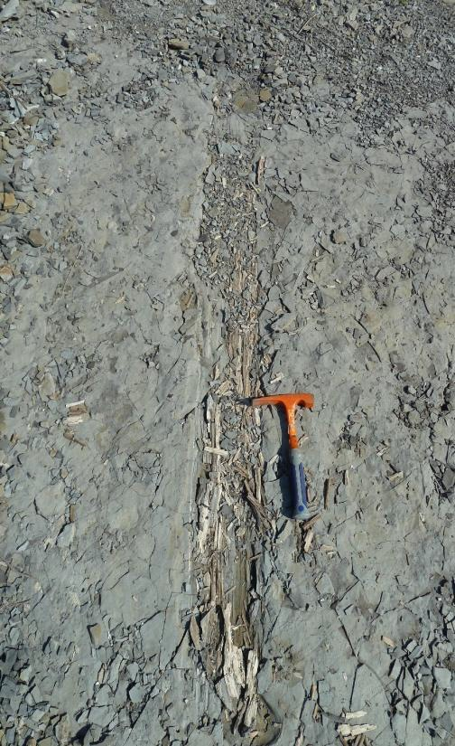
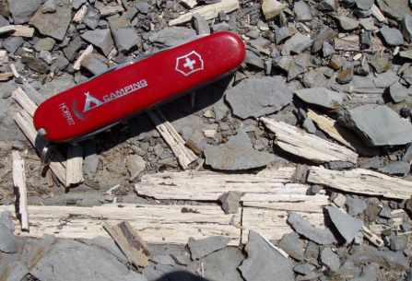
Location and age control
b)
(East Central College, Ada Ok)
Wikipedia
After Miceli-Romero and Philp, 2011

Slide 7
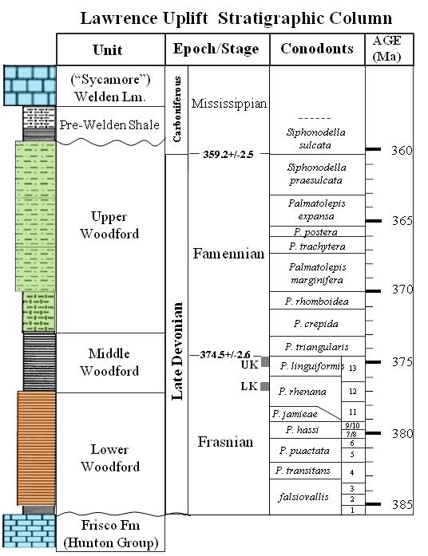
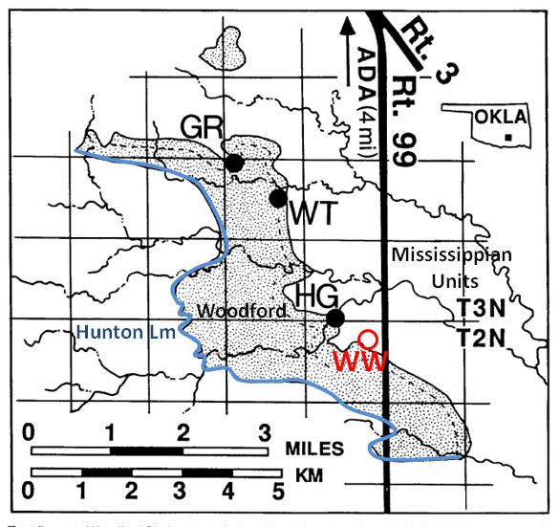
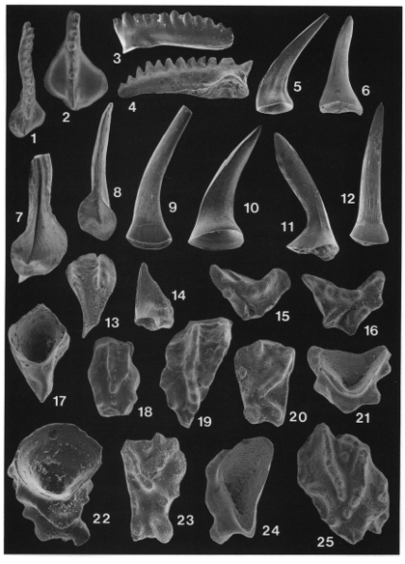

Location and age control
?
GR = Guest Ranch Section,
WT = Welden Type Section
HG = Hass G Section
WW = Wyche well and shale pit
Limestone
Interbbeded siliceous and fissile shales , with abundant phosphate and pyrite nodules
Black to gray siliceous shale,
interbedded with fissile shale
Organic rich, black to dark
gray fissile shale
Black to gray siliceous shale
interbedded with fissile shale, without phosphate nodules
Conodonts
Conodonts zones After Barrick et al., (1990); Over and Barrick, (1990); Over, (1992)

Slide 8
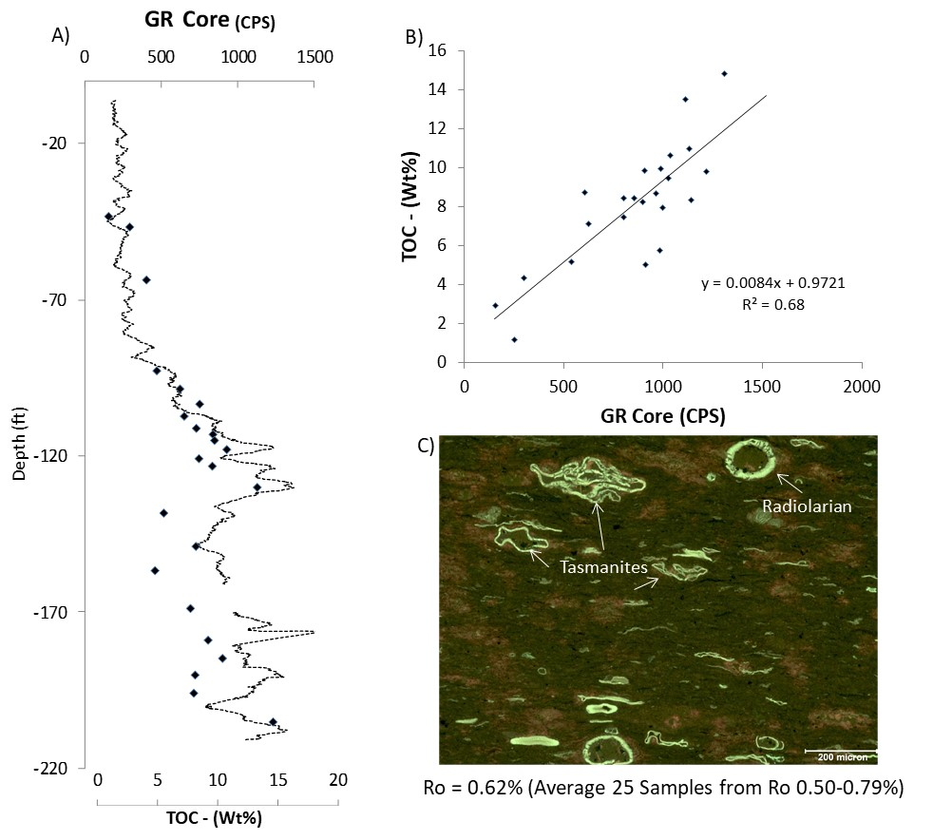
C
B
A
D
E
D
F1
F2
(A) Siliceous laminated mudstone
G
F2
(B) Light
-
gray siliceous finely laminated mudstone
H
(C) Light
-
gray siliceous/argillaceous calcareous mudstone
(D) Siliceous/argillaceous, mudstone with phosphate nodules
(E) Siliceous/argillaceous laminated mudstone with phosphate nodules
(F1
-
F2) Black to dark gray laminated argillaceous mudstone
(G) Mixed siliceous/argillaceous mudstone, with thin clay laminations
Regressive hemicycle
(H) Argillaceous siltstone with abundant angular detrital quartz
Transgressive hemicycle

Slide 9
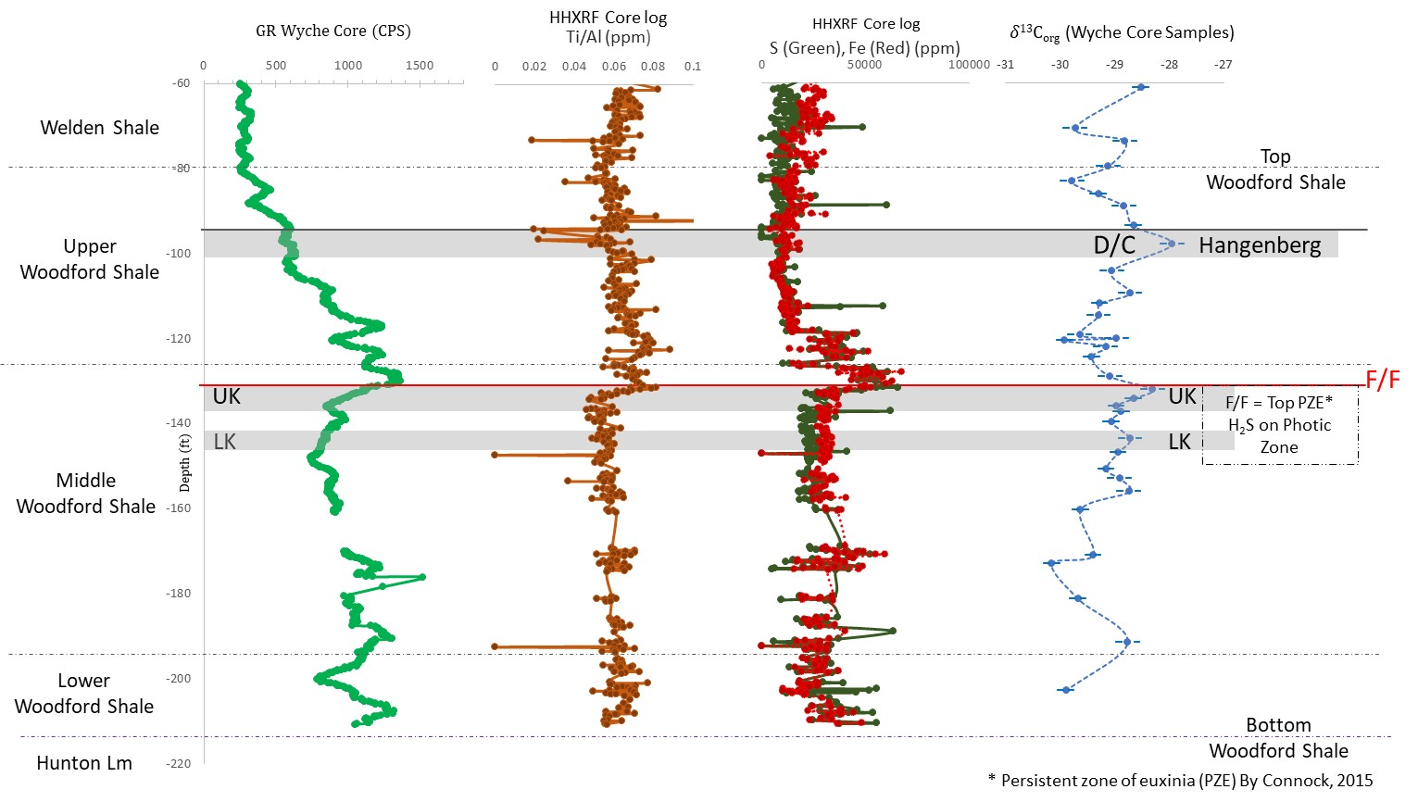
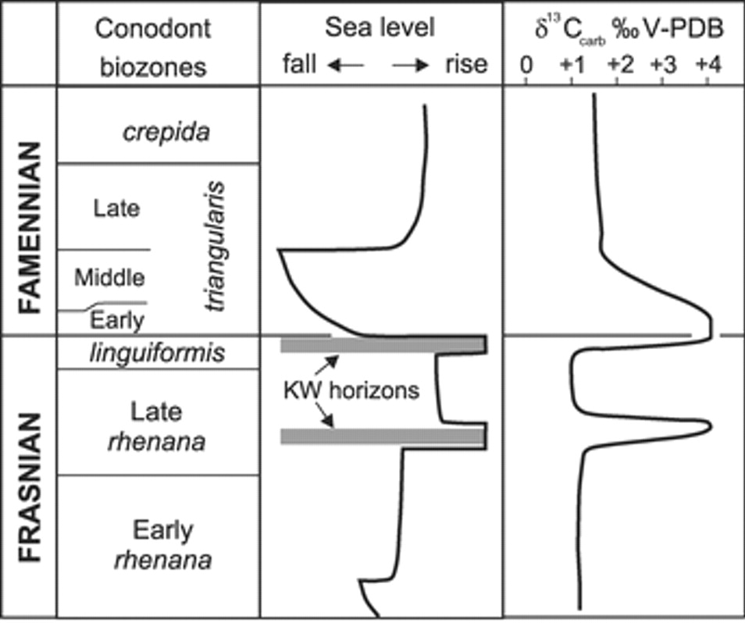
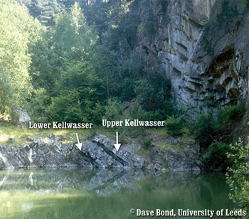
Location and age control
Joachimski and Buggisch, Geology 2002

Slide 10
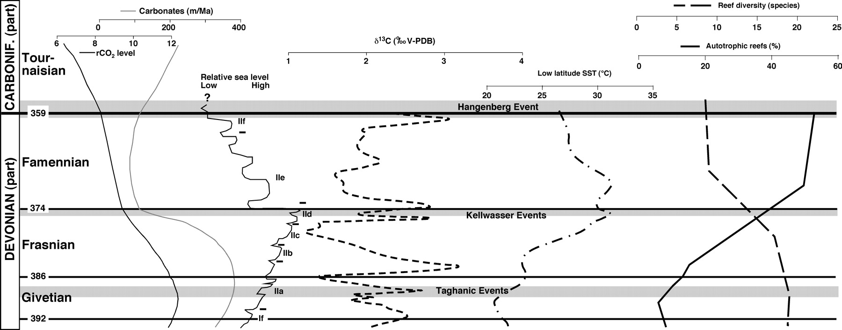
Late Devonian events in west-central Utah, United States
From Morrow et al., Palaios 2011

Slide 11
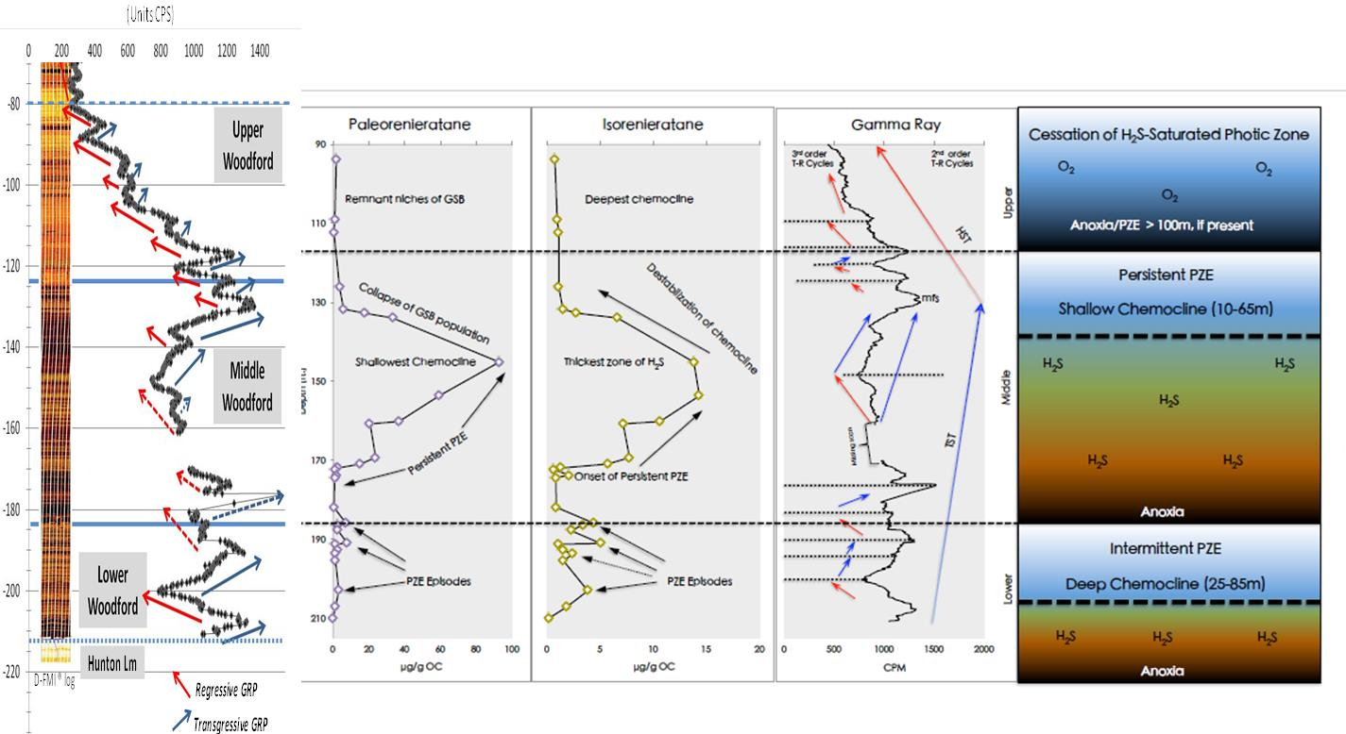
Euxinic conditions during the accumulation of the WDS
2nd order
PZE = Persistent Zone of Euxinia
Euxinic
Msc Thesis Connock, 2015

Slide 12
XRF element ratios
DW 21 (119.3)

Slide 13
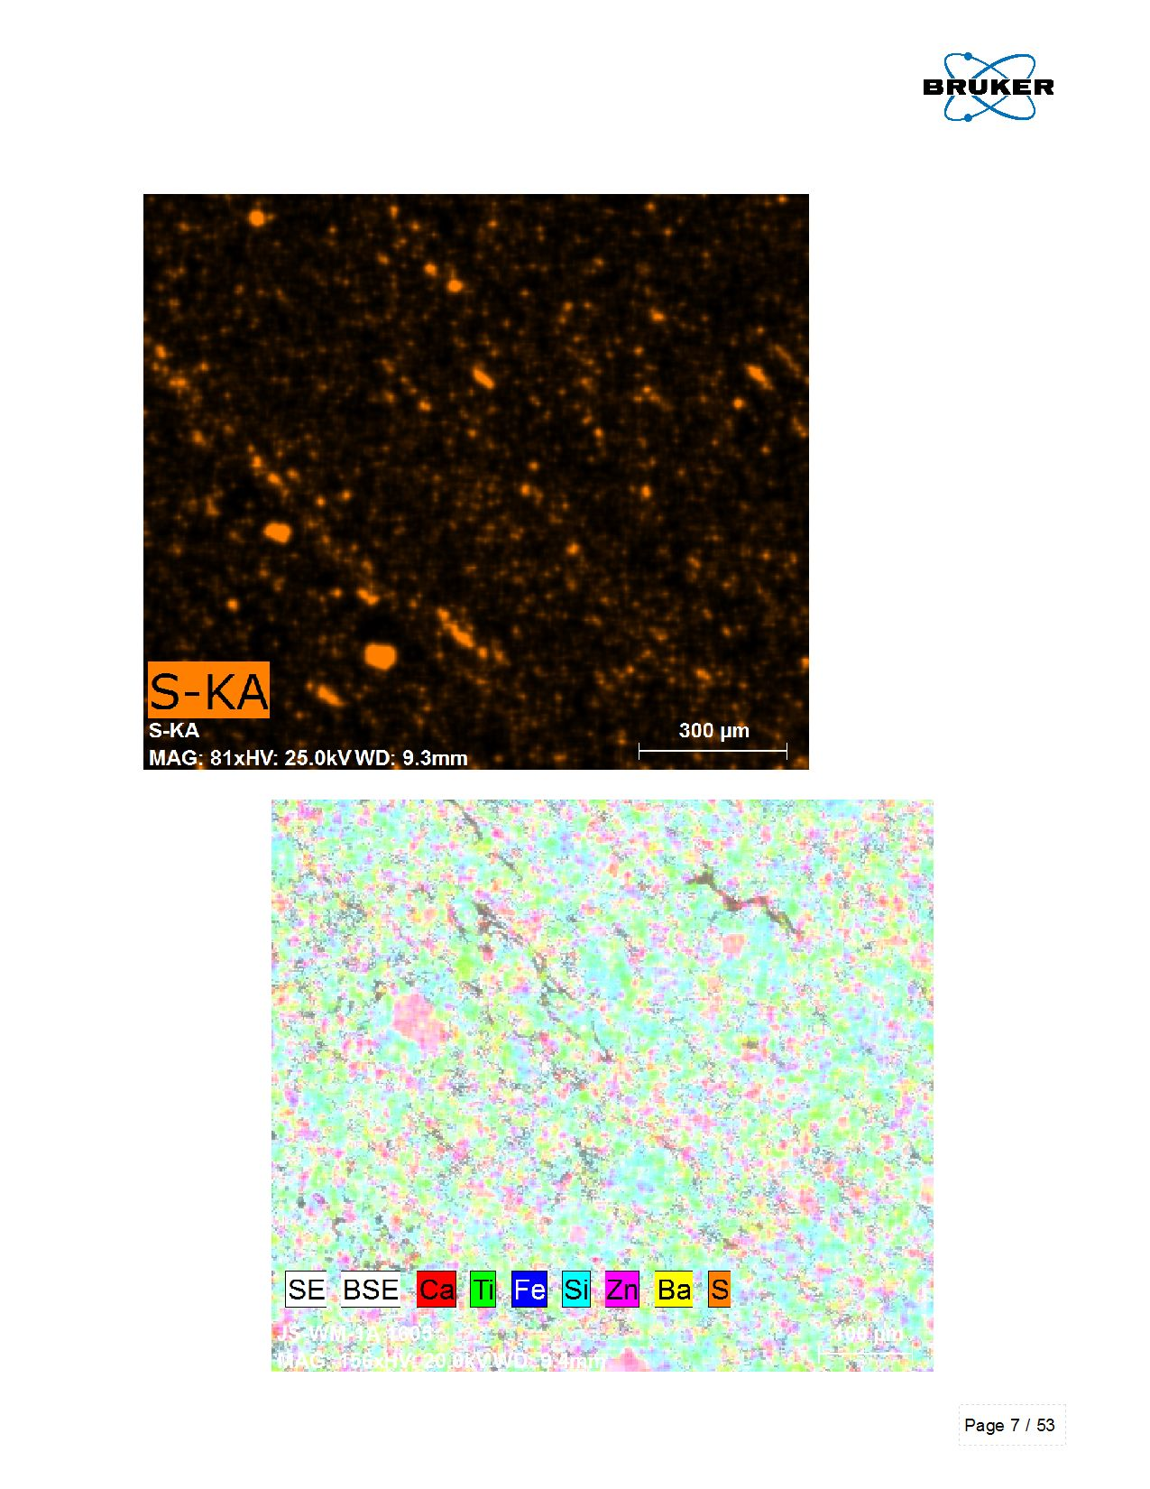
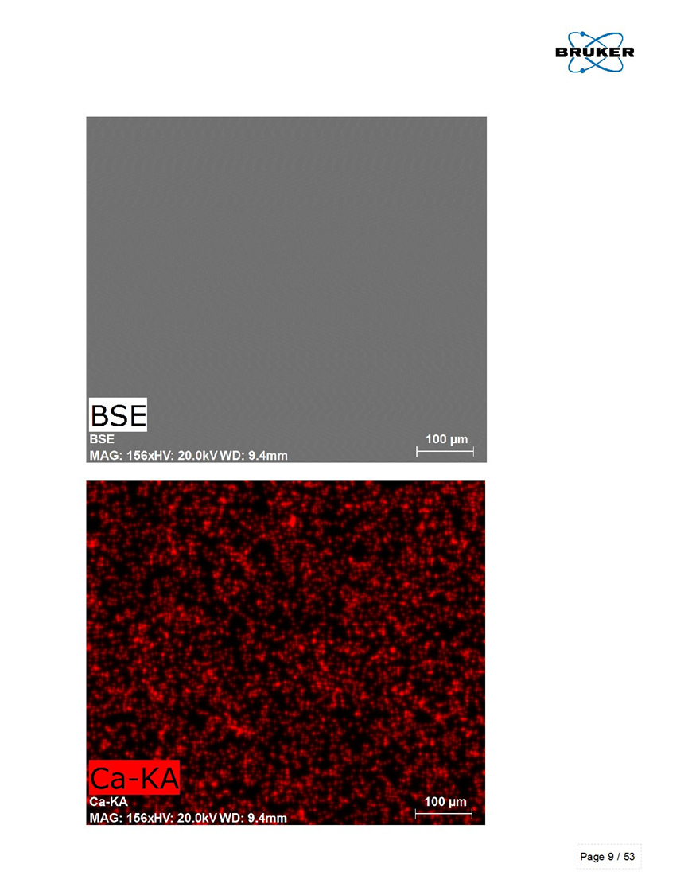
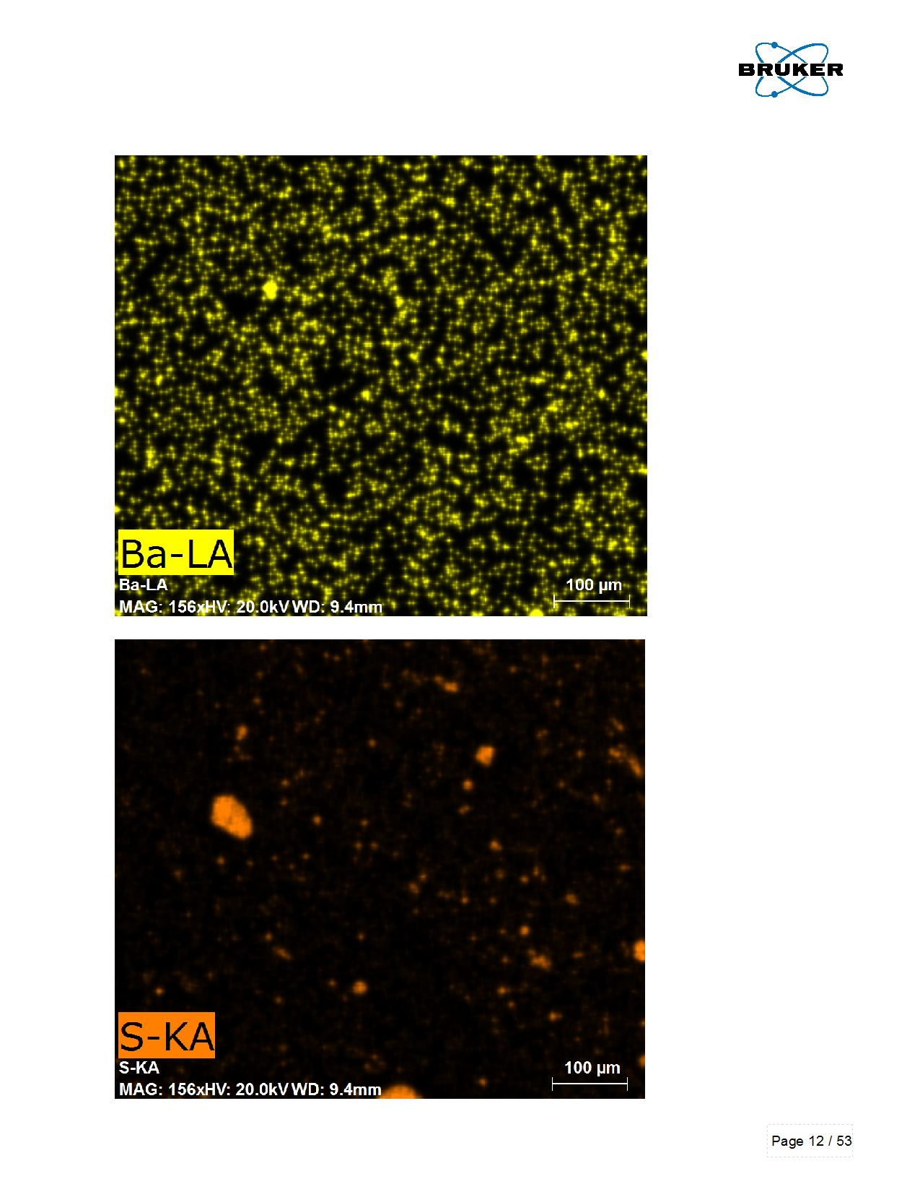
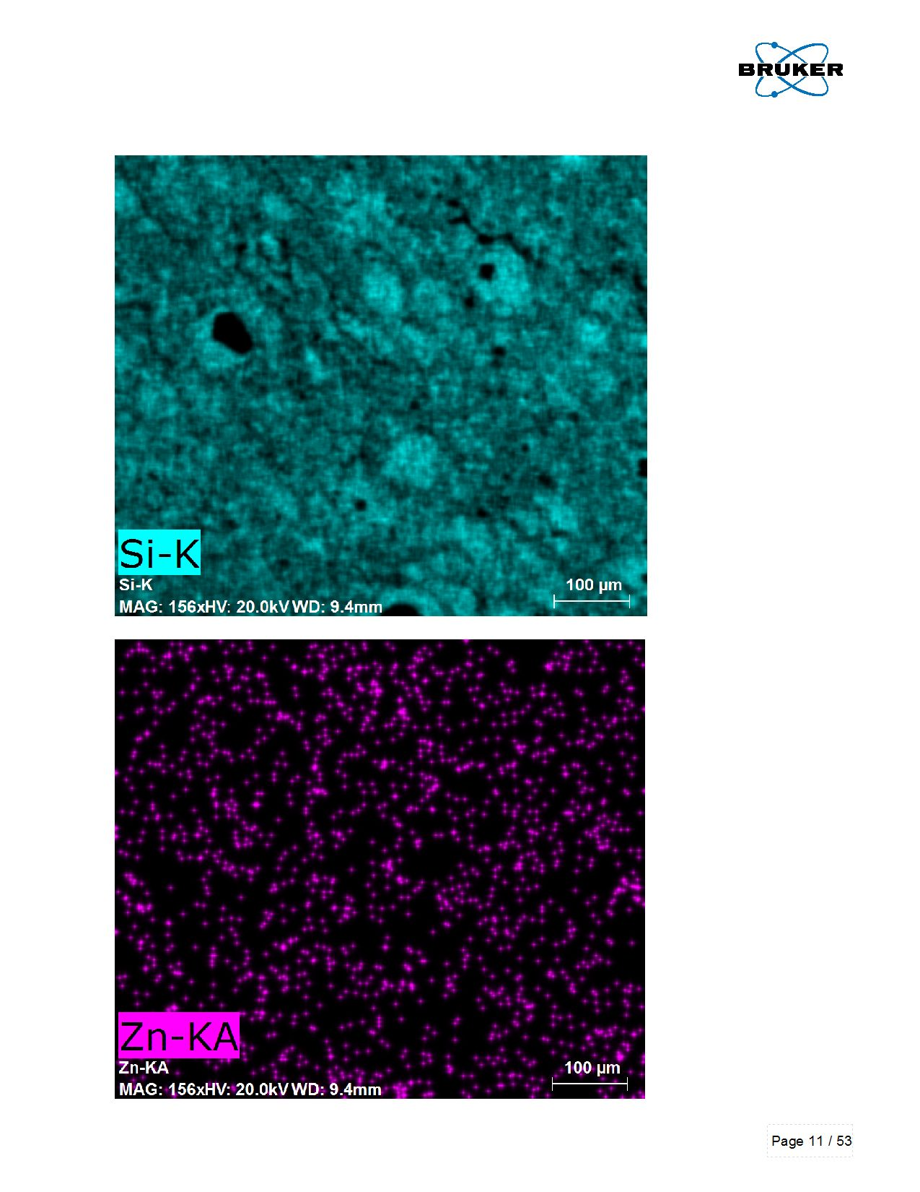
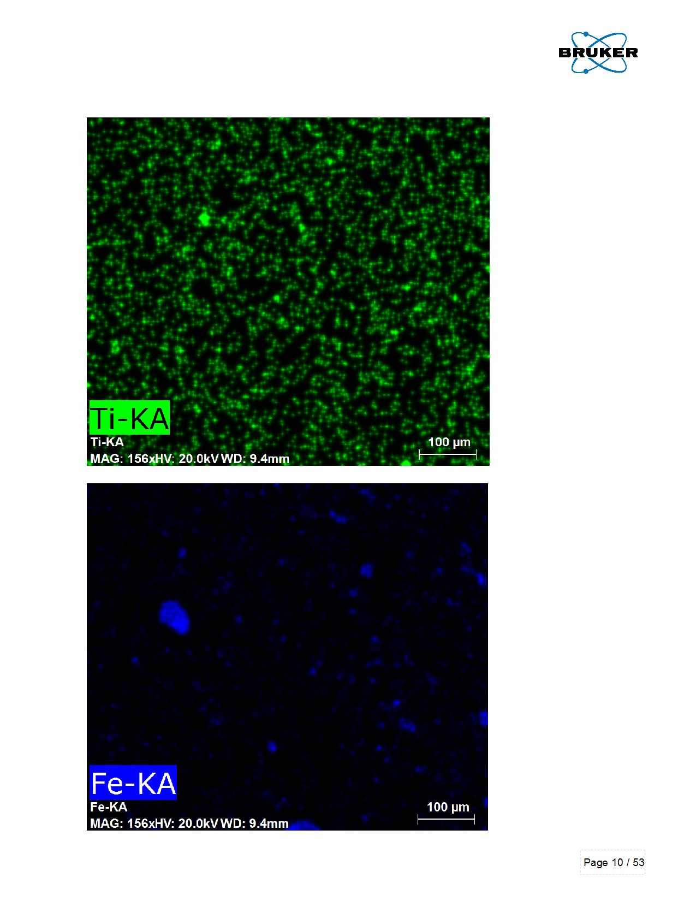
SEM -EDX element analysis

Slide 14
SEM -EDX element analysis

Slide 15
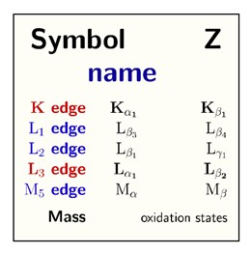
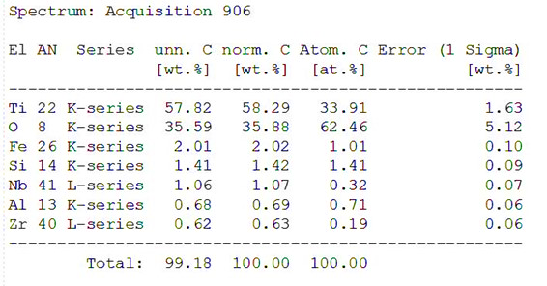
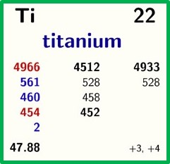
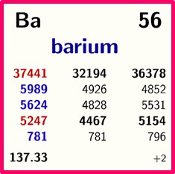
SEM -EDX element analysis

Slide 16
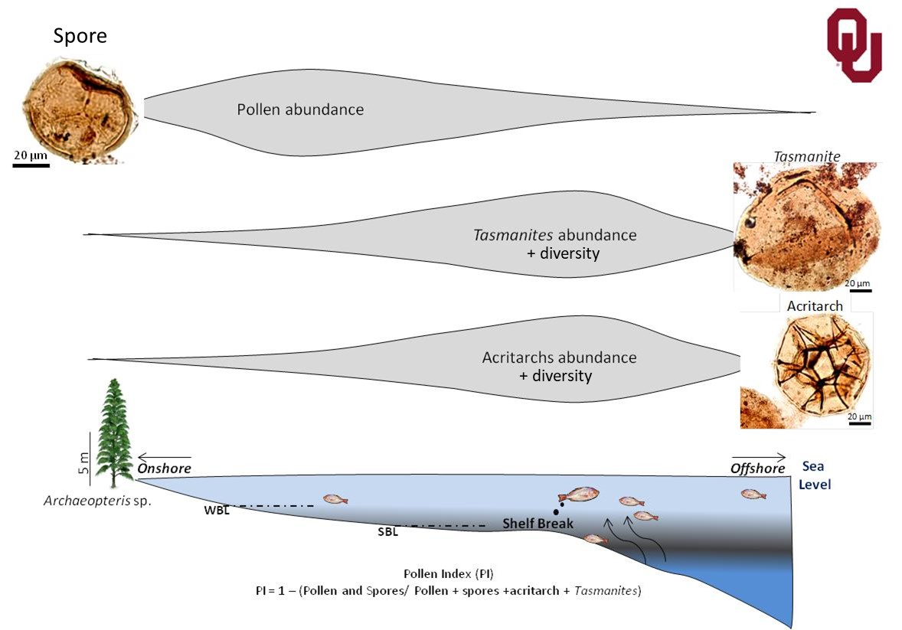
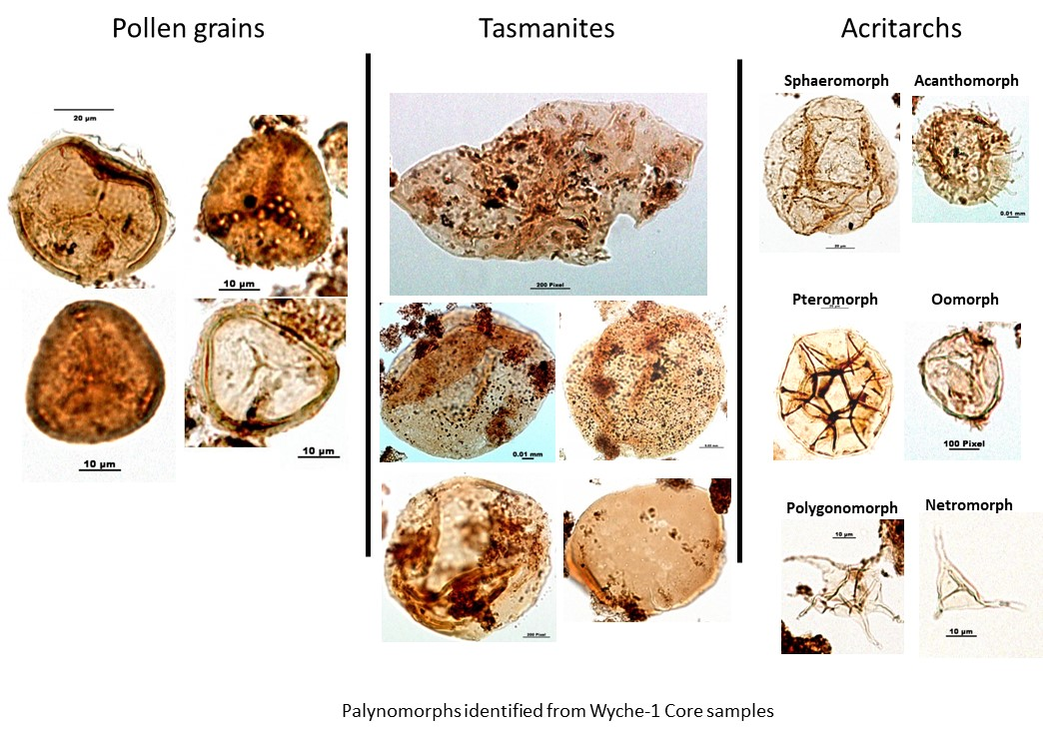
Palynological Assemblages

Slide 17
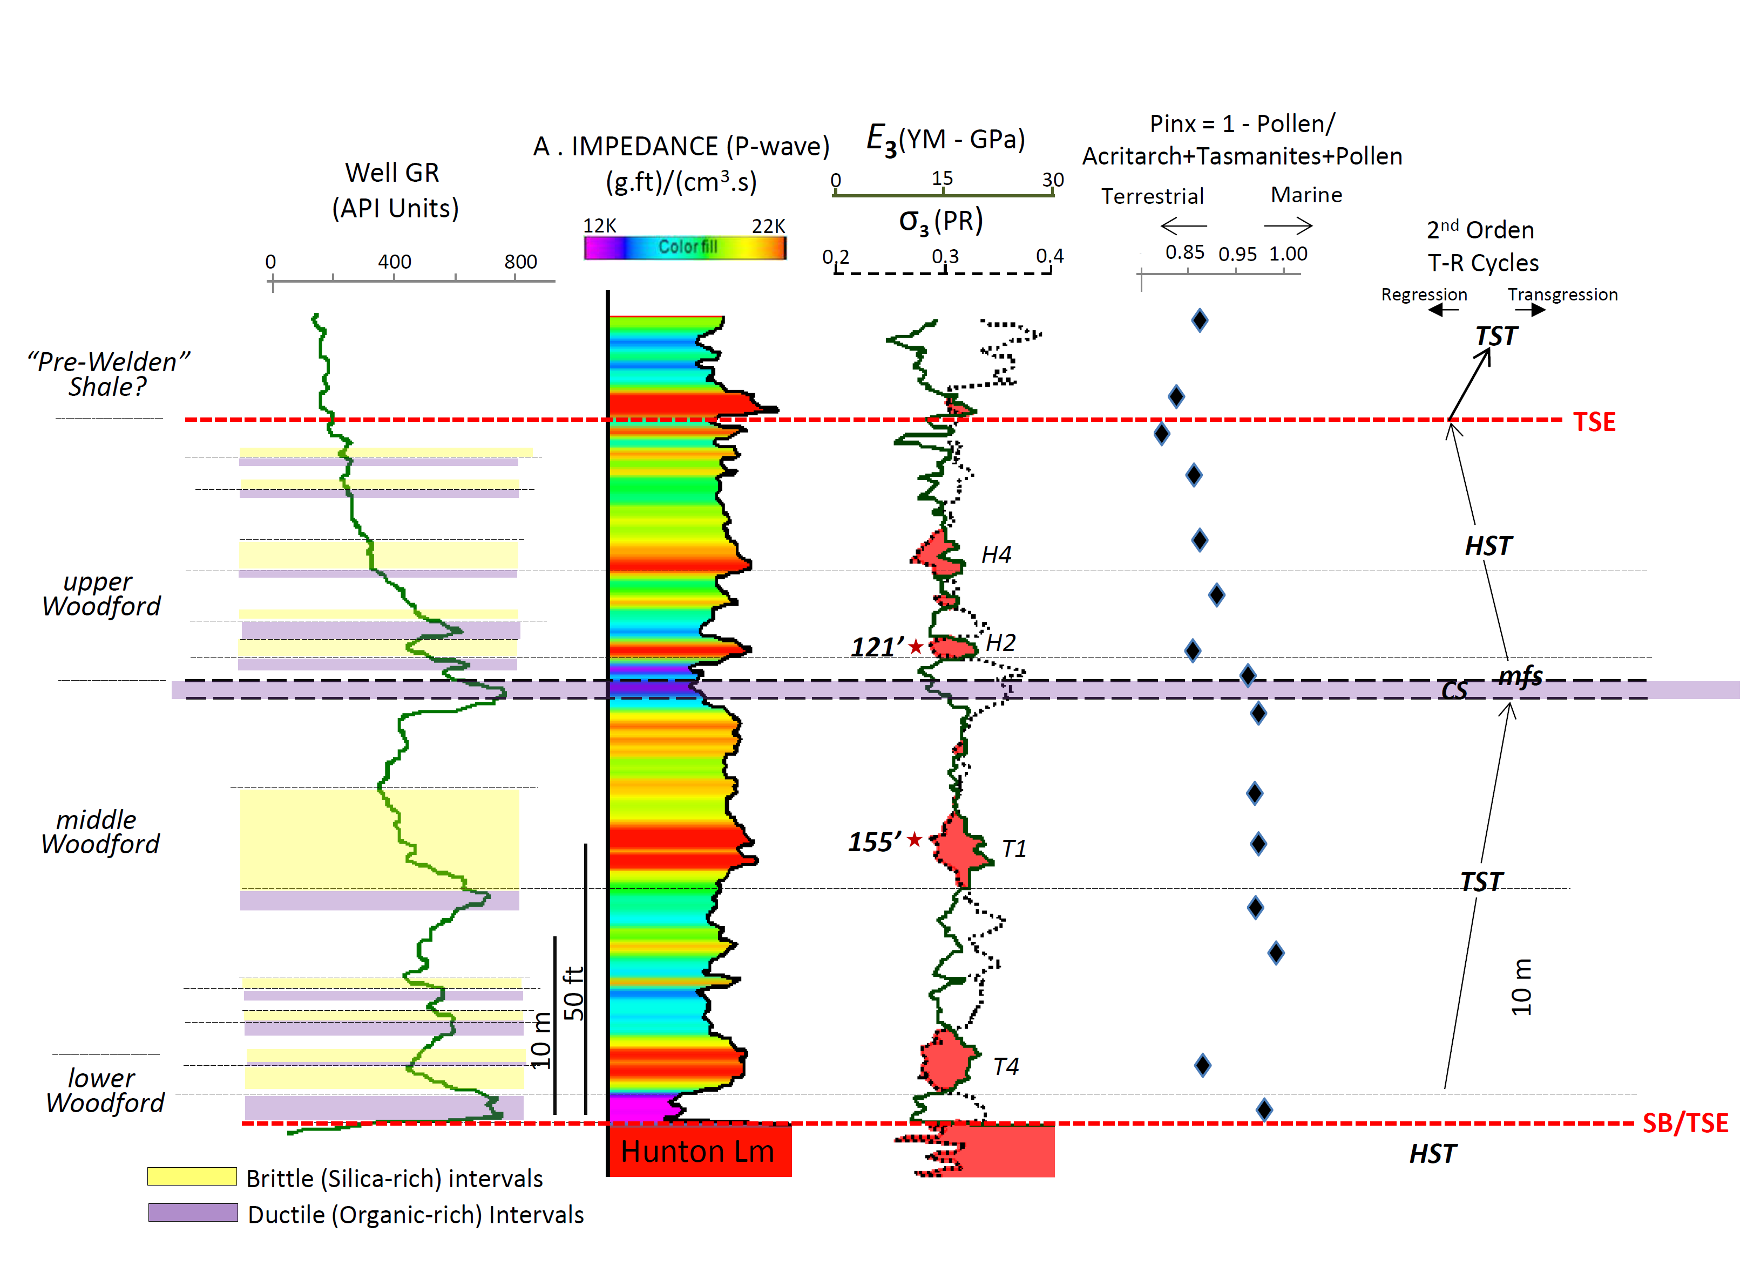
Palynological Assemblages

Slide 18
Conclusions
The Woodford Shale was accumulated during Late Devonian – Early Mississippian time and a series of positive isotopic excursion events were correlated with the Kellwasser and Hangenberg global (anoxic) events
The Ti/Al ratios and Palynological assemblages suggest a transgressive/regressive sea level turnover associated with the younger Kellwasser’s top
Higher Ti concentration values are possible associated with Ilmenite and higher Fe contents. Iron is a biolimiting factor in modern environments characterized by high nutrient (P, N) and low productivity (low-Chlorophyll)

Slide 19








Acknowledgements !
Notes:
We’d like to say a very big thank you to all the companies who have supported our research efforts at the institute of reservoir characterization over the years. We really appreciate your contributions.

Slide 20
Late Devonian Organic-Rich Woodford Shale Deposits and The Frasnian/Famennian (F/F) and Devonian Carboniferous (D/C) Global Anoxic Events
Questions?
cmolinares@ou.edu
South-Central Section - 52nd Annual Meeting - 2018
Paper No. 19-3
Little Rock, Arkansas 03-13-2018

