Slide 1
GEOCHEMICAL ANALYSIS OF A SMALL URBAN FLOODPLAIN: FOURCHE CREEK BOTTOMS IN LITTLE ROCK, ARKANSAS
Jason Simmons¹(jdsimmons1@ualr.edu), Laura S. Ruhl¹, and Erik Pollock²
¹Department of Earth Sciences, University of Arkansas at Little Rock
²Department of Geosciences, University of Arkansas at Fayetteville

Slide 2
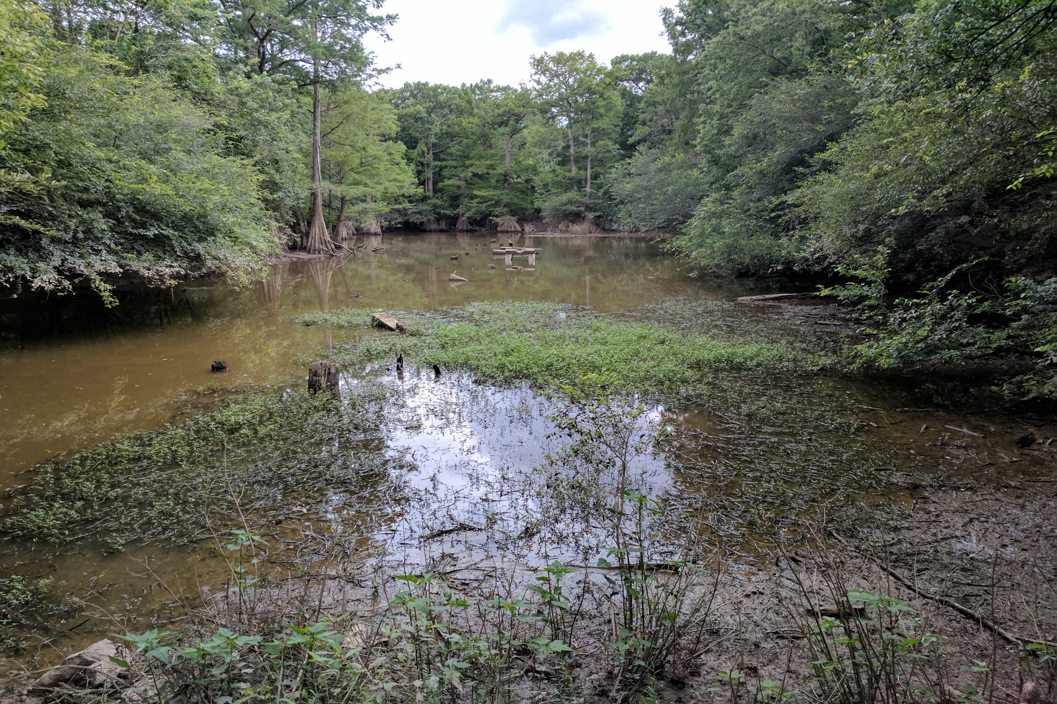
Roadmap
Fourche Creek Bottoms
Urbanization
Methods
Results and Discussion
Conclusions
References
Acknowledgements
Figure 1. Fourche Creek, Little Rock Arkansas

Slide 3
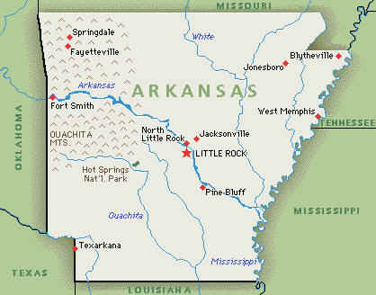
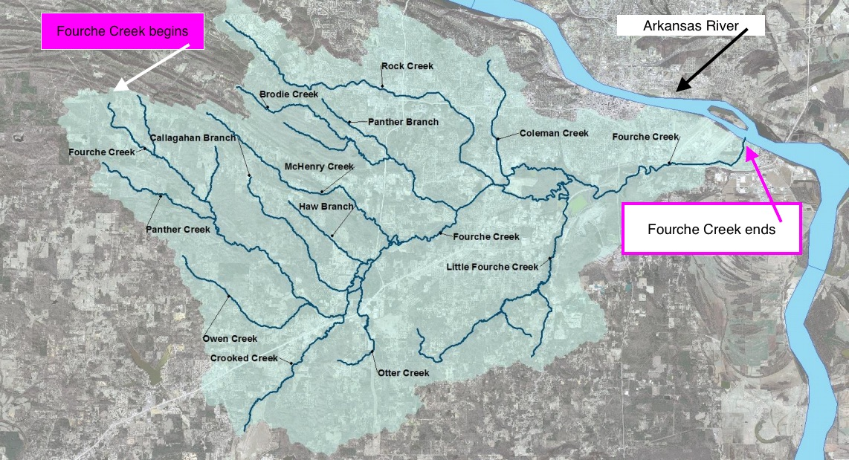
Fourche Creek Bottoms
Drains 73% of the city before emptying into Arkansas River
Contains a natural wetland
Properties of the wetlands
Wildlife Refuge
Noise Absorbance
Store 1 billion gallons of water
Contamination filtration
Figure 2 and 3. Location map of Little Rock and Fourche Creek watershed (image retrieved from Google Earth and http://www.barbsnow.net/Arkansas.htm )

Slide 4
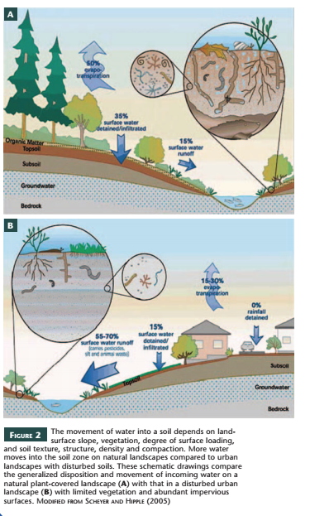
The movement of water into a soil depends on land-surface slope, vegetation, degree of surface loading,and soil texture, structure, density and compaction. More watermoves into the soil zone on natural landscapes compared to urbanlandscapes with disturbed soils. These schematic drawings comparethe generalized disposition and movement of incoming water on anatural plant-covered landscape (A) with that in a disturbed urbanlandscape (B) with limited vegetation and abundant impervioussurfaces. MODIFIED FROM SCHEYER AND HIPPLE (2005)
Disruptions to natural landscape
Loss of pervious surfaces
Increased storm water runoff
Changes to hydrologic cycle
Changes in soil chemistry
Increased flooding
Figure 6. Water movement in urban vs natural landscapes (Lyons and Harmon, 2012).

Slide 5
Environmental Concerns
New sources of pollution
Industrial
Mining
Sewage disposal and sewer overflow during flooding
Metal contamination in car exhaust
Greenhouse gas release
Watershed and water quality degradation
Contaminants enters watershed via increased storm water runoff

Slide 6
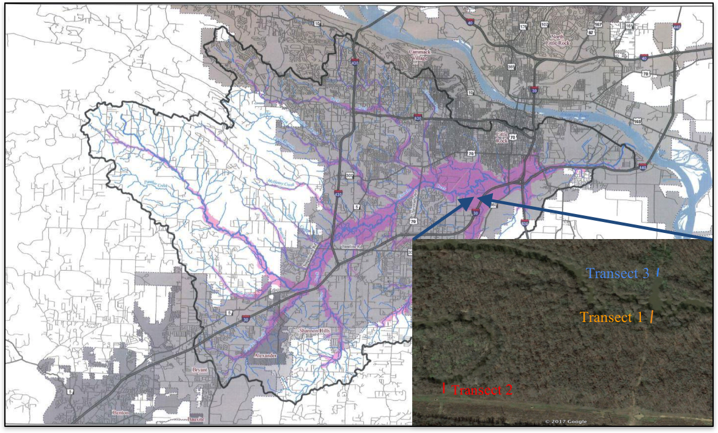
Methods
Floodplains along Fourche Creek wetlands
3 transects chosen and GPS locations recorded
44 Surface (4-5 in.) samples collected at various distances into the floodplain
Transported to UALR and dried at room temp
Figure 8. Location map of sampling area (image retrieved from audubun.org; Google Earth)

Slide 7
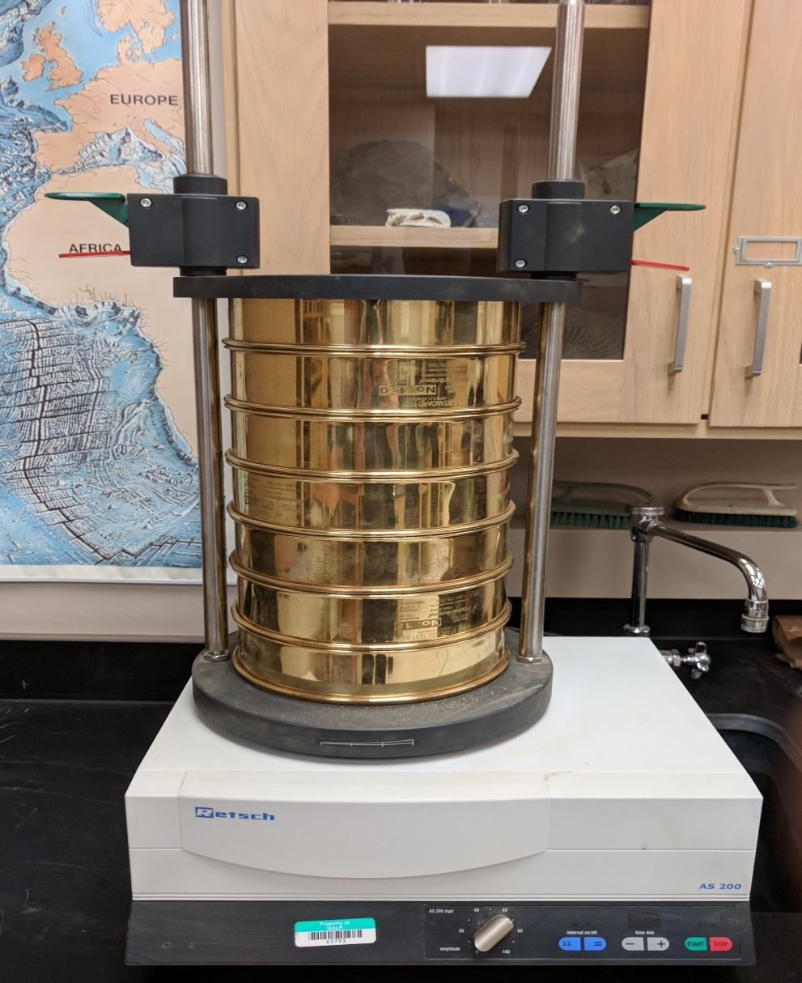
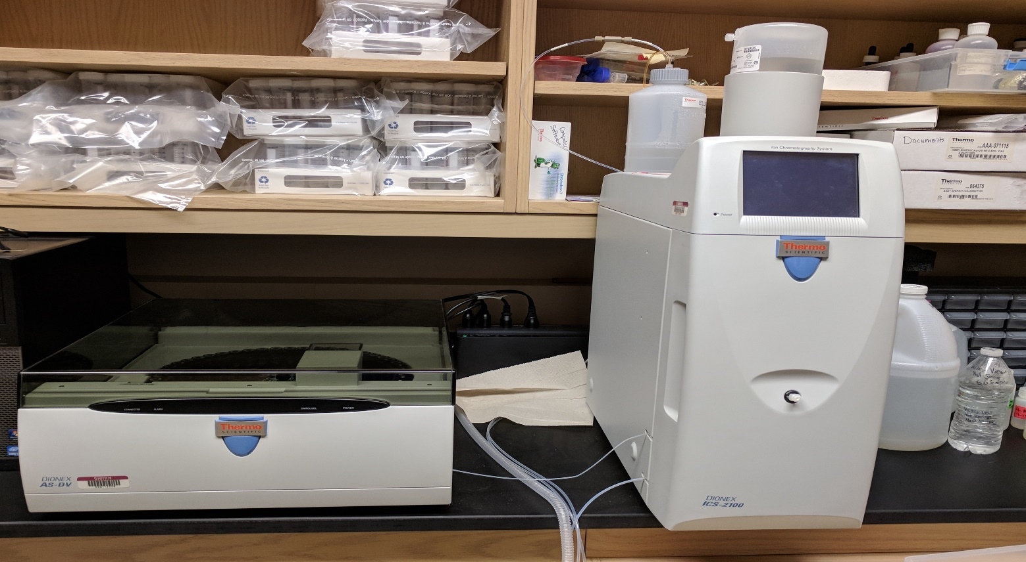
Methods
Grain size analysis performed
Standard sieves and shaker
Leaching experiments performed
10:1 liquid to solid ratio; deionized water
Combine and react 24 hrs (+/-)2hr
Centrifuged for 20 mins 10,000 rpm
Filtered with .45um filter
Leachate analyzed
Ion Chromatography (IC)
Inductively Coupled Plasma Mass Spectrometry (ICP-MS)
Figure 9. Standard Sieve, UALR
Figure 10. Ion Chromatography, UALR lab

Slide 8
Grain Size Distribution
Figure 12. Grain size at transect 1
Figure 13. Grain Size at transect 2

Slide 9
Grain Size Distribution
Overall fine to coarse grain sand
Transects 2 has largest amounts of fines
Slight variations in silt based on elevation changes in study area
Transect 2 more flat floodplain
Transect 1 and 3 steady elevation increase for first 10 feet
Homogenous grain size distribution at each location
Due to size of the study area
Quantity of each size present or washed away during a flood event
Figure 14. Grain size at transect 3

Slide 10
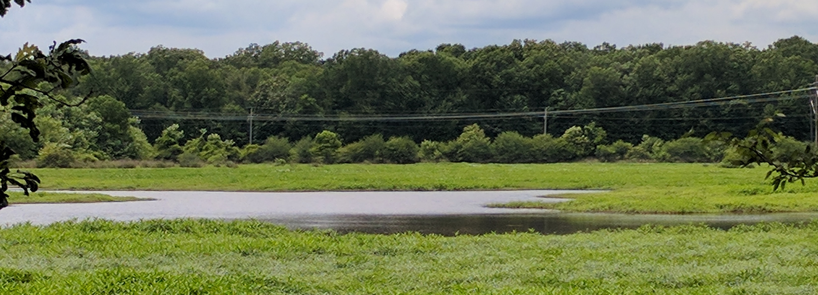
Major Ions
IC measured concentrations of eight major ions
Cations: calcium, ammonium, magnesium, sodium and potassium
Anions: sulfate, nitrate, and chloride
Most of these constituents are highest at the water’s edge which could be due to greater interactions with and accumulation from the water
Figure 16. Fourche Creek Wetlands, metropolitan Little Rock

Slide 11
Cations
Figures 17-19. Cation concentration present in our floodplain
Ca⁺ and Mg²⁺ are naturally occurring
Ca highest at water edge and decrease into the floodplain
Mg decreases at transect 2, increases at 1 and 3
Ammonium (NH⁴⁺) enters via runoff
Highest at creek bed of trans 3 then decrease. 1 and 2 increase into the floodplains
Notes:
Previous Research reveals Ca and Mg removed from water in wetlands

Slide 12
Anions
Figures 20-22. Anion concentration present in our floodplain
All three are highest at the waters edge and decrease as you move into the floodplain

Slide 13
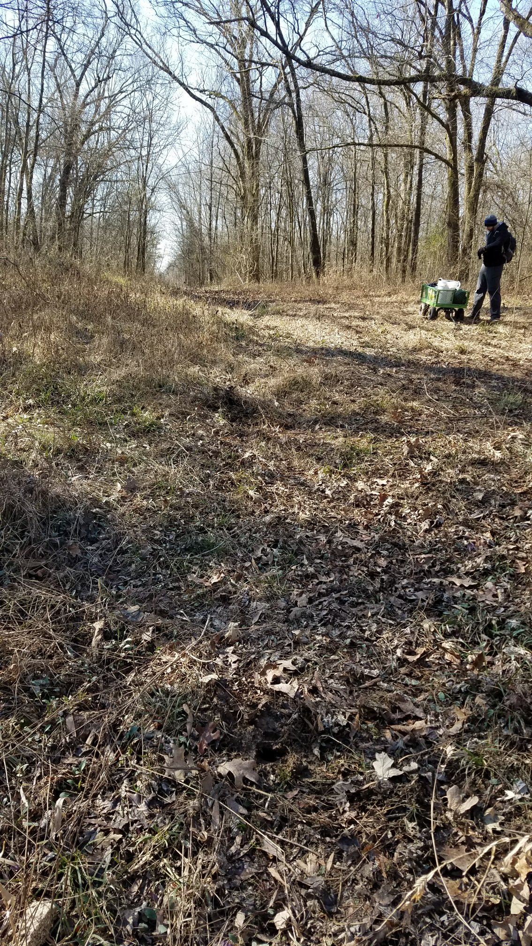
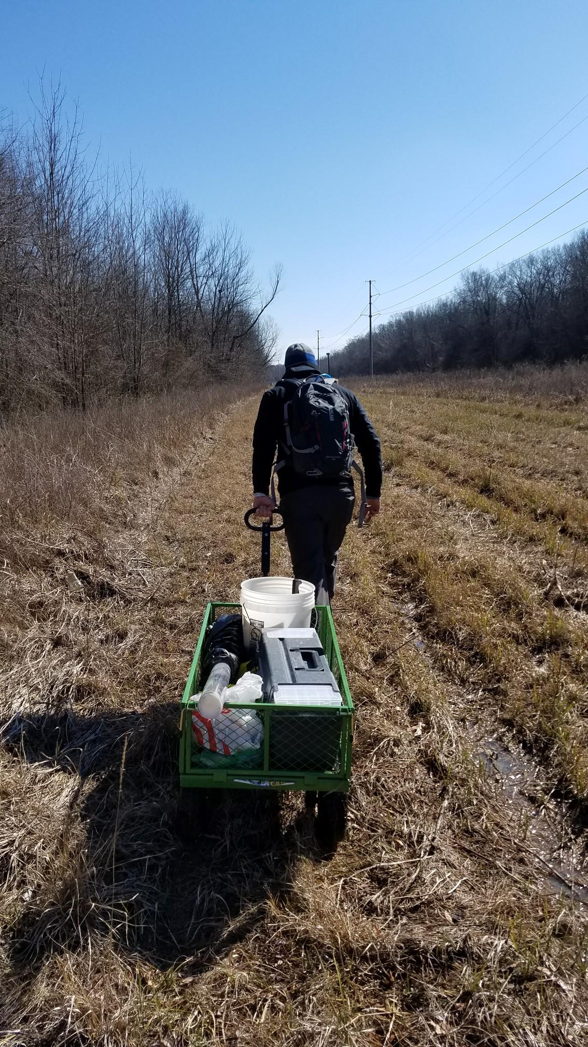
ICP-MS measured concentrations of over 40 trace elements
Figure 23 and 24. Fourche Creek Bottoms
All measurements varied with distance in the creek and location in the wetlands

Slide 14
Trace Elements
Figures 25 and 26. Selenium and Manganese concentrations
Se reached a max at 80 ft of trans 1
Se can impact aquatic life
Mn decreases as you move into the floodplain
Can adsorb other constituents and remove them from the water column

Slide 15
Trace Elements
Figure 27 and 28. Zinc, and Lead concentrations
Zn decreases as you move into the floodplain
Pb increases from the creek into the floodplain
Both from anthropogenic sources (roadways)

Slide 16
Trace Elements
Figure 29 and 30. Arsenic and Cadmium concentrations
As reached a max at 20 ft of trans 1 and then increases
Of concern for human health
Cd decreases into floodplain
Associated with creek water

Slide 17
Conclusions
We found consistent data linking the finest grain size to trace element concentrations within all locations
Several factors appear to affect the concentration in the sediment:
Grain size
Distance from the creek
Amount of interaction with the creek water
Nearby contaminant sources
Trace elements measured under USGS Geochemical Survey reference values for this area and EPA freshwater sediment quality guidelines
Due to differences in testing; leaching vs acid dissolution

Slide 18
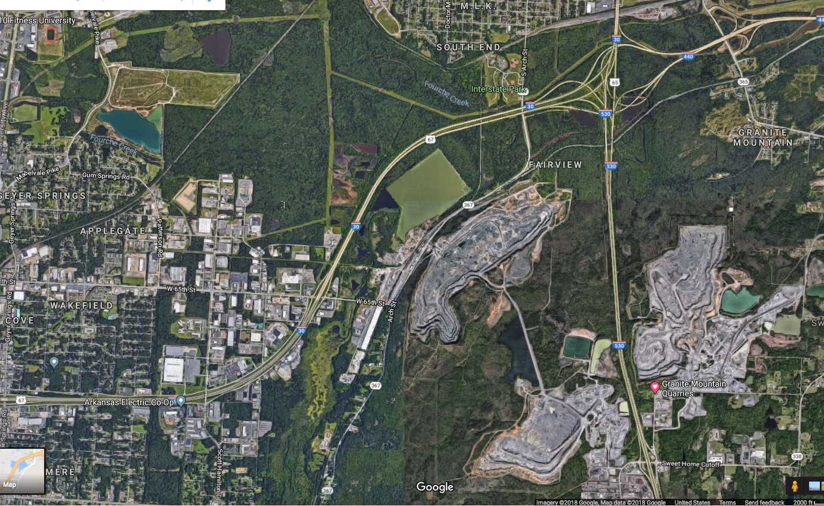
Conclusions Cont.
Study Area
Industrial District
Mining Area
Figure 30. Study area and surrounding area (retrieved from Google Earth
Broader Impacts
Locally affects fish and wildlife and humans who consume them
Empties into Arkansas River
This study helps provide a better understanding of urban wetlands role in ecological health

Slide 19
Current work
To assess results as related to watershed health:
Eleven surface samples collected in Feb 2018
Two core samples
Samples collected after a storm event
In process of analyzing samples
Background sample site chosen for comparison of all results

Slide 20
References
Albanese, S. and Breward, N., 2011. Sources of anthropogenic contaminants in the urban environment. Chapter 8. In: Johnson, C.C.,
Demetriades, A., Locutura, J. and Ottesen, R.T., eds., Mapping the chemical environment of urban areas, Chichester, U.K., John Wiley & Sons, Ltd, 116-27.
Alvarez E, Perez A, Calvo R. 1993. Aluminum speciation in surface waters and soil solutions in areas of sulphide mineralization in Galicia (N.W. Spain). Sci Total Environ 133:17-37.
Agency for Toxic Substances and Disease Registry (ATSDR). Toxicological profile index. Atlanta, GA: U.S. Department of Health and Human Services, Public Health Service. https://www.atsdr.cdc.gov/ (accessed October 2017 – March 2018)
http://ar.audubon.org/fourche-creek (accessed October 15, 2017)
Chen, J., Theller, L., Gitau M. W., Engel, B.A. Harbor, J. M., 2016. Urbanization impacts on surface runoff of the contiguous United States: Journal of Environmental Management 187, p. 470-481.
De Vos, W. & Tarvainen, T. (Chief-editors) & Salminen, R. & Reeder, S. & De Vivo, B. et al. 2006: Geochemical Atlas of Europe. Part 2: Interpretation of Geochemical Maps, Additional Tables, Figures, Maps, and Related Publications. 690 p.
Eckel WP, Jacob TA. 1988. Ambient levels of 24 dissolved metals in U.S. surface and ground waters. Am Chem Soc Div Environ Chem 28:371-372.

Slide 21
Elinder CG. 1985a. Cadmium: Uses, occurrence and intake. In: Friberg L, Elinder CG, Kjellström T, et al., eds. Cadmium and health: A toxicological and epidemiological appraisal. Vol. I. Exposure, dose, and metabolism. Effects and response. Boca Raton, FL: CRC Press, 23-64.
Elinder CG. 1992. Cadmium as an environmental hazard. IARC Sci Publ 118:123-132
Filipek LH, Nordstrom DK, Ficklin WH. 1987. Interaction of acid mine drainage with waters and sediments of West Squaw Creek in the West Shasta mining district, California. Environ Sci Technol 21:388-396.
Lyons, B.W. and Harmon, R.S., 2012. Why Urban Geochemistry: Elements, Vol. 8, p. 412-422.
Schueler, T.R., 1994. The importance of imperviousness. Watershed Protection Techniques vol.1 (30), p. 100-111.
Smith RA, Alexander RB, Wolman MG. 1987. Water-quality trends in the nation's rivers. Science 235:1607-1615.
United Nations, Population Division, Department of Economic and Social Affairs, 2017, World Urbanization Prospects, the 2017 Revision: Data Tables and Highlights; UN Directorate: New York.
U.S. Environmental Protection Agency. 1984a. Health assessment document for chromium. Research Triangle Park, NC: Environmental Assessment and Criteria Office, U.S. Environmental Protection Agency. EPA600883014F.

Slide 22
U.S. Environmental Protection Agency. 1986a. Air quality criteria for lead. Research Triangle Park, NC: U.S. Environmental Protection Agency, Office of Research and Development, Office of Health and Environmental Assessment, Environmental Criteria and Assessment Office. EPA600883028F.
U.S. Environmental Protection Agency. 1986b. Quality criteria for water. Washington, DC: U.S. Environmental Protection Agency, Office of Water Planning and Standards. EPA440586001.
U.S. Environmental Protection Agency. 1995. National Primary Drinking Water Regulations: Barium {Technical Version}. https://nepis.epa.gov accessed December 29, 2017.
U.S. Environmental Protection Agency, 2003a. Health effects support document for manganese. U.S. Environmental Protection Agency. EPA822R03003.

Slide 23
Acknowledgements
This study would not have been possible with out the help of Matt Carey who assisted in field sampling, and in providing much needed lab assistance. Funding for this project is provided by the UALR Signature Experience Grant.

