Slide 1
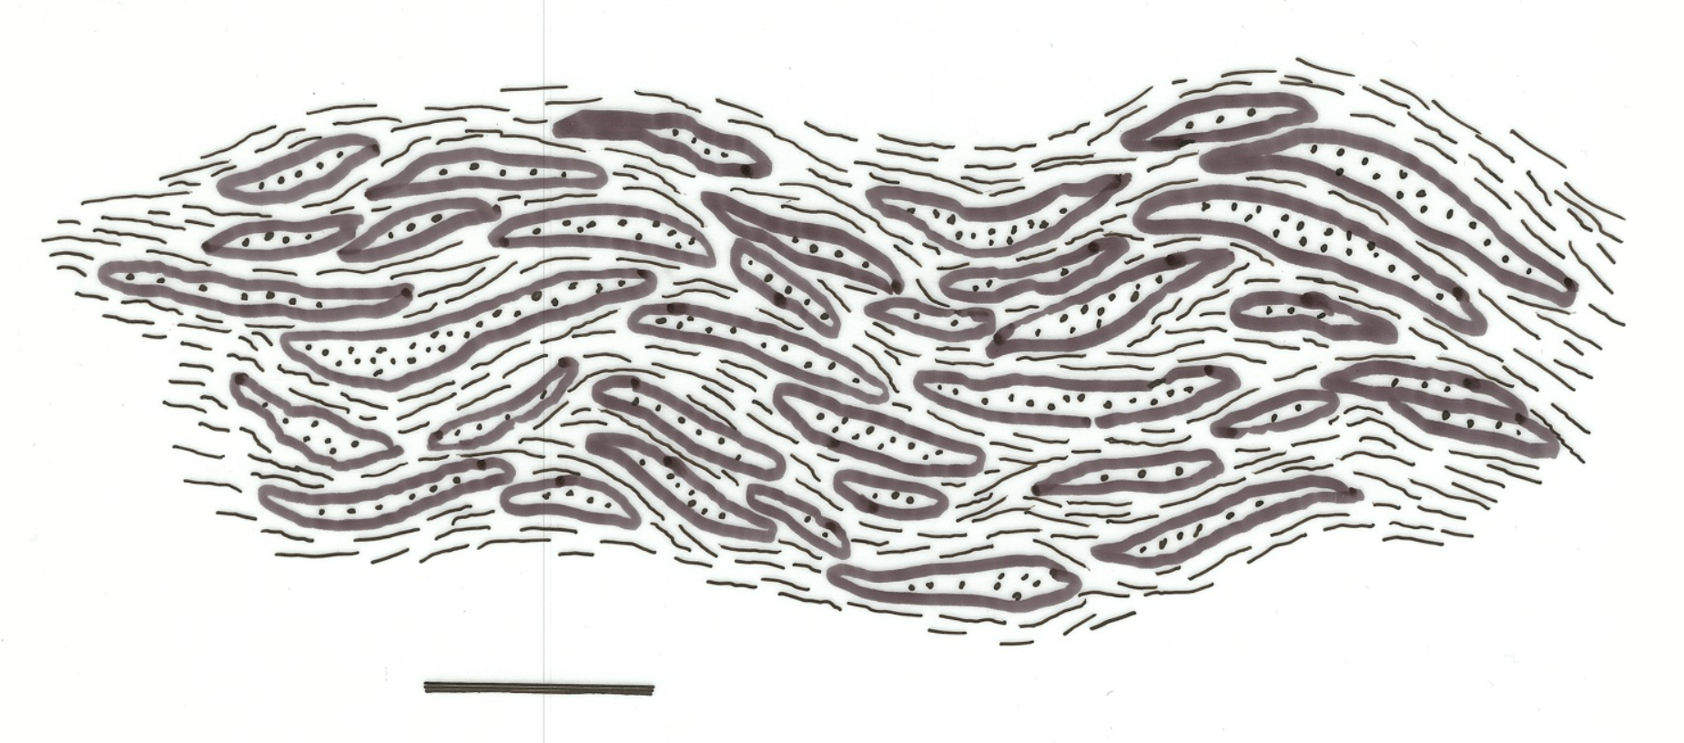
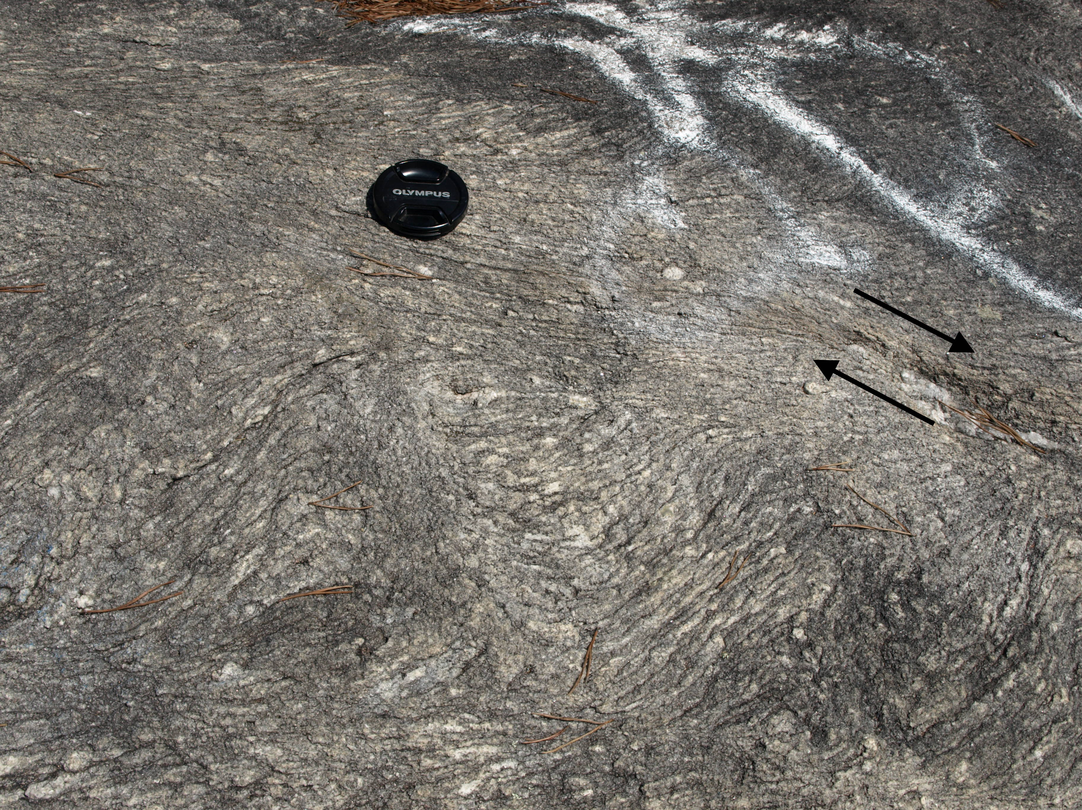
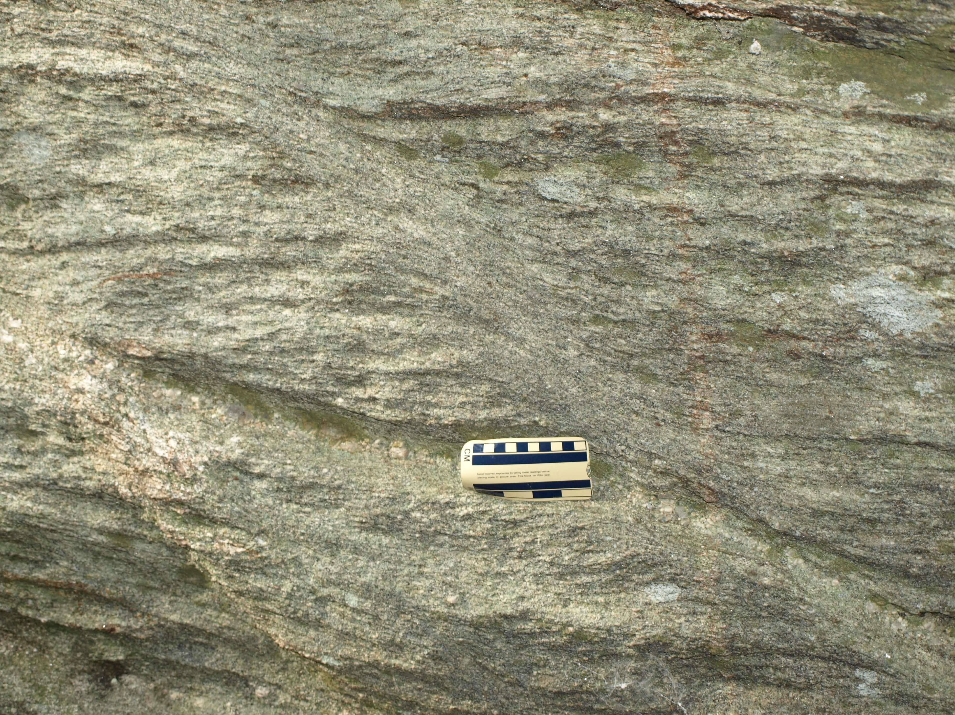
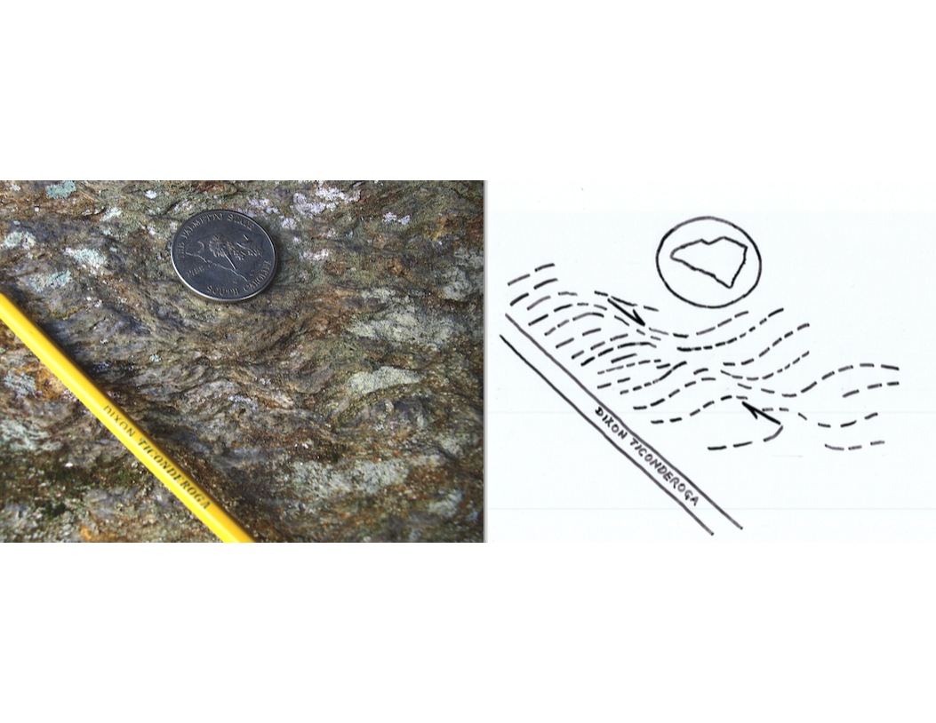
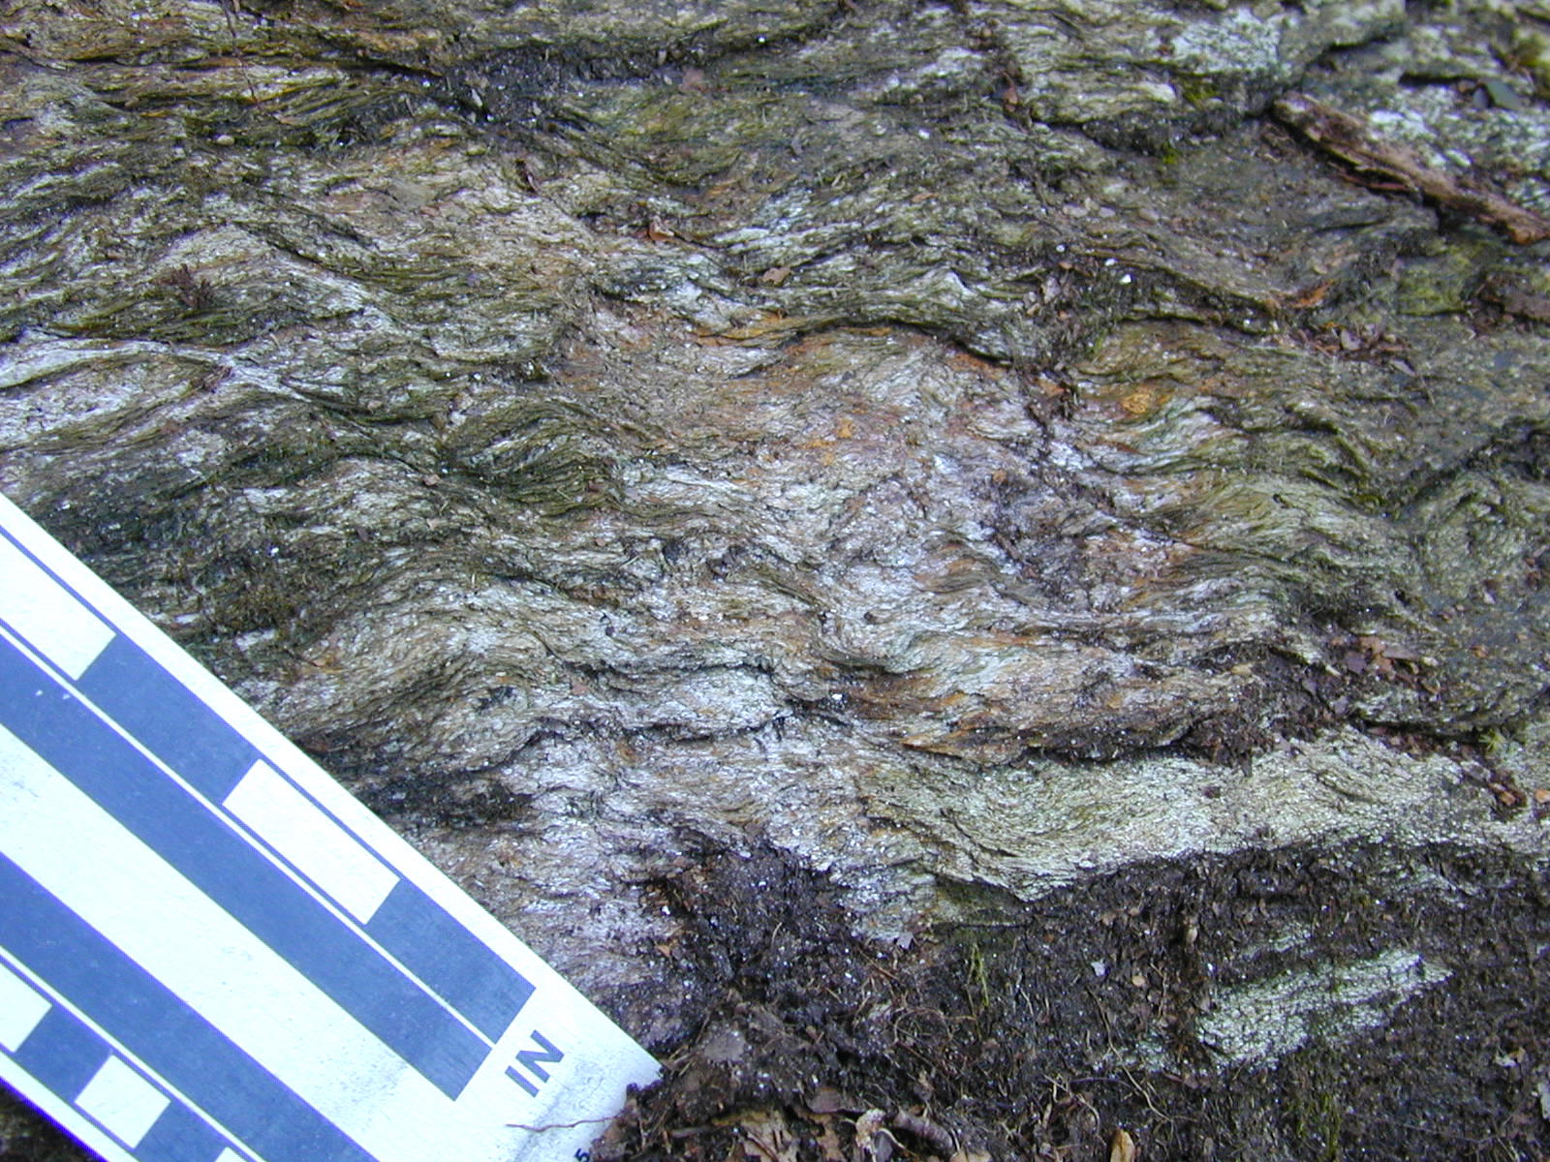
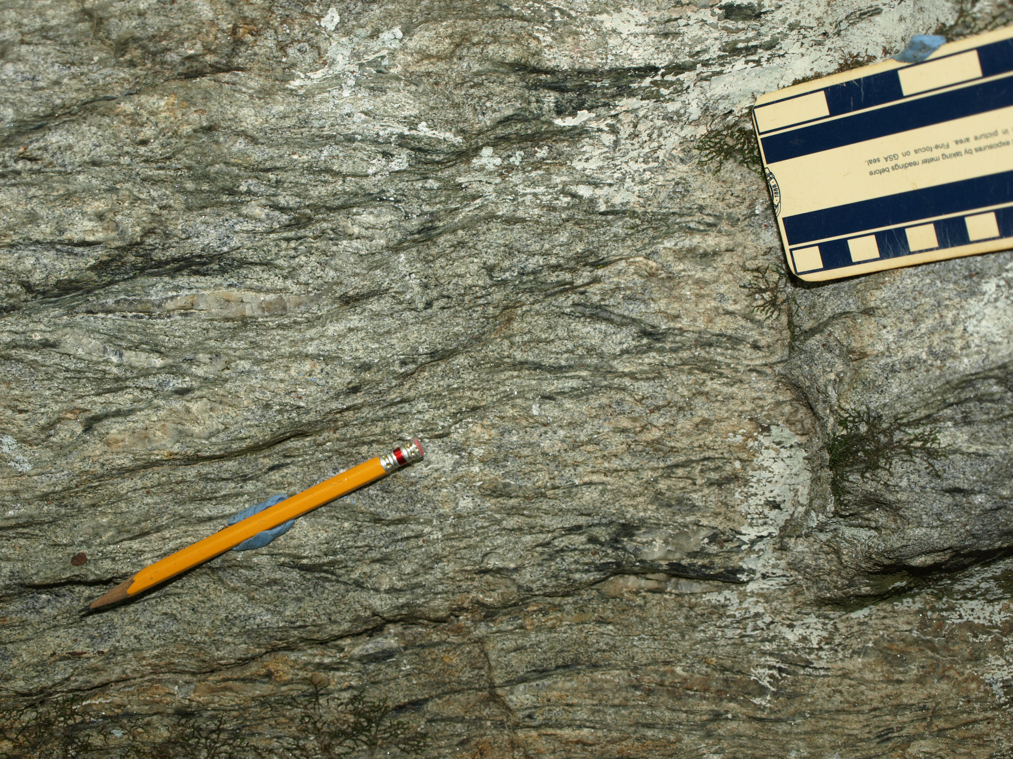
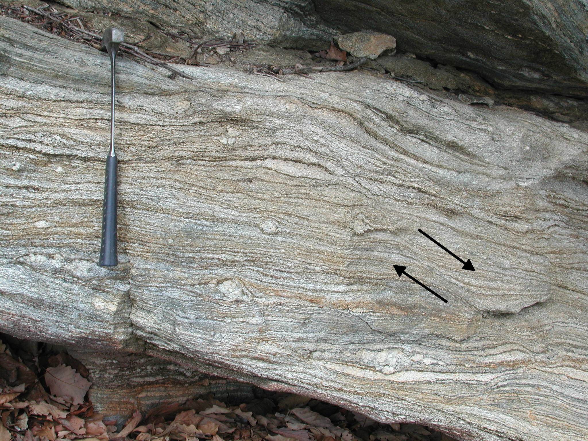
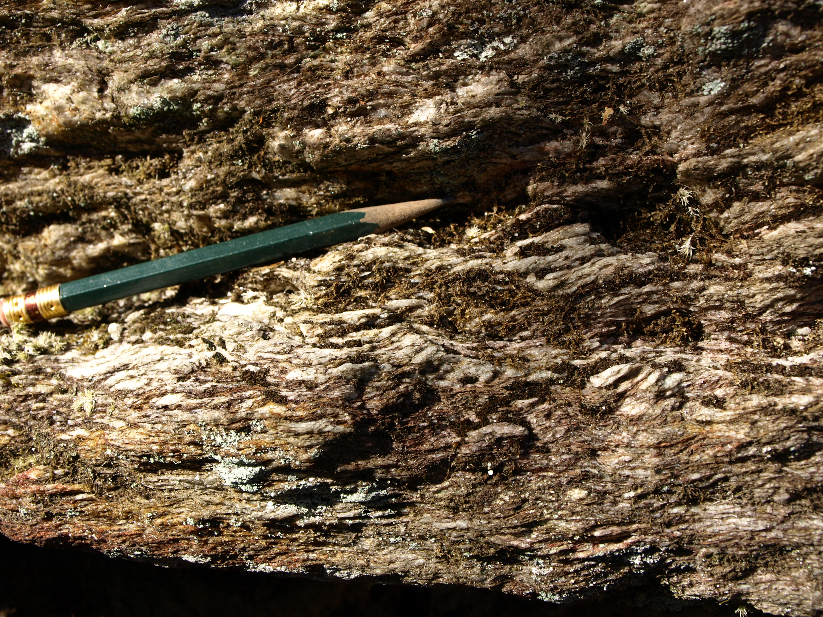
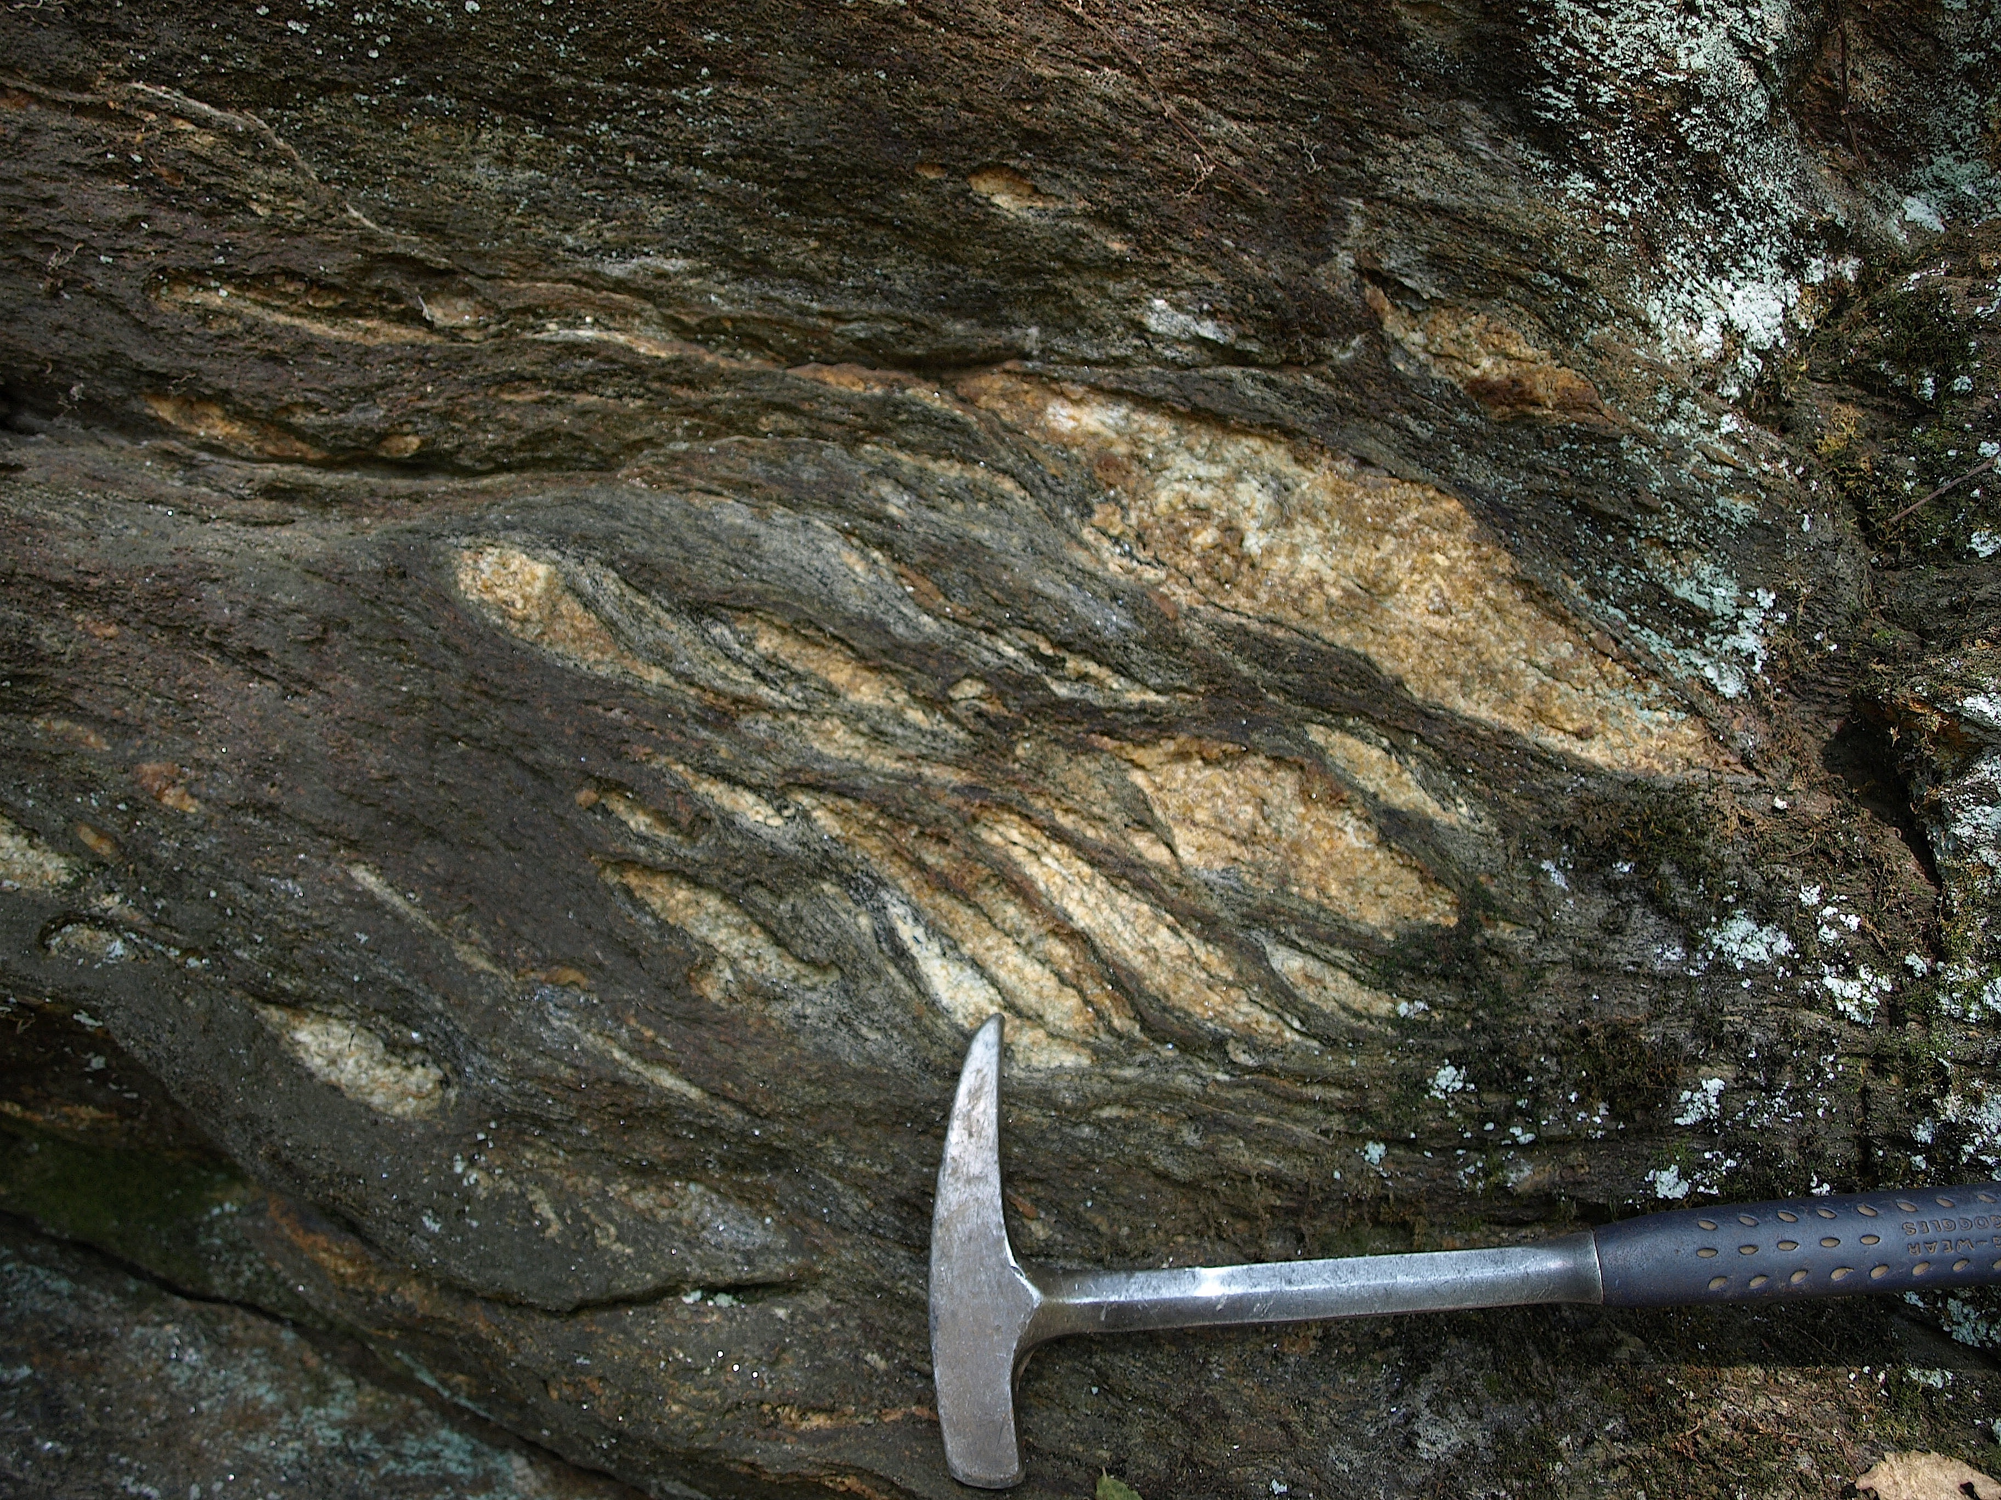
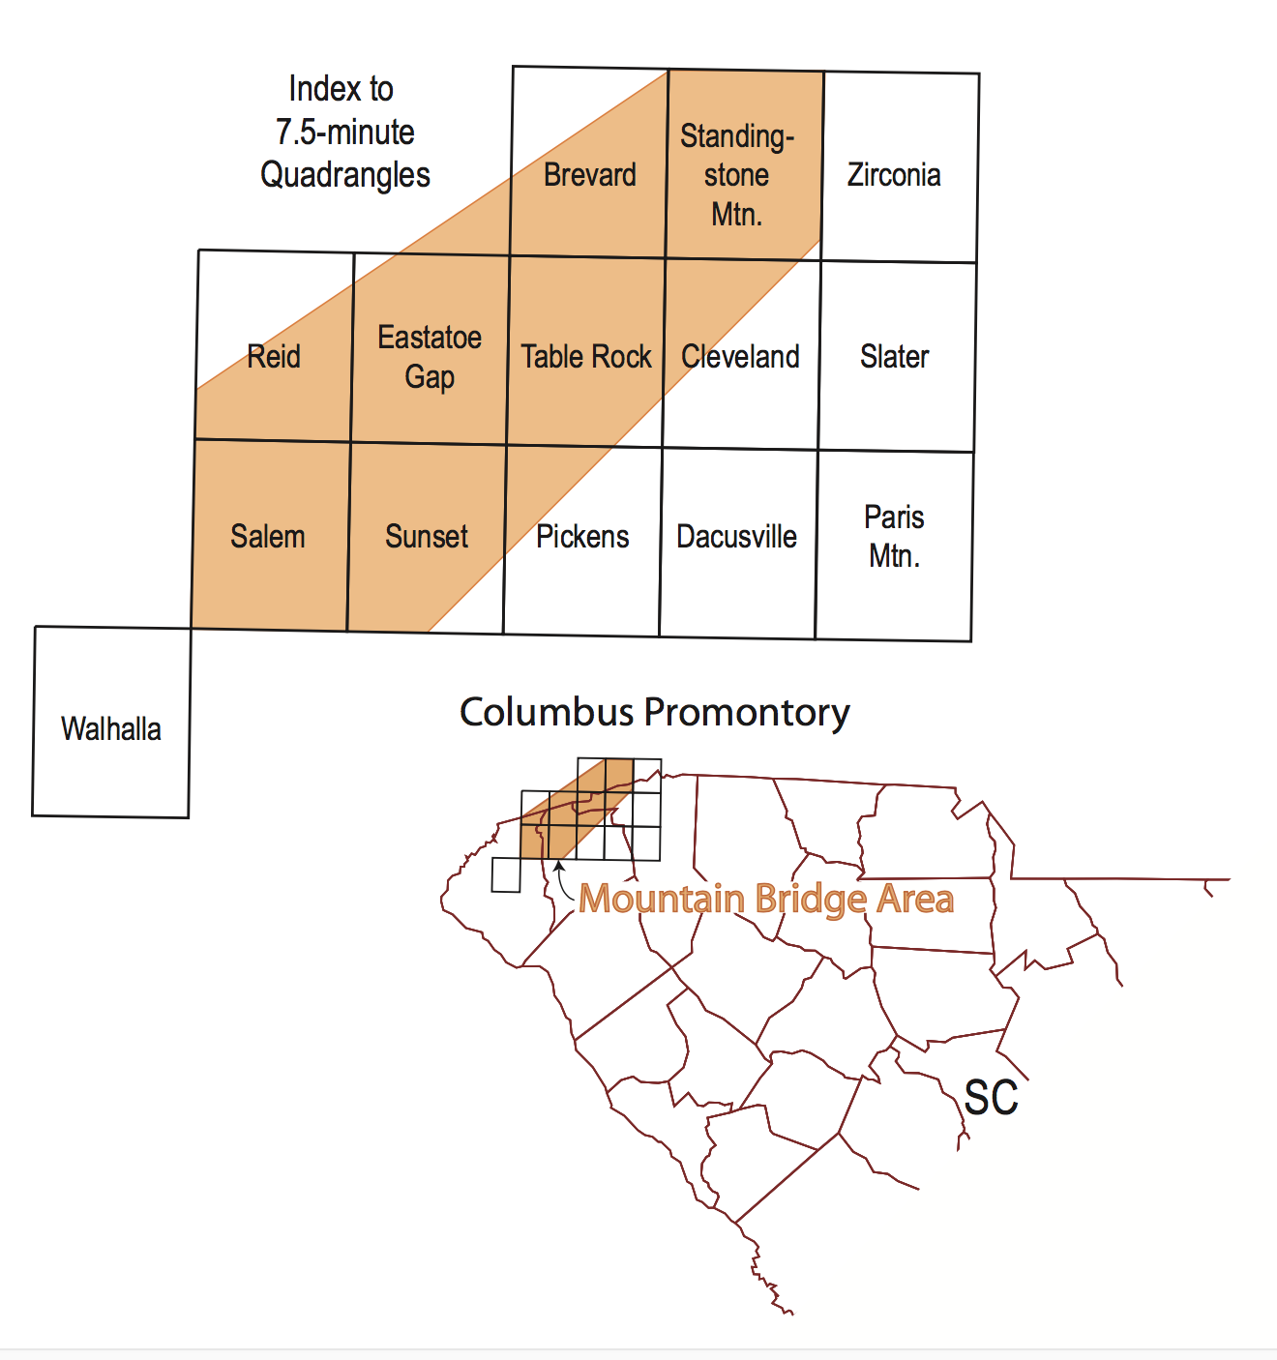
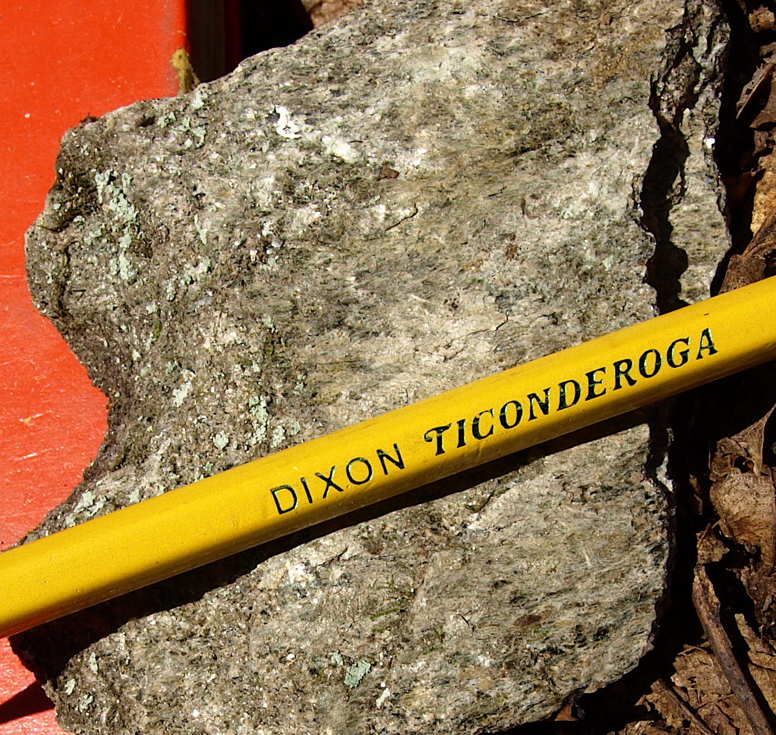
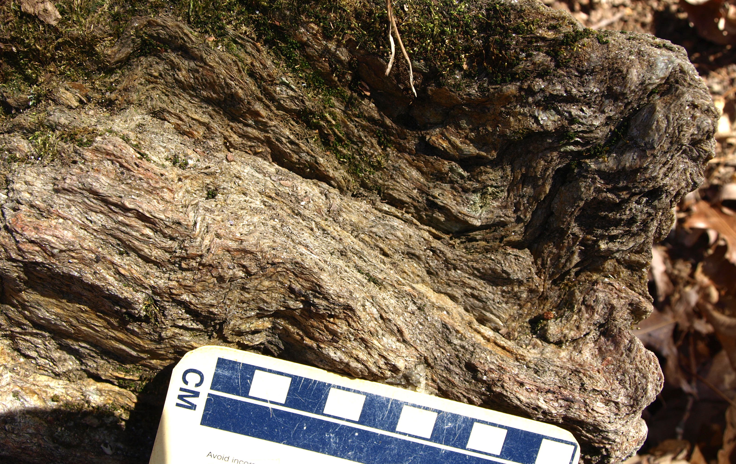
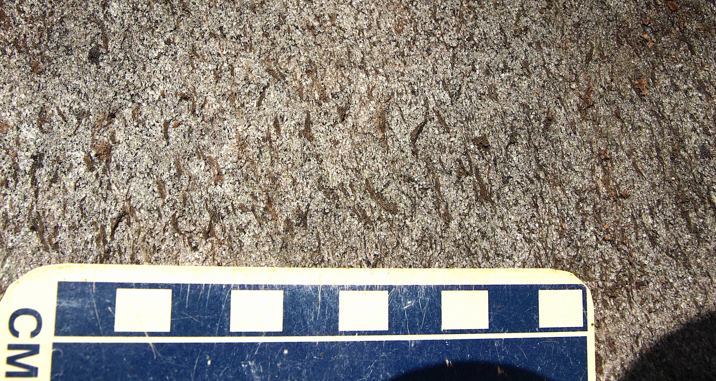
GRAVITATIONAL COLLAPSE OF THE WESTERN INNER PIEDMONT DUCTILE THRUST STACK, SOUTH CAROLINA AND ADJACENT NORTH CAROLINA
John M. Garihan, Earth & Environmental Sciences Department,
Furman University, Greenville, SC 29613
Figure 3. Geologic sketch maps of two shear zones. UTM coordinates shown. A. Folded Mine Mountain shear zone, Standingstone Mountain quadrangle. MM- Mine Mountain. RR- Reasonover Road. SZ- shear zone. Fault (movement sense unknown) truncates shear zone to north. Drainages shown as unlabeled dashed lines. B. Folded Pinnacle Mountain trail shear zone, Cleveland quadrangle. CH- Caesars Head community. SZ- shear zone. Caesars Head fault- open sawtooth line. US 276 labeled. Drainages shown as unlabeled dashed lines.
ABSTRACT
INTRODUCTION
In the SC-NC western Inner Piedmont (IP), subsequent to compressional polyphase folding
and stacking of the Seneca and Eastatoee ductile thrusts, a variety of ductile features
developed near the base and within the Walhalla-Six Mile thrust stack. That is, they developed
at all infrastructural levels within a presumably warm, plastic orogenic wedge of thickened crust.
The extensional features, interpreted as due to gravitational collapse, are: 1) small-scale ductile
normal faults, 2) S-C’ and S-C-C’ in schist, 3) and sheared, asymmetric quartzo-feldspathic lenses
in schist; features are identified in Chauga River Formation garnet schist, Table Rock gneiss (TG), Poor Mountain Formation amphibolite, and Tallulah Falls Formation paragneiss and schist. Examples of these features (Figures 2a-e) from all structural levels within the orogenic pile consistently indicate top-to-the-SW shear sense, but also locally to the S and SE.
Southwest- to southeast-directed gravitational collapse of an oversteepened ductile thrust stack produced numerous greenschist-grade muscovite-quartz schist-phyllonite zones in western Inner Piedmont rocks of South Carolina and adjacent North Carolina. Collapse occurred subsequent to a complex tectonic history involving Ordovician supra-subduction zone granitic intrusion, early-middle Paleozoic polyphase folding episodes (regional NW-, W-, and SW-vergent folds), amphibolite-facies metamorphism, compressional ductile thrusting (emplacement of the Seneca fault-Six Mile and Eastatoee fault-Walhalla crystalline thrust sheets), and regional Type-1 interference folding. Ductile features produced by collapse include S-C’ and S-C-C’ fabrics, sheared asymmetric quartzo-feldspathic lenses in schist, and meso-scale normal faults. These extensional structures developed in Chauga River Formation garnet schist, Table Rock gneiss, Poor Mountain Formation amphibolite, and Tallulah Falls Formation schist and paragneiss units. Widespread extensional shear zones lie at the base of the collapsing stack (within the Chauga River Formation, near a rheological contrast with overlying more rigid Poor Mountain amphibolite) and at diverse infrastructural levels within the presumably warm, plastic orogenic wedge of thickened crust. Sense of shear on these dextral extensional structures is everywhere consistently top-to-the-southwest, although locally it is to the south and southeast. Subsequent folding and brittle thrusting episodes deformed these older shear zones.
Regional relationships suggest the timing of western Inner Piedmont gravitational collapse and development of associated shear fabrics occurred prior to Alleghanian orogenesis and prior to Acadian Brevard zone orogenesis. The Brevard zone later incorporated the older Eastatoee fault and the collapse-related, extensional fabrics of the Chauga River Formation into its own complex array of thrust and fold structures.
Figure 4. Sketch of typical shear zone texture. Lenses- fine-crystalline, equigranular quartz. Lines- aligned muscovite. Bar- 1 cm.
Figure 5. Shear fabrics in muscovite-quartz schist, Mine Mountain shear zone. a. S-C’ fabric, west limb of eastern syncline of Figure 3A. S surfaces dip gently left. C’ surfaces parallel to edge of scale. View SE; top-to-right shear sense. Scale in inches. b. S-C’ fabric, with interpretation, west limb of same eastern syncline. S surfaces dip gently to left. C’ surfaces parallel to pencil. View SE; top-to-right shear sense. Coin 2.6 cm. c. S-C-C’ fabric, E limb of eastern syncline of Figure 3A. Prominent quartz lenses. S surfaces dip gently left, approximately parallel to green pencil. C surfaces horizontal. Poorly developed C’ surfaces dip upper left to lower right. View NW; top-to-right shear sense. Folding reverses shear sense direction between a., b., and this view, c.
GENERALIZED TECTONIC HISTORY, WESTERN INNER
PIEDMONT, MOUNTAIN BRIDGE AREA, SC AND NC
A general tectonic history of the Mountain Bridge area (Figure 1) and quadrangles east, based geologic mapping is:
Late Ordovician supra-subduction zone granitic intrusion into metasedimentary and metaigneous protoliths.
Early (Taconic)- to Mid-Paleozoic polyphase folding, metamorphism, migmatization, and compressional folding-ductile thrust stacking episodes.
regional Type-1 interference folding.
regional extension along ductile schist-phyllonite zones, produced during SW-directed gravitational collapse of an oversteepened thrust stack.
Mid-Paleozoic (Acadian) formation of structural windows related to regional dextral strike-slip faulting.
Late Paleozoic (Alleghanian) thrusting and hinterland-directed, brittle back-thrusting and folding.
and Mesozoic brittle faulting and Jurassic diabase dike intrusion.
Figure 2. Shear sense features. a. ductile shear zone in Table Rock augen gneiss, Bald Rock, Cleveland quadrangle. View SE, top-to-right, normal shear sense. Lens cap 6 cm. b. ductile fault in Table Rock granitoid gneiss, Saluda quadrangle. View E, top-to-right normal shear sense. Upper scale in cm. c. S-C-C’ in Table Rock gneiss, Cleveland quadrangle. S surfaces (gneiss foliation) dip gently right, C surfaces horizontal, C’ surfaces parallel to yellow pencil. Lower scale in cm. View W; top-to-left shear sense. d. ductile shear zone in Tallulah Falls gneiss, Saluda quadrangle. View to NE; top-to-right normal shear sense. Hammer 40 cm. e. Assymetric quartzo-feldspathic lenses in Tallulah Falls schist, Cleveland quadrangle. View NW, top-to-left shear sense. Hammer 40 cm.
PINNACLE MOUNTAIN TRAIL SHEAR ZONE.
The Pinnacle Mountain trail crosses a shear zone on an E-W ridge of TG south of Caesars Head, NW Cleveland quadrangle. At its south end, the shear zone (Figure 3B) is truncated by a younger thrust of the Caesars Head fault system. The shear zone is not present south of the thrust. The garnet-sillimanite-muscovite-quartz schist as a discrete zone dies out within gneiss at its north end. S-C structures are poorly developed in this schist zone.
The texture of this shear zone is similar to that at Mine Mountain. However, sillimanite occurs as moderately- to well-aligned needles on thin, satiny (fine-crystalline) muscovite-quartz schistosity surfaces (Figure 6a). Thin lenses and discontinuous layers a few millimeters wide of clear, glassy, fine-crystalline, equigranular quartz are enveloped by schistose, anastomosing S-C’ tapered buttons of fine- to medium-crystalline muscovite and scattered limonite after euhedral pyrite. Euhedral garnet (generally 1-2 mm) grew within the quartzose lenses and within schistosity. Tight-close chevron folds up to a few centimeters across deform aligned sillimanite needles on schistosity surfaces (Figure 6b). In places a wavy, thin (1-2 mm), S-C’ fabric with or without aligned sillimanite needles, disrupt chevron limbs and lie parallel to their axial surfaces, as a discrete crenulation cleavage. That is, continuous, thin micaceous schistosity surfaces envelop individual chevrons. In addition, schistosity is warped by later gentle, upright folds.
A sheared texture developed adjacent to the discrete shear zone near its northern end (Figure 3B). Isolated aggregates of fine- to coarse-crystalline, ragged muscovite form dark gray buttons 1-2 mm thick (Figure 6c) in TG. Field observations suggest that narrow zones of movement at its northern end were distributed across a wide zone in the enclosing gneiss and migmatitic biotite schist. The shear zone in this way dies out to the N and E.
The Pinnacle Mountain trail shear zone was folded along an E-W strike and truncated by a Caesars Head thrust (Figure 3B). The addition of sillimanite in Pinnacle Mountain trail rocks suggests the adjacent Caesars Head thrust fault brought up, in its hanging wall, a ductile shear zone which was initially at elevated, sillimanite-grade temperatures consistent with greater depths in the orogenic pile. The absence of sillimanite in Mine Mountain greenschist-grade shear zone rocks, north of known back-thrusts, suggests their contemporaneous development at a shallower, cooler temperature position in the orogenic pile.
SHEAR ZONES PRODUCED BY GRAVITATIONAL COLLAPSE
Many widespread shear zones are present regionally; only three are described in detail here. The shear zones are composed of ductile muscovite-quartz schist (up to a few meters thick) and fine biotite-coarser muscovite quartzo-feldspathic TG. Muscovite formed at the expense of K-feldspar under greenschist facies conditions; growth was facilitated by circulating fluids. Muscovite in TG typically is up to five modal percent of the rock and fine-crystalline; coarser muscovite comprises up to forty modal percent of the sheared quartzo-feldspathic gneiss.
Two typical, texturally and structurally similar shear zones from the core of the Walhalla-Six Mile thrust stack are described.
MINE MOUNTAIN SHEAR ZONE
Mine Mountain is located in SW Standingstone Mountain quadrangle, in an area of TG (Figure 3A). The greenschist grade shear zone is comprised of a weathered, fine- to medium-crystalline garnet-muscovite-quartz schist with accessory pyrite. Schistosity is deflected around meter-scale pegmatite lenses. The rock is more resistant than the surrounding saprolitic gneiss and forms low ledges along strike. Shear zone thickness is variable along strike, estimated to be a few meters to tens of meters wide. In a few places, there are several parallel shear zones, separated by TG. The Mine Mountain shear zone is truncated to the north by a NE-striking fault.
The texture in the shear zone varies little along the length of the zone. Thin lenses and discontinuous layers of clear, glassy, fine-crystalline, equigranular quartz, euhedral to tapered garnet, and limonite after euhedral pyrite are embedded in schistose, wavy, S-C’ fabric (Figure 4). This texture resembles a strongly flattened honeycomb geometry, with cell walls being the schistose micas. Millimeter to centimeter scale chevron folding of schistosity is present locally.
The shear zone has been folded, with map-scale synforms showing arcuate axial traces (Figure 3A). An S-C’ fabric is well developed, particularly along both limbs of the eastern synform (Figure 5a, b). On the western limb of the eastern synform, C’ shear bands indicate top-to-the-SW movement. On the eastern limb the sense of shear is reversed due to the folding, indicating top-to-the-NE (Fig. 5c).
Figure 6. Shear fabrics in in sillimanite-muscovite-quartz schist, Pinnacle Mountain trail shear zone. a. Moderately- to well-aligned, prismatic sillimanite needles (parallel to pencil) on schistosity surface. b. Chevron folding of schistosity and prismatic sillimanite. Scale in cm. c. Dark buttons composed of ragged muscovite aggregates, Table Rock gneiss, near the northern end of the PMT shear zone. Scale in cm.
Figure 1. Index to quadrangles, Mountain Bridge area

