Slide 1
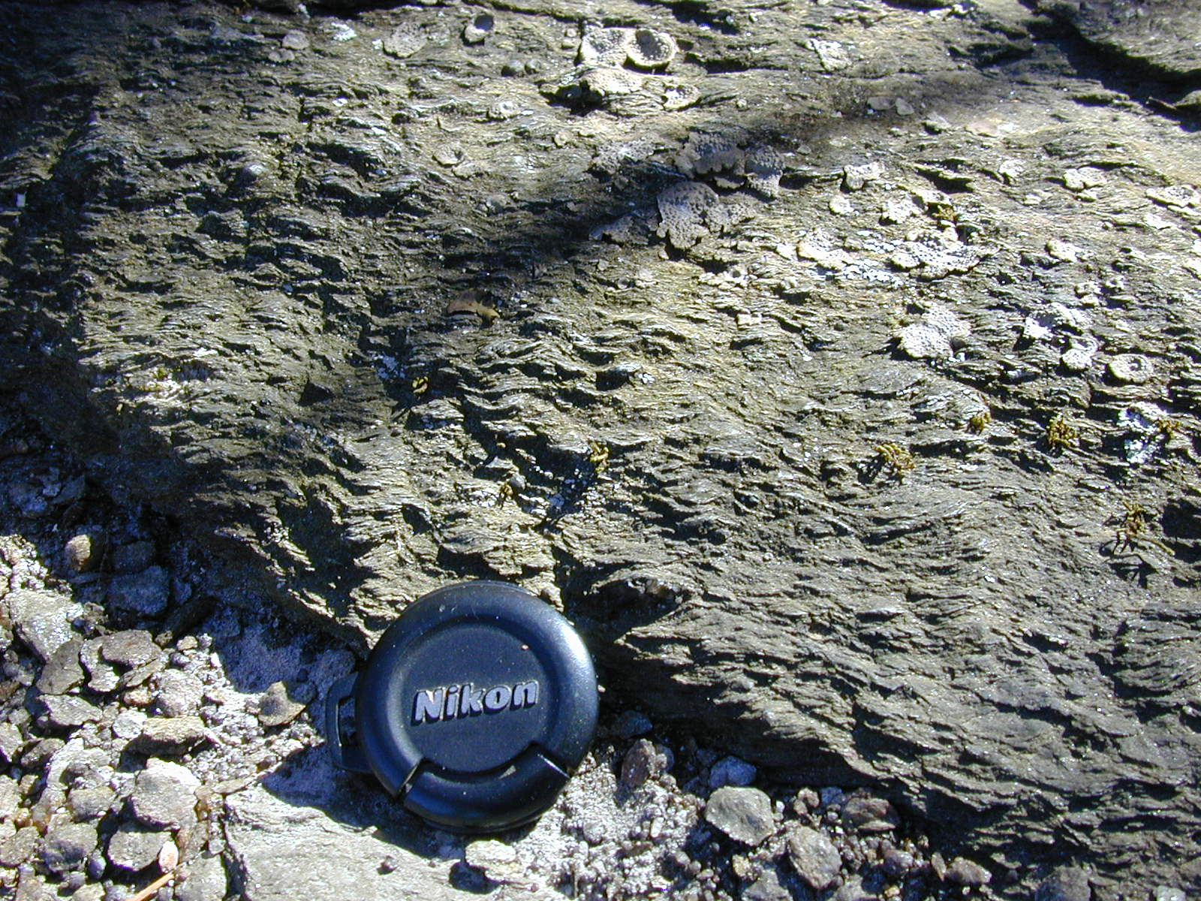
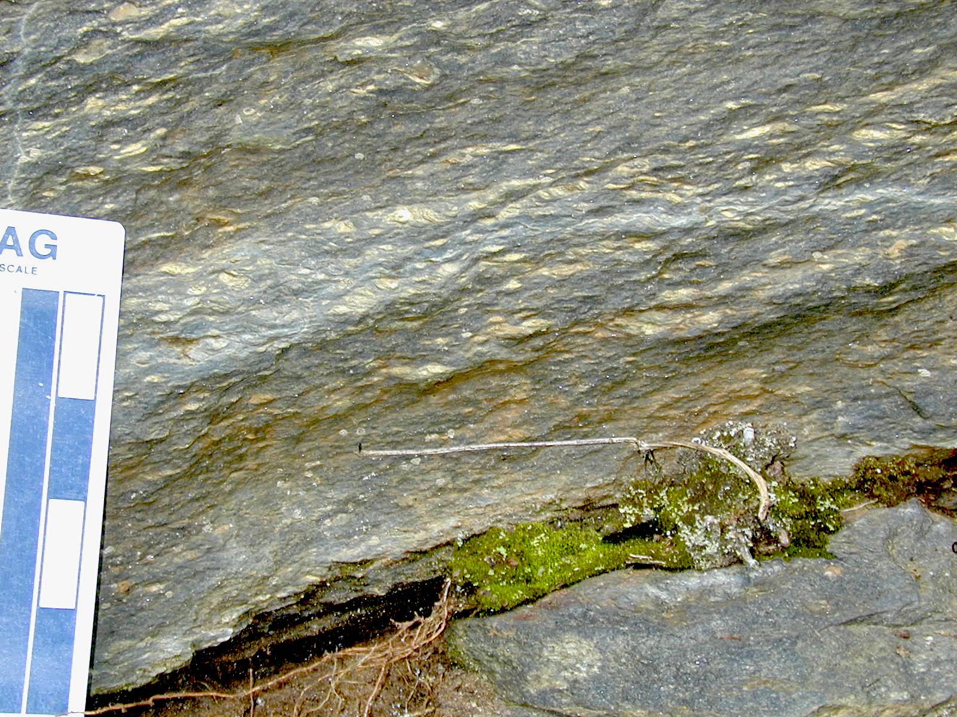
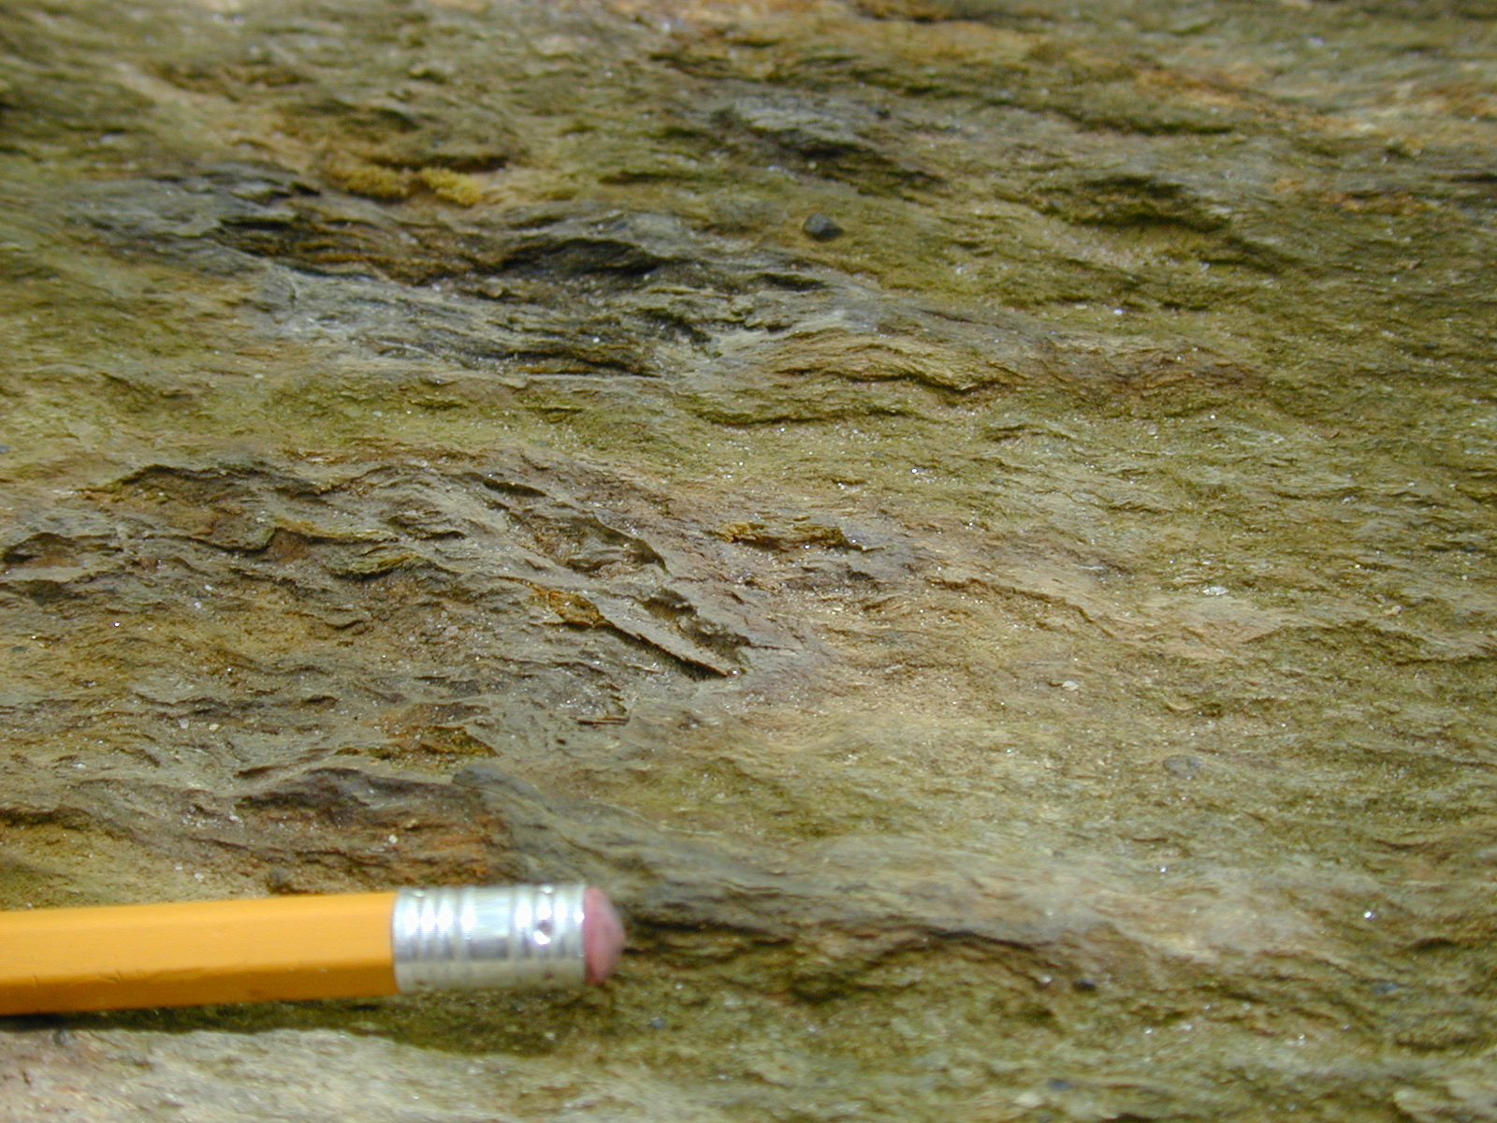
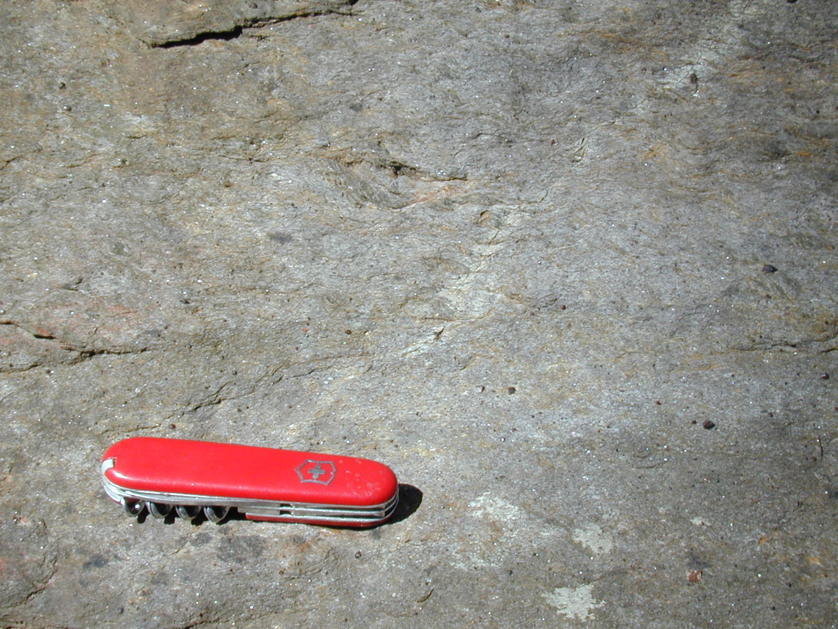
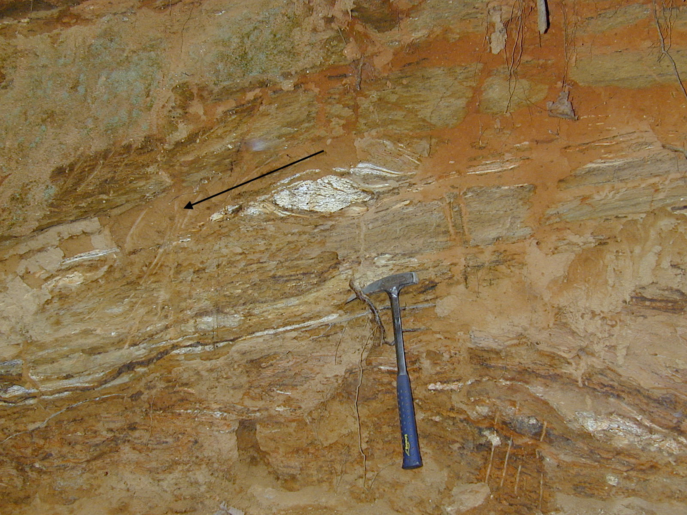

CHAUGA RIVER FORMATION DEFORMATIONAL FABRICS
In the western IP, Chauga River Formation garnet schist and garnet metasiltstone in the hanging wall of the Eastatoee fault forms a continuous belt of resistant rocks that crosses five quadrangles (between Salem and Standingstone Mountain quadrangles, Figure 1). S-C’ fabric, folds, and boudinage are common in ledge and cliff exposures. Foliation and schistosity in Chauga River Formation rocks is a secondary foliation, as indicated by intrafolial folds and lenticular amphibolite enclaves internally preserving isoclines with foliation truncated at their margins.
Two end-member lithologies are present. The first is a hard, dark-gray, fine-crystalline, poorly layered, equigranular metasiltstone contains garnet, muscovite, biotite, feldspar that is locally porphyroclastic, and quartz. The second is a schistose rock that is a dark, fine- to medium-crystalline garnet-muscovite-biotite button schist. An S-C’ fabric is developed in this schist throughout the outcrop belt, but particularly in Sunset, Eastatoee Gap, and SM quadrangles. Almandine garnet (1-2 mm, up to 5 mm) is idioblastic.
The S-C’ fabric consists of coarse muscovite flakes or aggregates of finer muscovite that form conspicuous buttons in a groundmass of fine-crystalline biotite (Figures 7a, b, c, d). Buttons litter the ground surface. The schistose rocks may contain resistant layers and pods of medium- to coarse-crystalline granitoid material and pegmatite, which is locally foliated and sheared (Figure 7e). S-C’ fabrics consistently indicate top-to-the-SW and -S movements.
The top-to-the-SW and -S movements may have been focused near the base of the collapsing regional thrust stack in weak Chauga River schist because that is the position of a sharp rheological contrast, with more rigid Poor Mountain amphibolite above and weak, more ductile schist immediately below.
TIMING OF GRAVITATIONAL COLLAPSE
A key issue is the direct linkages that exist between older features formed initially outside the Brevard zone in the western IP and their later incorporation into the Brevard zone. Those structures are: 1) the Eastatoee ductile thrust, which had been incorporated into the Brevard
zone and duplicated by imbricate thrusting within it, and 2) top-to-the-SW S-C’ fabric in the Chauga River Formation. Bobyarchick and others (1988) recognized that ‘early’ thrusts had been
incorporated into the Brevard zone from outside it, including the Eastatoee fault and thrusts that placed Henderson Gneiss onto Chauga River Formation rocks.
If the emplacement of crystalline thrust sheets and development of the nearby Brevard zone are both part of Acadian orogenesis (Hatcher, 2001), then gravitational collapse of the thrust stack took place between those deformational events. Therefore, three major tectonic events would necessarily have occurred within a relatively limited time interval (< 20? million years, as interpreted from data of Hatcher and Merschat, 2006). An alternate explanation is that thrust sheet emplacement and subsequent gravitational collapse in the western IP were part of
Taconic orogenesis.
Henderson Gneiss in the footwall of the Eastatoee fault is mylonitic wherever present in the Mountain Bridge area. Widespread sigma, delta, and S-C and S-C-C’ shear sense indicators in Henderson Gneiss are dextral, that is top-to-the-SW. These shear sense indicators were assigned to ‘earlier Alleghanian’ mylonitization by Bobyarchick and others (1988). Dennis (2007) gives Mid-Late Devonian ages to mylonitic Henderson Gneiss. Hatcher (2001) assigns the dextral, ‘chlorite-muscovite stable’ S-C fabric in the Brevard zone to ‘late Paleozoic’ (Alleghanian) reactivation.
I suggest here the Henderson Gneiss and Chauga River dextral fabrics are older than the Alleghanian and possibly older than the Acadian. The fabrics initially were developed during the gravitational collapse, top-to-the-SW episode of the western IP thrust stack. Formation prior to the BZ does not preclude later reactivation by the Acadian or Alleghanian events.
REFERENCES CITED
Bobyarchick, Andy R., Edelman, Steven H., and Horton, Wright, Jr., 1988, The role of dextral strike slip in the displacement history of the Brevard zone: in Secor, D., Jr., ed., Southeastern Geological Excursions Guidebook, S.C. Geological Survey, p. 53-154.
Dennis, A. J., 2007, Cat Square basin, Catskill clastic wedge: Silurian-Devonian orogenic events in the central Appalachians and the crystalline southern Appalachians, in Sears, J.W., Harms, T.A., and Evenchick, C.A., eds., Whence the Mountains? Inquiries into the Evolution of Orogenic Systems: A Volume in Honor of Raymond A. Price: Geological Society of America Special Paper 433, p. 313–329.
Hatcher, R.D., Jr., 2001, Rheological partitioning during multiple reactivation of the Palaeozoic Brevard fault zone, southern Appalachians, USA: in Holdsworth, R. E., Strachan, R. A., Magloughlin, J. F., Knipe, R. J., eds., The nature and tectonic significance of fault zone weakening, Geological Society, London, Special Publications, 186, p. 257-271.
Hatcher, Robert D., Jr., and Merschat, Arthur J., 2006, The Appalachian Inner Piedmont: an exhumed strike-parallel, tectonically-forced orogenic channel: in Law, R. D., Searle, M. P. & Godin, L., eds., Channel Flow, Ductile Extrusion and Exhumation in Continental Collision Zones, Geological Society, London, Special Publications, 268, p. 517–541.
Figure 7. Chauga River Formation shear fabrics.
a. S-C’ fabric in garnet button schist, Eastatoe Gap quadrangle. S surfaces dip gently left, C’ surfaces dip steeply, upper left to lower right. View E; top-to-right shear sense. Lens cap 3 cm.
b. S-C’ fabric in garnet button schist, Standingstone Mountain quadrangle. Schistosity in gold-weathering mica buttons dips gently right. C’ surfaces dip gently upper right to lower left. View to west; top-to-left shear sense. Scale in inches.
c. S-C’ fabric in garnet button schist, Eastatoe Gap quadrangle. S surfaces dip gently left, C’ surfaces dip steeply upper left to lower right. View SE; top-to-right (SW) shear sense. Pencil portion 6 cm.
d. S-C fabric in garnet mica metasiltstone, Eastatoe Gap quadrangle. Scattered dark muscovite buttons, with internal schistosity dipping gently right. C surfaces horizontal. View to NW; shear sense top-to-left (SW). Bleach zone along fracture. Knife 9 cm.
e. Asymetric quartzo-feldspathic lenses in saprolitic schist. View to NW; top-to-left (SW) shear sense. Hammer 40 cm.
ACKNOWLEDGEMENTS
I gratefully acknowledge the continued professional and logistical support for geologic mapping of the South Carolina Department of Natural Resources, South Carolina Geological Survey. Many discussions with Bill Clendenin have helped unravel the complexities of the IP.

