Slide 1
RECENT SEISMIC MONITORING RESULTS FROM THE CENTRAL
VIRGINIA SEISMIC ZONE: IMPLICATIONS FOR FAULT RUPTURE
AREA - MOMENT RELATIONS
Martin Chapman, Jacob Beale
Department of Geosciences
Virginia Tech
Blacksburg, Virginia
email: mcc@vt.edu
GSA Southeastern Section Meeting
Knoxville, TN
April 13, 2018

Slide 2
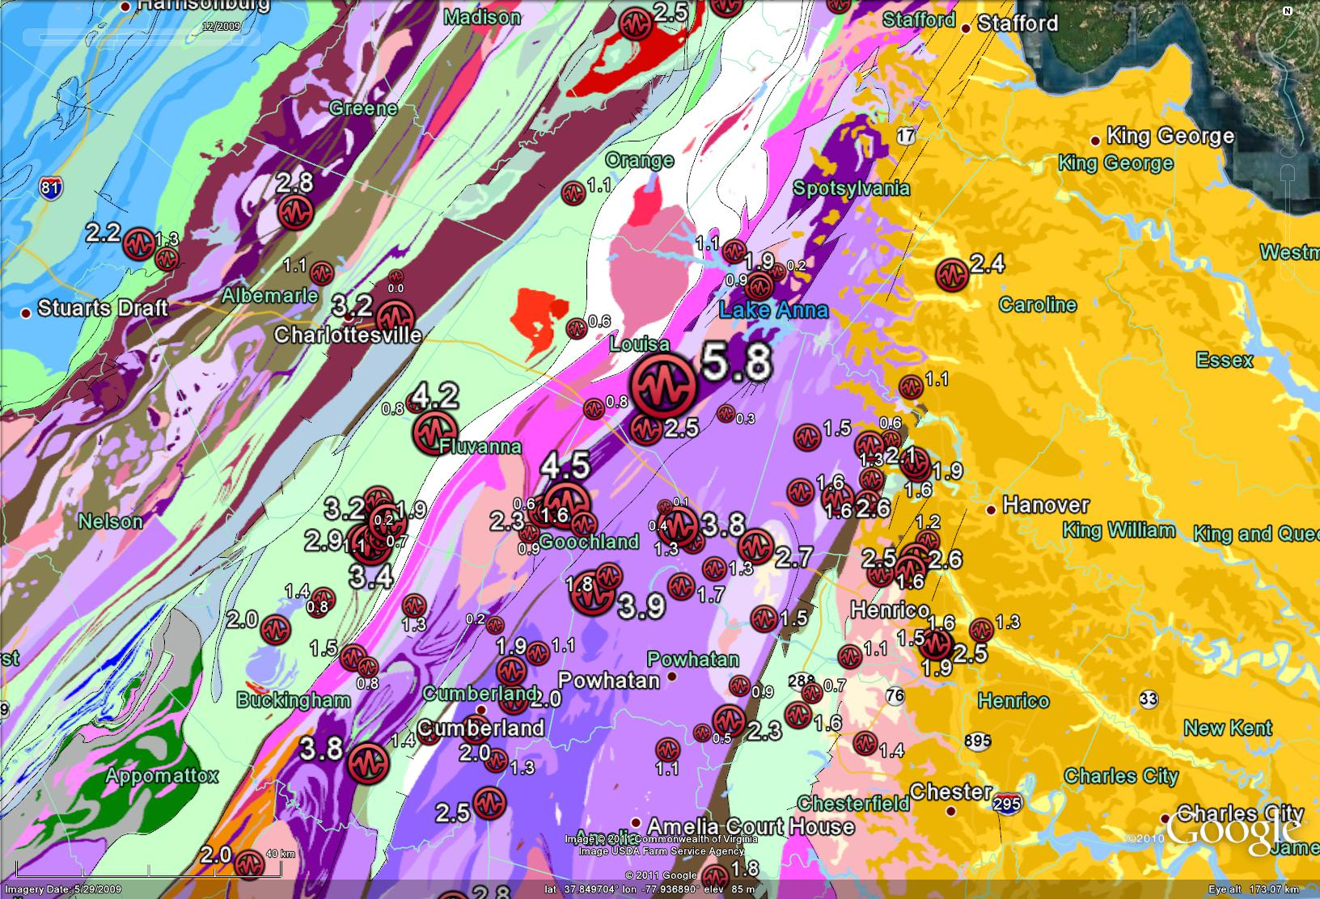
Circles show earthquake epicenters instrumentally located by the Virginia Tech
Seismological Observatory in central Virginia, 1977 - Aug. 23, 2011. Numbers are earthquake
magnitude. Colored regions indicate major geologic units.

Slide 3
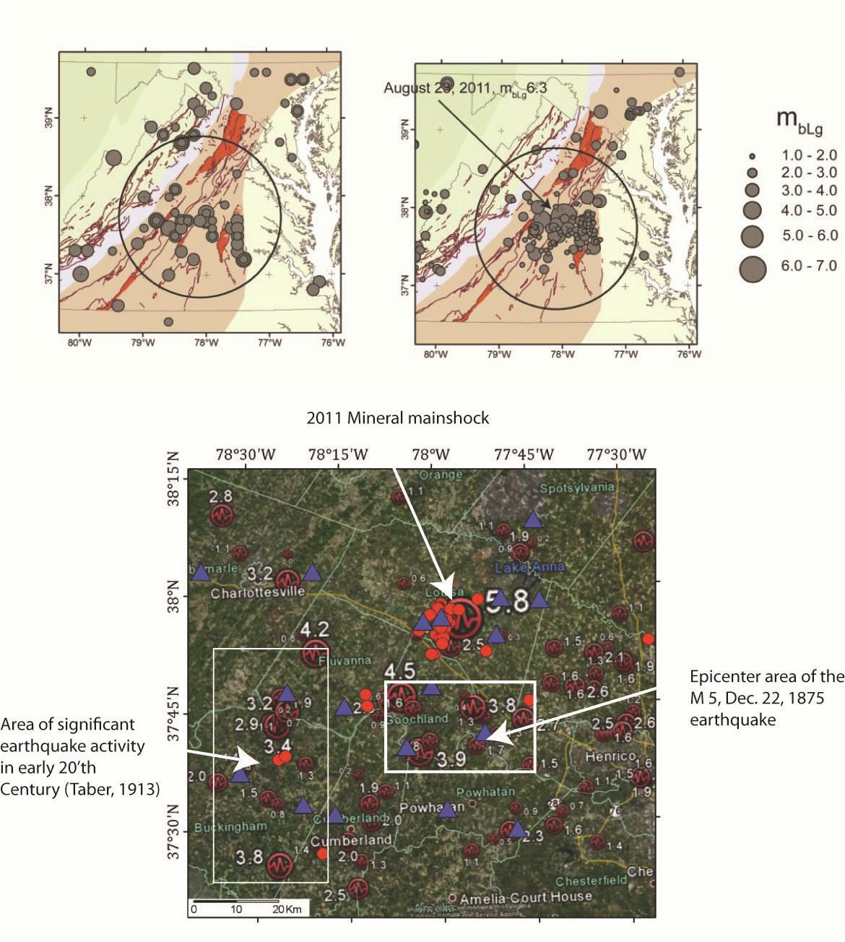
Historical
(pre-instrumental)
epicenters
Instrumentally located
epicenters
The great majority of
shocks in the Central
Virginia Seismic Zone have
been south of 38°N.
Red circles show epicenters of shocks
located by a 3-month Virginia Tech -
USGS deployment of
temporary seismic stations in early 2014.
Blue triangles show station locations

Slide 4
Although the Mineral 2011 mainshock was poorly recorded, the early aftershock
sequence was the best recorded in eastern U.S. history.
northeastern cluster
main cluster
From: Wu, Qimin, M.C. Chapman and J.N. Beale, 2015, The Aftershock Sequence of the 2011 Mineral, Virginia,
Earthquake: Temporal and Spatial Distribution, Focal Mechanisms, Regional Stress and the Role of Coulomb Stress Transfer, Bulletin of the Seismological Society of America, v. 105, no. 5, p. 2521-2537, doi. 10.1785/0120150032.

Slide 5
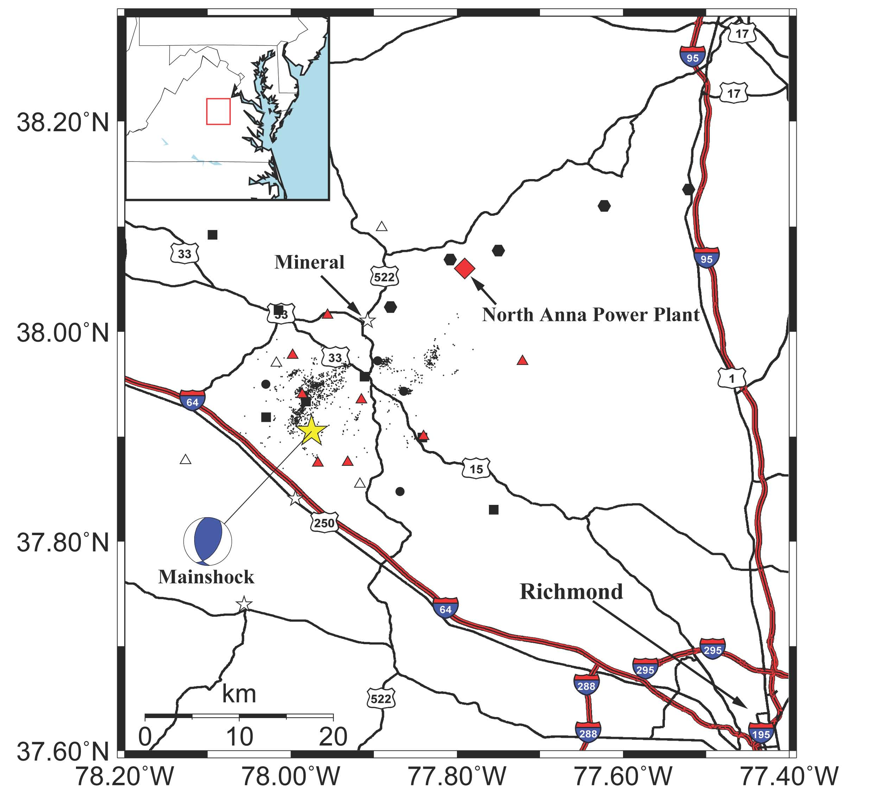
Temporary seismic
stations operating
from August 23, 2011
until early January, 2012.
Contributors: Virginia Tech, University of Memphis, Lehigh University, IRIS, USGS.
From: Wu, Qimin, M.C. Chapman and J.N. Beale, 2015, The Aftershock Sequence of the 2011 Mineral, Virginia,
Earthquake: Temporal and Spatial Distribution, Focal Mechanisms, Regional Stress and the Role of Coulomb Stress Transfer, Bulletin of the Seismological Society of America, v. 105, no. 5, p. 2521-2537, doi. 10.1785/0120150032.

Slide 6
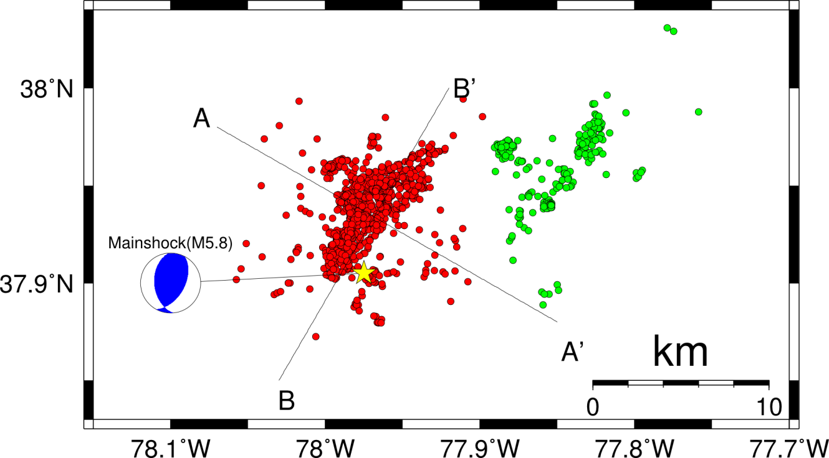
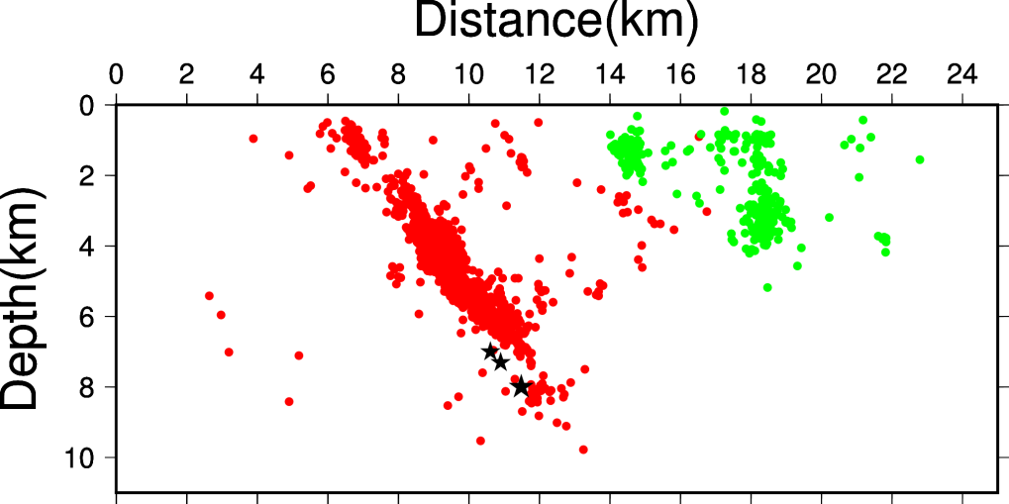
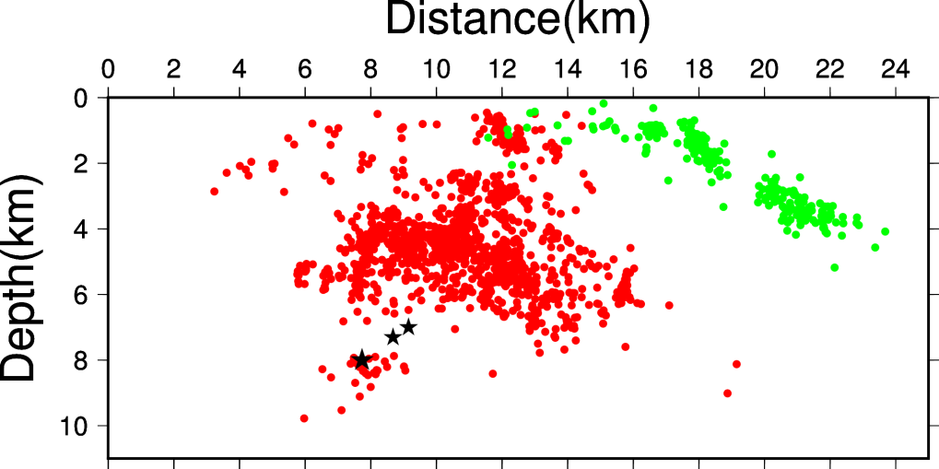
Double-Difference Aftershock Relocation (1,712 events)
Wu et al. (2015)
A
A’
B
B’
Black stars: 3 subevents of the mainshock (Chapman, 2013)
From: Wu, Qimin, M.C. Chapman and J.N. Beale, 2015, The Aftershock Sequence of the 2011 Mineral, Virginia,
Earthquake: Temporal and Spatial Distribution, Focal Mechanisms, Regional Stress and the Role of Coulomb Stress Transfer, Bulletin of the Seismological Society of America, v. 105, no. 5, p. 2521-2537, doi. 10.1785/0120150032.

Slide 7
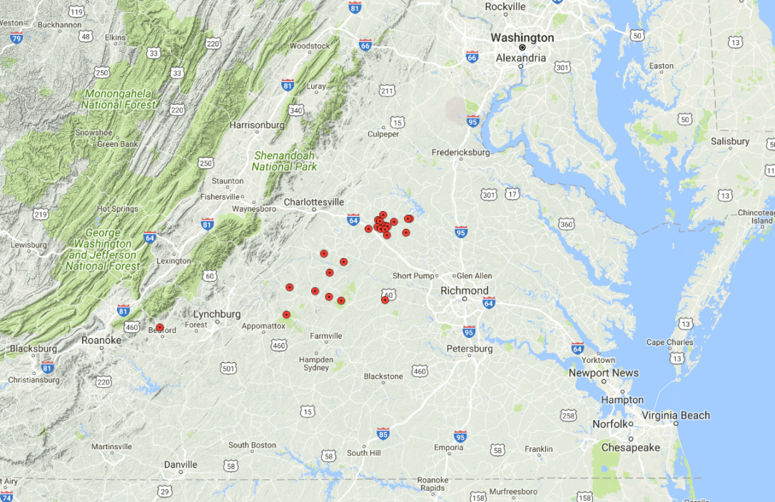
Recently (2017) Deployed Temporary Seismic Stations in Central Virginia
Currently, there are 24 broadband and short-periods seismic stations operating in central
Virginia, with support from the USGS National Earthquake Hazards Program. The stations were
installed in early 2017 and are planned to operate until early 2019 (2 years).

Slide 8
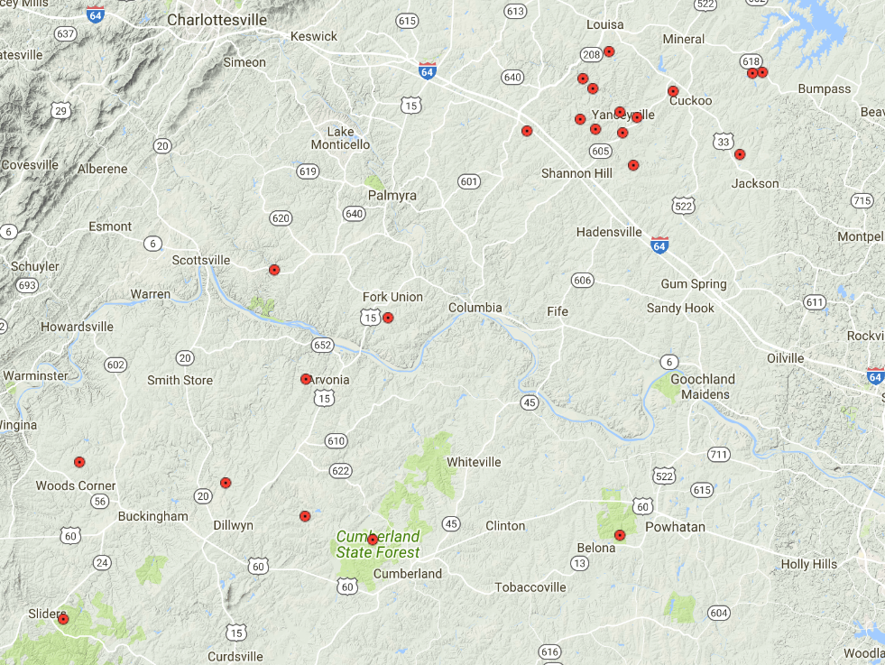
Two areas of Interest
Red symbols show temporary station locations
Lousia County Area
Buckingham County Area

Slide 9
Objectives
1) In Louisa County, monitor the on-going aftershock sequence of the August 23, 2011
Mw 5.7 (m_{blg} 6.3) Mineral earthquake.
Questions to be addressed:
What is the current rate of aftershocks (7+ years post mainshock)?
Is it consistent with Omori's Law and the early aftershock rate
of 2011?
How does the spatial distribution of current aftershocks compare
with that of 2011? Does the rupture zone still appear as a gap in the
aftershock pattern?
What are the focal mechanisms of the current aftershocks? How do
they compare with those of 2011?
2) In the Buckingham County area, we want to get accurate locations and focal
mechanisms for the first time. Is it possible that the seismicity is aftershock activity
from a large pre-historic shock?

Slide 10
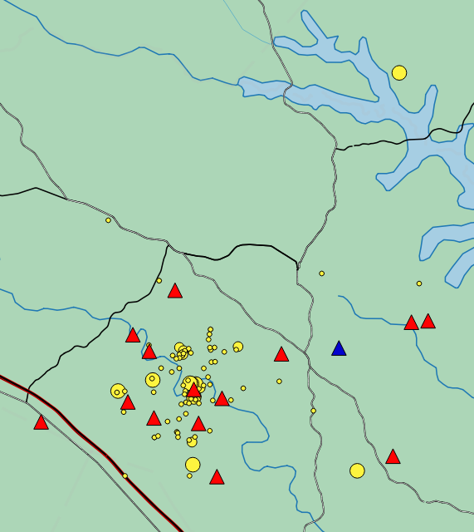

Recent Mineral earthquake aftershocks and seismic stations currently deployed in the
Louisa County, VA area.
The epicenters of earthquakes occurring from March 31 - Sept. 18, 2017
are shown as yellow circles, with sizes scaled to magnitude. Temporary seismic
stations are shown as red triangles. The blue triangle is ANSS N4 station R58B.
2017 aftershock
focal mechanism
2011 epicenter

Slide 11
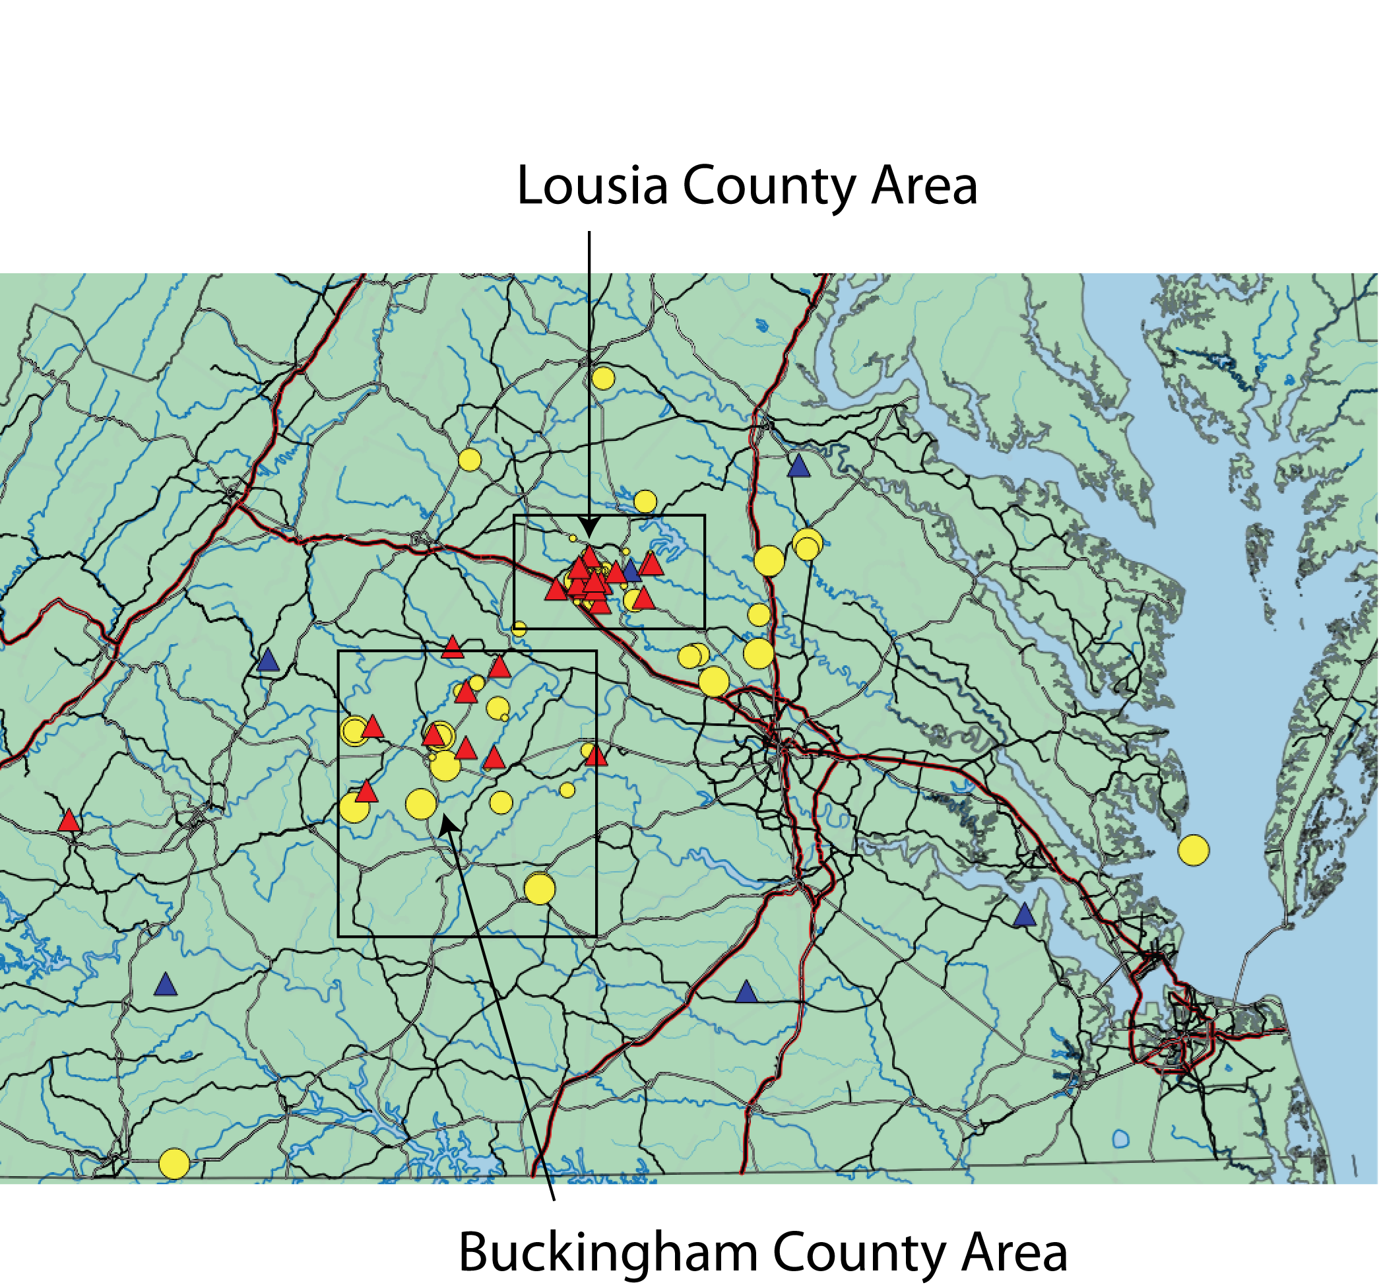


Slide 12
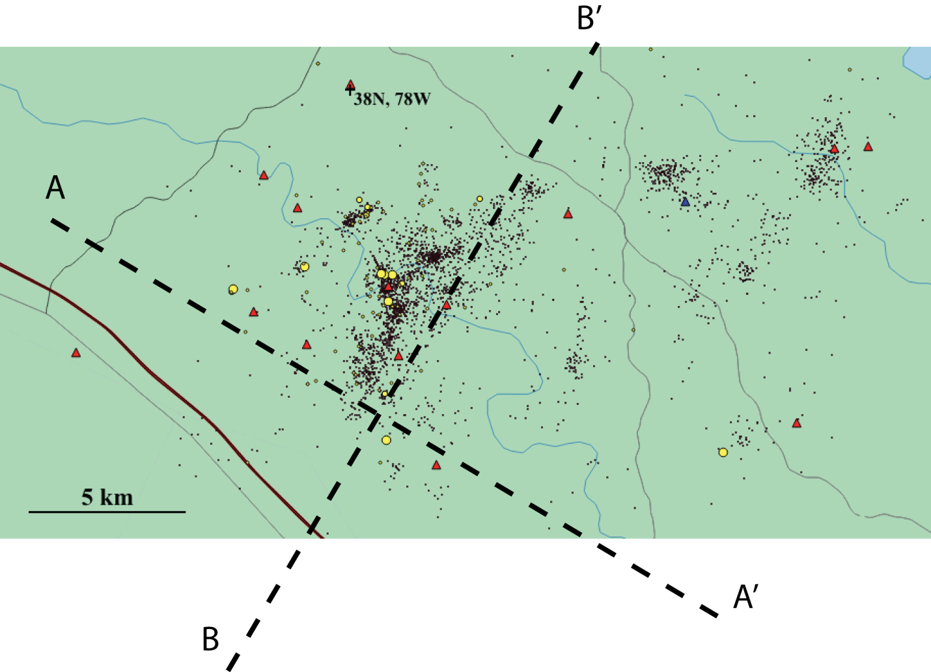
Louisa County Area
Red triangles show temporary seismic stations. Yellow circles show epicenters for the
March 31 -Sept 18, 2017 period. Small black circles show epicenters of immediate aftershocks that
occurred during the period August 25, 2011 - January 1, 2012.

Slide 13
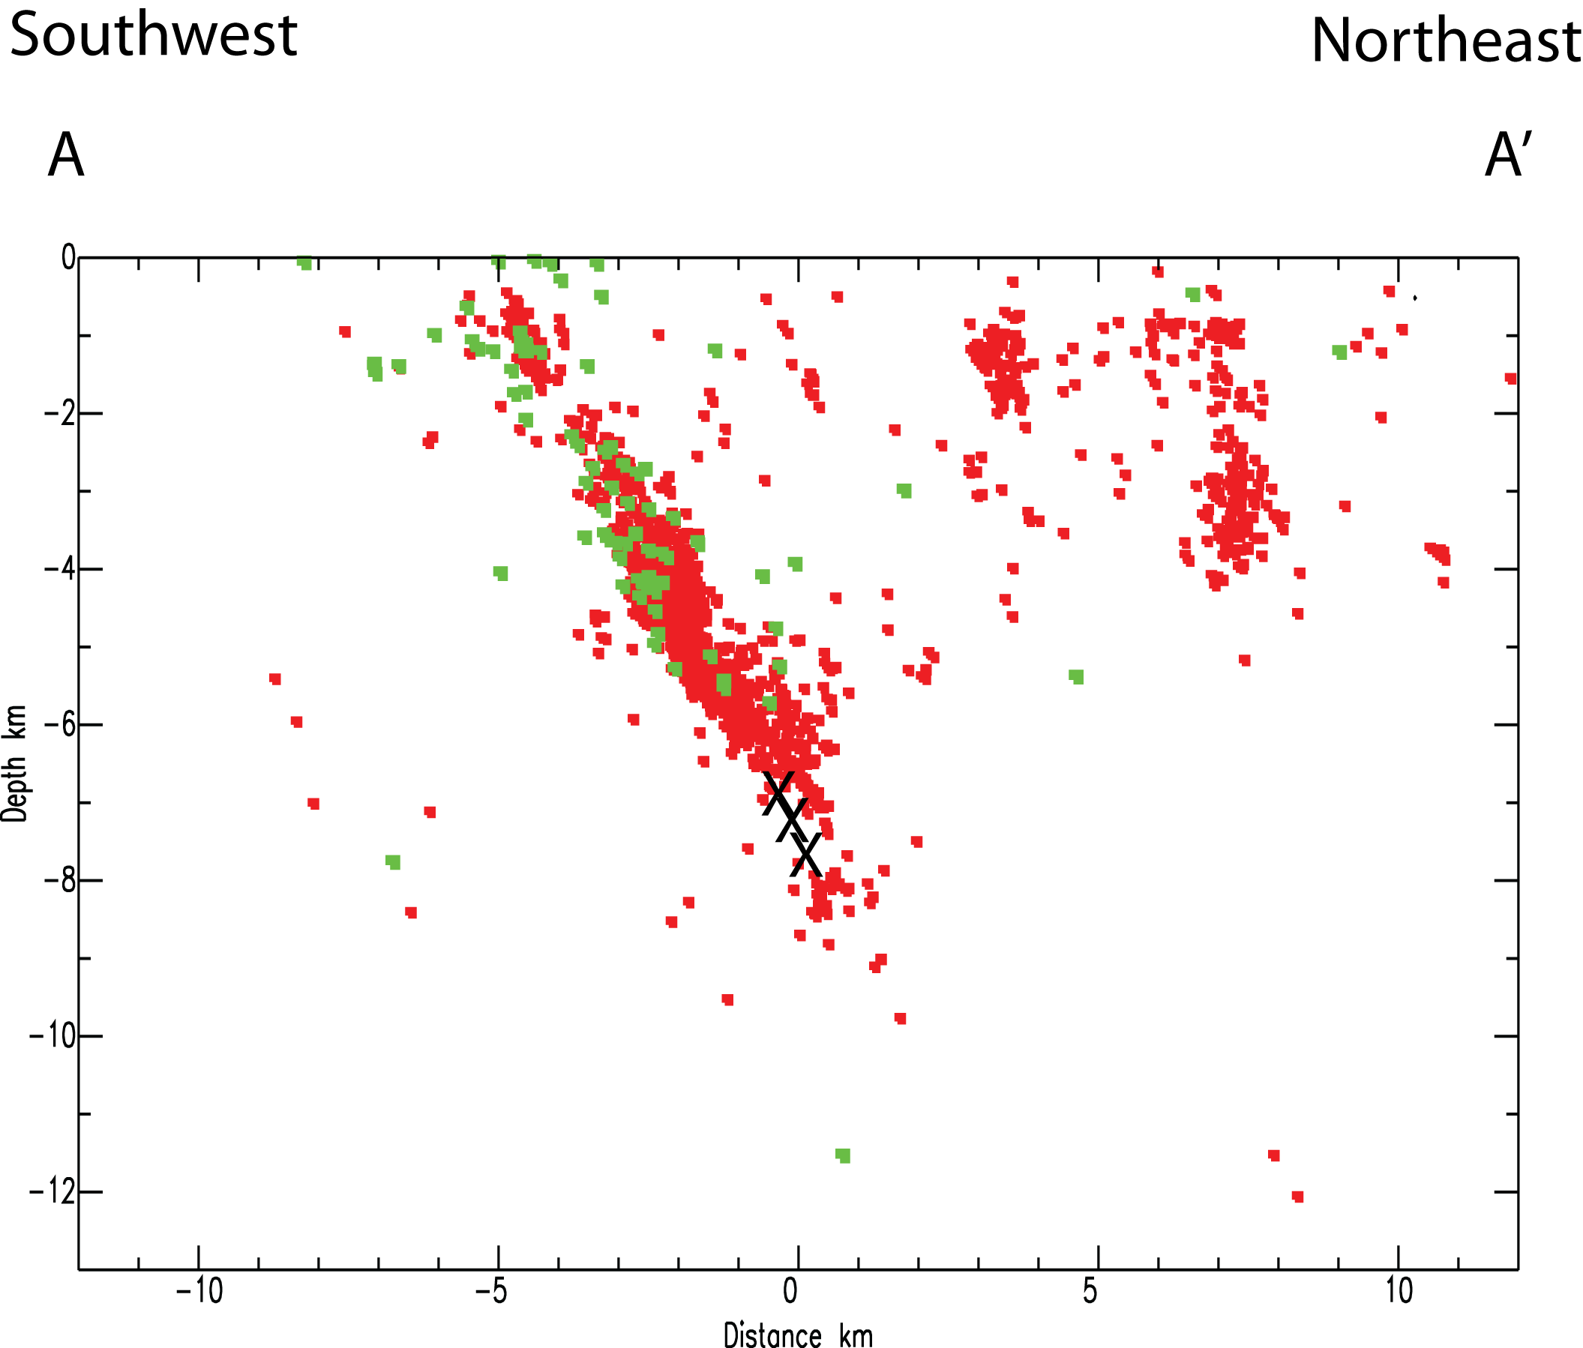
Red: Mineral aftershock hypocenters from 2011.
Green: aftershock hypocenters March 31- September 18, 2017.
N
Northwest
Southeast
mainshock sub-events

Slide 14
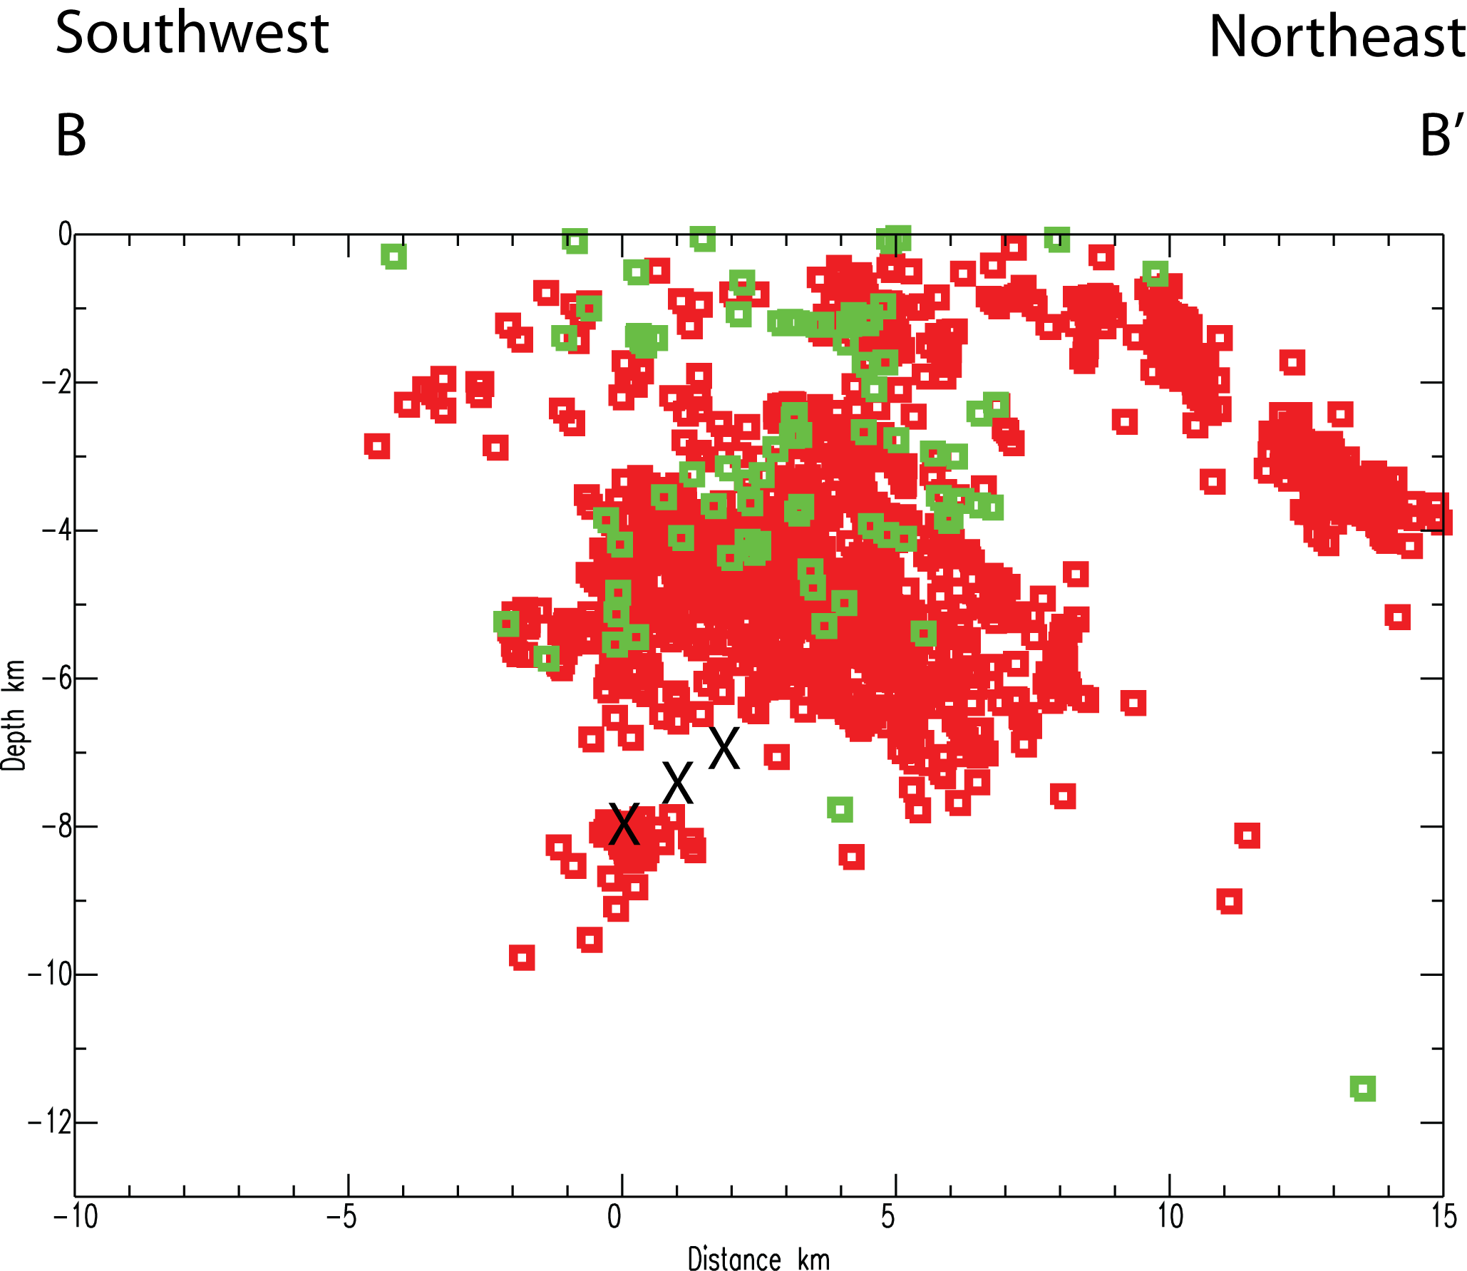
Red: Mineral aftershock hypocenters from 2011.
Green: aftershock hypocenters March 31- September 18, 2017.
Mw 5.7, stress
drop 70 MPa,
circular rupture
diameter 2.7 km
(Brune model)
mainshock sub-events

Slide 15
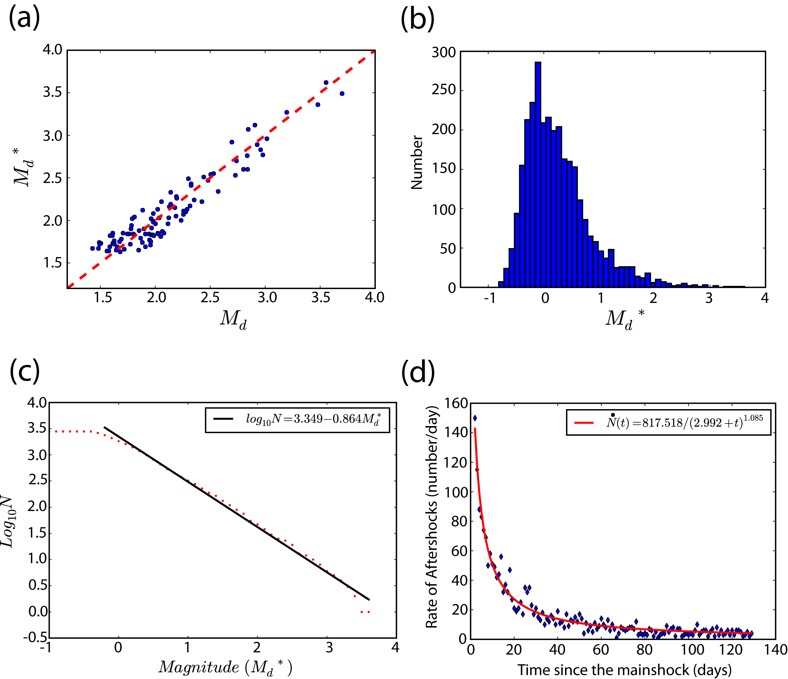
Early Aftershock statistics (August 25, 2011 - January 1, 2012)
Fit to Omori
Law
The fit to Omori's Law using the 2011 aftershock data predicts that we should be
seeing approximately 0.19 earthquakes per day with magnitudes greater than -0.4,
6 years later (i.e. August 23, 2017).

Slide 16
The fit to Omori's Law using the 2011 aftershock data predicts that we should
be seeing approximately 0.19 earthquakes per day with Md* greater than -0.4,
6 years later (i.e, August 23, 2017).
We recorded 153 earthquakes with Md* > -0.4 near the mainshock epicenter in the
period from March 13, 2017 through January 24, 2018. This corresponds to a rate of 0.48
earthquakes per day, or two and one-half times the rate predicted by Omori's Law based
on the early (2011) aftershock data.
Clearly, the aftershock sequence is still active, and is more intense than would be
predicted by Omori's Law and the early (2011) aftershock activity.

Slide 17
Conclusions
The Mineral aftershock sequence is still very much alive, and is more intense now
(6 years after the mainshock) than would be predicted by Omori's law, fitted to the early
2011 aftershock data.
The late aftershocks (2017) have a pattern very similar to the 2011 aftershocks. An obvious
gap in the aftershock activity near the zone that experienced mainshock rupture persists.
This aftershock gap is interpreted to represent the zone of actual moment release (rupture)
during the 2011 mainshock. The size of this gap is surprisingly small (a few kilometers) for a
moment magnitude Mw 5.7 earthquake in California, but Virginia is NOT California.
The results here are consistent with the findings of Wu and Chapman (2015). The
stress drop of the Mineral earthquake was 70 MPa (700 bars). This is huge, and is one of the
largest well-constrained stress drops ever documented for an earthquake. Assuming a
circular rupture and the Brune model, the predicted rupture diameter is 2.7 km. This is tiny
compared to a typical California shock of Mw 5.7.
If the Mineral earthquake is representative of intraplate earthquakes, then they
have tiny rupture dimensions compared to typical plate boundary shocks of the same
moment. They occur on small fault patches and are intensely energetic, with
relatively large displacements. In intraplate settings, pre-existing faults grow during larger
earthquakes by the breakage of fresh rock.

Slide 18
Thank you for your attention

