Slide 1



A Geochemical Analysis of Urban Dust and Soils in the Charleston Peninsula
Jordan Davis & Dr. Vijay Vulava
Notes:
Good afternoon my name is Jordan Davis. I am an undergraduate at the College of Charleston. Today I will be presenting research I conducted this past semester with Dr. Vijay Vulava analyzing the geochemistry of urban dust in the Charleston peninsula.

Slide 2
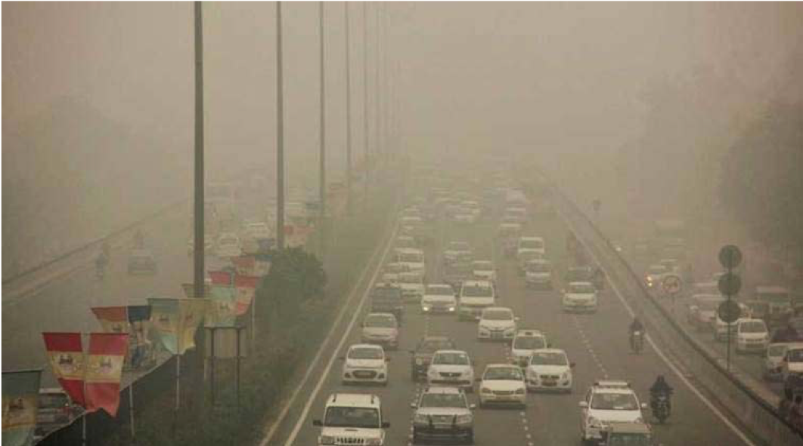
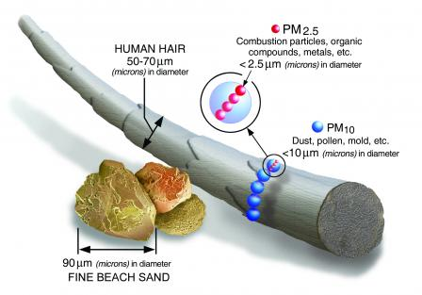
What is urban road dust?
High amounts of trace metals in urban road dust
Metals levels increased in dust compared to other media
http://indianexpress.com/article/cities/delhi/delhi-govt-proposes-aerial-sprinkling-of-water-to-keep-dust-at-bay-4903511/
Notes:
To begin, we must understand what urban road dust is. Road dust is a compilation of particles from natural sources like soil and rock as well as anthropogenic sources like traffic and construction material. Road dust is a form of particulate pollution associated with urban areas and research worldwide agrees that there are elevated levels of trace metals in urban road material.
Additionally, it has been shown that metal levels are higher in dust compared to other media, like soil. Road dust is easily inhaled due to its fine nature, which makes it a risk to human health in addition to being an environmental pollutant.

Slide 3
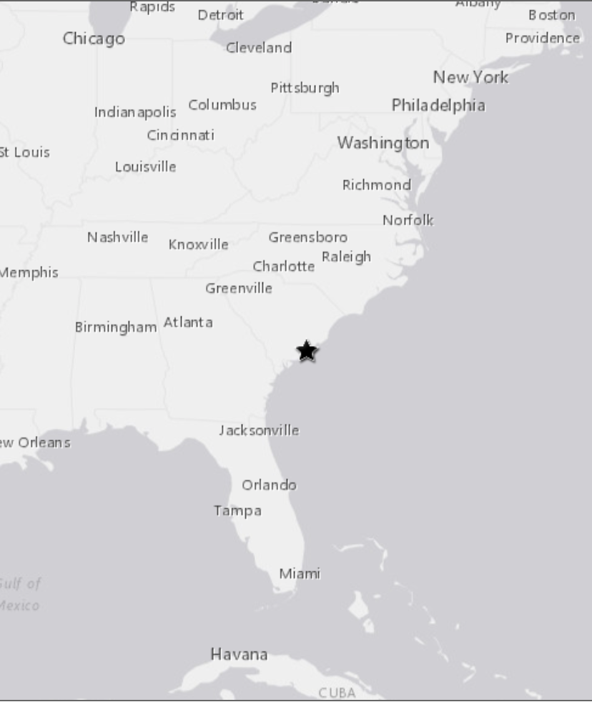
Charleston, SC
http://interactives.wncn.com/photomojo/gallery/37401/636807/flooding-in-charleston-after-6-of-rain/flooding-in-charleston-after-high-tide-and-6-of-rain/
Notes:
Our study focused on Charleston, a rapidly growing coastal city in the lowcountry of South Carolina. As of 2016, the Charleston area is growing at a rate of 3 times the national average, with approximately 34 people moving to the area every day. Urbanization has increased as a result of the growing population, leading to more construction and traffic-both of which are sources of metal contamination.
No prior studies of road dust have occurred in the Charleston area; however, it is a rapidly growing urban area and therefore warrants examination. Additionally, its coastal topography makes Charleston vulnerable for increased contamination in runoff, and we hypothesize urban dust is a major vector for contaminants associated with solid particles.

Slide 4
Objectives
Determine concentrations of select trace metals in urban road dust
Compare these concentrations across different land uses
Notes:
The goals of this study were to determine the concentrations of the trace metals chromium, nickel, copper, zinc, and lead present in urban road material and to correlate these concentrations across different land uses.
In order to do this…

Slide 5
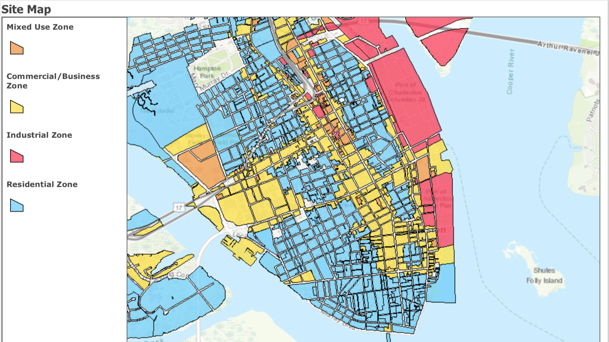

Establishing the Study Area
Notes:
We chose four different locations to sample road dust for trace metals. Sites were chosen based on their zoning to assess how contamination differed across different land uses. The decision to analyze urban dust at different zoning sites was based on a few other road dust studies that also took land use into account. The Charleston GIS Zoning Interactive Map was used identify different land use types in the peninsula and then ArcGIS was used to create a map that separated the majority of the Charleston peninsula into four zones: mixed use (shown in oragen), commercial (shown in yellow), industrial (shown in pink), and residential (shown in blue). Charleston’s zones are heavily blended, with residential space surrounded all other areas. The commercial and mixed use zones are similar, however mixed use allows for overlap in residential and commercial amenities. The industrial area in our study is zoned for industry; however, its primary use is as a shipping port and no heavy active industry is taking place.

Slide 6
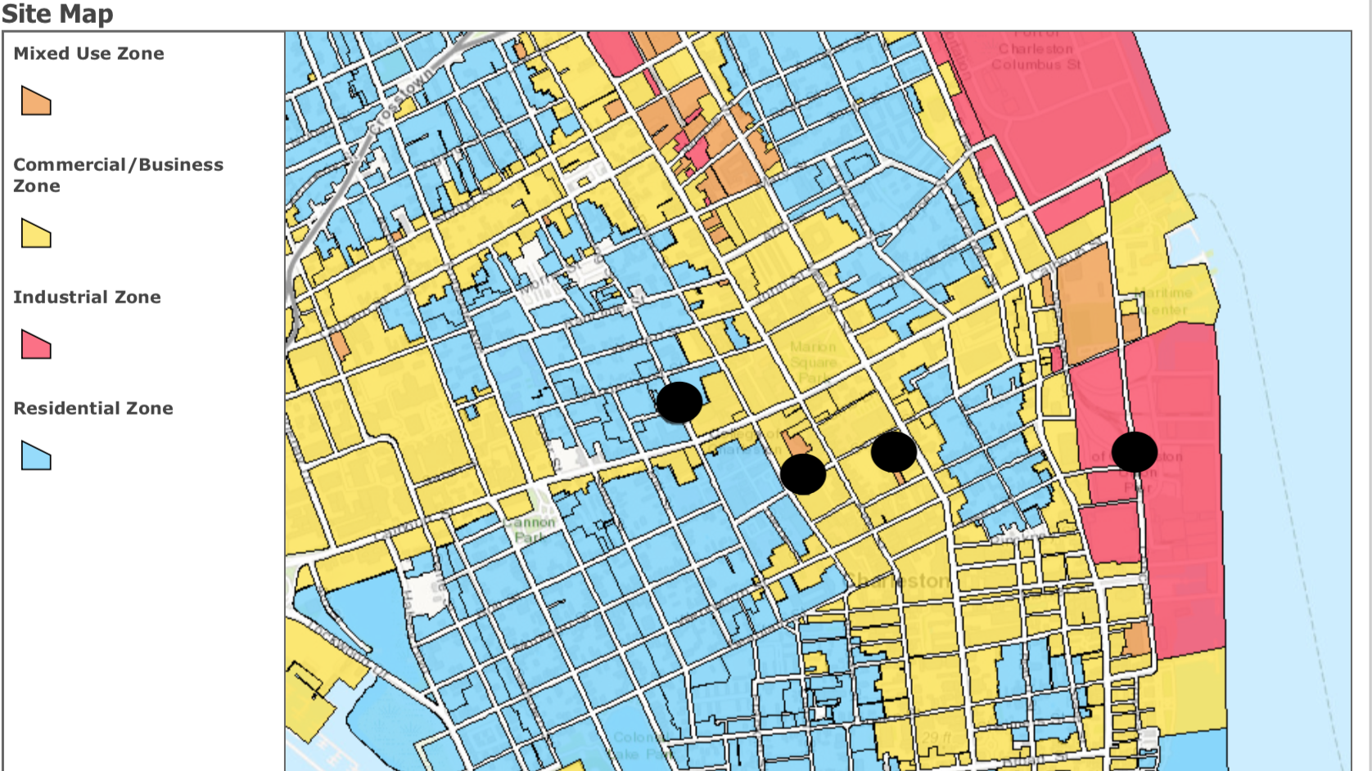


Identifying Site Locations and Collection
Notes:
After separating the study area into zones of interest, sites were determined. Available trace metal data from another undergraduate research was added to the site map to influence site location choice, as the residential and commercial sites are also site locations in a study for trace metals in stormwater puddles, which opened potential research comparing trace metals in dust and water. The two other sites, in the industrial and mixed use areas, were chosen based on proximity to other the first two sites and proximity to sites studied in the previous semester’s research.
After determining sites, sampling occurred. Samples were collected from a 5 square foot area of road surface adjacent to the curb using a Black and Decker cordless vacumn. A new replacement filter was used for each sampling event and location to prevent cross-contamination. After collection, the contents of the vacuum and the used filter were emptied into a labeled Ziplock bag. The vacuum was then cleaned with deionized water and dried with Kim wipes, and then a new filter was installed prior to the next sampling event.

Slide 7
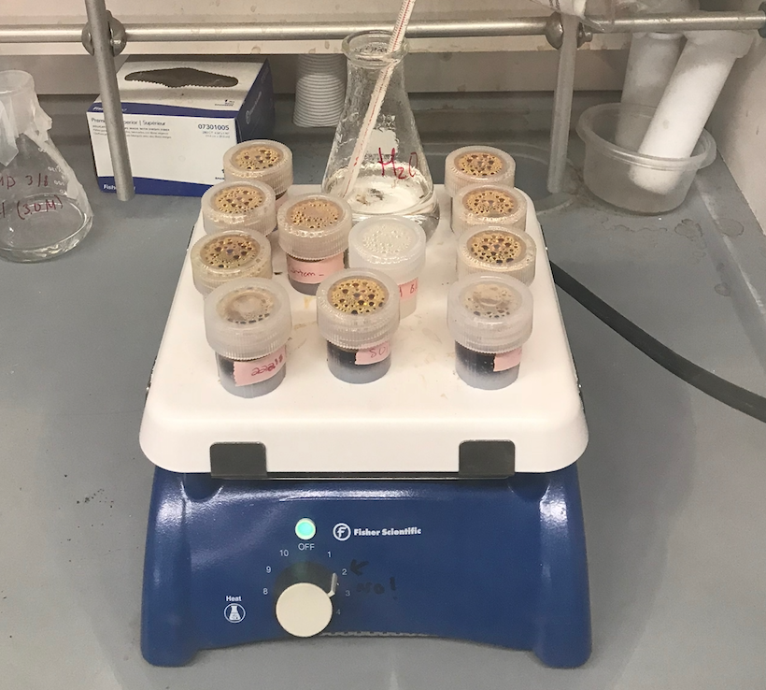
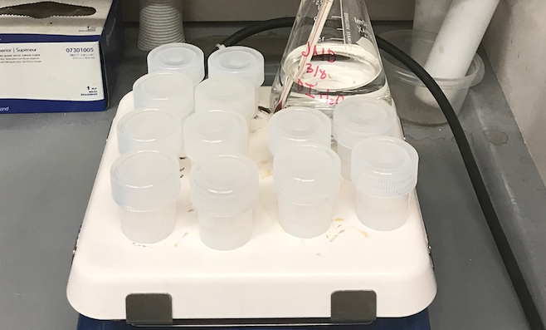
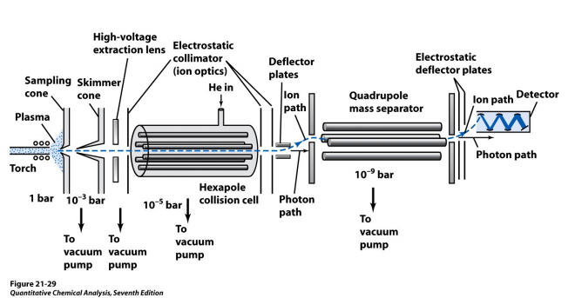
Acid Digestion for ICP-MS
Notes:
ICP-MS was used to determine the concentrations of trace metals present in the road dust samples. Samples were homogenized and sieved to particulate matter size then digested with nitric acid. Samples were diluted 100 times and prepared for ICP-MS analysis. Over 20 elements were analyzed with the ICP-MS; however, 5 elements were chosen as the focus based on their presence in road material and occurrence as primary metals in other studies.

Slide 8
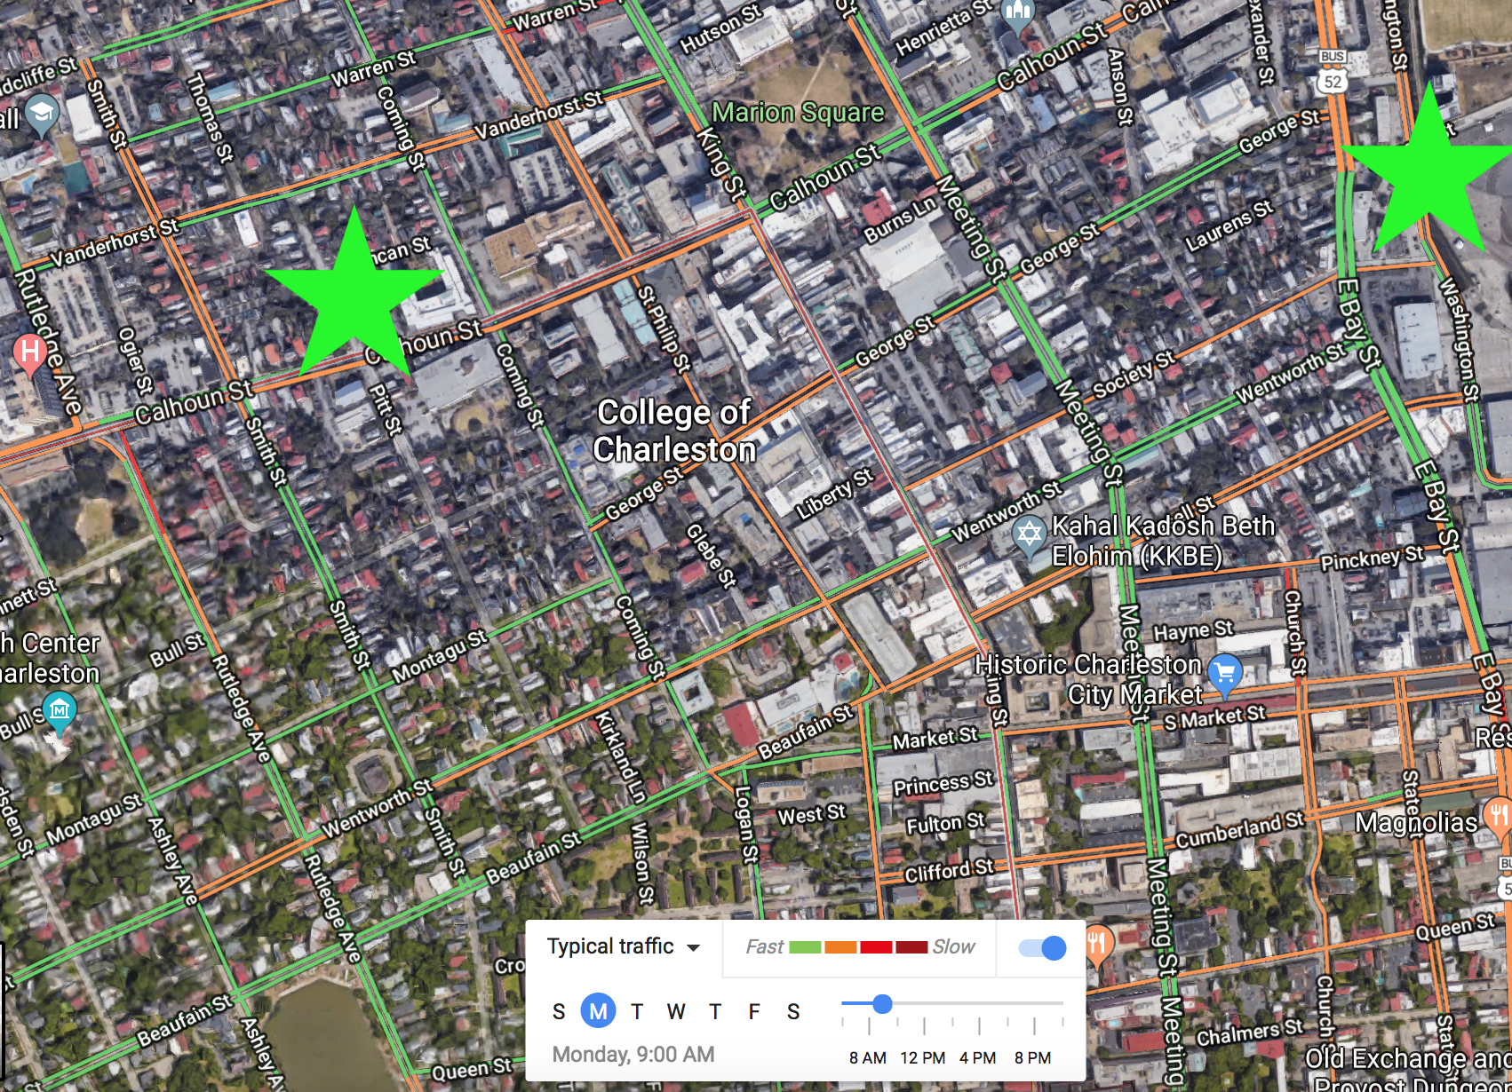
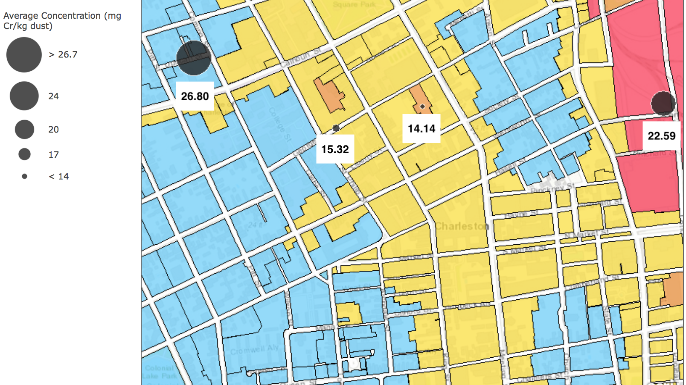

Chromium
Function of Traffic?
Notes:
We analyzed results in regard to each metal of interest individually in order to assess its variation throughout different zones.
The highest concentrations of chromium were found in the residential and industrial areas. Other studies of urban road dust cite sources of chromium as air conditioning coolants, brake emissions, and yellow road paint. The residential and industrial locations are located by busier, higher velocity roadways which could have influenced the elevated chromium levels. Although traffic was not quantitatively accounted for in this study, other research has cited increased traffic volume as correlated with increased trace metals. The google traffic map shows that these locations (shown in green) have increased traffic, depicted by the orange lines, which could explain their elevated levels.

Slide 9
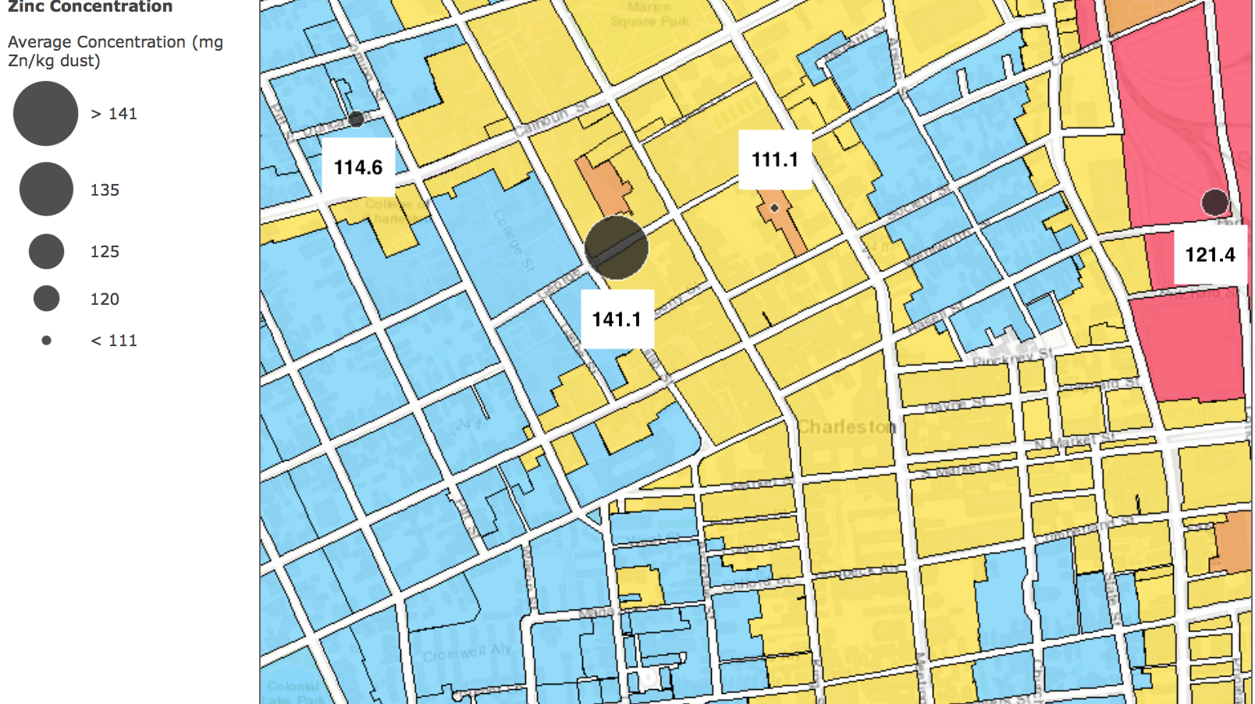
Zinc
Function of Traffic?
Notes:
We hypothesize zinc may also be a function of traffic, with the highest values of zinc found in the commercial and industrial zones. Other studies of road dust cite major sources of zinc as vehicular processes such as tire wear and brake emissions; which could explain the relatively close concentrations throughout the locations; however, we would expect to see a similar trend to chromium if zinc sources were primarily traffic related. More data is needed in this area to understand zinc’s differences in contamination across land use types, its relationship to traffic patterns, and similarities between it and chromium, as sources for both metals are associate with vehicles.

Slide 10
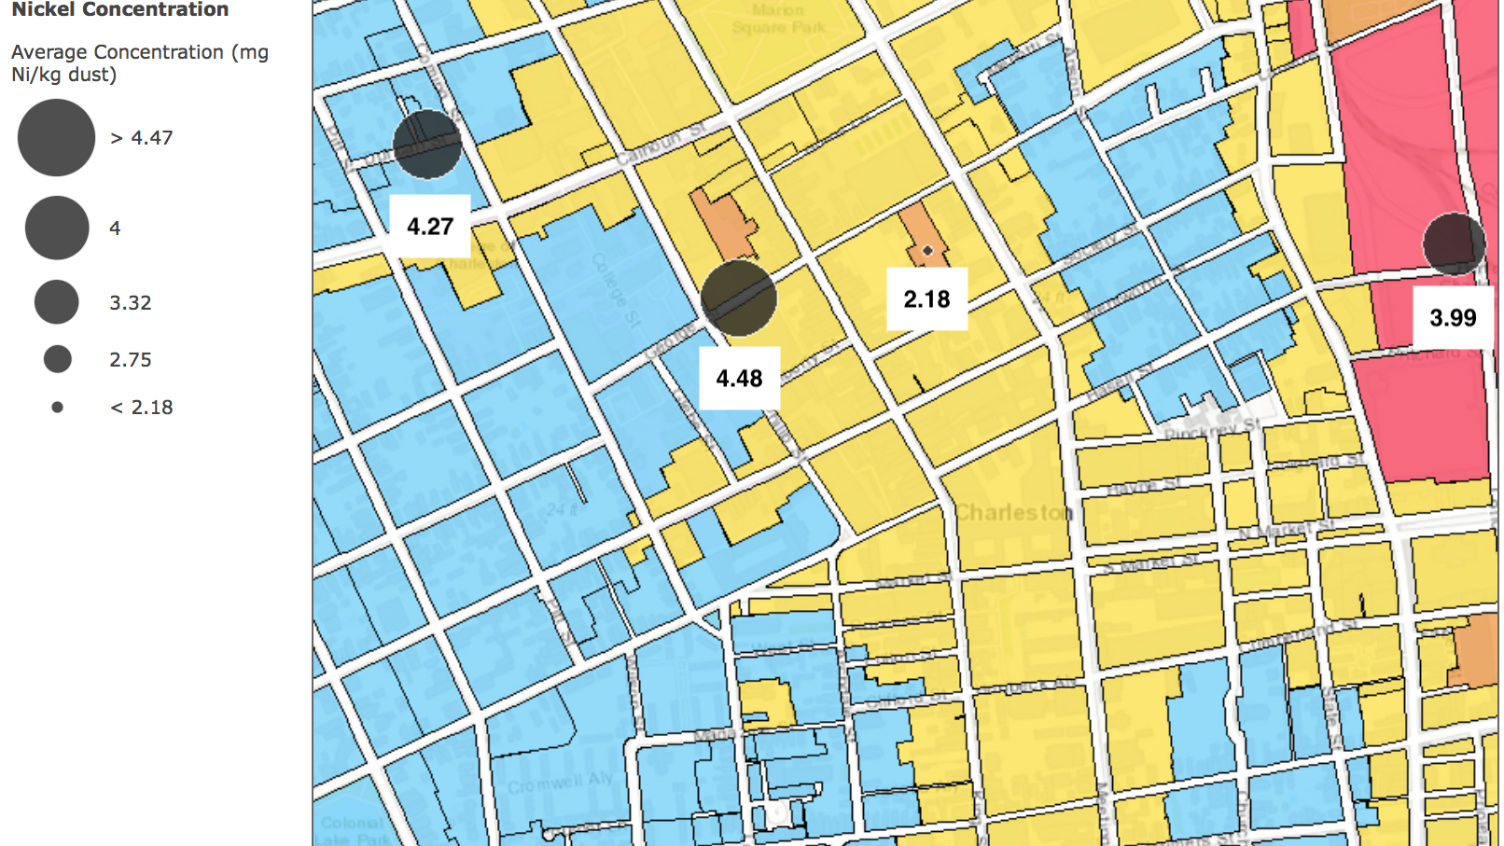
Nickel Minimal Anthropogenic Influence
Notes:
The concentrations of nickel are not are highly variable between sites; however, the values of nickel found in our study are significantly lower than expected based on values obtained in other urban road dust research. Multiple other road dust studies have found that nickel is typically one of the least contaminated elements and shows minimal anthropogenic influence, so differences in our data and other literature values could be a function of background levels. Slight variation in our values across sites may be an effect of nickel’s common use in steel products; however more data, and insight into background soil values in Charleston, are needed to understand nickel’s source in road dust.

Slide 11
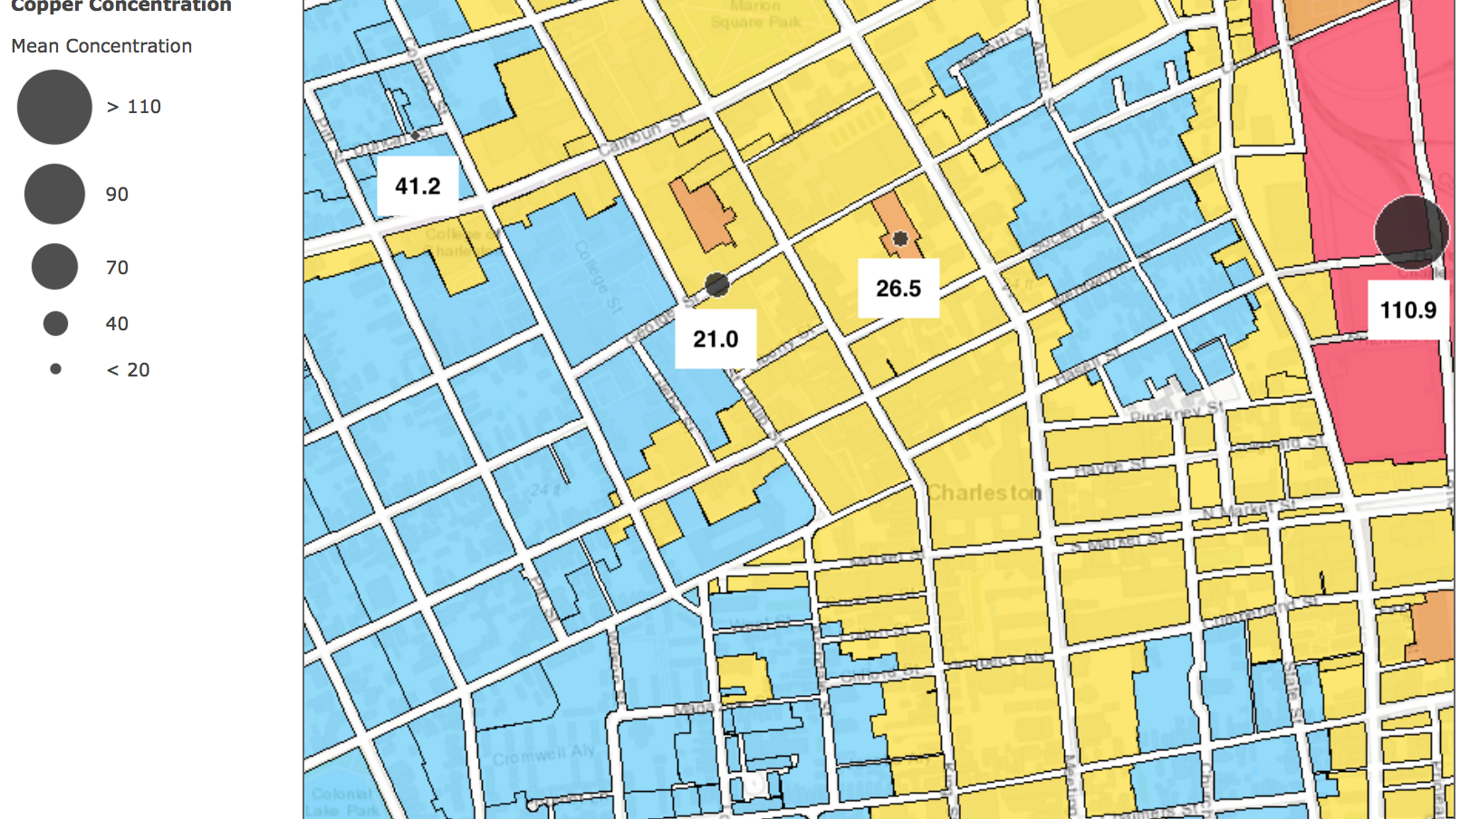
Copper Likely Related to Antifouling
http://www.mby.com/gear/anti-fouling-boat-tips-advice-43285
Notes:
Unlike the first three elements analyzed, copper had a significantly higher concentration in one area, with a concentration almost 3 times higher in the industrial zone than the next largest sample area. One possible explanation for copper’s high level at the industrial site is this location’s proximity to the Charleston shipping port and cruise access point. Copper paint is heavily used as a biocide for antifouling on boats, which keeps boat bottoms free from accumulation of barnacles. Copper from antifouling can accumulate in sediment and could explain the exceedingly high level.

Slide 12
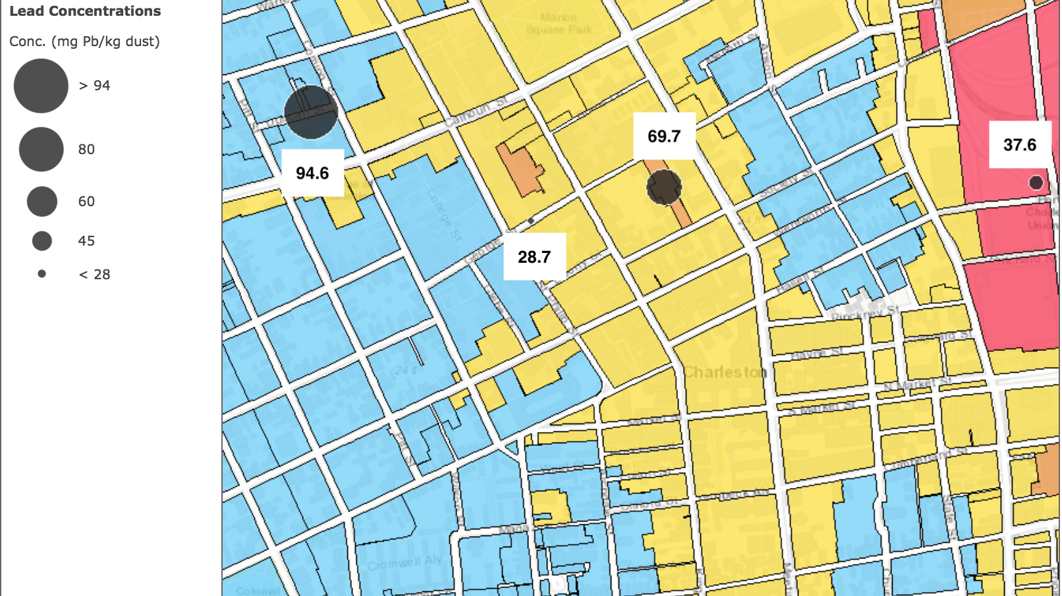
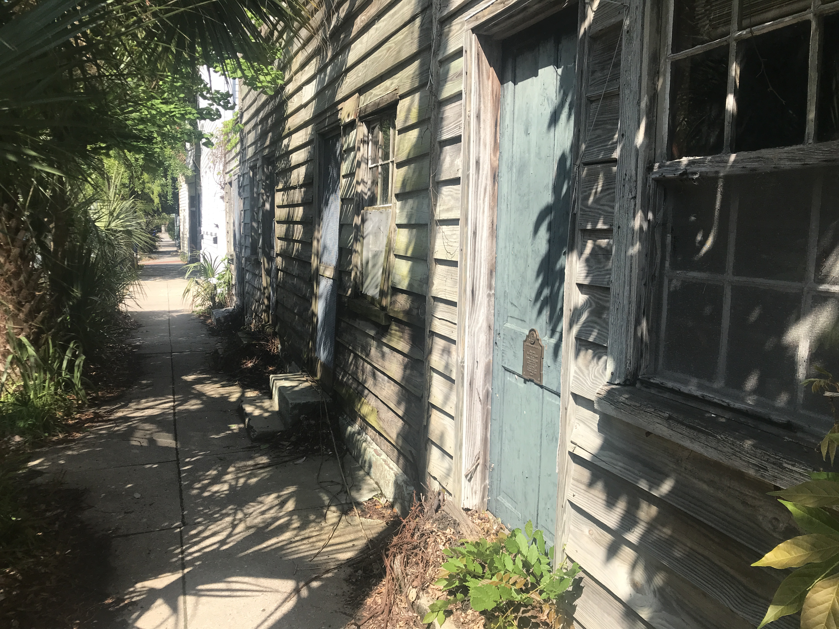
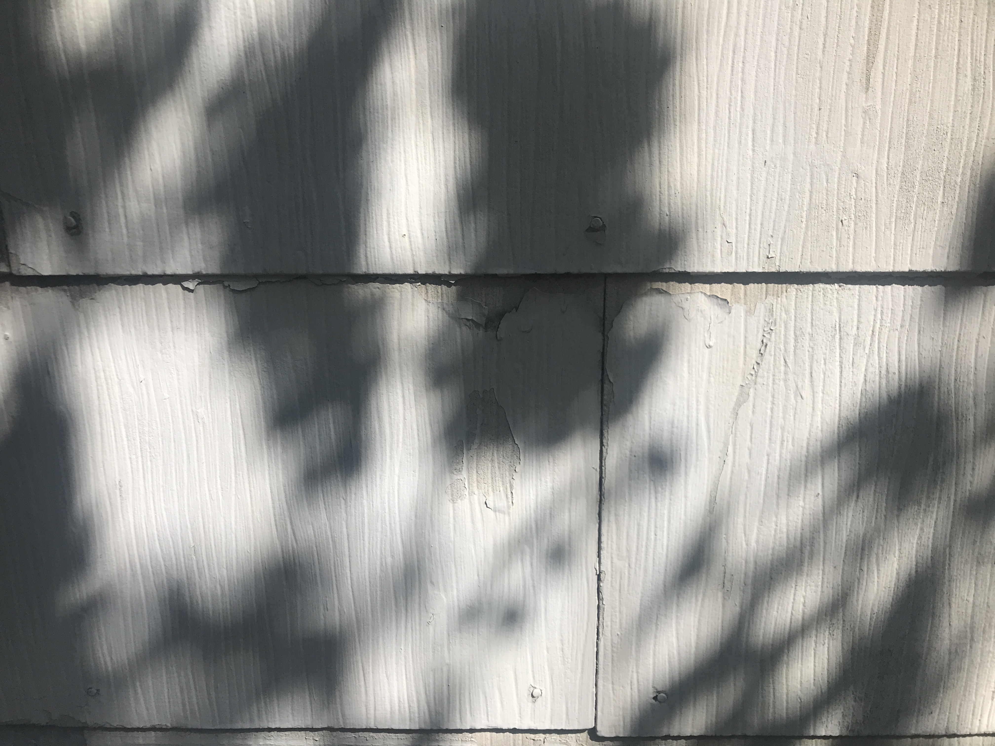
Lead
Historic Source
Notes:
Like copper, lead had a much higher concentration in one area above all others. The highest concentration of lead was found in the residential zone. Lead paint is problematic in Charleston, where there are a large amounts of historic homes and buildings. According to a staffer with the city of Charleston’s Housing and Community Development department you can almost assume a home will have lead paint if it was built before 1950, meaning lead paint is likely a source for contamination in these areas. This photo was actually taken from the sampling area in the residential zone and has visible paint chipping. Paint chipping here is beginning to peel in the “alligator pattern” associated with lead paint, so it is likely a source for increased contamination in this residential area.

Slide 13
Mean Concentration Comparison
Notes:
Data from Australia, Italy, Spain, China, and India was compiled from literature in order to compare our values to other studies globally. Using data from other literature, box and whisker plots were created to show the distribution and variability of the data for each of the metals of interest.
Our results are lower, but within a comparable range regarding Cr, Cu, and Pb, but are outside of range compared to other literature regarding Ni and Zn. One thing to keep in mind when comparing other data to the five other studies is that our study had a limited amount of data and covered a small sample area. Additionally, two of the countries, India and China, are much more industrialized than Charleston and have different environmental regulations which could influence data. Data from these countries was typically higher and influenced the median of the box plots, shown in the green lines. This details the distribution of the data and shows that it is not evenly distributed between metals.

Slide 14

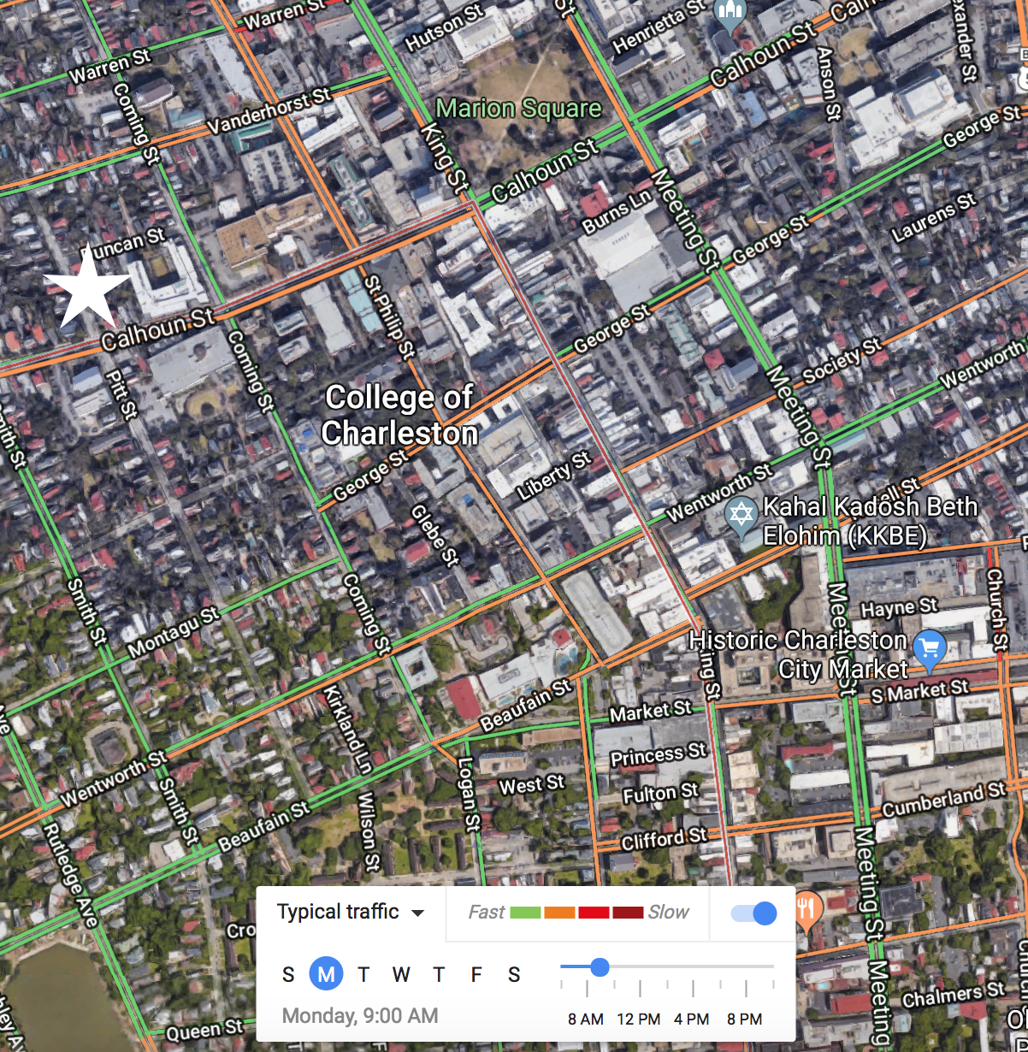
Our Data
Comparisons to other research
Further Research
Broad land use patterns
Particle size distribution
Questions
Jordan Davis davisjm2@g.cofc.edu
Vijay Vulava vulavav@cofc.edu
Notes:
Our values can be compared to other literature and show related concentrations in terms of chromium, copper, and lead; however, our findings are significantly lower than other cited values regarding nickel and zinc. By assessing trace metal concentrations in terms of land use, we were able to pinpoint likely influences of sources and determine where research should focus next.
More research is needed to understand the role of traffic density and speed to trace metal levels. Obtaining traffic data, similar to the google traffic viewer is a first step in comparison but more quantitative data is needed in this area. Additionally, determining particle size distribution is necessary in order to understand the mobility of metals and understand the ways in which dust can impact runoff. Furthermore, sampling should be done in consideration of storm events in order to understand how concentrations vary before and after rainfall. A larger sample area and more samples should be included to draw further conclusions.
Overall, this research and metholody is a start in geochemically analyzing urban road material in Charleston. Thank you to Dr. Vulava for giving me the opportunity to do this research and thank you to the College of Charleston Department of Geology for its support in this research. Lastly thank you all for being here today to hear my research. I will now be taking questions, and our contact information is available if time does not allow for all questions to be asked.

