Slide 1


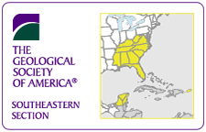
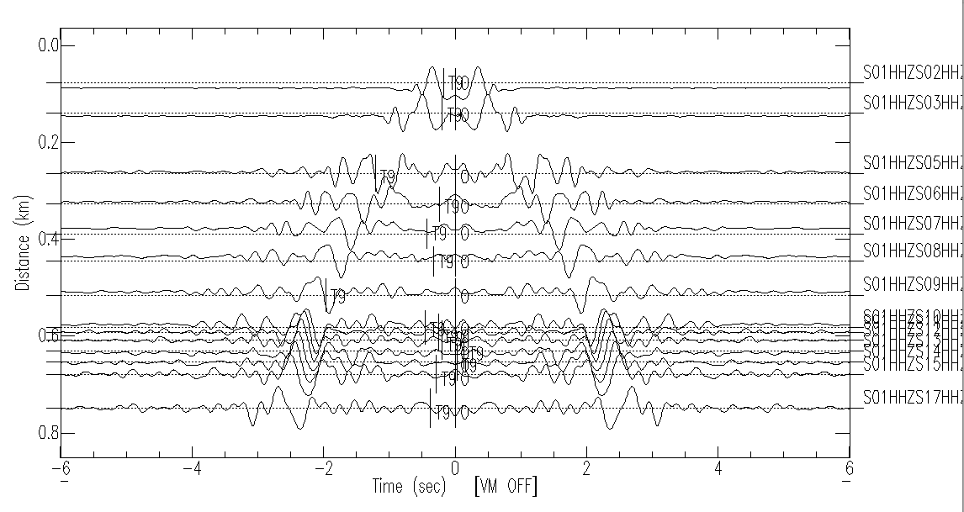
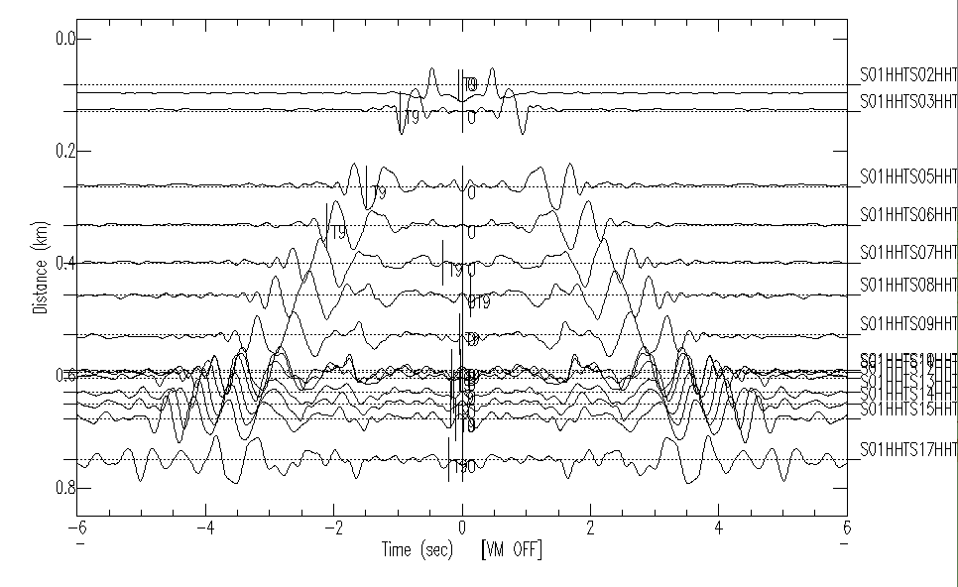
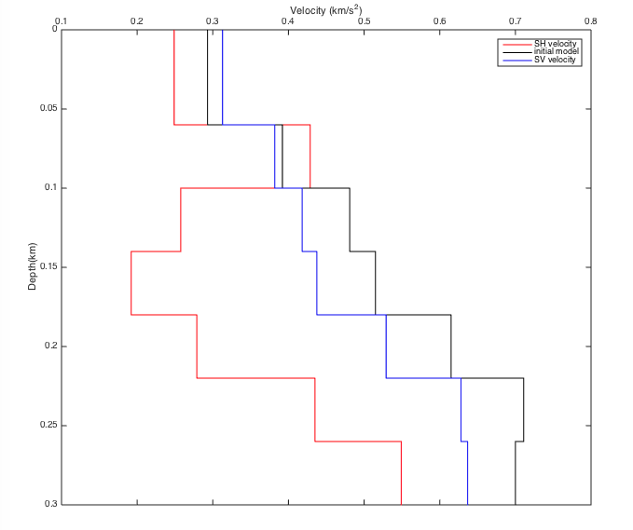
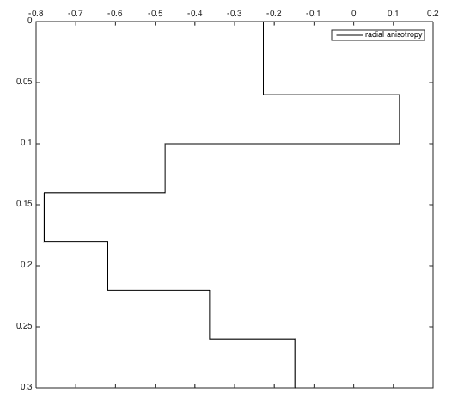
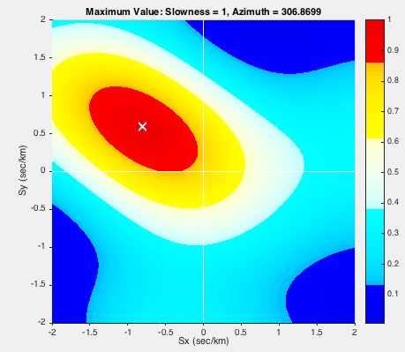
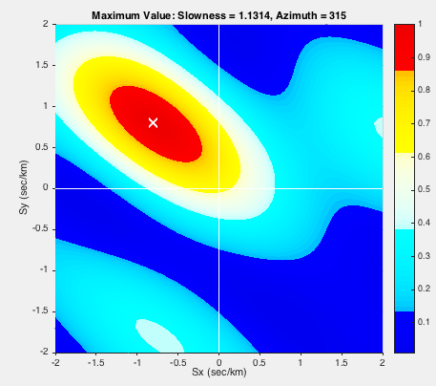
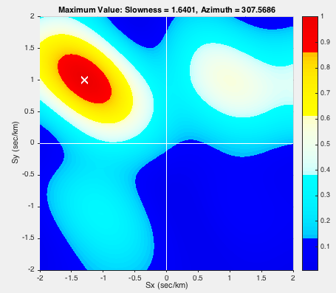
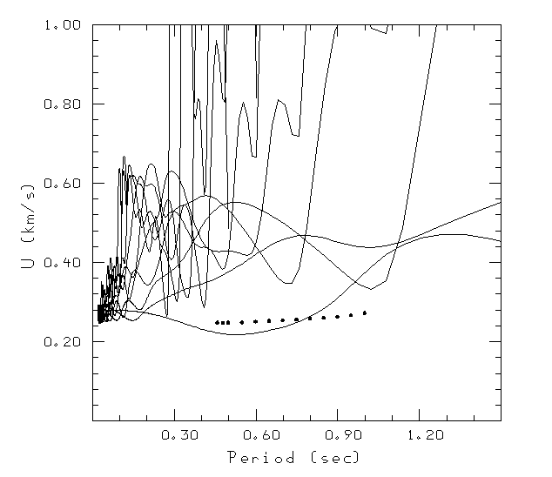
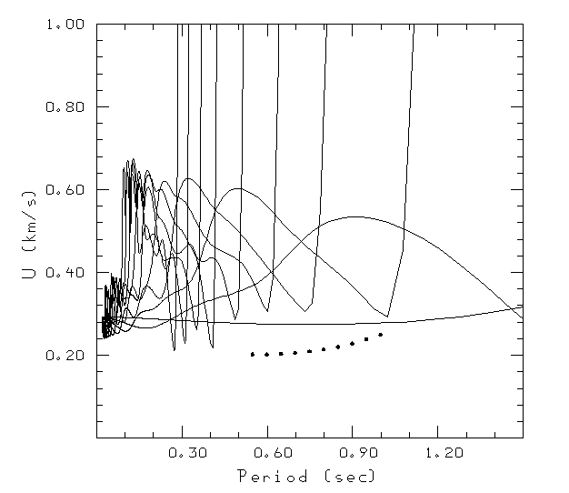
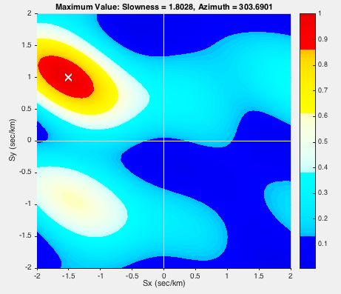
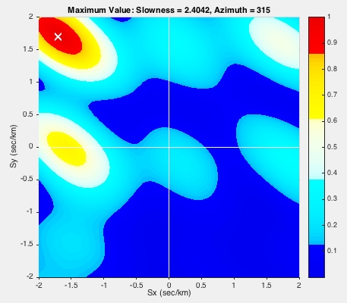
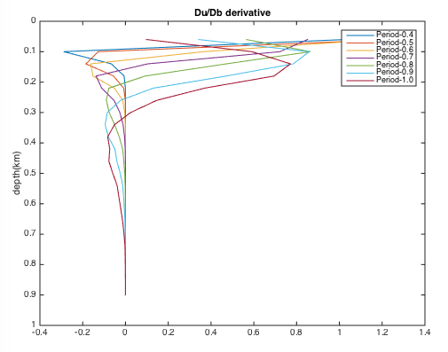
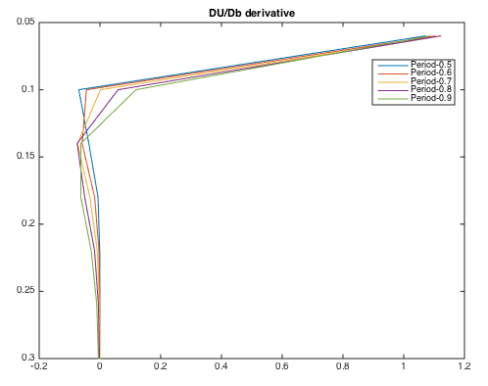
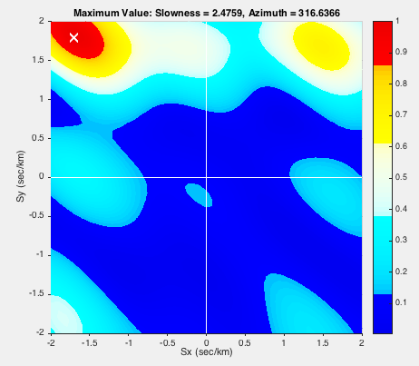
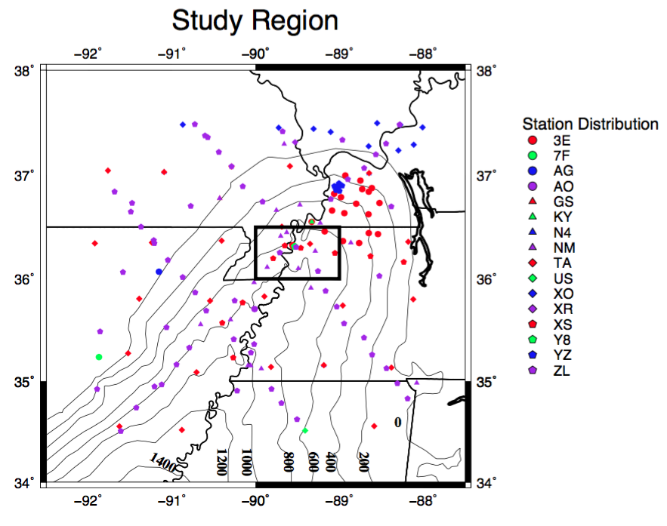
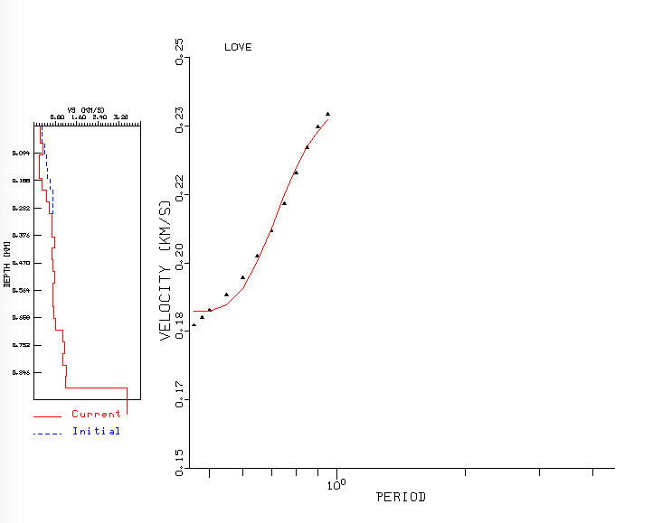
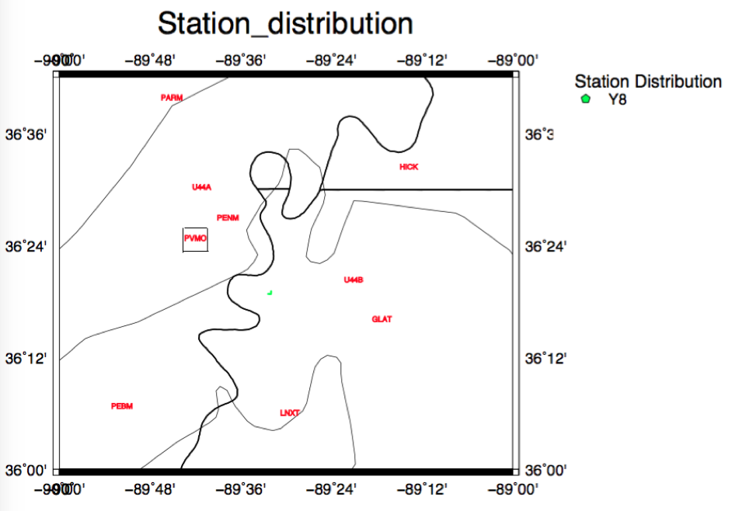
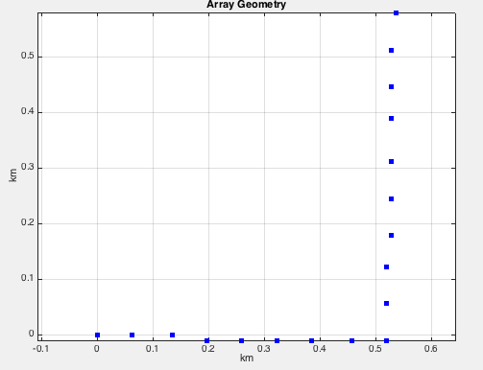
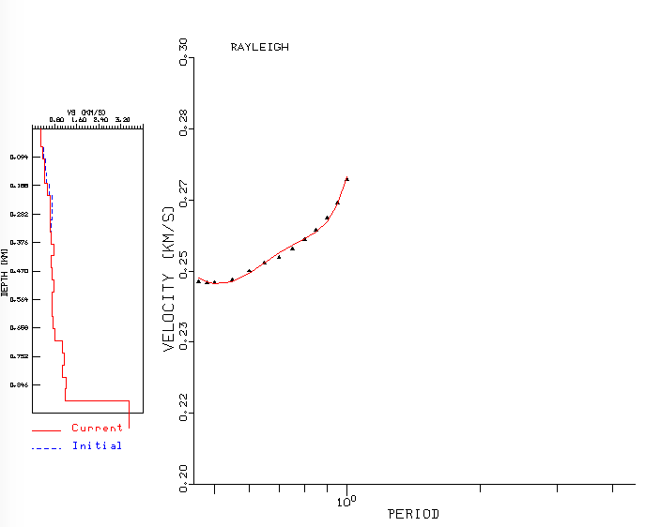
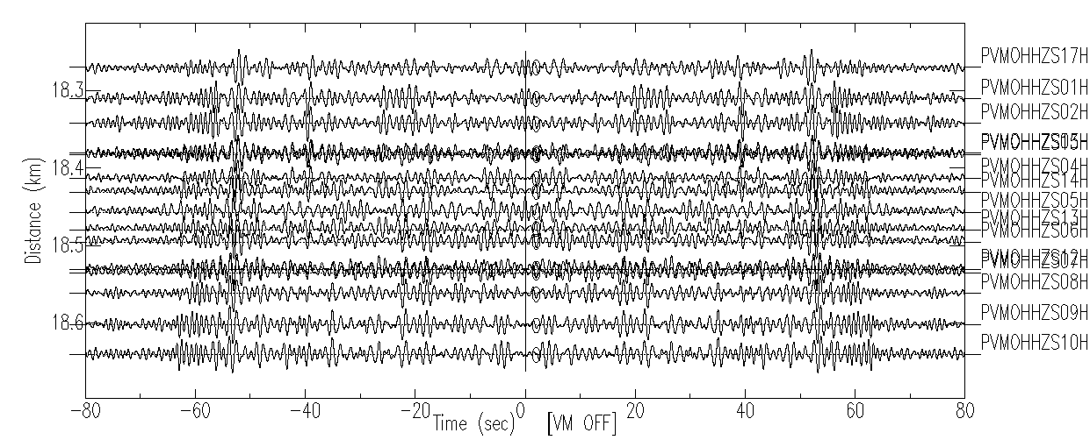
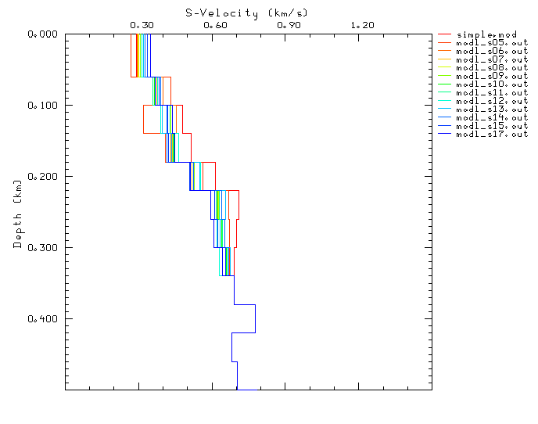
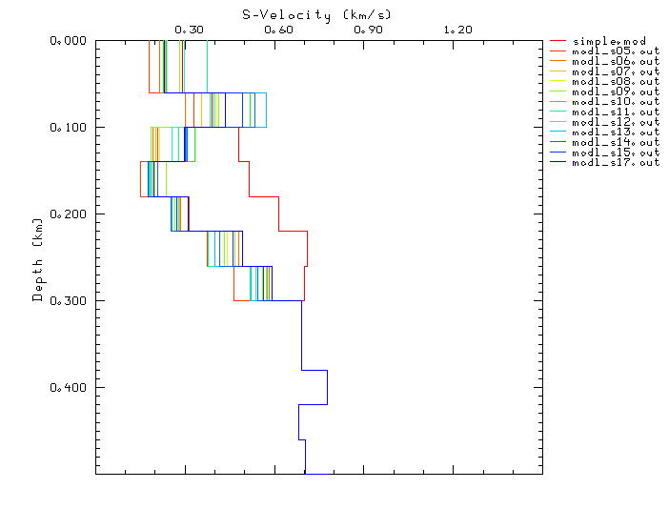
1-D Mississippi embayment sediment velocity structure and anisotropy: constraint from ambient noise analysis on a dense array Chunyu,Liu¹; Charles A. Langston¹ ¹University of Memphis
Abstract
Internal-array Results
Internal-array Results
F-K analysis Results
We applied ambient noise analysis on a small tremor array and one adjacent station in the Mississippi embayment. The array was deployed from the November of 2009 to December of 2011, and was composed of 19 stations with a distance of approximately 700 meters. One-month ambient noise from 18 broadband stations was used to cross-correlate with each other (internal-array) and with noise from one adjacent station (station-array). 136 pairs of cross-correlations have been produced. Fundamental-mode Rayleigh and Love waves were observed in internal-array cross-correlations between 1 and 6 Hz, and station-array cross-correlations between 0.5 and 6 Hz. Multiple arrivals were observed in the station-array cross-correlations, and we further applied frequency-wavenumber (FK) analysis to separate body waves and surface waves. 2-D FK analysis of station-array cross-correlations showed the slowness of Rayleigh wave increased from 1 s/km in the 0.6-0.7 Hz frequency band to 2.47 s/km in the 1.2-1.3 Hz. Synthetic dispersion analysis for internal-array cross-correlations showed better dispersion curve match for Rayleigh wave than Love wave, and also indicated the Love wave is slower than Rayleigh wave for the same frequency band. The group velocity of Rayleigh wave ranged from 0.25 km/s to 0.3 km/s in the frequency band of 1-6 Hz, while the group velocity of Love wave is about 0.2 km/s in the same frequency band. Love-Rayleigh discrepancies may indicate radial anisotropy, and the vertical structure like cracks or dikes other than horizontal layers plays an important role on surface wave propagation in the sediments of the embayment. We will further invert the deeper sediment shear wave velocity using station-array cross-correlations.
1-A
2-A
0.6-0.7 Hz
0.7-0.8 Hz
0.8-0.9 Hz
1-F
2-F
Figure 2: Internal array (Y8) cross-correlations and process to invert for shear wave velocity. Left columns are for Rayleigh wave, and right column is for love wave. (1-A) Vertical-vertical (2-A) transverse-transverse cross-correlations in passband of 1-6Hz. (1-B) synthetic dispersion curve calculated based on ( Langston et al., 2005) using CPS code (Herrmann, 2013) for Rayleigh wave and Love wave (2-B). (1-C) Sensitivity kernel for Rayleigh wave and Love wave (2-C). It could result as deep as 300 meters. (1-D) fitting of inverted dispersion curve (red) to real data (blue dot) for Rayleigh wave and Love wave (2-D). (1-E) all inverted model from all Rayleigh wave dispersion curves and Love wave dispersion curves (2-E). (1-F) Final SH ,SV and (2-F) anisotropy results.
1-B
2-B
0.9-1.0 Hz
1.0-1.1 Hz
1.1-1.2 Hz
1.2-1.3 Hz
Introduction
Station-array Results
Figure 3: F-K analysis of 50-60s of cross-correlation results and dispersion curve. The increase slowness with the frequency imply the dispersion property of surface wave. The resulted azimuth is close to the real azimuth 305, and the slowness increases from 1s/km in 0.6-0.7 Hz to 2.47 s/km in 1.2-1.3 Hz.
1-C
2-C
Figure 3: Tremor array and surrounding broadband stations. The boxed station is our targeted one. The green triangle indicate the location of tremor array.
Conclusion
Synthetic dispersion analysis for internal-array cross-correlations showed better dispersion curve match for Rayleigh wave than Love wave, and also indicated the Love wave is slower than Rayleigh wave for the same frequency band.
Love-Rayleigh discrepancies may indicate radial anisotropy, and the vertical structure like cracks or dikes other than horizontal layers plays an important role on surface wave propagation in the sediments of the embayment.
F-K analysis imply the existence of surface wave in station-array cross-correlations.
Figure 1: Seismic station/array geometry and distribution. (Left) All seismic networks in the Embayment since 1990. (Right) The geometry of our interested network Y8.
1-D
2-D
Pre-crosscorrelation processing:
Merge and check data
Remove mean, trend, and instrument response
Remove earthquakes
Filtering and whitening
Reference
Figure 4: PVMO and the tremor array Y8 cross-correlation results in the passband of 0.5 to 2 Hz. The target time clip used for surface wave analysis is between 40 and 60s. These arrivals before 50s are explained as direct arrival and multiples.
Langston, C. A., Bodin, P., Powell, C., Withers, M., Horton, S., & Mooney, W. (2005). Bulk sediment Q p and Q s in the Mississippi embayment, central United States. Bulletin of the Seismological Society of America, 95(6), 2162-2179.
Herrmann, R. B. (2013) Computer programs in seismology: An evolving tool for instruction and research, Seism. Res. Lettr. 84, 1081-1088, doi:10.1785/0220110096
1-E
2-E

