Slide 1


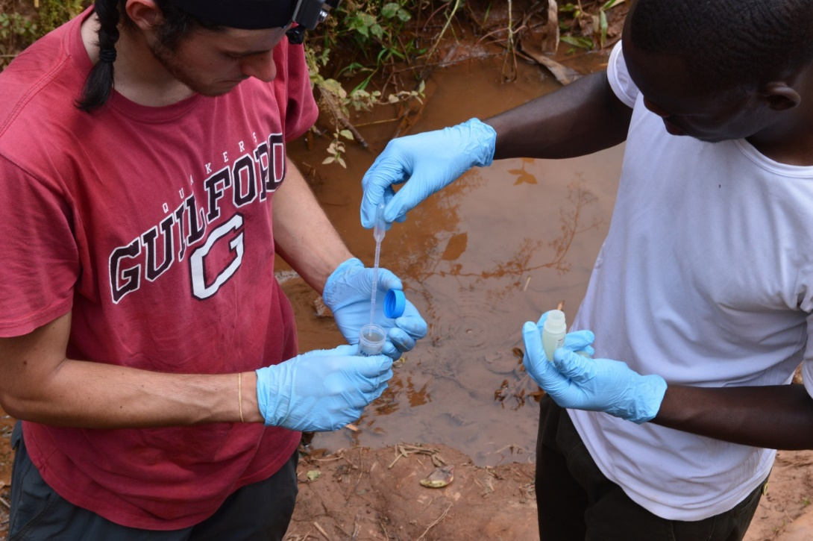
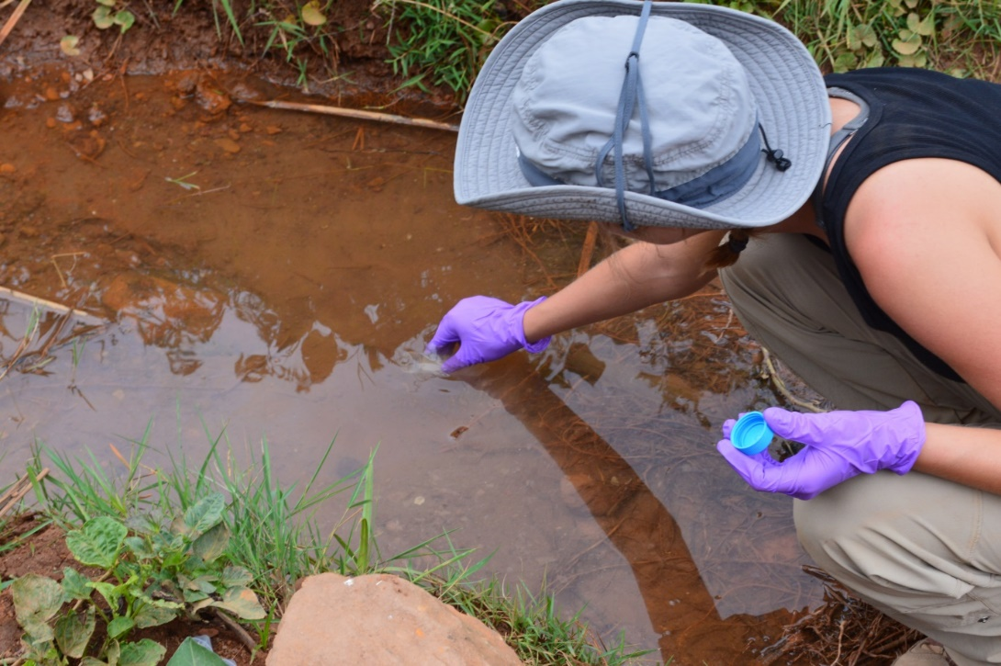
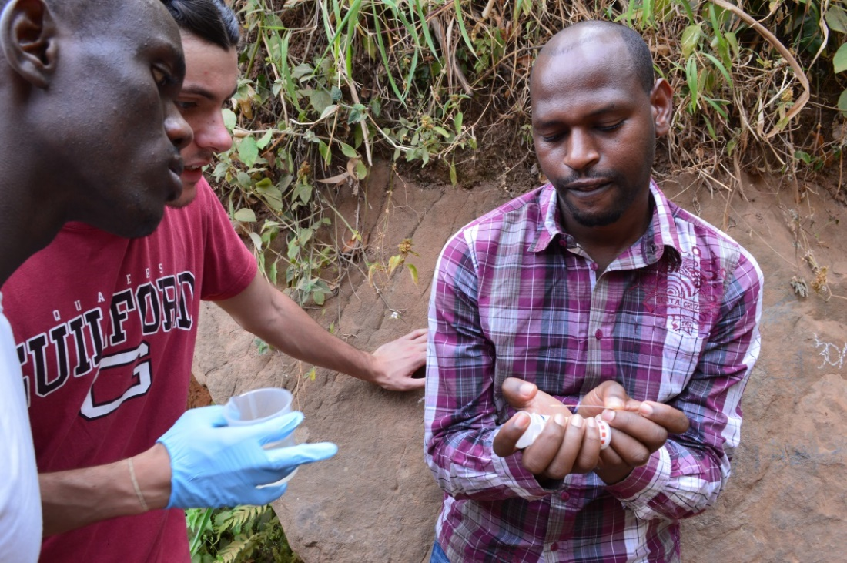
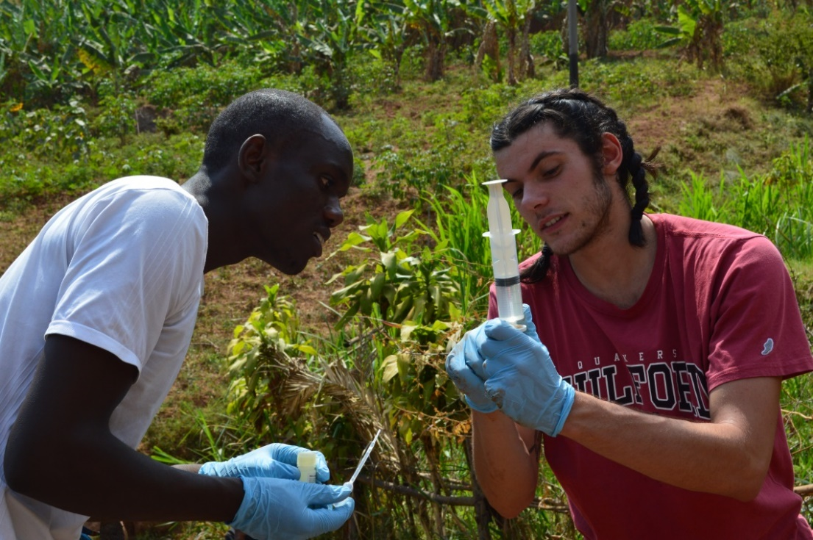
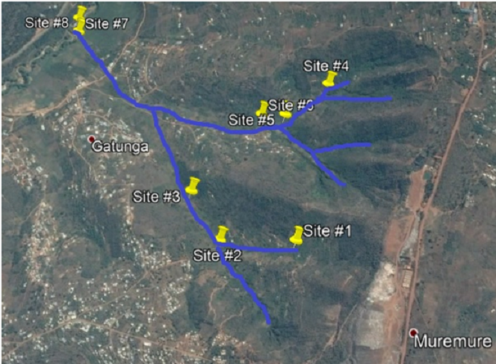
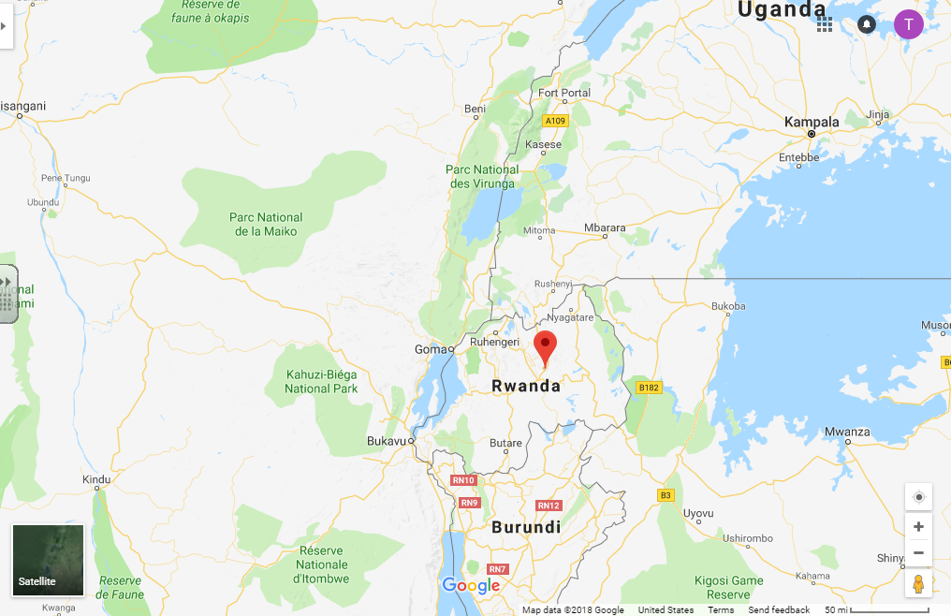
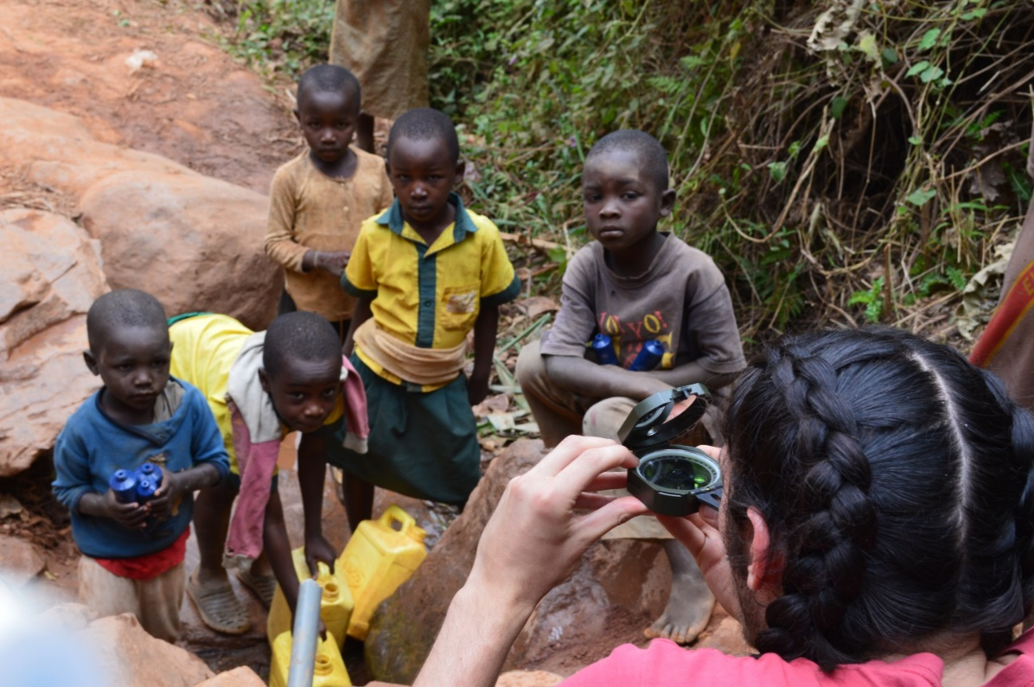
Preliminary Inorganic Surface Water Quality Analysis of the Gatunga Stream Near an Unlined Landfill in Gatunga, Kigali Province, Rwanda
Thomas Taylor Soiles, Dr. Sylvie Mucyo, Dr. Francois Xavier Nshimiyimana, Dr. Holly Peterson
Guilford College and the University of Rwanda CAVM
Abstract
Methods
Results and Discussion
Conclusions
The people of Gatunga village, in Kigali province Rwanda, use water from Gatunga stream to drink, cook, and clean with. In late July 2017, during Rwanda's dry season, we took water samples from six sites along the Gatunga stream, its tributaries, and the Nyabugogo River, all of which are located downstream of an unlined landfill near Kigali, Rwanda. In order to determine if the water meets drinking water quality standards, the samples were analyzed for elemental concentrations using ICP-MS and preliminary results indicate that concentrations of toxic elements associated with landfills were all below the US EPA primary drinking water standards and aquatic life surface water guidelines. If it is possible, additional research is needed to test for organic compounds and to assess and compare results from the rainy season with these results from the dry season.
Sampled for total and dissolved metals using 0.45 μm filters and 50% nitric acid
Used pH strips to get pH of site
Samples were analyzed with an ICP-MS at Middlebury College
Elements tested for: Na, Al, K, Ca, Ti, Mn, Co, Cu, Zn, As, Se, Rb, Sr, Ba, Pb, Mg, Si, Fe, V, Cr, Ni, Zr, Nb, Mo, Ag, Cd, Sn, and Sb
Our research led us to Gatunga because we hypothesized that the landfill was polluting the Gatunga stream and potentially effecting the Nyabugogo as well. However, we found levels of toxic elements such as lead, arsenic, and cadmium to be below the EPA recommended drinking water values. Sampling during the dry season as opposed to the rainy season could effect concentrations of elements as higher rainfall intensity leads to more leaching of elements through the landfill and into the groundwater. However, this also means that there will be more dilution of those elements. Additionally, there is a possibility that the elements are being transported elsewhere.
We found high concentrations of both calcium and magnesium leading to hard water. According to a 2006 study, hardness is significant because harder water can decrease the toxicity of heavy metals in soft tissues by up 88% (Yim, 2006). The hardness level found in Gatunga may be due to high erosion due to agriculture and slope. According to the revised universal soil loss equation, erosion rates increase as slope, rainfall intensity, and agricultural intensity increase. As erosion increases, its more likely that elements are transported into the stream.
Fig 4. pH increases from upstream to downstream (site 1 – site 3 and site 4 – site 6) as distance from the landfill increases. This suggests that the landfill may be making the groundwater nearby more acidic and the water could be buffered by other groundwater sources farther downstream. Low pH can lead to more leaching of metals, although we did not see a correlation to support that.
Introduction
Water is one of life’s most intrinsic needs. All living beings require it to survive and thrive. The goal of this research project is to determine whether or not the Nduba landfill is detrimentally affecting Gatunga stream which feeds into the Nyabugogo River. To understand the landfill’s effect on the stream, water samples were taken and analyzed using an ICP-MS to discover what concentrations of dissolved and total elements are present in the water. Humans, animals, and plants were considered in analyzing the results of this research. Lead (Pb), arsenic (As), and cadmium(Cd) are toxic metals that can cause a multitude of health problems to people who drink water that contain concentrations above the Environmental Protection Agency’s (EPA) recommended drinking water standards. The EPA also has Aquatic Life Guidelines that determine whether or not freshwater animals are being affected by various elements.
These elements have maximum contaminant levels because of the negative effects they can have. For example, lead has been found to stunt verbal IQ, mental development, and physical development in children with blood levels below 25 ppb (Lippmann, 1989). Arsenic is a carcinogen and can also cause complications during pregnancy and birth (Kapaj, 2006). Chronic cadmium exposure can lead to loss of bone density, testicular necrosis, kidney stones, and there is some evidence to suggest that it can induce prostate cancer (Godt, 2006).
Gatunga is a village that supports itself through agriculture. Many of the people who live in the village grow tomatoes, sweet potatoes, bananas, and sorghum. These crops, among other plants, can be damaged by high concentrations of various elements. The two primary ways plants can be affected by metals are their ability to germinate and grow. Lead specifically can lead to the inability to develop seedlings and cause mutations in the plant leading shorter roots and less biomass (Pourrut, 2012).
Elements can be carcinogenic and cause reproductive and other health effects to animals as well. As, Cd, Pb, and Hg have all been noted to be carcinogenic and cause damage to animal internal organs (Govind, 2014). Additionally, Ag, Cd, Hg, Se, and Zn all can cause reproductive issues affecting reproductive capacity by up to 75% to a number of different species (Fisher, 2002). These elements are especially damaging because they are not removed through natural processes and can be introduced through industrial processes and waste, such as landfills (Govind 2014).
Fig 3.A – Adding nitric acid to a sample at site 3
Fig 5. Ca, Mg, and hardness are highest on the Nyabugogo river. Hardness, calcium and magnesium decrease as you go downstream from site 1 to site 3 and site 4 to site 6. Dissolved and total metal values at each site are similar across all sites. This suggests that the stream is being diluted from other groundwater sources downstream. The Nyabugogo river has a much larger watershed and is being impacted by many more sources. Comparing site 7 to 8 suggests that Gatunga stream doesn’t appear to have an effect on the Nyabugogo river as far as hardness is concerned.
Future Work
This research could be expanded upon in a number of different ways. Similar sampling should occur during one of Rwanda’s rainy seasons in order to see if concentrations are affected. Additionally, groundwater, not just surface water, should be tested in order to see if its being affected in any way by the landfill. Ideally wells would be drilled along the ridge to see the extent of the landfills effect. Wells would also need to be drilled along the tributaries, near sites 1 through 6, in order to see how concentrations change along the stream. Hopefully that would give us an idea of what is being inputted from groundwater sources along the stream and what the groundwater quality is. The other side of the ridgeline should also be tested in order to determine if the topography and geology has led to elements leaching out the other side or not. Finally, groundwater samples should be collected along the Nyabugogo on either bank in order to determine if elements are being introduced from groundwater or other sources upstream.
Fig 3.B – Total metals sampling at site 3
Fig 3.C – Comparing pH strips to scale at site 4
References
Fig 6. Concentrations of cadmium at every site were below the minimum detection limit (1 ppb) for the ICP-MS and drinking water standards and aquatic life guidelines. Further testing needs to be done to determine whether or not cadmium is a potential risk to those that use the water, for example during the rainy season, in groundwater, or at different locations within Gatunga.
Bingham, F., Bradford, G. and Page, A., 1964. Toxicity of lithium to plants. California Agriculture, 18(9), pp.6-7.
Fisher, N.S. and Hook, S.E., 2002. Toxicology tests with aquatic animals need to consider the trophic transfer of metals. Toxicology, 181, pp.531-536.
Godt, J., Scheidig, F., Grosse-Siestrup, C., Esche, V., Brandenburg, P., Reich, A. and Groneberg, D.A., 2006. The toxicity of cadmium and resulting hazards for human health. Journal of occupational medicine and toxicology, 1(1), p.22.
Govind, P. and Madhuri, S., 2014. Heavy metals causing toxicity in animals and fishes. Research Journal of Animal, Veterinary and Fishery Sciences, 2(2), pp.17-23.
Kapaj, S., Peterson, H., Liber, K. and Bhattacharya, P., 2006. Human health effects from chronic arsenic poisoning–a review. Journal of Environmental Science and Health Part A, 41(10), pp.2399-2428.
Lippmann, M., 1990. 1989 Alice Hamilton lecture: lead and human health: background and recent findings. Environmental research, 51(1), pp.1-24.
Pourrut, B., Shahid, M., Douay, F., Dumat, C. and Pinelli, E., 2013. Molecular mechanisms involved in lead uptake, toxicity and detoxification in higher plants. In Heavy Metal Stress in Plants (pp. 121-147). Springer, Berlin, Heidelberg.
Yim, J.H., Kim, K.W. and Kim, S.D., 2006. Effect of hardness on acute toxicity of metal mixtures using Daphnia magna: Prediction of acid mine drainage toxicity. Journal of hazardous materials, 138(1), pp.16-21.
Fig 3.D – Securing filter onto syringe in order to take our dissolved metals sample
Acknowledgements
Guilford College Geology department for providing resources and financial support.
Mark Justad and the Center for Principled Problem Solving for financially supporting this research.
Holly Peterson for being my faculty advisor and walking me through this process every single step of the way.
Grace Bostic for being my research partner and for working with me over a period of two years to make this project happen.
Dr. Sylvie Mucyo and Dr. Francois Nshimiyimana for their time and efforts in supporting this research process.
Karen and James Soiles for providing financial and moral support, without them I wouldn’t be here today.
Dr. Krista Craven for her insight and knowledge of Rwanda.
Middlebury College and Jody Smith for allowing me to use their equipment and analytical support.
Dr. Bob Brown for pushing me towards my goals and supporting me financially.
Fig 7. Sites 7 and 8, both on the Nyabugogo river, have concentrations of lead that exceed the EPA Drinking Water MCLs. Site 7 has total lead concentrations above the EPA’s aquatic life guidelines. This could pose serious threat to the people and animals that use the Nyabugogo water for drinking or for habitats.
Site Location and Description
Sites 1, 2, and 3 are located on the southern tributary of the Gatunga stream. Site 1 was sampled on the hillside with a slope of 33°, taken from a spout that channeled the stream which locals used to collect water for drinking, cooking and cleaning. Sites 2 and 3 were located lower on the hillside as the land flattened out towards the Nyabugogo river. Their slopes were 9° and 6° respectively. Site 3 was located in the midst of an agricultural field. Primary crops were sweet potatoes, tomatoes, and bananas. A rainbow sheen was present on the surface of the water. Water flow was very low at site 1 and slightly higher at sites 2 and 3.
Sites 4, 5, and 6 are located on the northern tributary of Gatunga stream. Site 4 was on the hillside and similar to site 1, however a slope of 12° was recorded. Sites 5 and 6 were located further downstream on flatter ground closer to dwellings. Site 4 was specifically being used for washing clothes by locals when we sampled.
Author Profile
Fig 8. Concentrations of arsenic were below the EPA drinking water and aquatic life guidelines for all samples. All results were below the MDL for As (1 ppb) except for site 3 total and dissolved and site 7 and 8 dissolved. Further research could provide evidence as to why there are higher concentrations at site 3.
Thomas Soiles is a graduating senior at Guilford College. Receiving a BS in Geology, he has been working on this project for the past couple of years. His interests are within the environmental and hydrologic fields and is looking forward to making an impact in his community.
Fig 2. Site map of Gatunga Village showing the landfill, bottom right, Gatunga village, center left, and Nyabugogo river where sites 7 and 8 are located.
Fig 1. Location of Gatunga within Rwanda which is located in east-central Africa. It is bordered by Uganda to the north, Tanzania to the east, Burundi to the south, and the Democratic Republic of Congo to the west.
All element concentrations not shown were either below the MDL or MCL
Fig 3.E – The author observed by locals while taking an azimuth for stream flow.

